Slide 1
The LBT suite of operational AO instrument
Lorenzo Busoni, Enrico Pinna, Carmelo Arcidiacono, Guido Agapito, Marco Bonaglia, Simone Esposito, Alfio Timothy Puglisi, Fabio Rossi, Kalyan Radhakrishnan, Iskren Georgiev, Wolfgang Gaessler, Sebastian Rabien, Philip M Hinz, Steve Ertel

Slide 2
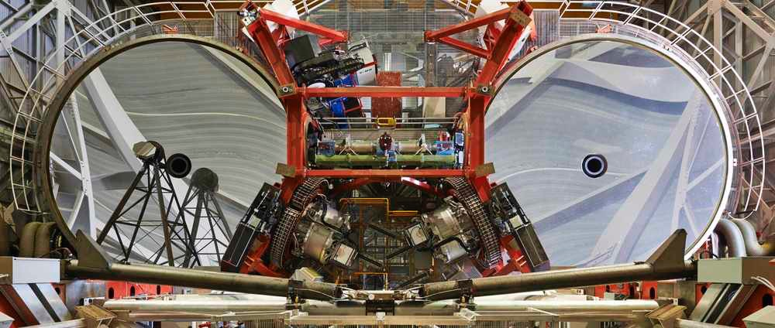


LBT AO InstrumentATION
LINC NIRVANA
shark-nir
LBTI
LUCI 2
LUCI 1

Slide 3
The LBT AO iNSTRUMENTS ASSORTMENT
LUCI + SOUL: High Strehl Small Field NIR camera & LSS
LUCI + ARGOS: Wide Field NIR MOS & Imager
LBTI: K L M band Imager & IFU, Fizeau & Nulling Interferometer
LINC NIRVANA: NIR MCAO camera with interferometric capabilities

Slide 4
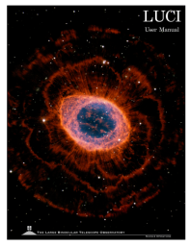
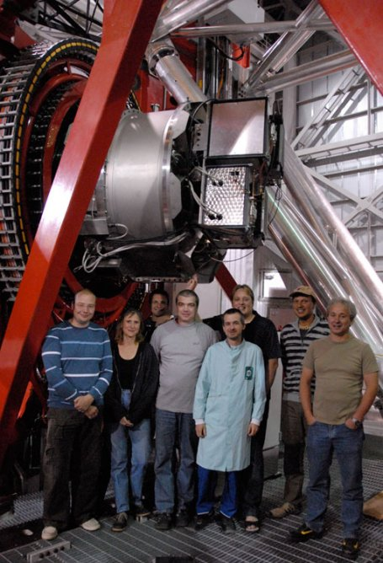
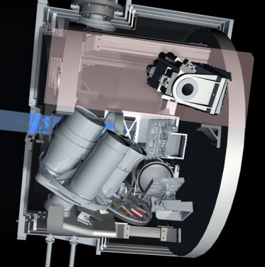
LUCI – The NIR cameras of LBT
Two identical units on the 2 eyes
Spectro-imager from z to K band (1-2.5um)
LSS & MOS
Fully binocular observation
User manual
https://www.lsw.uni-heidelberg.de/users/jheidt/LBT_links/LUCI_UserMan.pdf
Exposure Time Calculator
http://luci-etc.lbto.org/calculator.py
MOS unit
gratings
Mode | Parameter | Imaging | Spectrosc.
Wide Field N3.75 | FoV | 4x4’ | 4x2’
 | Scale | 0.12’’/px | 0.25’’/slit
 | Resolution |  | 3800-17000
Diffraction limited N30 | FoV | 30x30’’ | 30x30’’
 | Scale | 0.015’’/px | 0.030’’/slit
 | Resolution |  | 10000-40000
camera wheel
filter wheel

Slide 5
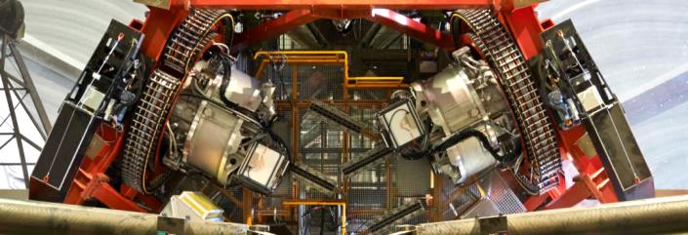
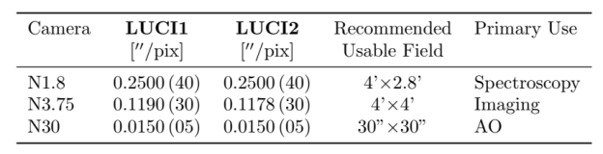
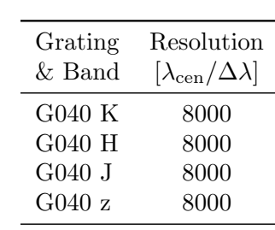
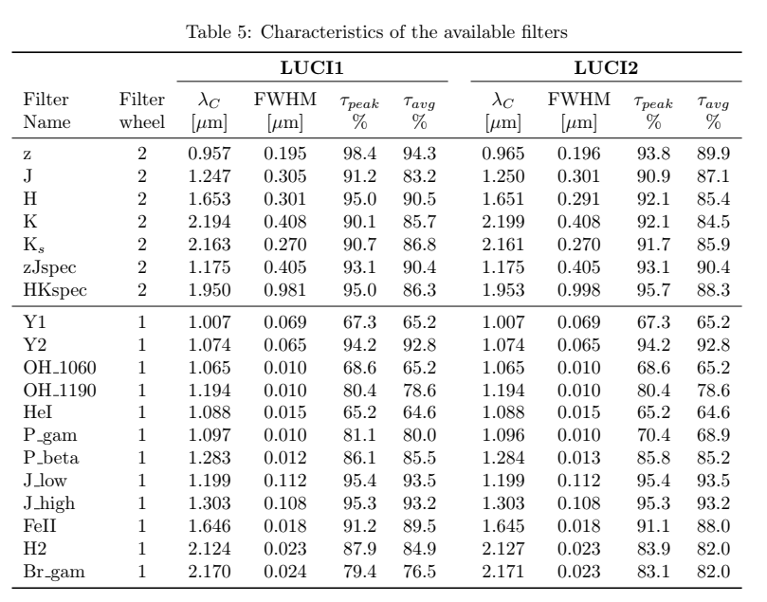

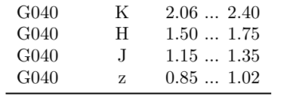
LUCI1 and luci2 dl camera (n30)
LUCI 1
LUCI 2
Imager + LSS + MOS at J-H-K
Seeing limited and AO assisted
User manual
https://www.lsw.uni-heidelberg.de/users/jheidt/LBT_links/LUCI_UserMan.pdf
Exposure Time Calculator
http://luci-etc.lbto.org/calculator.py
GLAO Assisted with ARGOS
(imag. + LSS + MOS)
Diffraction Limited
LSS on LUCI2
SCAO Assisted by SOUL
(Imag. + LSS)
Filter wheel #1
Filter wheel #2

Slide 6
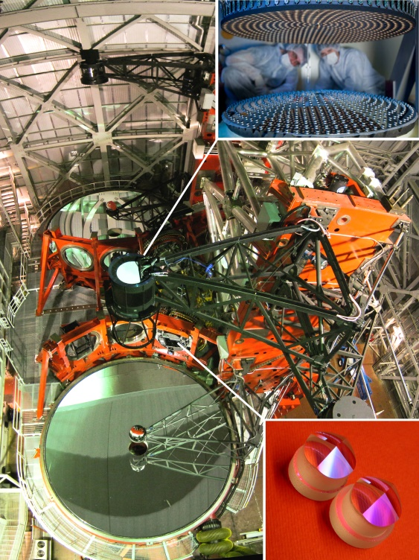

SOUL: upgrade of LBT SCAO systems
FLAO 2010
Adaptive Secondary Mirror (672acts)
LUCI 2
LUCI 1
Pyramid
Wavefront
Sensor
Credits: E. Sacchetti
4 NGS SCAO systems
LUCI1 DL-imager J-H-K
LUCI2 DL Spectro-imager J-H-K
LBTI SX + LBTI DX
Imager - Fizeau & Nulling interferometer - IFU
K-L’-M’

Slide 7
SOUL - TIMELINE
2014-05 SOUL proposal approved as II generation instrument for LBT
2016-03 Design review approved
2017-06 Ready for 1st upgrade on LBTI WFS - stopped 1 year by NASA
2018-03 First WFS upgraded
2018-09 First light on LBTI SX [#1]
2018-11 First light on LUCI1 (SX) – first NIR images [#2]
2019-02 First light on LBTI DX [#3]
2019-11 SOUL-LUCI1 offered for science operations
2019-11 Upgrade on LUCI2 [#4]
2020 New instruments: SHARK-NIR, SHARK-Vis, iLocater
Today

Slide 8
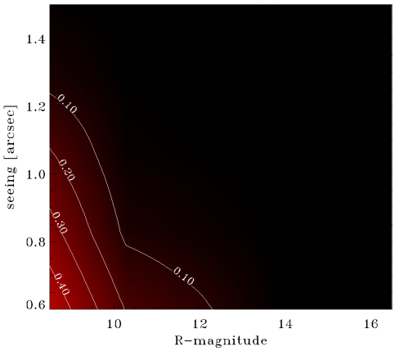
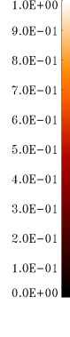
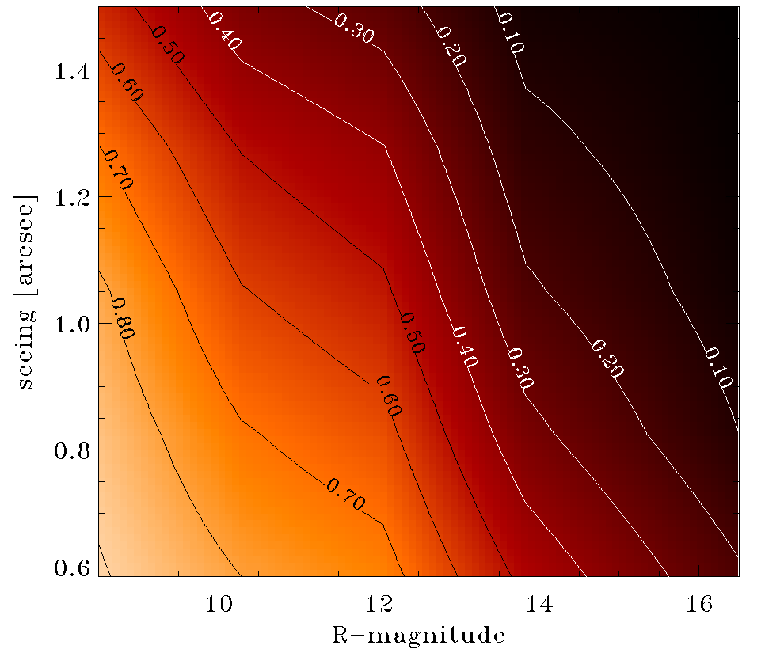
SOUL - Expected performances
FLAO
SR
E2E simulations
R band
K band

Slide 9
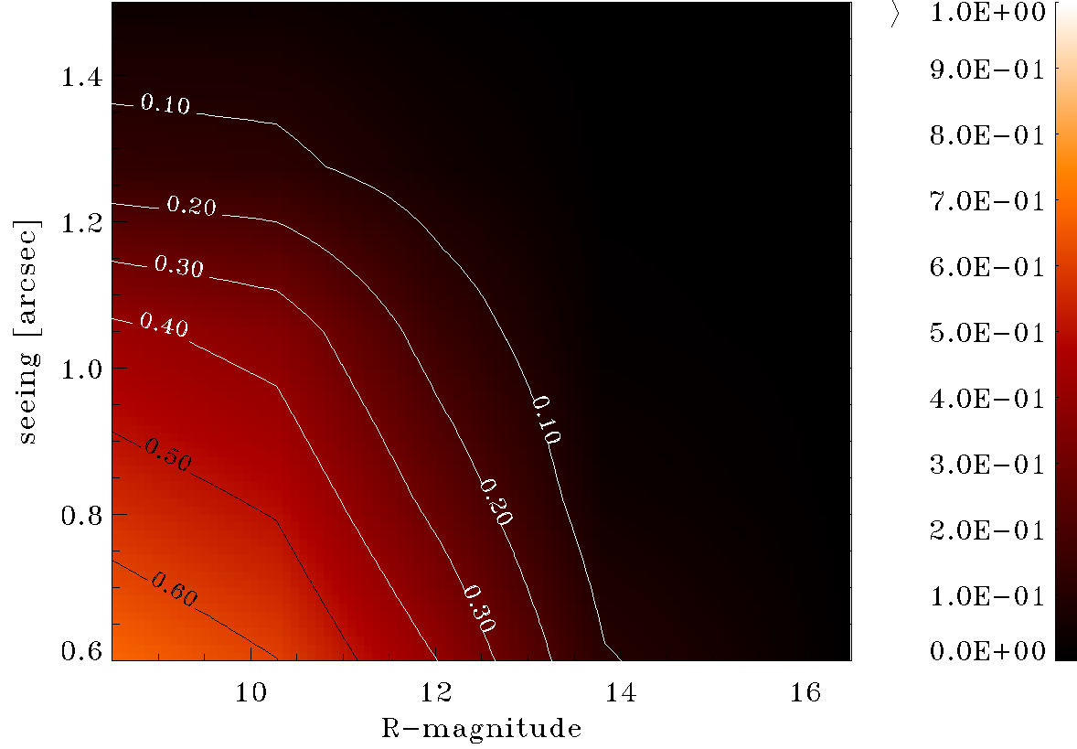
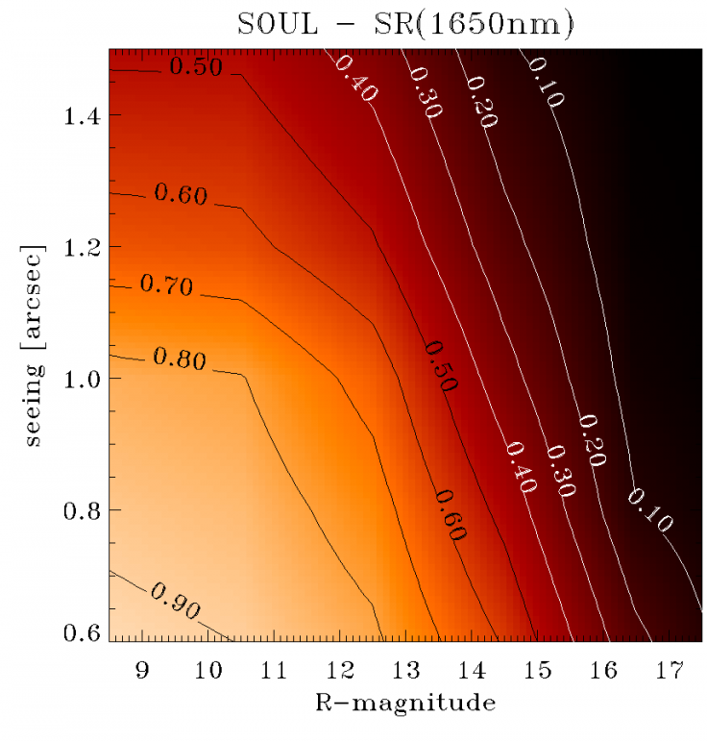


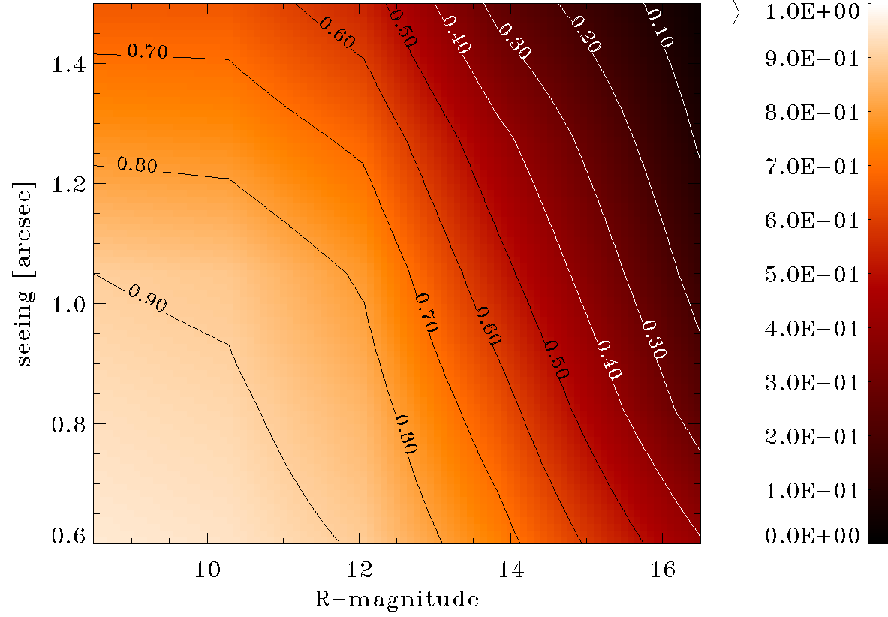
Exptected performances
FLAO
SOUL
SR
Enable vis AO up to R12-R13
E2E simulations
R band
20%
20%
High contrast at R12-13 in H
2-3 mags
High resolution in Ks and L’-M’ for extragalctic targets R>14
50%
50%
Improve performances in «strong» seeing
Improve AO loop robustness with new control algorithms
K band
2 mags

Slide 10
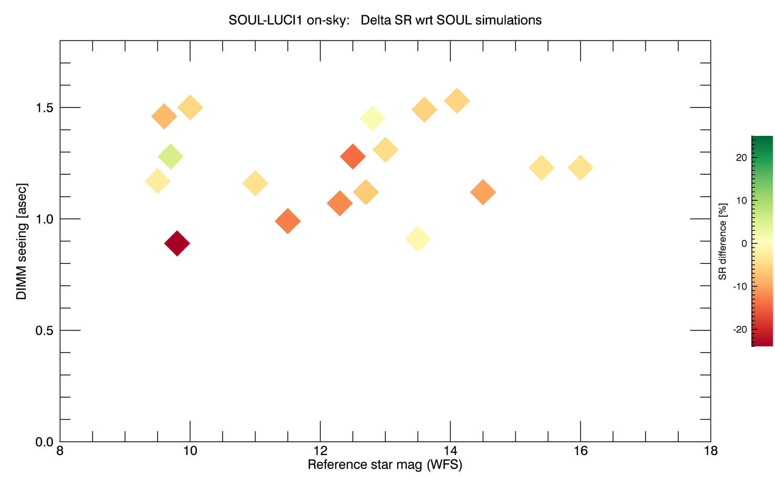
ON-sky luci1+soul Vs simulation
SR measured on LUCI1 PSF
(each point average of 3-10 logn exp
So far, not much luck with seeing
To be improved
BIN3 in progress
High SR affected by NCPA
Fast evolution on LUCI1

Slide 11
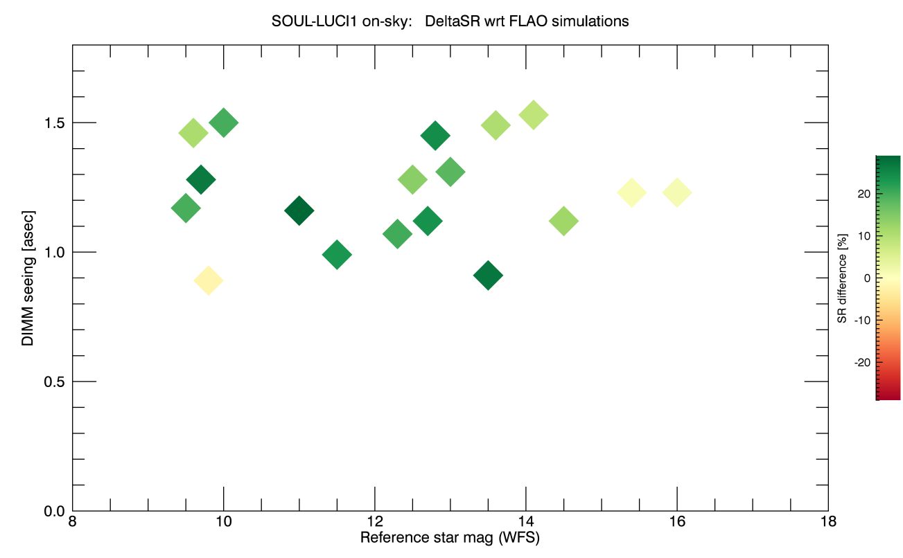
ON-sky luc1+soul Vs FLAO simulation
Improvements at all regime wrt FLAO up to 25%
Demonstrated:
robustness + performance in bad seeing
SR measured on LUCI1 PSF
(each point average of 3-10 long exp
So far, not much luck with seeing

Slide 12
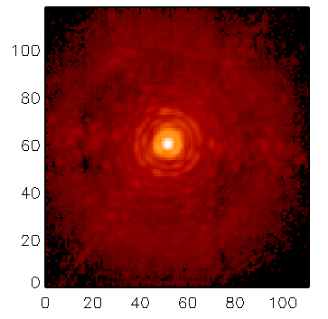
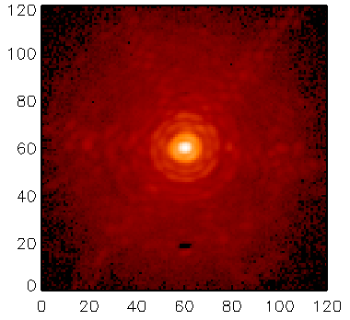
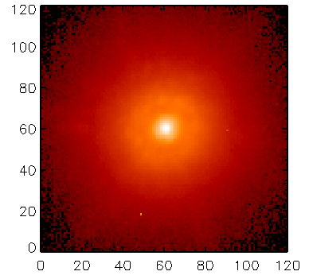
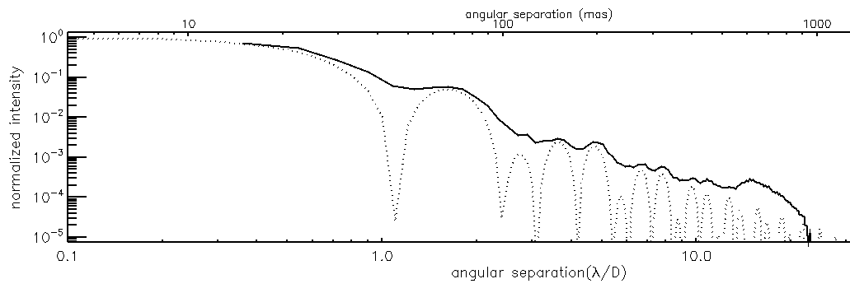
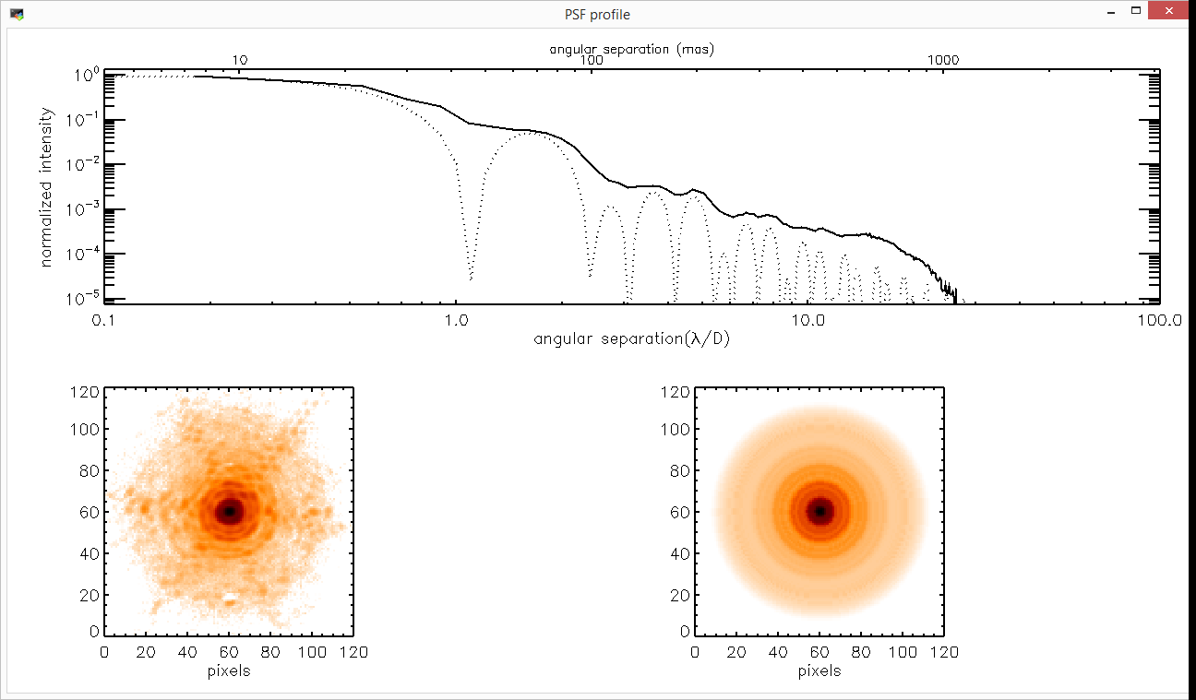
On-sky SOUL-LUCI PSF GAllery
R = 9.5, S = 1.3’’
SR(1650nm) = 77%
40SA – 1.7kHz
500 modes
R = 11.5, S = 1.0’’
SR(1650nm) = 66%
40SA – 1.2kHz
500 modes
R = 14.5, S = 1.1’’
SR(1650nm) = 19%
40SA – 1.0kHz
54 modes
H-band (FeII)
H-band (FeII)
H-band
14<R<16
To be improved with Bin3
1.5 asec
10E-3

Slide 13
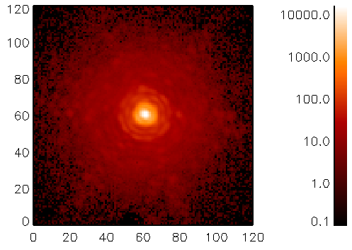
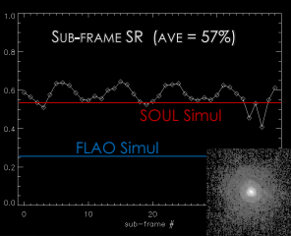
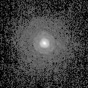

new limits for dimm NGS (ever!)
Long-exp 40x2s (NO shift-add)
SPHERE nominal R13.5, S= 0.6’’ -> SR = 48.5
SR = 57%
FeII (1650nm)
20190709_064042
R13.5
S = 0.93’’
20x20SA
870Hz
250modes
RAW contrast
10E-3
R13.5 S=0.93’’ + ave. vib.
SOUL simul = 54%
FLAO simul = 25%

Slide 14
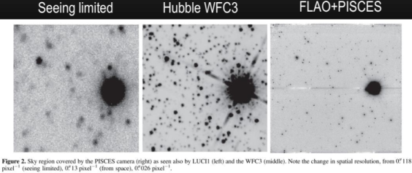
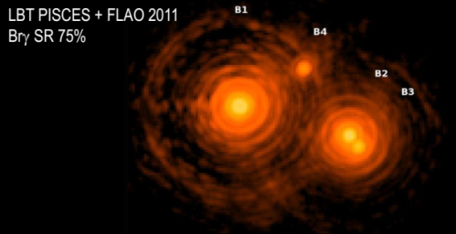
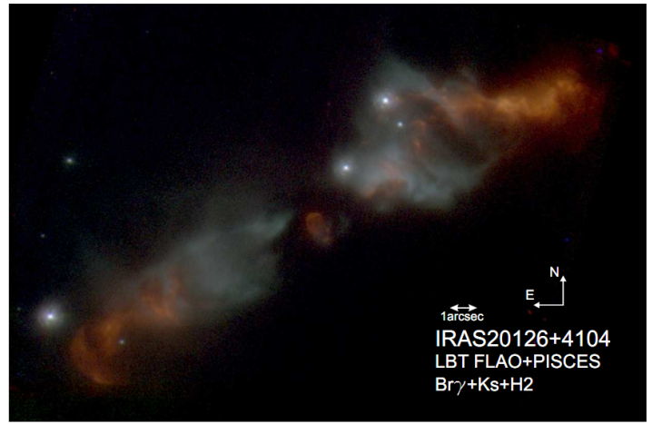
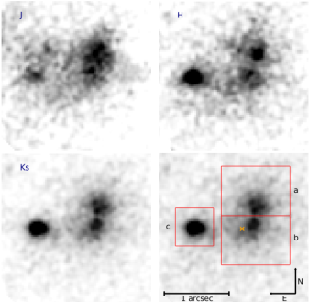
Which science for SOUL-LUCI?
Stellar population
Close multiple stars
2015 Monellu et al -ApJ
2012 Close2012+ - ApJ
Star formation
Merging galaxies
2013 Cesaroni et al . A&A
... solar system, AGN, and more
2019 Heidt et al . A&A
FLAO+LUCI

Slide 15
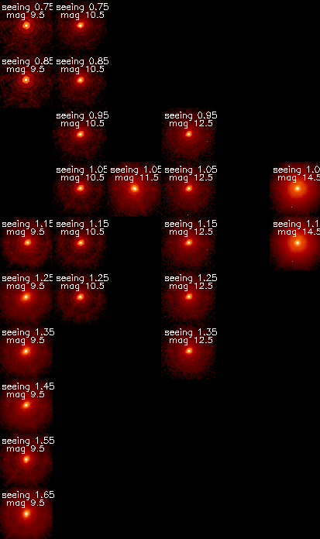
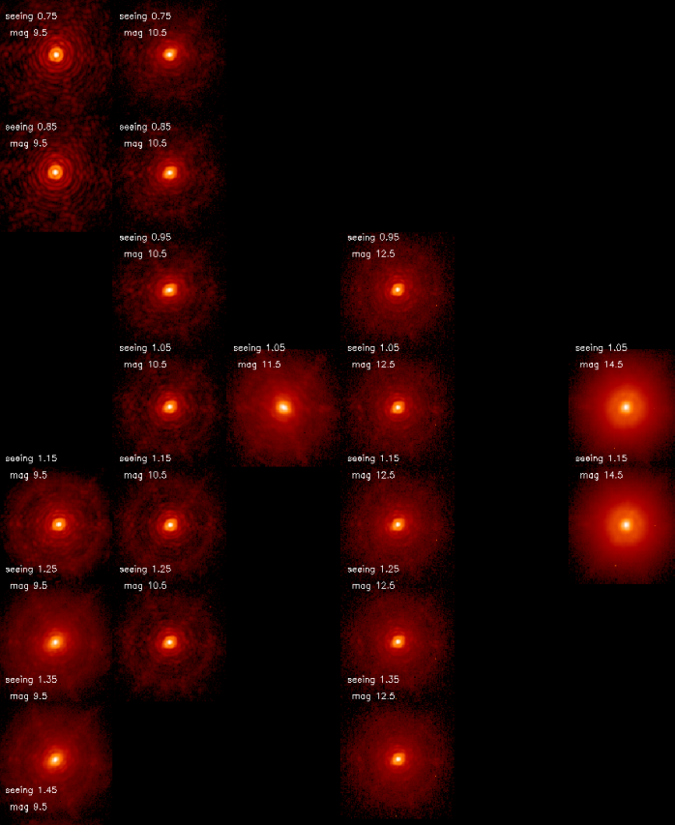
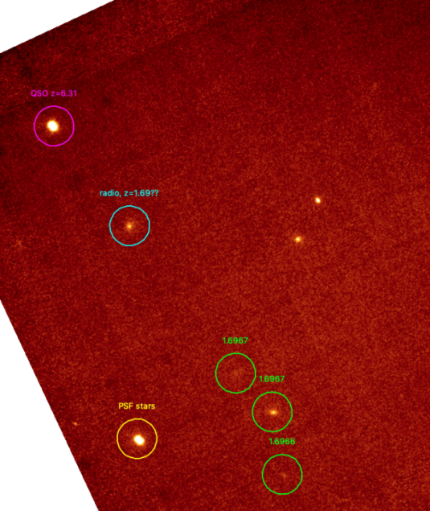
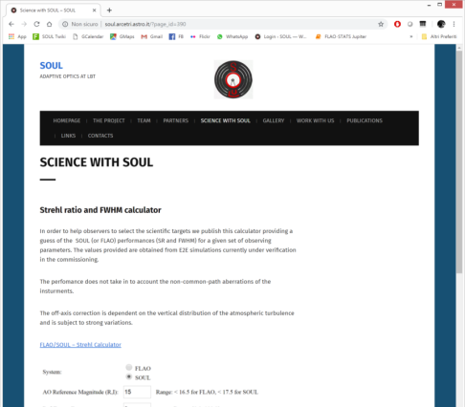
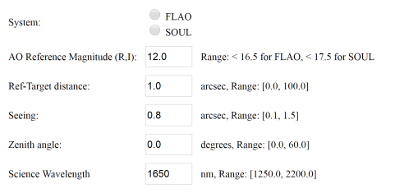
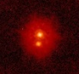
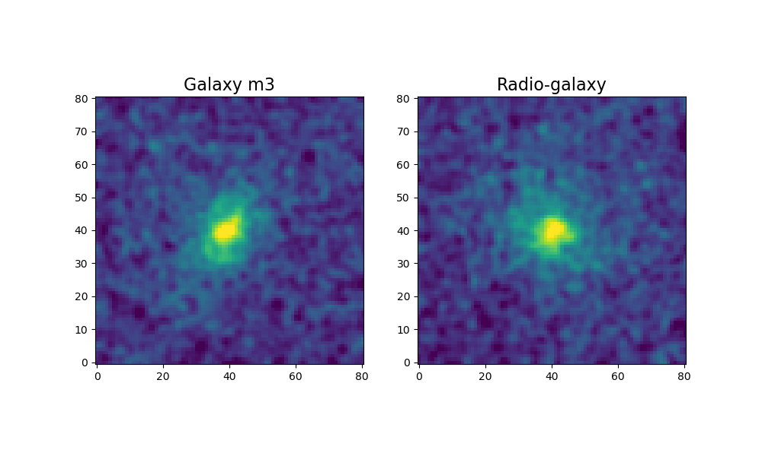
SOUL-LUCI toward science
SR calculator
On-sky PSF archive (in progress, soon online)
First extragalactic science
Still simulations values
2019 Gilli et al. A&A
R mag
J1030+0524
Glaxy protocluster
Ks
40min
soul.arcetri.astro.it
Seeing
NGS
R=12 (13)
Double!
0.4’’ sep.
23’’

Slide 16



Your science with SOUL-LUCI1
Enable vis AO up to R12-R13
Science Verification Time
Science Verification Time scheduled end of May 2020 (6 nights)
Looking for science cases:
  exploiting the SOUL potential
  open shutter time up to 2h
  fast track for publication
Call will open to all LBT partners in March 2020
Please contact the PI for details - enrico.pinna@inaf.it
High contrast at R12-13 in H
High resolution in Ks and L’-M’ for extragalctic targets R>14
Improved robustness performances in «strong» seeing
LBT call
Improve AO loop robustness with new control algorithms
SOUL-LUCI1 is offered as facility to the partners
Apply to the LBT-ITALIA annual call

Slide 17
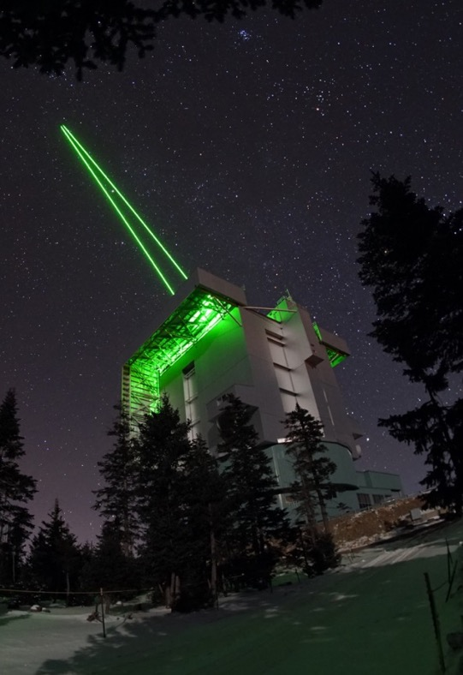
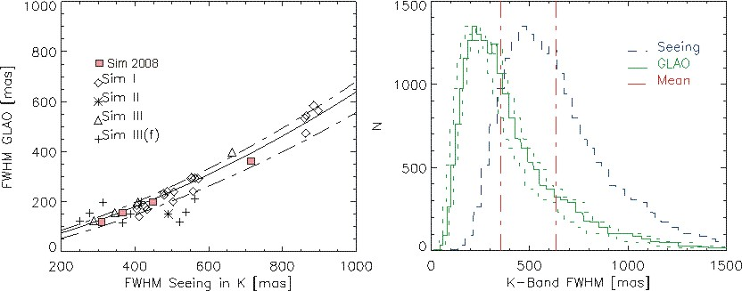
ARGOS – Wide Field AO for LUCI
Laser assisted Ground-Layer AO system
It provides high sky-coverage, wide-field, uniform correction for LUCI large field camera
‘Make a good night excellent’
A factor 2-3 in FWHM can be gained over the full 4x4‘ LUCI FoV
A factor 2-3 more flux is gained in a 0.25‘‘ slit.
‘Make a bad night acceptable’
‘The high resolution project nights’
It allows fully binocular observations
ARGOS acts as a seeing enhancer

Slide 18
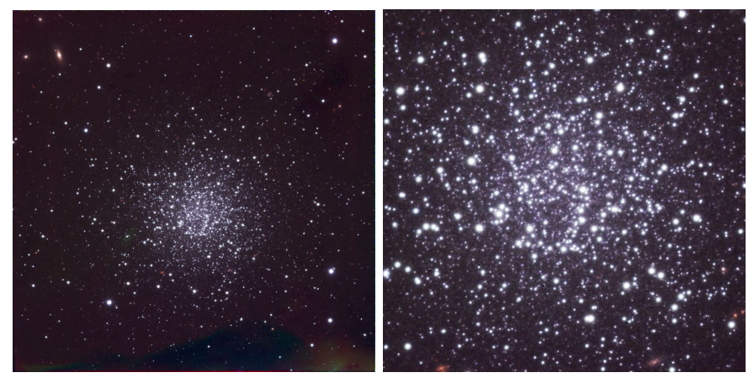
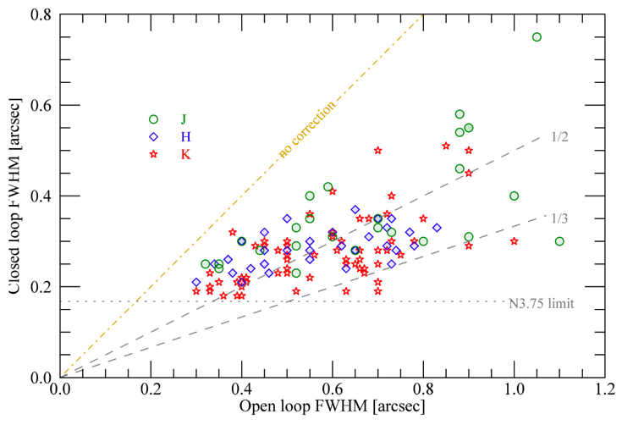
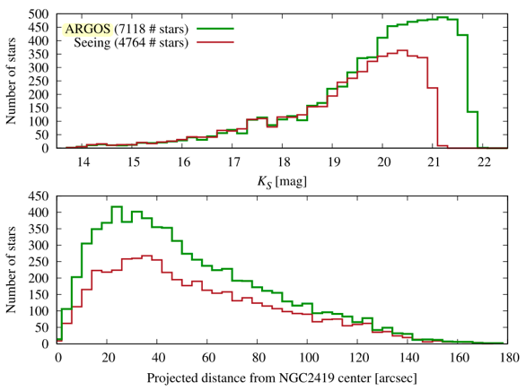
ARGOS – resolution gain
GC NGC2419 deeper in crowded fields
ARGOS improves FWHM by factor 2-3 (sample 123 obs)
From Rabien at al 2019

Slide 19
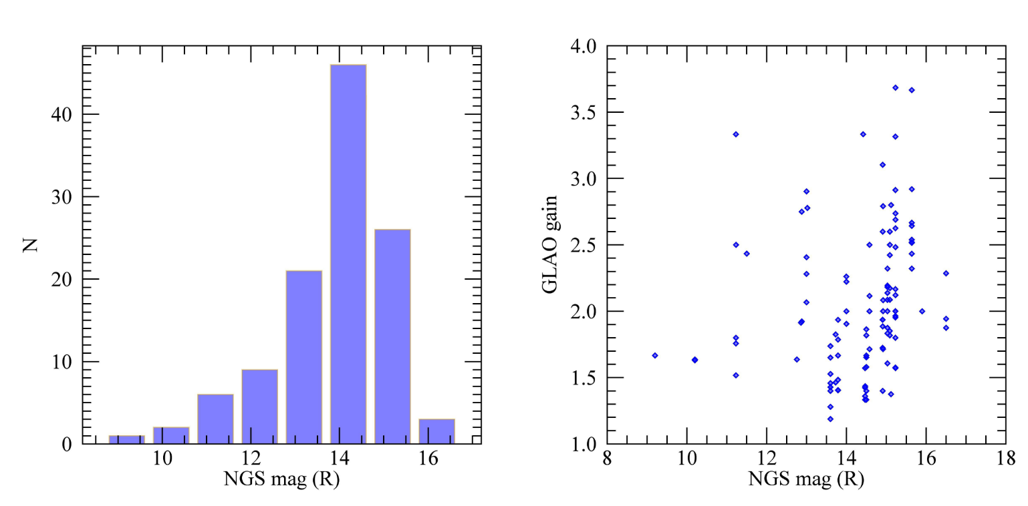
ARGOS – SKY COVERAGE
Need 1 NGS mag _{R} < 17
NGS < 2 arcmin from target
performances do NOT depend on NGS magnitude
Telescope elevation > 45 for laser safety
magR of ~100 NGS used during commissioning (left)
OL/CL FHWM ratio vs magR (right)

Slide 20
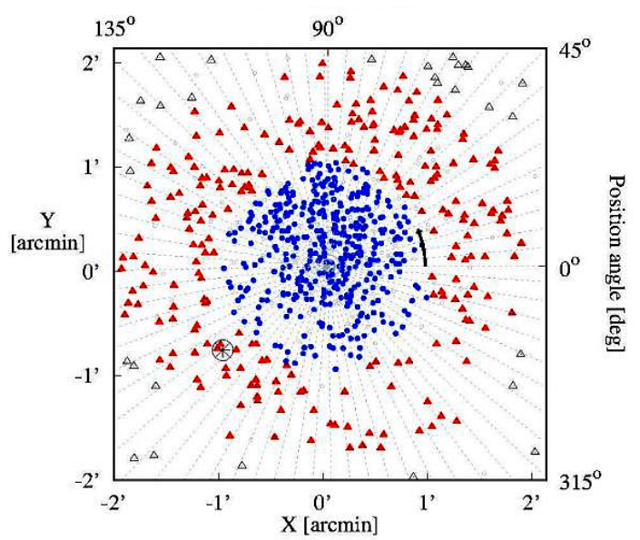
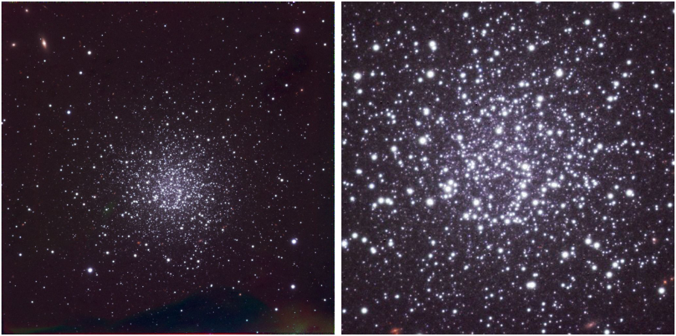
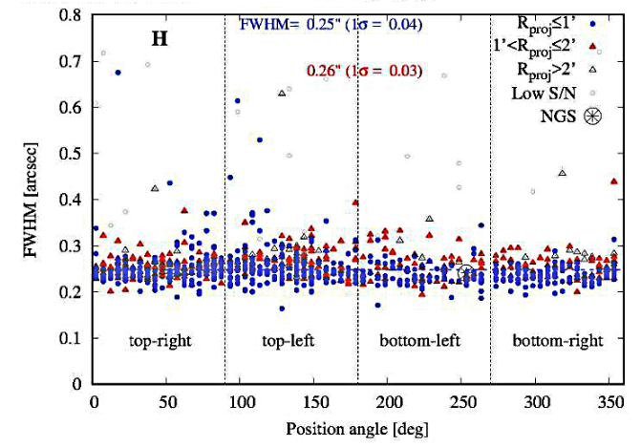
CORRECTION UNIFORMITY
NGC 2419 (seeing ~1.0")
ARGOS corrected FWHM
J: 0.27 (+0.02) +/- 0.04
H: 0.25 (+0.02) +/- 0.04
K: 0.25 (+0.02) +/- 0.04

Slide 21
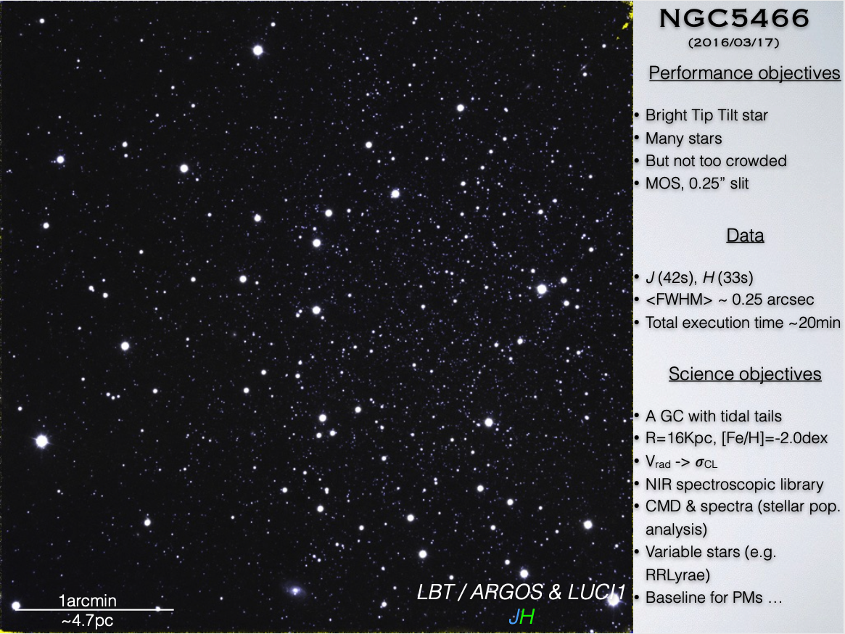
First LGS MOS observation
Courtesy of Iskren Georgiev (MPIA)

Slide 22
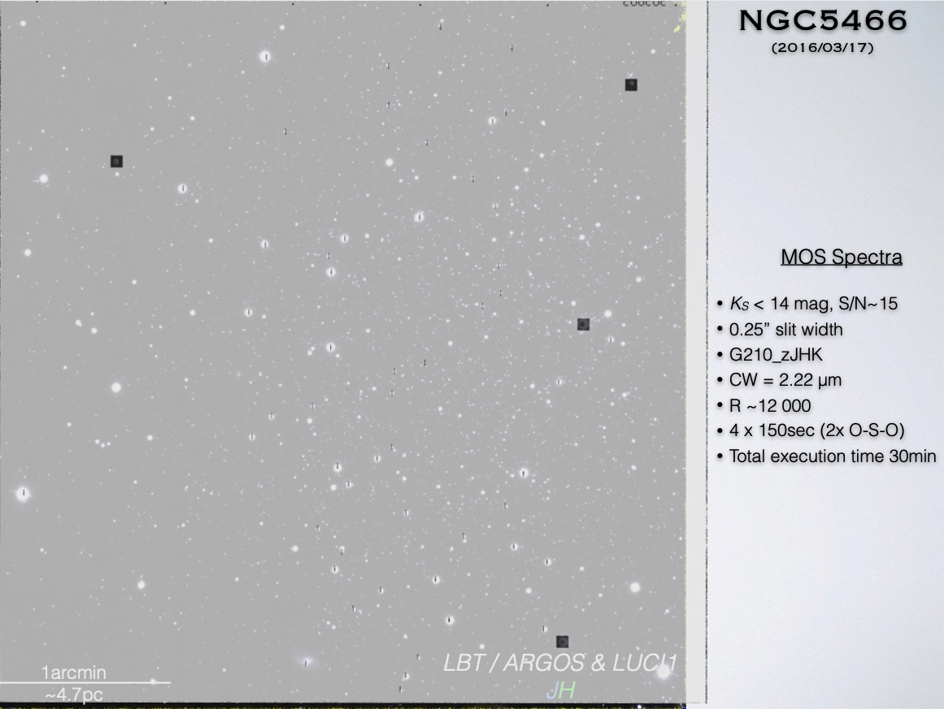
Courtesy of Iskren Georgiev (MPIA)

Slide 23
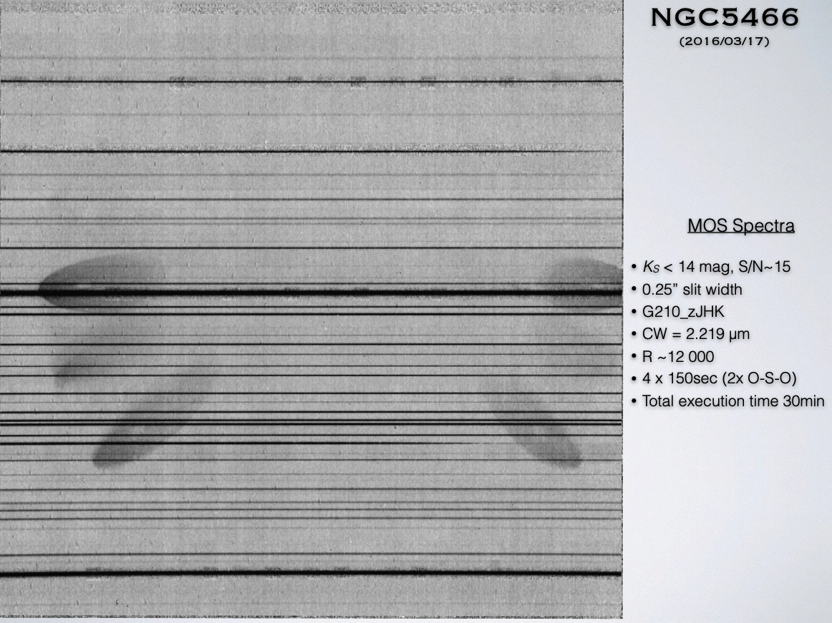
Courtesy of Iskren Georgiev (MPIA)

Slide 24
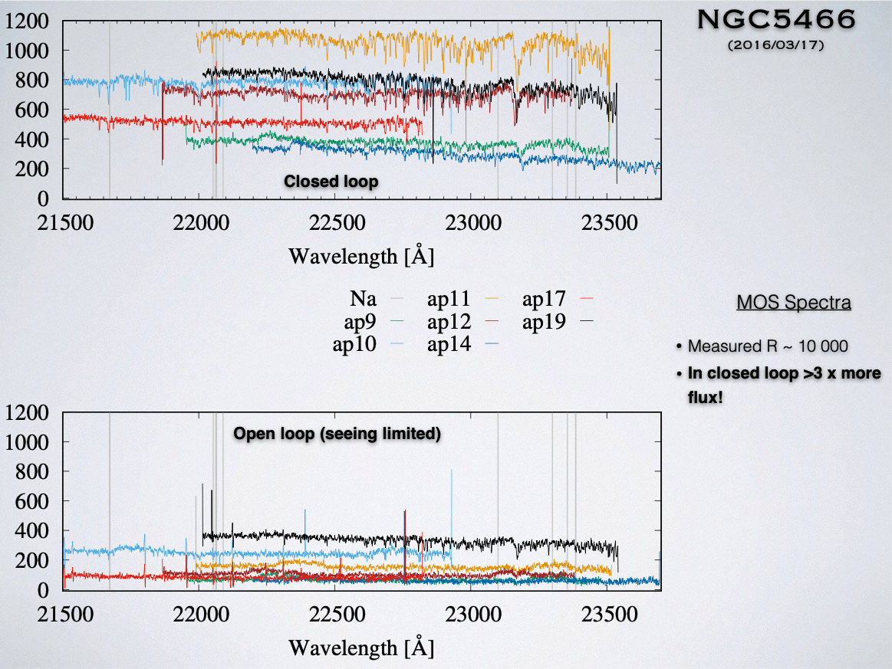
Courtesy of Iskren Georgiev (MPIA)

Slide 25


Custom slits shape
Imaging and spectroscopy of gravitional arcs with LUCI-MOS
SDSS1038+4849 (SMILE arc) z=2.197 MOS with curved slit
2D spectra of OIII e Ha (tint=4h)
G165 composite LUCI ARGOS (red) + HST/WFC3 (green & blue)
From Rabien at al 2019
Courtesy of Iskren Georgiev (MPIA)

Slide 26
Who is LUCI-ARGOS for?
spatial resolution (0.25"-0.3") in the zJHK bands over 4'x4' field of view.
high-resolution (R~10000) longslit or MOS spectra in zJHK with 0.2-0.3" spatial scale
Examples of commissioning observations: nearby embedded star-formation, high-redshift galaxies, lensed arcs

Slide 27








Publications based on ARGOS commissioning data

Slide 28



LINC NIRVANA
Binocular Natural Guide Star Layer-Oriented Multiple-FoV Multi-Pyramid MCAO system.
Possibility of achieving Fizeau interferometric beam-combination.
Science wavelengths are J, H, and K bands.
Two DMs: ASM of LBT compensates the ground layer turbulence while Xinetics DM on LN bench compensates for the altitude ~7km above the telescope pupil.
Commissioning on the left arm is almost complete and Science Verification will begin in the coming semester.

Slide 29



GWS
HWS
High layer WFS can use up to 8 NGSs from the central 2’ diameter FoV
Ground layer WFS can use up to 12 NGSs from the annular 2’-6’ diameter FoV

Slide 30



LINC-NIRVANA offers the AO community the unique opportunity to test MCAO related activities. This will be very useful for the future instrumentation such as MAVIS and MAORY.

Slide 31

What is the LBTI?
8.4 m
8.4 m
14.4 m
22.7 m
Courtesy of Steve Ertel – Steward Observatory

Slide 32



What is the LBTI?
LBTI is a ‘strategic’ (similar to PI) instrument
High angular resolution and high contrast at thermal infrared (L to N bands, can also observe at H & K bands)
AO assisted single sided, double sided, and interferometric observations to exploit LBT’s full resolution capabilities
Very low thermal background due to adaptive secondary and only three warm reflections
Courtesy of Steve Ertel – Steward Observatory

Slide 33
Current LBTI capabilities
LMIRCam
Imaging:
Wavelengths: J to M band
Field-of-view: 20”
High contrast (12 mag at 0.5” in L band)
Background limit: 23 mag (H), 17 mag (L)
8.4m resolution, two sides in parallel
AGPM & vAPP coronagraphy
Fizeau imaging interferometry:
Interferometric technique to reach full 23m equivalent angular resolution
Open phase loop or fringe tracked (K < 5)
Aperture masking:
Interferometric technique
Faint companions & disks inside diffraction limit
Contrast ~6mag at 100 mas
Wall-eyed pointing mode:
Precision relative IR photometry
Two apertures point at two different stars
Maximum separation ~2 arcmin
Prism spectroscopy:
Imaging and spectro-interferometric modes
Spectral resolution ~100
Adaptive optics system:
Natural guide ‘star’ needed, off-axis separation <50”, limiting magnitude R<17 (demonstrated), R<18 (expected)
NOMIC
Imaging:
AO assisted N band imaging
Diffraction limited, stable PSF
Very high sensitivity:few mJy (1 sigma, 10 min)
Field-of-view: 18” (but some vignetting)
Nulling interferometry:
Interferometric technique
High contrast detection of circumstellar emission
Contrast: few 10⁻⁴
Limiting magnitude: K~5
Fizeau imaging:
Same as LMIRCam but in N band
Prism spectroscopy:
Imaging and spectro-interferometry
Spectral resolution ~100
Courtesy of Steve Ertel – Steward Observatory
ALES
Integral field spectroscopy:
Spatially resolved spectra
High angular resolution, high contrast imaging techniques with spectral resolution
Spectral resolution ~80
Field of view 2”
Wavelength range 2-5 micron (only 3-4 routine)
Routinely combined with vAPP coronagraphy
Future: Combine with AGPM coronagraphy and Fizeau interferometry

Slide 34


The LBTI/HOSTS program
Hunt for Observable Signatures of Terrestrial Systems
Main LBTI science driver: Search for HZ dust around nearby stars
Characterize dust, evaluate risk for future exo-Earth imaging missions
Detection rates:
WISE: 22 of 24174 (0.09%)
KIN: 5 of 44 (11%)
LBTI: 10 of 38 (26%)
Exo-Earth imaging
is possible!
WISE
NASA funded to build the LBTI, execute survey
Recently completed, 38 stars observed, 10 detections
KIN
LBTI
WISE: Kennedy et al. 2013
KIN: Mennesson et al. 2014
LBTI: Ertel et al. 2018 & subm.

Slide 35











LBTI science
Phase 0.048
17 May 2017
Credit: G. Weigelt
Phase 0.109
2 Nov 2017
Jones et al. 2019
Wagner et al. 2019
VY CMa
Phase 0.171
6 May 2018
Gordon et al 2019
HST 1μm
LBTI 2.2μm
LBTI 9μm
Crepp et al. 2018
2.15um
3.95um
Also: LEECH survey
Stone et al. 2018
Notes:
Top-left: Spirals in the protoplanetary disk of MWC758 with a candidate companion that (if confirmed) would likely be responsible for the spiral formation.
Top-center: This is a quasar lensed by a foreground galaxy (not visible here). The goal was to measure the infrared flux difference between the lensed images to determine the distribution of dark matter in the foreground galaxy.
Right: A Wolf-Rayet star in a binary system. During periastron passage of the companion, a dust ejection event was triggered. We’ve followed the evolution of the dust for over three years now, the first year is shown here.
Bottom-left: VY CMa red supergiant. The ejected dust clump to the lower-right was only imaged in scattered light before, which limited constraining its mass and dust properties. ALMA could not see it. We imaged it at 9um for the first time and determined the dust mass and constrained the composition.
Bottom-center: A white dwarf companion to a nearby main sequence star (Sirius-like system).
Bottom-right: Also a note on the recently completed LEECH survey for giant planets around mature, nearby stars that put the strongest constraints so far on the planet occurrence rate assuming cold start planet formation models.

Slide 36


ALES integral field spectroscopy
First thermal IR IFS in the world!
Get spectral image cubes
Can be combined with coronagraphy and interferometry
~1 arcsec
Hinz et al. 2016

Slide 37



FIZEAU interferometry
Resolved high contrast imaging with the full 23m eff. aperture
20’’ field of view, L/M/N band
(H/K in principle possible)
Makes the LBT the first 30-m class telescope
Can be combined with ALES, aperture masking, spetroscopy
Io in 400 years
8.4 m
23 m
Conrad et al. 2015
de Kleer et al. 2017

Slide 38
LBTI queue mode
Observations scheduled and executed following target observability, weather requirements & TAC+PI priorities
Maximizes use of available open dome time
Good probability that high priority observations are completed under suitable conditions
Expert preparation and execution of observations by instrument team
Minimal effort from science PIs required
PIs (teams) always welcome to attend runs
Limited support on data reduction
Steve Ertel (leading instrument scientist, user support, observations): sertel@email.arizona.edu
Jordan Stone (instrument scientist, NALES expert): jstone@as.arizona.edu
PI approval for proposal submission: lbtipi@lbto.org

Slide 39
CONCLUSIONS
Four AO instruments are in operation at LBT (and counting...)
  LUCIs – NIR imager-MOS small/wide field
  LBTI – Mid infrared camera / IFU / 23m baseline Interferometer
  LN – MCAO assisted NIR camera
Italian astronomers are encouraged to apply for observations with AO instruments
Italian instruments representatives are willing to support them!

