Slide 1

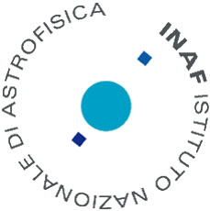
AO data analysis challenge
How PSF shape relates to the technique used, vs. the field, vs. wavelength, vs. turbulence profile, and many more
Carmelo Arcidiacono
carmelo.arcidiacono@inaf.it
INAF OaPd, ADONI

Slide 2
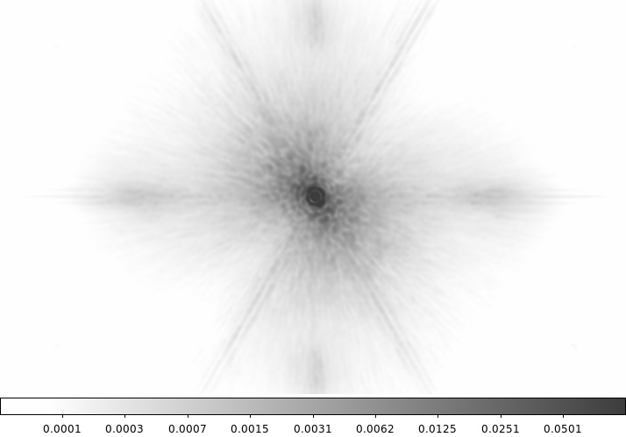
General context
The Point Spread Function (PSF) ignorance can lead to significant systematic errors for science data extraction.
The PSF estimation technique is one of the key ingredients for the analysis of the observations.
The actual PSF is not a priori fully determined, since the degree of Adaptive Optics (AO) correction is sensitive to the observing conditions: seeing, wind speed, the brightness of the reference stars, etc.
Each AO technique produces PSF with specific morphology and field variation.

Slide 3
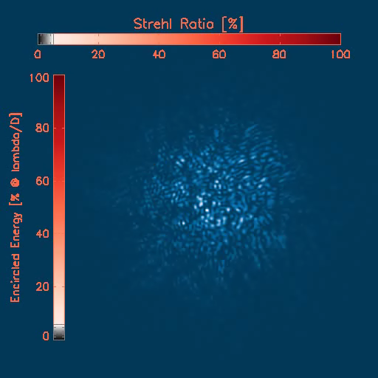
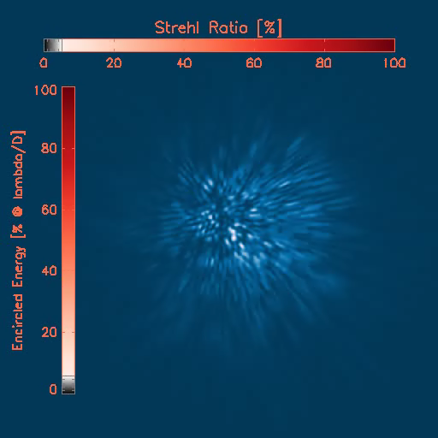

PSF formation and AO effects
Open Loop Sequence monochromatic
Open Loop Sequence polychromatic
The PSF is the result of the integration along the time of consecutive instantaneous PSF and across the wavelengths within the filter used for the observations.
Example: 20 sec, 1.2’’ seeing in V
X bar: SR Ratio
Y bar: EE in the diffraction limited core

Slide 4
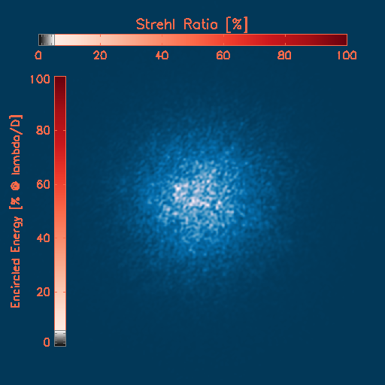
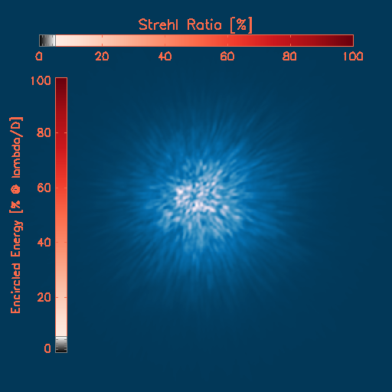
PSF formation and AO effects
Open Loop Sequence monochromatic
Open Loop Sequence polychromatic
The speckles, dancing on the focal plane of ground-based telescopes, produce the seeing disk.
Example: 20 sec, 1.2’’ seeing in V
X bar: SR Ratio
Y bar: EE in the diffraction limited core

Slide 5
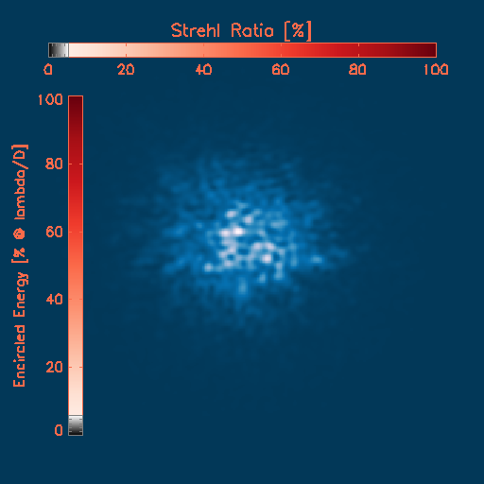

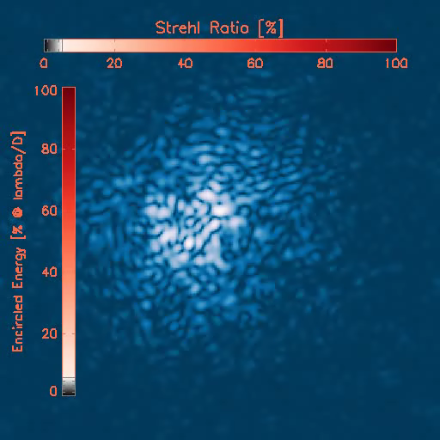
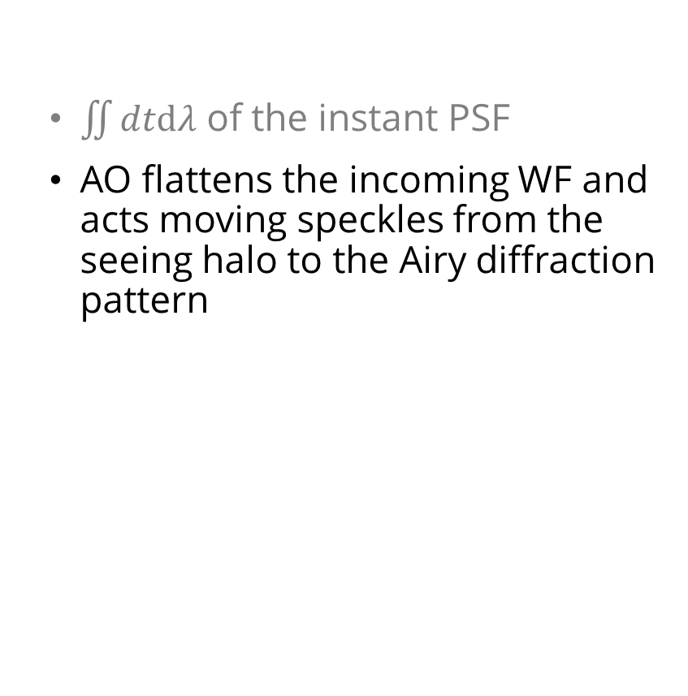
PSF formation and
AO effects
$\iint{dtdλ}$ of the instant PSF
AO flattens the incoming WF and acts moving speckles from the seeing halo to the Airy diffraction pattern
Example: 20 sec, 0.9’’ seeing in V,
X bar: SR Ratio
Y bar: EE in the diffraction limited core
Closing Loop
Sequence

Slide 6
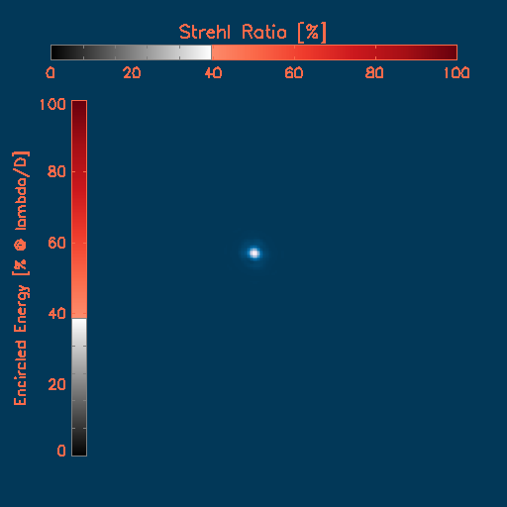
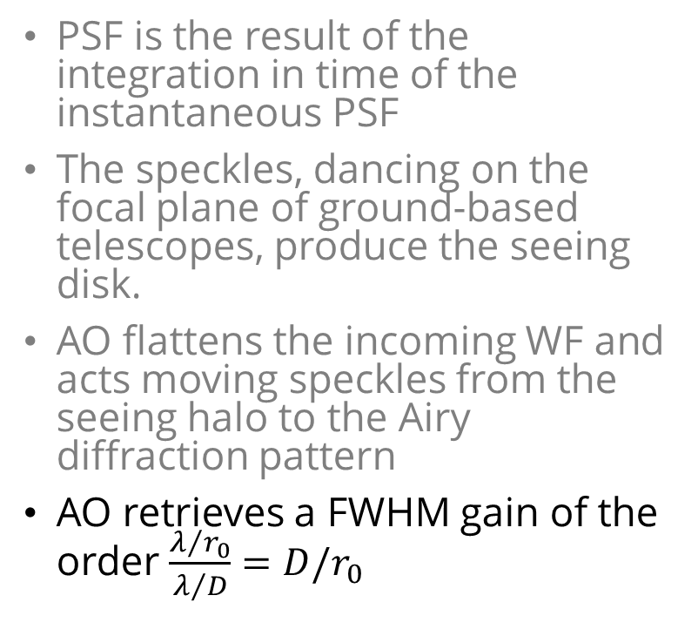
PSF formation and AO effects
PSF is the result of the integration in time of the instantaneous PSF
The speckles, dancing on the focal plane of ground-based telescopes, produce the seeing disk.
AO flattens the incoming WF and acts moving speckles from the seeing halo to the Airy diffraction pattern
AO retrieves a FWHM gain of the order $\frac{λ/{r_{0}}}{λ/D}=D/r_{0}$

Slide 7
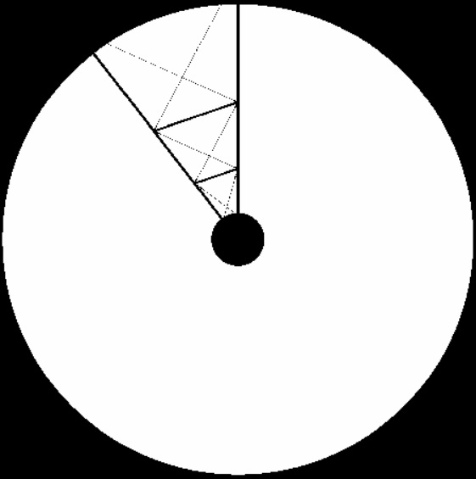
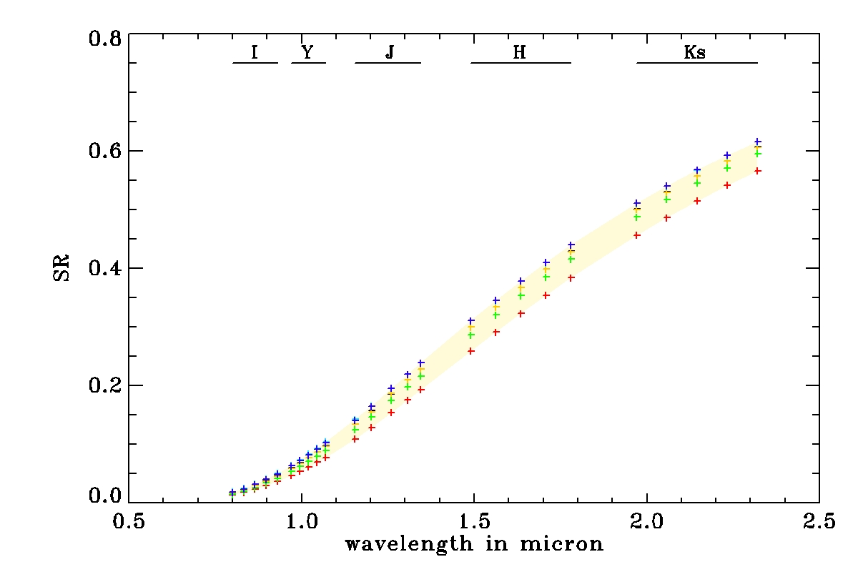
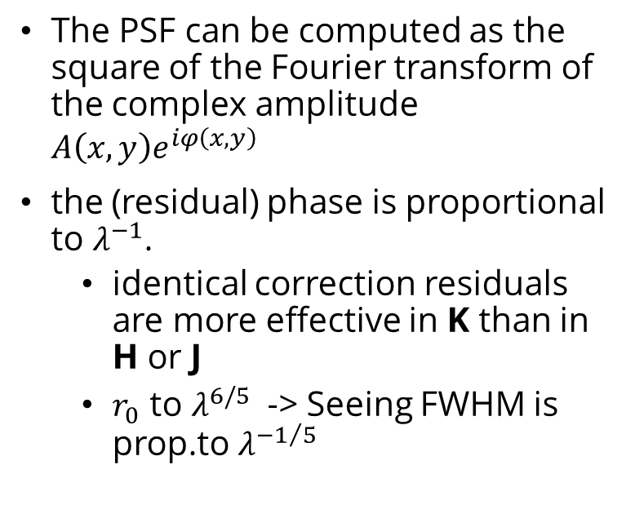

PSF vs Wavelength [λ]
$$A\left(x,y\right)$$
From a MAORY Case
The PSF can be computed as the square of the Fourier transform of the complex amplitude $A\left(x,y\right)e^{iφ\left(x,y\right)}$
the (residual) phase is proportional to $λ^{−1}$.
  identical correction residuals are more effective in K than in H or J
  $r_{0}$ to $λ^{6/5}$ -> Seeing FWHM is prop.to $λ^{−1/5}$

Slide 8
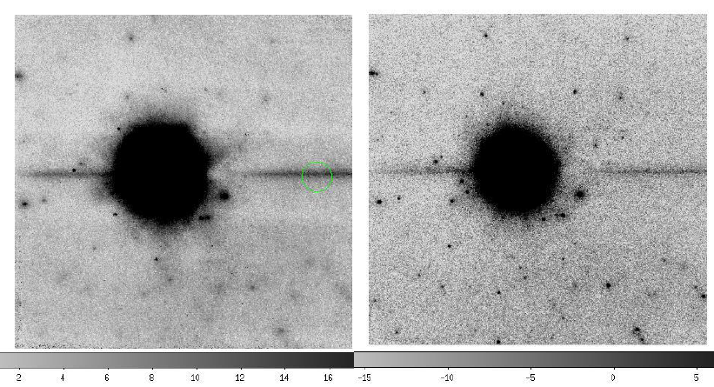

PSF vs Wavelength [λ]
Resolving stars in NGC 1560 FLAO + PISCES, Closed loop on foreground local star
J
Ks
20% SR K
2% SR J
14’’
17-19 Feb 2020

Slide 9
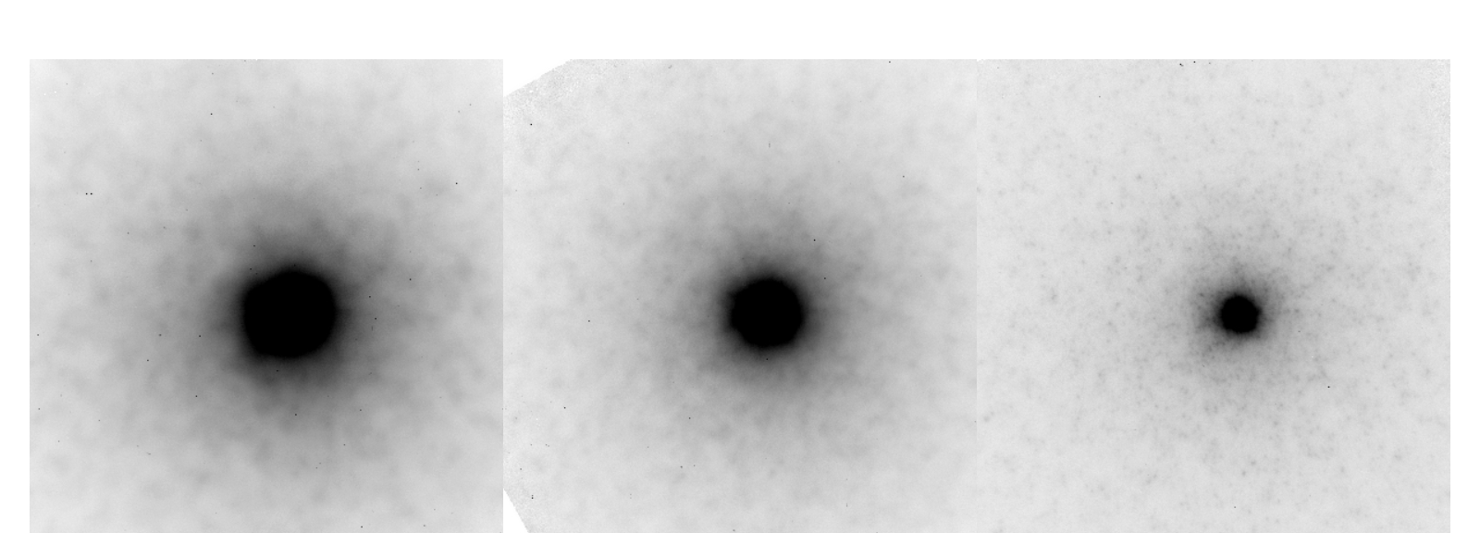
PSF vs Wavelength
NGC 404, FLAO + PISCES, Closing Loop on the core of the galaxy.
J
H
Ks
18’’
We can approximate the PSF as the square of the Fourier transform of the complex amplitude
the phase is proportional to the wavelength.
Therefore an identical correction is more effective in K than in H or J

Slide 10
PSF vs Wavelength
Better performance toward the red.
Narrower peak: More Resolution
Lower Halo: More Contrast
J
H
Ks
18’’
We can approximate the PSF as the square of the Fourier transform of the complex amplitude
the phase is proportional to the wavelength.
Therefore an identical correction is more effective in K than in H or J
Resolution, Contrast, Wavelength

Slide 11
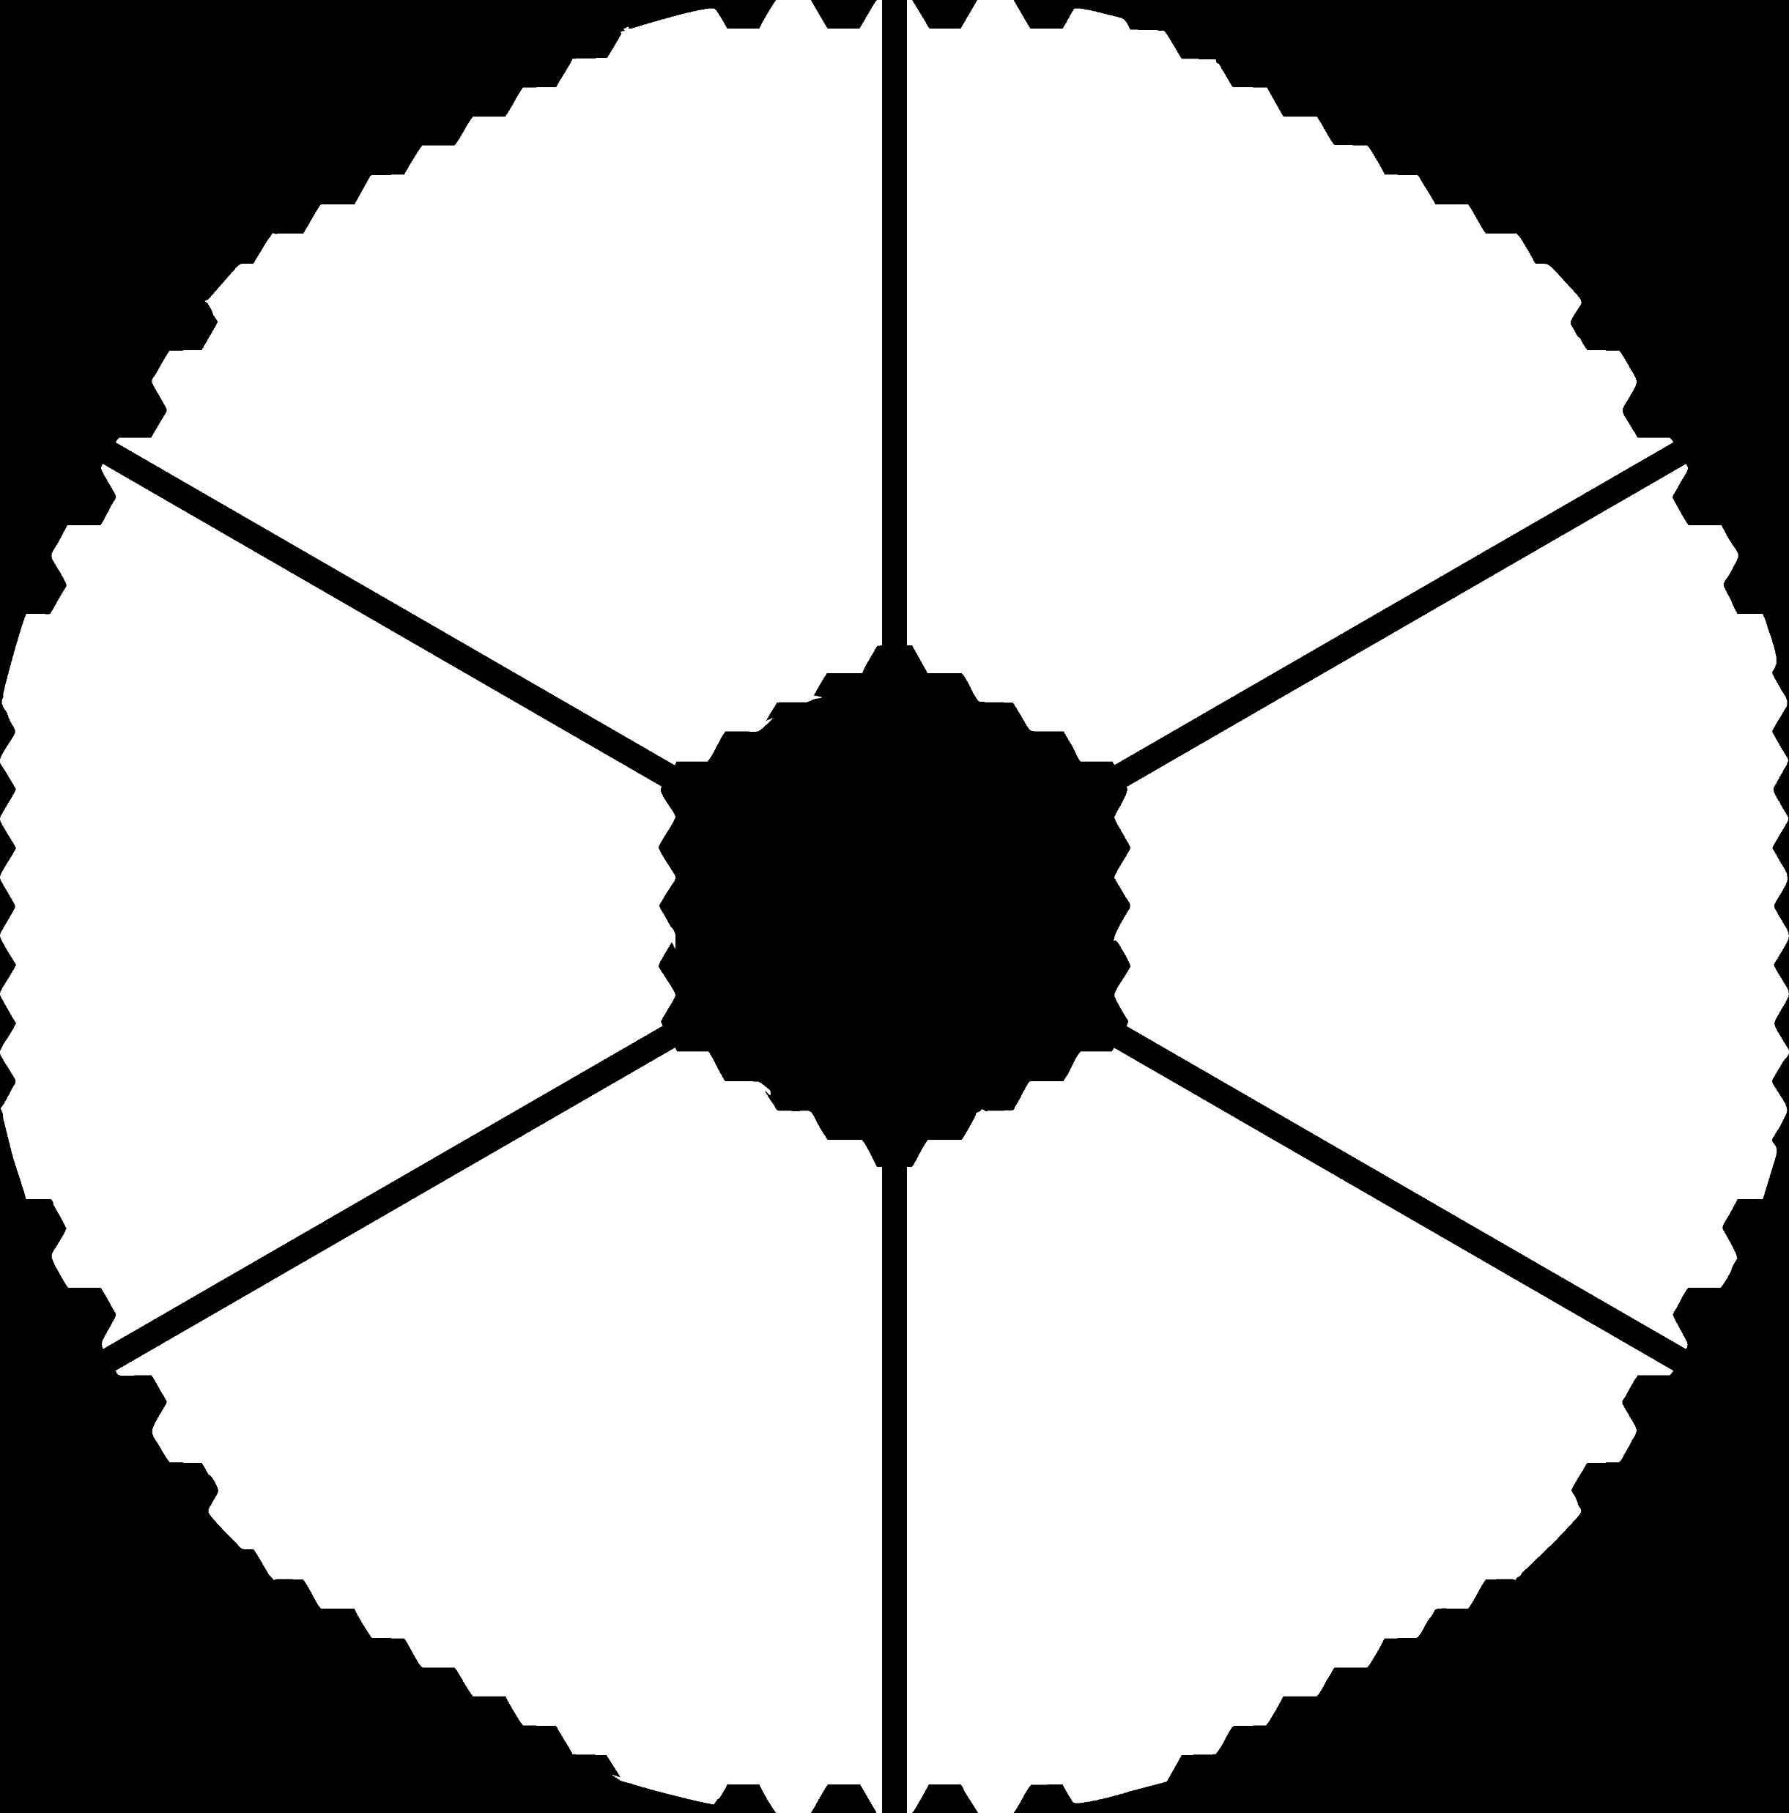
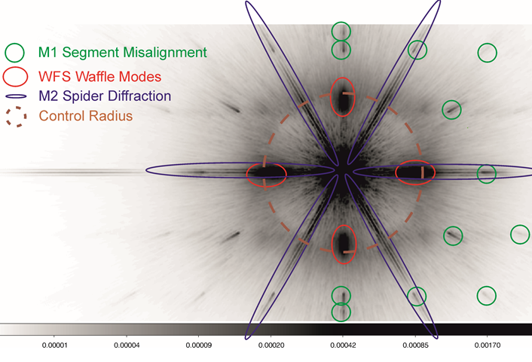
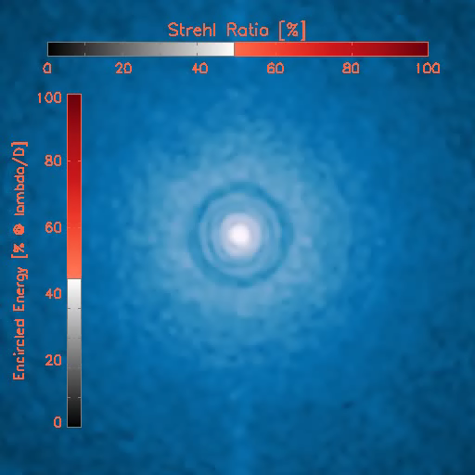
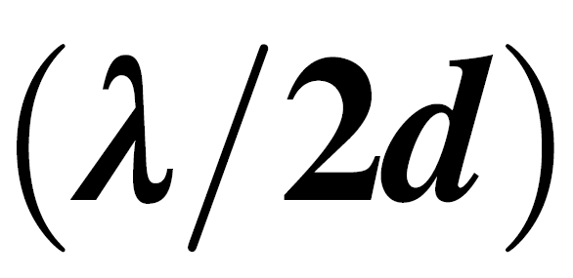
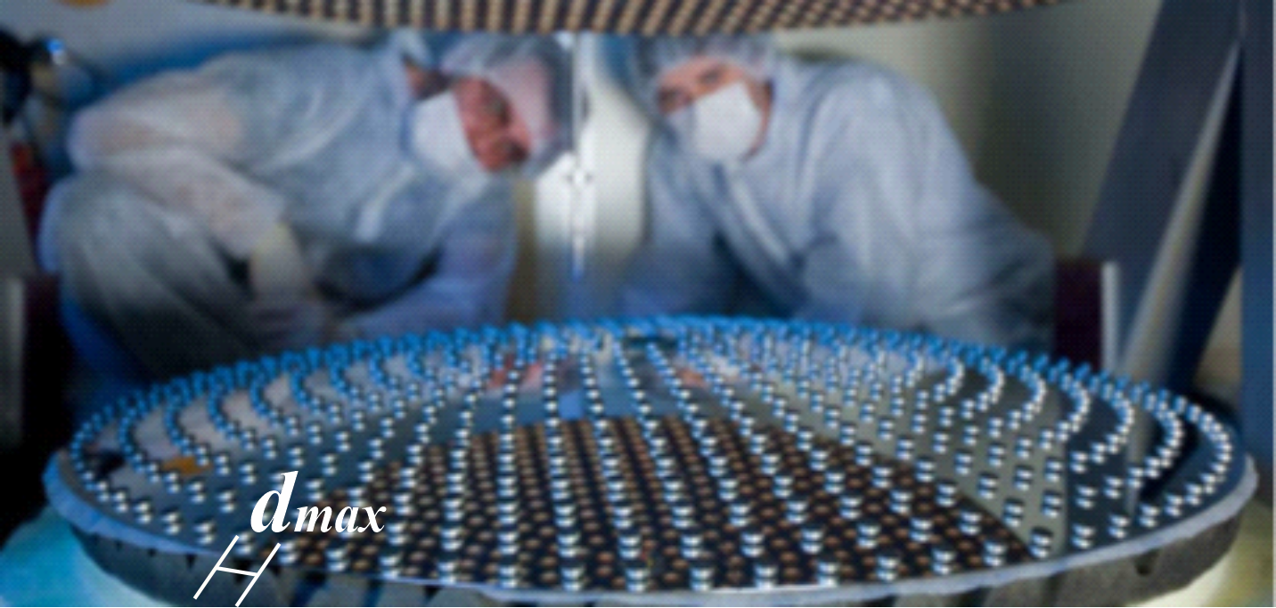
Quasi Diffr.-Lim. PSFs have Structures
The number of DM modes used fixes the highest frequency corrected
It is ultimately limited by the number of actuators
It appears in the PSF fixing the so-called control radius (Perrin+2003), well visible in SCAO mode
Control Radius is at where d, is the dimension of the smallest correction patch on the DM
Low spatial freq
High spatial freq
i.e., the c. radius follows the maximum frequency controlled by the AO, accordingly to the mode number, here fixing the rms of the corrected WF.

Slide 12
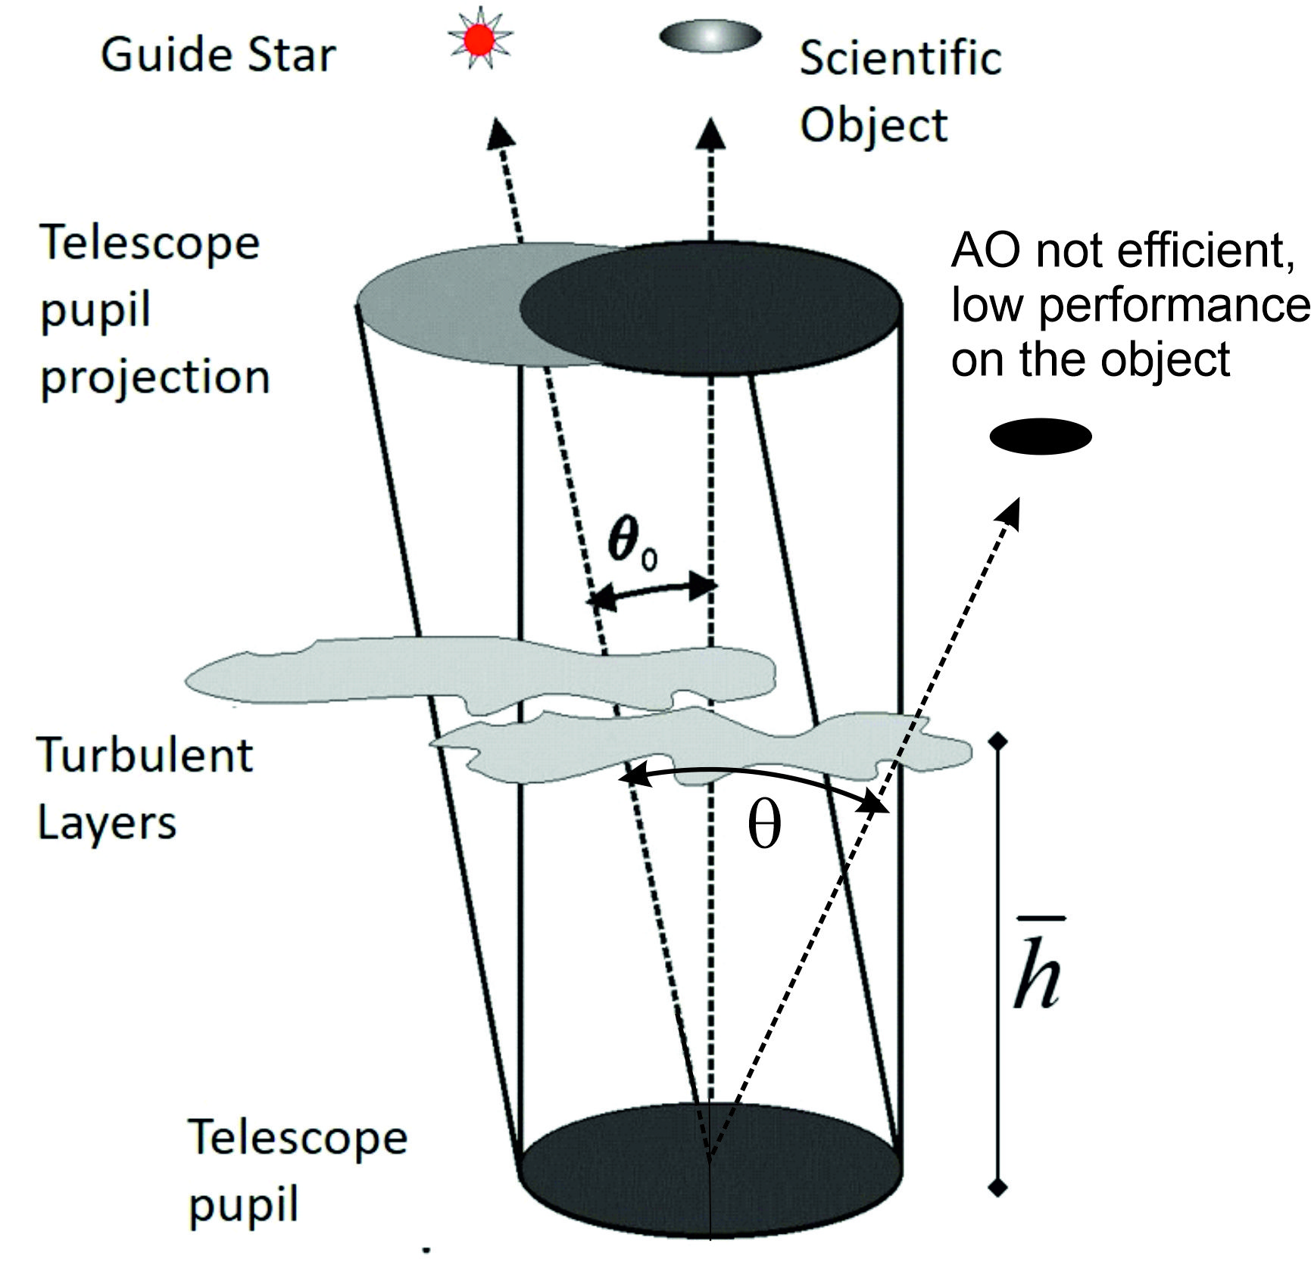

Space variant PSF
SCAO efficiency is limited to the region within the isoplanatic angle,${ θ<θ}_{0}$.
The $θ_{0}$ depends on the turbulence vertical profile (i.e., $\overline{h}$) and this makes it very variable, intranight and even in short timescale (min-hour).

Slide 13

Space variant PSF
Example: M15 J band data
20’’x20’’, PISCES+FLAO, SR_{J} & EE_{0’’.1}
Measured values and temporal rms
In a minute I will show here the point by point rms due to temporal evolution

Slide 14
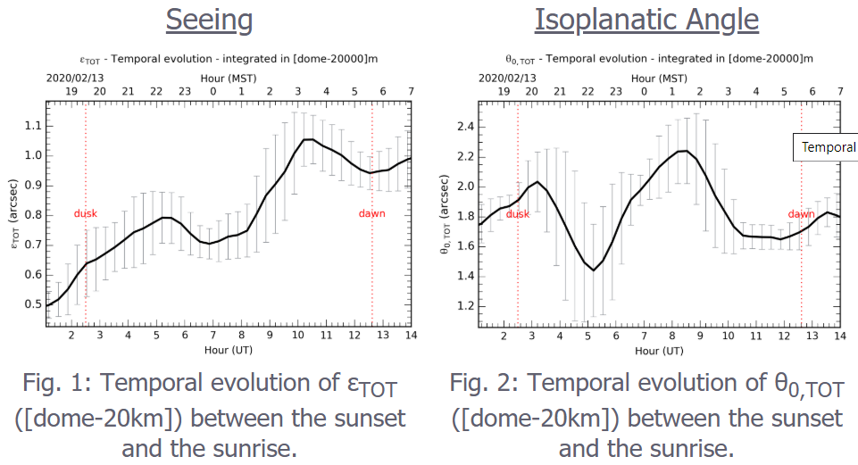

Space variant PSF
SCAO efficiency is limited to the region within the isoplanatic angle, $θ_{0}$.
The extension depends on the turbulence vertical profile (i.e., $\overline{h}$) and this makes it very variable, intranight and even in short timescale.
ALTA PREDICTIONS FOR THE 13th Feb

Slide 15

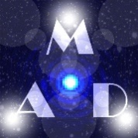
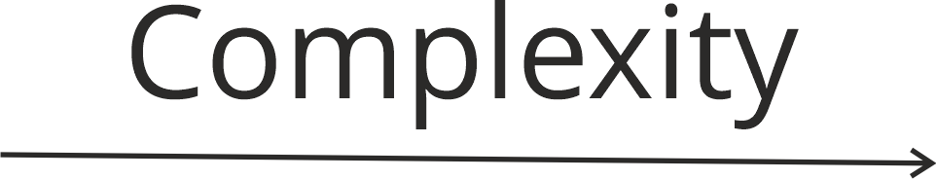

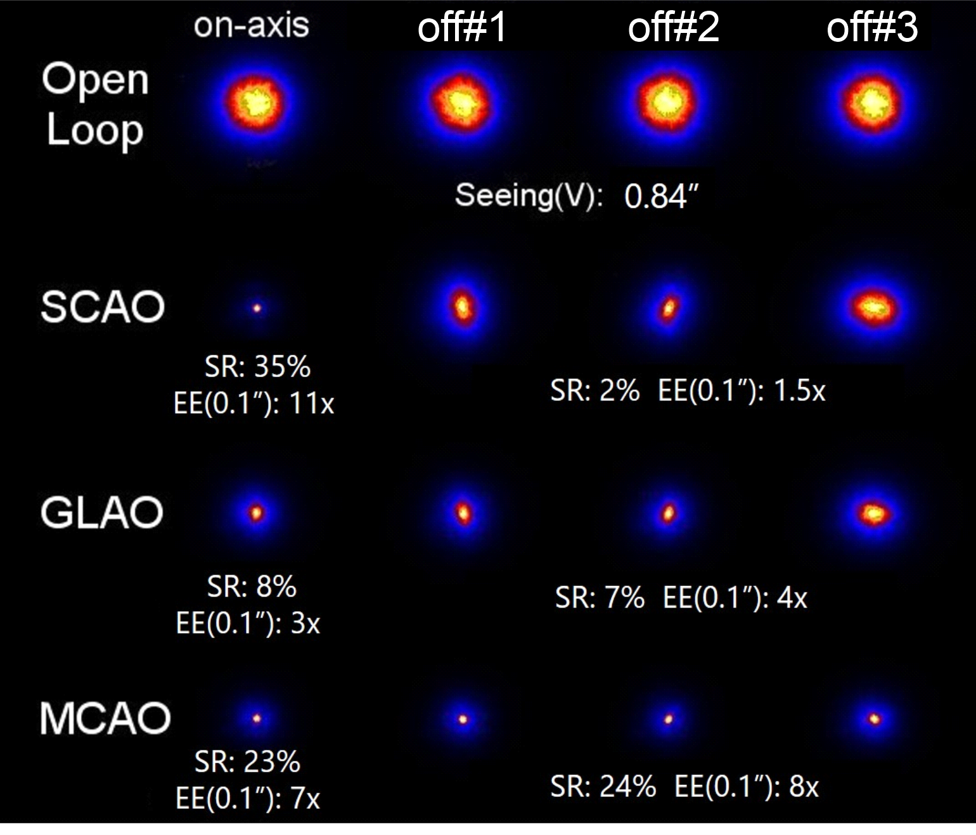



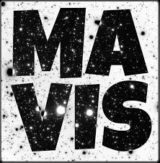
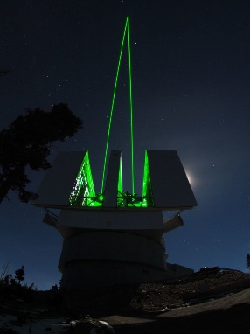
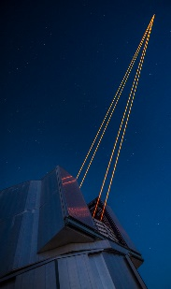
Trading complexity for performance
MCAO
Adding complexity
GLAO
Multiple references
2-3 Deformable mirrors
Multiple references
1 DM
Large FoV
Adding References to sense the atmospheric turbulence volume
Adding Deformable Mirrors to apply field dependant correction
Firing lasers to generate low (Rayleigh <10km) or high (Sodium 90km) artificial stars for sky coverage.
Rayleigh LGS
Sodium LGS

Slide 16
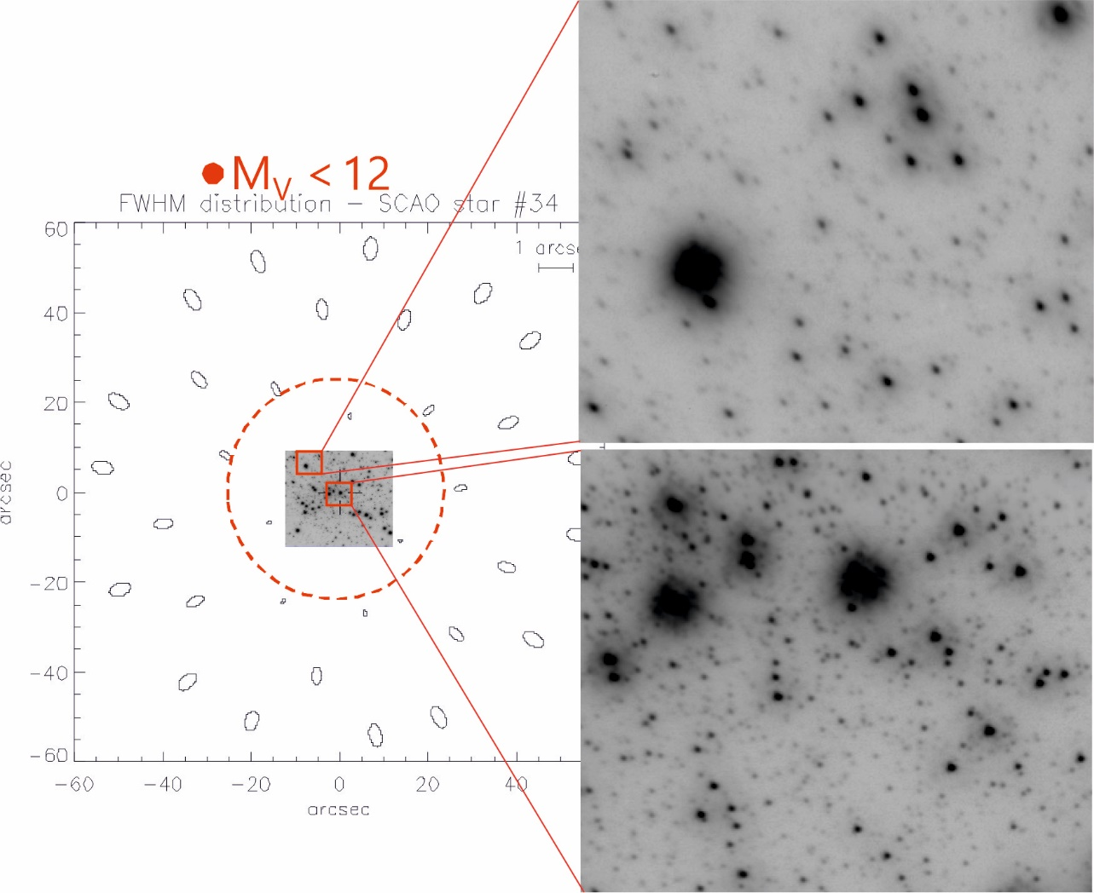
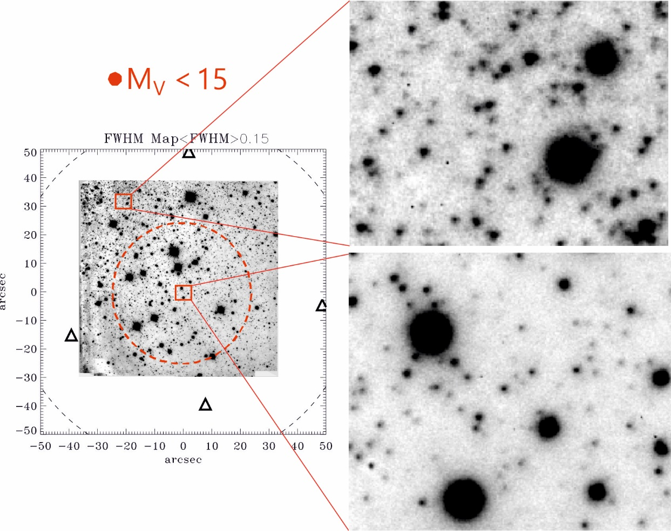
Beyond Single Conjugate adaptive optics
SCAO
MCAO
*M15 core, 23’’x23’’ data J band
PISCES+FLAO @ LBT, inset 6 ’’x5’’
*NGC 6388 halo,65’’x63’’, Ks band, MAD @ VLT, inset 6 ’’x5’’

Slide 17
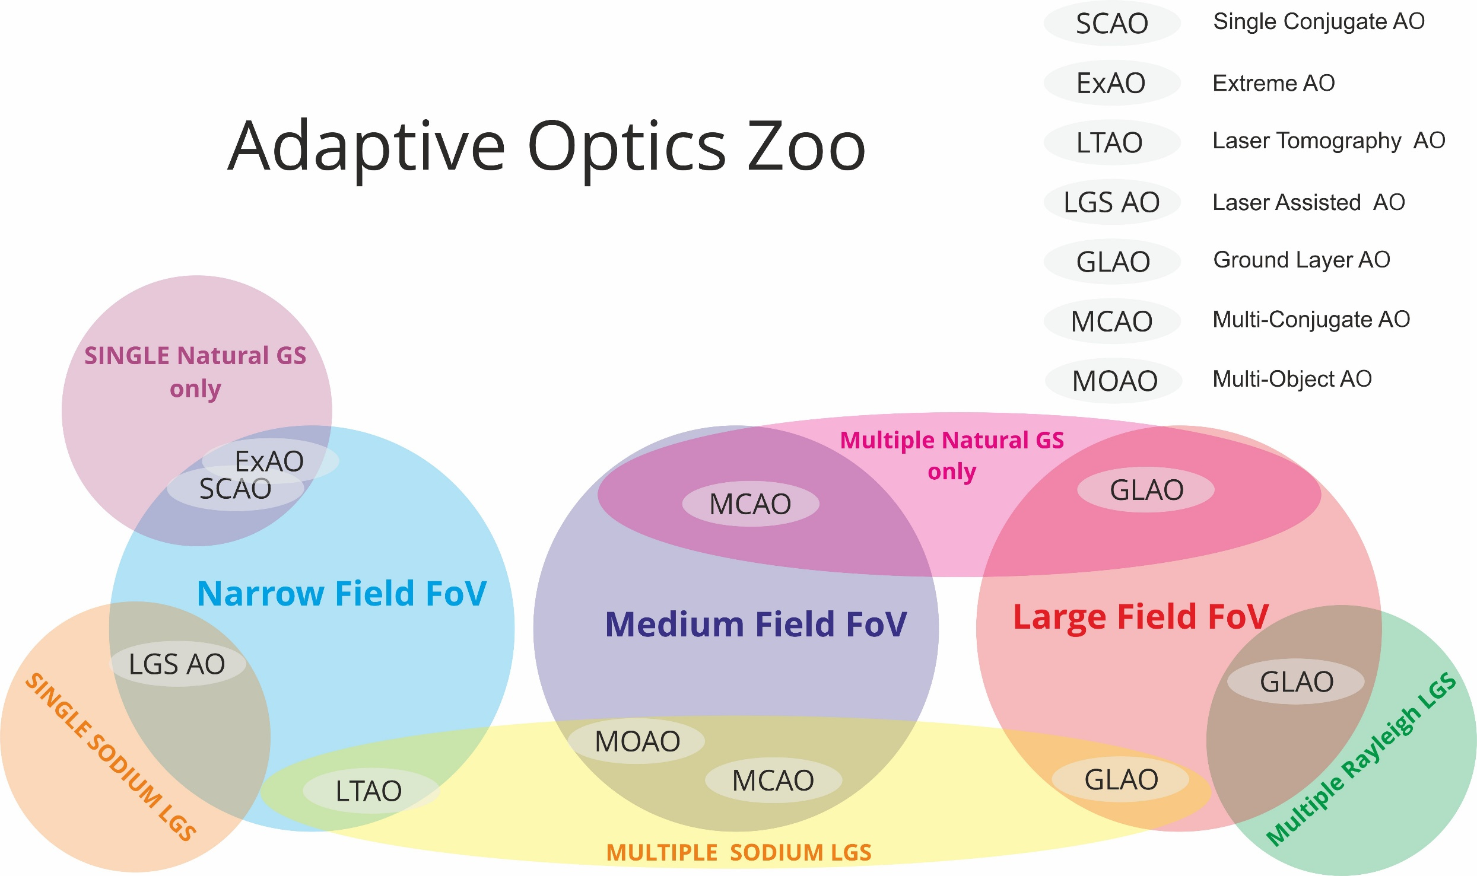
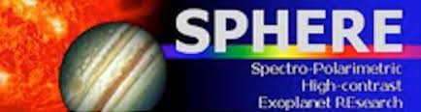
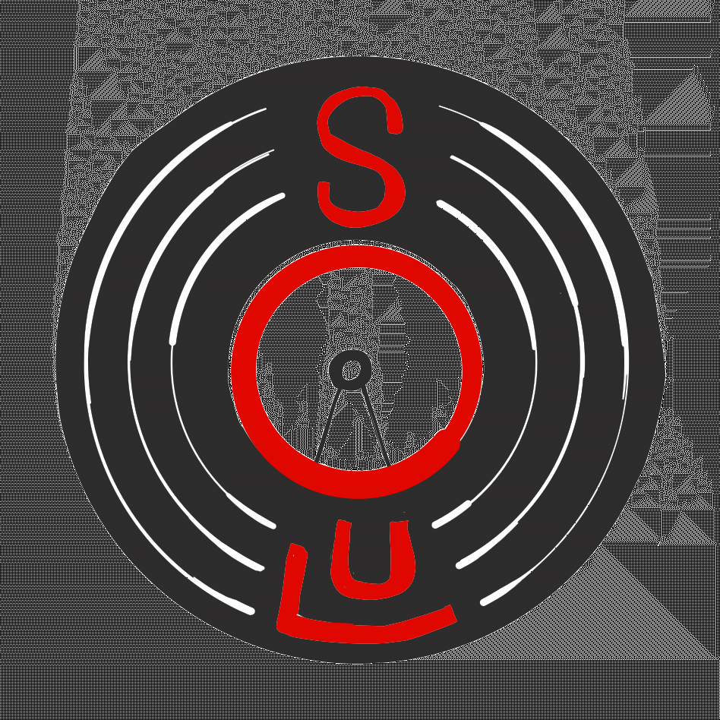





Notes:
Tecniche di grande campo come la MCAO o il GLAO offrono una maggiore uniformità anche su grandi campi di vista, a scapito di una maggiore complessità e performance di picco più limitate.

Slide 18
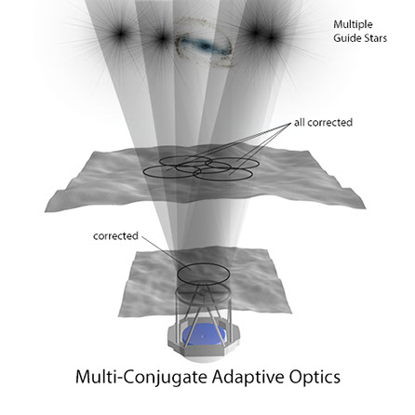
Multi-Conjugate Adaptive Optics
In MCAO mode we get a uniform PSF over the field by correcting the turbulence volume using multiple reference and multiple deformable mirrors
Data reduction software can deal with the residual field aberration, enabling accurate photometry
*Refereed GC Papers by AO mode, MCAO exceeds SCAO by a factor 2

Slide 19
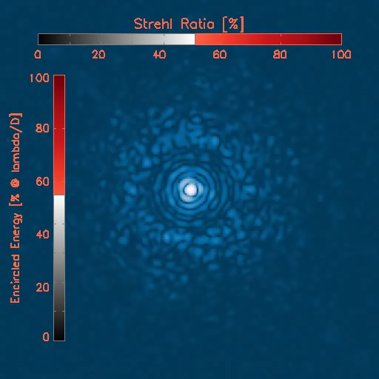
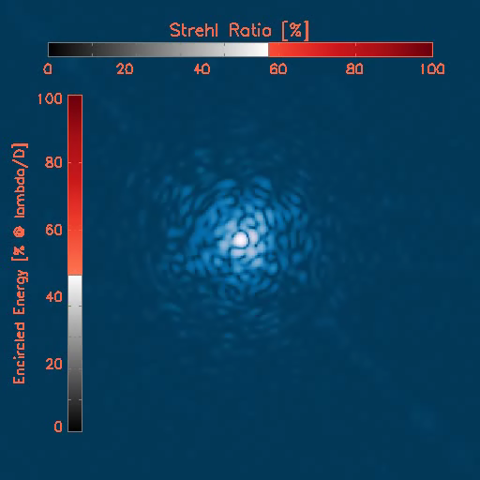
MCAO vs SCAO PSF
SCAO removes:
higher and higher spatial frequencies correcting the turbulence in the direction of the ref.
The MCAO removes:
higher and higher spatial freq from conjugated layers,
Limited to lower freq. proportionally to the distance of the layer from the conjugation plane.
SCAO ev. 20sec, K
SR 50%
MCAO ev. 20sec, K
SR 50%

Slide 20
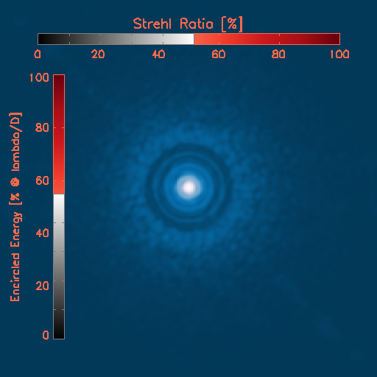

MCAO vs SCAO PSF
SCAO removes:
higher and higher spatial frequencies correcting the turbulence in the direction of the ref.
The MCAO removes:
higher and higher spatial freq from conjugated layers,
Limited to lower freq. proportionally to the distance of the layer from the conjugation plane.
It’s much challenging to obtain 50% on MCAO than in SCAO!
Typically, in MCAO the correction radius is almost invisible. The uncorrected layers far from the conjugated planes introduce residuals including the lowest spatial frequencies filling the area included in the control radius

Slide 21
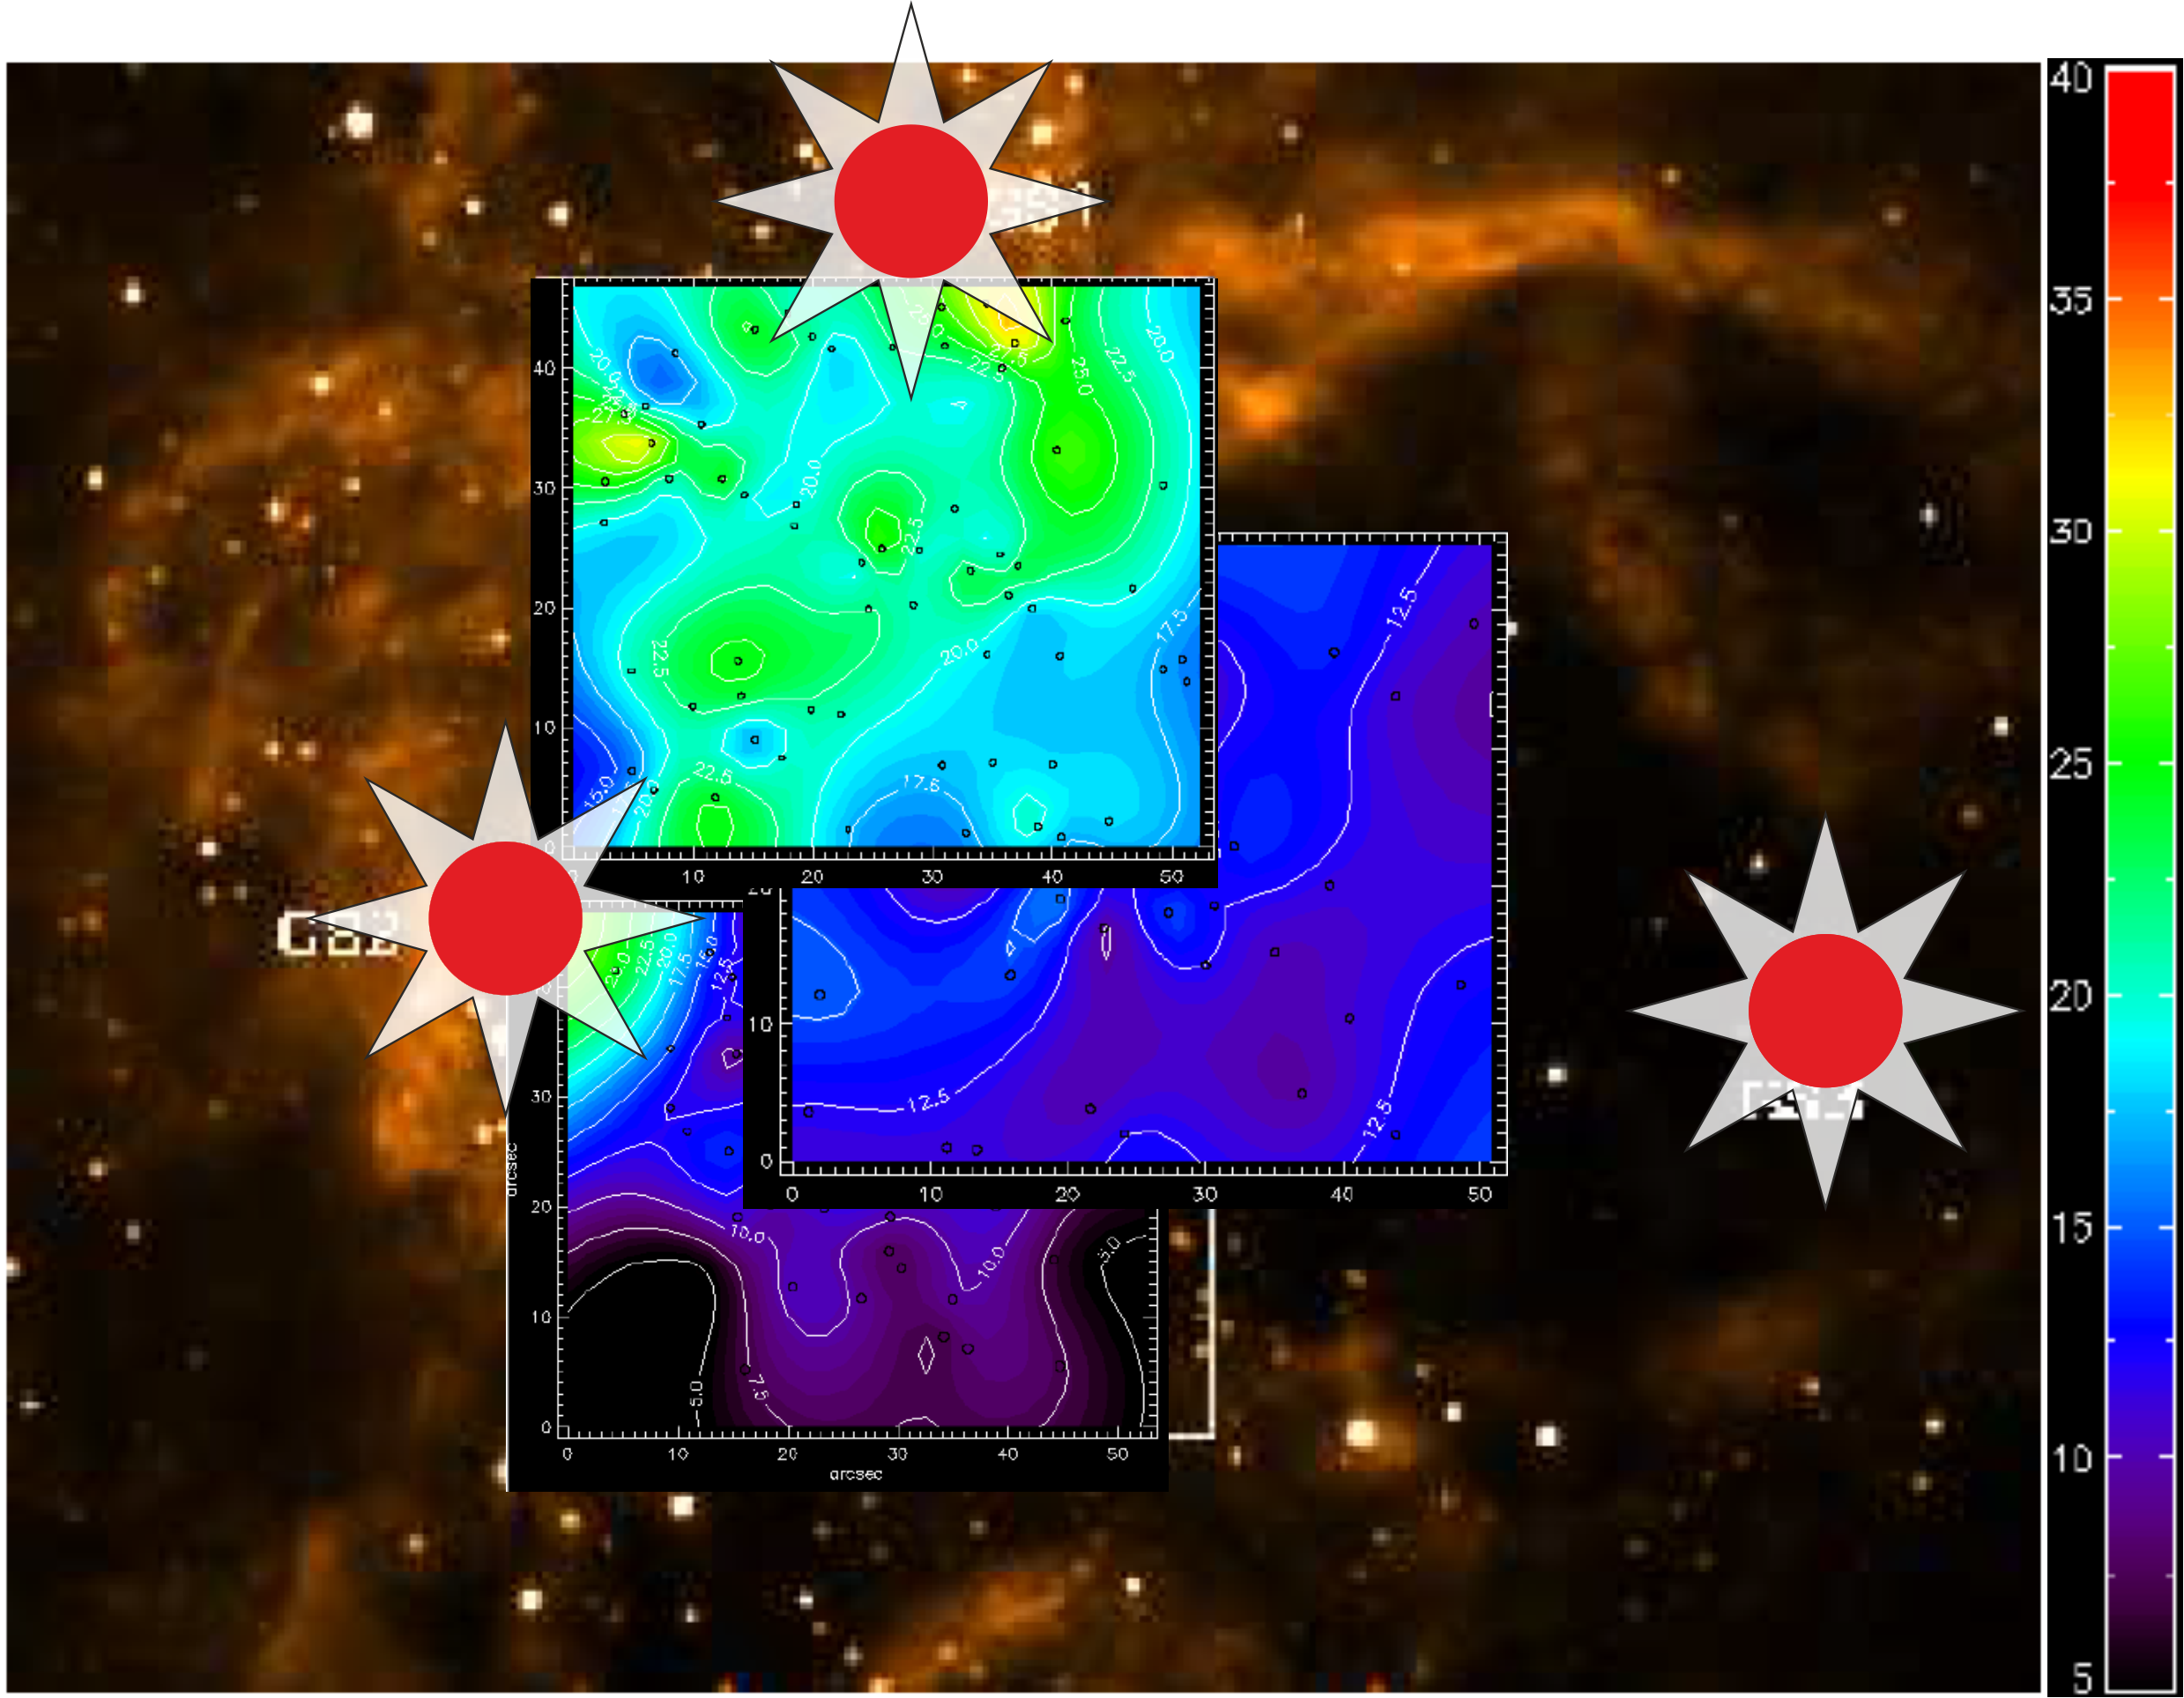
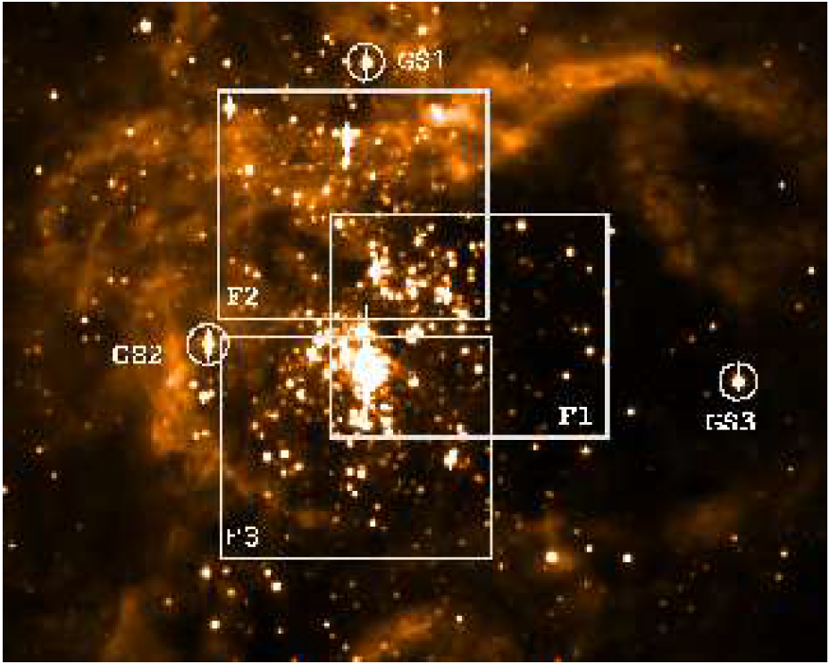
MCAO limitations
Ks, MAD @VLT, R136, 30 Dor
MCAO peforms turbulence volume correction, still, the correction is not exactly uniform, depending on Guide Stars magnitude and spatial configuration.
It can be uniform within the area inscribed by the Guide Stars
MCAO does not provide extreme peak performance as the SCAO may do, leading to important difference within different filters.
2 arcmin FoV

Slide 22
The role of PSF
The main methods of PSF-dependent post-processing can be broadly grouped into four classes:
Image Deconvolution;
Model convolution;
Photometry and astrometry [Marasco A, Schreiber L];
Speckle suppression [Li Causi G].
If you know the PSF over the field, PSF should not be a limitation for photometry-astrometry.
However, PSF field variation introduces spatial dependent errors because of the field varying SNR.
This may be source of systematic errors:
regions of the observed field have different depth;

Slide 23
PSF and PSF-R
The PSF-Reconstruction is a method for retrieving the PSF shape(s) from the focal plane data, the telescope and WFS telemetry, or both (aka hybrid), it is even possible to develop ad hoc numerical simulations for that.
Refer to Grazian A., about MICADO PSF-R, later today
Massari D., Marasco A., Beltramo-Martin O., Milli J., Fiorentino G., Tolstoy E., Kerber F., 2020, A&A, 634, L5
PSF-R, Beltramo-Martin O., Correia C.M., Ragland S., Jolissaint L., Neichel B., Fusco T., Wizinowich P.L., 2019, MNRAS, 487, 5450
Sphere Simulation, Fètick R.J.L., et al., 2019, A&A, 628, A99

Slide 24
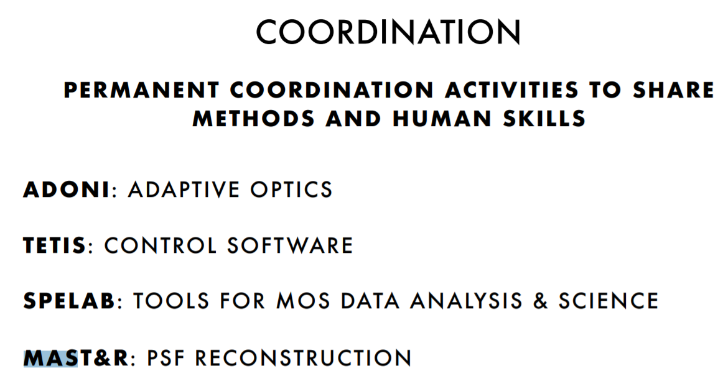
Math, ASTronomy and Research (MAST&R)
An INAF group working on mathematical methods for high-resolution imaging
It supports several current mainstream AO projects as MAORY, MICADO, ERIS, SHARK, MAVIS
Focus on PSF- Reconstruction activities
Looking for beneficial return for other large project as Gaia and Euclid

Slide 25
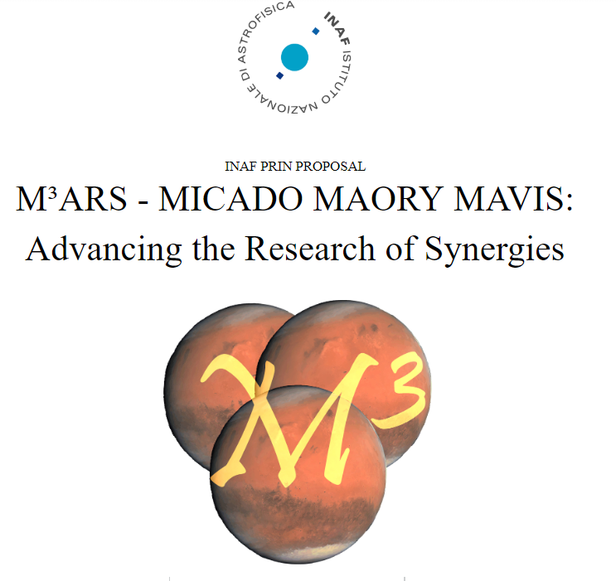
M³ projects
In the framework of the science related activities of MAORY, MICADO and MAVIS, we built a collaboration devoted to the scientific exploitation of the unique combination of:
Large Spectral Coverage V to K;
similar spatial resolution ~10mas;
‘’Large’’ FoV ~30’’-50’’;
High-SR > 15%V - 50% K;
High-sky coverage > 50%;
almost parallel schedule, operative 2026-2027.

Slide 26
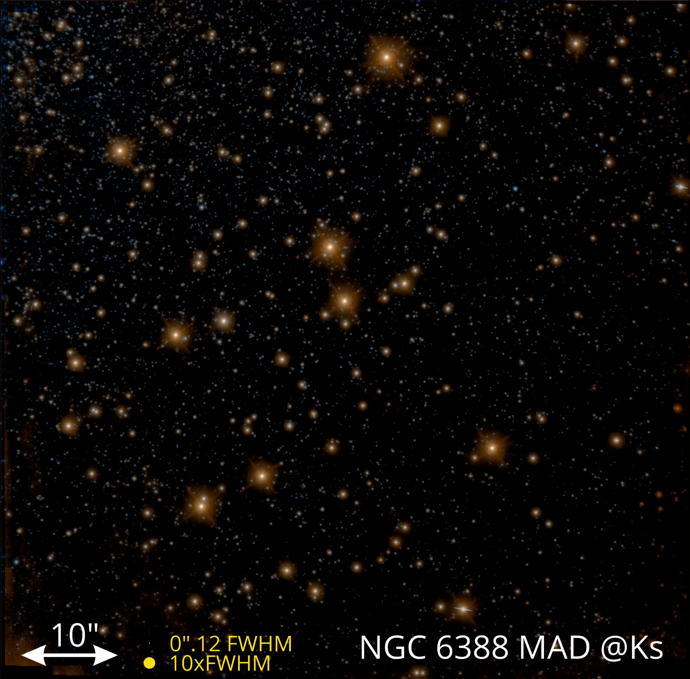
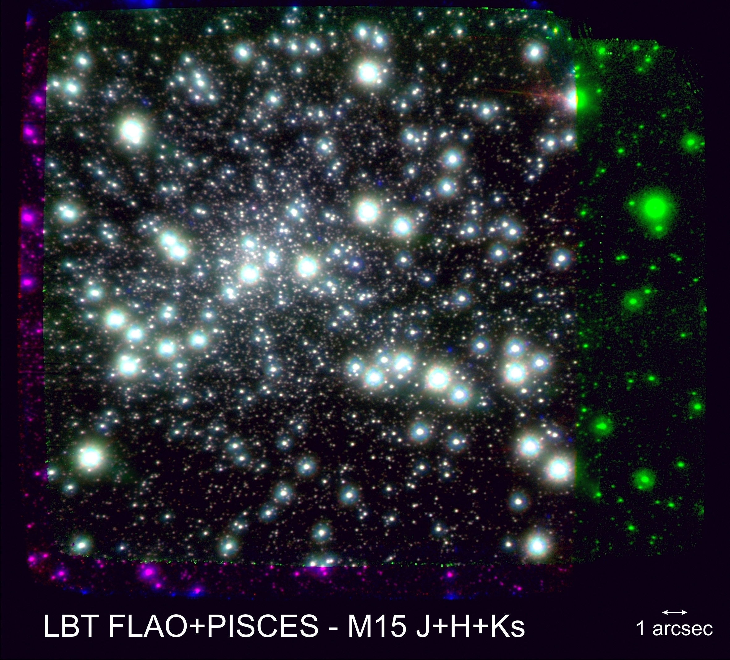
And that’s all, thanks

Slide 27
Reference
M. D. Perrin, A. Sivaramakrishnan, R. B. Makidon, B. R.Oppenheimer, and J. R. Graham, “The structure of high Strehl ratio point-spread functions,” Astrophys. J. 596, 702–712 (2003).

Slide 28
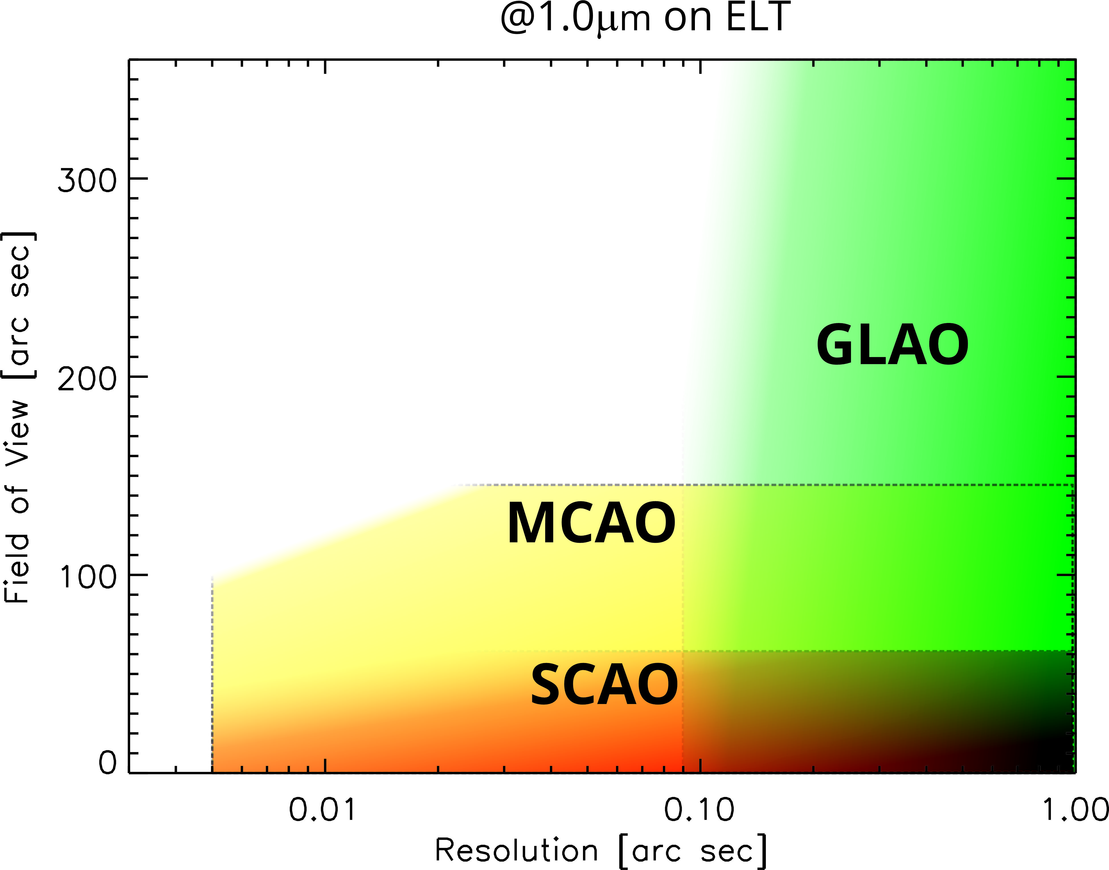
Plot shows the reasonable maximum resolution achievable on a 39m (ELT) telescope and resolution range of different AO technique.
Better performance on larger FoV require:
more actuators per DM;
more DM;
Brighter References;
More References.
In general, the higher the correction the lower the realization tolerances.
Complexity

Slide 29
PSF is partially fixed to NGS geometry
Pupil rotates, [Shape, Spider footprint rotates]

Slide 30
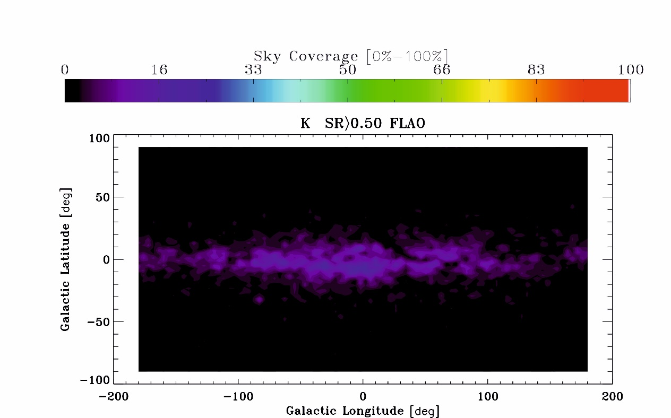
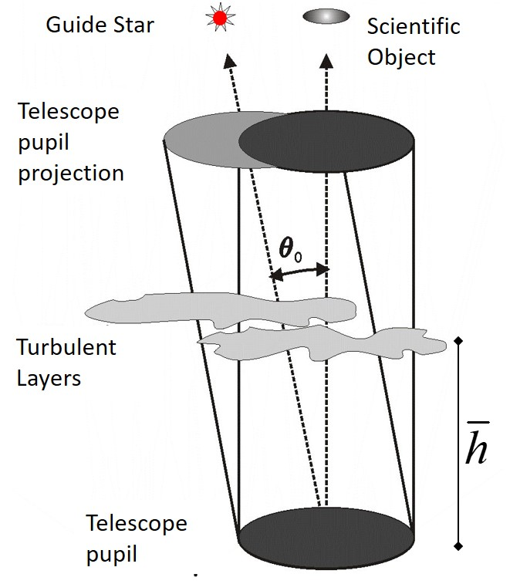
Beyond Single Conjugate adaptive optics
SCAO
Challenging photometry because of the large PSF field-variation
Sky coverage < few %, limited to the galactic plane
PSFs are elongated towards the direction of the reference star
Guide Star Limiting Magnitude 12 (15 for field stabilization)
*M15 core, 23’’x23’’ data J band
PISCES+FLAO @ LBT, inset 6 ’’x5’’

Slide 31
Multi-Conjugate Adaptive Optics
MCAO
In MCAO mode we get a uniform PSF over the field by correcting the turbulence volume using multiple reference and multiple deformable mirrors
Data reduction software can deal with the residual field aberration, enabling accurate photometry
*Refereed GC Papers by AO mode
*NGC 6388 halo,65’’x63’’, Ks band, MAD @ VLT, inset 6 ’’x5’’

Slide 32
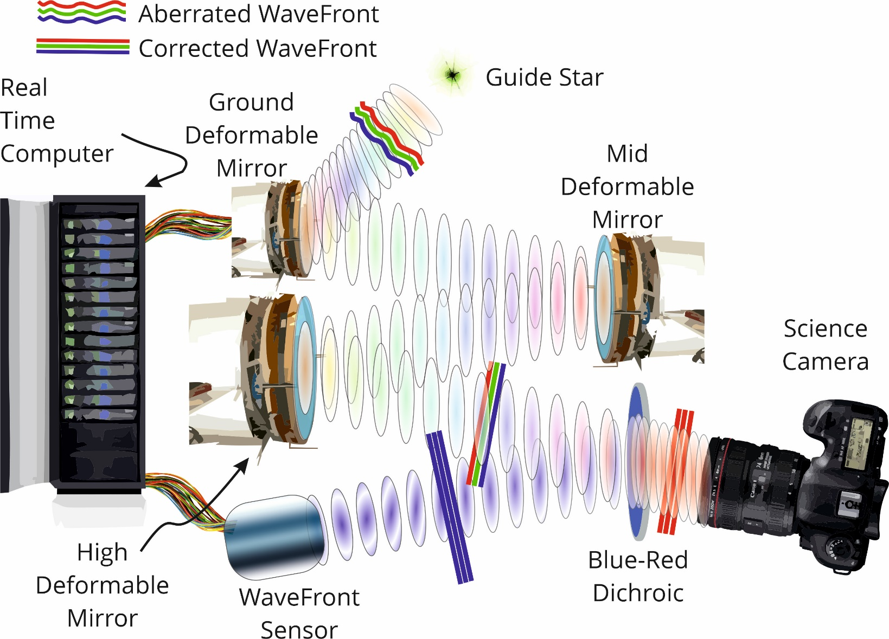

SCAO vs MCAO
To correct the turbulence volume the MCAO needs to apply field dependant correction inserting multiple deformable mirror conjugated out of the pupil plane.

Slide 33

SCAO vs MCAO
The multiple reference stars sense the turbulent volume above the telescope and illuminate different portions of the DM, enabling Closed Loop control.

