Slide 1
Interrelations between local correlations, nonlocal correlations and causality
Eliahu Cohen
Theory (mainly) together with:
Avishy Carmi (BGU)
Experiments together with:
The Genovese Group (INRiM)
The Karimi Group (uOttawa)
TM 2019, September 2019, Turin
Notes:
ניתן להשתמש בתבנית זו כקובץ התחלתי להצגת חומרי הדרכה בסביבת קבוצה.
מקטעים
לחץ באמצעות לחצן העכבר הימני על שקופית כדי להוסיף מקטעים. מקטעים יכולים לסייע בארגון השקופיות שלך או להקל את שיתוף הפעולה בין עורכים מרובים.
הערות
השתמש במקטע 'הערות' עבור הערות העברה או כדי לספק פרטים נוספים עבור הקהל. הצג הערות אלה בתצוגת מצגת במהלך המצגת שלך.
שים לב לגודל הגופן (חשוב עבור נגישות, ניראות, צילום בווידאו וייצור מקוון)
צבעים מתואמים
הקדש תשומת לב מיוחדת לגרפים, תרשימים ותיבות טקסט.
קח בחשבון את העובדה שהמשתתפים ידפיסו בשחור- לבן או בגווני אפור. בצע הדפסת בדיקה כדי לוודא שהצבעים שלך מוצגים כראוי בעת הדפסה בשחור-לבן מלא ובגווני אפור.
גרפיקה, טבלאות וגרפים
שמור על פשטות: אם הדבר אפשרי, השתמש בסגנונות ובצבעים עקביים שאינם מסיחים את הדעת.
סמן בתוויות את כל הגרפים והטבלאות.

Slide 2
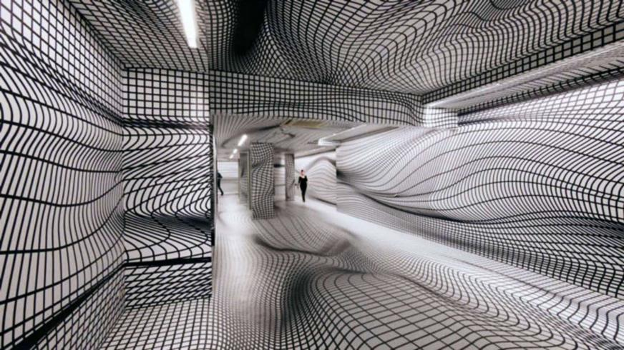
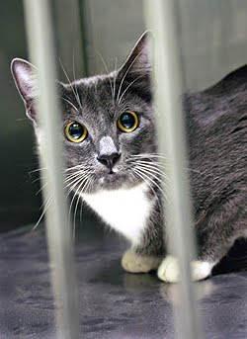
Motivation
Time Machine Factory: “Space-time is your jail”
And quantum mechanics as well
But we can rely on theory-independent observations and correlations

Slide 3
Motivation-Cont.
Previous times – Two-State-Vector Formalism and Weak Measurements were the goals
Now, weak measurement is one of the tools
While the goals are
Deriving bounds on correlations in general signaling and non-signaling models
Understanding the relations between causality, uncertainty and nonlocality
Trying to characterize and possibly reconstruct the structure of space-time from empirical correlations

Slide 4
Introduction
Notes:
זוהי אפשרות נוספת עבור שקופיות סקירה המשתמשות במעברים.

Slide 5
Quantum Correlations
Quantum mechanics exhibits unique correlations in space and time
The former correlations violate Bell inequalities (local-realism)
The latter, tightly related to uncertainty, violate Leggett-Garg inequalities (macro-realism)
How do violations occur? To which extent?
Why is causality preserved?
What can be more general?
Which experiments and which applications?
Relativistic Independence

Slide 6
Bell-CHSH Experiment – Intro
LHV:
QM:

Slide 7
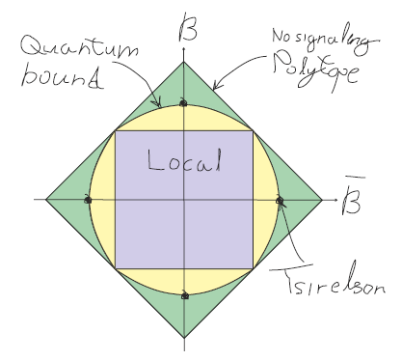
Quantum bounds beyond Tsirelson’s
TLM:
Uffink:
NPA: Q … Q³ Q² Q^{1+AB} Q¹

Slide 8
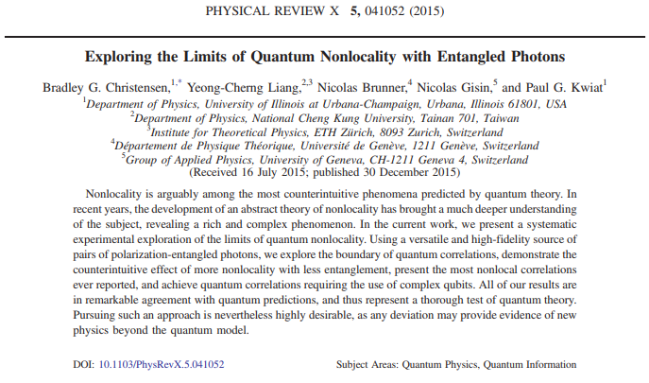
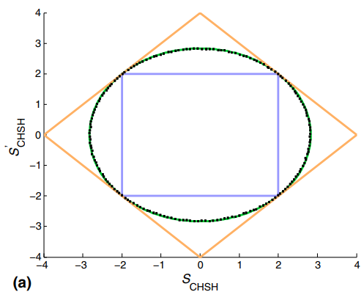
Quantum bounds beyond Tsirelson’s
Uffink:
Ours:

Slide 9
Quantum bounds beyond Tsirelson’s
Incorporating local expectations:
Multipartite scenarios: Alice, Bob, Charlie,…
Multiple-input – multiple-output scenarios: non-dichotomic operators:

Slide 10
Why are quantum correlations the way they are?
Why and not
Models such as PR-boxes seem to have stronger correlations without violating relativistic causality
Many principles were suggested to rule them out…
PR boxes and other post-quantum models violate either generalized uncertainty or relativistic causality!

Slide 11
Main Theme
Relativistic Causality
Quantum Uncertainty
Quantum Nonlocality
New quantitative relations!

Slide 12
Relativistic Independence
A. Carmi, E. Cohen, Relativistic independence bounds nonlocality, Sci. Adv. 5, eaav8370 (2019).
Notes:
זוהי אפשרות נוספת עבור שקופיות סקירה המשתמשות במעברים.

Slide 13
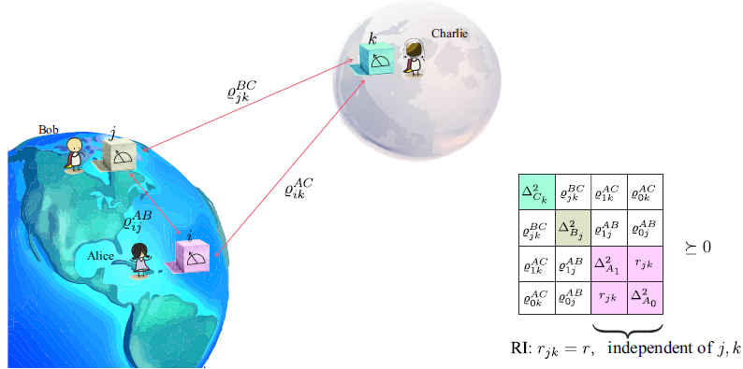
Relativistic Independence
We proved that relativistic causality and generalized uncertainty alone yield all the aforementioned bounds, and even some new ones

Slide 14
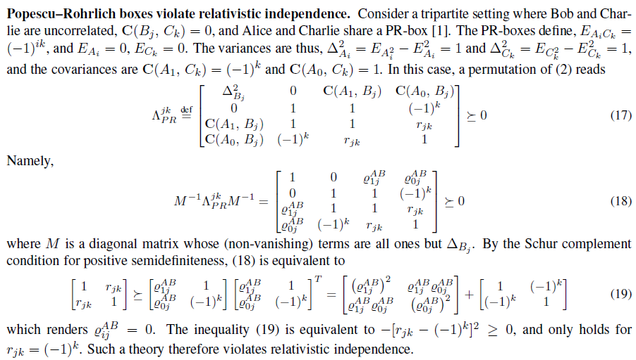
PR Boxes

Slide 15
Deriving the TLM bound

Slide 16
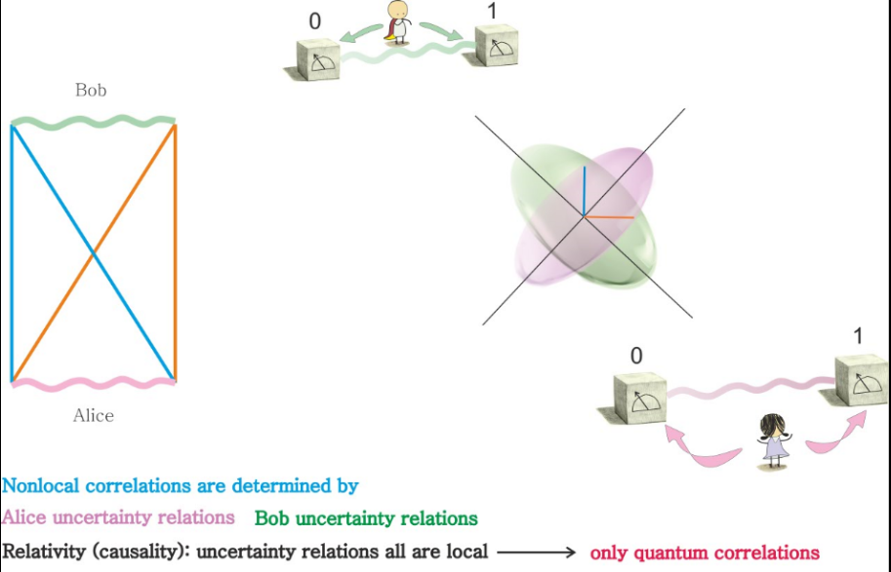
New Approach to Quantum Nonlocality

Slide 17
New Approach to Quantum Nonlocality
Local (Alice)
Nonlocal
Local (Bob)
Nonlocal
Local correlations determine the extent of nonlocal correlations!

Slide 18
New bounds on nonlocal correlations
Quantum bounds on correlations are uncertainty principles
We thus propose new, richer quantum bounds

Slide 19
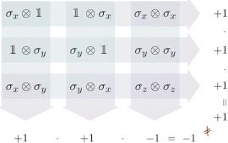
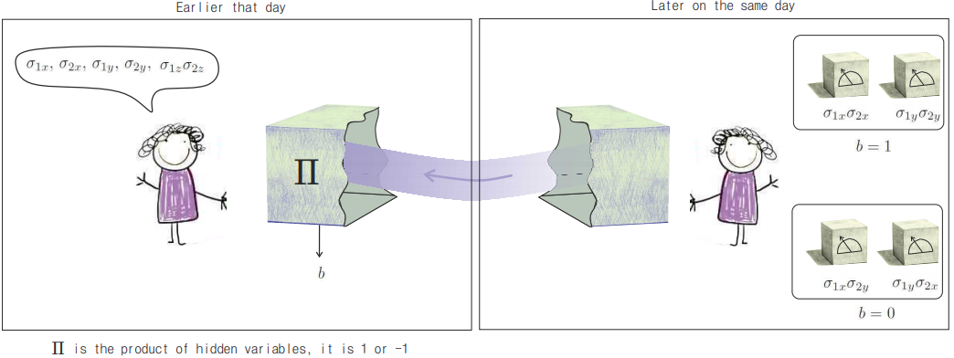
Quantum Hidden Variables and signaling backwards in time
A. Carmi, E. Cohen, L. Maccone, H. Nikolic, Knowledge of Quantum Hidden Variables Enables Backwards-In-Time Signaling, arXiv:1903.01349

Slide 20
Ways out: Pseudolocal and Quasilocal boxes
With: Sandu Popescu
Paul Skrzypczyk
Local Hidden variables fail to reproduce quantum correlations
Nonlocal hidden variables having produce in general correlations stronger than quantum
We found two ways in which they give rise to quantum correlations without signaling in time:
Pseudolocal boxes
Quasilocal boxes
New Bell-like inequality

Slide 21
Applications of our approach
Connection with Tsallis Entropy
Multiplicative Bell Inequalities and new quantum games
Correlations in non-Hermitian and signaling systems:
Parafermions as simulators
Correlations in CV systems and Negativity of the Wigner function
Correlated Networks
Predator-Prey Models
Cognitive networks and emergent spacetime

Slide 22
Tighter-than-CHSH Inequalities
where is the Tsallis entropy with parameter ½:
A. Carmi and E. Cohen, Entropy 20, 500 (2018)

Slide 23
Tighter-than-Mermin Inequality
Bound on tripartite quantum correlations:
A. Carmi and E. Cohen, Entropy 20, 500 (2018)

Slide 24
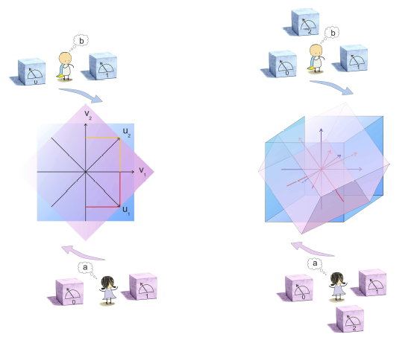
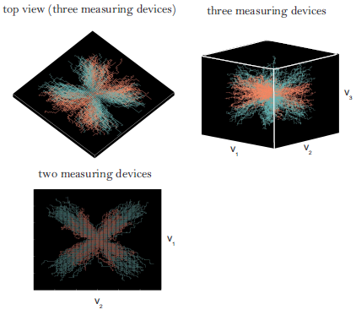
Multiplicative Bell Inequalities
B.Y. Peled, A. Te'eni, A. Carmi, E. Cohen E., Phys. Rev. A 99, 040102(R) (2019)

Slide 25
Quantum Optics and CV systems

Slide 26
Quantum Optics and CV systems
New bounds on CV systems originating from uncertainty relations, e.g.
From the study of nonlocal hidden variables we know that negativity is essential for achieving nonlocal correlations
When the Wigner function becomes more negative, stronger correlations can be reached
Seeking for new higher-moment relations…
Connection with Fisher Information…

Slide 27
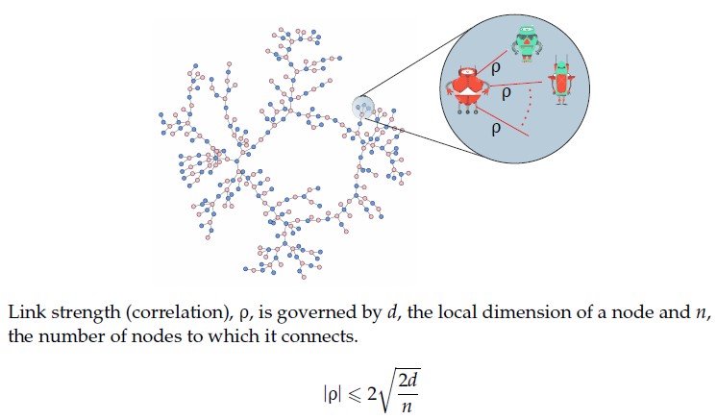
Entangled Networks

Slide 30
Further Generalization
How to measure? Weak measurements!
The quantum formalism is so restricting that even correlations between non-Hermitian, “signaling” operators cannot go beyond
A. Carmi A., Y. Herasymenko, E. Cohen, K. Snizhko, NJP 21, 073032 (2019)

Slide 31
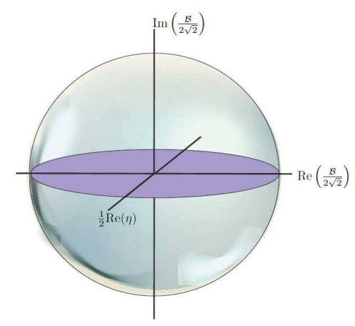
Interrelations between local correlations, nonlocal correlations and causality
local
nonlocal
signaling
A. Carmi A., Y. Herasymenko, E. Cohen, K. Snizhko, NJP 21, 073032 (2019)

Slide 32
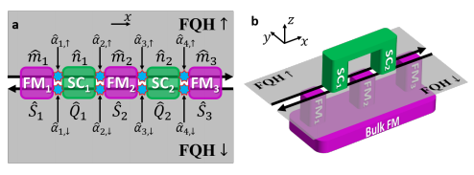
Parafermions
Non-Abelian quasiparticles that generalize Majorana
fermions, yet with a more complex braiding behavior
May be realized in strong electron-electron interactions, e.g.
edge states of fractional quantum Hall systems
Allow to realize entangling gates through quasi-particle braiding
(copied figure from Yuval Gefen et al.)

Slide 35
Alice and Bob are non-signaling
Alice and Bob are signaling
Correlation Matrix

Slide 36
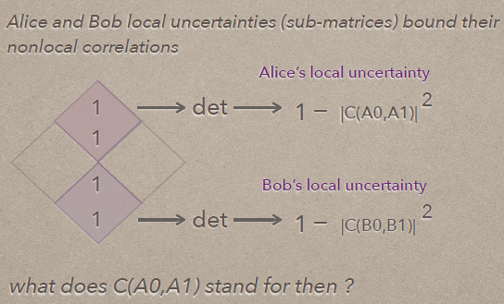
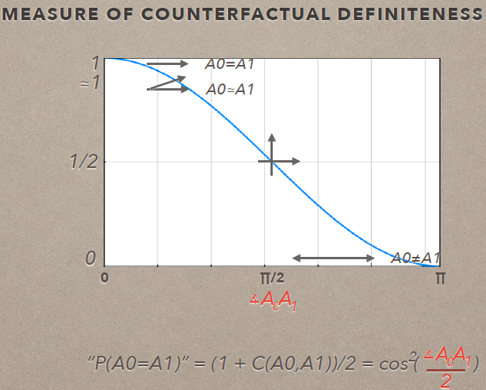
and time-reversibility

Slide 38
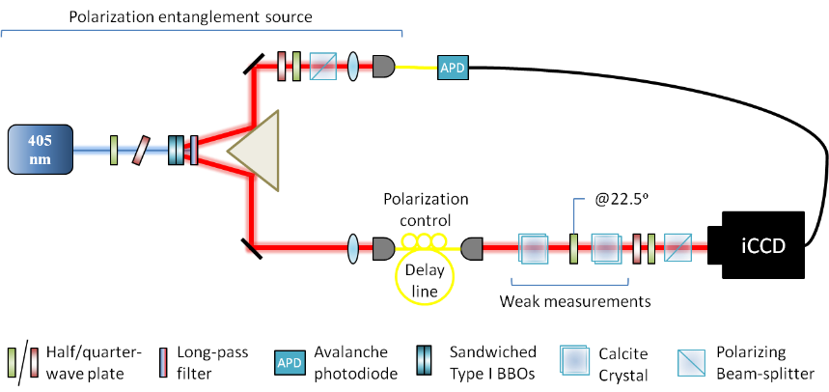
Experiments
with the Genovese Group
Forthcoming in Torino and Ottawa
Employing SPDC source and sequential weak measurements
with the Karimi Group
Based on our: Sequential Weak Measurements - Phys. Rev. Lett. 117, 170402 (2016)

Slide 39
Take-Home Message
Outside QM:
Uncertainty+Causality Bounds on Nonlocal Correlations
PR boxes and other stronger-than-quantum models violate either relativistic causality or generalized uncertainty
Imaginary correlations imply signaling
Causality, uncertainty and nonlocality are confined to the unit sphere
Within QM:
local correlations bound quantum nonlocal correlations
Derivation of new, richer bounds on nonlocal correlations
Multiplicative Bell inequaltiies, Tsallis entropy, networks, HVs, etc.
Some experimental validations coming soon
References
A. Carmi, E. Cohen, Sci. Adv. 5, eaav8370 (2019)
A. Te'eni, B.Y. Peled, A. Carmi, E. Cohen E., Phys. Rev. A 99, 040102(R) (2019)
A. Carmi A., Y. Herasymenko, E. Cohen, K. Snizhko, NJP 21, 073032 (2019)
A. Carmi and E. Cohen, Entropy 20, 500 (2018)
A. Carmi, E. Cohen, L. Maccone, H. Nikolic, arXiv:1903.01349
Notes:
סקור בקצרה את המצגת. תתאר את הנקודה המרכזית במצגת ומדוע היא חשובה.
הצג כל אחד מהנושאים המרכזיים.
כדי לספק מפת דרכים עבור הקהל, באפשרותך לחזור על שקופית סקירה זו במהלך המצגת, תוך הדגשת הנושא המסוים הבא שתדון בו.

Slide 40
I’m grateful to all collaborators and especially Avishy Carmi* and Marco Genovse’s Group for the long, fruitful and still ongoing joint research
* To whom, by the way, most of the graphics belong

Slide 41
Questions?
http://www.eng.biu.ac.il/cohenel4/
eliahu.cohen@biu.ac.il
Graduate and postdoc positions available!
Special Issue of Entropy on Axiomatic Approaches to Quantum Mechanics

Slide 42
Outline
Introduction and motivation
The principle of Relativistic Independence
Applications and consequences
On-going photonic experiments
Mainly based on: A. Carmi & E. Cohen, Relativistic independence bounds nonlocality, Sci. Adv. 5, eaav8370 (2019) and follow-up papers

Slide 43
Motivation – Why Entanglement?
Entanglement is a unique quantum characteristic
It lies at the heart of many quantum protocols for
Information processing and error correction
Communications and cryptography
Sensing, metrology and imaging
Computation
Simulation
It also affects the structure of novel quantum materials and inspires new approaches towards quantum gravity
We wish to have a better understanding of entanglement (and nonlocality in general) for both conceptual and practical purposes

Slide 44
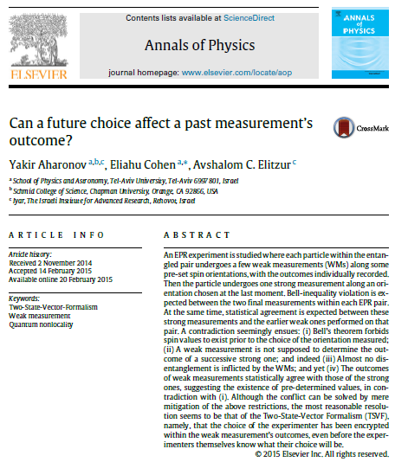
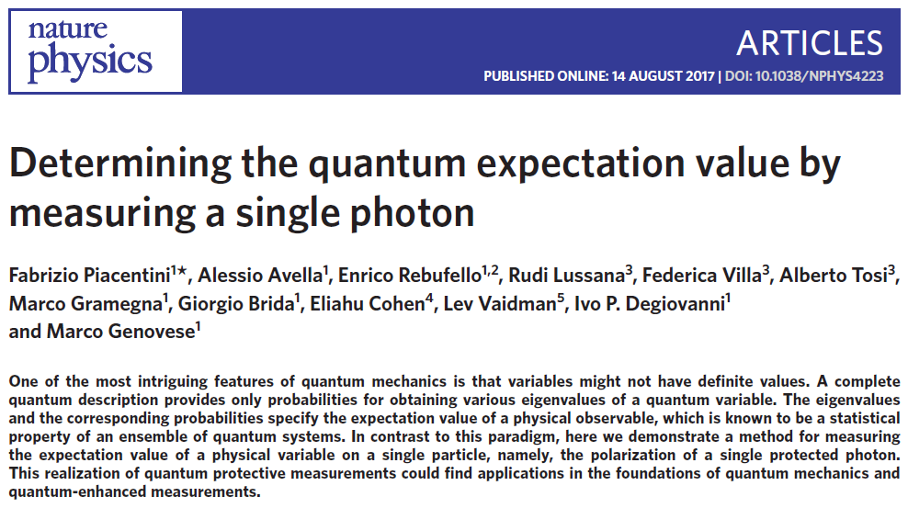
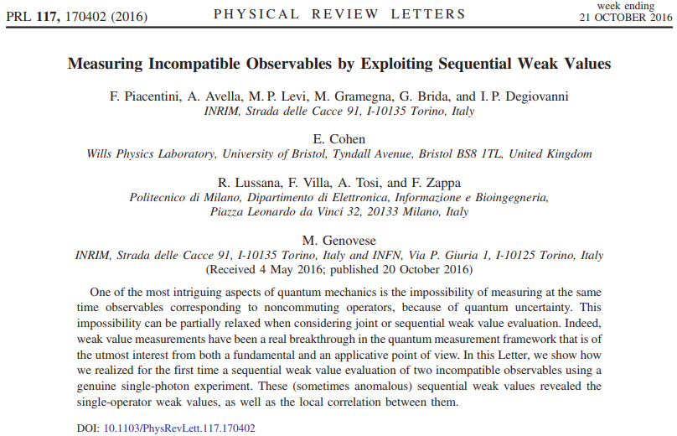
Time Evolution in Turin

