Slide 1
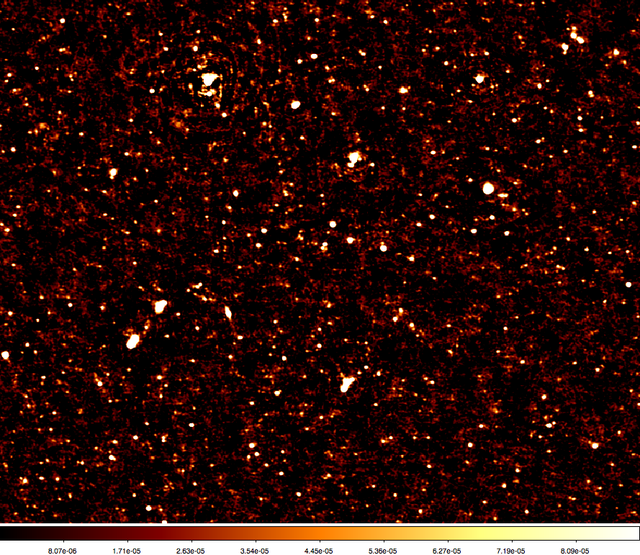
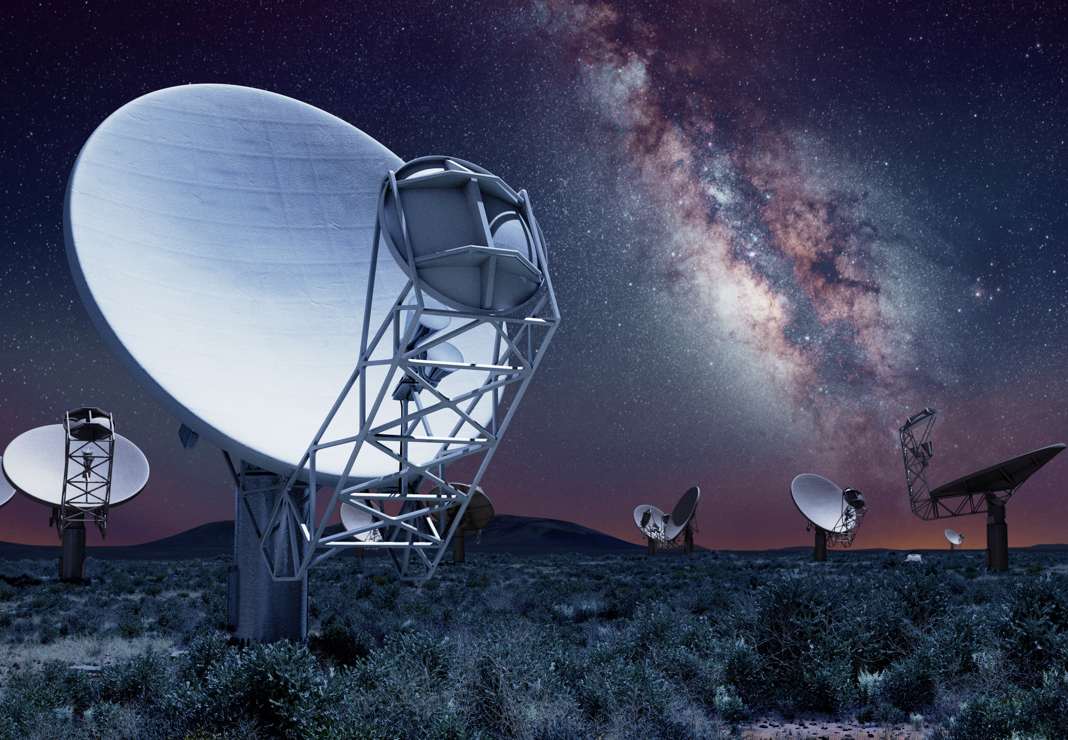
SKA Data to Knowledge: Processing and Analytics
Data Conditioning
Calibration and Imaging
Data fusion
multi-wavelength
Parameterized catalogues
Object identification and Abstraction
Classification and
characterization
Image arrays
Exploration
unknown unknowns

Slide 2
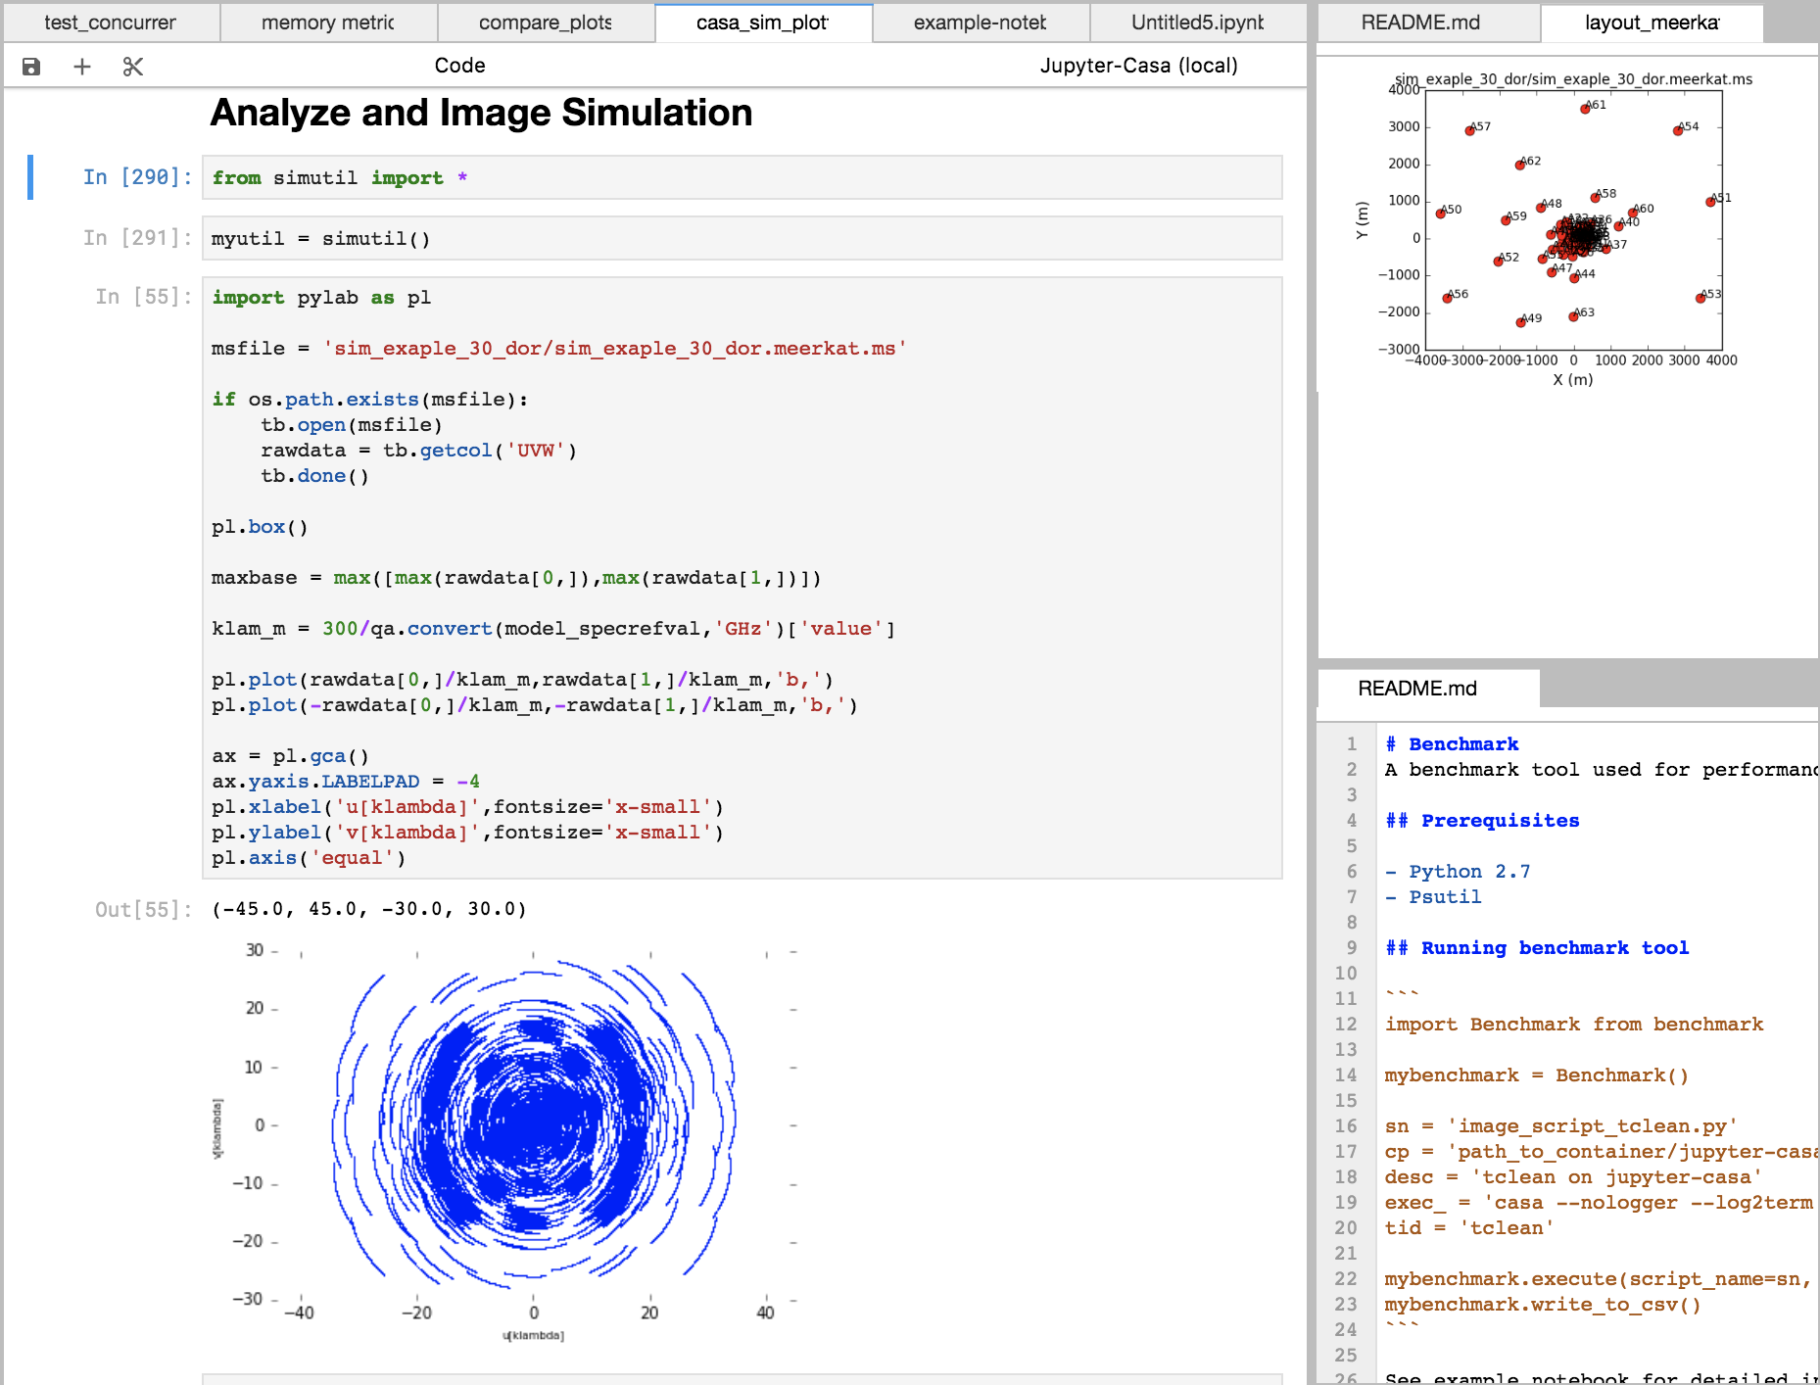
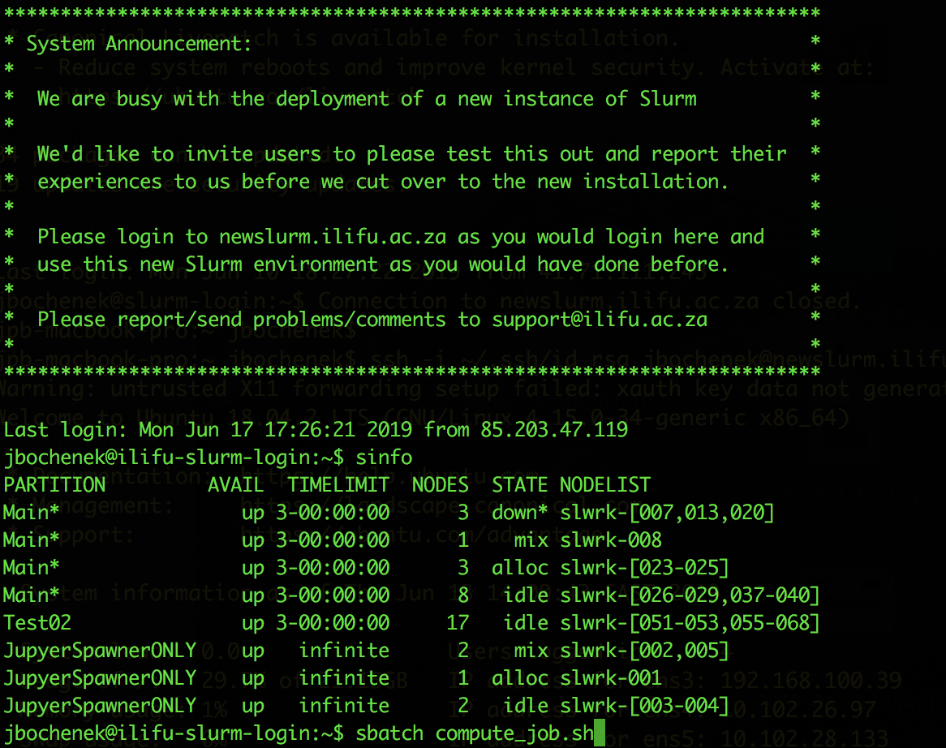
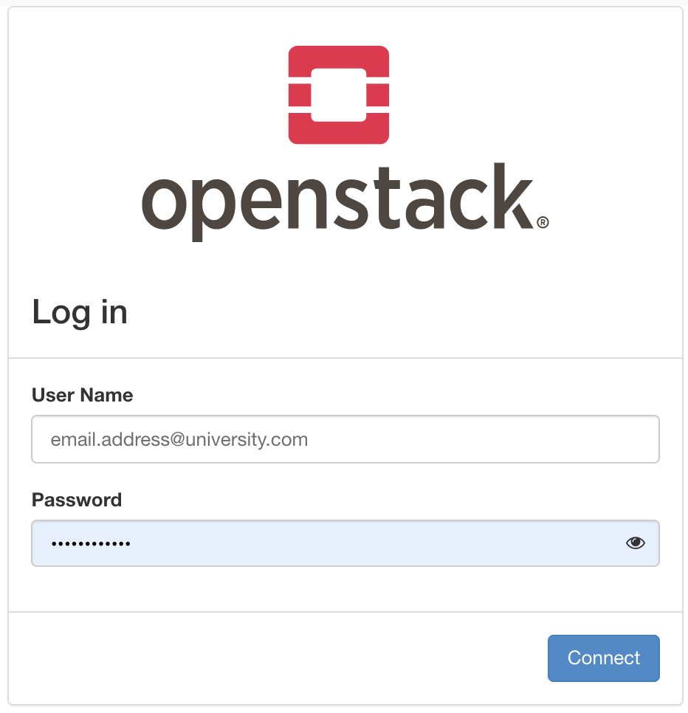
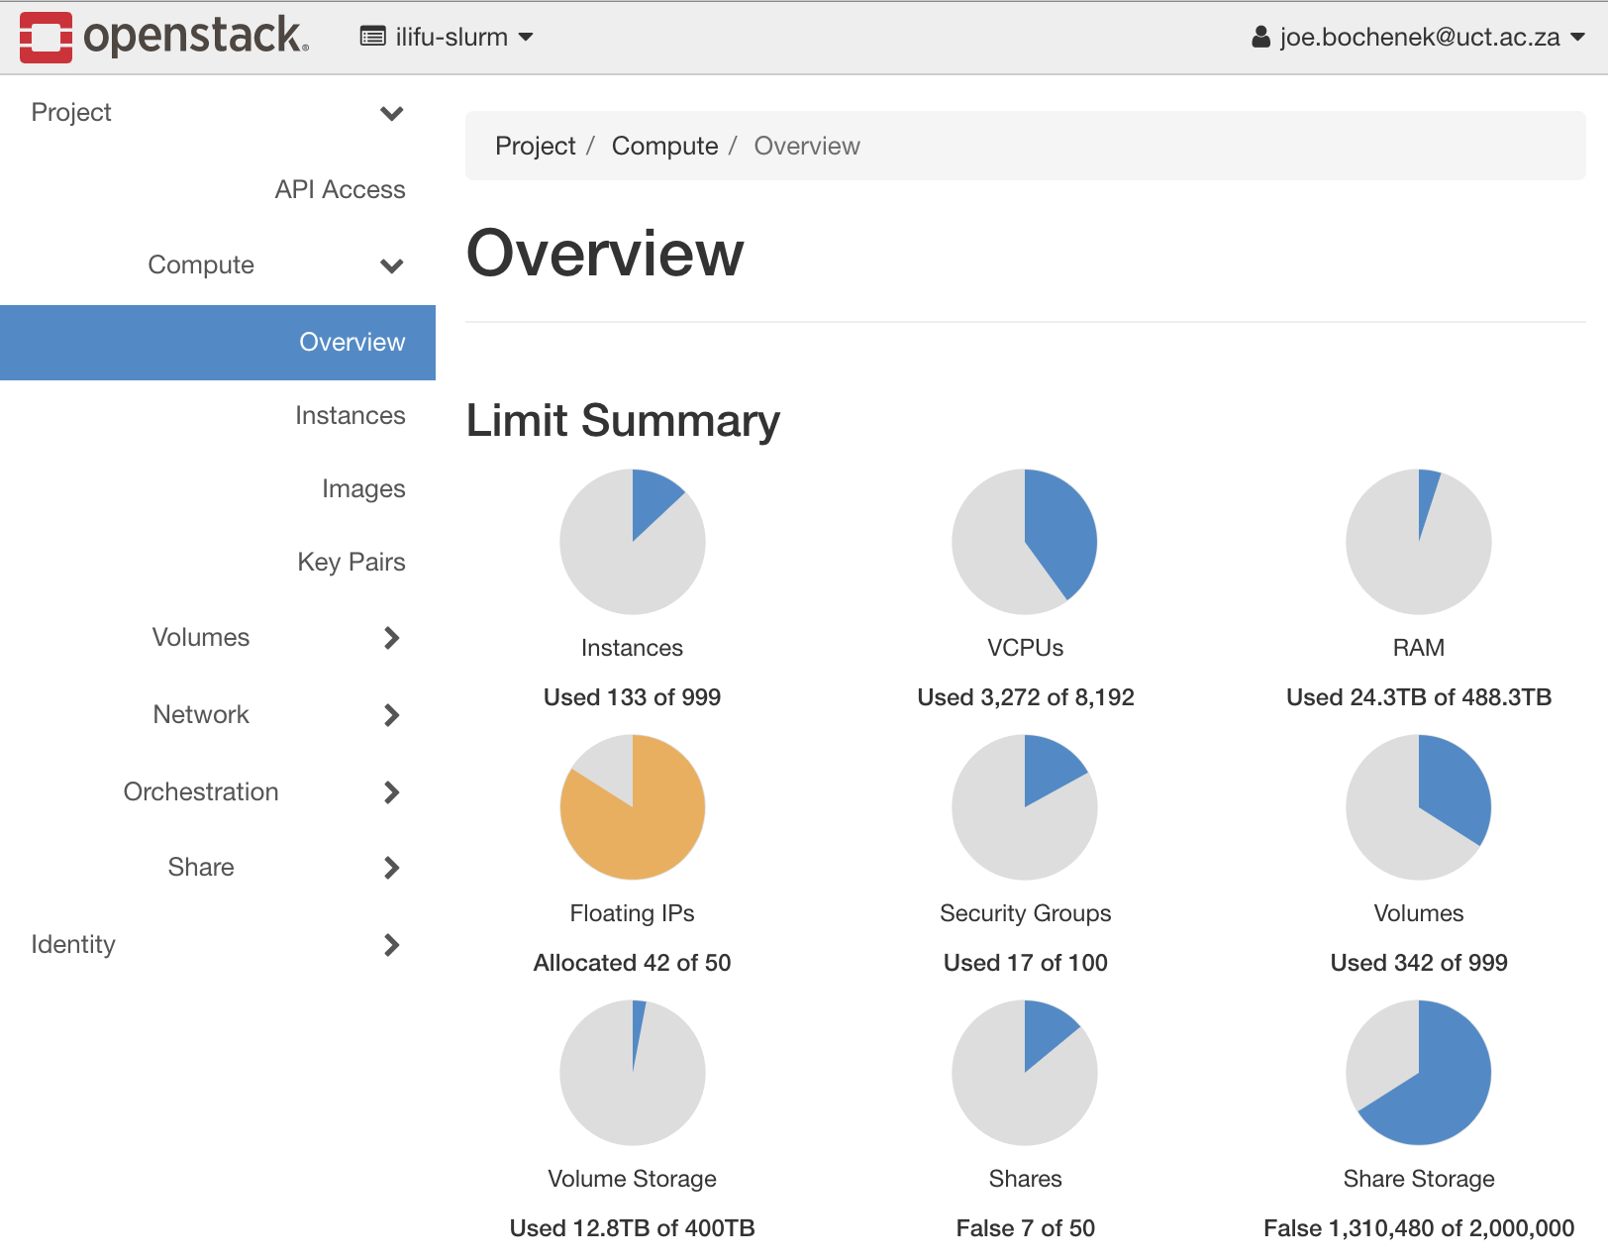
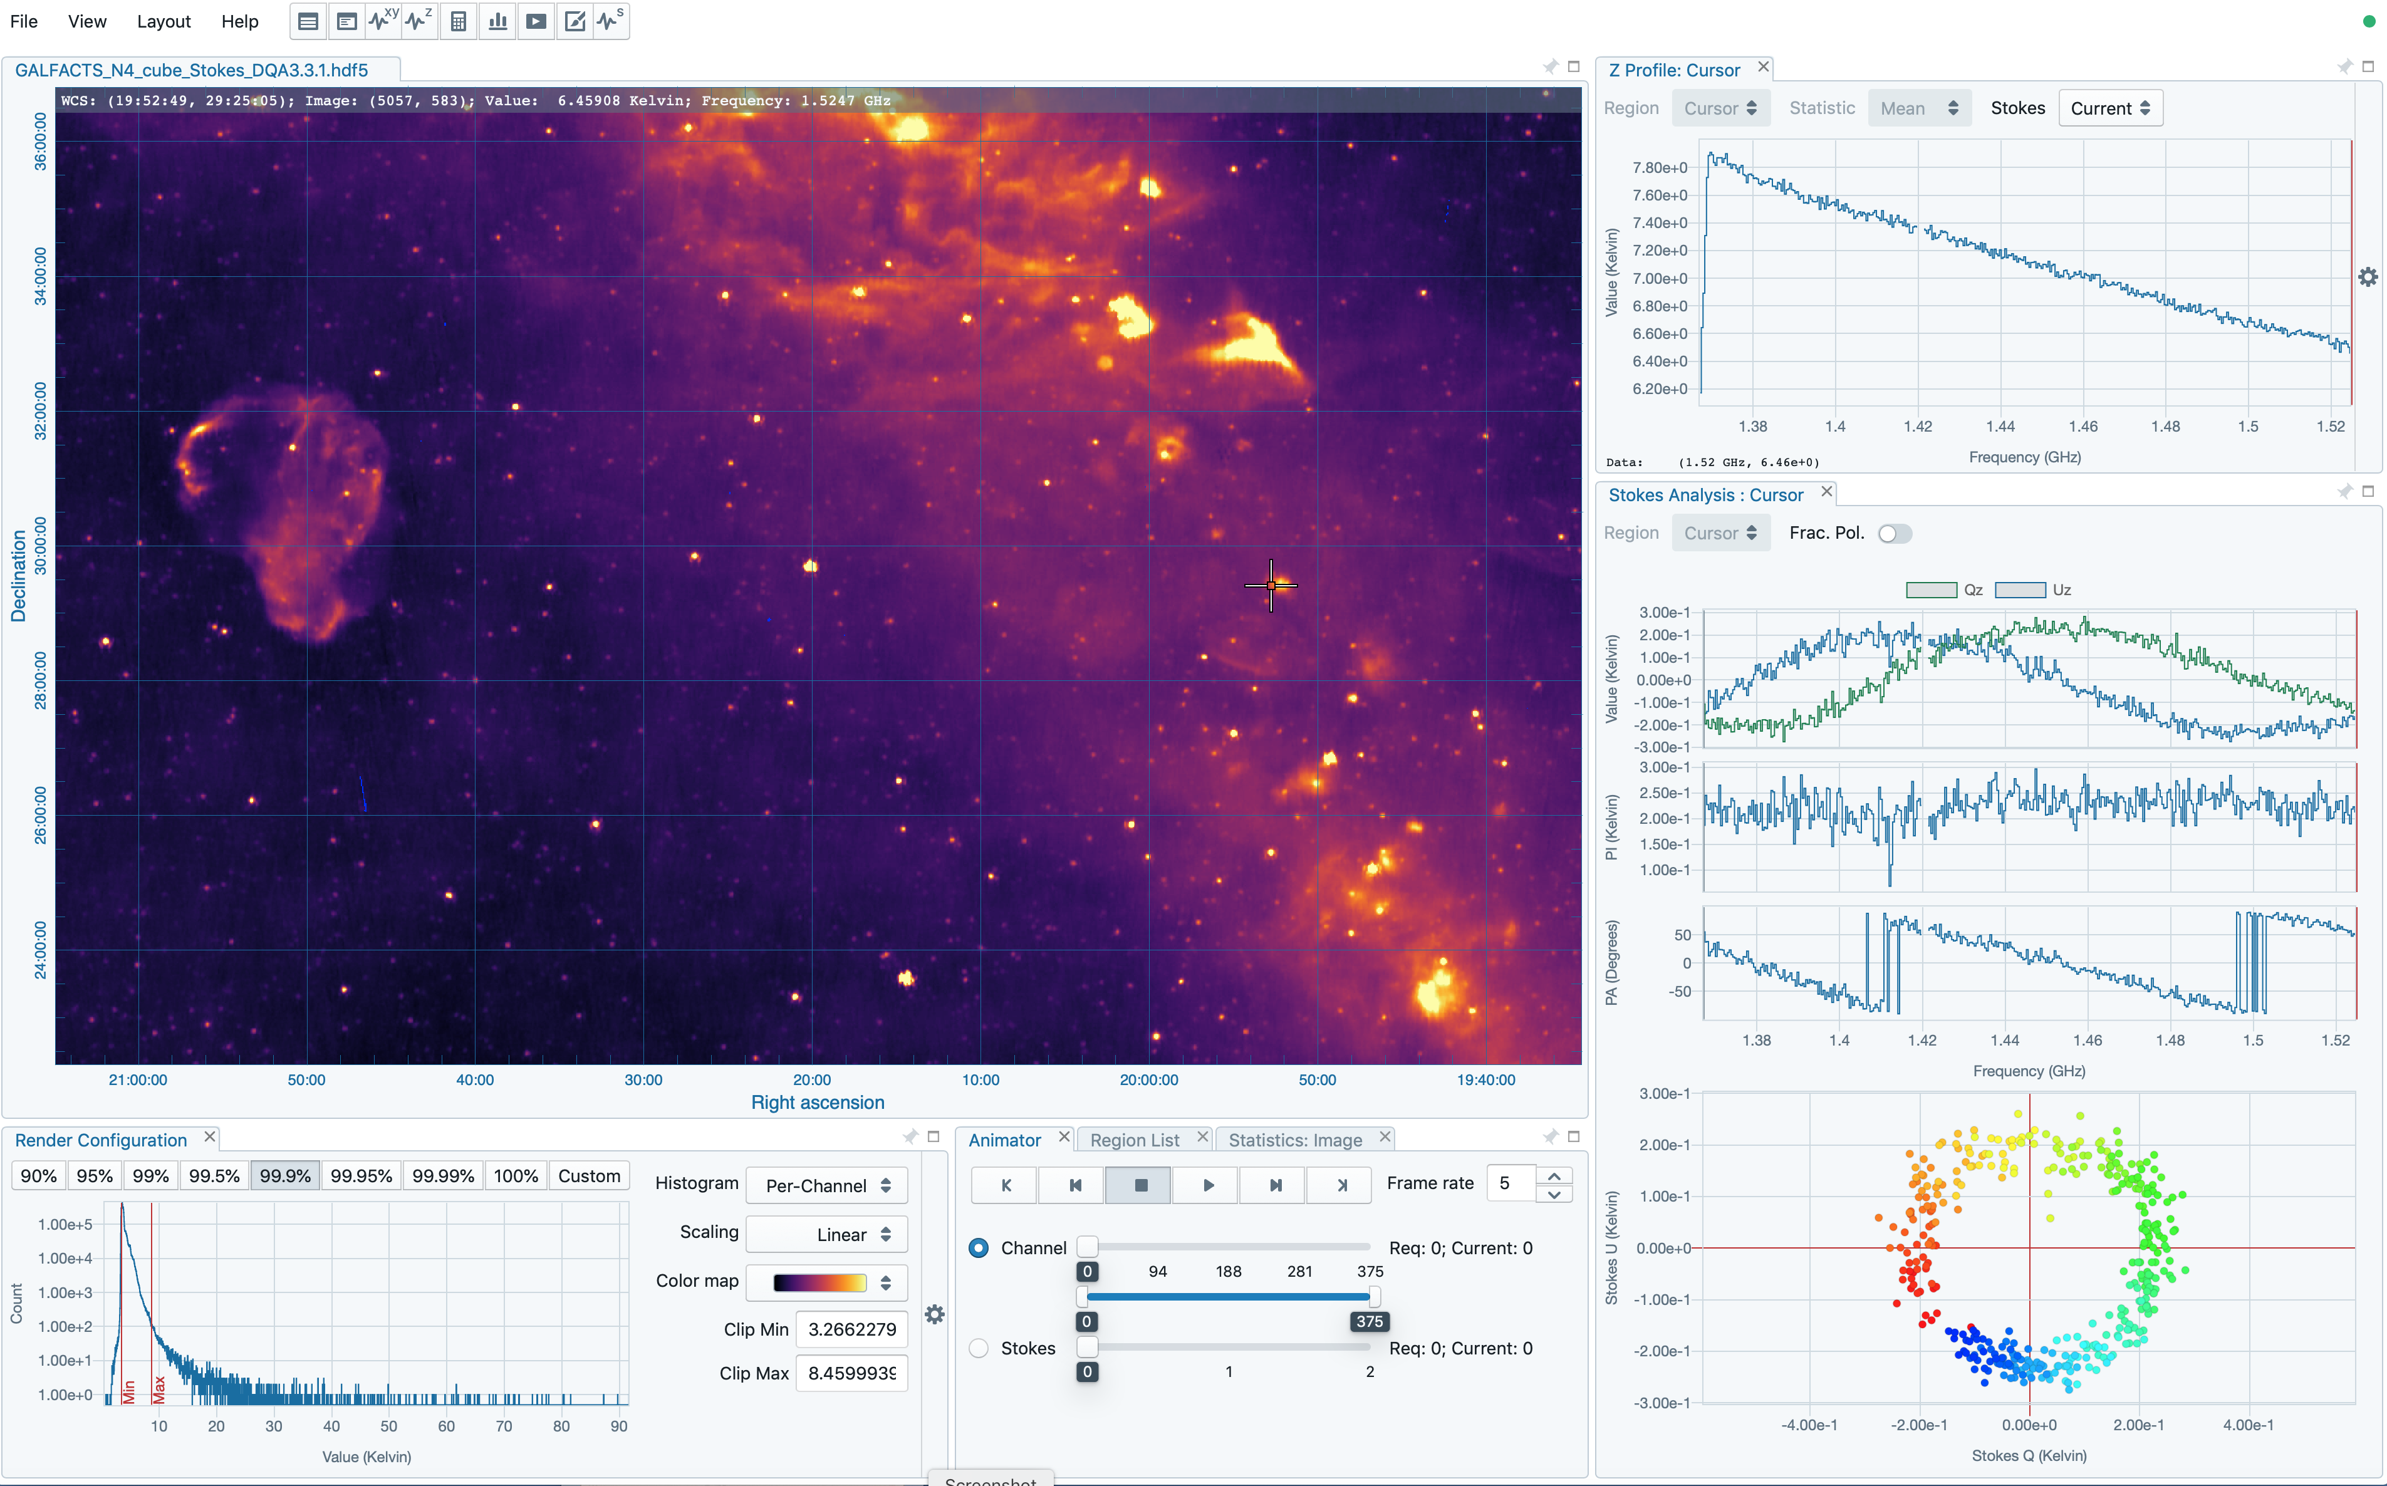
ILIFU User interface
User Interfaces
JupyterLab
ILIFU Cloud
Singularity
Containers
ssh
…
Compute
Cluster / Job
Scheduler
Clusters
Openstack
Partitions
Shared Storage
CephFS
BeeGFS
Virtual Machines
VM
VM
VM
Virtual
Networking
services
single use nodes
etc.
Visualization
All this complexity hidden from user

Slide 3
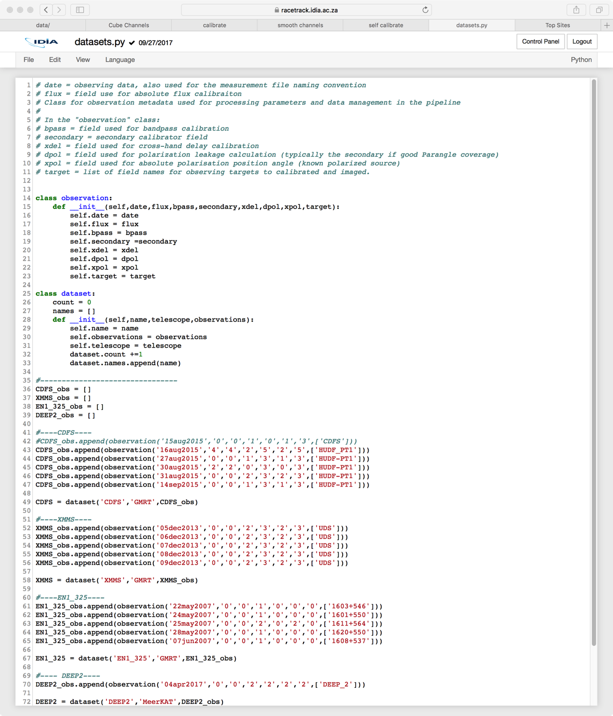
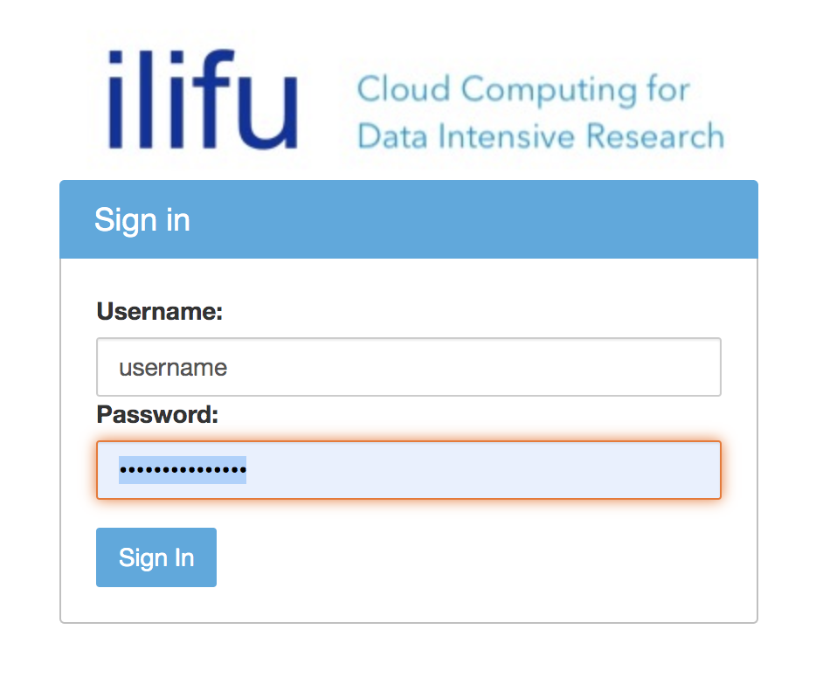
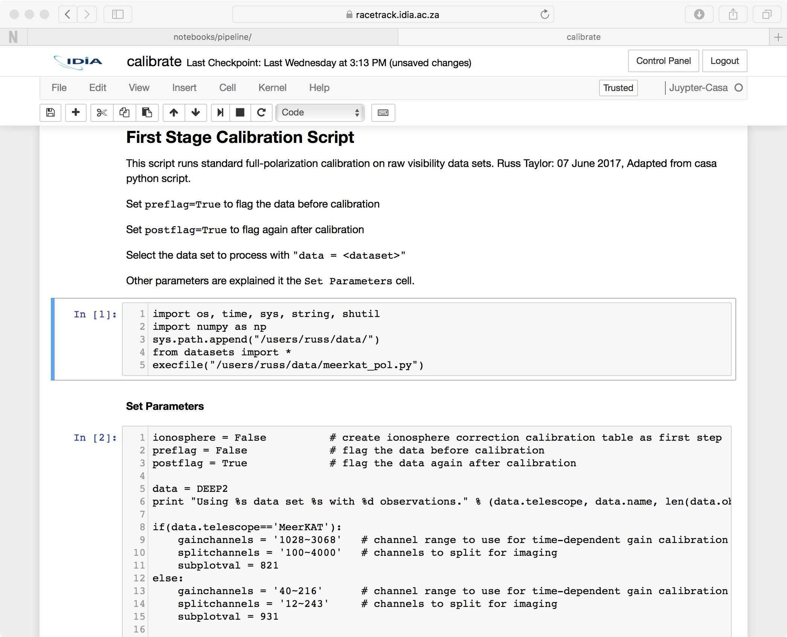
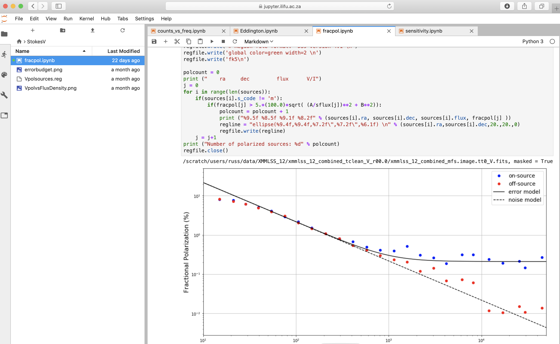
Data Intensive Research Cloud
jupyter.ilifu.ac.za

Slide 4
IDIA/ILIFU cloud-supported Projects
A Transient IDIA
Pipelines processing and joint post-processing analytics for ThunderKAT radio and MeerLICHT optical observations
Pipeline Development for the MeerKAT Imaging Large Survey Projects
Collaboration among 5 MeerKAT LSPs to jointly develop pipeline processing of MeerKAT data
IDIA Visualization Toolkit: Converting Data Into Discoveries
Development of visualization and visual analytics for MeerKAT big image data sets and use cases.
HIPPO: HELP-IDIA Panchromatic Project
Multi-wavelength data fusion and analysis
Machine learning for classification from multi-wavelength data
Data Intensive Astronomy with LADUMA
analytics and simulations for LADUMA HI science
How do Galaxies Form and Evolve
Analytics and simulations for MONGHOOSE
HI Intensity Mapping
MeerKLASS preparatory studies
Wide-field Very Long Baseline Interferometry
Calibration, imaging and analytics of VLBI data sets
Open time science projects
E.g. MHISHAPS, VELA,…
Must be lead by South African Researchers at IDIA partner institutions
Involve young South African trainees
Provides
access and support on the Data Intensive Astronomy Cloud
funds for postgraduate and postdoctoral researchers

Slide 5
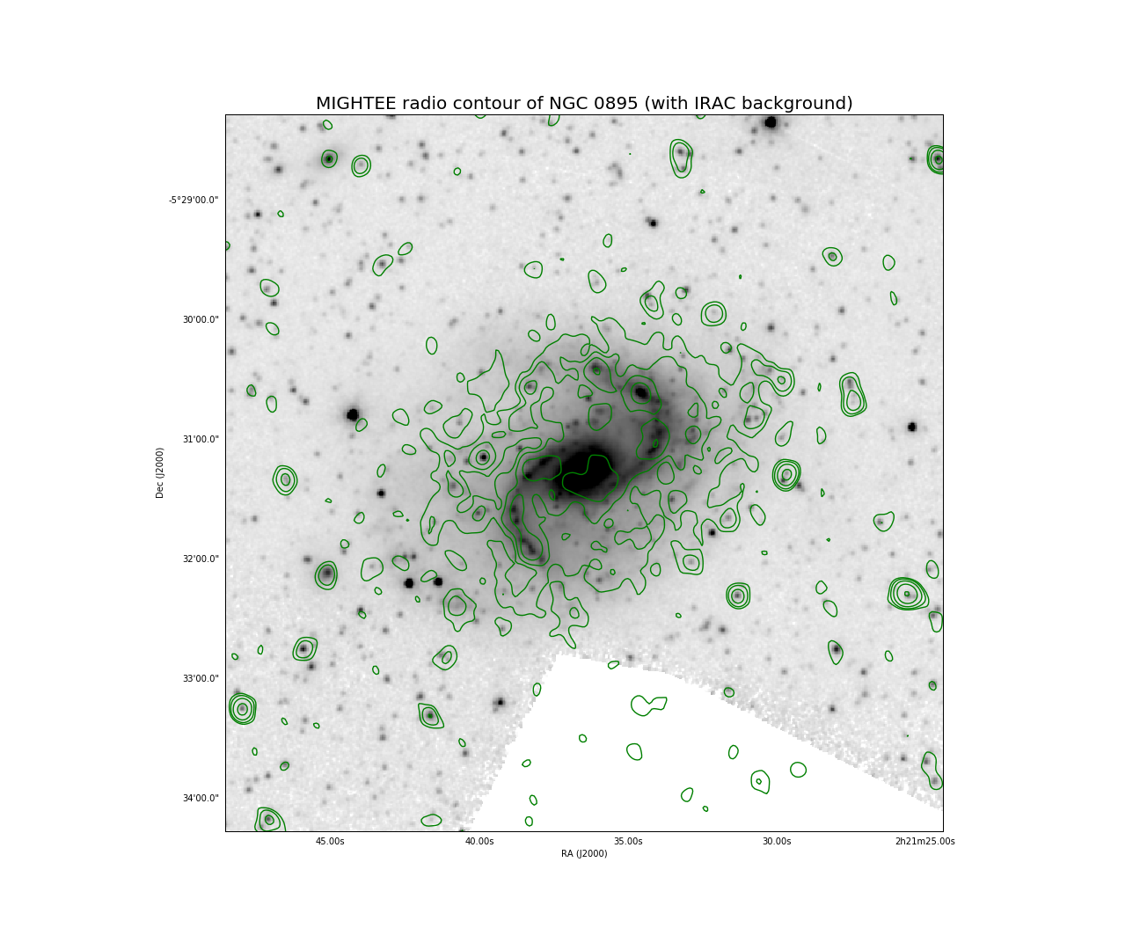
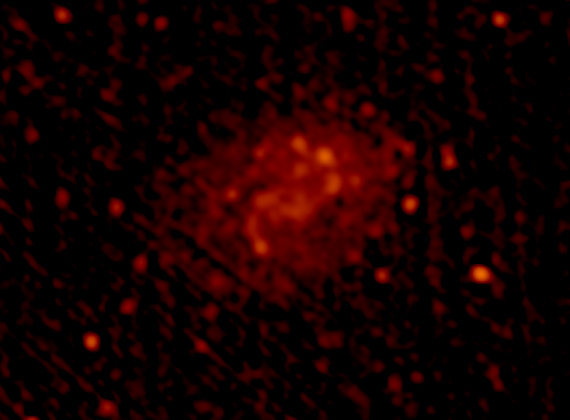
MIGHTEE XMMLSS: Multi-wavelength Postage Stamp tool
NGC 0895
RMS ~2 𝜇Jy, Robust = -0.5, Beam = 7.3” x 6.3”

Slide 6
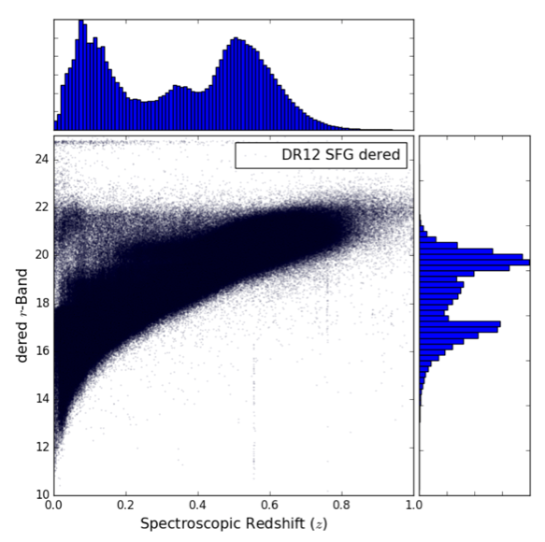
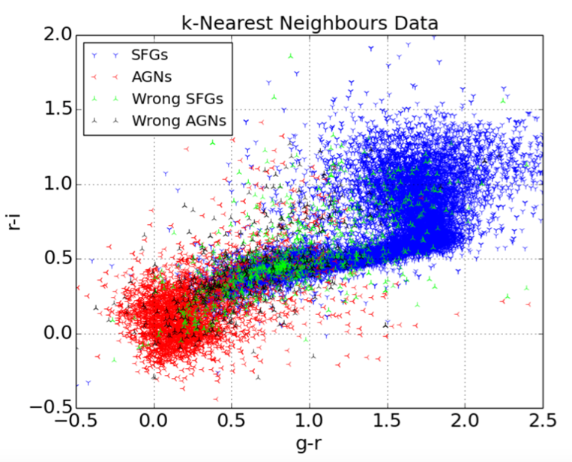
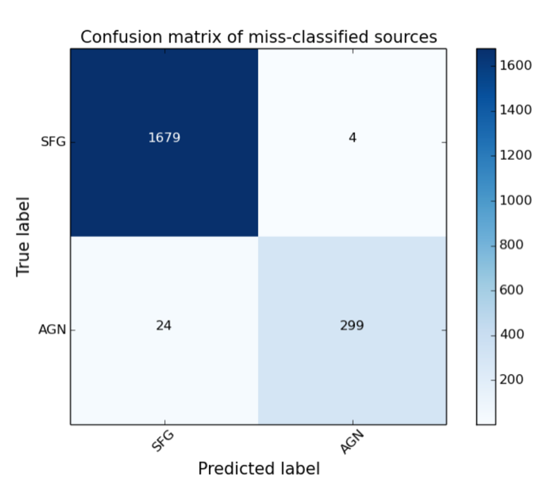
Cloud-enabled Machine Learning for Catalogue-Based Classification and Photometric Redshift Estimation
Case Study : combining SDSS & WISE multi-band photometry to classify sources as SFGs/AGNs

Slide 7
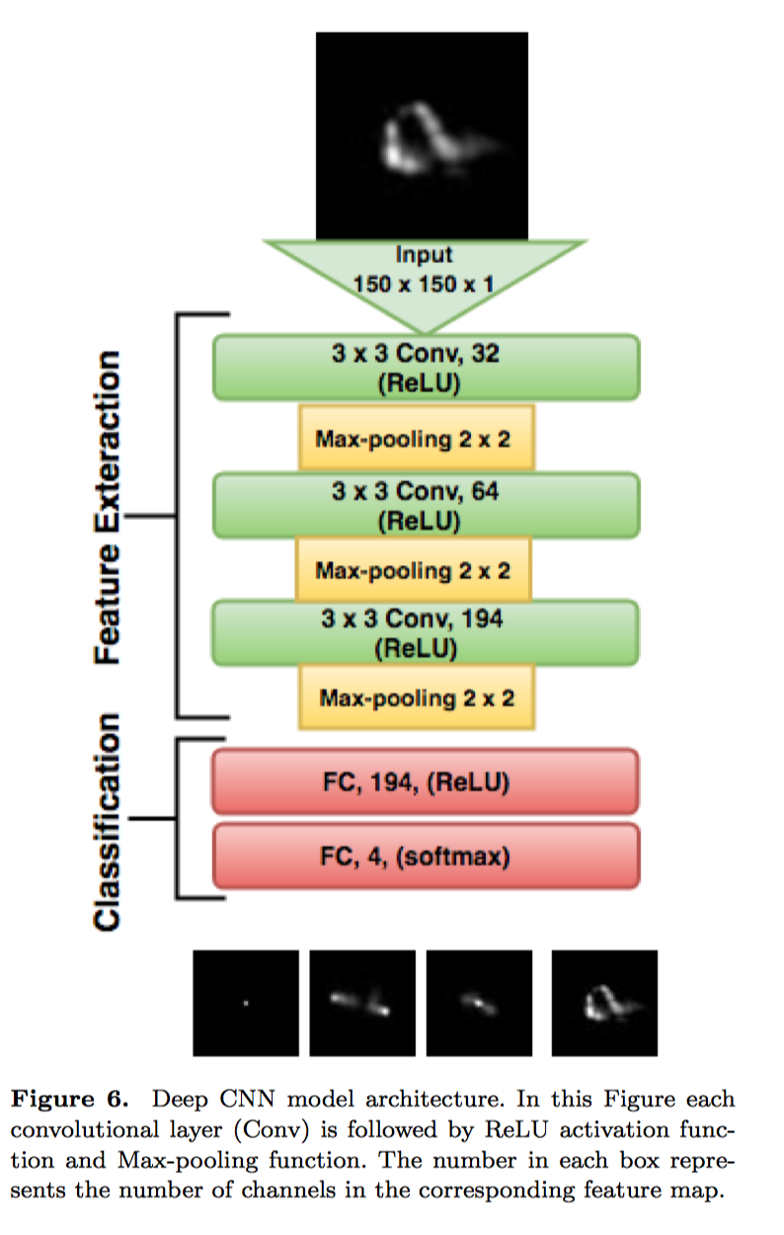
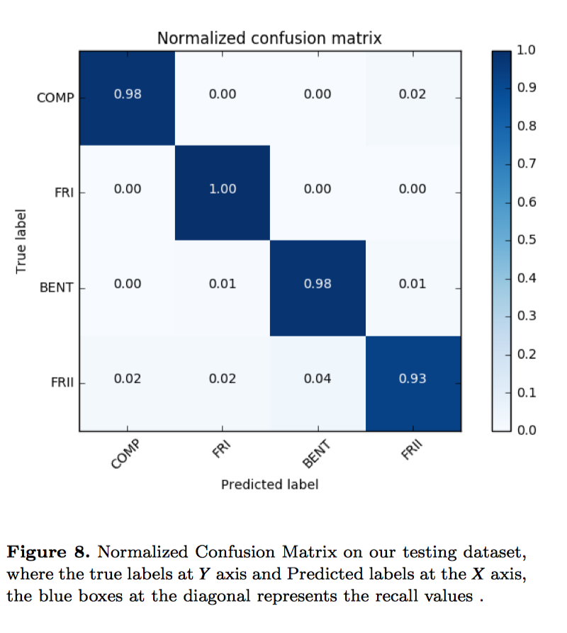
CNN for radio galaxy classification
Wathela Hassan, MSc. UCT: 2018

