Slide 1
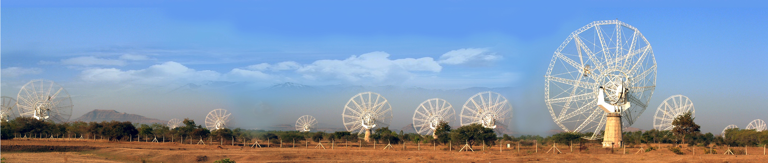
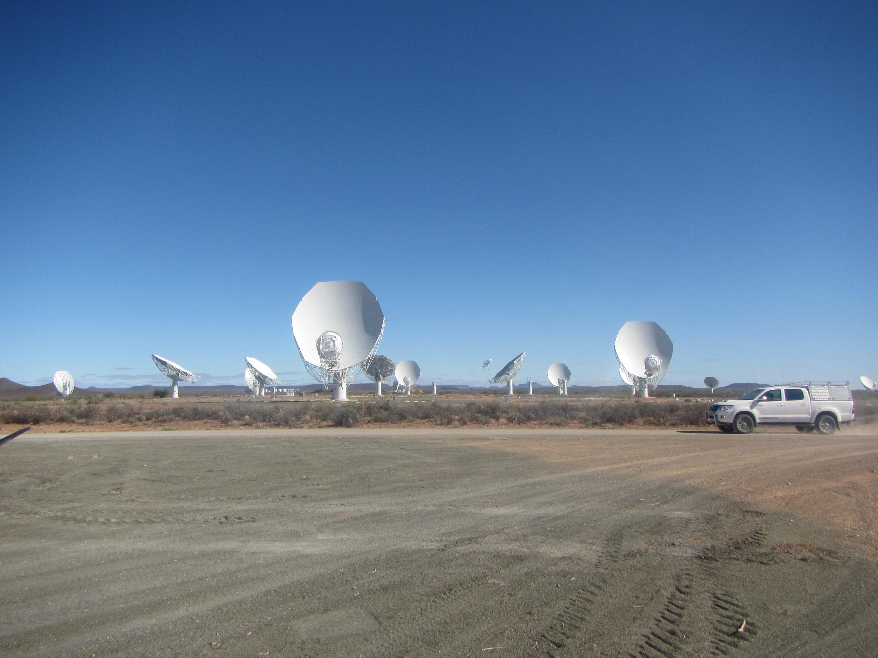
superMIGHTEE
Ultra-broad Band Imaging of the deep GHz Sky

Slide 2
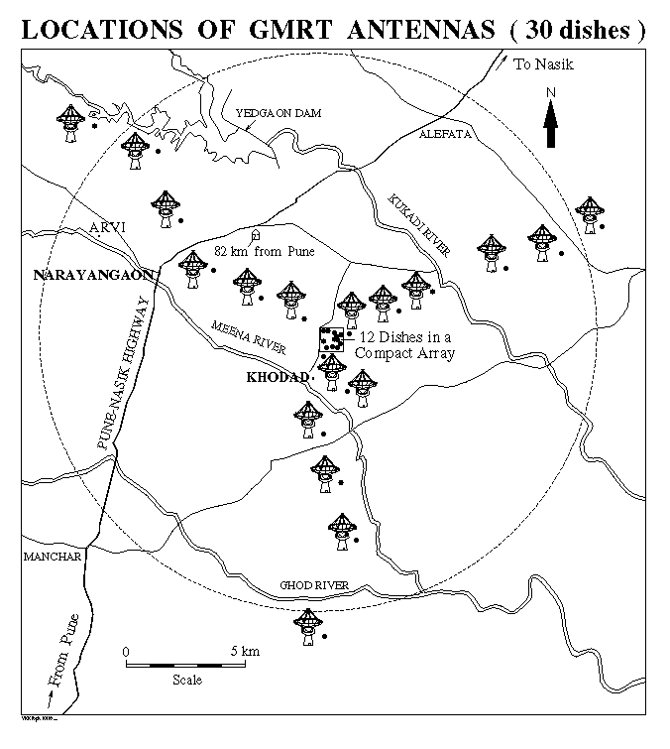
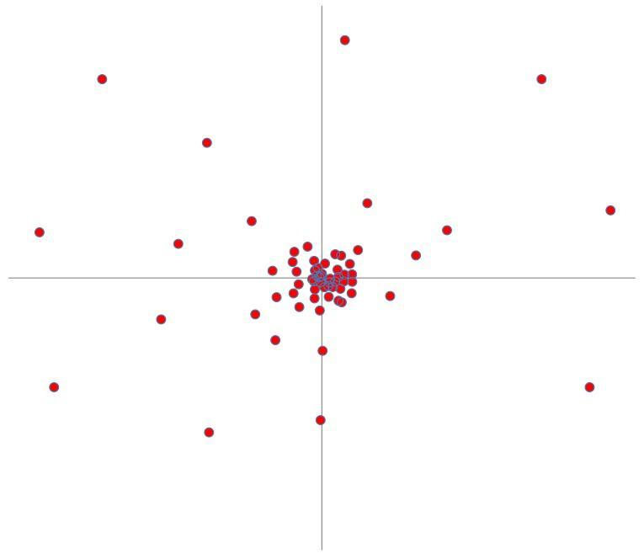
uGMRT–MeerKAT
Angular Resolution Complementarity
MeerKAT Core Stations
MeerKAT
GMRT
8 km
25 km

Slide 3
uGMRT-MeerKAT
Sensitivity Complementarity
MeerKAT L-Band
uGMRT Band-3
uGMRT Band-4

Slide 4
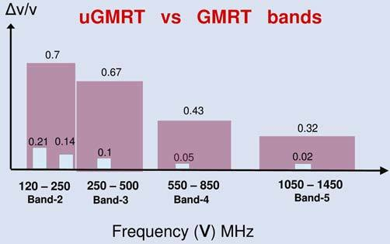
uGMRT-MeerKAT
Frequency Complementarity
MeerKAT

Slide 5
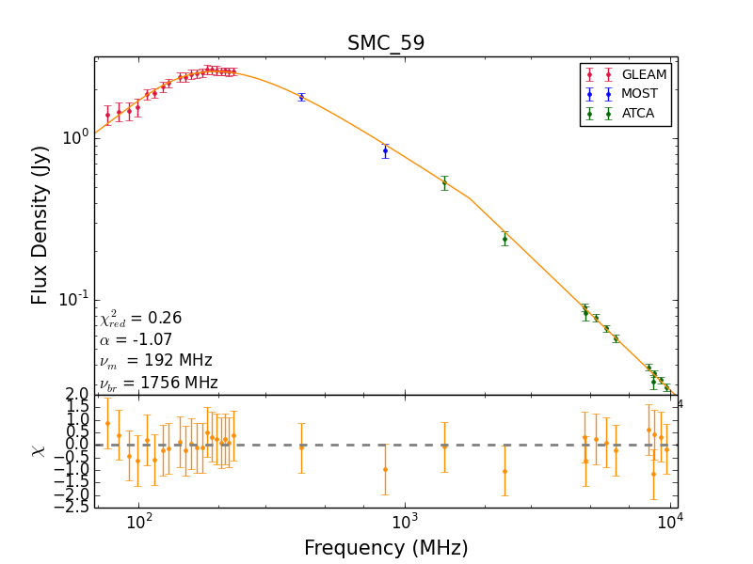
“There’s nothing as useless
as a radio source” - J. Condon
Slide complements: Jordan Collier (IDIA)

Slide 6
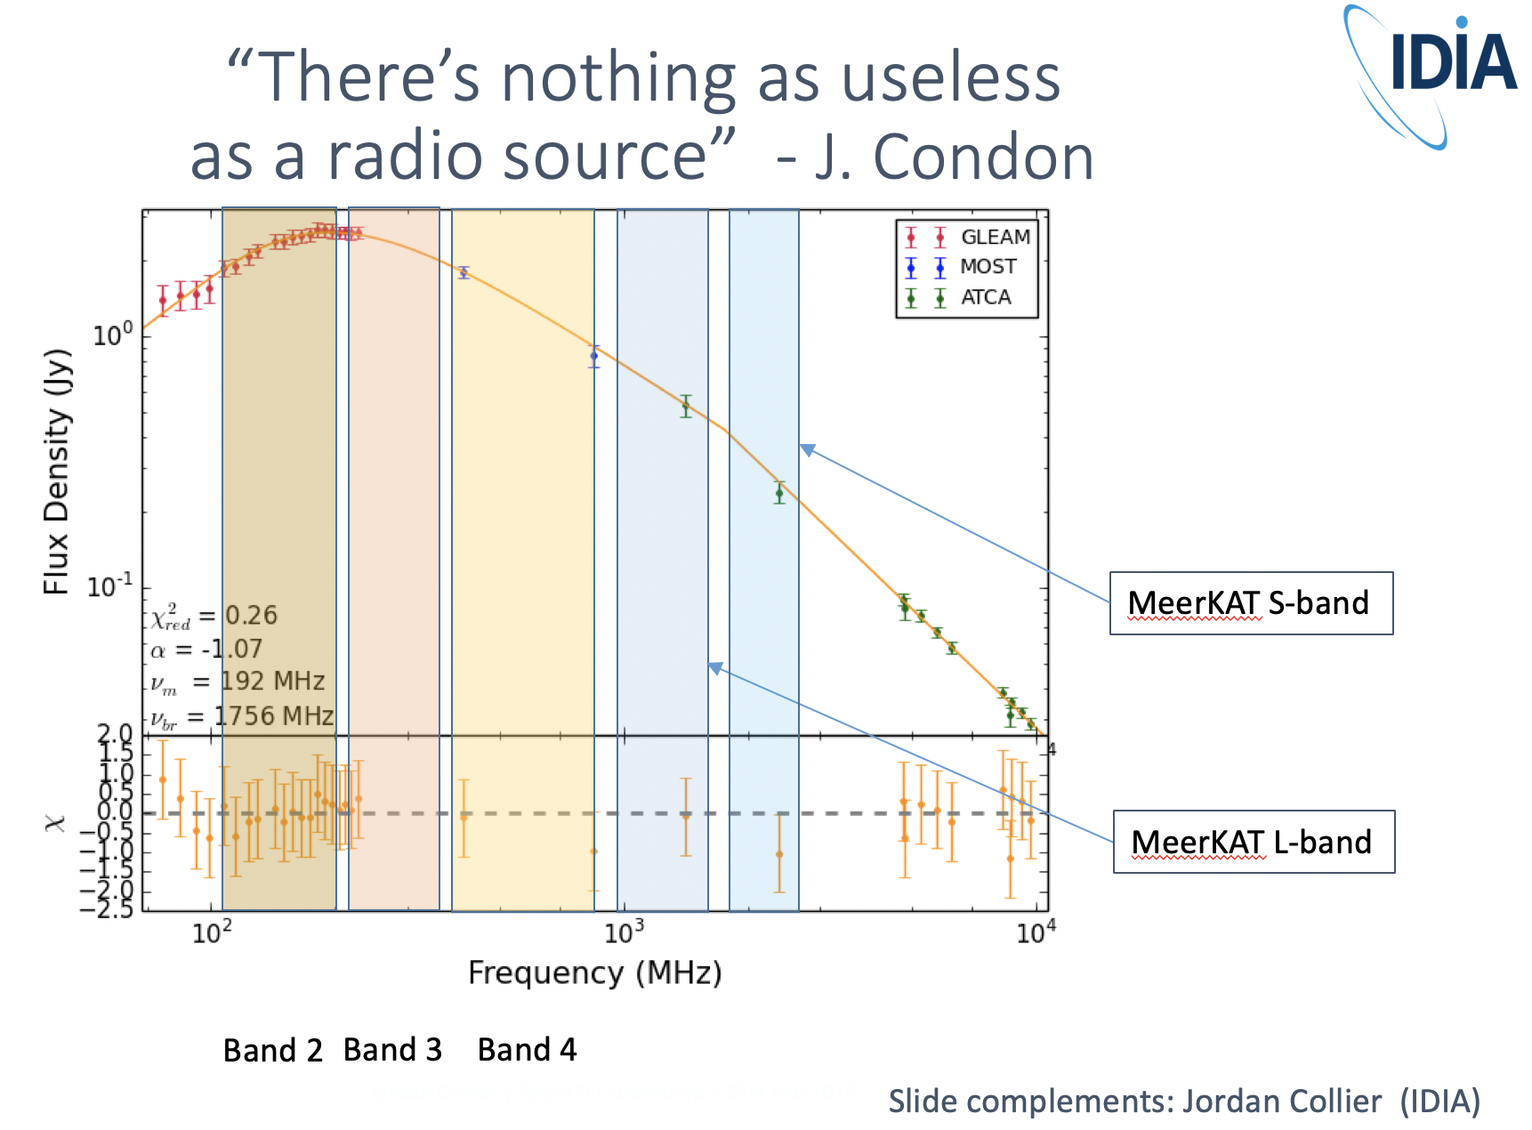

Slide 8
Polarimetry: Bandwidth is key
900 - 2750 MHz (MeerKAT)
550-900 MHz (GMRT)
0.03 0.06 0.09 0.12 0.15 0.18 0.21
00.03 0.06 0.09 0.12 0.15 0.18 0.21
0.03 0.06 0.09 0.12 0.15 0.18 0.21
Polarimetry of PKS B1610-771 (O’Sullivan et al. 2012)
Slide modified from Bryan Gaensler

Slide 9
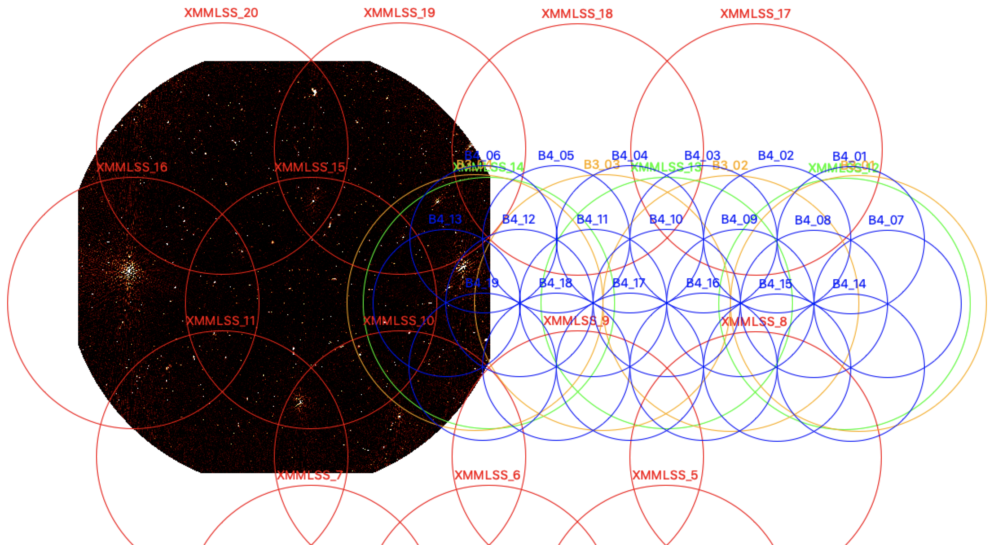
First SuperMIGHTEE Observing Proposal
4 pointings band-3 250-450 MHz
19 pointings band-2 550–800 MHz
Band-3 observations:
September 2019
Target rms 5 𝜇Jy /beam
superMIGHTEE
MIGHTEE

Slide 10
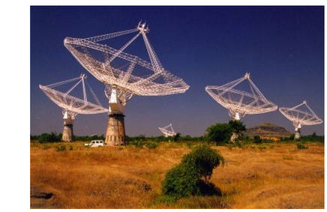
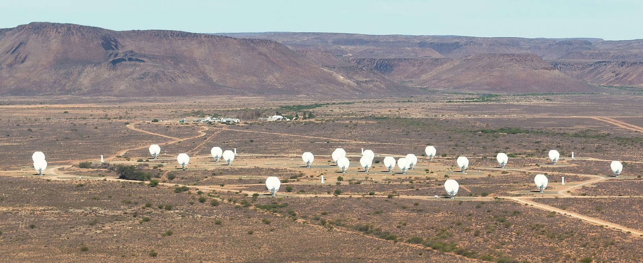
Summary: SuperMIGHTEE
Combined data sensitivity to <1 𝜇Jy (0.25-2.7 GHz)
Well matched resolution (a few arcseconds) from 0.25-2.7 GHz
Spectral analysis from 0.25 – (1.7-2.7) GHz for very large sample of 𝜇Jy radio sources
Ultra-broad band polarimetry to measure Faraday complexity
  3.2 times the Faraday synthesis precision over MIGHTEE alone
  Samples important frequency range for complex de/repolarization
HI science to high redshift and higher resolution for stacking

