Slide 1
Electronic : PM0 (former IM0)

Slide 2
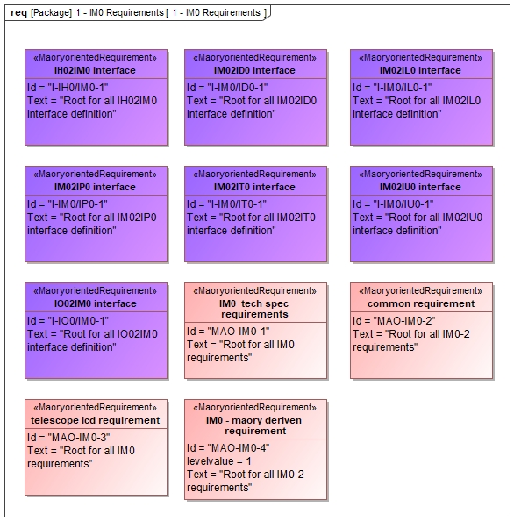

Slide 3
boundaries
Mass limitation: 12,5T EVERYTHING included
Bench + legs
elevator 1+2 + CU boxes
Enclosure Micado
Enclosure Maory (to be discussed)
Volume under negotiation with ESO
Heat dissipation limit (for each)
Electrical power limit (for each)
No vignetting
Motion on the optics how to budget with Optomech: 250um 5arcsec
Alignment Range, (coming from optical design and Nasmyth DUG)
Bench shall guarantee that the Access to the instrument across the Nasmyth platform will be exclusively via the walkway area shown in CAD-130610.
emissivity

Slide 4
Time budget (mainly for elevators)
Time Budget in start up shut down online to/from standby and standby to/from offline time.
Time Budget in integration
Time budget in maintenance

Slide 5
Interface to Telescope
Eigenfrequency
Load to the telescope (earthquake but not only)
Point stiffness
Nasmyth flexures

Slide 6
Interface to subsystems
I-IM0/IU0-1.2.3 Calibration unit mounting The Calibration Unit mounting interface to IM0 is shown in DWG XX
I-IM0/IU0-1.2.4 Volume allocation The volume reserved for Calibration Unit unit is defined in XX
I-IM0/IU0-1.2.5 Loads To be completed
I-IM0/IU0-1.2.6 Mass The mass aconsidered for the CU equipments is 200Kg
I-IM0/IU0-1.2.7 MOI in symmetric config TBC
I-IM0/IU0-1.2.8 CoG in symmetrical "The Center of Gravity is TBC"
I-IM0/IU0-1.2.9 Acting forces To be completed
I-IM0/IU0-1.2.10 Structural frequency To be completed
I-IM0/IU0-1.2.11 Vibration requirements To be completed

Slide 7
Routing
I-IH0/IM0-1.2.5 Cable routing Optomechanics The cable routing from the Optomechanical mountings to IH0 is defined by IM0 in XX
I-IH0/IM0-1.2.6 Pipe routing Optomechanics The pipe routing from the Optomechanicsequipment to IT0 (manifold) is defined by IM0 in XX
I-IH0/IP0-1.4.1 Cabling definition for Opto-mechanical mountings The Opto-mechanical mountings will be connected to ICH through the cable defined in XX

Slide 8
Mechanics
Review of subsystem specifications
what are the requirements assumed so far for the design?
requirements from new baseline design
requirements from the Optical WP, DM WP, Thermal WP
budget split between bench and mounts
Status of analysis and design
overview of the mechanical design
earthquake analysis
effect of thermal expansion
effect of nasmyth platform flexures
effect of variable loads (calunit, lgsw)
effect of wind
elevator for the calibration units
AIV
Subsystem management and interfaces
Interface with other subsystems: LGSW, DM
how do you share mechanical activities of bench, mounts, LGSW, CalUnit
resume contract with Libra: when? scope of Libra’s work?
interface with the telescope
interface with LGSW, CalUnit, MICADO CalUnit, Thermal
schedule towards PDR (set WP milestones)
cost estimate (bench, mounts, …)

