Slide 1
Electronic : PH0 (former IH0)

Slide 2
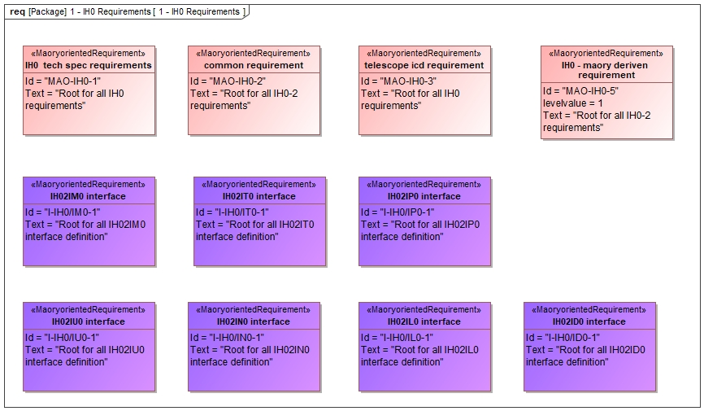
IH0 to IS0 interface

Slide 3
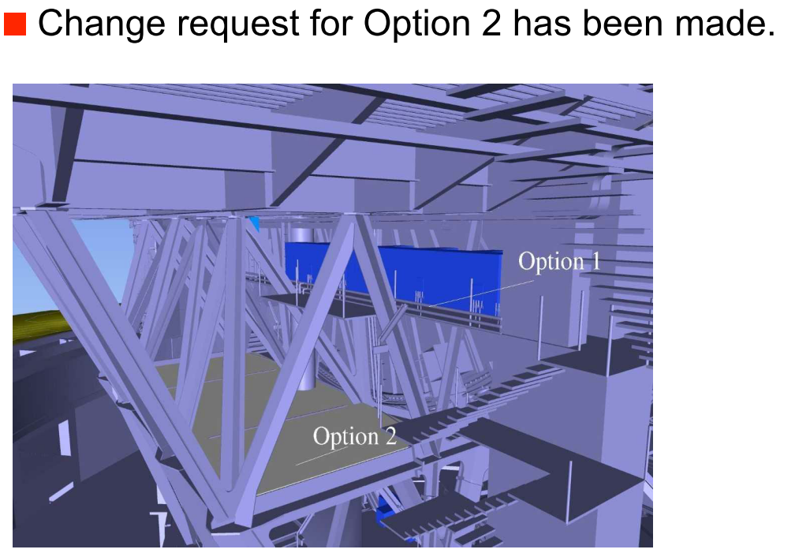

Slide 4
boundaries
Mass limitation: 3T EVERYTHING included (cabling, all electornic)
Volume to be agreed (number of rack)
Heat dissipation limit (still to be defined)
Electrical power limit (see next slide)
Number and frequency of motion

Slide 5
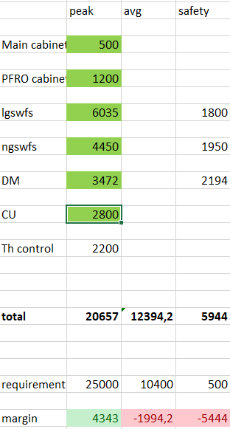

Slide 6
Time budget
Time Budget in start up shut down online to/from standby and standby to/from offline time.
Time Budget in integration
Time budget in maintenance

Slide 7
Interface to Telescope
MAO-IH0-3.10.1.1 E-ELt provide routing tray The E-ELT System shall provide in the form of a metallic tray for cabling and piping, permanently installed on the Telescope Main Structure, with a minimum cross-section of 400x200 mm. The pipe and cable trays provided by the E-ELT System will not extend into the Nasmyth Instruments design volume.
MAO-IH0-3.10.1.2 E-ELT define cable paths The E-ELT System shall define the routing path for the above cable tray considering the need for maintenance access after first installation.
MAO-IH0-3.10.2.1 Routing inside the volume "shall procure, deliver and install the cabling and piping including its thermal insulation, between the SCPs and itself (IH0).
shall procure, deliver and install the cabling and piping routing (e.g. metallic trays) inside the instrument design volume up to itself (IH0)"

Slide 8
Interface to subsystems
I-IH0/IP0-1.4.2 Electrical bonding "The electrical bonding between the IP0 and the rest of Maory will be defined for the MAORY FDR"
I-IH0/IP0-1.4.3 Grounding and Isolation "A common grounding between the IP0 and the rest of Maory will be defined for the MAORY FDR"
I-IH0/IP0-1.4.4 Shielding "The shielding strategy between the IP0 and the rest of Maory will be defined for the mAORY FDR"
I-IH0/IP0-1.4.5 Electrical Power Allocation to IP0 "The power allocation from IH0 to IP0 (to drive the motors) is:
Average (over 24hours) normal power: xx kW
Peak normal power: xx kWAverage (over 24hours)
safety power: xx kW"

Slide 9
Routing
I-IH0/IP0-1.4.1 Cabling definition for Opto-mechanical mountings The Opto-mechanical mountings will be connected to ICH through the cable defined in XX
I-IH0/IM0-1.2.5 Cable routing Optomechanics The cable routing from the Optomechanical mountings to IH0 is defined by IM0 in XX
I-IH0/IM0-1.2.6 Pipe routing Optomechanics The pipe routing from the Optomechanicsequipment to IT0 (manifold) is defined by IM0 in XX

Slide 10
Interface to software

Slide 11
Electronics
Review of subsystem specifications
what are the requirements assumed so far for the design?
are ALL the specifications and recommendation from ESO taken into account? (materials to be used, standards, connectors, best-practices, …)
new requirements from baseline
Current status of design and analysis
overview of the entire electronic system of MAORY
distribution of cabinets, routing between cabinets, routing to devices, mechanical interface to the Nasmyth
internal layout of the cabinets
list of selected devices/controller
distributed vs centralized controllers on the main bench
prototyping: short term, medium term plan
power/mass/cooling budget update
operational scheme (what is always on, who switch on/off who)
safety (overcurrent / overtemperature / glycol leaks / …)
AIV
Sub-system coordination
internal guidelines / standards to be followed by everyone working on electronics
common services: power supply, cabinet thermal insulation and cooling, data distribution
how do you share activities between electronics of MPO, CalUnit, LGSW, LOR
interface with the telescope and MICADO
interfaces with bench
schedule towards PDR
cost estimate

