Slide 1
MAORY Status of the project
PAOLO CILIEGI

Slide 2
WELCOME TO
NICHOLAS DEVANEY
ALEXANDER GONCHAROV
School of Physics at the National University of Ireland Galway

Slide 3
Short history from last November
21/12/2018 Roberto Tamai informed us that MAORY received a Red Flag due to possible consequences of the MAORY Managerial Team restructure. The decision has been taken with the goal of improving the situation and ESO will be happy to withdraw the Red Flag once the project is back on track
11/01/2019 Presentation of the new team to ESO and start of trade off and consolidation Phase. We propose 30 June 2019 to finish the trade off and consolidation phase.
6/03/2019 Progress meeting with ESO and MICADO to illustrate our acitivities
19/03/2019 Document received from ESO «Criteria for Evaluating the Level of Success of the MAORY Consolidation Phase»

Slide 4
Criteria for Evaluating the Level of Success of the MAORY Consolidation Phase
ESO asked to use the following criteria :
A feasible baseline instrument design compliant with the technical specifications and interface to the ELT, MICADO and 2 nd port instrument
Design trade off report
Draft risk analysis report
A credible schedule for the design , development , construction, installation and commissioning of the MAORY instrument within the available budget
Schedule for the complete project, fully detailed up to PDR and containing major milestones up to delivery of the instruments
Cost estimate for selected baseline
A functional consortium ready to take an agreed baseline to PDR and beyond
Updated project management plan and work packages description
Formal agreement on the instrument baseline by the MAORY steering committee

Slide 5
How we proceeded…
A feasible baseline instrument design compliant with the technical specifications and interface to the ELT, MICADO and 2 nd port instrument
Design trade off report
Draft risk analysis report
We introduced the System Engineering team in order to ensure that the System Overview is shared between an adequate number of people . The System Engineering Team was presented to ESO on January 2019.
We improved the communication and interaction between Consortium Institutes. An example is the LGS Objective design done in collaboration between Magrin (Padova), Rabou (Grenoble) and Munari (Catania).
We shared as much as possible the information also with ESO and MICADO. ESO experts (Madec for Optics, Frank for Mechanics, Kosmalski for Optica Design, Amico for System Engineerging) regularly participate in ours meetings. This was strongly appreciated by ESO
Evaluation Matrix has been prepared by the MAORY team and discussed with ESO at System Engineer level (Riva – Amico) to compare the different solutions

Slide 6
How we proceeded…
5/4/2019 Progress Meeting with ESO (Progress Report)
Section 5.4 The next key milestone in our current activity is the end of the trade off studies. Initially scheduled at the end of June, we anticipated the delivery of the documents at the end of May, with a face to face meeting to be scheduled in the second half of June

Slide 7
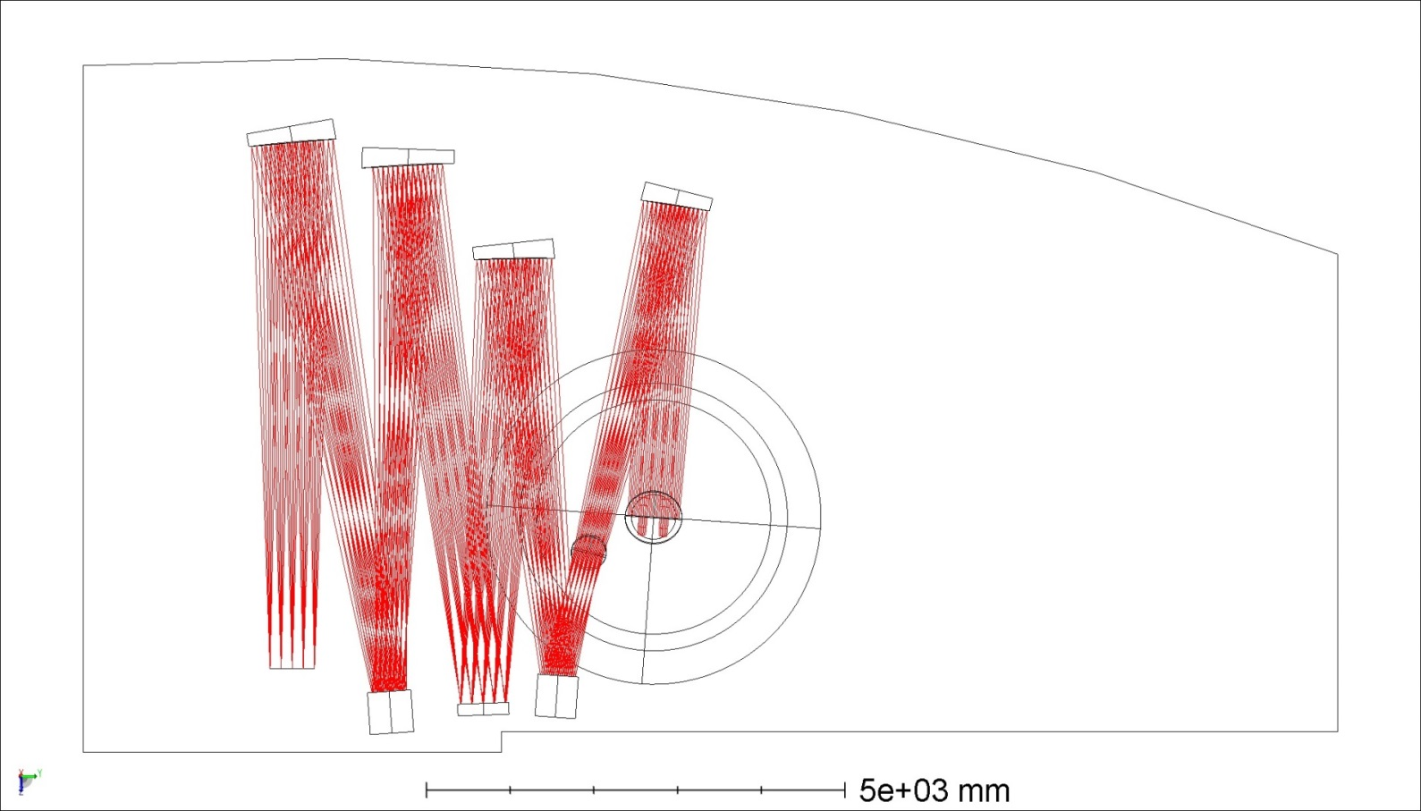
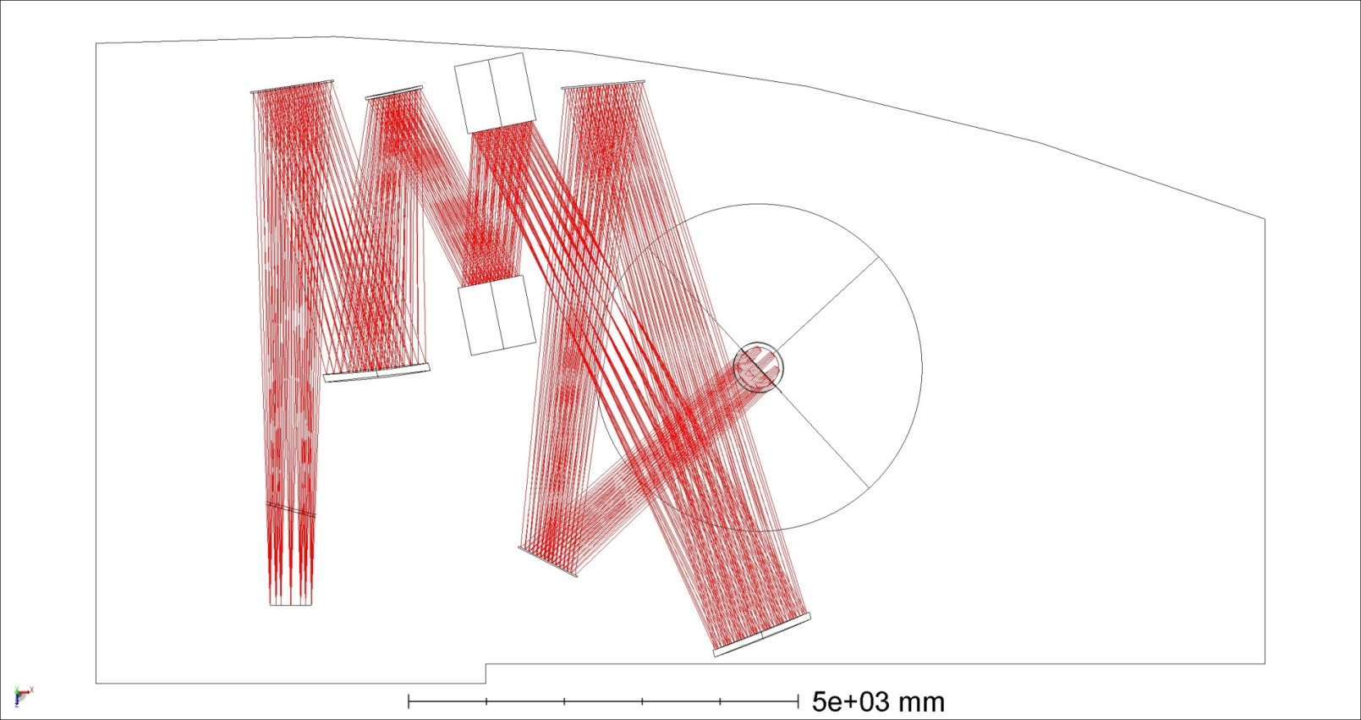
Alternative Optical design investigated
4 parabolas based
3 spheres based
Pro and Cons of all solutions have been investigsted and compared to the current baseline
Collaboration with the MICADO team to evaluate the impact of alternative design on MAORY-MICADO interfaces
The 4 parabolas based solution has an excellent quality but it not allow a proper optical correction due to the focal plane field curvature

Slide 8
How we proceeded….
A credible schedule for the design , development , construction, installation and commissioning of the MAORY instrument within the available budget
Schedule for the complete project, fully detailed up to PDR and containing major milestones up to delivery of the instruments
Cost estimate for selected baseline
SHORT TERM SCHEDULE
7/6/2019 Delivery trade off documentation to ESO
End July 2019 Consolidation Design Meeting (TBC)
31/01/2020 Delivery PDR documentation to ESO
April 2020 PDR
June 2020 Discussion of the MAORY Status at the ESO Council

Slide 9
LONG TERM SCHEDULE
Activity | Duration (days) | Start | End
MAORY PROJECT | 3099 | 02/02/2016 | 19/09/2028
Phase B : Preliminary Design | 1103 | 02/02/2016 | 01/06/2020
Phase C : Final Design | 445 | 02/06/2020 | 04/05/2022
Phase D : MAIT | 1568 | 11/02/2021 | 24/08/2027
Preliminary Acceptance in Europe (PAE) | 10 | 21/04/2027 | 04/05/2027
Phase E : Commissioning | 275 | 25/08/2027 | 12/09/2028
FIRST LIGHT | 1 | 21/12/2027 | 21/12/2027
Provisional Acceptance in Cile (PAC) | 1 | 12/09/2028 | 12/09/2028

Slide 10
Cost estimation
OUR BUDGET
Signed agreement ESO – INAF 18.500 M EUR (2015) of which
1.755 M EUR for ESO deliverable (AO WFS Cameras detector) as reported in the signed agreement
1.53970 M EUR cost incurred by INSU-IPAG (upper limit) excluding AO WFS cameras required for the production of the deliverables products of INSU-IPAS (MoU)

Slide 11
Component Baseline 2016 Baseline 2019 4 parabola based 2019
Post Focal relay optics
including LGS Object 3559 3675 3900
Main Structure+ Opt Mounts+ICH+TCS 2000 1920 2070
Calibration Unit 200 550 550
LOR WFS (no camera) 800 800 800
LGS WFS (no camera) 1540 1400 1400
AO WFS camera (ESO deliverable) 1755 1755 1755
2 DM 6200 8820 8820
RTC 1800 3474 3474
AIV tools 200 1100 900
Shipment in Chile 200 300 300
TOTAL 18254 23794 23969
COST
ESTIMATION
K
EUR

Slide 12
Actions to mitigate cost
Major difference for DM , RTC and AIV tools
Contact with a different providers to receive different ROM cost estimation for optics .
Start a feasibility study for an alternative RTC design based on CPU (TMT-like) ( Jean Pierre Veran)
Cost budget to be discussed with ESO as soon as possible

Slide 13
How we proceeded ….
A functional consortium ready to take an agreed baseline to PDR and beyond
Updated project management plan and work packages description
Formal agreement on the instrument baseline by the MAORY steering committee
Management Plan and WP description has been revised and delivered to ESO
Also the MoU must be revised
NUIG will be in charge for a WP called «Test and Wavefront Correction Verification»
It will involve developing a strategy to test MAORY on Integration (possibly both in Italy and Chile). We need to determine exactly what can realistically be verified, and so, of course, the financial allocation for hardware is impossible at this point.
New PM. Selected. Full time expected by September October

Slide 14
NEXT STEP
Technical discussion with ESO

Slide 15
Conclusion
Considerable effort has been done from the technical point of view to conclude the trade off analysis
The documents nave been delivered to ESO first week of June
The whole team is working well. The improved communication and collaboration between the team located in different Institutes helped to build a more compact and collaborative team
The entry of NUIG as new consortium partener will consolidate the team both in technical and
political terms. ESO is very positive in this regard.
Some critical points remain
The new PM must be involved in the project as soon as possible.
Cost budget .

