Slide 1
Work Package END TO END SIMULATION
Work Package END TO END SIMULATION team
Presented by W.P. manager Guido Agapito

Slide 2
Stereo-SCIDAR profiles

Slide 3
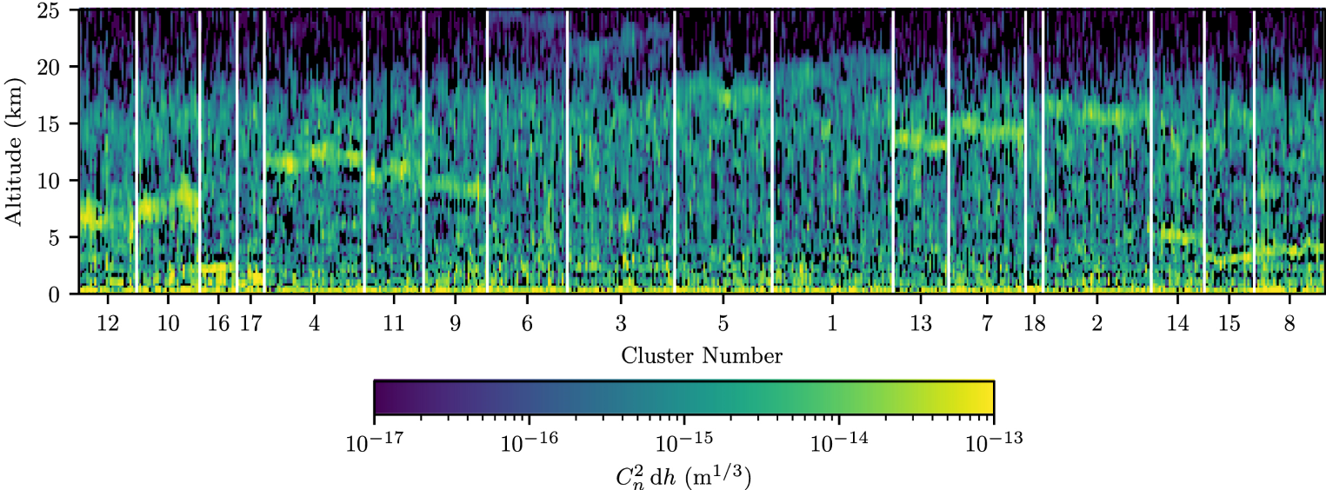
New atmospheric profiles
After a long discussion with ESO and the discovery of some inaccuracies we have rejected the 4 profiles proposed by ESO in 2018, but despite this ESO asks us to use the stereo-SCIDAR atmospheric profiles data released by Osborn et al. → they are 10k profiles, so we can not run sky coverage analysis on all of them.
Ollie Farley propose a method to cluster them based on morphology, but we want to choose profiles that correspond to a certain level of performance.

Slide 4
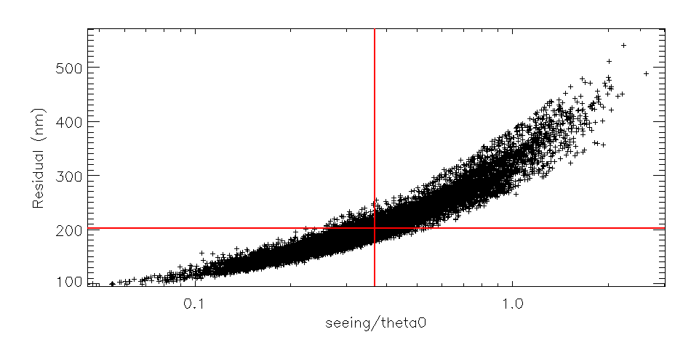
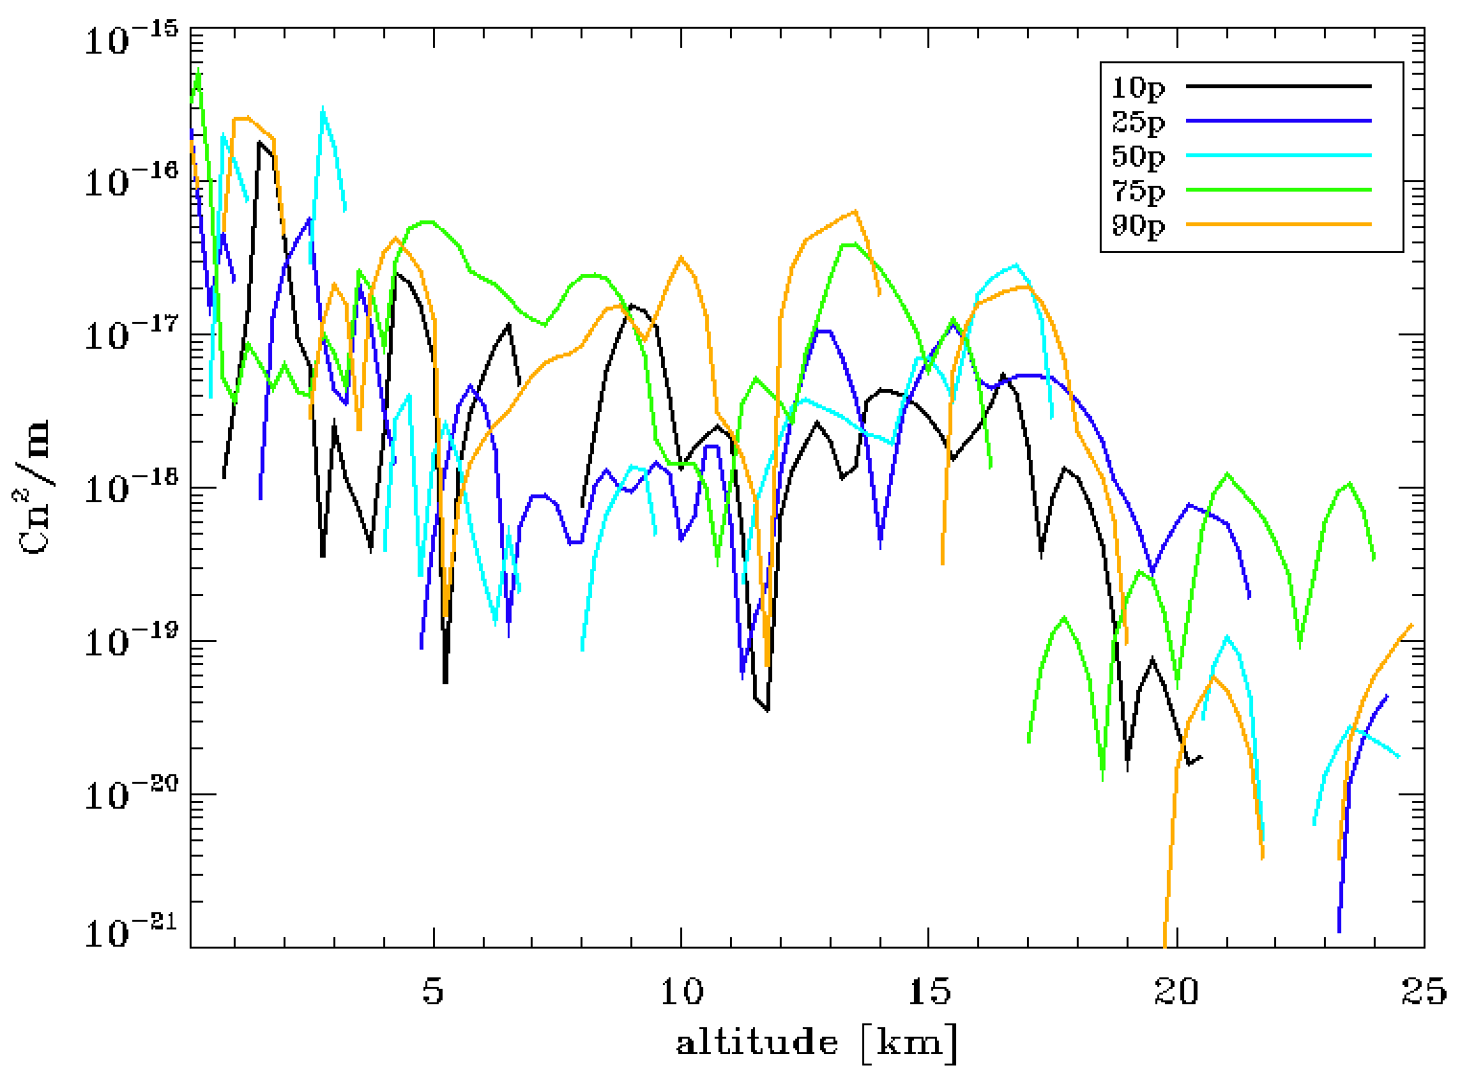
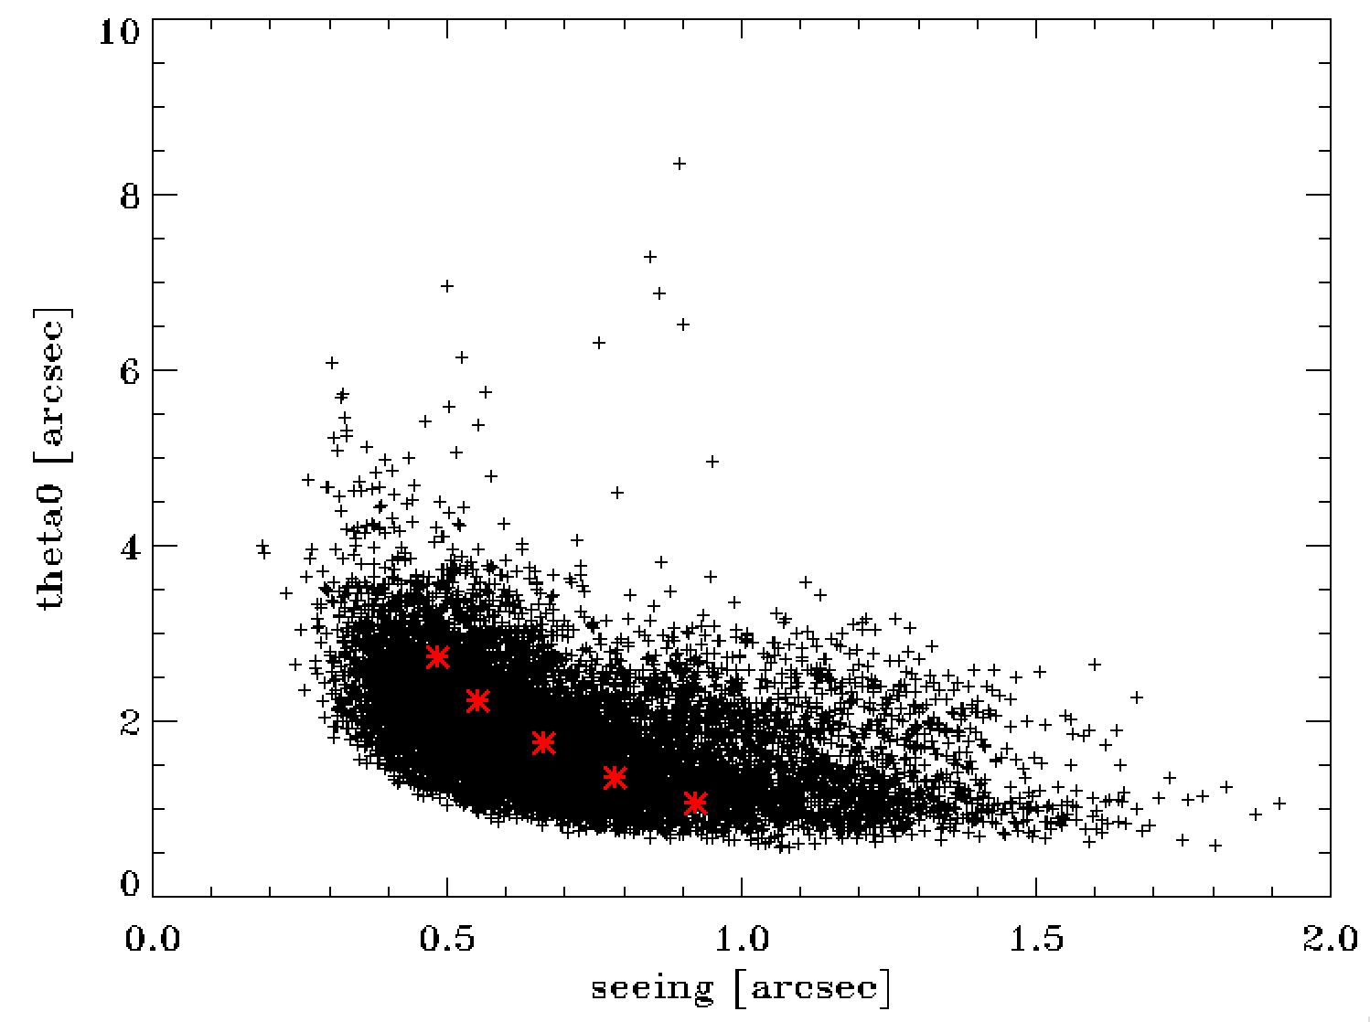
Reference profiles
We estimate MAORY HO performance on all 10k profiles with a Fourier based code, but ESO asks us to select profiles with a merit function independent from performance.
0.37
Median k=seeing/theta0 and median performance of Fourier analysis agree
So, we extract reference profiles for 10, 25, 50, 75, 90 percentile
Perc. | 10 | 25 | 50 | 75 | 90
k | 0.176 | 0.247 | 0.375 | 0.589 | 0.878
prof. index | 3101 | 536 | 2773 | 872 | 5280
prof. ε[“] | 0.486 | 0.552 | 0.663 | 0.784 | 0.922
prof. θ₀ [“] | 2.74 | 2.23 | 1.76 | 1.34 | 1.06
10p
25p
75p
50p
90p

Slide 5
HO/LGS tomographic reconstruction, projection and control

Slide 6
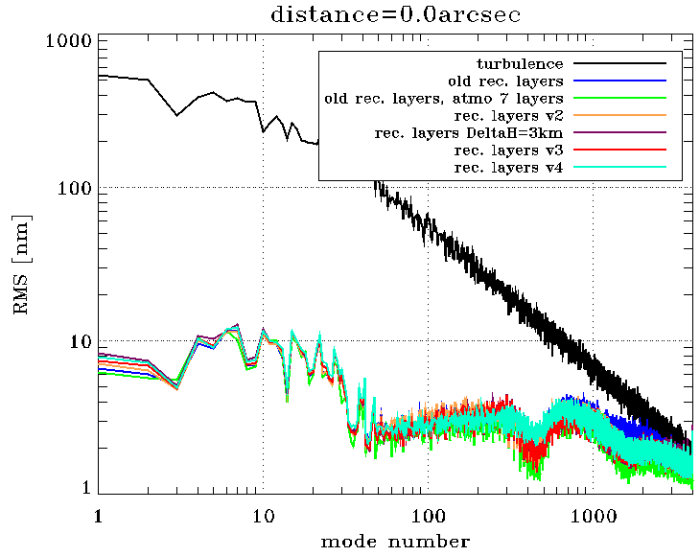
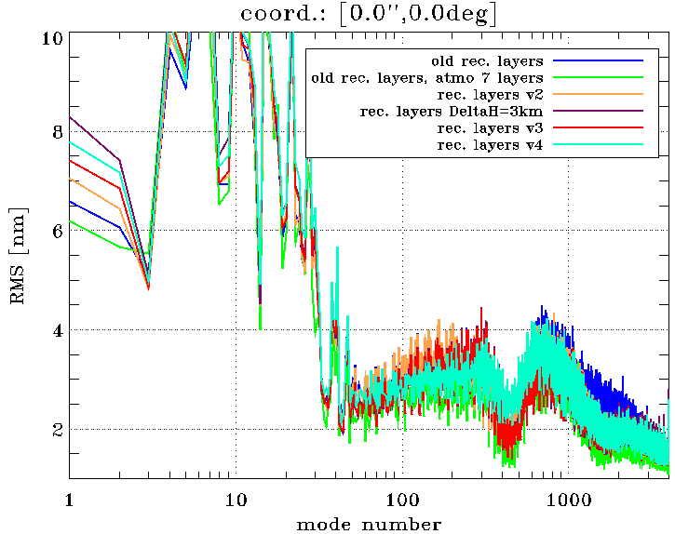
Best rec. layers altitude
Search for the best rec. layers altitude (tomo+fitting errors):
best configuration (v3, red line) altitude vector is [0, 2, 4.4, 7.6, 11, 15, 18] km.
The gain w.r.t. the old configuration (blue line) is ~70nm (161 vs 146nm), and full E2E simulation confirms this.
“All” Cn² profile
2PFDMs 4000modes
off-axis [arcsec] | old | old without gen. fitting | v2 | Δh=3km | v3 | v4
0 | 162 | 134 | 150 | 147 | 146 | 150
15 | 194 | 172 | 183 | 184 | 179 | 180
25 | 209 | 186 | 200 | 202 | 196 | 198
30 | 222 | 197 | 212 | 215 | 209 | 212
45 | 294 | 271 | 288 | 296 | 285 | 296
55 | 342 | 312 | 339 | 350 | 338 | 357
70 | 462 | 431 | 460 | 477 | 466 | 491
85 | 593 | 567 | 592 | 612 | 602 | 628

Slide 7
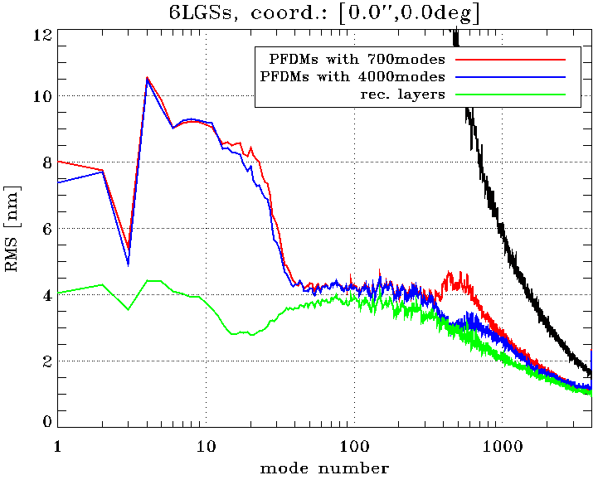
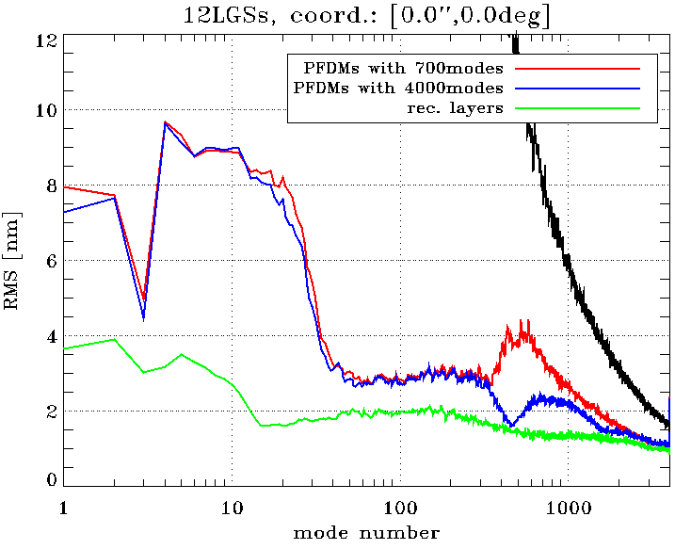
No. LGS and no. modes
6 LGSs
12 LGSs
green line is without gen. fitting error
PFDMs with 700 – 4000 modes difference is bigger with 12 LGSs because tomography gives more margin to projection

Slide 8
No. LGS and no. modes
6 LGSs
12 LGSs
green line is without gen. fitting error
Correction on modes 2000-4000 is limited by tomography, more actuators will be useless

Slide 9
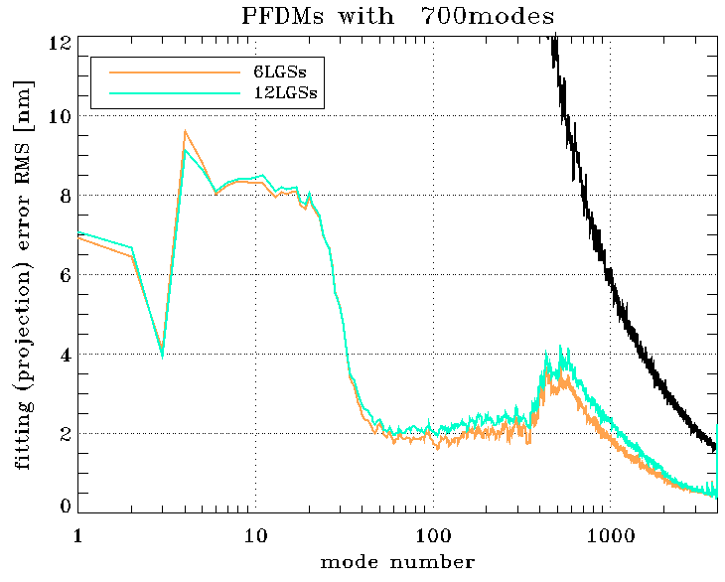
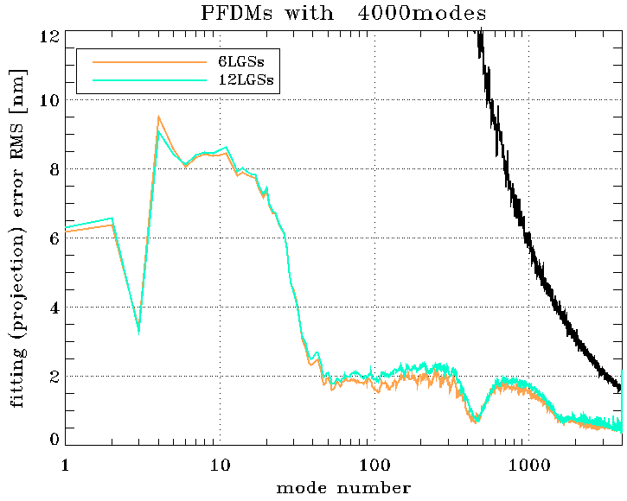
Gen. fitting (projection) error
Difference between 7 layers (DMs) correction and 3 DMs correction
PFDMs with 700modes
PFDMs with 4000modes
Same projection matrix, same PFDMS → almost same error for 6 and 12LGSs

Slide 10
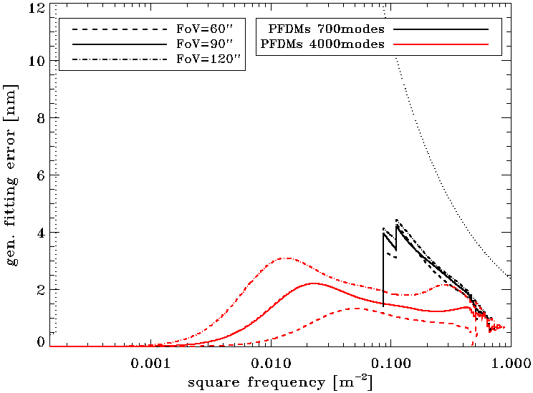
Gen. fitting (projection) error
Difference between 7 layers (DMs) correction and 3 DMs correction
PFDMs with 700modes
Generalized fitting error code
Left and right show good agreement (note: curve level depends on frequency sampling!)

Slide 11
Considerations on POLC
Pseudo Open Loop Control (POLC) is used because it gives a stable MCAO control.
Equations (previous version):
$$\left.s_{ol}\left(k\right)=s_{meas}\left(k\right)+ℐ_{DM}c(k−d\right)$$
$$∆c\left(k\right)=P R s_{ol}\left(k\right)−c\left(k−1\right)$$
New version:
$$\left.∆c\left(k\right)=P R s_{ol}\left(k\right)−c\left(k−d\right)=P R s_{meas}\left(k\right)−Hc(k−d\right)$$
$$H= I−P Rℐ_{DM}$$
the use of the correct loop delay $d$ to compute the error term is important: we gain ~30nm using the new expression.
The matrix $H$ (dimension $N_{com}×N_{com}$) has a clear statistical meaning: it is the expected noise (in the modal space) given the DM commands.
$H=I−P Rℐ_{DM}=I−Rℐ=$ ${\left(ℐ^{T} {C_{N}}^{−1}ℐ+{C_{φ}}^{−1}\right)}^{−1}{C_{φ}}^{−1}$
$R$limits the propagation of noise at time $k$, but residual slopes are also affected by noise propagated through closed loop at time $k−d$, $Hc(k−d$) term takes this into account.

Slide 12
Other activities

Slide 13
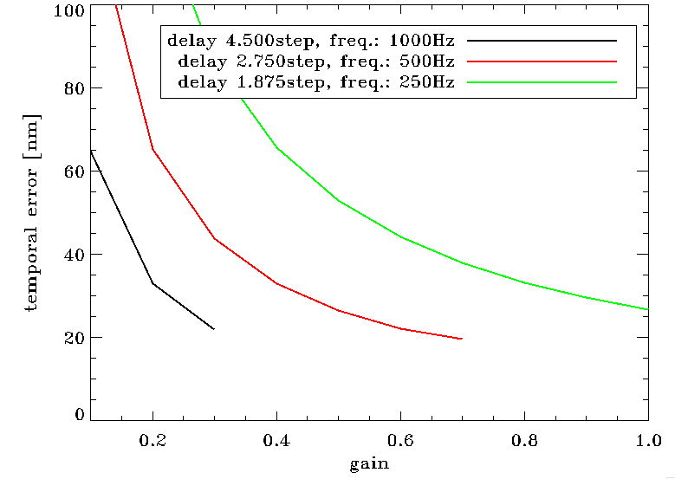
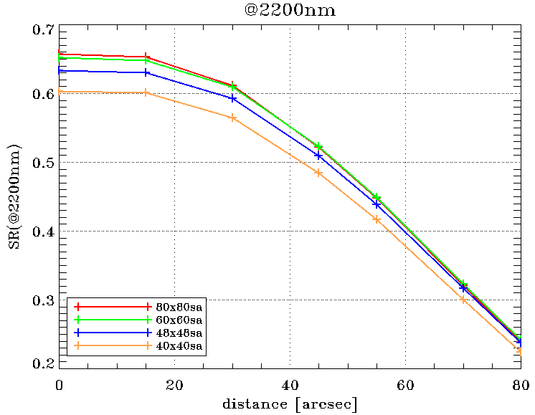
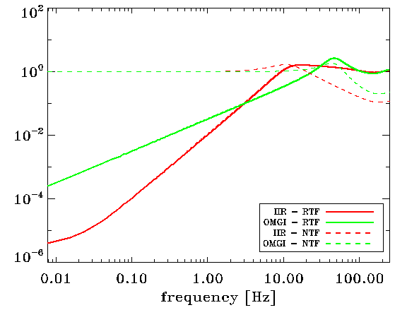
LGS/HO loop
As you will see increasing the number of LGSs gives significative advantage in term of performance, but noise propagation will be affected, so we have studied:
No. of LGS SHS sub-aperture
temporal error
temp. error
On-axis:
0.5% loss with 60x60sa
2.4% loss with 48x48sa
5.5% loss with 40x40sa
more complex temp. control
Lower noise prop. f>20Hz
no. sub-aperture
Better rejection f<3Hz

Slide 14
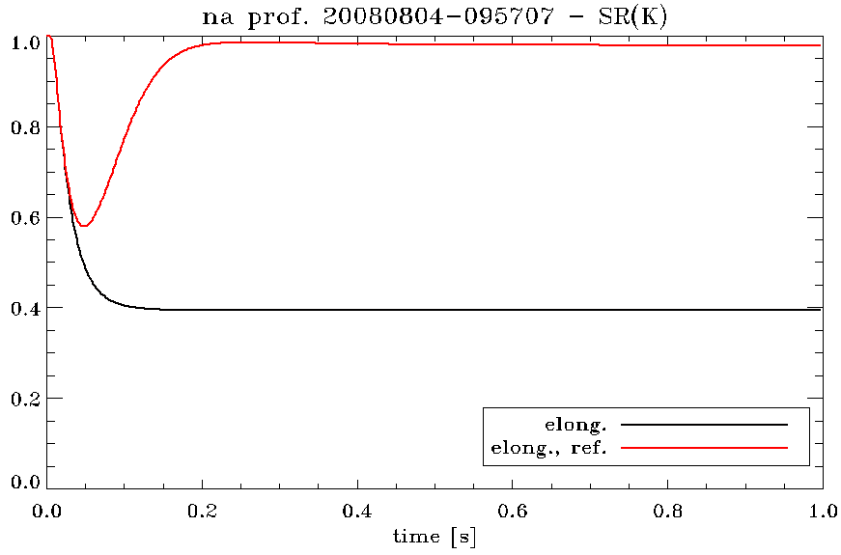
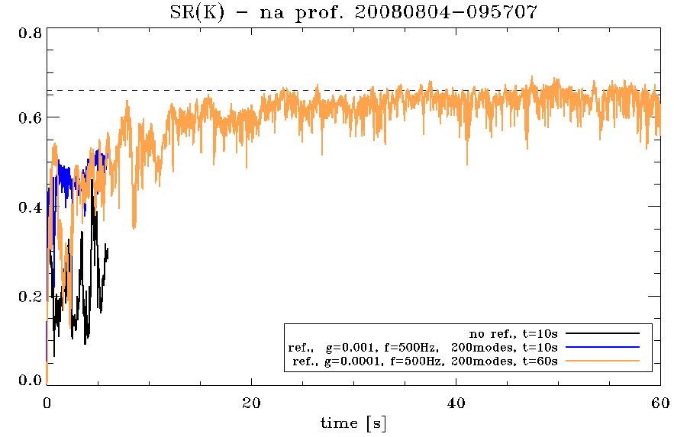
Reference WFSs
We run simulation with sodium elongation to have some bias to be corrected by reference WFSs.
Ref. WFSs bring SR back to ~100%
on-axis SR(K)
Without atmosphere ref. WFSs works really well, but when atmosphere is there, ref. WFSs correct it with higher tomographic error than LGSs.
No atmosphere
with atmosphere
Conclusion:
3 10x10sa Refs with a good asterism:
can correct ~200modes on each DM
zero the truncation effect (res. 50-70nm, depends on asterism).
do not introduce a tomographic error on HO correction if bandwidth is slow enough (~0.01Hz)
Different ref. WFSs bandwidth

Slide 15
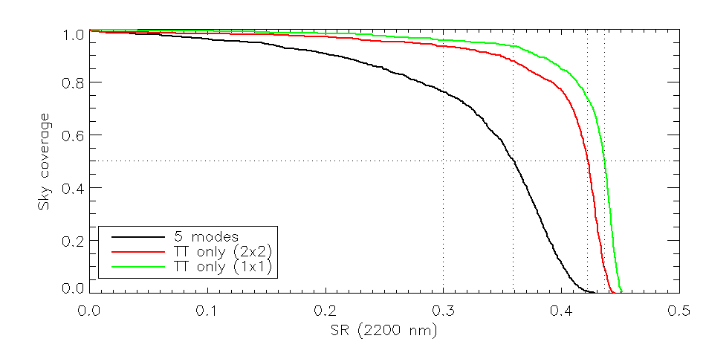
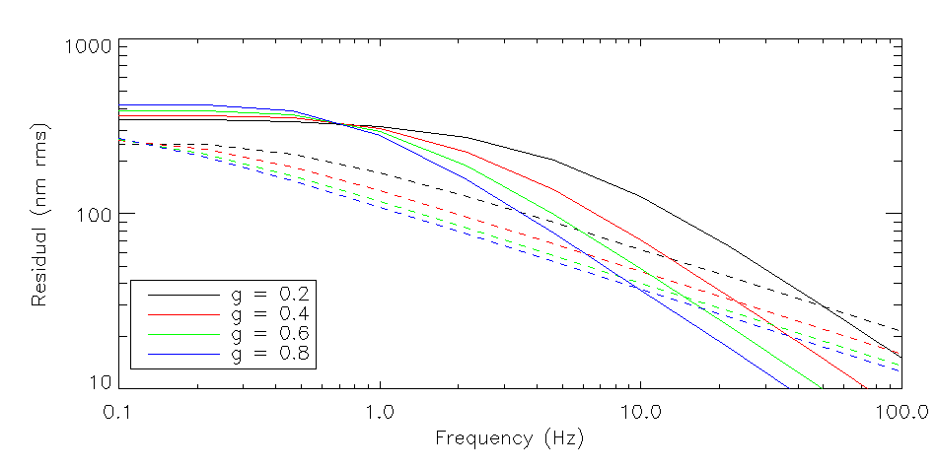
Sodium layer focus correction
Can we use ref. WFSs to correct for tracking sodium layer focus variations and so using a single sub-aperture SH for LO?
LO SHS 1x1 has a small gain with respect to 2x2 (measuring only TT) of ~65nm.
We will be limited by the brightest star to get enough bandwidth (~1Hz) with a 10x10 SHS.
1Hz bandwidth will give a significative correction of turbulence focus, so we will get an isoplanatic error.
Probability of getting a sufficient bright star (R<22) is not 100%.
Sky coverage 1x1 VS 2x2
Focus (turb. and sodium) residual
Turb (foc)
1PFDM
7.7%
Sodium focus
~35nm

Slide 16
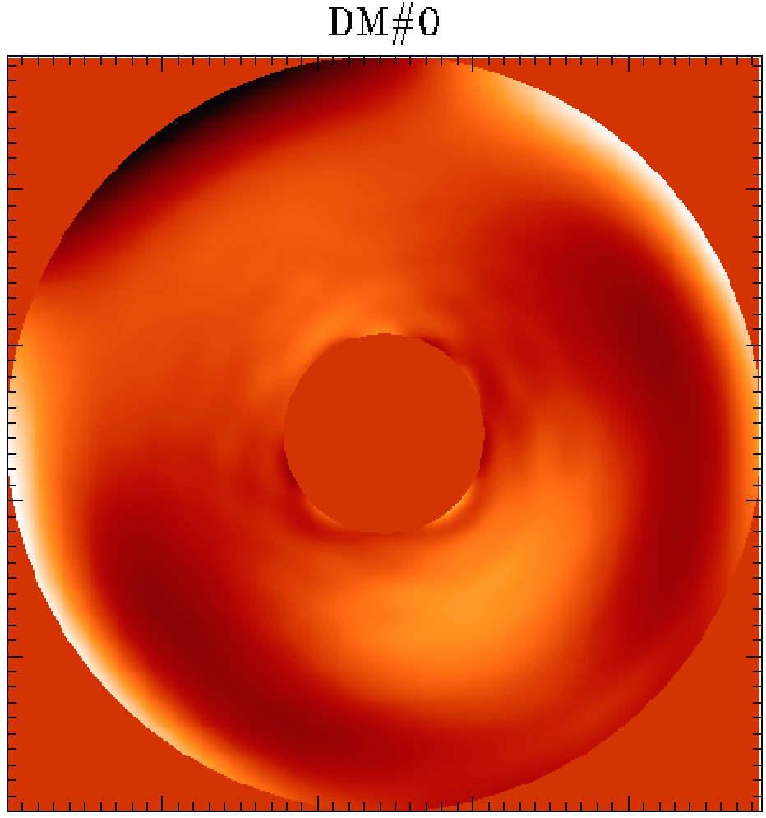
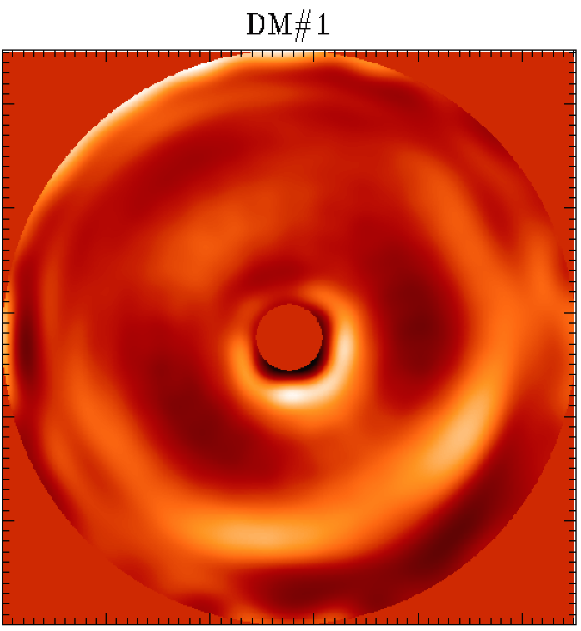
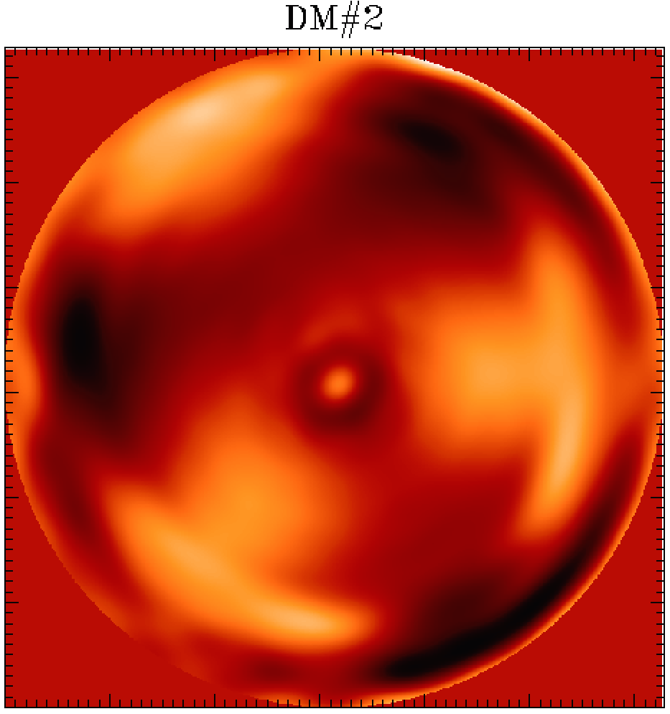
Support to optical design
6 LGS aberrations
(from old objective – MOC)
Impact of LGS objective aberrations:
interface zemax with IDL to get tomographic reconstruction of LGS objective aberrations.
help choosing best optical design.
3
6
5
Effect on DMs
2
1
4

Slide 17
Simulator test
ESO E2E simulations (Octopus/FRIM) are in good agreement

Slide 18
Sky Coverage

Slide 19
Error budget comparison (median spec. profile)
Making MAORY great again!
# LGS | 6 | 6 | 6 | 6 | 6 | 12 | 6+6
# PFDMs | 1 | 1 | 1 | 2 | 2 | 2 | 2
pitch | coarse | coarse | coarse | coarse | fine | fine | fine
# subaps LO | 2 | 2 | 2 | 2 | 2 | 2 | 2
# LO modes | 5 | 5 | 2 | 2 | 2 | 2 | 2
Dual AO | x | x | x | x | x | x | x
Telescope | 145 | 50 | 50 | 50 | 50 | 50 | 50
Residual (nm) | 355 | 328 | 312 | 299 | 293 | 279 | 277
Difference with 1st | 0 | 136 | 170 | 192 | 201 | 220 | 222
Step difference | 0 | 136 | 102 | 90 | 59 | 89 | 31
SR (K) | 0,357 | 0,416 | 0,452 | 0,483 | 0,497 | 0,530 | 0,534
SR (J) | 0,041 | 0,066 | 0,086 | 0,105 | 0,115 | 0,140 | 0,143
Parameters
50% sky cov. performance
We “reduce” the 145nm error from the telescope to 50nm following HARMONI computation on ELT data package (wind shake, M1 phasing, …). Now we are making the same computation to verify this assumption.
We list the main steps which improve the performance from one year ago baseline configuration, SR(K)36%, to the best one we could have, SR(K)=53%.

Slide 20
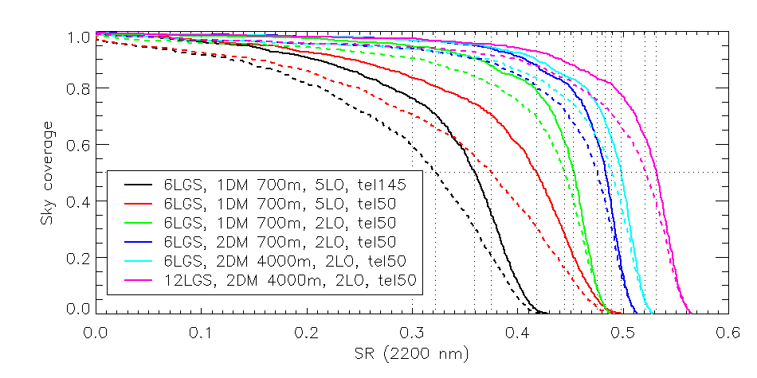
Median SPEC profile
Technical FoV
Solid = 180’’
Dashed = 160’’
All SR(K)>30% for 50% sky.
We selected:
LO measures only TT (2LO in legend) → significative performance improvement
Technical FoV 160” → better for optical design

Slide 21
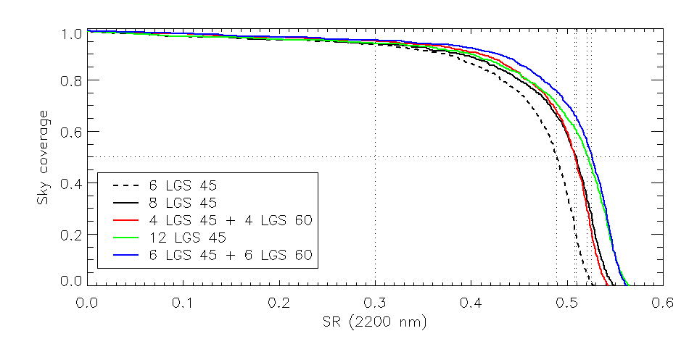
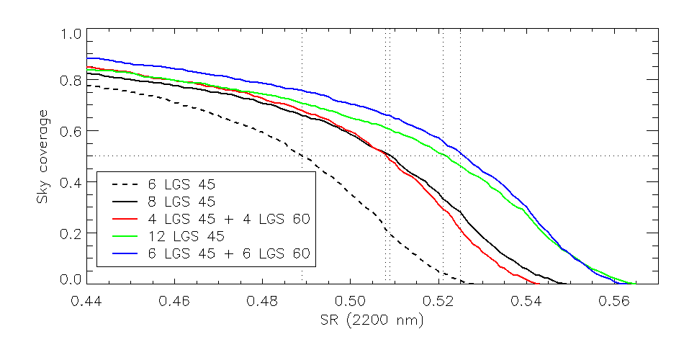
LGS asterism 1 VS 2 rings
2 rings option gives better performance, but having LGS at r=60” is a real challenge for optical design

Slide 22
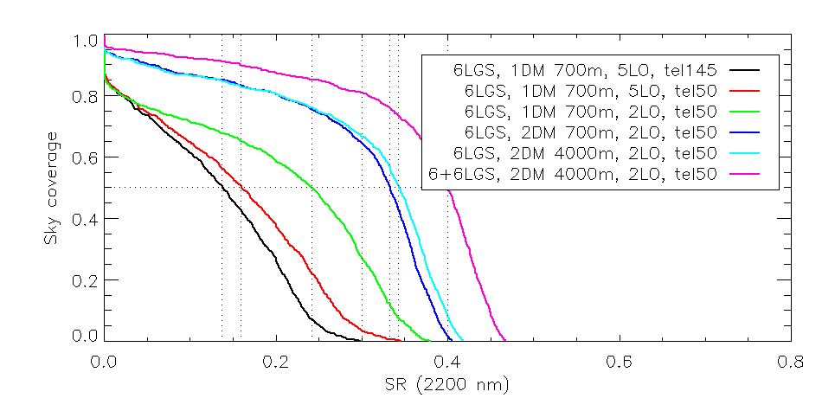
Stereo-SCIDAR P=50% profile
Technical Fov = 160’’
6+6 means:
6 at r=45” and 6 at r=60”
Single post focal DM case is below SR(K)=30% at 50% sky.
2 rings options gives better results, but LGS at r=60” is challenging for optical design.

Slide 23
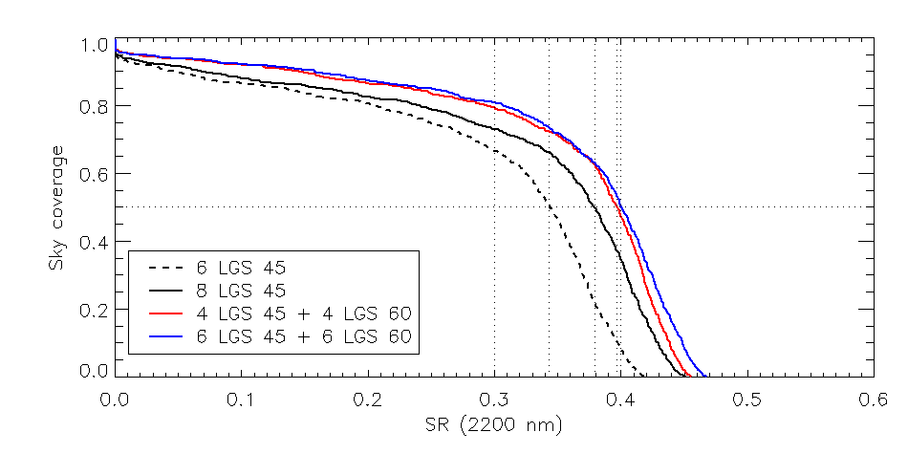
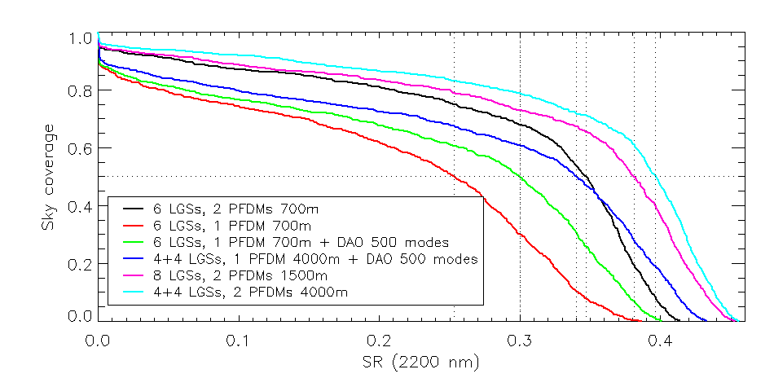
Other LGS asterism and dual AO
4+4LGSs gives the same performance as 6+6
Optimization shown in previous slides benefits more the 2 post focal DMs case :
Dual AO improves significatively performance, but not at the level of 2 post focal DMs case.

Slide 24
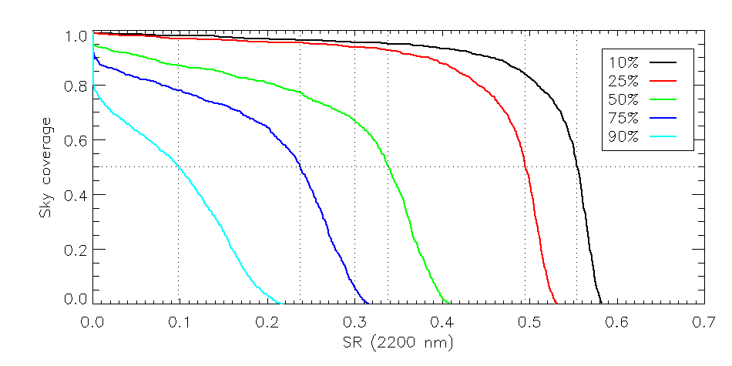
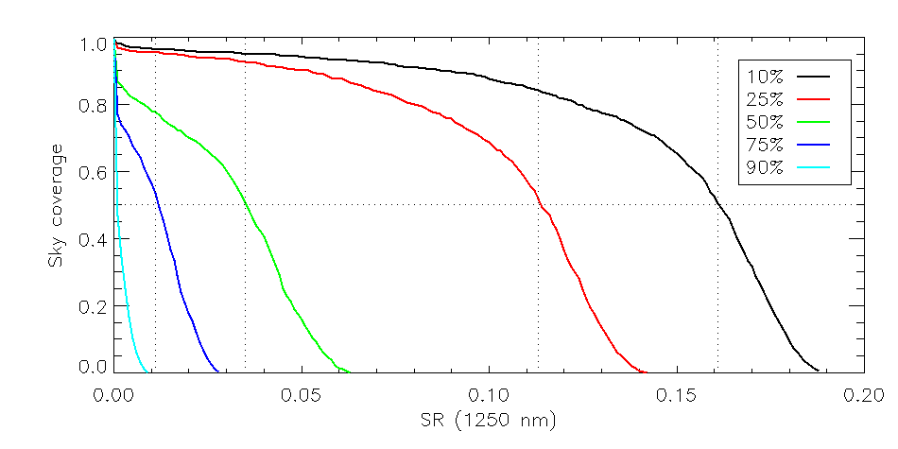
2 PFDMs coarse 6 LGS
K band
Sky coverage computed with the new stereo SCIDAR profiles gives a good way to visualize expected MAORY performance
J band

Slide 25
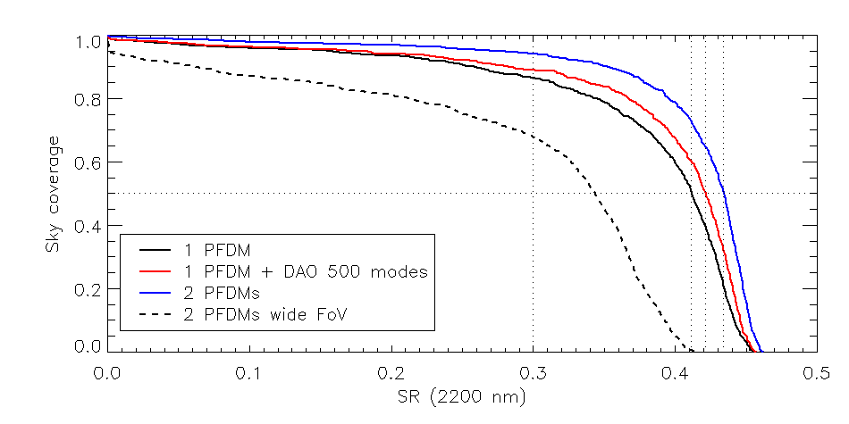
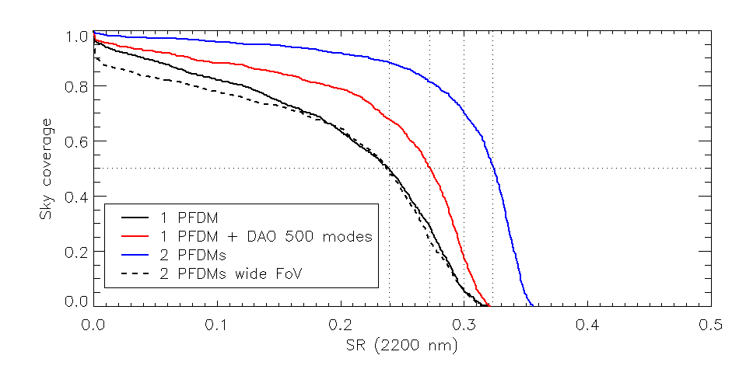
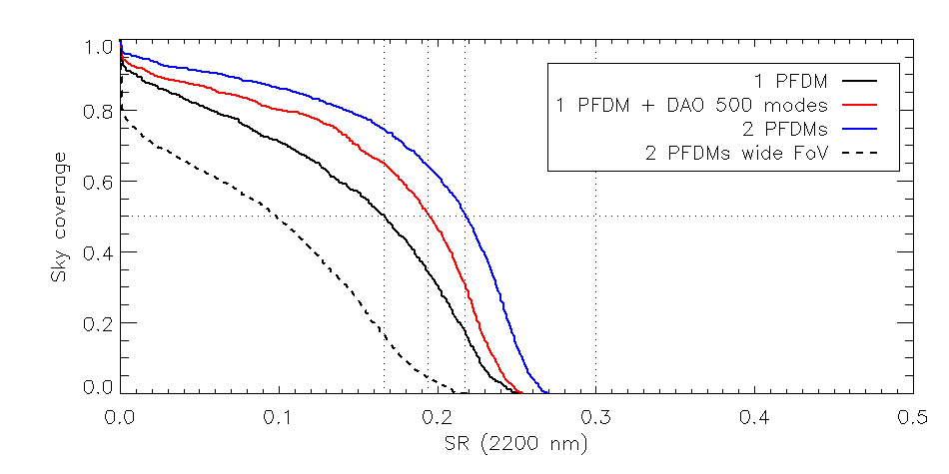
Small scientific FoV (20x20’’)
P=50%
P=75%
Sky coverage with small Sc. FoV is much higher and could compete with HARMONI one.
P=90%

