Slide 1
MAORY AO description
Work Package END TO END SIMULATION team
Presented by W.P. manager Guido Agapito

Slide 2
How will MAORY AO work?
Telescope collimates (Active optics correction, phasing, …).
Telescope turns on LGS on and points them where MAORY needs them.
LGS light on MAORY WFSs.
Telescope gives control to MAORY.
MAORY starts collimating optical relay and corrects HO turbulence – no TT correction, no plate scale correction, no truth correction.
MAORY acquires LO and starts correcting TT, plate scale and truth.

Slide 3
How will MAORY AO work?
Telescope collimates (Active optics correction, phasing, …).
Telescope turns on LGS on and points them where MAORY needs them.
LGS light on MAORY WFSs.
Telescope gives control to MAORY.
MAORY starts collimating optical relay and corrects HO turbulence – no TT correction, no plate scale correction, no truth correction.
MAORY acquires LO and starts correcting TT, plate scale and truth.

Slide 4
MAORY AO
MAORY corrector is M (=3) DMs, M4 at 600m and 2 post focal DMs at 8 and 16km.
DMs
Science FoV
Technical FoV
Telescope pupil

Slide 5
MAORY AO
Science FoV
DMs
Technical FoV
Edge of DMs is not used for Science FoV correction.
Telescope pupil

Slide 6
MAORY AO
We want to optimize correction on a FOV of interest (science FoV) while sensing a large FOV (technical FoV).
Reconstruction is done on the full sensed atmospheric volume discretized in N layers (N>M) and n modes for each layer.
Then this reconstruction is projected on DMs maximizing performance on the FoV of interest.
DMs
layers
Telescope pupil

Slide 7
MAORY AO
LGS:
slopes (6 stars, 80x80 SHSs): 54k elements
Reconstruction matrix: 54k × 28k elements
Projection matrix: 28k × 6k elements
DMs
layers
Telescope pupil

Slide 8
MAORY AO
LGS spot
DMs
layers
LGS launcher
telescope
Telescope pupil

Slide 9
MAORY AO
LGS spot
LGS spot
Multiple LGSs, like human binocular vision, gives the ability to perceive a three-dimensional image (phase).
DMs
layers
tech. FoV
X”
LGS launcher
telescope
Telescope pupil

Slide 10
MAORY AO
LGS spot
LGS spot
Technical FoV is partially uncontrolled:
DMs and layers edge is not sensed by LGS.
DMs
layers
LGS launcher
telescope
Telescope pupil

Slide 11
MAORY AO – LGS/HO
MAORY uses “multi direction vision” given by LGSs to measure aberration (no TT) and reconstruct it on a discretized volume:
N (=7) planes, called layer or reconstructed layers.
n (=4000) shapes, called modes, for each plane/layer.
MAORY projects the reconstructed aberration from the discretized 3D volume to M (=3) planes collocated on the DMs (M4 and the post focal ones).
The projection is optimized to maximize performance on science FoV without affecting too much PSF quality technical FoV (correction on NGSs is required to get good SNR).
MAORY RTC integrates the actual shape with each new aberration residual measurement.
Integration is done at the level of DMs modes.

Slide 12
How will MAORY AO work?
Telescope collimates (Active optics correction, phasing, …).
Telescope turns on LGS on and points them where MAORY needs them.
LGS light on MAORY WFSs.
Telescope gives control to MAORY.
MAORY starts collimating optical relay and corrects HO turbulence – no TT correction, no plate scale correction, no truth correction.
MAORY acquires LO and starts correcting TT, plate scale and truth.

Slide 13
MAORY AO
NGSs are used by:
LO WFSs:
Correct Tip-Tilt.
Correct plate scale errors (quadratic ones).
Reference WFSs:
Truth sensing (NCPA, sodium related aberrations).
DMs
layers
Telescope pupil

Slide 14
MAORY AO
Multiple NGSs, like LGSs, gives the ability to perceive a three-dimensional image (phase), but their position (asterism) depends on their availability…
DMs
layers
tech. FoV
X”
Telescope pupil

Slide 15
MAORY AO
LO:
slopes: 24 elements
Reconstruction matrix: 24 × 5 elements
Reference:
slopes: 450 elements
Reconstruction matrix: 450 × 1400 elements
Projection matrix: 1400 × 600 elements
DMs
layers
Telescope pupil

Slide 16
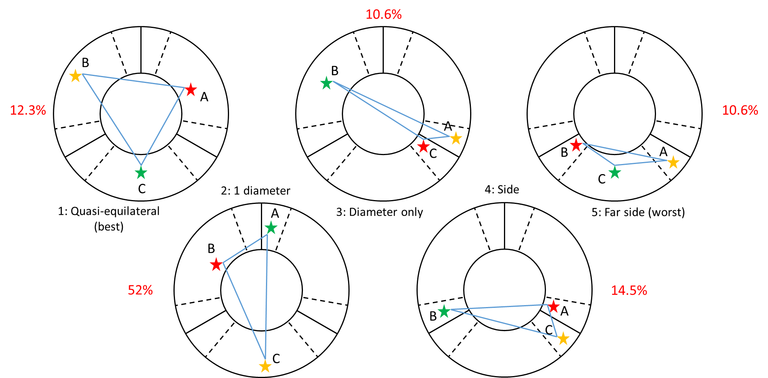
MAORY AO
… and pick-up geometry
DMs
layers
Telescope pupil

Slide 17
MAORY AO
DMs
layers
NGSs are always outside science FoV and so they pass through the edge of the layers/DMs…
Telescope pupil

Slide 18
MAORY AO
DMs
layers
… and even through the volume not sensed by LGS
Telescope pupil

Slide 19
MAORY AO – NGS/LO-reference
LO control can be done with a direct reconstruction of TT and plate scale (quadratic term) on DMs without passing through layers.
Reference has same reconstruction and projection scheme of HO/LGS.
LO control is almost* independent from HO/LGS one (*LO SNR depends on PSF quality, PSF quality depends on HO correction).
Reference gives zero point for HO/LGS.

