Slide 1
SOXS
On behalf of Riccardo Claudi e Federico Biondi
INAF-OAPD-days
Padova, 17-18 Giugno 2019
Notes:
coinvolto ma supplisco Biondi e Claudi

Slide 2
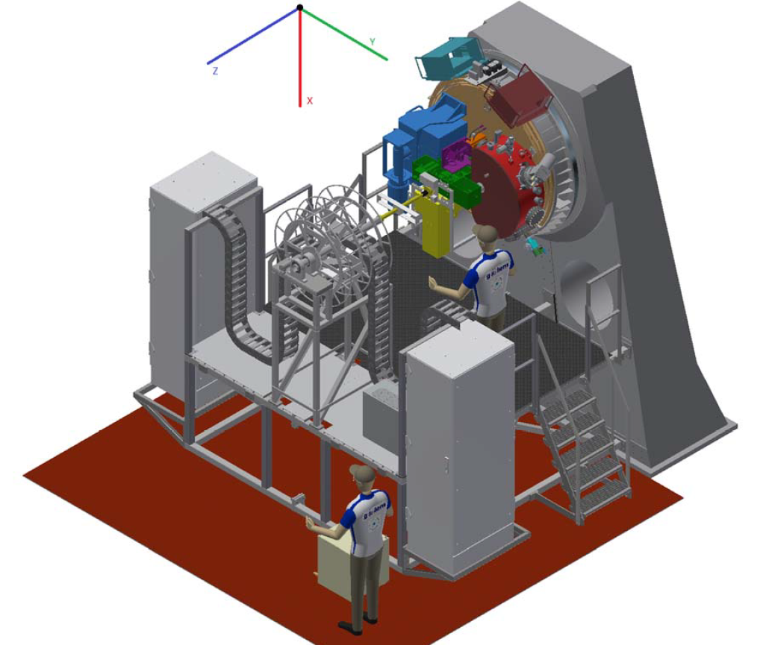
Son Of X-Shooter
Double Spectrograph
for follow up of Transient Sources
… but despite the name, there are a lot of differences!
i.e.
- @Nasmyth (not Cassegrain)
- 2 channels (not 3)
- New smart design for UVVIS arm
Notes:
nuova piattaforma

Slide 3
-- Destination:
Nasmyth platform of 3.5m NTT@ESO La Silla
-- Timeline:
2014 → ESO call for ideas at the NTT
2015 → SOXS selected among 19 proposals
2017 → PDR passed
2018 → FDR passed + 1st National SOXS Meeting
2019-20 → Procurement & AIT Phase in Europe
2020-21 → AIT and Commissioning in Chile

Slide 4
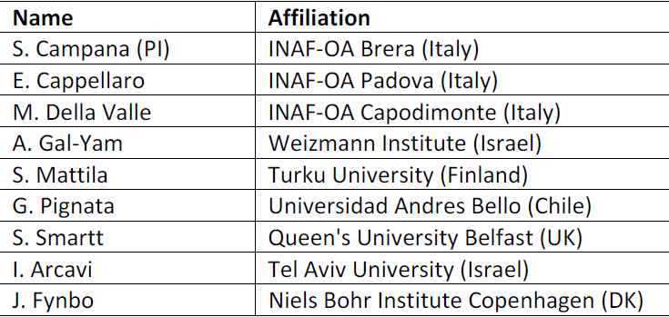
CONSORTIUM
INAF
Milano → PI-ship + Mechanics + Instrument Scientist
Napoli → PM + Electronics
Padova → SE + Common path + AIT + SW
Catania → Optical Design + CryVacuum System
Roma → NIR Spectrograph + NIR Detector
TNG → UV-VIS Detector
Weizmann Institute
→ UV-VIS Spectrograph
Universidad Andres Bello + Millennium Institute
→ Acquisition Camera
University of Turku
Calibration Unit
Science Board
Queen’s University Belfast
Pipeline

Slide 5
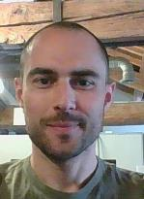
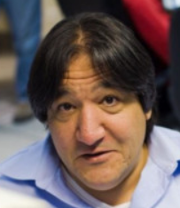
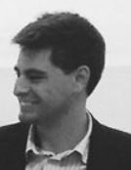
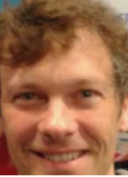
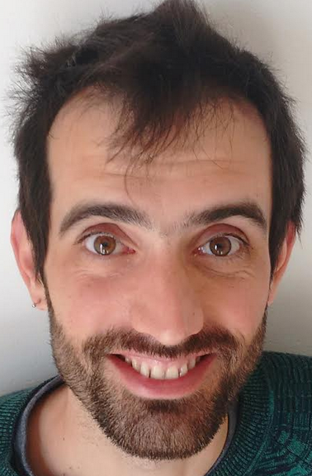
Science
PADOVA TEAM
Enrico Cappellaro
Massimo Turatto
System
Software
Andrea
Baruffolo
Control SW Manager
Davide
Ricci
Riccardo Claudi
System engineer
Federico Biondi
AIT Manager
Bernardo Salasnich
Marco De Pascale

Slide 6
SCIENCE CASE
Golden Age of time-domain astronomy:
--- deep ground-based optical surveys (PanSTARRS, Dark Energy Survey, SkyMapper, Zwicky Transient Factory, Large Synoptic Survey Telescope, etc.)
--- space-based optical surveys (Gaia and Euclid)
--- high-energy instruments (Swift, Fermi, INTEGRAL, MAXI and SVOM, CTA)
--- radio surveys (LOFAR, MeerKAT, SKA)
--- Gravitational Wave (GW) experiments (A-VIRGO, A-LIGO)
--- neutrino experiments (KM3Net, ICECUBE, ANTARES)
all calling for a rapid follow-up and characterization (and distance determination) of the detected transients.
40% of astronomical papers on Nature (2005-2014) → transient objects/events.
NOTE: Transients discovered by current surveys have limiting magnitudes R~20, that are well suited to be followed-up by a 4 m-class telescope.

Slide 7
BOTTLENECK: spectroscopic classification and follow-up
Current ESO answer is PESSTO/ePESSTO @NTT (90n/yr):
initially focused on SN, now open to more science cases
service classification activity
64 papers in 5 years and ~600 ATel (2018)
EFOSC2 + SOFI (aged & inefficient)
Forthcoming ESO answer is SOXS@NTT:
a facility fully devoted to transient science
Opt+NIR, hence replace EFOSC2 + SOFI

Slide 8
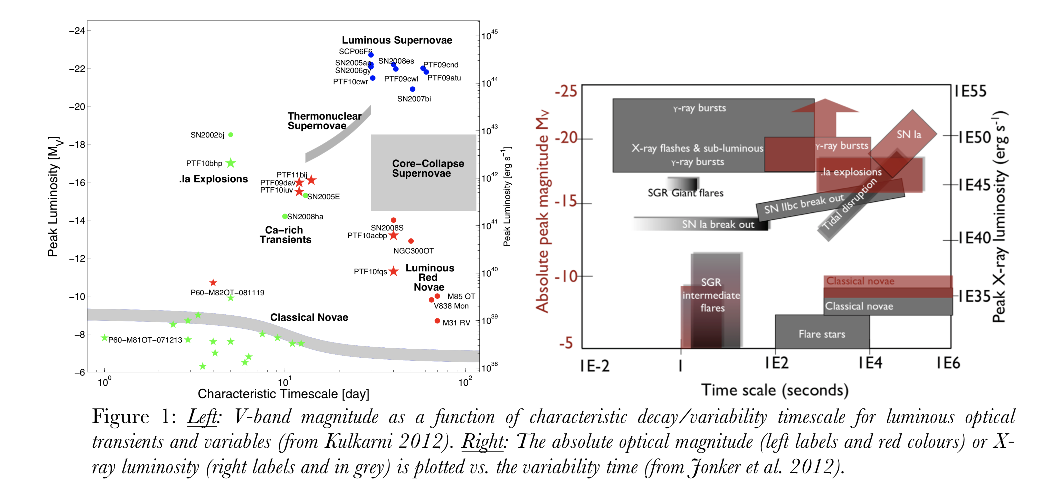
SOXS SCIENCE CASES:
Classification (service)
SNe (all flavours)
GW & 𝝼 counterparts
TDE & Nuclear transients
GRB & FRB
X-ray binaries & novae, magnetars
Moving minor bodies in the solar system (Asteroids, Comets, …)
Young Stellar Objects & stars
Blazars & AGN
Unknown

Slide 9
OPERATIONS (TBFD)
ESO will reward the SOXS consortium with observing time: ~180n/yr (rest for ESO)
SOXS consortium responsible for the operations. Flexible schedule on a day-by-day basis (one day in advance) (SOXS+ESO targets).
SOXS team (3 people) on weekly rounds to cope with observations (schedule, classification, etc.) and on call for reaction to GW (GRBs, etc.) with fast (<1hr) ToO and problems.
ESO-TNO to carry out observations.
<5% of the consortium time open to the community as ToO (Swift-like) observations (public data).
Relevant information (classification, peculiar sources, etc.) announced in real time through GCN, ATel, IAUC, etc.
Consortium data public after a short (6-12 m - TBD) proprietary period.
Notes:
To be fully defined

Slide 10
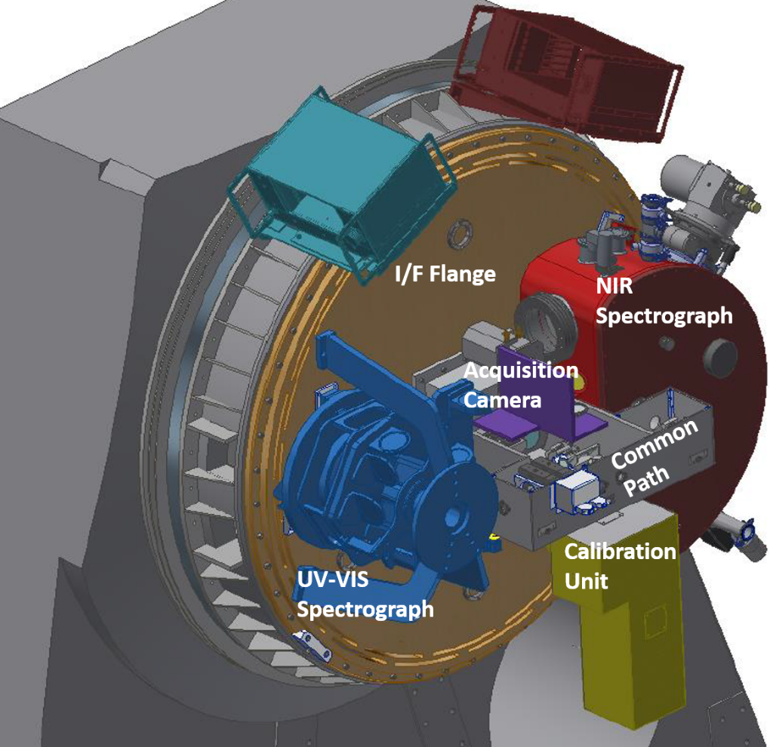
TECHNICAL ASPECTS
UV-VIS Spectrograph
λ = 350 – 850 nm
R = 4500
4 polychromatic beams produced by ion-etched gratings
NIR Spectrograph
λ = 800 – 2000 nm
R = 5000
4C concept based cross dispersed echelle
Calibration Unit
Pinhole mode for star simulation
Acquisition Camera
Monitor targets / Monitor Spectrographs alignment / VIS Photometry
+ pinhole mode for alignment purposes
Total Mass ca 800 kg
Bearing diameter ca 1600 mm
Notes:
UV-opt no echelle ma “quasi-order”, range spettrali
4C concept spiegato dopo
Sovrapposizione dovuta a dicroico per calibrazione 2 rami (stesso per quasi-orders”)

Slide 11
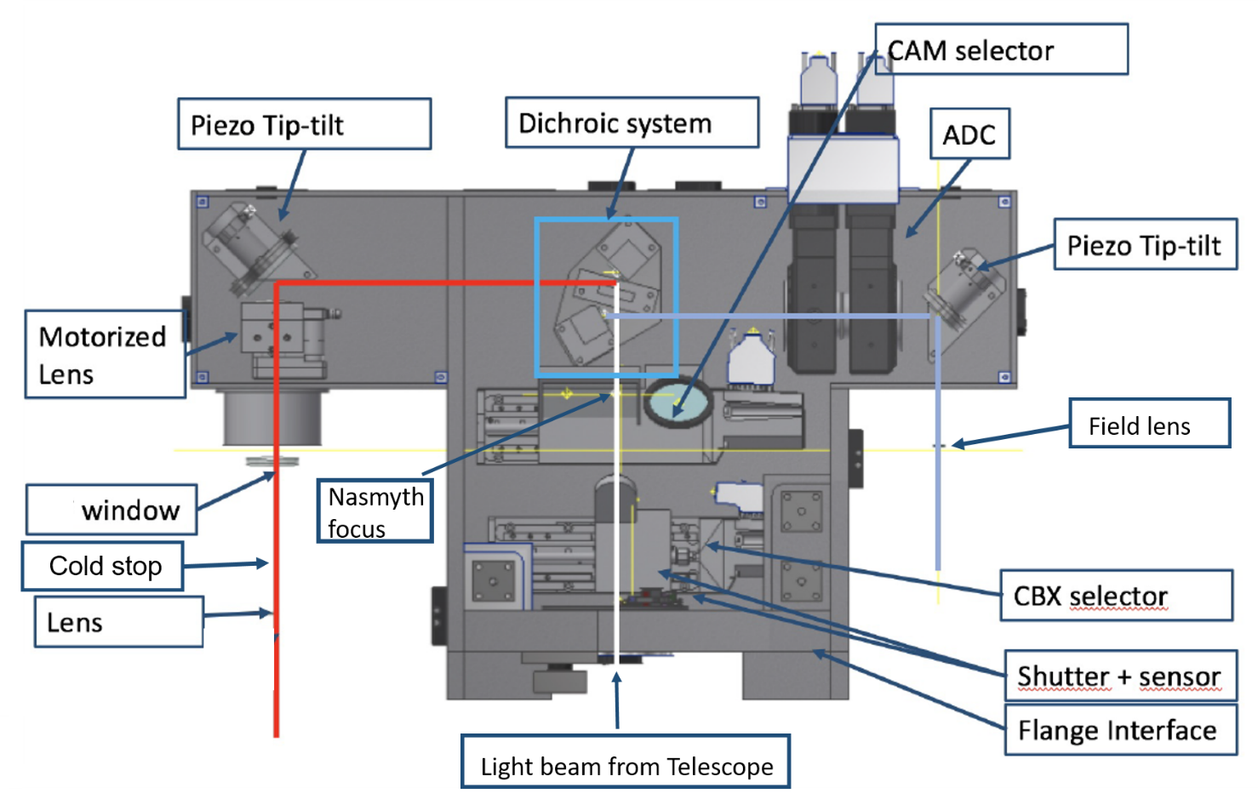
COMMON PATH@ OAPD
Common Path AIT
Backbone of the instrument
The dichroic feeds the 2 arms
Takes input from CU
Gives input to AC, UVVIS, NIR
Piezo Tip/tilt Folding Mirrors for flexures compensation
Atmospheric Dispersion Corrector
Notes:
INTEGRATO DAPPRIMA DA SOLO A PD

Slide 12
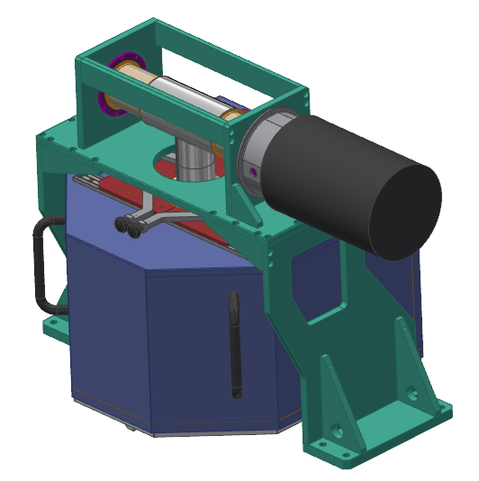
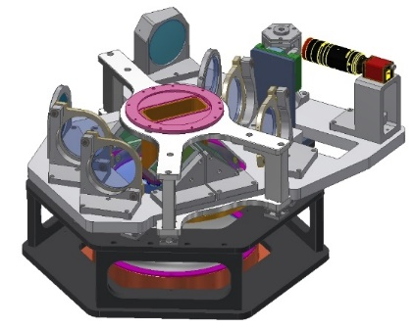
UV-VIS Arm
Cryostat
Next slide
Feeding “floor”
Camera “floor”
Notes:
SU 2 PIANI

Slide 13
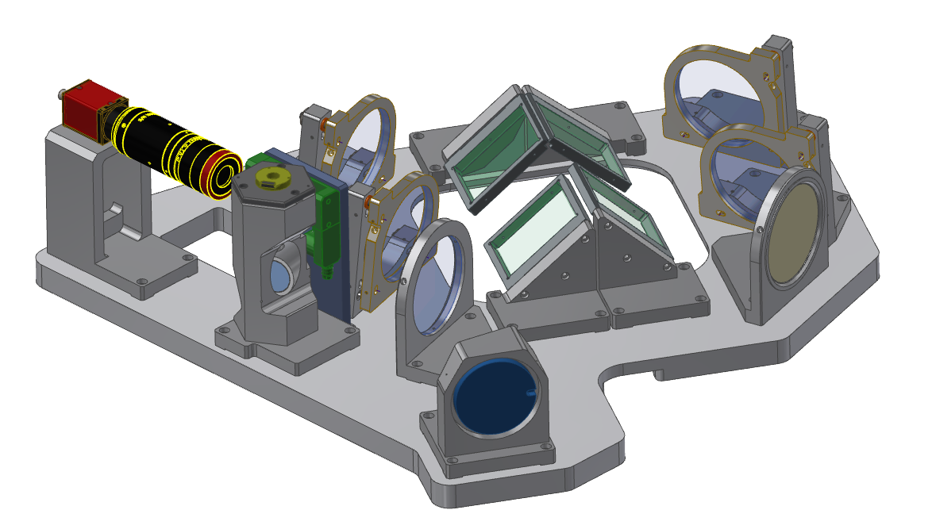
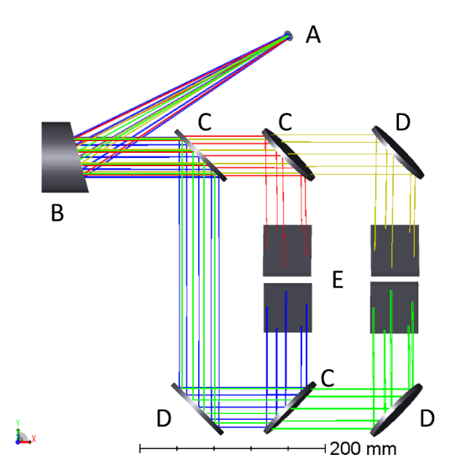
UV-VIS Arm
Feeding “upper floor”
Dichroics
Gratings
Slit
Off Axis Parabola
Notes:
DETERCTOR SU PIANO INFERIORE

Slide 14
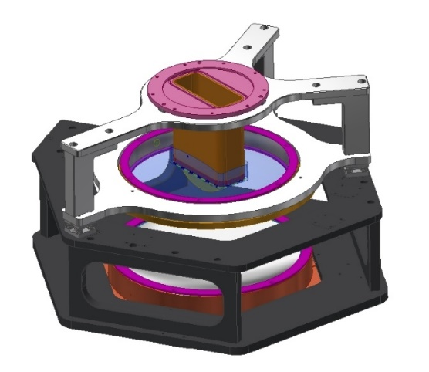
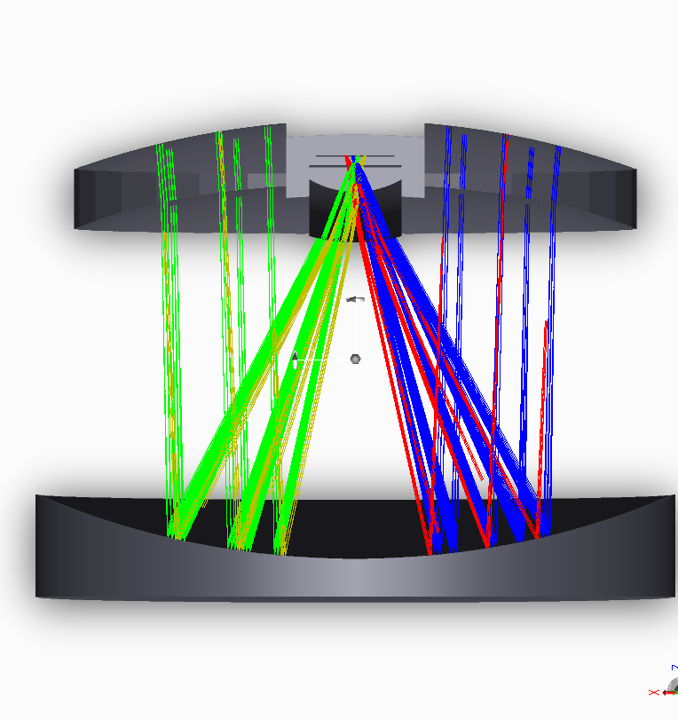
UV-VIS Arm
Camera “lower floor”
E2v CCD44‐82 2K x 4K CCD
Detector
Field Flattener
CaF2 Corrector
Aspheric Mirror
Notes:
ATTESI 4 SPETTRI ORIZZONTALI
SLIT LENGTH 12 ARCSEC IN OPT & NIR

Slide 15
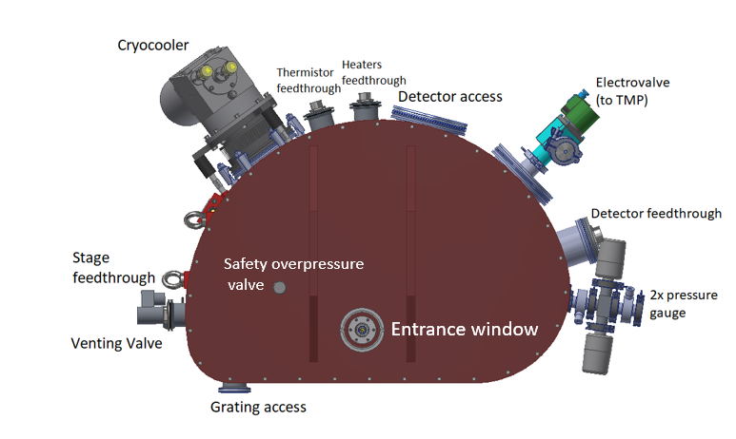
NIR Arm
Notes:
TUTTO raffreddato a 150K
Detector a 40 K

Slide 16
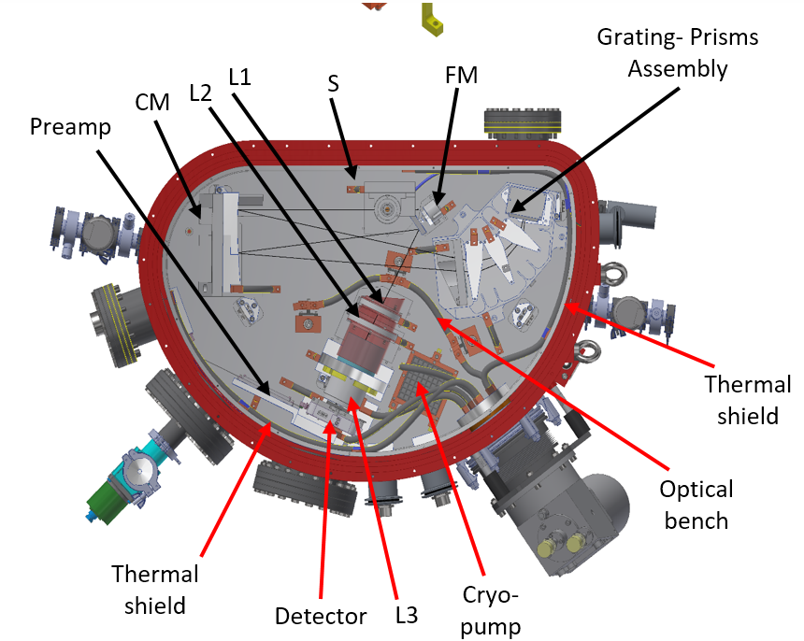
NIR Arm
Teledyne
HAWAII 2RG
HgCdTe array
Notes:
Speculare a slide precedente
S slit
CM collimatore
Prismi
Grating
Prismi
CM
FM folding mirror
camera

Slide 17
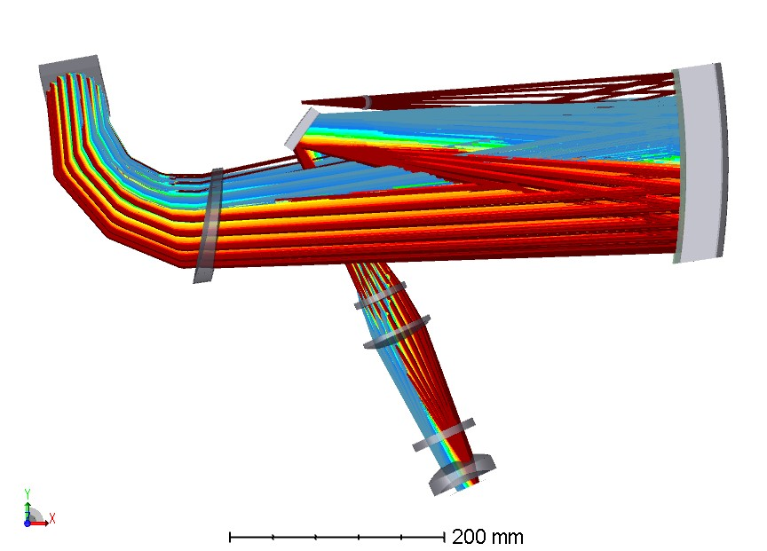
NIR Arm
4C design (collimator compensated
camera chromatism) + «COTS» grating
Maksutov off-axis all spherical - collimator
Slit
Disperser (prisms)
One aspheric optic in the camera

Slide 18
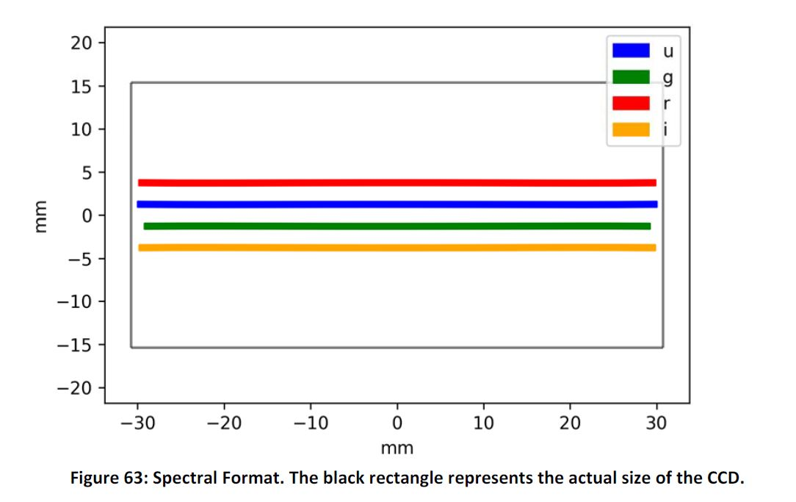
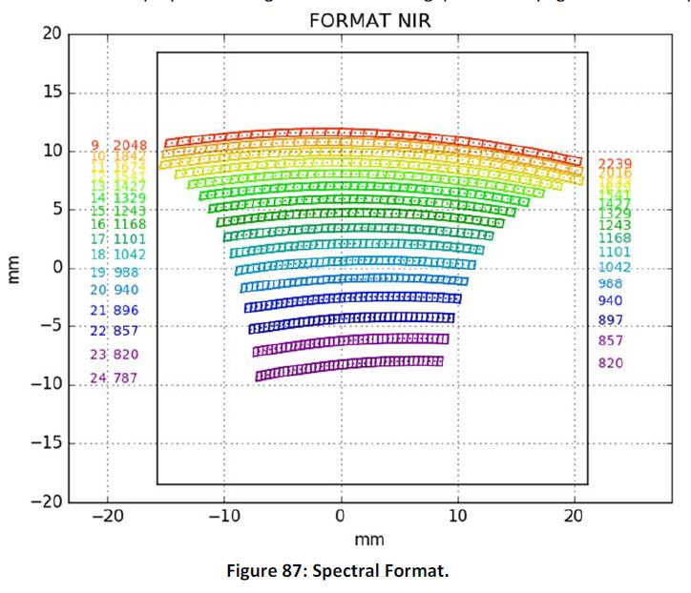
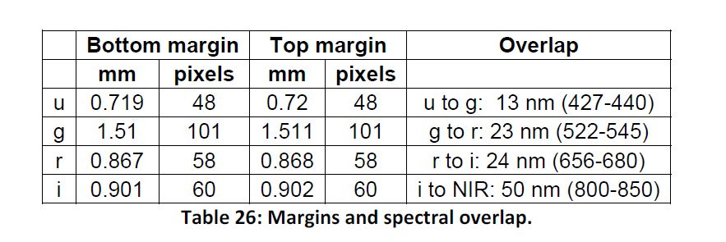

Slide 19
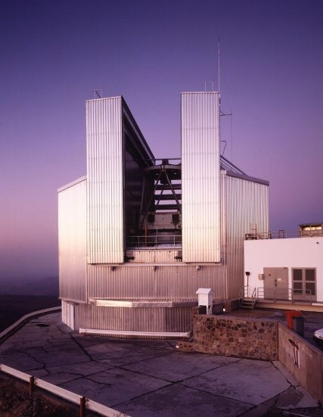
AIT@system level is conduced twice
@ INAF – OAPD laboratories (Padova, Italy)
Full size test
Tuning of the procedures
Define mutual position among sub-systems
Define mutual position between sub-system and telescope
PAE
@ NTT La Silla Chile
Notes:
A partire da 2020 => 2021 PAC

Slide 20
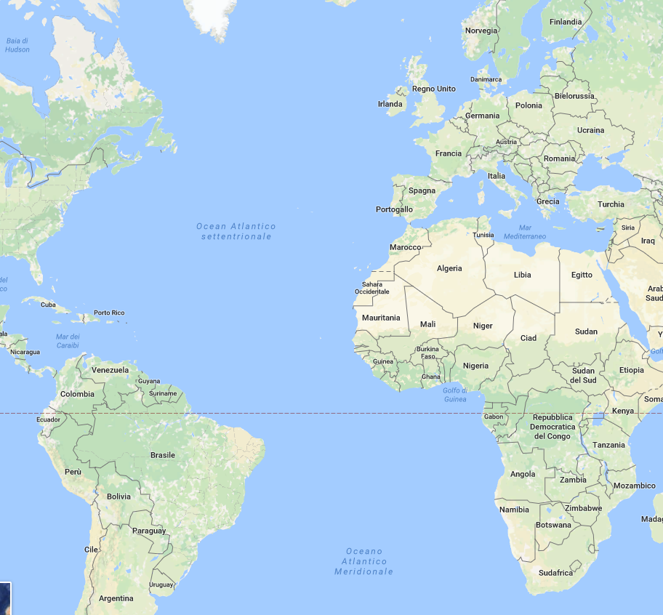
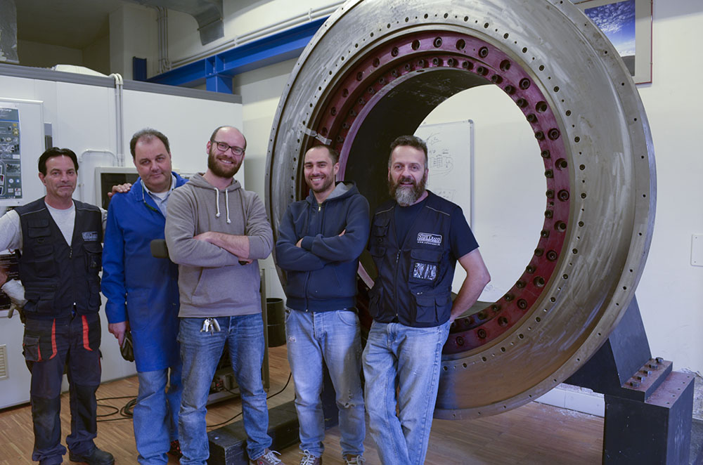
All aligned sub-systems will be shipped to INAF-OAPD
Integration on NTT Nasmyth Mech Simulator
(arrived 1 month ago from ESO and installed in the “Laboratorio Carro Ponte”)
Notes:
Fantin Trasporti e servizi tecnologici (di strumentazione)

