Slide 1
Interacting white dwarf binaries
Massive Be+WD binaries: with Ciroi, Cracco, the SALT telescope

Slide 2
Our research on interacting white dwarf binaries
Relatively common systems (up to 10% of the vast majority of all binary stars)
Crucial to understand the nature of SNe Ia progenitors
Possible: even formation of neutron star (AIC, merging)
May interact when the secondary is on the mains sequence or shortly thereafter (short period systems, up to ~2 days P_{orb}) or when it becomes a red giant (P_{orb}~years)
Novae: a very luminous outbursts (>8 mag optically) triggered by shell CNO burning – natutal laboratories of all sorts of important astrophysical phenomena
Not all burning sources become novae… (and not all eject accreted material)

Slide 3
Observational tools
New, interesting and ripe with problems to solve: high resolution X-ray spectroscopy (currently gratings Chandra, XMM, future X-ray IFU spectrocalorimeter – XRISM, Athena)
X-ray broad band spectroscopy and timing
UV and optical imaging
Time series: X-rays, optical
Optical spectroscopy (lately especially with the SALT telescope)

Slide 4
Observational tools
The (probably) most interesting and most difficult: high resolution X-ray spectroscopy (currently gratings Chandra, XMM, future X-ray IFU spectrocalorimeter – XRISM, Athena)
X-ray broad band spectroscopy (and timing)
UV and optical imaging
Time series: X-rays, optical
Optical spectroscopy (lately especially with the SALT telescope)

Slide 5
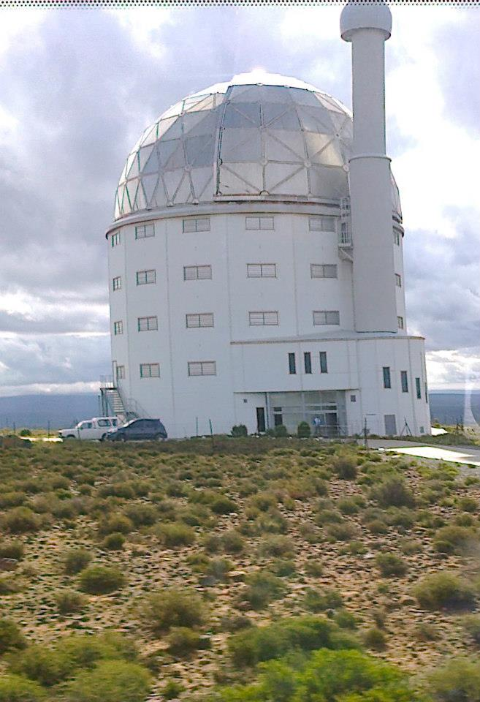
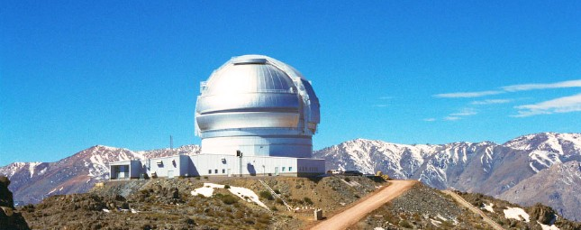
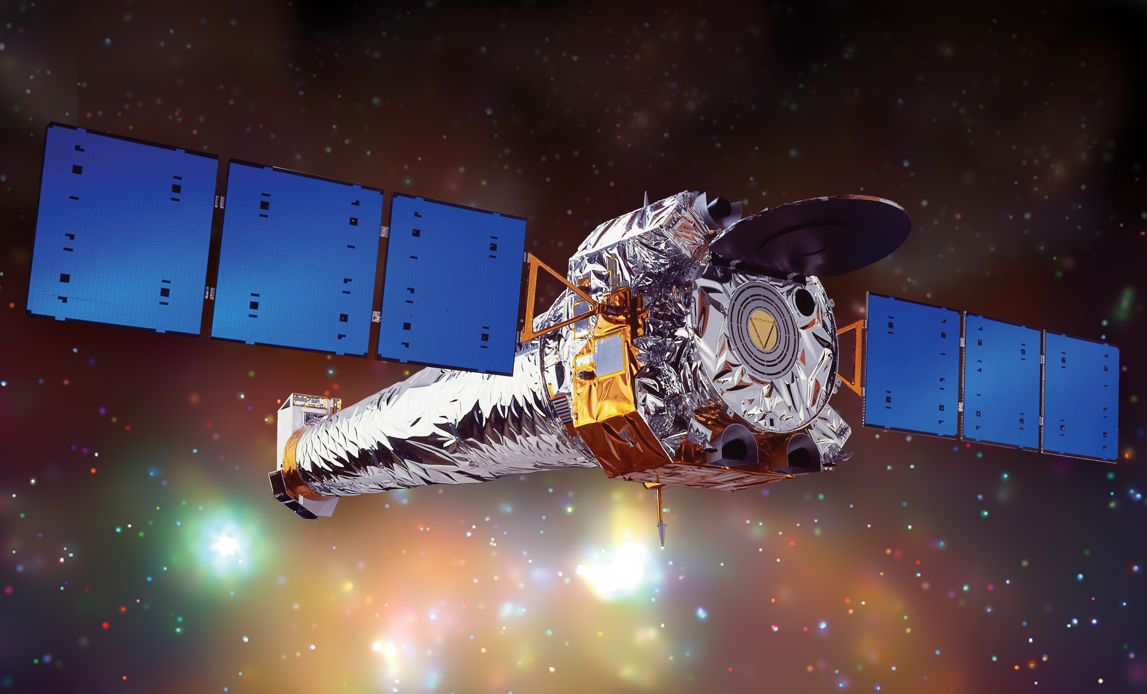
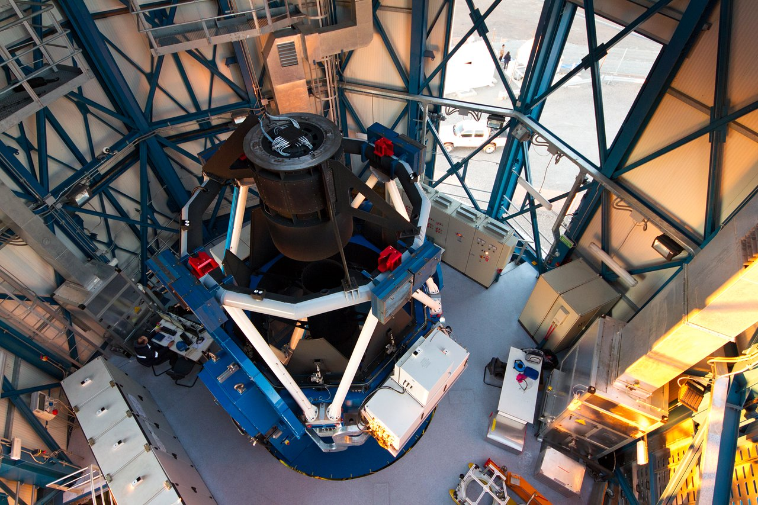
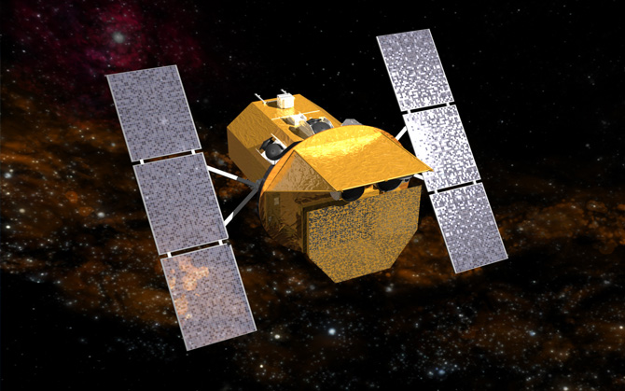
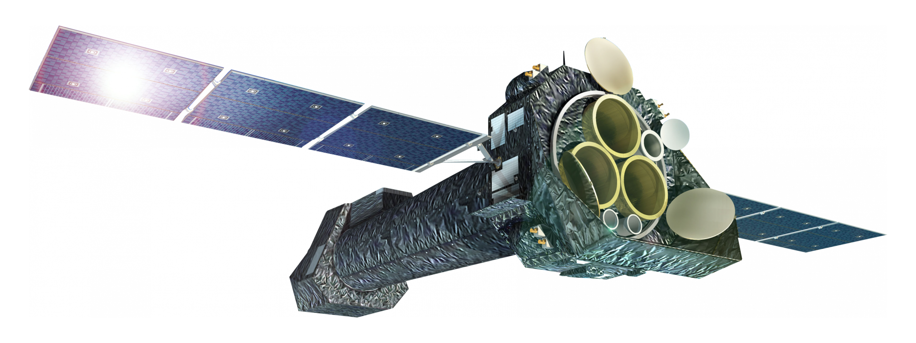

Slide 6
Massive white dwarf binaries
Many high mass X-ray binaries known, but they contain neutron stars (about 100 in the SMC)
Two likely black hole interacting binaries also known
Where are all the white dwarf massive binaries?
Expected for all systems with both components with m< 8 M or as product of very interactive binary evolution (the primary was the secondary)
Large number predicted by population synthesis
What role as progenitors of type Ia SNe?

Slide 7
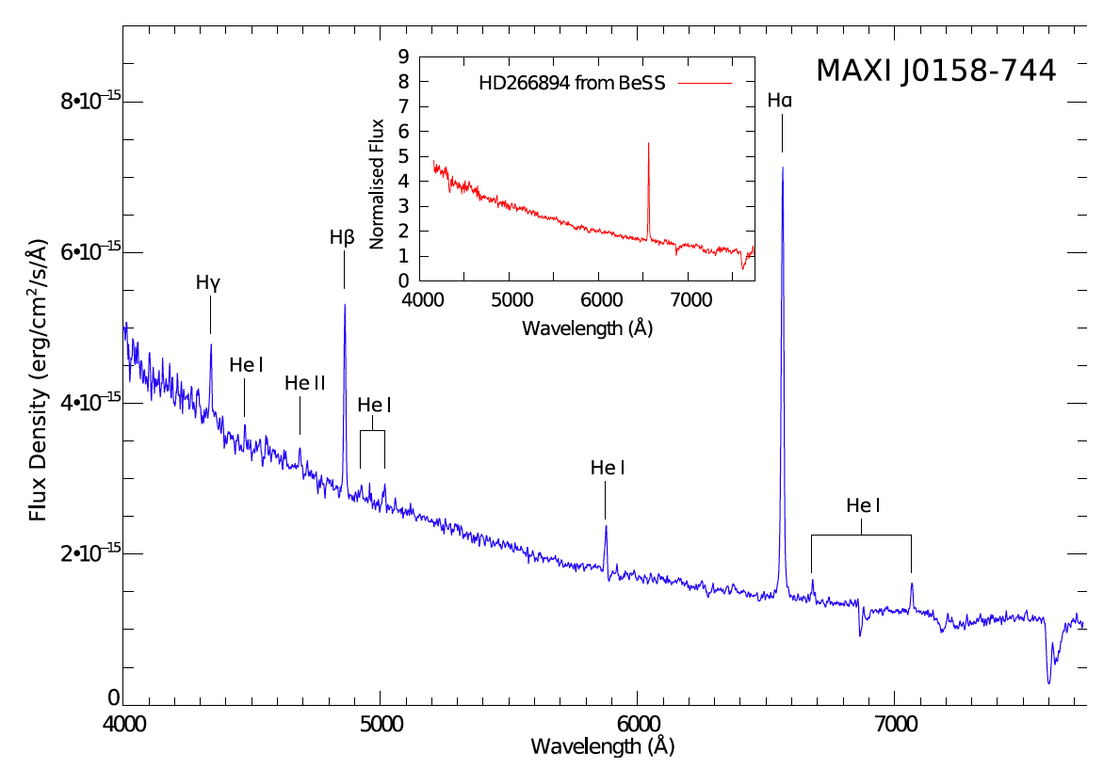
5 supersoft X-ray binaries with Be stars (LMC, SMC)
Hydrogen burning in an accreted shell produces a very luminous source (near Eddington, 10³⁶⁻³⁸ erg/s) in the soft X-rays close to EUV
T_{eff} 10⁵-10⁶ K
Supersoft X-ray sources observed in low extinction directions
A handful in the MC, transient or recurrent, associated with Be stars: tip of the iceberg?
Cracco et al. (2018, ApJ)
Li et al. 2012

Slide 8
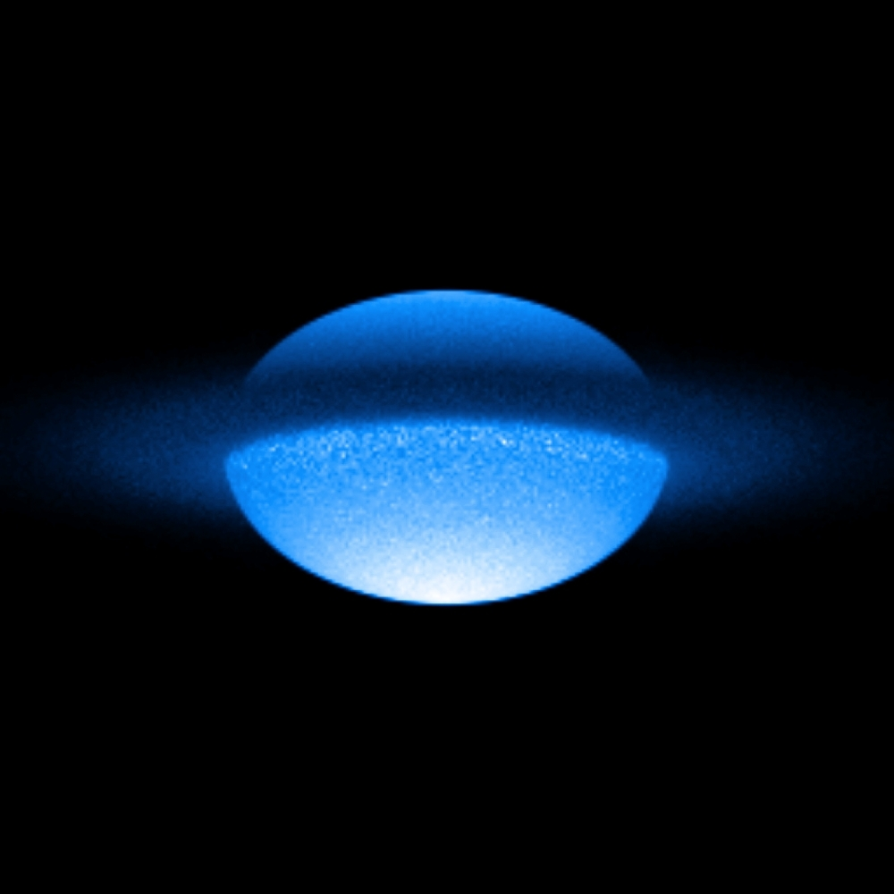
Be stars
Rapidly rotating B stars forming a decretion (or “excretion”) Keplerian emission line disk
Equivalent width of Hα from some Å to tens of Å
Emission line variability on time scale of years
Emission line profile variability: time scales of weeks for binary Be
Excess of near infrared emission
Probably the majority are binary
Is the transient SSS emission due to nuclear ignition when WD crosses the disk?
Notes:
6/18/19
8
8

Slide 9
Photometric and spectral monitoring of four sources
Four months of photometric monitoring at VST
SALT: ongoing spectral monitoring with several goals
Measure equivalent width and heliocentric velocity of Be disk emission lines (so far: two tentative periods, of 2-4 years, much longer than in “average” Be+NS )
Measure broadening of absorption features => rotation velocity v sin(i)
Estimate Be star temperature and log(g)
Detect orbital variability of red versus blue peak => in phase with orbital period?

Slide 10
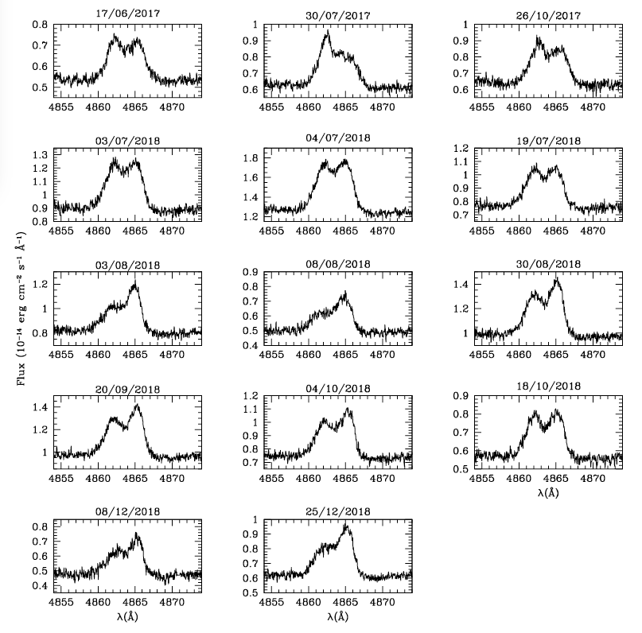
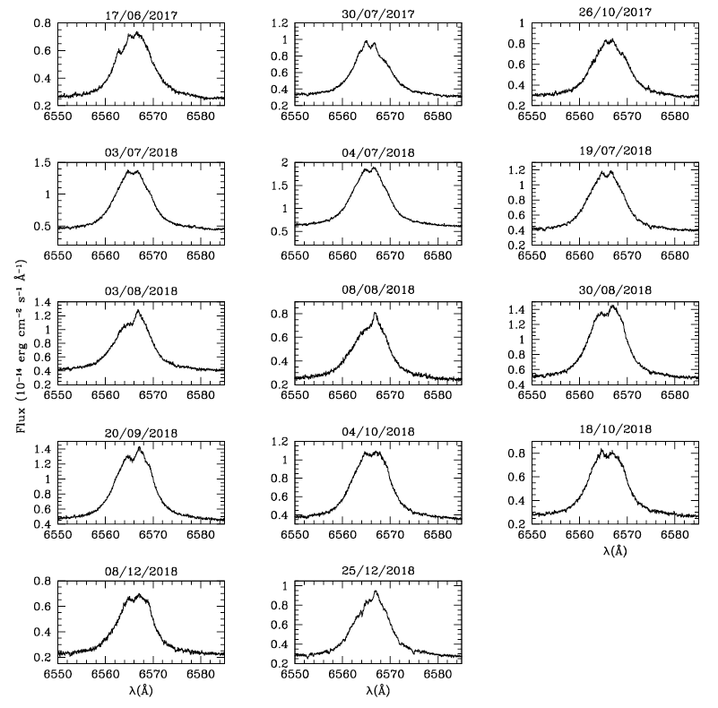
Example: XMMU-J010147.5-715550 (first year)
Notes:
6/18/19
10
10

Slide 11
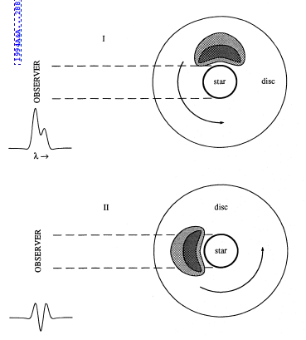
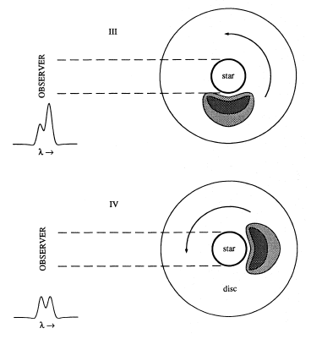
(Telting+ 1994)
Notes:
6/18/19
11
11

Slide 12
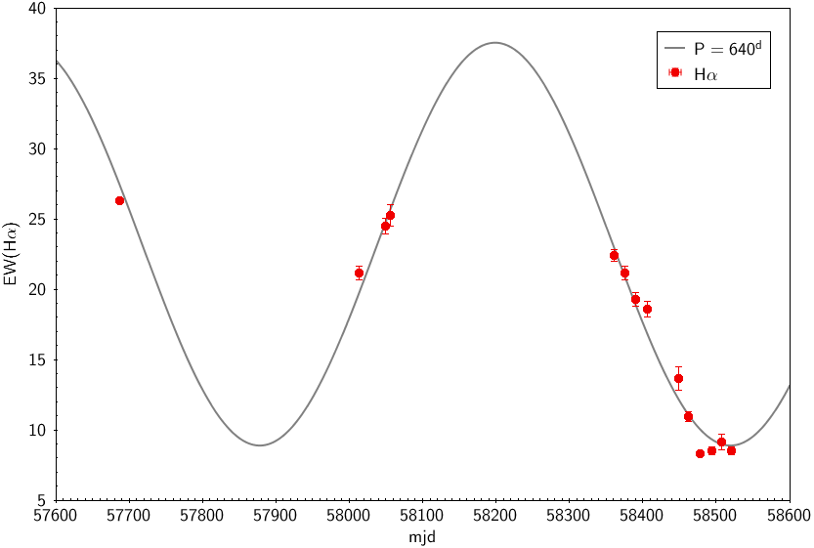
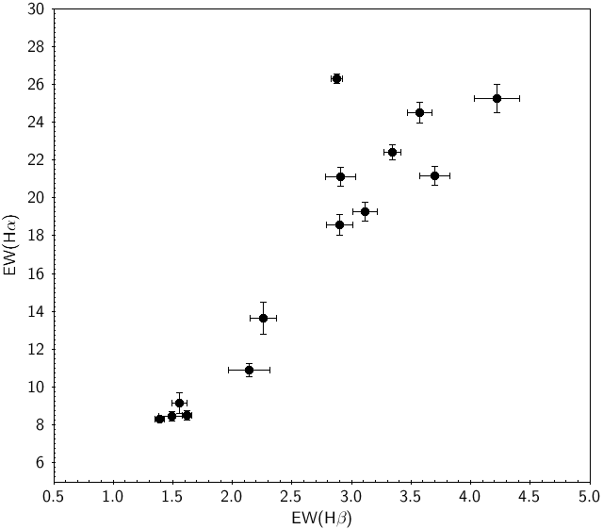
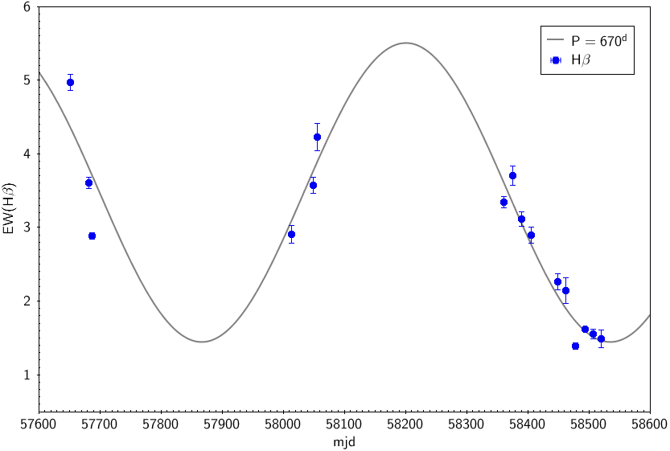
Equivalent Width
P(Hβ) = 670 days (fap = 0.02%)
P(Hα) = 640 days (fap = 0%)
Notes:
6/18/19
12
12

Slide 13
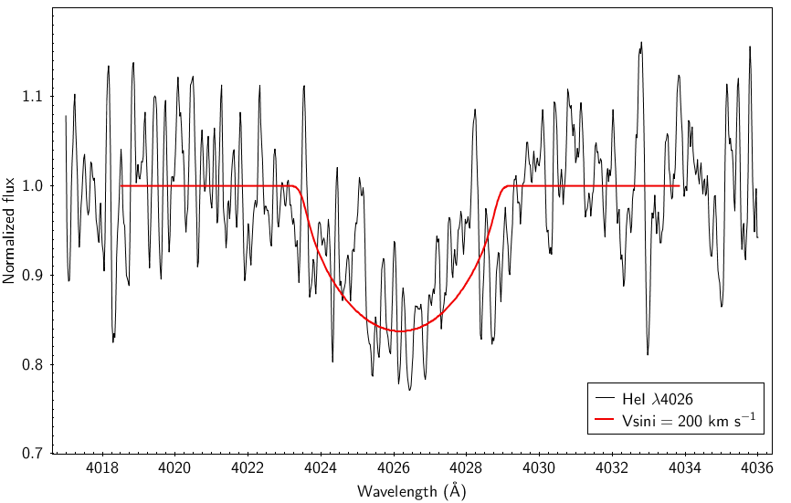
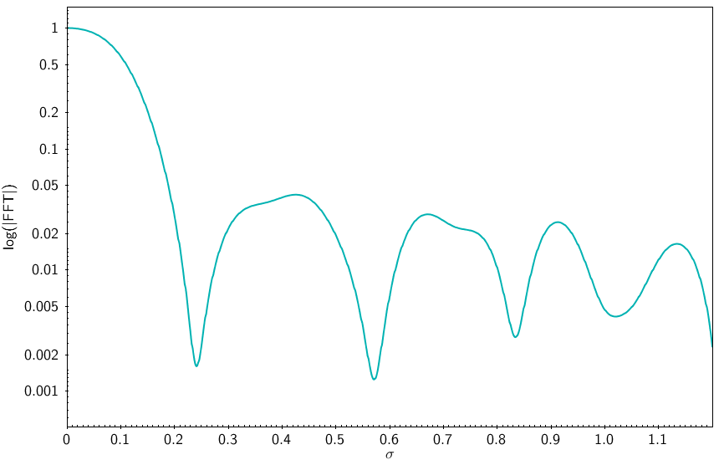
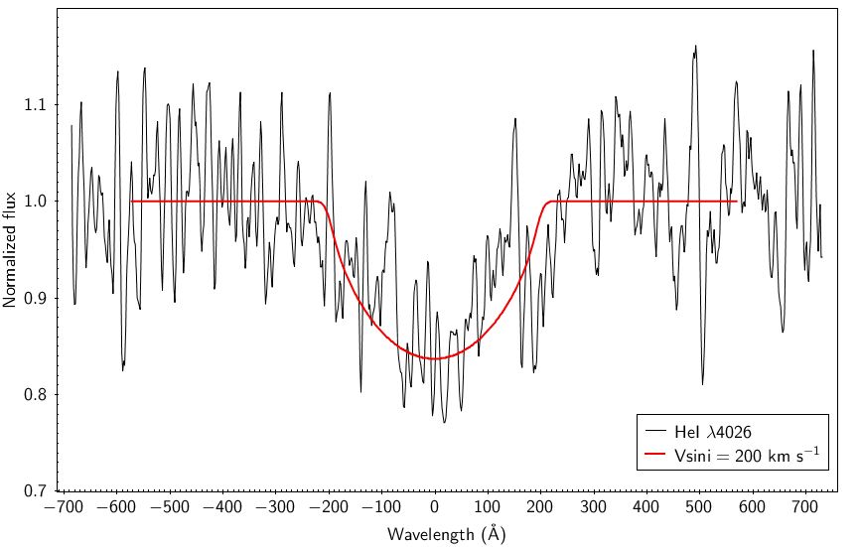
≈ 200 km s⁻¹
Notes:
6/18/19
13
13

Slide 14
Scope of our long-term monitoring
Measure orbital periods (through disk rotation, alterance of blue and red peak)
Be rotation from absorption lines’ width
Characterize B star and its mass (< 8 M?)
Find evidence of compact object nature
Evaluate statistical significance of this type of binaries
Back of the envelope calculation: they may even account for all SNe Ia

