Slide 1
Space missions for planetary transits
Davide Greggio
on behalf of the PLATO and CHEOPS OAPd teams

Slide 2
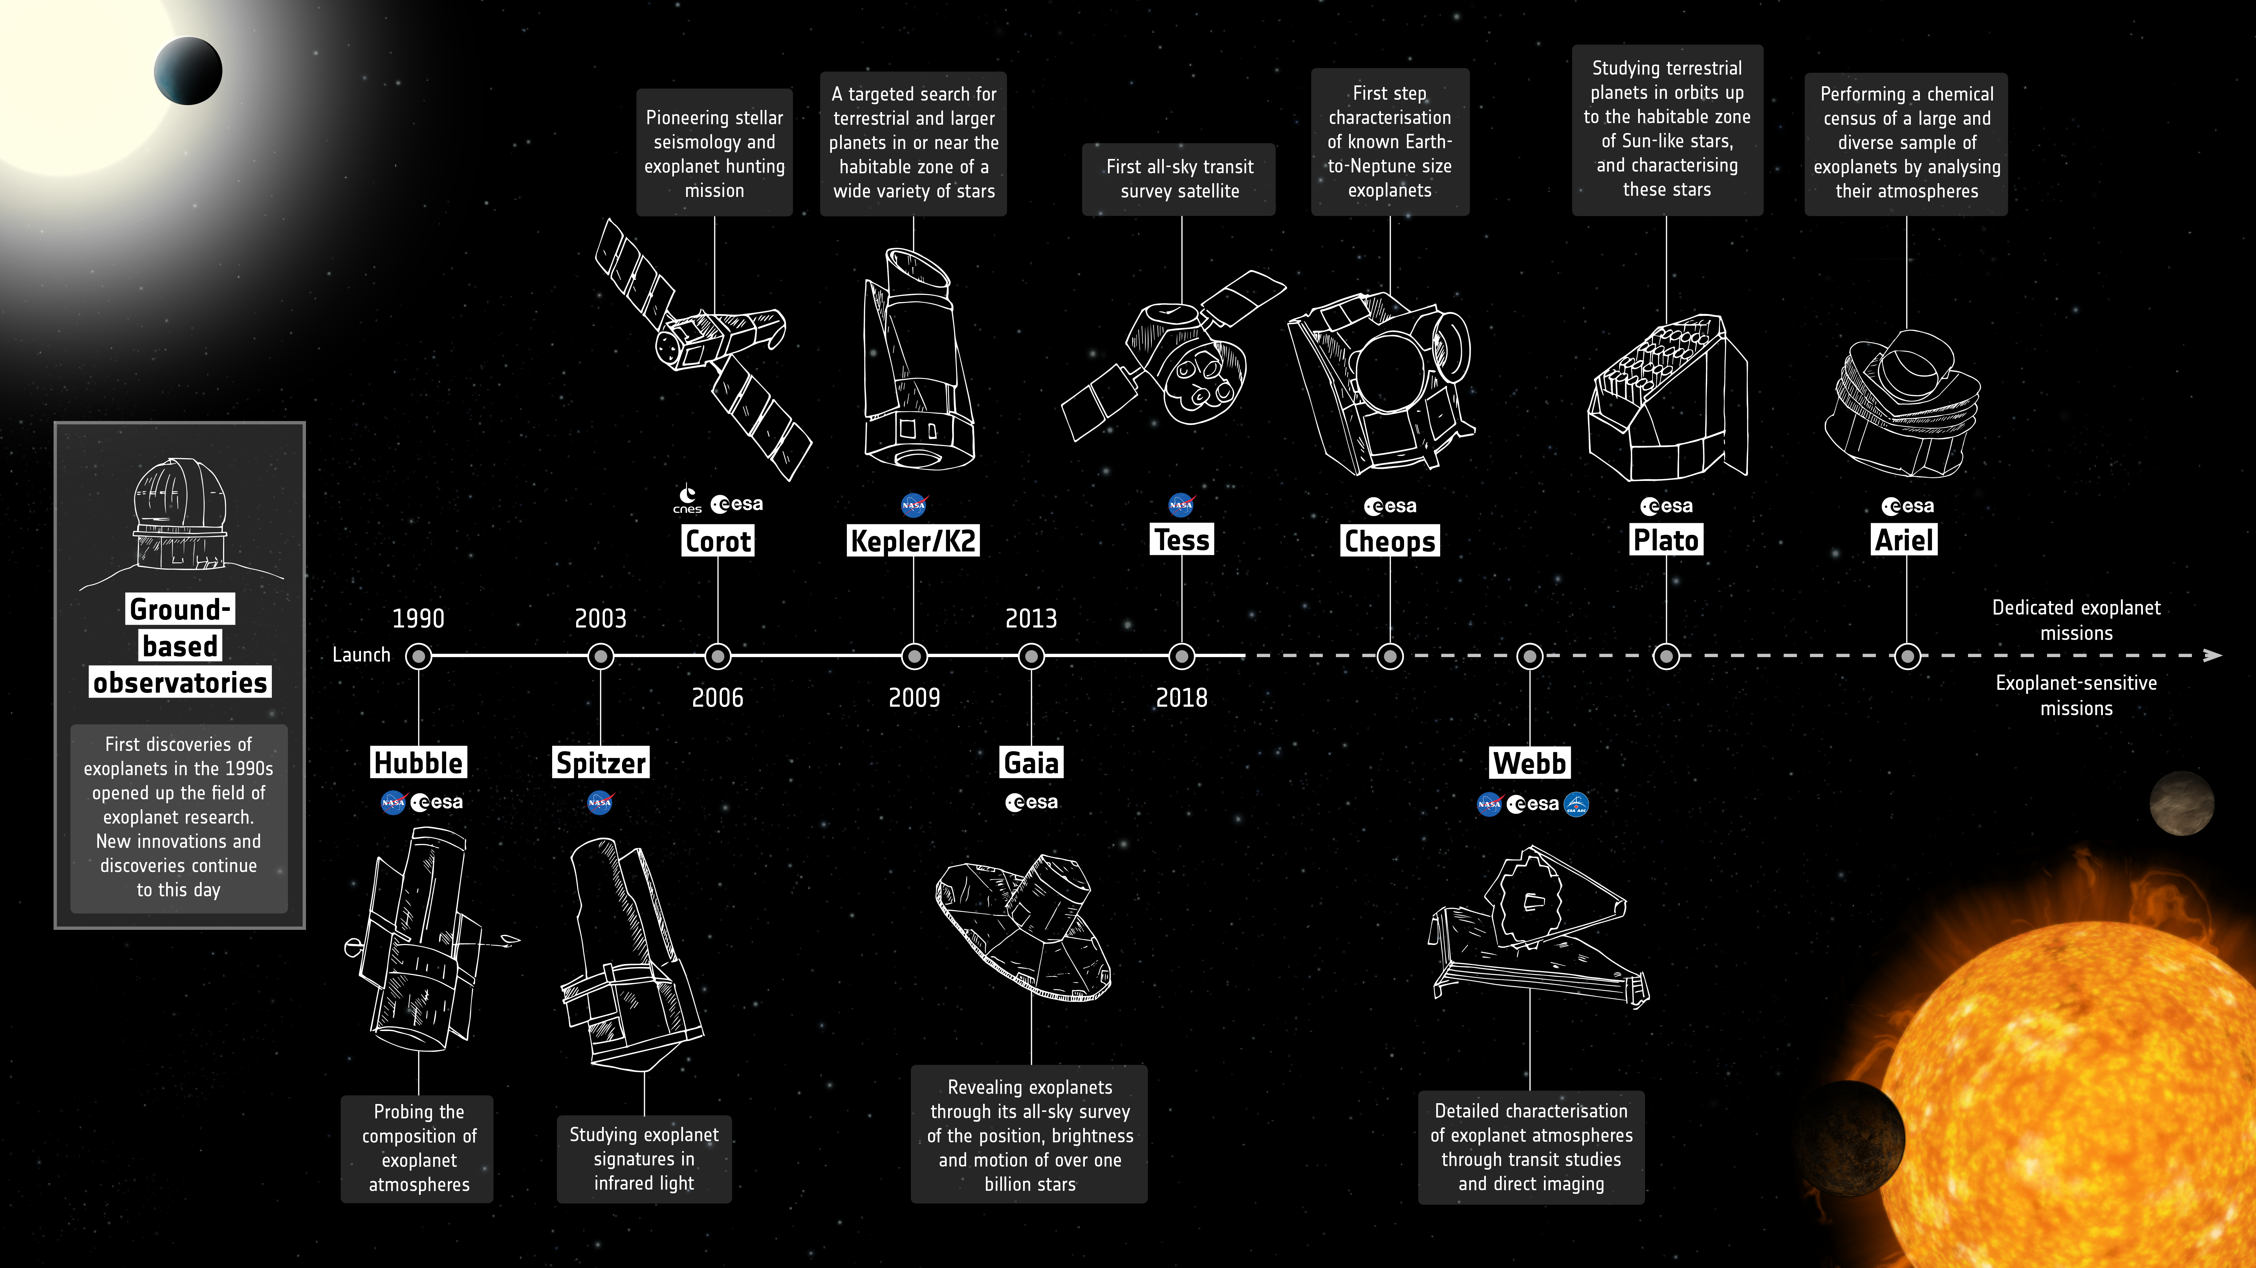
Missions for the study of exoplanets
Copyright: ESA

Slide 3
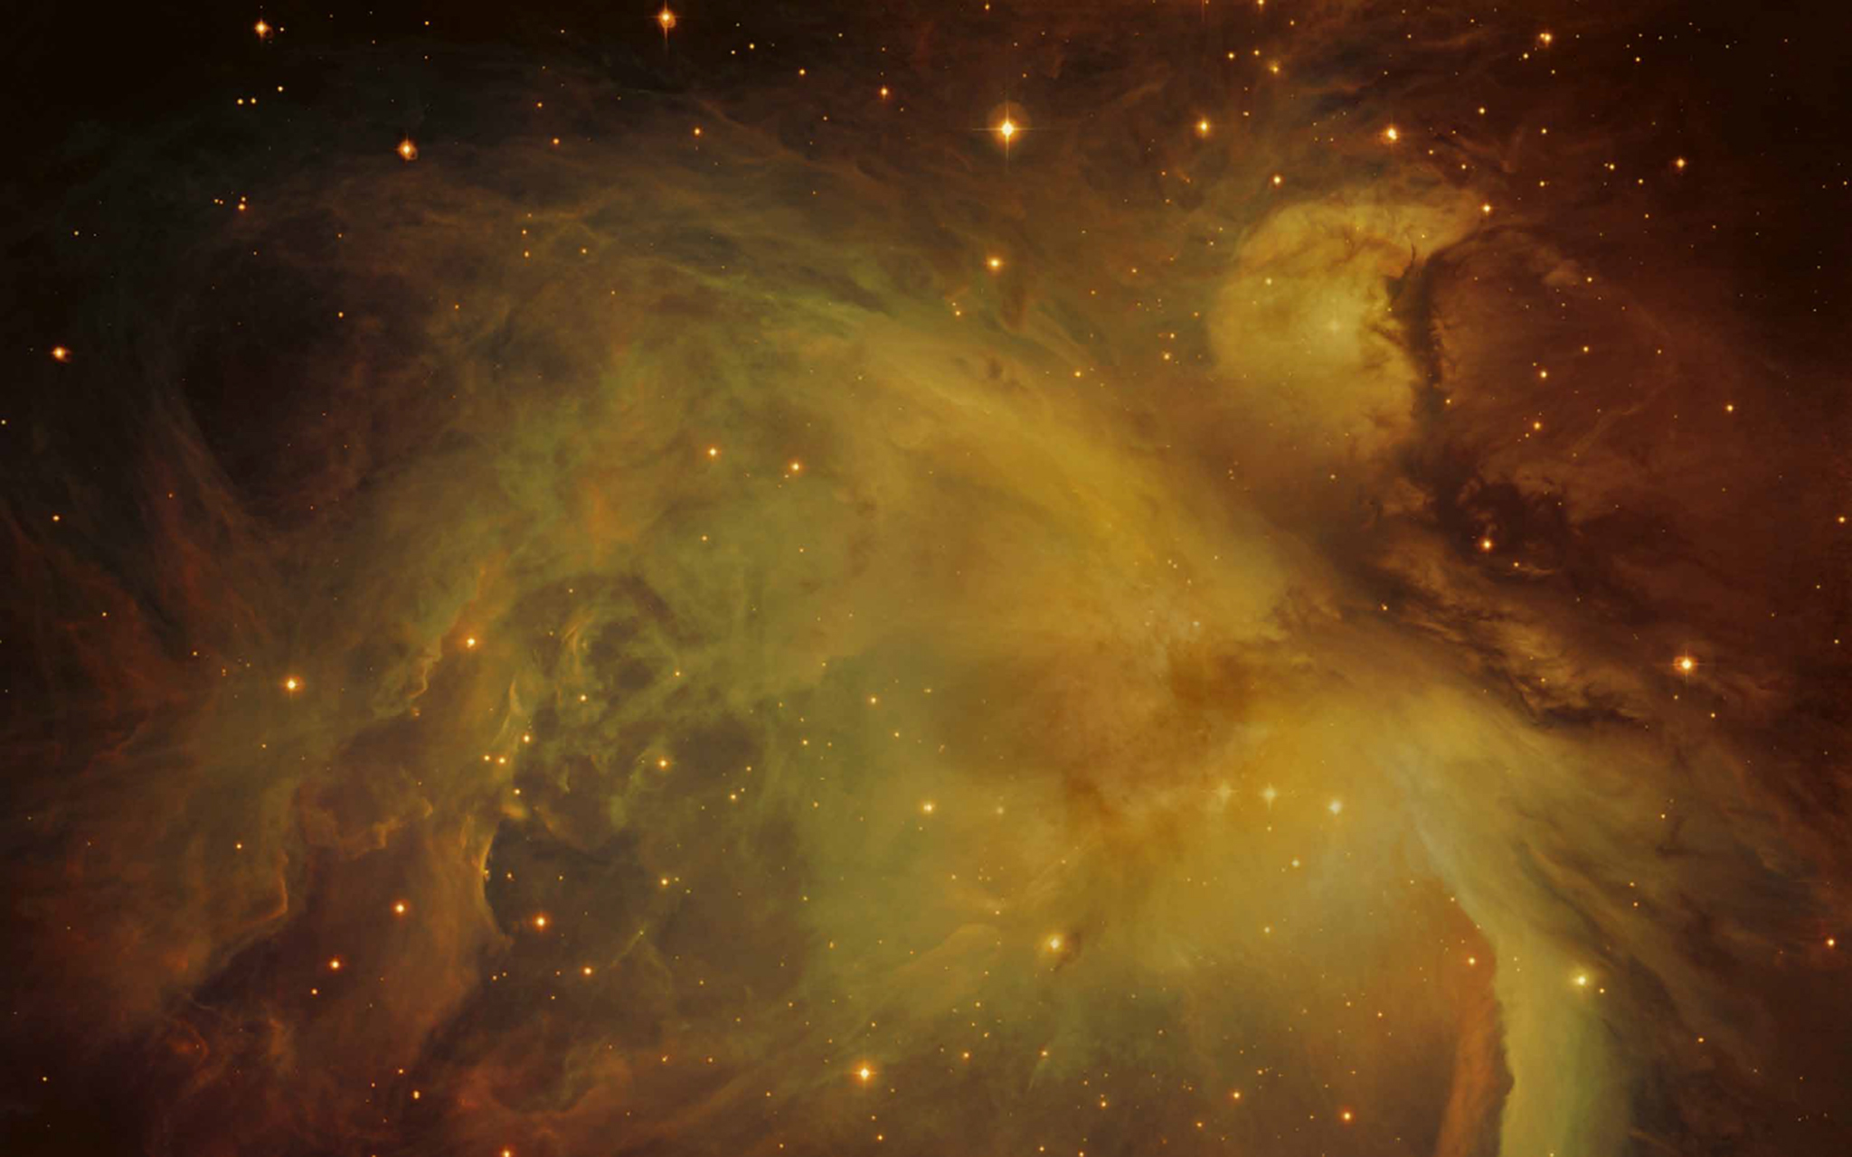
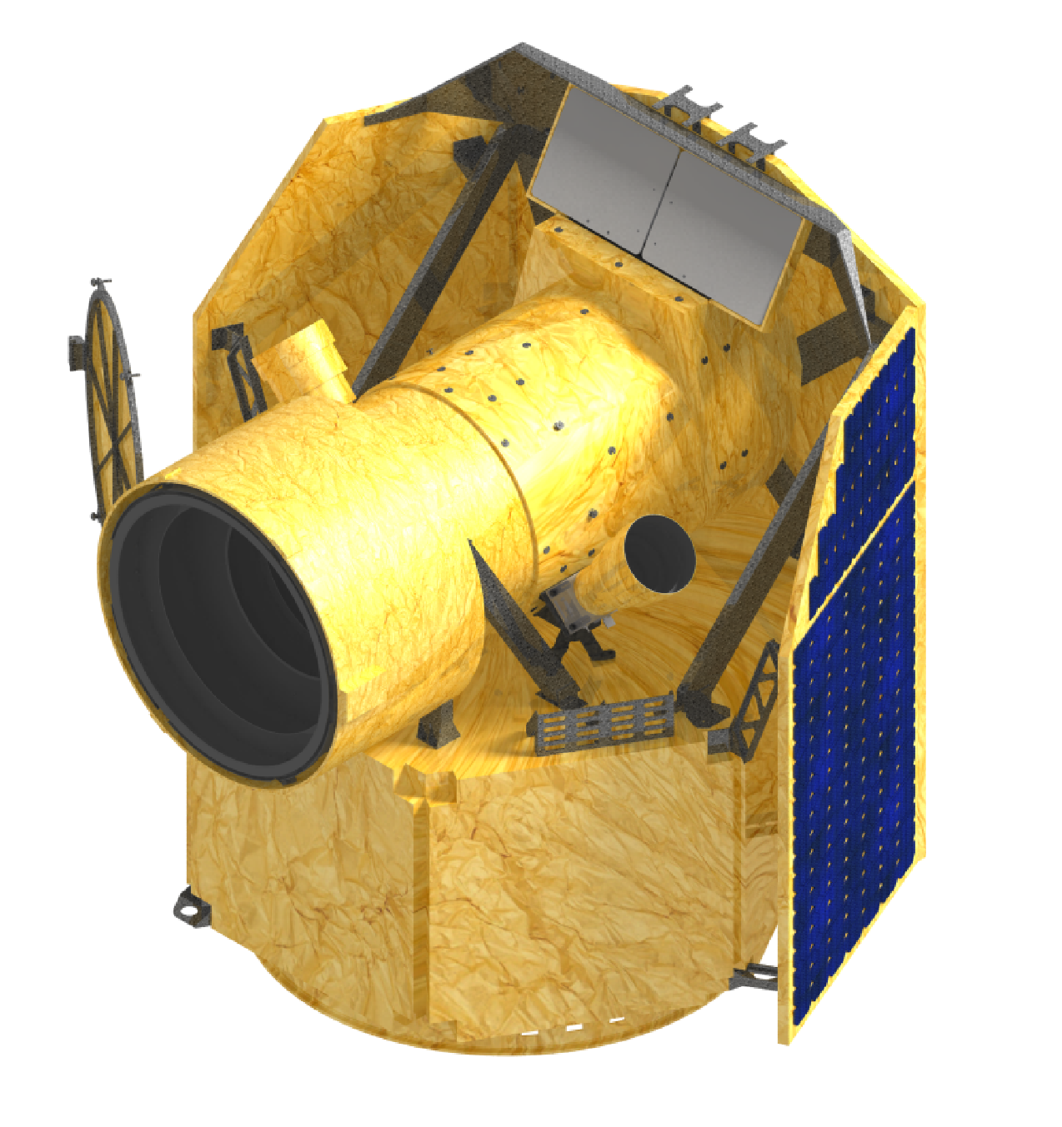
ESA S-class mission
Cost: < 150 M€
Launch: Oct. – Nov. 2019
Lightweight: 250 kg
Operations: 3.5 (+1.5) yrs

Slide 4
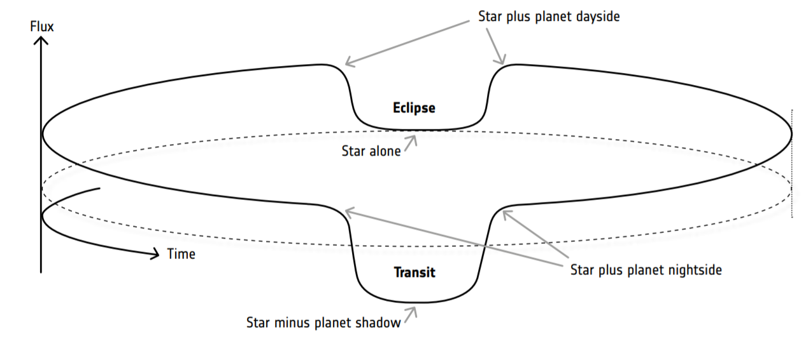
Science with CHEOPS
Determination of radius of known exoplanets orbiting bright stars (6<V<12) in order to get their density (mass is known from radial velocity measurements).
Technical Challenge
S/N ratio: 20 ppm per 6h exposure time
Selection of targets for future follow-up spectroscopic studies
(possibile follow-up: E-ELT, JWST)

Slide 5
INAF – OAPd contribution
Italy is member of the CHEOPS Consortium Science Team
INAF is responsible of the Telescope:
Optical Design
Straylight Analysis
Integration, Analysis and Test
Support to industry: Leonardo S.R.L

Slide 6
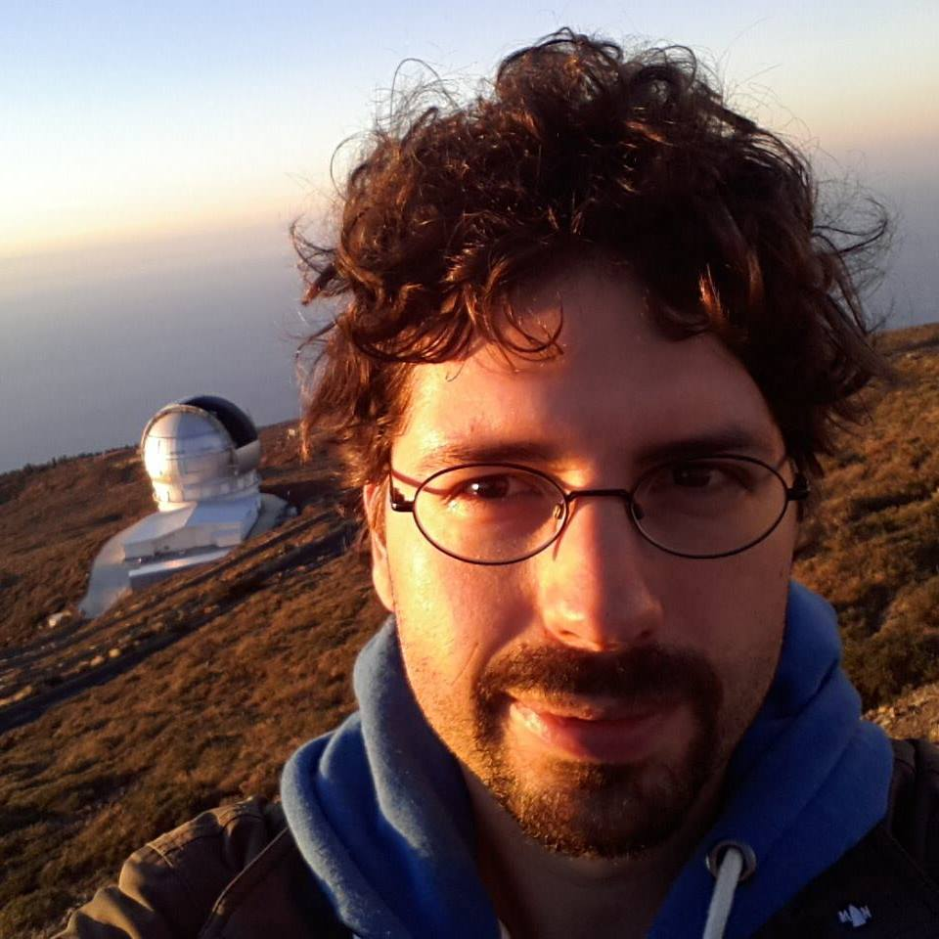
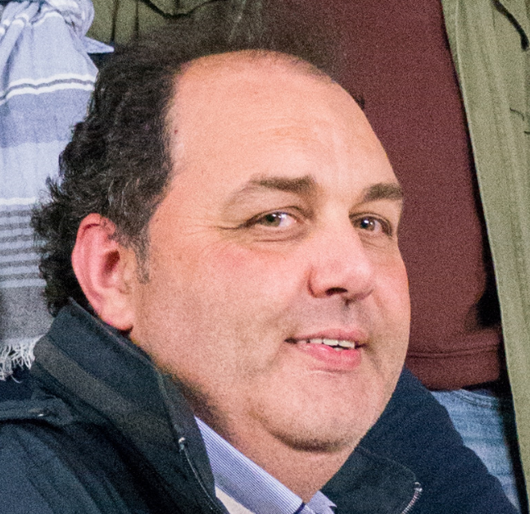
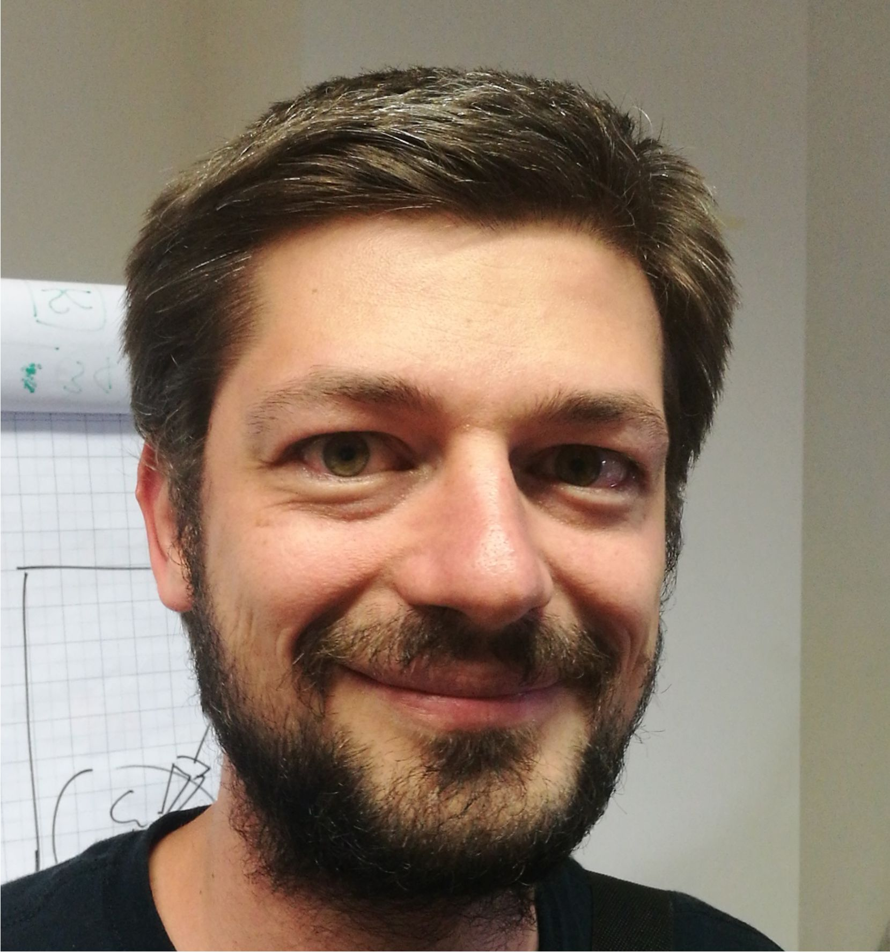
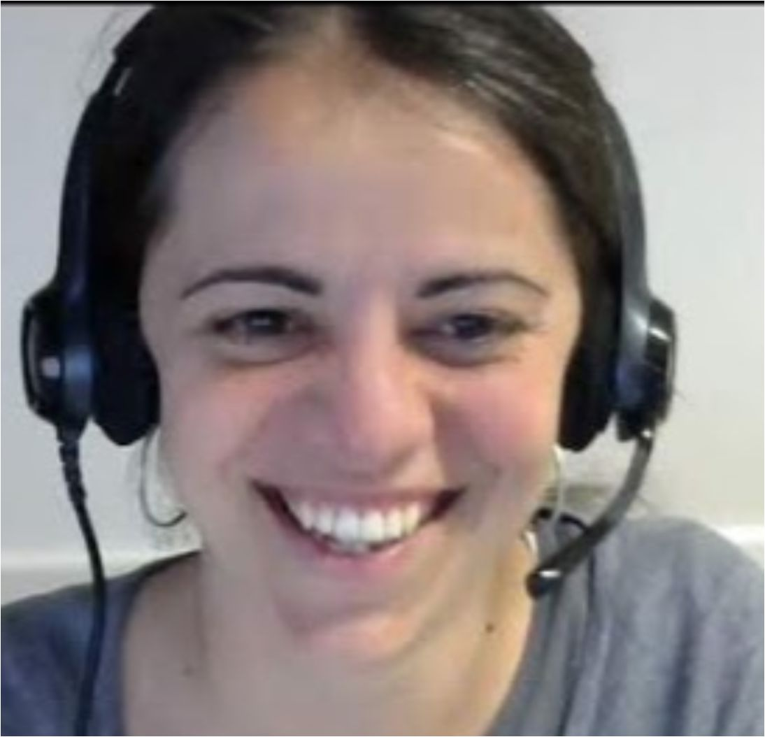
INAF – OAPd contribution
Italy is member of the CHEOPS Consortium Science Team
INAF is responsible of the Telescope:
Optical Design
Straylight Analysis
Integration, Analysis and Test
Support to industry: Leonardo S.R.L
Board
Optical design
Science team
Assembly, integration and test
Video maker
3D models
System
engineering

Slide 7
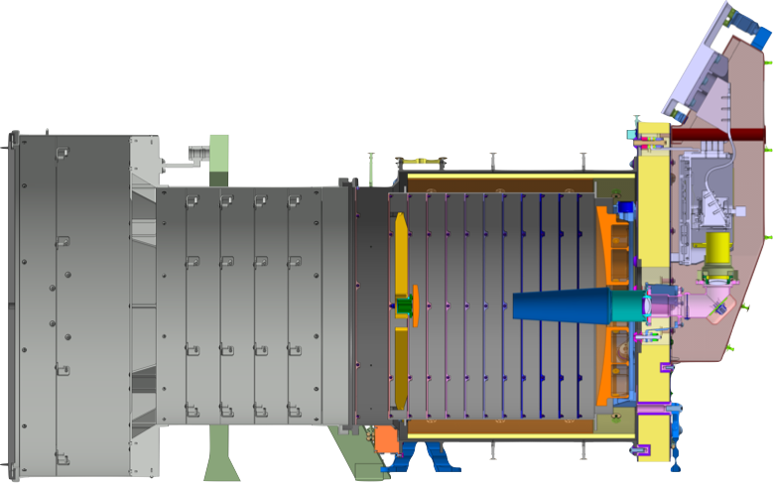
The Instrument
telescope
internal baffle
radiators
primary baffle
baffle
cover
secondary baffle
telescope
structure
vanes
CCD
300 mm
star tracker
focal plane
module
back-end
optics
secondary mirror
primary mirror

Slide 8
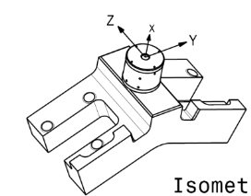
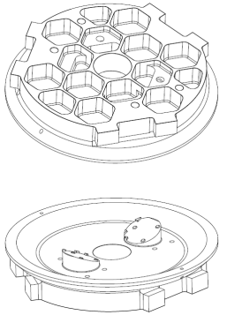
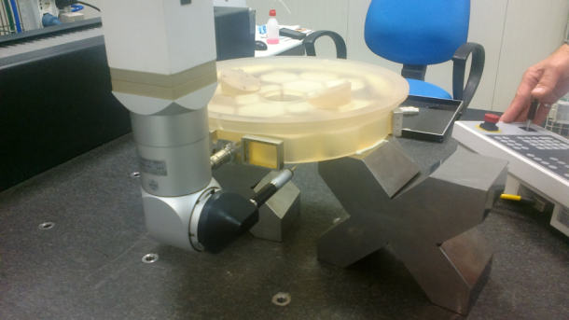
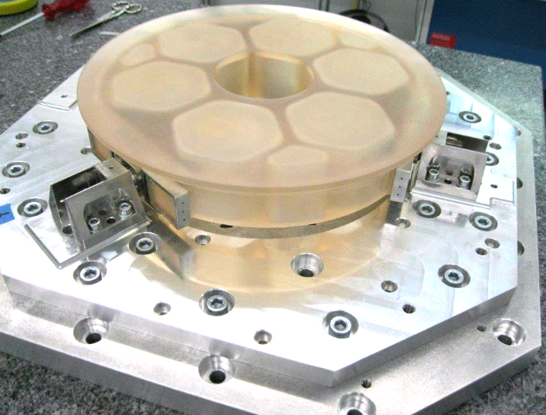
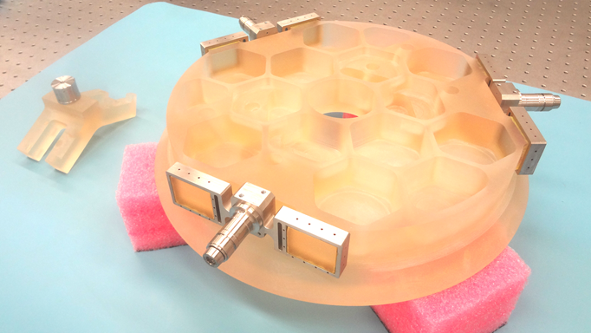
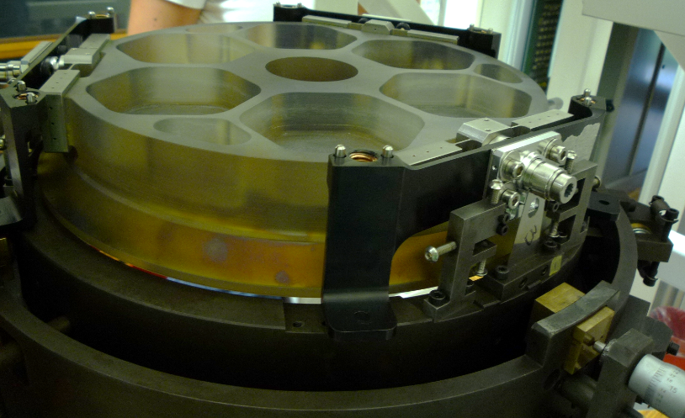
STM1
STM2
DM

Slide 9
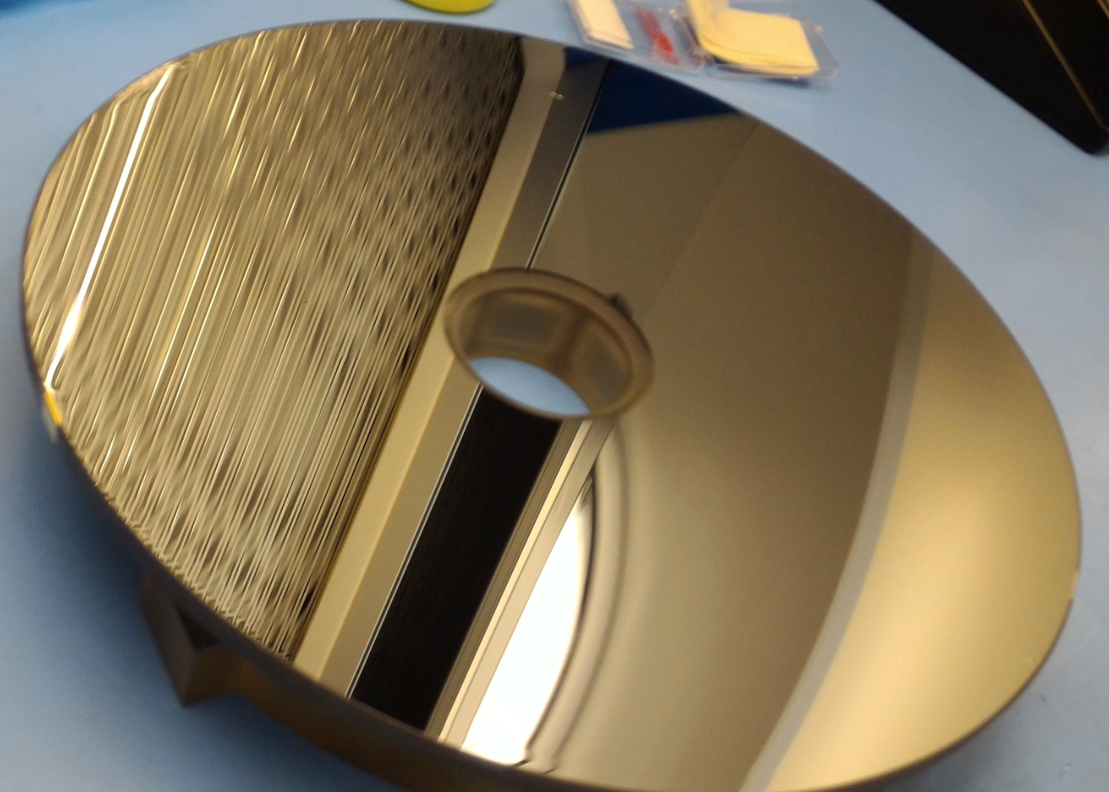
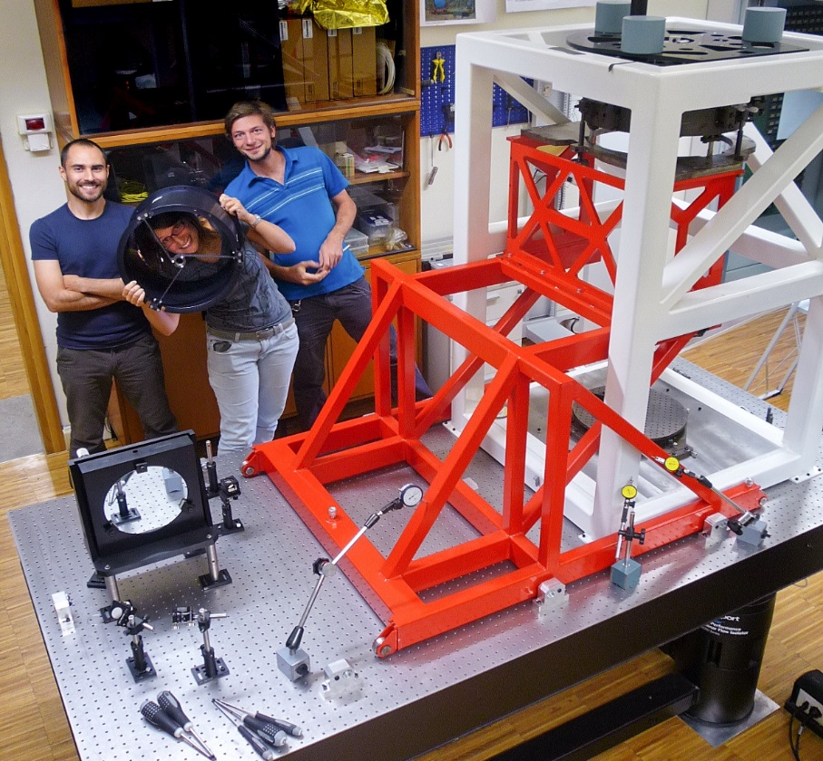
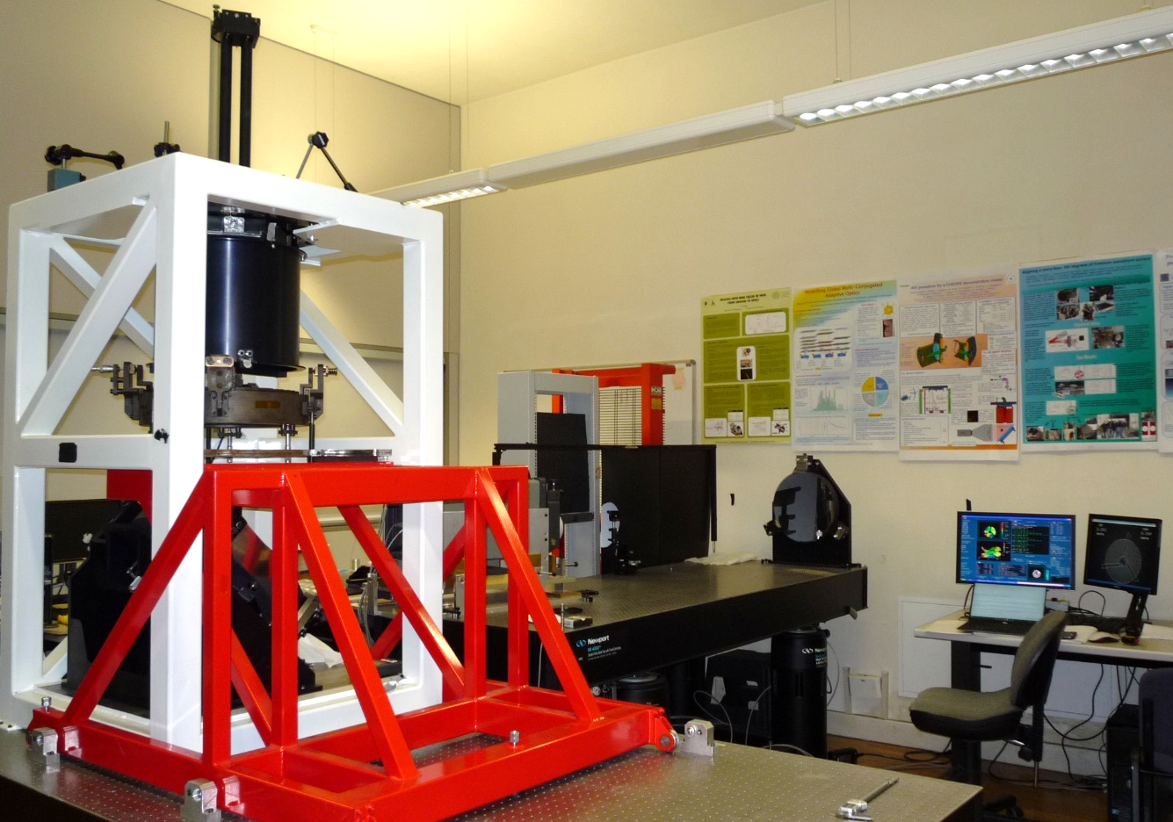

Slide 10
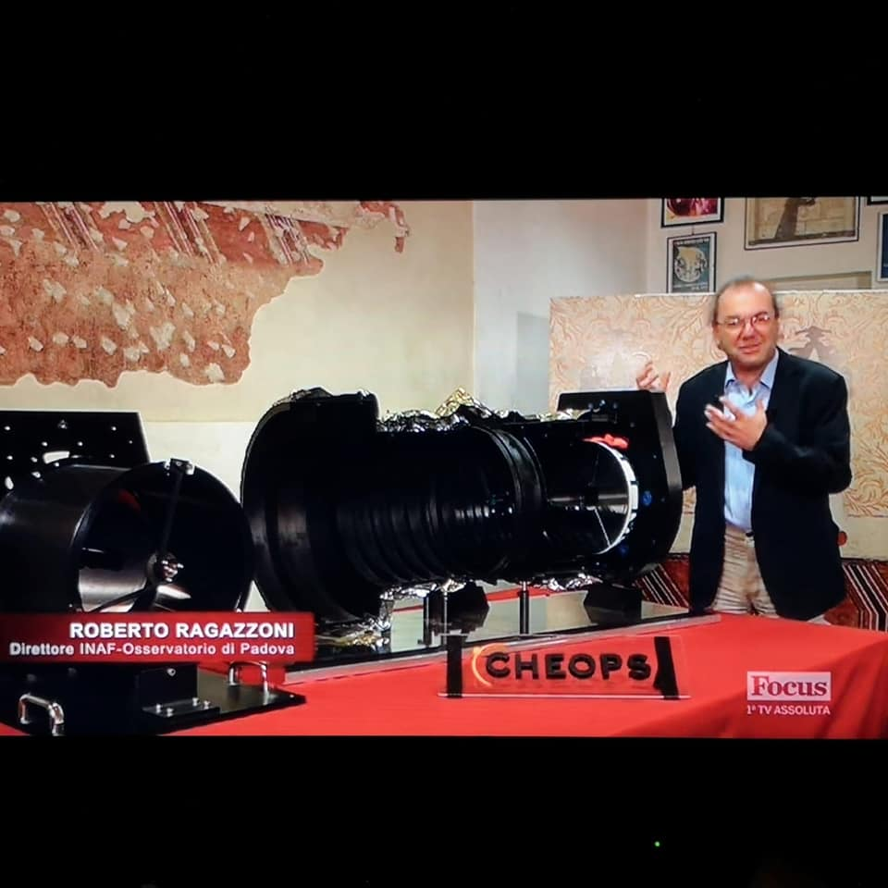
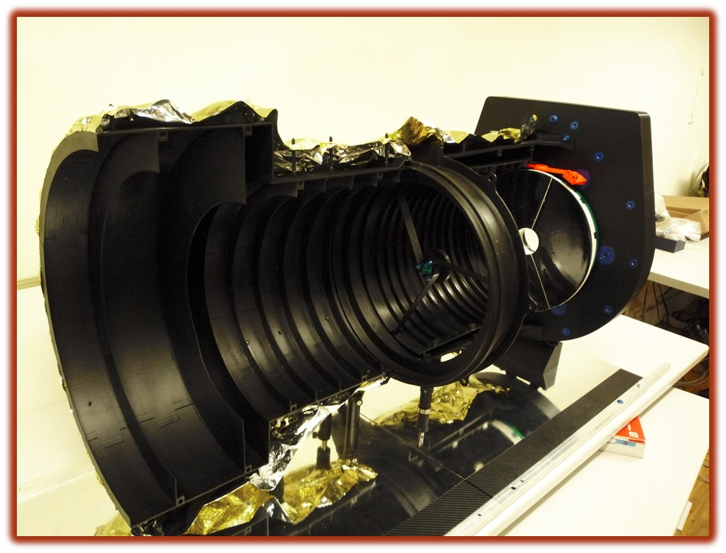

Slide 11
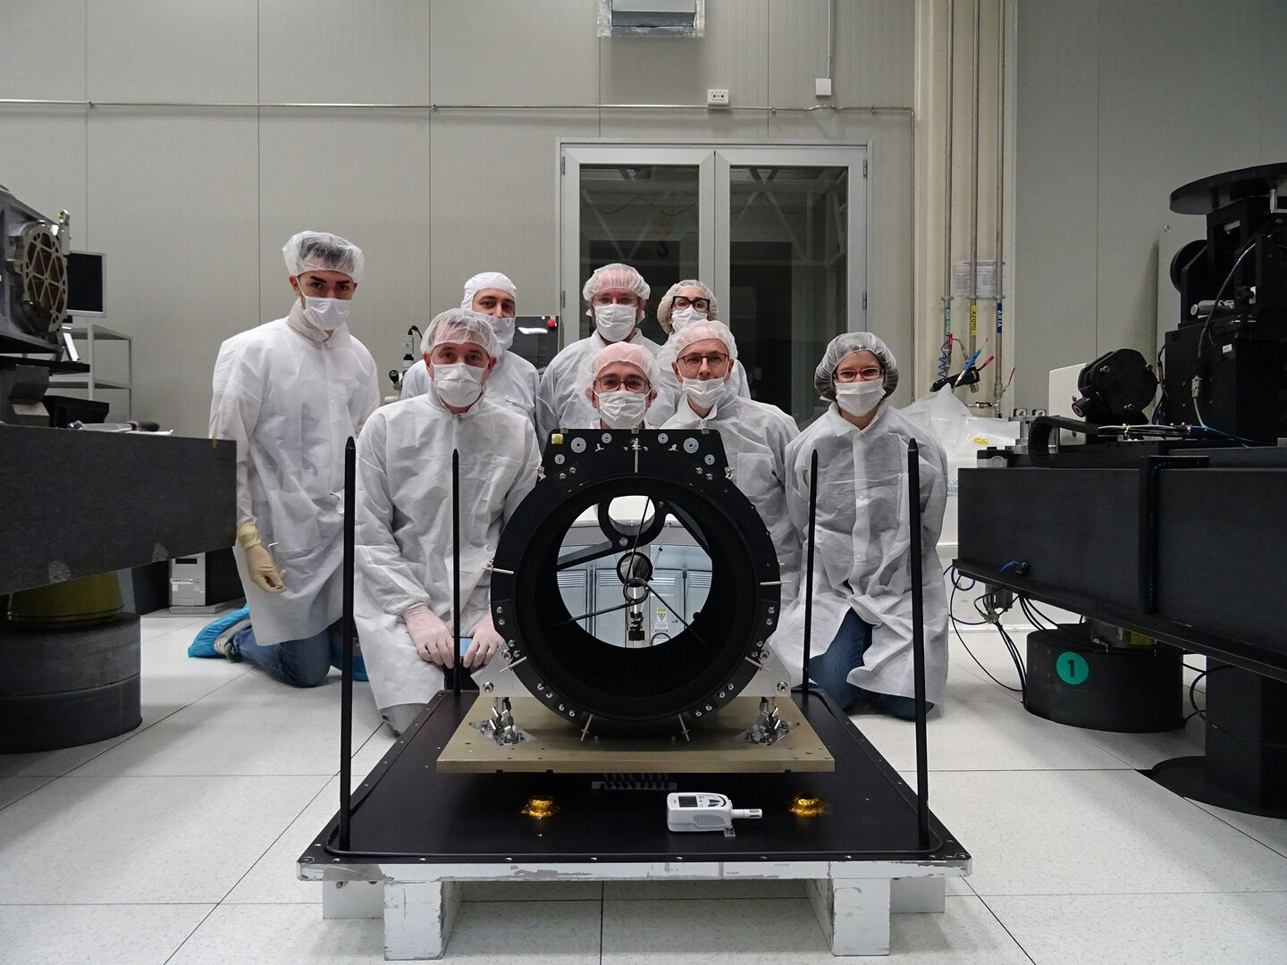
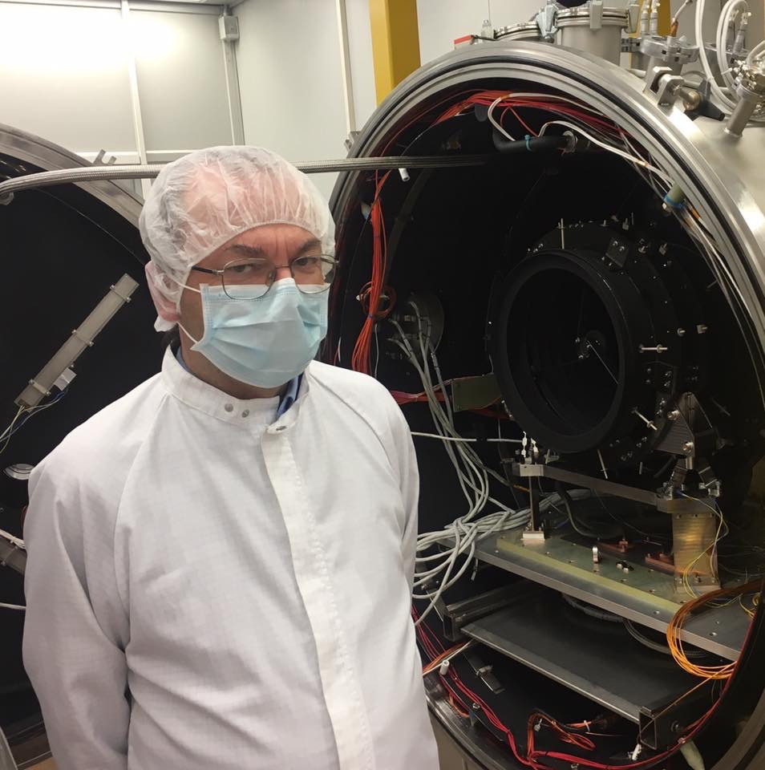
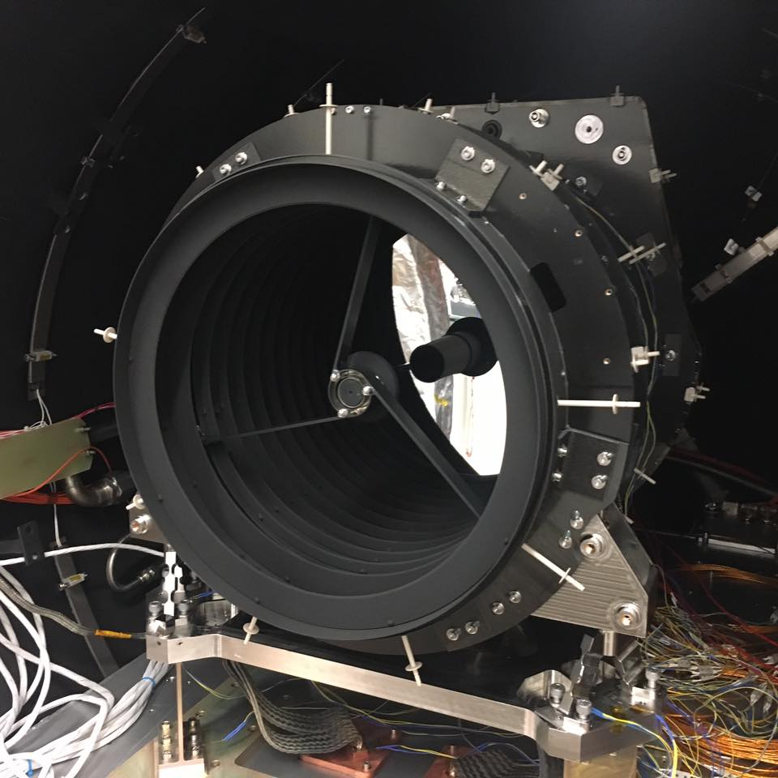

Slide 12
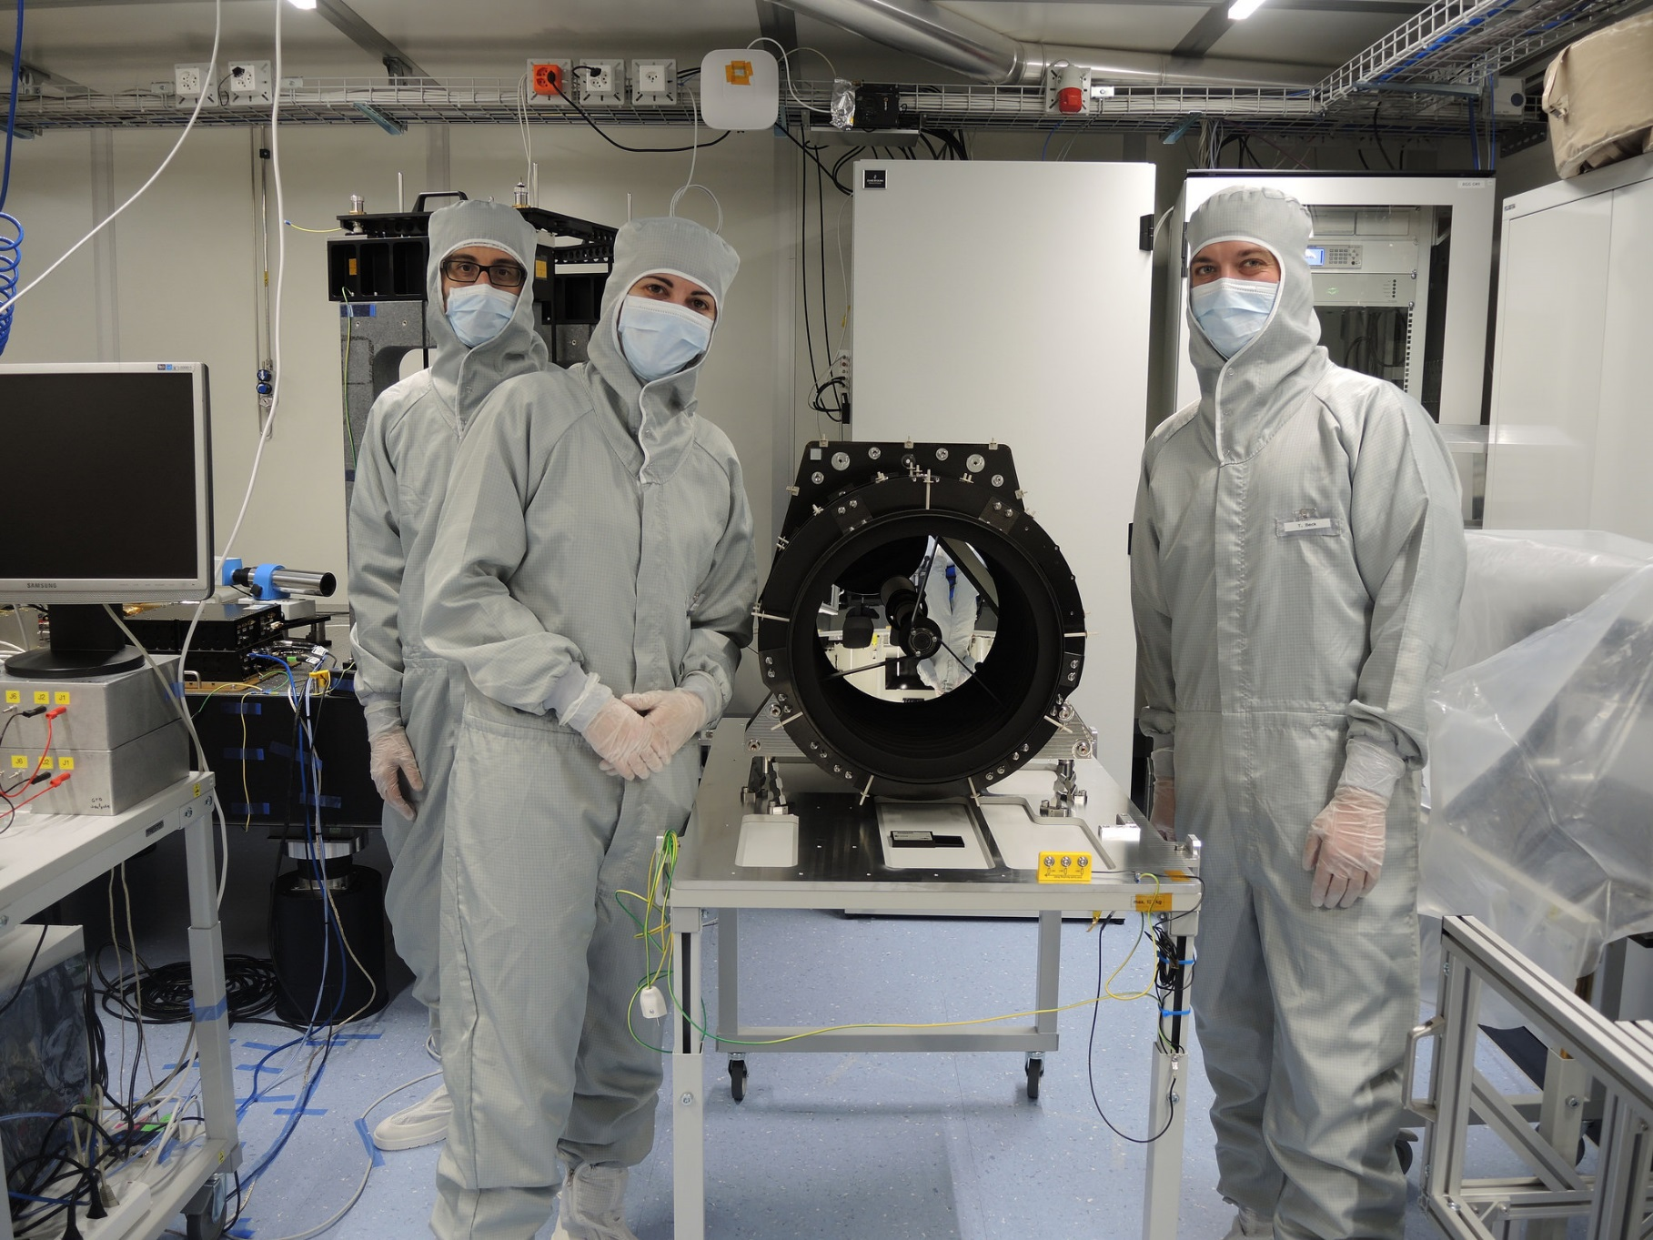

Slide 13
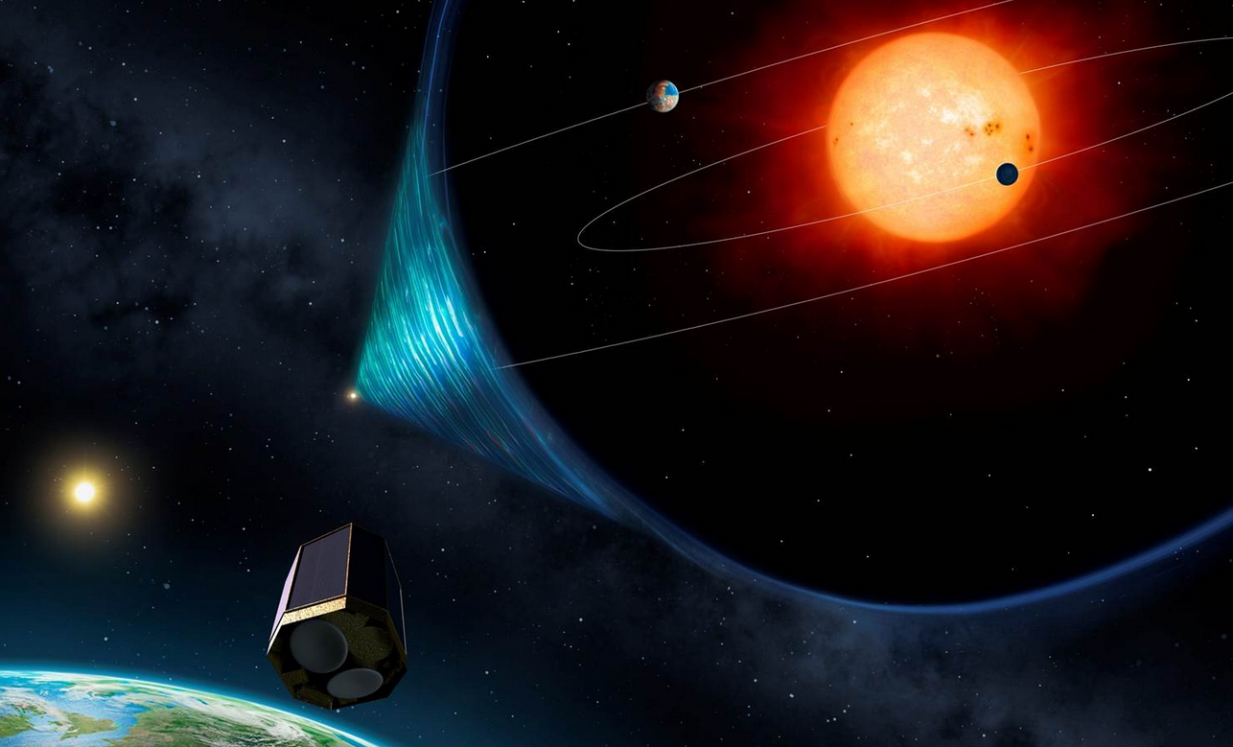
PLATO
ESA M-class mission
Cost: < 650 M€
Launch: 2026
Operations: 4.25 (+2) yrs

Slide 14
Italian contribution
INAF
OA Catania (Science, Payload)
OA Padova (Science, Payload)
OA Brera (Science, Payload)
IAPS-Roma (Science, Payload)
FGG (Payload)
OA Palermo (Science)
OA Torino (Science)
OA Capodimonte (Science)
OA Roma (+Teramo) (Science)
OA Arcetri (Science)
Università di Padova, Dipartimento di fisica e astronomia (Science)
ASI-SSDC (PDC, Science)
Payload
Telescope Optical Units
Instrument Control Unit
Science Preparation
Input catalogue
Data processing
Preparatory and follow-up database management.

Slide 15
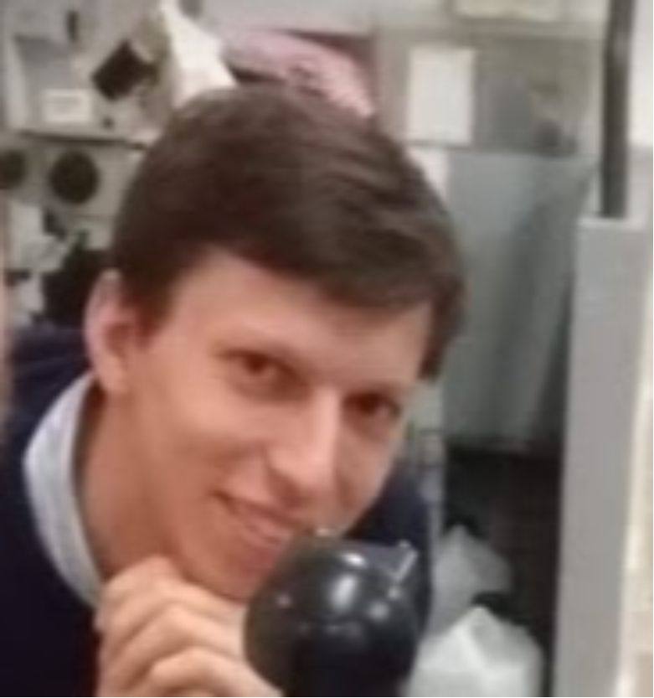
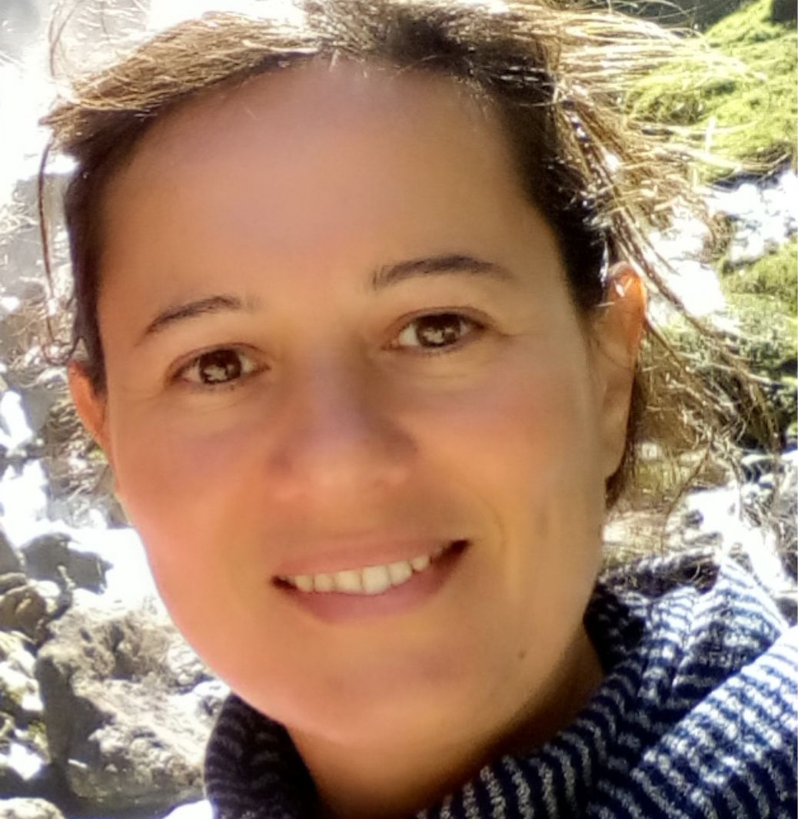
INAF – OAPd contribution
Board
Science team
Assembly, integration and test
Optical design
System engineering
Breadboard/Prototype
Video maker
3D models
Product
assurance

Slide 16
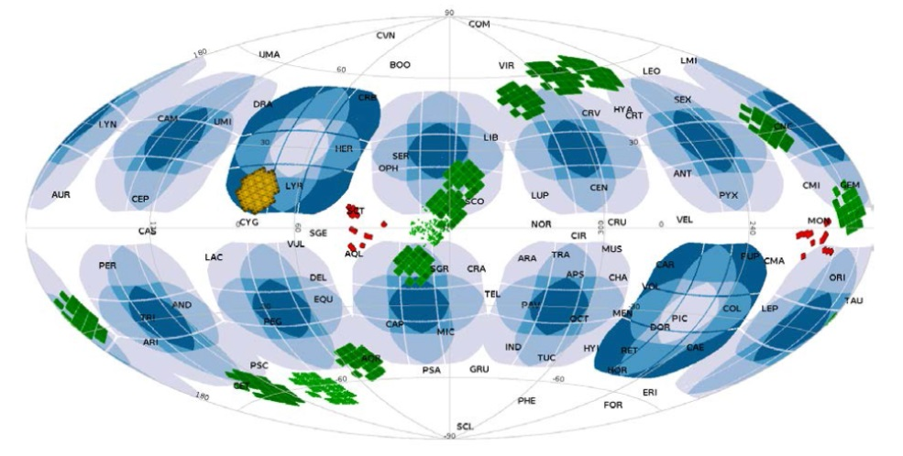
Science with PLATO
Asteroseismology of exoplanets host stars (V<11)
Measurement of mass, radius and age of stars
Measurement of mass, radius and age of
orbiting exoplanets
Spectroscopic follow-up:
Determine orbital parameters
Study physical and chemical properties of exoplanets and their atmosphere
Expected performances
(TTV + RV + Asteroseismology):
radius ~3%
Mass ~10%
Age ~10% (K-G dwarfs)

Slide 17
The Instrument
PLATO

Slide 18
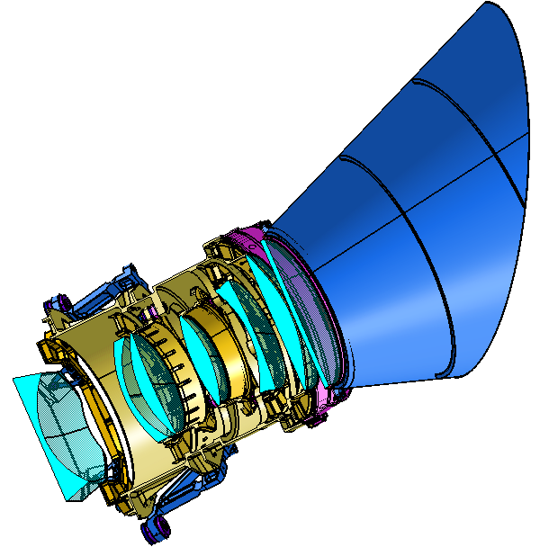
The Instrument
PLATO
FoV
48.5°
58.8°
6
12
6
18
18
12
24
12
18
18
6
12
6
TOU
24+2 CAMERAS
CAMERA = TOU+FPA+TCS+FEE
Collecting area + Dynamic range

Slide 19
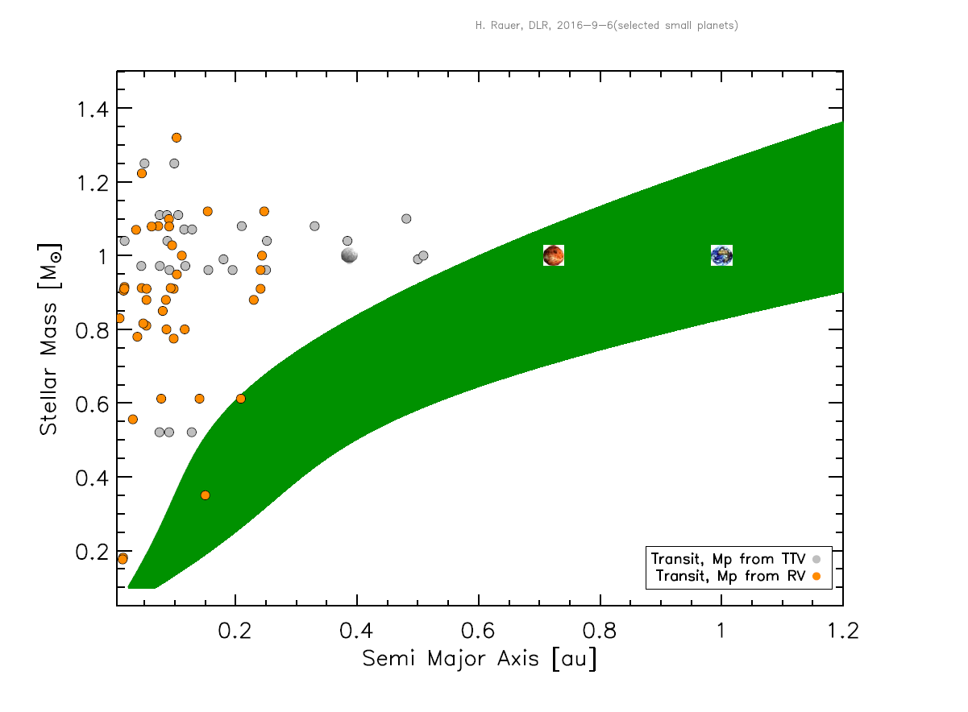
The Instrument
Mercurio
Venere
Terra
TESS, CHEOPS, K2
TESS ecliptic poles

Slide 20
The Instrument
Mercurio
Venere
Terra
TESS, CHEOPS, K2
PLATO
TESS ecliptic poles

Slide 21
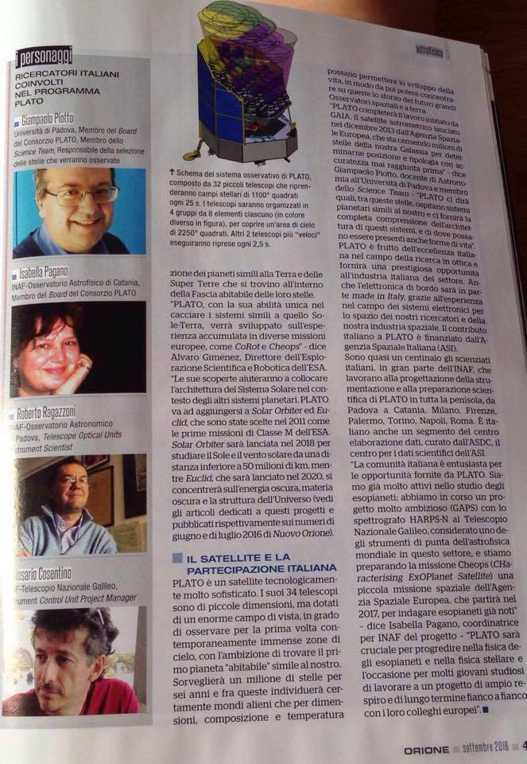
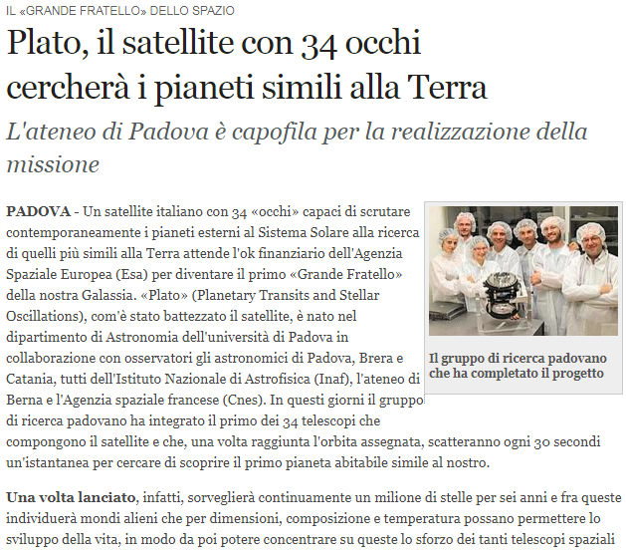

Slide 22
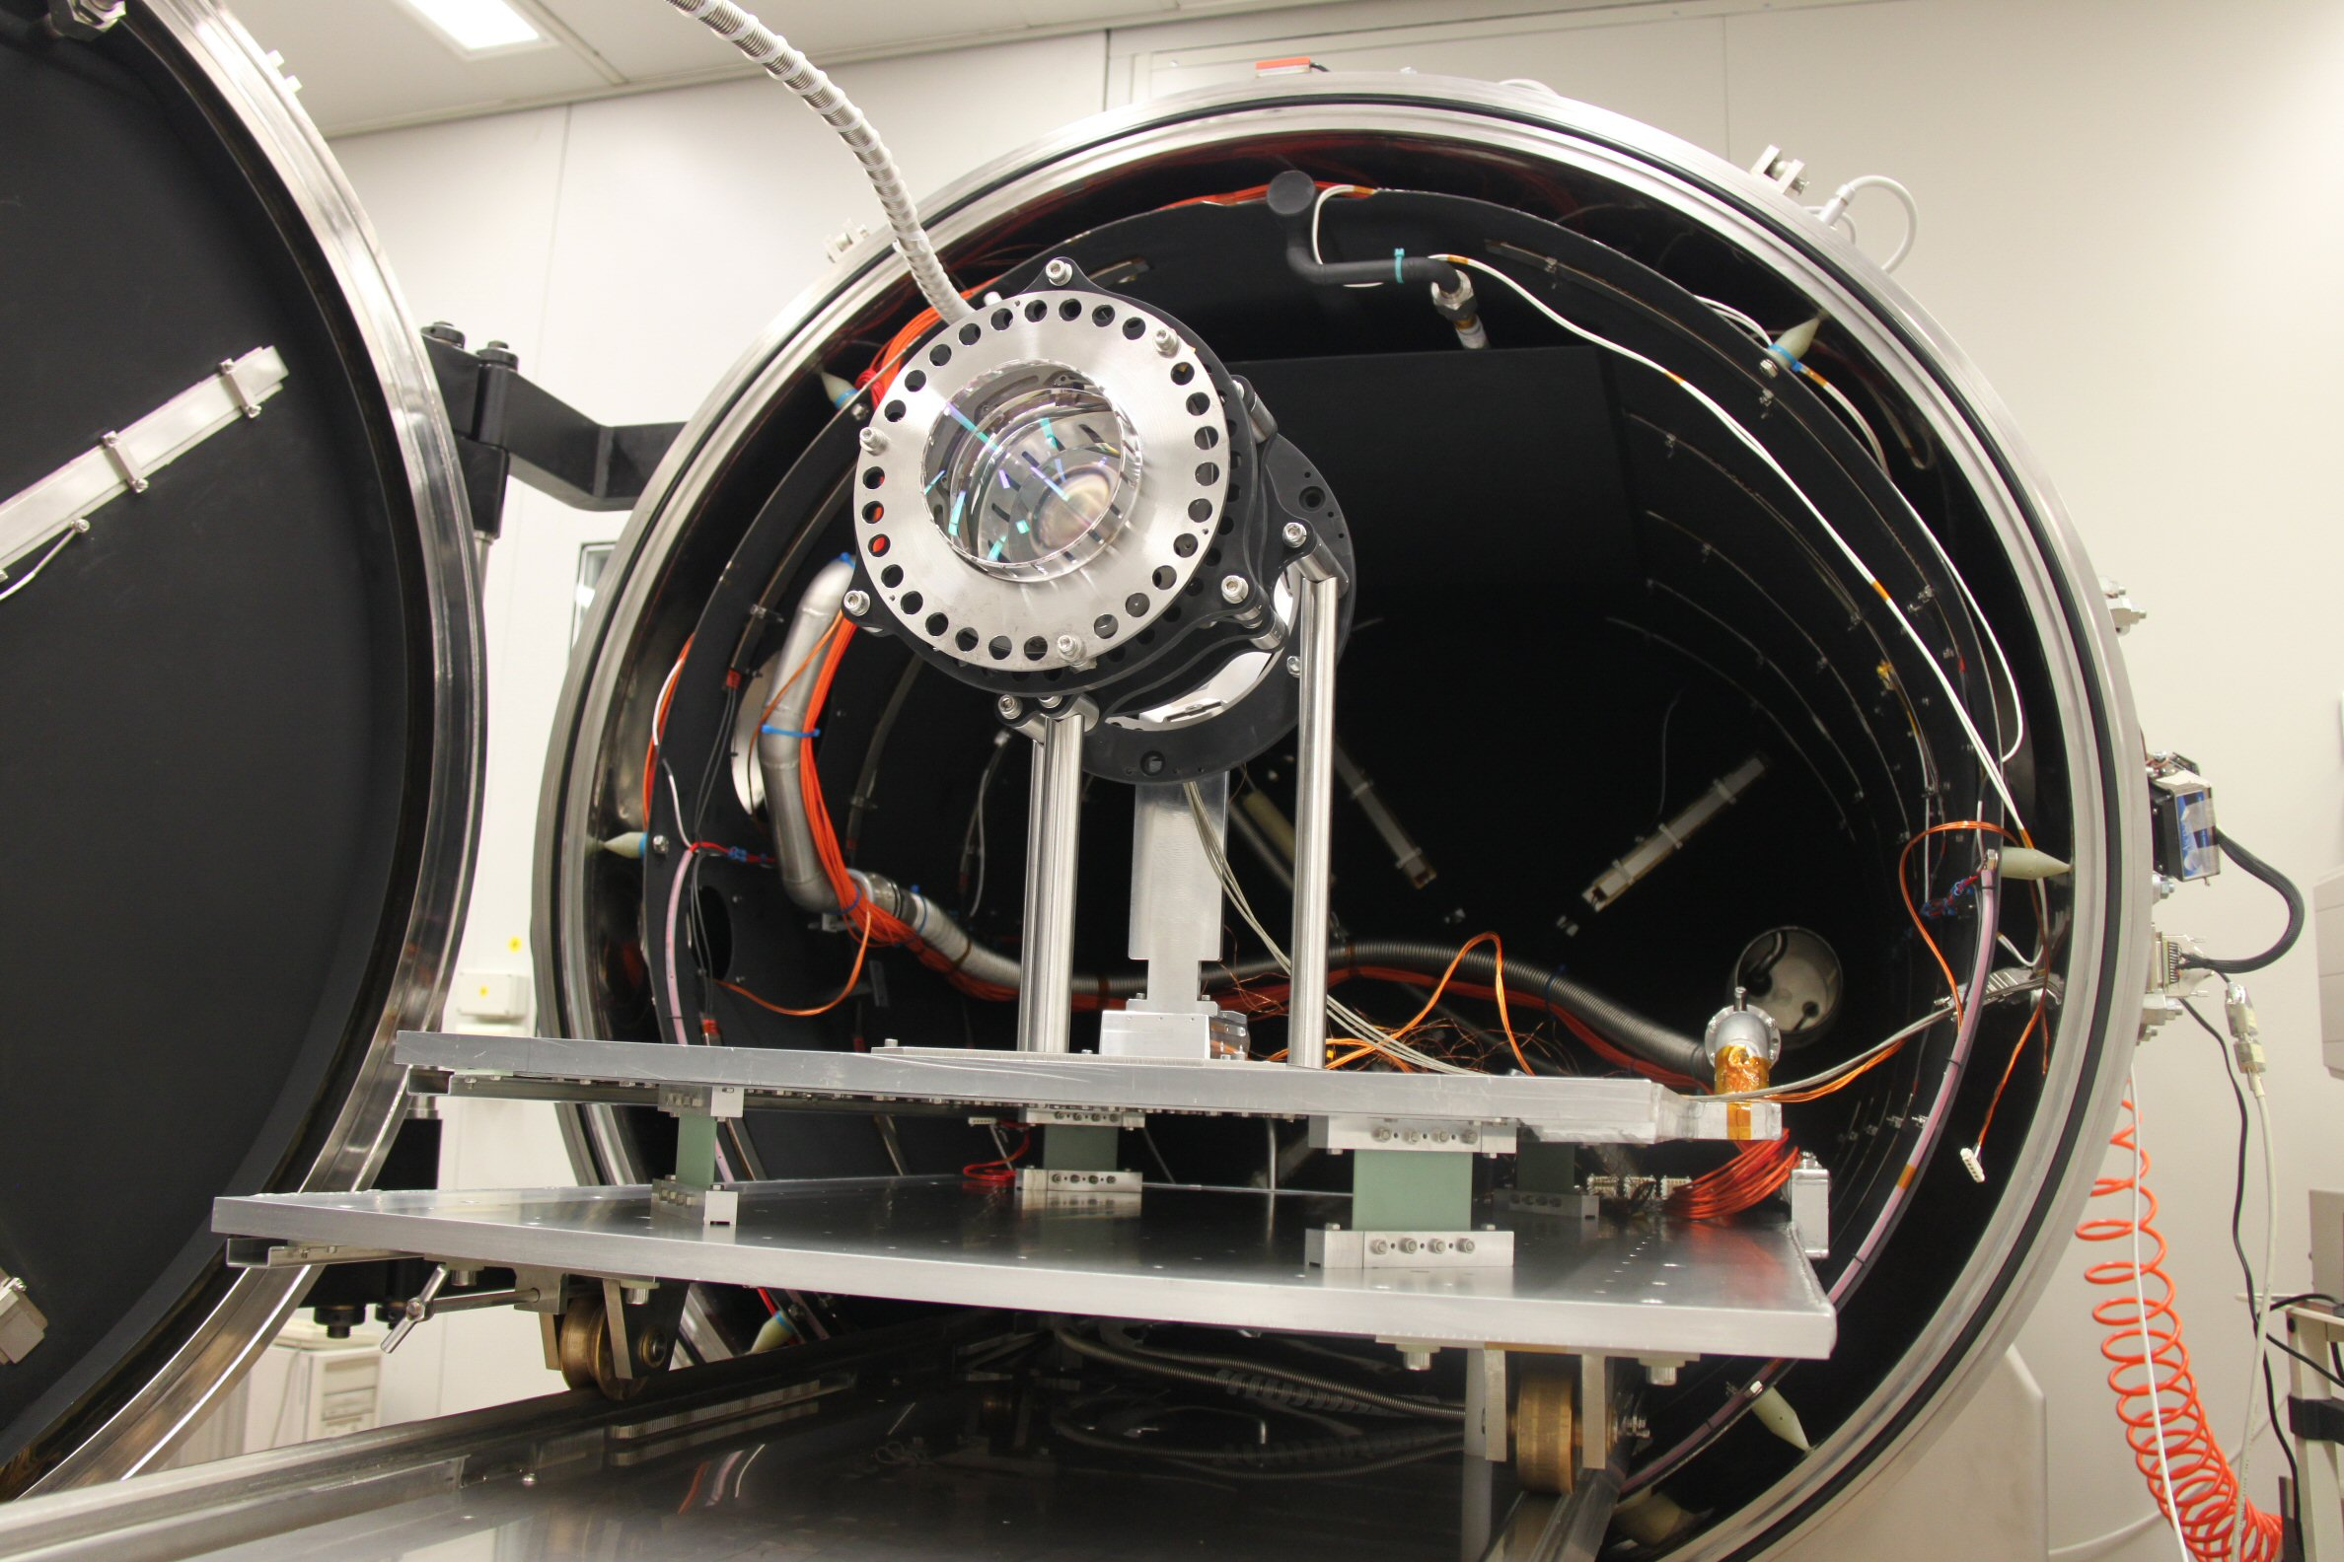
PLATO Breadboard
(2011)

Slide 23
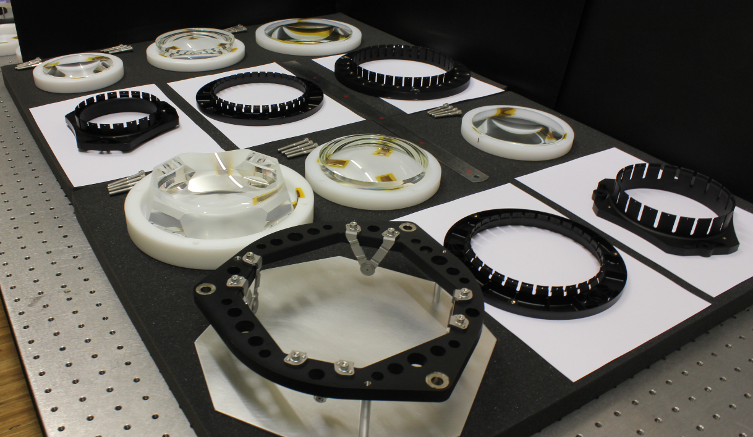
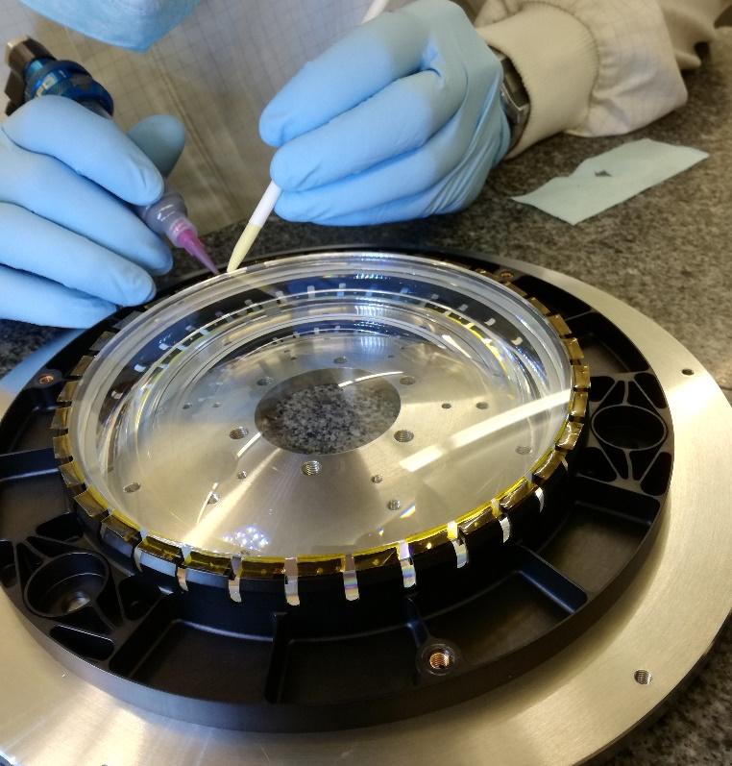
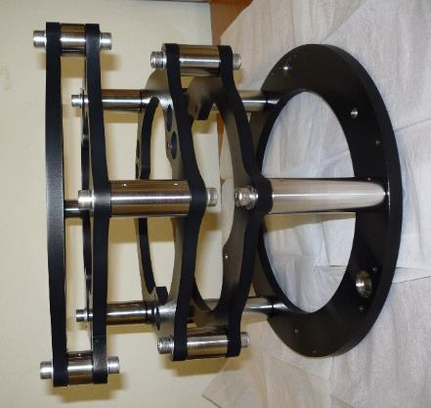
PLATO
Prototype
(2015)

Slide 24
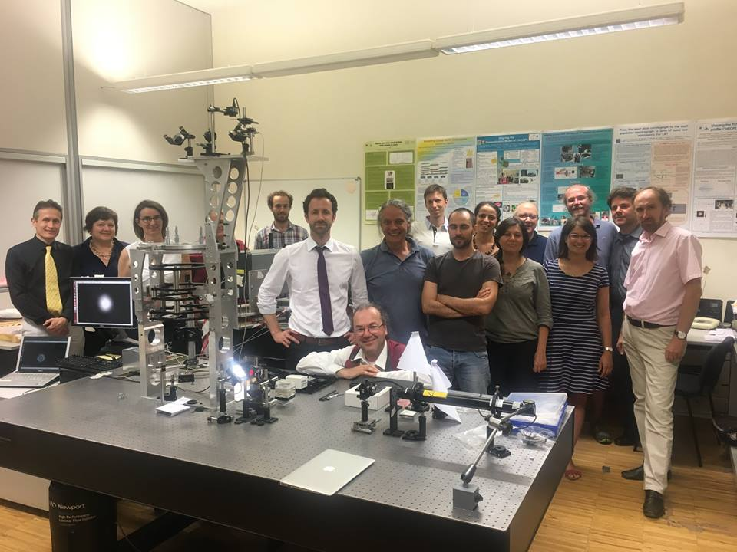
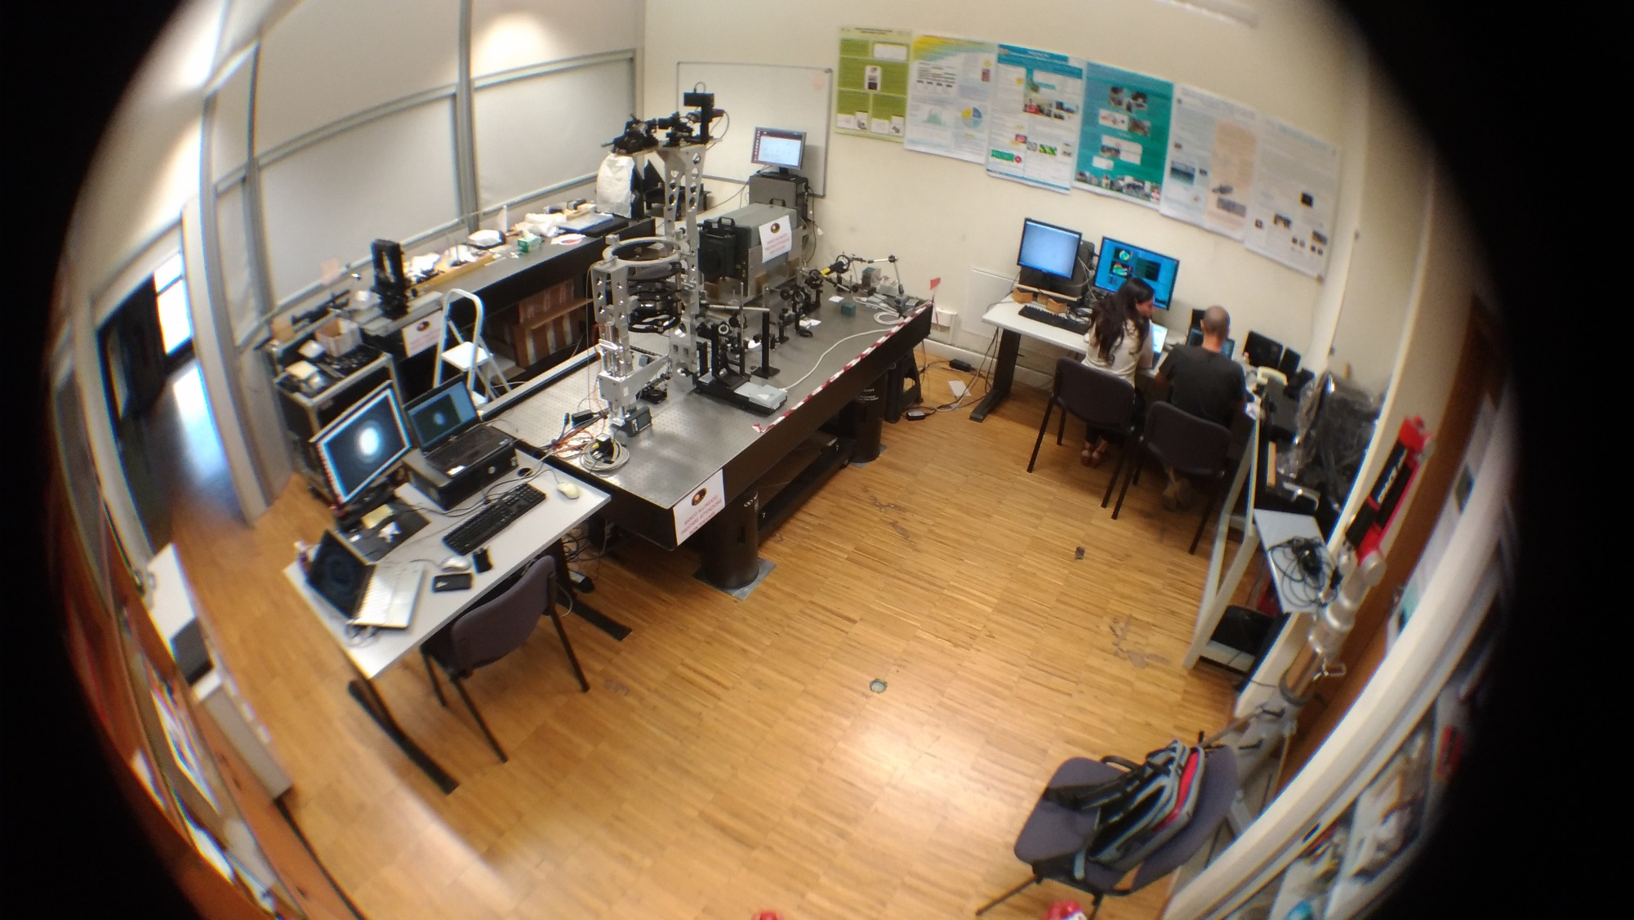
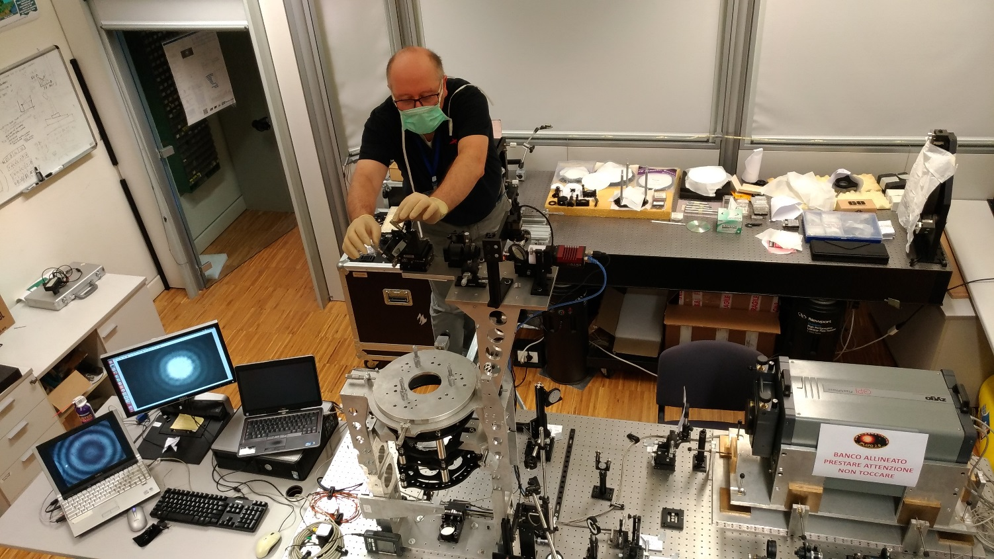

Slide 25
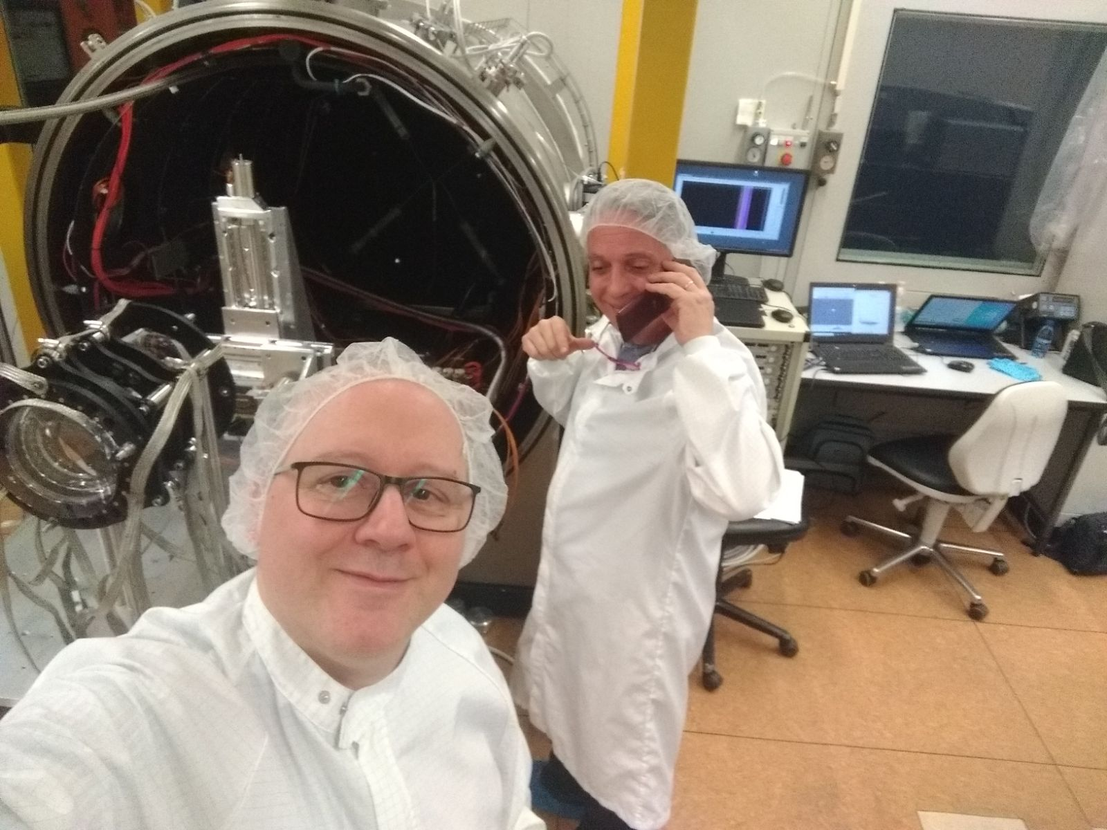
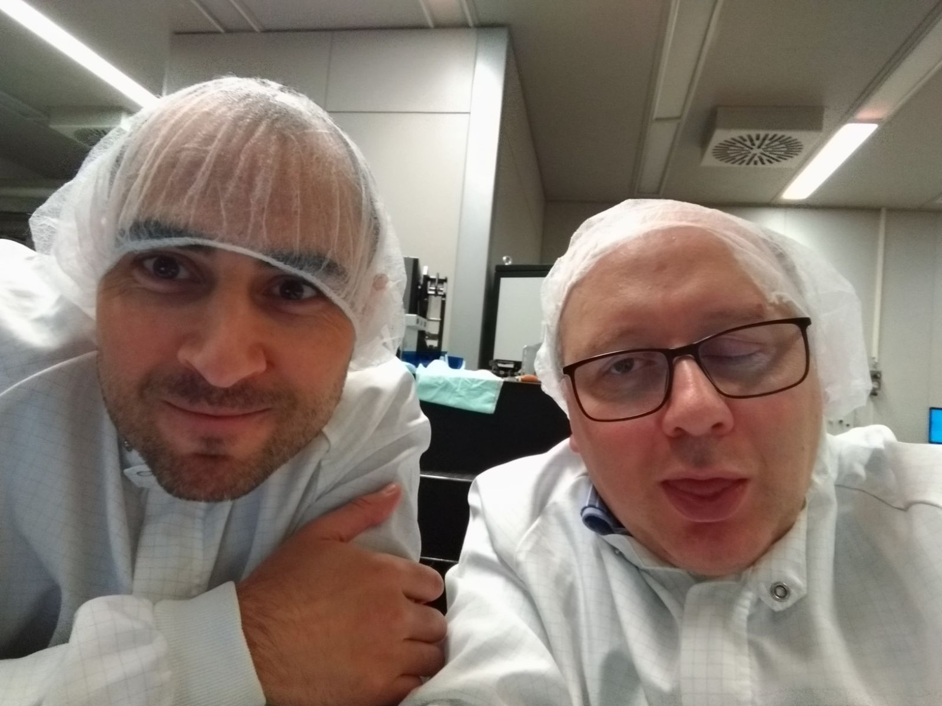
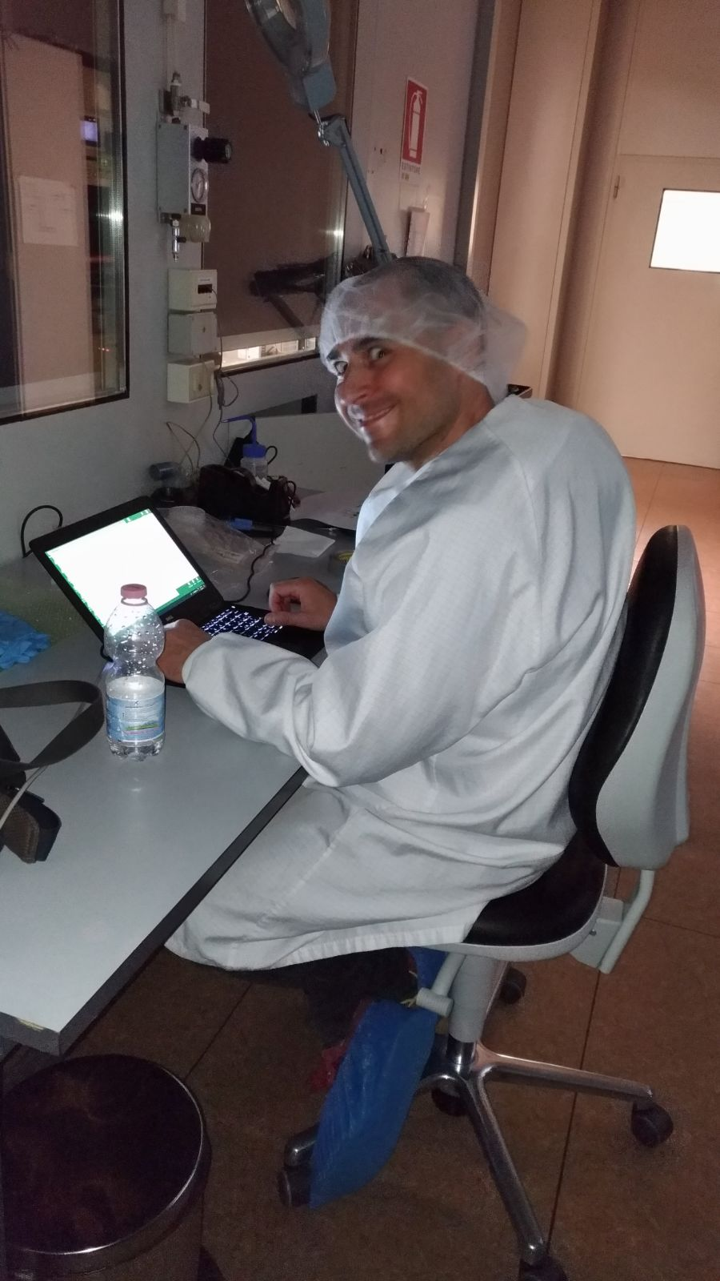

Slide 26
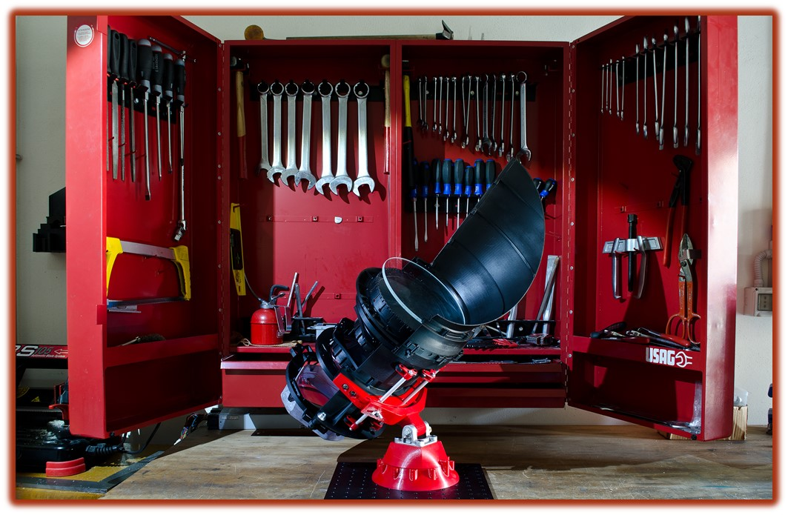
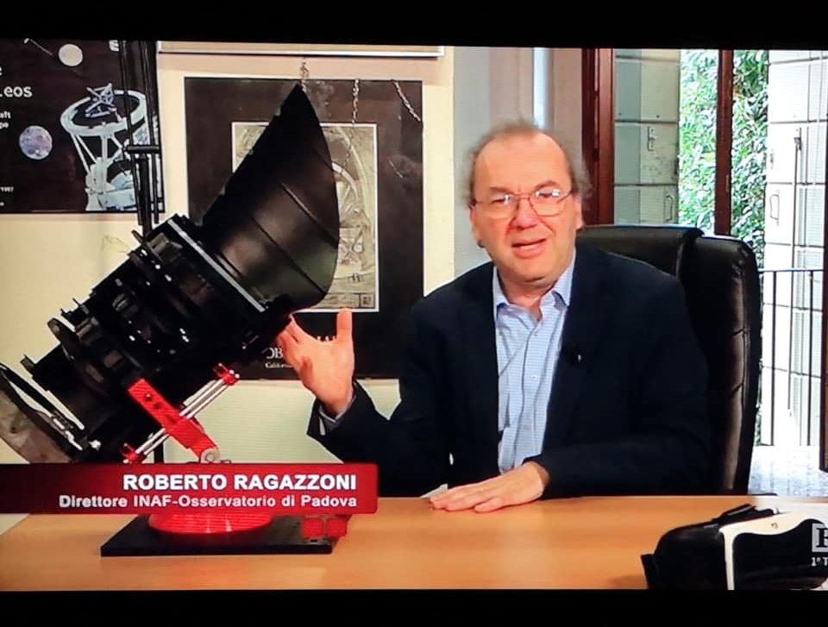
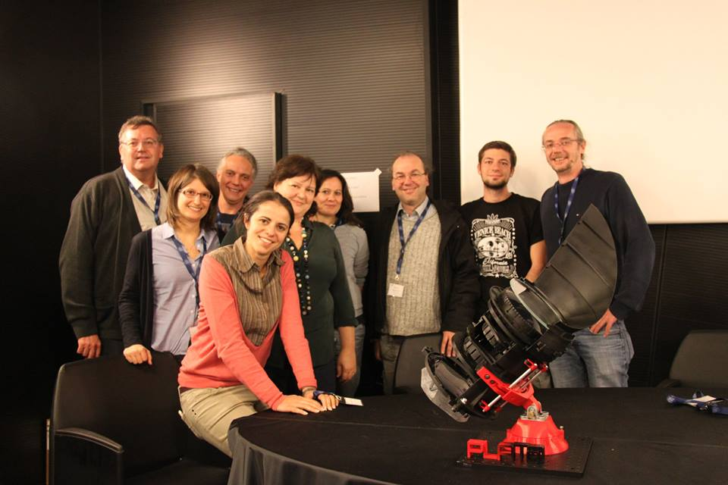

Slide 27
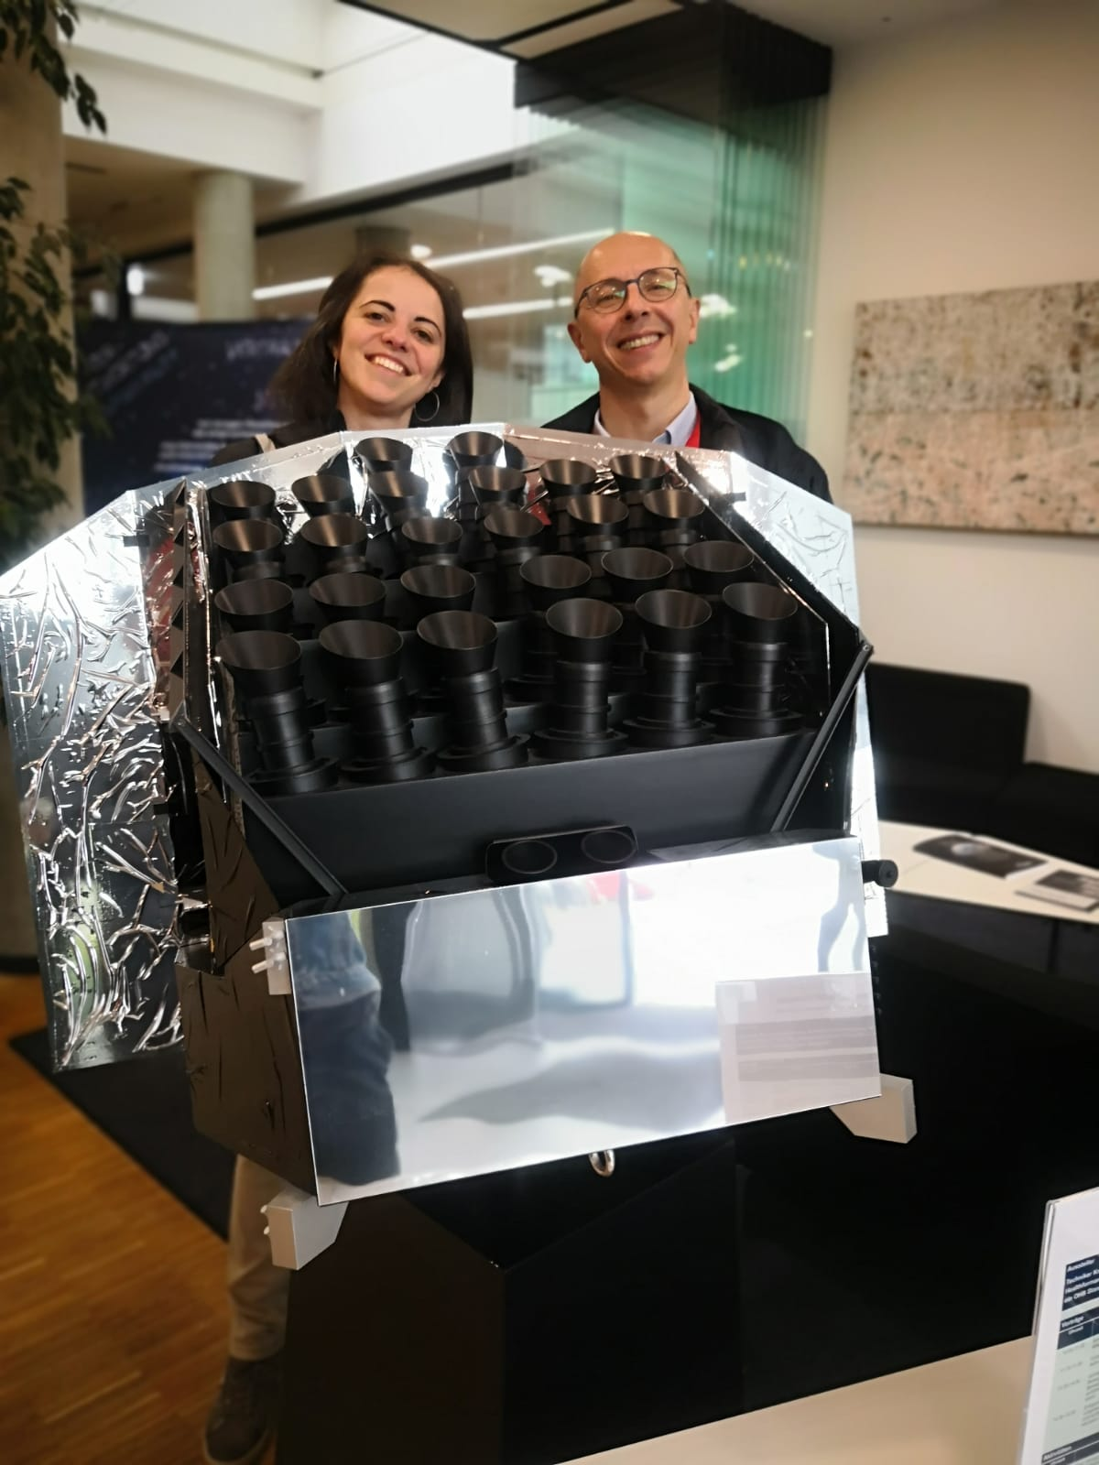
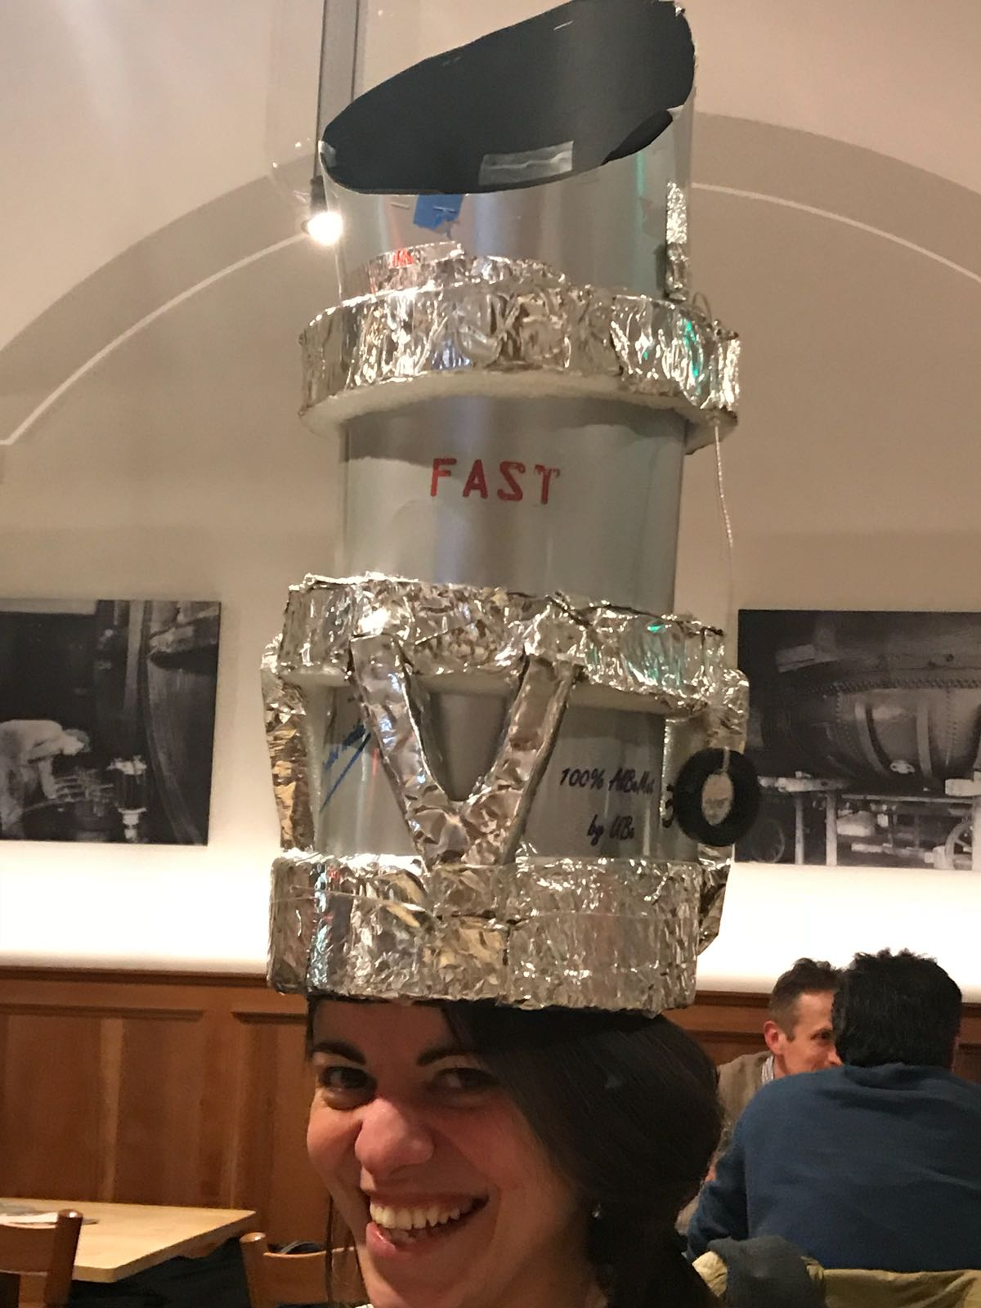
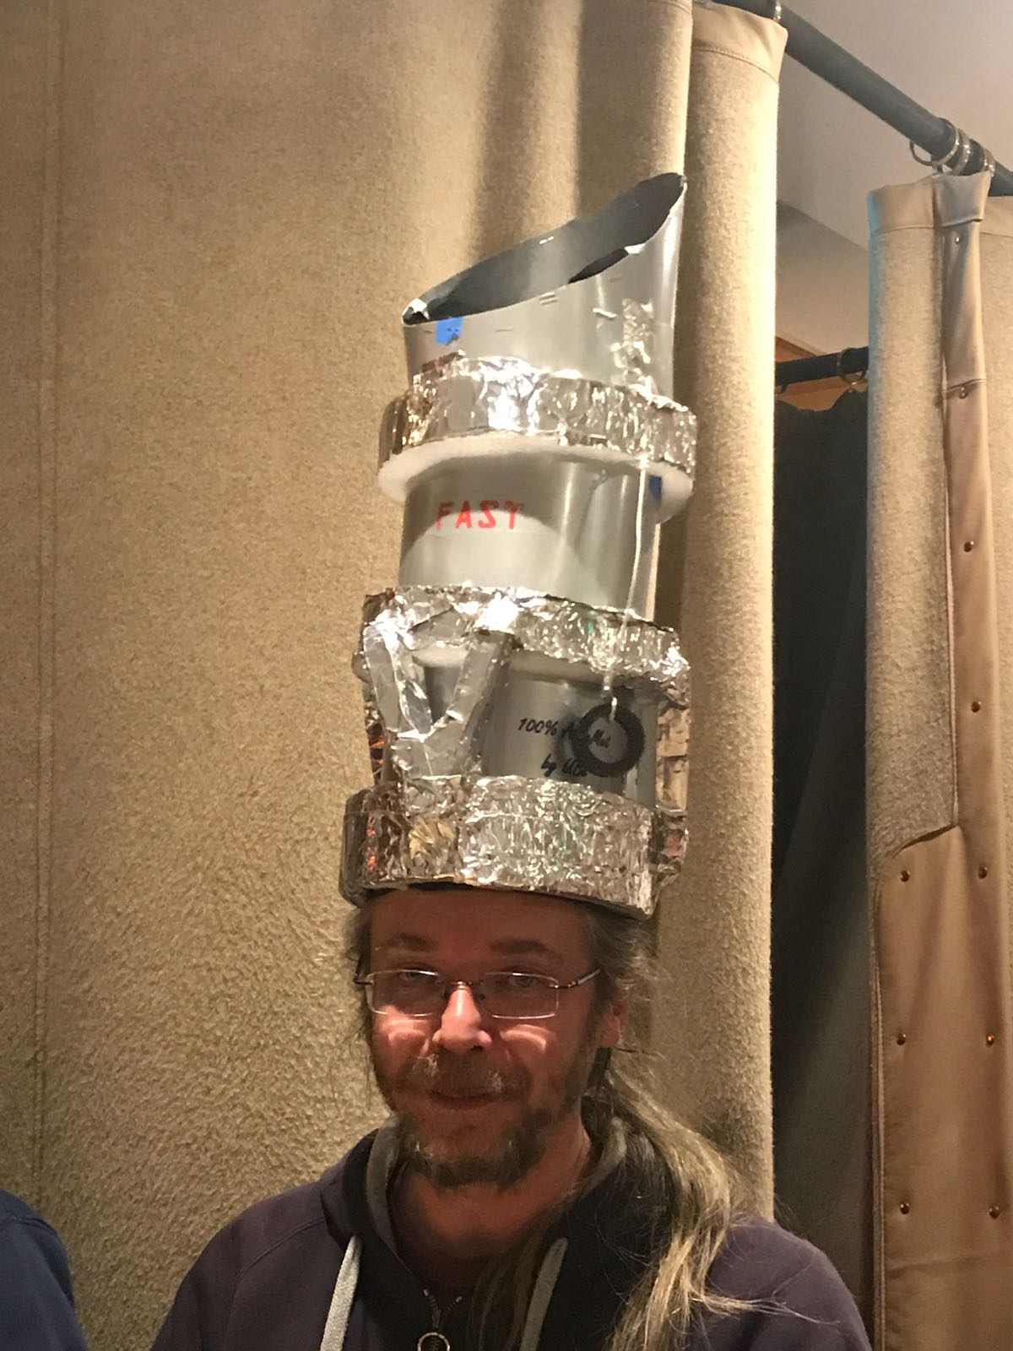
Full Payload
Fast TOU #1
Fast TOU #2

Slide 28
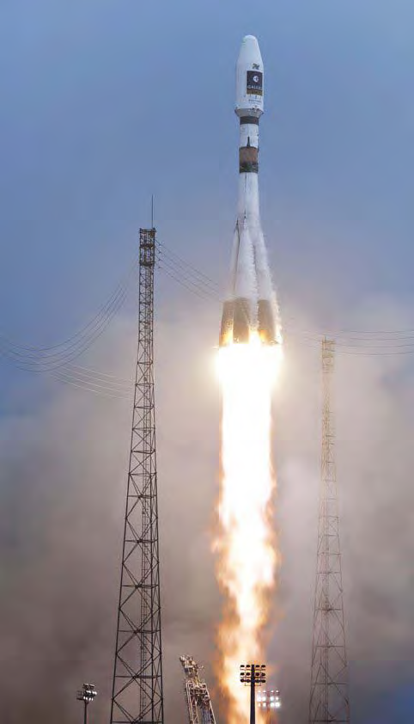
Stay Tuned!
CHEOPS: Launch on October-November 2019
@ @CHEOPS_IT
PLATO:
Launch on 2026
@PLATOMissionCon
Notes:
PLATO: Soyuz 2
CHEOPS: Soyuz 2

