Slide 1
SHARK-NIR
Daniele Vassallo on behalf of SHARK-NIR team
OAPd days, June 18 2019

Slide 2
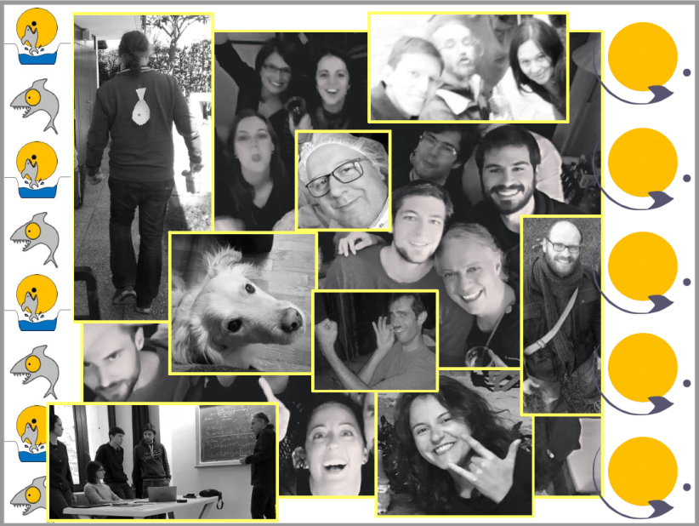
THE Padova SHARK-NIR TEAM
PI: Jacopo Farinato
System Engineer: Valentina Viotto
Project Manager: Maria Bergomi
Optical design: Davide Greggio, Demetrio Magrin
Mechanical design: Tomelleri Srl with a local interface: Luca Marafatto
Procurement: Maria Bergomi, Davide Greggio, Daniele Vassallo, Valentina D’Orazi, Luca Marafatto, Simonetta Chinellato
AIV Team: Luca Marafatto, Federico Biondi, Elena Carolo, Luigi Lessio, Gabriele Umbriaco, Maria Bergomi, Marco Dima, Davide Greggio, Daniele Vassallo, Kalyan Radhakrishnan
SW Team: Marco De Pascale, Andrea Baruffolo, Bernardo Salasnich, Daniela Fantinel
Data reduction: Dino Mesa, Elena Carolo, Daniele Vassallo
Coronagraphic performance & simulation: Daniele Vassallo, Elena Carolo
Science Team: Valentina D’Orazi, Raffaele Gratton, Silvano Desidera
Notes:
40 ordini

Slide 3
THE SHARK-NIR CONSORTIUM
Steward Observatory (LBTI interfaces, NIR camera sub-system)
MPIA (Motors electronics and SW design support)
IPAG (Coro mask design)
INAF-Brera (Dispersive elements design)
INAF-Trieste (Data archiving)
INAF-Arcetri (AO Interface)
INAF-Roma (Synergy with VIS Channel)
Science team (astronomers from 12 institutes)

Slide 4
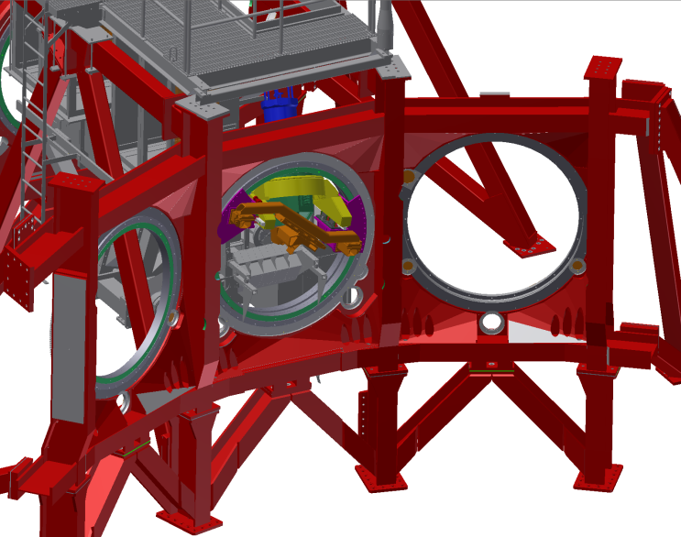
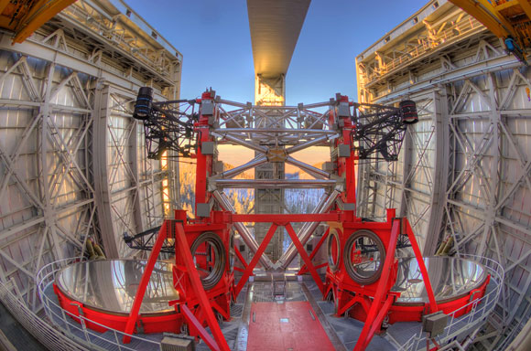
WHAT IS SHARK-NIR?
Camera for high-contrast imaging and spectroscopy in the NIR, mainly dedicated to detection and characterization of exoplanets
Observing modes:
Classical Imaging
Coronagraphic imaging
Long Slit spectroscopy
Dual Band Imaging
Synergy with other LBT instruments
(SHARK-VIS, LMIRCAM)
SHARK-NIR
LBTI
SHARK-VIS

Slide 5
INSTRUMENT SPECIFICATIONS
SHARK-NIR main characteristics
Observing Modes | Imaging/Coronagraphy/Spectroscopy/DBI
Detector format [px] | 2048x2048 (≈1220x1220 used area)
Waveband [μm] | 0.96 – 1.7
FoV ["] | 18 x 18
FoV along the diagonal ["] | 25.5
Plate scale [mas/px] | 14.5
Airy Radius @ 0.96 micron [px] | 2
Nominal Strehl at <18’’ FoV diameter (in all Bands) | >98%

Slide 6
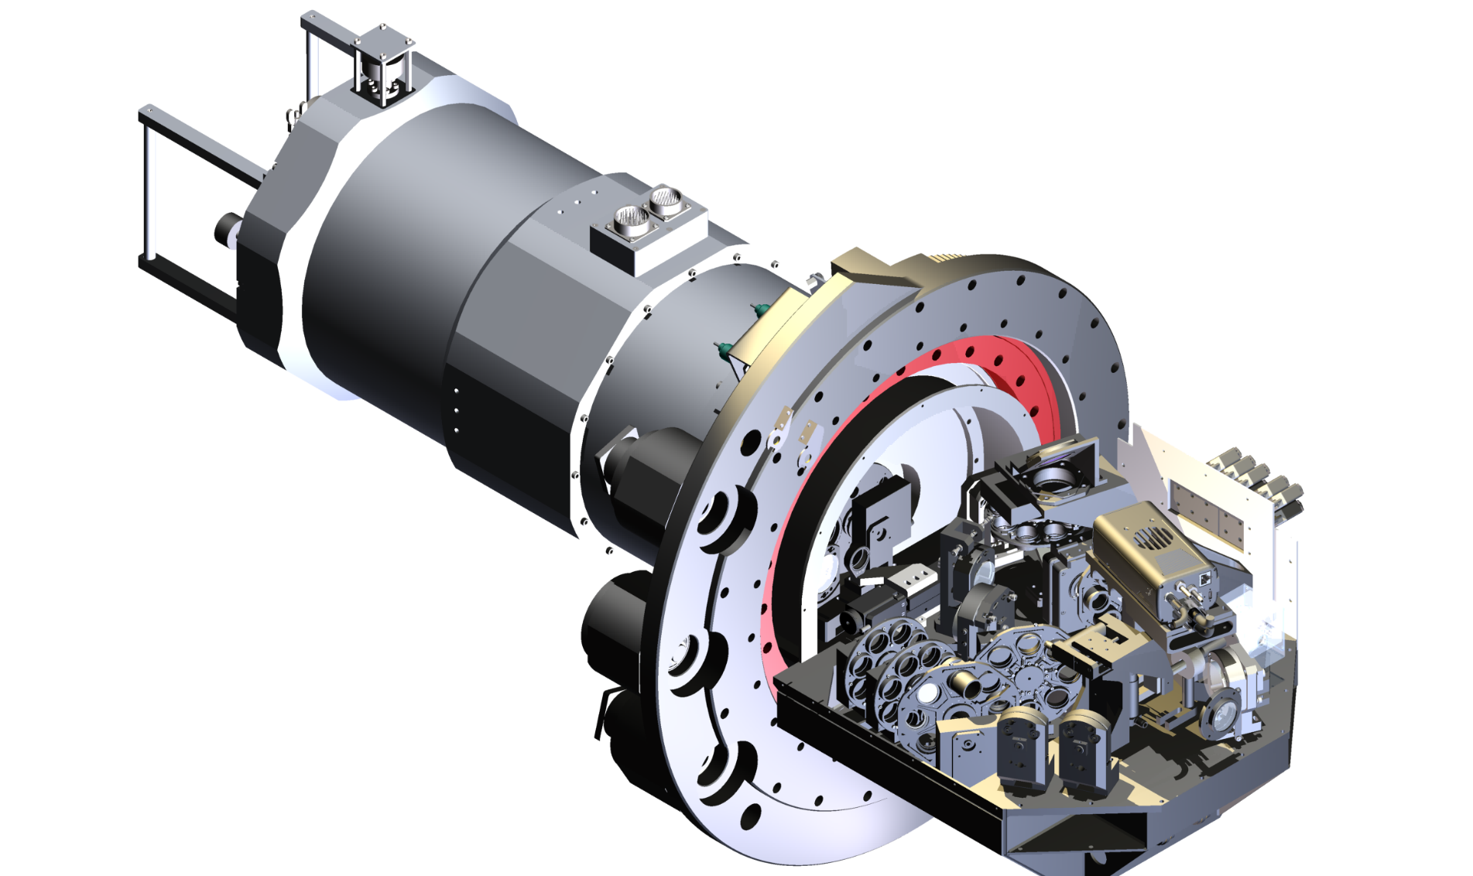
OPTO-MECHANICAL LAYOUT
Weight: 350 kg
Size: 1500 x 800 x 800 mm

Slide 7
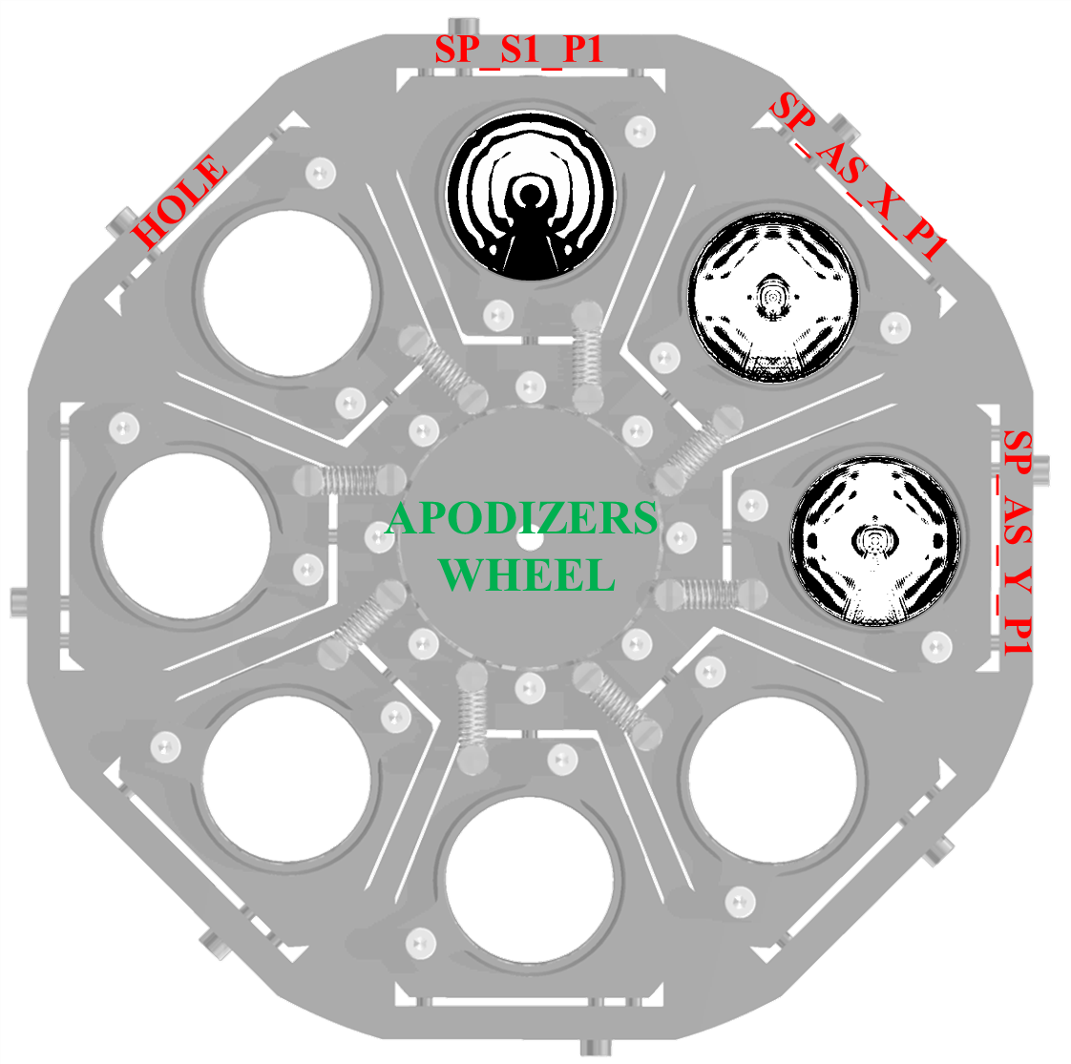
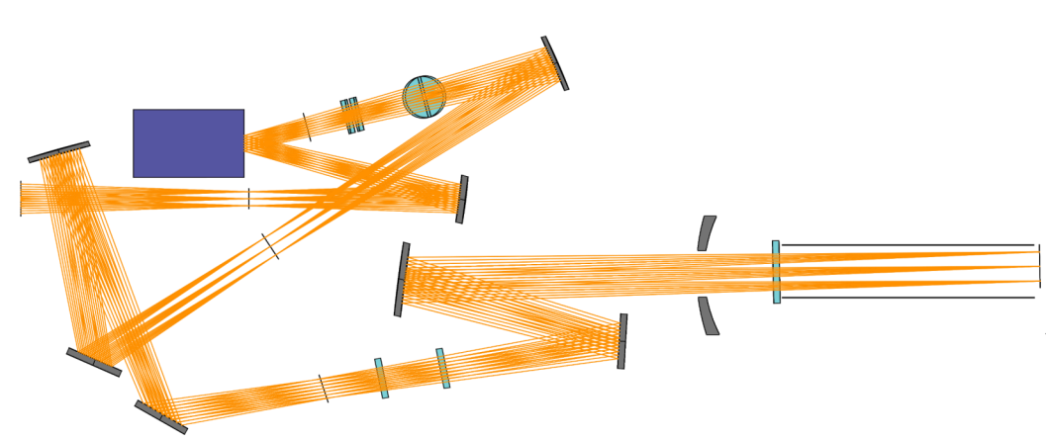
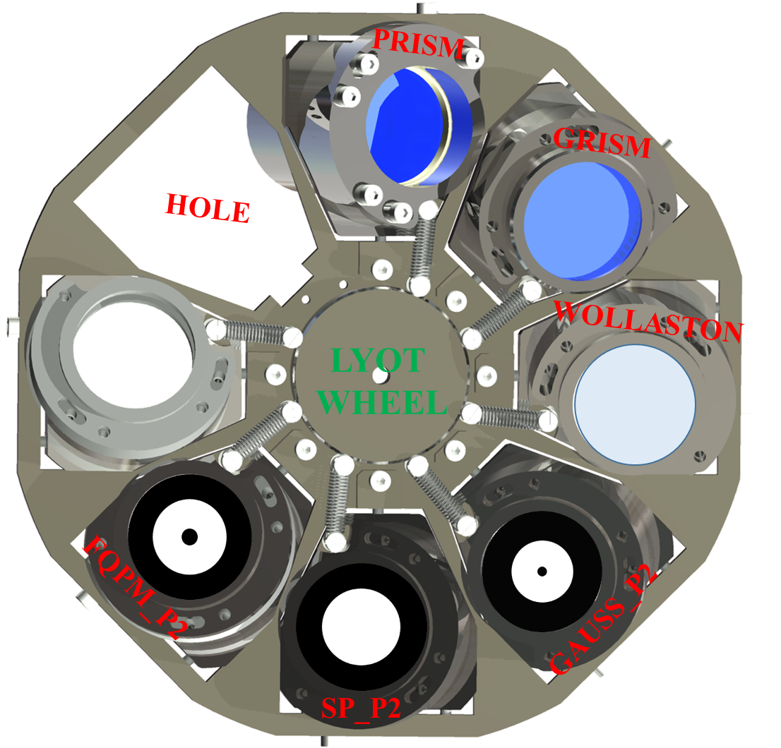
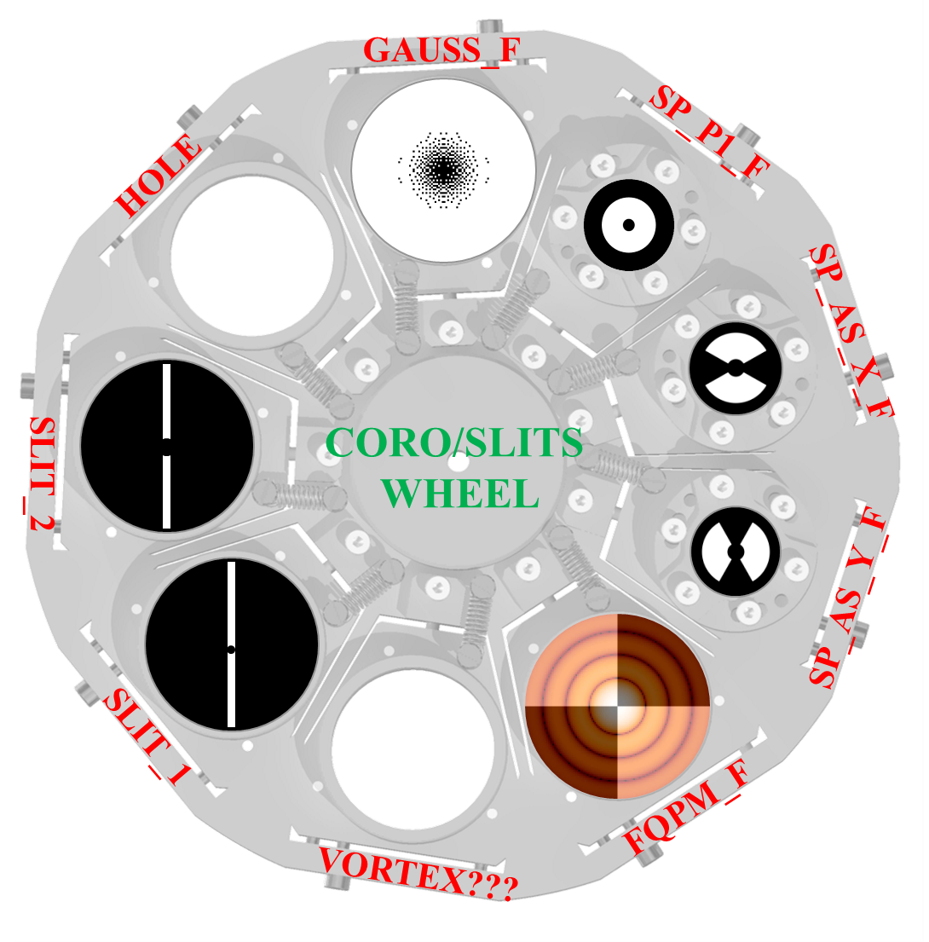
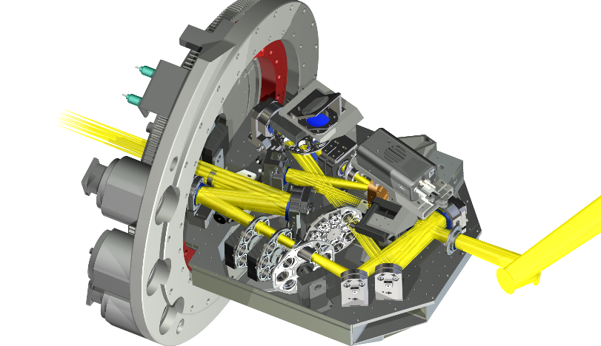
OPTO-MECHANICAL LAYOUT
beam splitter to
the tip-tilt WFS
apodizer
DM
ADC
off-axis
parabola
Coronagraphic planes
off-axis
parabola
Pupil lens
(deployable)
off-axis
parabola
cryostat
window
detector
incoming
light
off-axis
parabola
~300 mm
occulters
and slit
cold baffle
fold mirror
Narcissus
mirror
fold mirror
fold mirror
Lyot stop,
GRISM
Science filter
wheels
~600mm

Slide 8
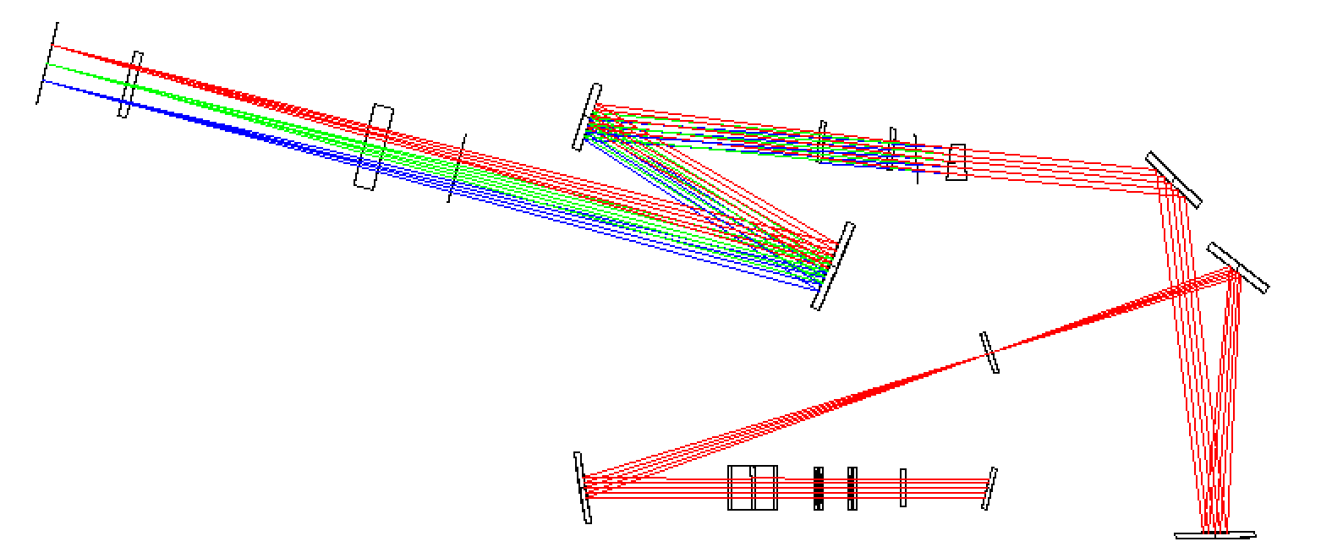
SPECTROSCOPIC MODE
DISPERSIVE ELEMENTS
 | Low Res | Medium Res
Dispersing element | Prism | Grism
R | 100 | 700
CORO SLITS WITH OCCULTER
 | Slit width | Occulter size
Coro slit 1 | 100 mas | 100 mas
Coro slit 2 | 100 mas | 200 mas
Focal plane

Slide 9
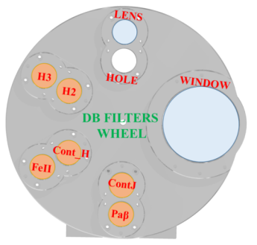
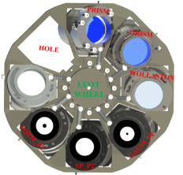
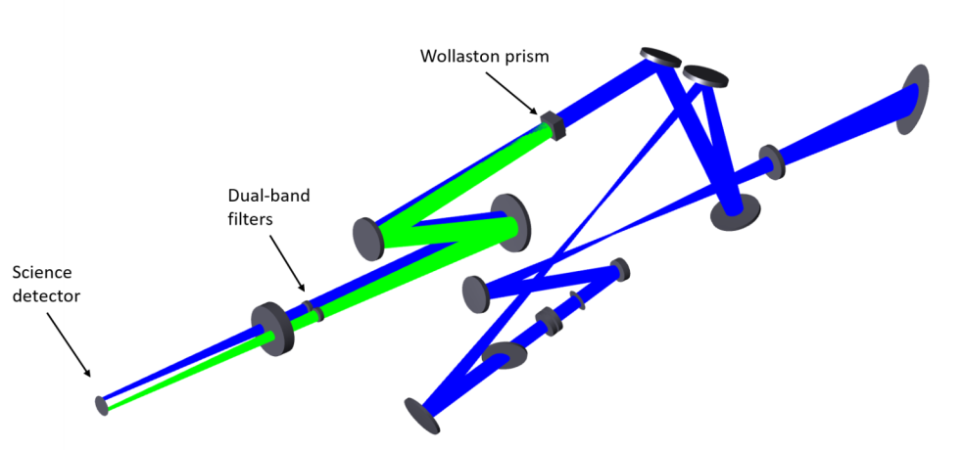
DUAL BAND IMAGING MODE
Pupil plane
DUAL BAND FILTERS
Name | λ₁ [nm] | Δλ₁ [nm] | λ₂ [nm] | Δλ₂ [nm]
HOLE (no DBI) | - | - | - | -
H2-H3 | 1588.8 | 53.1 | 1667.1 | 55.6
ContJ-Pa β | 1215.7 | 18.3 | 1281.3 | 20.9
ContH-Fe II | 1557.8 | 24.1 | 1645.5 | 26.1
Phase diversity | Window |  | Defocusing lens
NIR Camera
Window
Radial FoV 1”

Slide 10
THE HIGH-CONTRAST IMAGING FORMULA
How do we obtain high contrast in the vicinity of such bright stars?
XAO correction +
Optimized wavefront control strategy +
Coronagraph(s) +
Post-processing pipeline =
High contrast

Slide 11
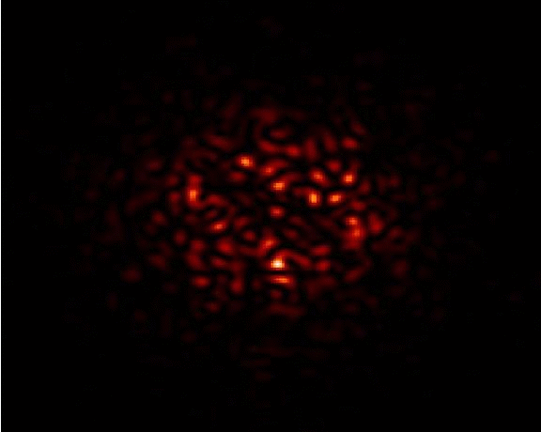
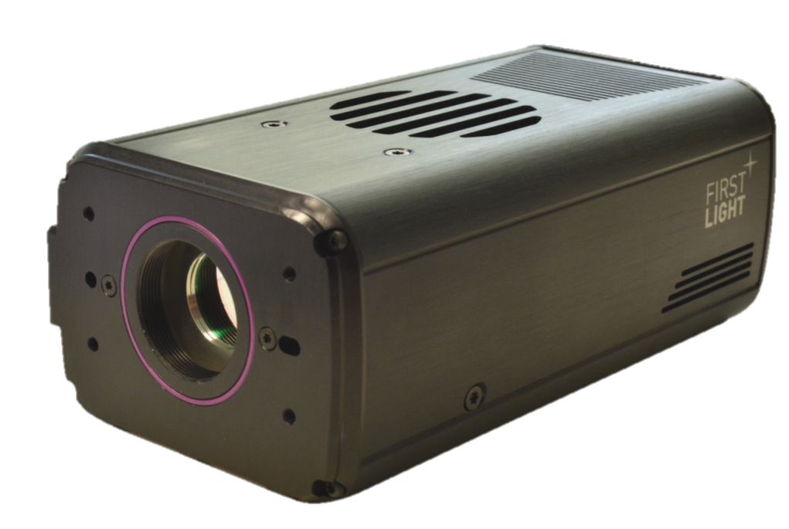
WAVEFRONT CONTROL
A deformable mirror to correct for instrumental aberrations and to stabilize the PSF
WFS Camera
InGaAs camera (C-RED2)
Sensitive in the full SHARK-NIR waveband (0.96-1.7 μm)
Frame-rate up to 14 kHz (with 32X32 px window)
Low RON (<30 e⁻ )
3-5 mas precision up to R=10 @ 1KHz
Deformable Mirror
ALPAO DM 97-15
97 actuators, 13.5 mm pupil, up to 2 kHz speed
NCPA can be corrected internally without affecting pyramid’s performance
NCPA measured with phase diversity on science image

Slide 12
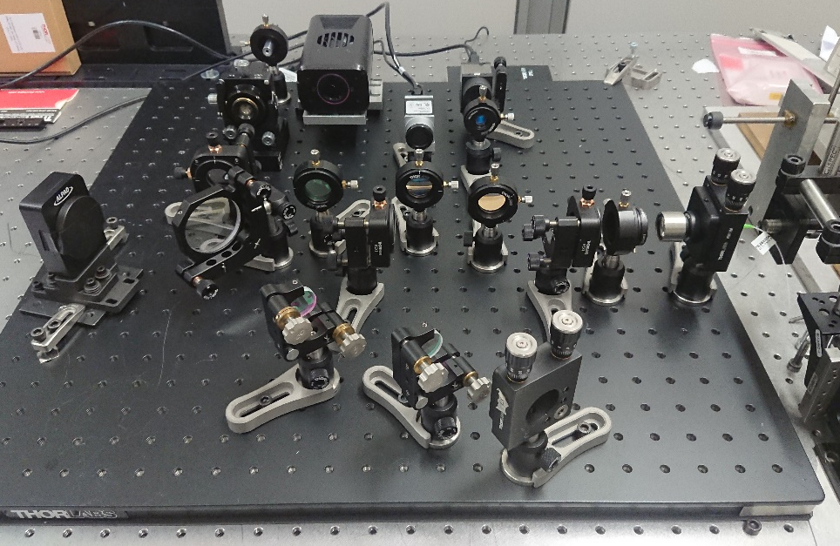
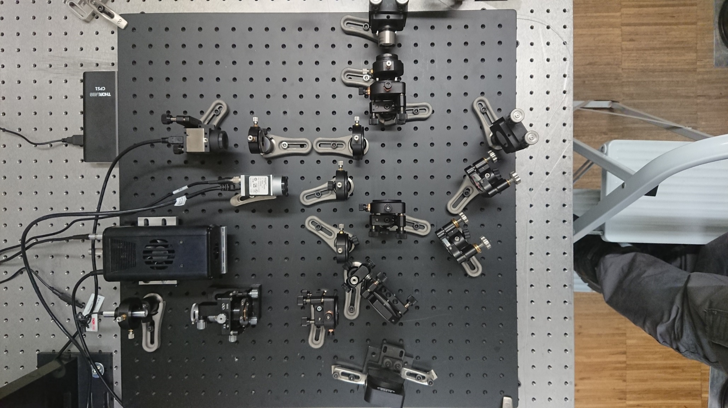
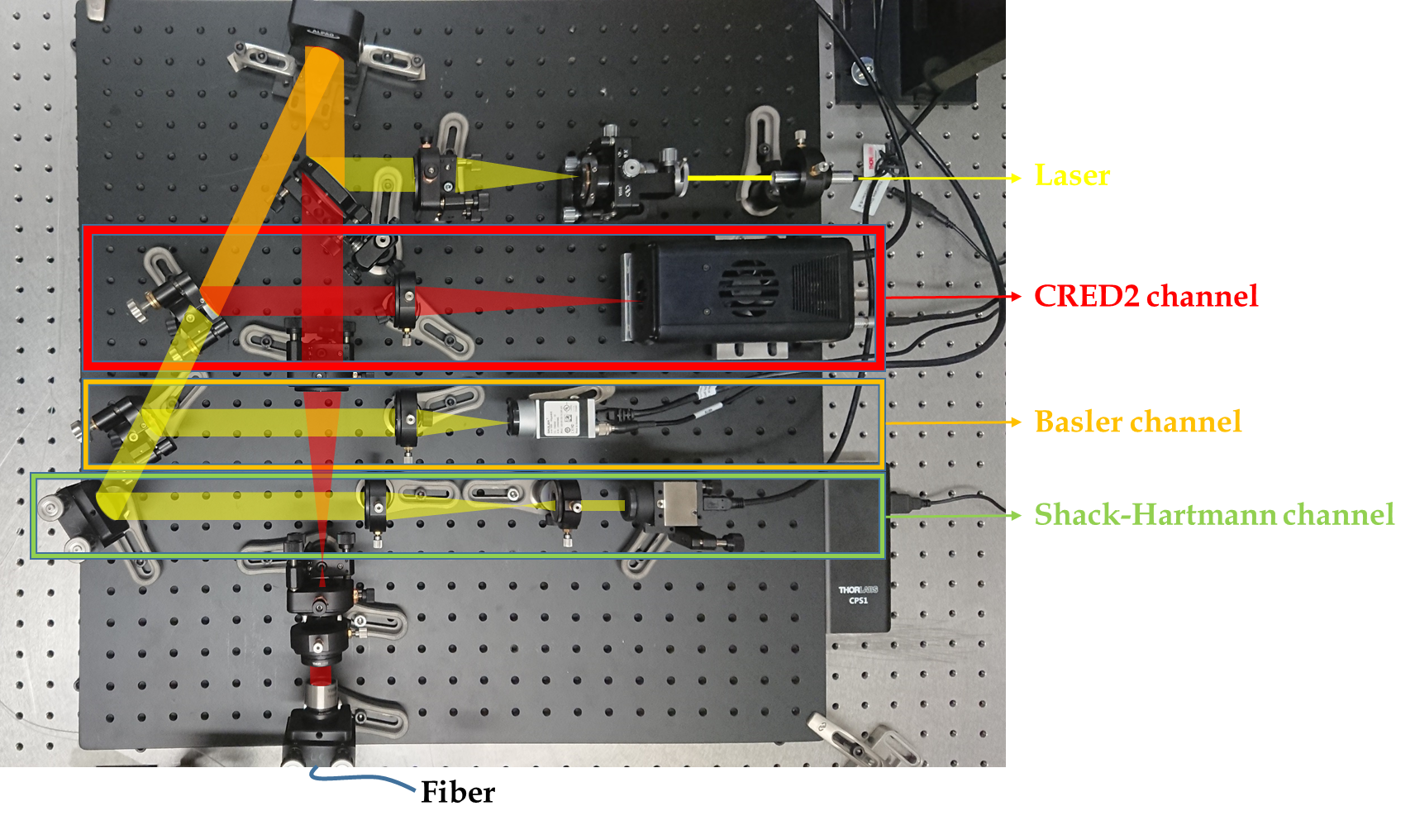
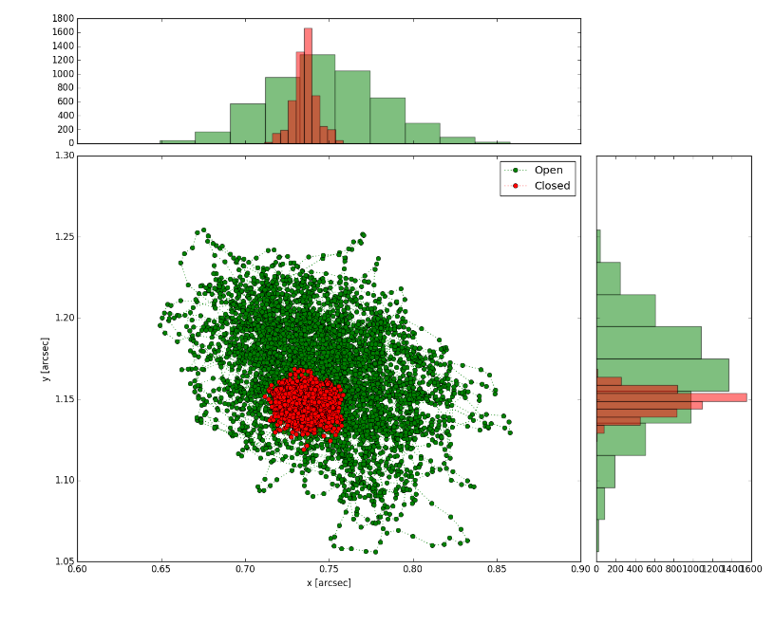
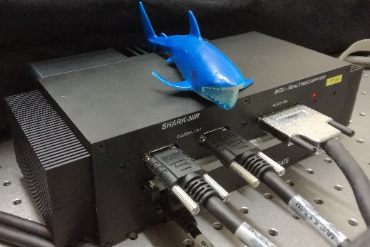
WAVEFRONT CONTROL - ON-GOING ACTIVITIES
RTC tests, applying a time history taken from real data at LBT
1 KHz correction
45 mas disturbance
RTC by Microgate:
TT control loop and quasi static NCPA application

Slide 13
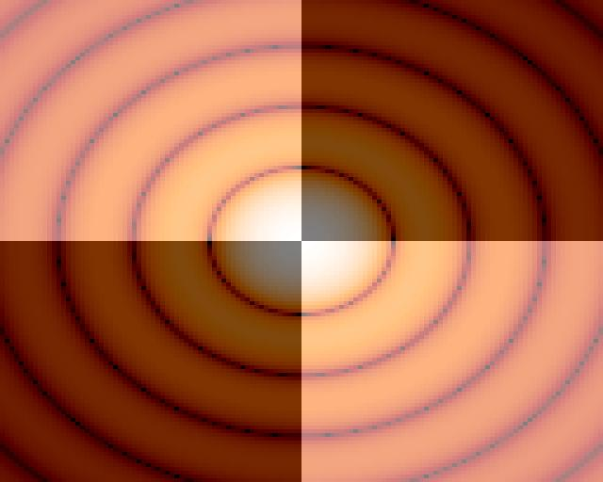
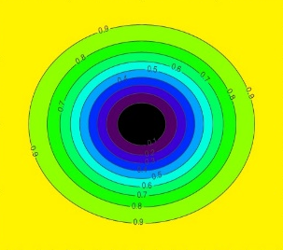
CORONAGRAPHS
1st pupil
plane
Intermediate
focal plane
2nd pupil
plane
Science
focal plane
Apodizer Mask
Occulter Mask
Lyot Stop
Scientific
image
Weak companion
Lyot stop
Weak companion
Exoplanets | FQPM Working in H-band Access to the whole 18ⅹ18’’ FoV Very small IWA (~50 mas) High throughput Very sensitive to low-order aberrations | SHAPED PUPIL Working in H-band Small field (100-300 mas) High contrast near to the star Robust to low-order aberrations
Disks/Jets/ AGN |  | GAUSSIAN LYOT Optimized for both J and H band observations Moderate contrast Access to the whole FoV
13

Slide 14
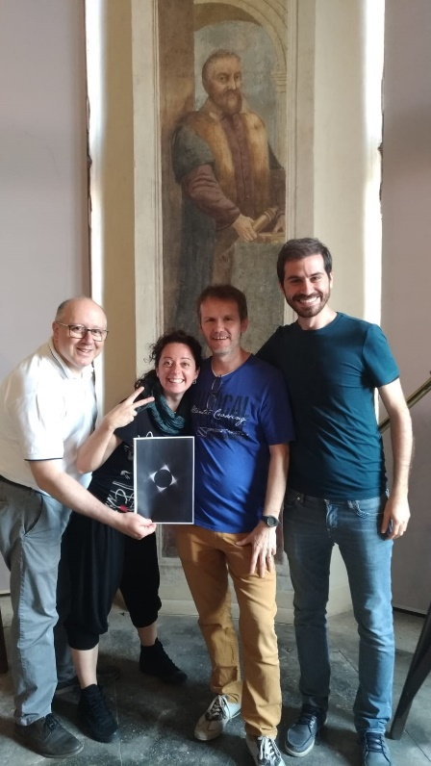
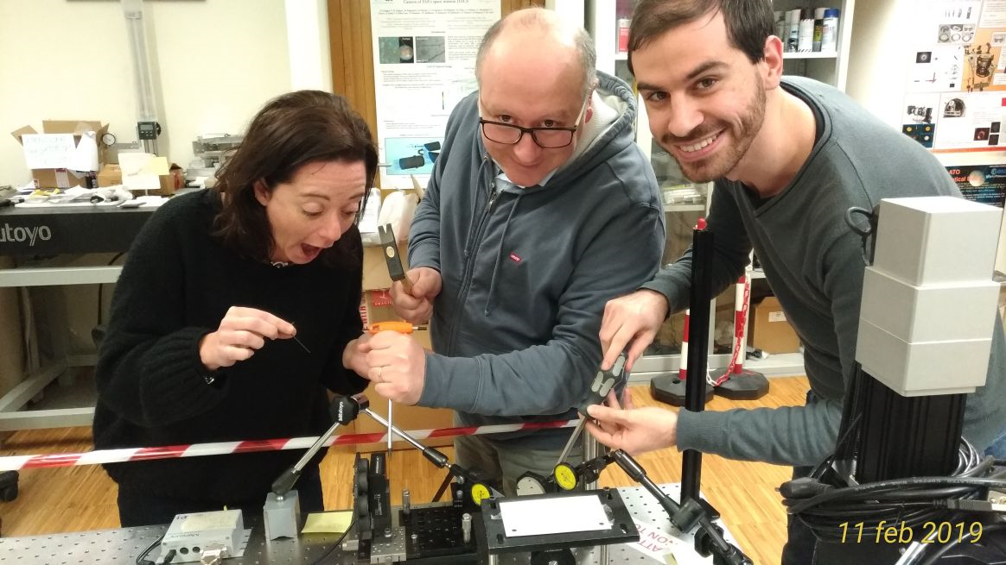
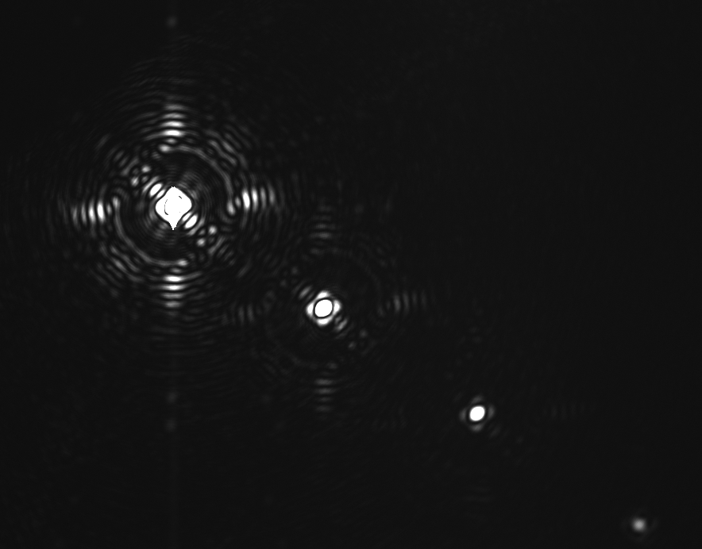
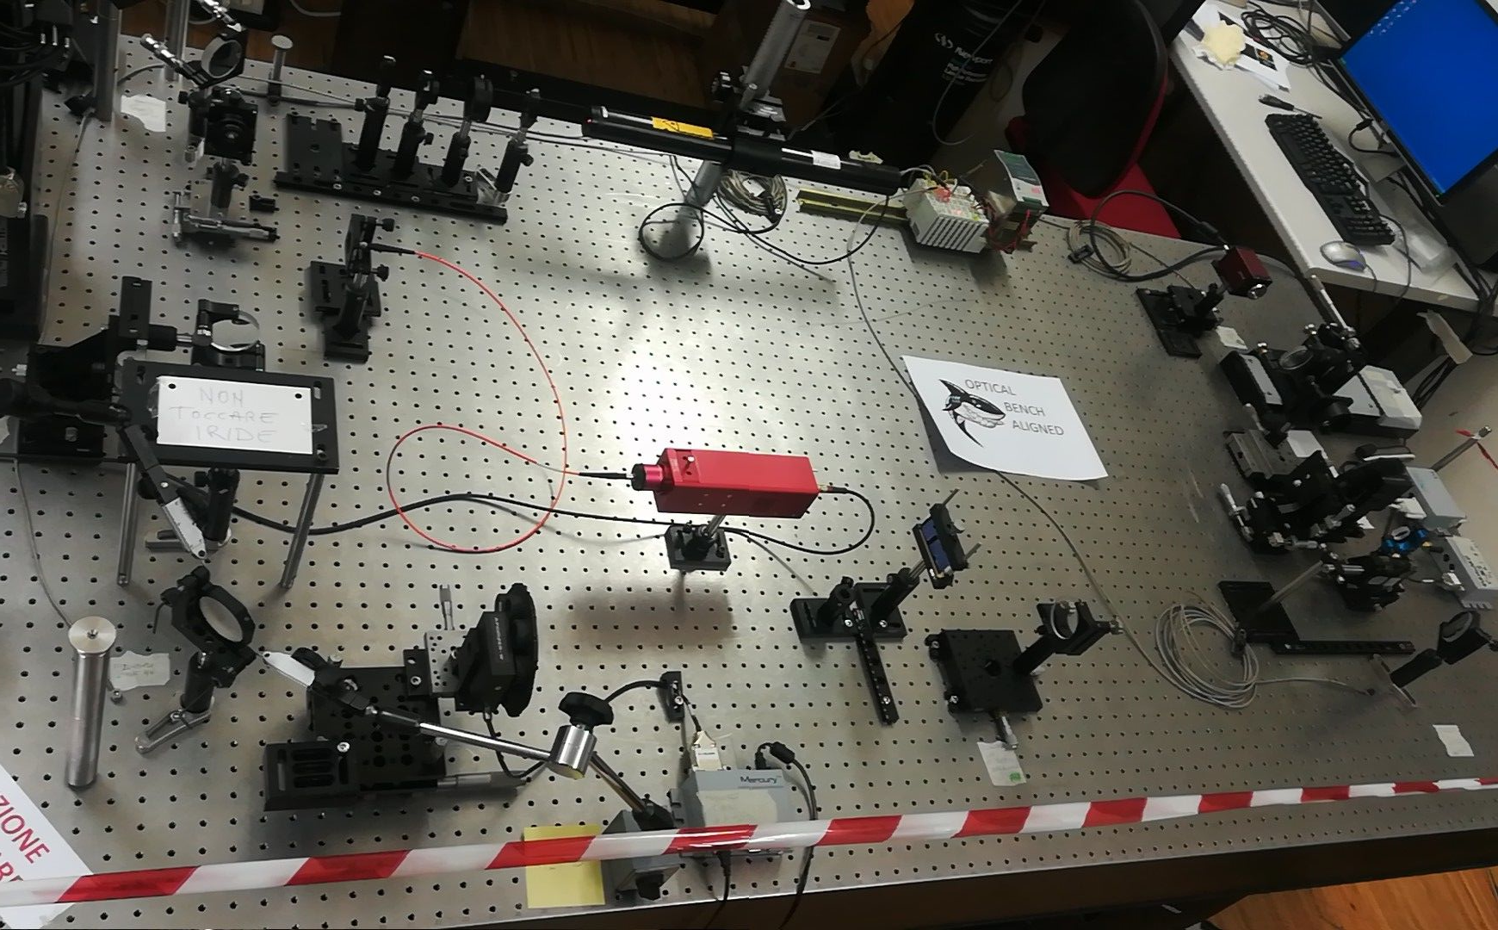
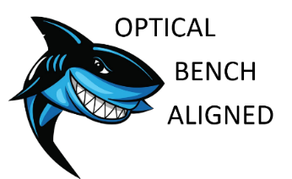
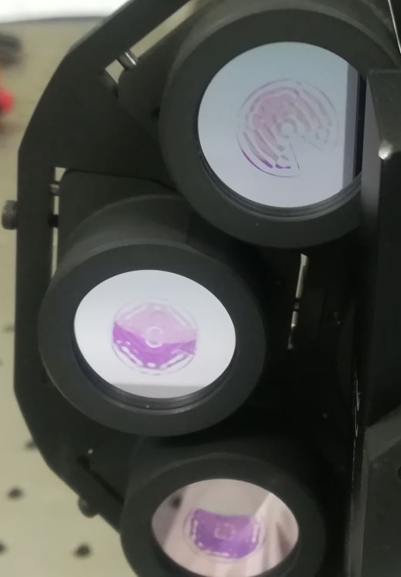
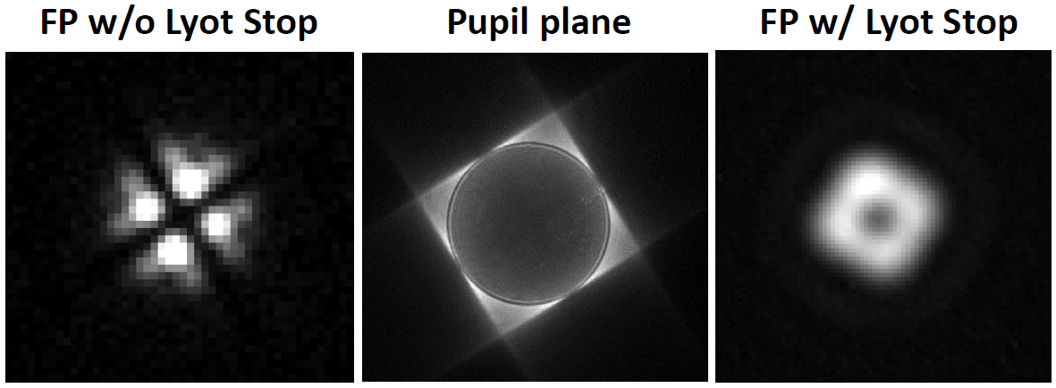
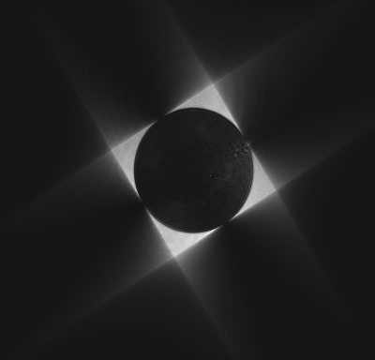
CORONAGRAPHS - ON-GOING ACTIVITIES
Coronagraphic masks characterization, performance analisys, alignment procedure
Simulated Real
Simulated Real

Slide 15
MILESTONES
2016 Feb. Conceptual Design Review end 2017 Jan. Final Design Review 2017 Apr. FDR delta review 2017 Jul. Board approval 2017 Aug. Start of procurement phase 2017 Nov. Start of AIV phase with component tests 2017 Nov. Delivery of the Electronics Rack from MPIA to INAF 2018 Oct. Delivery of the coronagraphic masks from IPAG to INAF 2019 Sep. Delivery of the NIR camera sub-assembly from SO to INAF 2019 Sep. Delivery of dispersive element 2019 Dec. End of SW MAIT 2019 Dec. End of AIV phase 2020 Mar. PAE review 2020 Mid Start of commissioning at LBT 2020 Fall SHARK-NIR in operation

Slide 16
Thank you for your attention!

