Slide 1
Electromagnetic counterpart of gravitationaL wave events
Enrico Cappellaro
Stefano benetti, riccardo ciolfi, LIna TOmasellA,
Massimo Turatto, andrea pastorello, sheng yang,
achille fiore, Nancy Elias-Rosa (michela MAPELLI)

Slide 2
2014 Nature news:
After two decades and more than half a billion dollars, LIGO, the world's largest gravitational-wave observatory, is on the verge of a detection.
Maybe.
GRAWITA
VST
trigger
X-Shooter
trigger
ENGRAVE
MoU INAF
Ligo/Virgo
O1
O2
O3
2014
2015
2016
2017
2018
2019
2020
Virgo
joining
LHVC
Nobel prize
public
alerts
first
BBH
first
BNS
14 CBC
triggers

Slide 3
GW170817 and the Kilonova
~80 papers
in one month
3 on Nature
for INAF

Slide 4
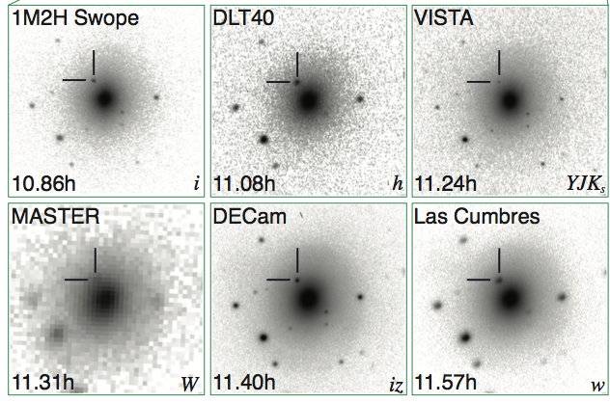
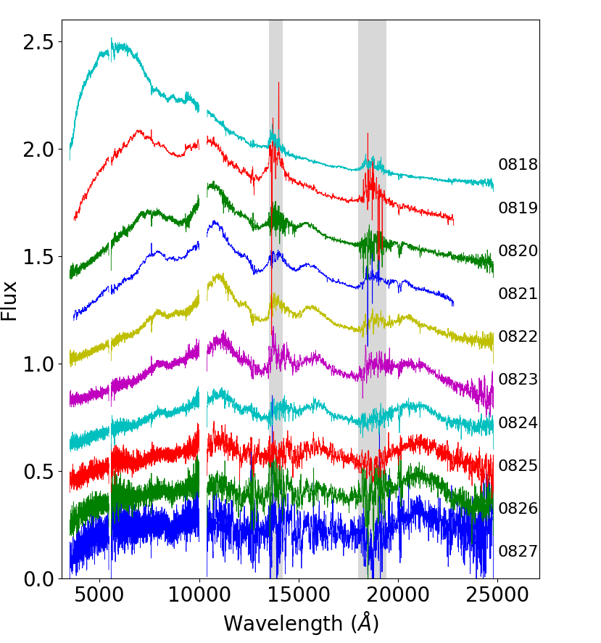
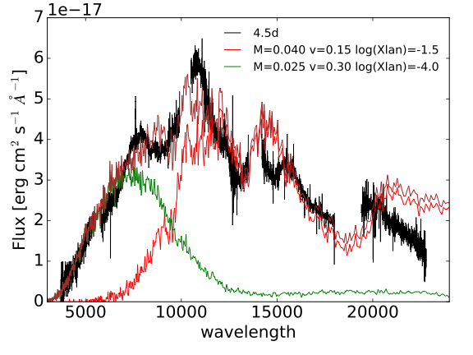
GW170817 and the Kilonova

Slide 5
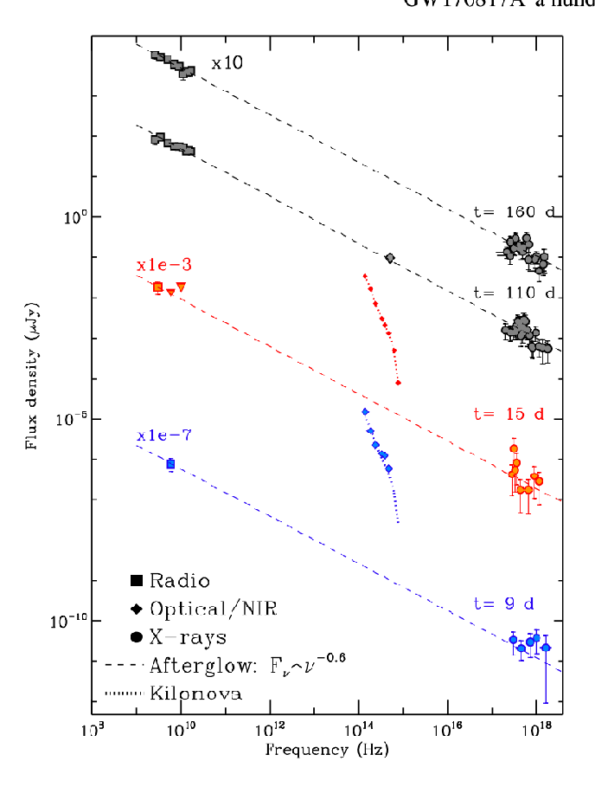
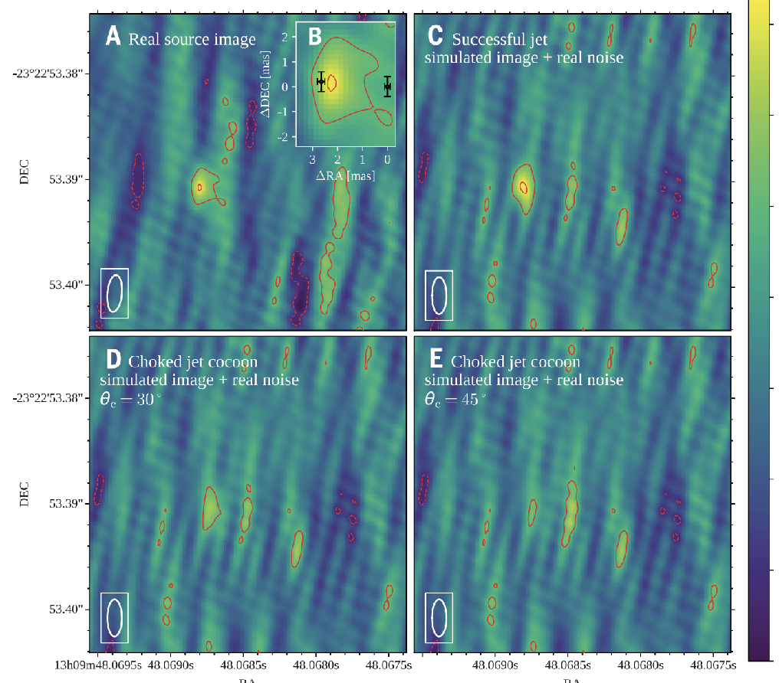
GW170817 and the Kilonova
Margutti et al. 2018
Ghirlanda et al. 2019
.. … a successful jet with a structured angular velocity and energy profile, featuring a narrow (θc = 3.4°) and energetic (2.5×10⁵² erg isotropic equivalent energy) core seen from a viewing angle of ~15 degrees. … The energy and bulk velocity of the jet material decrease steeply away from the jet producing a sheath of slower material surrounding the core (this material emits the observed sGRB).
Notes:
global b VLBI 32 antennas in 5 continents

Slide 6
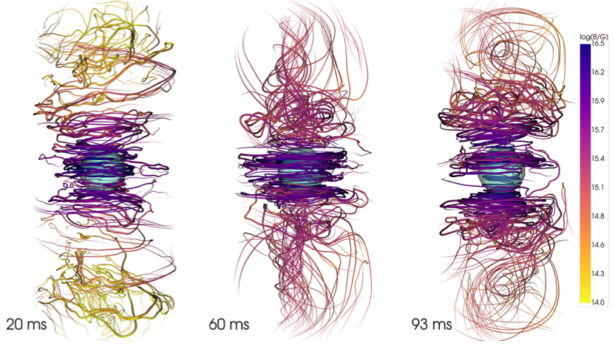
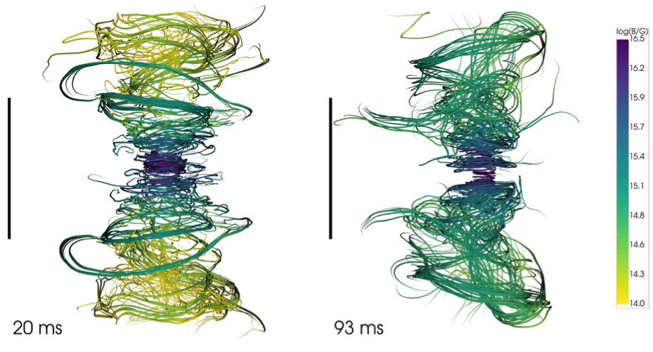
GW170817 and the Kilonova
Ciolfi et al. 2019
astro-ph 1904.10222
30km
The first 100 ms of a long-lived magnetized neutron star formed in a binary neutron star merger
100km
Notes:
la bfield line remnant mostra come in poche decine di ms il campo magnetico venga amplificato (scala di colore a dx) ed organizzato lungo l'asse di rotatione.
La sfera ha un raggio di 10km e serve a dare un'idea della scala spaziale
- la bfield mostra lo stesso su piu' larga scala, con la barra nera di lunghezza 100km.
Il fatto che linee di campo magnetico si estendano fino a ~100km dal remnant lungo l'asse indica che una struttura globale di campo poloidale sta emergendo (cosa vista per la prima volta in questa simulazione, paper recentissimo https://arxiv.org/abs/1904.10222).
Tale struttura di campo favorisce la possibile formazione di un SGRB jet.

Slide 7
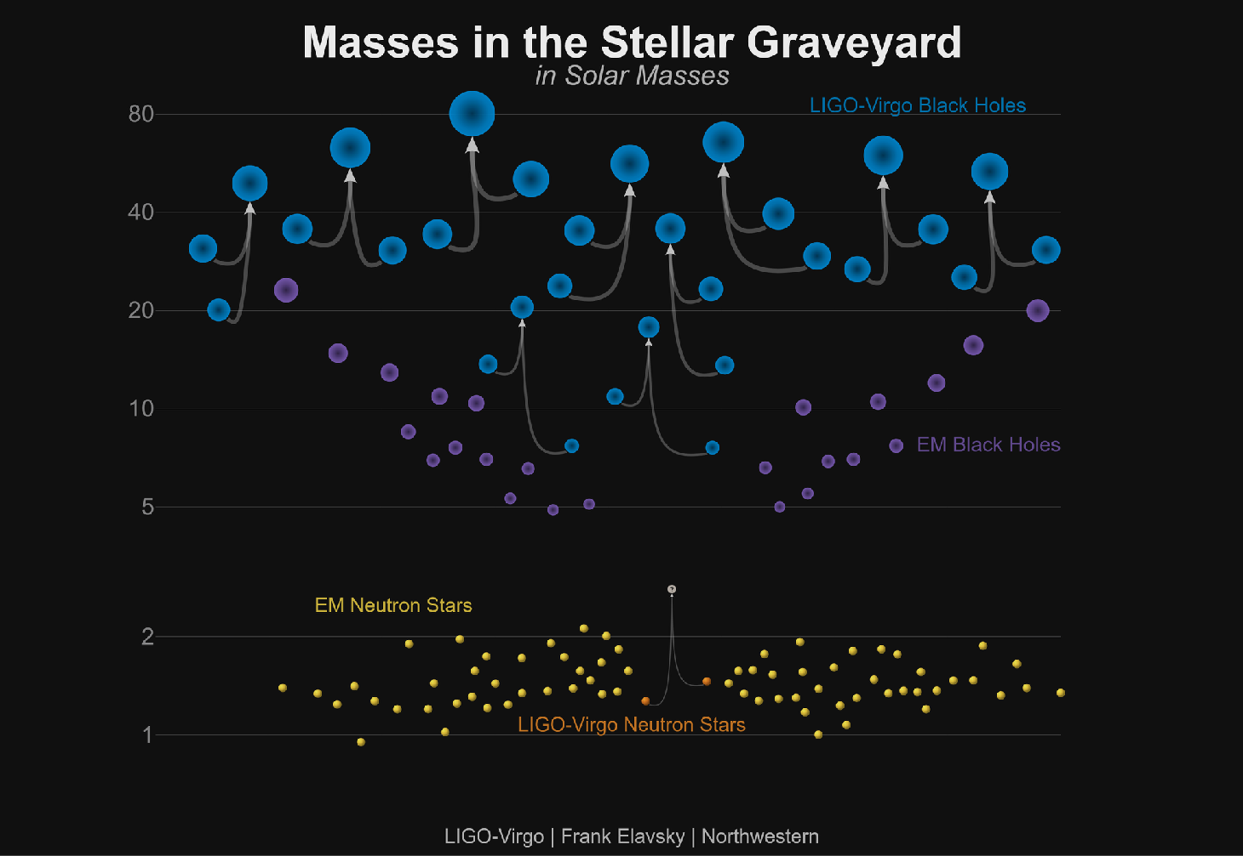
Astrophysics with GW
O1-2 Trigger
GW | CBC | Distance
GW150914 | BBH | 420 Mpc
GW151012 | BBH | 1.1 Gpc
GW151226 | BBH | 450 Mpc
GW170823 | BBH | 1.9 Gpc
GW170818 | BBH | 2.2 Gpc
GW170814 | BBH | 555 Mpc
GW170809 | BBH | 955 Mpc
GW170729 | BBH | 2.8 Gpc
GW170806 | BBH | 325 Mpc
GW270104 | BBH | 730 Mpc
GW170817 | BNS | 40 Mpc
BBH <dist> = 1.2 Gpc

Slide 8
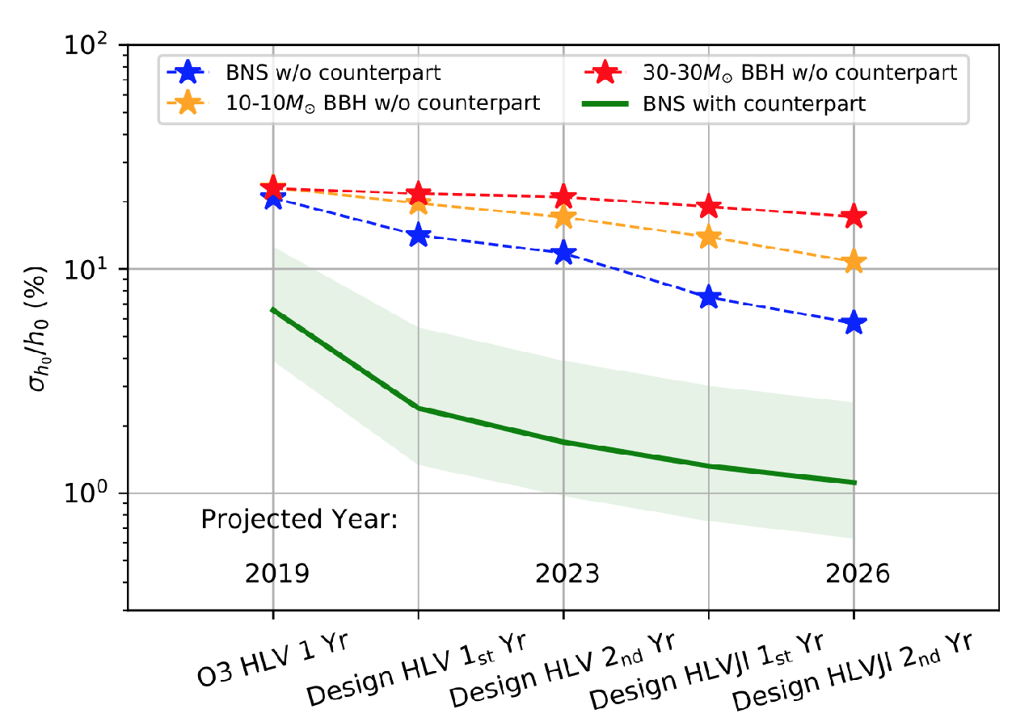
Tension with the Hubble constant
Cepheids/SNe (73) or CMB (67) ?
A two per cent Hubble constant measurement from standard sirens within five years Hsin-Yu Chen et al. 2018 Nature 562,445

Slide 9
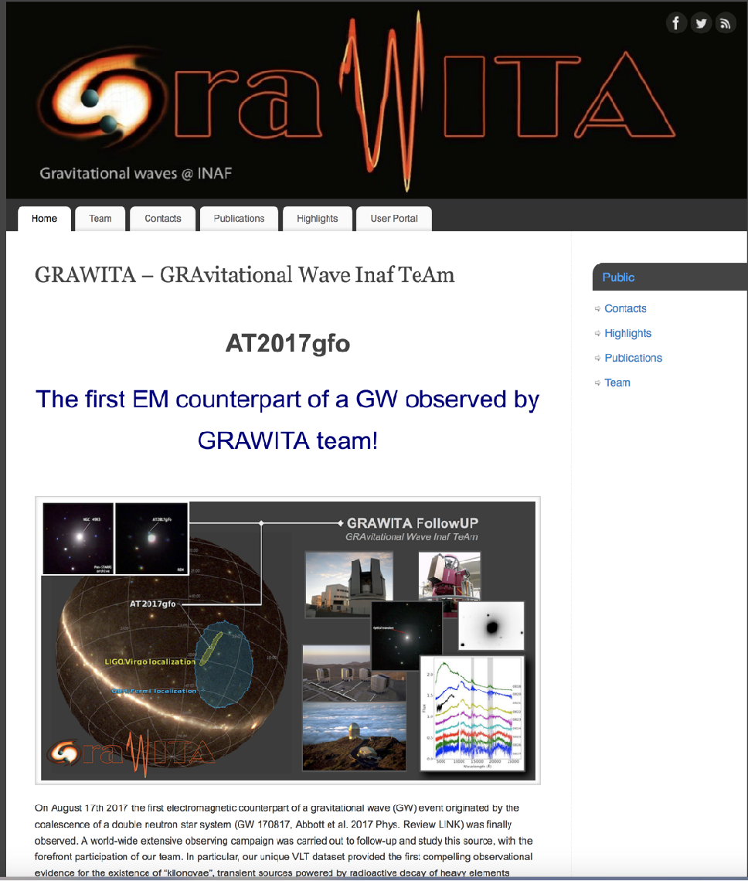
O3: building collaborations

Slide 10
O3: getting support
PRIN MIUR 2017
The new frontier of Multi-Messenger Astrophysics: follow-up of electromagnetic transient counterparts of gravitational wave sources.
! 800 Keuro !
5 University’s departments
7 INAF structures

Slide 11
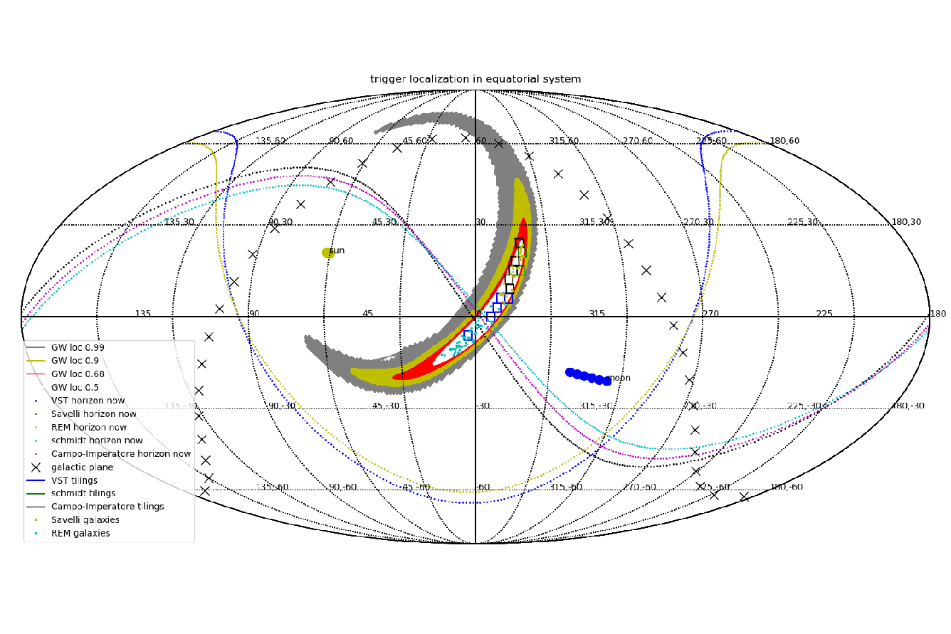
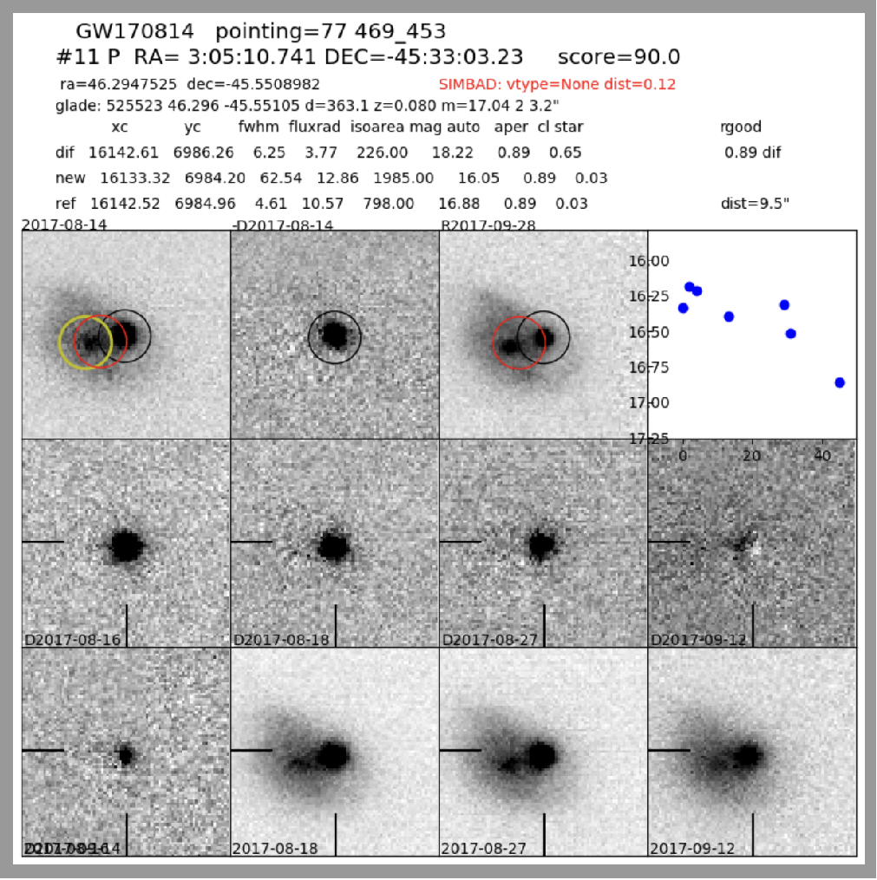
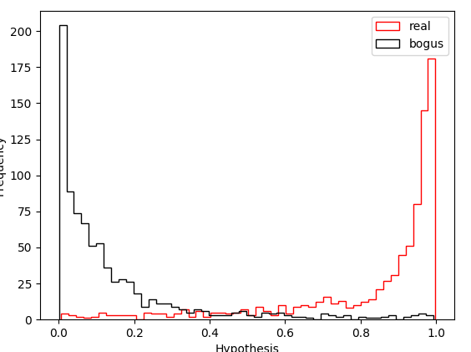
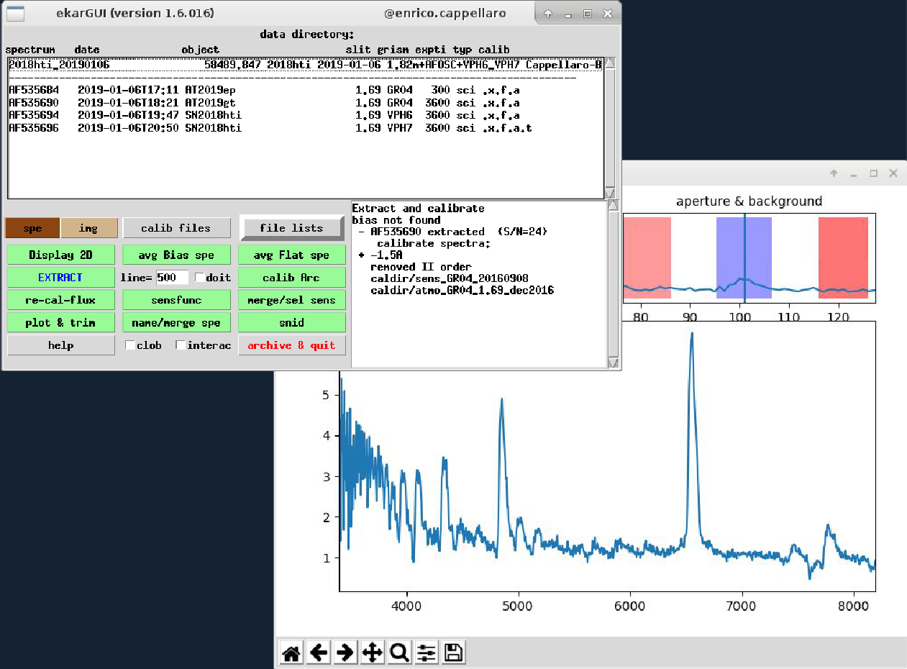
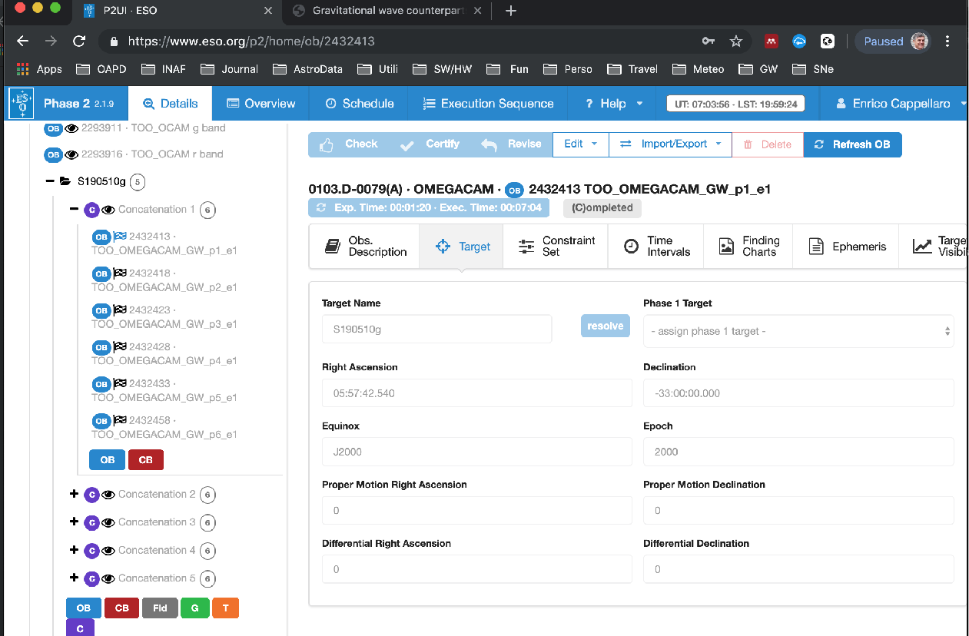
O3: Preparing tools
Automatic planning for transient search
Machine learning
for bogus rejection

Slide 12
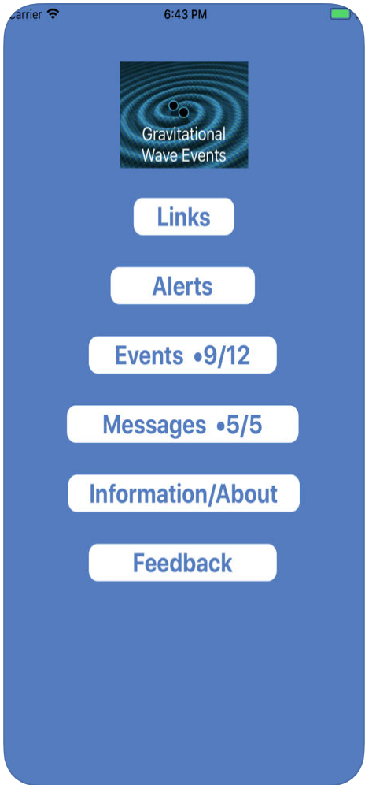
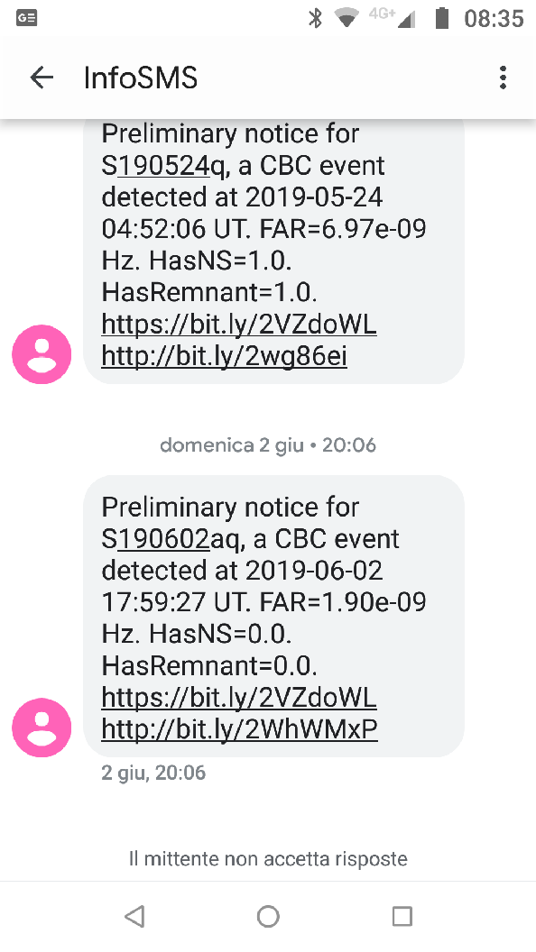
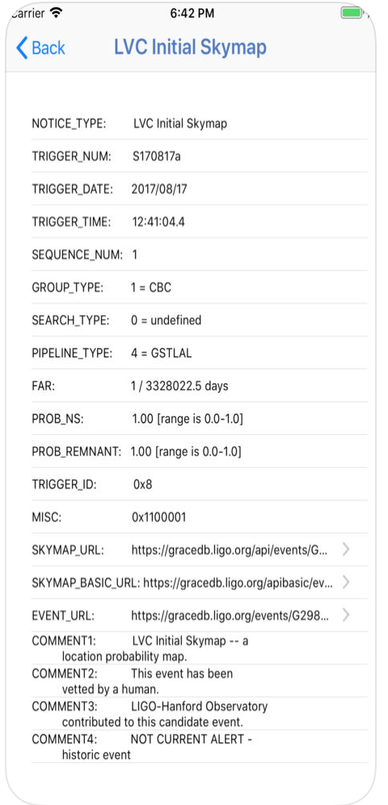
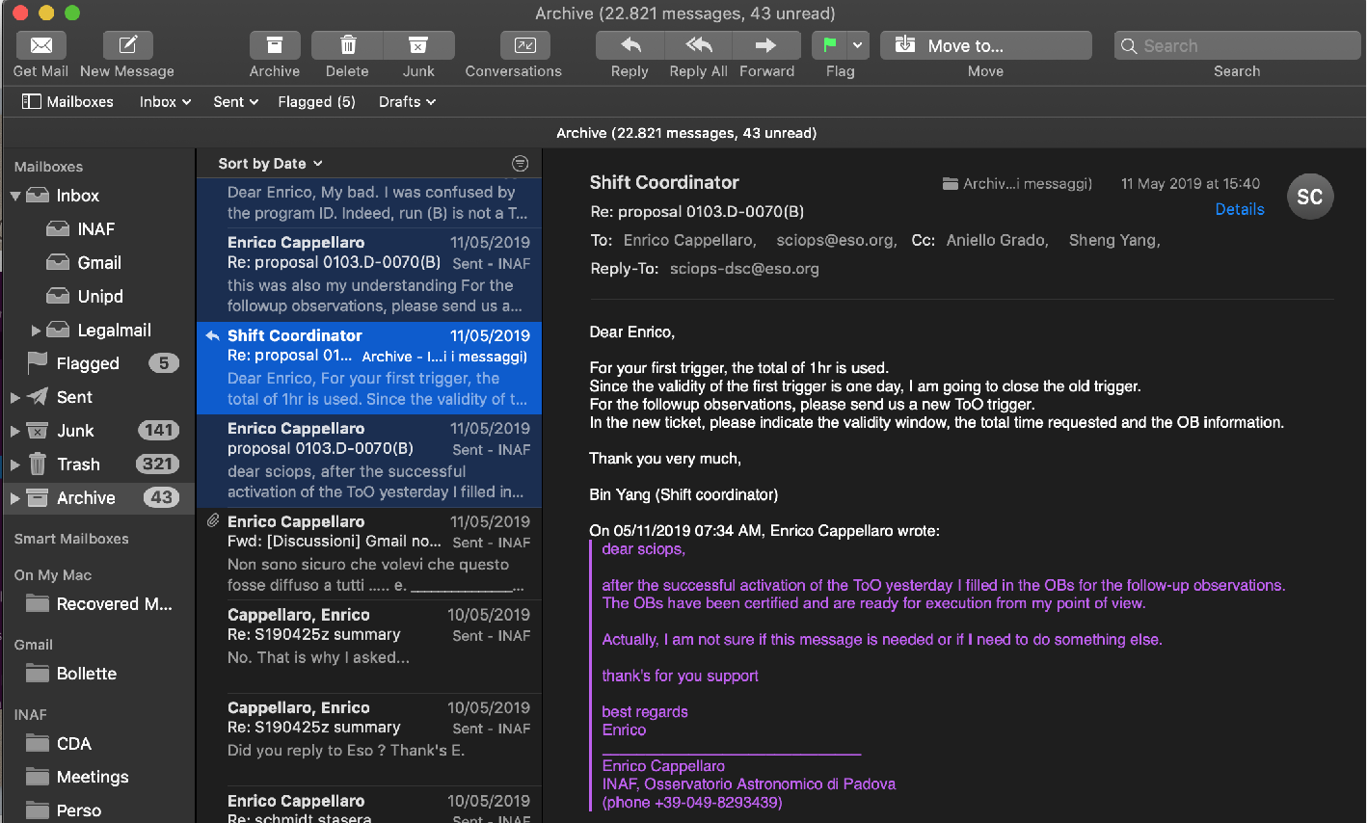
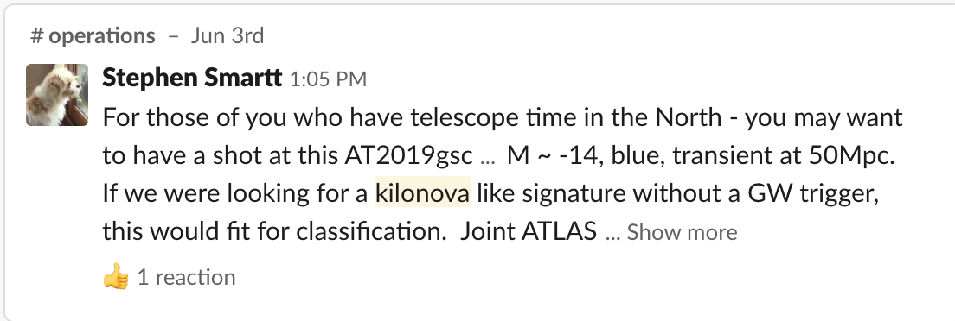
O3: managing alerts

Slide 13
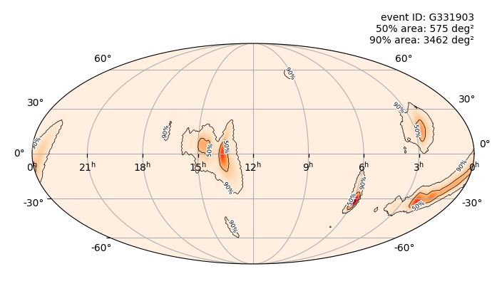
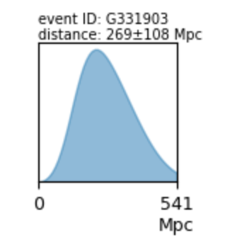
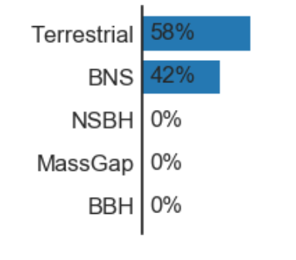
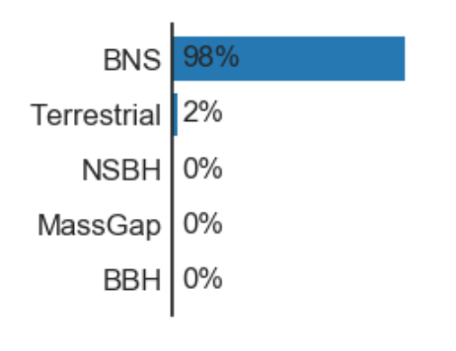
O3: what is going on
S190510G
May 10, UT 04:03
May 11, UT 18:54

Slide 14
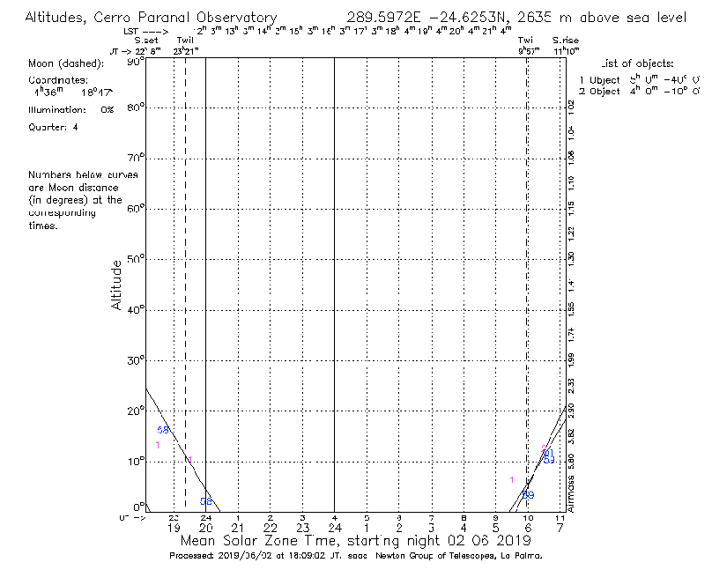
O3: what is going on
GW | FAR | 50% area (sq deg) | CBC | Distance
S190602aq | 1/17 yr | 286 | BBH 99% | 797 Mpc
S190521r | 1/100 yr | 162 | BBH 99% | 1.1 Gpc
S190521g | 1/8.3 yr | 144 | BBH 97% | 3.9 Gpc
S190519bj | 1/5.6 yr | 169 | BBH 96% | 3.2 Gpc
S190517h | 1/13 yr | 152 | BBH 98% | 3.0 Gpc
S190513bm | 1/85000 yr | 134 | BBH 94% | 2.0 Gpc
S190512at | 1/17000 | 79 | BBH 99% | 1.3 Gpc
S190510g | 1/3.6 yr | 31 | BNS 42% (Terr 58%) | 270 Mpc
S190503bf | 1/19 yr | 213 | BBH 96% | 1.2 Gpc
S190426c | 1/1.6 yr | 472 | BNS 49% (mass gap 24%, NS 13%) | 423 Mpc
S190425z | 1/70000 yr | 2806 | BNS 99% | 155 Mpc
S190421ar | 1/2.1 yr | 399 | BBH 97% | 1.6 Gpc
S190412m | 1/2E19 yr | 37 | BBH 100% | 812 Mpc
S190408an | 1/1E10yr | 82 | BBH 100% | 1.4 Gpc
BBH <dist> = 1.9 Gpc

Slide 15
O3: what is going on
?
Apr
May
Jun
Jul
BBH
BNS
LIGO-VIRGO
telecon
?

