Slide 1
Esplorazione del Sistema Solare e analisi di superfici planetarie
INAF-OAPD:
G.Cremonese, A.Lucchetti, M.Pajola, A.Petrella, E.Simioni, C.Re
Dip.Geoscienze (UniPD):
M.Massironi, B.De Toffoli, S.Ferrari, L.Penasa, R.Pozzobon
IFN-CNR:
V.Da Deppo, A.Slemer
Dottorandi e studenti:
P.Cambianica, S.Cammisa, G.Lovati, M.Mastropietro,
G.Munaretto, J.Peng, C.Tettamanti

Slide 2
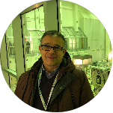

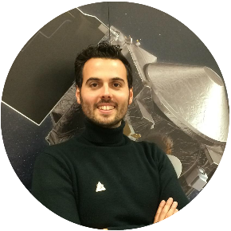
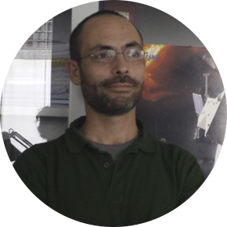
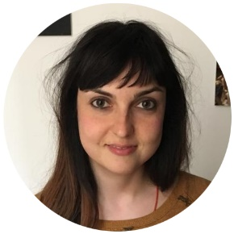

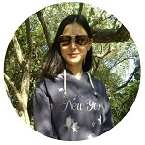

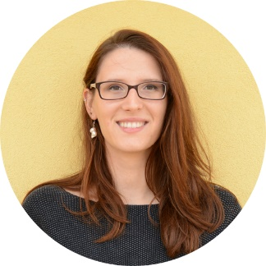
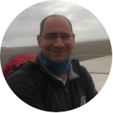

Gabriele Cremonese
Alice Lucchetti
Maurizio Pajola
Emanuele Simioni
Cristina Re
Giovanni Munaretto
Jimin Peng
Matteo Massironi
Riccardo Pozzobon
Barbara De Toffoli
Pamela Cambianica

Slide 3
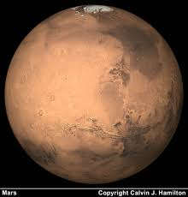
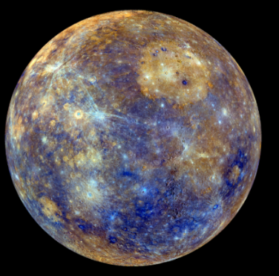
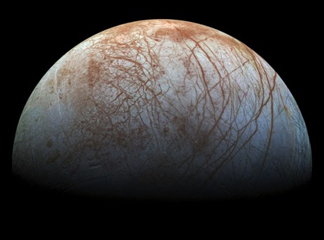
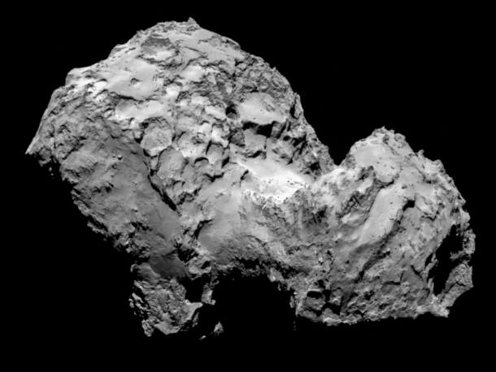
Coinvolgimento in tutte le
missioni spaziali per l’Esplorazione del Sistema Solare dell’ESA, e
alcune della NASA
Responsabilità e contributo
alla realizzazione e studio
di stereo camere
e camere per satelliti

Slide 4
International context (G.Cremonese)
2014-present. Chair of the Terrestrial Planets group in the Science Organizing Committee of the European Planetary Science Congress
2016-present. Member of the Italian team, led by ASI, associated to the NASA Solar System Exploration Research Virtual Institute
2017-2019. Member of the Solar System Exploration Working Group of ESA
2017. Member of the panel review of ESA for the M5 mission selection
2018-present. Member of Sub-Center of International Cooperation and Research on Lunar and Planetary Exploration, approved by the Minister of Education of China
2018-2019. Member of the panel review of ESA for the F-class mission selection
2019-2020. Member of the ESA-CNSA International Lunar Research Team

Slide 5
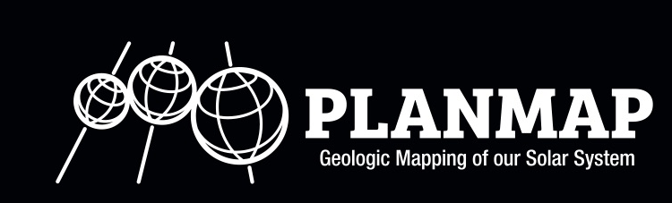

The H2020 PLANetary MAPping project
M. Massironi, F. Altieri, H. Hiesinger, N. Mangold, D. Rothery, A. Pio Rossi, M. Balme, C. Carli, F. Capaccioni, G. Cremonese, F. Filacchione, S. Le Mouélic, V. Unnithan , C. Van der Bogert

Slide 6
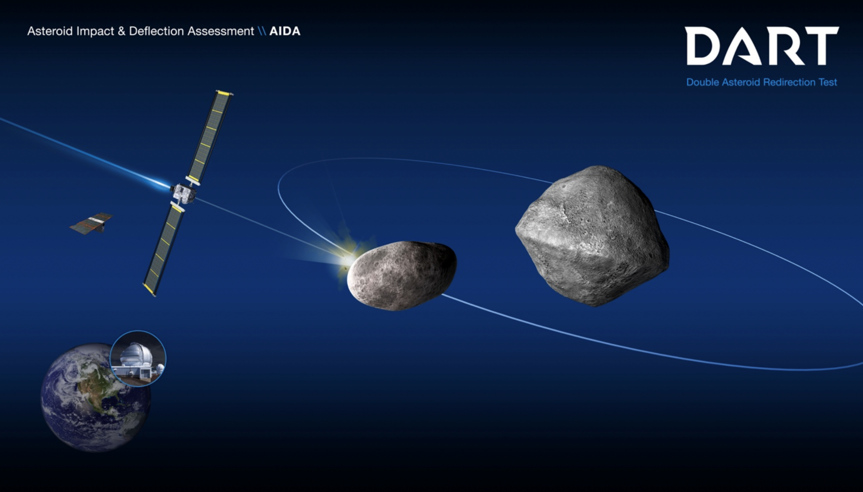
LICIACube
DART-LICIACube will be launched by Space X (Falcon 9) on July 2021 arriving on the asteroid
on September 2022
LICIACube funded by ASI and realized by Argotec.
Scientific Team: INAF (OAR, IAPS, OAPD, OAA, OATs), IFAC-CNR, PoliMI, UniBO

Slide 7
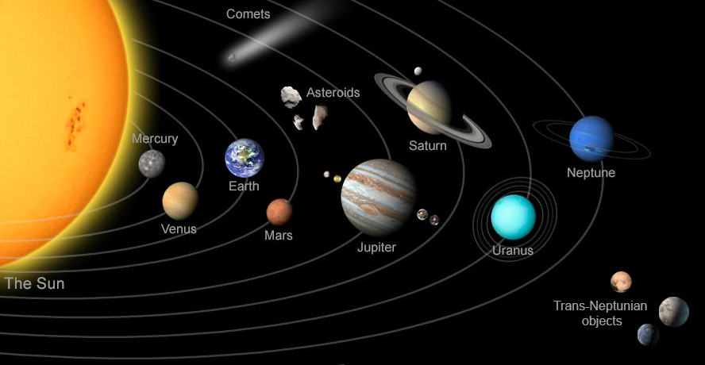

Slide 8
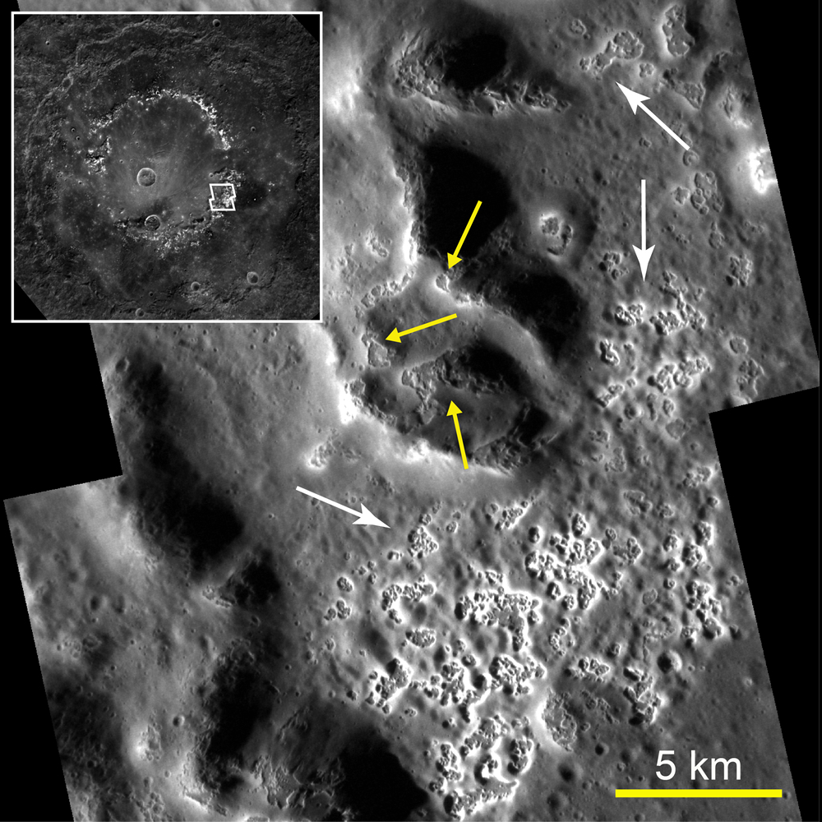
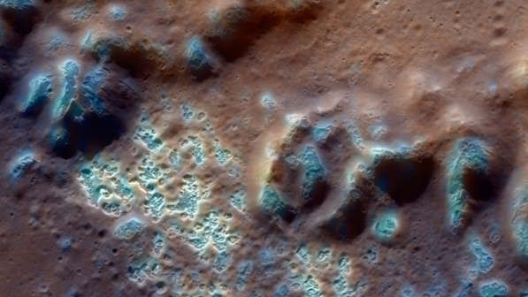
NASA MESSENGER mission
Hollows
Shallow, irregular, rimless, flat-floored depressions with bright interiors and halos, often found on crater walls, rims, floors and central peak whose nature is still unknown (Blewett et al., 2011,2013).

Slide 9
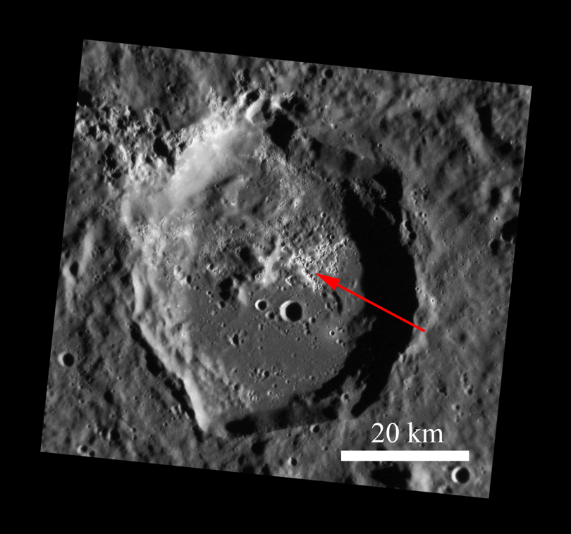
SPECTRAL CLUSTERING AND GEOMORPHOLOGICAL ANALYSIS OF HOLLOWS
CANOVA CRATER
Hollows are fresh in appearance and may be actively forming today (Blewett et al., 2011; Xiao et al., 2012) and likely form via a mechanism that involves loss of volatiles (Blewett et al., 2011; Vaughan et al., 2012).
→ Understanding the composition of these features provides additional information on Mercury’s surface characterization.
On the left the NAC image (EN1022224039M) for Canova crater (resolution of 43 m/px). Hollows are here identified on the floor of the crater.

Slide 10
SPECTRAL CLUSTERING AND GEOMORPHOLOGICAL ANALYSIS OF HOLLOWS
SPECTRAL CLUSTERING
statistical clustering over the entire dataset based on a K-means partitioning algorithm developed and evaluated by Marzo et al., (2006, 2008, 2009) and makes use of the Calinski and Harabasz criterion (Calinski, T., Harabasz, J., 1974) to find the intrinsically natural number of clusters, making the process unsupervised.
CORRELATION BETWEEN SPECTRAL UNITS AND GEOLOGICAL ONES
Comparison between spectra and geomorphological map reveals a correlation between different spectral units and geological ones. Hollows in different craters are identified by a similar spectrum.
Hollows are the expression of both the remnants of materials from devolatilization and bedrock forming material (Lucchetti et al., 2018).
Result coming from the comparison between the geological map and the spectral clustering analysis for Canova crater. Hollows are here identified by a well-defined visible spectrum, which is represented by cluster #9.

Slide 11


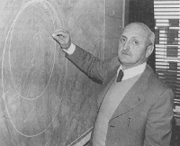
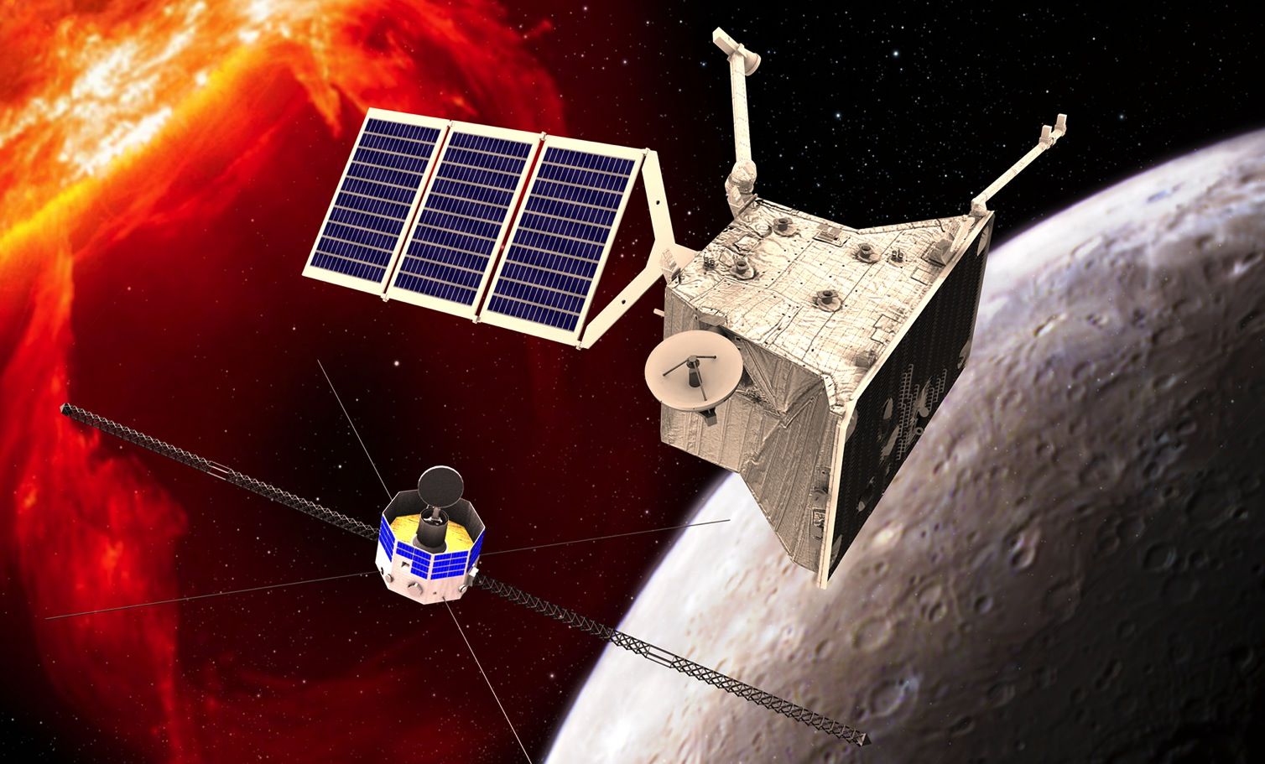

BepiColombo ESA Cornerstone n.5
Professor Giuseppe Colombo
a dual spacecraft mission

Slide 12
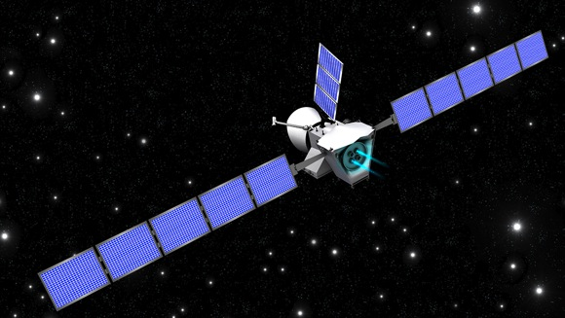
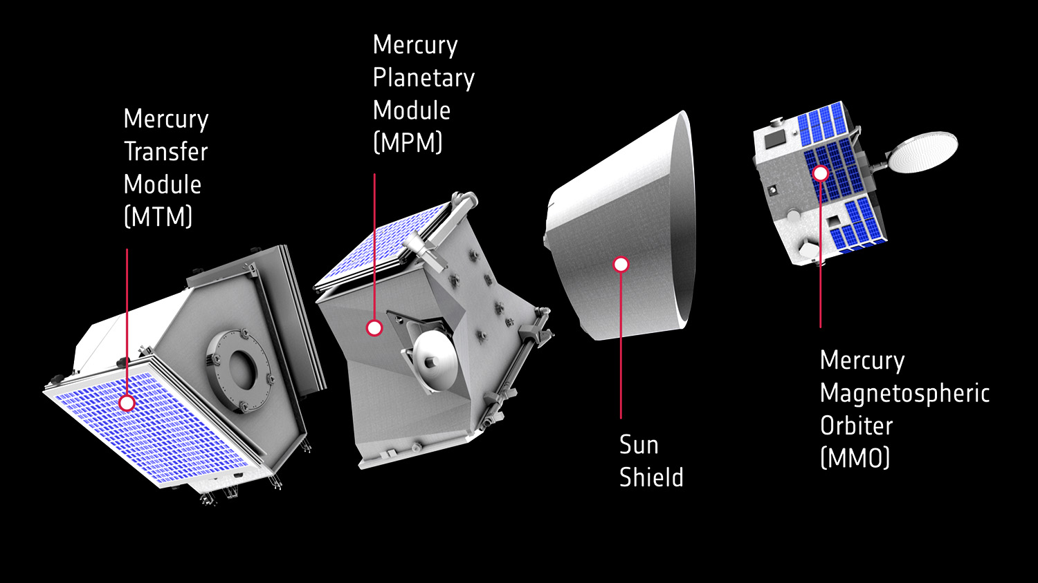
Spacecraft Configuration

Slide 13
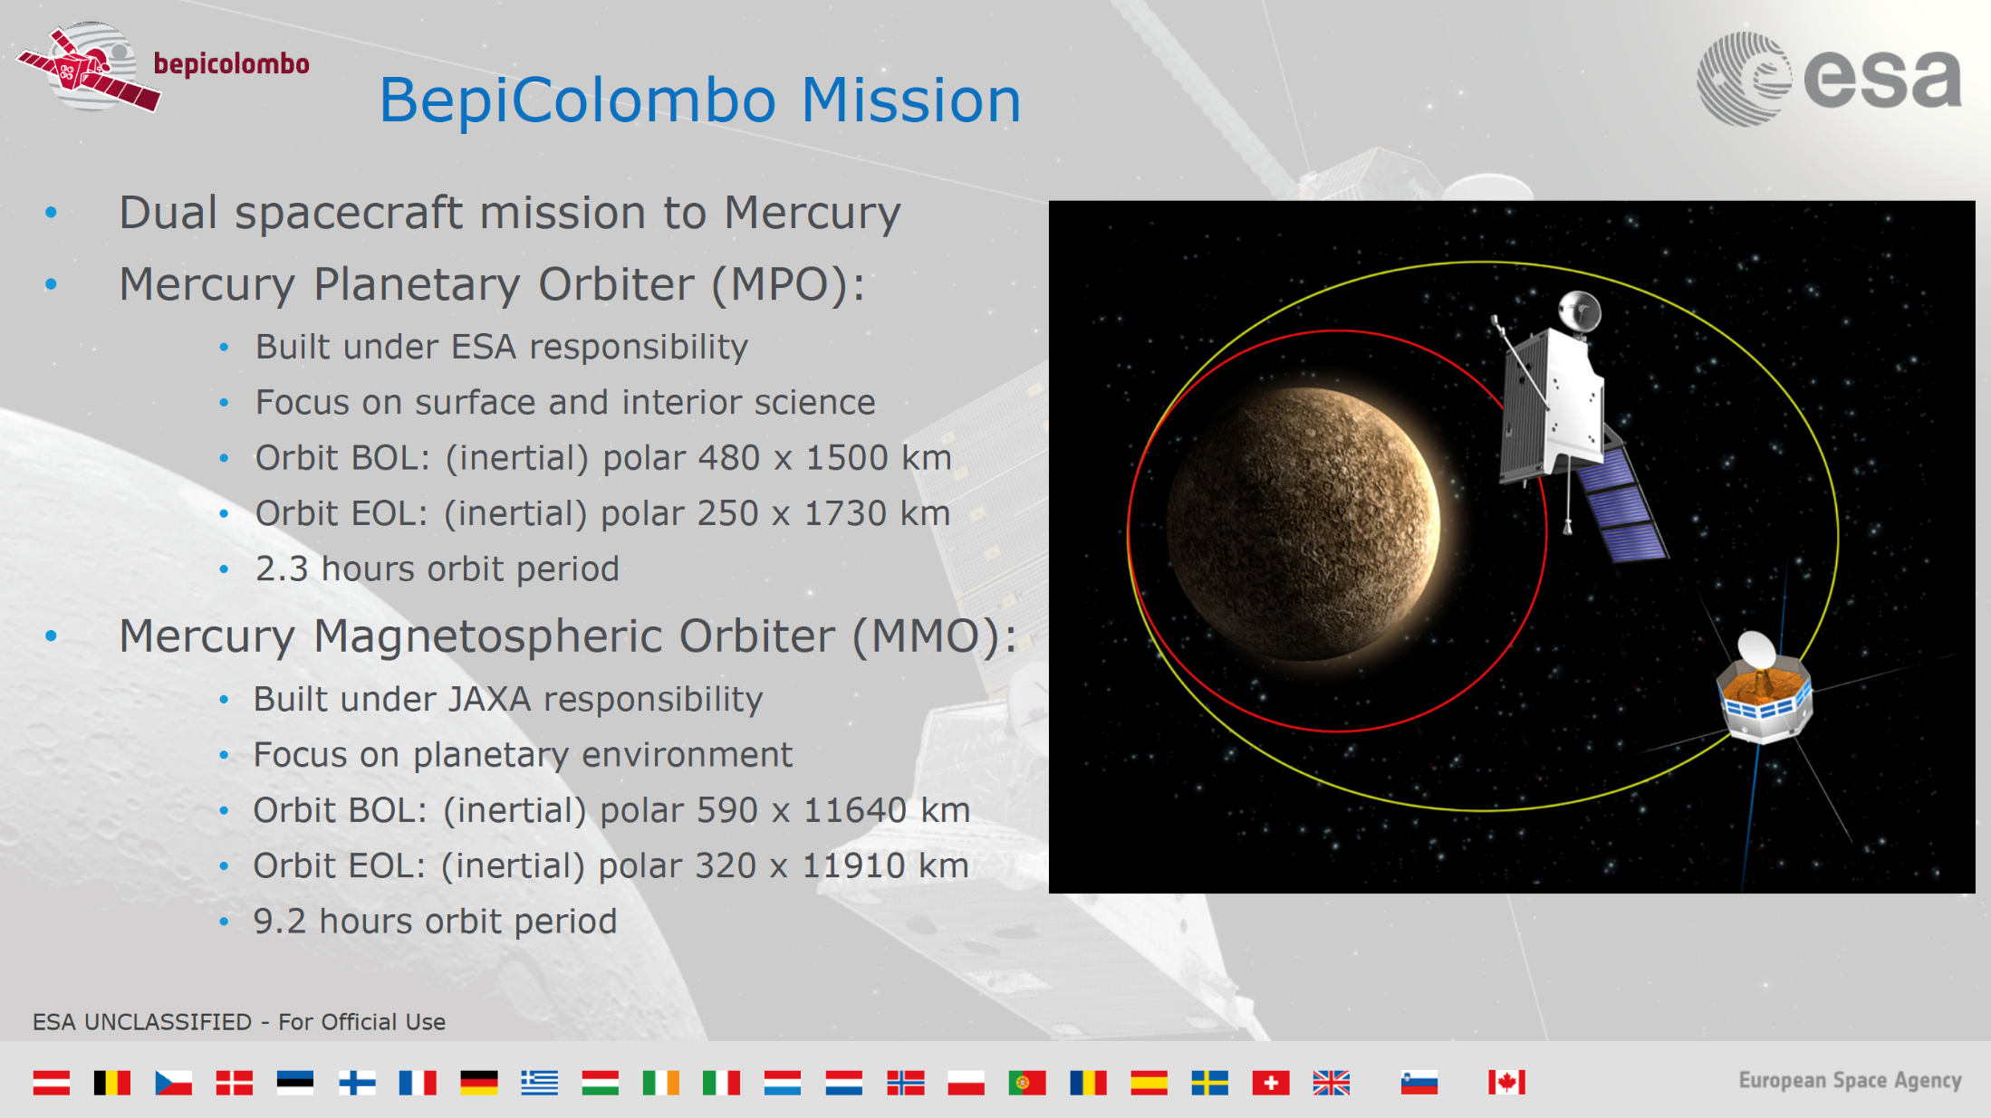

Slide 14
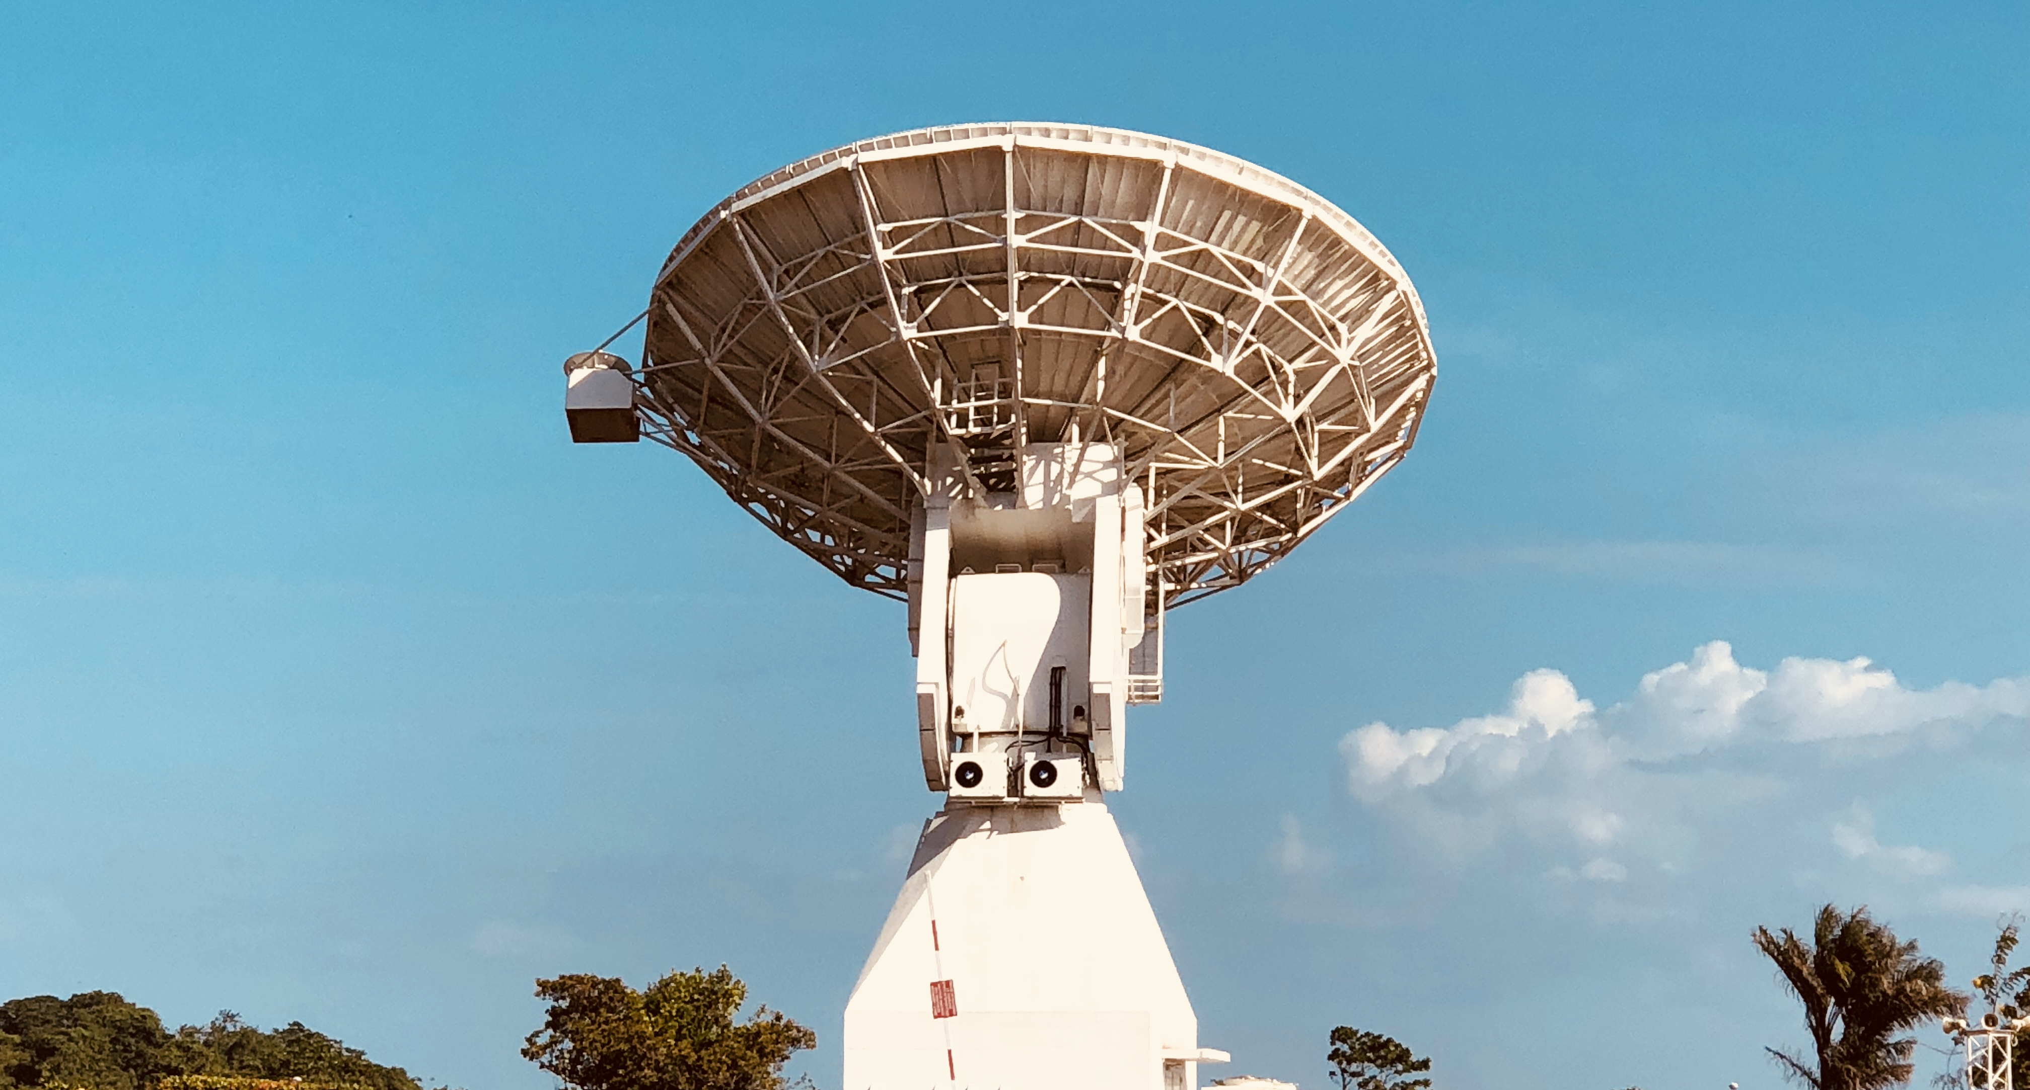
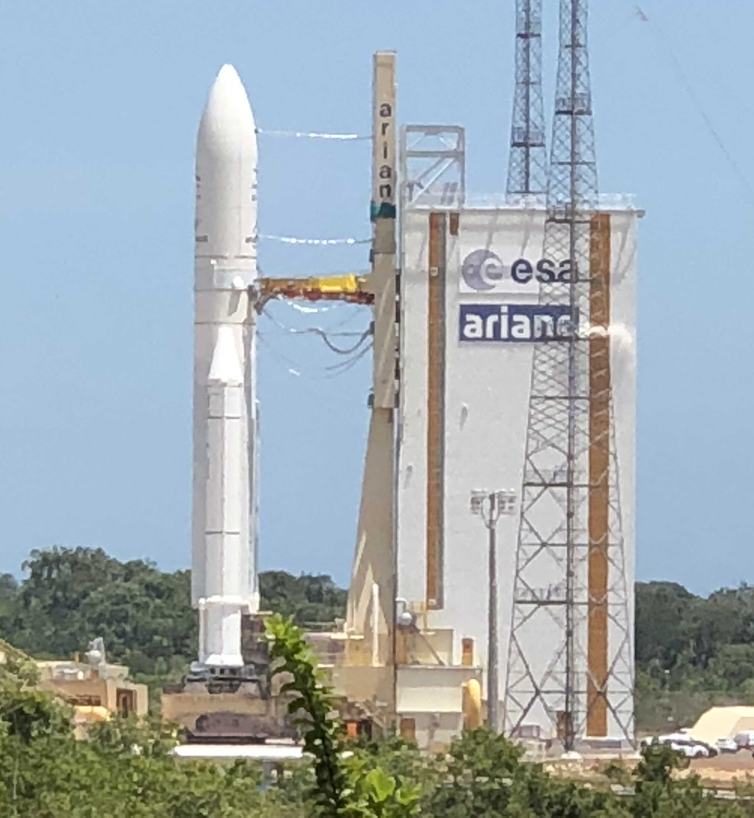
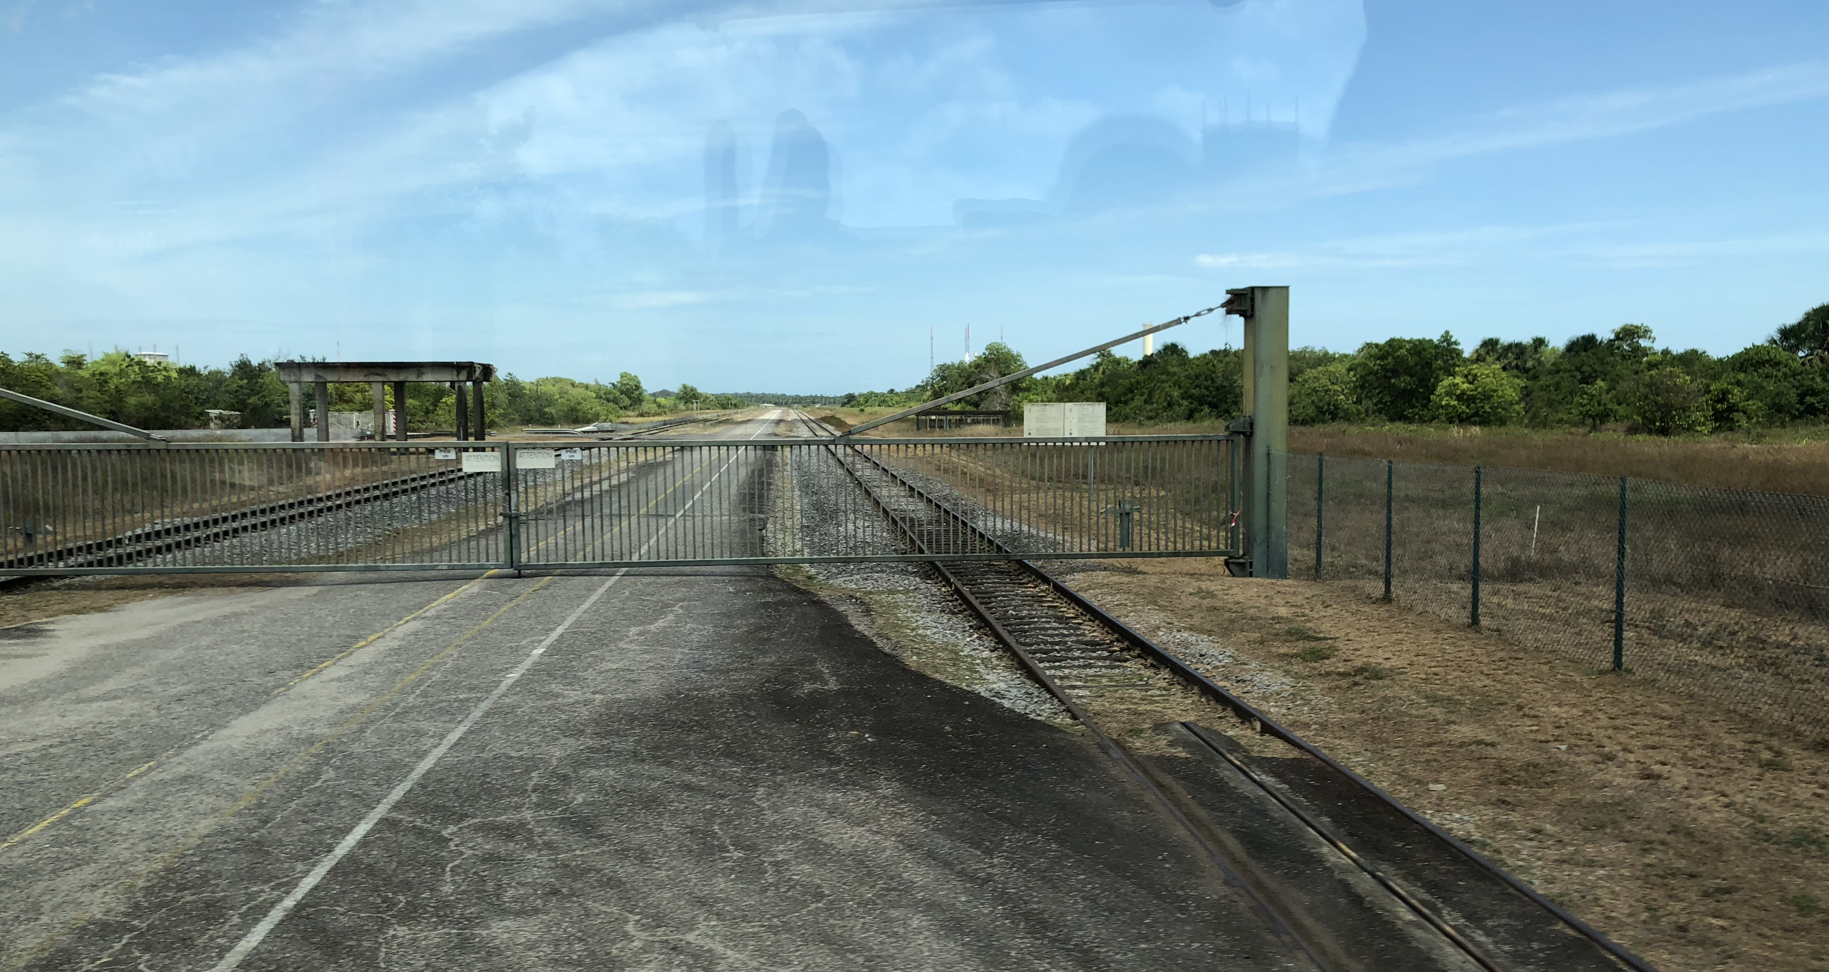
Kourou, 20 October 2018 1:45 UT

Slide 15
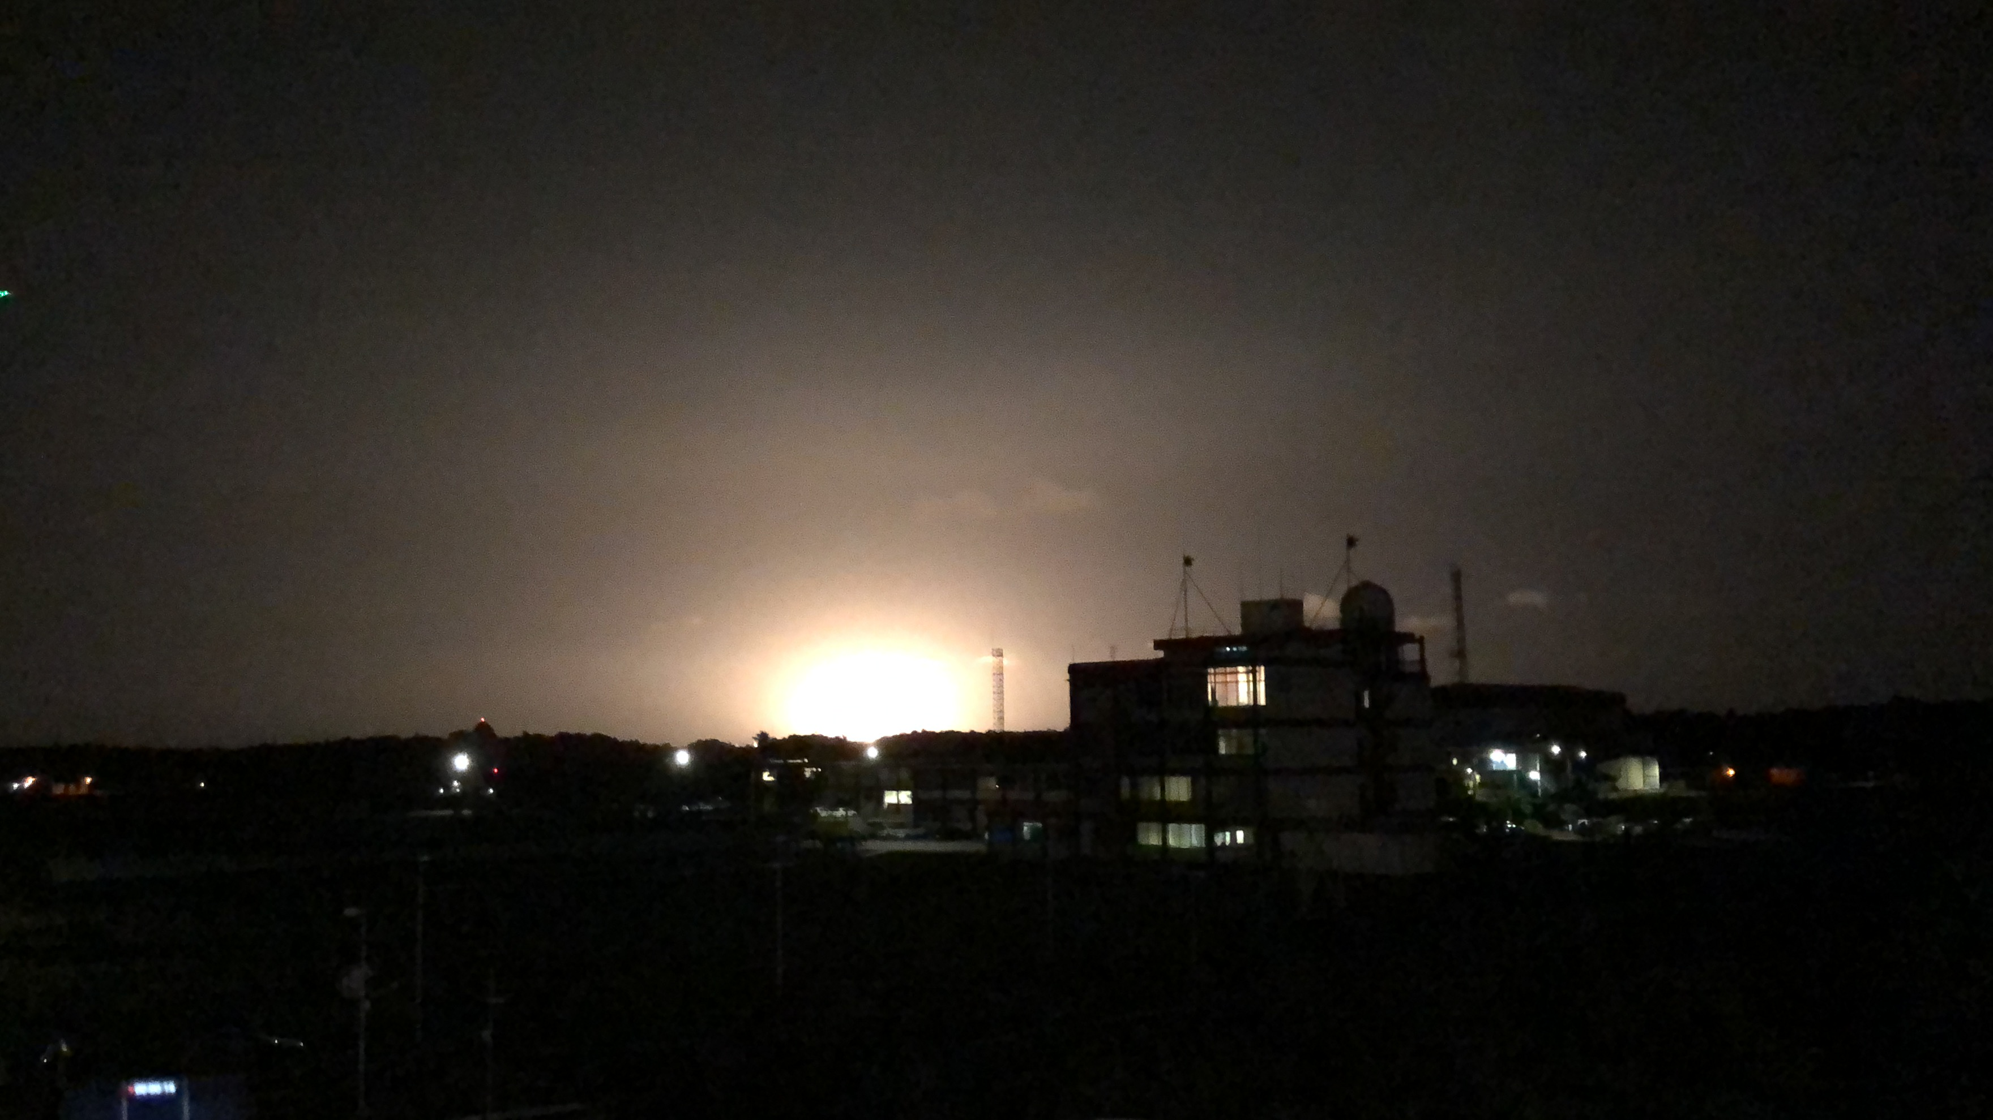
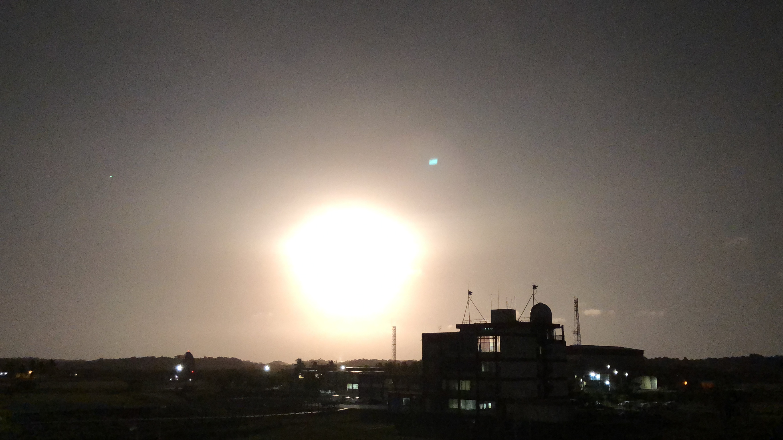
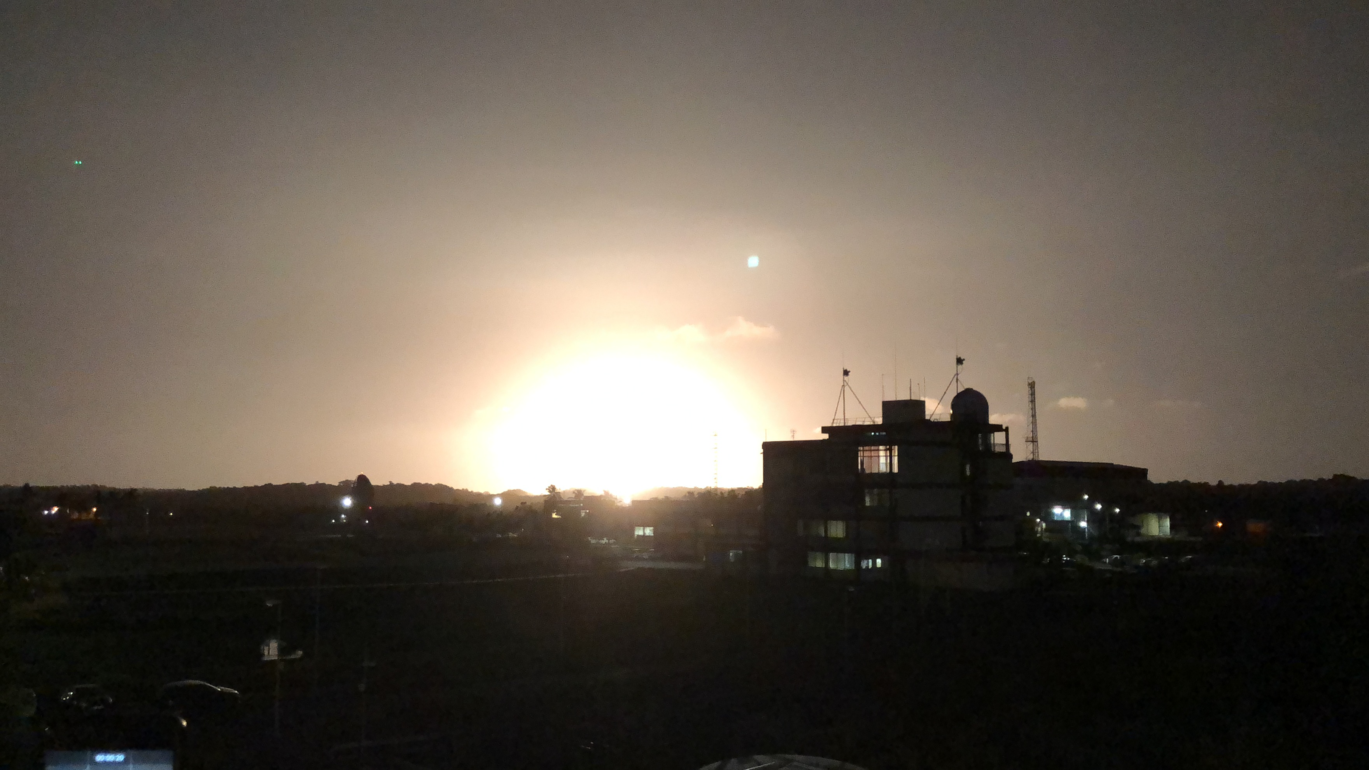
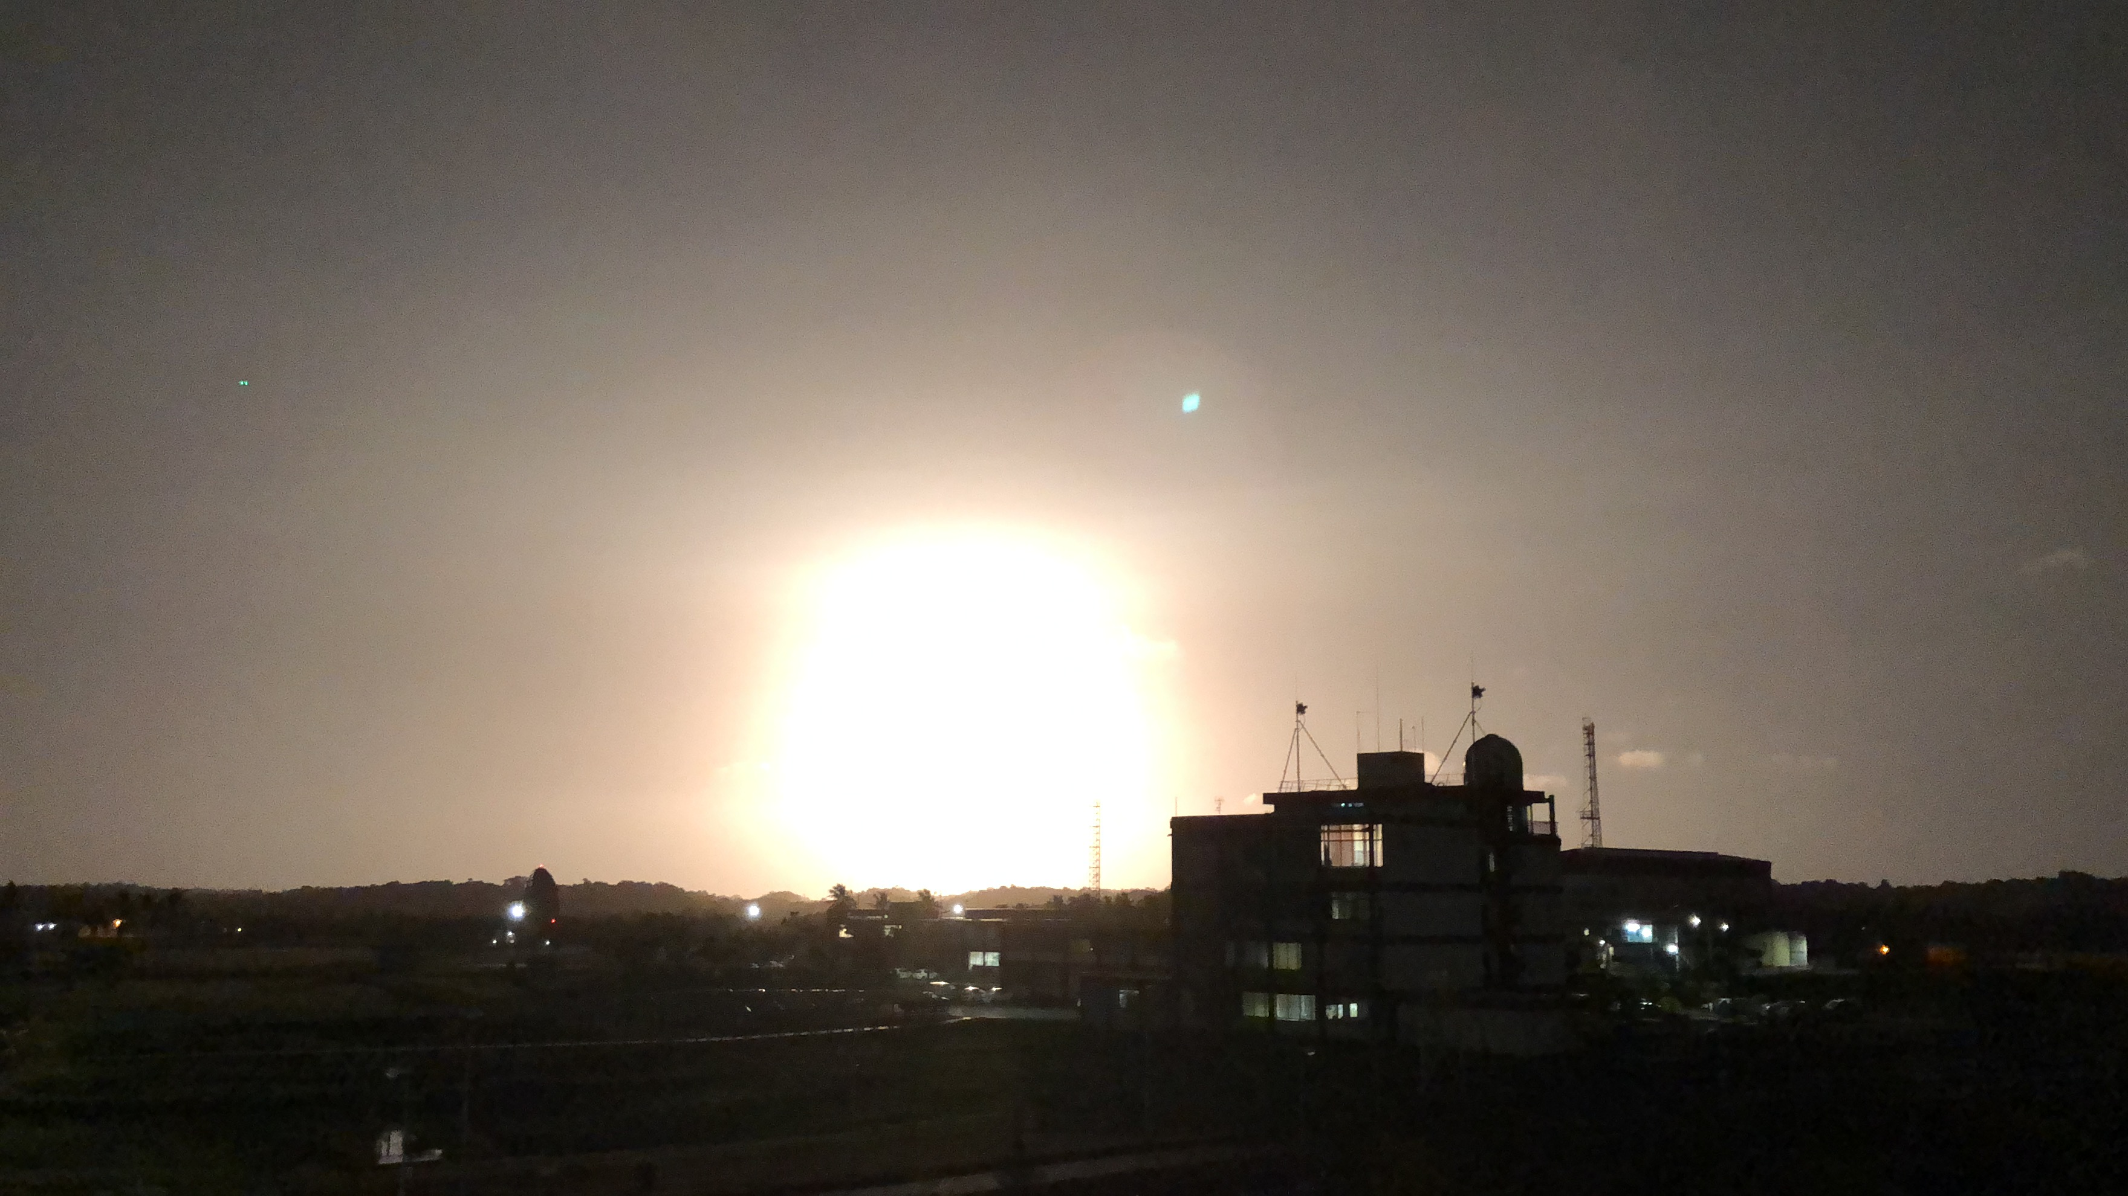
Kourou, 20 October 2018 1:45 UT

Slide 16

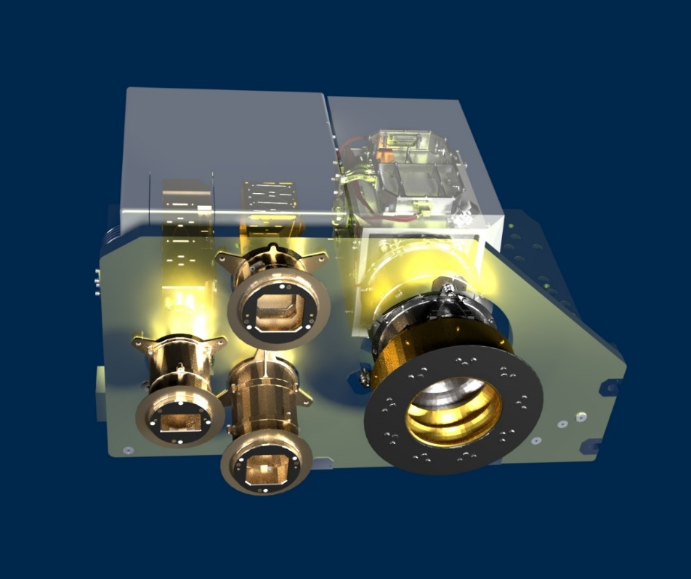
Spectrometer and Imagers for MPO BepiColombo – Integrated Observatory SYStem
HRIC
Local mapping at high resolution with colour capabilities.
Pixel scale of 6-12 m/pixel @ periherm (480 km)
Filters: pan, 550, 750, 880 nm.
STC
Global stereo mapping and DTM generation.
Pixel scale of 60 m/pixel @ periherm (480 km)
Filters: pan, 420, 550, 750, 920 nm.
VIHI
Global mineralogical mapping.
Pixel scale of 120 m/pixel @ periherm (480 km)
Spectral range of 0.4-2.0 µm with spectral sampling of 6.25nm
VIHI
STC
HRIC
3 optical channels sharing the Main Electronics and power supply
Mass 13 kg

Slide 17



🇮🇹
🇫🇷
SIMBIO-SYS consortium
PI Gabriele Cremonese
Co-PI Fabrizio Capaccioni VIHI overall responsibility
Co-PI Pasquale Palumbo HRIC overall responsibility
Co-PI Maria Teresa Capria STC overall responsibility
Co-PI Mathieu Vincendon Main Electronics
Calibration at package level
Co-PI Alain Doressoundiram VIHI proximity electronics
IR FPA proc. and calibration
TM Stefano Debei Instrument architecture
Thermal and structural design
Scientific Req. Implementation
Industrial prime Leonardo s.p.a.

Slide 18
The scientific team
The SIMBIO-SYS scientific team is composed by 57 Co-Investigators:
F.Altieri, A.Barucci, G.Bellucci, J.Benkhoff, S.Besse, C.Bettanini, M.Blecka, J.R.Brucato, C.Carli, P.Cerroni, L.Colangeli, V.Da Deppo, V.Della Corte, M.C.De Sanctis, E.Epifani, S.Erard, F.Esposito, D.Fantinel, L.Ferranti, F.Ferri, G.Filacchione, E.Flamini, G.Forlani, S.Fornasier, O.Forni, M.Fulchignoni, V.Galluzzi, K.Gwinner, W.Ip, L.Jorda, L.Lara, F.Leblanc, C.Leyrat, S.Marchi, L.Marinangeli, F.Marzari, M.Massironi, M.Mendillo, V.Mennella, K.Muinonen, G.Naletto, E.Palomba, D.Perna, G.Piccioni, F.Poulet, R.Ragazzoni, C.Re, A.Rotundi, G.Salemi, M.Sgavetti, E.Simioni, N.Thomas, T.Van Hoolst, M.Vincendon, F.Zambon, M.Zusi.
…and 19 associates:
A.Aboudan, N.Bott, A.Cicchetti, G.Colombatti, M.El Yazidi, S.Ferrari, J.Flahault, L.Giacomini, L.Guzzetta, A.Lucchetti, E.Martellato, R.Noschese, M.Pajola, R.Politi, G.Serventi, A.Slemer, G.Tognon, D.Turrini, L.Yuan.
13 different countries are represented:
Italy, France, Belgium, China, Finland, Germany, Poland, Spain, Switzerland, Taiwan, Tunisia, UK, USA

Slide 19
Principles of operations
SIMBIO-SYS operations shall allow both global coverage and target-oriented observations
Global coverage shall be completed asap, minimizing data volume => ops fine tuning needed in global coverage phase for VIHI and STC
Target-oriented observations for HRIC shall take advantage by all orbiter passages on the targeted regions to allow required coverage. For this reason, HRIC shall operate during the entire mission on the basis of a long-term observation plan
Target-oriented observations will follow global coverage for VIHI and STC
All SIMBIO-SYS channels shall be able to operate in parallel to allow needed operational flexibility
50% of the data volume of the entire mission is allocated to SIMBIO-SYS
750 Gbit per year (mostly data compressed by a factor 7).

Slide 20

New technology of SIMBIO-SYS
  SIMBIO-SYS: 3 instruments for 13 kg
  OSIRIS: the cameras NAC+WAC on board Rosetta → 27 kg
        Similar high spatial resolution
  High Resolution Stereo Camera: on board Mars Express + SRC → 21.5 kg

Slide 21
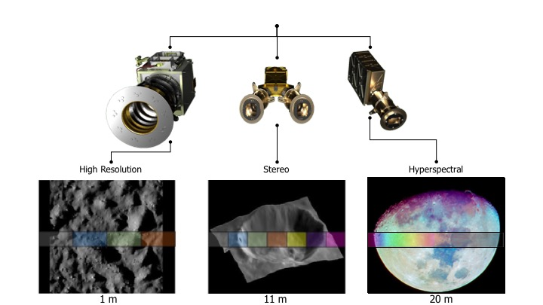
SIMBIO-SYS → SIMIO-SYS
MERCURY → MOON
Proposal submitted to ESA on December 2018 in response to the Request for Information
for the European exploration of the Moon
Low Lunar Orbit 100 km

