Slide 1
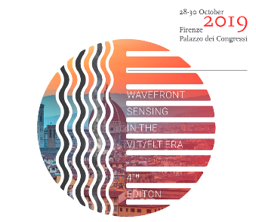
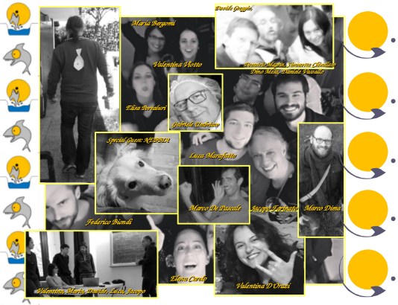
The laboratory characterization of the SHARK-NIR
Adaptive Optics channel
Biondi, F., Vassallo, D., Marafatto, L., Farinato, J., Bergomi, M., Viotto, V., De Pascale, M., Santhakumari, K.K.R., Carolo, E., Umbriaco, G., Greggio, D., Arcidiacono, C., Lessio, L.
Andrighettoni, M.
Biasi, R.
Briguglio, R.
Selmi, C.
Agapito, G.

Slide 2
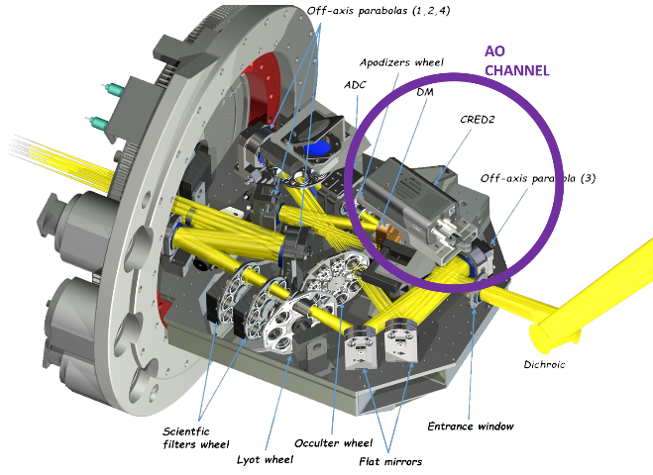
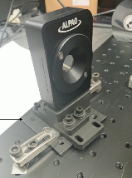
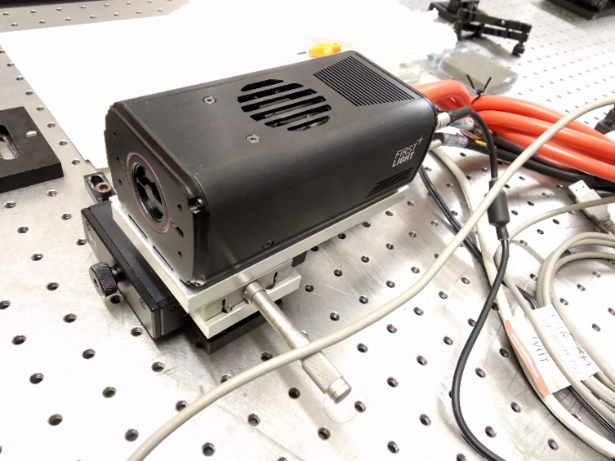
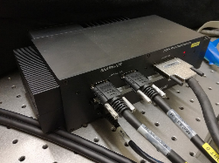
SHARK-NIR in its European AIV Phase @ INAF-OA Padova
Integration preceded by an intense
HW / SW / SS characterization activities
AO – channel:
- ALPAO 97-15 Deformable Mirror
- FirstLight Cred2 Camera
- Microgate Real Time Computer

Slide 3
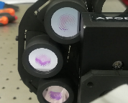
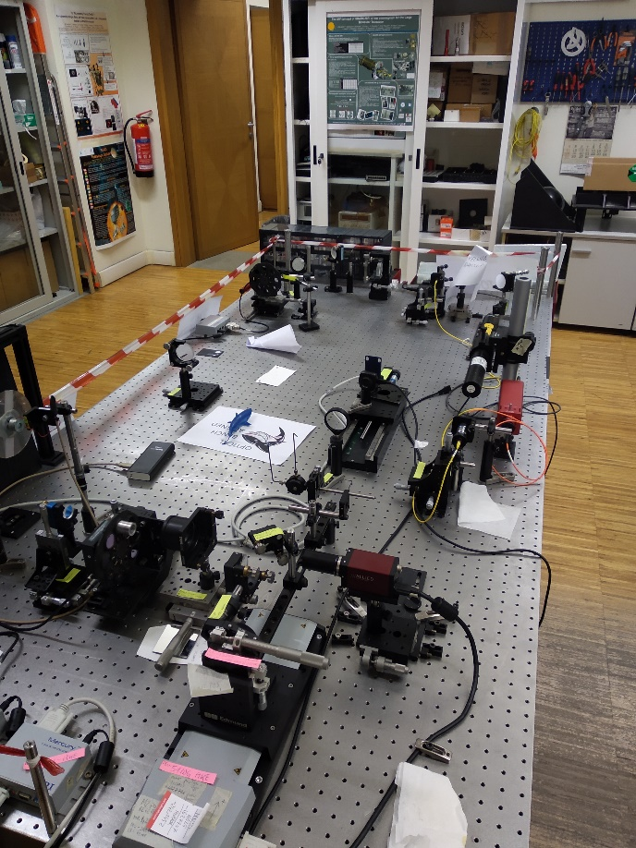
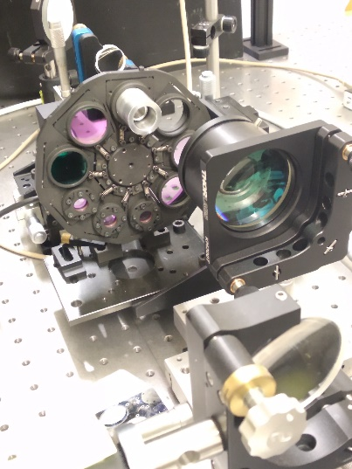
SHARK-NIR Coronagraphs
Scientific / Technical Goals
The direct imaging of giant planets needs coronagraphic contrasts of 10⁻⁵ – 10⁻⁶
This translate in a requirement on wavefront control
SHARK-NIR receives the already corrected wavefront from FLAO
~ 50 nm residual
The Non Common Path Aberrations should be reduced from
~110 nm to ~30 nm
Correct the telescope jitter to reach tip-tilt residuals of
3 – 5 mas
Strictly related to the design of the coronagraphic masks

Slide 4
NCPA
Contribution:
Nominal optical design
Dichroic (nominal + tolerances on surfaces)
Alignment tolerances and manufacturing
Thermal effects
Flexures
Combining company data and mc wf realization,
we put 110 nm rms
as typical number for NCPA
(distributed on 30 Zernike’s modes)
Dichroic is the main (75%) contributor

Slide 5
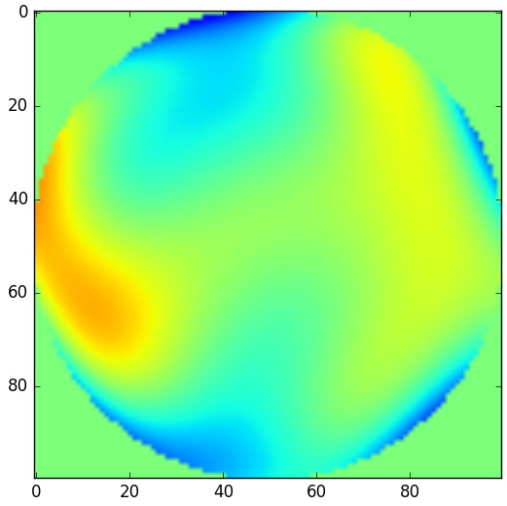
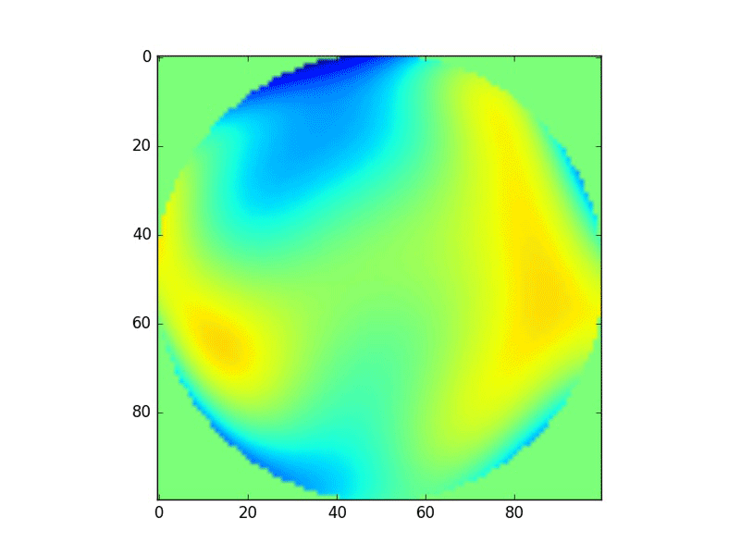
Evaluate the NCPA before the observation
When: once a year? Once a season? Every night?
How? Phase diversity? Fiber and reconstruction through PSF on scientific detector?
Apply the correspondent correction
Close the tip tilt loop and maintain the correction!

Slide 6
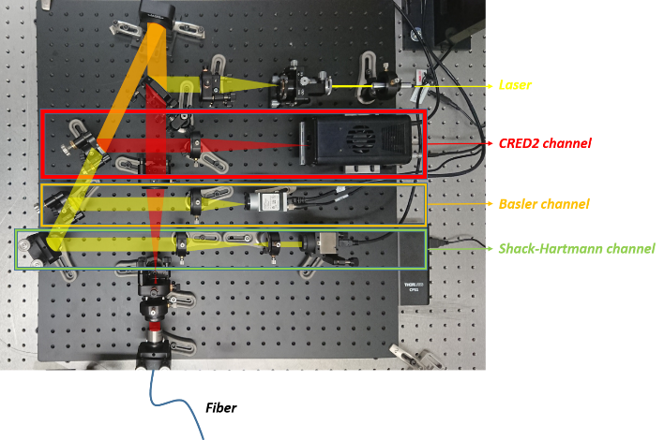
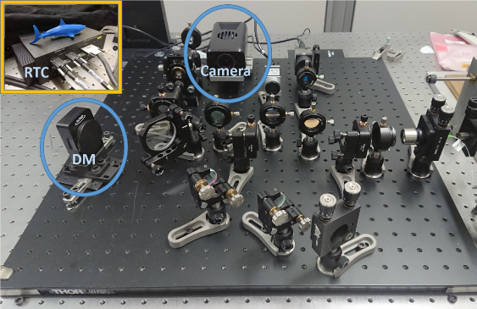
Test Bench
Sources: - diode 635 nm, 1.2mW
- Tungsten-Halogen Light Source,
360 - 2600 nm (with fiber);
75 W tunable
Detectors: - CRED2
- Shack-Hartmann wavefront sensor (19x15 - 300 µm pitch - lenslet; 1024x1280 4.65 µm px; 400-900 nm bandwidth)
- Basler (1024x1280 5.3 µm px)

Slide 7
TT LOOP
GOAL
Check the performance of the TT loop
Starting from different amplitudes of residual Tip Tilt histories
Working with different source luminosity
Correcting at different frame rates
8
9
10
11
12
15
10
5
0
500
1000
Hertz
mas
R magnitude

Slide 8
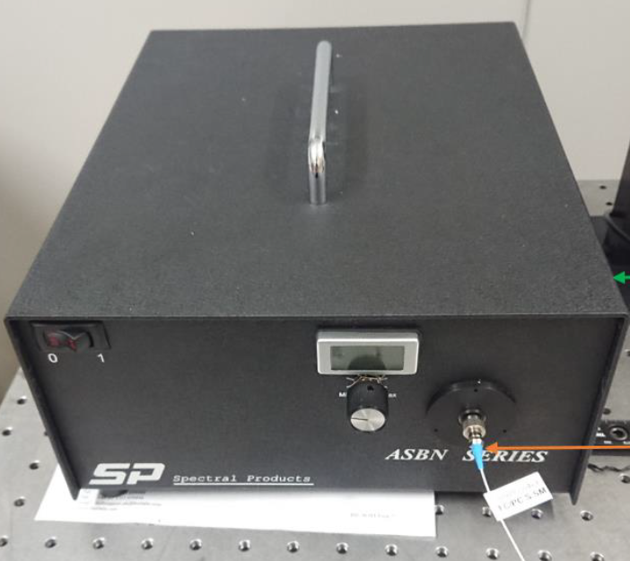
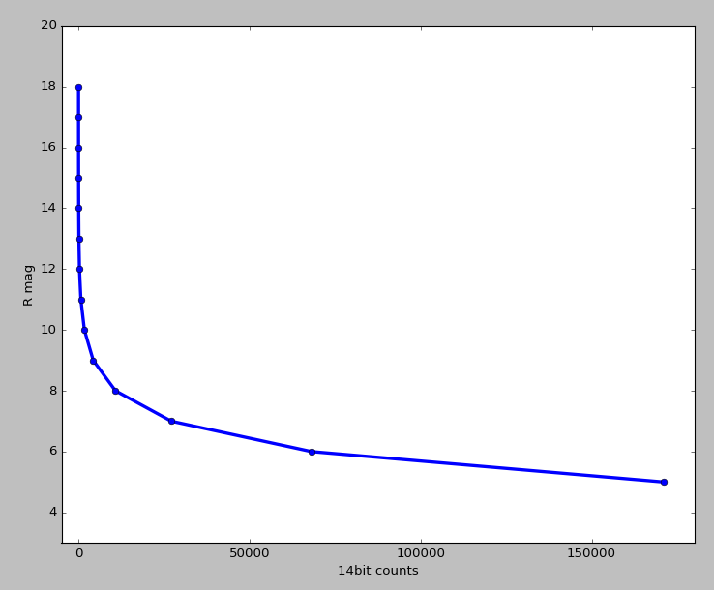
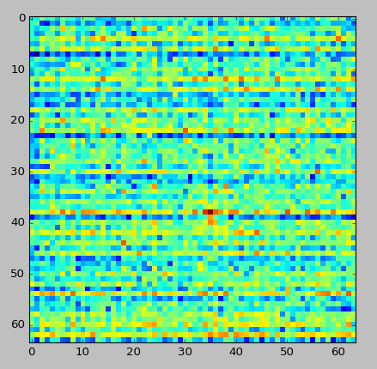
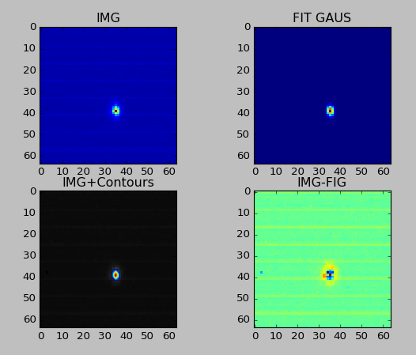
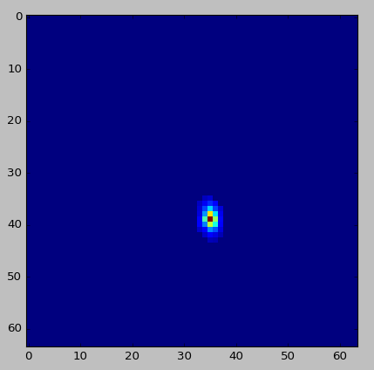
Calibrate the lamp to simulate R mag

Slide 9
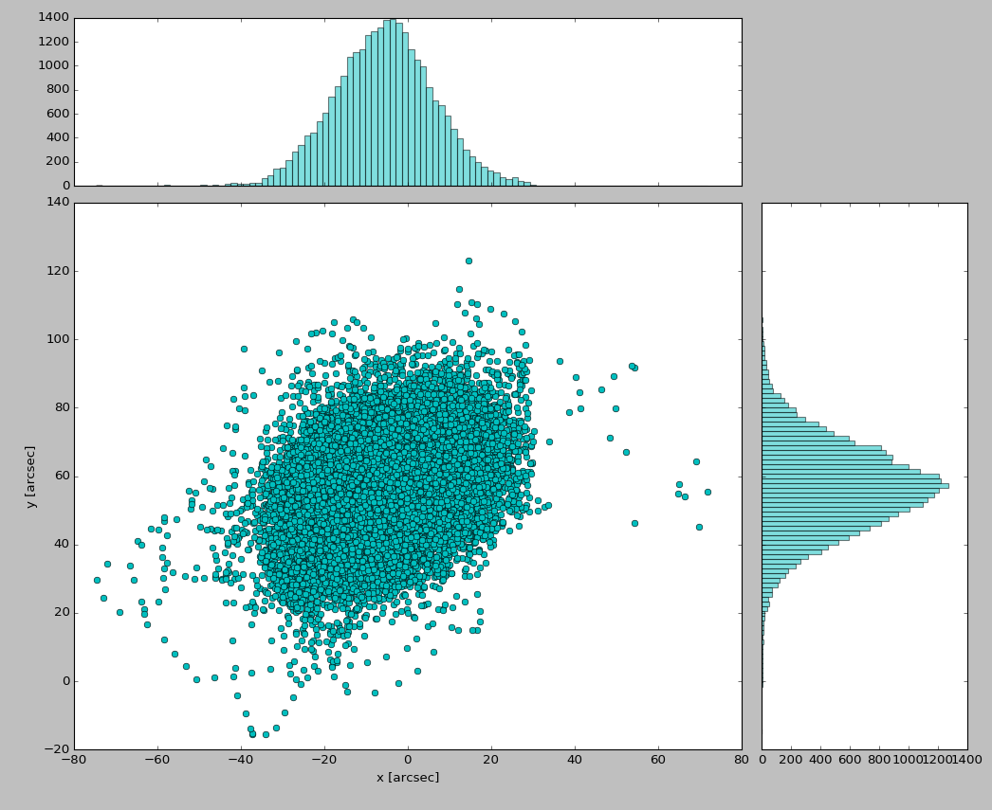
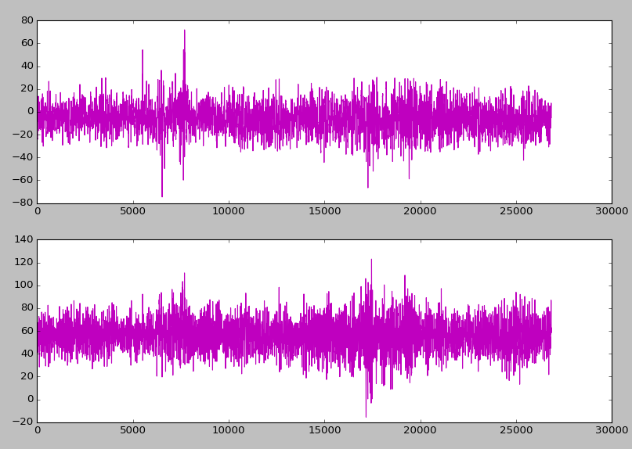
Time history
Centroid data
courtesy of
Fernando Pedichini and Marco Stangalini from SHARK-VIS forerunner test @LBT
X
Y
20 seconds history
Here FLAO is correcting the WF

Slide 10
TT loop
SW provided by Microgate
Apply the TT history on the DM
-- Takes images on (a cropped area of) the CRED2
-- Subtract the proper dark image
-- Calculate the centroid
Try to close the loop correcting the “next step of” the TT history
Almost all the parameters are accessible, e.g. the DM PID, Camera crop, Frame Rate, pxGain, pxTarget…

Slide 11
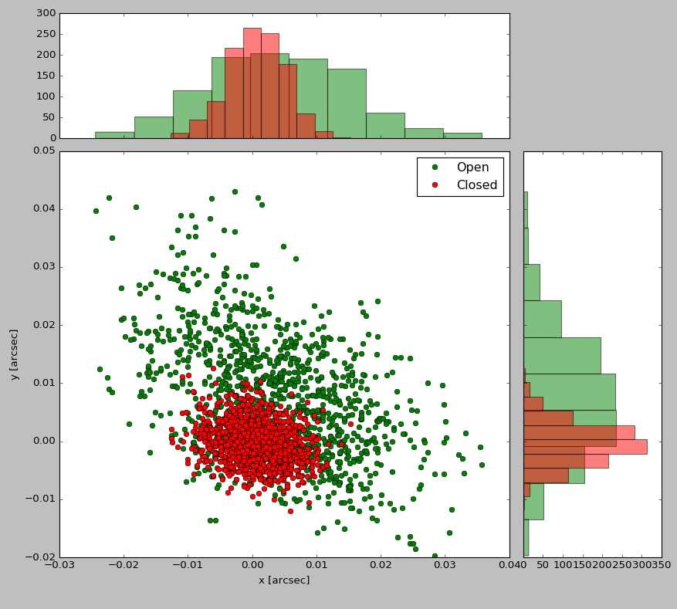
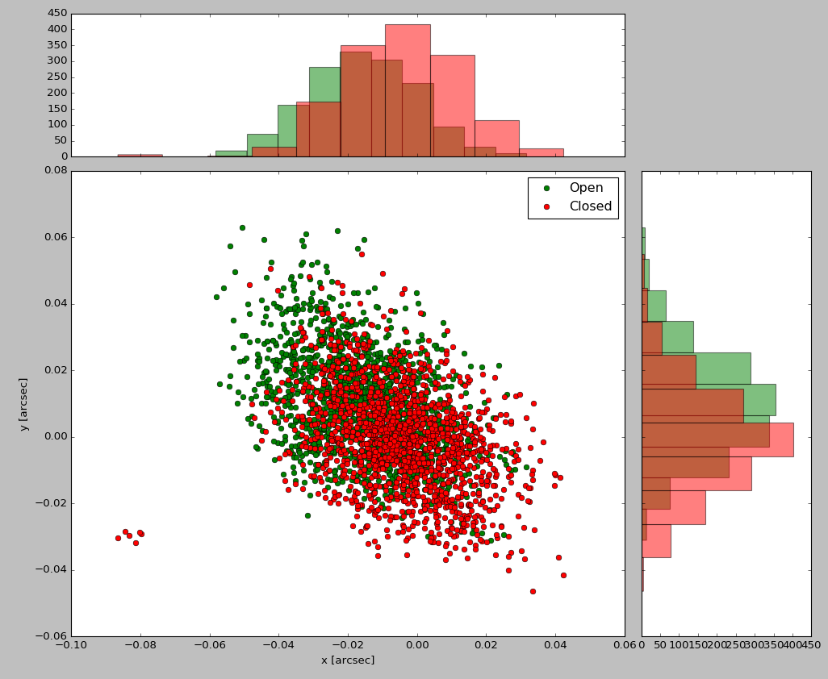
We saved images during 3 seconds tests and found centroids using cross correlation
Green → No TT history correction
Red → Trying to correct the TT
Es.
-- Time history amplitude: 15 mas
-- Rmag = 9
Es.
-- Time history amplitude: 15 mas
-- Rmag = 12

Slide 12
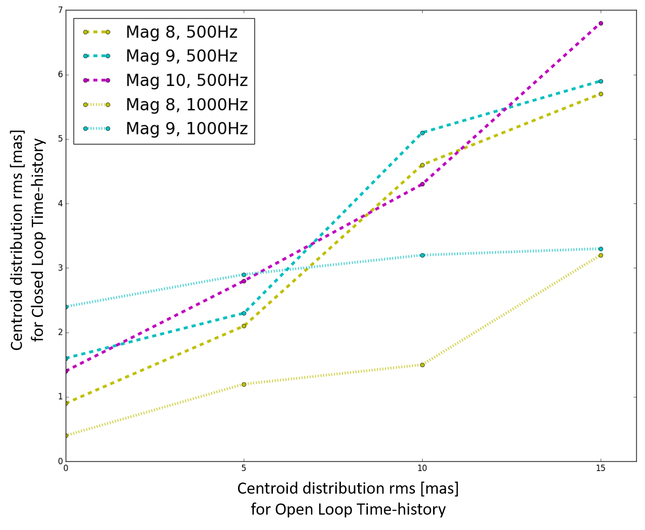
TT results
R magnitude | Input time history Frame Rate [Hz] | 15 mas | 10 mas | 5 mas | No input time-history
Mag 8 | 500 | 5.7 | 4.6 | 2.1 | 0.9
 | 1000 | 3.2 | 1.5 | 1.2 | 0.4
Mag 9 | 500 | 5.9 | 4.1 | 1.3 | 1.6
 | 1000 | 3.3 | 3.2 | 2.9 | 2.4
Mag 10 | 500 | 6.8 | 4.3 | 2.8 | 1.4
 | 1000 | --- | --- | --- | ---
Classical centroid
(px-coordinates weighted by px-flux)
Capability to close the loop is a function of
residual jitter
frame rate… 1KHz seems better but you lose photons
Gain in the centroid distribution wrt the input amplitude:
2.1 --- 2.5 @ 500 Hz
3 --- 5 @ 1 KHz
almost independent by the magnitude.

Slide 13
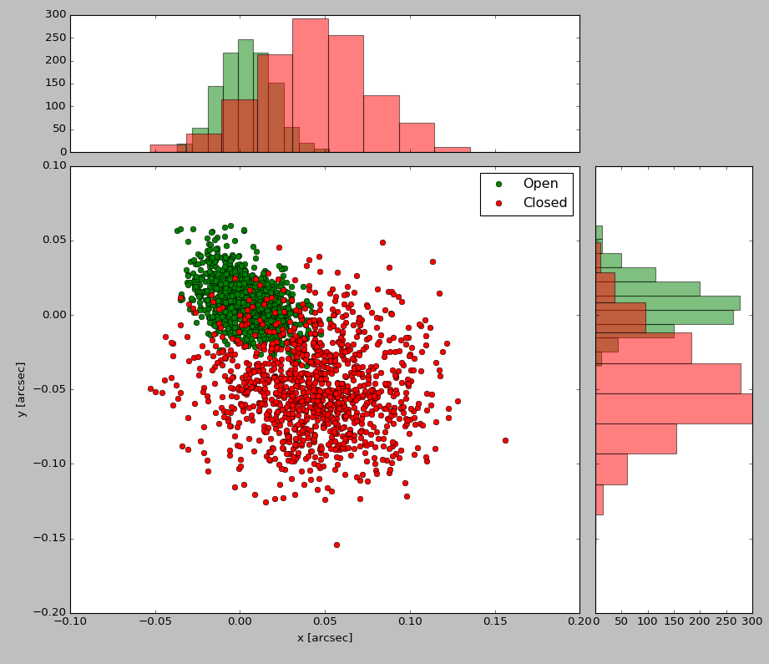
Higher Magnitudes?
-- Time history amplitude: 15 mas
-- Rmag = 11
What we tried:
-- Cropping smaller roi on the detector
-- Working at different camera temperatures
(-40, 0, 20 °C)
-- Apply Non Destructive Read Out mode
(FirstLight and Microgate algorithms)
-- Change Mirror PID
-- Using slightly different algorithm for centroid computation
Reasons → camera ron + rts (next slides)

Slide 14
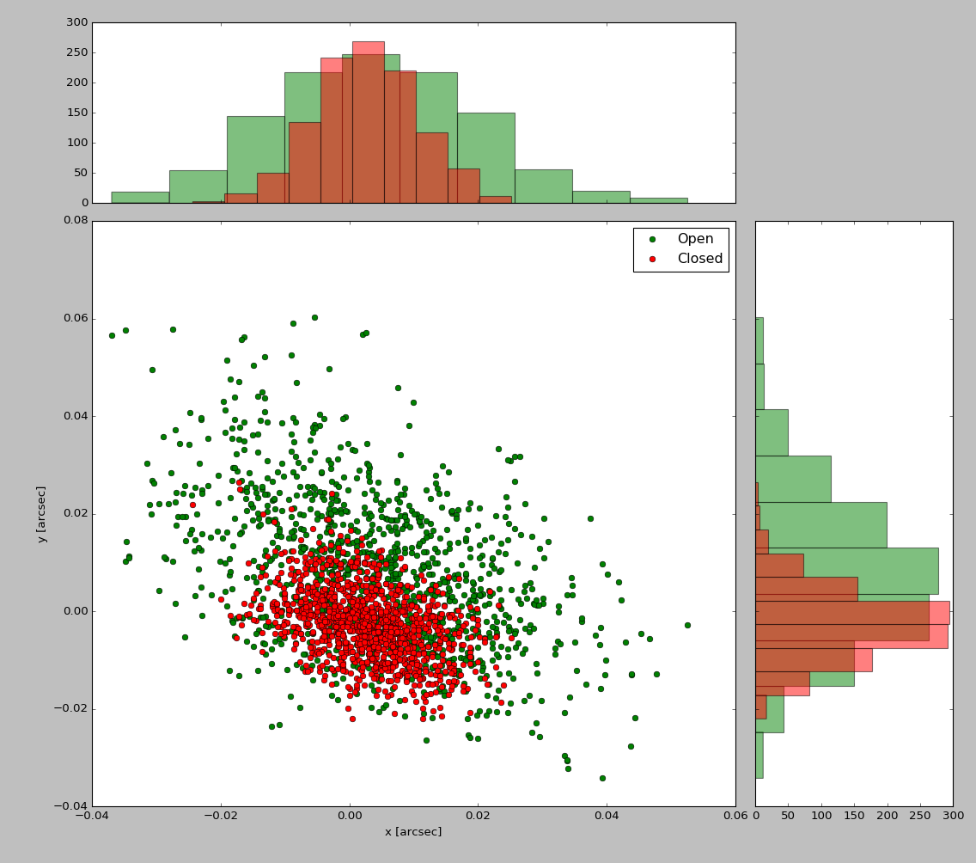
R magnitude | Input time history Frame Rate [Hz] | 15 mas
Mag 11 | 500 | 7.5
Classical centroid:
thresholding
px-coordinates weighted by px-flux
Strongly dependent on magnitude
Enhanced method:
thresholding
px-coordinates weighted by px-flux and
by Gaussian distance from the expected psf position
Rmag = 11
Gaussian weighting does the job, this is just to clean the image

Slide 15
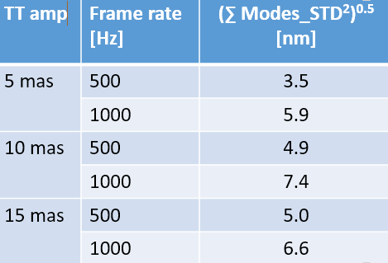
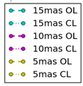
NCPA correction during TT loop
Apply a typical (110 nm rms)-NCPA correction shape to the DM
Track the firsts 30 Zernike’s mode with the SH channel during TT loop and TT closed loop
Checked the stability of the DM-”NCPA”-shape
500 Hz
STD
1 KHz
High capability of the DM
in maintaining a NCPA correction
during fast TT loop
STD

Slide 16
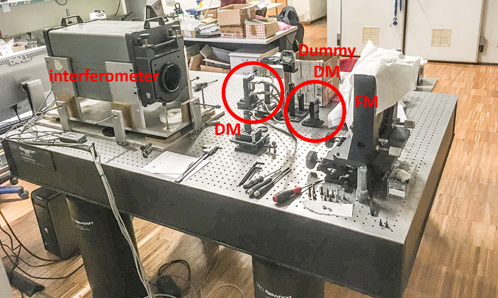
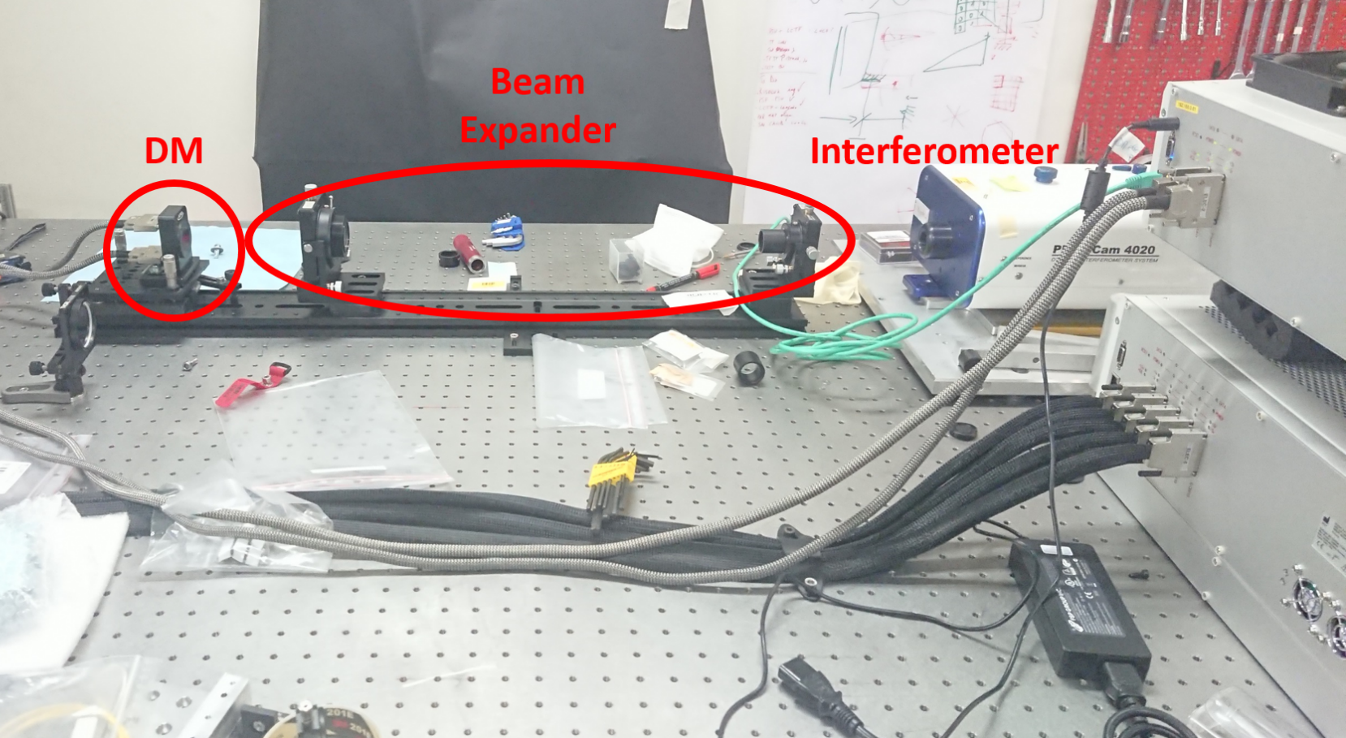
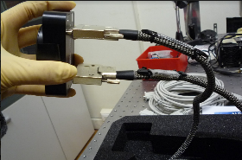
Padova Laboratory
Deformable
Mirror
Arcetri Laboratory

Slide 17
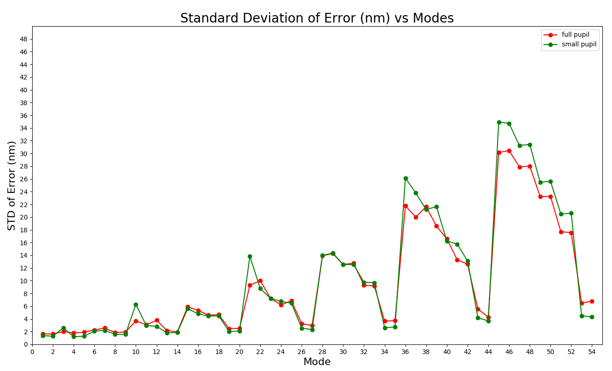
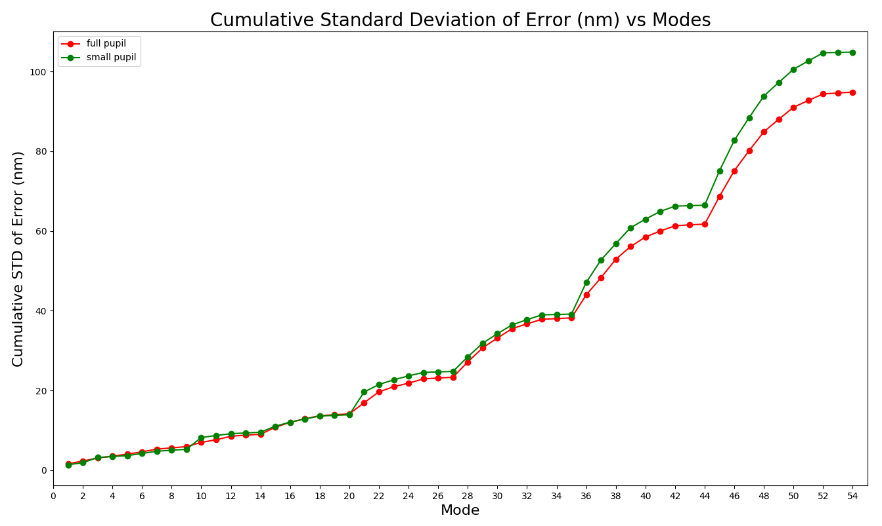
@Arcetri:
Define the influence functions (78 20% max amplidute push&pull for each actuator) → create a Zernike modal base for the full 13.5 mm pupil and for the smaller 11 mm
Found the best flat: 4 nm rms
Found the fitting error 54 Zernike modes applied individually → multiple push and pull measurements (50 nm rms full pupil, 40 nm small-pupil)
Upper limit of the fitting error (fitting n modes together) since it is the sum of n independent errors obtained applying the same power for each mode.
Higher for circular symmetry modes

Slide 18
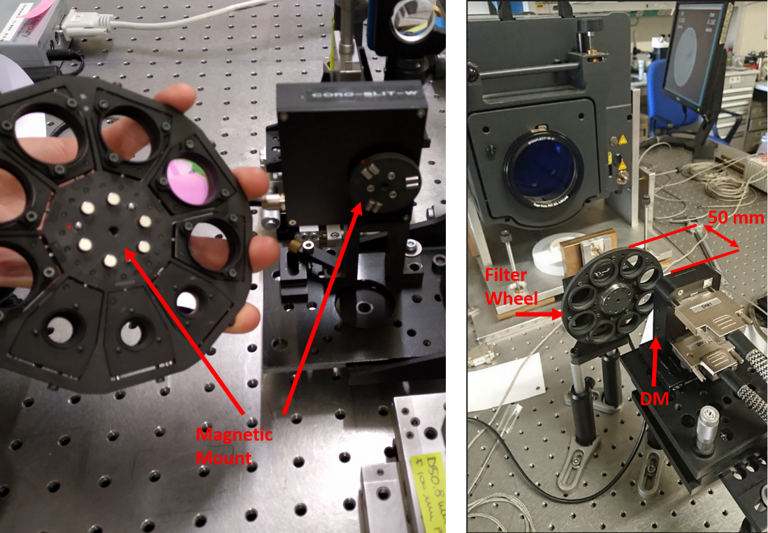
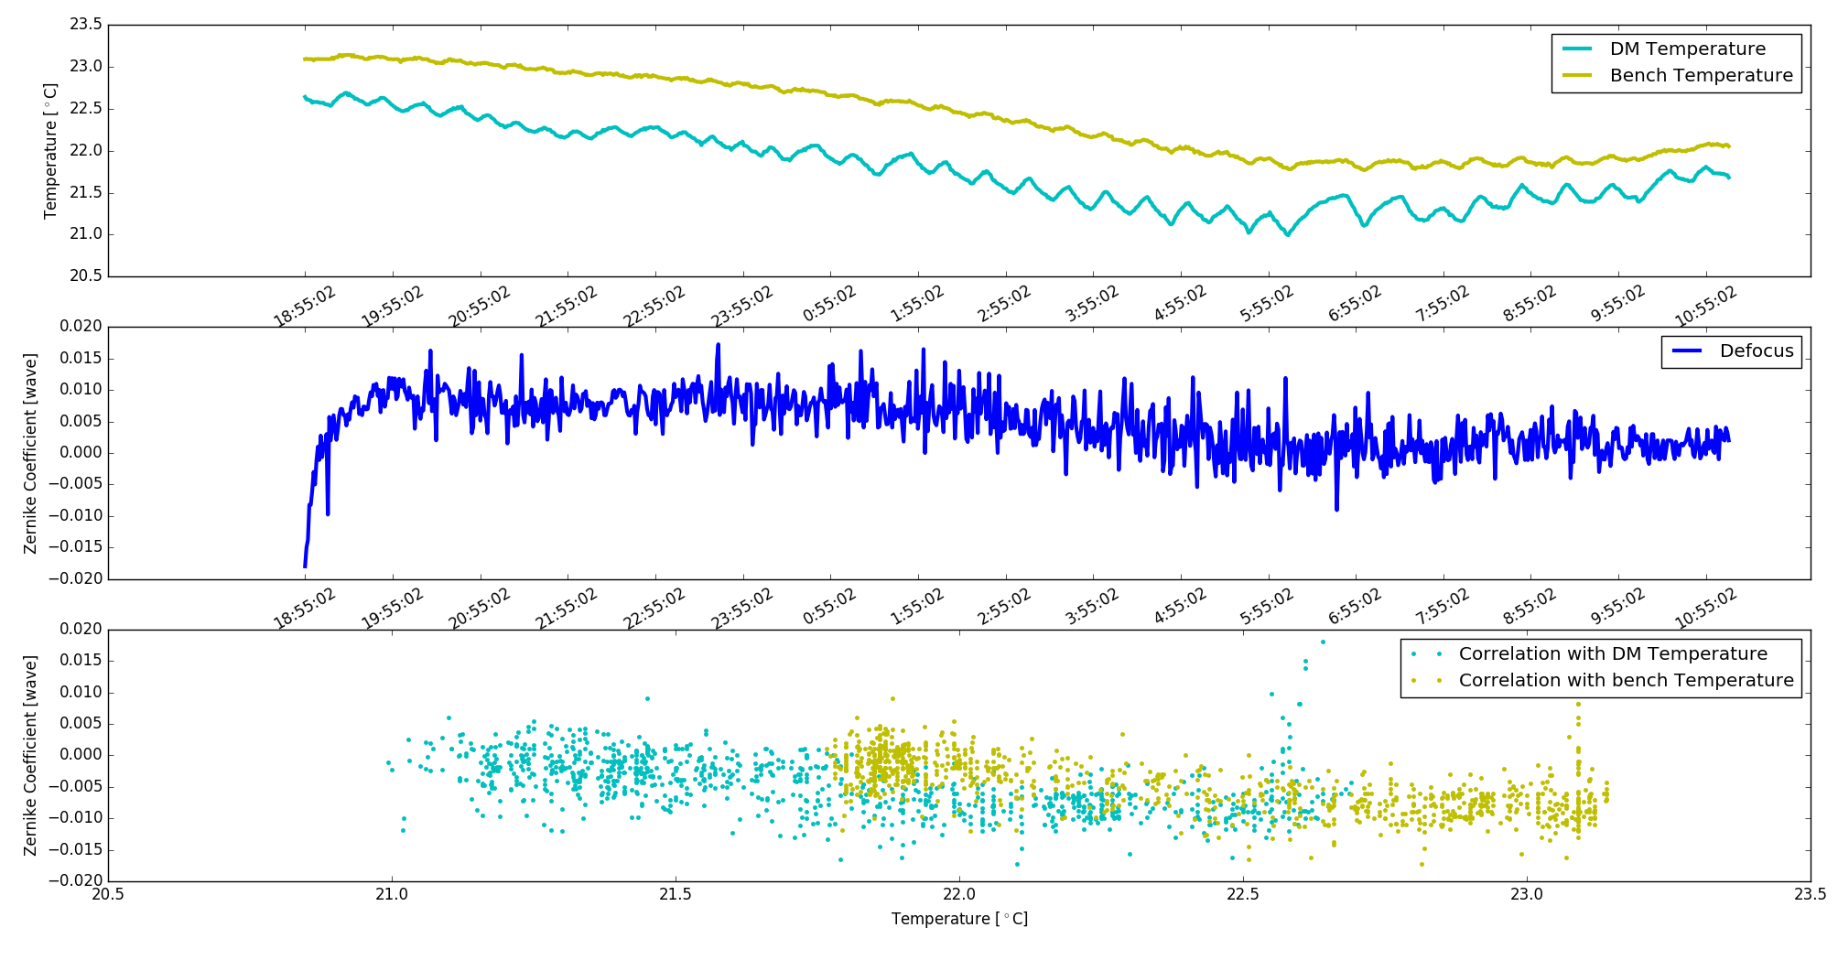
@Padova:
Re-check flat → 14 nm (Transportation? Error on cavity?)
Thermal effects: Difficult to disentangle from creep effect (see next item) when working outside the cleanroom. We measure about 8 nm rms Power on the flat shape from outside (about 22°C) to inside the cleanroom (20°C) consistent with a fit from an overnight test
Effect of filter wheel magnets: negligible
Memory effect: Negative
Creep effect: Positive ☹
0.005 [wave] / °C

Slide 19
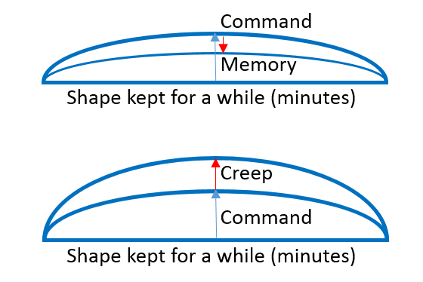
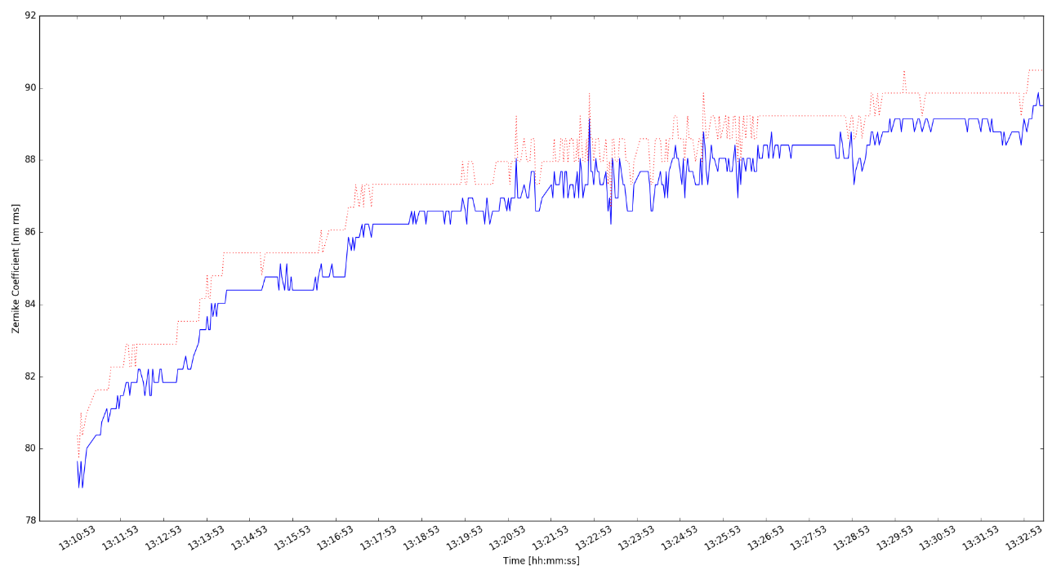
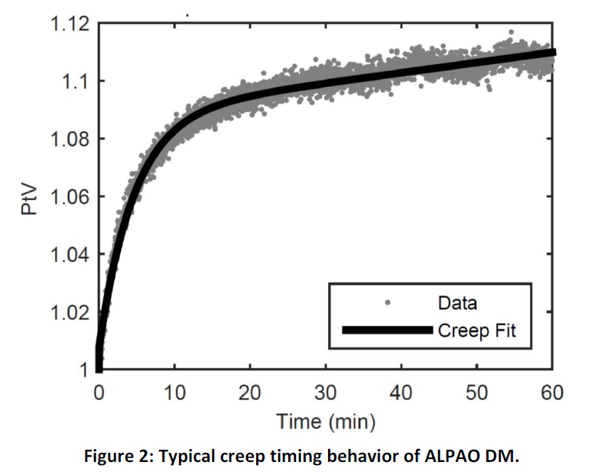
Creep effect → measured on low order modes
Time scale
Plateau
Creep
Given command= 80 nm rms defocus
Target

Slide 20
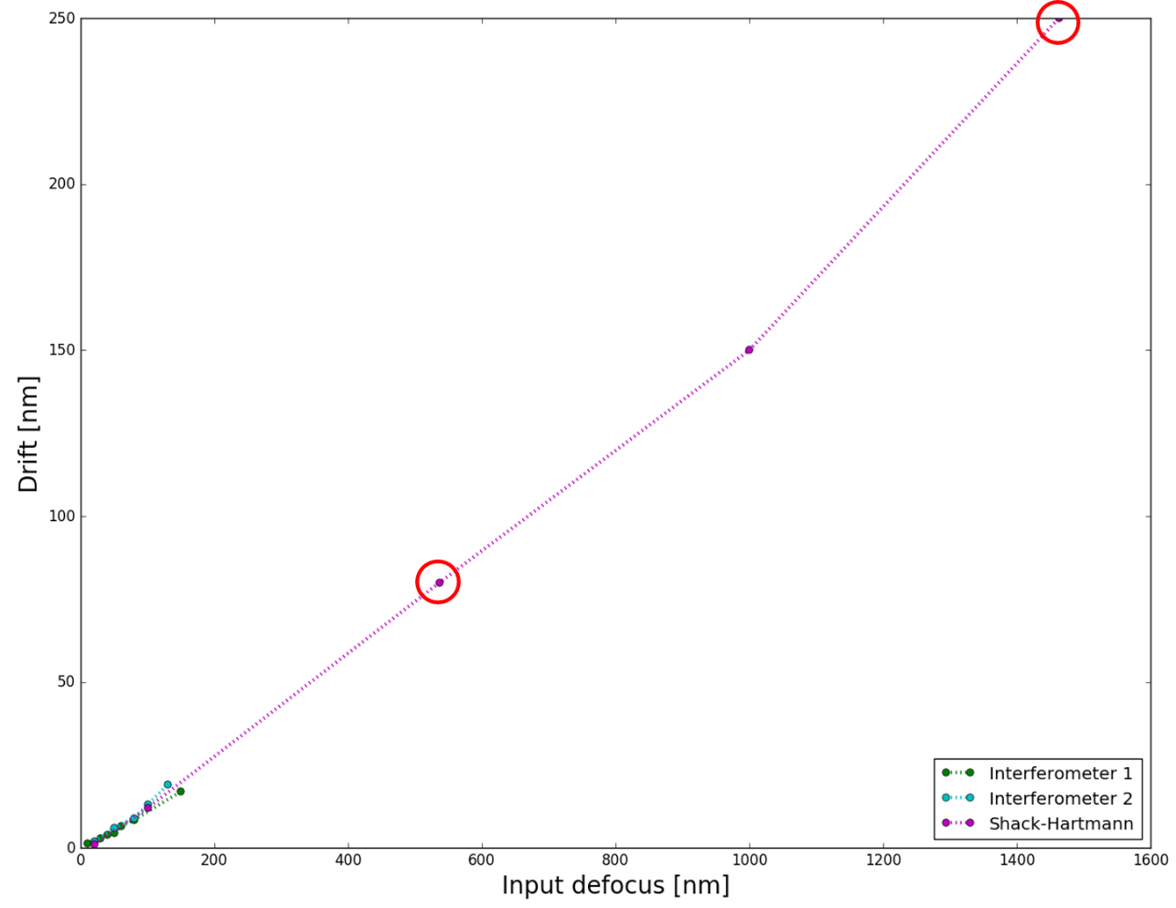
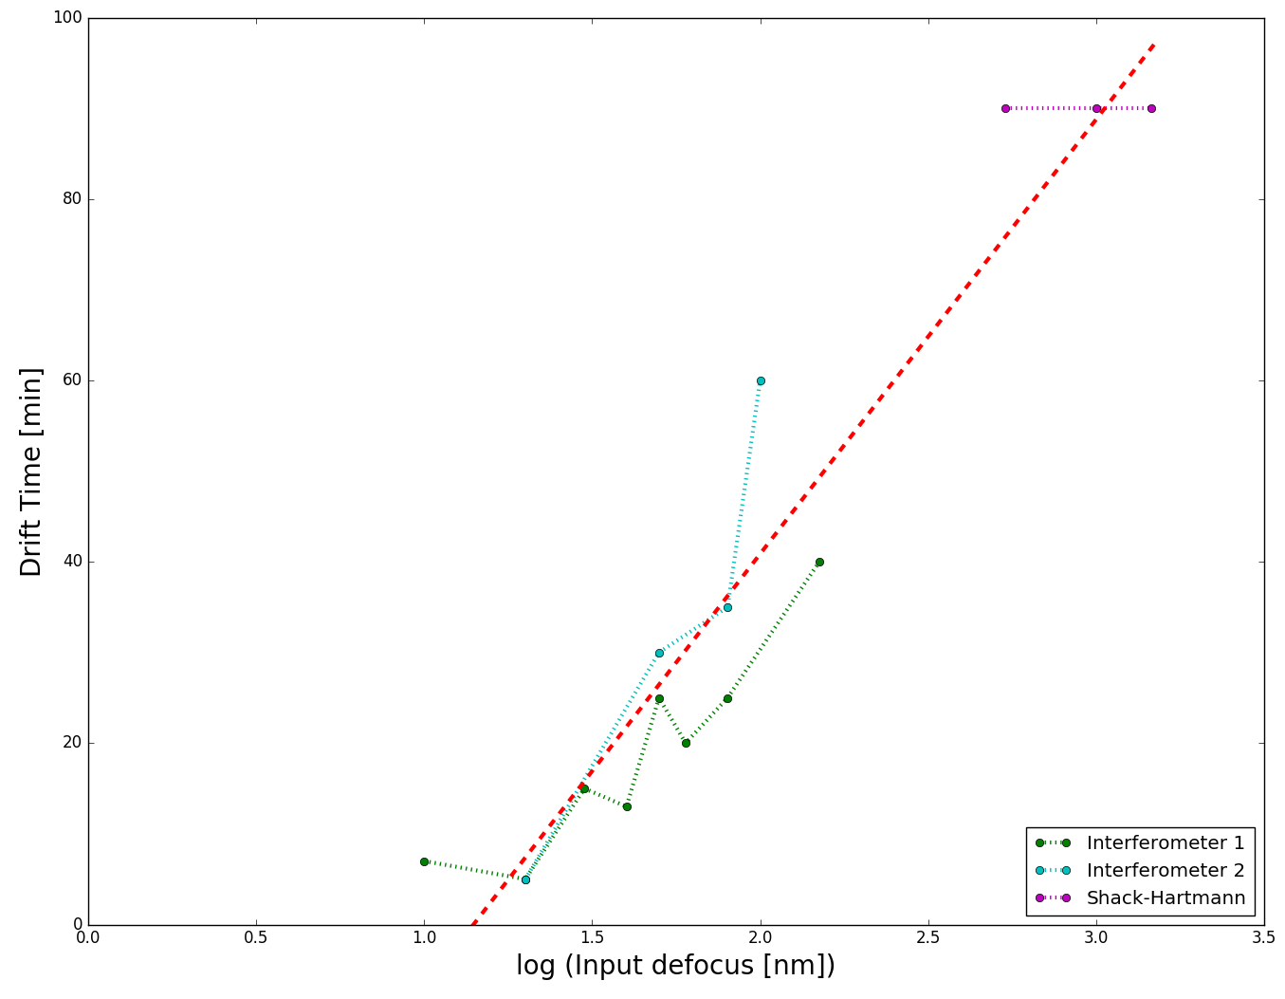
Relations for the defocus
Time to reach the plateau
VS Amount of input aberration
Amount of creep VS Amount of input aberration
Drift = 0.00003134*input^2 + 0.124*input – 0.367
In our input regime, this means about 13% of the input.
Plateau is reached in 90 minutes for 400 nm rms

Slide 21
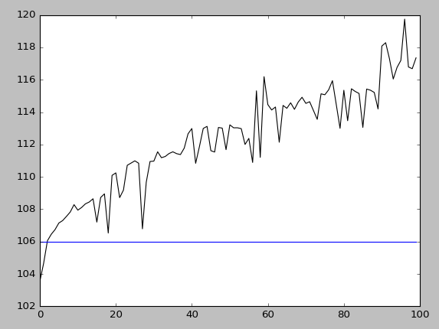
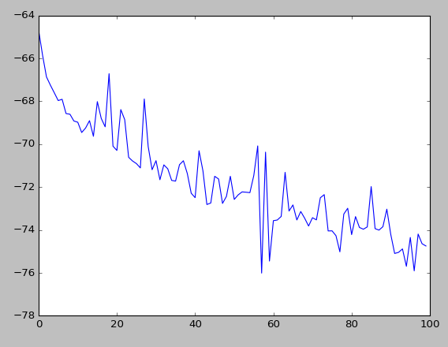
Creep on NCPA
Start from flat shape
Apply NCPA
Apply a random TT for 5 sec
Stop the TT loop
Save an interferogram (ca 10 sec)
Do this 100 times
Measured NCPA rms
WF RMS [nm]
Astigmatism
Nominal NCPA rms
Zernike coefficient [nm]
ca 30 min
CA 30 min

Slide 22
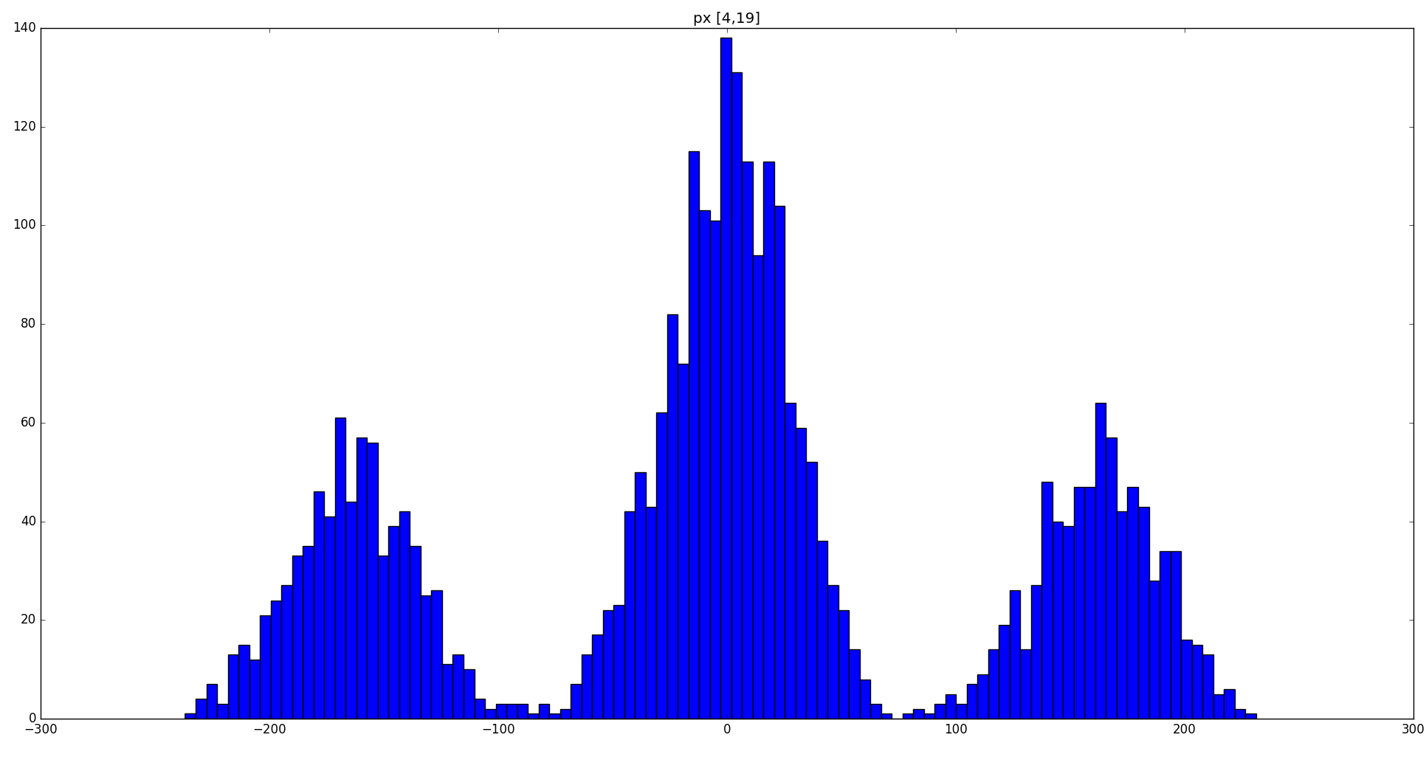
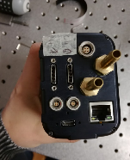
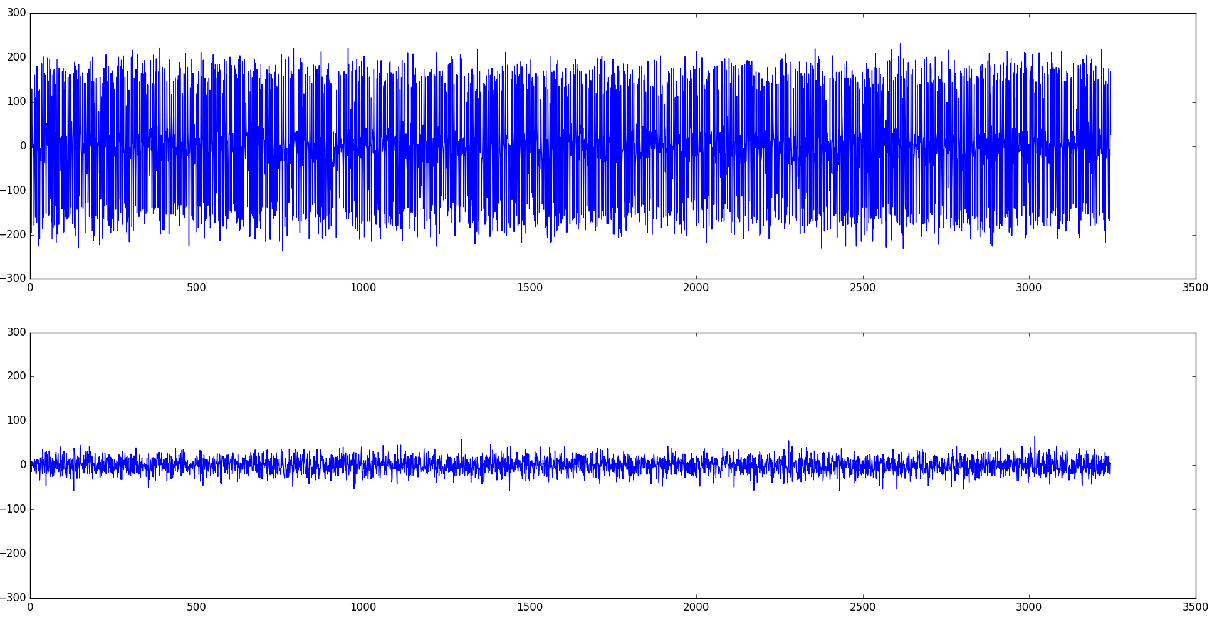
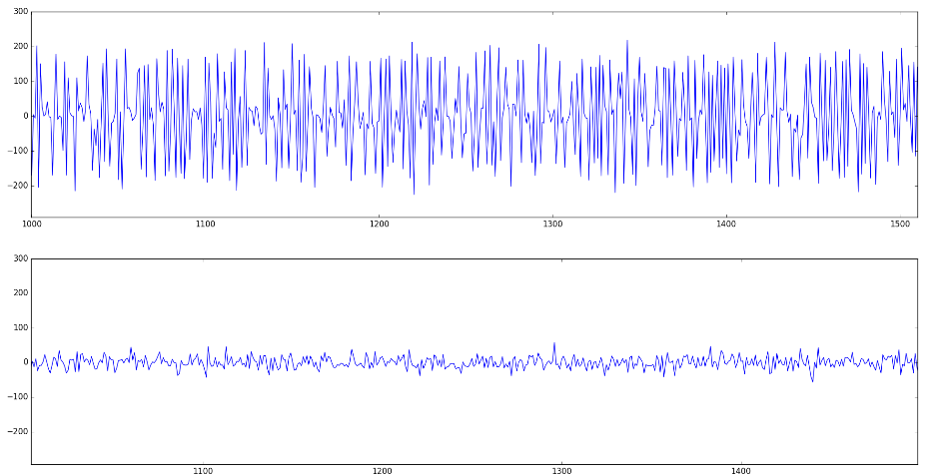
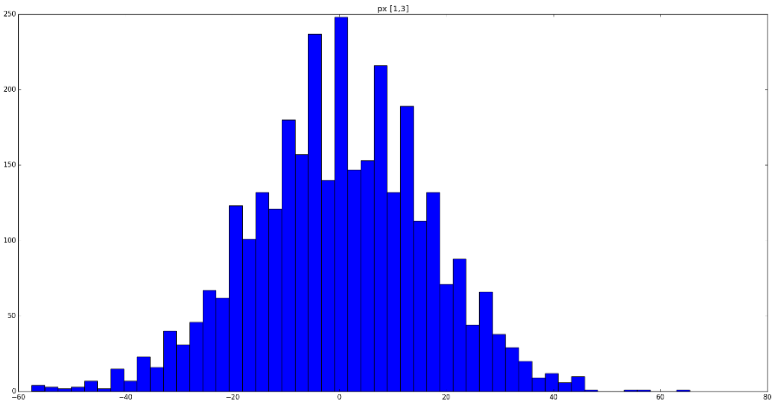
150 count threshold
Test on the detector
N of px over threshold = 519
Random Telegraph Signal
Step-like transitions between two or more discrete voltage at random and unpredictable times
Max=231
COUNTS
We can minimize RTS increasing detector T, but for R=12 mag RON-tail acts like RTS
Standard vs RTS px behavior

Slide 23
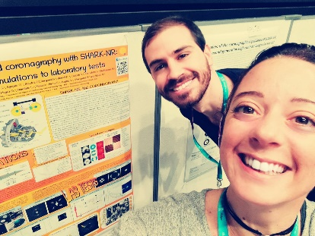
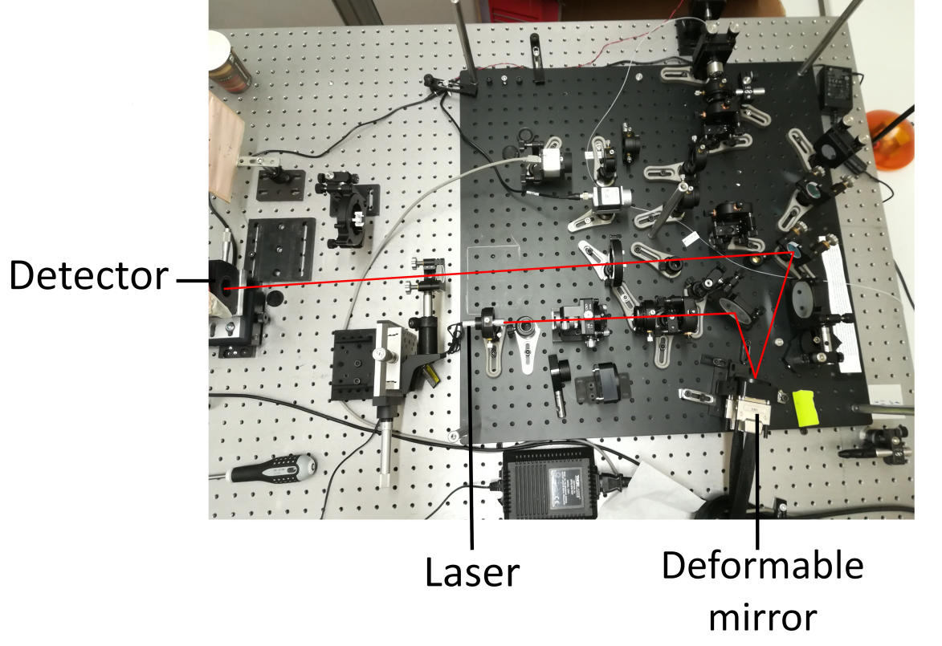
Phase Diversity
Phase diversity is a technique that reconstructs the instrumental aberrations directly from two images: one in focus and the other out-of-focus. The reconstruction algorithm has been developed by ONERA (Paris).
We are testing the algorithm on the same optical bench used for the characterization of the TT-loop.
We applied several modes on the DM and registered the response of the phase diversity sensor.
We tuned the sensor parameters by comparing the results with the output of a SH sensor.
We recently obtained from ONERA a new optimized version of the algorithm and we are re-analyzing the data.
Preliminary results seem to show that the
sensor is able to reconstruct
up to 20 modes in high S/N ratio images.
in focus
out of focus
Response of the phase diversity sensor to 100, 200 and 400 nm rms WFE of vertical coma applied with the DM

Slide 27
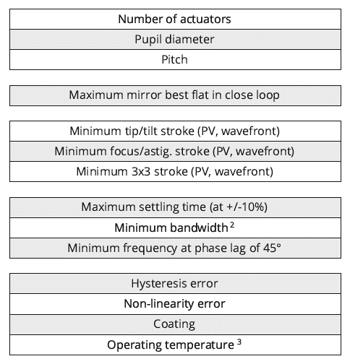
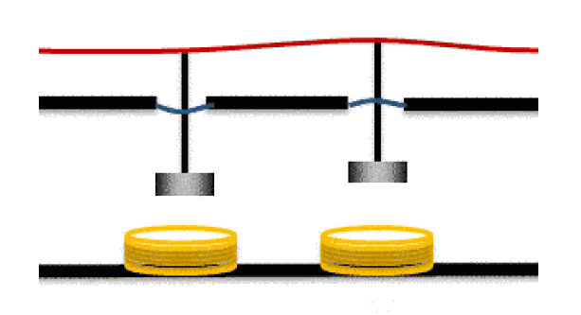
Deformable
Mirror

Slide 28
C-RED2
640 x 512 (15 µm) px InGaAs sensor
400 / 600 FPS full frame
Windowing (2000 FPS @ 64x64 px)
30 e⁻ RON
Cooling (air or liquid)
Possibility to work in Non Destructive Read Out Mode

