Slide 1
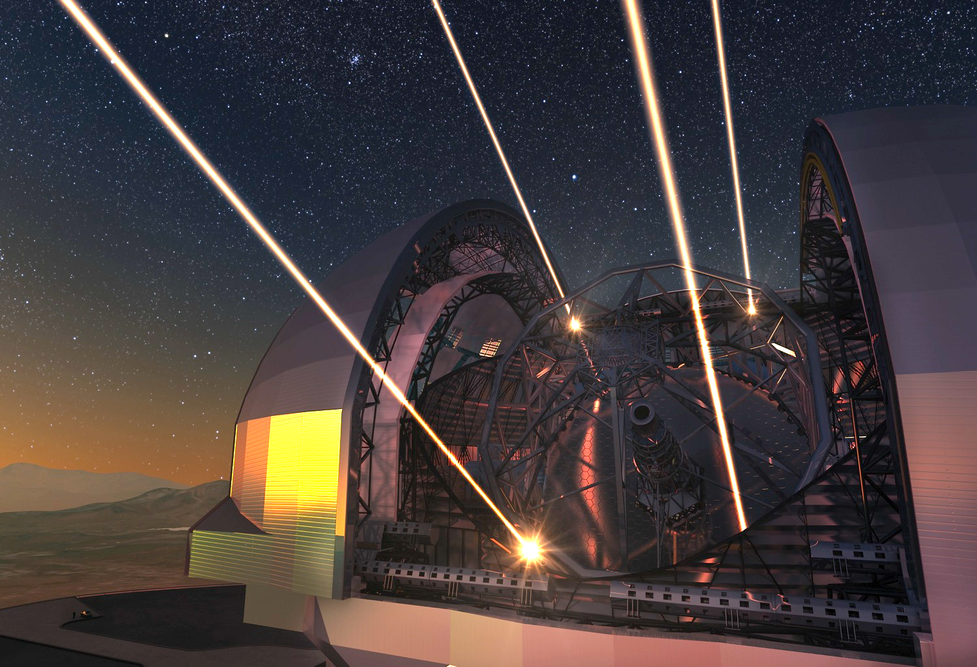


Toward ELT observations Preparation:
The ‘’AO performance and PSF simulations’’
Working Group
Benoit Neichel on behalf of the Working Group
WFS workshop – Arcetri – Oct. 2019

Slide 2
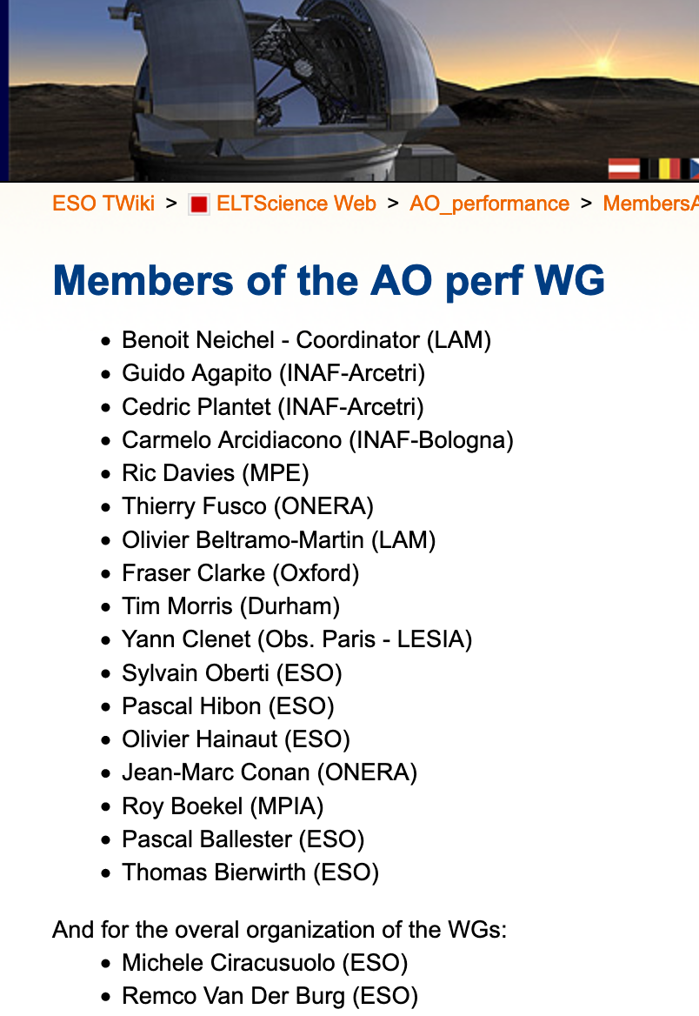
Toward ELT observations Preparation:
The ‘’AO performance and PSF simulations’’
Working Group
Benoit Neichel on behalf of the Working Group
WFS workshop – Arcetri – Oct. 2019

Slide 3
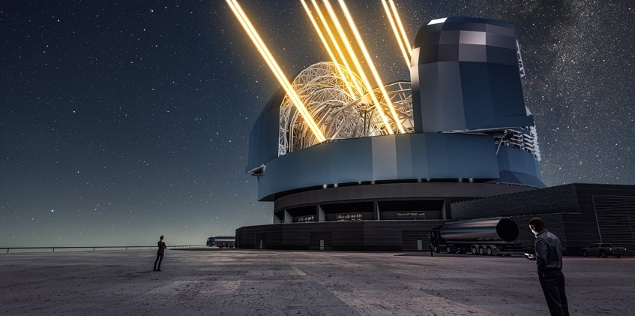
Context
There will be only 1 ELT => Each photon counts.
How to optimize the operations so we make the best use of this big machine ?

Slide 4

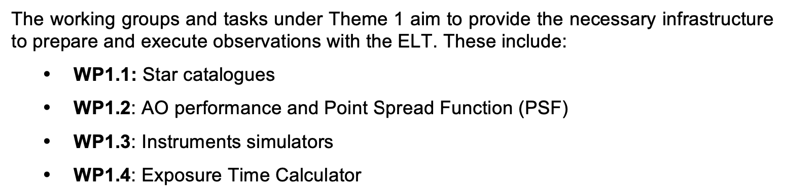
Context

Slide 5
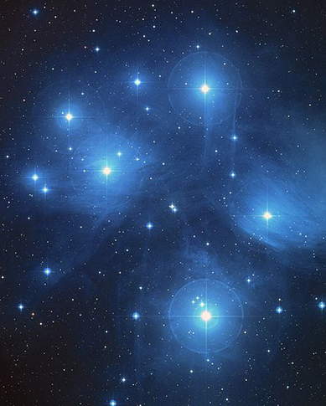
Context

Slide 6
Context

Slide 7
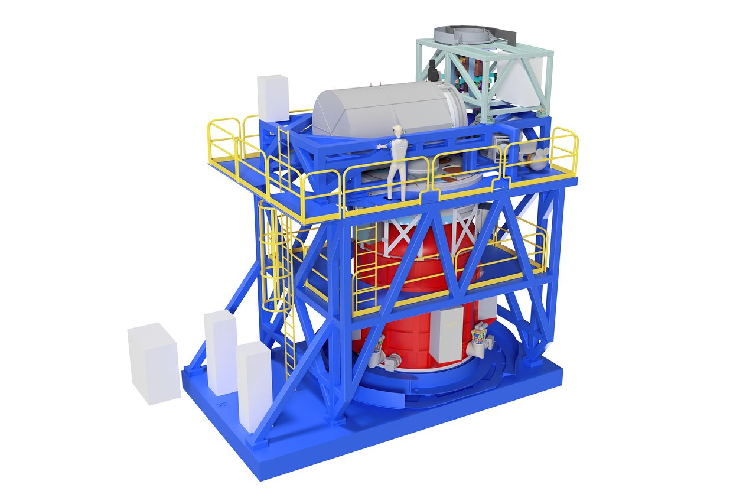
Context

Slide 8
Context
These Working Groups involve scientists from all the ELT instruments

Slide 9
Context

Slide 10
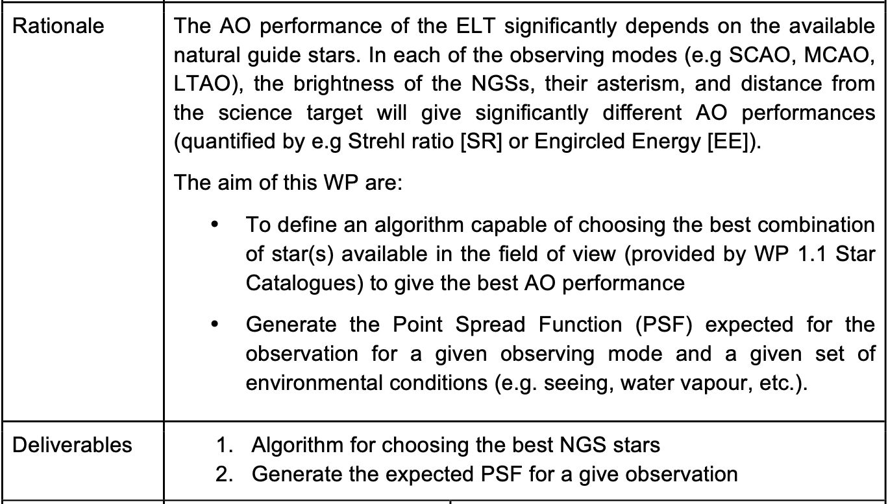
Need first to define a simulation strategy

Slide 11
Strategy for AO Simulation
Full E2E
Analytical
Pros:
Very accurate
Able to model specific effects
Cons:
Convergence time is slow
Require a lot of computing power
Ex. Tools:
- OOMAO, PASSATA, COMPASS, YAO, SOAPY, …
Pros:
Very fast
No need for big computer
Cons:
Not able to model all aspects
Some assumptions to be known
Ex. Tools:
- FAST, PAOLA, CIBOLA, …
(And we can think on using hybrid methods, mixing E2E and analytical)

Slide 12
Strategy for AO Simulation
Full E2E
Analytical
Pros:
Very accurate
Able to model specific effects
Cons:
Convergence time is slow
Require a lot of computing power
Ex. Tools:
- OOMAO, PASSATA, COMPASS, YAO, SOAPY, …
Pros:
Very fast
No need for big computer
Cons:
Not able to model all aspects
Some assumptions to be known
Ex. Tools:
- FAST, PAOLA, CIBOLA, …
(May be ok for SCAO)
(Certainly required for MCAO, LTAO, as they will need to scan many constellations)
(And we can think on using hybrid methods, mixing E2E and analytical)

Slide 13
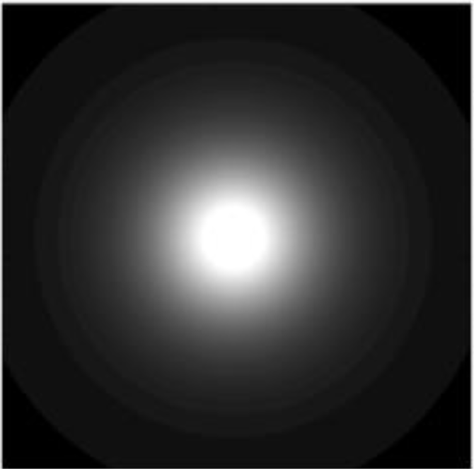
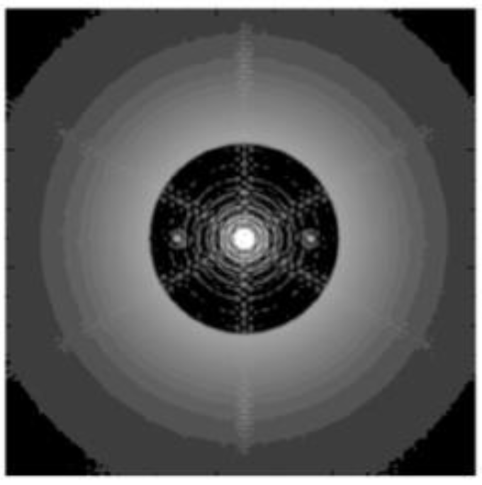
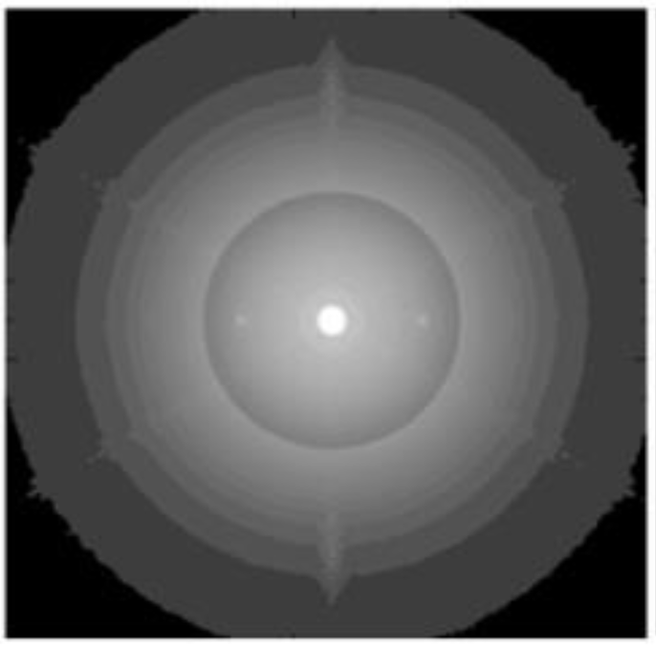
PSF Analytical Approach
Laser (High-Order) PSF
NGS (Low-Order) PSF
PSF = PSF_HO * PSF_LO

Slide 14
PSF Analytical Approach
Laser (High-Order) PSF
NGS (Low-Order) PSF
Depends on Cn2, seeing, L0, LGS constellation, LGS flux.
Depends on Cn2, seeing, L0, NGS constellation, NGS flux.
To a first order, this is mostly constant.
To a first order, this is very variable.
PSF = PSF_HO * PSF_LO

Slide 15
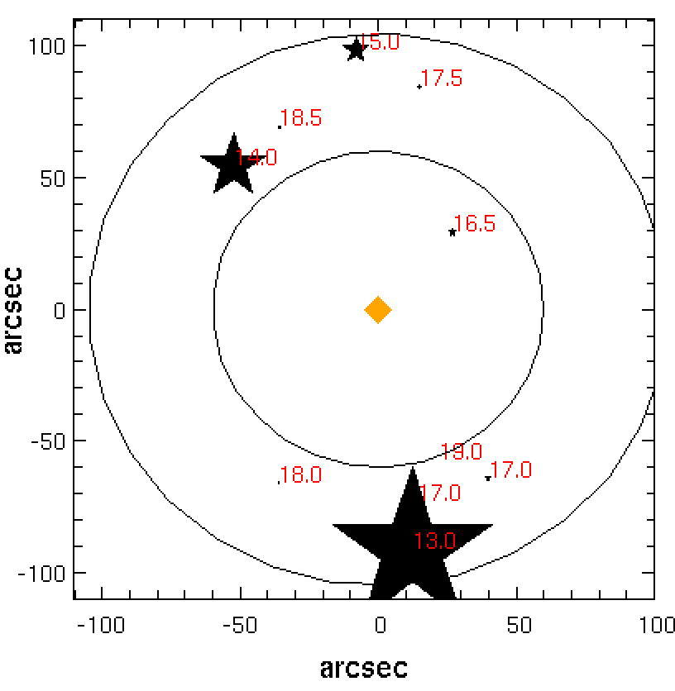
PSF Analytical Approach
Questions: How to find the best NGS asterism ?
How to get the LO PSF from this constellation ?

Slide 16
PSF Analytical Approach
Questions: How to find the best NGS asterism ?
How to get the LO PSF from this constellation ?
It depends on many parameters… let’s try to simplify it…
Simulation strategy:
Residual errors are computed in an “error budget” fashion:
Tomography: depends on the distance (and number) of the NGSs + Cn2
Temporal errors: this only depends on the NGS loop frequency.
Noise propagation: This depends both on the distance and magnitude of the stars, as well as the WFS choice…

Slide 17
PSF Analytical Approach
Questions: How to find the best NGS asterism ?
How to get the LO PSF from this constellation ?
It depends on many parameters… let’s try to simplify it…
Simulation strategy:
Residual errors are computed in an “error budget” fashion:
Tomography: depends on the distance (and number) of the NGSs + Cn2
Temporal errors: this only depends on the NGS loop frequency.
Noise propagation: This depends both on the distance and magnitude of the stars, as well as the WFS choice…

Slide 18
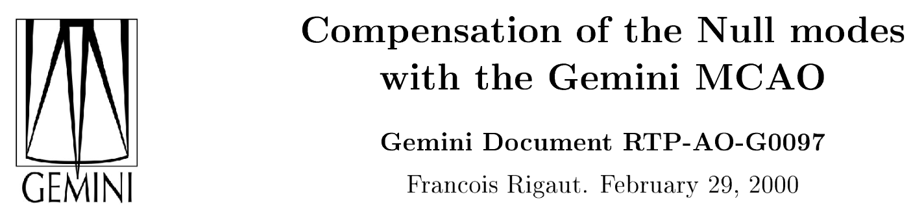
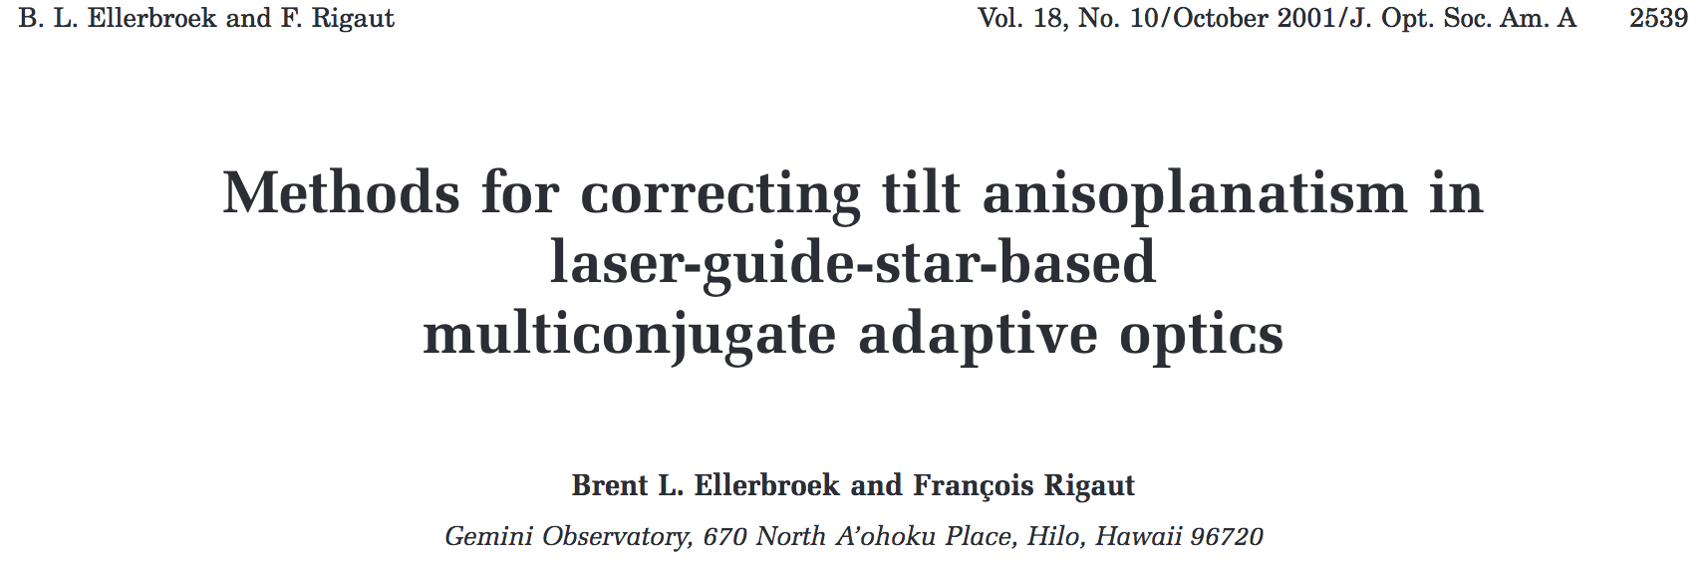
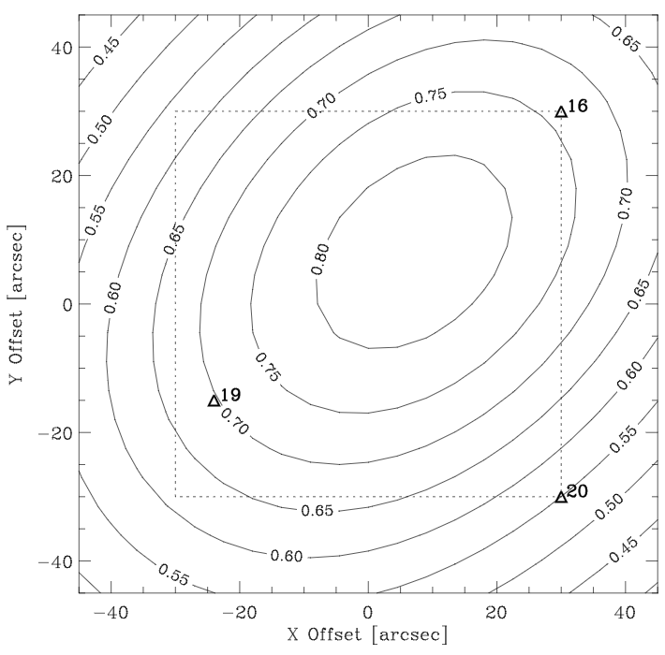
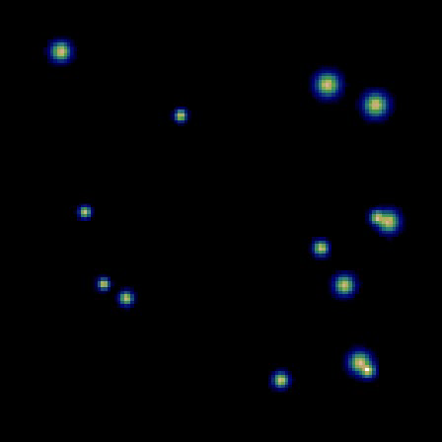
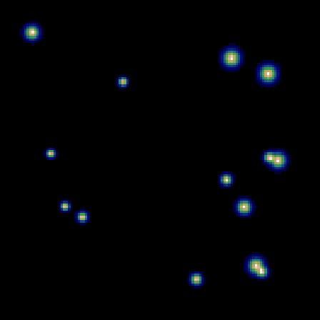
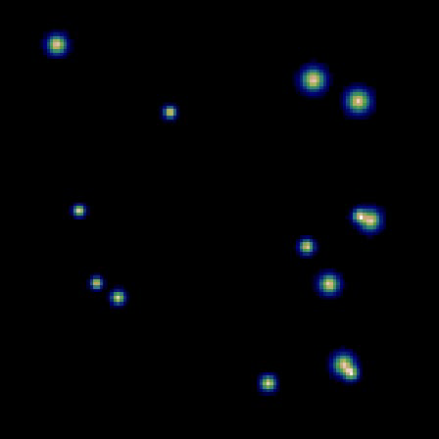
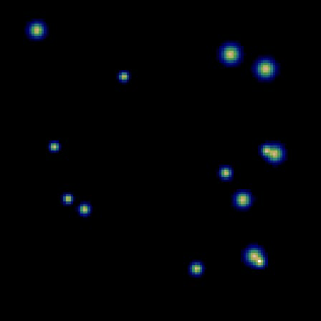
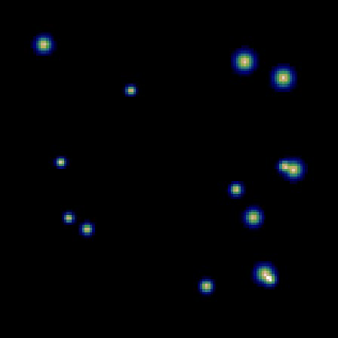
PSF Analytical Approach
Tomography
Temporal
Noise

Slide 19
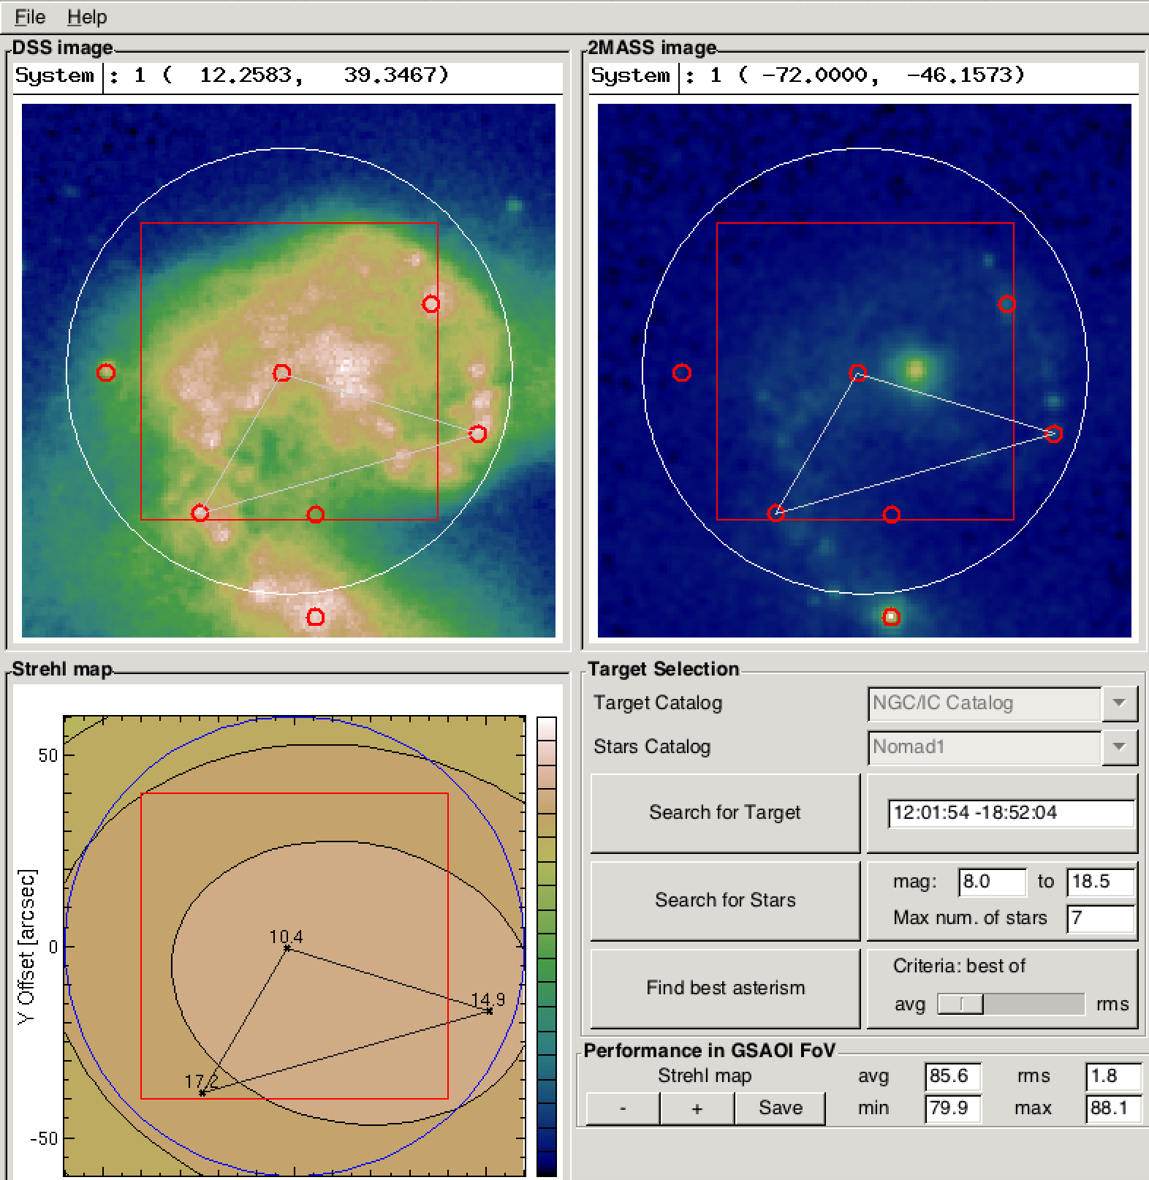
PSF Analytical Approach
Tomography
Temporal
Noise
MASCOT – D. Gratadour

Slide 20
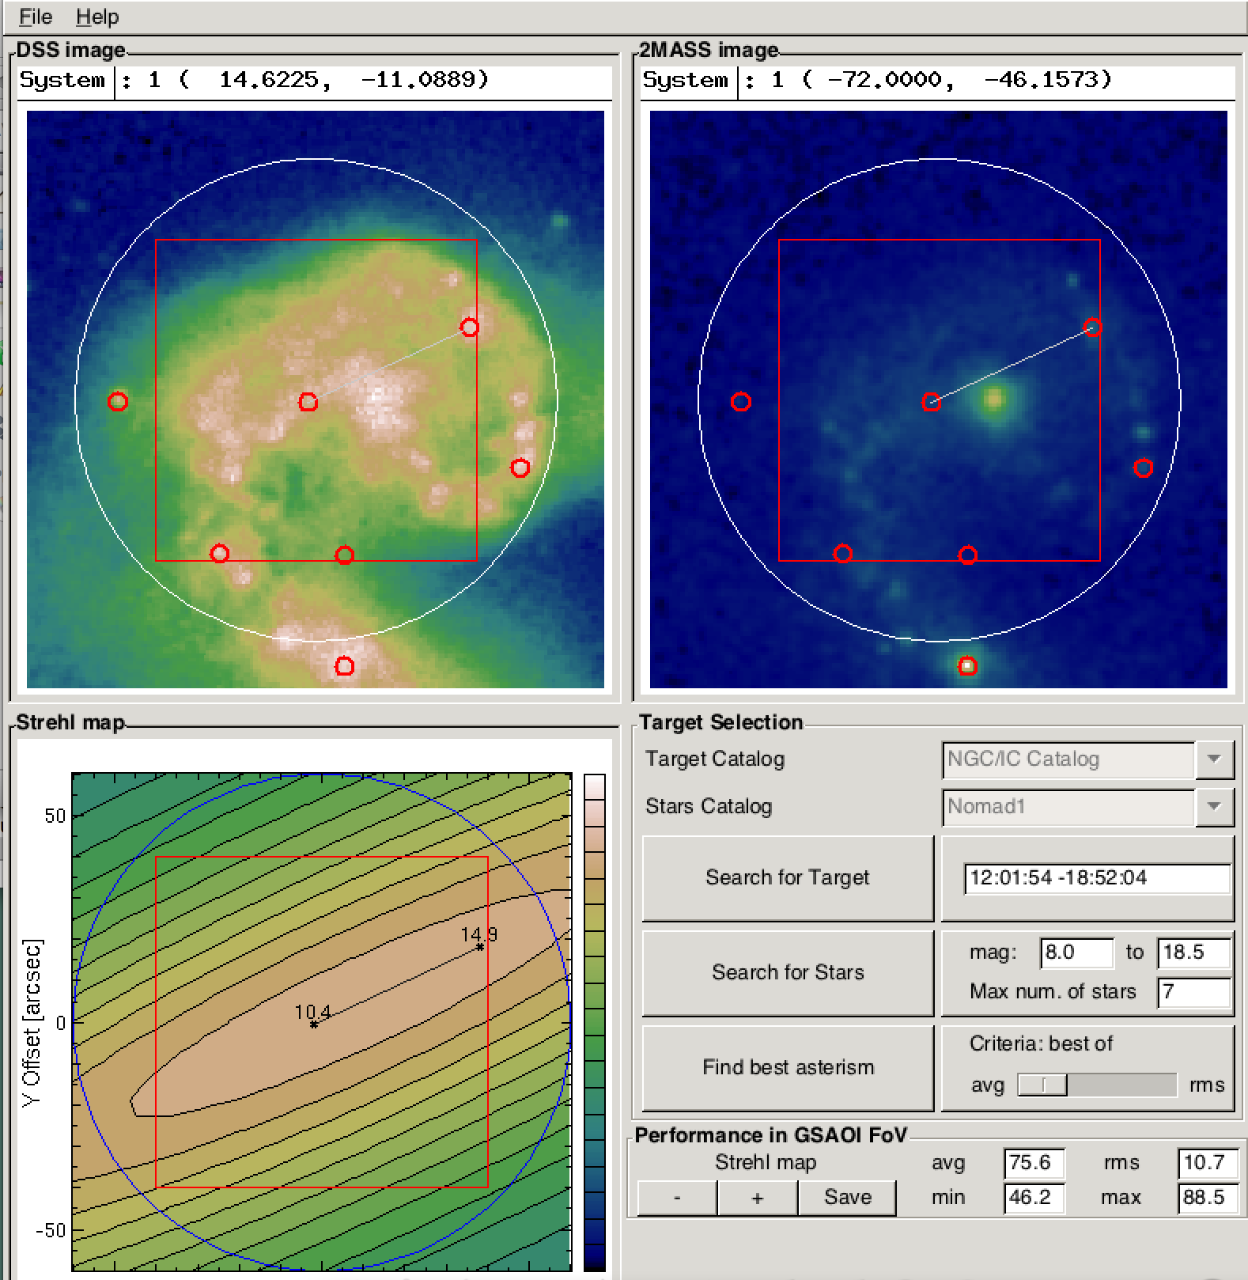
PSF Analytical Approach
Tomography
Temporal
Noise
MASCOT – D. Gratadour

Slide 21
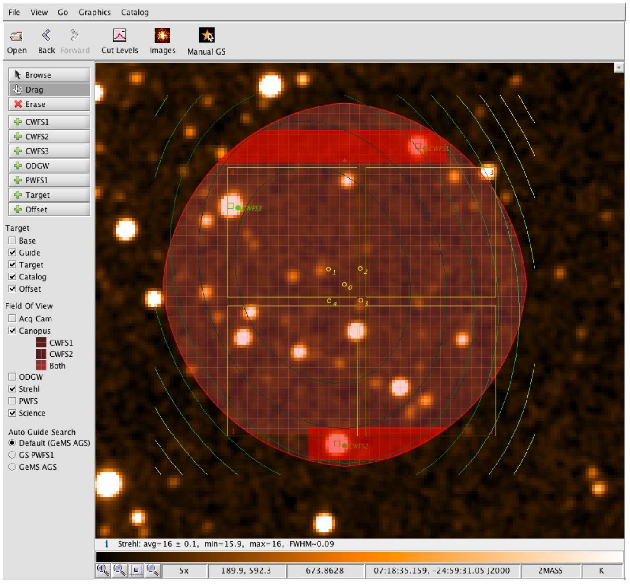
PSF Analytical Approach
Tomography
Temporal
Noise
Gemini Observing tool

Slide 22
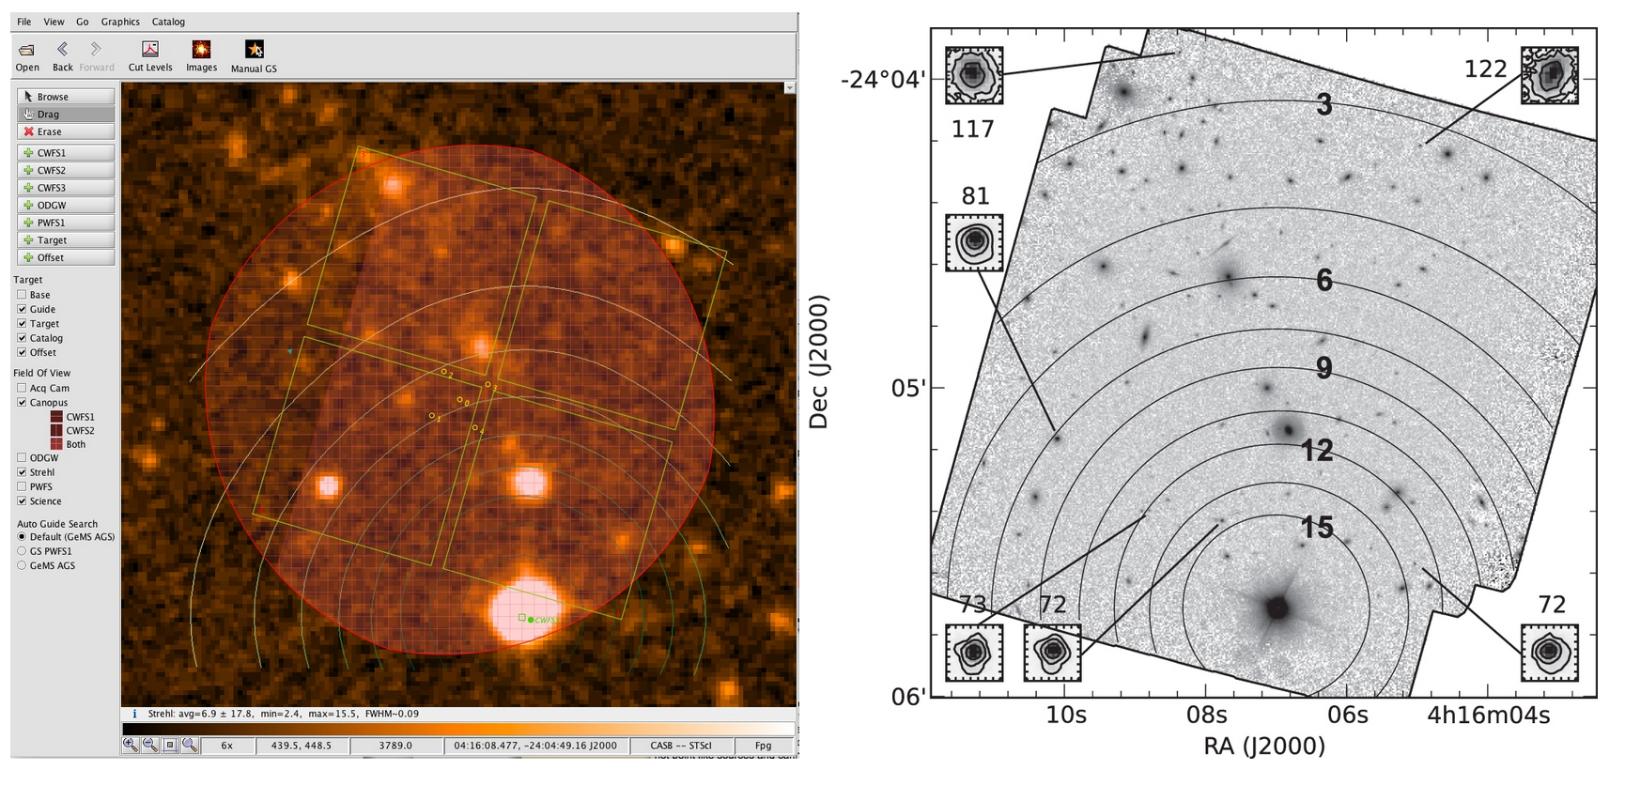
PSF Analytical Approach
Tomography
Temporal
Noise
Gemini Observing tool
Schrimer et al., ApJS, 2014

Slide 23
PSF Analytical Approach
Tomography
Temporal
Noise
we need to revisit those methods for the EELT
(So far we have mainly worked on this term)

Slide 24
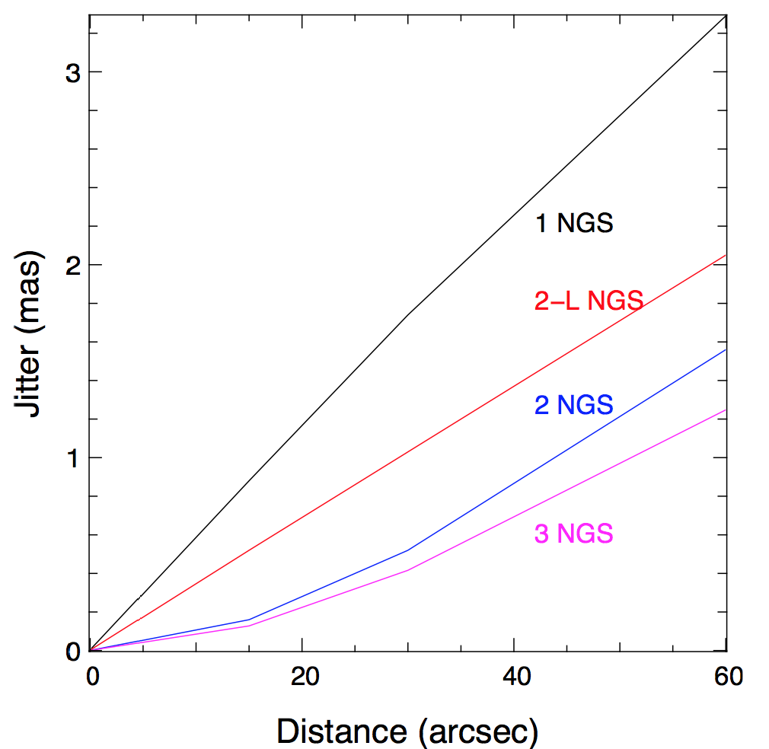
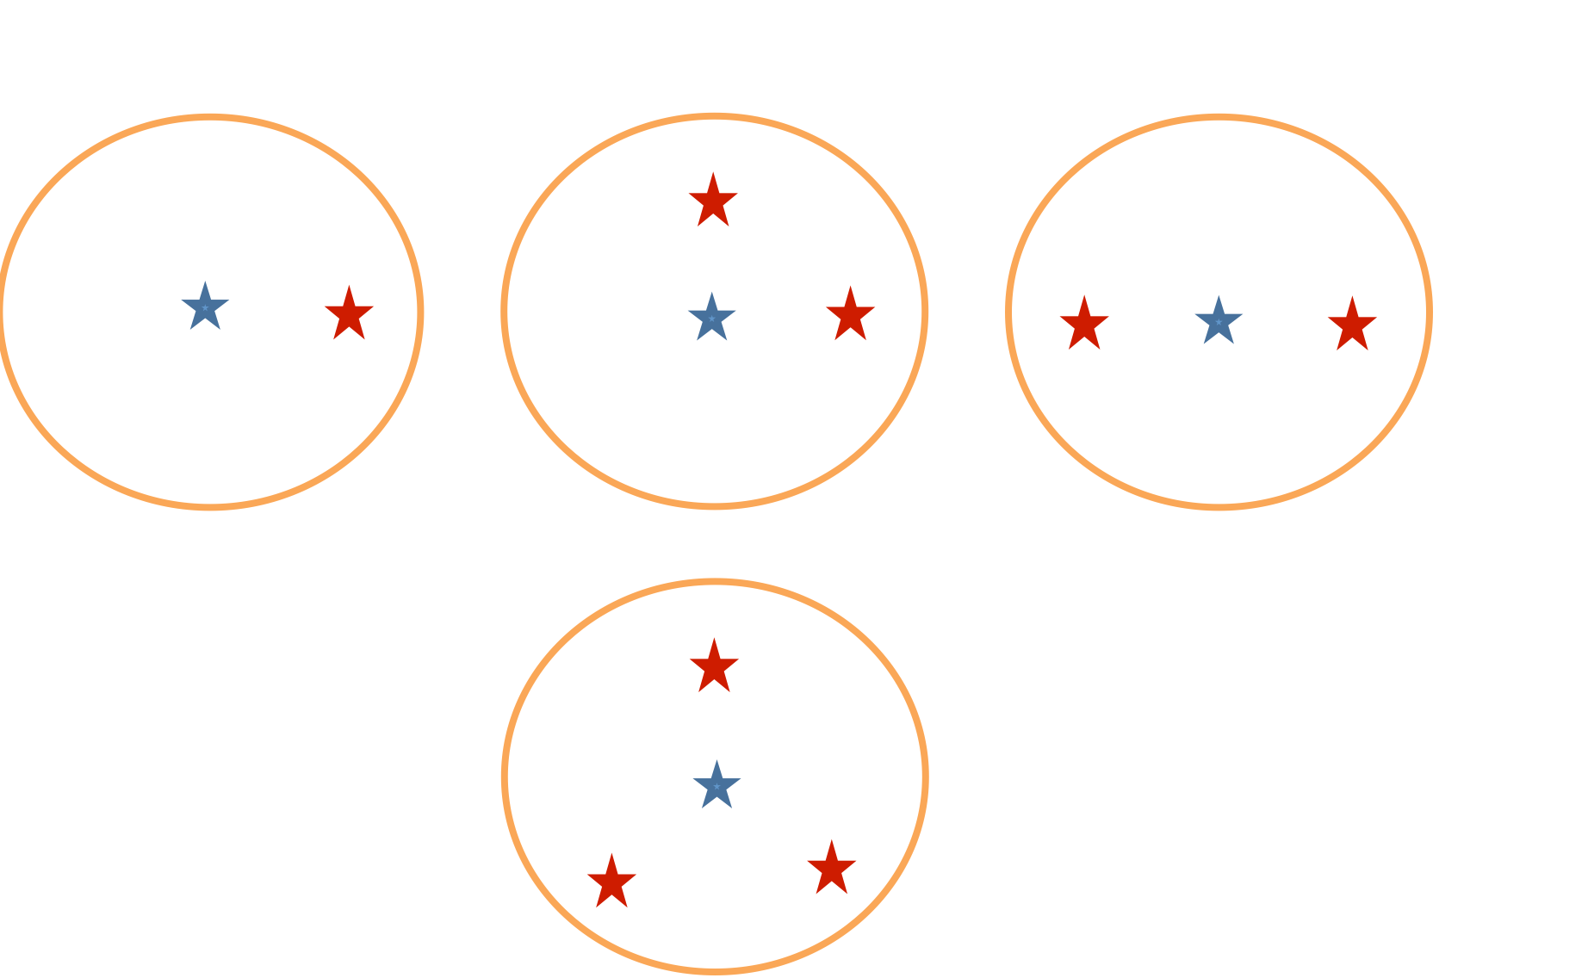
NGS error budget
Tomography
Impact on residual jitter of different NGS constellation
e.g. Sasiela, Chassat, Whiteley…
For 40m Telescope – L0 = 25m

Slide 25
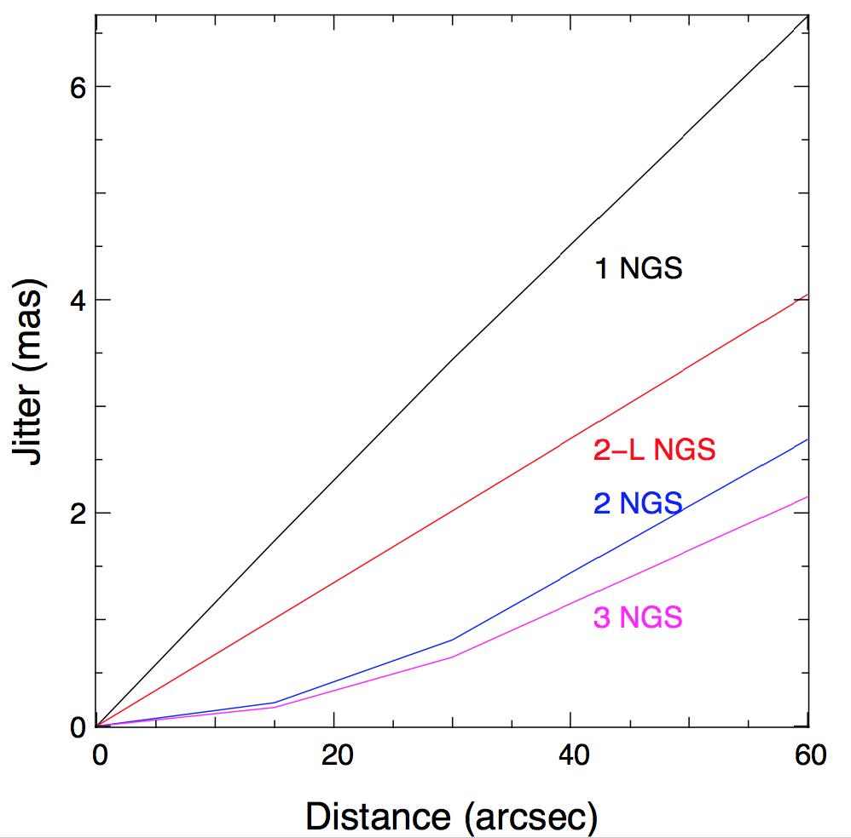
NGS error budget
Tomography
Impact on residual jitter of different NGS constellation
For 40m Telescope – L0 = 50m

Slide 26
NGS error budget
Temporal
First need to determine the rejection transfer function.
It depends on the controller performance…
Assuming ELT scheme with M4/M5 we could have:

Slide 27
NGS error budget
Temporal
First need to determine the rejection transfer function.
Then, need to know the inputs, it may be Turbulence and Windshake
Still assuming an EELT configuration, we have:
Turbulence

Slide 28
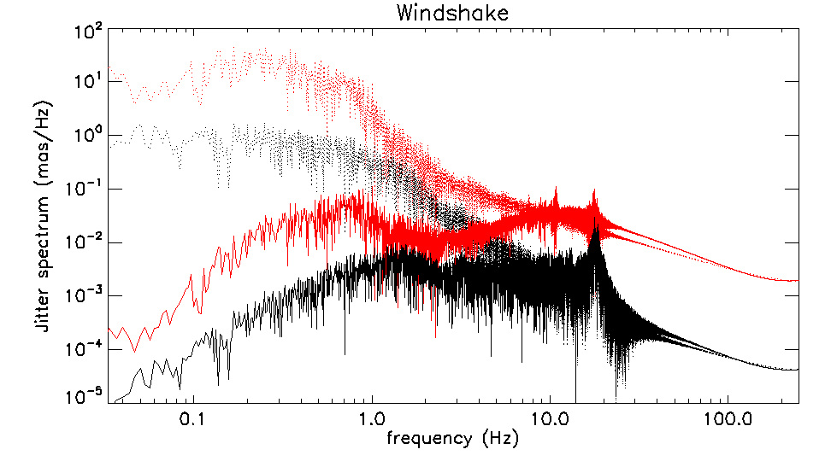
NGS error budget
Temporal
First need to determine the rejection transfer function.
Then, need to know the inputs, it may be Turbulence and Windshake
Finally, simply apply the rejection:
Turbulence

Slide 29
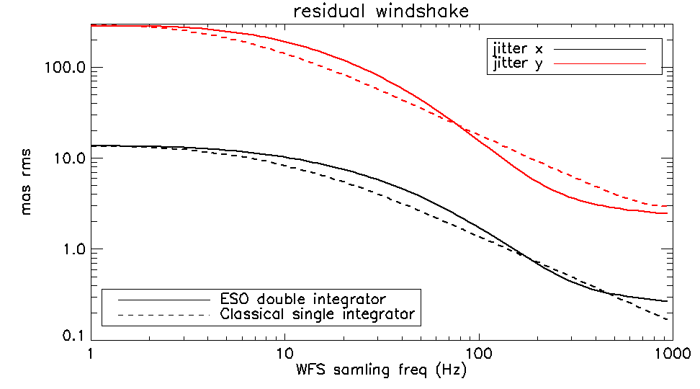
NGS error budget
Temporal
First need to determine the rejection transfer function.
Then, need to know the inputs, it may be Turbulence and Windshake
Finally, simply apply the rejection.
Eventually – play with the NGS gain, and loop frequency

Slide 30
NGS error budget
Noise
Noise depends first of all on the WFS strategy chosen.
For instance, for SH, noise coefficients have been well studied, and are defined as:
e.g. Rousset et al., Nicolle et al.
Photon Noise
Read-Out Noise

Slide 31
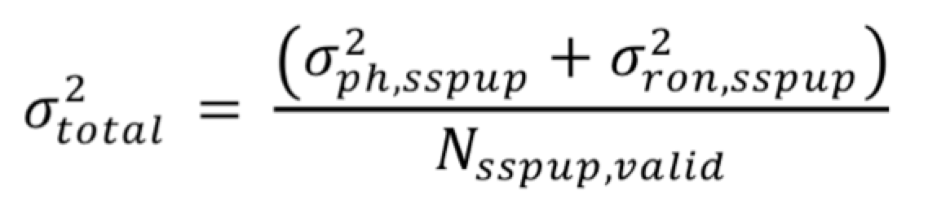
NGS error budget
Noise
Noise depends first of all on the WFS strategy chosen.
For instance, for SH, noise coefficients have been well studied, and are defined as:
e.g. Rousset et al., Nicolle et al.
Photon Noise
weighting
diffraction
Read-Out Noise
FWM of subap. PSF

Slide 32
NGS error budget
Noise
Noise depends first of all on the WFS strategy chosen.
For instance, for SH, noise coefficients have been well studied, and are defined as:
e.g. Rousset et al., Nicolle et al.
Photon Noise
weighting
diffraction
Read-Out Noise
FWM of subap. PSF
This is however not valid anymore in presence of residual turbulence.

Slide 33
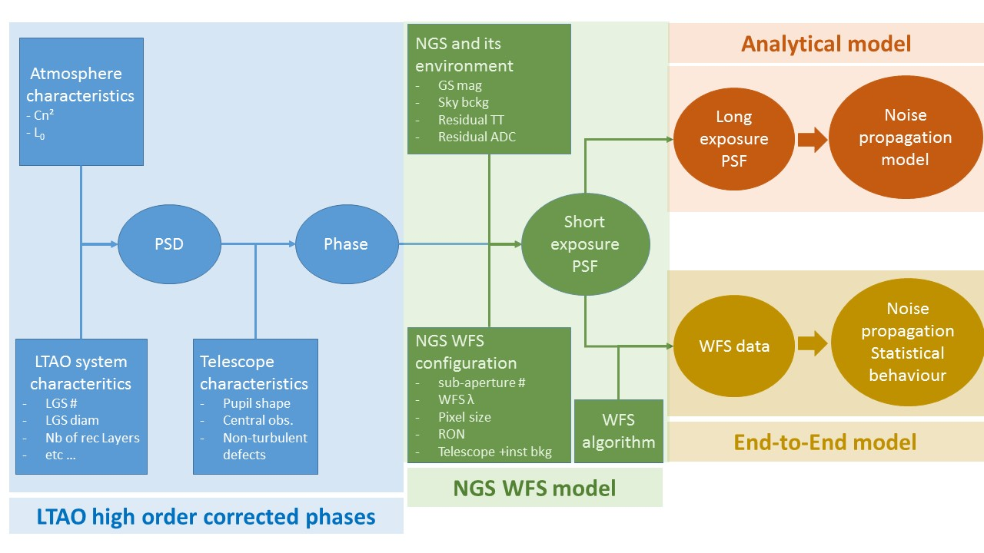
NGS error budget
Noise
Wok done by Thierry !!

Slide 34
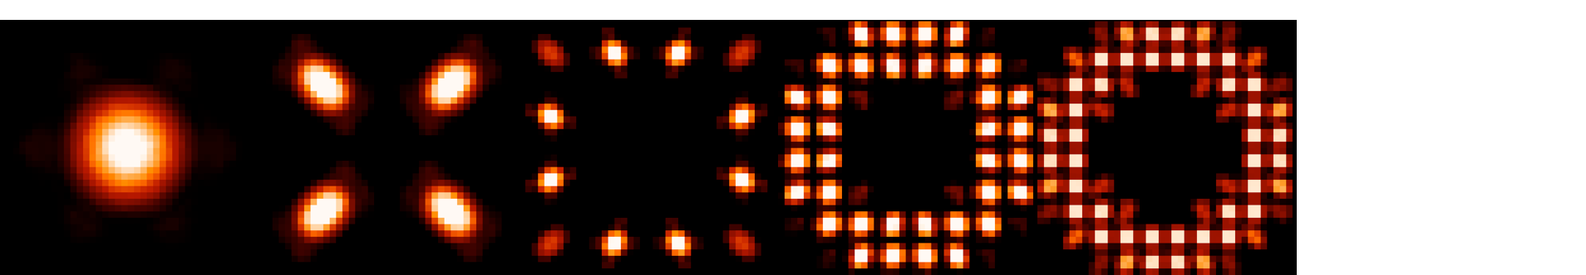
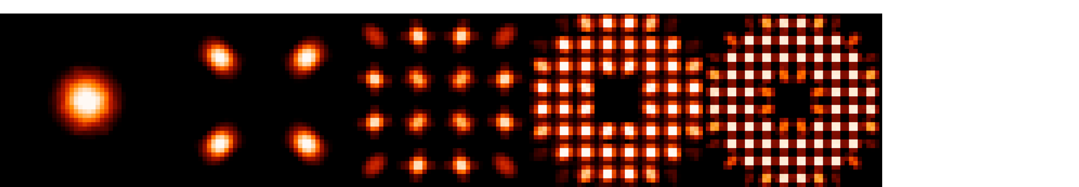
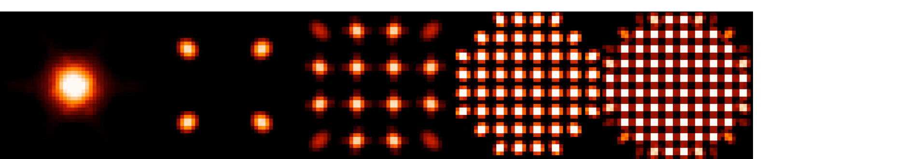
NGS error budget
Noise
Wok done by Thierry !!

Slide 35
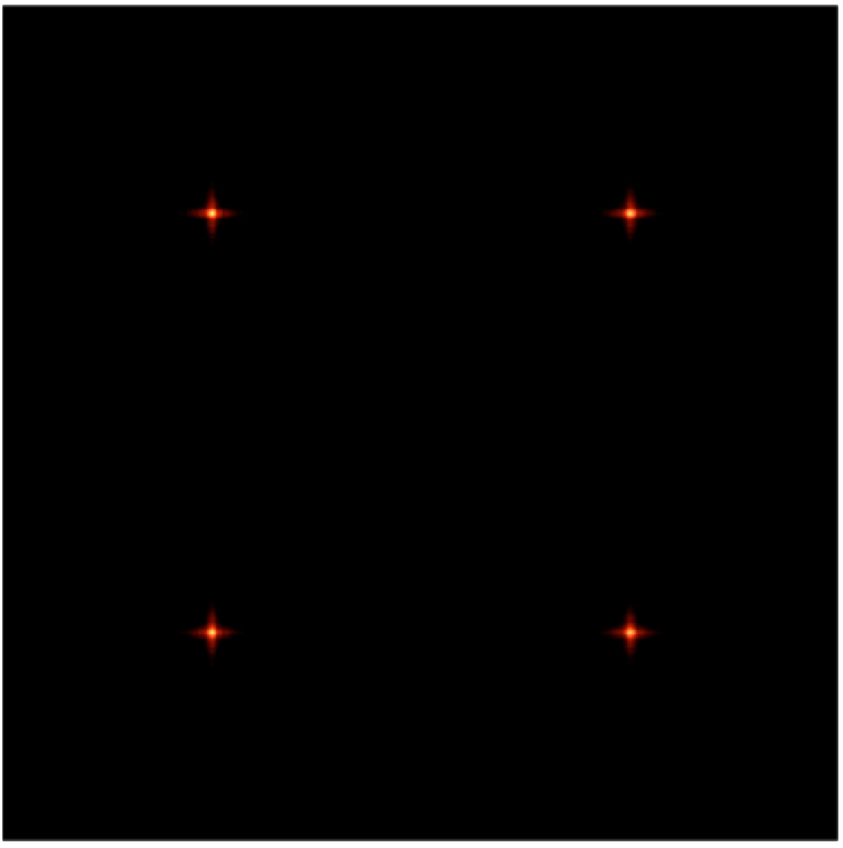
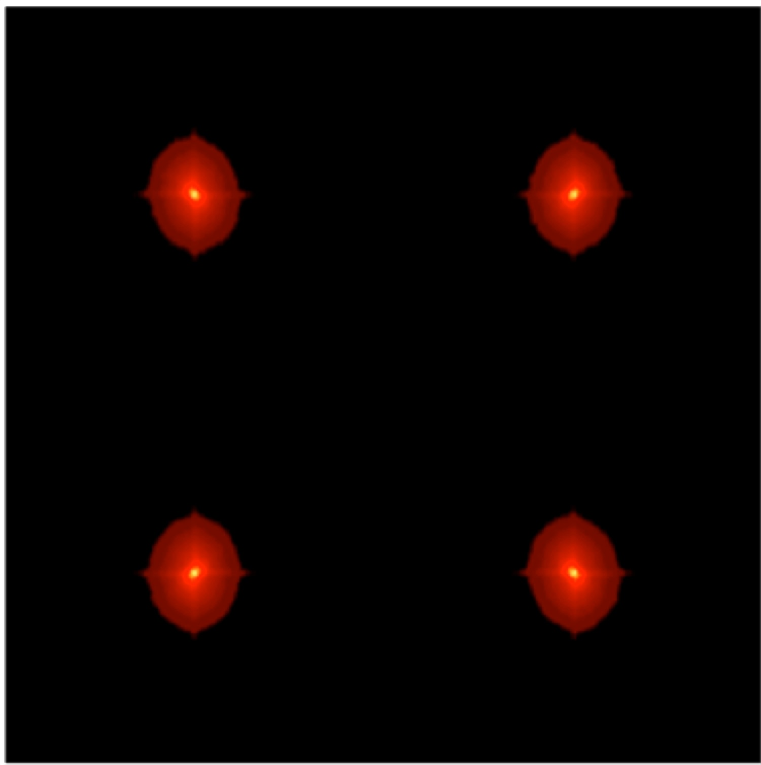
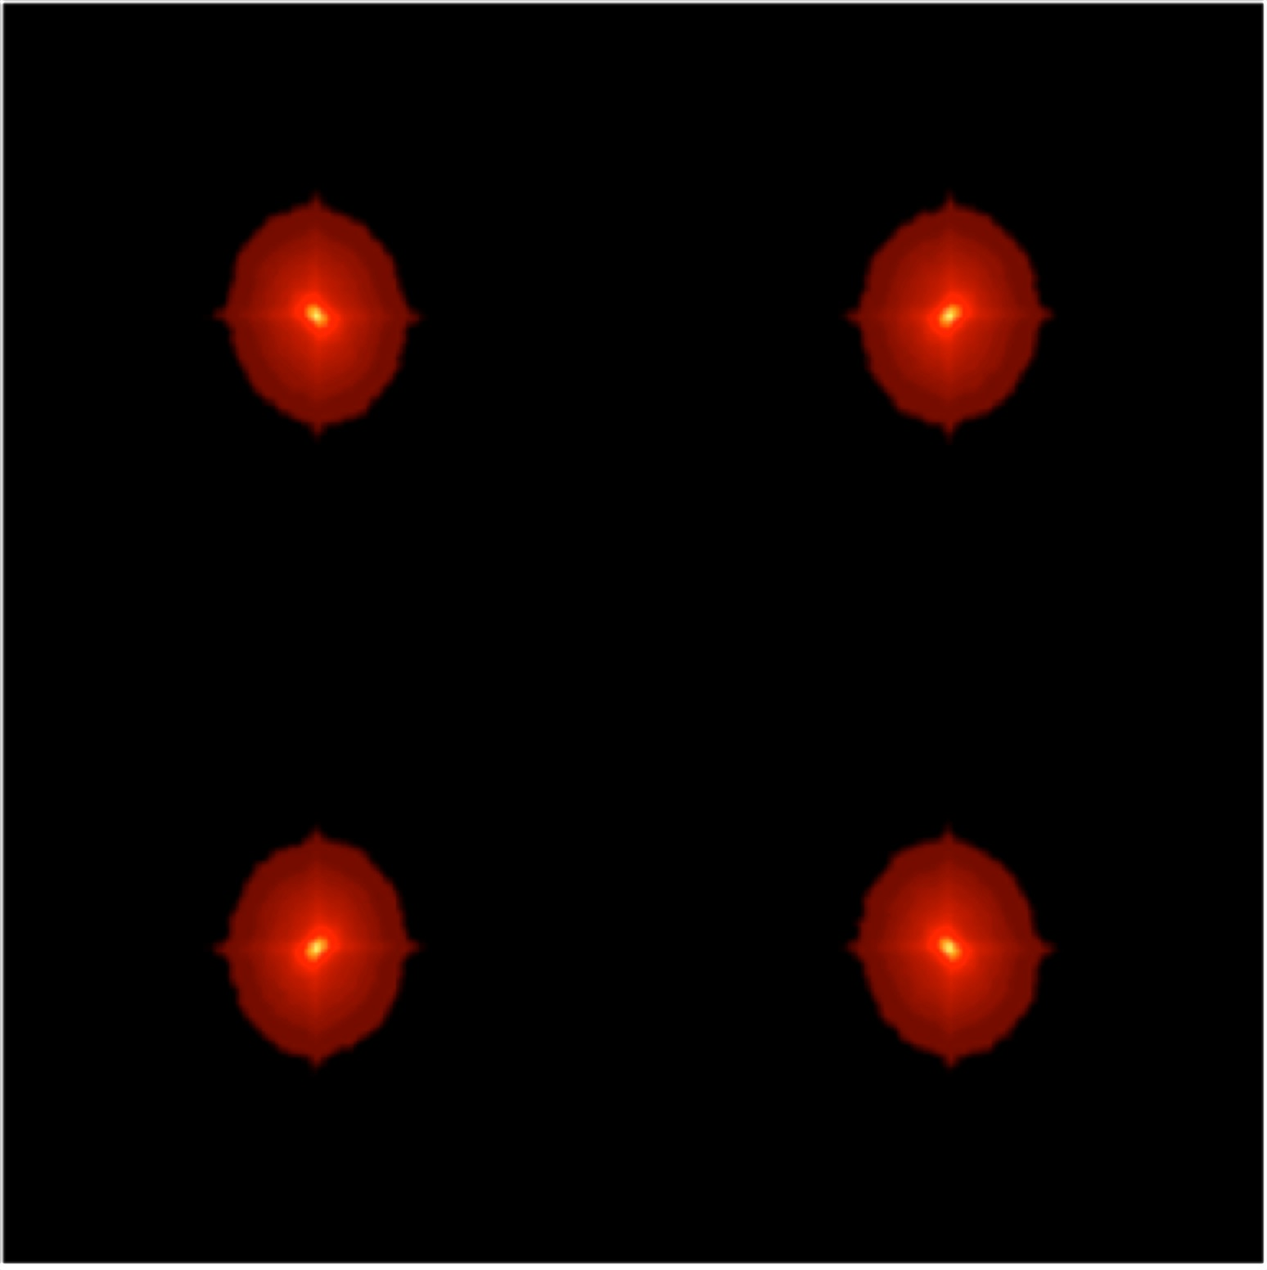
NGS error budget
Increasing residual phase seen by the WFS
Good SR regimes
Seeing limited regimes

Slide 36
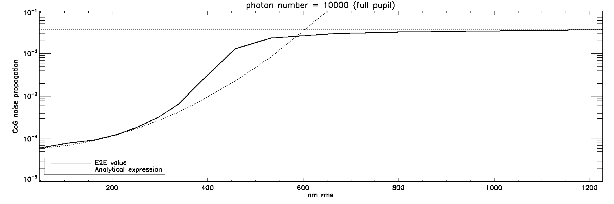
NGS error budget
Noise
“Good SR” regime
(SR > 10%)
Seeing limited regime

Slide 37
NGS error budget
Noise
“Good SR” regime
(SR > 10%)
Seeing limited regime

Slide 38
Context
Tomography
Temporal
Noise
Questions: How to find the best NGS asterism ?
How to get the LO PSF from this constellation ?
1. For a given field, we can compute, for each star:
The anisoplanatism
The temporal error
The noise coefficient
Note: an optimization between noise and temporal error can be performed
2. Reproduce the process for each pair of stars
3. Reproduce the process for each 3NGS constellation available
Then simply sort the results by performance, and pick the best one !

Slide 39
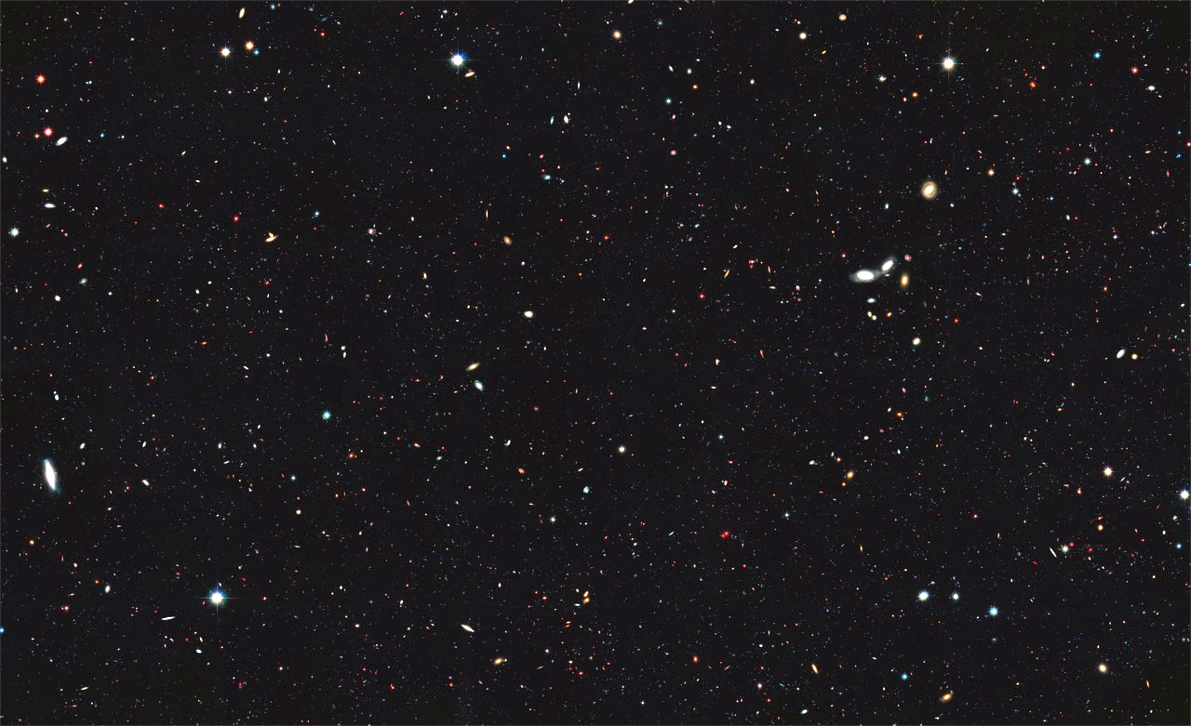
Application to HARMONI (LTAO for the EELT)
Test on “classical” cosmological fields

Slide 40
Application to HARMONI (LTAO for the EELT)

Slide 41
Application to HARMONI (LTAO for the EELT)
Impact of Cn2 profile (from old ESO to new 35 layers)

Slide 42
Application to HARMONI (LTAO for the EELT)
Impact L0 (from 50m to 25m)

Slide 43
Application to HARMONI (LTAO for the EELT)
Impact L0 (from 50m to 25m)

Slide 44
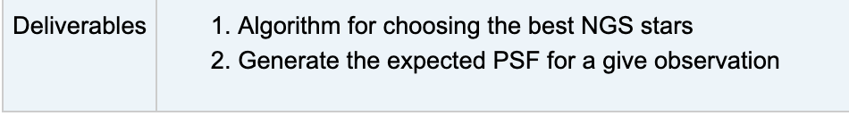
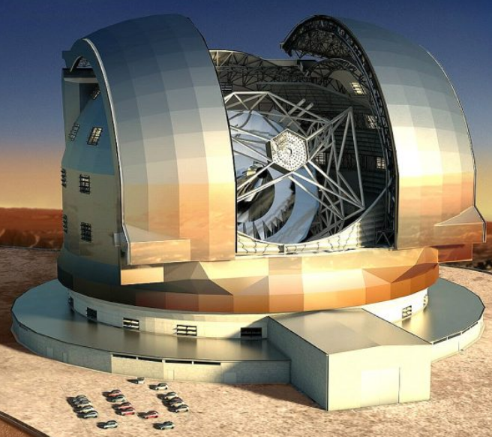
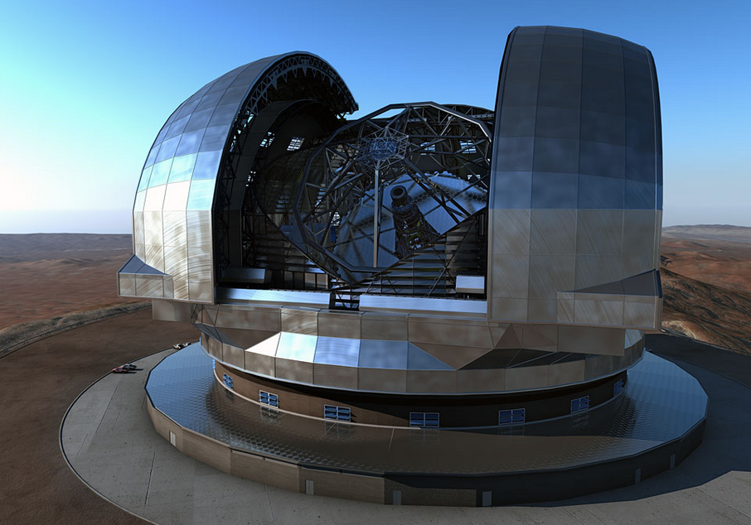
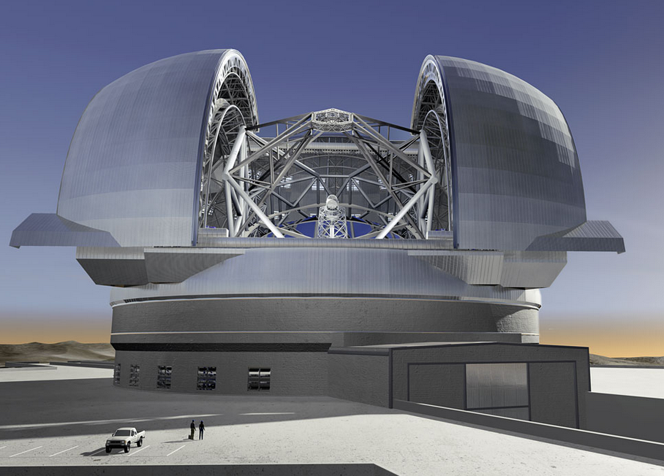
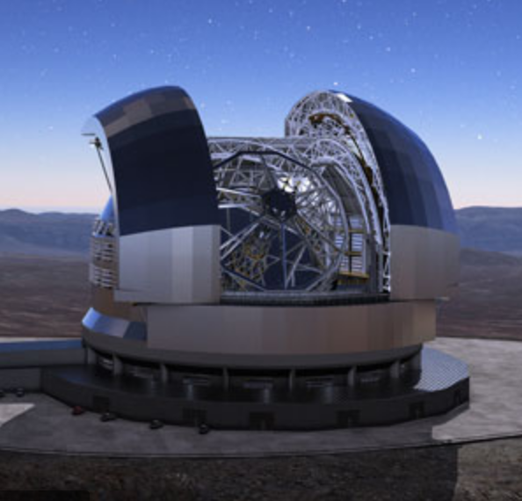
CONCLUSIONS
First steps will be to explore the simulation tools available and define the strategy
Some solutions already exists on the market, but probably will need to develop specific tools
Work has just started !

