Slide 1



High Performance Computing and Artificial Intelligence for Solar System activities at SSDC
A. Zinzi, M. Giardino, G. Sindoni, A. Baraldi, D. Grassi, F. Tosi, G. Polenta
angelo.zinzi@ssdc.asi.it
INAF Science Archives & the Big Data Challenge
19th June 2019, INAF HQ, Rome

Slide 2
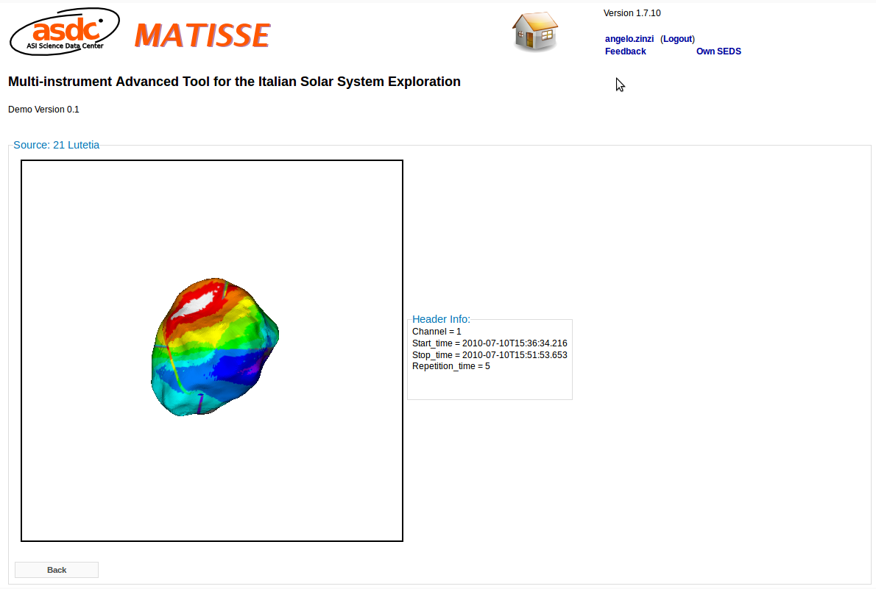
6 years ago
(Bormio 2013)
MATISSE was firstly presented to the Italian planetological community, with a demo version

Slide 3
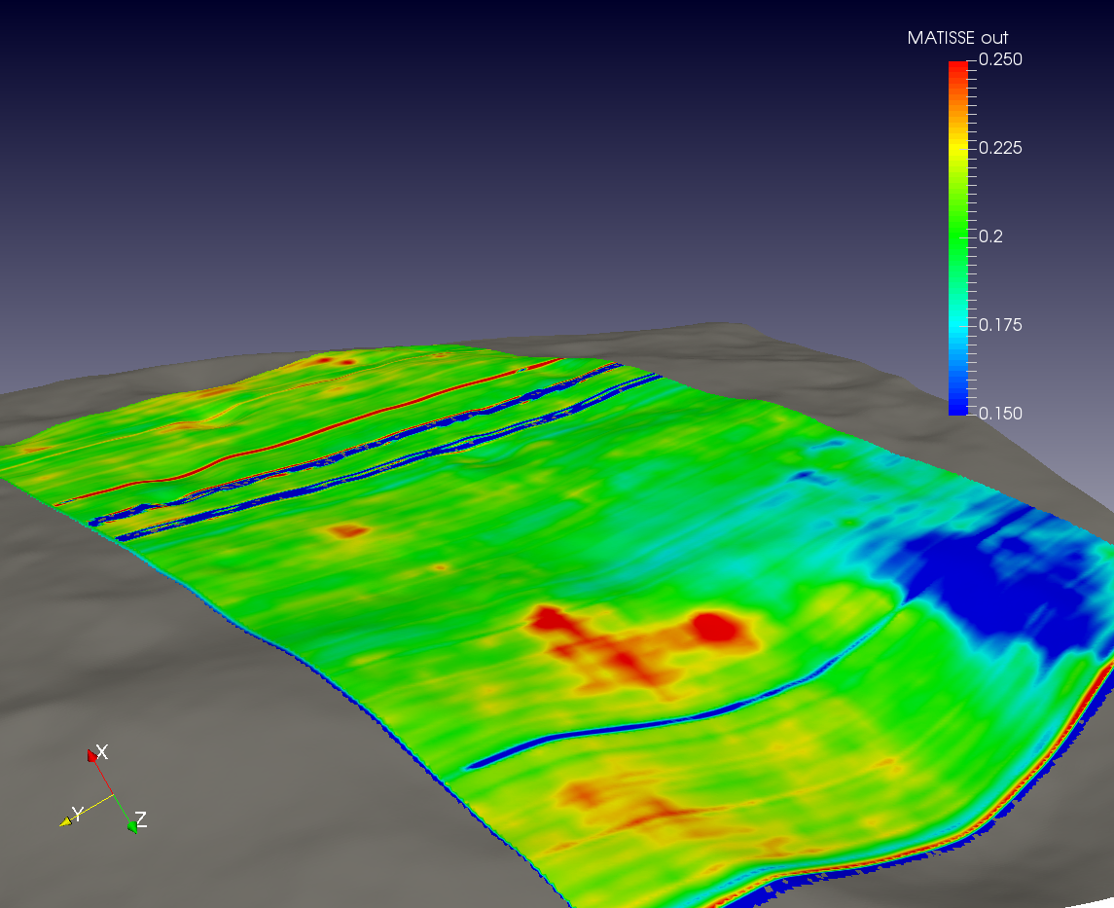
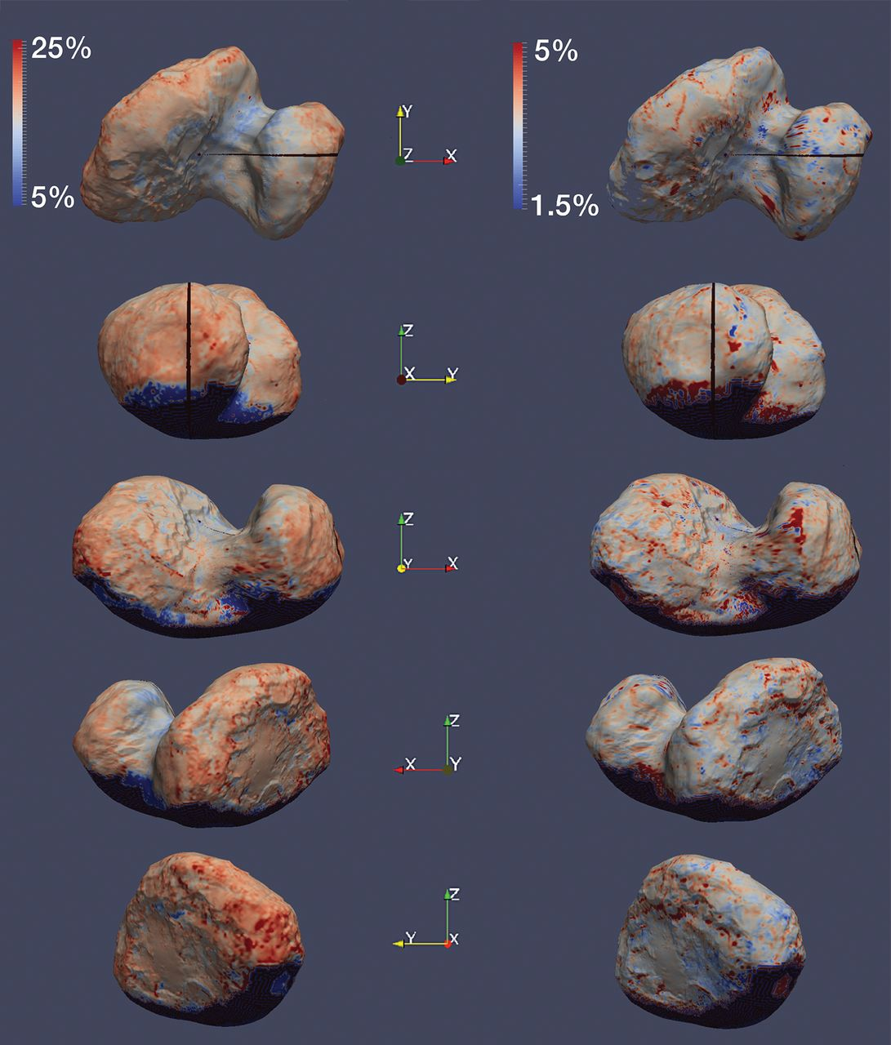
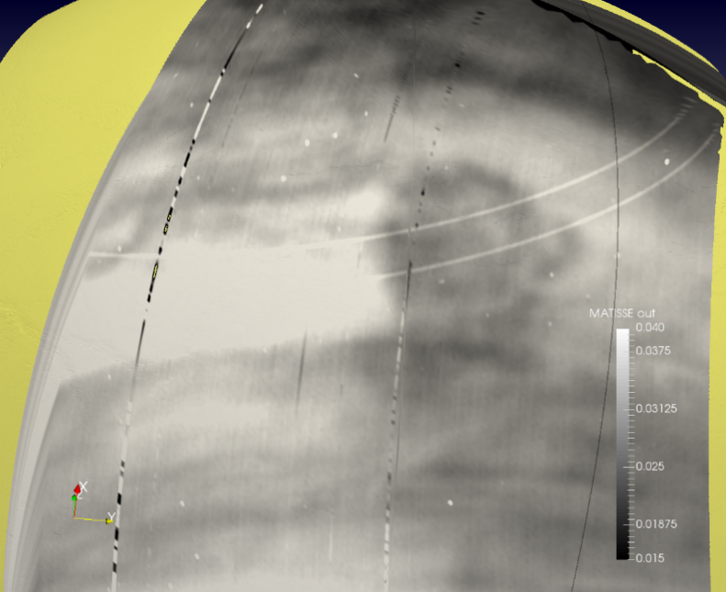
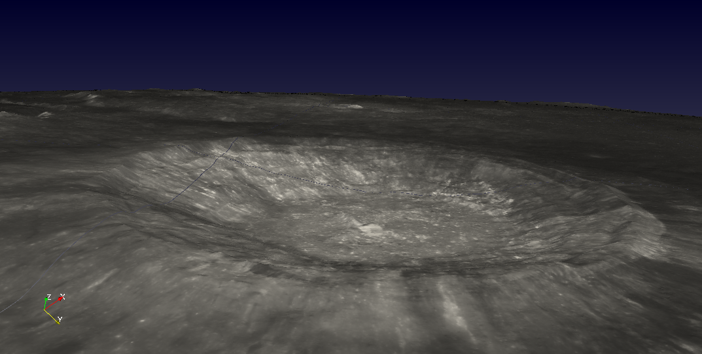
During these years the tool has grown up, improving its scientific capabilities and including several targets, missions
It’s now time to release a brand new version of the tool
A beta version online
https://193.204.103.156/Matisse

Slide 4

A new version of the tool to overcome fundamental issues
A new DBMS
Servlet based
Advanced ICT solutions
User-friendly interface
The PostgreSQL + PostGIS solution allows to correctly manage spatial queries, also improving spatial interpolation between observations and DTMs/shape models

Slide 5
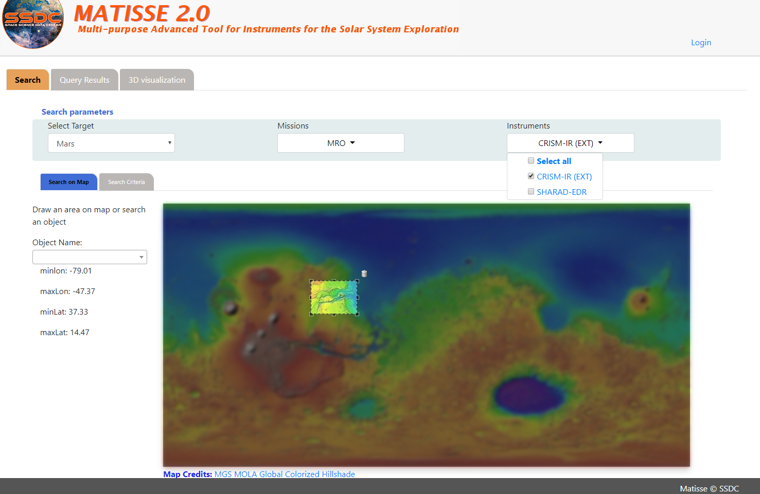
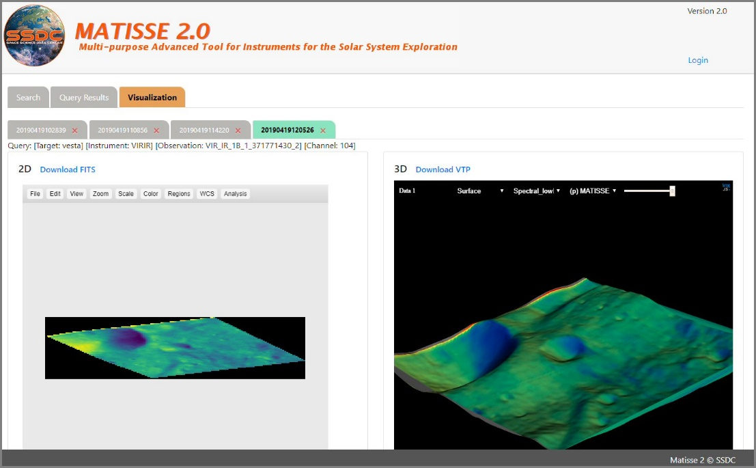
A new version of the tool to overcome fundamental issues
A new DBMS
User-friendly interface
Servlet based
Advanced ICT solutions
3D
JS9 + Planetary FITS

Slide 6

A new version of the tool to overcome fundamental issues
A new DBMS
User-friendly interface
Servlet based
Advanced ICT solutions

Slide 7

A new version of the tool to overcome fundamental issues
A new DBMS
User-friendly interface
Servlet based
Advanced ICT solutions
Big data, featuring the 5 Vs of
Variety, Veracity, Velocity, Volume and Value

Slide 8
Advanced ICT solutions
High Performance Computing
Artificial Intelligence = Big data analytics

Slide 9
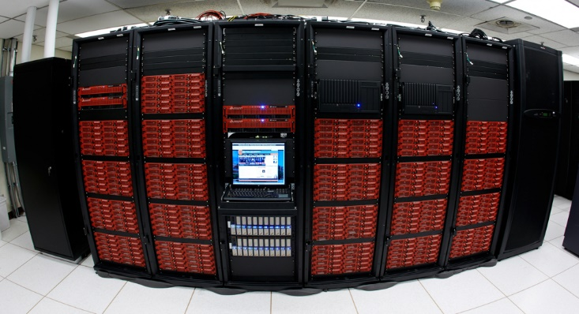
HPC
CPU cluster system based on Dell technology HPC dedicated HW infrastructure (to be acquired)
Primary task
Develop a set of software engineering techniques to apply parallel computing to existing non-parallel retrieval algorithms
Medium term goal
Exploit commonalities between similar science cases to produce a single library dealing with platform portability issues

Slide 10
The generalization task to be pursued through a double path
Platform abstraction level
(distributed memory model / shared memory model)
Programming language level
(Python environment and wrapping of native code)
The reference platform for development is the Microsoft Azure cloud, used as a suitable workbench to define, test and profile different scenarios

Slide 11
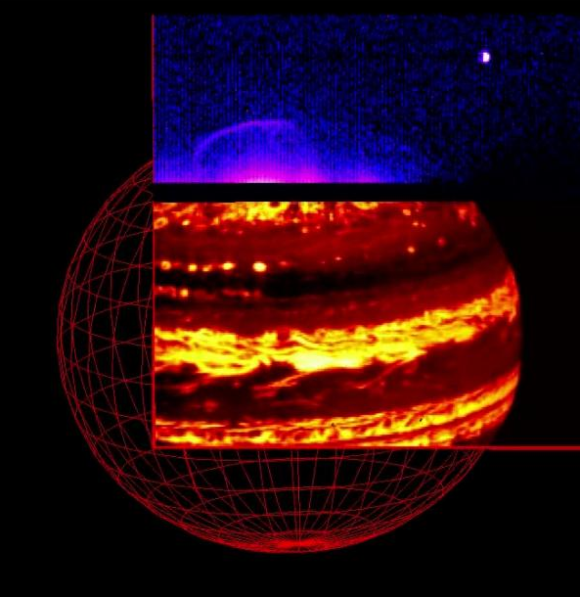
HPC case study 1
JIRAM atmospheric retrieval code developed at INAF IAPS (D. Grassi) for serial applications
Going to be optimized for parallel computing, boosting its performances
Resulting dataset added to MATISSE
see
Grassi et al., 2017, DOI: 10.1016/j.jqsrt.2017.08.008
Grassi et al., 2010, DOI: 10.1016/j.pss.2010.05.003

Slide 12
Current ‘scientific’ serial approach
Serial computing
Serial computing
Spectrum
Retrieval
Spectrum
Retrieval
Parallel approach under development
Parallel computing by launching several independent simultaneous jobs
Group of independent spectra
Group of independent retrievals

Slide 13
The achievement of goals from the first test case will pave a way for a number of different scientific cases that can be treated using HPC in SSDC
A similar algorithm could be applied to
Venus
Exoplanets
…

Slide 14

Artificial (general) Intelligence for Big Data analytics Qualitative/equivocal information-as-data-interpretation
In SSDC we are integrating high-level skills in the Computer Vision (CV) field, where CV is subset-of Artificial General Intelligence (AGI)
These skills could be extremely useful and versatile for a wide range of scientific cases, ranging from astronomy to Earth observation, passing through planetary sciences

Slide 15
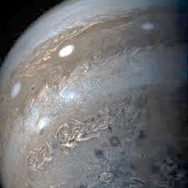
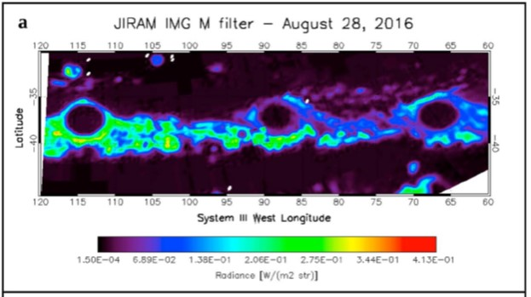
A.I. case study 1
Detection of Jupiter White Ovals from JIRAM imagery
(see Sindoni et al., 2017)
Finding best colorimetric and spatial features to extract cyclones and anticyclones from the «image background (clutter)»
Make this CV task automatic and robust to changes in a series of input test images

Slide 16
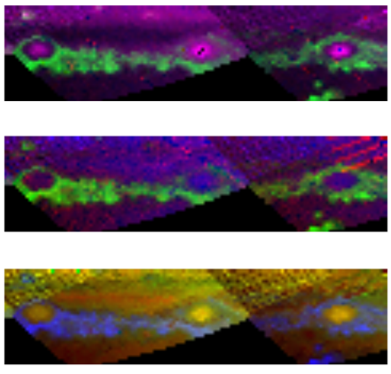
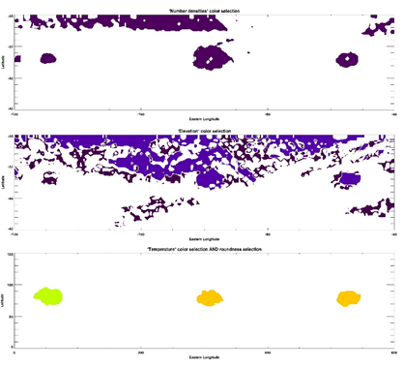
Color Constancy
+
RGB Image Automatic Mapper
RGB images
Top
Number densities of R: NH3, G: NH4SH, B:N2H4
Middle
Heights of R: NH3, G: NH4SH, B:N2H4
Bottom
R: NH3 VMR, G: NH3 RH, B: Temperature
Color, Shape, Orientation, Size, Texture, Inter-Object Spatial Topological Relationships, Inter-Object Spatial non-topological relationships

Slide 17
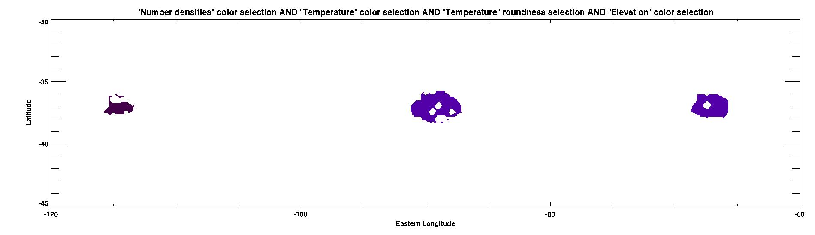
Combination of selected properties from CV approach
White Ovals
detection and classification
Detailed discussion of the task at EPSC/DPS (talk 1278 by Zinzi et al. in OPS4)

Slide 18
This approach is completely horizontal and could be applicable to extremely differentiated cases.
It only requires images and prior knowledge to be used
Planetary atmospheres
Surface features (rocks, craters…)
Celestial transients
…

Slide 19
… and …

Slide 20
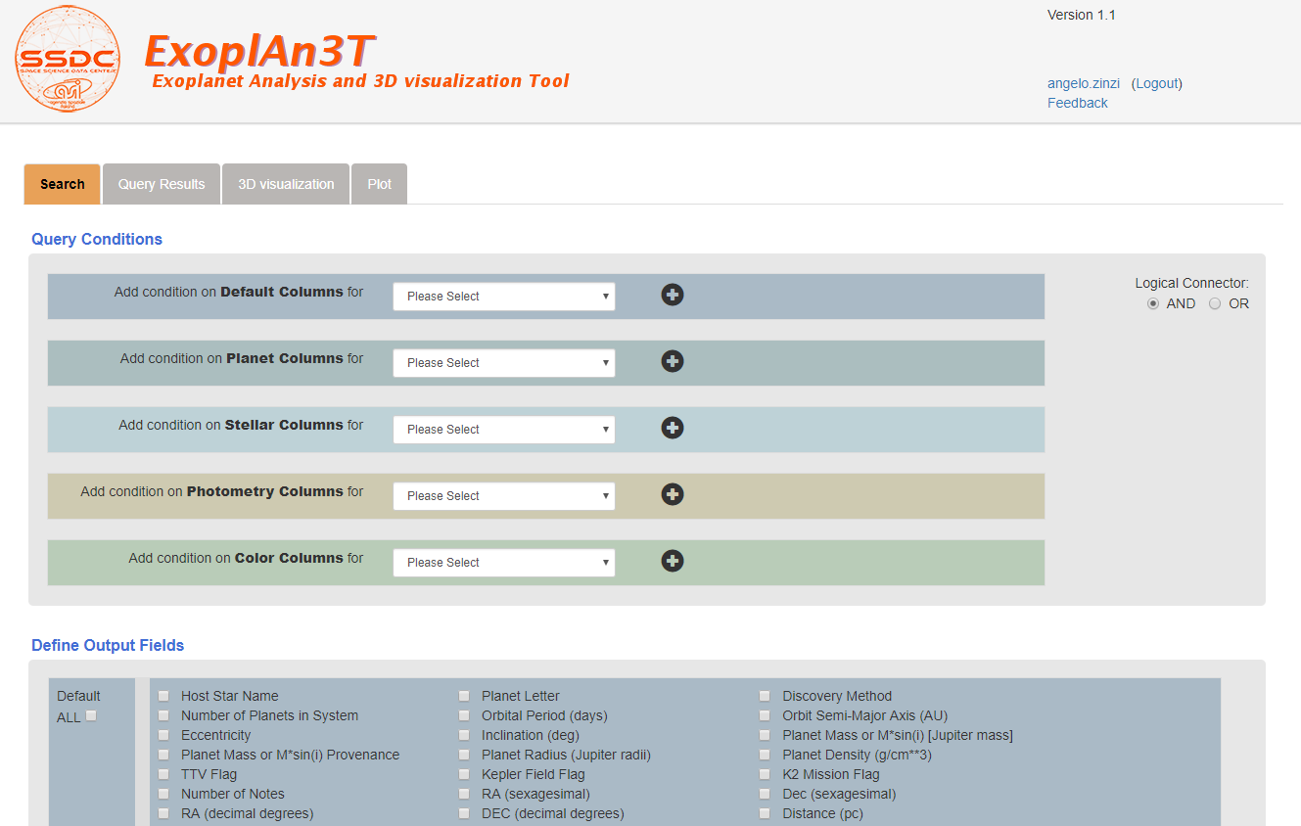
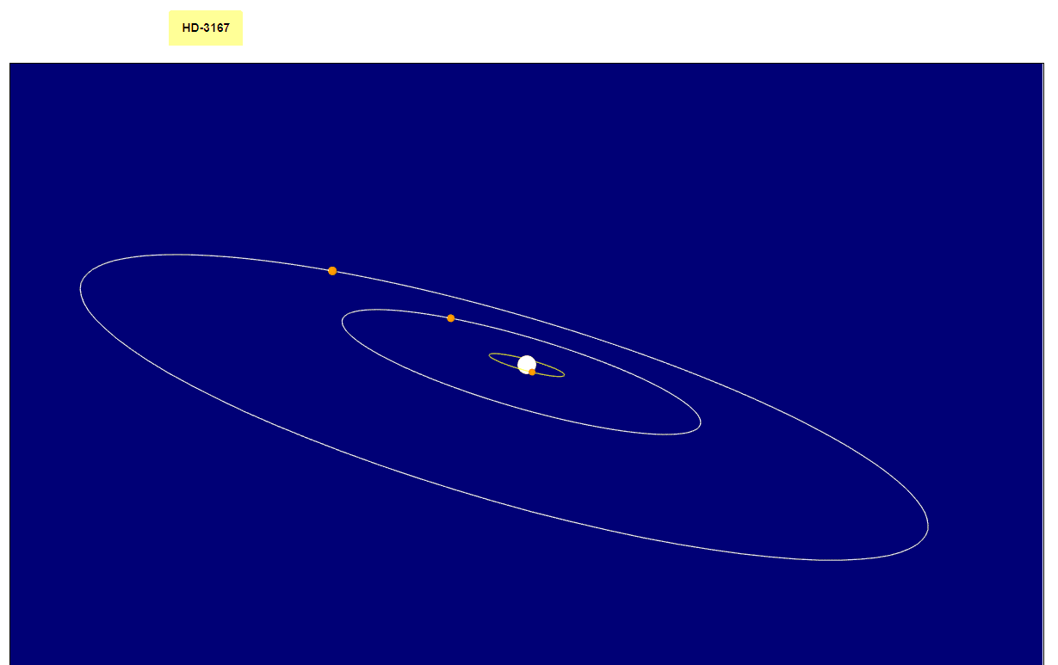
ExoplAn3T
https://tools.ssdc.asi.it/exoplanet
The new SSDC webtool designed to study exoplanetary systems as a whole, starting from exoplanetary data present in different online archives
Using a two-fold query totally transparent to the user, it allows to find relation between exoplanetary systems sharing at least one similar planet.
The tools also provides a novel 3D visualization of the selected exosystems, thus facilitating the comparison between results.

Slide 21
Conclusions and future works
A powerful HPC machine is going to be acquired by SSDC and major activities to be fulfilled are now under development
Computer Vision techniques applied to scientific test cases are being tested to acquire knowledge about them and to integrate these skills in the SSDC tools
Together with the development of the new version of MATISSE these advanced ICT solutions to be adopted by SSDC will constitute a crucial milestone for the advancement of solar system exploration activities of the center

Slide 22

Thank you for your attention
angelo.zinzi@ssdc.asi.it

