Slide 1
Square Kilometre Array:
Current status and INAF activities
R. Smareglia, INAF ICT Head Rosie Bolton, SRC Project Scientist
INAF Science Archives – 19 June 2019

Slide 2
SKA– Key Science Drivers:
The history of the Universe
Cosmic Dawn
(First Stars and Galaxies)
Testing General Relativity
(Strong Regime, Gravitational Waves)
Galaxy Evolution
(Normal Galaxies z~2-3)
Cradle of Life
(Planets, Molecules, SETI)
Cosmology
(Dark Matter, Large Scale Structure)
Cosmic Magnetism
(Origin, Evolution)
Exploration of the Unknown
Broadest science range of any facility on or off the Earth.

Slide 3
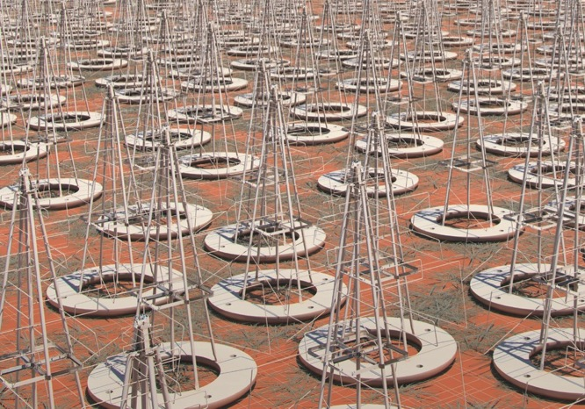
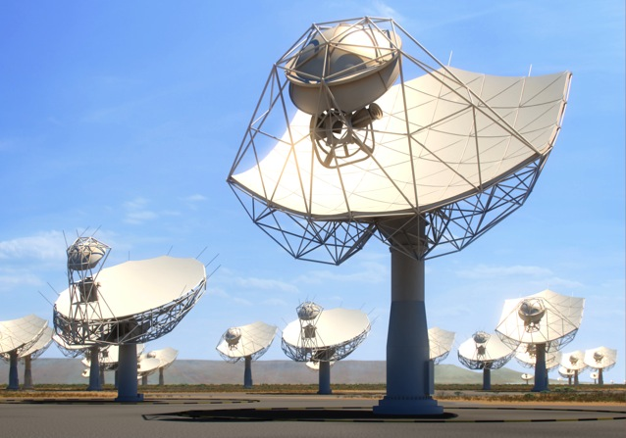
SKA Phase 1
3 sites (AUS, RSA, UK-HQ) 2 telescopes (LOW, MID) one Observatory (SKAO)
Construction Cost-cap: €691M (2017)
Construction: 2020-2027 (Science commissioning 2022+)
SKA1-Low: 512 x 256 low-freq dipoles,
50 – 350 MHz
65 km baselines (11” @ 110 MHz)
Murchison, Western Australia
SKA1-Mid: 133 x 15m + 64 x 13.5m dishes,
0.35 – 15 GHz
120 km baselines
(0.22” @ 1.7 GHz; 34 mas @ 15 GHz)
Karoo, South Africa

Slide 4
CDR Activity – February 2019
Element | RRN Submission | CDR Submission | CDR Meeting | CDR Close
TM | 29 January 2018 | 28 Feb 2018 | 17-20 Apr | 14 Jul 2018
SaDT & SAT | 17 January 2018 | 28 Feb 2018 | 15-18 May 2018 | Jan2019
INAU | 19 March 2018 | 30 April 2018 | 27-29 June 2018 | Dec 2018
INSA | 19 March 2018 | 30 April 2018 | 2-4 July 2018 | Jan2019
CSP | 18 May 2018 PSS Element CDR PST Element CDR CBF Low CBF Mid | 30 Jun 2018 (includes LMC sub-element) | 25-28 Sep 2018 | Jan 2019
MeerKAT Integration |  |  | 22 Oct 2018 | 31 Dec 2018
SDP Pre-CDR SDP CDR | 09 Mar 2018 17 Sep 2018 | 25 Apr 2018 31 Oct 2018 | 20-22 Jun 2018 15-18 Jan 2019 | 29 Mar 2019
LFAA re-planned | 15 Oct 2018 | 05 Nov 2018 | 11-13 Dec 2018 | 28 Feb 2019
AIV | Oct 2018 | 30 Nov 2018 | 04 Mar 2019 | 30 Mar 2019
DSH Pre-CDR DSH CDR | 17 Sep 2018 23 Aug 2019 (w B2) | 28 Sep 2018 13 Sept 2019 (w B2) | 26-27 Nov 2018 25-29 Oct 2019 (w B2) (Dish Structure: Aug 2019) | 26 Nov 2019 (w B2)
System CDR |  |  | Nov 2019 | Feb 2020
Green: Successful phase
Red: Changes since April Board
Notes:
2 new elements

Slide 5
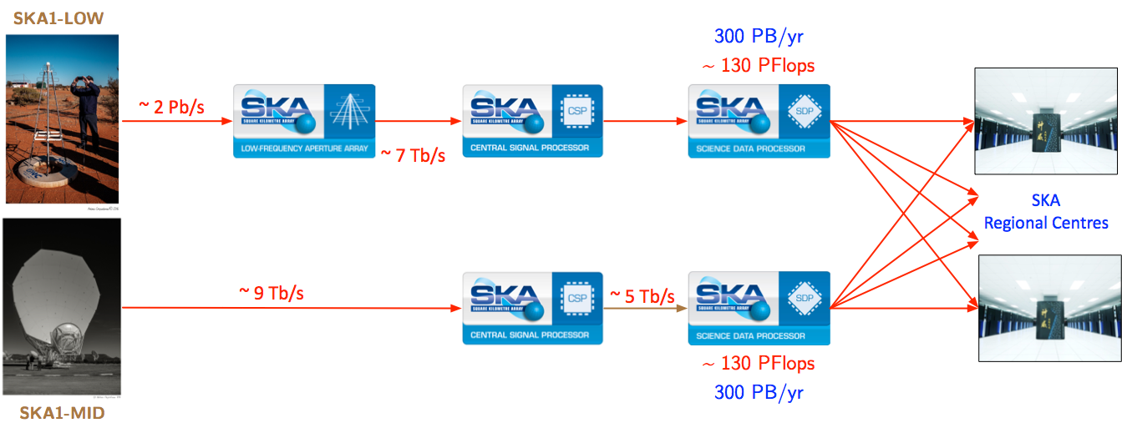
Data flow challenges
SKA
Uploads to
Facebook
Phase1 Science Archive
600PB
180PB

Slide 6
Development of Governance
Establishing treaty organization similar to ESO, CERN
Text of treaty and key protocols now finalized and agreed.
Ministerial-level signing ceremony in Rome on 12th March, 2019
Expect treaty ratification ~12 months later.

Slide 7
SKA Regional Centre Steering Committee
New group is been established to take forward the development of SRCs.
One representative per SKA member
Much better connection between individual countries and the work that will be done
Representatives will have access to resources (both infrastructures and people)
Working groups will be established to take forward various aspects of the work

Slide 8
Plan for the SRC-­‐SC : White paper development page
Discussed in the f2f meeting
Complete operating descriptions for end-­‐to-­‐end SKAO/SRC use for all user group Bolton, Rosie, Gaudet, Séverin
Common SW platform
Scaife, Anna, Vilotte, Jean-­‐Pierra, Lourdes Verdes-­‐Montenegro
Community engagement roadmap, plan for initiation of user fora Lourdes Verdes-­‐Montenegro, An, Tao, Bolton, Rosie, Andrea Possenti
Description of the SRC body Quinn, Peter van Haarlem, Michiel
White paper needs to identify sizing components, cost/size scaling Simon Ratcliﬀe

Slide 9
Plan for SRCSC working groups
Workload management - compute and data placement

Slide 10
Plan for SRCSC working groups
Workload management - compute and data placement
Data Lifecycle, Quality of Service requirements
Create
Distribute / Store
(Re-) Use
Archive
Destroy

Slide 11
Plan for SRCSC working groups
Workload management - compute and data placement
Data Lifecycle, Quality of Service requirements
Users –
Archive Exploration
Data interaction and visualization

Slide 12
Plan for SRCSC working groups
Workload management - compute and data placement
Data Lifecycle, Quality of Service requirements
Users –
Archive Exploration
Data interaction and visualization
Science Gateway, large job submission

Slide 13
Plan for SRCSC working groups
ODP
ODP
ODP
ADP1
Workload management - compute and data placement
Data Lifecycle, Quality of Service requirements
Users –
Archive Exploration
Data interaction and visualization
Science Gateway, large job submission
Programme users (KSP, PI), User Support
ADPn

Slide 14
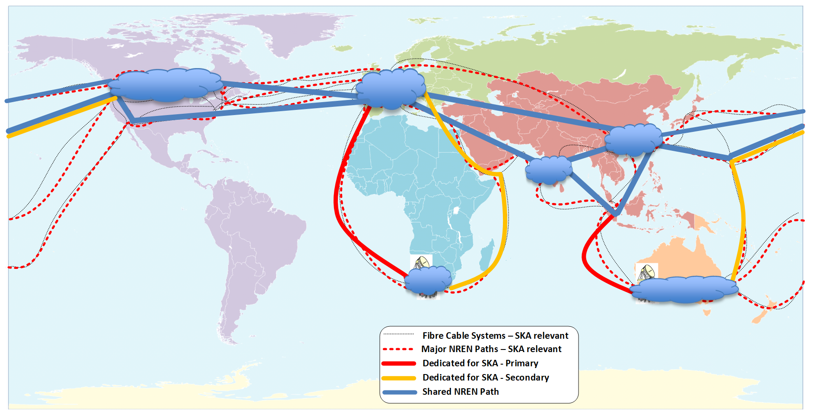
Plan for SRCSC working groups
Workload management - compute and data placement
Data Lifecycle, Quality of Service requirements
Users –
Archive Exploration
Data interaction and visualization
Science Gateway, large job submission
Programme users (KSP, PI) User Support
NREN/ International data transfer

Slide 15
Possible* areas for SRCSC working groups
Workload management - compute and data placement
Data Lifecycle, Quality of Service requirements
Users –
Archive Exploration
Data interaction and visualization
Science Gateway, large job submission
Programme users (KSP, PI) User Support
NREN/ International data transfer
SRC operations and resource management
1
2
3
*Working groups still TBD at first SRCSC meeting

Slide 16
How to engage with SRCSC work
We need to hear the views from across the community – are there areas not covered here?
Please get in touch with your national representative if you want to be involved in SRCSC sub-group work
If you don’t have a national representative, of if you represent an international body, but want to be involved, get in touch with us at SKA
Antonio Chrysostomou and Rosie Bolton (r.bolton@skatelescope.org)

Slide 17
What about INAF: Relevant Projects
AENEAS: https://www.aeneas2020.eu/ Italy leads WP5 and has task leaders in many WPs
ESCAPE: https://escape2020.eu/wp_escape.html Italy leads some tasks
EOSCPilot: https://www.eoscpilot.eu/ Cloud Project where INAF participate in main activities and is involved in porting software analysis tools in the cloud (EOSC)
Exanest: http://www.exanest.eu/ European Exascale System Interconnect and Storage
EuroExa https://euroexa.eu/ co-­‐design of innovative exascale system: INAF is involved in the co-­‐design of Exascale infrastructure with the application porting
IA2 data center
Authentication Authorization and Accounting (AAA) actions (RAP)
First SKA Science Data Challenges
User Space and INAF Radio Science Gateway
Radio archive
SRT data center
VO activities (IVOA)
Collaborations (active and in progress):
LOFAR: Pipeline parallelization
ASKAP: source ﬁnding tools
Meerkat: Virtual reality for structure recognition
MeerKATHI: pipeline parallelization

Slide 18
What about INAF: National landscape
HPC
CINECA Italian super-­‐computing centre that oﬀers HPC peta-­‐scale computing facility (~25 PetaFLOPS)
EURO HPC pre-exascale
NETWORK
GARR national infrastructure
Backbone 400 Gbps up to 1 TBps soon
some INAF Structures and Observatories on 10 Gbps at the moment:
Antennas VLBI ( SRT, Mc, Nt) ⇒ 10 Gbit/s
OATrieste ==> 10 Gbit/s
Upgrading to 10 Gbit/s:
OACAgliari ,IRA Bologna, OACatania
HTC & CLOUD
Italian Computing and Data Infrastructure: includes major institutions involved in HTC, HPC and Cloud computing: INAF, INFN, CNR, ENEA CINECA, GARR
GARR Cloud oﬀers cloud services to the Italian academic and research community based on open standards
…. And more

Slide 19
INAF computing and data storage resources
INAF distributed HPC/HTC infrastructure that involves diﬀerent sites in Italy and oﬀers a computing resource for ~ 25 TFLOPS and HPC storage for about 500 TB
INAF – CINECA MoU to oﬀer HPC resources for Astronomers
Cagliari HTC-­‐HPC system will oﬀer soon 12+ nodes dualCPU-­‐dualGPU
LOFAR.IT distributed infrastructure based on 4 sites in Italy to oﬀer HTC resources for LOFAR data reduction and analysis
INAF cloud service oﬀers a EOSC compatible cloud access to computing and storage resources based on OpenStack
INAF Commercial Cloud ( GCloud & AWS )
INAF archive/storage
IA2 data center ( 0.5 PB on disk + 8 PB on tape )
SRT data center ( 2.5 PB on disk + 8 PB on tape )
More than 3 PB on disk shared across several structures and project
INAF Big Data Project @ Tecnopolo ( Bologna )

Slide 20
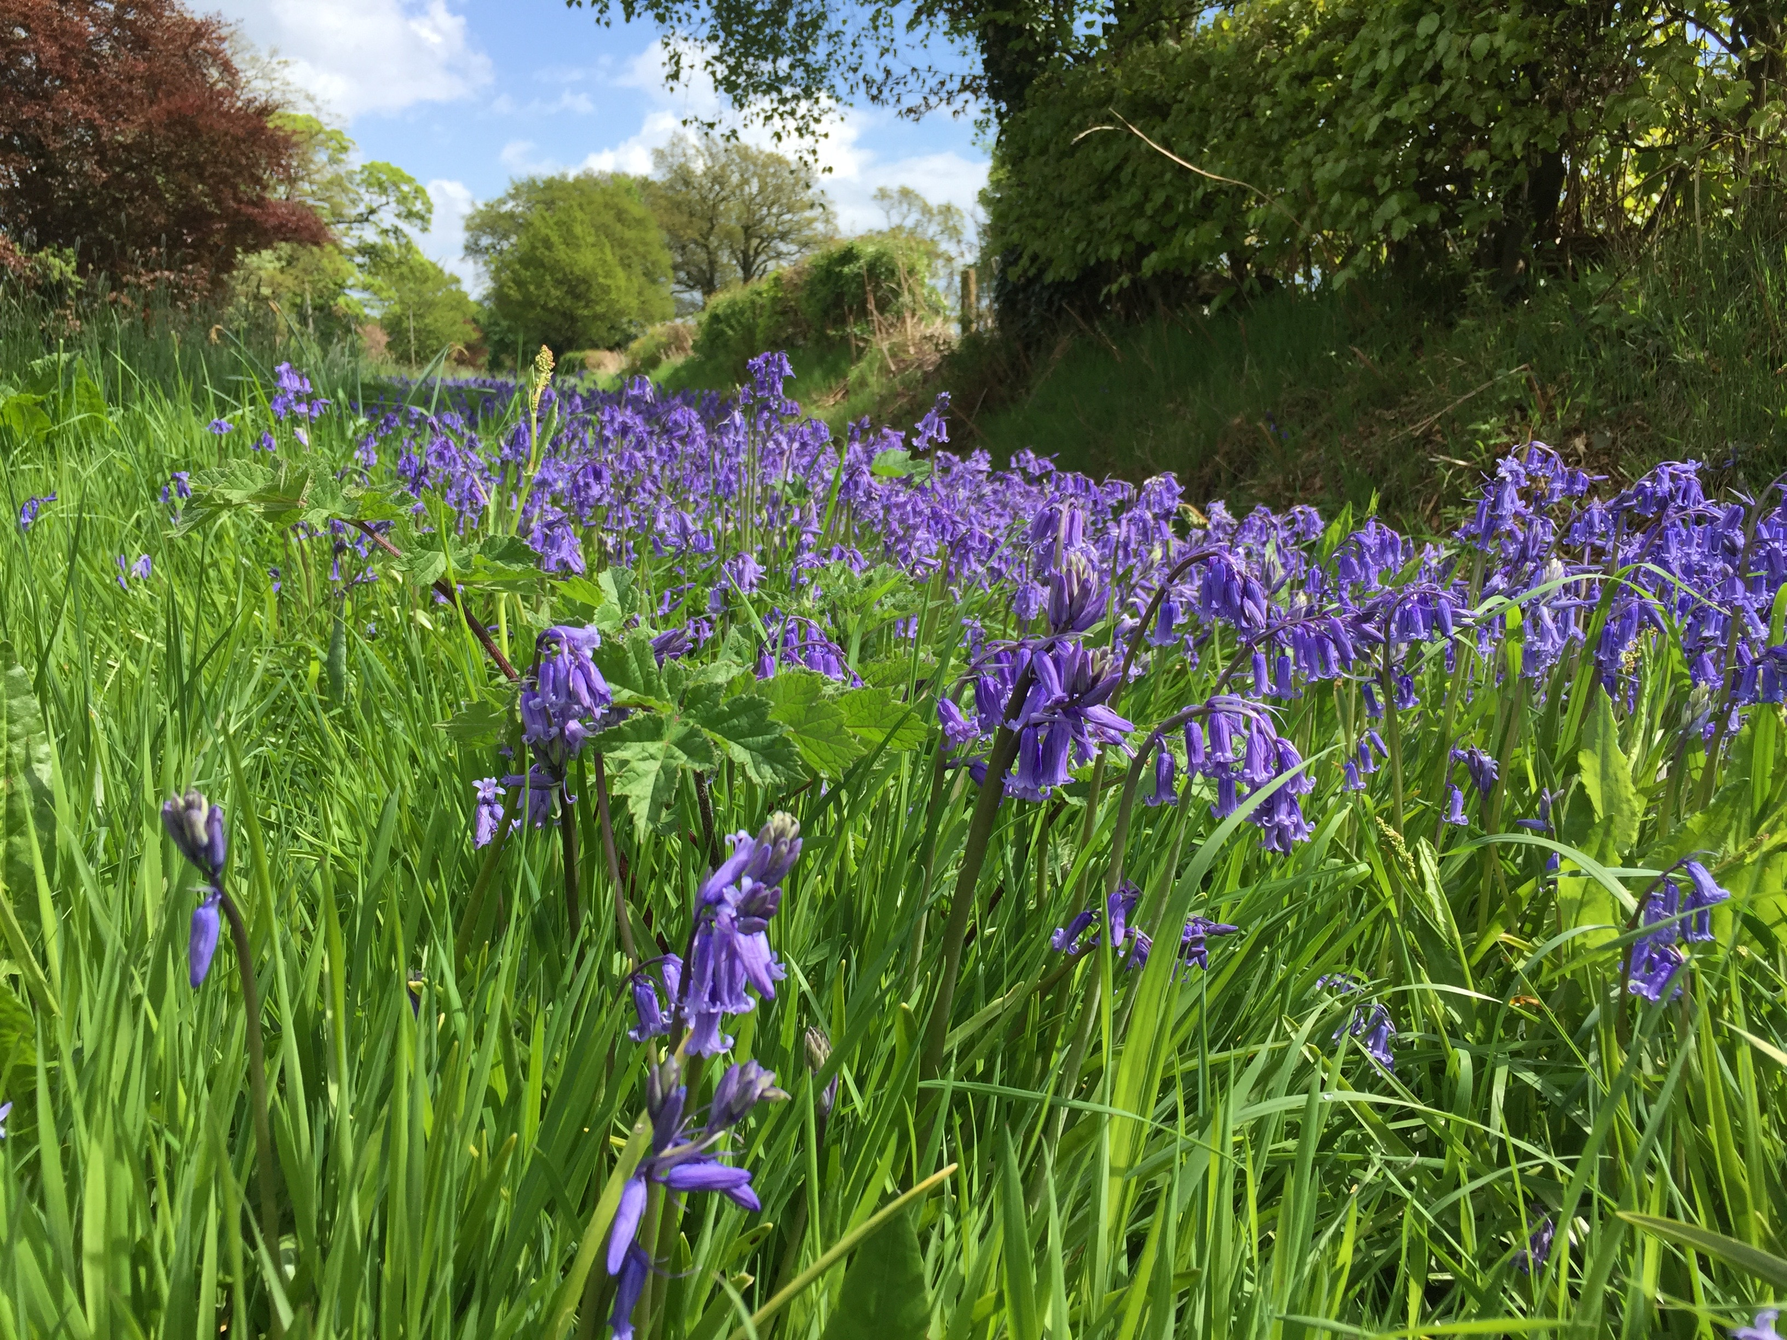
Thanks for attention

