Slide 1
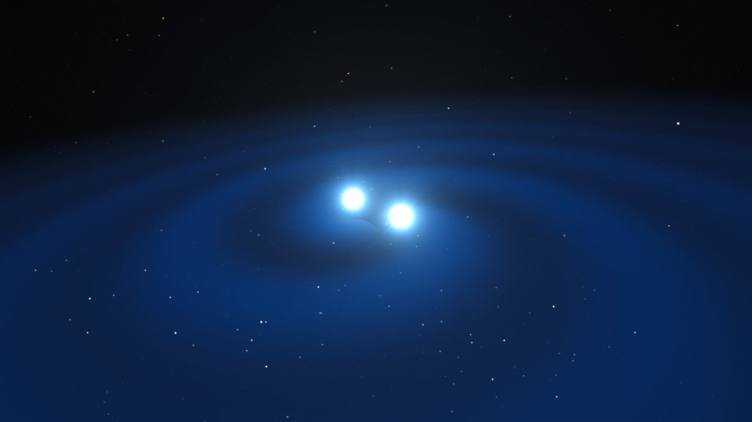
Challenges in data management and distribution within the terrestrial network of gravitational wave detectors
Pia Astone
LV collaboration
INAF Science Archives & the Big Data Challenge 2019/19/06
LIGO-DCC number: G1901123

Slide 2
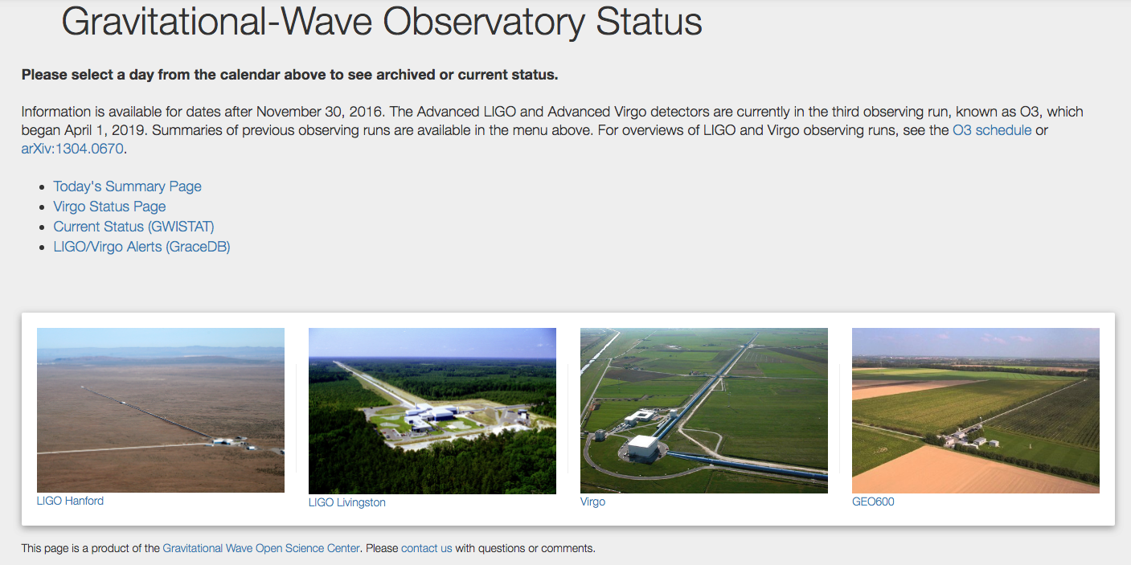
The third scientific run of Advanced GW detectors is ongoing
O3, started on 2019, April 1st
If you click here..
https://www.gw-openscience.org/detector_status/

Slide 3
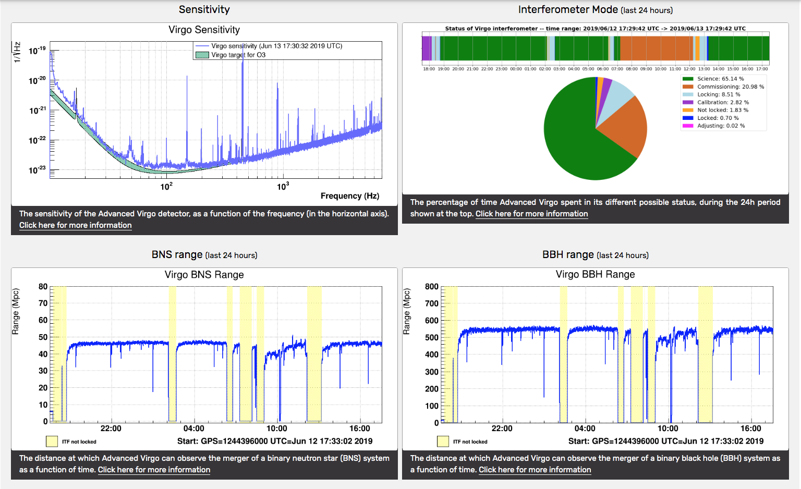
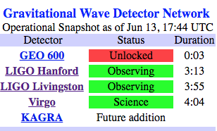
These information are publicly
available in ~ real time
➔ a proper data and
software organization has been set

Slide 4
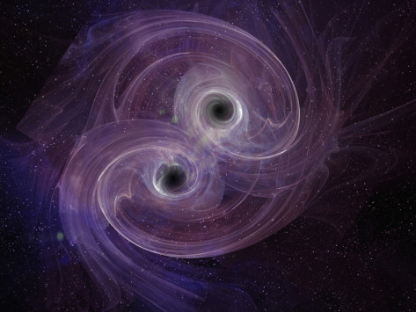
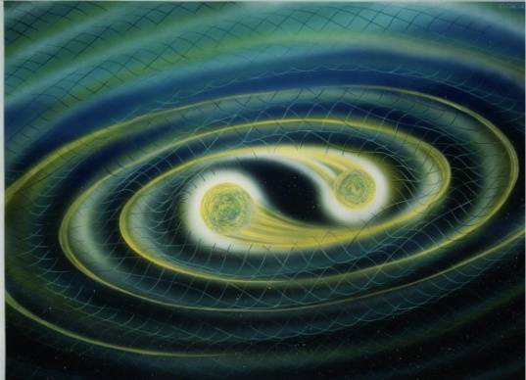
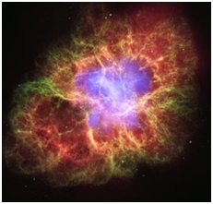
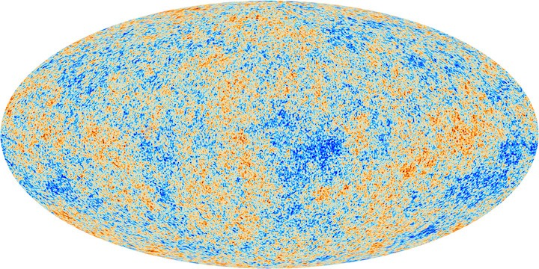
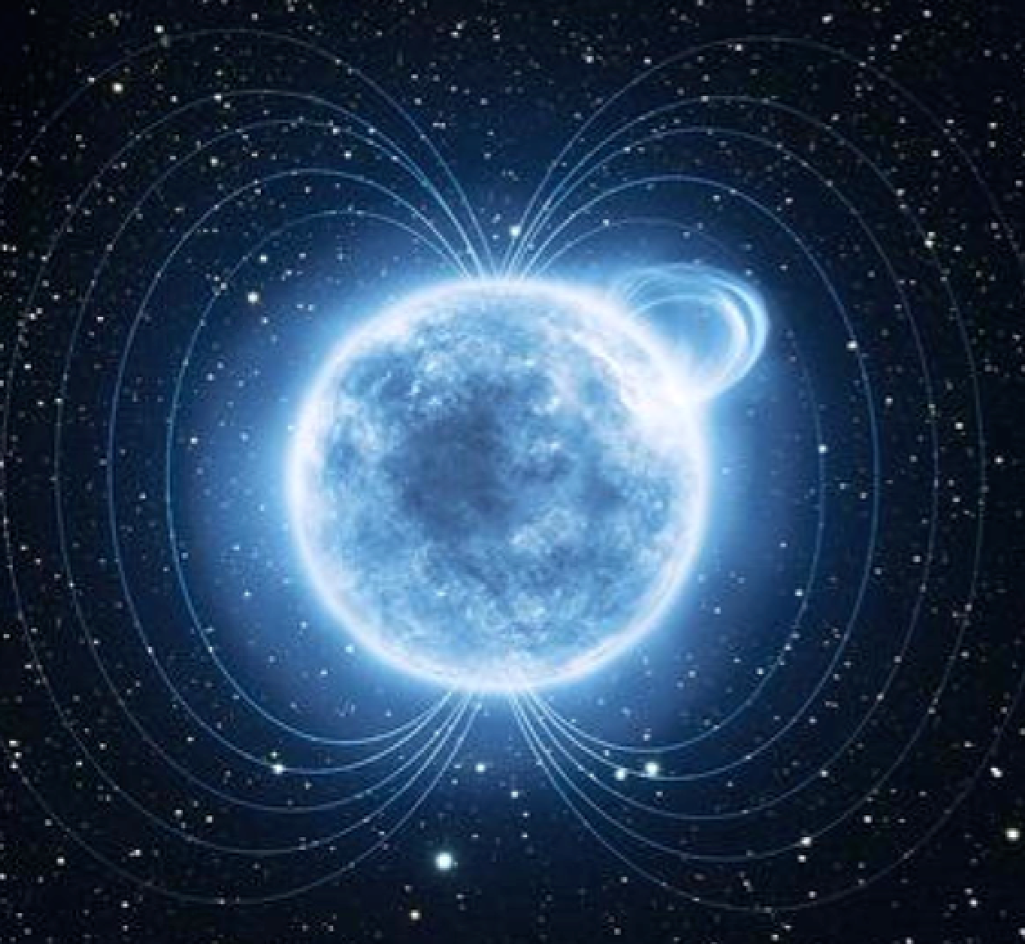
Astrophysical sources emitting GW signals detectable by LIGO and Virgo (10-2000 Hz)
CBC: Coalescence of binary
system of neutron stars and/or stellar-mass black-hole
Burst: Core-collapse of
massive stars
Matched-filter Modeled searches
Unmodeled searches
CW: Isolated or binary neutron-star
Cross-correlations
Stochastic Background
FFT based and hierarchical searches

Slide 5
Computing model,
covering data management and distribution plans
LIGO Data Management Plan, LIGO-M1000066-v25
http://dcc.ligo.org/LIGO-M1000066/public/
Open Archival Information System

Slide 6
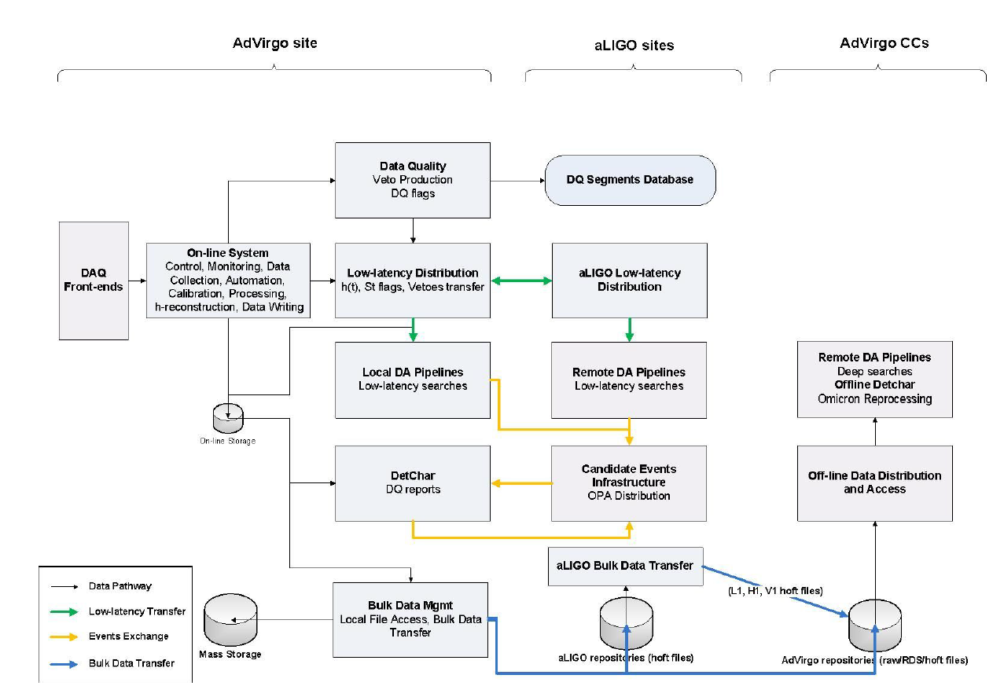
The AdV Computing Model, Version 2.1
VIR-0548A-19 The AdV data flow scheme.

Slide 7
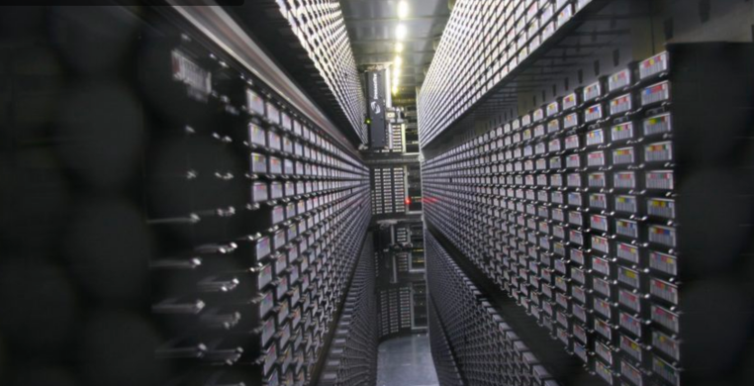
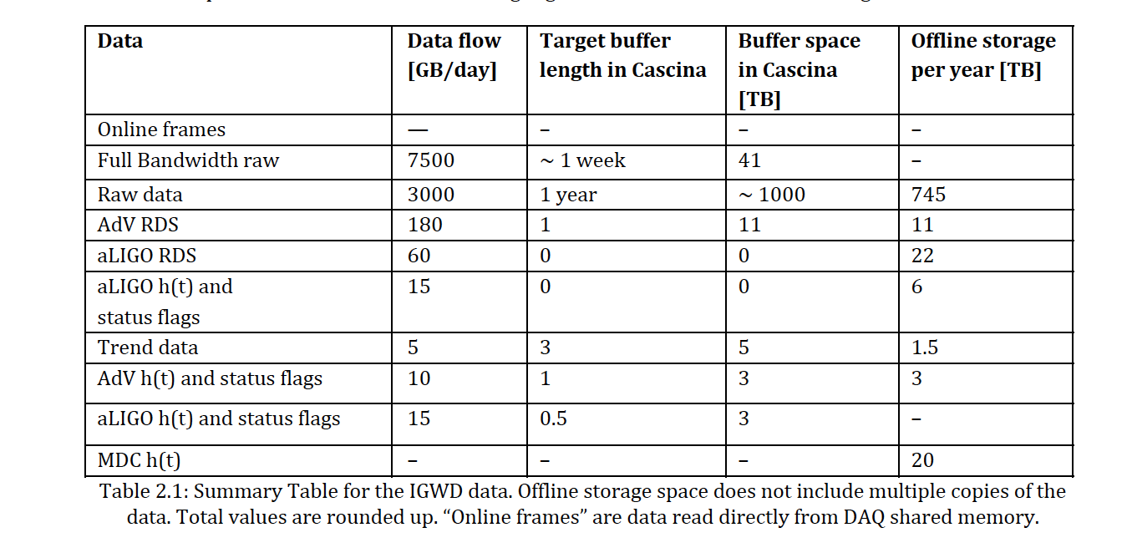
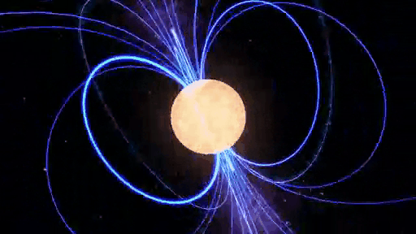
The AdV Computing Model, Version 2.1
VIR-0548A-19
CNAF @ Bologna
Mainly used in Virgo for the search of CWs
Additional data come from the detector characterization work and from
the scientific analyses: ~ +90 TB/yr/detector
Offline analyses make an intense usage of GRID (EGI, LIGO Data Grid)

Slide 8
2017, August 17
2 Neutron Stars
3 GW detectors
~ 100 telescopes

Slide 9
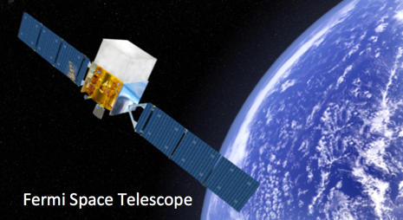
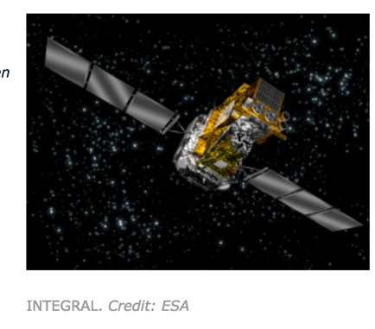
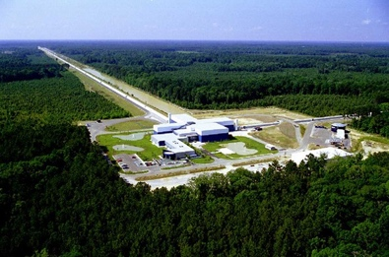
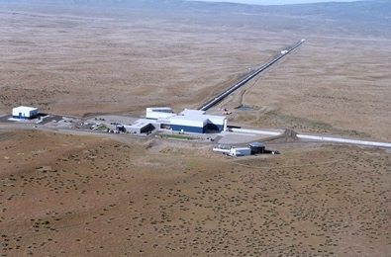
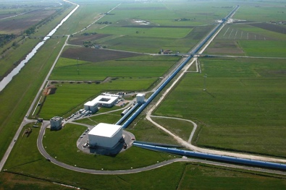
Not only Gravitational Waves
Credit: NASA's Goddard Space Flight Center/CI Lab
The Astrophysical Journal Letters, 848:L13

Slide 10
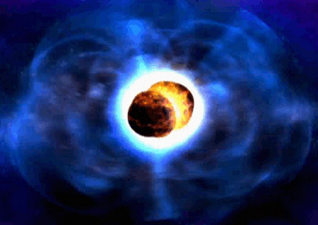
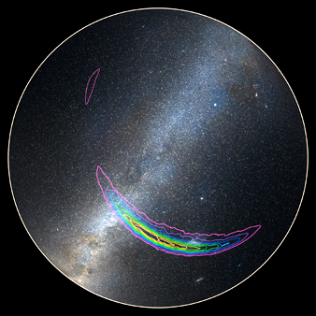
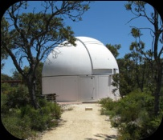
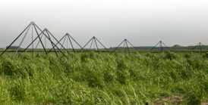
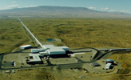
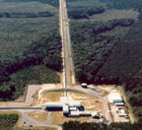
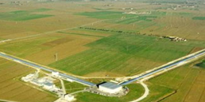
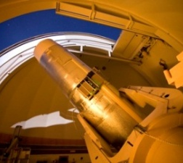
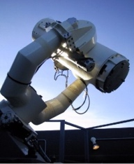
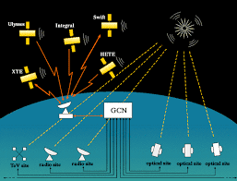
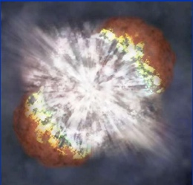
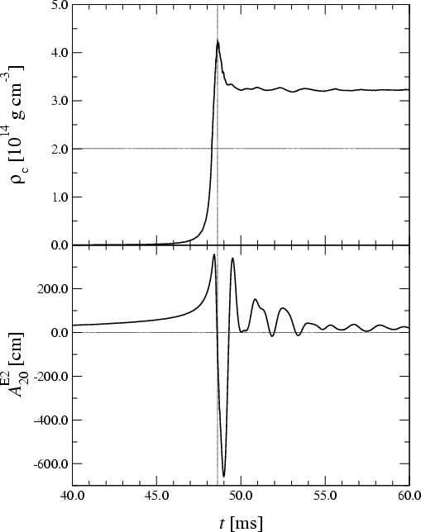
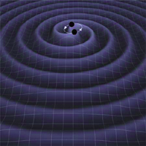
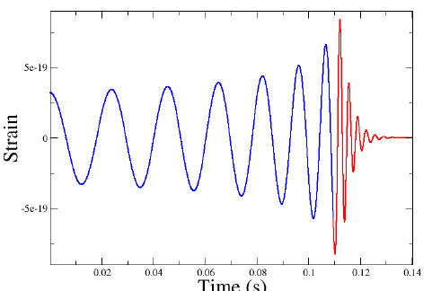
Low-latency GW data analysis pipelines to promptly identify GW candidates and send GW alert to obtain EM observations
GW candidates
Sky Localization
EM facilities
LIGO-H
LIGO-L
Virgo
Event validation
Low-latency Search
to identify the GW-candidates
Software to
select statistically significant
triggers wrt background
check detector sanity and
data quality
determine source localization
Unmodeled GW
burst search
Matched filter with waveforms of compact binary coalescence
a few min
30 min
GW candidate updates
Parameter estimation codes
Hours,days

Slide 11
Multi-Messenger Searches with GWs,
as it was organized in O1 and O2
For the O1 and O2 analysis
LIGO & Virgo have signed MOUs with 95 groups for rapid
EM/neutrino follow-up of GW candidate events found in low-latency
INVOLVED:
About 200 EM instruments - satellites and ground based telescopes covering the full spectrum from radio to very high-energy gamma-rays
Worldwide astronomical institutions, agencies and large/small teams of astronomers

Slide 12
GraceDB in O3: now this is immediately public
No login done
https://gracedb.ligo.org/latest/
Slide done on June,13th

Slide 13
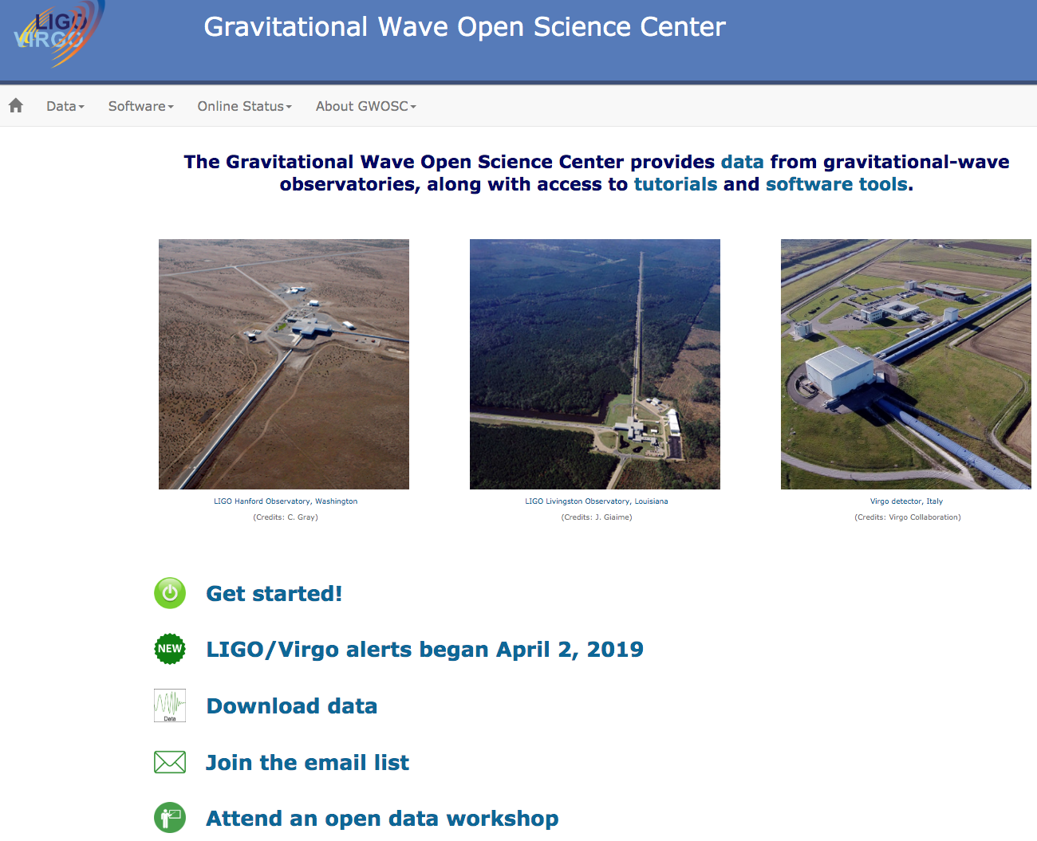
GWOSC @ https://www.gw-openscience.org/

Slide 14
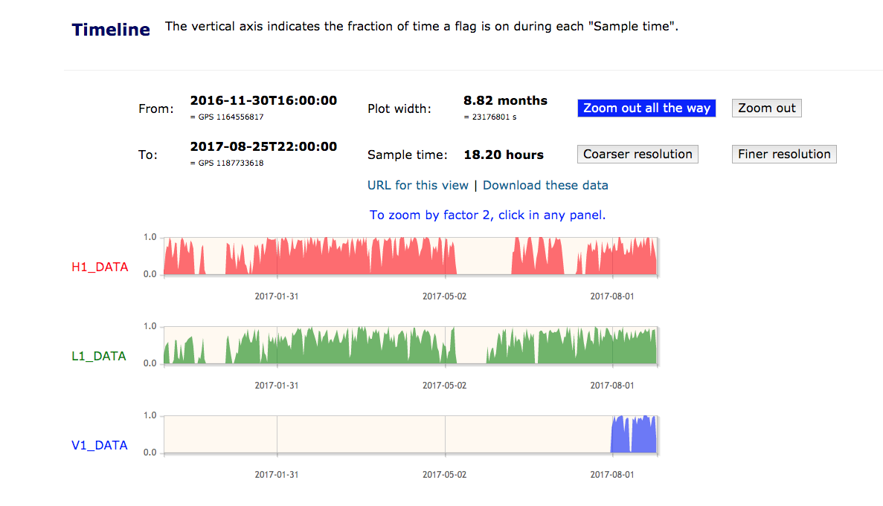
Timeline for all the detectors is easily obtained

Slide 15
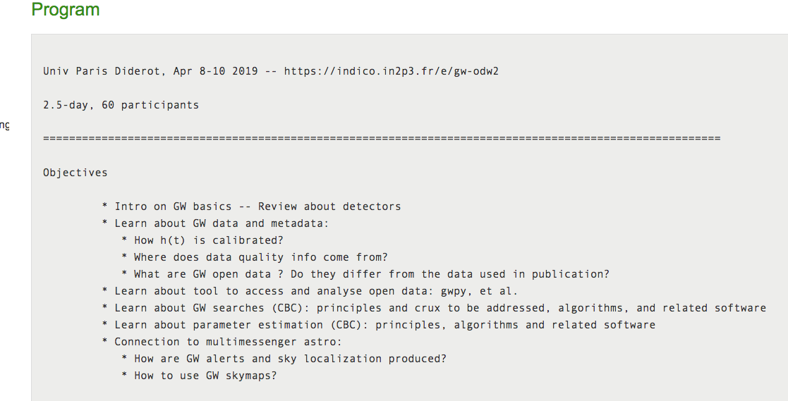

Slide 16
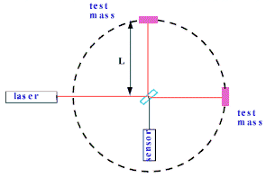
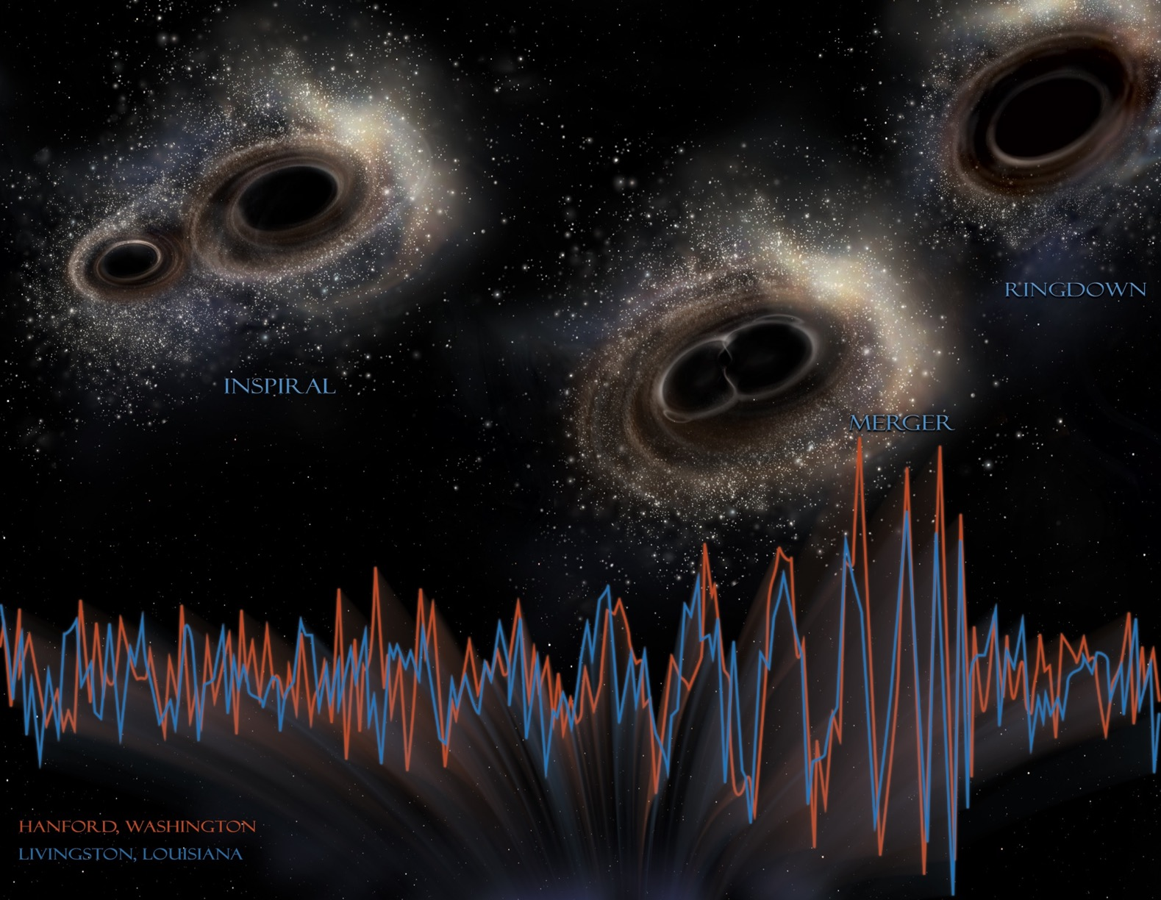
What are the LIGO/Virgo GW data we distribute ?
1-We distribute the main GW channel data, the strain h.
With additional information, like metadata, data quality
and hardware injections parameters
2-And the data at and around the time of GW signals
h = $\frac{ΔL }{L}$

Slide 17
Advanced detectors data released so far
Which data | When
GW150914 | Feb 2016 (5 months after the detection)
LVT151012, GW151226 | July 2016
GW170104, GW170608, GW170814 | June-November 2017
GW170817 | October 2017 (2 months after the detection)
O1 (September 2015-Jan 2016) | January 2018 (2 years after the end)
O1 and O2 GW signals (The first catalog) | December 2018
O2 (November 2016-August 2017) | February 2019 (1.5 year after the end)

Slide 18
New LV data distribution policy
The third scientific run started on 2019, April, 1°
and we will release the data with the following schedule:
- the first data release: 2020, October, 1°
- the second data release: 2021, April, 1°
maybe delayed for up to a few months due to possible mid-term O3 commissioning break

Slide 19
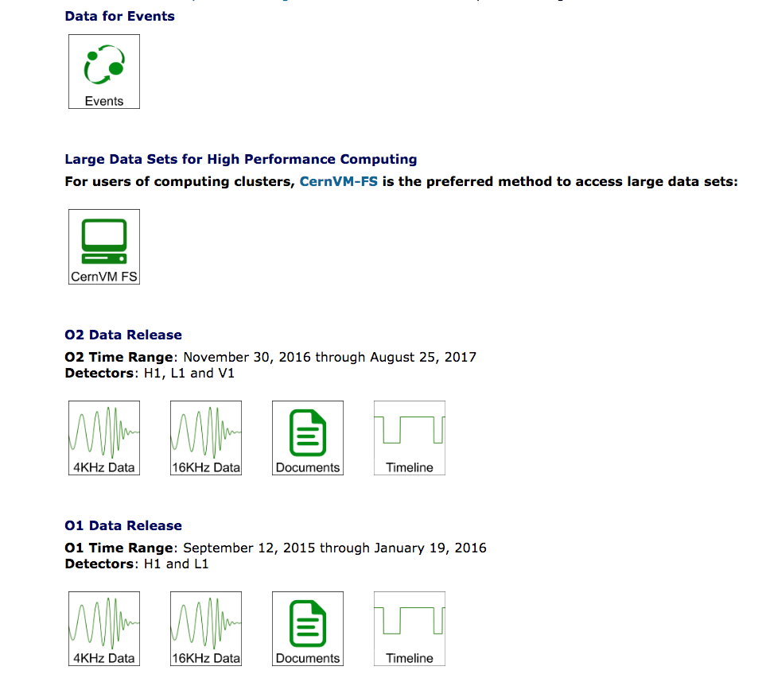
Download the data
https://www.gw-openscience.org/data/
A filesystem to mount and manage the data locally

Slide 20
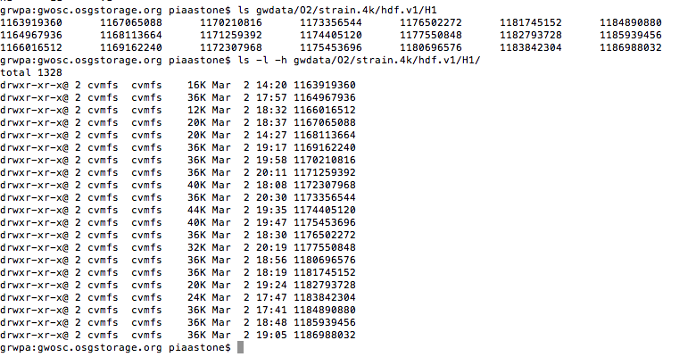
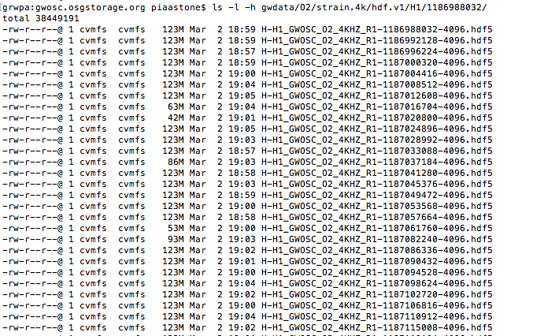
du -h gwdata/O2/strain.4k/
1.6 Tb
843 GB for HDF5
843 GB for frames
9 months 2 detectors
1 month 1 detector
O2 data on
my laptop
Data are in files in different formats:
HDF5
Frame format (.gwf)
GPS beginning time and time
duration in seconds are in the name
(eg 1186988032 and 4096)

Slide 21
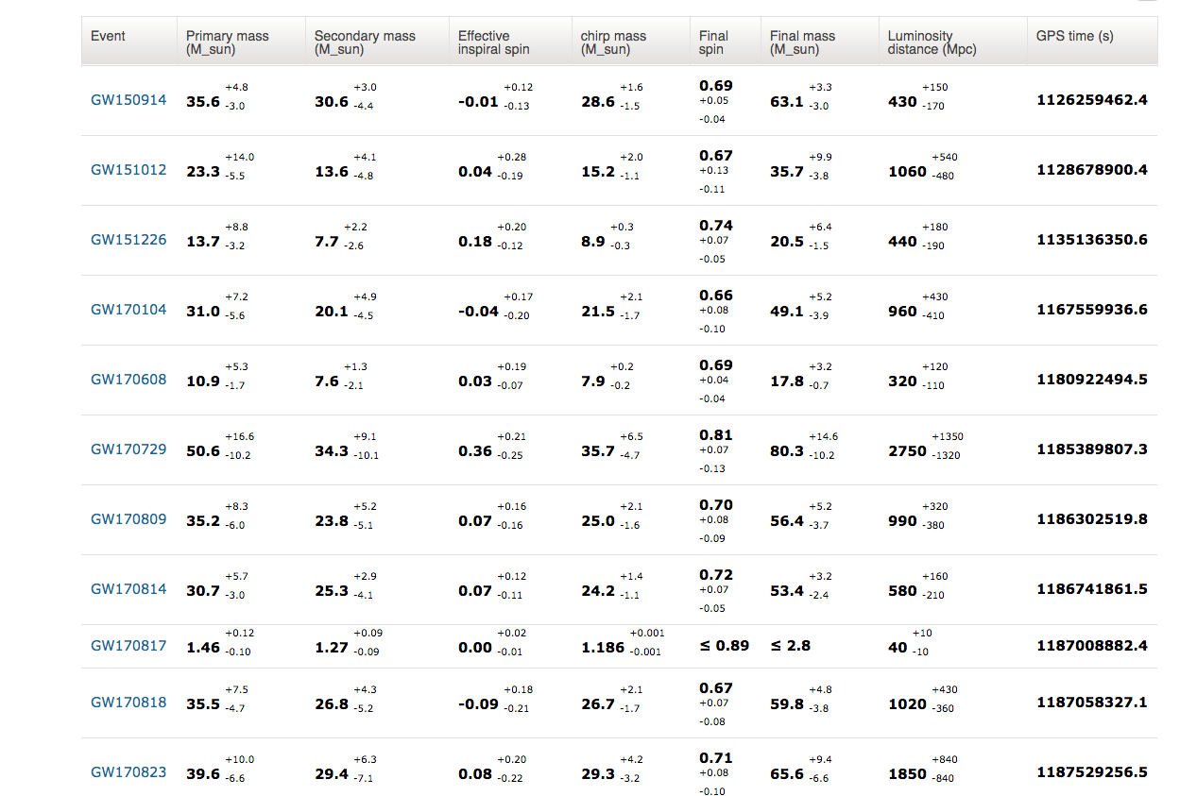
The event catalog: GWTC-1-confident
https://www.gw-openscience.org/catalog/GWTC-1-confident/html/

Slide 23
We use computing resources for:
Detector characterization work
Searches for all the different signals we can look for (to identify candidates and assess their significance)
Modeled searches use templates that are convolved with the data (matched filtering)
Unmodeled searches do not assume the form of the signal
Simulations
Parameter estimation, in case of detections

Slide 24
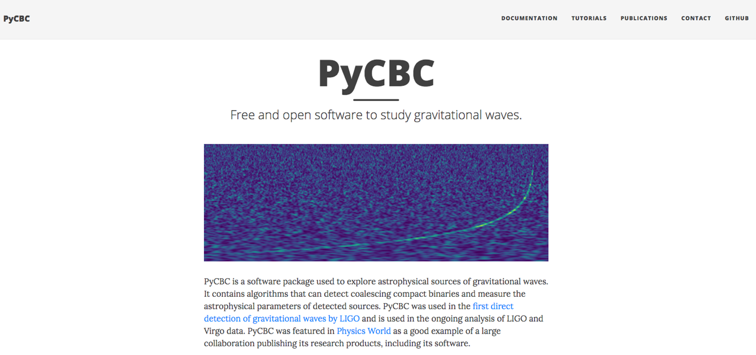
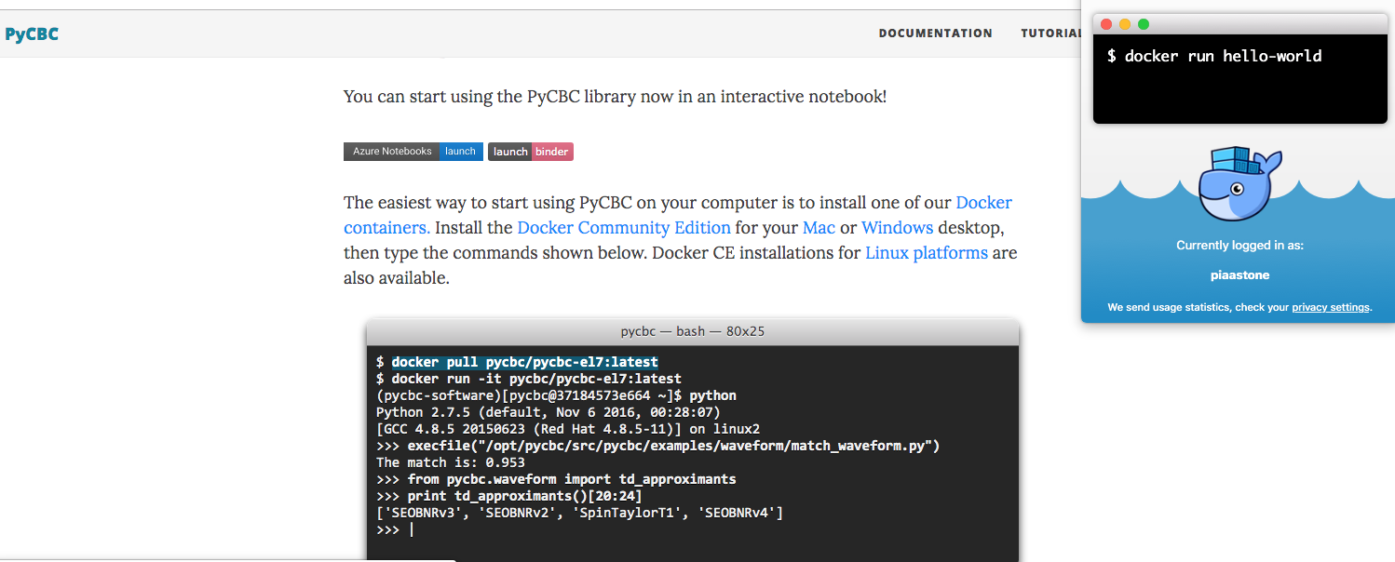
Software distribution LV policy. Examples
https://www.gw-openscience.org/software/

Slide 25
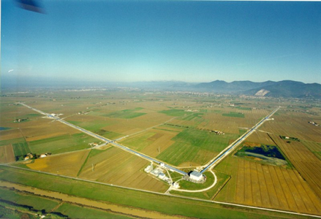
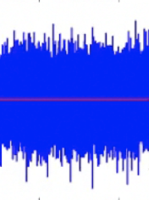
Procedures to extract the signal from noise
+

Slide 26
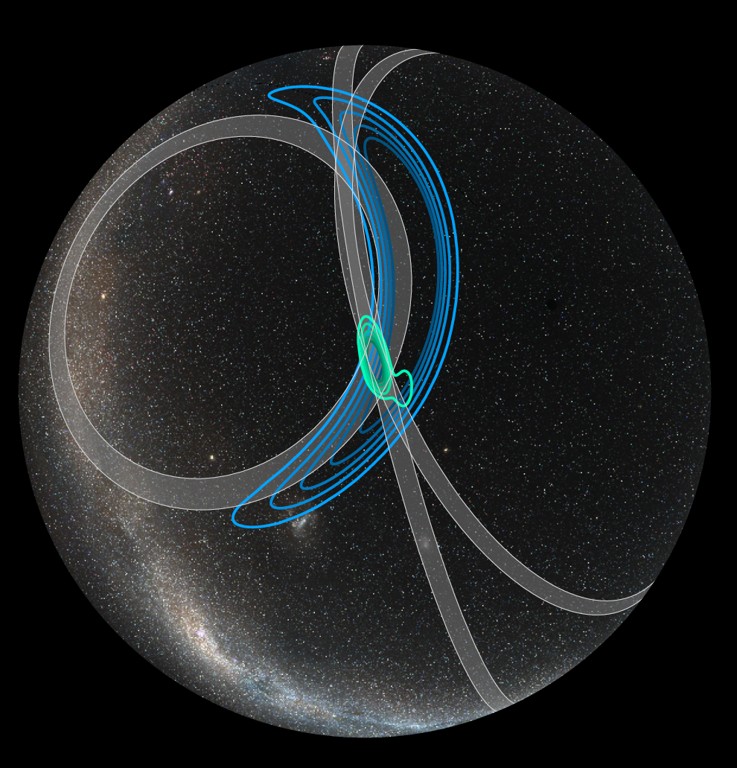
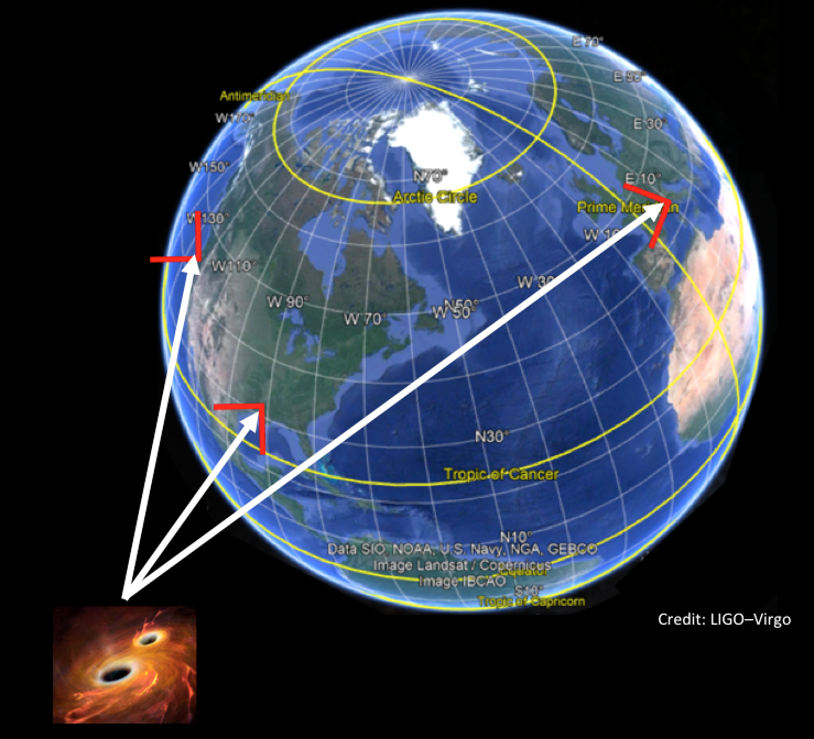
Source localization is fundamental and requires a network of detectors
→ BBH 2017 August 14 14
Credit: Leo Singer
LH 1160 square degrees
LHV 80 square degrees

Slide 27
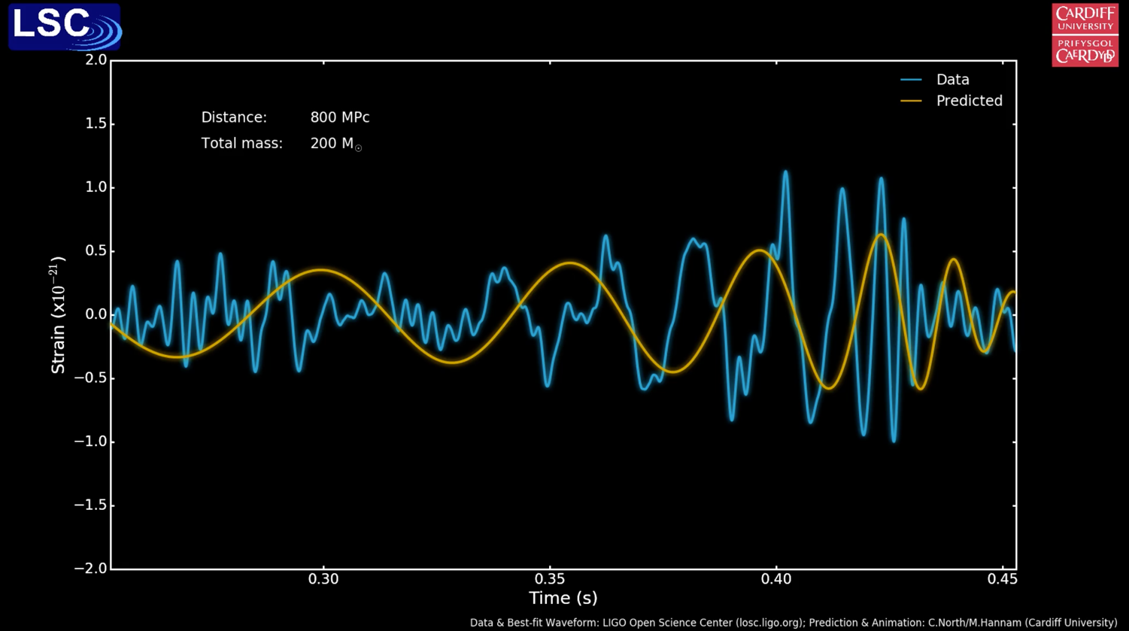
Procedures to detect the signal and estimate the parameters

Slide 28
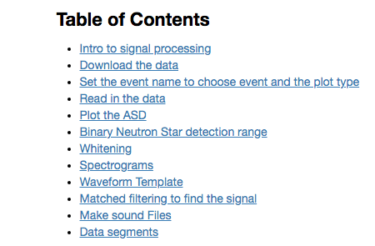
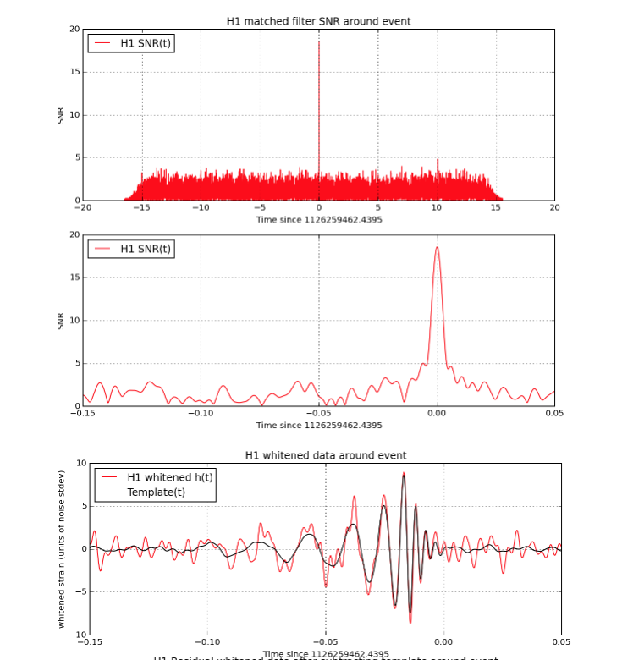
Tutorial: How to find BBH signals in LIGO/Virgo data
Analyze the data around GW150914
Use the template for GW150914
https://www.gw-openscience.org/GW150914data/LOSC_Event_tutorial_GW150914.html

Slide 29
https://gracedb.ligo.org/latest/
Back to GraceDB
(introduced in slide 12)
Documentation:
https://gracedb.ligo.org/documentation/
EM followup user guide:
https://emfollow.docs.ligo.org/userguide/

Slide 30
For a general
search (not Latest) click here
Example of a search on Supervents and using 2 labels

Slide 31
The search in GraceDB can be done
using different parameters
(detectors, false alarm, time,labels,id..)
Example of how names are
assigned to Superevents
(see Data Models in the documentation)
Labels list: https://gracedb.ligo.org/documentation/labels.html

Slide 32
The CW searches: a source still not detected
To detect these signals we need to integrate over long times.
At the actual sensitivities our main target for continuous searches are galactic non-axisymmetric spinning NS, isolated or in binary systems, such that the frequency of the emitted GW, is in the band of our detectors ~[20-2000] Hz.
We know that potential sources of CW exist: 2700+ NS are observed (mostly pulsars) and O(10⁸ - 10⁹) are expected to exist in the Galaxy.
Multi-messenger astronomy plays and will play an important role

Slide 33
The computational problem: the CW case
Picture credit. Palomba
Known for Sco-X1n
Order of magnitude estimation is: 1 year, 3 detectors.
~ 80 million core-hours.
All the h data are needed for the analysis. .

Slide 34
We have implemented a robust data (and software)
preservation and distribution model;
Data and basic software are distributed, using
different formats and different languages;
The sensitivity of the detectors is still improving,
new detectors will join the network ….
New GW sources will probably be seen….
There is a lot of work ahead for us and the contribution of people from other sectors is highly encouraged and welcome.

Slide 35
https://www.gw-openscience.org/projects/
Presently more than 50 scientific publications
And other activities, like:
- An iphone app (GW events)
- Artistic installation: Void
Amount of data downloaded since the beginning of the year
20 TB
10 TB
Plot credit: A. Trovato, ASTERICS, March 2019

