Slide 1
A brief introduction to TETIS
Future TETIS
logo here
A. Baruffolo on behalf of all TETIS members
INAF ICT Workshop 2019
IASF Milano – 23 Ottobre 2019

Slide 2
What is TETIS?
…..a “collateral effect” of the ICT effort in the past years of surveying and putting together all groups in INAF involved in SW development activities.
Starting from the ICT meeting in Trieste (2016), a session dedicated to present to the community the control SW developed in various groups of INAF has been included. The main aim was to allow the technological groups involved in these activities for both ground based and space based instrumentation to start knowing each other and exchanging their experience (analogous sessions included in the ICT 2017 and 2018 WS).
Final result: the shared awareness that to optimize resources and results a coordination at national level is necessary

Slide 3
What is TETIS?
TEchnologies for Telescopes and Instruments control Software
A Coordination Group within the INAF UTG1 OptNIR Division (Divisione per l’Astronomia Ottica e IR), born to fulfill the need of a “coordination of interests, activities, tools and expertise” of all INAF technological groups involved in the instrument control software development.
The original proposal for TETIS has been subscribed by 20 INAF researchers with exertise in the design and development of control SW (or, more in general, HW related SW) for both ground based and space based astronomical instrumentation working in several different wavelength ranges.

Slide 4
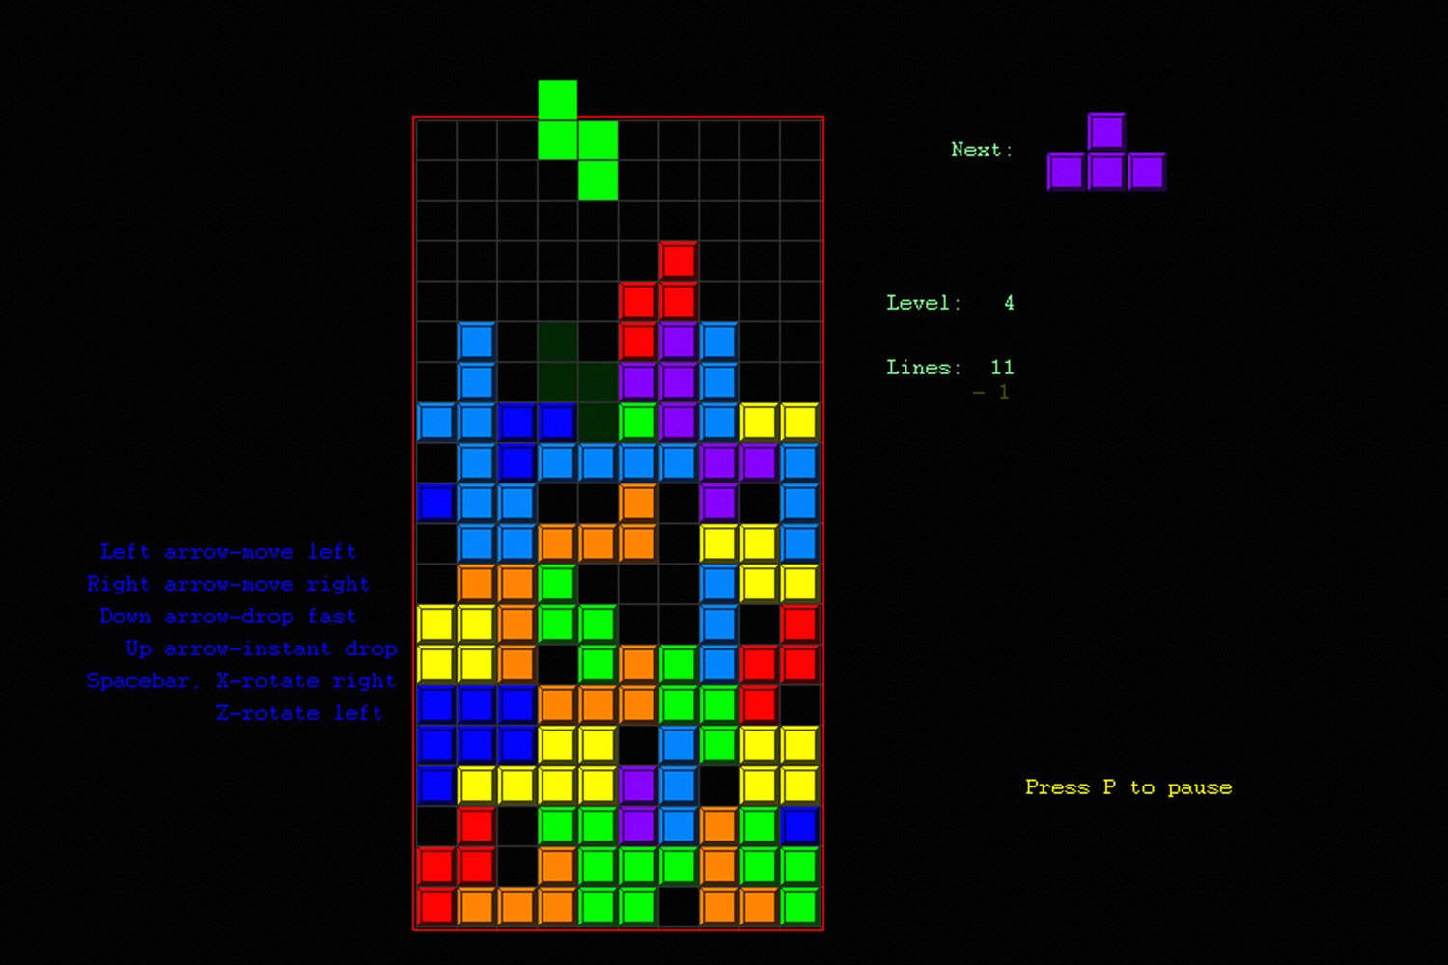
What is NOT TETIS?

Slide 5
Why TETIS?
Main aims:
maximize synergies between the different participating groups by sharing knowledge and skills
support and maintain the level of excellence achieved today, through both the acquisition of tools, hardware and software, and the improvement of the training activities related to new technologies, strategic for the near future.

Slide 6
Origin of TETIS
TETIS has been initially proposed to answer the INAF call for “Mainstream” projects
The proposal has been "redirected" to the OptNIR Division by the evaluation committee of the call answers.
The initial project organization has been consolidated and slightly revised to couple with the structure of a “coordination group”
The coordination group (see after) appointed a ~ mid-September u.s.

Slide 7
The TETIS proponents
The initial group of TETIS “proponents” consists of 20 staff units, both permanent and non-permanent, divided into four locations (OA Padova, IAPS Roma, OA Torino and OA Trieste).
This initial group of participants has a consolidated expertise in the development of control SW for instruments and telescopes:
Ground based facilities: OmegaCAM, UVES, FLAMES/GIRAFFE, X-Shooter, SPHERE, ESPRESSO, ERIS, SHARK, SOXS, MAORY, …
Space missions: ISO, Herschel, Euclid, Plato, Athena, ARIEL, SPICA, OST, …

Slide 8
TETIS organisation
TETIS has a very simple organization, with a Management Committee and a Coordinator:
The Management Committee (Comitato di Gestione, CdG) is composed by one representative for each one of the INAF structure in which there are at least two staff units involved in TETIS
The Coordinator is appointed by the Manager of UTG-I "Opt-NIR", within the Management Committee and having heard his opinion.
In this initial phase, CdG members are: Andrea Baruffolo (OAPd, Coordinator), Anna Maria Di Giorgio (IAPS), Sebastiano Ligori (OATo), Paolo Di Marcantonio (OATs).

Slide 9
Short term planned activities
Organization of the first "TETIS Workshop", ~ spring 2020:
Present TETIS to the community
Extend participation to interested / not yet involved groups
Expand mutual knowledge of the groups that deal with the SW control
Discuss the plan of the medium and long term activities
Stay tuned!

