Slide 1
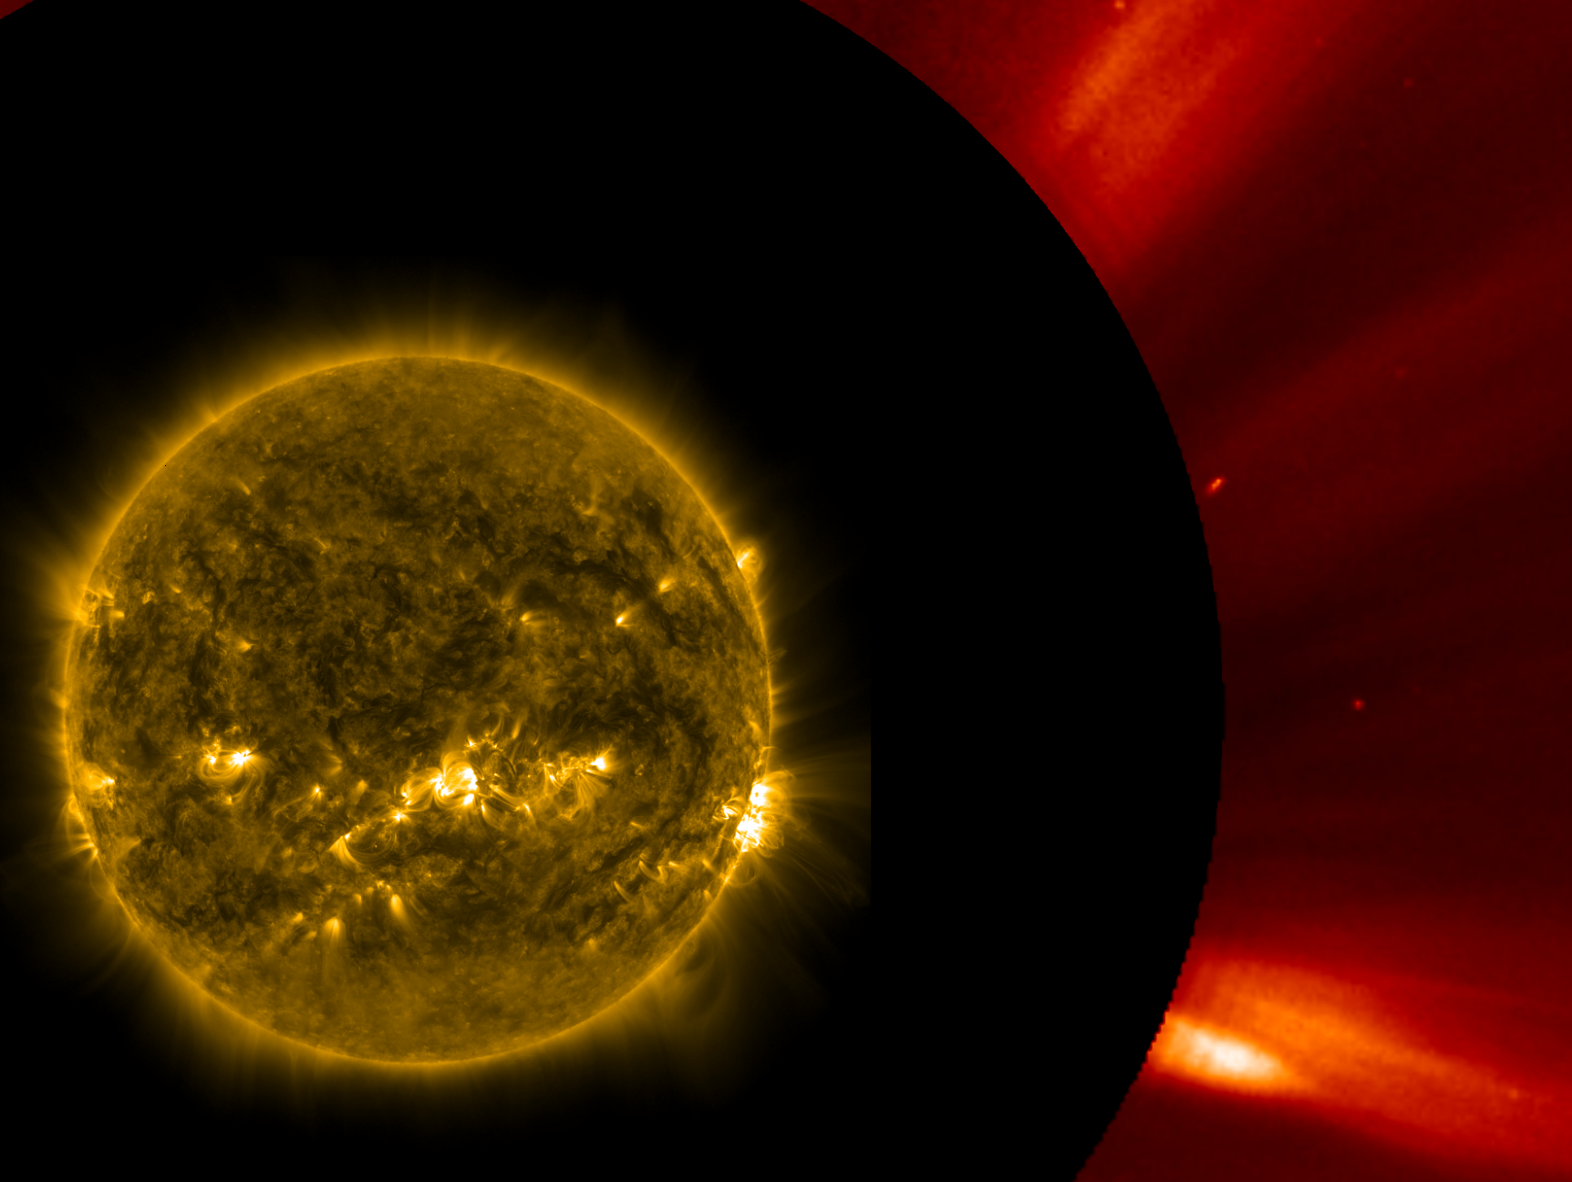
Failed eruption stopped at the distance of
2R_{ʘ} from the photosphere.
Tomasz Mrozek^{1,2}, Urszula Bąk-Stęślicka², Kamil Bicz², Sylwester Kołomański², Karol Kułaga², Marek Stęślicki¹
Space Research Centre, Polish Academy of Sciences
Astronomical Institute, University of Wrocław

Slide 2
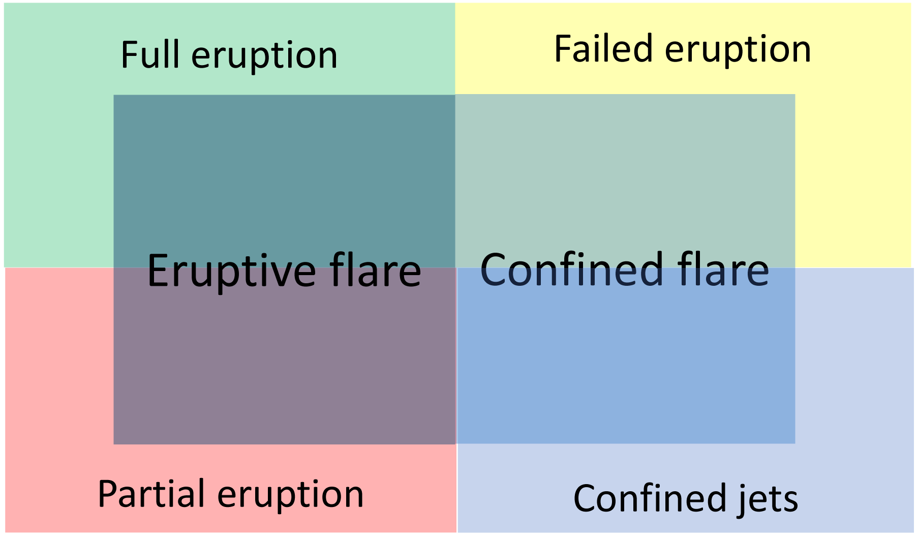
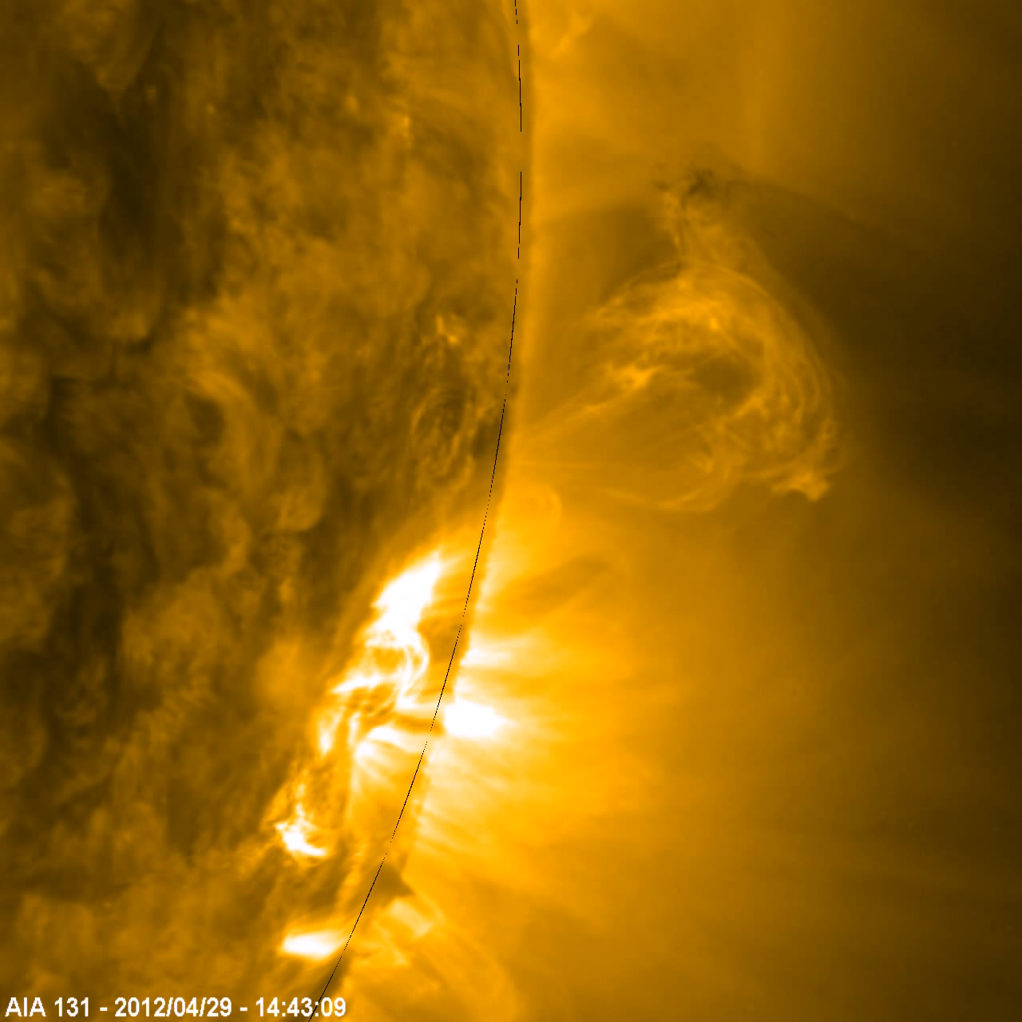
Failed eruption
Some eruptions fail to escape the Sun. They do not initiate CME.
They may be related to confined flares (even strongest ones).
There are many mechanism proposed for eruption stop and energy dissipation. The main factor seems to be magnetic field decay index.

Slide 3
Stopping mechanism and maximum heights of failed eruptions
too strong magnetic tether
Vrsnak, B. 1990, Solar Phys. 129, 295
flux emergence
Archontis, V., et al. 2007, A&A 466, 367
kink/toroidal instability
Ji, H. i in. 2003, ApJ, 595, L135
collision with overlying field
Amari, T., & Luciani, J.F. 1999, ApJ 515, L81
non-axisymmetry of magnetic flux rope
Zhong et al. 2021, Nat. Communications 12,2734
75 – 250 Mm
Filippov, B. 2020, MNRAS 494, 2166
50 Mm
Nisticò, G. et al. 2017, A&A 600, A37
<140 Mm
Gilbert, H. et al. 2000, ApJ 537, 503
178 Mm
Liu, L. et al. 2018, ApJ 858,
125 Mm
Zhong et al. 2021, Nat. Comm. 12,2734
120 Mm
Song, H.Q. et al. 2014, ApJ 784, 48
280 Mm
Song, H.Q. 2018, ApJ 864, L37
100 Mm
Xu, H. et al. 2020, ApJ 901, 121
126 – 329 Mm
Zhou, Z. et al. 2019, ApJ 877, L28

Slide 4
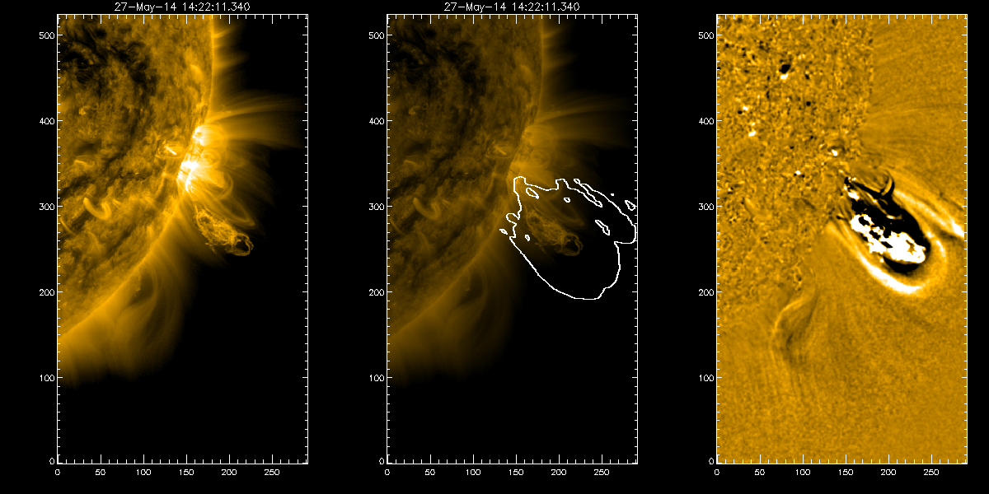
Failed eruptions catalogue (eruptivesun.com/), Mrozek et al. 2020, ApJSS 249, 21M
27 May 2014, 14:20 UT
C6.0 flare
Originally classified as succesfull eruption
Stopped in the field of view of SOHO\LASCO C2 & C3
Observed by:
SDO
Proba2
SOHO
RHESSI
STEREO (A and B)

Slide 5
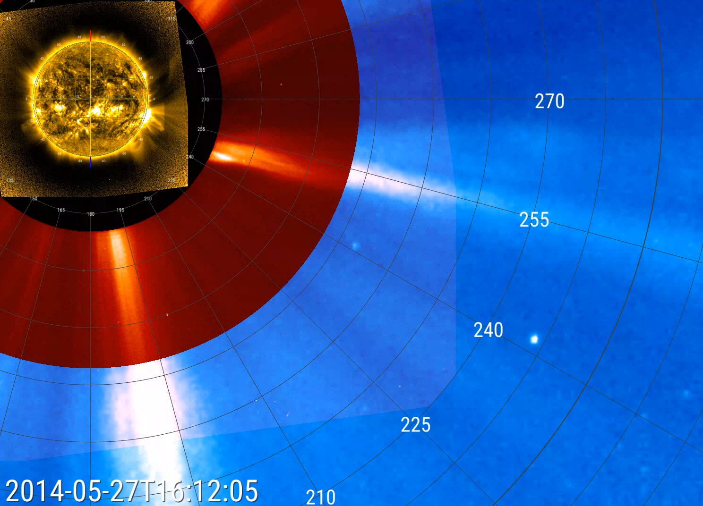
Overall evolution

Slide 6
The struggle for breaking out
symbols: small plus (AIA 171 Å), big plus (PROBA2\SWAP), square (AIA 131 Å), triangle (AIA 304 Å)
280 km/s
190 km/s
260 km/s
shell – overlying loops
leading front – dissapears when close to AIA FOV
following front – visible up to Proba2\SWAP FOV

Slide 7
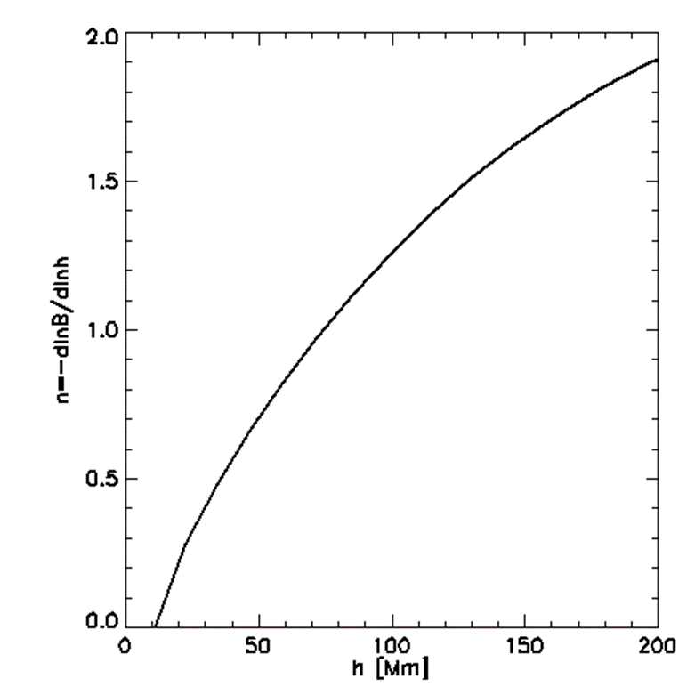
Mechanisms of stopping the eruption
symbols: small plus (AIA 171 Å), big plus (PROBA2\SWAP), square (AIA 131 Å), triangle (AIA 304 Å)
Decay index
280 km/s
Eruption slowed down at the height range of 100 – 170 Mm.
Slowing down was connected to the reconnection within the eruption magnetic structure and with overlying field.
190 km/s
260 km/s

Slide 8
Mechanisms of stopping the eruption
symbols: small plus (AIA 171 Å), big plus (PROBA2\SWAP), square (AIA 131 Å), triangle (AIA 304 Å)
Decay index
280 km/s
Eruption slowed down at the height range of 100 – 170 Mm.
Slowing down was connected to the reconnection within the eruption magnetic structure and with overlying field.
190 km/s
260 km/s

Slide 9
RHESSI observations
Signs of energy release just before slowing down the eruption.
Spectral analysis is difficult as RHESSI was just before the annealing (detectors in poor condition).

Slide 10
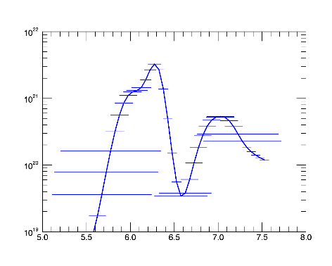
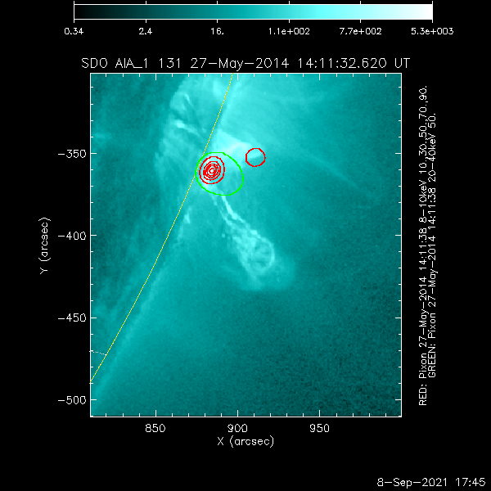
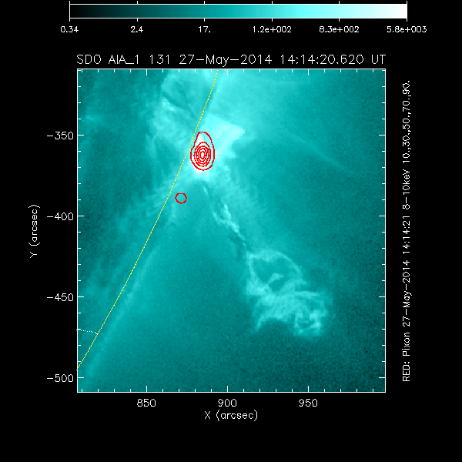
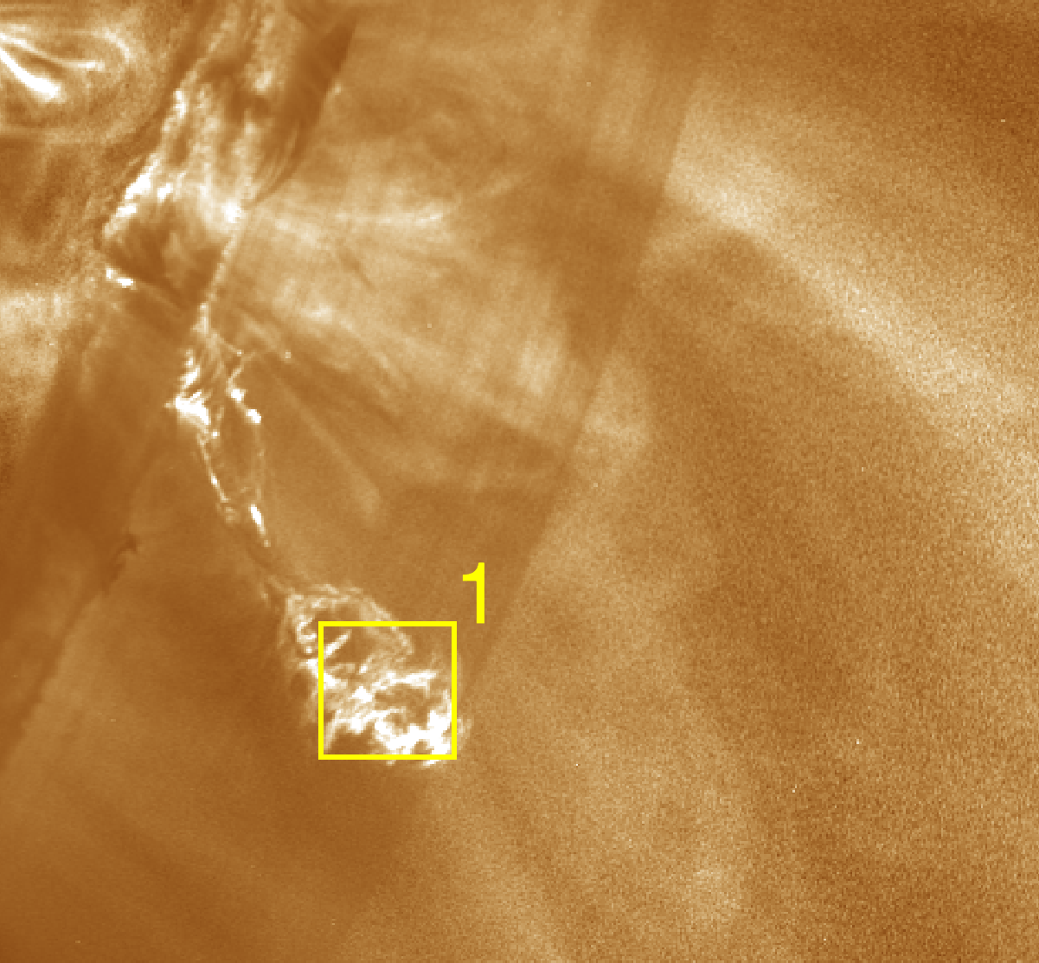
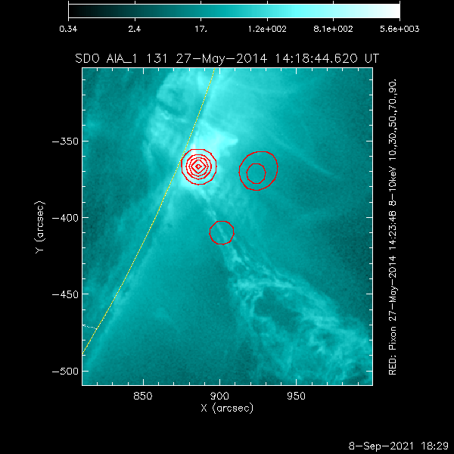
RHESSI sources, AIA DEM maps
DEM map 14:13:39 UT
280 km/s
190 km/s
260 km/s

Slide 11
LASCO C2
Following front was observed up to 2R_{ʘ}
Deceleration was estimated to be ~60 m/s²
It is about 2 times larger than the gravity force at this height.

Slide 12
CME core fallbacks
Wang & Sheeley 2002, ApJ 567, 1211
Failed CME core
Joshi, N.C. et al. 2013, ApJ 771, 65

Slide 13
Summary
We observed a failed eruption stopped at the distance of 2R_{ʘ} (~1400 Mm!) from the starting point (photosphere level).
The height reached by the eruption is exceptional for failed events.
Some characteristics suggest similarities to CME core fallback, however no CME was observed.
Numerical modeling of this event is necessary!
Loop stopped by other force than gravity (magnetic tension?) at 2R_{ʘ}
Part of material (decelerated by gravity only) reached distance >5R_{ʘ} from the starting point.

