Slide 1
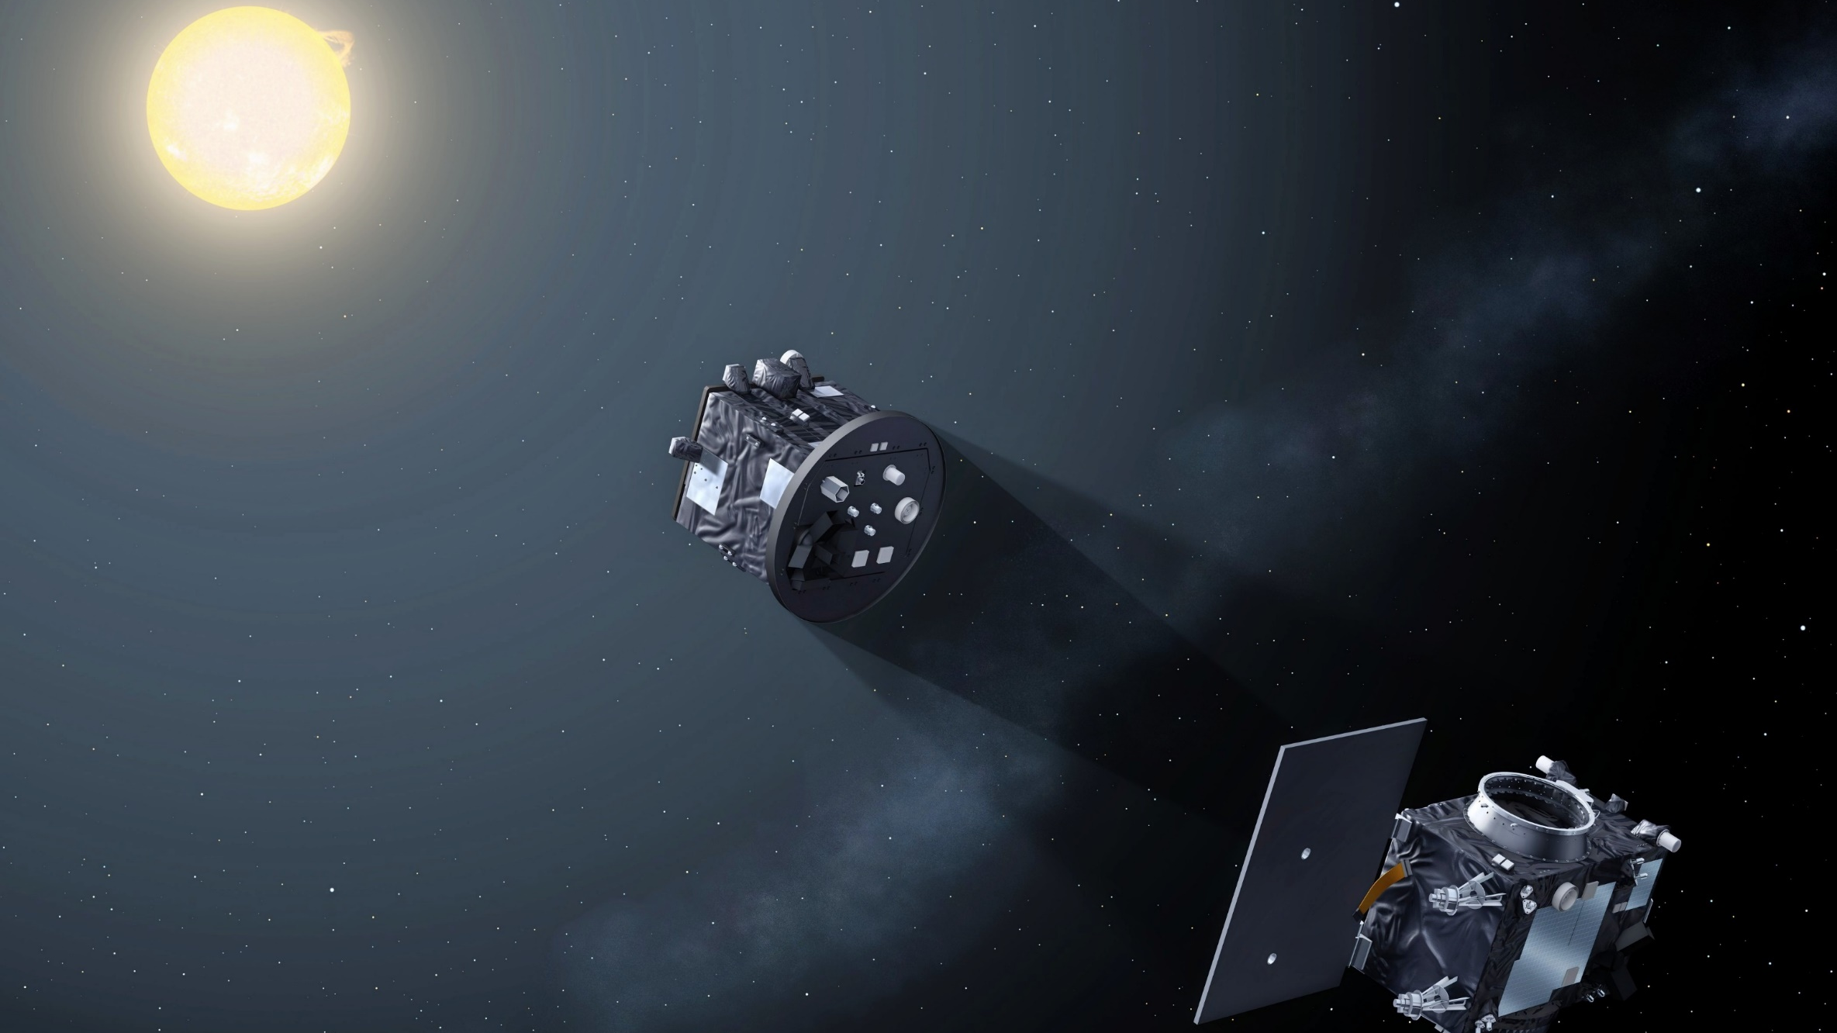
Expected performances of ASPIICS/Proba-3: simulated data
S. V. Shestov, A. N. Zhukov, B. Inhester, L. Dolla, M. Mierla
Royal Observatory of Belgium,
Max Planck Institut für Sonnensystemforschung

Slide 2
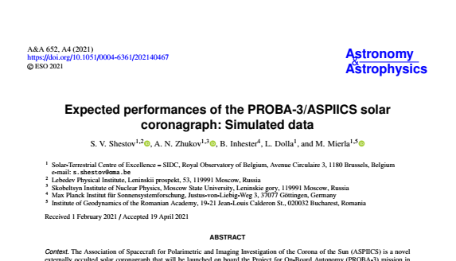
Shestov et al. // A&A 652, A4, 2021

Slide 3
ASPIICS/Proba-3 summary
6 spectral channels:
• white light (535-565 nm) • 3 polarized white light • Fe XIV passband at 530.5 nm • He I D3 passband at 587.7 nm
2048x2048 pixels (2.8 arc sec per pixel)
cadence 60 s / 2 s (using ¼ FoV)
Launch: Q2 2023
Orbit 19h38m; 6h – formation flying
ROB – Science Operation Center
Advantages of ASPIICS:
minimal FoV ~ 1.097 R⊙
and
extremely low straylight
144 m

Slide 4
ASPIICS simulated data: optical effects
Optical throughput / sensitivity;
Spectral sensitivity;
Vignetting by the external occulter;
Flat field;
Straylight – diffraction, scattering, ghost light;
objective Ø (5 cm);
lenses&filters;
2.81 “/pix;
wide-band (535-565 nm),
for FeXIV line (0.6/530.5 nm),
for HeI line (2/587.7 nm);
~25 pix circular zone, inner FOV;
detector sensitivity;
Aime (2013), Rougeot et al. (2017);
Shestov&Zhukov (2018);
Shestov et al. (2019);

Slide 5
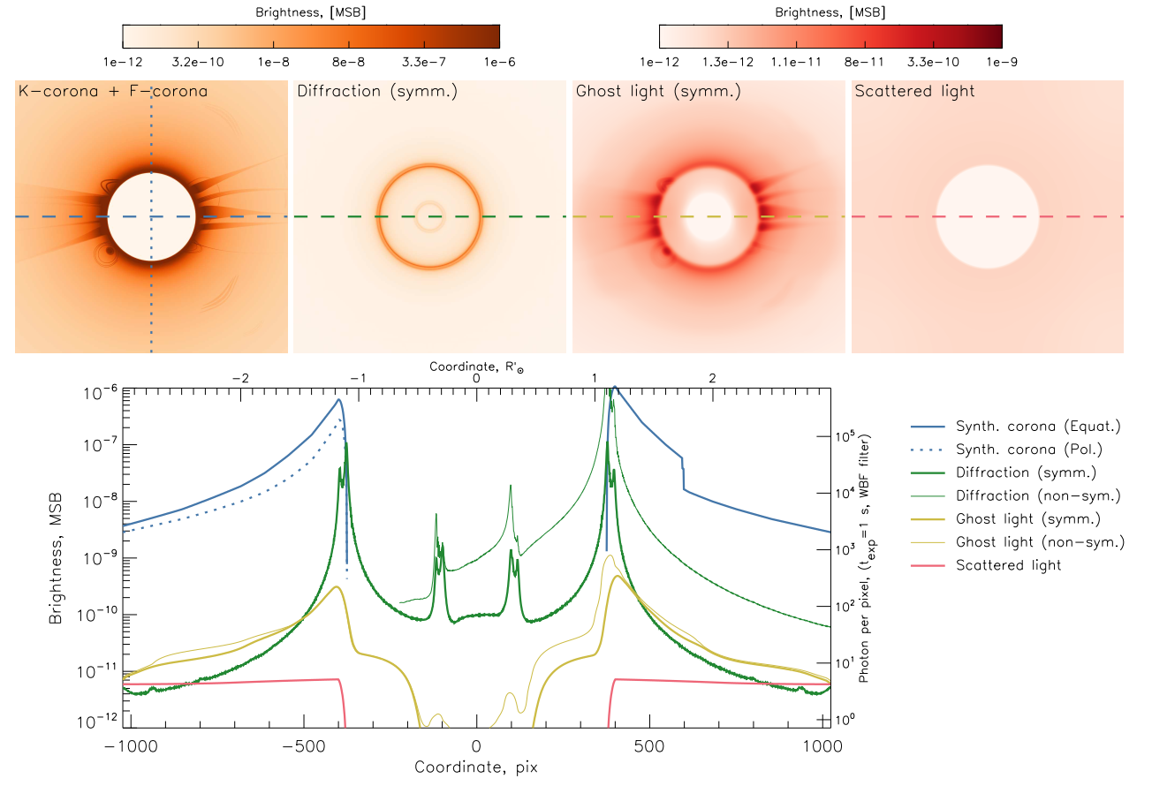

Slide 6
ASPIICS simulated data: detector effects
ISPHI CMOS from CMOSIS, 2k × 2k, 10 μ pixel, 14 bits;
Quantum efficiency (~65%);
Flat field;
Gain ~ 0.12 DN/el;
Read-out noise ~ 8 DN;
Dark current (small at <-40 °C) + bias;
Nonlinearity;
Noises (incl. shot, read-out, ADC);

Slide 7
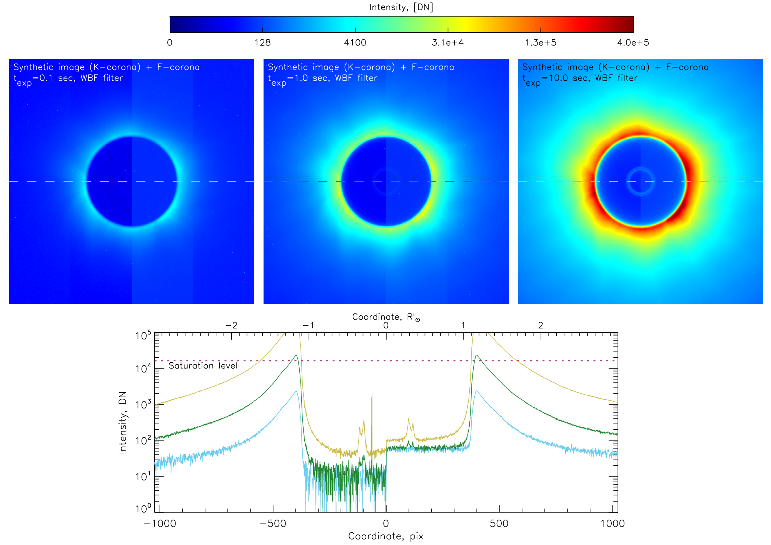
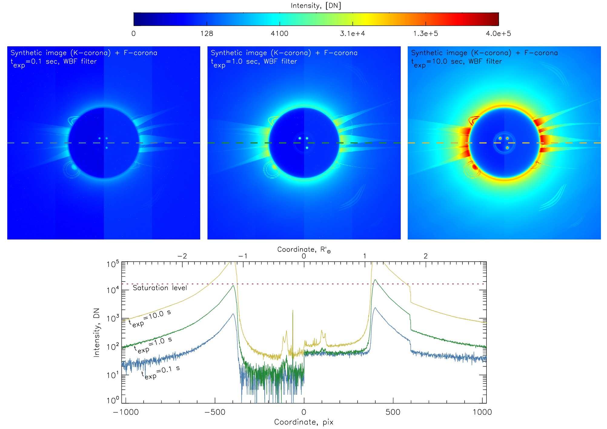
Simulated images [DN] for t_{exp} 0.1, 1.0, and 10 s;

Slide 8
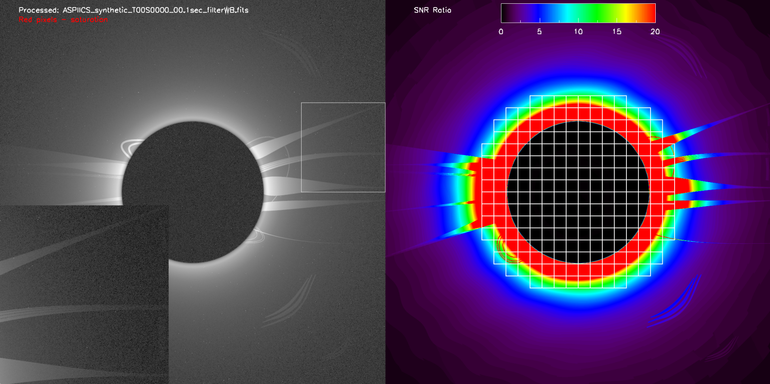
Influence of random noise

Slide 9
Summary
Physical model for ASPIICS simulated images;
Correct parameters as input → realistic images, sensitivity, SNR, etc;
Main contribution of noise – readout noise;
IDL code;
Also in the manuscript:
Discussion of assumption & models;
Influence of noises and systematic errors;
Possibility to work with 2 t_{exp} to cover full dynamic range;
“Expected performances of the PROBA-3/ASPIICS solar
coronagraph: Simulated data” Shestov et al. // A&A 652, A4, 2021

