Slide 1
2.5D simulation of coronal rain in randomly heated arcades
Xiaohong Li
Collaborators: Rony Keppens, Yuhao Zhou
Centre for mathematical Plasma Astrophysics, Department of Mathematics, KU Leuven
ESPM-16，2021.09.08

Slide 2
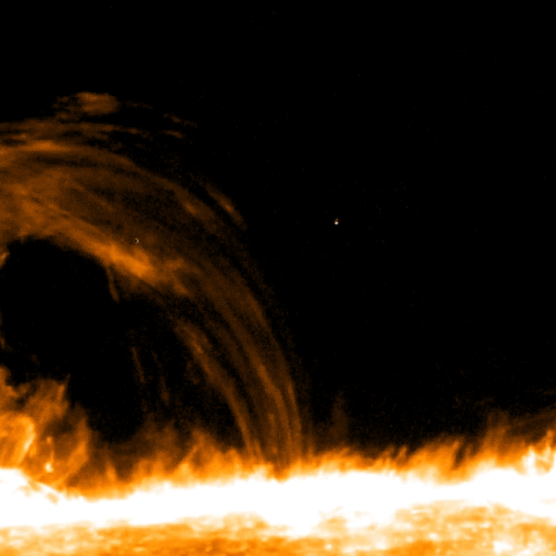
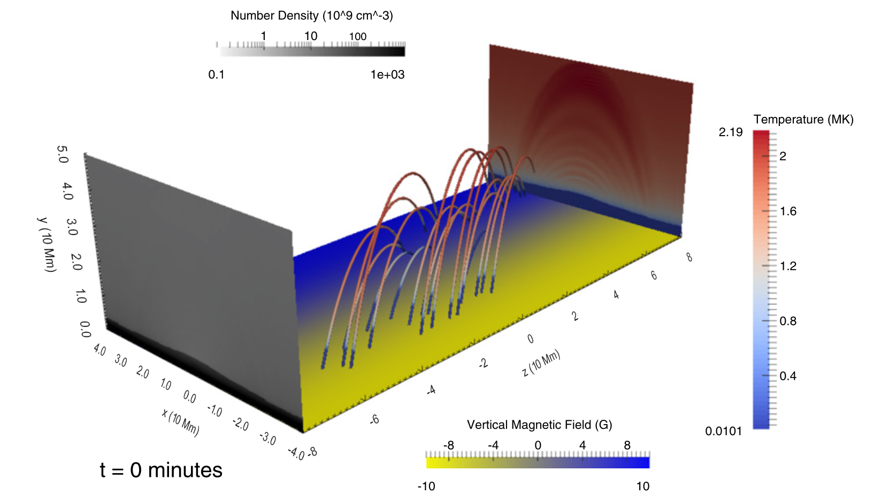
Numerical setup: 2.5D evaporation-condensation model
Code: MPI-AMRVAC (http://amrvac.org)
Include gravity, field-aligned heat conduction, and radiative cooling and parameterized heating terms:
Cartesian geometry, x: (-30, 30) Mm, y: (0, 60) Mm, ignoring the curvature of the solar surface.
Mesh: 5-level AMR, resolution: 1536×1536，39 km per cell
Linear force-free magnetic arcades, stratified atmosphere
IRIS April 3, 2014
${{H=H}_{bgr}+H}_{loc}$
$H_{bgr}$: vertical exponentially decaying background heating
$H_{loc}$: localized heating randomly distributed both spatially and temporally
Use the transition region adaptive conduction (TRAC) method (Johnston & Bradshaw 2019; Zhou et al. 2021) to correct the underestimated evaporation.
(Fang et al. 2015)
Notes:
2.5D assuming invariance along the sheared arcade

Slide 3
Results: overall evolution
Notes:
If no TRAC method is used, we can only see a hot coronal loop whose temperature is gradually increasing, though this happens very slowly. However, if the TRAC method is applied, after we add the localized heating for about half an hour, thermal instability occurs so that condensation sets in.

Slide 4
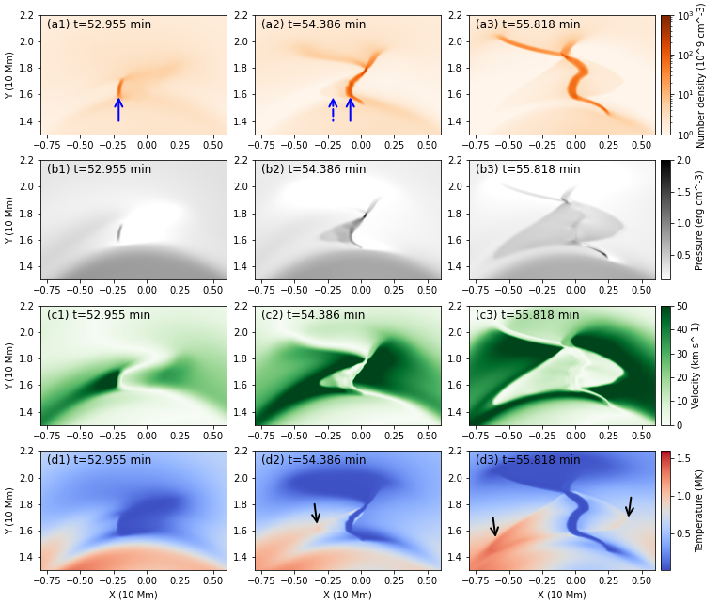
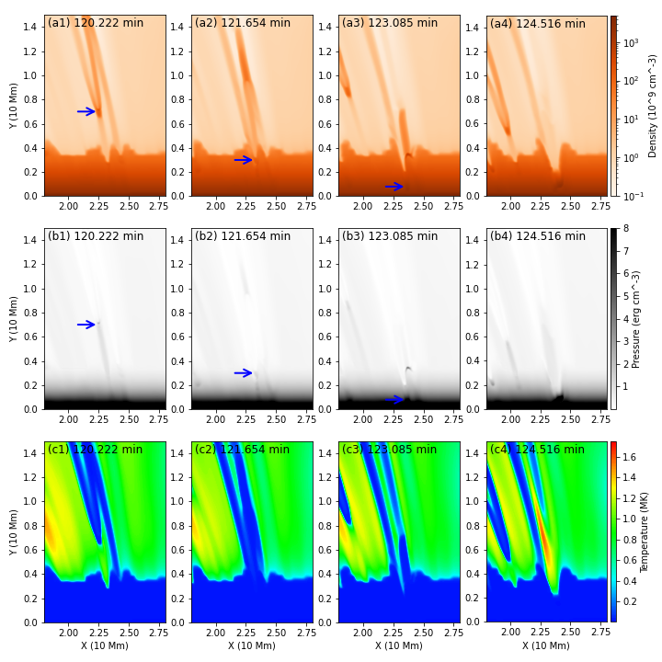
Results: rebound shocks and concurrent upflows

Slide 5
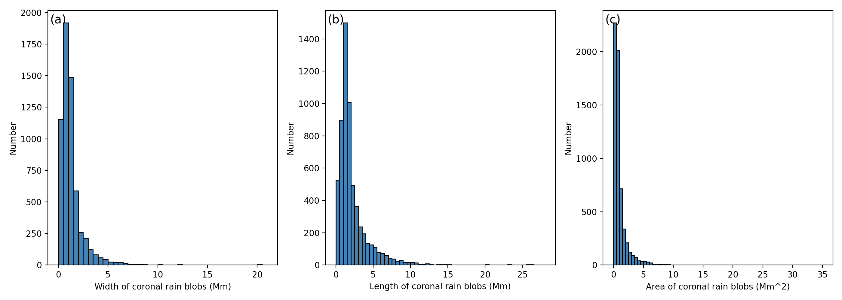
Results: statistical analysis
continuous heating-condensation cycles
FFT shows periodicities of 58 minutes.
Width: from a few hundred km to 20 Mm
Length: mostly under 5 Mm, with the bulk peaking at 1.0 − 1.5 Mm.
Area: mostly under 3 Mm², with a peak number of 0.5 Mm².

Slide 6
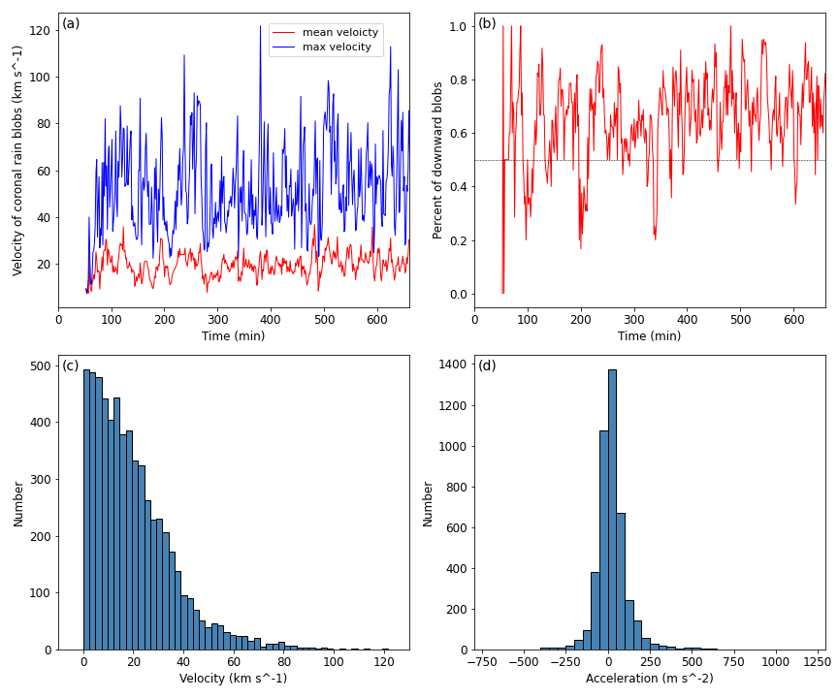
Results: statistical analysis
Although most blobs are falling downward, there are blobs moving upwards at basically every moment.
Velocities: from only few km s⁻¹ to over 120 km s⁻¹.
Mean velocity:
22.4 km s⁻¹
Acceleration:
clustered around 50 m s⁻², below the gravitational free-fall acceleration.

Slide 7
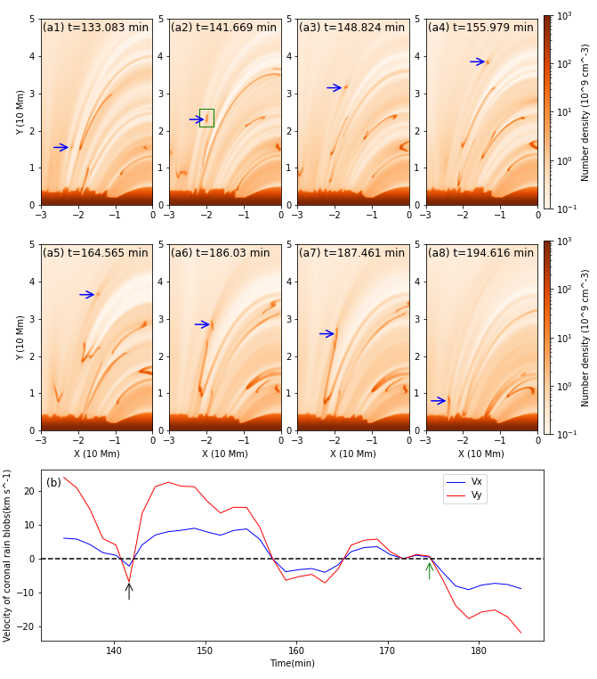
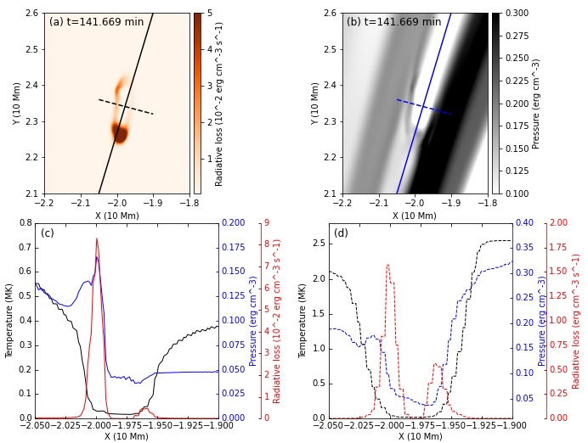
Results: blob dynamics
Prominence-Corona-Transion Region (PCTR) structure:
the temperature changes rapidly from a coronal temperature outside to a cool plasma temperature inside the blob, the radiative cooling is stronger and the pressure is lower in this area.

Slide 8
Conclusion
We performed a 2.5D simulations of coronal rain where a power-law distribution of Gaussian heating events centered in both space and time is adopted.
After the initial formation stage of condensations, expansion rebound shock fronts introduced by fast siphon inflows are also generated, displaying a fan-shaped structure and heating the plasma near the fronts.
As the blobs eventually hit the TR and enter the chromosphere, they trigger concurrent upflows which follow the same loops as the downflows.
Statistical study of the coronal rain blobs finds that the number and mass seem to have continuous cycles. Blobs with width less than 3 Mm, length under 5 Mm and area smaller than 3 Mm² dominate the population. The blobs have a broad velocity distribution ranging from only few km s⁻¹ to over 120 km s⁻¹, with a mean value of 22.4 km s⁻¹.
The blobs are found to have a surrounded PCTR structure, where exists strong radiation loss peak and temperature decreases sharply from a coronal temperature outside to a chromospheric temperature inside.
Notes:
Considering that the solar lower atmosphere is full of turbulent convection and ephemeral or moving magnetic features, we point out that the localized chromospheric heating should be turbulent, looking apparently random. With the turbulent heating imposed to the footpoints of an arcade of magnetic field lines (Fig. 6), in this paper we reproduced the thermal structures in a filament channel.

