Slide 1
Energy Distribution Heating Events Observed by HRIEUV During the May 2020 Solar Orbiter Perihelion
16th European Solar Physics Meeting: “The Solar Atmosphere: Heating, Dynamics and Coupling”
9 September, 2021, 11:00
ROB
O. Podladchikova, L. Harra, D. Berghmans, F. Auchere, U. Schuehle, P. Antolin, M. Georgoulis, A. Zhukov, C. Verbeeck, L. Dolla , S. Parenti, H.Safari, E. Buchlin, D. Long , R. Aznar Cuadrado, M.Mierla, E. Soubrie, K. Barczynski, A. Katsiyannis, L. Rodriguez , M. Haberreiter, E. Kraaikamp, P. J. Smith, K. Stegen , E. D'Huys, A. De Groof , W. Thompson, P. Rochus , M. Gyo, W. Schmutz, J-P. Halain, B. Inhester

Slide 2
Outline
Observational campaign
Campfires Morphology
Campfires Energy
See also Paper 1 and Paper 2 EUI consortium papers:
Paper 1. Berghmans and EUI team, 2021, A&A, SO issue, in press.
“Extreme-UV quiet Sun brightening observed by the Solar Orbiter/EUI” .
campfire geometry an cinematic and statistical properties.
Paper 2. A. Zhukov and EUI team, A&A, SO issue, in press.
“Stereoscopy of extreme UV quiet Sun brightenings observed by Solar Orbiter”
- 1st determination of campfires vertical height

Slide 3
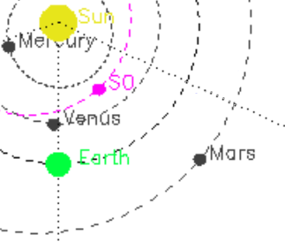
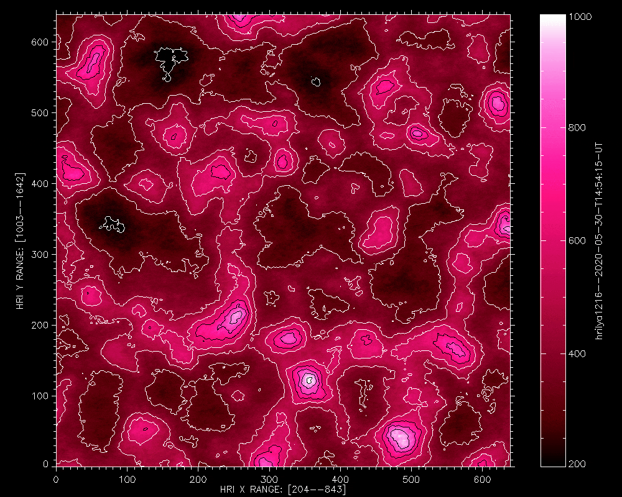
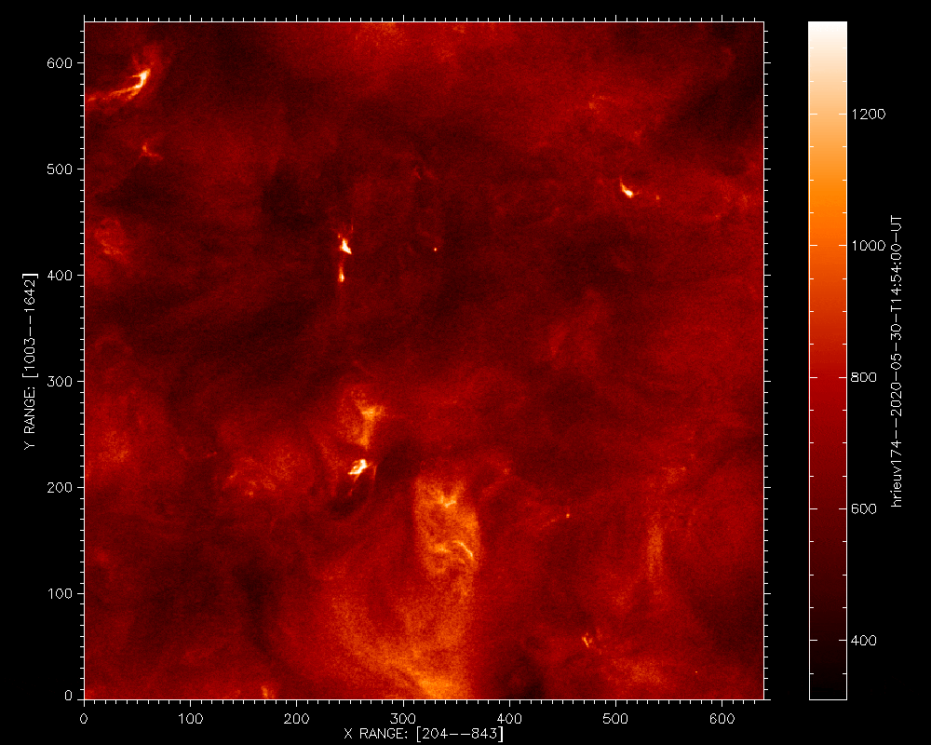
EUI HRI Campfires ZOOM 1st Solar Orbiter Perihelion: 30-05-2020, 14:55 – 15:00 UT, 5 sec cadence
1. Campfires are located above the chromospheric network: Berghmans et al, A&A, 2021, in press
Smallest campfire event [2 pxl ] EUV enhancements
CHROMOPSHERIC
NETWORK (BRIGHT)
INTRACELL (DARK)
SO position 2020-05-30
HRI Lyman-α
co-aligned
HRI EUV 174 Å
7 000 km
7 000 km
3.5 EIT PIXELS HIGH RES. OBSREVATIONS

Slide 4
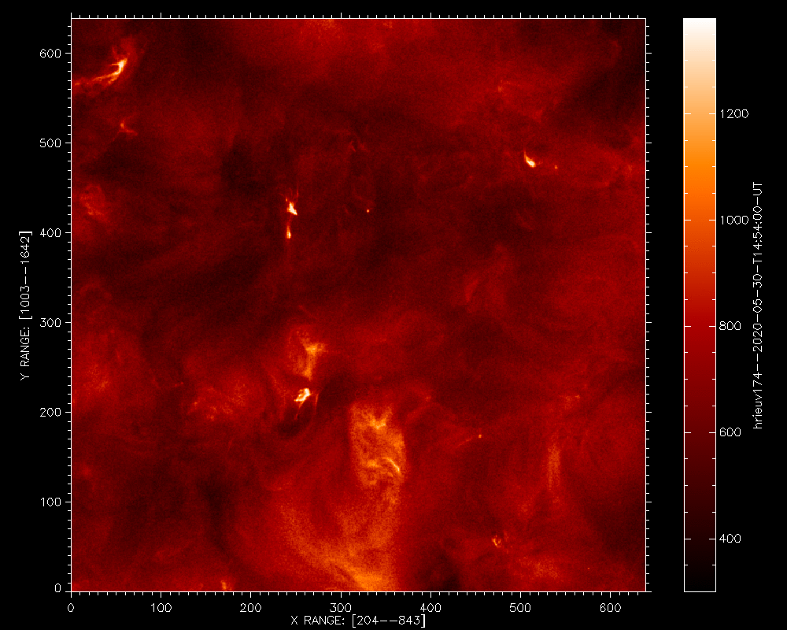
Nanoflares Structures Extraction
II. Image processing reveals campfires are the loop brightenings, Berghmans et al, A&A, 2021, in press
We applied the image processing (eigenvalues decomposition in space and time) technique to reduce noise and put campfires structures in evidence
LOOPS
HRI EUV 174 Å - original
After Denoising- structures!
1
9
10
2
7 000 km
3
6
4
5
7 000 km
3.5 EIT PIXELS HIGH RES. OBSREVATIONS

Slide 5
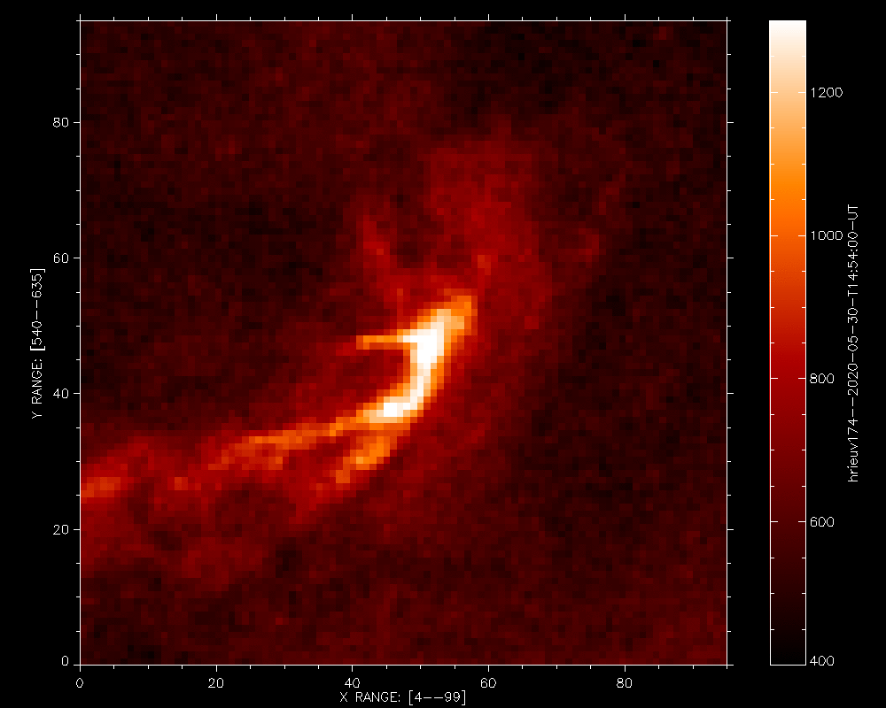
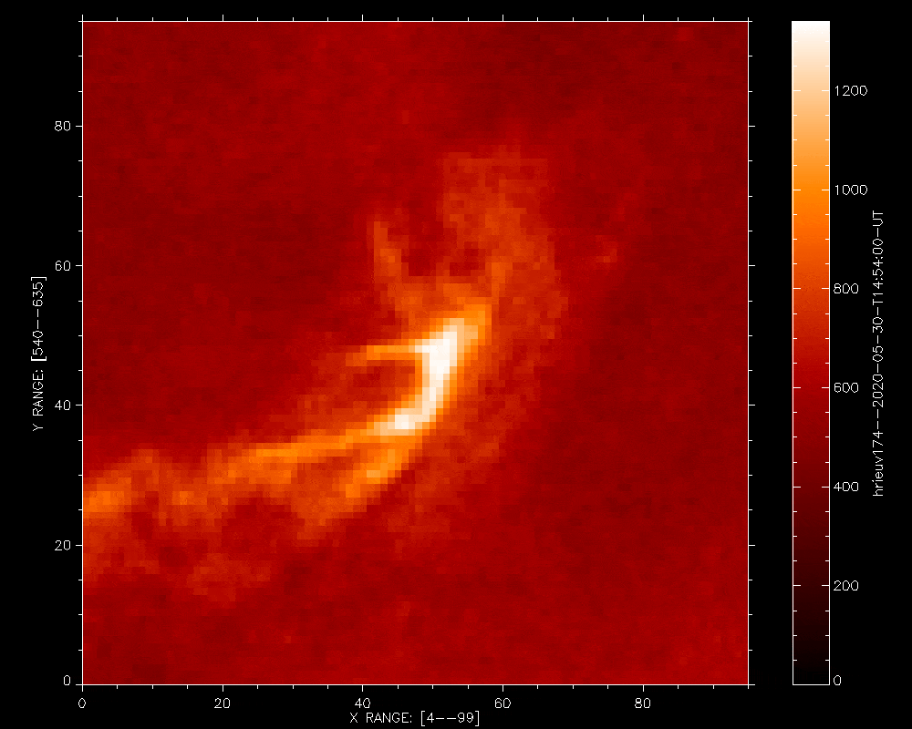
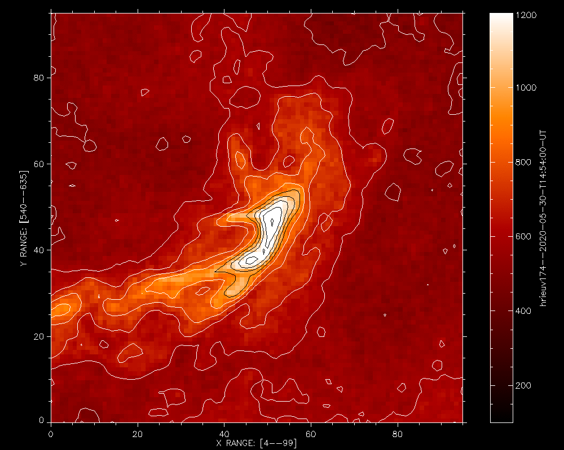
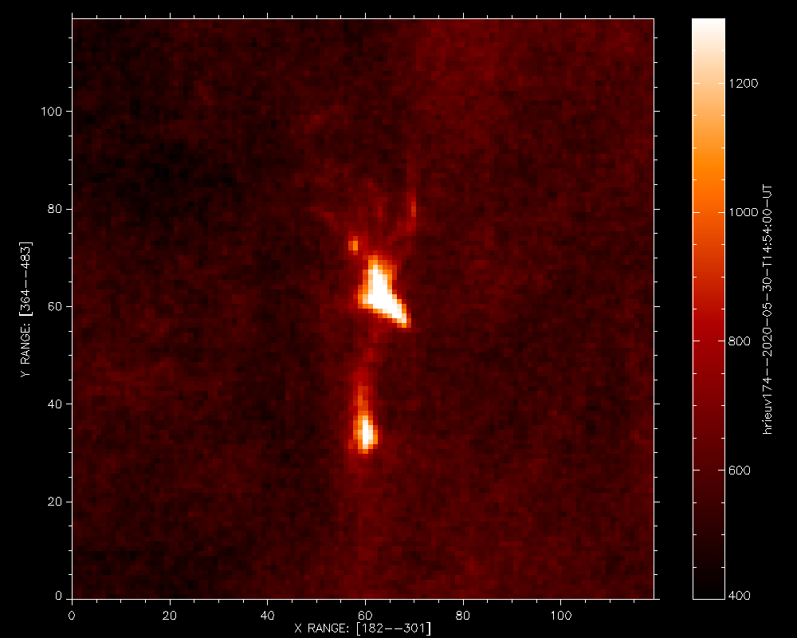
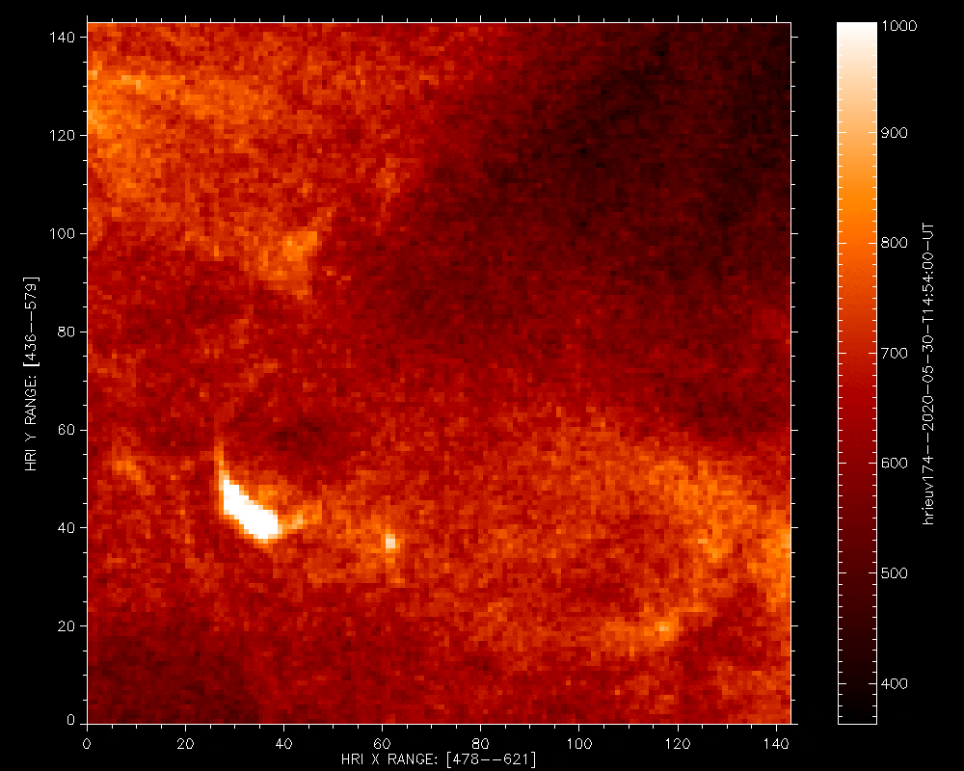
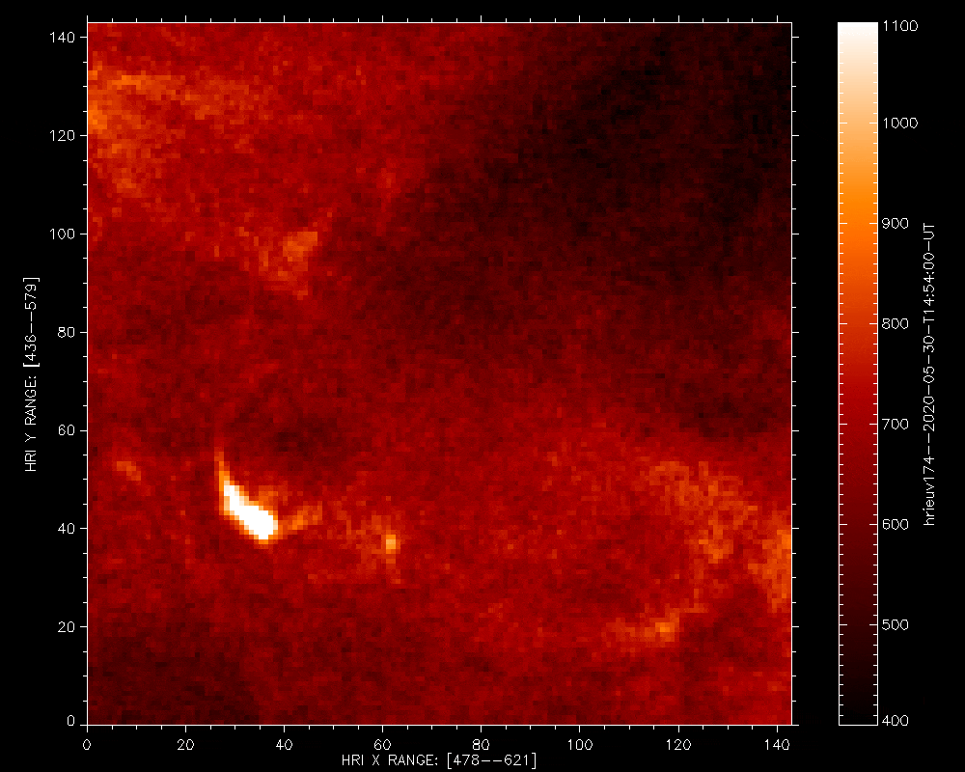
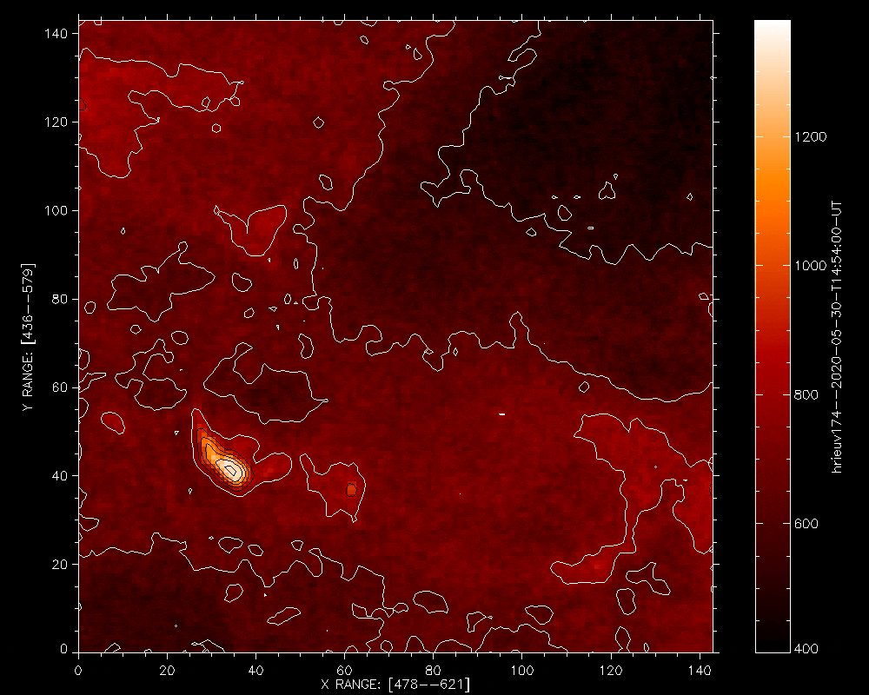
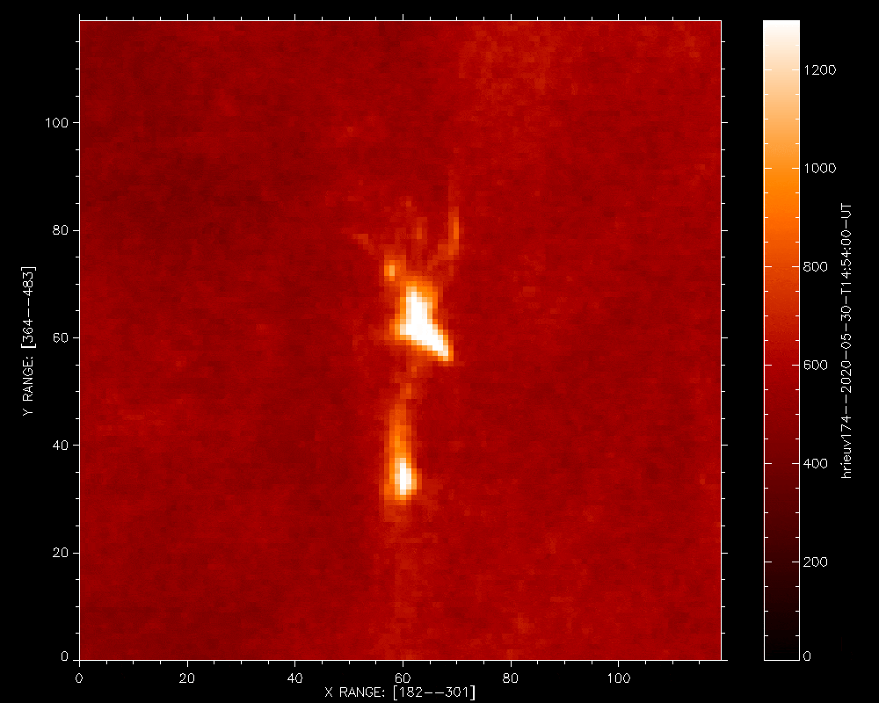
Nanoflares ZOOM 1: Variety of structures
III. EIT nanoflares observed as bright dots have an intrinsic variety of structures, Berghmans et al, 2021
Campfire 1: Loop top EUV Enhancement
Campfire 2:
Multi-loop event
1 000 km
1 300 km
original
Denoised
Int=const. contours
Campfire 9: Dynamic Top Loop Enhancement
original
1 500 km
1 300 km
Denoised
EUI HRI sheds light on inner nanoflare structure
< 1 EIT PIXEL

Slide 6
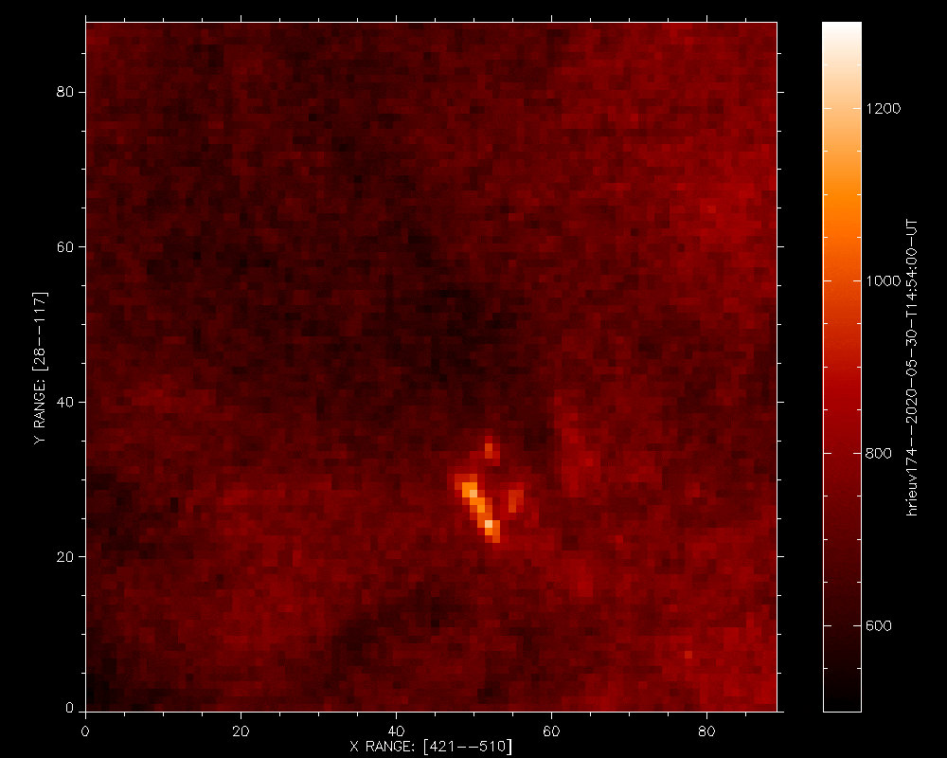
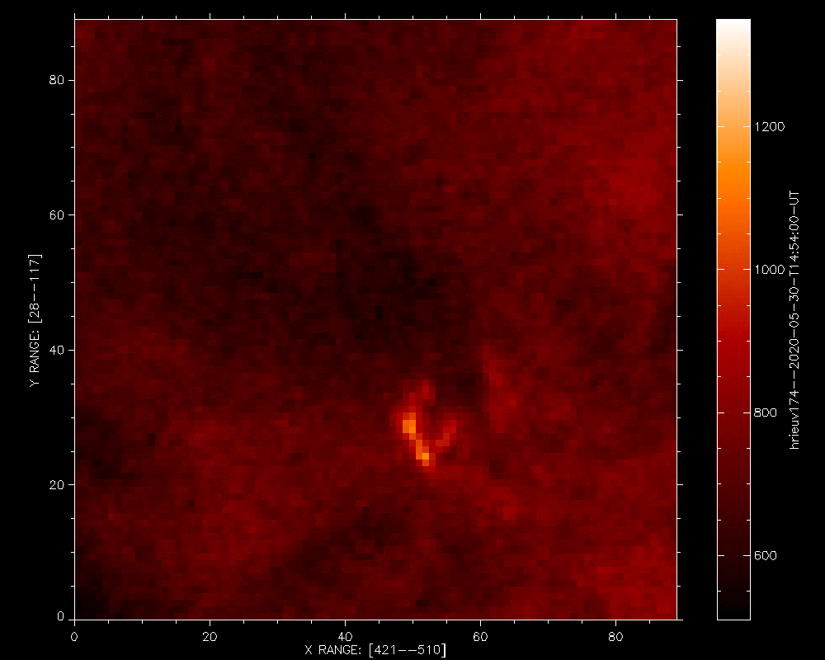
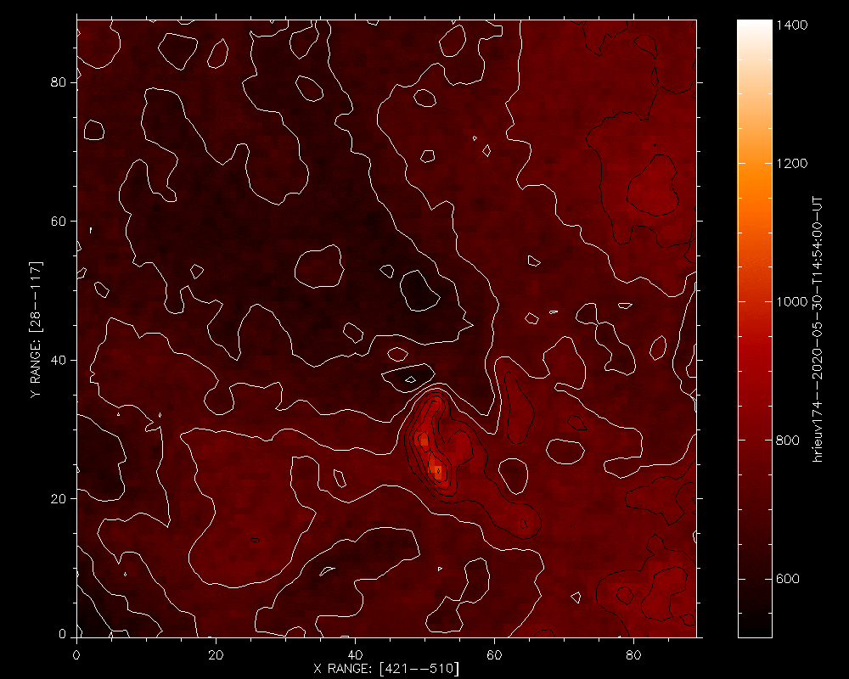
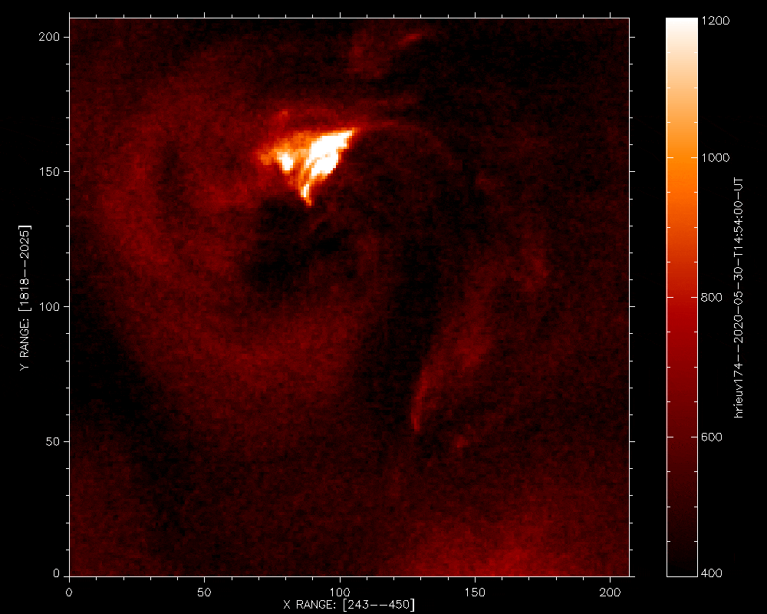
Nanoflares ZOOM 2: Dynamic events
IV. EIT nanoflares observed as bright dots have an intrinsic variety of structures, Berghmans et a;.,2021
Campfire 5: EUV nanojet
990 km
Original
Denoised
Int=const. contours
Campfire 23: Brightening at loop footpoints
We observe both
footpoint and loop top
EUV brightenings!
2 000 km
Visual examination shows the simultaneous or sequential propagation of luminance in the loop as predicted (Priest, 1998, 2000).
original
Denoised

Slide 7
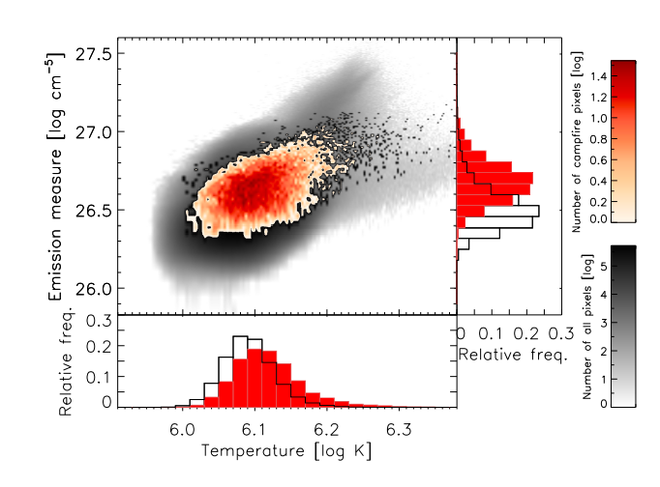
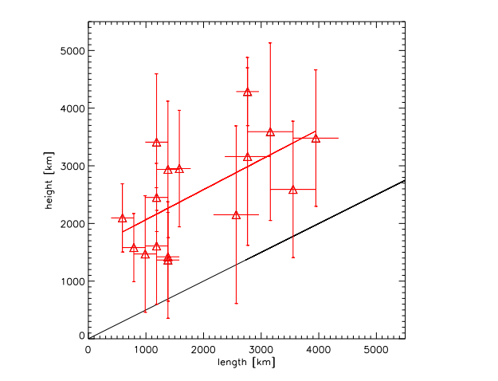
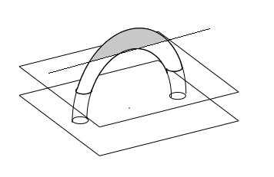
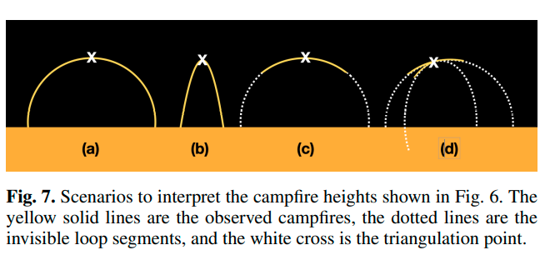
V. Emission Measure, temperature and Vertical extent of campfires
1467 campfiers (method: Auchere and Sorbie in Paper 1)
Threshold for impulsive events: σ > 5
For each event, area, duration and height are computed
Berghmans , Antollin, Long et al. 2021
HRIEUV
Usually unknown parameter - vertical extent
Zhukov , Mierla, Auchere et al., 2021, A&A, in press

Slide 8
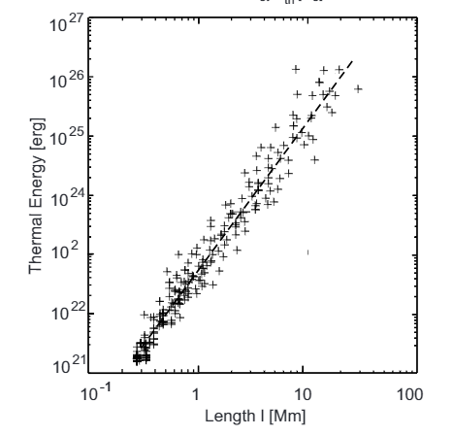
Thermal Energy
VI. Thermal Energy per pixel
Energy of impulsive EUV brightening: is determined from the observed DELTA EM increase in the campfire pixels.
Method introduced by
Benz, 1997,
Krucker an Benz, 1998
Aschwanden, 1998
geometrical parameters and filing factor
HRIEUV
NEW
STATS
Event occupies
only partial coronal
volume
HRIEUV

Slide 9
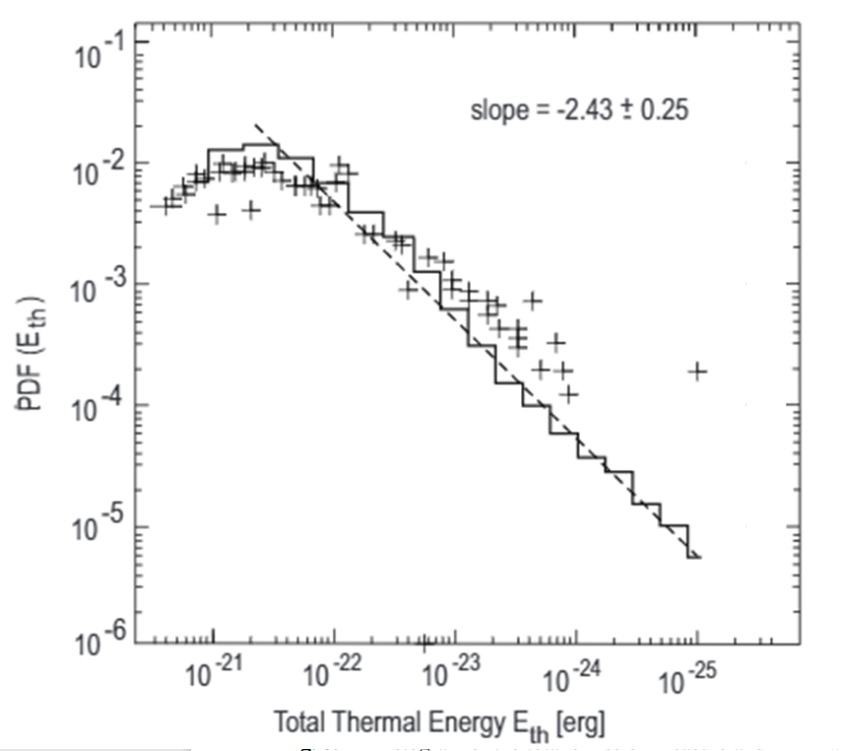
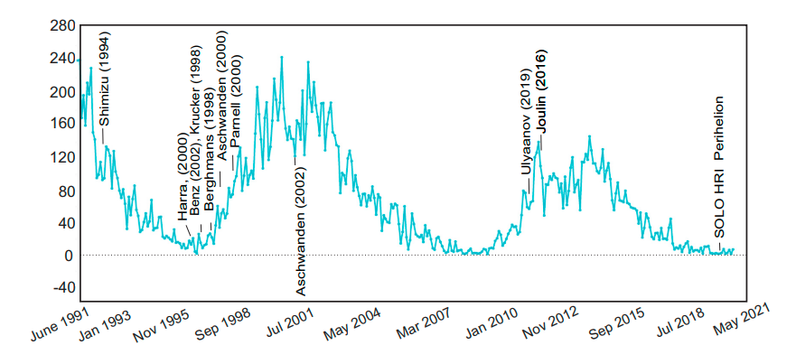
Main findings
VII. Campfires Thermal Energy per event
Thermal energy per event
EUV brightenins observatons versus solar cycle

Slide 10
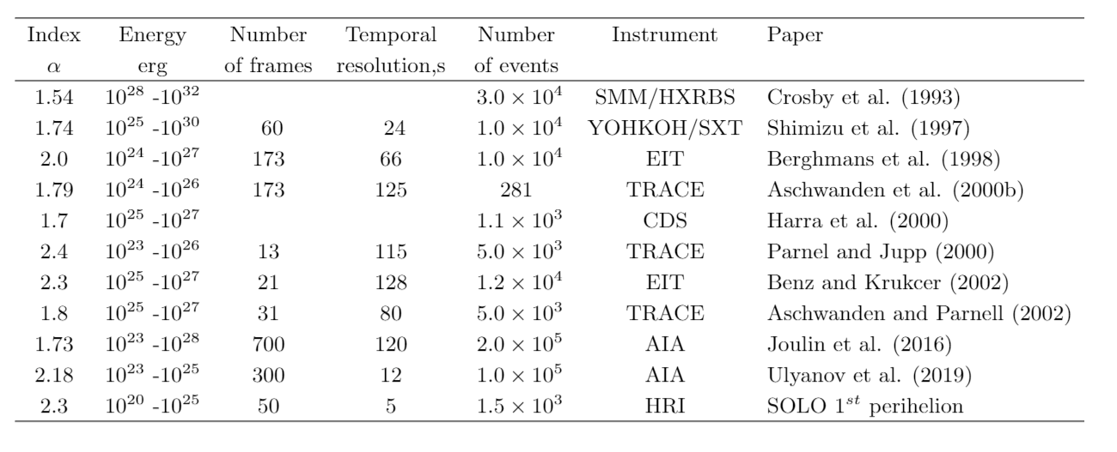
Picoflares energy range
VIII. Campfires Thermal Energy

Slide 11
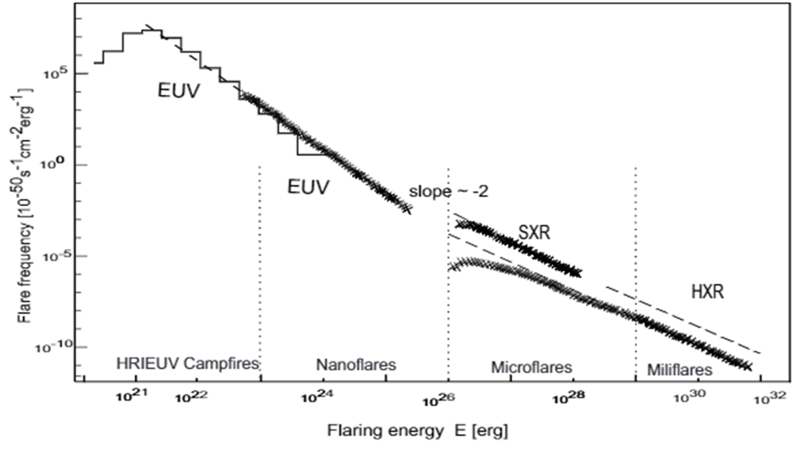
Coronal heating by Flares
XI. Coronal heating by flares – updated by new EUI HRI events M. Aschwanden 2010, summary plot
Extended energy range toward small energies
Observed campfires events contribute extra to the coronal heating of about 2.5 %
NEW
STATS
Picoflares
+2.5%
HRIEUV
ROB

Slide 12
Conclusions
Campfires impact on coronal heating
The thermal energy content of campfires detected during the 1st SO perihelion campaign (in Paper 1 and Paper 2) has been evaluated at the peak of emission measure enhancements.
The energy distribution of thermal energy per event is approximate power law. At low energies, approaching picoflare value of 10²¹ ergs, the distribution is influenced by the instrument resolution.
At high energies the thermal energy content is limited by 10²⁶ ergs per observed event due to 260 sec total observational time.
The existence of picoflares is compliant with the necessary power balance in solar corona and the quantities of free magnetic energy deposited for heat.
EUI campfires are a new picoflare extension of the flare-like events family

