Slide 1
Variations of field-aligned currents and ionospheric trough during
September 2017 geomagnetic storm
Poster ID: 293
Agata Chuchra-Konrad, Barbara Matyjasiak, Barbara Popielawska, Hanna Rothkaehl
Contact: achuchra@cbk.waw.pl
Space Research Centre of Polish Academy of Sciences
16th European Solar Physics Meeting

Slide 2
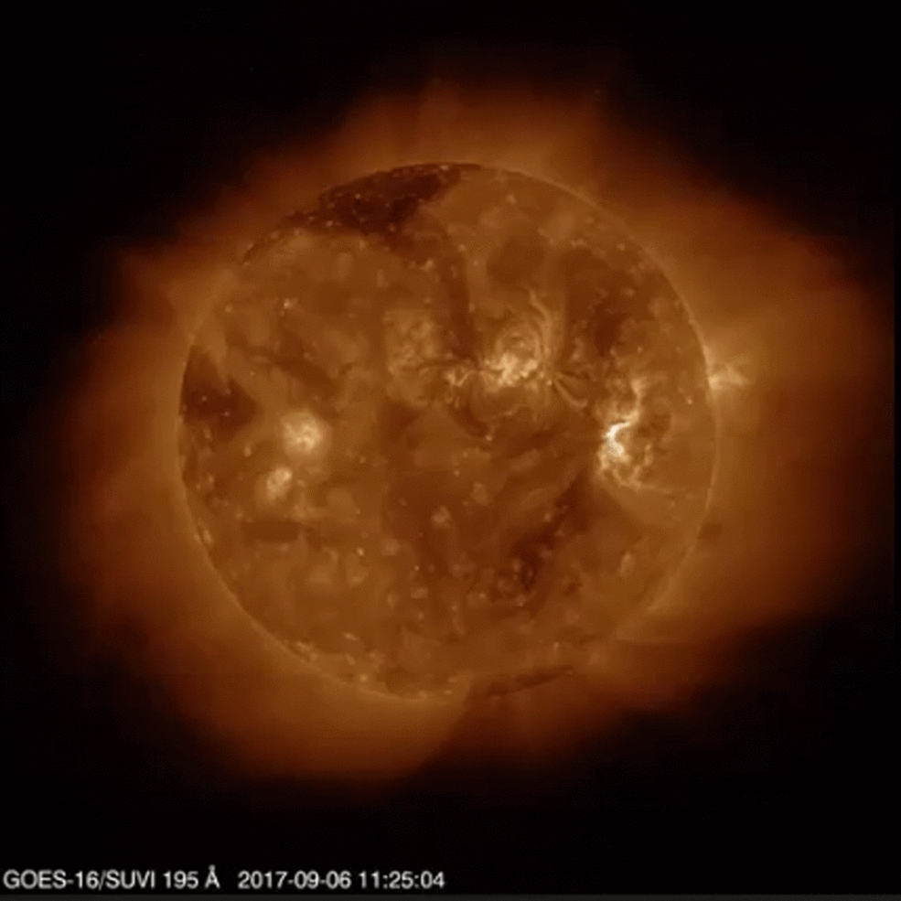
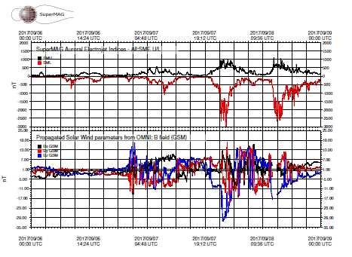
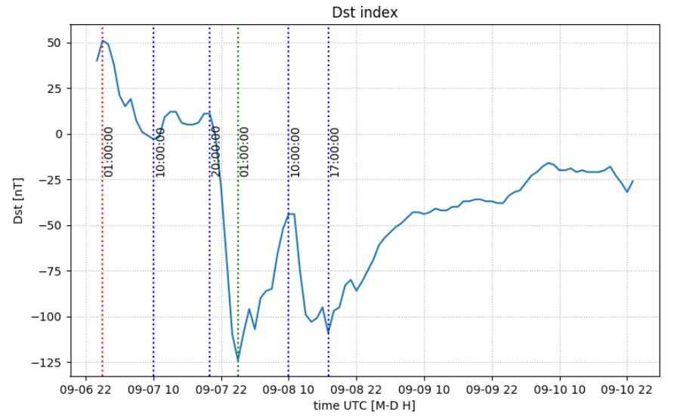
Sun and ionosphere
Between 6-10 of September, the Active Region AR12673 on the Sun released several strong CMEs and emitted 27 M-class and 4 X-class flares, including the strongest flare X9.3 of Solar Cycle 24 on Sep. 6, 2017, after which began G4 – severe geomagnetic storm on 07-08.09.2017.
The second strongest flare (X8.2) of the 24th Solar Cycle was detected on Sep. 10 and immediately generated the ground level enhancement of cosmic rays (GLE72).
The storm was characterized by sequential occurrence of two Dst-index minima (first -124 nT at 01:08 8 Sep., second −109 nT at 17:00 8 Sep.). Sequence of two geomagnetic storms.

Slide 3
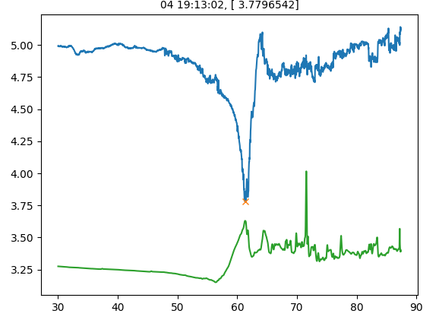
The main ionospheric trough (MIT)
Electron density (blue) and electron temperature (green) plot from Swarm data.
sudden electron density drop at 60º-70º dip latitudes, both hemispheres
mostly night-time phenomenon
narrow in latitudes but extended in longitudes
polar wall usually steeper than equatorial wall
strongly dependent on seasonal conditions
storm-phase dependent structure, very sensitive for geomagnetic conditions
formation mechanism: stagnation model
its variability strongly affects the propagation of different natural and artificial signals
We can distinguish 3 characteristic regions of MIT:
equatorial wall
polar wall - formed by electron precipitation from equatorial boundary of diffuse auroral precipitation
trough minimum

Slide 4
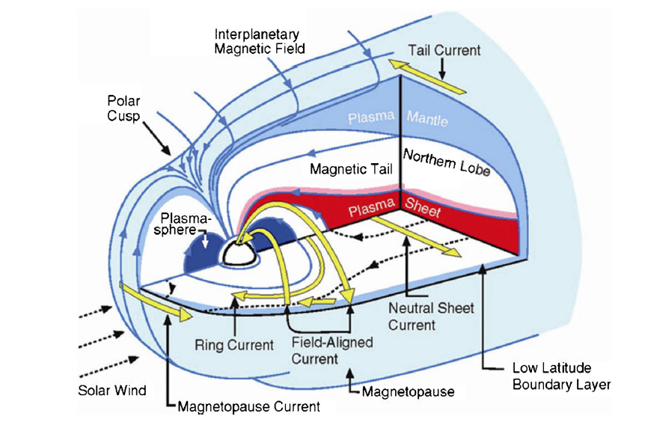
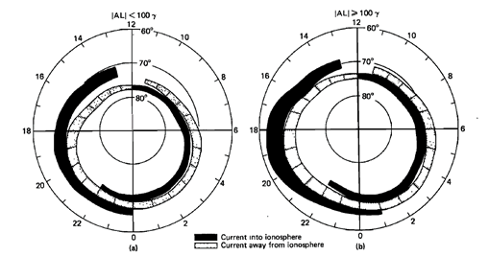
Field aligned currents (FACs)
Flow along magnetic field lines and transfer energy and momentum of the solar wind between M-I-T. FACs consist of two current sheets (Iijima & Potemra, 1976; 1978): Region 1 at higher latitudes, poleward of the auroral oval, where currents flow into the ionosphere on the dawn side and out of the ionosphere on the dusk side and Region 2 at lower latitudes, equatorward of the auroral oval, in which currents flow opposite of that in the Region 1 (Forsyth et al., 2018).
Diagram of the Earth’s magnetosphere and its current systems (Oliveira, Ngwira, 2017)
Distribution of field-aligned currents during (a) weakly disturbed geomagnetic conditions and (b) strong geomagnetic activity (Iijima, Potemra, 1978)

Slide 5
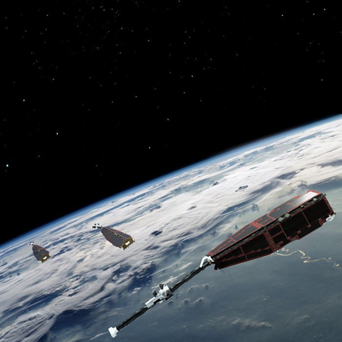
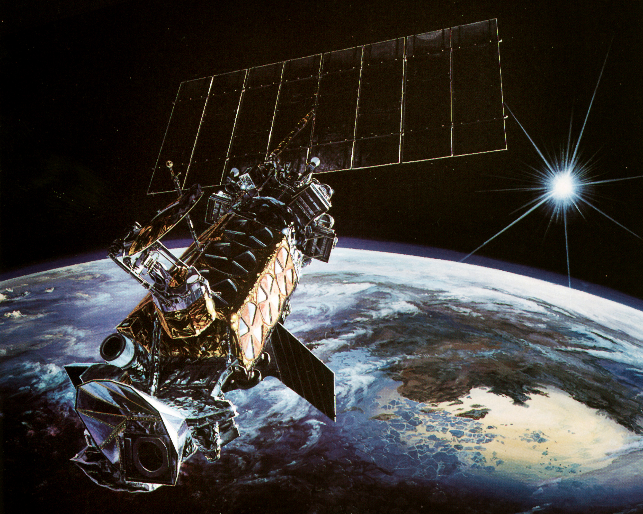
Missions
Defense Meteorological Satellites Program (DMSP) - satellite program managed by the United States Space Force with on-orbit operations provided by the NOAA.
Collected data are used for e.g. to study the effect of the ionosphere on long-range communications, global auroral activity monitoring and to predict the impact of the space environment on satellite operations.
Each DMSP satellite provides global coverage twice per day from polar orbits (101.6-minute orbit) at a nominal altitude of 833 km
Swarm - constellation of three satellites placed in two different polar orbits, measuring the gradient of the magnetic field.
Swarm A and C fly side by side at an altitude of 450 km and Swarm B fly at an altitude of 530 km in a different local time sector.
The satellites make high-precision and high-resolution multi-point measurements of the strength, direction and variations of the Earth's magnetic and electric field, complemented by precise navigation and acceleration measurements.

Slide 6
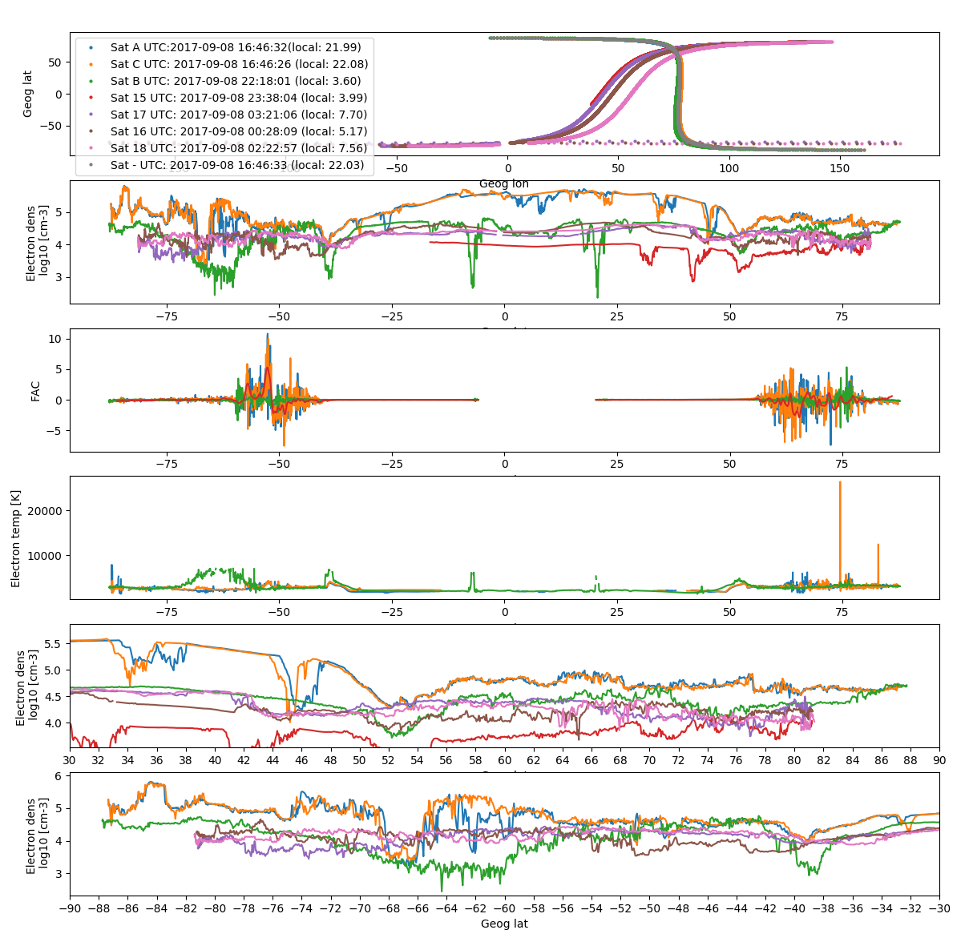
Equatorial plasma depletions

Slide 7
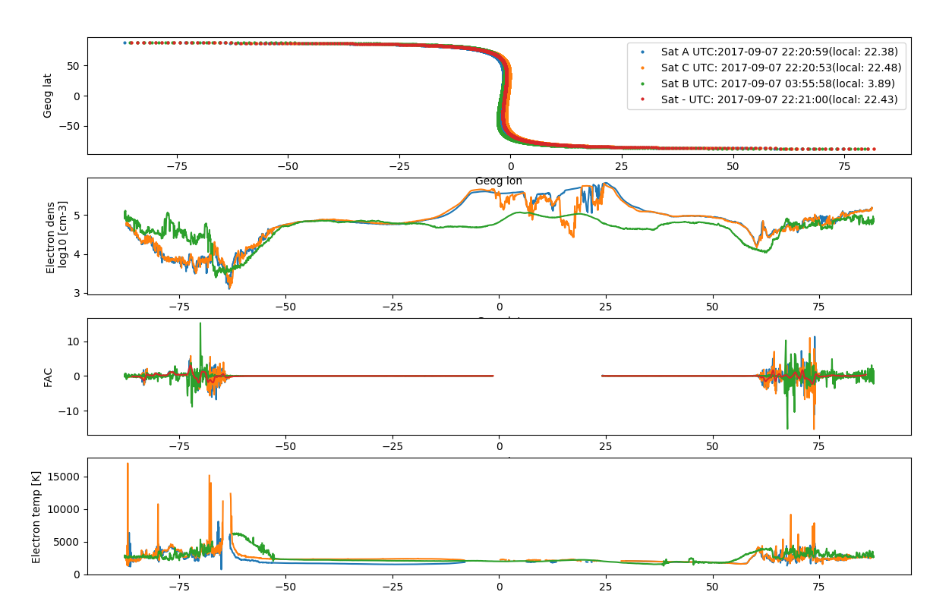
Top: The animations showing ionospheric trough minimum around geomagnetic latitude of 62°.
Bottom: Left plot shows the measurements of electron density, FACs density and electron temperature just after the onset of the first storm and on the right is during the main phase of the second storm.

Slide 8
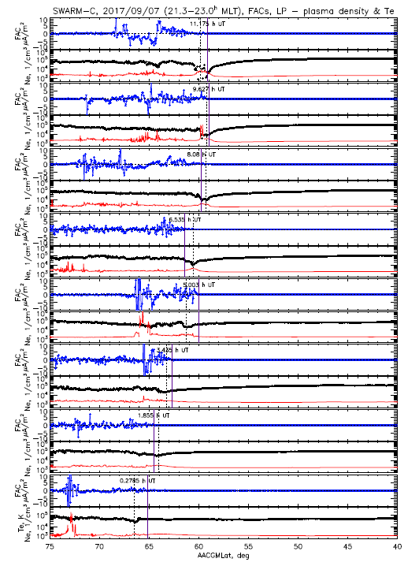
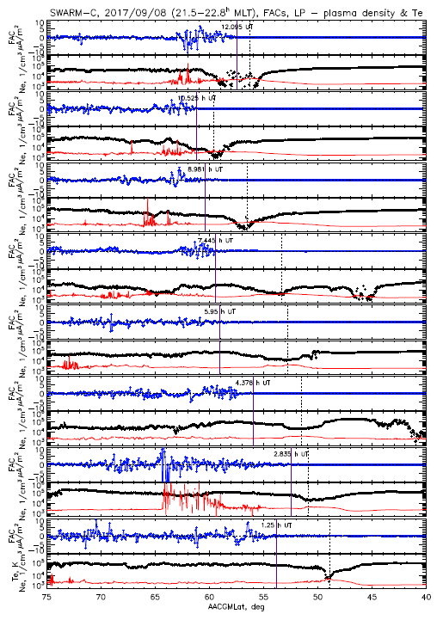
Plots of field-aligned currents density (blue), electron density (black), electron temperature (red) on 7 (left) and 8 (right) September from 00 to 12 UT (up to down) from Swarm C.
Black dotted line indicate the trough minimum, purple line indicate end of FACs occurrence.

Slide 9
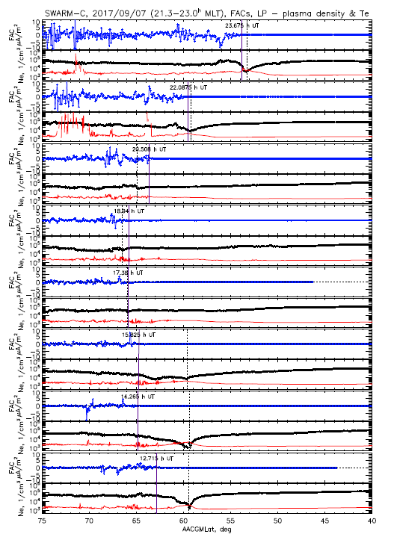
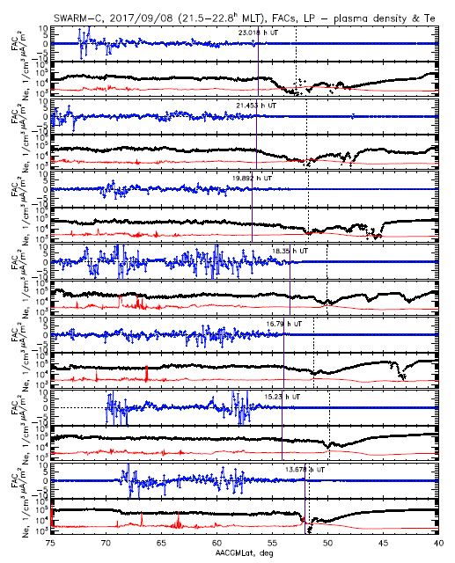
Plots of field-aligned currents density, electron density, electron temperature on 7 (left) and 8 (right) September from 12 to 23:59 UT (up to down) from Swarm C.

Slide 10
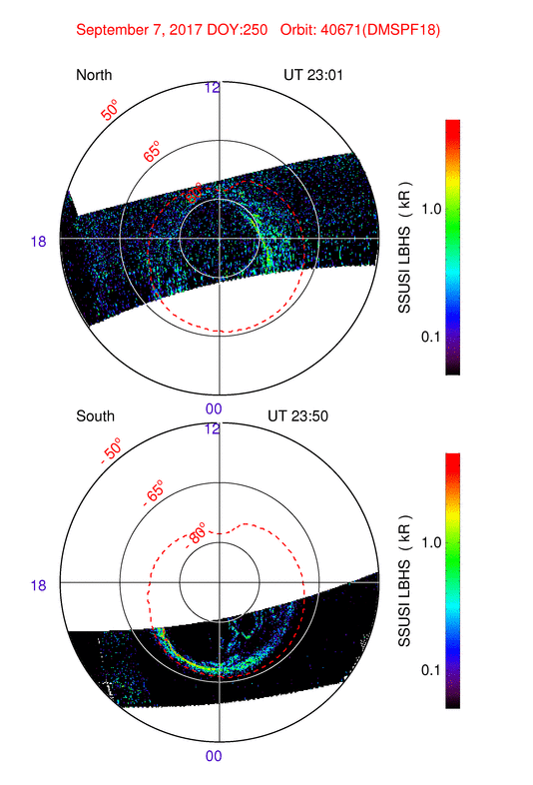
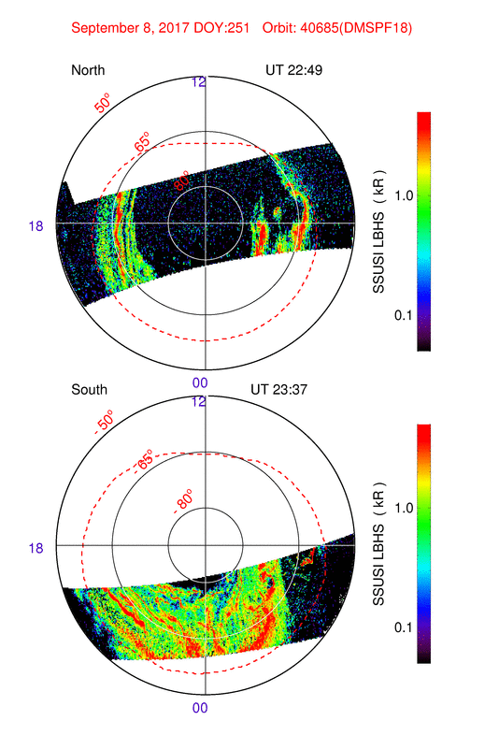
Maps of the auroral radiance and auroral oval boundary location in the NH and SH from Special Sensor Ultraviolet Spectrographic Imagers (SSUSI)

Slide 11
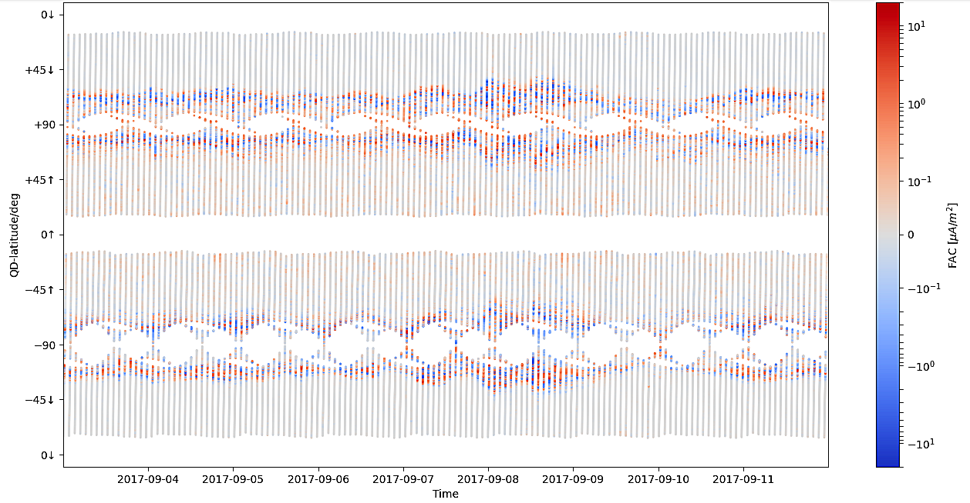
Downward currents (toward the ionosphere)
Upward currents (away from the ionosphere)
There is a clear intensification of FACs after the main phase of the storm.
Before the beginning of the storm FACs seem to be withdrawn towards the poles, and on 7-8 Sep. shifts of the currents to lower latitudes (< 50°) can be observed.
Field-aligned currents in the NH are stronger than in the SH.

Slide 12
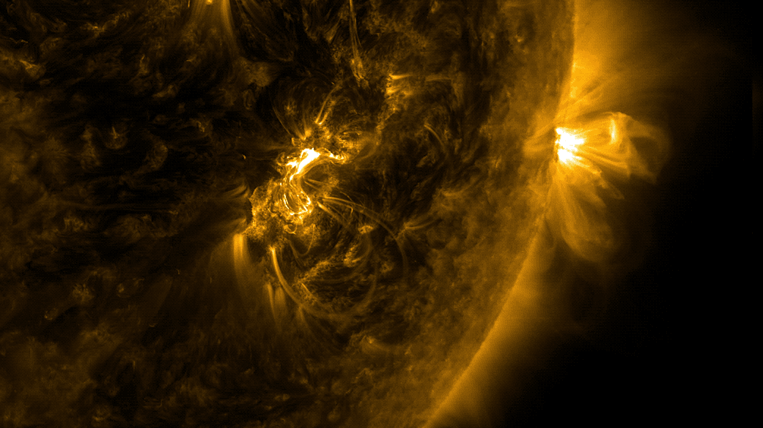
Summary
From the satellite in situ measurements we can track movement of the whole ionosphere as a result of the strong geomagnetic storm - e.g. equatorward shift of the trough position. Changes in the main ionospheric trough properties are related to energetic particles precipitation and the convection, that intensify with the growth of the storm.
The relationship between the ionospheric trough and field-aligned currents is under investigation.
The energization of the storm developed strong R1 and R2 FACs.
An intensification of field-aligned currents' density is also observed in response to the minima of Dst-index on 8th September.
Usually an increase in FACs’ density corresponds to an increase in electron temperature and a decrease in electron density.
An increase in electron temperature agrees with the occurrence of ionospheric trough minimum.
Credit: NASA/GSFC/SDO

Slide 13
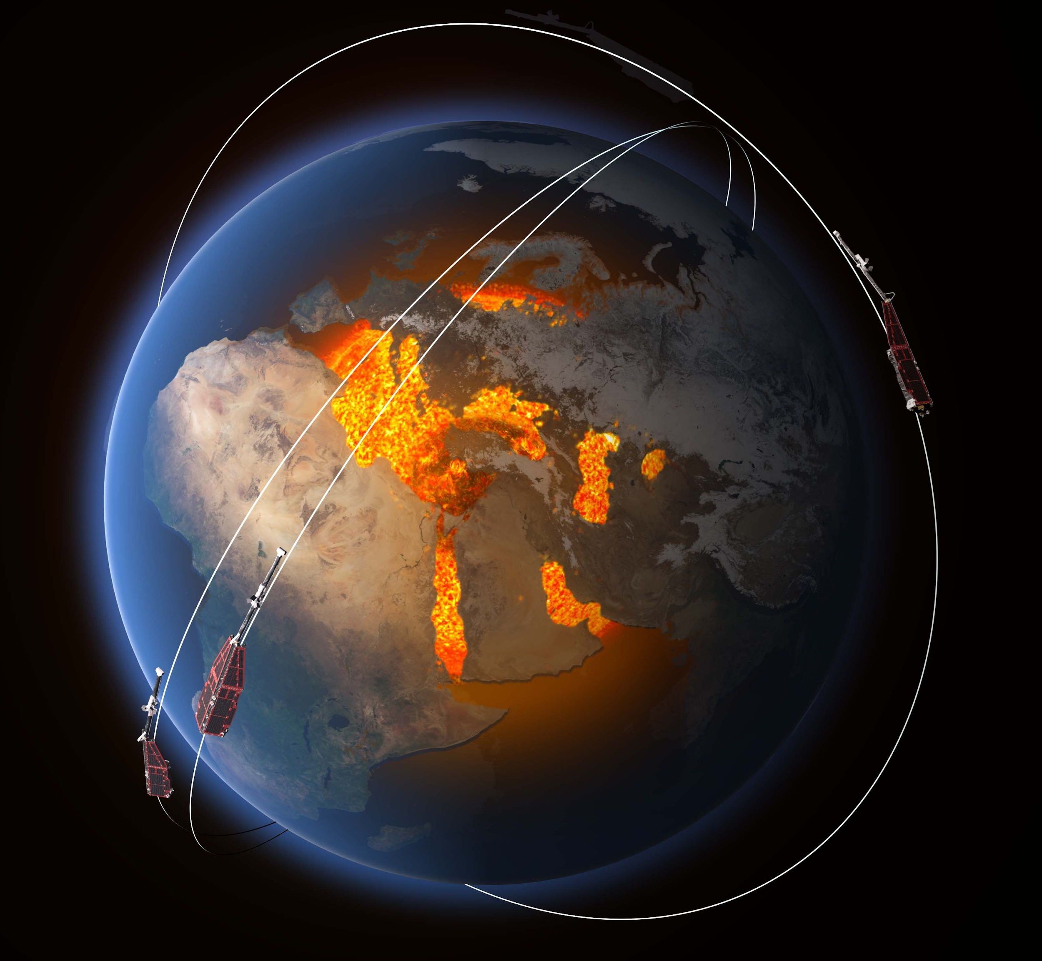
We acknowledge the Swarm Science Team for providing the Level 2 data, the Swarm visualization tool (https://vires.services/), and Virtual Research Environment ("VRE").
The Dst index used in this presentation was provided by the WDC for Geomagnetism, Kyoto (http://wdc.kugi.kyoto-u.ac.jp/wdc/Sec3.html).
Data from the DMSP satellites are kindly provided by Patricia Doherty and were downloaded from the CEDAR Madrigal Database (http://cedar.openmadrigal.org/).
I would like to thank the ESPM-16’s conference organizers for the opportunity to participate in it and to present this presentation.

