Slide 1
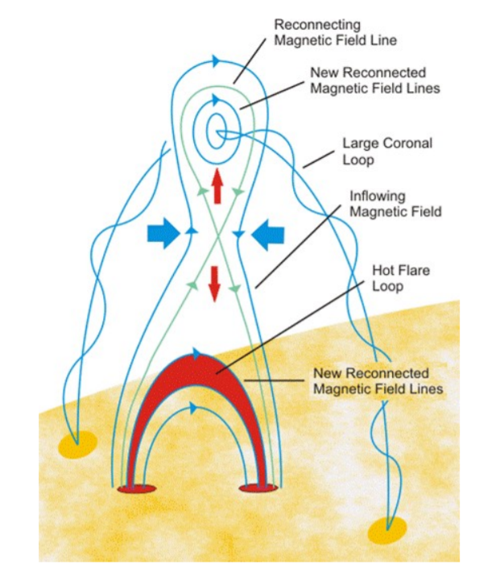
The Role of Magnetic Reconnection in
the Late-Phase Acceleration and Expansion of
the 2013 February 27 CME
Bin Zhuang^{[1]}, Noé Lugaz^{[1]}, Manuela Temmer^{[2]}, Tingyu Gou^{[3]}, and Nada Al-Haddad^{[1]}
[1] University of New Hampshire, Durham, NH
[2] University of Graz
[3] University of Science and Technology of China

Slide 2
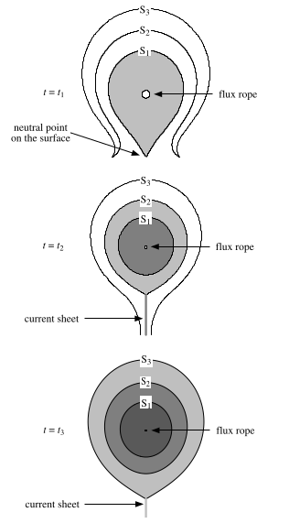
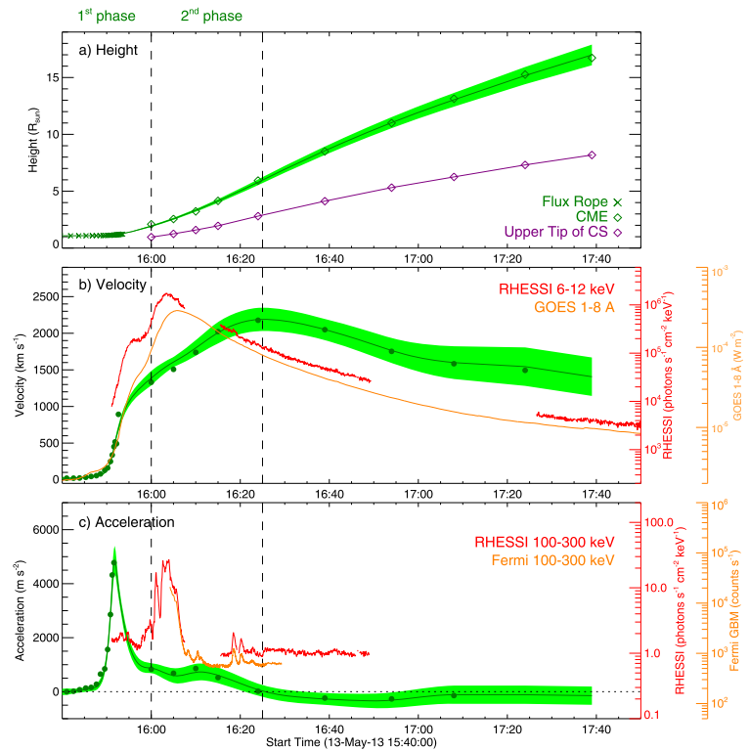
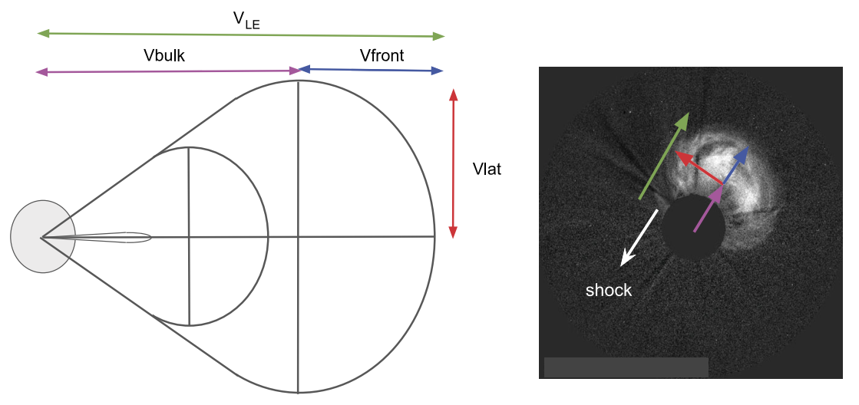
Magnetic Reconnection in CME Dynamics
CME Expansion:
$$V_{LE}=V_{bulk}+V_{exp}$$
$$a_{LE}=a_{bulk}+a_{exp}$$
Gou et al. 2020
Balmaceda et al. 2020
Lin et al. 2004
Notes:
CME acceleration stops at ~7 Rs; one of the typical properties

Slide 3
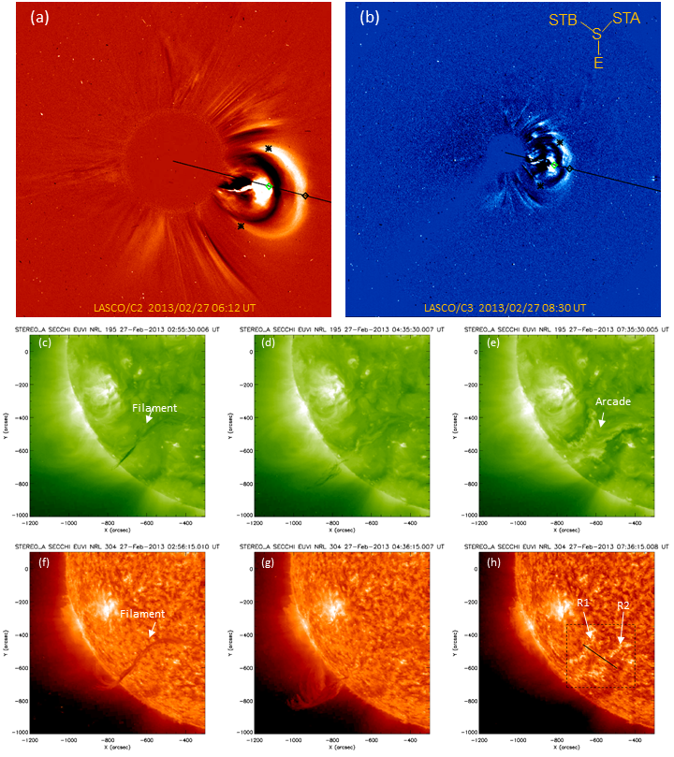
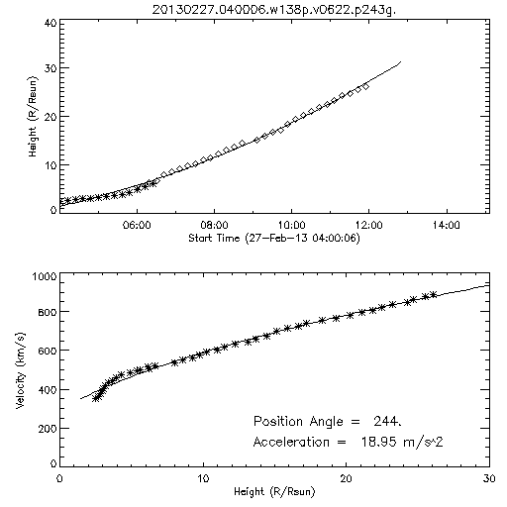
Continuous Acceleration of Moderately Fast CME
From CDAW catalog: a moderately fast CME (with speed larger than the solar wind speed) has positive and continuous acceleration in the high corona.

Slide 4
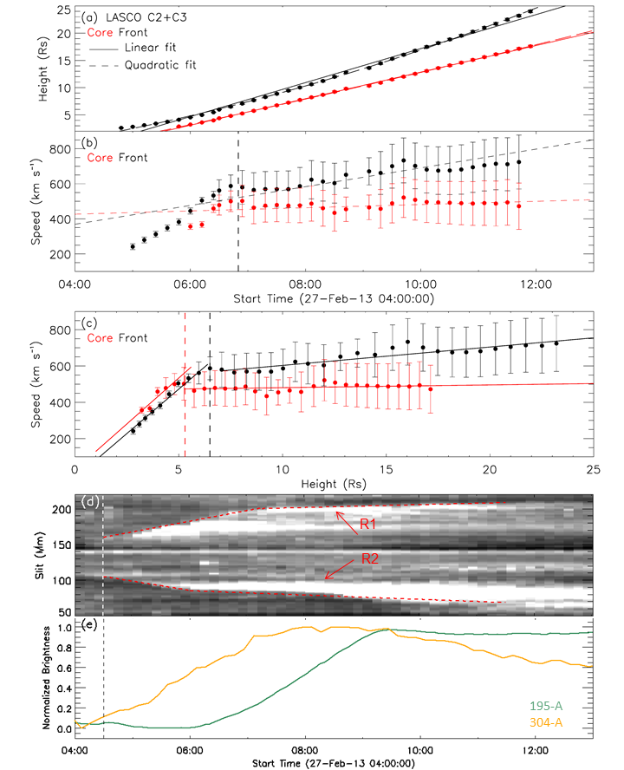
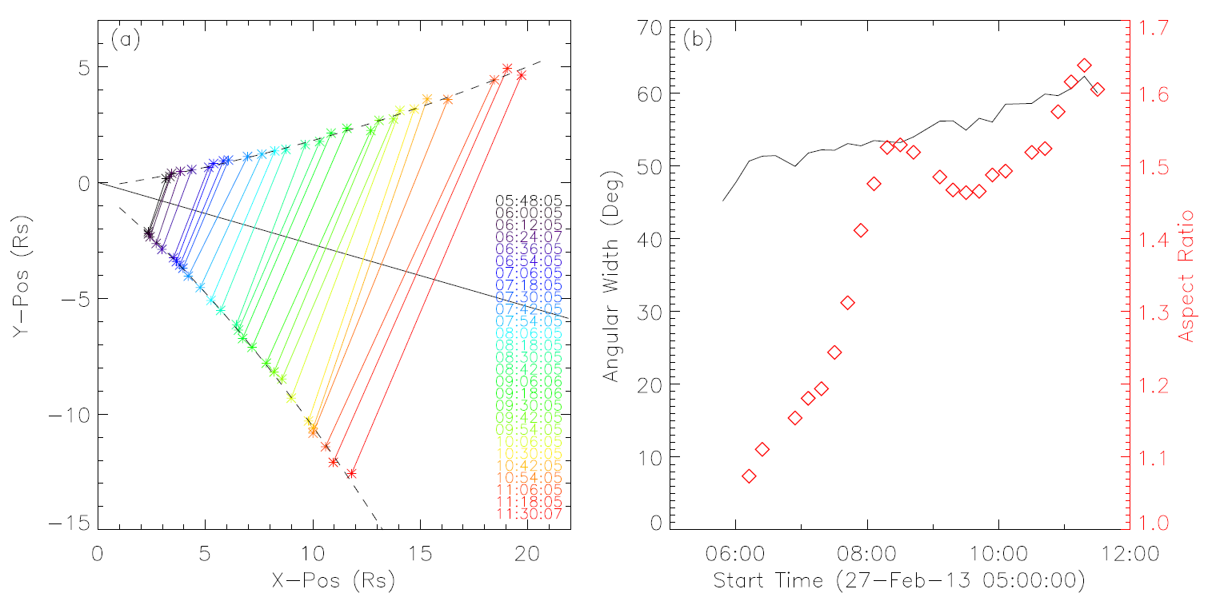
Acceleration, Expansion and Reconnection
Two acceleration phases: (1) impulsive (initiation, ~60 $m/s^{2}$) + gradual (late-phase, ~10 $m/s^{2}$).
CME is moderately fast, with speed ~600 to 700 km/s, and faster than the solar wind (~300 km/s).
Acceleration in the late-phase lasts for a long time in the high corona (e.g., 10-25 Rs), leading to an increase of ~170 km/s in speed.
Apparent acceleration of the front may be due to (additional) expansion.
Signatures of long-lasting magnetic reconnection.
Additional expansion in lateral direction is comparable to that in radial direction.
$a$~10 $m/s^{2}$
$a$ ~60 $m/s^{2}$
$a$~1 $m/s^{2}$
$v$ ~260 k$m/s$
$a_{exp}$~9 $m/s^{2}$
$a$~14 $m/s^{2}$
Ribbon separation
CME expansion in lateral direction

Slide 5
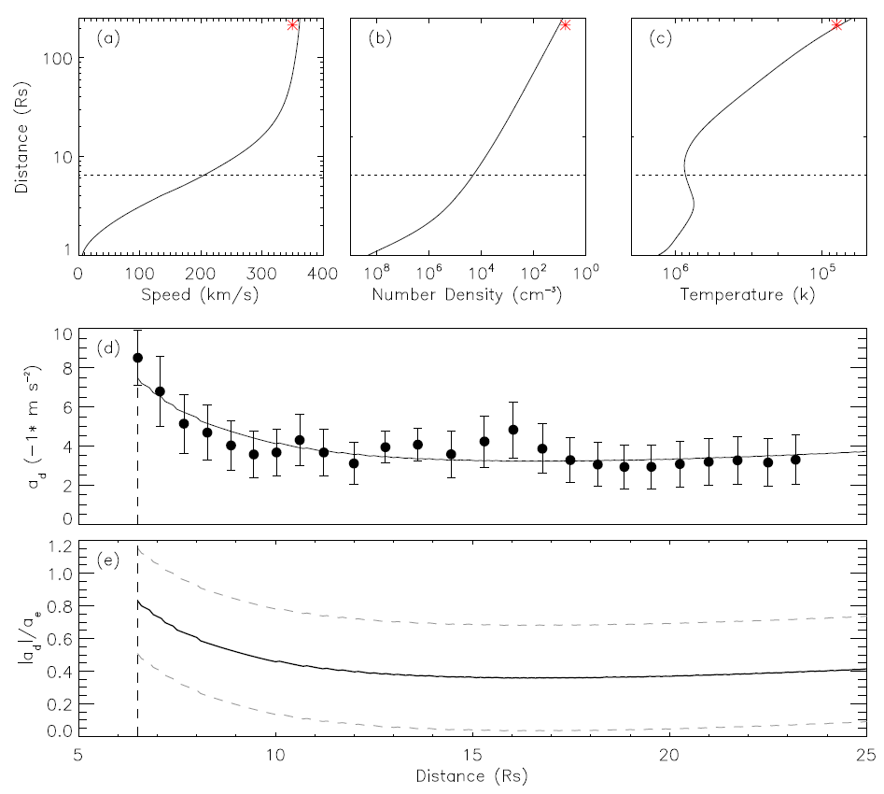
Role of Magnetic Reconnection in Acceleration and Expansion
Assume the deceleration caused by the solar wind drag force is compensated by the acceleration due to magnetic reconnection.
MHD simulations (Hu 1998)
Magnetic reconnection not only leads to apparent acceleration (expansion) but also compensates the deceleration due to the solar wind drag. The contribution of magnetic reconnection to CME expansion is comparable to or even larger than that to CME acceleration (in the high corona).
To be discussed:
Acceleration of fast CME.
Structure of the CME bright core (Gibson et al. 2006; Howard et al. 2017; Veronig et al. 2018).
Reconnection contribution to expansion and acceleration in the low solar corona.
How does reconnection influence CME dynamics when CME is at large distance (e.g., rate)?
…

