Slide 1


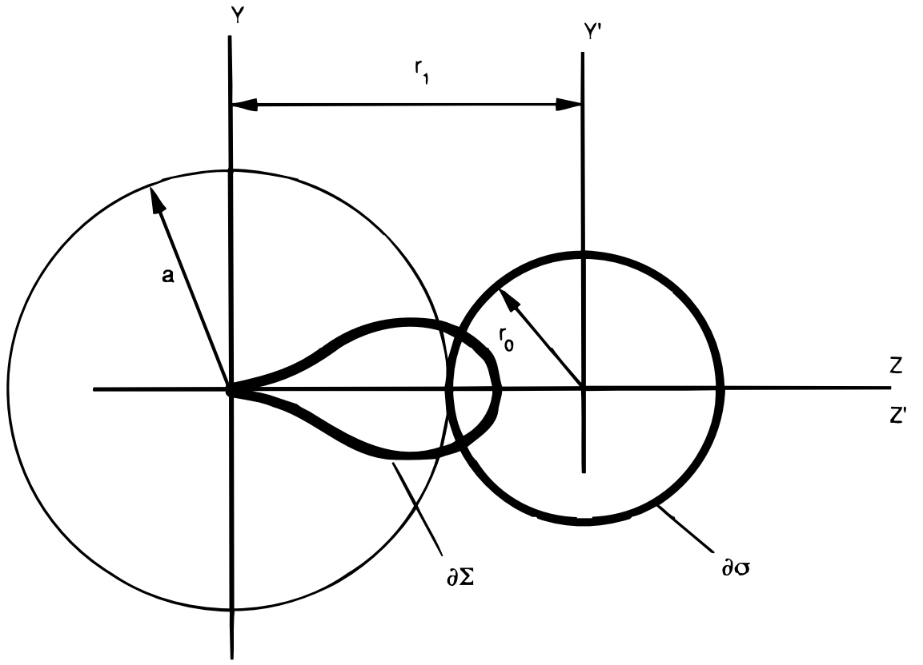
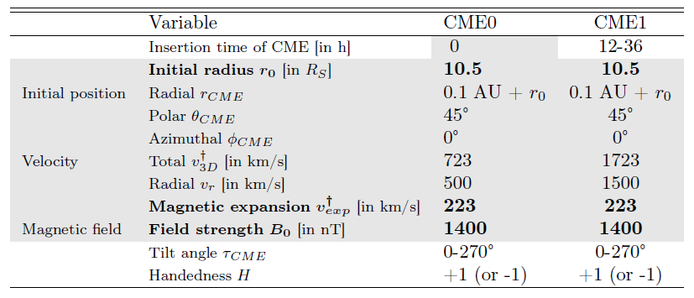
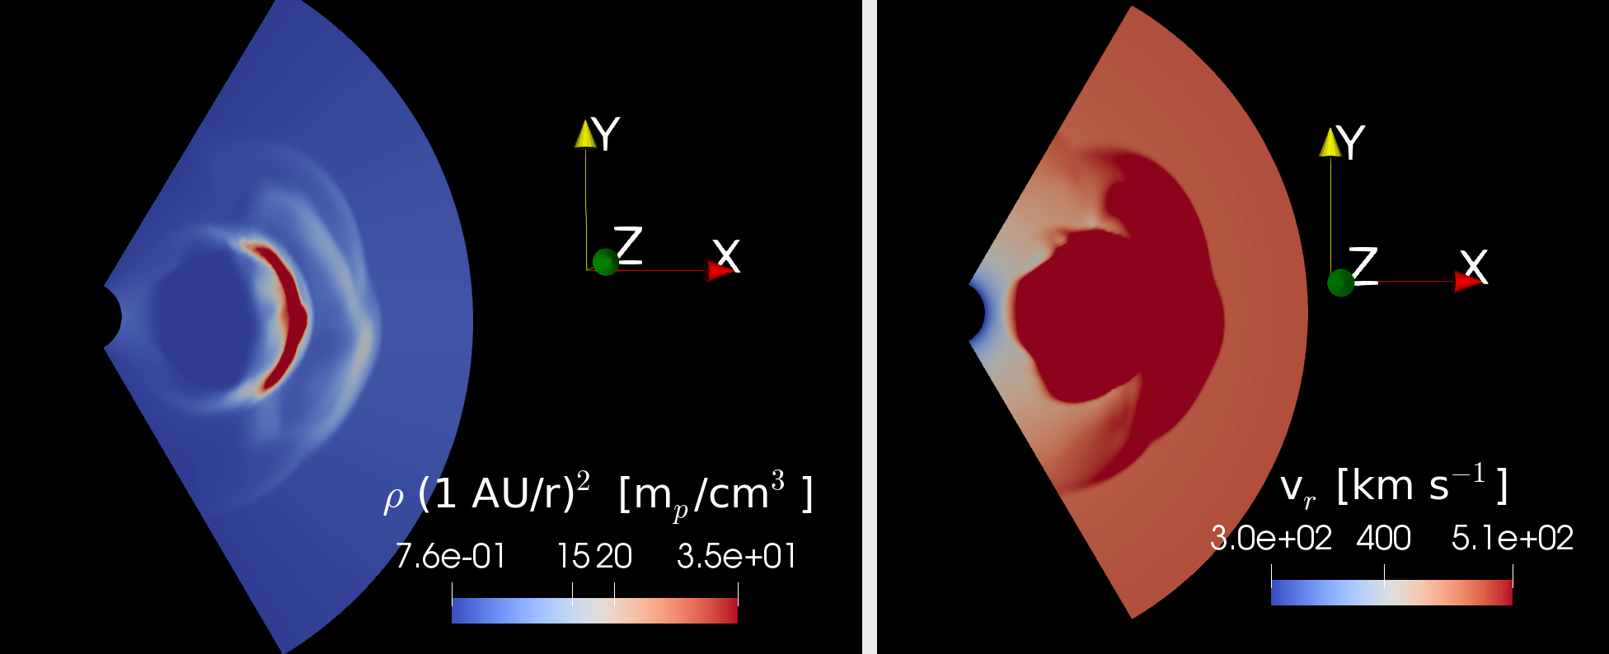
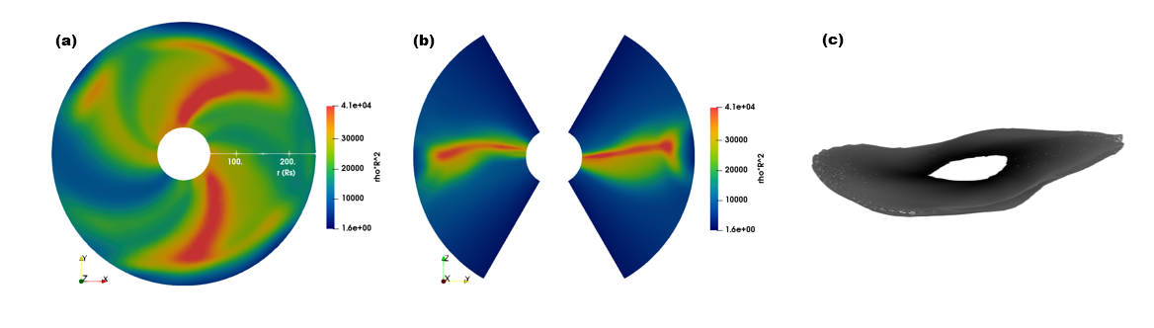
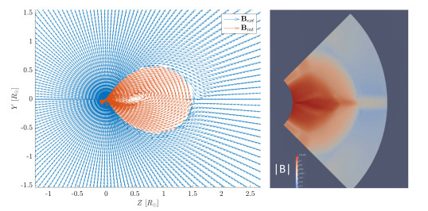
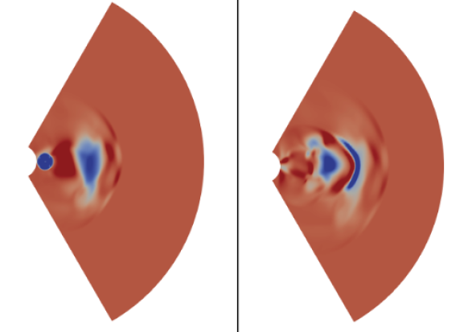
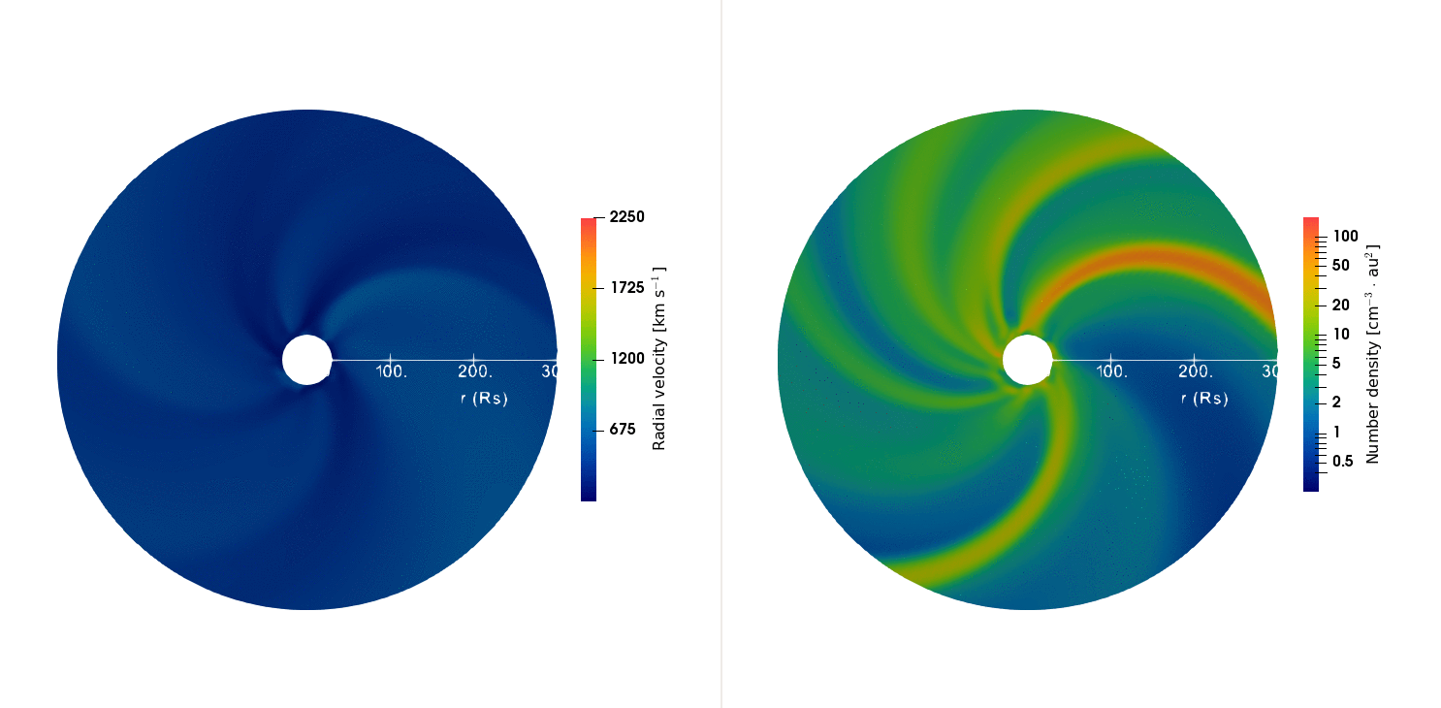
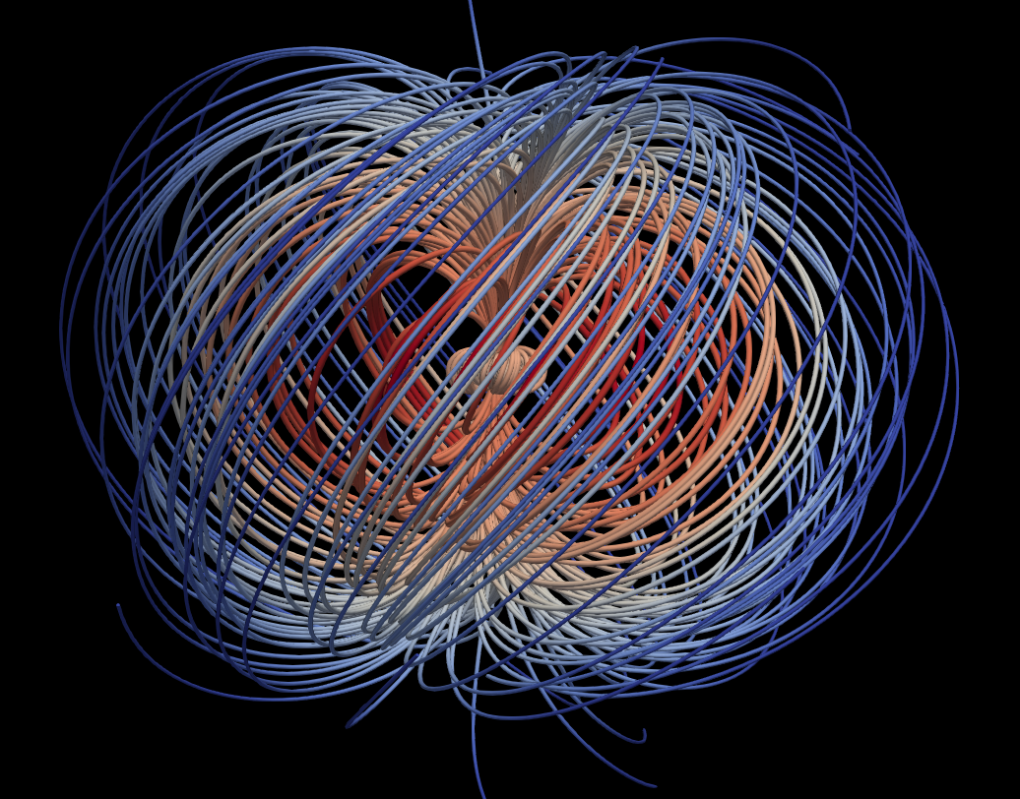
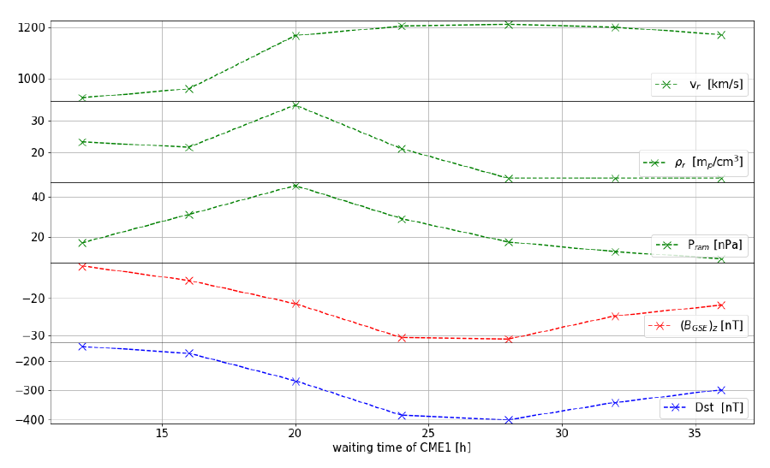
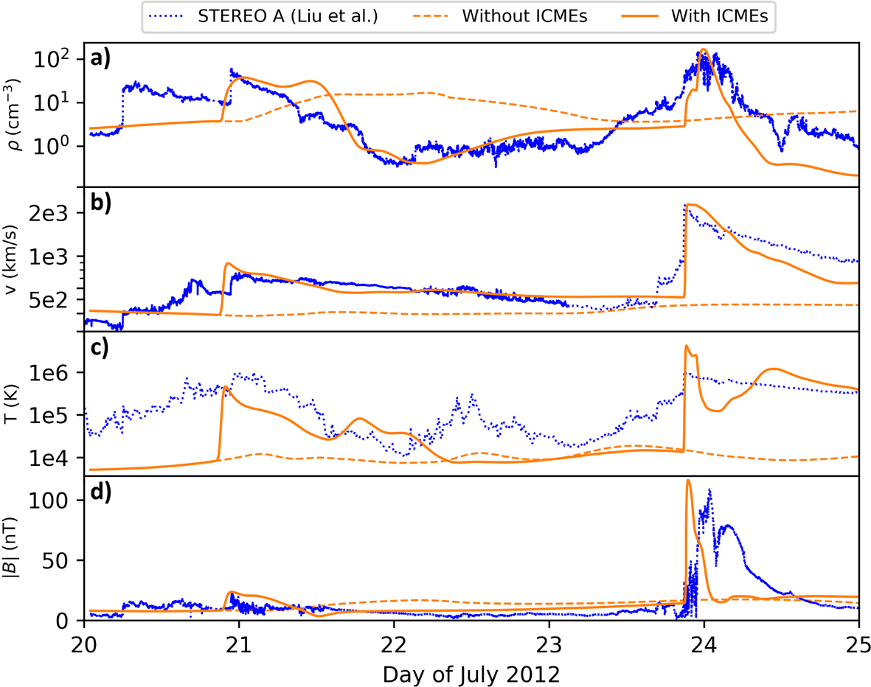
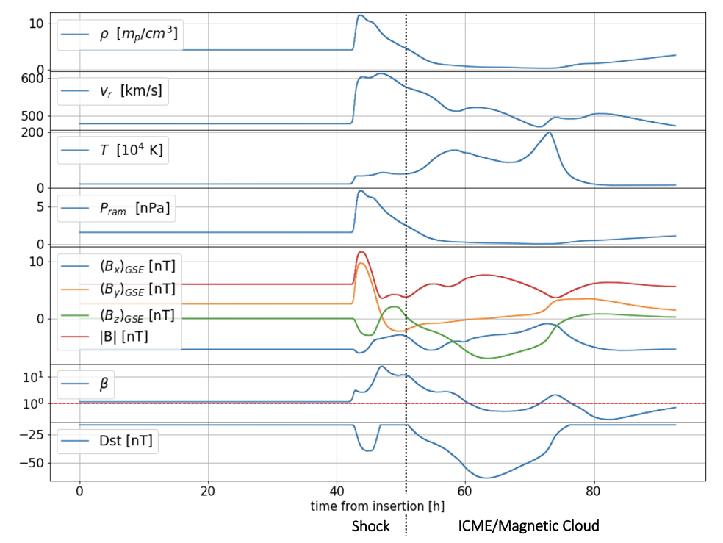
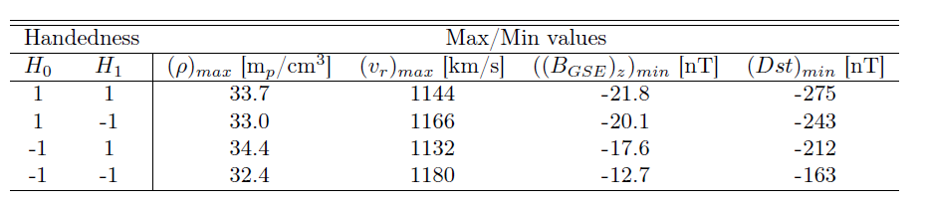
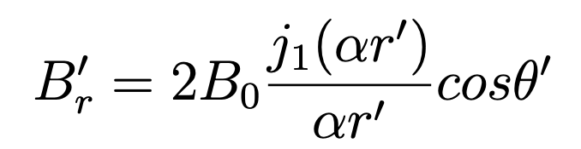
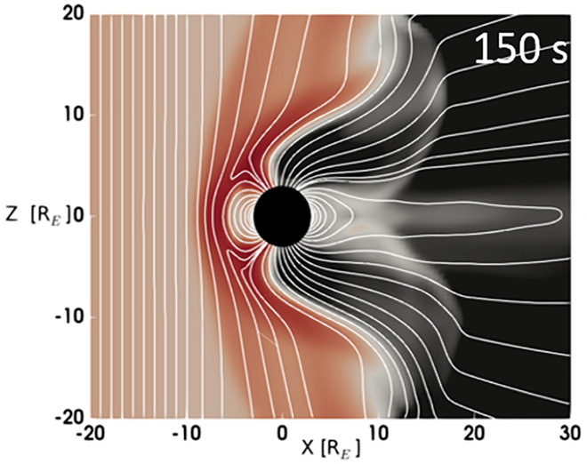
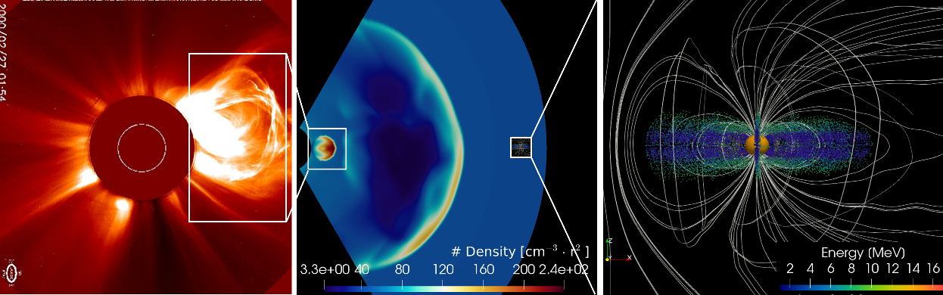
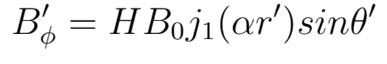
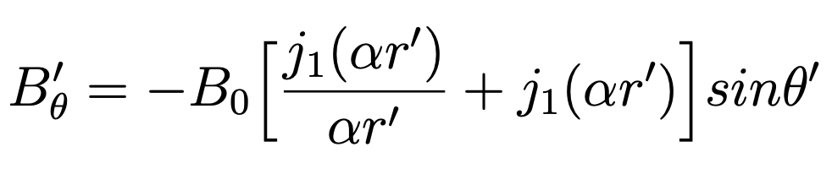

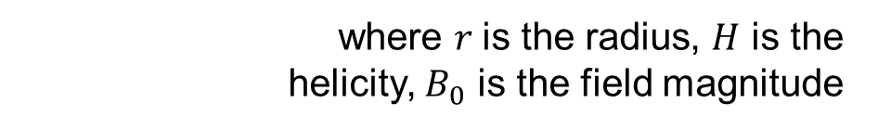
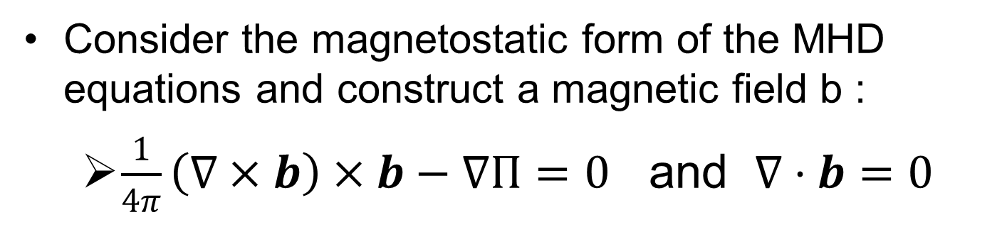
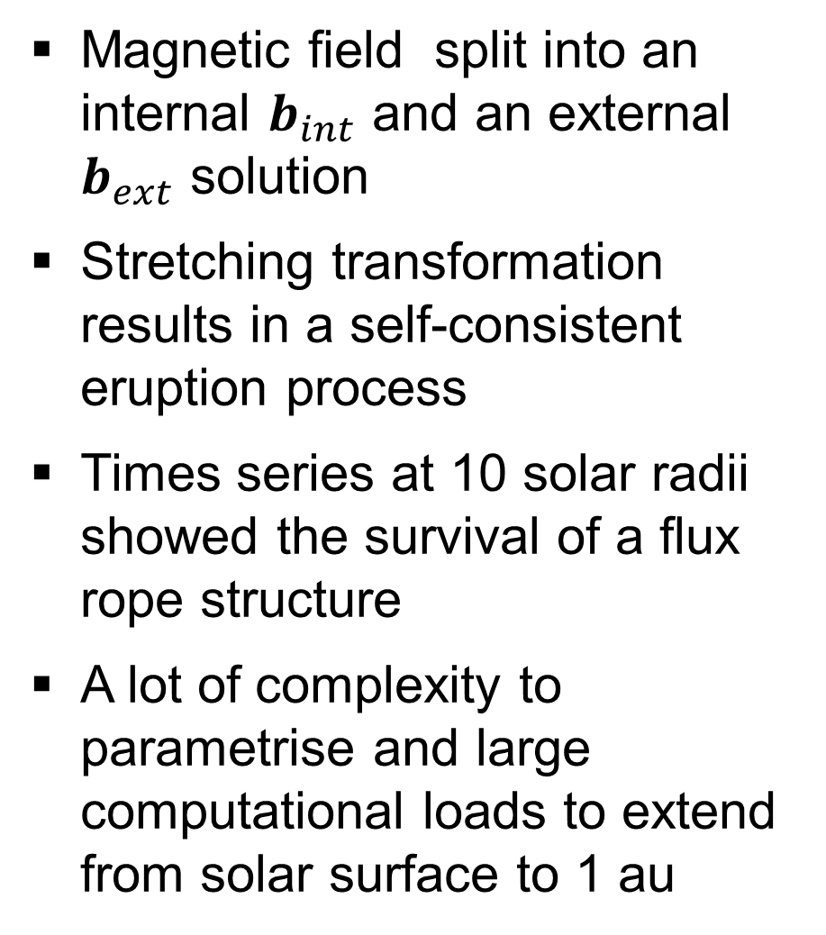
Three Dimensional MHD Simulations of Coronal Mass Ejections in the context of Space Weather Forecasting
Ravindra T. Desai¹ (ravindra.desai@imperial.ac.uk), Gordon J. Koehn¹, Maxime Battaillard¹, Jeffrey Blunier¹, Han Zhang²
¹Space & Atmospheric Physics Group, Blackett Laboratory, Imperial College London, UK.
²Department of Physics, University of Durham, Durham, UK.
Overview
Gibson-Low Flux Rope Model
Parametric Study of CME-CME Interactions
We conduct a 3-D simulation study to study: What interplanetary conditions lead to the most extreme Coronal Mass Ejections (CMEs) at Earth orbit?
This project uses the astrophysical MHD Code PLUTO [Mignone et al., 2007] to simulate the inner heliosphere
We explore the solar wind-CME and CME-CME interactions and estimate the resultant geo-effectiveness
Consider the magnetostatic form of the MHD equations and construct a magnetic field b :
$\frac{1}{4π}\left(∇×b\right)×b−∇Π=0$ and $∇⋅b=0$
CME-CME collisions have also been observed to create severe geomagnetic storms such as in September 2017 [Scolini et al., 2020]
We consider a slow-moving 723 km/s CME following by a fast-moving 1,732 km/s CME
Magnetic field split into an internal $b_{int}$ and an external $b_{ext}$ solution
Stretching transformation results in a self-consistent eruption process
Times series at 10 solar radii showed the survival of a flux rope structure
A lot of complexity to parametrise and large computational loads to extend from solar surface to 1 au
Solar Wind Preconditioning
Most if not all Extreme Space Weather events appear to involve multiple Coronal Mass Ejections [Liu et al., 2014, 2017]
Preliminary results
Fast-forward shock from a secondary CME appears to significantly compress (and enhance the characteristics of the initial CME
“Waiting time” results confirm previous preconditioning trends reported by Desai et al., (2020) with a cone model
We use the Wu & Lepping (2005) relationship for estimating geo-effectiveness / DST based on $B_{z}$ and $v_{r}$
Merge near 1 au appears most geo-effective
Further hypothesis is that CME-CME reconnection might induce a more effective merge?
Driven using the Magnetohydrodynamics Algorithm outside a Sphere (MAS) Polytropic coronal model [Linker et al., 2016]
+1 , -1
Linear Force Free Spheromak CME Model
Force-free magnetic field structure defined by spherical Bessel functions [Verbecke et al., 2019]
Magnetic fields are closed in the azimuthal direction rendering glancing blows less accurate
Bz
Cone model simulation of the 23 July 2012 “Carrington-scale” event and preconditioning CME [Liu et al., 2014]
The transit-time and velocity and density profiles are a close match
Cone-type implementation provides an intermediary method between cone and GL-type flux rope models
Time series at 1 au matches definition of a “magnetic cloud”
CME0
CME1
Preconditioning surprisingly didn’t seem significant
But it could have been with maximum velocities of 2,750 km/s
Summary
We need an accurate method for predicting solar wind / CME conditions at 1 au
Global magnetospheric models can be used to assess geoeffectiveness of CME-CME merges
[Desai et al., Sol. Phys. 2020]
where $r$is the radius, $H$ is the
helicity, $B_{0}$ is the field magnitude
[Desai et al., GRL, 2021]
References
Mignone et al., (2007), Astrophys. J. Supl. series, 170, 1
Liu et al (2014), Nat. Comm.,5, 3481
Liu et al., (2017), Astrophys. J., 242(2), 15
Desat et al., (2020), Sol. Phys., 295, 130
Linker et al (1999), J. Geophys. Res., 104, A5, 9809
Gibson & Low (1998), Astrophys., J., 493
Verbecke et al., (2019), Astron. Astrophys., 627, A111
Scolini et al., (2020), Astrophys. J. Supl. series, 247 (1), 21
Wu & Lepping (2005), J. Atmos. Solar-Terr. Phys. 67(3), 283
Desai et al., (2021), Geophys. Res. Lett., 48
Acknowledgements
RTD is funded by the National Environment Research Council (NERC) Highlight Topic grant, “RAD-SAT”, to Imperial College London
This work used the Imperial College High Performance Computing Service (doi: 10.14469/hpc/2232).
Further work

