Slide 1
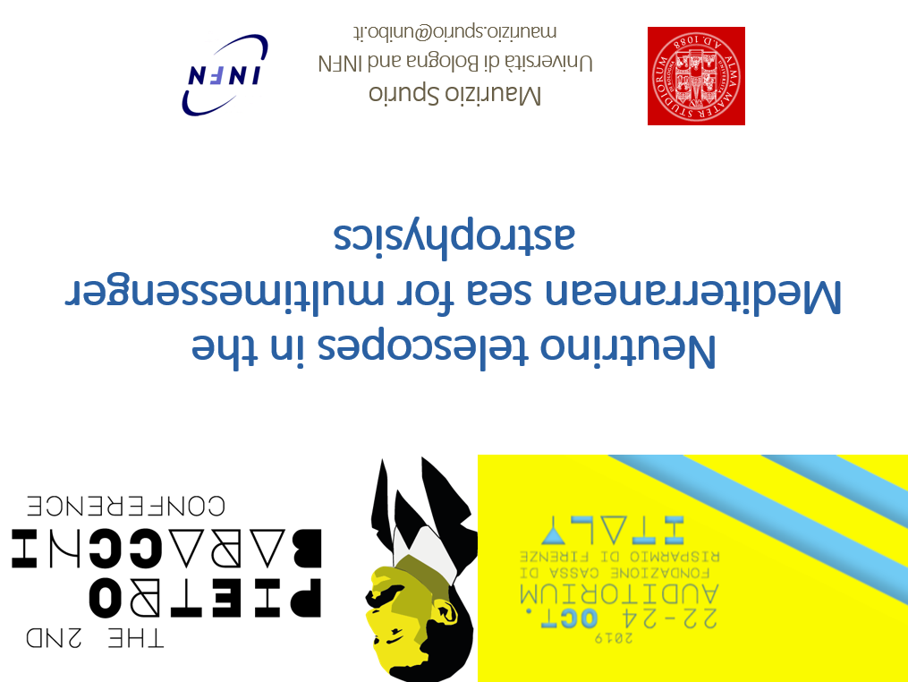



Neutrino telescopes in the Mediterranean sea for multimessenger astrophysics
Maurizio Spurio
Università di Bologna and INFN
maurizio.spurio@unibo.it

Slide 2
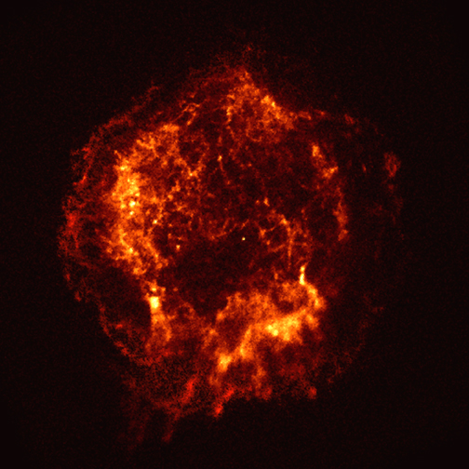
CRs, γ-rays and neutrinos
radiation fields and matter
p
ν
π±
p
γ
π⁰
protons/nuclei
electrons/positrons
e±
γ
Inverse Compton
(+Bremsstr.)

Slide 3
Recipes for a Neutrino Telescope (NT)
M. Markov:
“We propose to install detectors deep in a lake or in the sea and to determine the direction of the charged particles with the help of Cherenkov radiation”
1960, Rochester Conference
M.A. Markov and B.M. Pontecorvo at the International conference on neutrino physics and astrophysics. Baksancanyon, Cheget, the Caucasus, 1977

Slide 4
Neutrino flux:
E^{-γ}
Log(Flux)
Log(Energy)

Slide 5
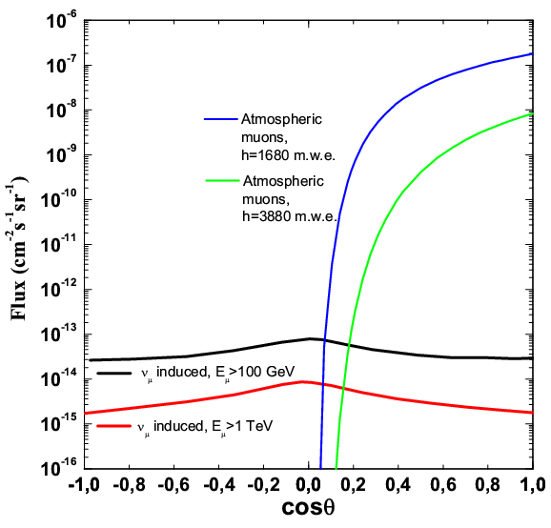
Deep in a transparent medium
Water and Ice:
large and inexpensive target for ν interaction
transparent radiators for Cherenkov light;
large deep: protection against the cosmic-ray muon background
μ
In a ∼1 km³ detector there are:
Atmospheric muons: ∼10¹⁰⁻¹¹/y, i.e., 1 kHz
Atmospheric ν◊ μ : ∼10⁵/y, i.e., 1 in 5 minutes
Cosmic ν◊ μ : ∼100/y, i.e., 2/weeks, mostly hidden in the atmosph. bck
ν

Slide 6
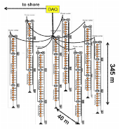
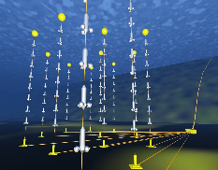

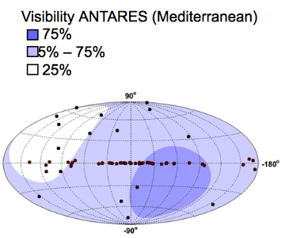

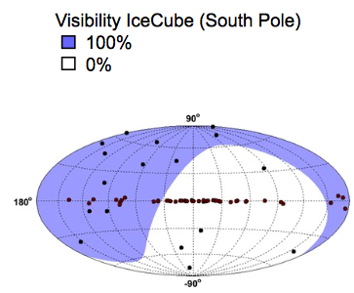
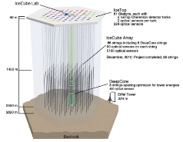
Neutrino telescopes. Where …
ANTARES
KM3NeT/ORCA
KM3NeT/ARCA
GVD
IceCube

Slide 7

Two topology (track/showers) of events
Detection principle: Optical Cherenkov radiation
  6 order of magnitude in energy (GeV-PeV )
  All flavour detection
Track-like
ν_{μ} CC interactions
Angular resolution:
∼0.1º (full, E>10 TeV)
Energy resolution:
<0.5 (log E_{μ})
μ
ν_{μ}
Shower-like
ν_{e} , ν_{τ} CC interactions
ν_{X} NC interactions
Angular resolution:
~3º (full, E>10 TeV)
Energy resolution: (E_{ν}) ~25%
ν_{e}

Slide 8

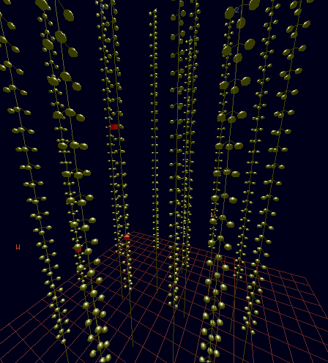
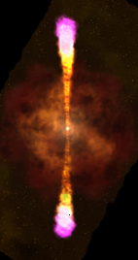

Shower- and track-like events
Cherenkov photons emitted by charged particles are correlated (space/time)
Event Reconstruction based on time-space correlations of fired PMTs (hits) in the PMTs
Tracks (CC ν_{μ}): Long pattern
Cascades (CC ν_{e}+ NC): Short pattern
Neutrino Direction reconstructed from time-space correlation between hits produced by Cherenkov photons
Neutrino Energy reconstructed from signal amplitudes of the detected hits

Slide 9
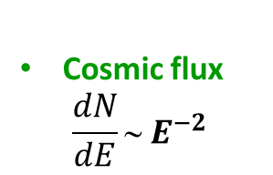
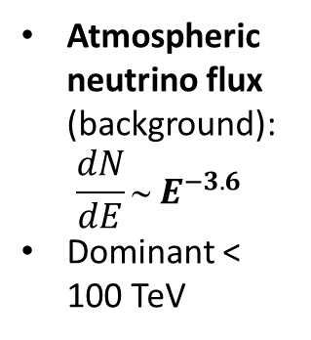
Detecting cosmic neutrinos
Significant excess in the sky map (point sources). Rely on the detector angular resolution and the measurement of the ν direction
Excess of HE neutrinos over the background of atmospheric events (diffuse flux). Based on the estimation of the ν energy
Coincident event in a restricted time/direction windows with EM/γ/GW counterparts. Relaxed ν energy/direction measurement + transient/ multimessenger information
Atmospheric neutrino flux (background):
$$\frac{dN}{dE}∼ E^{−3.6}$$
Dominant < 100 TeV
Cosmic flux
$$\frac{dN}{dE}∼ E^{−2}$$

Slide 10
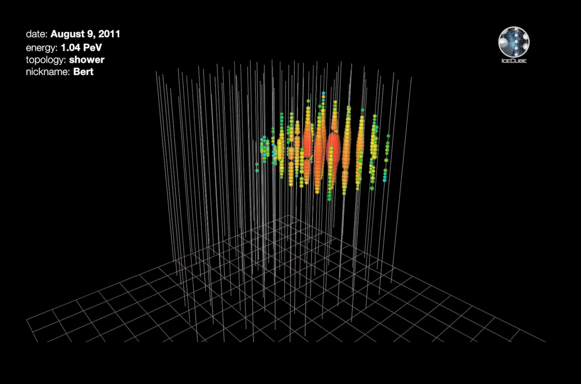
IceCube: ν interacting inside the detector (HESE)
Total energy measured
All ν flavors
All sky (Ω=4π)

Slide 11
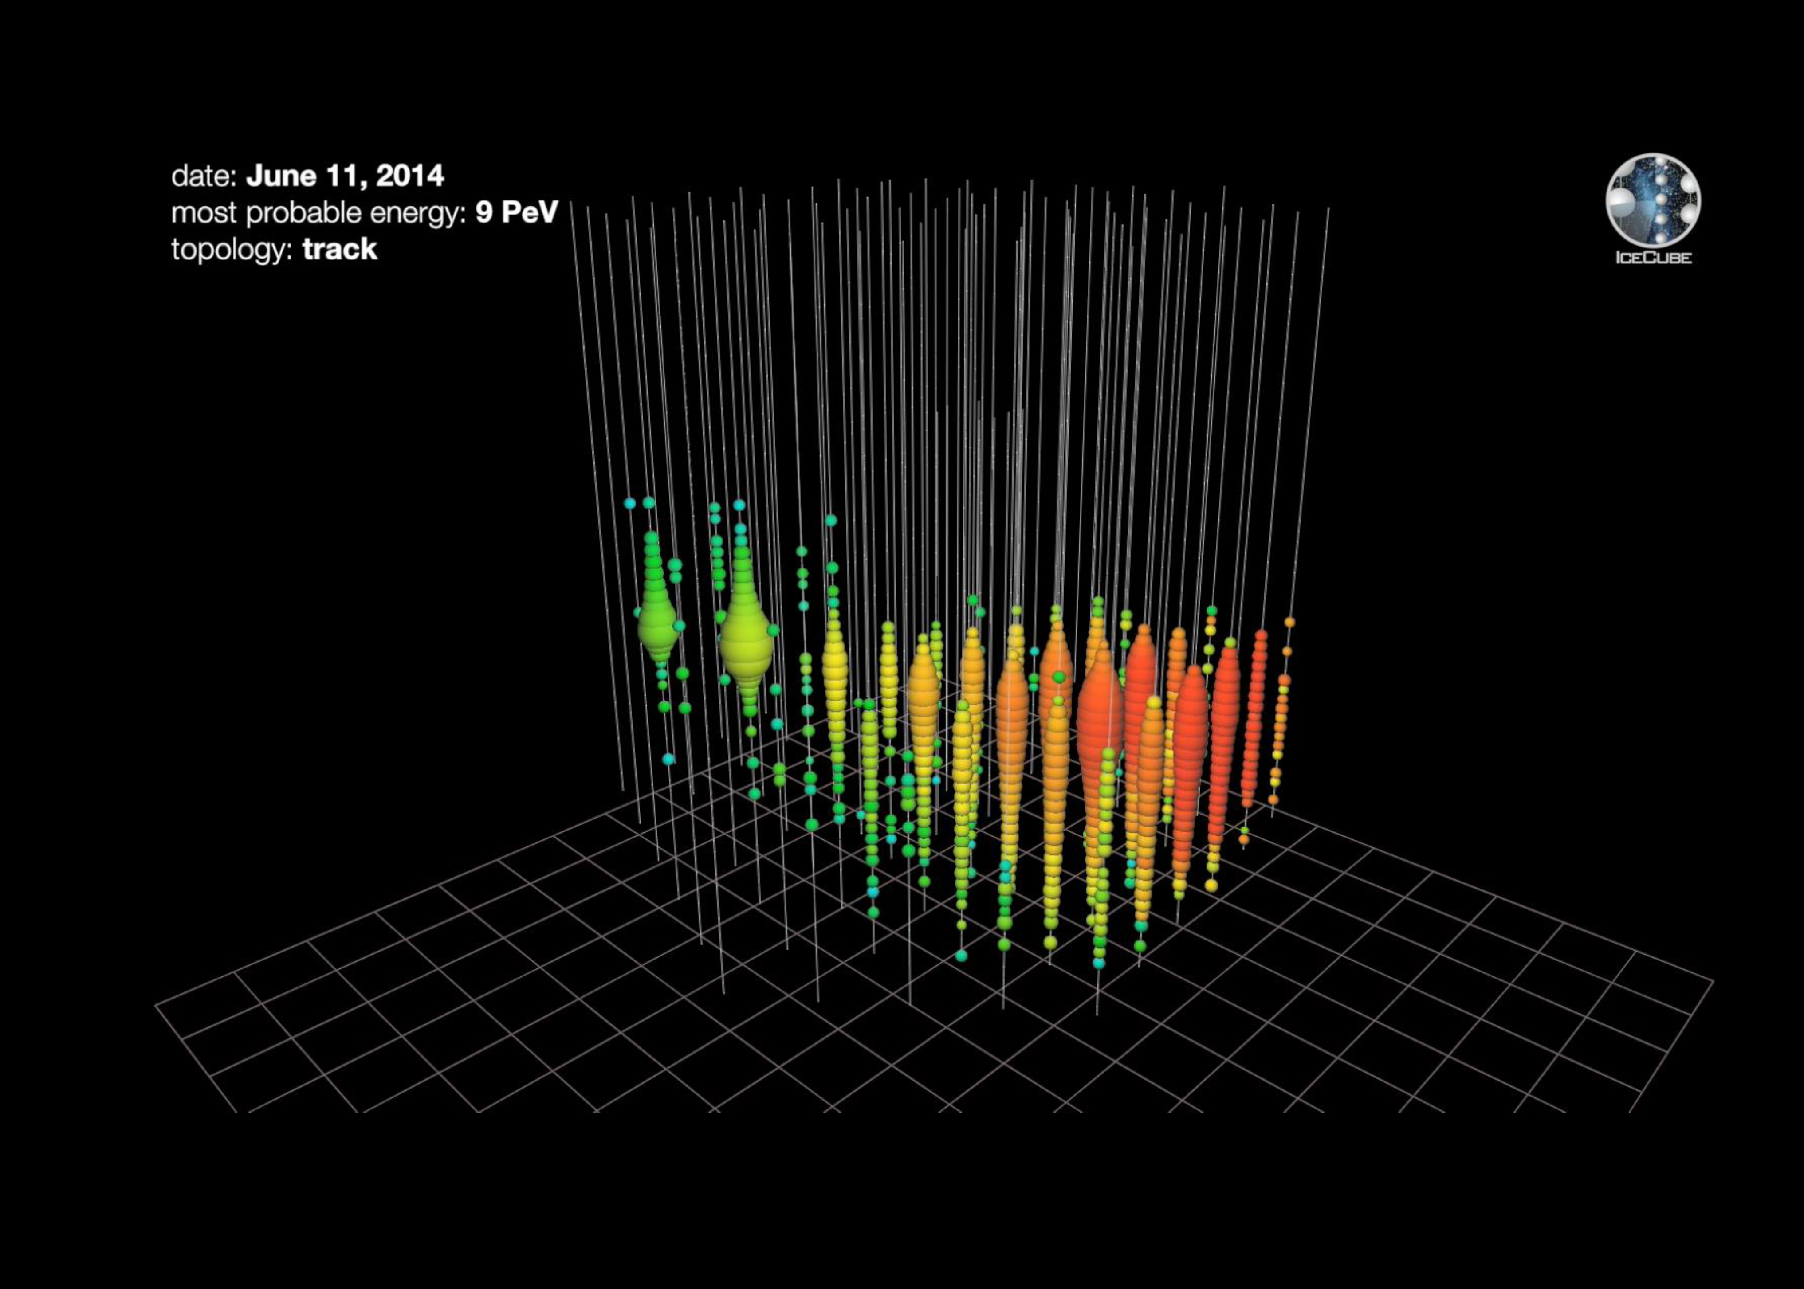
IceCube: upgoing ν_{μ}
Neutrino direction
ν_{μ} flavors
Half sky (Ω=2π)
Poorer energy determination

Slide 12
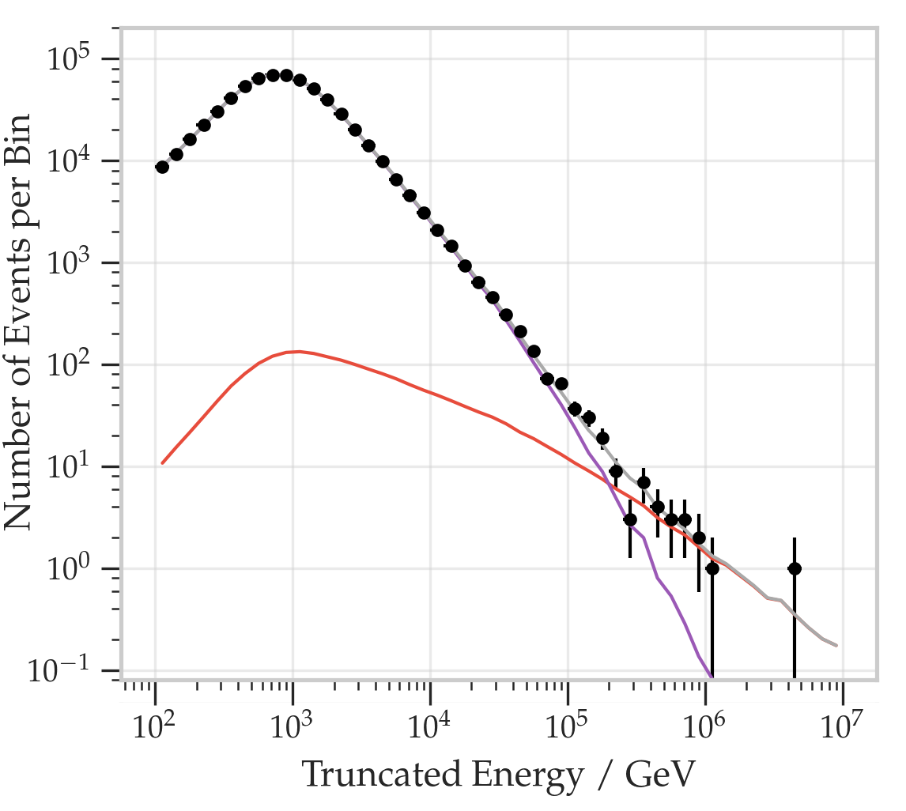
Excess of cosmic neutrinos in IceCube
Atmospheric neutrinos
up ν_{μ}
Cosmic
neutrinos
HESE
HESE
up ν_{μ}
Discrepancy ?

Slide 13
Neutrinos from the blazar TXS 0506+056 (I)
An electromagnetic follow-up campaign of the event IceCube-170922A* indicated that this event came from the direction of a known AGN blazar named TXS 0506+056.
TXS 0506+056 is a BL Lac object, found at redshift z=0.3365±0.0010
It was at that time flaring at multiple wavelengths.
In particular, TXS 0506+056 was monitored by FERMI-LAT and observed by MAGIC after the IC trigger
* muon neutrino, angular resolution < 1º

Slide 14
Neutrinos from the blazar TXS 0506+056 (II)
PoS(ICRC2019)1032
A further analysis of archival IceCube data revealed that this blazar was emitting neutrinos before;
Within Oct. 2014-March 2015 an excess of 13±5 events over background was found.
During this period, there was no significant EM flaring activity
Not simple theoretical interpretation
IceCube conclusion: Compelling evidence of a HE ν from a blazar

Slide 15
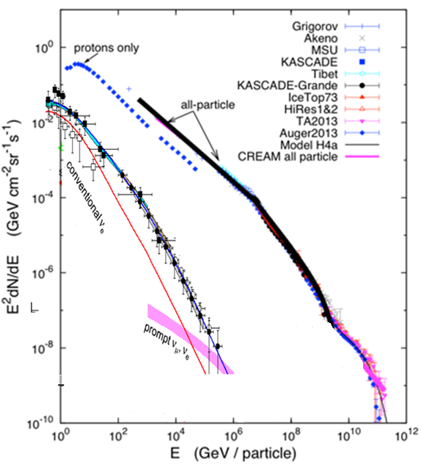

Open questions for neutrino astrophysics
Neutrino: fundamental probe to identify galactic and extragalactic Cosmic Ray (CR) sources
Origin of IceCube HE astrophysical neutrinos
Production sites of high energy cosmic particles
Study of galactic and extra galactic propagation of CR with neutrinos as tracers
Test the neutrino sector of the SM and BSM physics
Galactic “TeV-PeVatrons”: necessary a ν telescope in the Northern hemisphere
Cosmic ray spectrum

Slide 16
Neutrino telescopes in the Mediterranean sea
Upgoing events: O(0.1º) angular resolution for tracks; O(3º) for showers
Complementary f.o.v. for Mediterranean and South Pole detectors. Most of the Galactic plane seen as “upgoing events”
Online analysis, fast response (few seconds), immediate alert
Water is an homogeneous medium, but detectors need for positioning calibrations due to sea currents (offline analysis)
Very high duty cycle (∼100%)
Large observation solid angle (2π upgoing events, 4π in fiducial volume)
Telescopes in water optimized for E_{ν}<100 TeV
ν’s not significantly absorbed by the Earth for E_{ν}<100 TeV

Slide 17
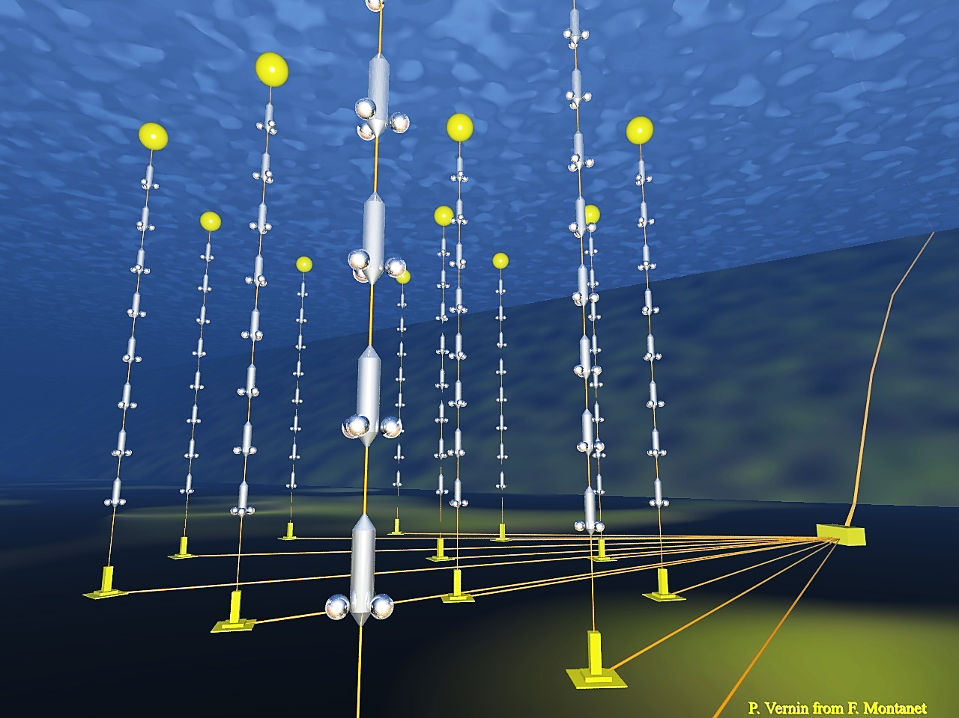
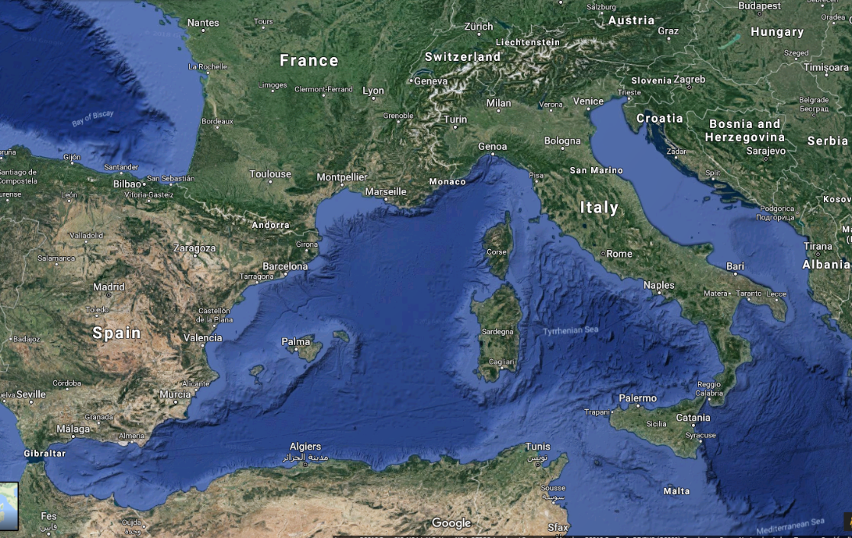
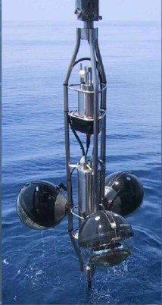
Details: see arXiv 1409.4552
ANTARES
40 km to
shore
Junction
Box
70 m
2500m
Interlink cables

Slide 18
Details: see arXiv 1409.4552
The ANTARES ν telescope in numbers:
Stable data taking since 2008 with high duty cycle (93-96%)
Large field of view (2π instantaneously, upgoing)
Quite good angular resolution: 0.3° -0.4° (median)
But it is also small: A^{eff} ≈ 1m² @ 30 TeV [O(12000) detected ν’s]
Real-time data processing
Decommissioning: 2020
40 km to
shore
450 m
Junction
Box
70 m
Interlink cables

Slide 19


ANTARES – Diffuse flux ApJL 853, L7 (2018)+ PoS(ICRC2019)891
Sample:
2007 – 2018; livetime 3330 days
All-flavour analysis (track+showers)
Event selection chain + energy-related cut applied to
obtain a high-purity neutrino sample
maximize sensitivity
Signal modeled according to the IceCube flux
Result:
50 events (27 tracks + 23 showers) in data
36.1±8.7_{stat.+syst.} events background in MC
1.8σ excess, null cosmic disfavored at >85% CL
Tracks
Showers

Slide 20
CR propagation in the Milky Way: γ and ν.
Do diffuse Galactic νs contribute to the IceCube astrophysical signal?
B/C
LAT: γ diffuse
Neutrinos allow testing CRs propagation
Dense matter regions boost γ and ν fluxes
Models can be tuned to γ and CR observations
Northern Hemisphere optimal point of view for galactic CRs
ν diffuse

Slide 21
ANTARES+ IceCube
ANTARES, PRDD96 (2017) 062001
ANTARES+IC, APJ 868 (2018), L20
Combined U.L. at 90% CL (blue line) on the 3-flavor neutrino flux of the KRAγ model (5-50 PeV cutoff)
Stacked expected signal vs. δ (top) and energy (bottom). Colors represents the relative contribution to the sensitivity
ANTARES
IceCube
ANTARES
IceCube
Result: total flux contribution of diffuse Galactic neutrino emission <8.5% of the total diffuse IC astrophysical signal (E_{ν}> 30 TeV) [ApJ 809:98(2015)].

Slide 22
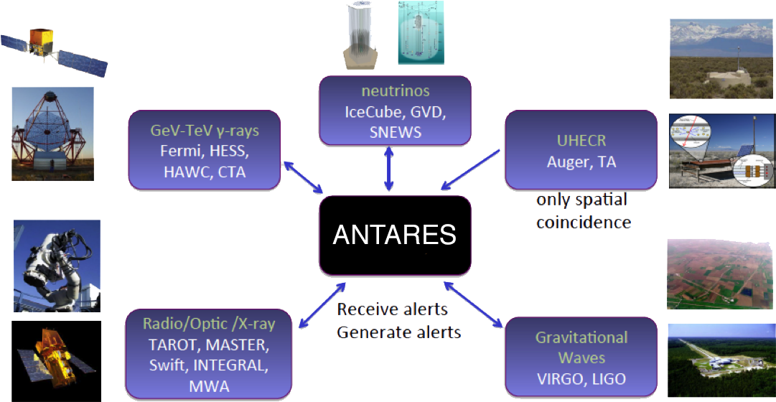
ANTARES: Multi-messenger
APP35 (2012)530
JCAP02(2016)062
* participation to
Gamma-ray Coordinates Network (GCN) https://gcn.gsfc.nasa.gov/

Slide 23
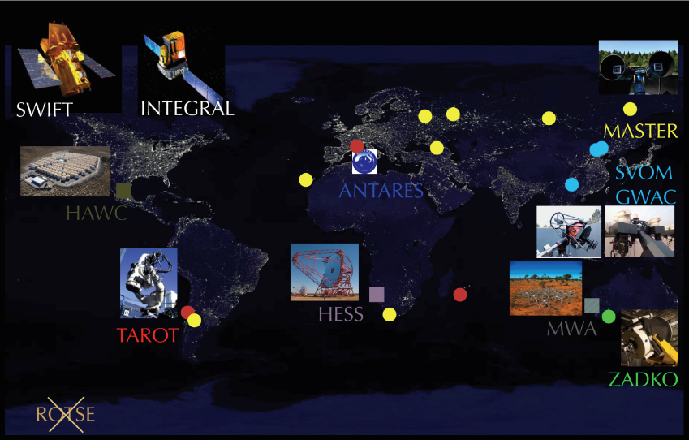
ANTARES neutrino alerts
JCAP 02 (2016) 062
PoS(ICRC2019)871
GeV γ-rays
TeV γ-rays
Optical
X-ray
Radio
EM frequency/γ energy
MWA
TAROT, ZADKO
MASTER, GWAC
Swift
INTEGRAL
Fermi
HESS
HAWC
ANTARES real time alerts:
Time to send an alert: ~5 s
Track median angular resolution: 0.5°
Doublet of neutrinos: ~0.04 events/yr
Single neutrino with direction close to local galaxies: ~1 TeV, ~10 events/ yr
Single HE neutrinos: ~5 TeV, 20 ev/ yr
Single VHE neutrinos: ~30 TeV, ~3-4 ev/yr
311 to robotic telescopes
+18/25 followed by Swift
+4 to INTEGRAL
+4 to MWA (radio)
+2 to HESS
Sent neutrino alerts
(2009-2019)

Slide 24
ANTARES multimessenger and transients
Object(s) | Messenger | Telescope
Flaring Blazars | γ-rays | Fermi/LAT
Flaring X-ray binaries | X & γ-rays | Swift, MAXI, RXTE/ASM, Fermi/LAT
Flares from Mrk 421 and Mrk 501 | γ-rays (TeV) | HAWC
HAWC 2-year catalog | γ-rays (TeV) | HAWC
Gamma Ray Bursts | γ-rays | Swift, Fermi, GCN
IceCube Events | ν | IceCube
UHECR | CRs | Auger, TA
Galactic Plane | CR & γ-rays | Fermi/LAT, Milagro
Fast Radio Bursts | Radio | SUPERB@Parkes
Fermi Bubbles | γ-rays | Fermi/LAT
Galactic Plane | CRs | HAWC
BH/NS mergers | Gravitational waves + EM + γ-rays+ ν | Ligo/Virgo (+ IceCube, PAO)

Slide 25

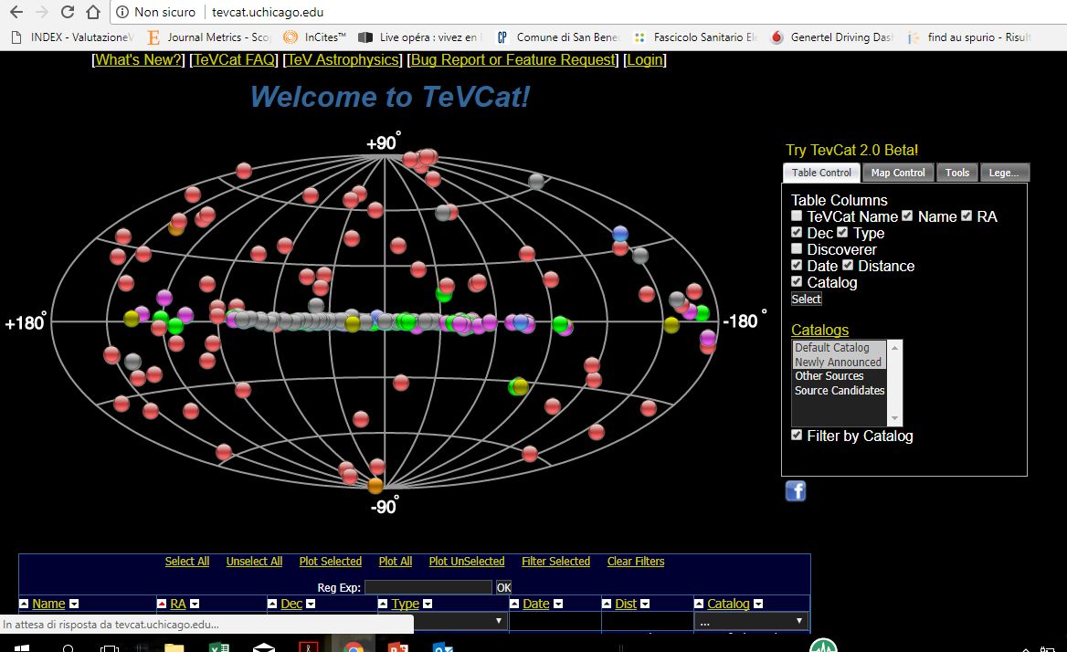
Why we do not have a “neutrino map”?
γ
Welcome to νcat

Slide 26
Sensitivities and limits for sources
PoS(ICRC2019)851
PoS(ICRC2019)919
ANTARES
IceCube ICRC2019
Southern sky sin(declination) Northern sky
Mediterranean sea South Pole ice

Slide 27

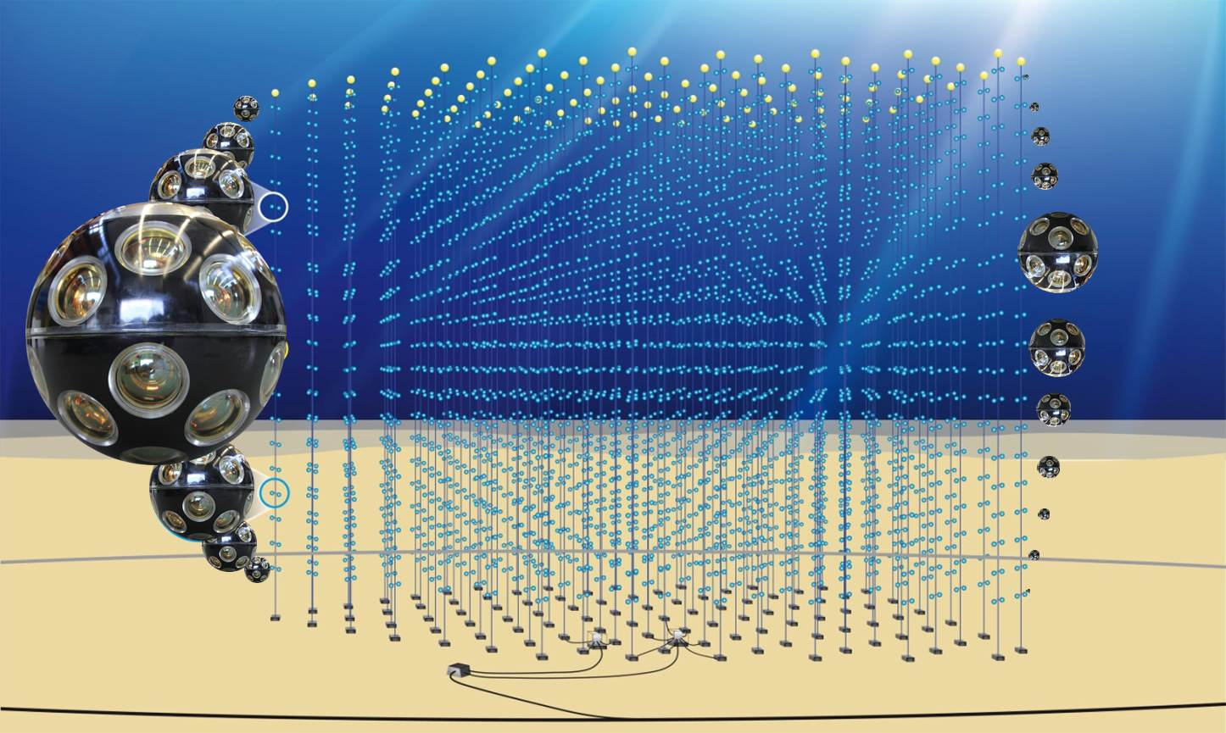
The future: KM3NeT
Deep-sea array of photo-sensors
31x3’’-PMTs in one
digital optical module (DOM)
18 DOMs per Detection Unit, DU
115 DUs per building block
All data to shore

Slide 28
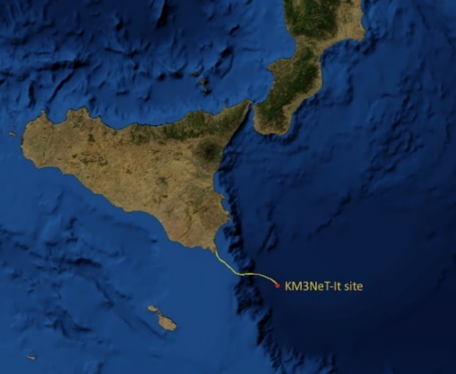
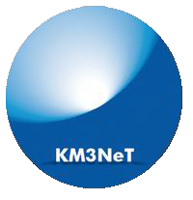
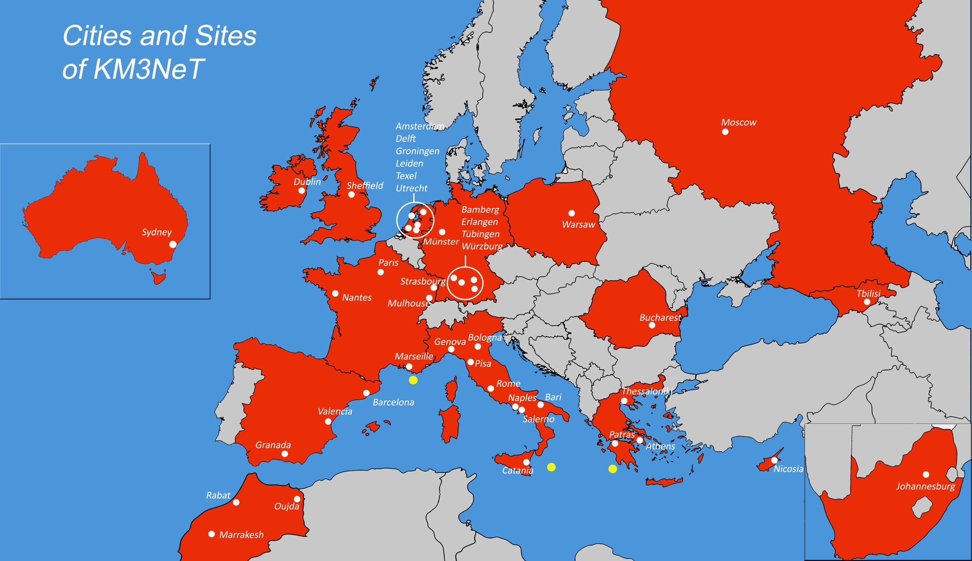
The future: KM3NeT
KM3NeT is the neutrino research infrastructure in the deep Mediterranean Sea
  Study of high neutrino sources in the Universe
  ARCA (off shore Capo Passero, It @ 3500 m depth)
  Determine neutrino mass hierarchy
  ORCA (off shore Toulon, Fr @2500 m depth)
Same collaboration, same technology, two installation sites
  15 Countries
  55 Institutes
  >240 Scientists
  Number of Institutes and
  Scientists constantly increasing
3400m
ARCA
Here, ARCA (Astrophysics) features presented

Slide 29
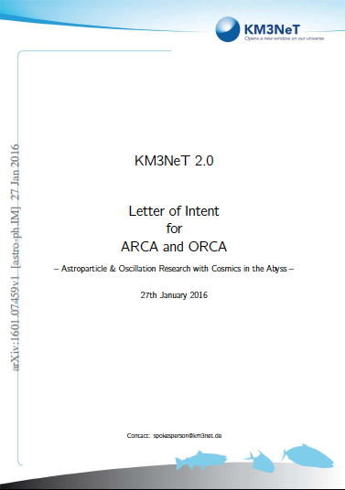
KM3NeT: A Phased Approach
PHASE | BLOCKS | PRIMARY DELIVERABLES | FUNDS
1 | 0.2 | Proof of feasibility and first science results 24 ARCA strings + 6 ORCA | Fully funded
2 | 2+1 | All flavor neutrino physics and astronomy 2 x 115 ARCA strings 1 x 115 ORCA strings | Funding in progress
3 | 6 | Neutrino astronomy including Galactic sources | Not yet
KM3NeT LoI: J. Phys. G, 43 (2016) 084001
H2020: funds to prepare the ERIC
Since 2016 (2018) KM3NeT is back in the ESFRI (APPEC) roadmap
The process to build the KM3NeT ERIC is in progress

Slide 30
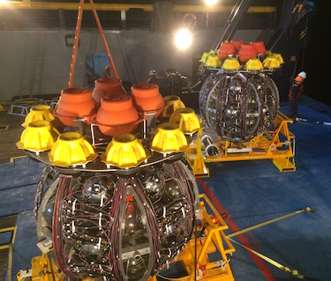
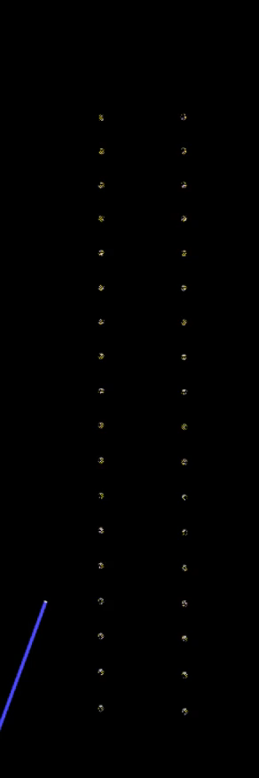
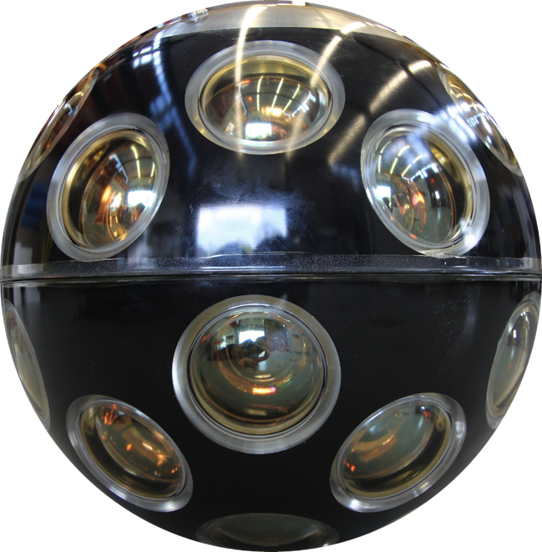
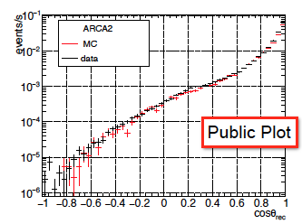
The Detection Units (DUs)
LAUNCHER VEHICLE
DOM
700 m
18 DOM in one DU string
Strings arranged on the LOM, ready for deployment
KM3NeT preliminary

Slide 31
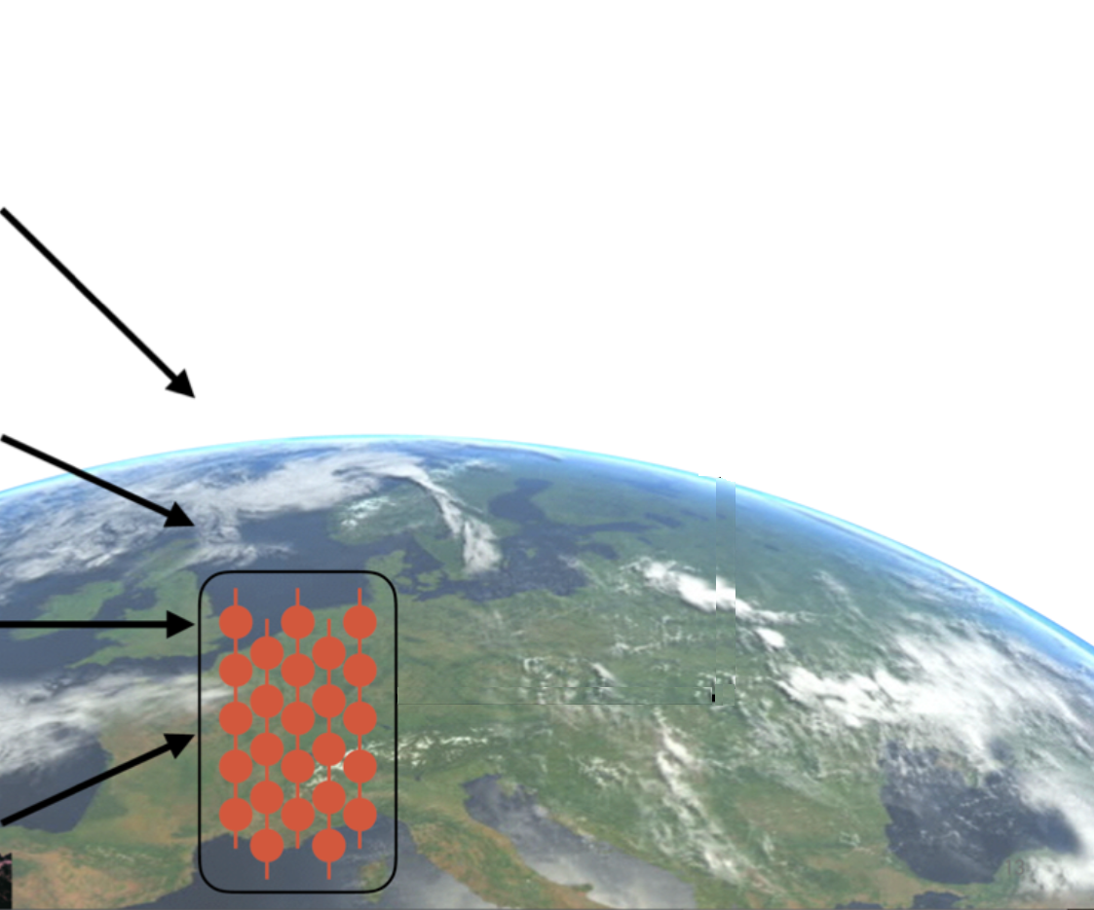
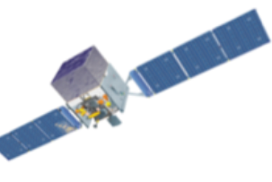
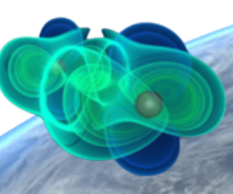
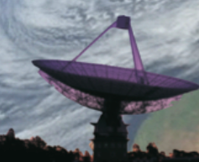
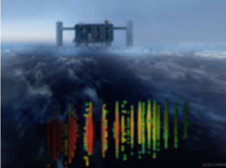
KM3NeT online alert system
ANTARES Performances: Online, no calibrated, reconstruction within 5 s, median angular resolution 0.4º.
Tasks running in parallel
Online Calibration
(charge, time, positioning)
Track reco
Time and charge of all PMTs over threshold to the computer farm (100 km away)
1
Alert sending
Shower reco
Data filter
SN identification
2
Online searches
Data monitoring
“L0” buffering

Slide 32





Summary and Perspectives
ν astronomy is on its way to increased sensitivity and full sky coverage
ν are an indispensable ingredient of multi-messenger astronomy
ν telescopes: opportunities for precision measurements in ν physics
ANTARES: more than 10 years of continuous data taking!
ANTARES data taking continues up to the end of GW O3
  - then, pass the baton to KM3NeT
ANTARES results from various searches of astrophysical ν emission.
  - (point-like, diffuse, extended regions, dark matter, …)
ANTARES/KM3NeT active multi-messenger program:
  - Neutrino alerts distribution, participation to GCN and AMON
  - External alerts reception, prompt analysis
  - Offline multi-messenger analysis.
  - Combined analyses with IceCube (point sources, galactic plane, …).
Best practice and multi-messenger collaborations ported to KM3NeT!

Slide 33
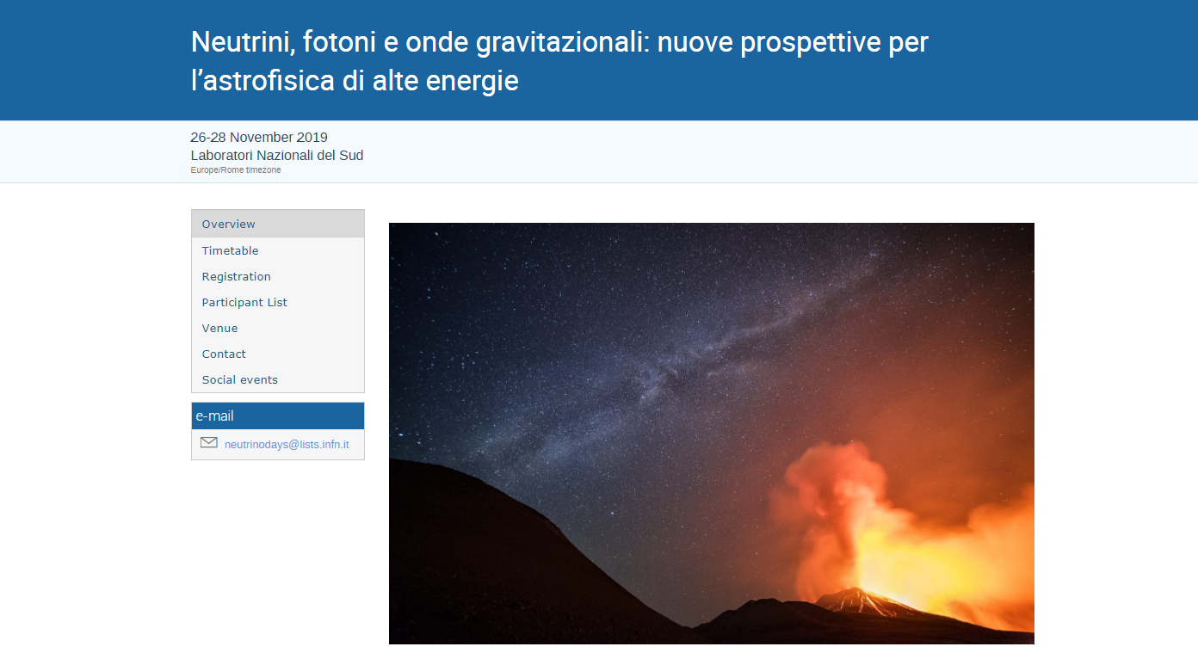
https://agenda.infn.it/event/19259/
Il Meeting ha l’intento di stimolare la discussione tra le comunità di fisici operanti nei settori dell’astronomia con neutrini, dell’astrofisica delle alte energie con radiazione elettromagnetica e delle onde gravitazionali. L’incontro è organizzato congiuntamente da INFN e INAF
Nel Meeting saranno discussi
I principali risultati dei rivelatori di neutrini di alta energia già operanti e le prospettive future tenendo conto dei rivelatori già in costruzione ed in fase di progetto.
I risultati ottenuti nell'ambito delle onde gravitazionali in connessione con le possibili osservazioni multi-messagere
Discussioni sulle possibili sorgenti di neutrini, gamma di alta energia e raggi cosmici.

Slide 34
Spares

Slide 35
Searching for HEN from BBH coalescences (O1-O2)
HEN emission coincident with GW signals expected ?
If hadronic/magnetic environment
Tidally heated outer rim; active magnetorotational instabilities
ν
Online neutrino searches (ANTARES/IceCube) for every GW alert during O2: results to LIGO/Virgo on private GCN
Offline optimized event-by-event searches for
  GW150914: HEN emission<20% of GW energy; PRD93 (2016) 122010
  GW151226+LVT151012: HEN <1-15% of GW energy; PRD96 (2017) 022005
  GW170104: first full sky search, optimization. EPJC 77(2017) 911
  O1 sub-threshold events ApJ 870:134(2019)

Slide 36
Binary NS Mergers and HEN?
Prompt neutrino production on-axis
Off-axis scenario, neutrino-production related to the extended γ-ray emission (Kimura et al. 2017).
(Later) Extended emission from a relativistic wind with its rotational energy, (Fang&Metzger. ApJ 2017).
ν ?
ApJL 850:L35 (2017)
(multimessenger): ApJL 848 L12 (2017)

