Slide 1
UAV-based Antenna Measurements for the Bridging Project of SKA1-low
2nd Pietro Baracchi Conference
G. Virone, F. Paonessa, P. Bolli,
A. Magro, D. Minchin, A. McPhail
Oct. 23, 2019, Florence, Italy

Slide 2
The Australian Campaign with the UAV
June 3-7, 2019
From https://virtualtours-external.csiro.au/MRO/
EDA2
AAVS1.5
Verification of the models using a drone
AAVS1
MRO

Slide 3
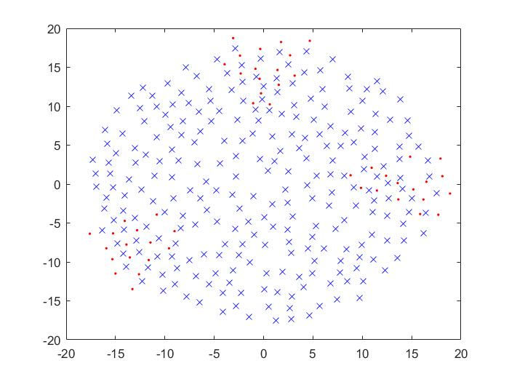
AAVS1
256 SKALA2 antennas in 16 tiles, on ground plane
Hybrid cables combining dc power wires with 2 optical fibers (RFoF)
Pseudo-random configuration

Slide 4
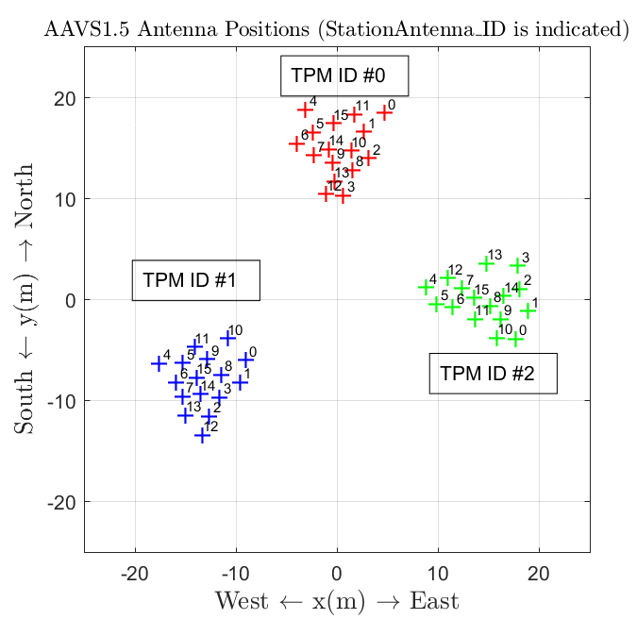
AAVS1.5
Under deployment during the campaign, now completed
256 SKALA4.1-AL (Reference antenna design for System CDR of SKA)
Same config. of AAVS1 but larger footprint
Only 3 clusters deployed for phase 1

Slide 5
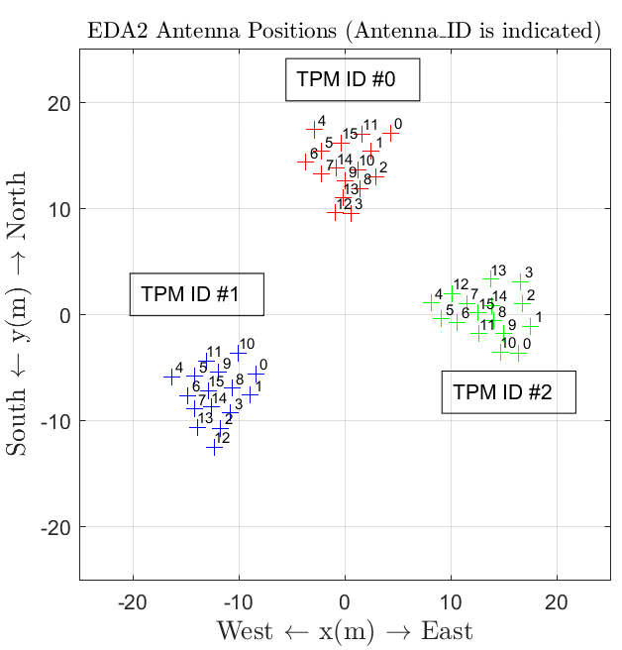
EDA2
256 MWA dipoles mounted on a ground plane
Same layout as the AAVS1

Slide 6
Objectives of the measurement campaign
Objectives | Description
Validation of EM models | Embedded Element Patterns, with particular reference to predicted non-smooth behaviours Digitally beam-formed array patterns (mainly NF) Differential embedded element phase patterns In-situ validation of the array element design and manufacturing.
End-to-end System Verification (level L0) | Instrumental calibration (magnitude and phase of RF/digital chains) Magnitude and phase stability of the RF/digital chains Antenna positions / connections / mapping Overall levels and RF gains / dynamic issues
Verify feasibility & required effort of UAV-based measurements @ MRO | Logistics, shipment, regulation and environmental issues. Important as far as the planning of future SKA-low commissioning strategies is concerned

Slide 7
Involved people
Gianni Comoretto (firmware modification and setup suggestions)
Jader Monari, Federico Perini (RF chain setup)
Simone Rusticelli (Shipment)
Eloy de Lera Acedo, Daniel Ung, David Davidson, Paola Di Ninni, Mirko Bercigli (Simulations)
Mark Waterson (campaign requirements)
Lorenzo Ciorba (data elaboration)

Slide 8
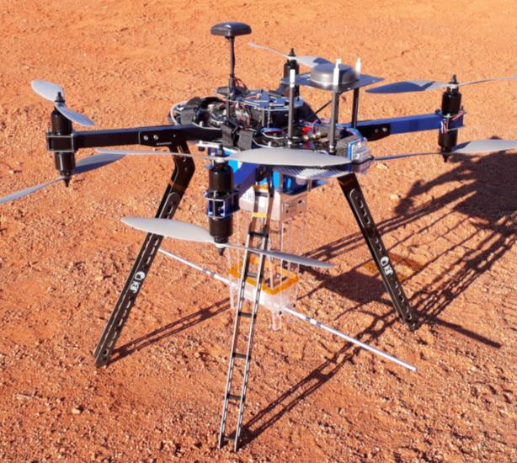
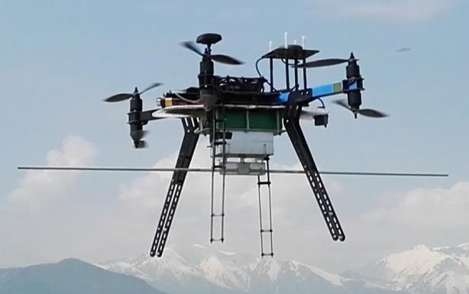
UAV-based system as far-field point source
Developed by CNR & INAF for EM characterization of LFAAs
Based on a commercial drone customized to carry a frequency synthesizer and a dipole antenna
Autonomous DGPS navigation & flight path programming
Possibility to control the UAV heading during the flight
Position measurement accuracy: < 5 cm
UAV orientation measurement: ~ 2°

Slide 9
Flight strategy example: Cross Scan above AAVS1.5
N
Crosses centered on each array
(E-plane & H-plane)
All the EEPs at the same time
UAV oriented along north-south
Constant height 120 m / 160 m
Flight extension selected in order to achieve ±45° from zenith
AAVS1
EDA2
W
AAVS1.5
E
S

Slide 10
Table of performed tests
MHz | EDA2 | AAVS1.5 | AAVS1
50 | Cross-scan Y-pol (120 m) | Cross-scan Y-pol (120 m)
70 | Cross-scan Y-pol (120 m) | Cross-scan Y-pol (120 m)
110 | Cross-scan Y-pol (120 m) Cross-scan X-pol (120 m) | Cross-scan Y-pol (160 m) | Double-linear-scan Y-pol (160 m) Cross-scan X-pol (160 m)
160 | Cross-scan Y-pol (120 m) | Cross-scan Y-pol (160 m)
230 |  | linear-scan Y-pol (200 m)
320 | Cross-scan Y-pol (160 m) | Cross-scan Y-pol (160 m)
 | Collected data
EDA2 | 3.80 Gbyte
AAVS1.5 | 4.84 Gbyte
AAVS1 | 4.36 Gbyte

Slide 11
AAVS1.5
4 antennas x 4 frequencies E-plane EEPs
70 MHz
110 MHz
160 MHz
320 MHz
Ant 0
Ant 3
Ant 14
Ant 15

Slide 12
EDA2
4 antennas x 4 frequencies E-plane EEPs
70 MHz
110 MHz
160 MHz
320 MHz
Ant 0
Ant 3
Ant 14
Ant 15
2nd Pietro Baracchi Conference, 2019

Slide 13
AAVS1.5
NF array beam @ 320 MHz (TPM#0 only)
E-plane
EEPs equalization
@ zenith
Same flight used
to get the EEPs

Slide 14
EDA2
NF array beam @ 320 MHz (TPM#0 only)
E-plane

Slide 15
AAVS1
NF array beam @ 110 MHz
E-plane

Slide 16
Conclusion and future work
A UAV campaign in the Murchison Desert is feasible
The non-uniformity of EEPs has been successfully characterized
Overall quality good, understand peak and distortion phenomena
Statistical analysis to compare measurements & simulations
Next campaign for 2020 is being discussed

