Slide 1
Gravity and nonequilibrium thermodynamics: the origin of evolution equations
Máté Pszota
in collaboration with
Péter Ván and Sumiyoshi Abe

Slide 2
Overview
A nonequilibrium thermodynamic theory incorporating gravity
Evolution equation and flow-frames
Modified gravity and its applications
Connection to quantum mechanics
Notes:
An extension of standard nonequilibrium thermodynamics is presented, where the gravitational potential is a thermodynamic state variable,
Standard and rigorous methods of Rational Mechanics and nonequilibrium thermodynamic framework allow a set of evolution equations to be derived for the gravitational field and the derivation of thermodynamic forces and fluxes.
The method effectively substitutes variational principles for ideal systems without dissipation, and provides the evolution equations for dissipative continua at the same time.
An important aspect of this framework is the application of $β$-, or thermometer flow-frame, i.e. tying the flow of the continuum, the flow-frame, to the temperature four-vector, compared to the usual Landau-Lifshitz (or energy) or Eckart (conserved particle) flow-frames, which have been proved unstable.
With certain straightforward assumptions for the gravitating system, a nondissipative gravitational field equation can be derived in the form of a modified Poisson equation
Analytical solutions show a double crossover, allowing for different gravitational behaviour on different size scales (S. Abe & P. Ván, Symmetry 2022, 14, 1048(7)).
This property presents a possible approach to explain Dark Matter-related phenomena on galactic scales, and different dynamics on extragalactic scales.
A direct connection to quantum mechanics is presented, as well, (P. Ván, Physics of Fluids, (2023) 35(5).).

Slide 3
Gravitation and thermodynamics
Gravitational field coupled to thermodynamic equations of state
The internal energy separately contains the field and interaction energy:
$$u=Ts−pv+μ=e−φ−\frac{∇φ∙∇φ}{8πGρ}$$
Hydrodynamic framework, extensivity is conserved
Simple heuristic derivation or Liu’s procedure for the evolution equations
The appearance of functional derivatives without variational principles, the classical holographic property and the emergence of quantum phenomena are unexpected general consequences of the II. law of thermodynamics
VÁN and ABE, Physica A: Statistical Mechanics and its Applications, 588:126505
VÁN, Physics of Fluids 35, 057105 (2023)
Notes:
Nemrelativisztikus kapcsolat a grav + thermo közt új dolog (relativisztikusan nehéz, mint látni fogjuk)
Dissipative field equation is obtained
Stationary solution can be derived with given density distribution

Slide 4
Gravitation and thermodynamics
Balances of mass, momentum and internal energy are constraints:
$$\dot{ρ}+ρ∇∙\vec{v}=0$$
$$ρ\dot{\vec{v}}+∇∙P=0$$
$$ρ\dot{e}+∇∙\vec{q}=−P∶∇\vec{v}$$
II. law of thermodynamics:
$$ρ\dot{s}+∇∙\vec{j}≥0$$
Notes:
j – conductive entropy current (entropy flux)
(s pont) – specific entropy rate
Egyenlőtlenség bal oldala – entropy production density rate

Slide 5
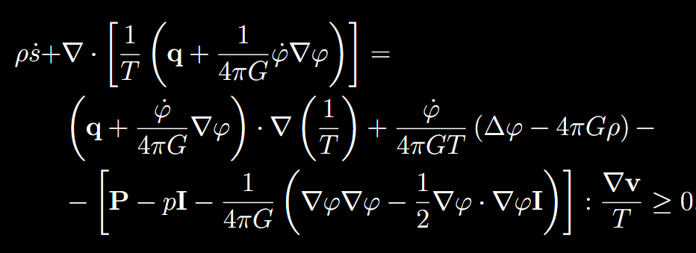
Thermodynamic derivation

Slide 6
Thermodynamic forces and fluxes
Interaction | Thermodynamic force | Thermodynamic flux
Thermal | $$∇\left.\left(\frac{1}{T}\right.\right)$$ | $$q+\frac{\dot{φ}}{4πG}∇φ$$
Mechanical | $$∇v$$ | $$−\frac{1}{T}\left.\left[ P−pI−\frac{1}{4πG}\left.\left(∇φ∇φ−\frac{1}{2}∇φ⋅∇φI\right.\right)\right.\right]$$
Gravitational | $$\frac{1}{4πG}\left.\left(Δφ−4πGρ\right.\right)$$ | $$\dot{φ}$$
Notes:
Lineáris és izotróp kapcsolat a mechanikai és gravitációs tagok közt

Slide 7
Constitutive relations
$$q+\frac{\dot{φ}}{4πG}∇φ=λ∇\left(\frac{1}{T}\right)=−λ_{F}∇T$$
$$\dot{φ}=l_{1}\left(\frac{Δφ}{4πG}−ρ\right)+l_{12}∇⋅v$$
$$\frac{1}{3}\text{Sp}\left(P\right)−p+\frac{∇φ⋅∇φ}{24πG}=l_{21}\left(\frac{Δφ}{4πG}−ρ\right)+l_{2}∇⋅v$$
$$P−\text{Sp}\left(P\right)\frac{I}{3}−\frac{1}{4πG}\left(∇φ∇φ−\frac{1}{3}{\left(∇φ\right)}^{2}I\right)=−η\left(∇v+{\left(∇v\right)}^{T}−\frac{2}{3}∇⋅vI\right)$$
Notes:
Nemdisszipatív esetre is információt adnak a formulák
Fejlődési egyenletet tud adni a themo. a gravitációra
Eta – sheer viscosity
3. + 4. egyenlet a gravitáció nélkül a Navier-Stokes egyenlethez vezet
Nagy P – Newtoinian pressure tensor

Slide 8
Flow-frames and evolution equations
$N^{α}=c \int_{ℝ^{3}}{p^{α}f\frac{dp}{p^{0}}}$
$T^{αβ}=c\int_{ℝ^{3}}{p^{α}p^{β}f\frac{dp}{p^{0}}}$
Eckart frame – particles:
$$N^{α}=n_{E} u_{E}^{α}, T^{αβ}=\frac{e_{E}}{c^{2}}u_{E}^{α}u_{E}^{β}+P_{E}^{αβ}+W_{E}^{α}u_{E}^{β}+W_{E}^{β}u_{E}^{α}$$
The choice of a frame becomes a key problem in relativistic generalisations of theories involving hydrodynamics
Stability analyses are a topic of current research avenues
Idea: the flow is derived by assuming stability (Kovtun)
$$x^{α}=\left(ct, x\right)$$
$${ p}^{μ}=\left.\left(\sqrt{{\left(mc\right)}^{2}+{\left|p\right|}^{2}}\right.,p\right)$$
L. Gavassino, M. Antonelli, and B. Haskell, Phys. Rev. D 102, 043018 (2020)
P. Kovtun, J. High Energ. Phys. 2019, 34 (2019)
Notes:
Frame = mi áramlik a folyadékban, nem reference frame
Probléma: disszipatív relativisztikus folyadékok esete: mi folyik? Nemrelativiszikusan megoldódik, relativisztikusan buktatók
Nem triviális.
Eckart-frame (and Landau) – drastically unstable
Stability Kovtun – hyperbolic equations

Slide 9
Flow-frames comparison
Landau-Lifshitz frame – energy:
$$N^{α}=n_{L} u_{L}^{α}−ν^{α}, T^{αβ}=\frac{e_{L}}{c^{2}}u_{L}^{α}u_{L}^{β}+P_{L}^{αβ}$$
Eckart frame – particles:
$$N^{α}=n_{E} u_{E}^{α}, T^{αβ}=\frac{e_{E}}{c^{2}}u_{E}^{α}u_{E}^{β}+P_{E}^{αβ}+W_{E}^{α}u_{E}^{β}+W_{E}^{β}u_{E}^{α}$$
$β$-, or thermometer flow-frame – temperature four-vector:
$$β^{α}=β\left(n_{T}, e_{T}\right)u^{α}, T^{αβ}=\frac{e_{T}}{c^{2}}u_{T}^{α}u_{T}^{β}+P_{T}^{αβ}+W_{T}^{α}u_{T}^{β}+W_{T}^{β}u_{T}^{α}$$
Akihiko Monnai, Phys. Rev. C 100, 014901, 2019
Byung-Hoon Hwang, Fluid Dyn. Res. 54 015501, 2022
Notes:
Beta/thermometer frame – forró kvark-gluon plazma leírásában játszik nagy szerepet
--Presents good opportunities for investigating stability
--Nincs térszerű komponense automatikusan
To complete the set of equations of the relativistic balances, we can use entropy production, and for it, a chosen flow-frame. Here, the thermometer frame can prove useful

Slide 10
Gravitation and thermodynamics
Cross-effect can arise between 2 of the resulting constitutive equations:
$$\dot{φ}=l_{1}\left(\frac{∆φ}{4πG}−ρ\right)+l_{12}∇∙\vec{v}$$
$$\frac{1}{3}Sp\left(P\right)−p+\frac{{\left(∇φ\right)}^{2}}{24πG}=l_{21}\left(\frac{∆φ}{4πG}−ρ\right)+l_{2}∇∙\vec{v}$$
Dissipative field equation for gravity:
$\frac{∂φ}{∂t}=\frac{l^{2}}{τ}\left(∆φ−4πGρ+\frac{l_{12}}{6det\left(L\right)}{\left(∇φ\right)}^{2}\right)$, where $K∶=\frac{l_{12}}{6det\left(L\right)}$
Stationary solution is a modified Poisson’s equation:
$$∆φ=4πGρ+K{\left(∇φ\right)}^{2}$$
Notes:
Jó modellezési tulajdonságok (meglepő eredmény asztrofizikusan)
(Hidrodinamikai keret)

Slide 11
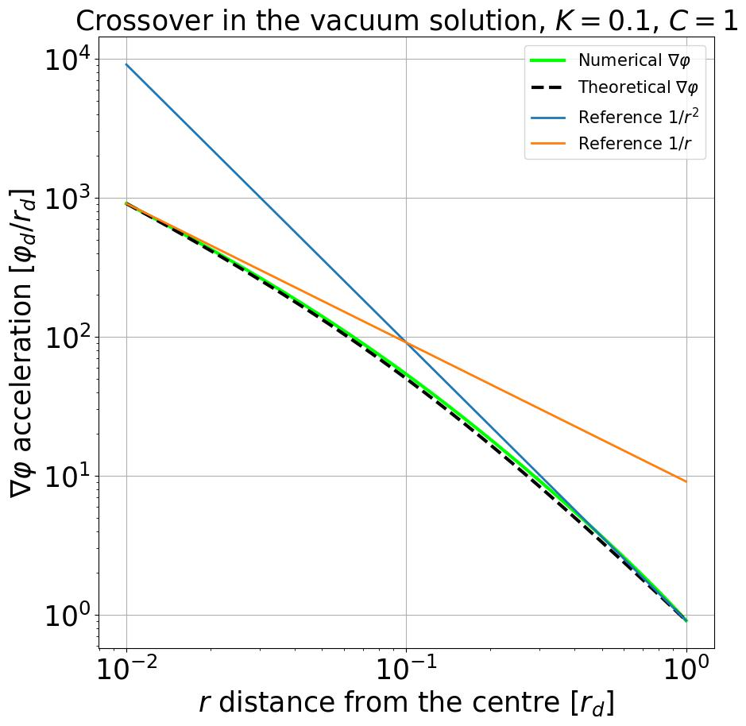
Vacuum solution
$g\left(r\right)=−\frac{1}{Kr+Cr^{2}}$
$φ\left(r\right)=\frac{1}{K}\ln\left(\frac{r}{K+Cr}\right)+φ_{0}$
In Newtonian limit:
$C=\frac{1}{GM}$
What does M mean here in the context of thermogravity?
ABE and VÁN, Symmetry 2022, 14(5), 1048

Slide 12
Why do we need Dark Matter?
Astronomical observations suggest an abundance of gravitating matter, more than what can be accounted for:
The dynamics of galaxies and galaxy clusters
Large-scale structure of the universe and CMB-anisotropies
Gravitational lensing

Slide 13
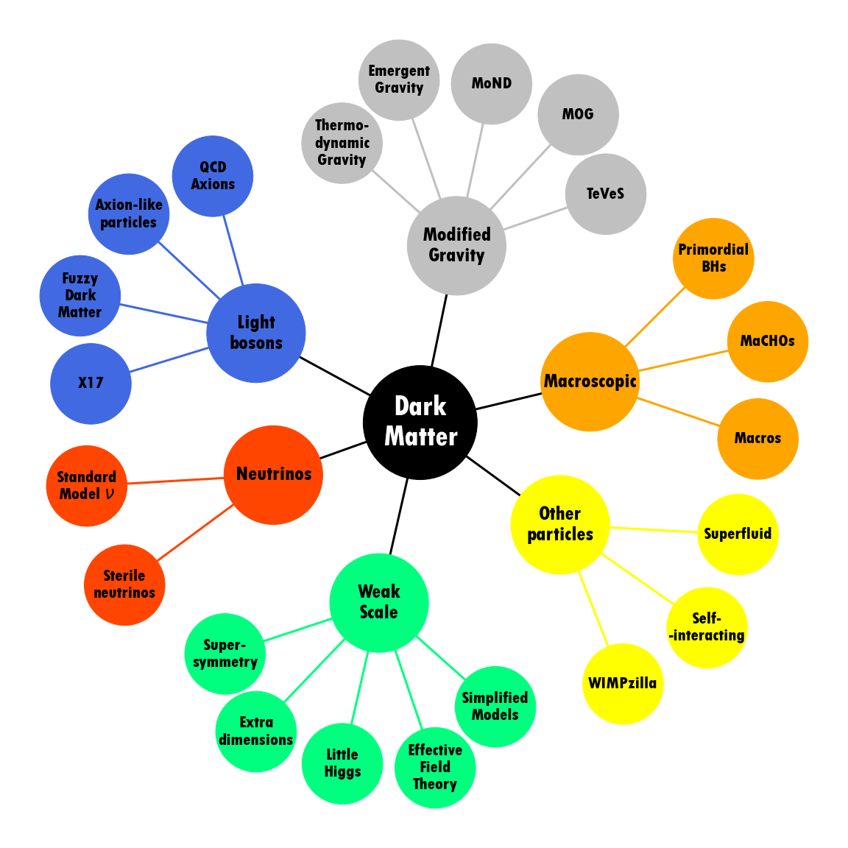
Own work, based on G. Bertone and T. M. P. Tait. Nature, 562(7725):51–56

Slide 14
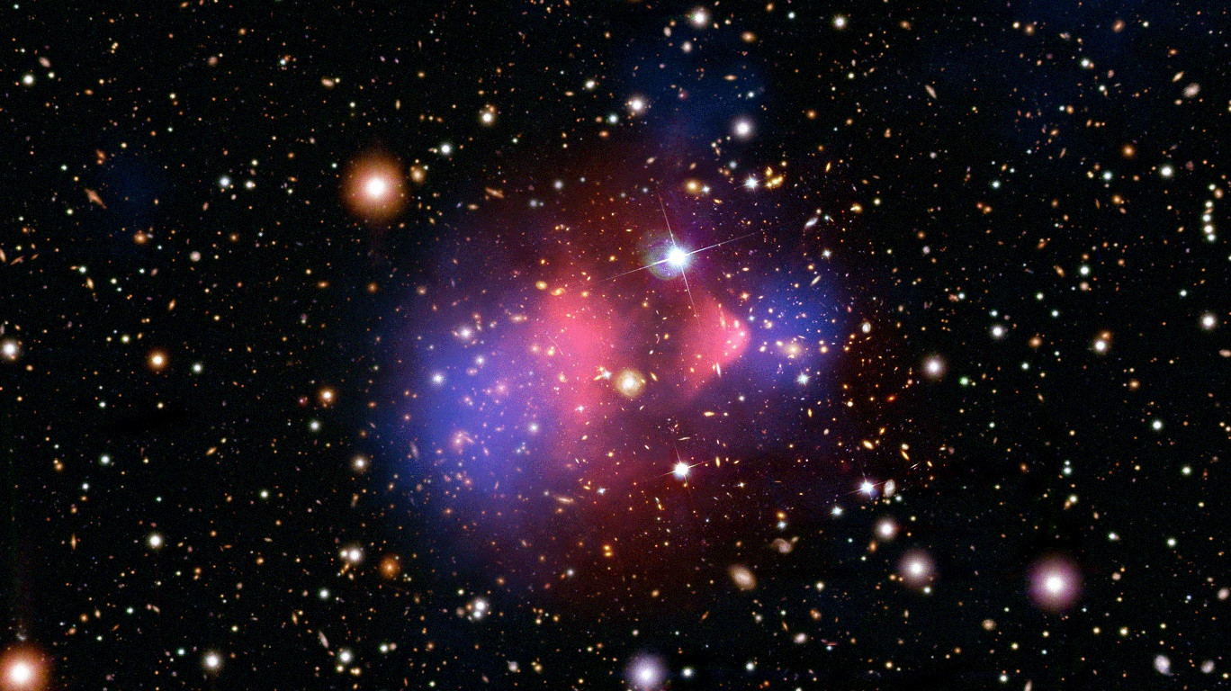
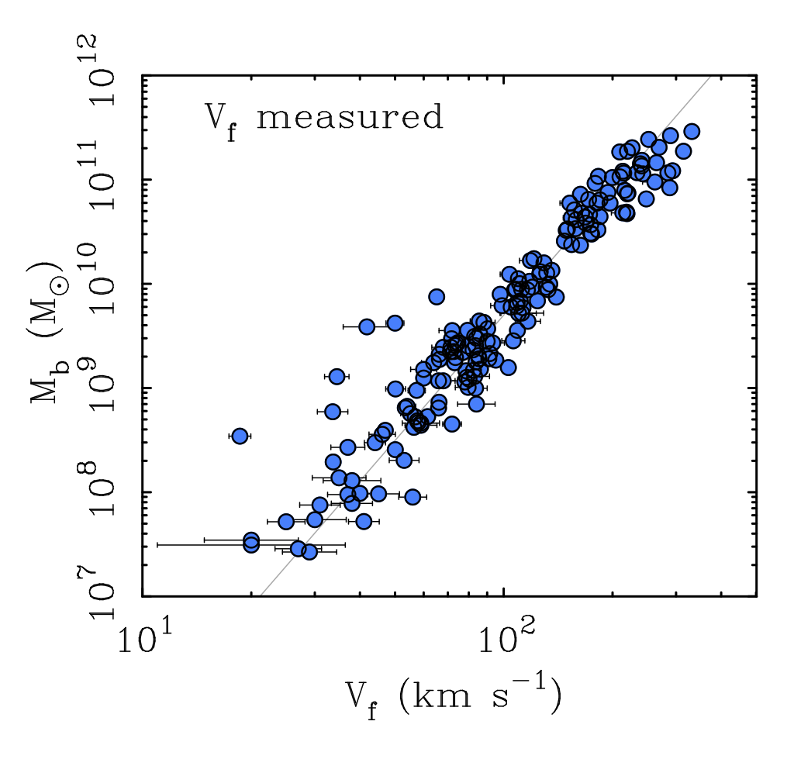
Is modified gravity better than dark matter?
Regularities in local scaling relations between baryons and dynamics in galaxies pose a problem for dark matter descriptions, but explain a broad range of observations
Left: Bullet Cluster (1E 0657-56),
X-ray (pink): NASA/CXC/CfA/M.Markevitch et al.;
Optical: NASA/STScI; Magellan/U.Arizona/D.Clowe et al.;
Lensing Map (blue): NASA/STScI; ESO WFI; Magellan/U.Arizona/D.Clowe et al.
Right: Baryonic Tully-Fisher relation
Stacy McGaugh

Slide 15
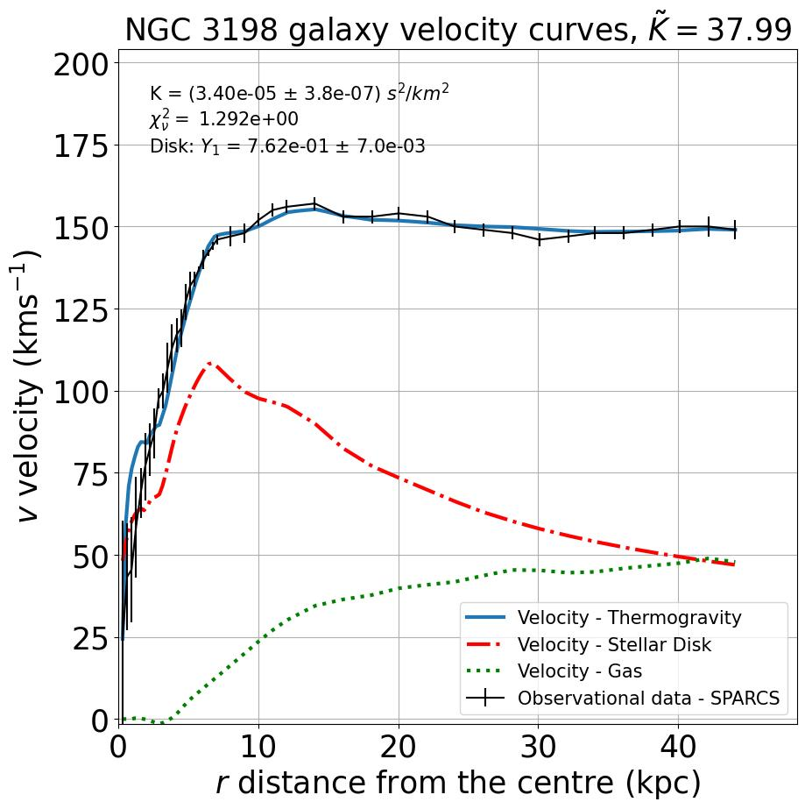
Galactic rotation curves
Thermodynamic gravity applied to observed density distributions
Comparable results to Dark Matter or MOND approaches (DOI 10.1016/j.dark.2024.101660):
Fewer parameters, but
Model | $$χ_{ν}^{2}$$
Thermodynamic gravity | 1.29
Dark matter – DC14 | 1.26
MOND – EFE realisation | 1.62

Slide 16
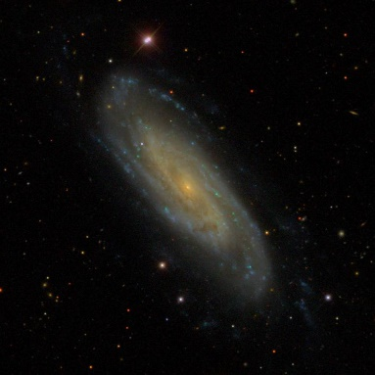
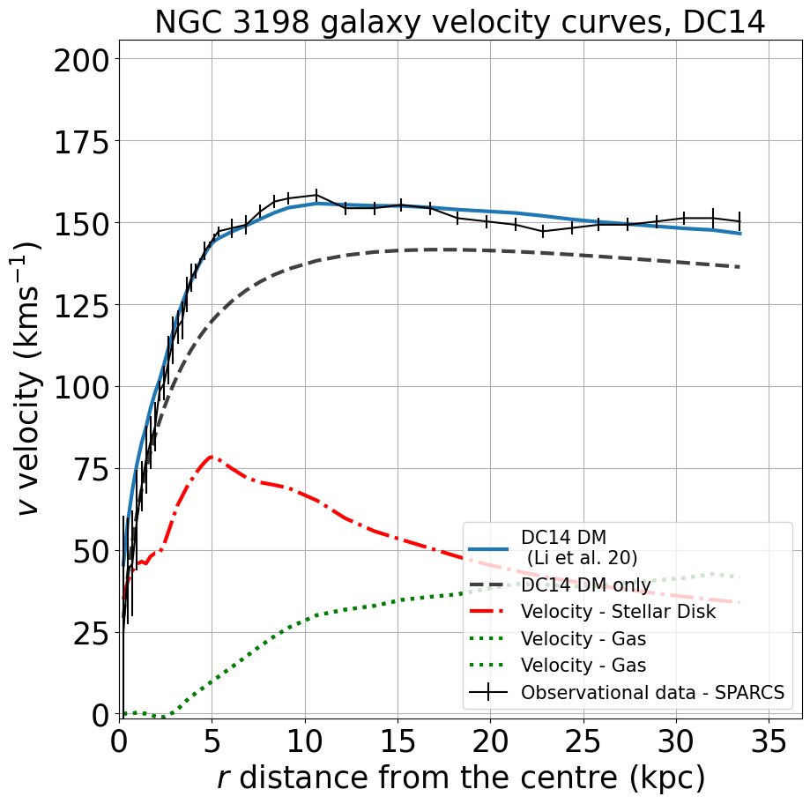
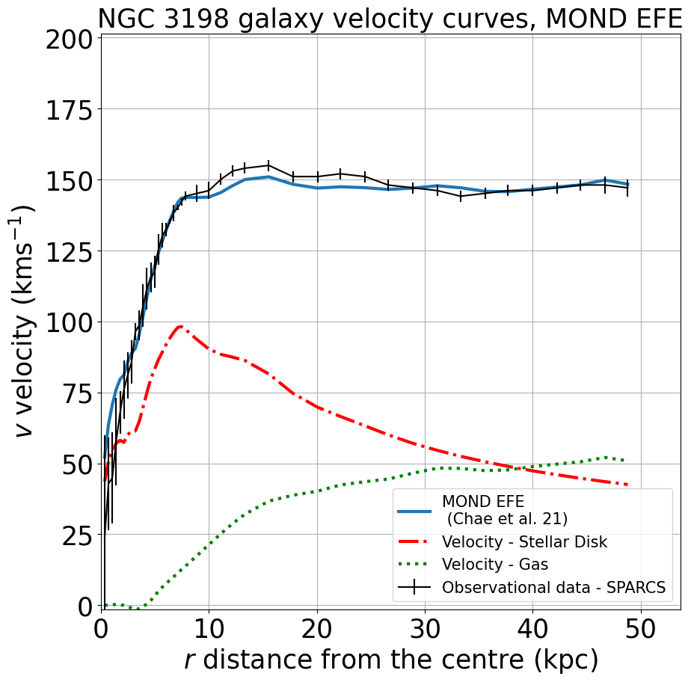
NGC 3198
Source: Sloan Digital Sky Survey
NGC 3198 rotation curves

Slide 17
Connection to quantum mechanics
Korteweg fluids – constitutive state variables: $(e, ∇e, ρ, ∇ρ,∇^{2}ρ,v, ∇v)$
Entropy production: $ρ\dot{s}+∇⋅J=q⋅∇\left.\left(\frac{1}{T}\right.\right)−\left.\left[ P−pI−\frac{ρ^{2}}{2}\left.\left( ∇⋅\frac{∂s}{∂∇ρ}I+∇\frac{∂s}{∂∇ρ}\right.\right)\right.\right]:\frac{∇v}{T}≥0$
Rigorous methods are needed: Liu’s procedure, as before
The resulting pressure has classical holographic property:
$$∇⋅P_{K}=ρ\left(∇φ+T∇s\right), where φ=\frac{∂ρu}{∂ρ}−∇⋅\frac{∂\left(ρu\right)}{∂∇ρ}=δ_{ρ}\left(ρu\right){\left.​\right|}_{ρs}$$
Additivity leads to Bohm potential: $φ_{Q}\left.\left(ρ,∇ρ,∇^{2}ρ\right.\right)=−\frac{ℏ^{2}}{2m^{2}}\frac{Δ\sqrt{ρ}}{\sqrt{ρ}},$ recover the Schrödinger equation
These fluids thus allow the modelling of quantum-classical transition
Notes:
Korteweg folyadékok olyan folyadékok, amik állapottere ki van egészítve grad-squared rho taggal, ekkor XY alakú entrópiaprodukció adódik
We use the same method as before
Holografikus tulajdonság a quantum mechanics esetén is fennáll, nem csak a korábban látott gravitációnál
A QM *is* szoros kapcsolatban van a hidrodinamikával, nem csak a gravitáció
Ismert: Schrödinger-egyenlet – transzformálható hidrodinamikai alakba, de ITT a részecske vs folyadék viszony a hidrodinamikában van benne

Slide 18
Connection to quantum mechanics
The derivation of evolution equations can be inverted: QM equations can be obtained using this hydrodynamic connection from thermodynamic principles
Using Liu’s procedure, the II. law alone produces holography and dynamics
QFT, GR can have fluid interpretation: Jackiw et al. (JP A, 2004), Biró and Ván (Foundation of Phys, 2015)
The connection of thermodynamics and gravity has also been explored by Jacobson (PRL 1995) and Verlinde (JHEP 2011)
Gradient fluids and/or fields
Superfluids and more
Quantum mechanics
Notes:
A Thermo evolúciós egyenletének származtatása megfordítható, a 2. főtételből következnek a QM egyenletei – hidrodinamikai kapcsolat, speciális folyadékként bukkan fel a nemrelat. Termo.
Holografikus tulajdonság a qmnél is fennáll, nem csak a korábban látott gravitációnál
2. főtétel magától vezet a holográfiára és a mozgásegyenletre ebben az esetben, míg korábban a 2. főtétel + holográfia együtt vezetett (Jacobson és Verlinde esetén feltevés volt)

Slide 19
Summary
Particle approach to DM has been a long and unfruitful search, while alternatives keep being developed
Models using hydrodynamic descriptions have potential for describing galactic dynamics
Thermodynamic gravity within the hydrodynamic framework offers a potentially powerful method for the description of dynamics on cosmological scales
Hydrodynamic description greatly benefits from a rigorous foundation and can be a thermodynamic link between QM and gravity
Notes:
Új gravitációs modell – új predikciókat ad
ÉS kapcsolódási pont a QM-el – egységes leírásban vannak

Slide 20
Thank you for your attention!
Main references:
Peter Ván and Sumiyoshi Abe. Emergence of extended Newtonian gravity from thermodynamics. Physica A: Statistical Mechanics and its Applications, 588:126505, 2022
P. Ván, Holographic fluids: A thermodynamic road to quantum physics, Physics of Fluids 35, 057105, 2023
L. Gavassino, M. Antonelli, and B. Haskell, When the entropy has no maximum: A new perspective on the instability of the first-order theories of dissipation, Phys. Rev. D 102, 043018, 2020
S. Abe and P. Ván. Crossover in Extended Newtonian Gravity Emerging from Thermodynamics. Symmetry, 14(5), 2022
M. Pszota and P. Ván. Field equation of thermodynamic gravity and galactic rotational curves. DOI 10.1016/j.dark.2024.101660, accepted in Physics of the Dark Universe, (arXiv:2306.01825v3)

Slide 21
Cosmological and galactic simulations
Evolution of ΛCDM halos in the fluid approximation (left)
N-body simulation (right)
Periodic boundary conditions
Scalar Field DM, Bose-Einstein condensate (superfluid) description
FOIDL, RINDLER-DALLER, and ZEILINGER, PHYS. REV. D 108, 043012 (2023)

