Slide 1

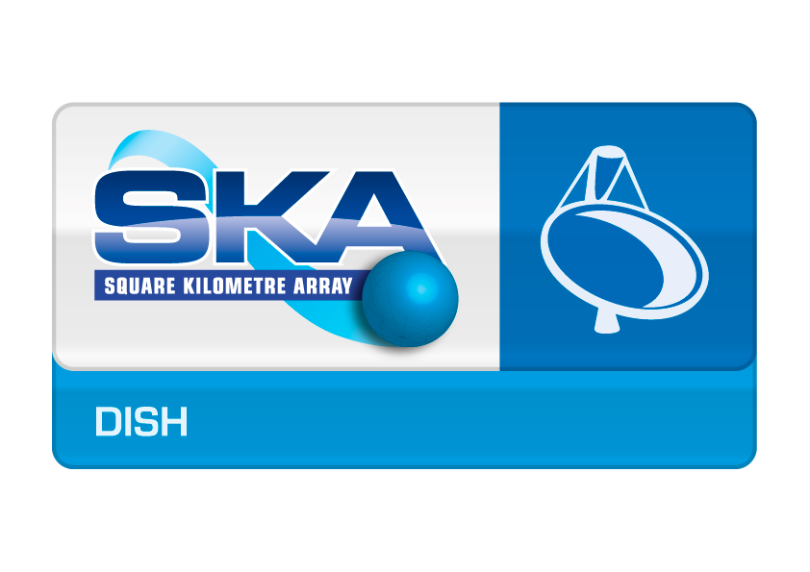
DISH LMC
Corrado Trigilio, Simone Riggi
LMC Standardization Workshop
Trieste 25-27 March 2015

Slide 2
Outline
Dish LMC Team
Dish Overview – SKA-Mid SKA-Survey after RBS
Dish LMC architecture
Dish LMC requirements
Technologies considered
Plans for prototyping
Preferred LMC common frameworks: TANGO, EPICS…?
Scope of LMC standardisation expected
2

Slide 3
DSH LMC team
INAF – Italy
Catania, Trieste, Noto
Corrado Trigilio,
Veronica Baldini, Ugo Becciani, Igor Coretti, Alessandro Costa, Adriano Ingallinera, Alessandro Marassi, Gaetano Nicotra, Carlo Nocita, Simone Riggi, Francesco Schillirò
JLRAT – China
Shijiazhuang
Zhang Yifan
Zhang Qiang, Qiao Jianjiang, Geng Xuguang, Zhang Bing, Chen Long
3

Slide 4

After Re-baseline:
SKA1 Mid:
incorporates 64 MeerKAT
70% of planned dishes → 133 Dishes
Maximum baselines 150 km (funds, or 120 km), not 200 km
Receiver bands 2,5,1
SKA1 Survey:
deferred
SKA PAF program initiated as part of a broader Advanced Instrumentation Program
Operation of ASKAP as integral component of SKA1
ASKAP as a platform for the development of new PAFs
4

Slide 5
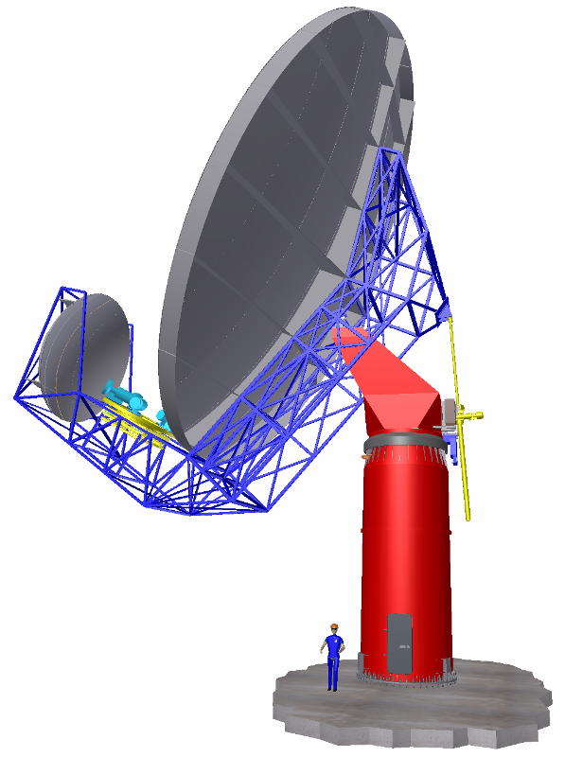

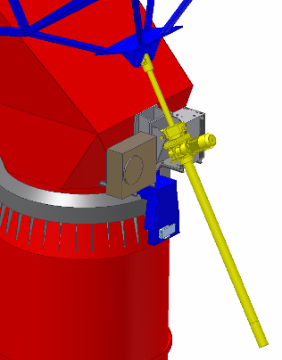
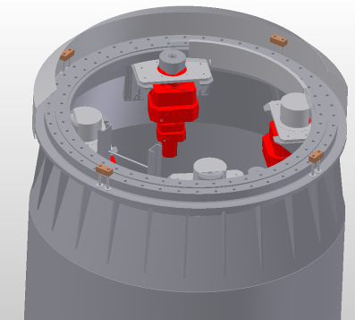
Dish Structure - Antenna Concept
Design: Gregorian, feedarm down; feeds at secondary focus
Elevation Actuator
Feed indexer
Main reflector
Backup Structure
Sub reflector
Turning Head
Feed and Sub-reflector Support Structure
Pedestal
Shielded (80 dB)
compartment with:
Azimuth actuator
Azimuth bearing
5
Notes:
5

Slide 6
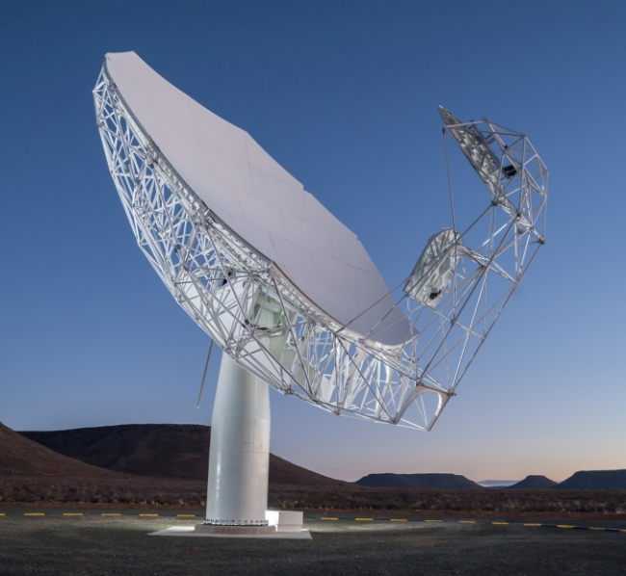
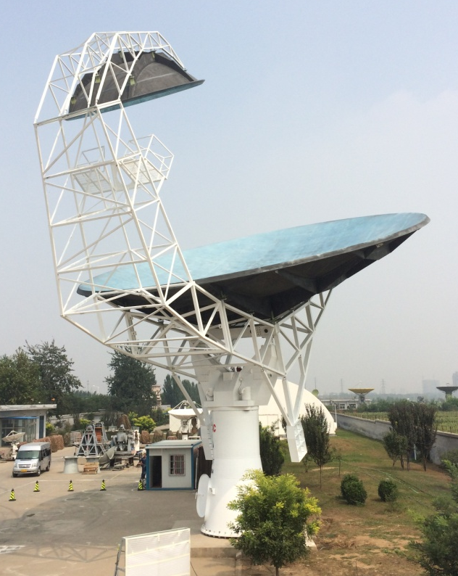
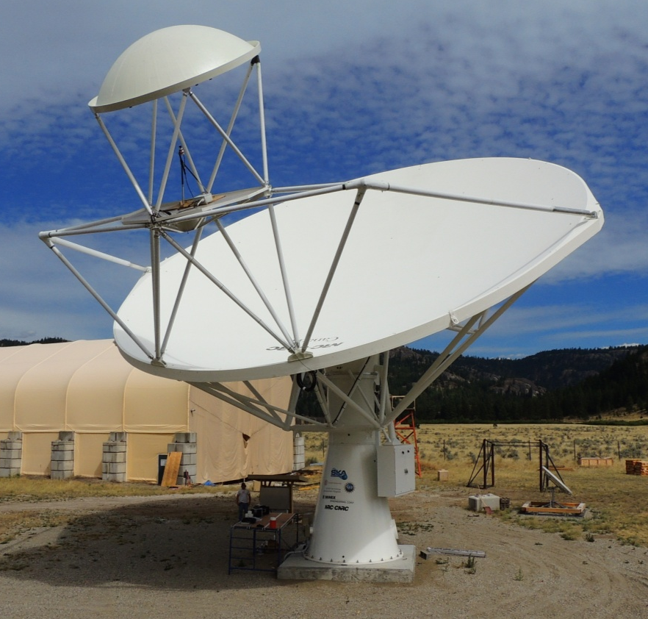
Dish Prototypes Assembled
SKA-P
MKT-1:
South Africa
March 2014
DVA-C:
JLRAT China
August 2014
DVA-1:
NRC Canada
July 2014
6

Slide 7
SKA-Mid: SPFs - Bands
Frequency Coverage for SKA1
SPF Bands
  2: 950-1760 MHz
  5: 4.6-13.8 GHz
  1: 350-1050 MHz
  3: 1.65-3.05 GHz
  4: 2.8-5.2 GHz
Priority
2
5
1
Log Freq/GHz
High priority bands for SKA-1 construction
7

Slide 8
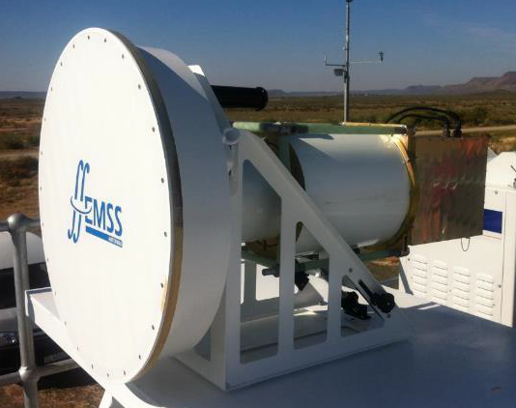
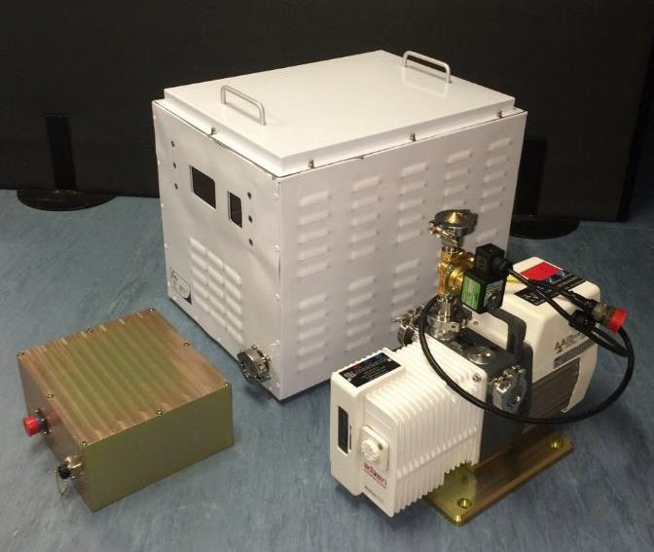
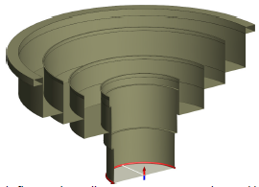
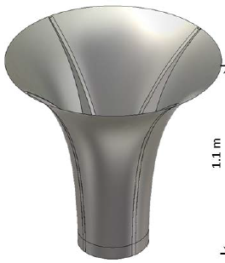
SKA-Mid: SPFs - Bands
Band 1 and 2 cryostat: LNAs to ~20K. Two amplification stages, calibration noise.
Bands 3, 4 and 5 in one cryostat. for Band 5 the entire system will be cooled.
He System: Common He system; single He compressor and supply at yoke.
Vacuum System: Rotary vane vacuum in indexer; vacuum lines to all SPF.
SPF controller: One controller in pedestal to C&M all three SPFs, He and vacuum systems, interfaces with the Dish LMC for external control and monitoring
Quad-ridge feed horn (QRFH) SPF Band 1
MeerKAT
vacuum assemblies
MeerKAT L-Band (EMSS) => Band 2
8

Slide 9
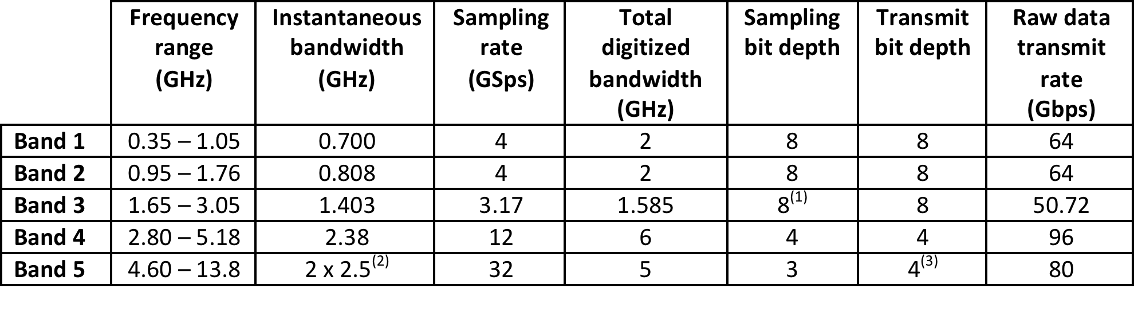
SKA-Mid: Receivers
From SPF to RX (location):
Pedestal with coax cables from feeds
Feed indexer (fibres to the SaDT and LMC)
Pedestal with RFoF links from feeds
Master Clock timer :
time and frequency reference (SaDT )
control of the calibration noise source
Digitisers:
RF conditioning (filtering and level control).
Bands 1-3 direct digitised (1 and 2 in the 1° and Band 3 in 2nd Nyquist zone)
Bands 4 & 5 are band selected and direct digitised
Band 5, two individually tuneable sub-bands of 2.5GHz bandwidth
Data packetised and transmitted to CSP
9

Slide 10
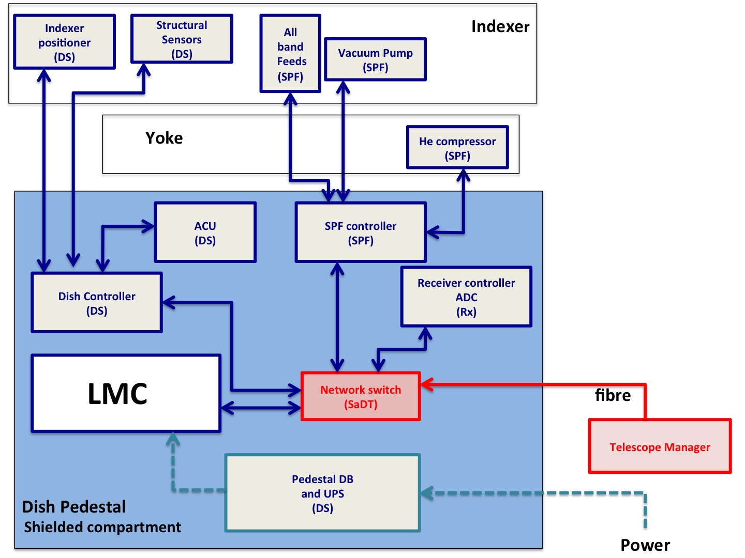
LMC physical overview
Blue: internal sub-elements and connections
Red: external elements and connections
Green: power links
Functional
External: TM
Internal:
    SPF
    Rx
    DS
10

Slide 11
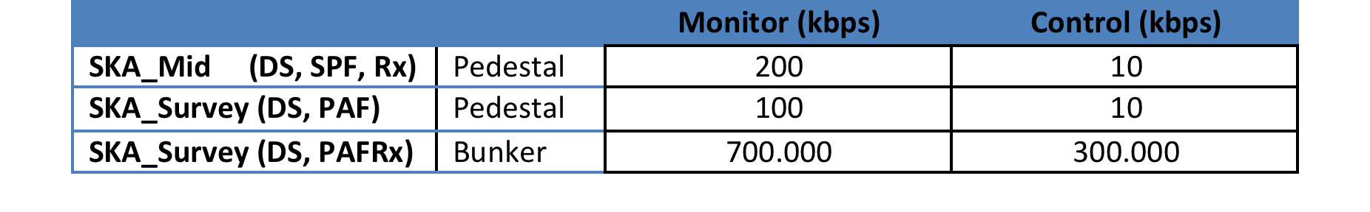
Data rate for SKA_Mid
11

Slide 12
Overview SKA-Sur – LMC perspective
DISH 2
1 computer in dish “LMC_DSH”
1 computer in Bunker “LMC_PAFRx”
BUNKER or
Block of 3 PAFRx in Central Building
LMC_DSH 2
DISH 1
PAF
Rx 2
LMC_DSH 1
PAF
Rx 1
LMC_PAFRx 2
PAF
Rx 3
data flow
>200 kbps
LMC_PAFRx 1
NS
LMC_PAFRx 3
data flow
3-4 Gbps
DISH 3
Network Switch (SaDT)
LMC_DSH 3
TM
data link not drawn
lines are only for monitor&control
12

Slide 13
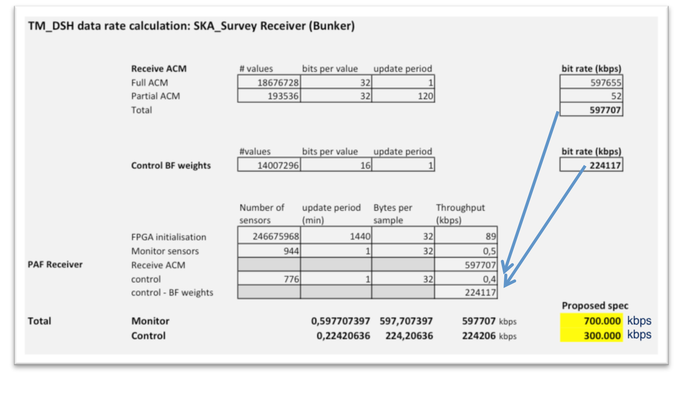
Data rate for SKA_Sur- PAF (bunker)
Total M&C ~ 1 Gbps
13

Slide 14
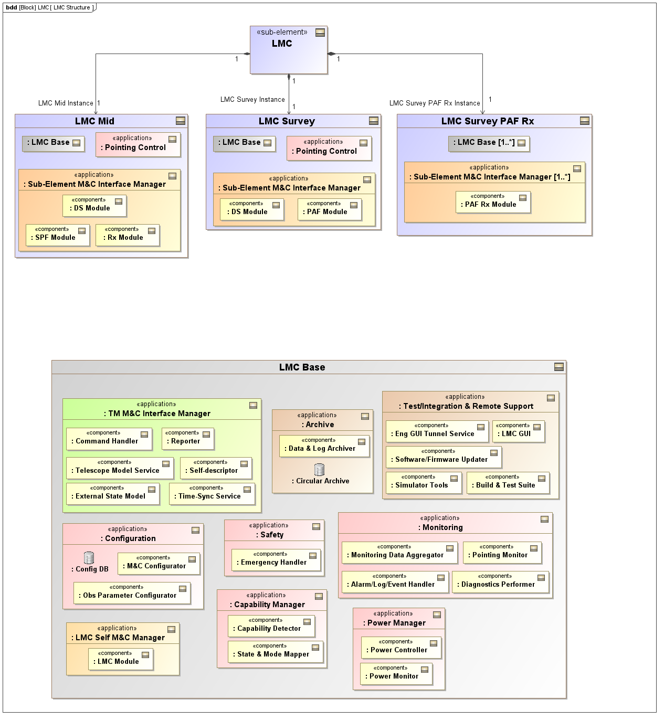
LMC software before RBS
Specific modules for SKA-Suvey will be developed later, as SKA-Suvey is deferred, not deleted.
The architecture shall be modular.
14

Slide 15
LMC software after RBS
15

Slide 16
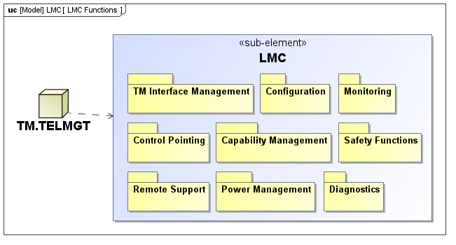
LMC functions
provided by LMC
required by TM.TELMGT or by an LMC operator
(Other functions - Sub-element and internal Functions - will be defined after ICD)
TM Interface Management Function
Configuration Functions
Monitoring Functions
Control Pointing Functions
Capability Management Functions
Safety Functions
Remote Support Functions
Power Management Functions
Diagnostics Functions
16

Slide 17
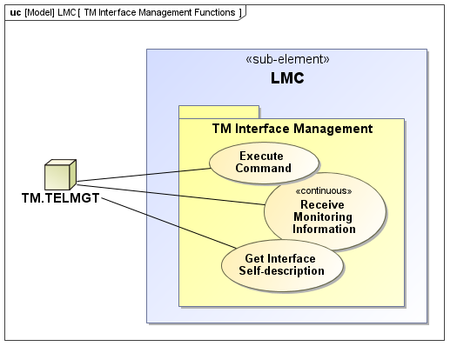
LMC functions - an example
Execute Command:
TM.TELMGT sends commands to LMC through the TM-LMC interface.
TM don’t know the LMC logic, components and protocol; it sends command to the appropriate LMC; conversion while executing the request. This function is allocated to the LMC Command Handler component.
Receive Monitoring Information: TM.TELMGT shall continuously receive monitoring data, meta-data and alarm/log/event/fault information from LMC.
Get Interface Self-Description of the interface with TM.TELMGT to facilitate configuration of monitoring interface. It includes a list of monitored information (monitoring parameters, states, capabilities) with corresponding attributes (range, units, alarm thresholds, polling rate...), a list of commands (name, args, expected response, ...) exposed on the interface.
17

Slide 18
LMC requirements
Configure DSH | Band switch time <100 ms Set all internal states, modes and configuration based on TM command LMC Configure/Report MID/SUR Capability (bands/PAFs) Configure Noise diode switching waveform
Control pointing | Receive pointing control (time stamped Az/El and PA by TM) Apply pointing corrections (pointing model by TM) Send to DS <100 ms
SKA-MID (+SURVEY Dish) LMC <-> TM max data rates | - 10 kbps for control data - 200 kbps for monitoring data
SKA-SURVEY – PAF RXs PAF Rx <-> LMC LMC <-> TM max data rates | - 300 000 kbps for control data - 700 000 kbps for monitoring data
18

Slide 19
LMC requirements
Manage equipment safety | LMC Extreme conditions stow, LMC TM comms fail stow
Manage TM_DSH interface | LMC configure TM_DSH interface, provide a self-description of DSH, use defined protocol.
Report Dish Monitoring Data | Aggregate Sensors, report Alarm, events, external states, failures, logs
Dish power consumption | LMC, when commanded by TM, shall send power control commands to DS according to power levels requested. When powering up, LMC shall command DS to remain in the lowest power level state
19

Slide 20
SKA-P construction & qualification
6 months at least
End PDR
(May 2015)
Pre-production model for Qualification
20

Slide 21
Towards an LMC Prototype
Internal ICD Status: LMC-SPF ICD currently under analysis
  Internal states/commands/monitoring data provided by SPF
  State mapping to SKA Control Model attempted, interactions with SPF required
Prototyping activities started with ICD development
  Goal I: explore internal standardization (message formats, protocols, ...)
  Goal II: evaluate different protocol solutions for LMC-SubEl comm
Prototype Modeling
  List of requirements for the internal communication set-up (many are now in the framework req doc)
  Preliminary communication model defined (message types and content, comm patterns expected, controller module, ...)
Prototype process
  Implement a prototype for the LMC module and the SubEl controller
  Prototypes to be implemented (time-consuming task)
    LMC: Tango, Sub-El: Tango, Zmq, Ice, KaTCP
    LMC: Epics4, Sub-El: Epics4, Zmq, Ice, KaTCP
  Rank protocols against requirements

Slide 22
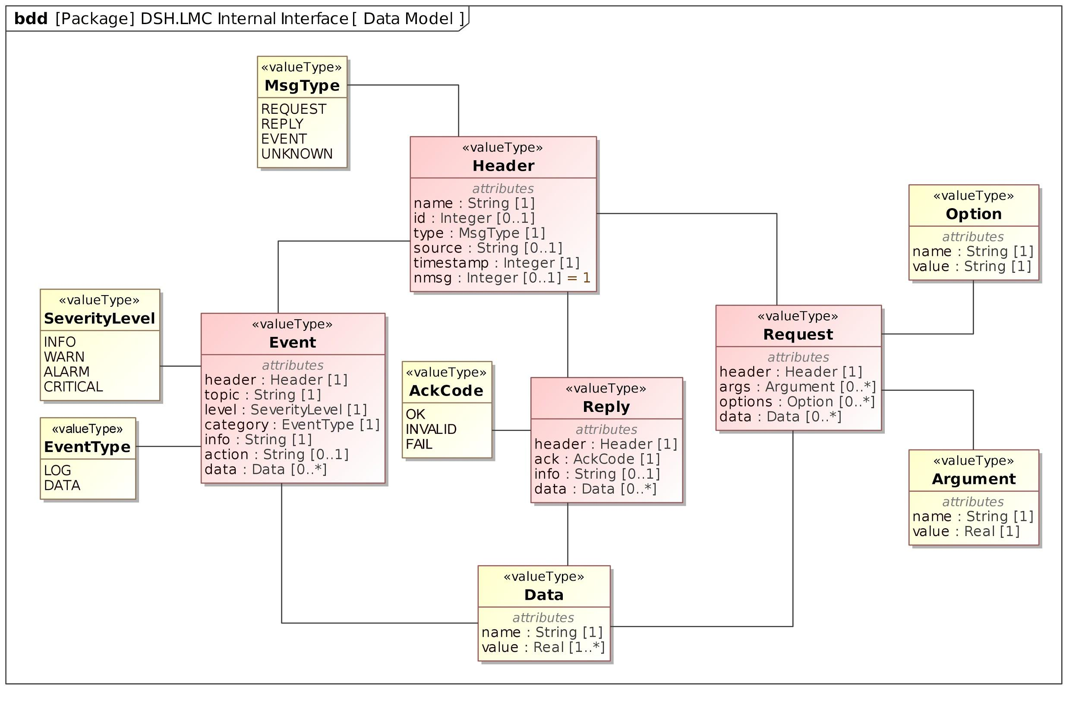
Message Model
Abstract message types inspired to KaTCP protocol: Request, Reply, Event
Message model implemented using middleware serialization schema
  ZeroMQ: Protobuf/MsgPack (binary), Json standard (human-readable)
  Ice: binary encoding via the internal Slice language
  Tango: limited structured data types, external serializer?
  KaTCP: native ascii encoding

Slide 23
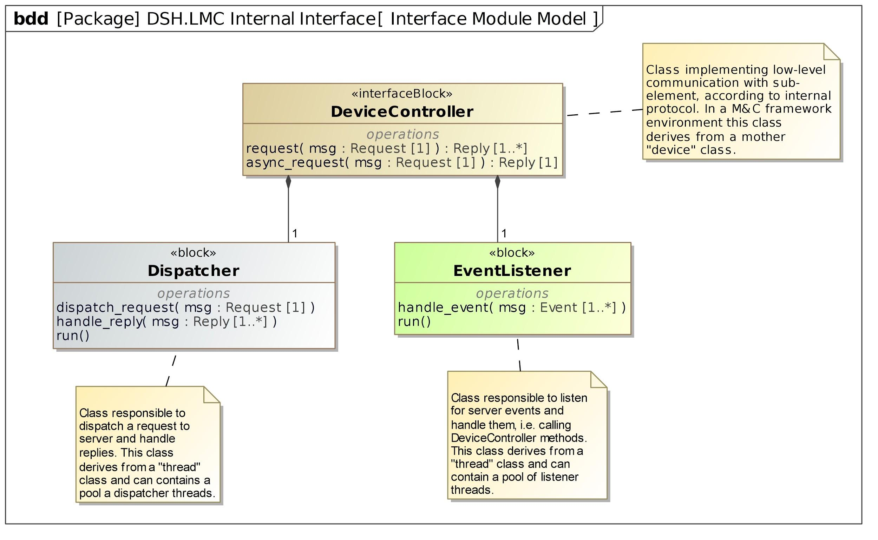
Device Controller Module
Device controller features:
  Methods to perform sync and async requests to SubEl server
  A dispatcher thread to serve async request and callbacks
  An event listener thread to receive filtered events from SubEl server and react on them

Slide 24
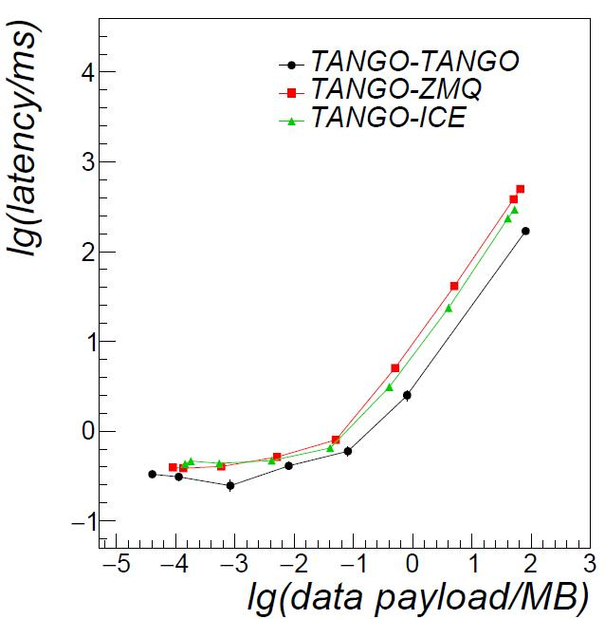
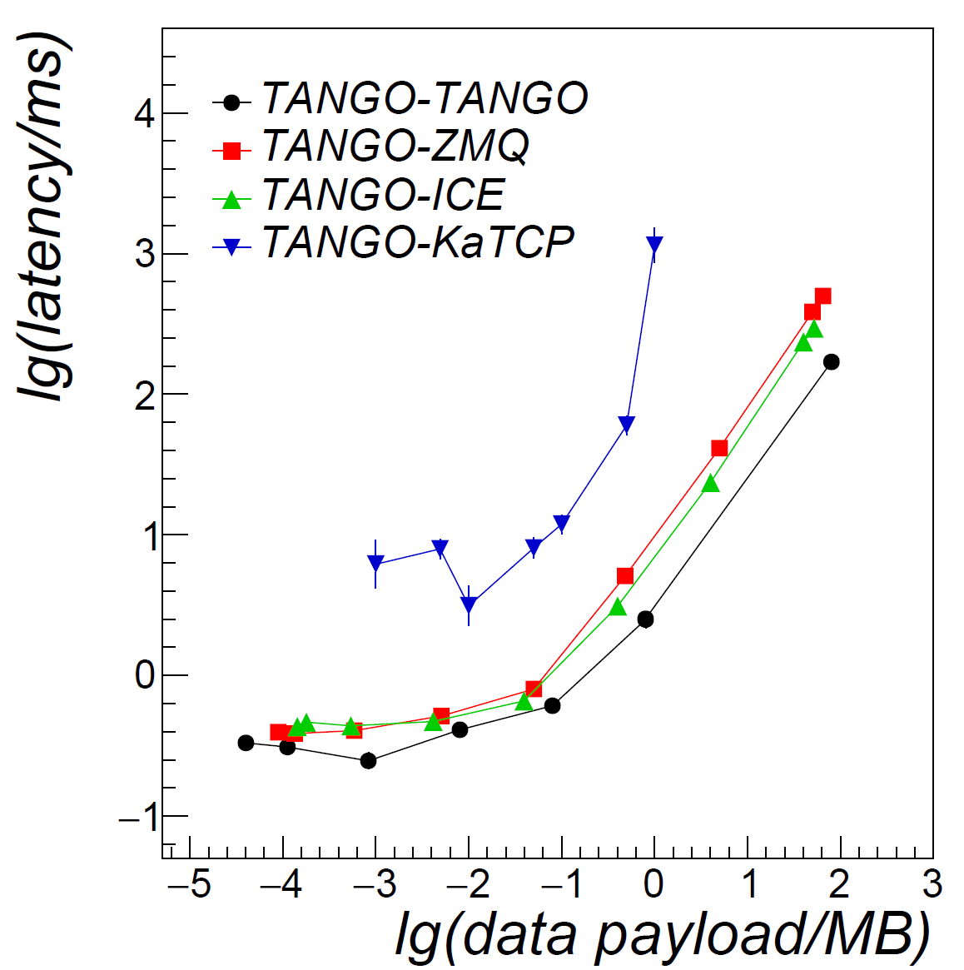
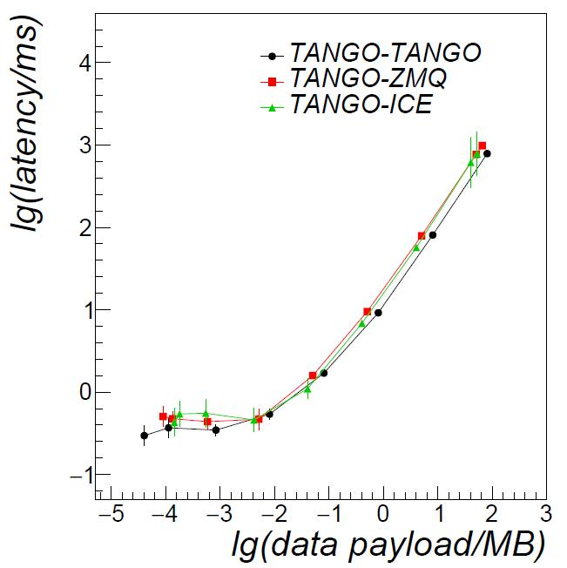
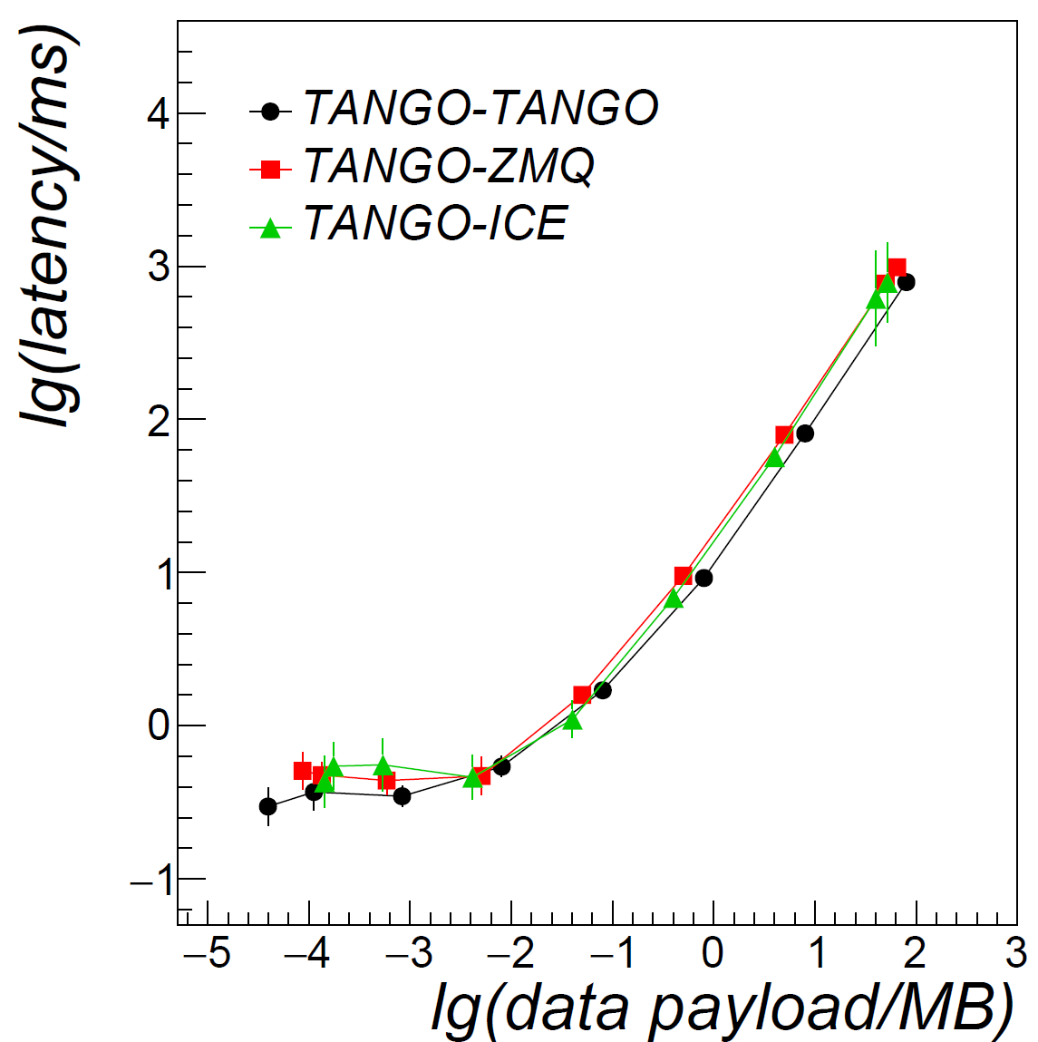
Preliminary test results
Loopback
Network 1 Gbps
Tango prototypes implemented (still incomplete)
  Tango-Tango (C++): message payload is a 1D float array
  Tango-Zmq (C++): message model implemented with Protobuf/MsgPack/Json libs
  Tango-Ice (C++): message model implemented via Slice language
  Tango-KaTCP (python): payload is a message string
Latency tests for pub-sub vs message payload (MB)
  others to come (data throughput, increase number of subscribers, ...)
To be implemented: Epics prototypes

Slide 25
Middleware Evaluation
Key constraining requirements
  Reliability, maturity, modernity: from literature surveys/reports, developer teams
  API completeness (language/data type support, features, ...), learning curve (documentation, data types, ...): from doc inspection, hands-on, expert opinion
  Performance reqs: LMC reqs, small prototypes needed
  Internal logic/philosophy: more related to architecture, personal taste...
Preliminary score assigned to some candidate middlewares
  Zmq & Ice have higher score: QoS, modernity, maturity
  Many reqs requires further investigation (doc/tutorials, tests, expert opinion, ...)
Some example (mandatory) requirements scored: Score 0-3
Description | Tango | ZMQ | ICE | KaTCP | Epics3 (4)
Interoperability The middleware shall provide consistent and high-quality API, enabling interoperability among components developed in different programming languages, at least C++, Java and Python, for both server and client side. | 2 | 3 | 3 | 1 | 2 (2?)
Data types The middleware shall support to exchange, independently on the programming language adopted, scalar data types, 1D/2D arrays of scalar types and structures of scalar/array types. | 2 | 3 | 3 | 1 | 1 (3?)
PAF ACM Transfer Latency The middleware shall allow to publish up to 72 MB (ACM full matrix list) to TBD clients in less than 1 s (TBC) | 2 | 2 | 2 | 0 | TBD

Slide 26
Technology Summary
Technology under review according to:
surveys, precursor experience, LMC architecture and reqs, previous experiences...
Non-exhaustive list, open to consider suggestions from other teams
Category | Technology | Comments
M&C framework | TANGO, EPICSv4 | Most mature products
Middleware | ZeroMQ, ZeroC ICE, KaTCP | Used @ Cern, ASKAP, Meerkat
System Monitoring | Nagios
Message Formats | Google Protobuf, MsgPack, JSON | If not using native framework/middleware serialization
GUI | QT, Javascript-based Web Framework (i.e. MEAN, ...) | If not using native framework GUIs GUI analysis to be performed yet
Archiving | File-based (i.e. ROOT, ...) | Only circular archive (24 h) required. No need for DB archive (TBC)
Dev. and Integration Tools | Eclipse, SVN, Jenkins, ... | to be investigated yet.
OS/Virtualization | Ubuntu/Scientific Linux Virtualbox, ProxMox | to be investigated yet

Slide 27
LMC Standardization Levels
Level 1 mandatory
Level 2 preferable
Level 3 preferable
Level 4 optional
Level 5 optional
TM-LMC communication
+ unique middleware for TM-LMC comm
+ message/command/data/event types, format
+ common states/modes/...
LMC-SubEl communication
+ same TM-LMC middleware for internal comm
+ extend all conventions internally
Common M&C Framework
(mandatory features)
+ unique M&C framework for TM and LMCs
+ internal middleware, M&C logic, logging
Common M&C Framework
(non-mandatory features)
+ archiving, GUI, administration, ...
Development & Deploy Strategy
+ design approach, dev tools
+ deployment strategy (i.e. virtualization tools)
+ supporting hardware/OS platforms
+ other technologies ...
Level 1: No need for LMC to join the middleware evaluation, plain middleware expected
Level 2-3: LMC impacted, provides input to LIG dev, join the framework evaluation
  Check if Dish SubElements agree to follow standardization (TBC)
Level 4-5: Nice to have, but focus first to converge on Levels 2-3

Slide 28
Summary
After RBS: both Mid and Survey to be considered
Strong requirements for PAF
Several technology considered
Same communication protocol for internal and external preferred
Preliminary tests on data transfer
DSH.LMC prefers object oriented/modular framework
Is June/July 2015 a good deadline to define a common framework?

Slide 29

Thank you

Slide 30
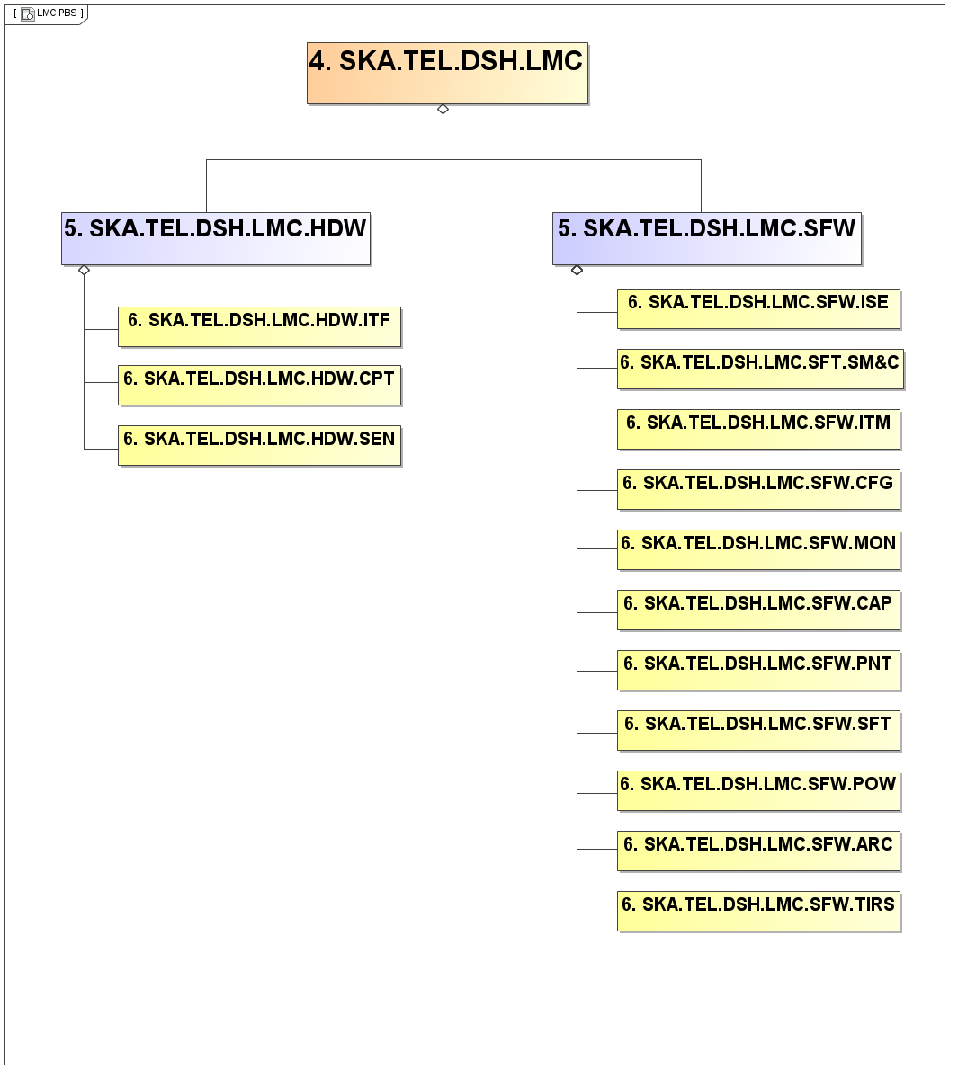
DSH.LMC PBS (software)
Sub-el Interface Manager (commun, control, monitor sub-el)
LMC Self Mon Manager
TM Interface Manager (commands,reporter, telescope model…)
Configuration, obs parameters
Monitoring (Aggregator, Pointing Alarms, diagnostic)
Capability Manager (Capability Detector, State and Mode Mapper)
Pointing Control, local correction for telescope model
Safety, Emergency Handler
Power Manager monit of power distribution, UPS
Internal Archive, circular buffer
Test, Integration and Remote Support, GUI, tunneling
30

Slide 31
DSH.LMC hierarchical structure
TM
Interface TM
Sub El Mng
LMC self M
Config
Monitor aggre
Capability Mng
Sub-el Interface Manager (commun, control, monitor sub-el)
LMC Self Mon Manager
TM Interface Manager (commands,reporter, telescope model…)
Configuration, obs parameters
Monitoring (Aggregator, Pointing Alarms, diagnostic)
Capability Manager (Capability Detector, State and Mode Mapper)
Pointing Control, local correction for telescope model
Safety, Emergency Handler
Power Manager monit of power distribution, UPS
Internal Archive, circular buffer
Test, Integration and Remote Support, GUI, tunneling
31

Slide 32
Data rate for SKA_Sur- DISH

Slide 33
SKA Mid: Single Pixel Feeds (SPFs)
Design and prototype feed elements for all 5 SPF bands
Optimize feed types with optical configurations
  down-select to final design
Design and prototype low noise amplifiers (LNAs)
Design and prototype three cryostats
  one each for Bands 1 and 2; one for all of Bands 3-5
Design and prototype helium and vacuum services
Integrate SPF packages
Develop test and calibration equipment

Slide 35
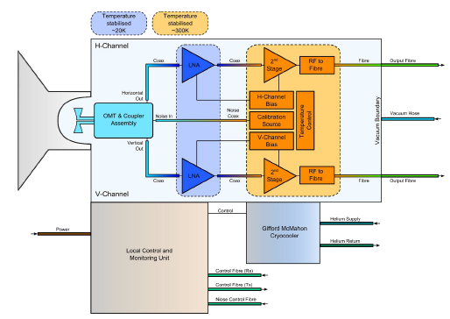
SKA-Mid: SPFs - Bands
SPF Bands
  2: 950-1760 MHz
  5: 4.6-13.8 GHz
  1: 350-1050 MHz
  3: 1.65-3.05 GHz
  4: 2.8-5.2 GHz
Block diagram for SPF Band 2
High priority bands for SKA-1 construction

Slide 36
DSH.LMC PBS (hardware)
Interfaces (cables, connectors)
Computing Resources (computing elements, chassis, storage)
Sensors (intrusion, flooding, dust, fire and smoke )
36

Slide 37
DSH.LMC Work Plan
Standardization Outcomes
-needed to refine architecture, start training/development
-expected before July 2015
Current Activity
- States/Modes for Sub-Elements
-Mapping to SKA Control Model
-Commands/Monitoring Points
-Deriving/refining LMC L5 Reqs
- Build simple prototypes
PDR Feb 2015 | Re-Baselining Mar 2015 | ICD Apr 2015 | DDR May 2015 | ? | Prototype Test Apr-Oct 2016 | CDR Nov 2016
Main impact
- LMC Survey canceled
-SPF Band 5 added
Prototype Testing
-Signal path LMC+SPF+Rx
-Test Location: Karoo (SA)
-Any test with TM?

Slide 38
a Trieste come sapete è prevista una presentazione di 30 min del nostro LMC. Le cose da riportare sono elencate su https://www.ict.inaf.it/indico/event/74/program). Mi chiedevo rispetto ad ogni punto cosa abbiamo pronto e cosa invece richiede del lavoro aggiuntivo:
1) Element architecture and proposed M&C designs and architectural solutions: OK! riportare quello messo nella PDR
2) Requirements and issues related to monitor and control within each Element: OK! riportare i punti critici dei requisiti di LMC
3) Assumptions made so far:
3.1 Technologies considered, investigated and/or used (in the case where a working prototype already exists)
Control Frameworks: TANGO, EPICS
Communication Protocol/Middlewares: ZeroMQ, ZeroC ICE. KATCP
Serialization Libraries/Standards: Protocol Buffer, MsgPack, JSON (others Capn' Proto)
GUI Technologies: QT, MEAN stack (i.e. NodeJS+AngularJS)
Database Technologies: MySQL no need for archiving database for LMC
Virtualization Technologies: VirtualBox, ProxMox (Meerkat)?
Development Environment & Tools: SVN, Doxygen, Eclipse? Jenkins?
Altro?
3.2 Plans for prototyping, state of existing prototypes
Questo punto richiede lavoro? Qualcosa di prototipaggio avevo cominciato a farlo...Cosa suggerite di presentare qui?
3.3 Short list of preferred LMC common frameworks to be evaluated: OK semplicemente riportare TANGO, EPICS come detto nella PDR?
3.4 Scope of LMC standardisation expected / required / preferred (protocols and communications middleware; but what about GUI frameworks, M&C design approaches and architectural solutions, supporting tools and computing platforms, development environments, etc).
In parte detto nel punto 3.1. Tempo fa volevo fare una survey delle tecnologie richieste dai sub-elements, ma non mi avete più fatto sapere se volete mandarla o no. Secondo me è importante per poter compilare i requisiti framework di DSH.LMC (cosa che dovremo fare entro un paio di settimane). Io ho scritto per il TM il documento che a breve arriverà agli LMC.

