Slide 1
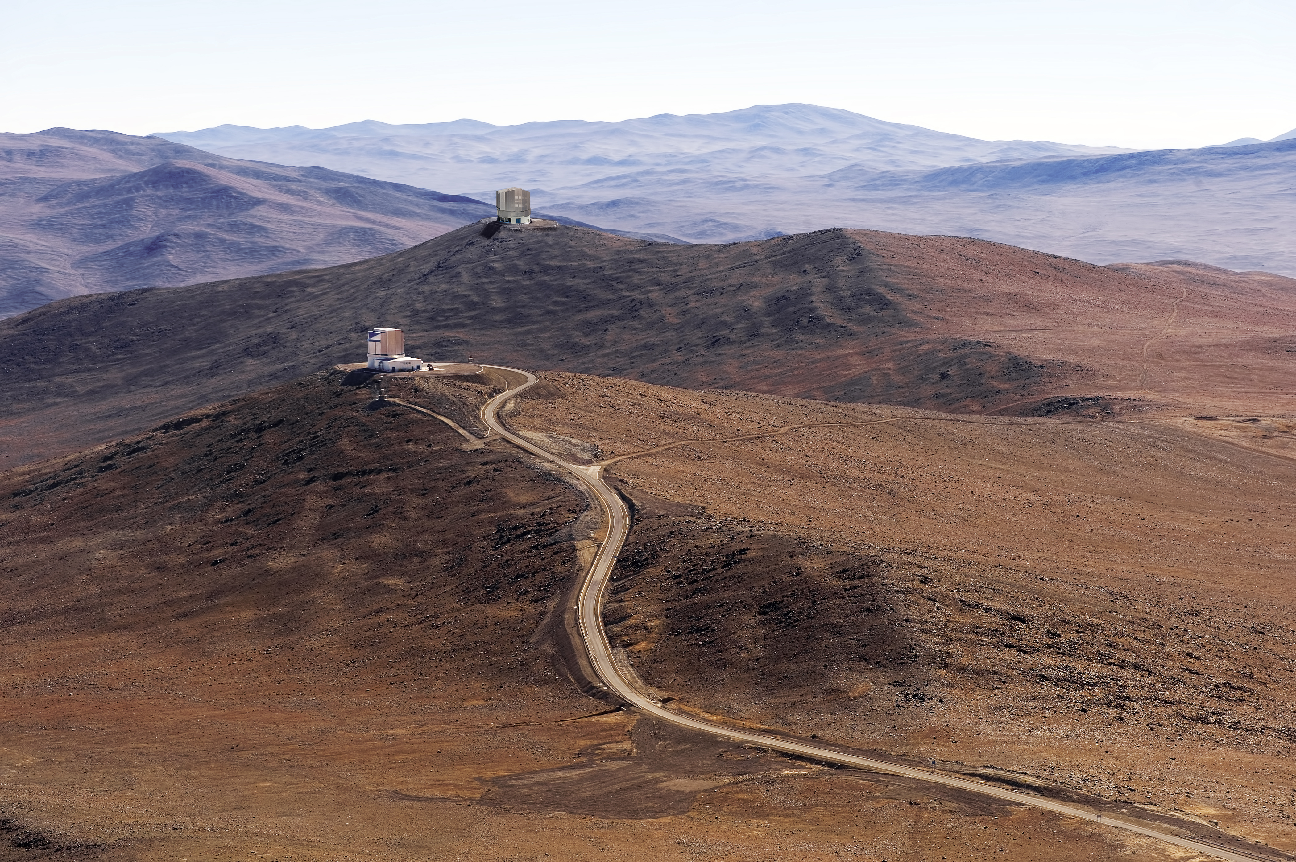
Future Spectroscopic Facility
L. Pasquini, ESO
B. Delabre, R. Ellis, J. Marrero, L. Cavaller

Slide 2
What
A Study Concept – Not a Project
Facility (Telescope & Instruments):
  Telescope > 10M
  Large Field of View
  Large Multiplex
  Dedicated
  In the Southern Emiphere

Slide 3
ESO Science Priorities - I
Q: What is most important capability for your research in 2020-2030?
1775 overall responses out of 9350 polled (20%)
ESO Messenger #161 September 2015

Slide 4
ESO Science Priorities - II
Q: What facilities are most required for your research in 2020-2030?
4575 answers (avg. 3 per respondent)
The most desired facility not being constructed by ESO

Slide 5
Technical genesis
Missing facility..
Something new….
Instrument friendly
Targeted– concepts presented at SPIE 2016

Slide 6
The ‘Ring’ Telescope

Slide 7
The ‘Fibre’ Telescope

Slide 8
A Highly Requested Facility
Australian decadal plan 2016-2025
NOAO: LSST best complement (Najita et al. 2016)
French-Canadian MSE: Science cases & proposal (McConnachie et al. 2016, 2018)
ESO working group… (R. Ellis, Chair , ESO)
  Missing facility with highest demand from community survey
Ellis et al. 2017: 2017arXiv170101976E

Slide 9
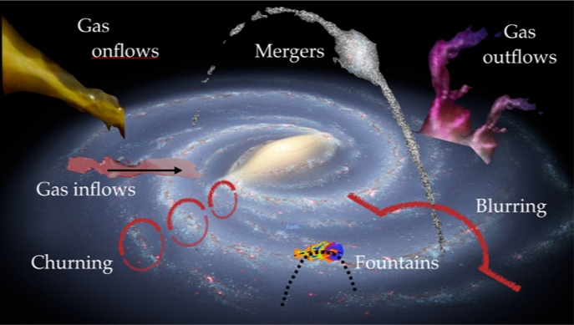
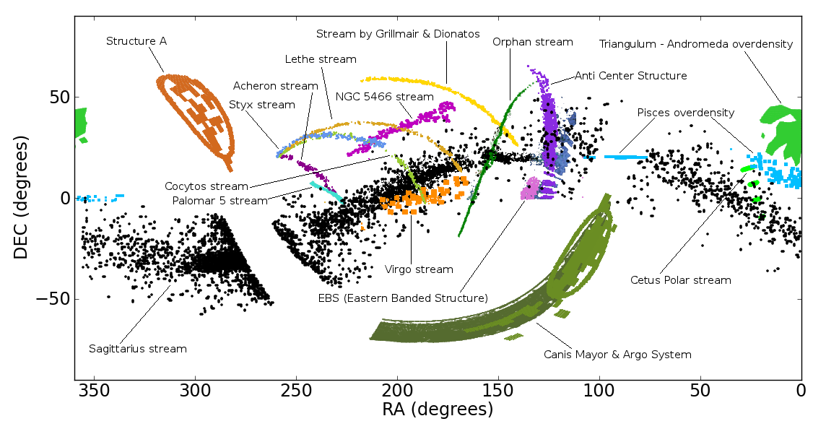
Galactic Science
The Milky Way as a Model Organism
Stellar chemistry and kinematics as probes of physical processes for galaxy assembly
Kinematics and ages of stars in Galactic streams as probe of the dark matter halo
A. Recio-Blanco
P. Diez
Ages, abundances & orbits of ~50-100 million stars throughout the Local Group

Slide 10
Four key answers
Galactic gravitational potential and role of dark matter
  3D distribution of DM in Galaxy and its visible satellites
  Evidence for low-mass dark halos (a key prediction of CDM)
Assembly history of a prototypical large galaxy
  Is this consistent with hierarchical cosmology?
  `Chemical tagging’ allows identification of widely-dispersed stars of common origin
Stellar physics and origin of the chemical elements
  Connecting nucleosynthetic yield with star formation history, gaseous inflow/outflows
  Formation of heavy elements e.g. r-process
Local group satellites as tests of low mass galaxy formation models
  Connection to earliest sources in re-ionisation era

Slide 11
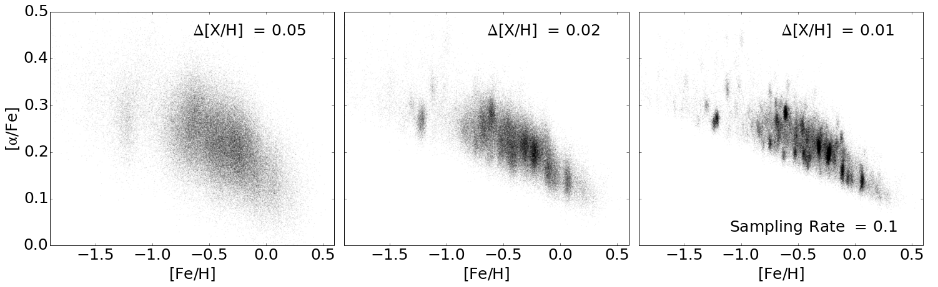
Illustrative Survey
R~20,000-40,000 spectra of 85M stars with m_{V}<17
Sharma et al 2011
Stellar target densities at V~17 range from 600 to 10,000 deg⁻² : a high multiplex requirement (N~5000)
Kinematic data can be secured to fainter limits
Precise abundances in 1-2 hours
Such an ambitious survey would take ~5 years
Ting et al 2016

Slide 12
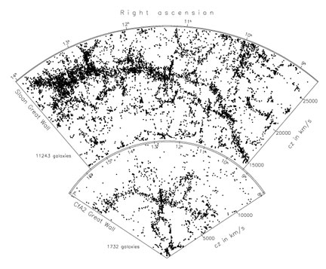
Extragalactic Science
➜ ?
Planck CMB
SDSS z < 0.1
The major goal is to chart the evolving 3D structure of the cosmic web and link this to the assembly history and chemical enrichment of galaxies and their circumgalactic gas
But reaching beyond z~1 to the peak of SF activity is prohibitive with current facilities.

Slide 13
Illustrative Surveys
Evolution of the Cosmic Web 1 < z < 4
  6 × 1 Gpc³ redshift bins each containing 10⁶ galaxies
  Magnitude limit ranges from i_{AB}~23.1 (z~1) to 25.8 (z~4)
  Emission line redshifts requires 2–7 hrs
  Lyα absorption tomography @ z~2.3-3 also requires 2-7 hrs
  Concurrent R~1000 surveys would take 400 nights (3-5 yrs)
  Commensurate with e.g. investment made by PFS
Baryonic cycle via stellar/ISM studies @ z~2.5-4
  Higher s/n~10 per Å and R~3000 for absorption lines
  Targetting i_{AB}~24 requires 20-50 hrs
  Diverting 5% of fibres in parallel with Cosmic Web survey yields 2 x 10⁵ high quality spectra (100 × VANDELS)

Slide 14
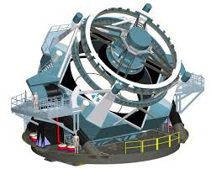
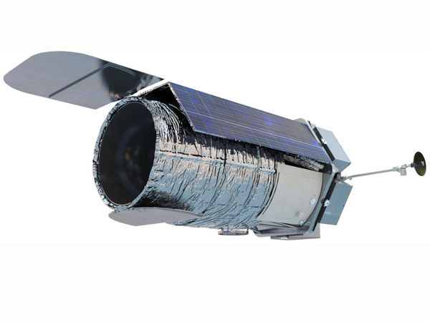
LSST and Transient Science
What Response to LSST?
LSST will transform searches for time-dependent phenomena, a major growth area in astrophysics
Science themes include:
  Classical SNe – astrophysics and cosmology
  Rarer events – SNe Ib/c, SLSNe, GW events, kilonovae, gap transients, tidal disruption events…smoking guns !
  AGN – reverberation mapping
Distinguish between follow-up of rare live events and accumulated transpired events where host galaxy redshifts and local environment properties will be ascertained
~300000 SNe/Yr – 10-20 live events ~400 transpired/field...

Slide 15
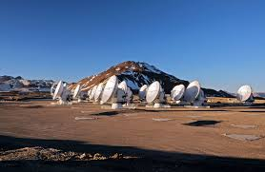
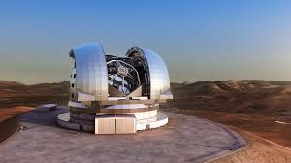
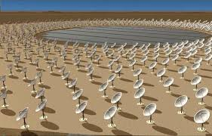
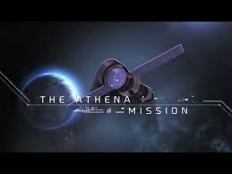
Synergies! Legacy!
A well-sampled deep spectroscopic survey of 1<z<4 galaxies over ~200+ deg² will provide legacy data for studies of sources located by a range of ground- and space-based observatories
GAIA, Euclide, LSST …
Specifically for the ELT there will be many synergies, e.g.
  MOS on ELT would trace the DM in finer detail (~1 Mpc) in denser regions in coordination with the wide field telescope
  HIRES will provide metallic absorption line spectra for 15-20 QSOs at z~2-3 per wide telescope FOV enabling the proposed facility to associate galaxies with the local IGM chemistry
  Rare, smoking gun objects for ELT follow-up!

Slide 16
Science Requirements (ESO WG)
Diameter > 10 m
FOV = 5 deg² (~25 X VLT, or ~25 X full Moon)
N_{obj} = >5000 LR, ~5000 HR
R = 1000-3000 LR, 20-40000 HR
Δλ = 360-1000 nm LR, 3(TBD) regions for HR
IFU: FOV>3x3 arcmin, R~5000, Δλ =325 - 1000 Nm
Non-science requirements (project)
  Use same LR spectrograph for IFU and fibres
  Use E-ELT components, located in ESO site
  Ambitious: Enhancing by > 10 existing/planned facilities

Slide 17
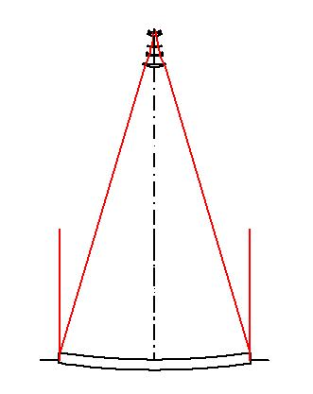
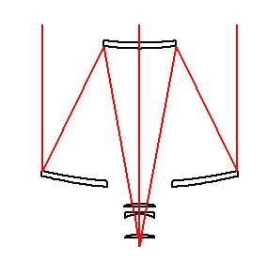
A Telescope Option
Is a 10-12m class telescope with a ~5 deg² FOV possible?
MSE and ESO study
(same scale)
Cassegrain design is compact & flexible
11.4m f/0.6 primary with a 5 deg² f/3 field ideal for fibres with good images from 360-1300nm.
Gravity-invariant f/26 Coudé focus with 10 arcmin FOV suitable for a Super-IFU
Pasquini et al SPIE 9906 arXiv 1606.06494

Slide 18
11.4M telescope
11.4m Telescope
2.5 °
Field of view
11.4 m
Silica lenses
(1.8m)
F/3.0
4.2 m
Exit beam
Concentric to
Exit pupil
11.4m- 2.5 Degrees diameter – 1.8 large corrector lens – 4.2m secondary (E-ELT)

Slide 19
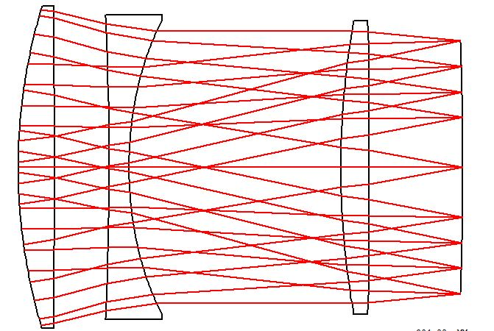
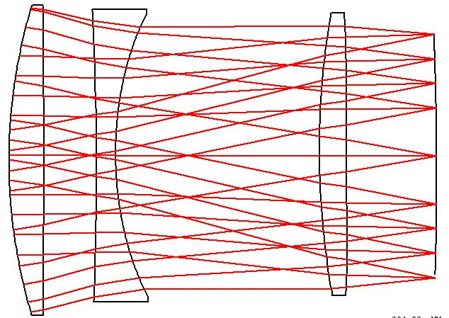
Corrector with Innovative ADC
Silica
Silica
Silica
F/2.86
2.5 °
Field of view
11.4 m
F/2.9
1800 mm
1425 mm
4.2 m
Aspheric surface
M2 translation to
compensate coma
ADC operates via modest tilt (<0.3 degree) of portion of corrector and positioner around a point 5m in front

Slide 20
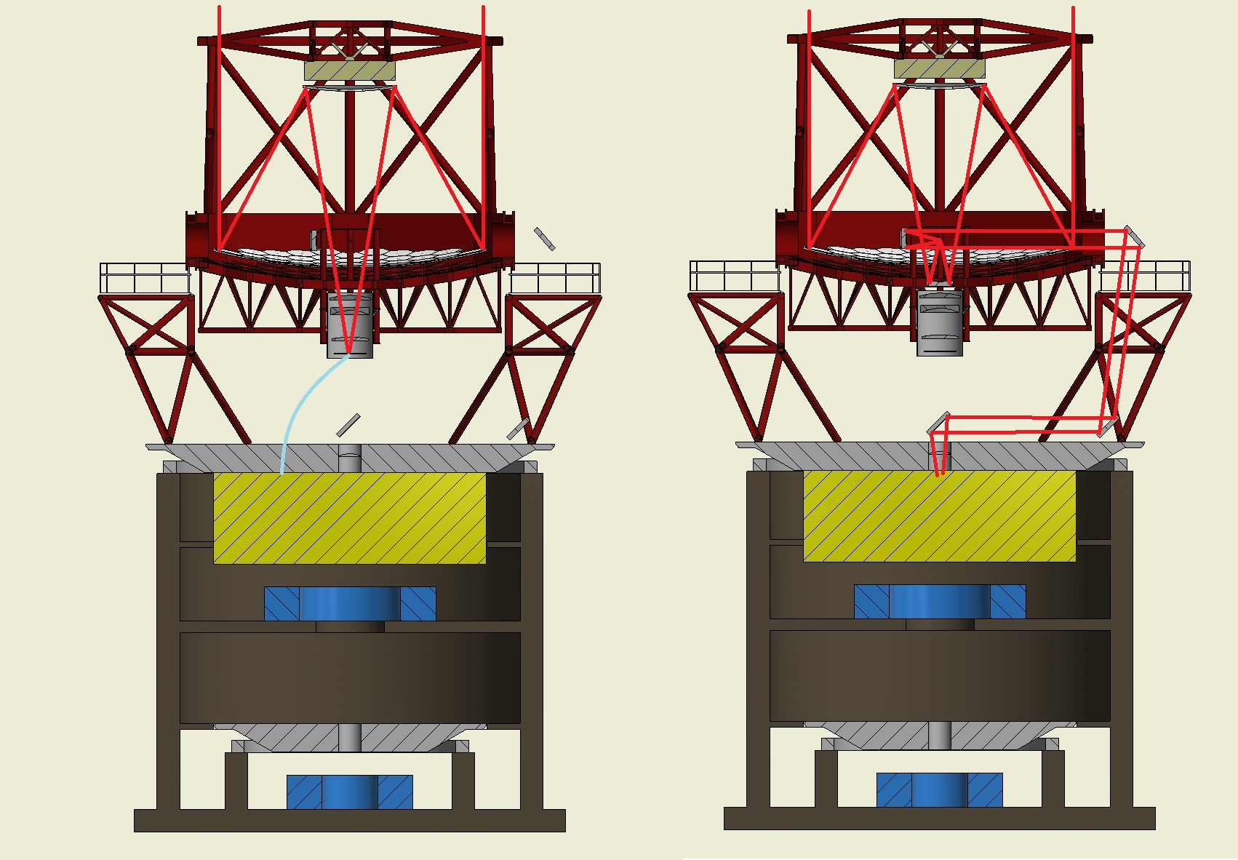
Concept Telescope
Can accommodate all spectrographs and Coudé focus in a compact enclosure
Coudé train
10 arcmin FOV
(Super-MUSE)
High Resolution
Low Resolution

Slide 21
A Ω product (m² deg²)
 | Telescope Diameter | Central Obstr. | Aperture² | Ω (deg²) | Product
ESO VLT (VIMOS) | 8.0 | 0.97 | 48.75 | 0.043 | 2.08
ESO VLT (FLAMES) | 8.0 | 0.97 | 48.75 | 0.136 | 6.63
ESO VISTA (4MOST) | 3.7 | 0.89 | 9.57 | 4.00 | 38.3
ESO VLT (MOONS) | 8.0 | 0.97 | 48.75 | 0.136 | 6.63
WEAVE | 4.2 | 0.88 | 12.2 | 3.14 | 38.3
SUBARU (PFS) | 8.0 | 0.97 | 48.75 | 1.33 | 64.7
MAYALL (DESI) | 3.8 | 0.85 |  | 8.00 | 77
 | Telescope Diameter | Central Obstr. | Aperture² | Ω (deg²) | Product
LSST (imaging only) | 8.2 | 0.63 | 33.27 | 9.62 | 320
MSE | 11.2 | 0.97 | 96.0 | 1.50 | 144
ESO CONCEPT STUDY | 11.2 | 0.86 | 84.6 | 4.91 | 415

Slide 22
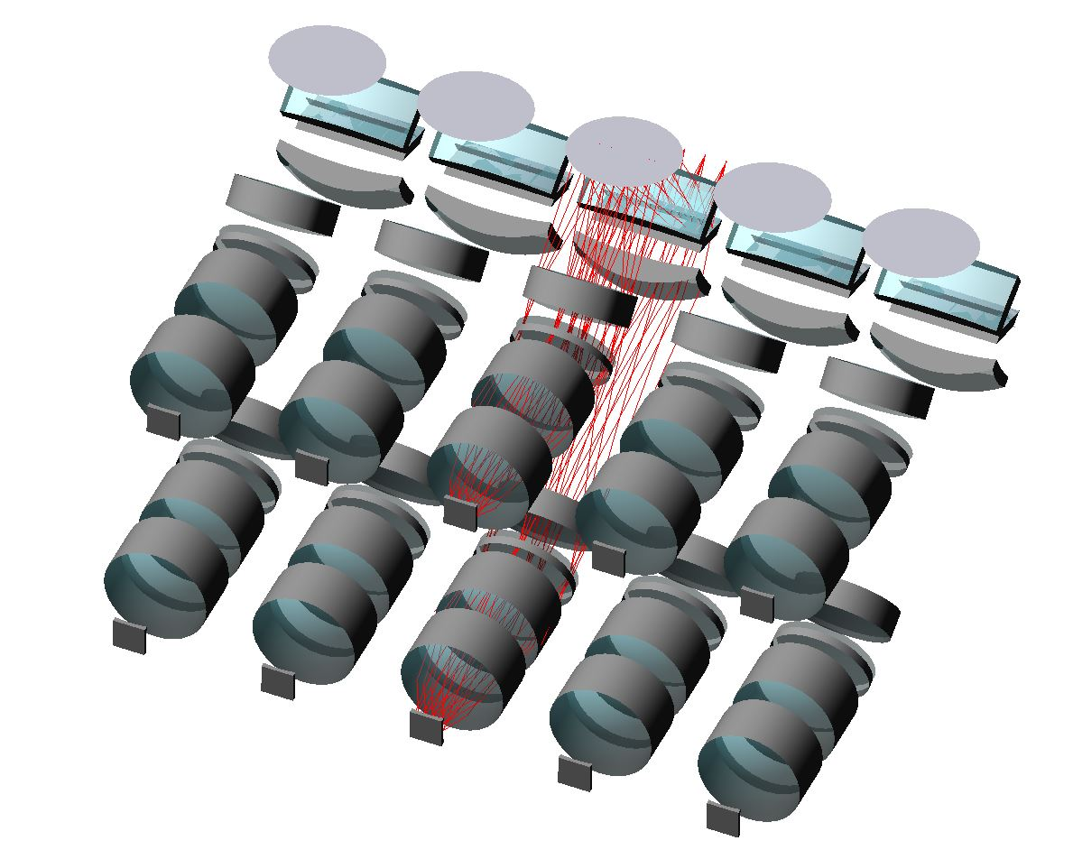
Concept Low-Res Spectrographs
Two-arm spectrograph design accommodating 650 fibers at R~2600
f/3.0 collimator with dichroic splitting λλ380-690nm and 680-1000nm
f/1.1 camera feeding curved 4K CCDs
RED ARM
F/1.1
Curved CCD (200mm)
4K x 4K
(15 µm)
Tilted 1.45° red
Tilted 2.90° blue
VPH 910 mm-1
F/1.1
Dichroic
Module of 5 such spectrographs would accommodate 3250 fibres
Curved (690 mm)
Fiber Slit
F/3.0
VPH 1000 mm-1
BLUE ARM
147.06 MM

Slide 23
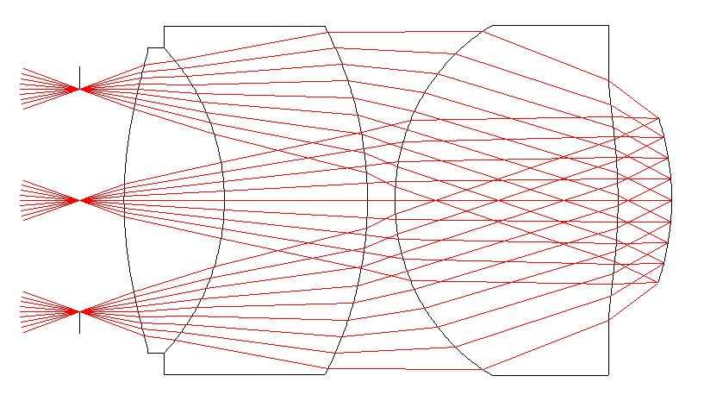
Fast Cameras,Curved Detectors
CURVED DETECTOR
Scale : 0.3 arc sec / pixels on 11.4 m telescope ~65 MUSE spectrographs for 3X3 arcmin
FAST CAMERAS are a MUST
For matching pixel
To reduce number of spectrographs
F/N | 1.1
Focal Length | 110 mm
Pupil | 100 mm
Field of view (ɸ) | 76 mm
Wavelengths | 450 - 900
100 mm
Schott FK5
Ohara PBM2Y
Schott FK5
40°Field of view

Slide 24
High Res. Spectrograph
~3-5000 Objects at R>20000 for a 11.4m and 3 spectral ranges (Blue-NIR)
  Very challenging
  Trade-off between N_{obj}, resolution and Pupil size to be done..
  Size, production, costs to be studied
  Careful analysis of the Requirements (second step in science cases) required
  Careful planning of bright time !

Slide 25
Recent Facts
😟 No scientific & technical development performed in the last year at ESO, and will likely remain so for some times.. (while ESO is building a ‘small’ telescope)
😄 MSE science cases and design progressing (keeping momentum in the community)
😄 Progress in curved detectors (Marseille, E2V (ESA)) & their requirements (Blue MUSE design)

Slide 26
Spectroscopic Surveys
Think in a different way for the long term? (post-MOONS, 4MOST, PFS, WEAVE, LAMOST, DESI…)
Design Telescope & Spectrographs together!!
What is the best follow-up for LSST?
What is most transformational ?
My aim: make the equivalent of the Schmidt survey in spectroscopy
Re-evaluate the case of a GIANT (e.g. 6x6 arcmin) IFU ?(see e.g. Pasquini & Kissler-Patig 2002)

Slide 27
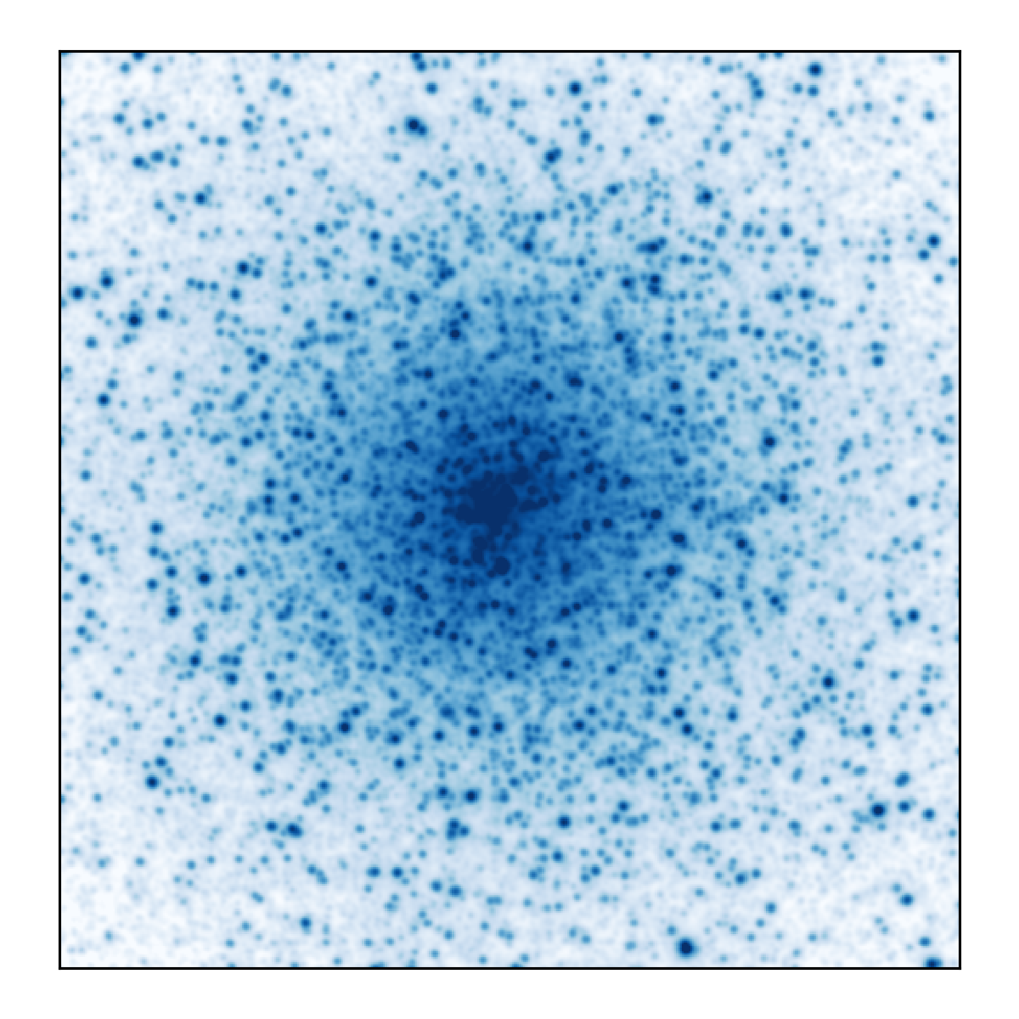
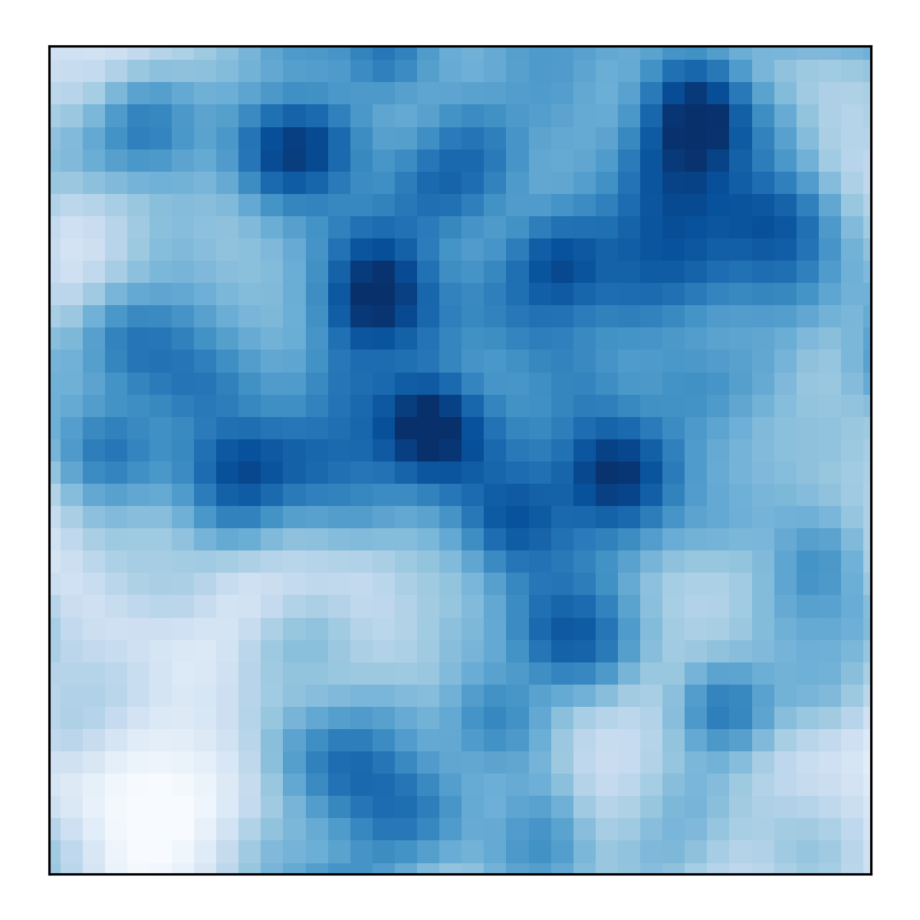
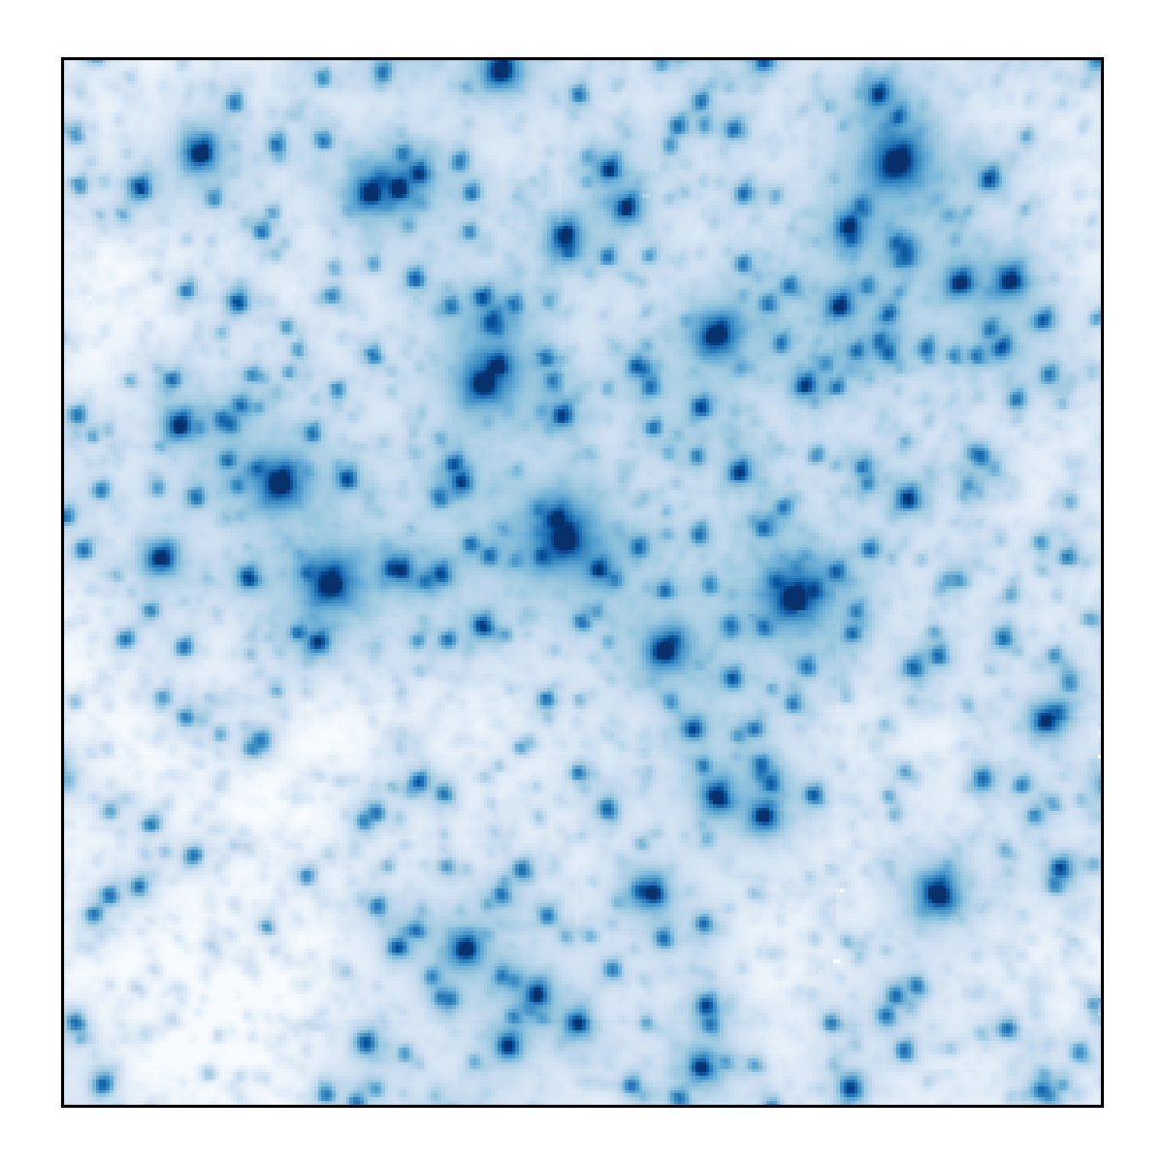
MUSE
NGC 6388
MUSE NFM image
7x7 arcsec²
LTAO on
NGC 6388
MUSE WFM image
1x1 arcmin²
Seeing limited
NGC 6388
MUSE WFM image
7x7 arcsec²
Seeing limited

Slide 28
Short Term
June 17-21 2019: “The Very Large Telescope in 2030” Science Conference:
  New and improved VLT and VLTI instrumentation
  Potential modifications or upgrades to the facilities
  Changes in the operational model
  Synergies with other facilities….

Slide 29
Summary
Should this be the next Facility? YES
  Scientifically unique & transformational
  Technically feasible
  Tremendous Synergies with other facilities, especially ELT, LSST
  Huge legacy, versatile..
International Collaboration
Several open challenges
One million spectra/week !

Slide 30
Backup Slides

Slide 31
Concept Fibre Positioner
Positioner for DESI: 10.4 mm pitch ➔ >14500 objects (5000 for DESI to be produced by 2017)
MOONS-type positioner allows each point to be reached by 3 buttons ➔ can be reached by 2 L-Res and 1 H-Res if 10K L-Res and 5K H-Res (2:1)
From Kneib 2017: size refers to
Motor sizes, pitch is larger

Slide 32
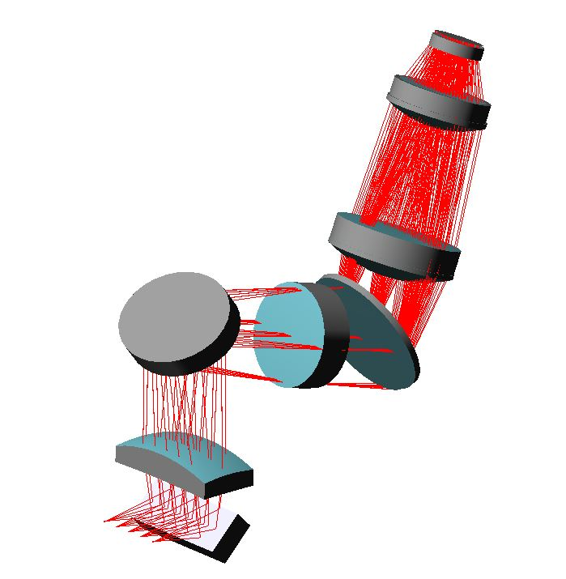
Small size pupil?
R=20000, 3x sliced, 625-695 nm, 6x4 K CCD, 200 objects, pupil 185mm
  Cheap optics, but x25 for 5000 objects (75 for 3 arms)

Slide 33
11.4m Costs

Slide 34
11.4M telescope
11.4m Telescope
WIDE FIELD FOCUS | COUDE
Field of view | 2.5° diameter
F/N | 2.9
Scale | 1 arc sec = 161 µm
Wavelelength range | 360 – 1300 nm
Primary mirror diameter | 11.4 m
Secondary mirror diameter | 4.2 m
Distance M1 – M2 | 7.75 m
Corrector diameter (largest element) | 1800 mm
Focal plane | Curved R=14 m (concentric to exit pupil)
SMALL FIELD FOCUS | COUDE
Field of view | 10 arc min diameter
F/N | 26.0
Scale | 1 arc sec = 1447µm
Wavelelength range | All mirrors
With a 1.425m diameter focal plane, host easily >14000 fibres with current
technology (e.g. MOONS/DESI-type)

Slide 35
TOP WBS
Project office
Telescope
Civil Works
Cassegrain
Nasmyth
High Res Spectro
Low Res Spectro
Operations
Board
General Services
Science Team
AIV
Plenty of work… for scientists, engineers, managers....

Slide 36
Surveys: Power Spectrum
Most cosmological information
is in the Power Spectrum
How many redshifts are needed
to reach the maximum information?
We need ~hundreds of millions
redshift
Dodleson et al. 2016, Kneib 2017

Slide 37
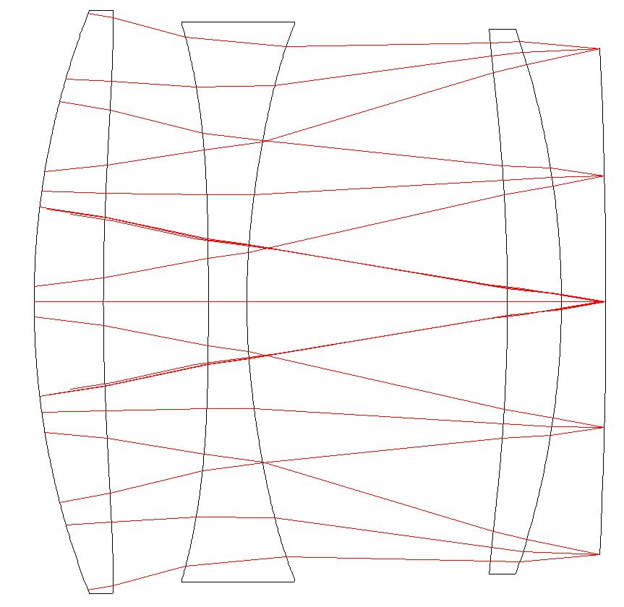
3 Lenses Corrector
14000 mm to exit pupil
R = 14000 mm
Silica
Silica
Silica
1500 mm
F/3.0
Aspheric
1486 mm

Slide 38
Spectroscopic Surveys Power
Telescope | Area (m²) | Ω (deg²) | N_{obj} | AxΩxN_{obj}
AAT/2df | 11.95 | 3.14 | 392 | 14700
WHT/Weave | 12.2 | 3.14 | 1000 | 38300
VISTA/4MOST | 9.6 | 4.00 | 2400 | 92160
Mayall/DESI | 12. | 8.0 | 5000 | 480000
VLT/MOONS | 48.8 | 0.14 | 1000 | 6832
Subaru/PFS | 48.8 | 1.3 | 2400 | 152256
CFHT/MSE | 96 | 1.5 | 4200 | 604800
SpecTel | 85 | 4.9 | 15000 | 6247500
Enhancing by a factor 10 the presently planned facilities
+Fully dedicated!

Slide 39
Gratings and trade offs..
Low-Res Spectrographs: (20 cm size)
  ~20 (65 for IFU) 1000 l/mm , θ=15.5 deg, λ_{c} = 535 nm
  ~20 (65 for IFU) 910 l/mm , θ=22.2 deg, λ_{c} = 810 nm
High-Res Spectrographs: 2000, 2400, 3300 l/mm, (3 ranges, Hα to Ca II K), θ=44.1 deg
  Three slices (N_{spectro}~18): 54 (18 each), 19*26 cm
  Two slices (N_{spectro}~12): 36 (12 each), 28*39 cm
  No slices (N_{spectro}~5): 15 (5 each), 56*77 cm

