Slide 1
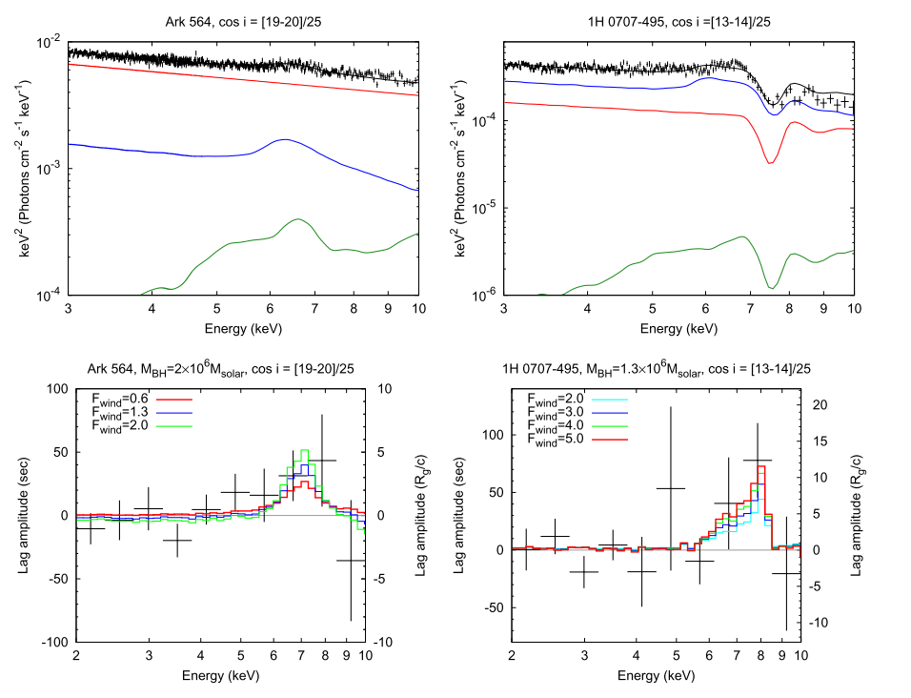
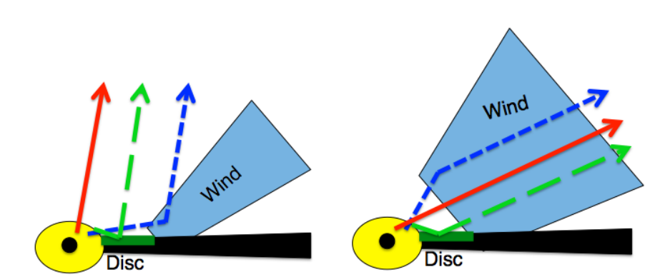
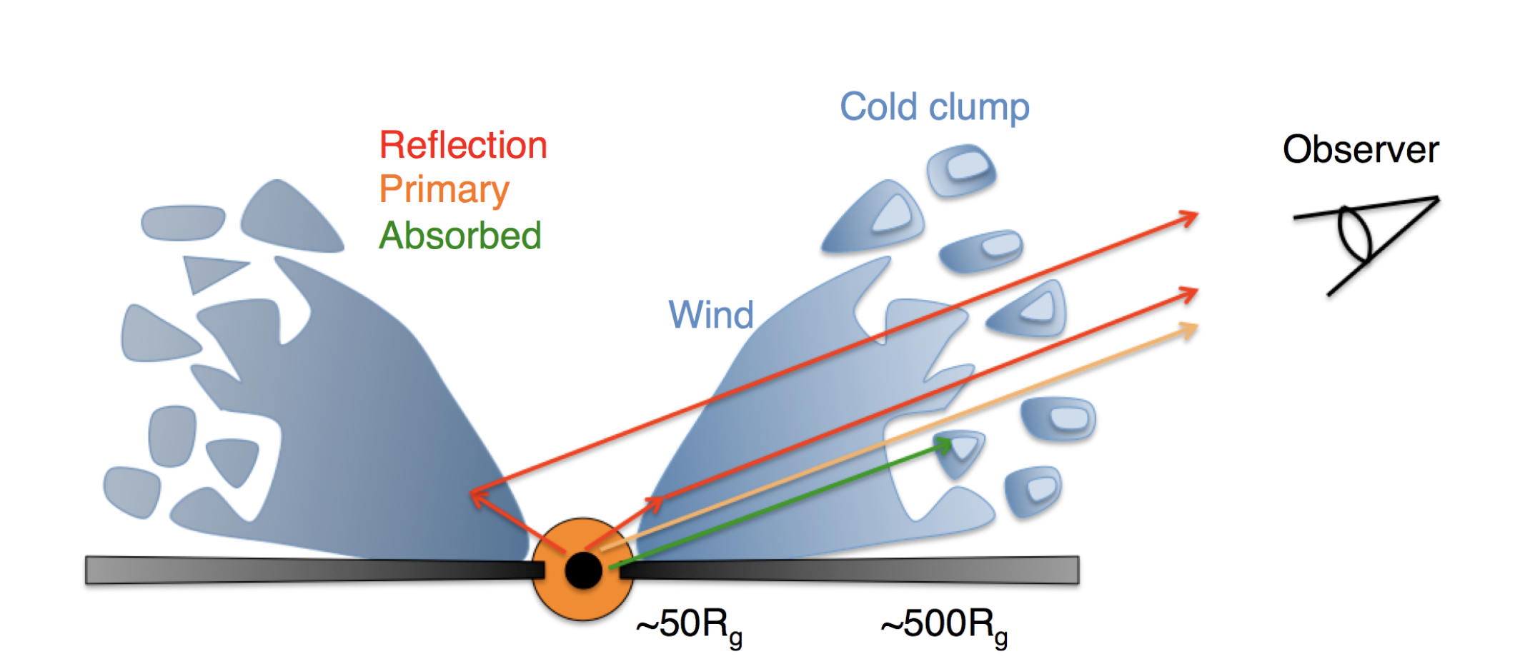
AGN Fe-K reverberation lags explained by the outflow (#413)
Ken Ebisawa (ISAS/JAXA) and Misaki Mizumoto (Durham University)
“Lamp-post” model does not work Short Fe-K reverberation lags of an order of ~100 sec are commonly observed in Type I Seyfert galaxies. If the observed timescale is interpreted as the light-travel time, an extremely compact X-ray emitting corona (“lamp-post”) is suggest to locate very close to the black hole. However, the lamp-post model cannot explain the deep Fe-K dip found in the RMS spectra of MCG-6-30-15 and IRAS13224-3809 (e.g., Inoue and Matsumoto 2003; Mizumoto et al. 2018). Instead, the deep RMS Fe-K dip is naturally explained by variation of the partial absorber in the line-of-sight (e.g., Inoue, Miyakawa and Ebisawa 2011; Miyakawa, Ebisawa and Inoue 2012).
“Apparently “ short Fe-K lag is due to dilution
The apparently short Fe-K lag is a natuｒal consequence of the reprocessing out of the line of site, where the time delay is ~1000 sec, such that the Fe-K photon lags are "diluted" by the direct photons which are not lagged and ~10 times more copious in the Fe-K energy band (e.g. Miller et al. 2010; Mizumoto et al. 2018).
AGN outflow explains both the Fe-K lag and energy spectra
We carried out a precise Monte-Carlo simulation of the Fe-K reverberation lags expected from AGN outflow (Mizumoto et al. 2019). We assumed a realistic biconical geometry of the outflow, which is highly photo-ionized. As a result, we quantitatively explained not only the short Fe-K reverberation lags but also their spectral shape observed from 1H0707-405 and Ark 564.
Outflow geometry constrained from the lag and spectral features
These sources show very similar Fe-K lag features, but the Fe-K spectral features are very different; 1H0707-405 shows a strong P-Cygni profile while Ark 564 shows a much weaker spectral signature. These spectral differences are understood assuming a large outflow solid-angle in the line-of-sight in 1H0707-405 , and a smaller outflow solid-angle out of the line-of-sight in Ark 564.
Direct component
Wind reflection component
Wind reflection component
Direct component
Ark564:spectrum
1H0707-405:spectrum
Disk reflection component
Disk reflection component
Ark564:Geometry
1H0707-405:Geometry
Ark564:Fe lag
1H0707-405:Fe lag
“Hot-inner and Clumpy-outer wind model” explains the overall spectral variations The hot-inner outflow will eventually get fragmented into outer clumpy clouds, which may have internal structure, due to instability. Such outer clumpy clouds cause partial covering of the central X-ray source and apparent spectral variations below ~10 keV. Consequently, the “Hot-inner and Clumpy-outer Wind” model simultaneously explains both the Fe-K reverberation lags and spectral variations of Seyfert galaxies. In fact, variation of the double layer partial absorber can explain most of the soft (<10 keV) spectral variations of 1H0707-405 (Mizumoto, Ebisawa and Sameshima 2014), IRAS13224-3809 (Yamasaki et al. 2016) and other >20 Seyfert galaxies (Iso et al. 2016) . Furthermore, only change of the partial covering fraction and the power-law normalization can explain 0.2-78 keV energy spectral variations of MCG-6-30-15, NGC 4593, NGC 1365, Swift J2127.4+5654 and MCG-5-23-16 (Kusunoki et al. 2019). Spectral variation of NGC5548 over 17 years is similarly explained, only that the soft excess component below < 1 keV is significantly variable in a timescale of years (Midooka et al. poster #440).
Hot-inner and Clumpy-outer wind model by Mizumoto et al. (2019)
NGC1365(XMM+NuSTAR) spectral variation explained only change of the partial covering fraction and the power-normalization
References: Inoue, H. and Matsumoto, C. 2003, PASJ, 55,625 ; Inoue, H., Miyakawa, T and Ebisawa, K. 2011, PASJ, 63, S669; Iso, N. et al. 2016, PASJ, 68 (SP1), S27; Kusunoki E. et al. 2019, in prep. (Univ. of Tokyo MSc thesis 2017); Miller, L. et al. 2010, MNRAS, 408, 1928; Mizumoto, M. Ebisawa, K. and Sameshima, H. 2014, PASJ, 66(6), 122; Mizumoto, M. et al. 2019, 482, 5316; Mizumoto, M. et al. 2018, PASJ, 70(3), 42; Mizumoto, M. et al. 2019, MNRAS, 482, 5316; Miyakawa, T., Ebisawa, K. and Inoue, H. 2012, PASJ, 64, 140; Yamasaki, H. et al. 2016, PASJ, 68)5), 80

