Slide 2
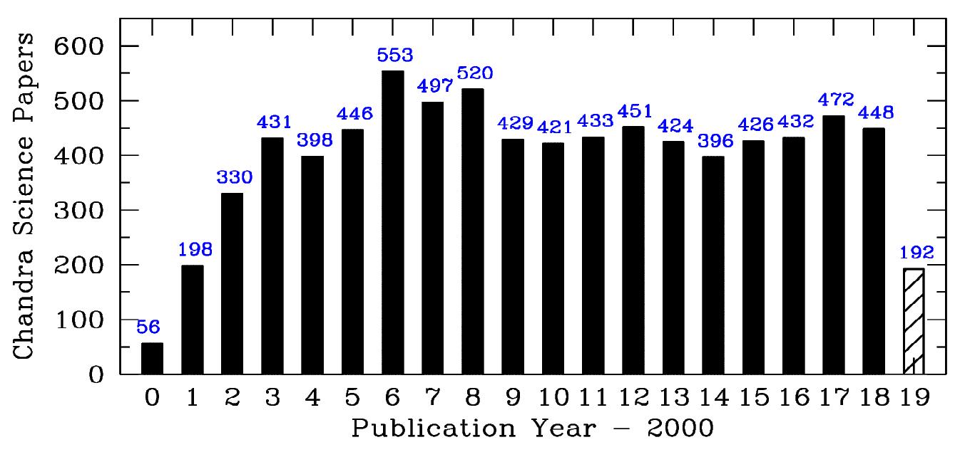
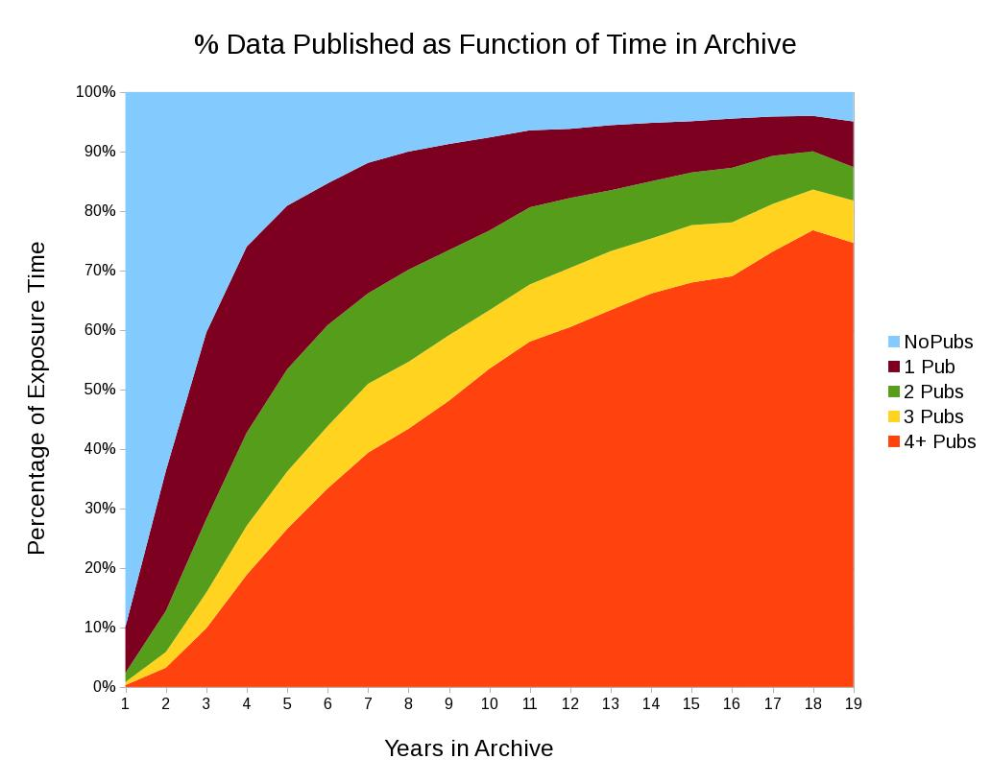
NASA’s Chandra X-ray Observatory
Uniquely high spatial resolution, ~0.5”, matching ground-based optical telescopes
High spectral (>1000) and timing (~16µs) resolution
Field-of-View: Maximum 30’ square (HRC)
Lifetime: 25-30 years, (~9 more) of operation
High Impact on Astrophysics:
Science Papers: >8000
~480 papers/yr
Citations/paper: >35 after 6 years
>4300 PIs&CoIs, ~150 new/yr (distinct)
Proposal oversubscription ~ 5.5
>90% data published
High Impact on Public via Press, website, social media etc.
1
2
3
4+ papers

Slide 3
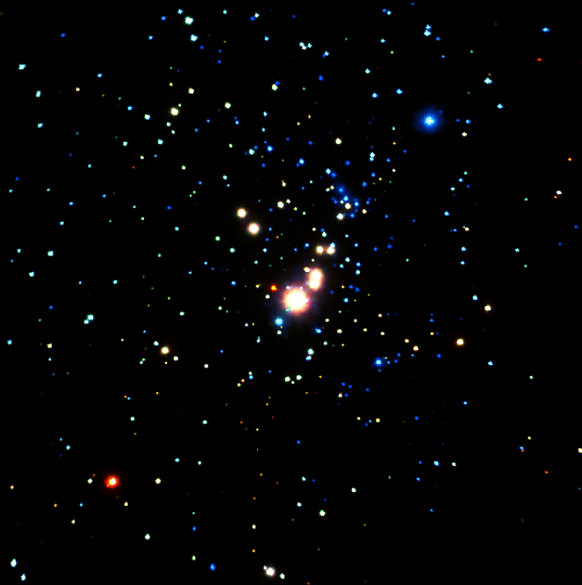
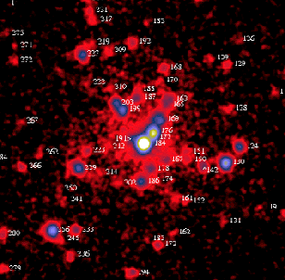
Star Forming Regions: Orion Nebula
ROSAT: ~100 sources
Chandra (840 ks): ~1400 sources
Chandra’s sensitivity and resolution was a game-changer for pinpointing young stars
Trace previously unseen populations, e.g. w/no protostellar disks
Chandra+Spitzer: estimate disk fractions (20-50%, ↑ as mass ↓), & evaporation timescales
Investigate triggering of SF
Stellar X-ray activity is key to determining:
exo-planet formation and habitability
reality of candidate detections vs starspots/flares
0.75 lt yr
ROSAT
Feigelson et al. 2005
Chandra

Slide 4
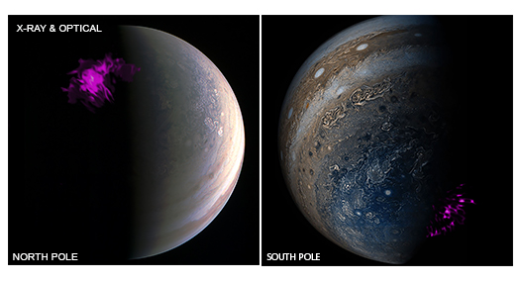
Solar System Objects
X-ray emission
mostly due to charge-exchange with solar wind ions
seen from comets, Venus, Mars, and Pluto (during New Horizon’s Flyby)
Jupiter
Aurorae at north and south poles
Triggered by magnetic unloading from Jupiter’s equatorial plasma sheet
Observations during Juno mission, timed to investigate this interaction
Dunn et al. 2017

Slide 5
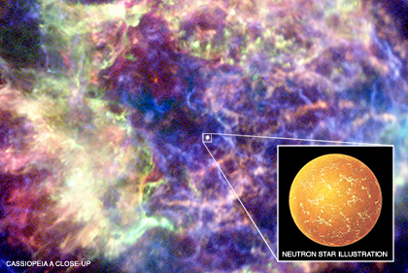
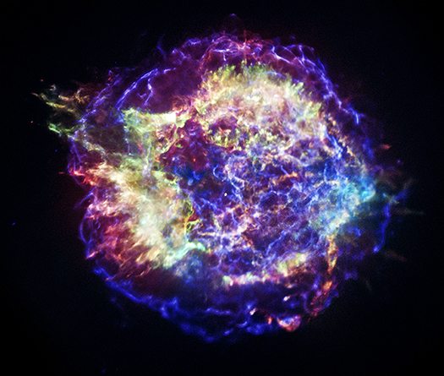
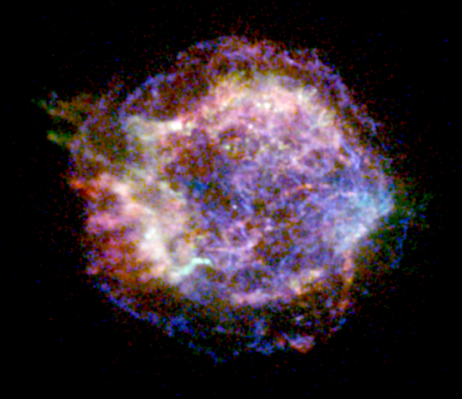
Official First Light (Aug 1999) Supernova Remnant: Cassiopeia A
Age: 320 years
Size: 29 lyrs
1 Msec Deep Image (12 days)
Chandra-discovered stellar remnant

Slide 6
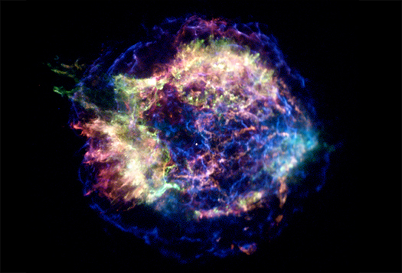
Cas A (continued)
Optical: stars + cool gas/dust
Fe
Neutron Star: find and study
SNR expansion
Explosion – inside out

Slide 8
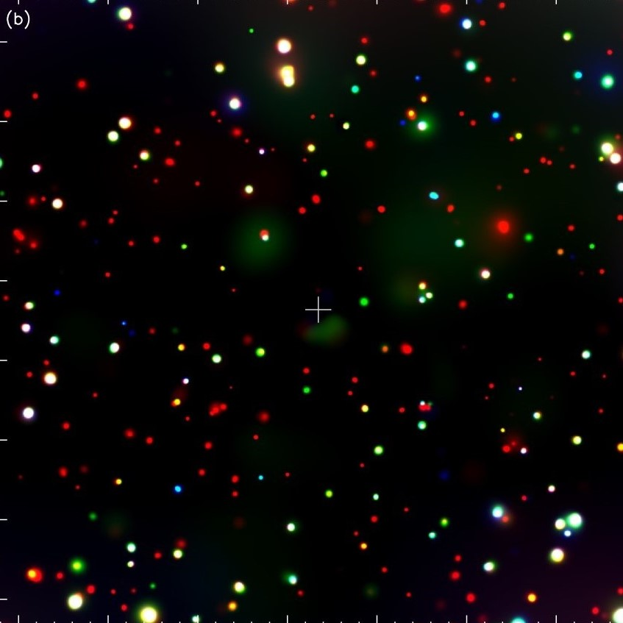
Deep Fields: Cosmic X-ray Background
Primary Chandra Science Goal:
Resolve CXRB, observed to be ubiquitous in previous X-ray missions
Fully resolved to ~9 keV: Chandra Deep Field South (CDFS, 7 Ms)
Looks back ~12-13 Gyrs, ~10% current age of Universe
1000 sources, mostly Super Massive Black Holes
Source Density: 50,500 deg⁻²
Detects log L_{X}~42 at z>4
Hardness: wide range, including highly obscured sources
Chandra is a SMBH finder
1’
1’
Luo et al. 2017
Luo et al. 2017
Luo et al - check

Slide 9
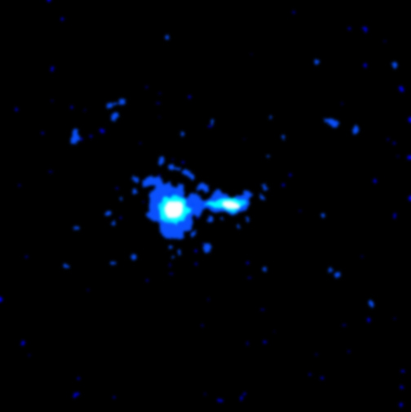
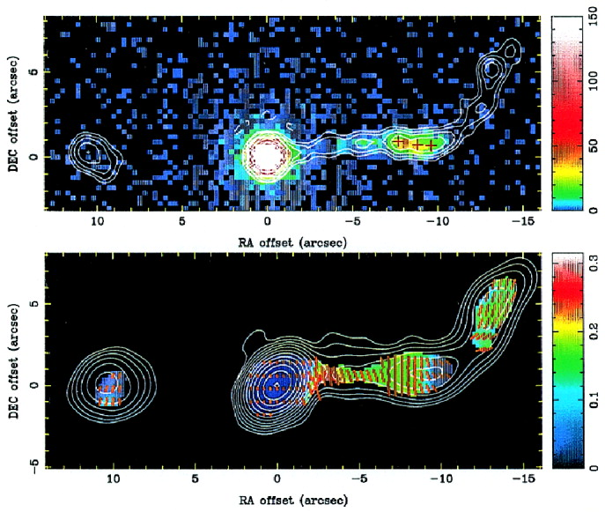
First Targeted Source Quasar: PKS 0637-75
Radio jet bend
Point Source to focus: Quasar, z=0.66
X-ray Jet visible: 9” long, (100 kpc)
Jet L~10^{44.6} erg s⁻¹
No X-rays beyond the jet bend
Radiation mechanisms:
Inverse-Compton/CMB, mildly relativistic (Tavecchio et al. 2000)
BUT
Ruled out by lack of Fermi GeV γ-ray emission (Meyer et al. 2015)
→Synchrotron emission from 2nd electron population
The birth of multi-λ studies of jets
X-ray
Radio
Schwartz et al. 2000
Schwartz et al. 2000

Slide 10
Perseus Cluster: Optical and X-ray
Credit: Paul Nandra, ESA Athena

Slide 11
Dark Matter: Direct Visualization
Bullet cluster
Colliding Galaxy Clusters:
Chandra: hot X-ray-emitting gas
HST,Magellan (white): galaxies
Dark Matter (inferred from gravitational lensing, ESO WFI)
Interpretation:
Drag on gas
No drag on stars/dark matter
Gravity due to dark matter clearly separated from baryons (gas)
Dark Matter:
weak self-interaction cross-section, σ/m < 0.7 cm²g⁻¹
Clowe et al. 2007, Randall et al. 2008

Slide 12
Dark Matter: Direct Visualization

Slide 13
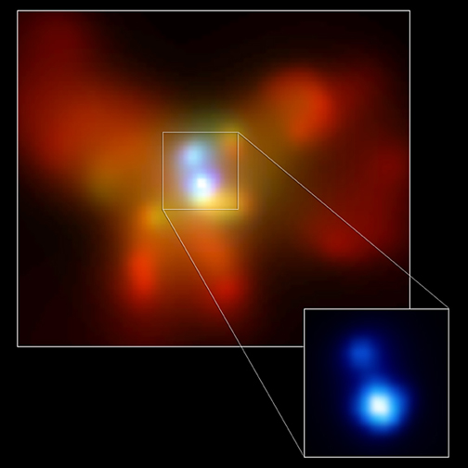
Binary Supermassive Black Holes
NGC 6240
Merging galaxies (optical: red)
Binary SMBHs (Chandra : blue)
SMBHs: 1 kpc apart, will eventually merge
Binary AGN in ~10% galaxies, X-ray bright are in closer pairs (<15 kpc) (Koss et al. 2012)
Numbers vs separation → Galaxy merger rate & binary SMBH merger rate (Comerford et al. 2013,2015)
D ~ 125 Mpc
Komossa et al. 2002
Notes:
1 kpc apart! In core of the highly disturbed merging galaxy NGC6240

Slide 14
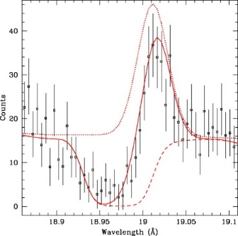
Grating Spectroscopy: NGC 3783
900 ks HETG Spectrum, z~0.01 active galaxy
2-phase clumpy absorber, high and low ionization, pressure equilibrium
Outflow, v~750 km s⁻¹
Dynamical agreement with UV absorber
Variability → ~6 pc from SMBH
Mass outflow rate 0.2-4 M_{sun} yr⁻¹
Plus: v~3000-6000 kms⁻¹, ~BLR (light days) (De Marco)
Blended absorption and emission components, e.g. OVIII λ18.969
Krongold et al. 2003,2005

Slide 15
Chandra Status
NASA contract extension, potentially operating to 2027 + 3-year closeout
No expendables, stable orbit, plenty of fuel
2014 engineering review: no show-stoppers to 25+ year mission
Current Status:
Degrading thermal insulation:
no sign of slow-down
All subsystems getting warmer
Temperatures: tracked and carefully managed → complex mission planning
→ shorter and split observations, Chandra cool targets (CCT) call
Limiting:
# constrained observations
Time > 60 degs ecliptic latitude
# ACIS chips
ACIS: contaminant build up on window:
Degraded effective area < 1.5 keV (A_{eff} ~30% of launch value at 1 keV, ~3% at 0.6 keV)
Continues to increase linearly on both ACIS-S and ACIS-I
Bakeout: results uncertain & too high risk, but will be reviewed in future

Slide 16
The Future for Chandra Science is Bright!
Lots more X-ray sources and sky out there!
Expand on current science, e.g.:
Complete and/or increase samples, e.g. AGN, Clusters (for cosmology), star forming regions
Observe individual sources in more detail, e.g. Cygnus A, A2146, Orion Nebula: Trapezium
Track evolution of young SNR: e.g. 1987A, Cas A, Tycho
Search for WHIM along more lines-of-sight (e.g. VLP approved Cycle 21)
Chandra Source Catalog: expand to include data > 2014, and continue to release new data

Slide 17
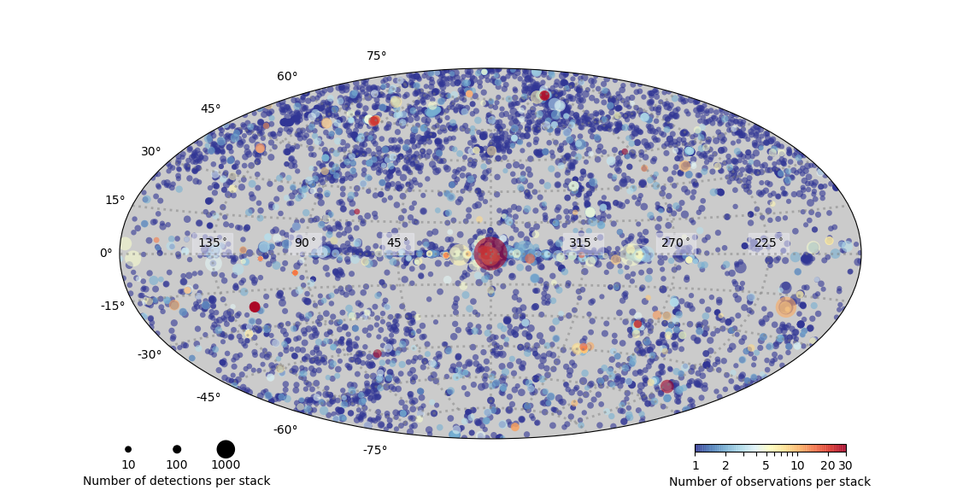
Chandra Source Catalog V2.0
>300,000 sources
All data up to 2014

Slide 18
The Future for Chandra Science is Bright!
Lots more X-ray sources and sky out there!
Expand on current science, e.g.:
Complete and/or increase samples, e.g. AGN, Clusters (for cosmology), star forming regions
Observe individual sources in more detail, e.g. Cygnus A, A2146, Orion Nebula: Trapezium
Track evolution of young SNR: e.g. 1987A, Cas A, Tycho
Search for WHIM along more lines-of-sight (e.g. VLP approved Cycle 21)
Chandra Source Catalog: expand to include data > 2014, and continue to release new data
Expanded multi-messenger and multi-wavelength studies
Transient phenomenon: resolve and track, particularly in LIGO/Virgo, e-ROSITA, LSST era
New facilities coming on-line → New Science and Targets: e.g.
TESS: coordinated stellar studies, check habitability of exo-planet candidates
e-ROSITA: follow-up new clusters, AGN, etc . (1 GTO program in Cycle 21)
JWST: IR/X-ray joint studies of AGN, stars, galaxies…….
XRISM: high-resolution Chandra imaging data to interpret high-resolution spectra
IXPE: Chandra follow-up of highly polarized targets

Slide 19
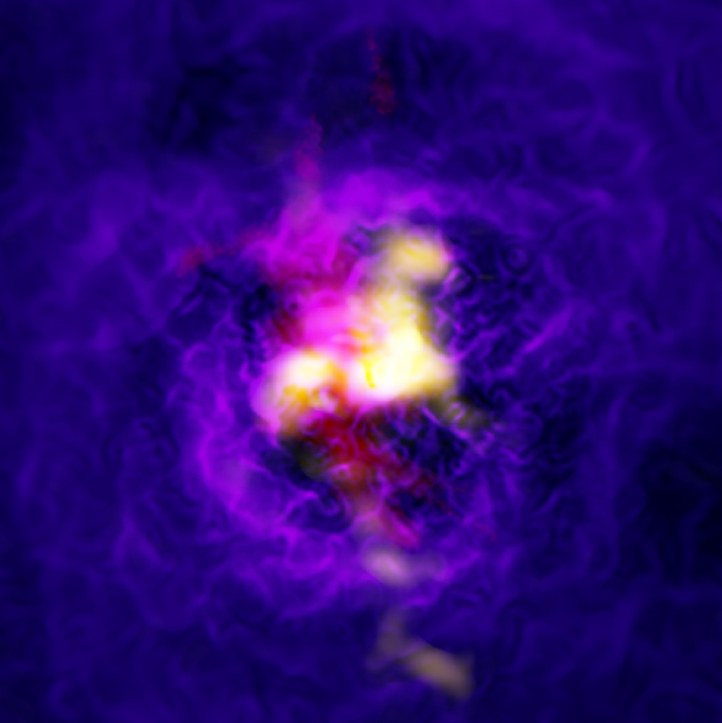
Rich, Multi-wavelength datasets: e.g. Abell 2597
BCG in cool core cluster
Blue Chandra, yellow ALMA, red VLT/ MUSE
Hot X-ray gas fills the central ~30 kpc
Cool molecular gas flows inwards towards the SMBH, feeding jet activity
AGN jets lift plume of multi-phase gas, heating the X-ray gas
Feedback in action!
Tremblay et al. 2019

Slide 20
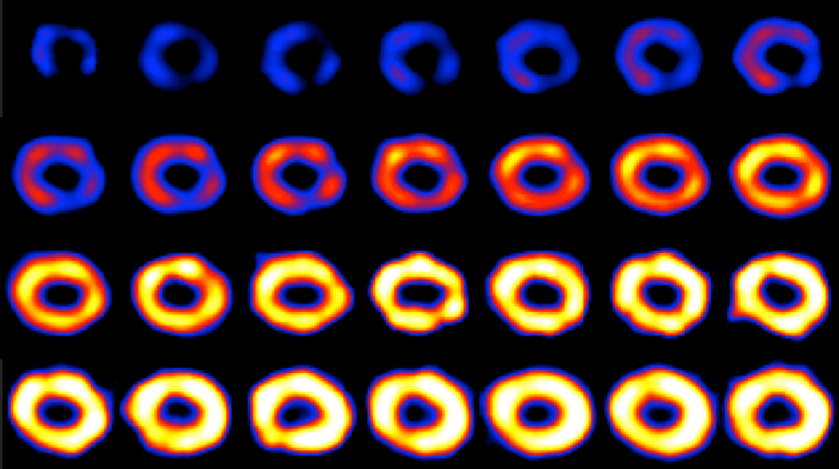
Extended Long-term Monitoring e.g. SN1987A
1999-2015
X-rays increase as blast wave interacts with circumstellar material
>10,000 days, X-rays fading, blast wave moving beyond equatorial ring
Frank et al. 2016

Slide 21
New Science: Multi-Messenger Merging Neutron Stars, LIGO/Virgo: GW170817
First EM detection of GW source!!
Detected via gravitational waves
Fermi: Faint, short gamma-ray burst ~2s later
Optical counterpart found, tracked, faded and reddened over ~2 weeks (kilonova, r-process elements formed)
→ X-ray & γ-ray jet viewed off-axis
Source went behind the sun – no X-ray observations until December
X-ray & Radio emission continued to brighten, and is now fading
X-ray
2 days
9 days
Optical

Slide 22
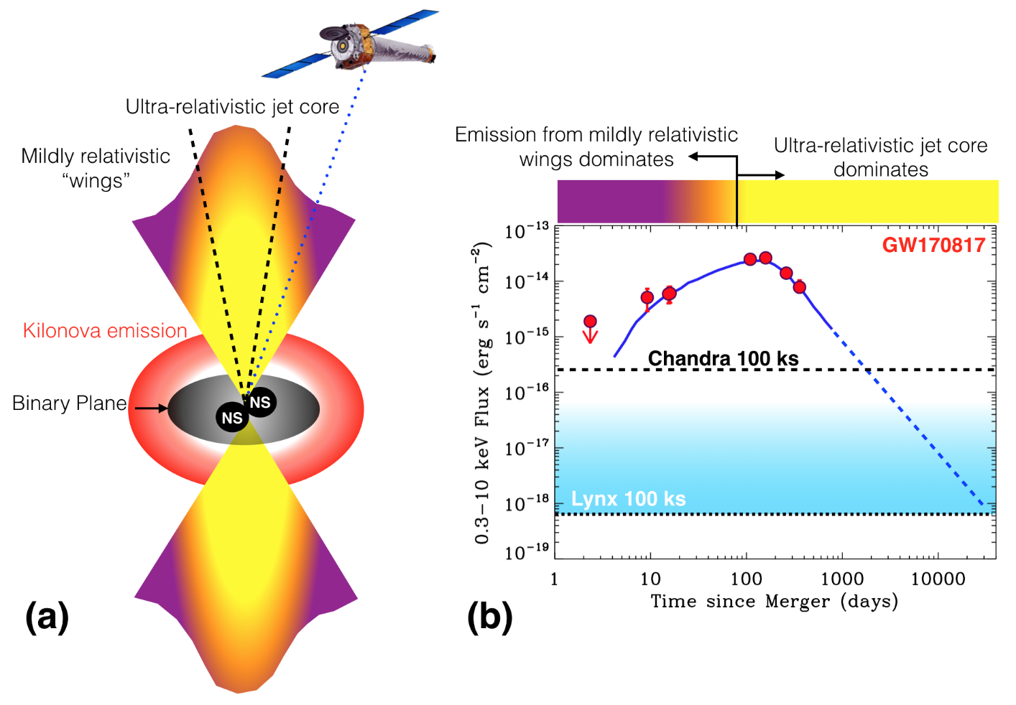
GW170817 (cont)
Chandra X-rays key to constraining models
Rise as jet expands
Peak corresponds to view down jet core
Chandra monitoring continues
Awaiting next NS-NS or NS-BH GW trigger!
Credit: Margutti, Fong, Haggard, (Chandra Newsletter #26)

Slide 23
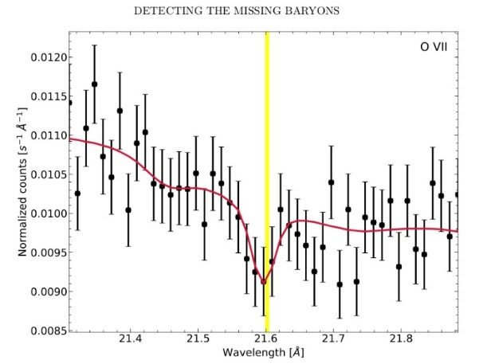
New Techniques: Missing Baryons detected
Quasar: H 1821+643, z=0.297
The missing baryonic mass at z<2 (1/3rd cf. high-z estimates) is thought to be in a Warm Hot Intergalactic Medium (WHIM, T< & > 10⁵ K)
Updated a technique to concentrate on OVII
Source has 17 UV absorption line systems in HST data
Stacked Chandra/HETG spectrum, blue-shifted to each UV redshift
Effective exposure ~8 Ms (470 ks observation)
Significant (3.3σ) OVII λ21.6 absorption line, EW~4.1 mA
N_{OVII}~1.4*10¹⁵ cm⁻², Ω_{b}(OVII)~0.0023 /[Z/Z_{sun} f_{OVII}]
Consistent with WHIM expectations for this los
Cycle 21 VLP to confirm this detection to >5σ (PI Bogdan)
Kovacs et al. 2019

Slide 24
20 years of Chandra Science Symposium
3-6 Dec 2019, Park Plaza Hotel, downtown Boston
Early registration deadline has been extended for 2 weeks
Price 540 euros ($600)
Includes breakfast, lunch and conference dinner!
Includes special session celebrating Riccardo Giacconi’s X-ray legacy
Several of “our” Astronauts: Eileen Collins (Commander), Cady Coleman (Mission Specialist), Steve Hawley (Flight Engineer), Jeff Ashby (Pilot) (?)
http://cxc.harvard.edu/symposium_2019/
We would love to welcome you to Boston!

Slide 25
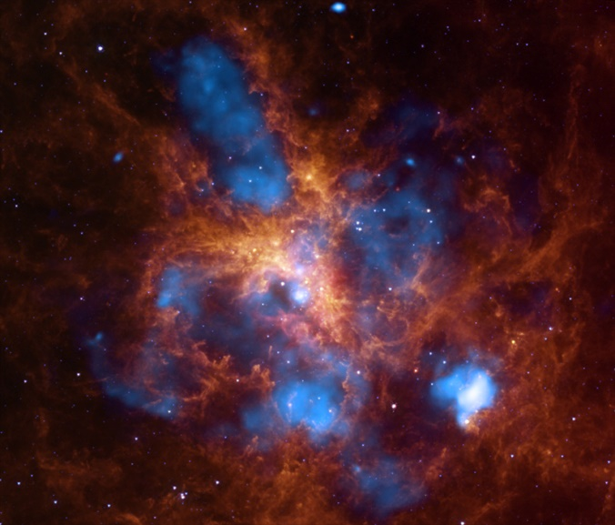
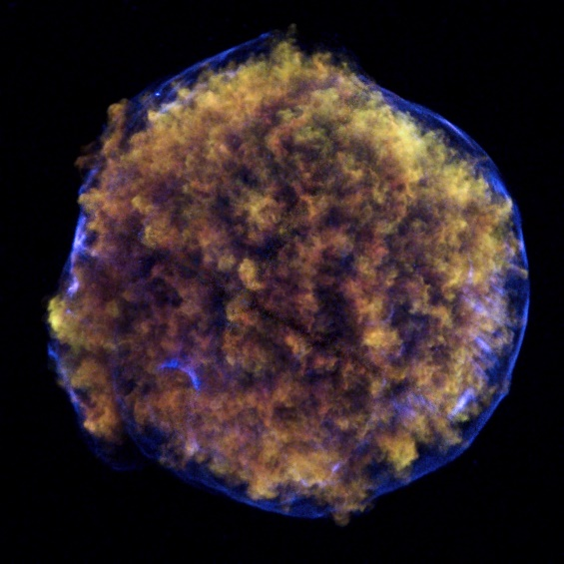
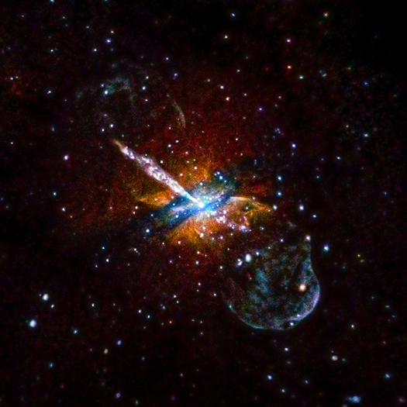
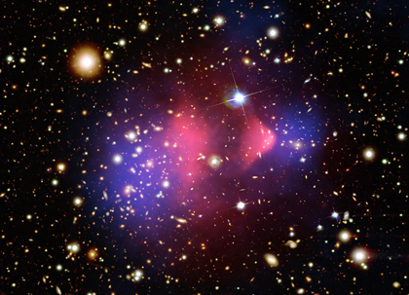
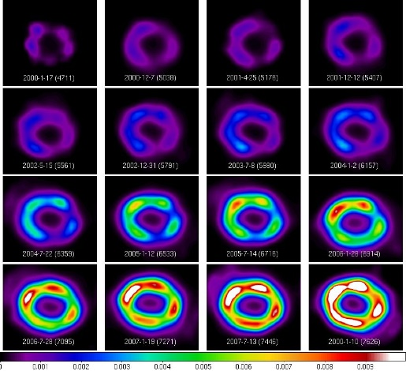
30 Doradus
Tycho
Cygnus A
Centaurus A
(X-ray only)
SN 1987A over time
Centaurus A
X-ray Only
Bullet Cluster

