Slide 1

Synergies with CHEOPS and PLATO
Isabella Pagano
INAF
Catania Astrophysical Observatory
Ariel Italian Meeting
Roma, 2-3 October 2018

Slide 2
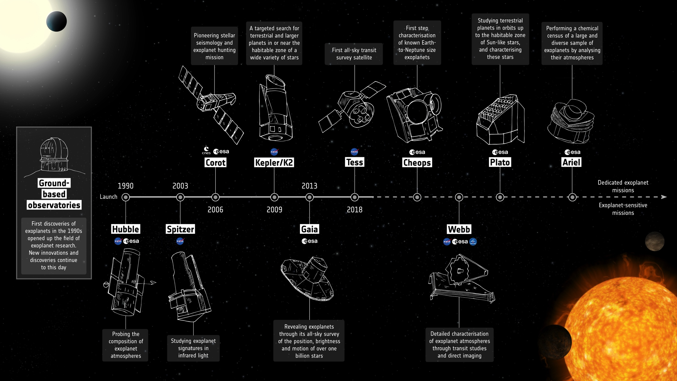

Slide 3
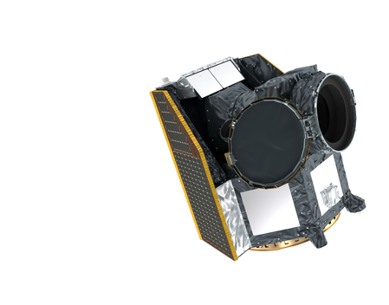

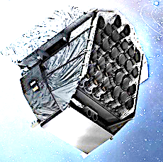

CHEOPS & PLATO
CHEOPS launch 2019 | Follow-up
PLATO Launch 2026 | Survey

Slide 4
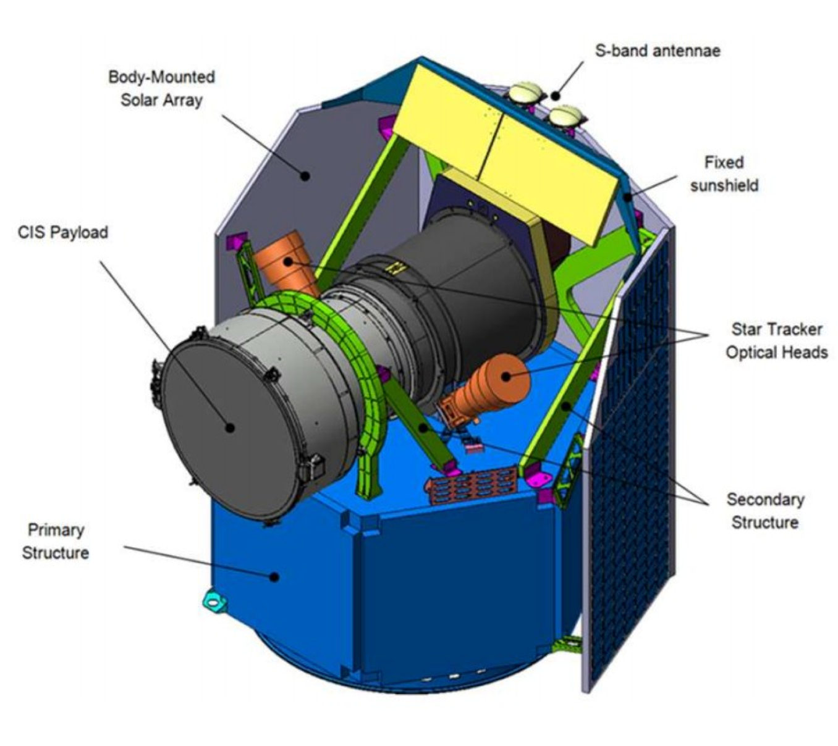
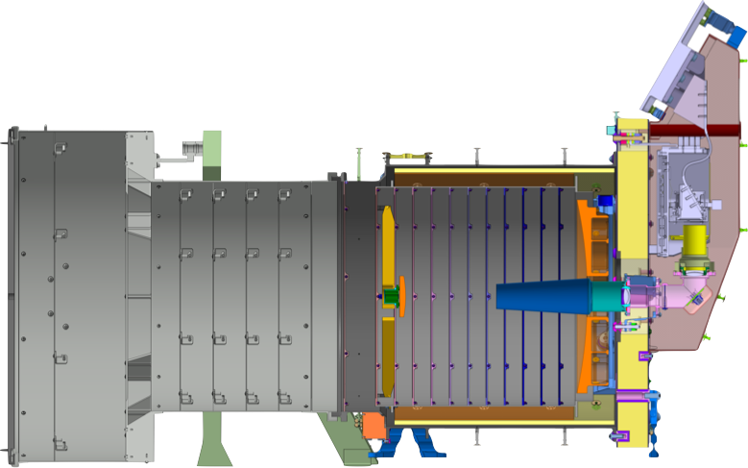











CHaracterizing ExOPlanet Satellite
  S class mission (S1)
  Budget envelope < 150 M€ (≤ 50 M€ from ESA)
  Launch: first semester 2019 => fast development (TRL 5 when selected)
  Operation: 3.5 (+1.5) yrs - shared launch
  Follow up mission
Mirror diameter: 33 cm
Weight: 60 kg

Slide 5
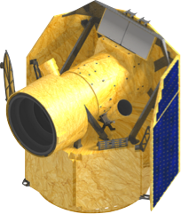
CHEOPS main science goals
Mass-Radius relation for low-mass (1-20 M_{E}) planets with P< 50 d
Provide golden targets for future atmospheric characterisation
How it works:
High-precision photometry
  Achieve a photometric precision similar to Kepler
Observing brighter stars anywhere in the sky
©CHEOPS Consortium

Slide 6
Core Science
(GTO Program)
TransitFind: search for transits in known planetary systems that have been discovered by other techniques, in particular radial velocity;
MRimprove: improve the determination of the mass-radius relationship for exoplanets in the sub-Saturn mass range in order to constrain planet formation and evolution models;
Explore: characterize known planetary systems, searching for new planets by TTV, Trojans, rings and exo-moons around transiting planets, and dust inhomogeneity in edge-on debris disks (Beta Pic-like);
Atmo.Characterize: measure the geometric albedos (secondary eclipses) and visible phase curves of hot-Jupiters;
Feature.Characterize: get precise analysis of the transit curve to determine the shape, Love number, or tidal factors of the systems.
Ancillary.Science: M stars microvariability, limb darkening, refining ephemeris, TNO occultations, search for asteroids/planets around evolved stars,….

Slide 7
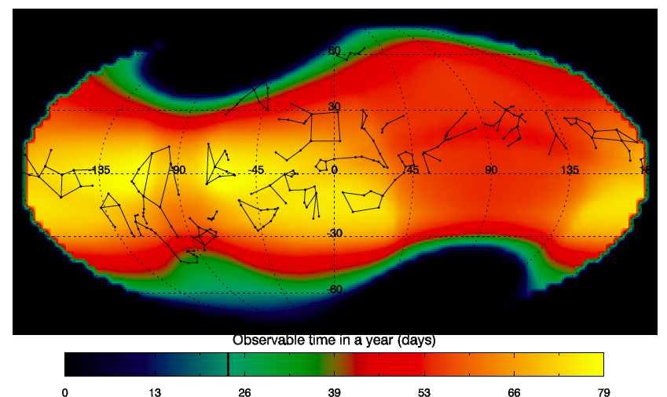
CHEOPS Sky visibility

Slide 8

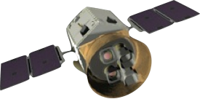
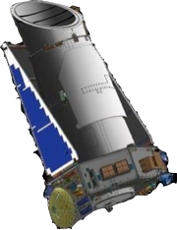
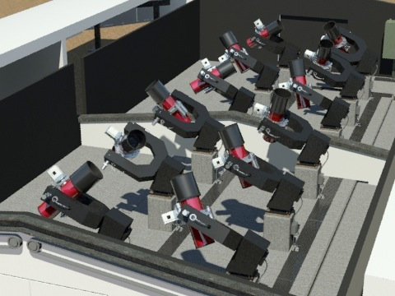
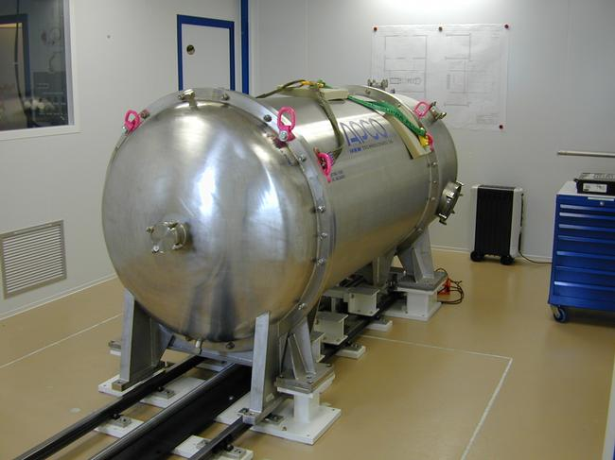
CHEOPS strategy: Follow-up
TESS
(2017)
Measure accurate light curves for Neptunes
Ground-based transit surveys
NGTS (2014)
K2
(2014)
Detect the transit of known super-Earths
Ground-based RV surveys
HARPS, HARPS-N, HIRES, SOPHIE (on going)
ESPRESSO (2017)
©CHEOPS Consortium
20% open time
(3.5-yr mission)

Slide 9
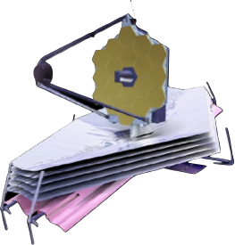
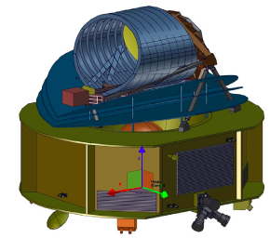
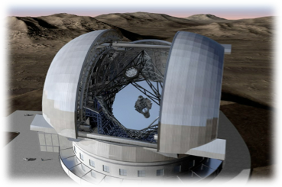
CHEOPS legacy
JWST
2021
Ariel
2028
E-ELT,
GMT, TMT
>=2024
©CHEOPS Consortium

Slide 10
CHEOPS input to Ariel
CHEOPS will derive the bulk density of the investigated planets:
  direct insights into the composition of the body
  quantitative constraint on the upper limit on the planet’s envelope mass.
CHEOPS main contribution to Ariel is therefore:
  some new transiting planets
  Identification of planets with significant atmospheres as a function of their mass, distance to the star, and stellar parameters, that worth spectroscopic investigation.

Slide 11
CHEOPS - TESS complementarity
The complementarity with TESS is very high. CHEOPS can:
  Confirm single-transit candidates for very bright targets;
  Refine ephemerides of targets with 1 or 2 TESS transits, whose drift is typically 1 hour per year, with great benefit to JWST and Ariel follow up;
  Improve the physical properties – mainly the accuracy of the radius - of a large number of candidate/discovered planets with a low number of TESS transits.
  Measure the TTV masses of (TESS) multi-planetary systems.

Slide 12
CHEOPS targets
A part from TESS targets that will populate its input catalogue, CHEOPS has two main typology of targets:
~100 very bright stars (6≤V≤9 mag) with known planet(s) from RV searches, including hot and warm super-Earths (SE), temperate, warm and hot sub-Neptunian (SN), Neptunians (N), and Jovians (J);
~150 bright stars (V≤12 mag) with a known transit from transit surveys. Among the latter, according to the present CHEOPS catalogue, ~ 80 hot Jovians, ~10 temperate or warm, and ~10 hot low-size planet (SE, SN, N) will be accessible to Ariel.

Slide 13
CHEOPS ➔ Ariel
Known planets from RV surveys currently in the CHEOPS core program catalogue, that are observable by Ariel in case a transit is identified.
Estimates made at end of 2016
to be updated
(according to CHEOPS IC update)

Slide 14
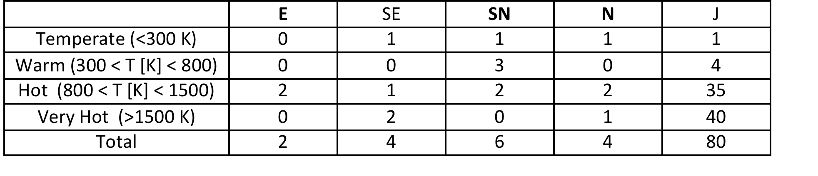
CHEOPS ➔ Ariel
Known planets from transit surveys currently in the CHEOPS core program catalogue accessible by Ariel, for which CHEOPS will put quantitative constraint on the upper limit on the planet’s envelope mass.
Estimates made at end of 2016
to be updated
(according to CHEOPS IC update)

Slide 15
CHEOPS flexibility
CHEOPS mission operation is conceived in order to adjust the program to accommodate new and interesting objects. E.g.:
  CHEOPS can follow-up any new targets identified by TESS requiring more data,
  Include in its schedule any new interesting targets whose characterization could be interesting to plan follow up spectroscopic measurements.
The CHEOPS input catalogue can be optimized almost in real time (weekly basis)

Slide 16
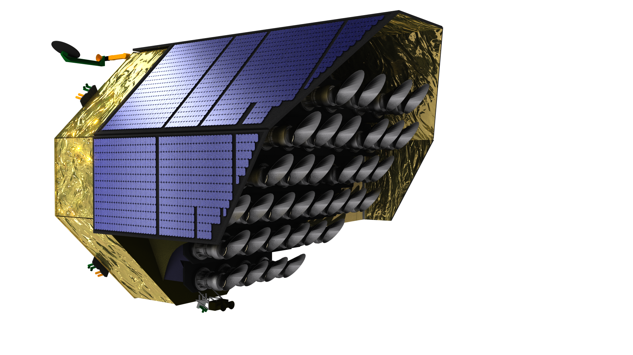



PLATO
PLAnetary Transits & Oscillations of Stars
  M class mission (M3)
  Budget envelope ~ 650 M€ (≤ 500 M€ from ESA)
  Launch: 2026 – Launcher Soyuz Fregat from Kourou
  Operation: 4.25 yr (+2) yrs
  [satellite built with consumable for 8 yr]
  Key Science Goals:
  Detection of terrestrial exoplanets in the habitable zone of
  solar-type stars and characterization of their bulk properties needed to determine their habitability.
  Understanding of the formation, the architecture, and the evolution (ages) of planetary systems by means of a full inventory of the physical properties of thousands of rocky, icy, and gaseous giant planets.
  TOP Key Objective:
  Up to a dozen of planets with Earth mass and Period > 80 d

Slide 17
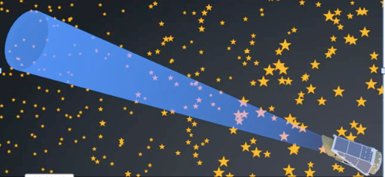

Large FoV concept
©PLATO @INAF
Searching for transits of Bright Stars ➔
➔ large FoV!
Rome, 5 Nov 2014

Slide 18

Telescope Concept
fully dioptric, 6 lenses
pupil 120 mm
dynamical range: 4 ≤ m_{V} ≤ 16
Spectral range = 500 – 1050 nm
©PLATO @INAF
Single Telescope FoV ∼1200 sqdeg
Equivalent to a circle of ~38.7 deg diameter

Slide 19
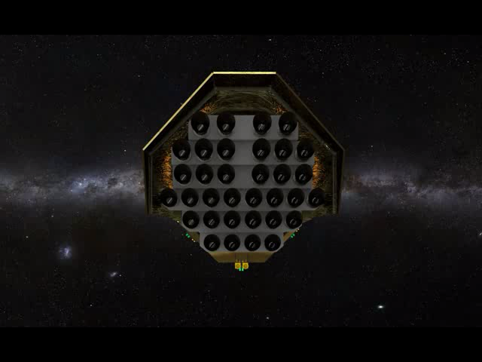
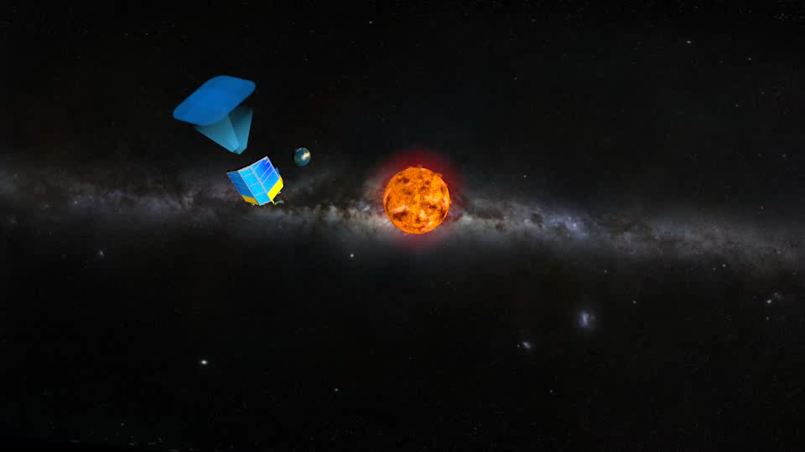
Multi-telescope concept & Mission profile
Very wide field + large collecting area:
multi-instrument concept
Overlapping FoV ∼2250 sqdeg
Ø ~53 deg
Collecting area of a 1.12 m
4 years nominal science operation (satellite consumables for 8 yr)
2 long pointings + step-and-stare phase

Slide 20
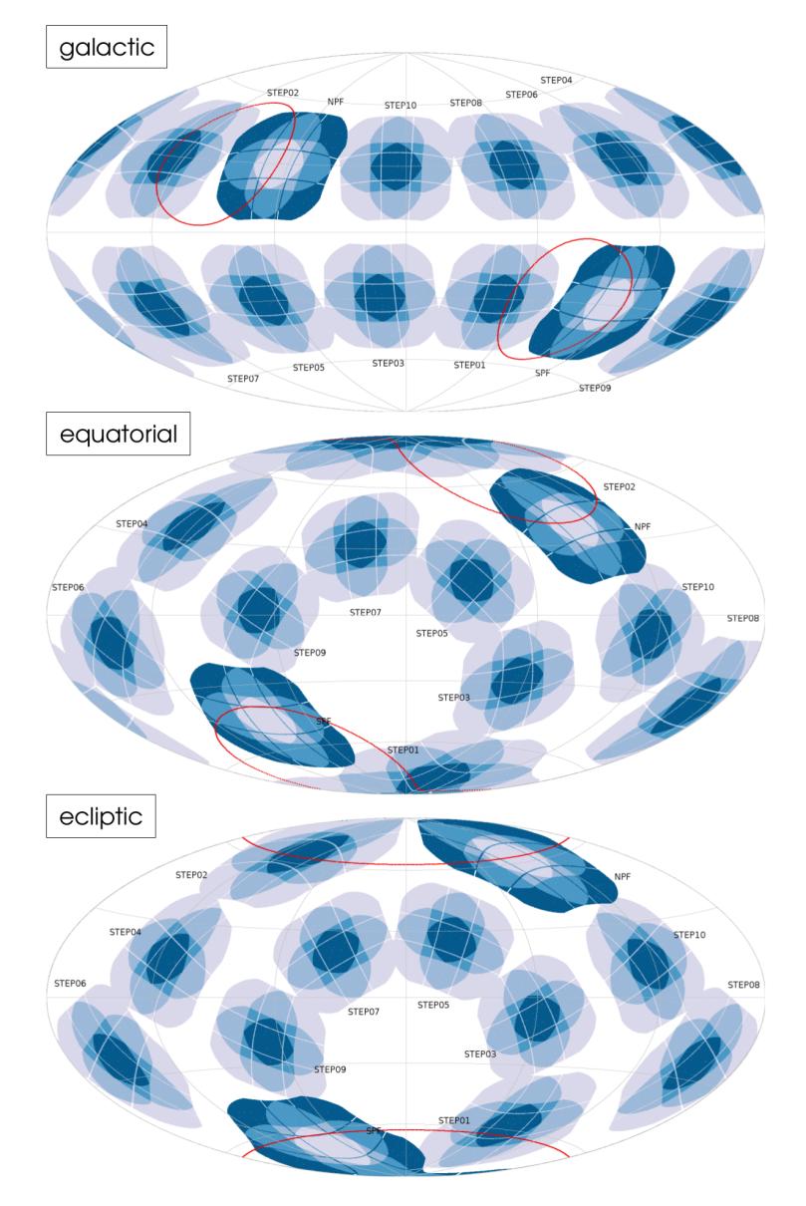
PLATO fields
Final Coverage:
2π sr ~ half of the sky
The LD fields cover N/S ecliptic poles, in good synergy with ARIEL.
Order of execution of LDs and S&S will be finalised in a coming phase.

Slide 21
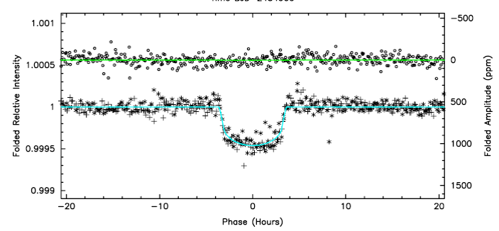
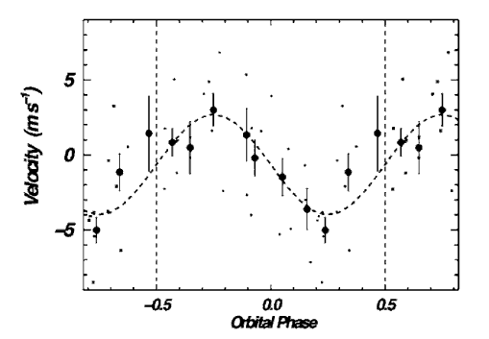
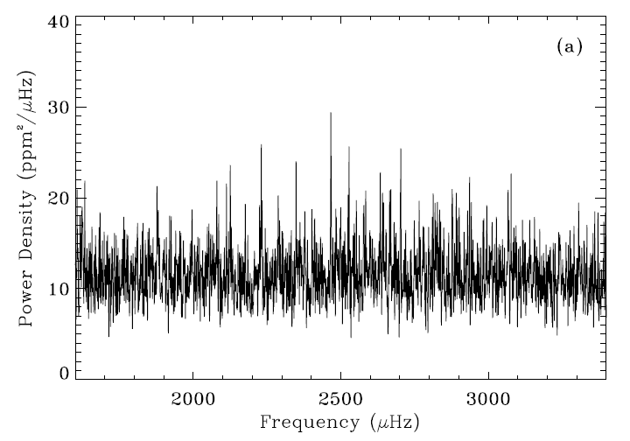
PLATO measurements
  radius ~3%
  mass ~10%
  age~10%
Techniques
Eg: Kepler-10 b (V=11.5 mag)
Transits
Radial Velocity
Asterosismology
©PLATO2.0 Consortium

Slide 22
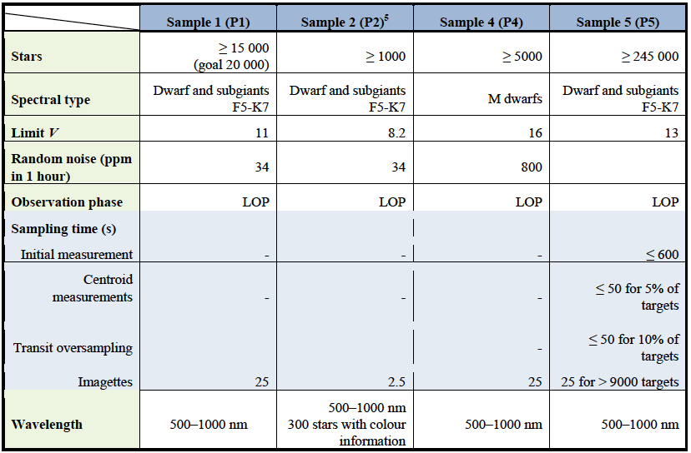
PLATO stellar samples

Slide 23
Expected planet yield by PLATO
planet yield = planet frequency x no. of stars observed x detectability
Kepler results
(Fressin et al. 2013)
estimated based on real stellar fields
(Nascimbeni, Piotto et al. 2015)
PLATO-UWA-PSPM-TN-001
Detectability depends upon:
geometric transit probability (depending on orbital period)
the efficiency of detection algorithms (based on Kepler and CoRoT experiences).

Slide 24
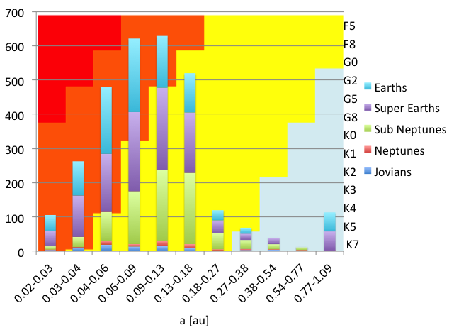
PLATO yield
F5-K7 dwarfs and sub-giants
brighter than V=11 mag.
very hot
warm
hot
temperate
Estimates made at end of 2016
PLATO yield are under update according to Gaia DR2 input
For all the planets PLATO will provide:
  (radius, mass) ➔ density, and age.

Slide 25
Expected PLATO yield for
M dwarfs
A sample of ≥5.000 M dwarfs is part of the PLATO Input Catalogue
  monitored during long-duration phases,
Expected 5.000 planets with R<2 R_{E} and P<50 d , half of which in the HZ, for each of the observed planets
Being the sample of M dwarfs made of star brighter than V~15 (K~11.7 for a M0, ~11 for a M4), there will plenty of hot and warm J, N, SN, SE, and E, and a moderate, but even relevant number of temperate planets suitable for Ariel observation.

Slide 26
Can PLATO provide targets to Ariel?
The launch date of the M3 and M4 missions are 2 years apart.
Observing strategy for PLATO not yet decided (LD and S&S sequence).
TESS will provide few targets with P> 27 d ➔ these can be provided by PLATO.
For all targets, including TESS planet candidates, PLATO will provide accurate physical properties:
  Density (Mass, Radius) ➔
  Age
Optimizing selection of targets for atmosphere studies

Slide 27
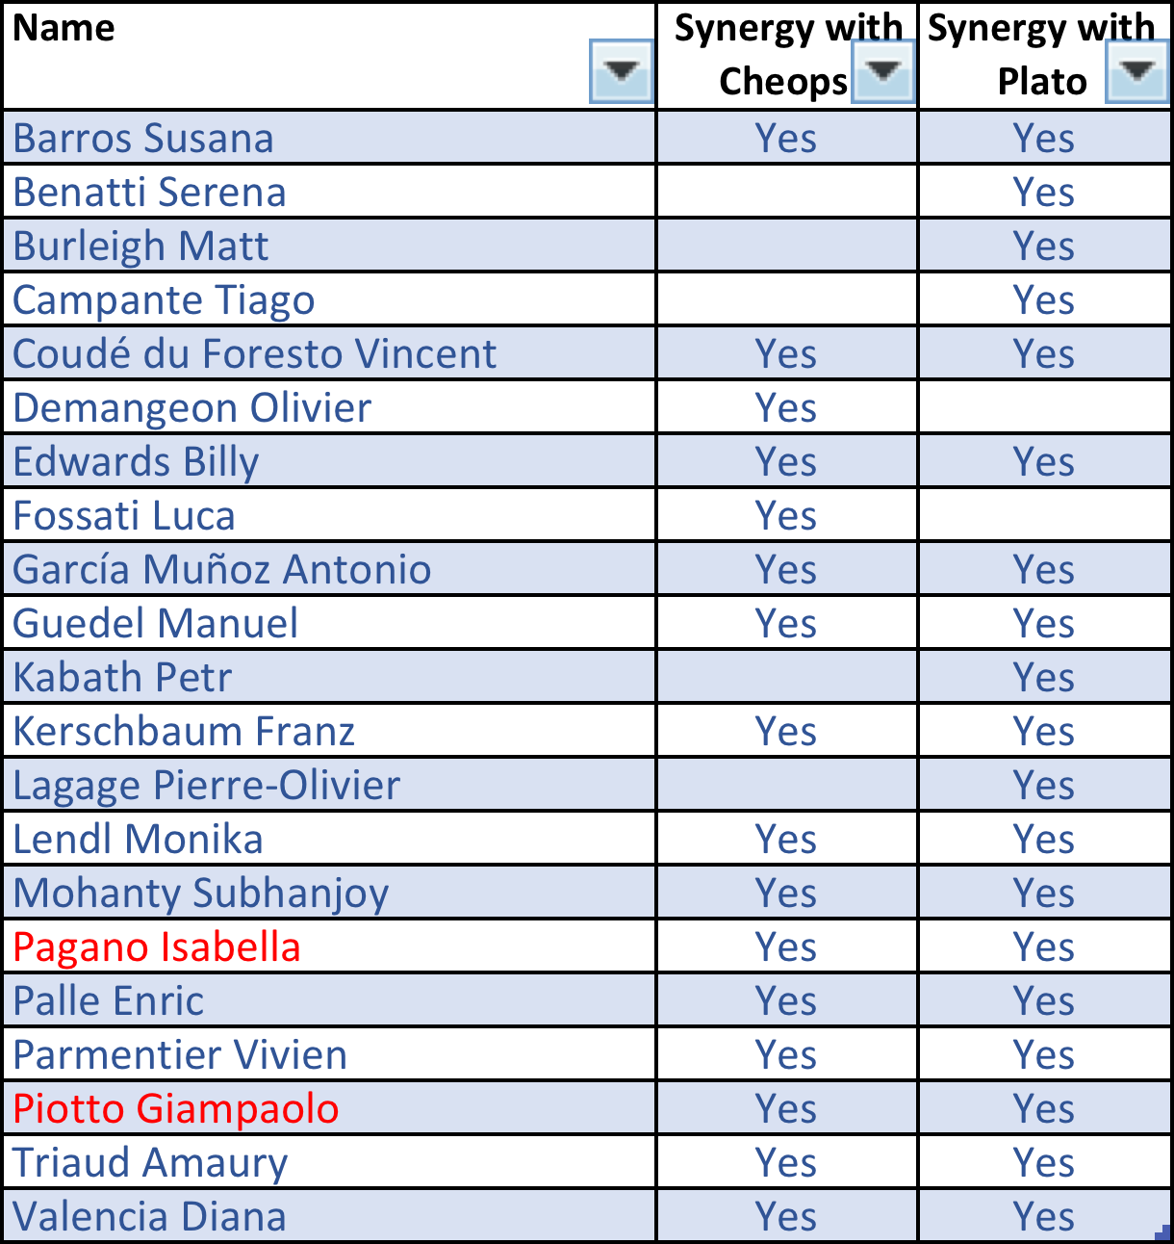
WGs on Ariel synergies with CHEOPS, PLATO
Open to new members!

Slide 28
WGs on Ariel synergies with CHEOPS, PLATO
Mailing lists
  CheopsSynergies@inaf.it
  PlatoSynergies@inaf.it
Current Plans:
  Update of current estimates for the Ariel RedBook
  Remote meeting every 3 months before CHEOPS launch.
  Ideas?

Slide 29
The end

