Slide 1
Discussion on Jets and Winds
1. Role of jets and winds in disk evolution?
What is the influence of jets and winds on accretion
disks? Effects on gas-to-dust ratio? Effects on grain
size distribution?
2. Will we ever be able to study magnetic fields?
How to detect the magnetic fields that are essential
for jet creation and collimation?

Slide 3
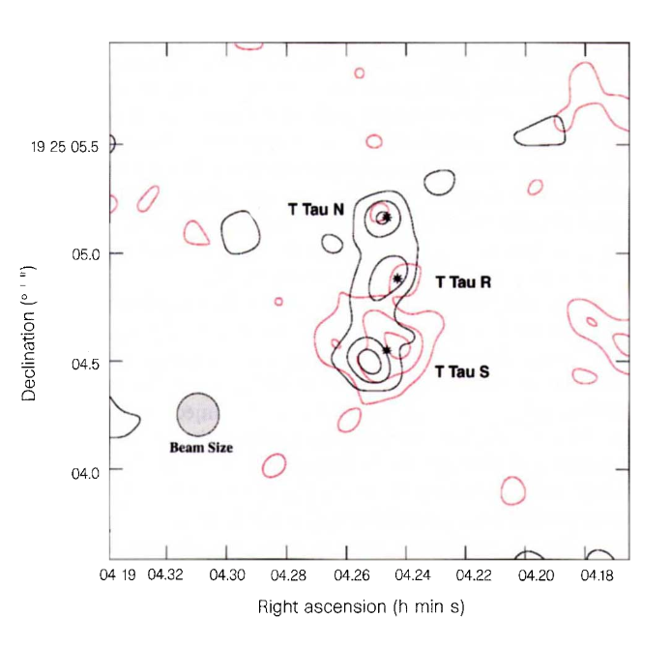
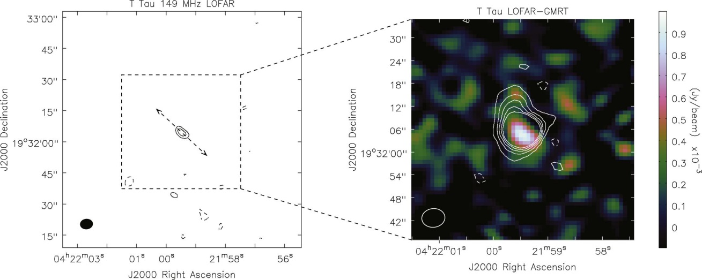
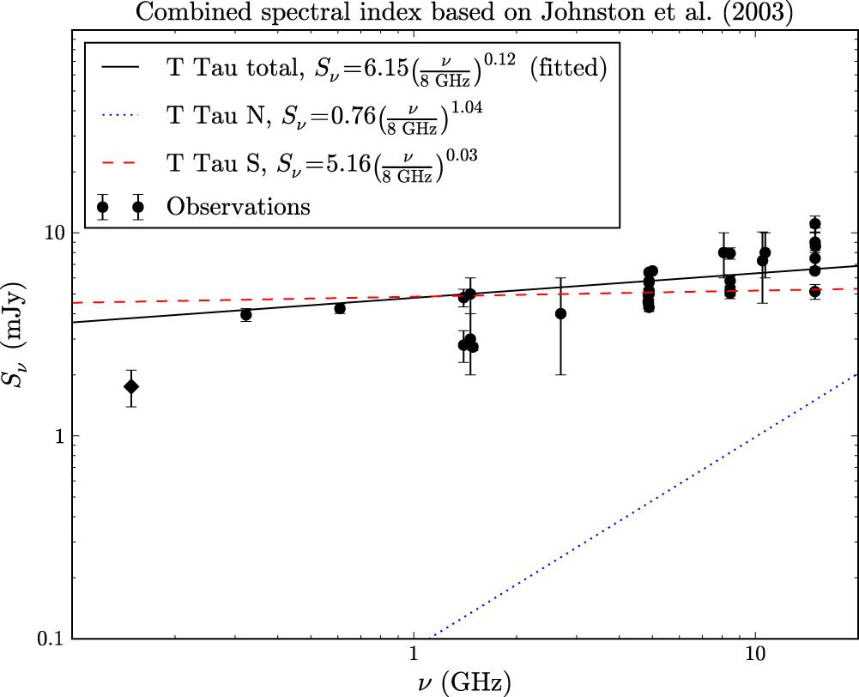
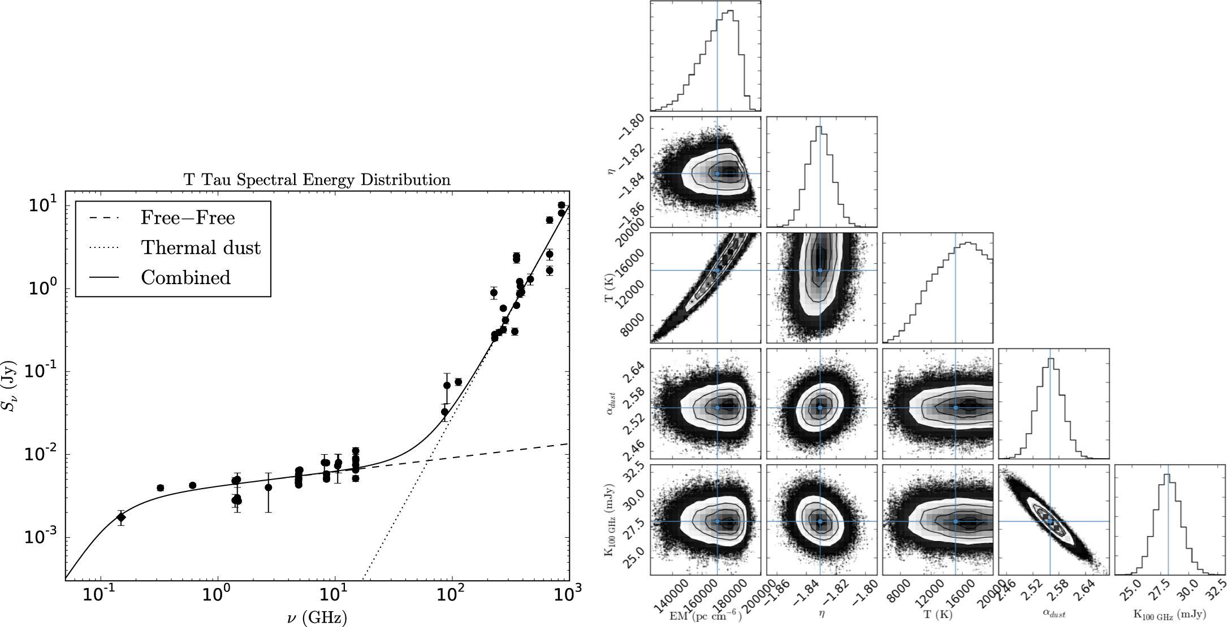
Ray et al. 1999
Coughlan et al. 2017

