Slide 1
Εuropean Exascale System Ιnterconnect & Storage
www.exanest.eu
Manolis Marazakis and Manolis Ploumidis,
Systems Software Engineers
Foundation for Research & Technology - Hellas (FORTH)
ExaNode, ExaNeSt, EcoScale Joint Application Workshop
INAF, Trieste - September 19-20, 2016

Slide 2
The ExaNeSt Consortium
Storage & data
Netherlands
Italy
Italy
Italy
Germany
Applications
UK
Italy
Greece - coordinator
UPV - ES
UK
Interconnects
www.exanest.eu
UK
Technology

Slide 3
What ExaNeSt is about
ARMv8, UNIMEM Partitioned Global Address Space (PGAS)
Low-energy compute nodes
Low-overhead communication
Heterogeneous: FPGA accelerators
Working closely with ExaNoDe, EcoScale (& EuroServer)
Network: unified compute & storage, low latency
Storage: distributed, in-node non-volatile memories
Extreme Compute Density: totally-liquid cooling
Prototype: 1K cores, 4 Tby DRAM, 40 Tby SSD, 0.5 M DSP sl’s
Real Applications: Scientific, Engineering, Data Analytics

Slide 4
The UNIMEM Architecture, used in ExaNeSt
Realistic rack-level shared-memory based on Unimem
Single owner per page: every memory page in at most one node’s cache
no system-level hardware coherence traffic
owner can be any node - not just the (local) one adjacent to DRAM
Example usage models
Remote memory accesses, remote mailbox, remote interrupts:
for fast synchronization & processing of distributed (read-only) data
Zero-copy remote direct memory transfer (RDMA)
sockets over zero-copy RDMA
MPI over sockets
Remote-page borrowing for memory disaggregation
Extension to in-node fast NVM
Every file in one node’s NVM cache

Slide 5
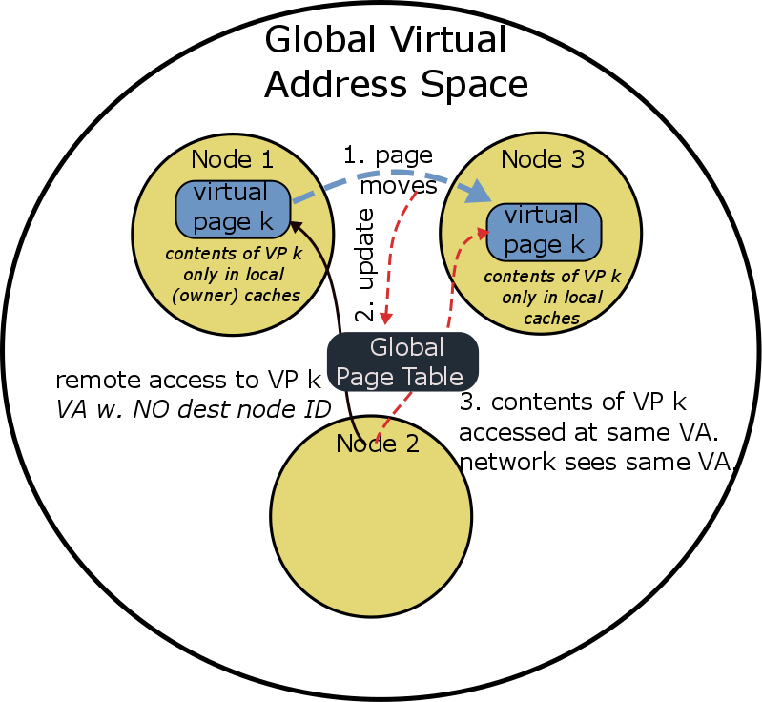
ExaNeSt: Unimem PGAS Memory Model
Enables remote loads/stores to global address space
System-wide coherent memories w/o expensive hardware
only one node may cache data
Global Virtual Address Space
Resiliency : page can move seamlessly upon node failures
Difficult to maintain a global page table

Slide 6
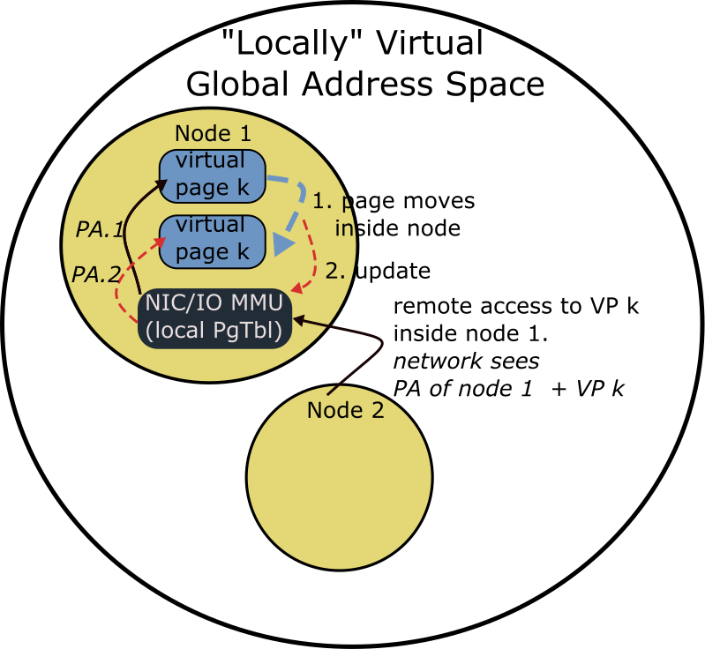
ExaNeSt Unimem Implementation
Enables remote loads/stores to global address space
System-wide coherent memories w/o expensive hardware
only one node may cache data
Global Virtual Address Space
Resiliency : page can move seamlessly upon node failures
Difficult to maintain a global page table
ExaNeSt pages stay within a coherence island (node)

Slide 7
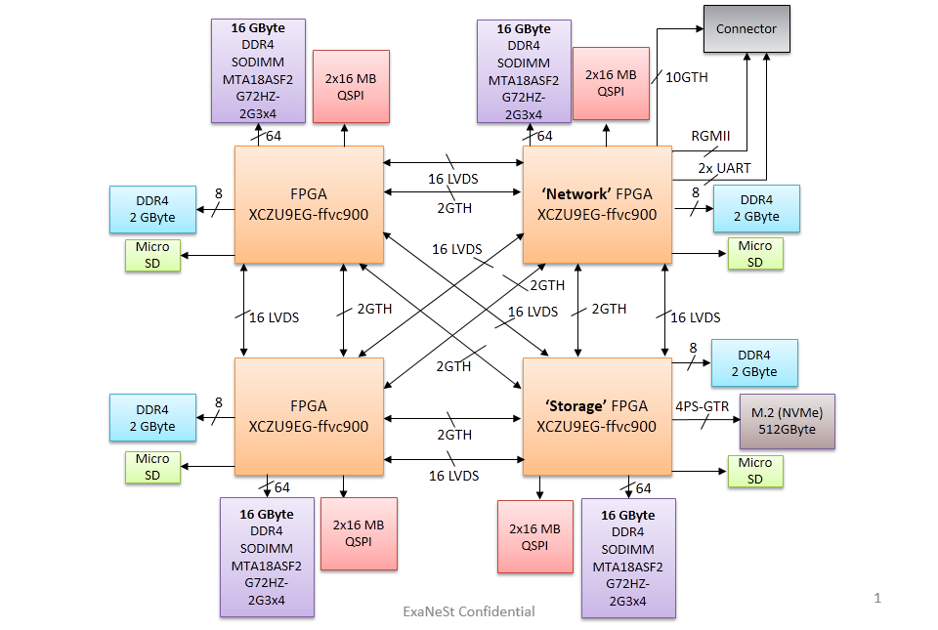
ExaNeSt Node: Quad-FPGA-DaughterBoard (QFDB)
4 Ultrascale+ FPGAs
all-to-all connectivity
2 x HSS (GTH) + 16 x LVDS
64 GBytes DDR4
16 GB/FPGA @ 160 Gb/s
512 GBytes SSD/NVMe
4x PCIe v2 (8 GBytes/s)
10 HSS links to remote
10 Gb/s per link
16 Gb/s best case
120x130mm2
Currently in layout + fabrication

Slide 8
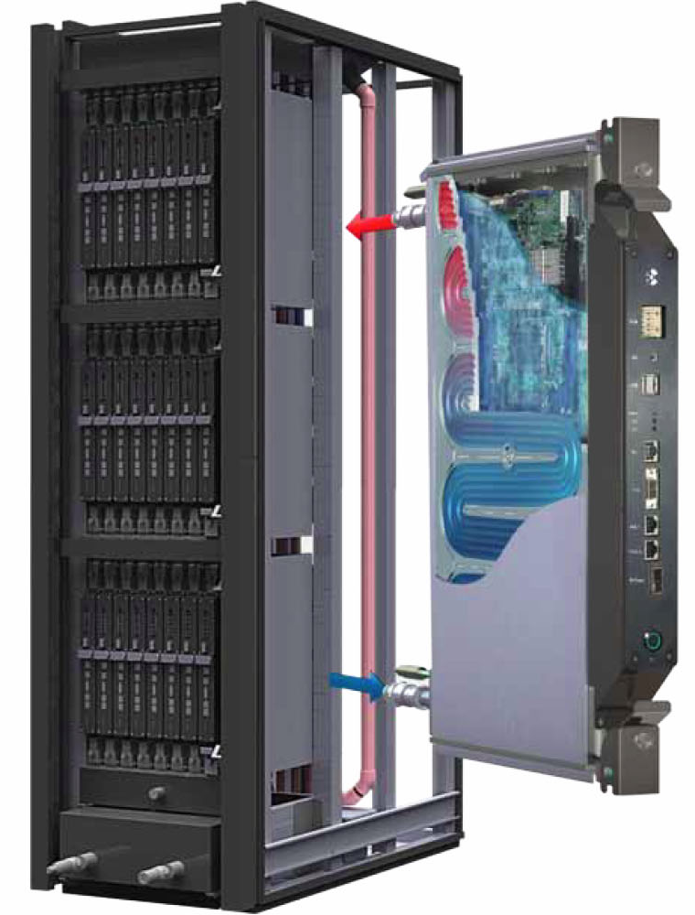
The ExaNeSt Prototype (2016 – 17)
Electronics immersed in
3M Novec liquid
Using Xilinx Zynq UltrScale+ FPGAs
Four 64-bit ARM cores per FPGA
Quad FPGA Daugther Boards (QFDB)
Four FPGAs per QFDB
8 QFDB’s per Blade
System: Dozen Blades
Rack-level water circulation

Slide 9
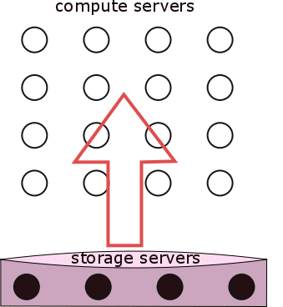
ExaNeSt Storage Architecture
QFDBs w. SSD storage
Bring data closer to compute → inside QFDB-level SSDs

Slide 10
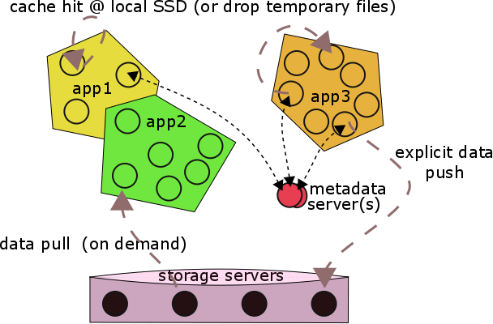
ExaNeSt: Per-Job On-Demand SSD Caches
File Payload : cache-hit @ SSDs cache; on miss → storage server

Slide 11
Applications, Traces
Main Applications:
Material science: LAMMPS
Climate change: REGCM
Engineering: openFoam, SailFish
Astrophysics: Gadget, Pinocchio, Changa, Swift
Neuroscience: DPSNN
High Energy Physics: LQCD
Data Analytics: MonetDB
Traces generated:
Scalasca profiling tool:
MPI calls instrumented,
several GBytes per trace,
filtered down to tens of Mbytes by keeping what our network simulators will need;
generally, to be made publicly available.
Next – Applications Porting & Tuning:
currently porting selected App’s to ARM, on the EuroServer+ExaNoDe Prototype

Slide 12
Inter-Project Areas for Collaboration
MPI for UNIMEM [ExaNoDe + ExaNeSt]
App. Profiling: time-based + network patterns
Implementation: MPICH vs OpenMPI ?
Evaluation
Accelerators [ECOSCALE + ExaNoDe + ExaNeSt]
Native + VMs
Toolchain and development workflow (OpenCL ?)
Evaluation
Resilience (cross-cutting concern → HARD)
Checkpoints
Replicated execution
RAS properties

Slide 13
Εuropean Exascale System Ιnterconnect & Storage
Interconnection Network
In-node Storage
Advanced Cooling
Real Applications
www.exanest.eu

Slide 14
Notes on MPI

Slide 15
MPI: Implementations
MPICH
High performance and widely portable implementation of the Message Passing Interface (MPI) standard
https://www.mpich.org/
OpenMPI
An open source high performance message passing library
https://www.open-mpi.org/
MVAPICH
MPI over InfiniBand, Omni-Path, Ethernet/iWARP, and RoCE
http://mvapich.cse.ohio-state.edu/

Slide 16
MPI: Messaging passing protocols (1)
Point-to-point
Collective communications
One-sided communications

Slide 17
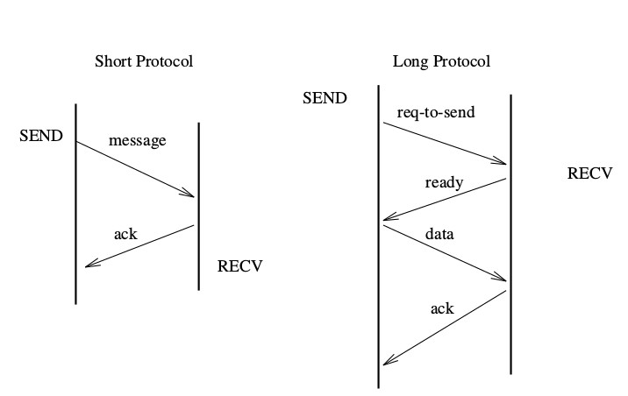
MPI: Message passing protocols (2)
short (eager-to-send) vs long protocol (rendezvous)
for point-to-point communication

Slide 18
MPI: Message passing protocols (3)
Collective operations in MPICH
(implemented through point-to-point2 communications)
Source: W. Gropp, E. Lusk, N. Doss, and A. Skjellum. A high-performance, portable implementation of the MPI message passing interface standard

Slide 19
MPI: Message passing protocols (4)
point-to-point communication in OpenMPI
Byte-Transfer Layers (BTL)
Communications framework (PML)

Slide 20
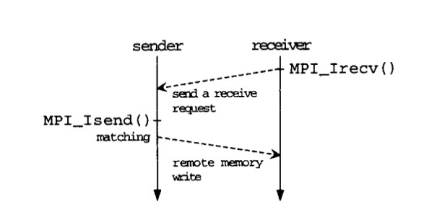
Message passing protocol optimization
Employing remote memory operations
Assuming underlying hardware support
Receiver advertises a buffer and tag for expected data
Sender directly writes to receiver’s advertise buffer
Osamu Tatebe and Yuetsu Kodama and Yoshinori Yamaguchi and Satoshi Sekiguchi
Highly Efficient Implementation of M PI Point-to-point Communication Using Remote Memory Operations
ICS '98 Proceedings of the 12th International Conference on Supercomputing

Slide 21
Notes on UNIMEM

Slide 22
The UNIMEM Architecture, used in ExaNeSt
island
island
P
P
P
P
P
P
cache
cache
cache
Memory
Memory
Memory
System-level interconnect
H/W cache-coherence island
NO system-wide
H/W coherence
Global Address Space

Slide 23
UNIMEM Remote Accesses: coherent at destination
island
P
P
P
P
cache
cache
Remote store
(and load)
Memory
Memory
System-level interconnect
H/W cache-coherence island
NO system-wide
H/W coherence
Global Address Space

Slide 24
UNIMEM Coherent Remote Direct Memory Access
island
P
P
P
P
cache
cache
RDMA
Memory
Memory
System-level interconnect
H/W cache-coherence island
NO system-wide
H/W coherence
Global Address Space

Slide 25
Page Borrowing: pages used & cacheable only remotely
island
P
P
P
P
cache
cache
Page borrowing
Memory
Memory
System-level interconnect
H/W cache-coherence island
NO system-wide
H/W coherence
Global Address Space

