Slide 1

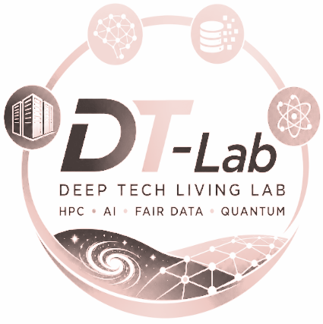
Producing Observables:
The Particles Modules of gPLUTO
Speaker: Agnese Costa¹
Main contributors: L. Ricci, A. Suriano, E. Lopresti, S. Truzzi, M. Rossazza, A. Mignone, G. Bodo, C. Zanni
1: INAF – OA Torino, agnese.costa@inaf.it
DT-Lab KickOff Meeting – Bologna, Sep 2026

Slide 2
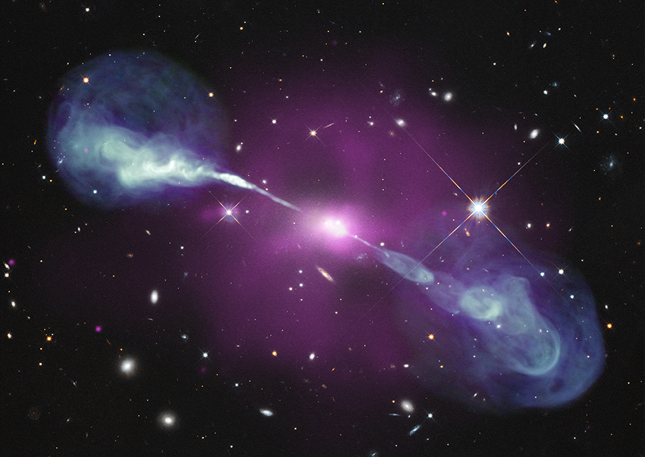
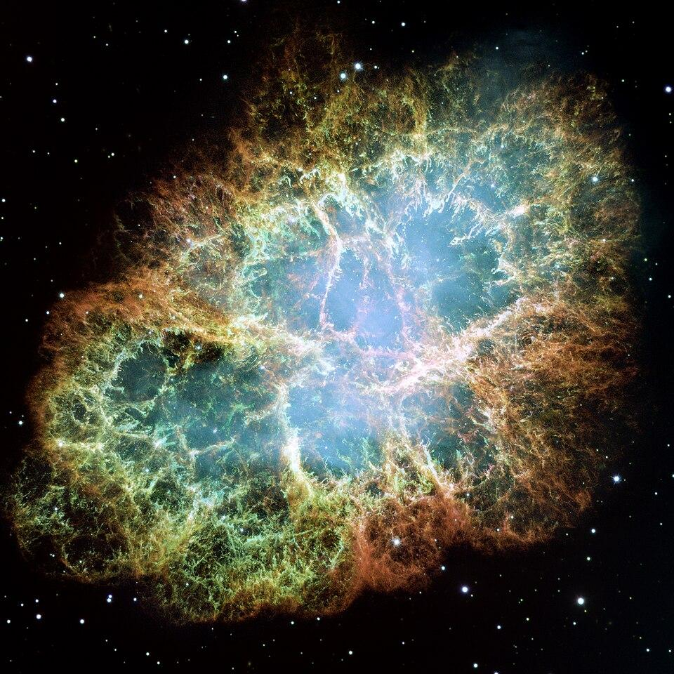
High-Energy Universe
Non-thermal multiwavelength / multimessenger emission: a multi-scale problem!
There are multiple unanswered questions (e.g. emission process, baryon loading, acceleration mechanism, absorption and propagation, variability…)
⇒ simulations are laboratories to test theory with observations.
Figures: Crab (NASA, ESA, J. Hester and A. Loll, Arizona State University); Hercules A (NASA/CXC/SAO/STScI/NSF/NRAO/VLA).
Bibliography: e.g., Tavecchio et al., 1998, 2000; Weidinger and Spanier, 2010; Krawczynski et al., 2002; Sikora et al., 2001; Ghisellini and Tavecchio, 2009; Davidson, 2001; Birdsall & Langdon, 1991; Ji et al., 2022.

Slide 3
High-Energy Universe
Non-thermal multiwavelength / multimessenger emission: a multi-scale problem!
There are multiple unanswered questions (e.g. emission process, baryon loading, acceleration mechanism, absorption and propagation, variability…)
⇒ simulations are laboratories to test theory with observations.
Magnetohydrodynamics
macroscopic description
scalable, well established methods, versatile
Particle-In-Cell
kinetic approach (skin depth / gyroradius)
first-principle description
Figures: Crab (NASA, ESA, J. Hester and A. Loll, Arizona State University); Hercules A (NASA/CXC/SAO/STScI/NSF/NRAO/VLA).
Bibliography: e.g., Tavecchio et al., 1998, 2000; Weidinger and Spanier, 2010; Krawczynski et al., 2002; Sikora et al., 2001; Ghisellini and Tavecchio, 2009; Davidson, 2001; Birdsall & Langdon, 1991; Ji et al., 2022.

Slide 4

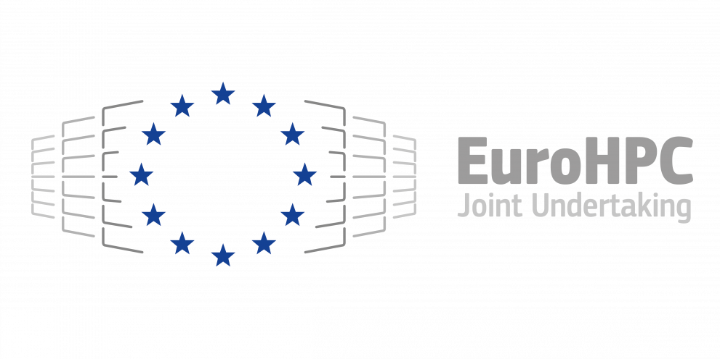
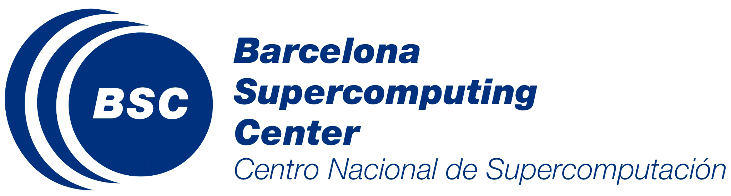




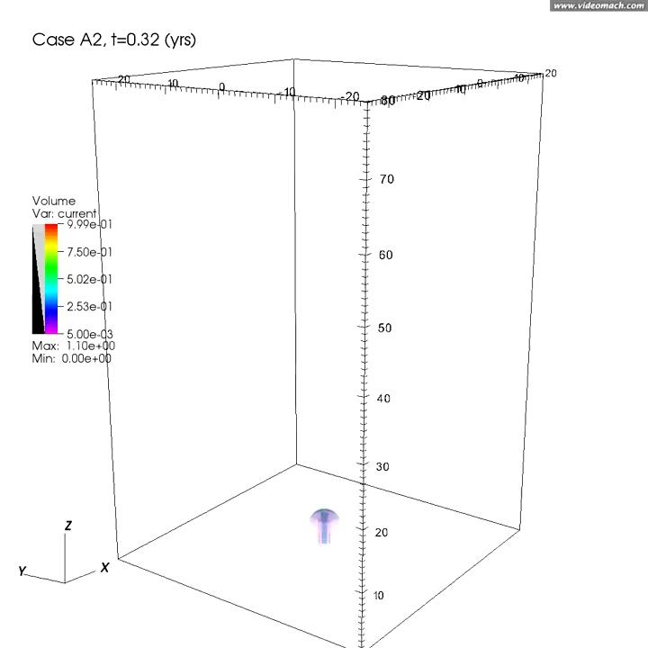
gPLUTO
Finite volume shock-capturing code solving the hyperbolic/parabolic equations of gas and plasma dynamics in astrophysics
Multi-algorithm and multi-physics framework
C++ parallel code (MPI)
Open source
Figures: Jet simulation; gPLUTO scaling (Rossazza et al. 2026).
Bibliography: Mignone et al., 2007; 2012; Rossazza et al., 2026; Suriano et al., 2026b.

Slide 5
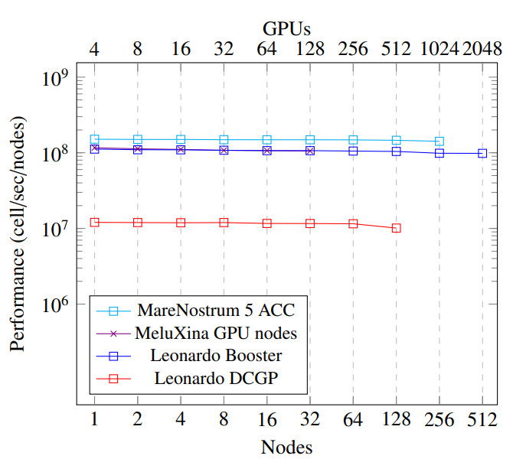
gPLUTO
Finite volume shock-capturing code solving the hyperbolic/parabolic equations of gas and plasma dynamics in astrophysics
Multi-algorithm and multi-physics framework
C++ parallel code (MPI)
Open source
GPU accelerated through OpenACC/OpenMP
Figures: Jet simulation; gPLUTO scaling (Rossazza et al. 2026).
Bibliography: Mignone et al., 2007; 2012; Rossazza et al., 2026; Suriano et al., 2026b.

Slide 6
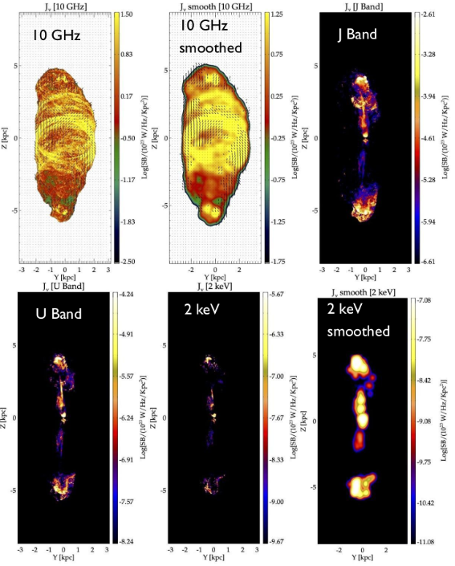
Particles in gPLUTO
Hybrid frameworks are scalable models that can capture kinetic processes. They bridge the gap between MHD and PIC.
Figures: RMHD+LP simulation; scaling (Suriano et al., 2026b)
Bibliography: Suriano et al., 2026b.

Slide 7
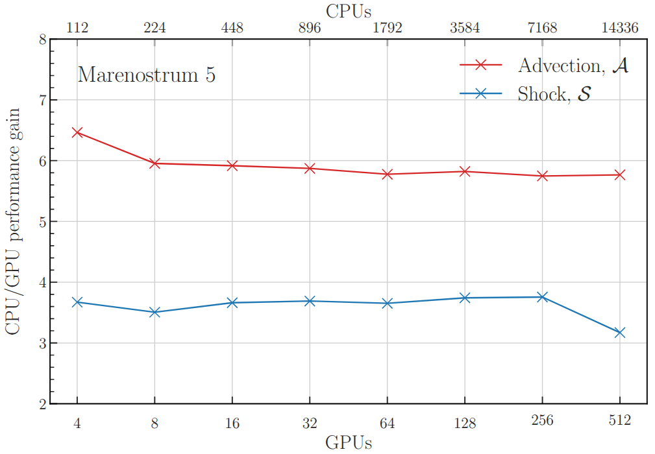
Particles in gPLUTO
Hybrid frameworks are scalable models that can capture kinetic processes. They bridge the gap between MHD and PIC.
Figures: RMHD+LP simulation; scaling (Suriano et al., 2026b)
Bibliography: Suriano et al., 2026b.

Slide 8
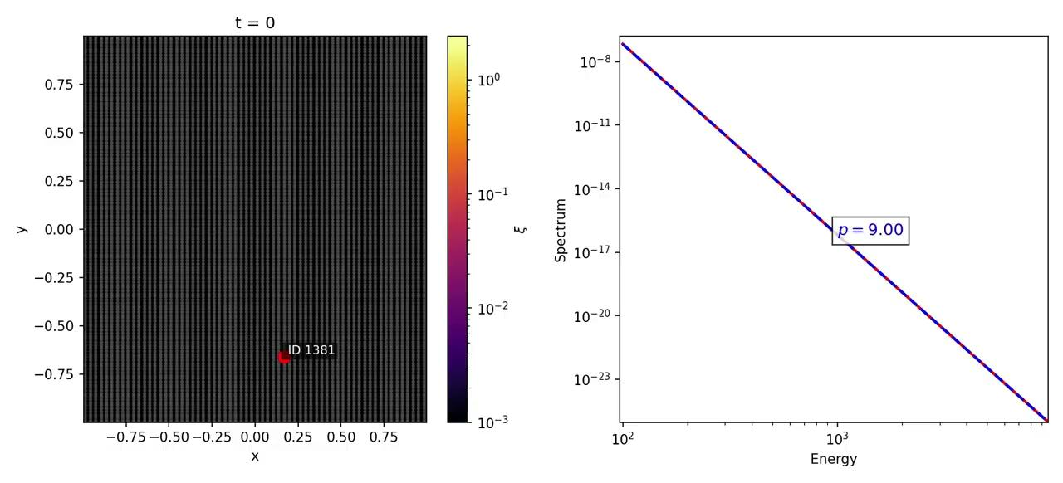
Lagrangian Particles
Regime: particle gyroradius << cell size.
Approach: Sub-grid Lagrangian. The LP is a distribution of NTPs.
Fokker-Planck evolution informed by the in situ fluid state.
Physics: adiabatic & radiative cooling, diffusive shock acceleration, magnetic reconnection, beaming.
Development status: ready and updated.
Video: Reconnection for 1 CR (credit to M. Fumero).
Bibliography: Vaidya et al. 2018; Mukherjee et al., 2021; Suriano et al, 2026b.

Slide 9
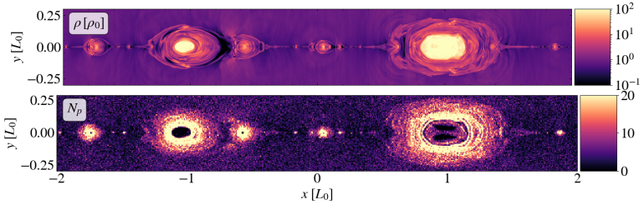
Cosmic Rays
Regime: particle gyroradius > cell size.
Approach: single fluid thermal plasma (MHD) + collisionless NTPs (PIC). The CR is a cloud of physical particles.
EoM of charged particles, informed by fluid conditions.
Physics: feedback (future development).
Status: verified on test problems. Parallel scaling and GPU acceleration are being tested on HPC clusters.
Figure: CRs around plasmoids (credit to E. Lopresti)
Bibliography: Mignone et al. 2018; Zhung et al., 2025.

Slide 10
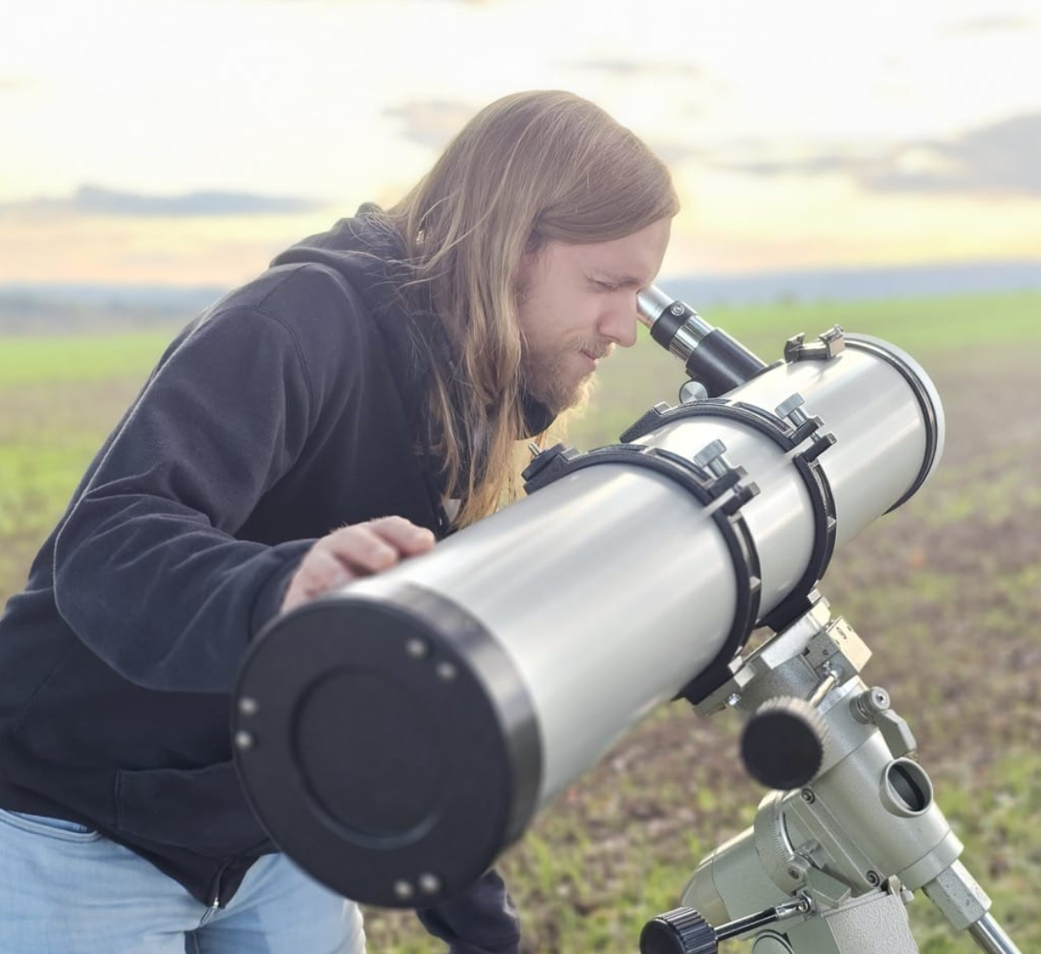
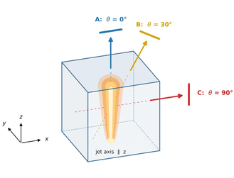
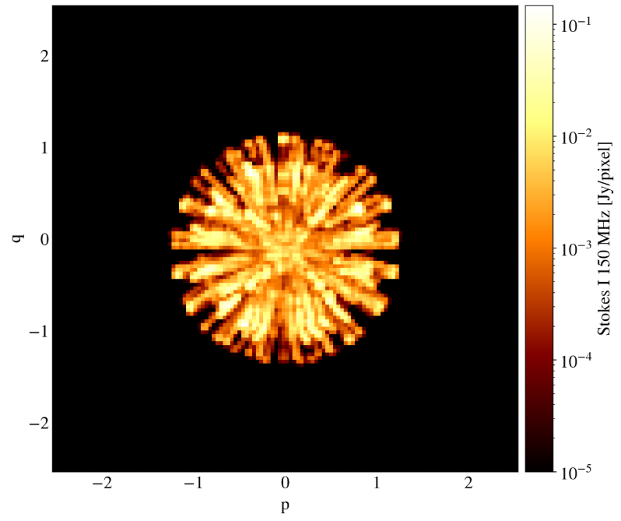
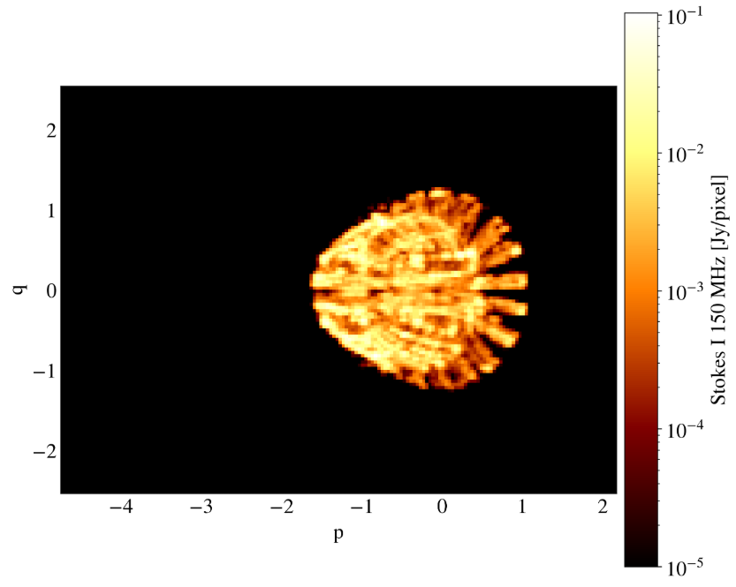
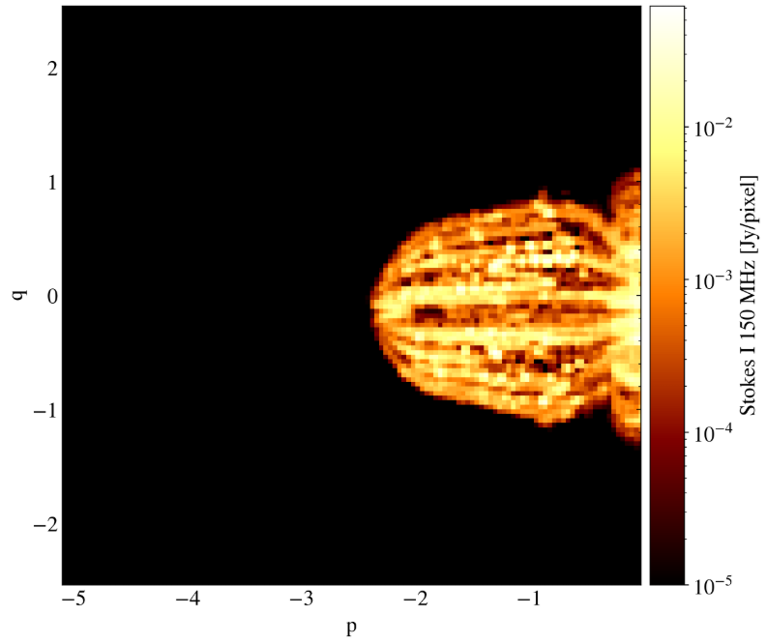
Ray-tracing / VLBI-PLUTO
Goal: direct comparison between simulations and observations.
Current development: ray-tracing code to project a 3D simulation onto the 2D plane of the sky
Physics: beaming, optically thin and thick emission.
Future prospects: VLBI-PLUTO = tool to reconstruct 2D emission maps as if they were observed by the desired VLBI array.
A
C
B
Figure: RMHD jet as if observed (credit to L. Ricci).

Slide 11
Thank you!

