Slide 1



Cosmological Applications of Quantum Computing
Quantum Markov Chain Monte Carlo for Cosmological Functions
Giuseppe Sarracino et al.,
30/09/2026,DT-LAB kick-off meeting.

Slide 2
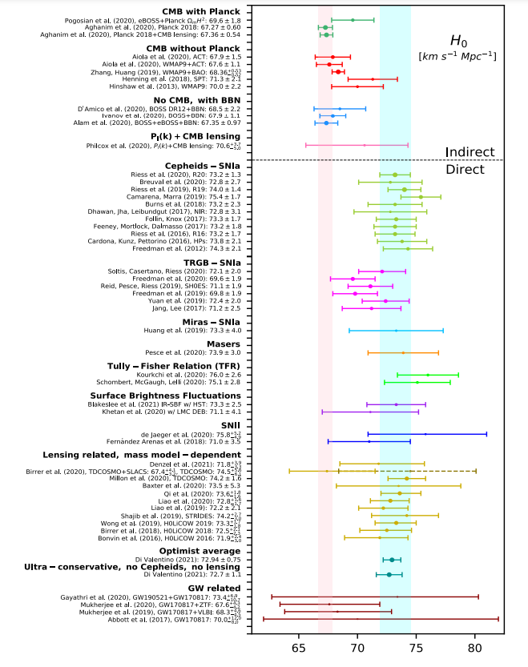
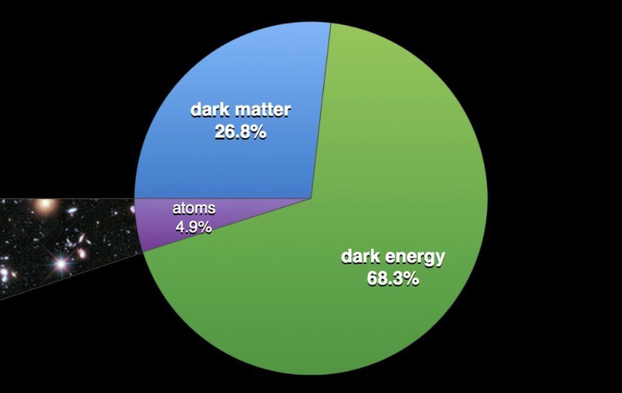
Investigating cosmological parameters.
Di Valentino et al. 2021, Abdalla et al. 2022

Slide 3
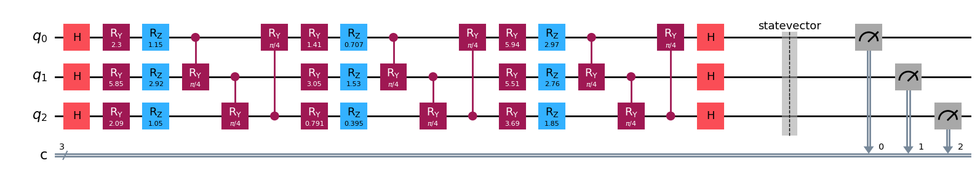
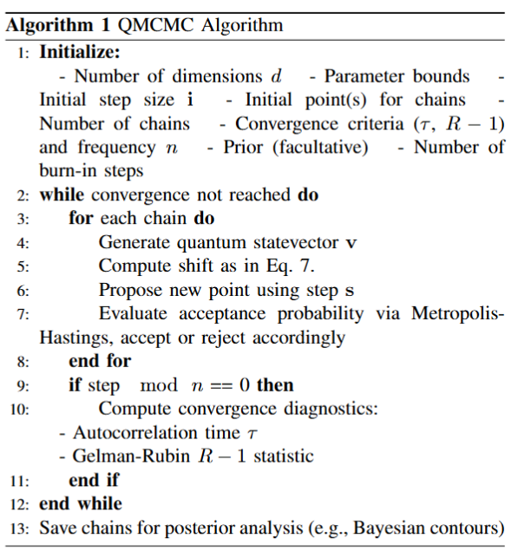
The Quantum MCMC (Quantum Step, Classical Evaluation)
https://arxiv.org/abs/2509.09395

Slide 4
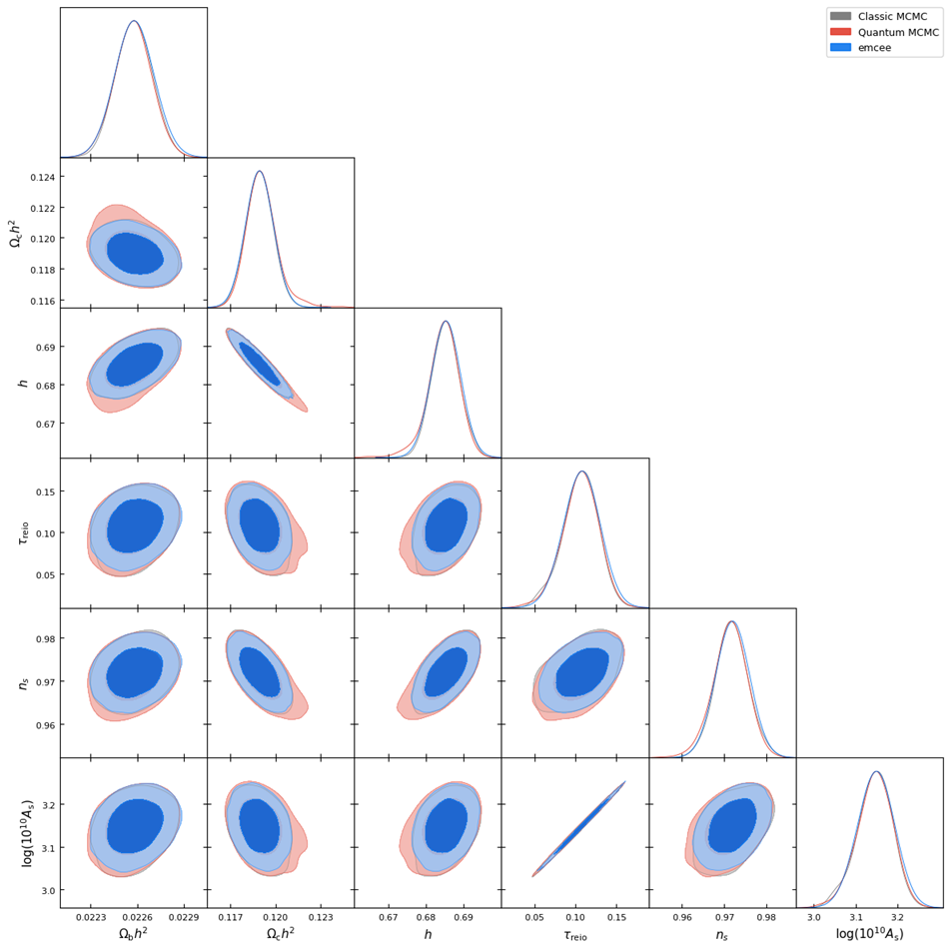
Results (4) Proper ΛCDM run with Planck Likelihood, SNe Ia, and BAO
Results (1): CMB+SNe Ia+BAO, using the proper CMB likelihood, cosmopower emulator

Slide 5
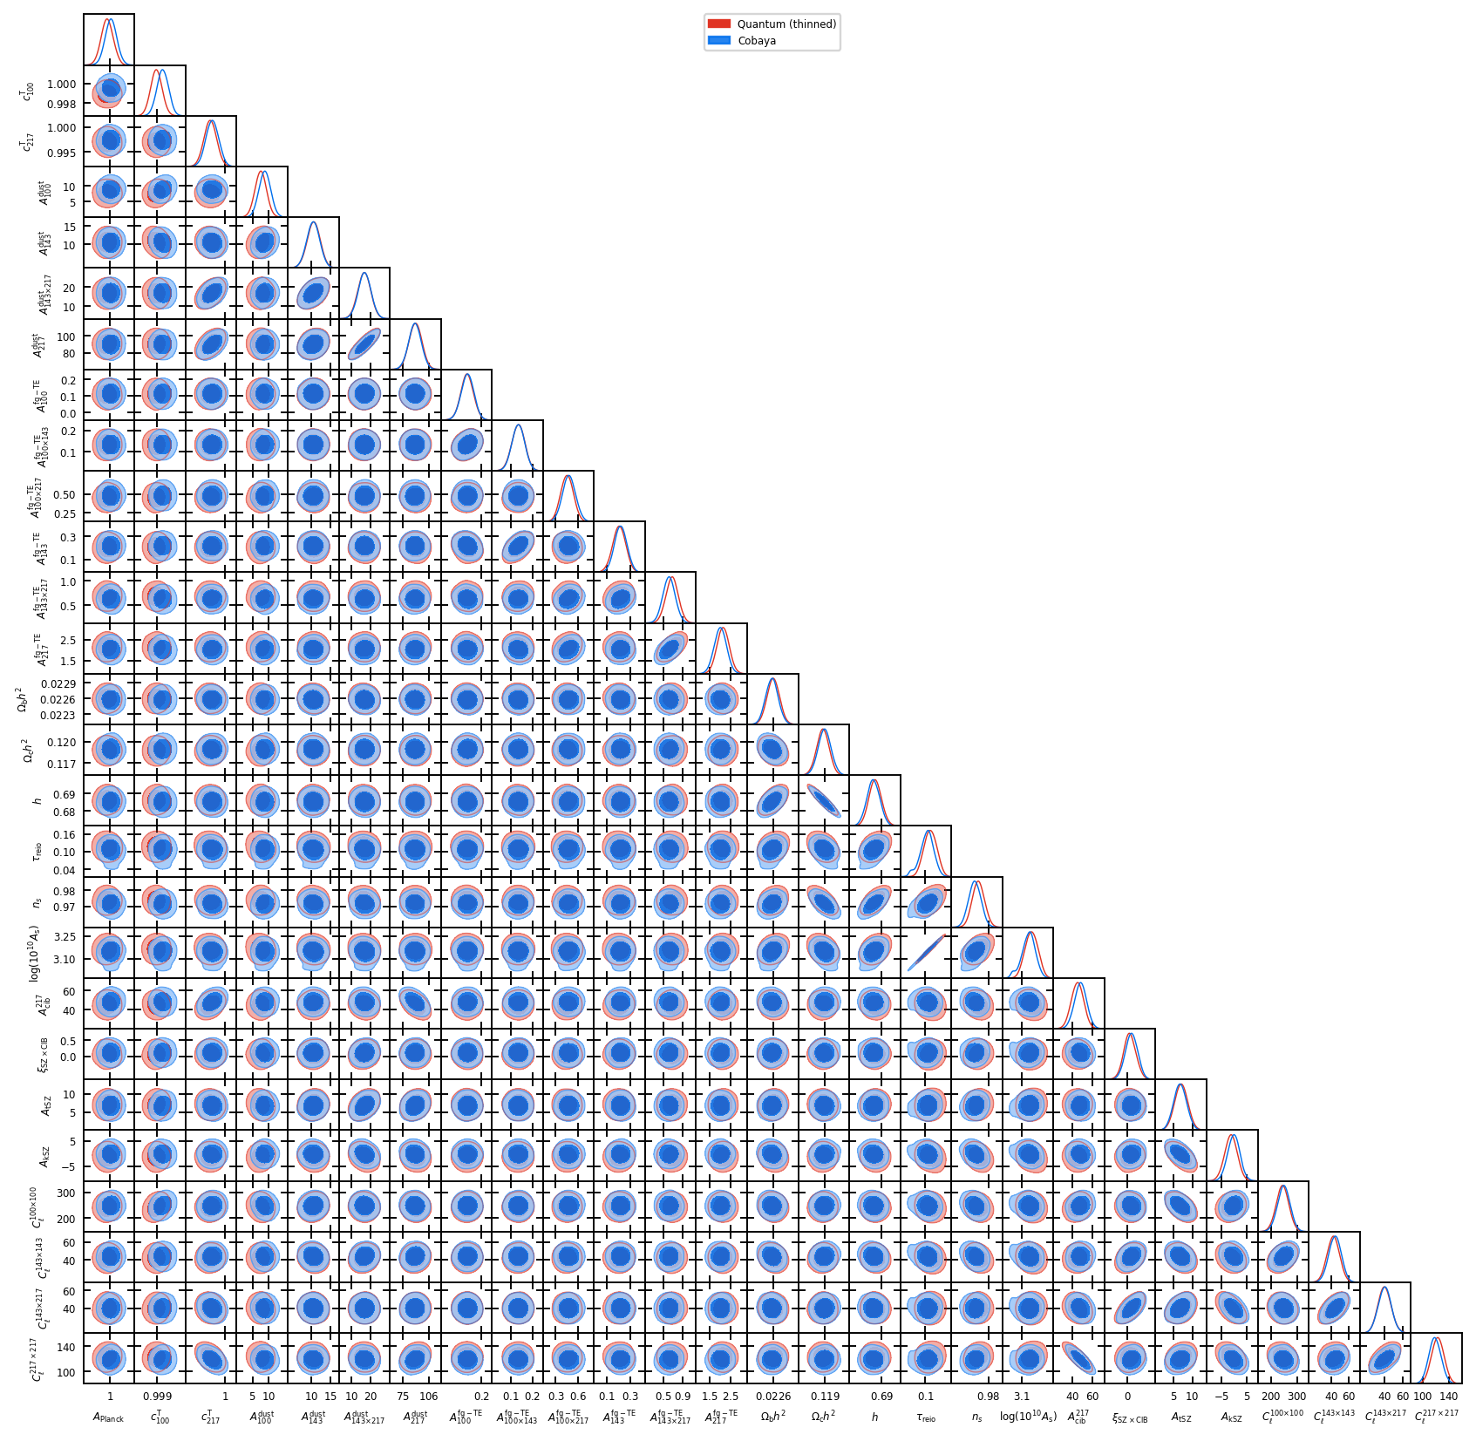
Results (4) Proper ΛCDM run with Planck Likelihood, SNe Ia, and BAO
Results (2): CMB+SNe Ia+BAO, using the proper CMB likelihood, 27 Parameters

Slide 6
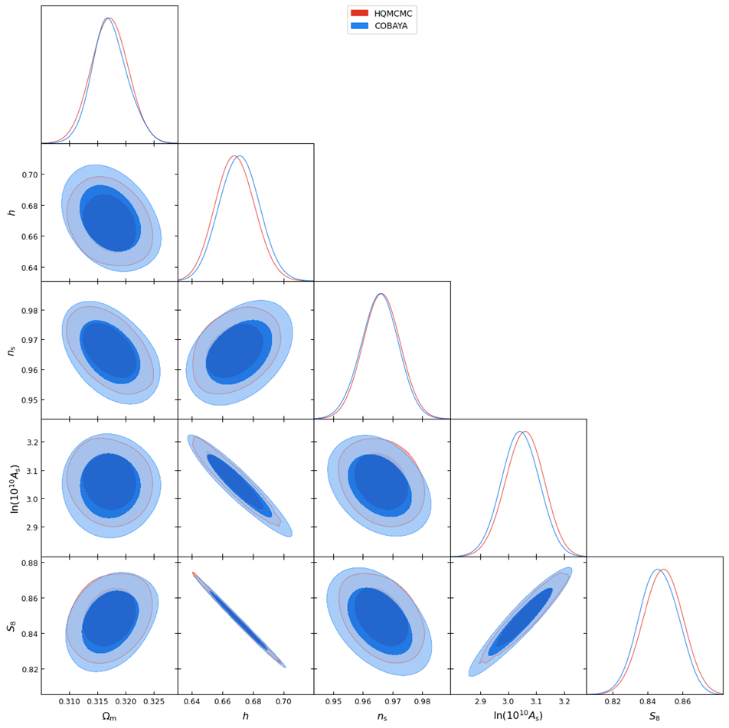

Results (4) Proper ΛCDM run with Planck Likelihood, SNe Ia, and BAO
Results (3): Mock Weak Lensing dataset buit by us, 4 parameters are sampled directly by the MCMC, one is derived by the others ($S_{8}$)

Slide 7
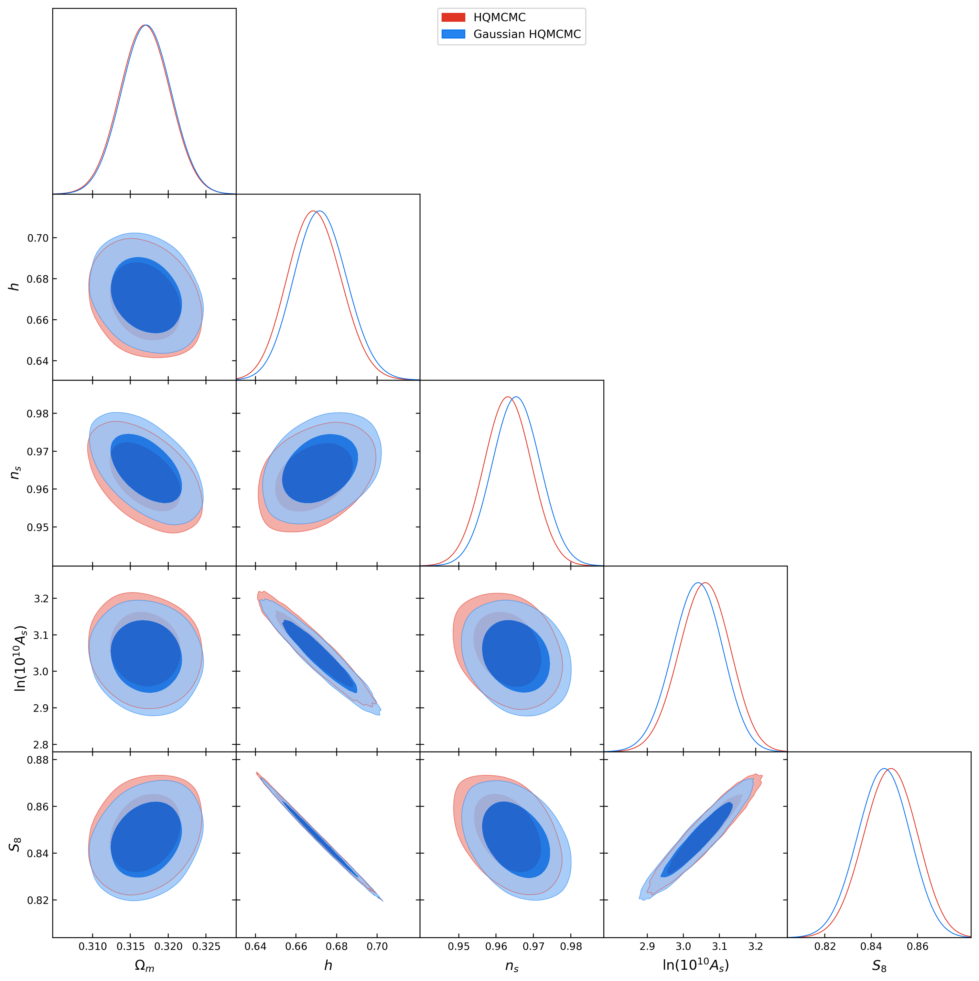
Results (4) Proper ΛCDM run with Planck Likelihood, SNe Ia, and BAO
Results (4): building a classical MCMC in the same way as HQMCMC
To find a proper speed up for the HQMCMC with respect to classical counterpart, we built a MCMC classical sampler with the same overall structure of HQMCMC, with the only difference being the proposal step, which is given by a classical gaussian. Testing the two sampler on the WL mock dataset and comparing the results we find that HQMCMC reached convergence after 48k steps, while the Classical version needed 68k steps, thus finding an andvantage given by how the Quantum circuit explores the parameter space.

Slide 8
Conclusions
1) A hybrid QMCMC has been built to find Bayesian contours for cosmological functions,
2) These algorithms has been tested with different probes and functions, finding results which are consistent with classical computations.
3) Given that the likelihood evaluations remain classical, a speed up has to be found in the number of evaluations necessary to reach convergence.
4) A possible outlook is to test these algorithms with combinations of different cosmological functions into a complex parameter space.
5) Finally, testing the algorithm on proper quantum hardware will allow us how does it behave with current quantum technologies.

Slide 9

Application of Quantum Fourier Transform in CMB Data Analysis

Slide 10
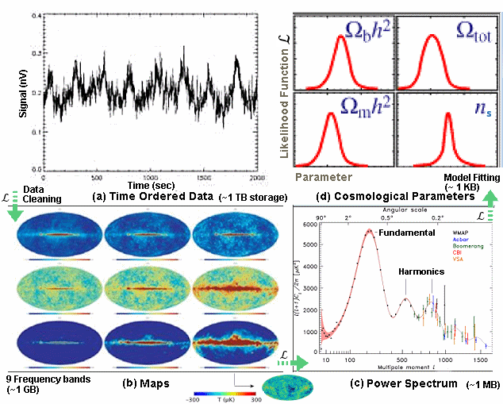
FOURIER TRANSFORM IN CMB DATA ANALYSIS
Decomposing Temperature Fluctuations: The Fourier transform breaks down CMB temperature anisotropies into different spatial scales.
Extracting the Power Spectrum: The Fourier coefficients allow computation of the CMB power spectrum.
Enhancing Statistical Analysis: Transforming CMB maps into harmonic space simplifies statistical studies, as the anisotropies become nearly uncorrelated.
Efficient Data Processing: Fast algorithms like the Fast Spherical Harmonic Transform (FSHT) enable computationally efficient analysis of high-resolution CMB datasets.

Slide 11
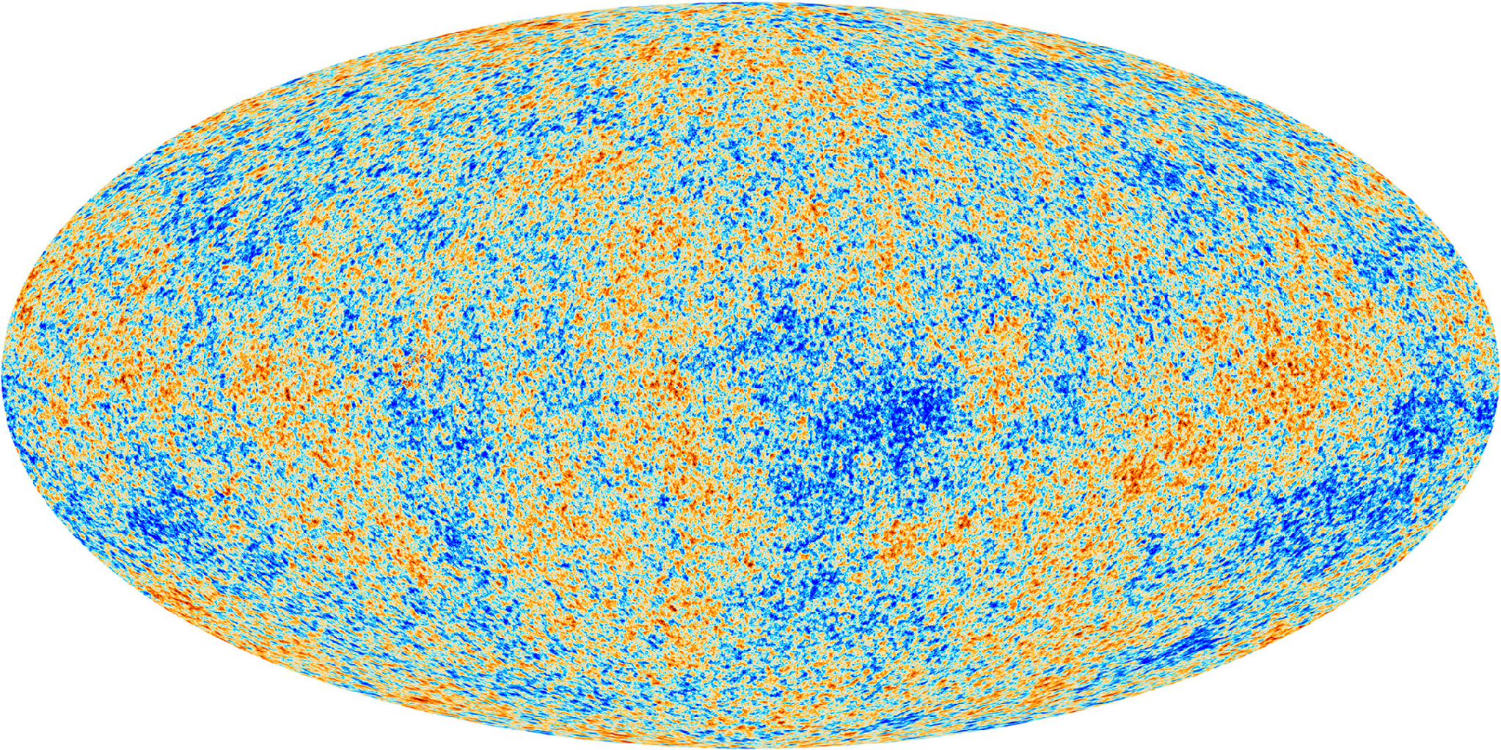
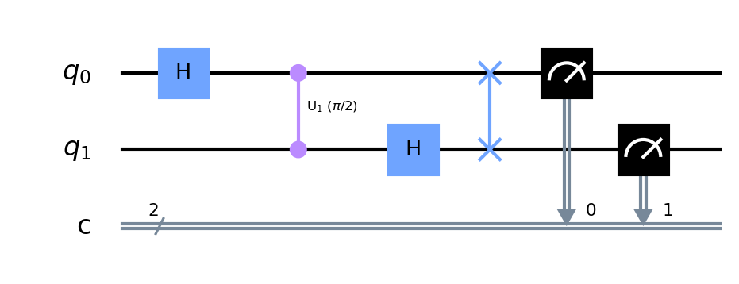
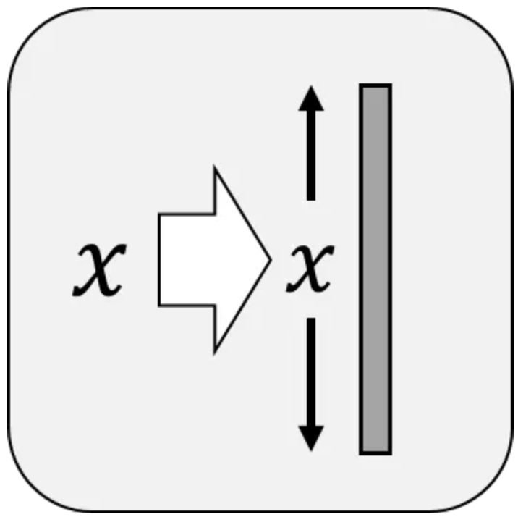
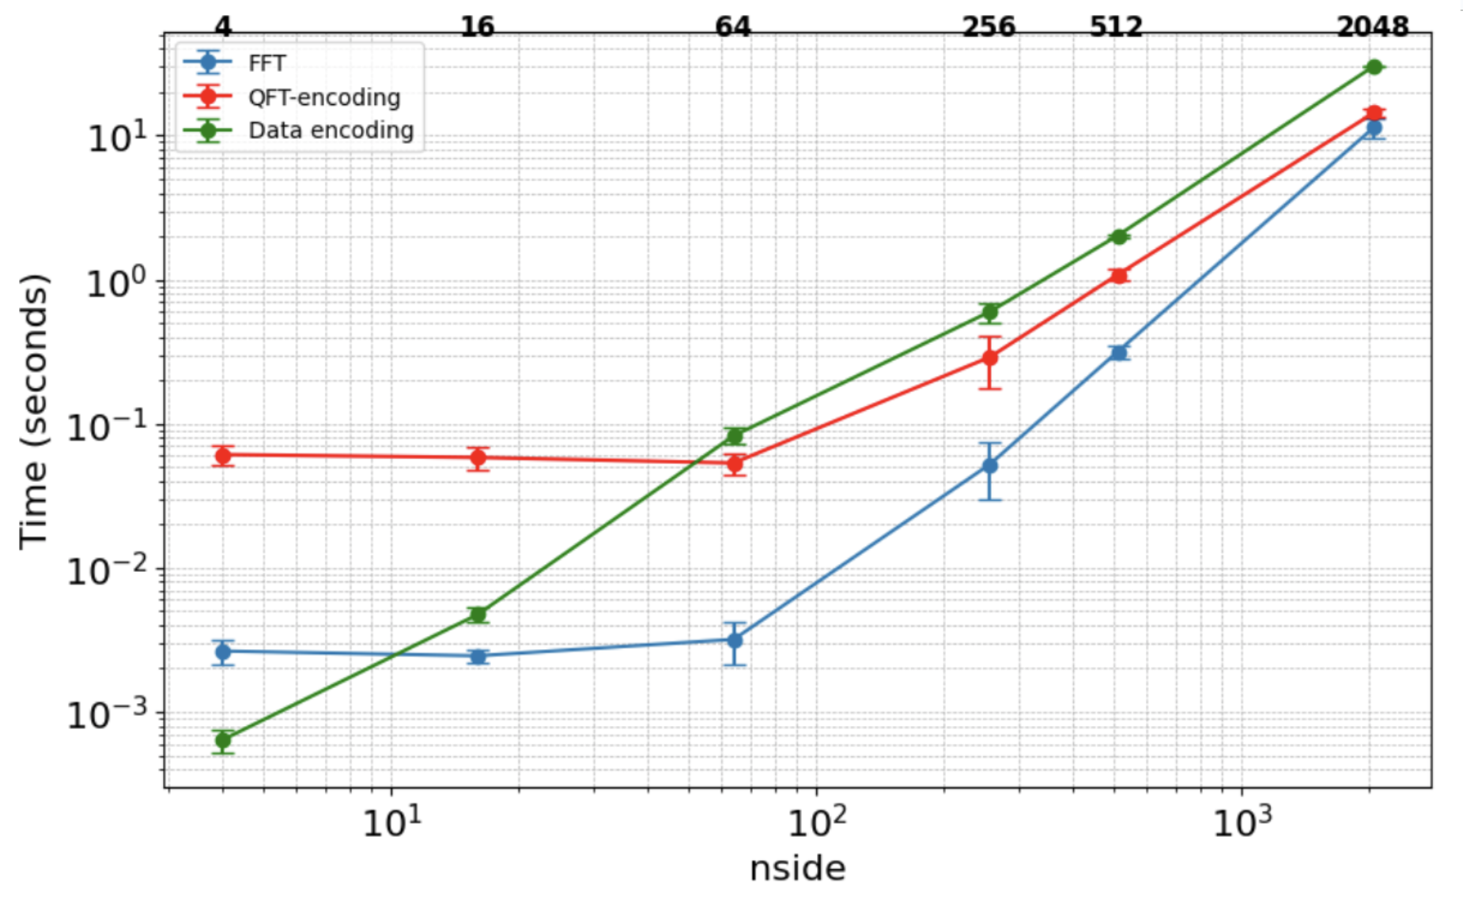
STEPS DOWN TO CHECK THE QFT PERFORMANCE
CMB Map Generation: Used CAMB to compute power spectra and healpy to generate maps.
Classical vs. Quantum Decomposition: Applied FFT and QFT in map2alm for spherical harmonic analysis.
QFT Implementation: Used Qiskit for state preparation, QFT execution, and measurement.
1
2
3
Data Encoding: Adopted amplitude encoding for efficient quantum data representation.
Padding Strategy: Used periodic padding to match quantum circuit constraints.
Performance Benchmarking: Compared QFT execution time with classical FFT.
4
5
6

Slide 12
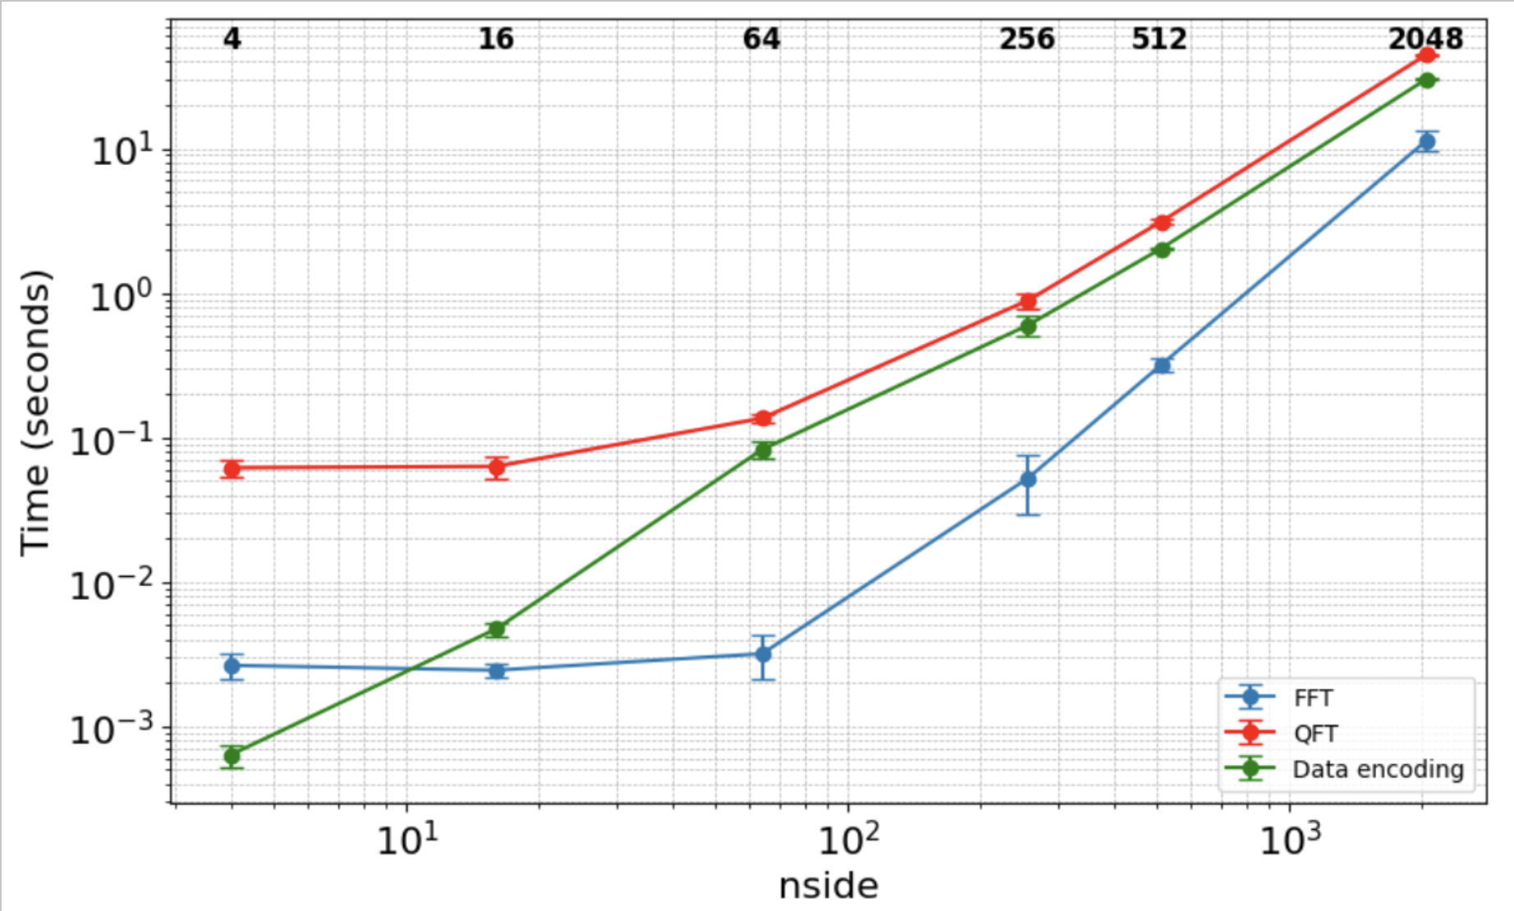
TESTS
The FFT consistently outperforms the QFT across all tested nside values, with significantly lower computational times.
The primary slowdown in the quantum approach comes from data encoding, which dominates execution time as nside increases.
The QFT itself is not the limiting factor; rather, the inefficiencies of amplitude encoding introduce significant computational overhead.
F.Farsian et al, 2025

Slide 13
TAKE HOME MESSAGES
Conclusion
We have explored QFT as an alternative to FFT in CMB map analysis, with comparable accuracy but limited by current data encoding overhead.
Quantum computation time is negligible compared to the classical-to-quantum encoding step, which is the main performance bottleneck.
Efficient encoding methods and hardware improvements are key to unlocking the full potential of QFT in astrophysical applications.
Future Prospects
Extend to ultra-high resolution maps (nside ≥ 2048) and test on real quantum hardware to assess scalability and feasibility.
Develop a fully quantum pipeline (QFT + inverse QFT) for CMB map synthesis from power spectra, reducing data input size and enhancing quantum advantage.

Slide 14
Back Up Slides

Slide 15
INAF and Quantum Computing (INAF, USC-C, QC)
INAF OAR Roma: Giuseppe Sarracino, Vincenzo Fabrizio Cardone, Vincenzo Testa, Roberto Scaramella.
INAF OAS Bologna: Andrea Bulgarelli, Massimo Meneghetti, Niccolò Parmiggiani.
INAF IRA Bologna: Carlo Burigana, Tiziana Trombetti.
INAF OACT Catania: Farida Farsian, Francesco Schillirò, Alessandro Rizzo, Fabio Roberto Vitello.
INAF OATs Trieste: Giuseppe Murante

Slide 16
The INAF Quantum Team: published papers and conference papers
"Exploring the potential of Quantum Graph Neural Networks in analysing large scale structure of Universe", F. Farsian et al. Astronomy & Computing, Volume 56, id.101095 (2026).
“Quantum computing for astrophysics and cosmology: Results from the INAF activities”, A. Bulgarelli et al., Astronomy & Computing, Volume 56, id.101108 (2026).
“Comparing Classical and Quantum Deep Learning Techniques for Anomaly Detection of Short-Duration Gamma-Ray Signals”, A. Rizzo et al., Astronomy & Computing, Volume 56, id.101090 (2026).
“A quantum genetic algorithm with application to cosmological parameters estimation” G. Sarracino et al., Astronomy & Computing, Volume 55, id.101078 (2026).
“Quantum Markov Chain Monte Carlo For Cosmological Functions” G. Sarracino et al., IEEE International Conference on Quantum Artificial Intelligence, 234-240 (2025).
“The Application of Quantum Fourier Transform in Cosmic Microwave Background Data Analysis” F. Farsian et al., QSW 2025, 250-256 (2025).
“Numerical limits in the integration of Vlasov-Poisson equation for Cold Dark Matter” L. Cappelli et al., IEEE PDP (2025).
“Benchmarking Quantum Convolutional Neural Networks for Signal Classification in Simulated Gamma-Ray Burst Detection” F. Farsian, et al. IEEE PDP (2025).
“ Photometric Redshift Estimation with Hybrid Quantum Neural Networks” G. Sarracino, et al. accepted for AIQxQIA (2026)
“Quantum Annealing for Gamma-Ray Source Detection and Localization with AGILE data” A. Rizzo, et al. accepted for AIQxQIA (2026)

