Slide 1
Opportunities at VLTI
Antoine Mérand
VLTI Programme Scientist
ESO Garching

Slide 2
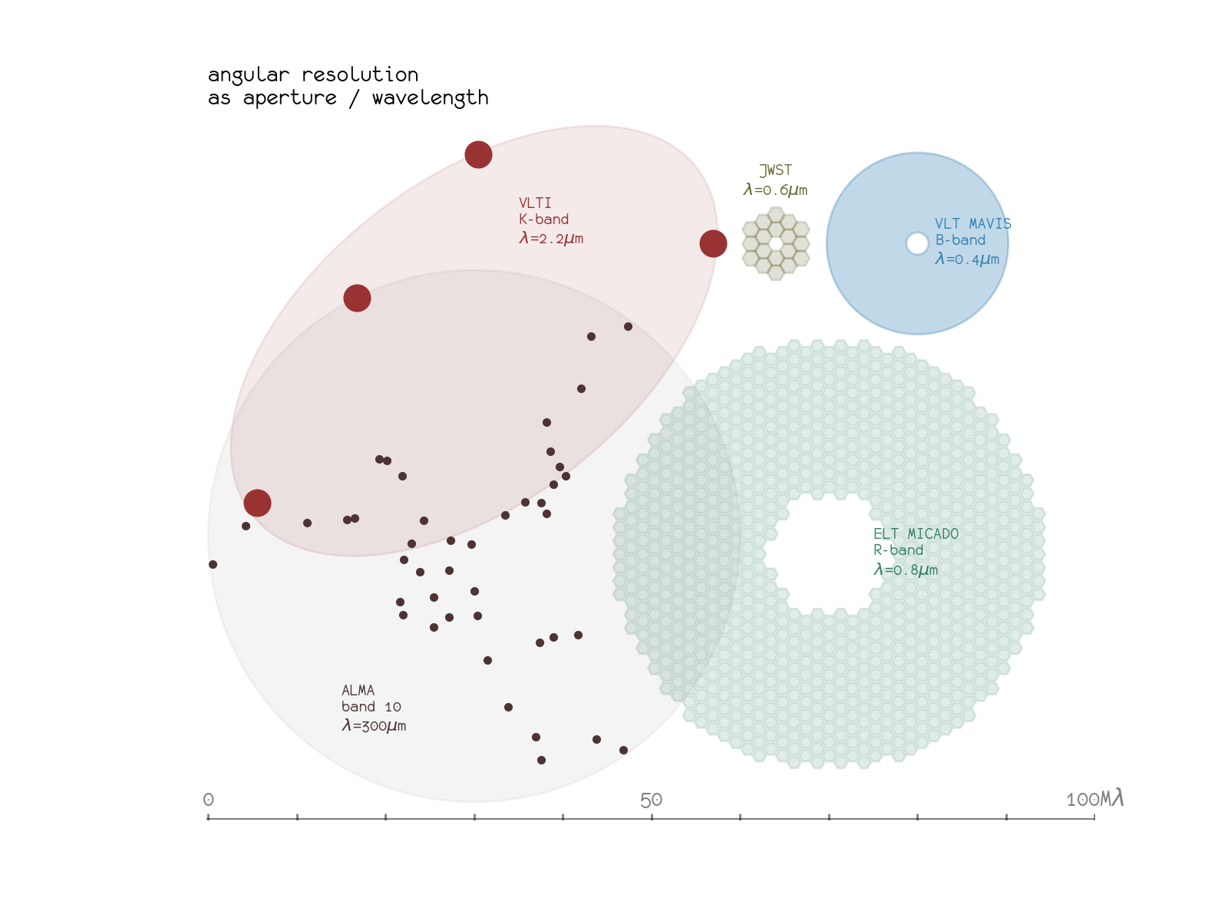
Instruments:
PIONIER: low resolution H band
GRAVITY+: K band dual field: astrometry and spectroscopy
MATISSE: LMN bands, spectroscopy (GRAVITY as fringe tracker)

Slide 3
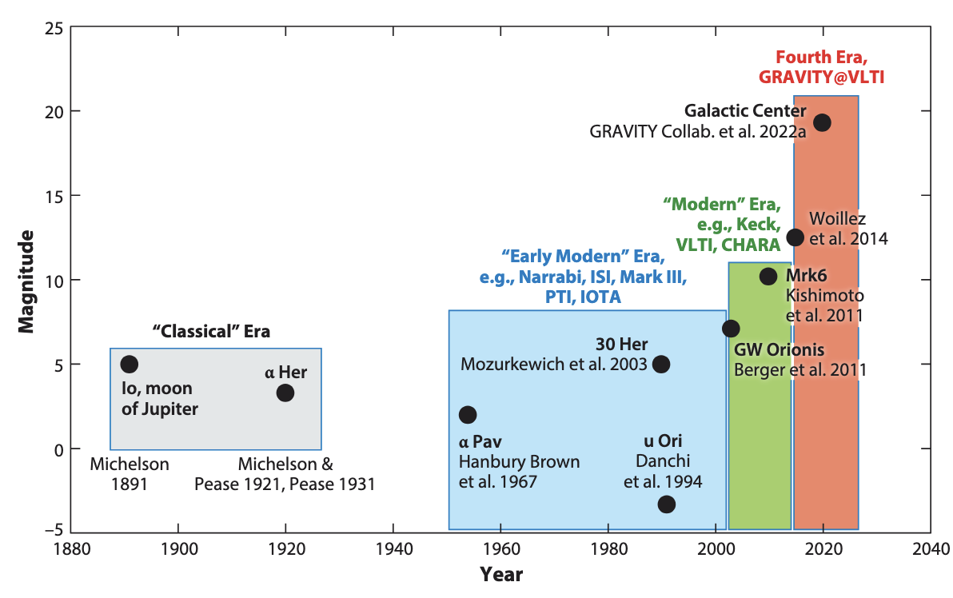
Optical Interferometry has come a long way
10 mag gain!!!
Einsenhauer, Monnier & Pfuhl (2023)

Slide 4

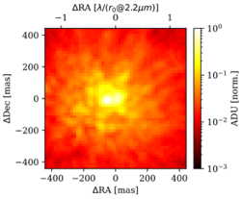
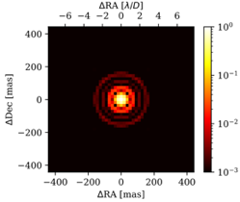
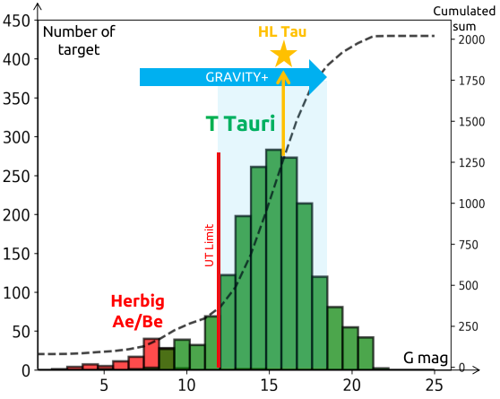
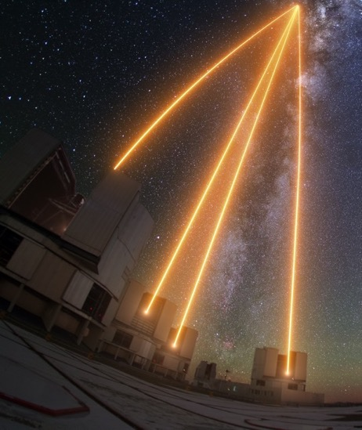
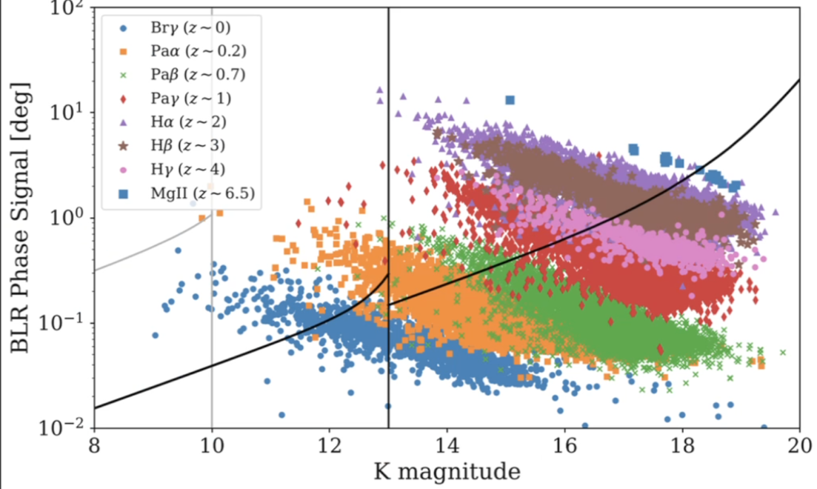
GRAVITY+: off-axis / new AO / Laser Guide Stars
Proposed in 2019, top priority from “VLT2030” (also BlueMUSE, SAXO+)
Old AO
MACAO
New AO (2024)
ERIS like
Young Stellar Objects
Black Holes at Cosmic Noon

Slide 5
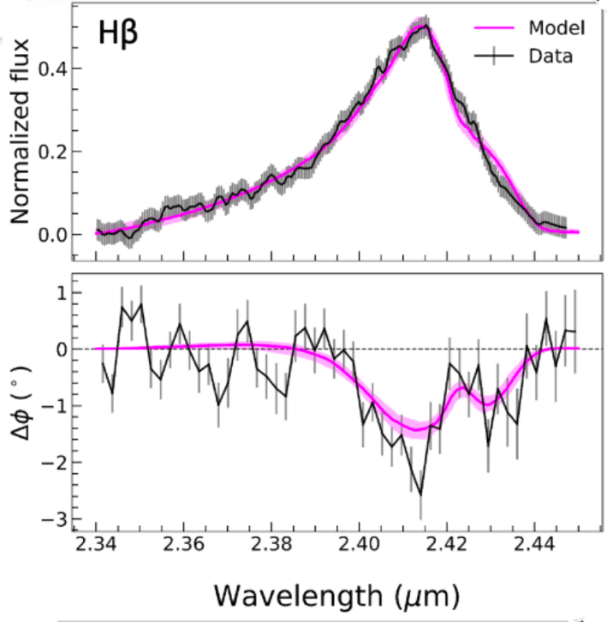
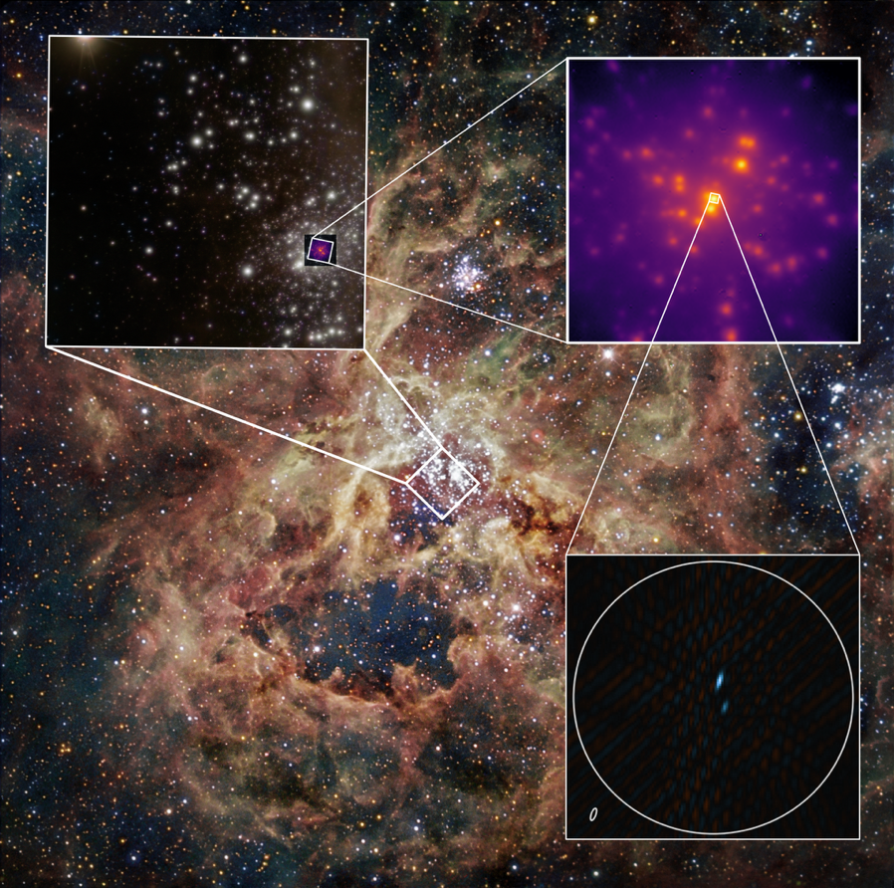
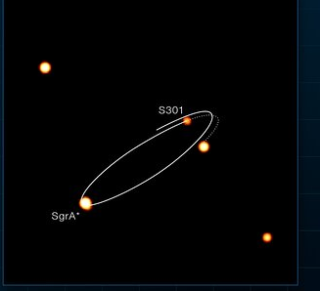
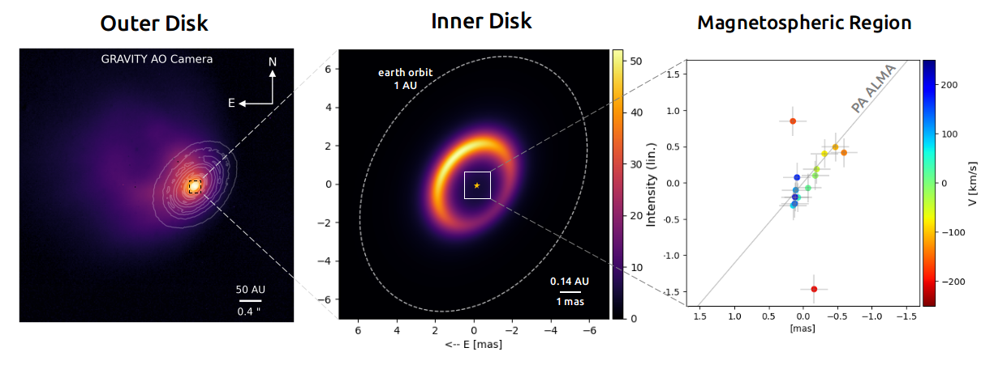


VLTI in 2026 is a reborn facility
Credit: ESO/J. Beltrán
Milky Way's fastest star orbits our supermassive black hole so closely it feels its spin
Spatially resolved broad-line region in a quasar at z = 4
(G+ collab, Abd El Dayem, et al. 2026)
Credit: ESO/GRAVITY+ Collaboration
Credit: GRAVITY+,
G. Bourdarot
Credit: ESO/GRAVITY collaboration
HL Tau
$$× 200$$
$$× 4$$
GRAVITY+ Collab, 2026
https://www.eso.org/public/news/eso2612/
Spectro-astrometry across the magnetospheric Br-γ line (preliminary)

Slide 6
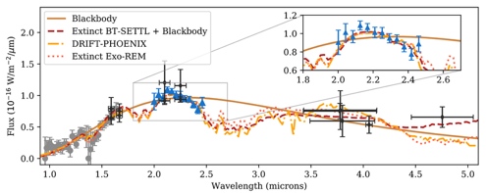
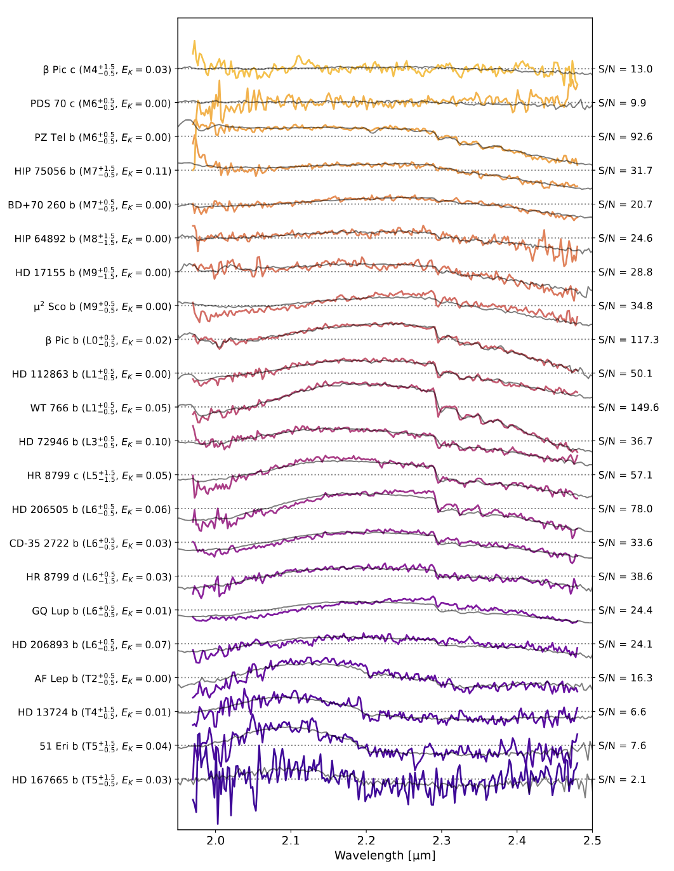
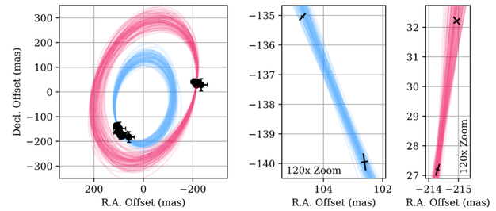
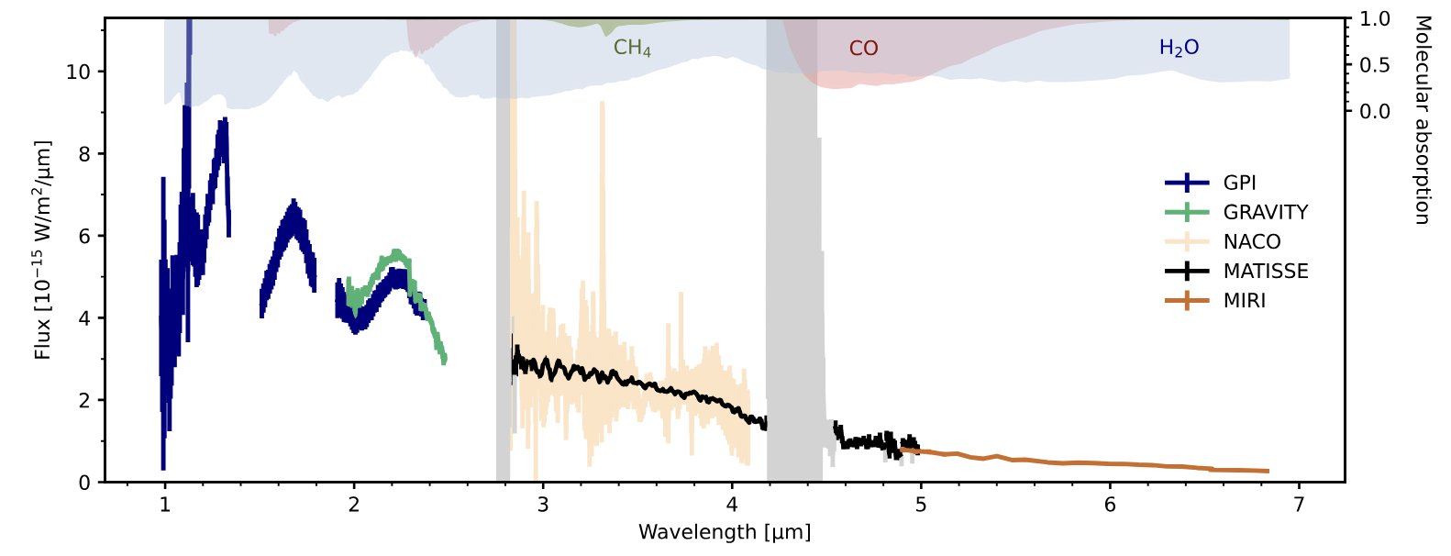
sub-mas astrometry and spectroscopy of PDS70b and c with GRAVITY (Wang+21)
Beta Pic b in K with GRAVITY (Lacour+21) and L+M with MATISSE (Houllé+25)
Kammerer+ 25

Slide 7
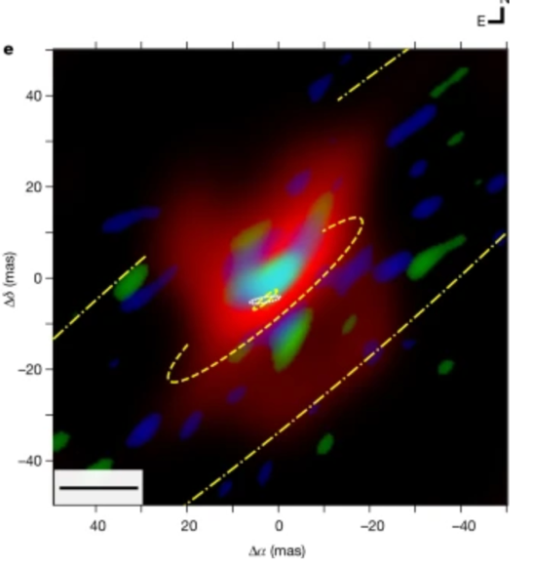
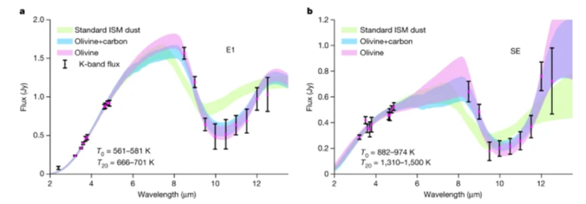
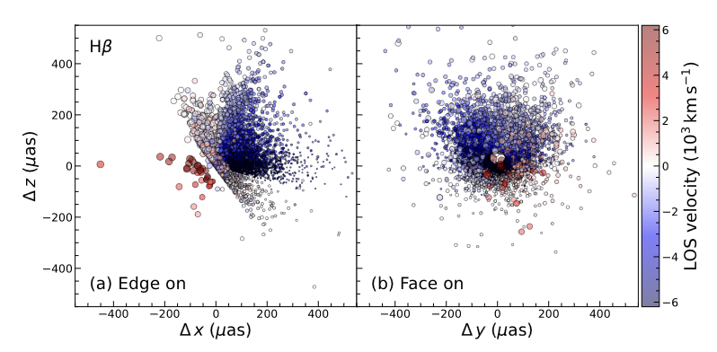
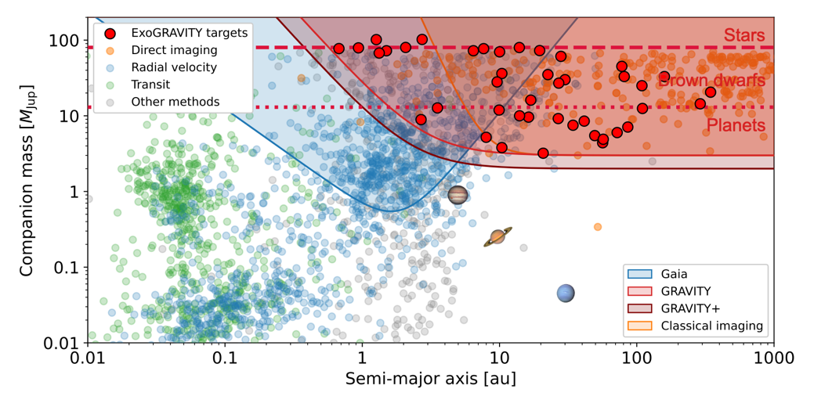
Science prospects are looking excellent
NGC 1068 with
MATISSE in LMN bands
(Gamez Rosas+ 21)
VLTI-UT time requests have tripled, 9n/months scheduled
Two accepted Large Programmes will observe ~50 AGNs with GRAVITY and MATISSE in the coming 2 years
Gaia DR4 will provide a wealth of exoplanets candidate GRAVITY is best position to follow-up
1pc
Courtesy of J. Kammerer
Reconstructed morphology of
BLR of quasar at z~4 (G+2026)

Slide 8
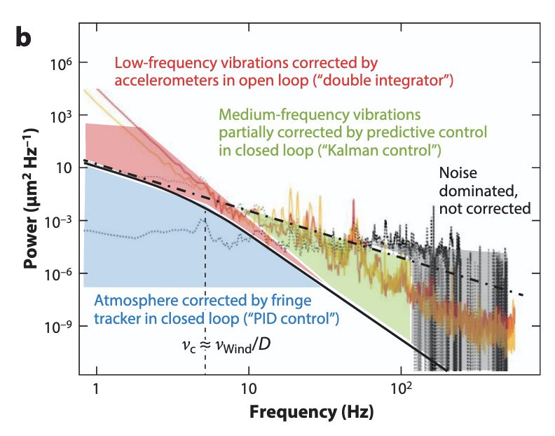
What is ongoing?
Upgrade of accelerometers (2027):
  Better control of vibrations: improves sensitivity
  FT sensitivity translates also into sky coverage
GRAVITY+ final stage (early 2028)
  Improved optics for lower astrometric systematics
  R~15000 Grism (improved from 4000)
Einsenhauer, Monnier & Pfuhl (2023)

Slide 9
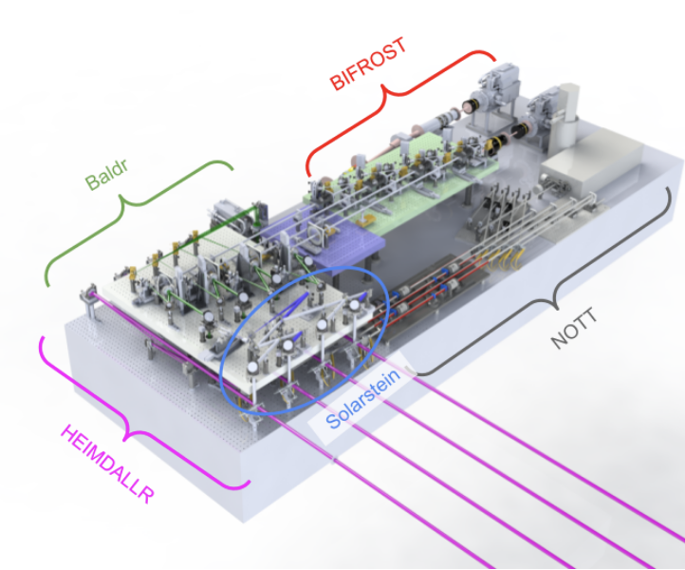
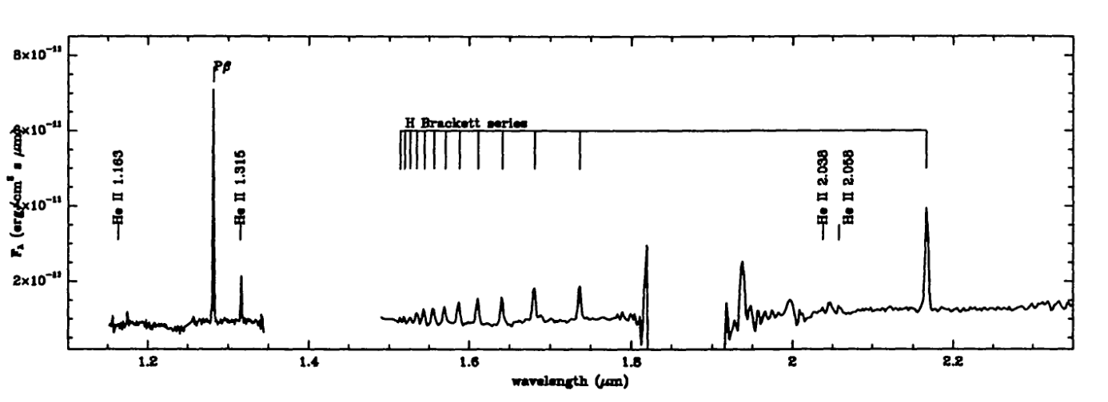
What is ongoing (2)
Martinod et al. 2026
ASGARD visiting instrument: on going commissioning and early science
  YJ spectrograph (goal 20000): accretion in YSOs,
  HK low resolution / fringe tracker: galactic archeology
  L band nuller: exo-zodii, exoplanets
PLANETES technology demonstrator (ESO TecDev+ERC):
  2k x 2k infrared eAPD (IBEX/FLI)
  Metrology with vibration sensing
  High contrast in J band (exoplanets)
Persi+2000
J
H
K

Slide 10
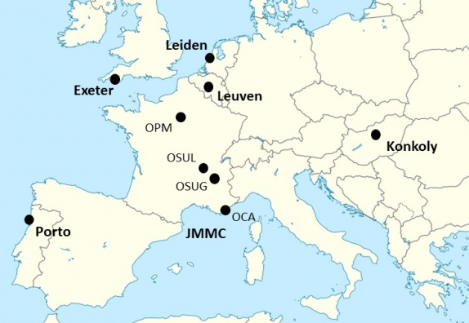
The current ecosystem
VLT type support for a technique as complex as ALMA…
  Strong reliance on community for advanced preparation tools, advanced analysis tools, etc
  As of 2025, ~50% of papers use public analysis tools
  Public archive of reduced data (all PIONIER and GRAVITY since 2026)
Institutional actors beside ESO:
  European Interferometry Initiative – EII (President: C. Paladini): coordinate EU grants (OPTICON, ORP), organize VLTI Schools, etc.
  VLTI Expertise Centres: advanced user support
  JMMC: French EC, develops and maintains many tools
VLTI Expertise Centres
https://european-interferometry.eu/vlti-expertise-centers/

Slide 11
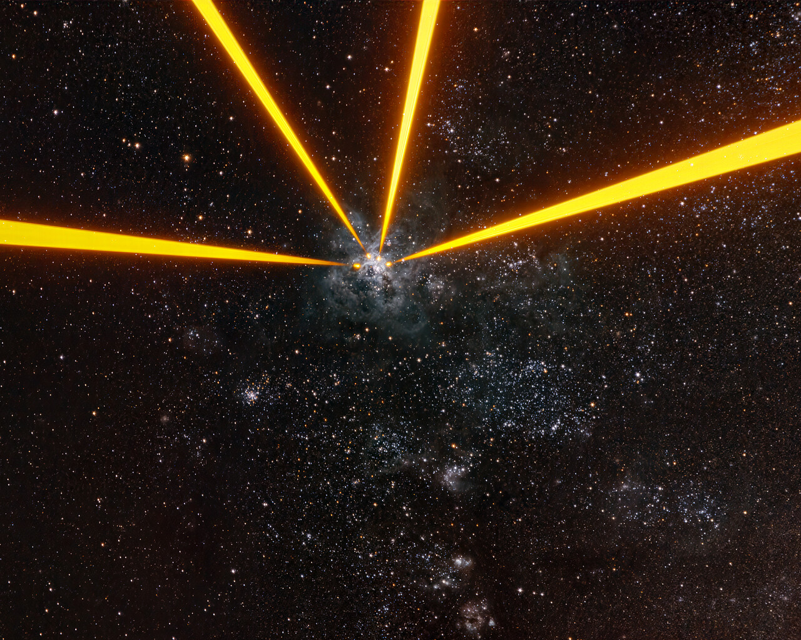
Summary
VLTI 2026+ has nothing to do with what it was 10 years ago
  AGNs, exoplanets, Massive Stars, Galactic Centre, etc.
Current developments going towards untapped potential
  higher spectral resolution, shorter wavelength
  higher sensitivity (less vibrations), high contrast
Future required developments:
  Metrology, large NIR detectors, compact spectrograph, photonics, control, etc.
The biggest (and easiest) opportunity is now!
  Scientific synergies with spectroscopy, AO imaging, ALMA, etc
  VLTI School in June 2027: stay tuned for announcement!

Slide 12
Here your name
and your contact details
Final slides include our flag row
@ESOastronomy
@ESOastronomy
@ESOastronomy
european-southern-observatory
@eso.org
@ESOastronomy
@ESOobservatory

