Slide 1
Instrumentation from Space and Ground beyond 2030
Adriano Fontana
INAF

Slide 2
Instrumentation from Space and Ground beyond 2030
Adriano Fontana
INAF
Provide a science-driven view on main facilities active in the 30s
Provide a sort of general-view landscape
Both aimed at introducing the discussion: what is the hottest sciene? how can we maximise our return?

Slide 3
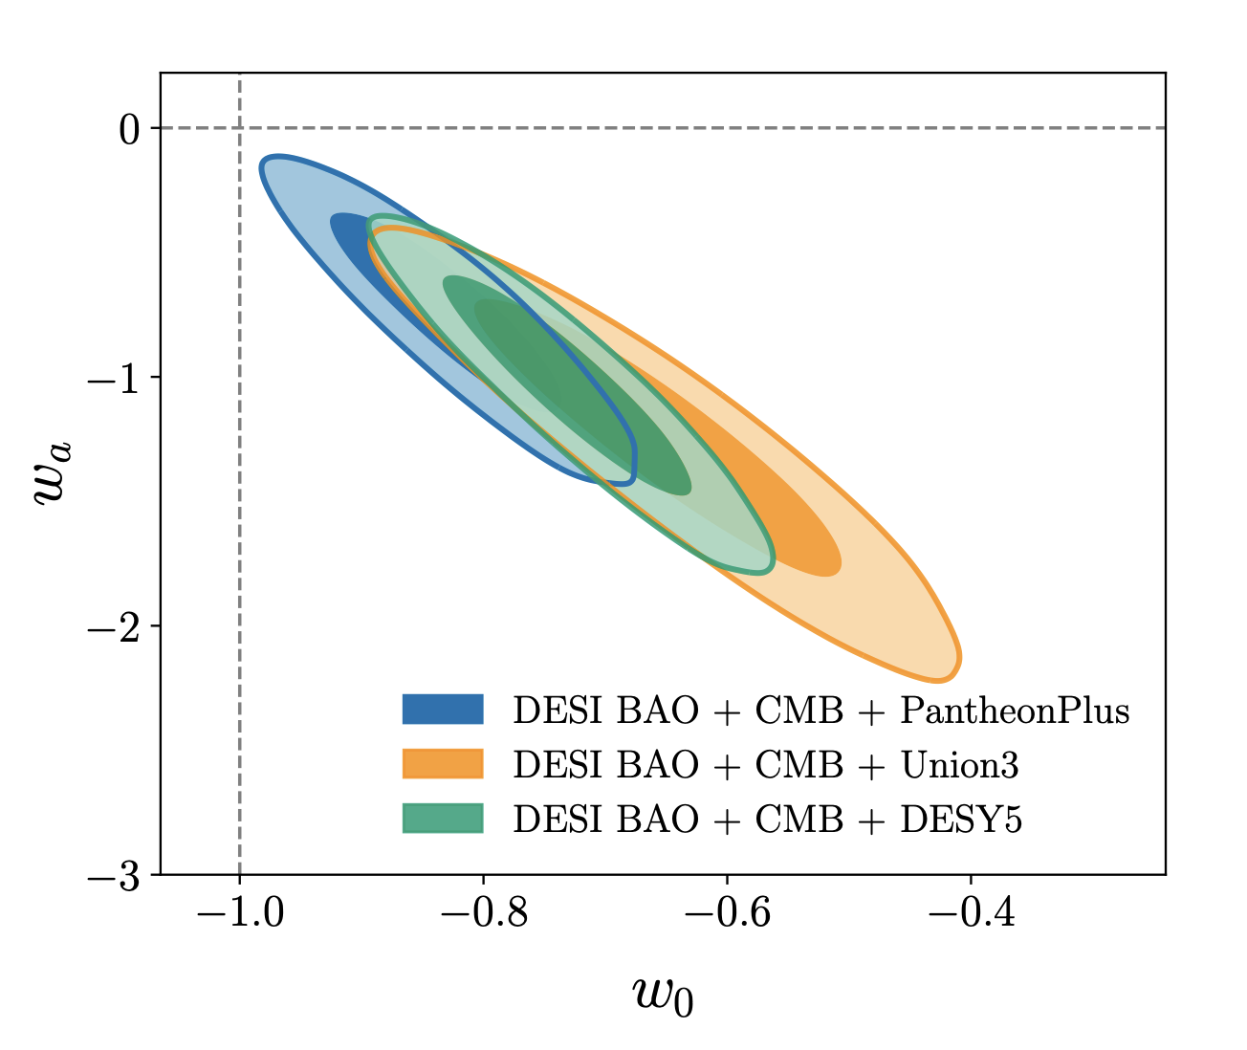
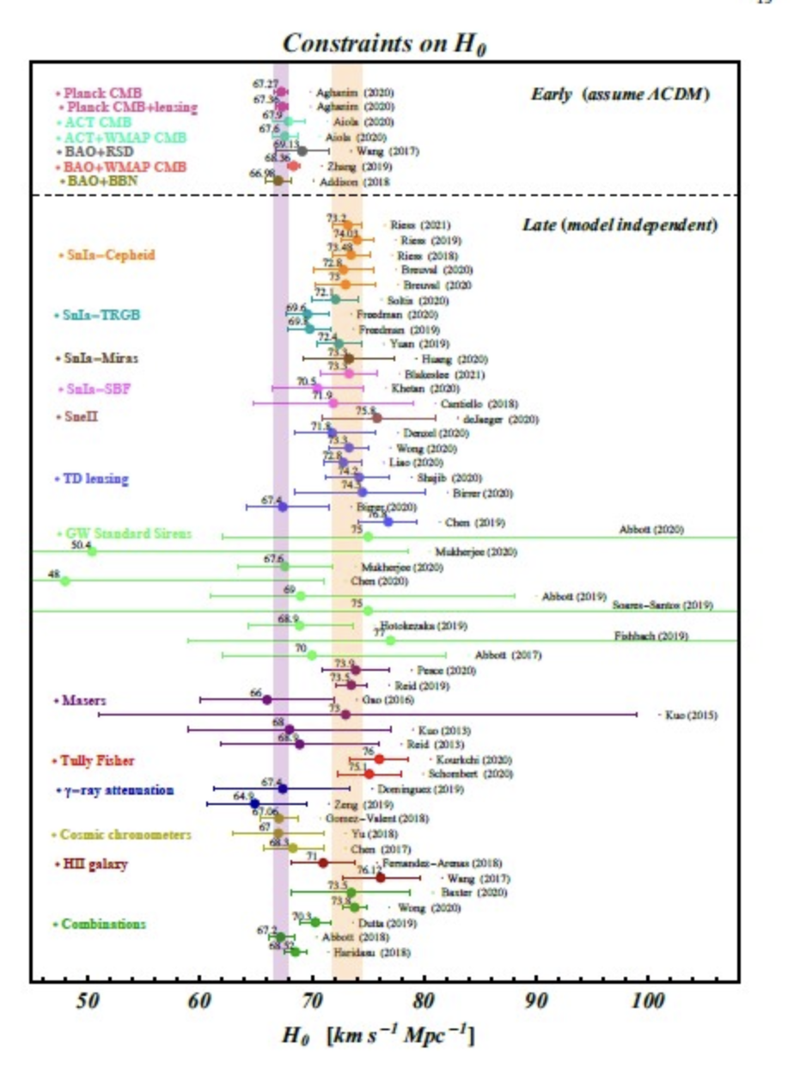
Is Λ-CDM Cosmology challenged?
However, Λ-CDM is challenged by other measurements.
Λ-CDM
CMB+ DESI-BAO + SN
Hubble constant tension
Desi Collaboration, 2024

Slide 4
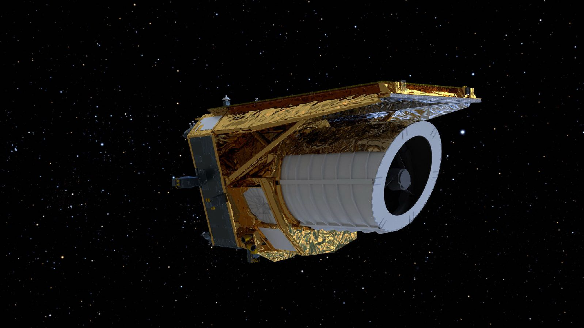
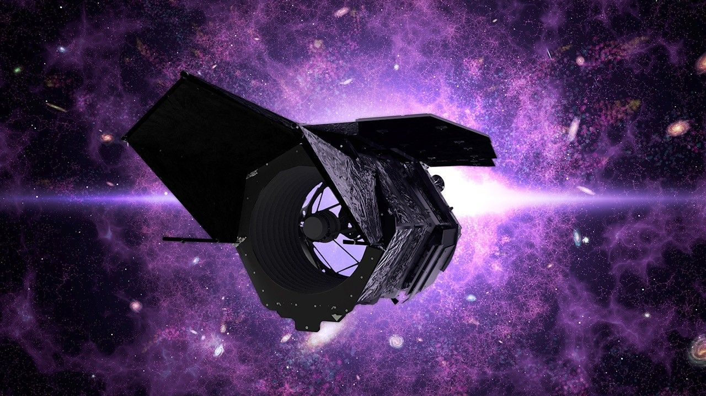
EUCLID
Gracy Roman
1.2m telescope
Wide field: 0.5sqdeg/pointing
0.6-1.8 μm
Exquisite PSF in the visible
2.4m telescope
Wide field: 0.28sqdeg/pointing
0.5-2.3 μm
Better PSF in the near IR
Wider/Shallower/survey telescope
Smaller/Deeper/Observatory-kind

Slide 5
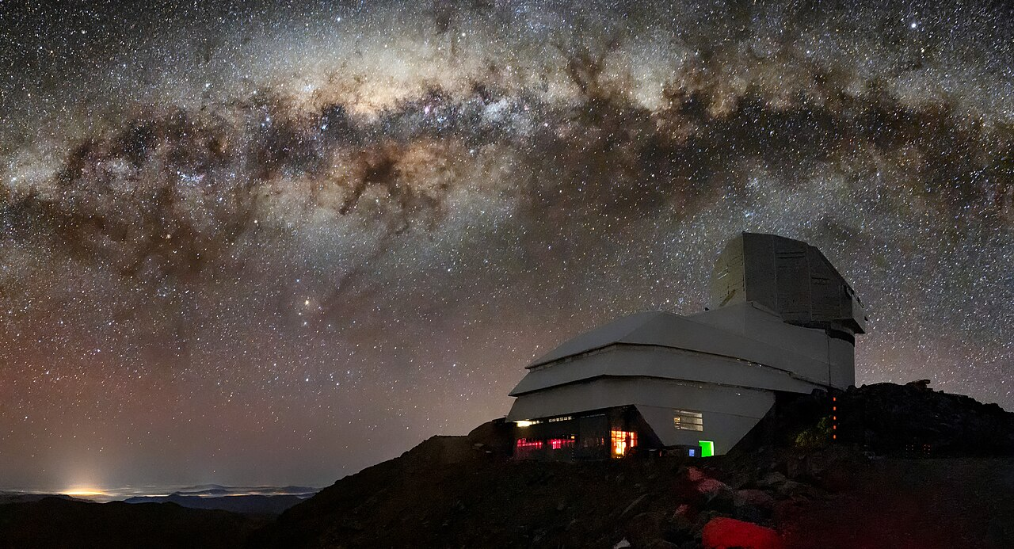
EUCLID
Gracy Roman
8m telescope
Wide field: 9sqdeg/pointing
0.4-1. μm
Ground-based PSF…
Vera Rubin
Observatory

Slide 6
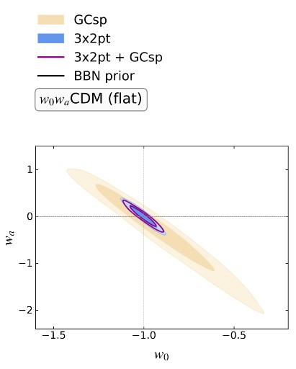
Euclid is a physics experiment.
Main goal: dark matter / dark energy
Wide field (~15000sq deg) survey of the extragalactic sky
Euclid Collaboration: Canas - Herrera, G., et al. 2025, arXiv:2510.09153,

Slide 7
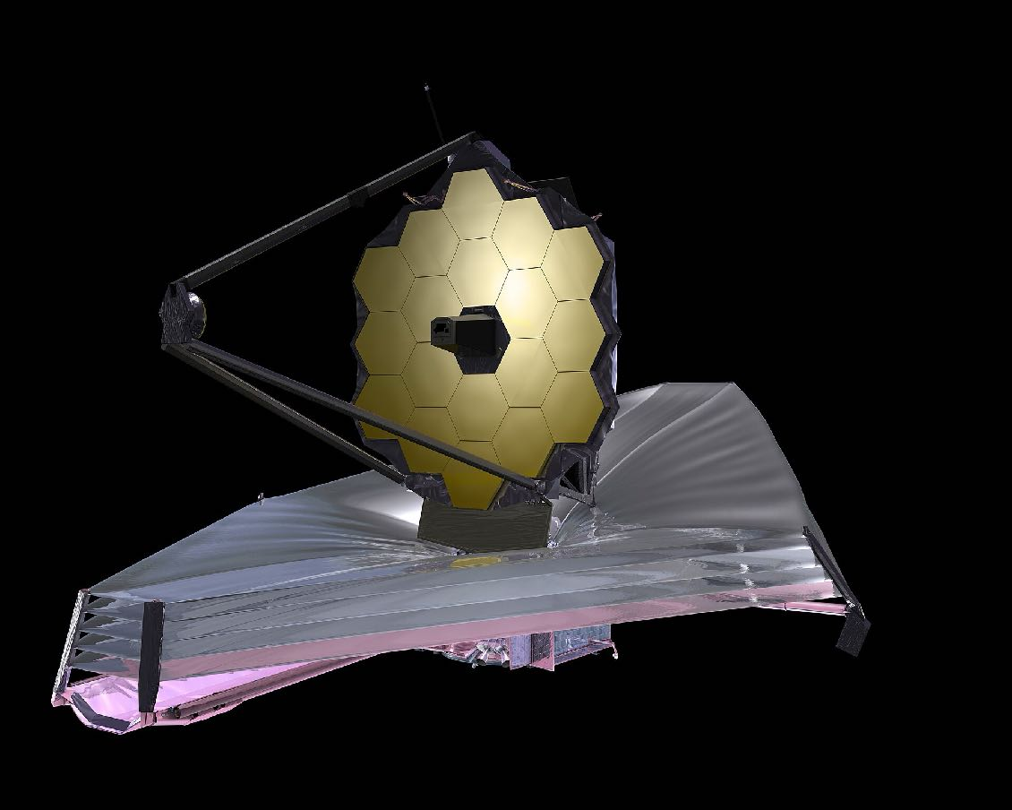
JWST
We need independent avenues to constraint cosmological parameters
6.5m cooled telescope
Small field of view (<2arcmin)
1-25 μm

Slide 8
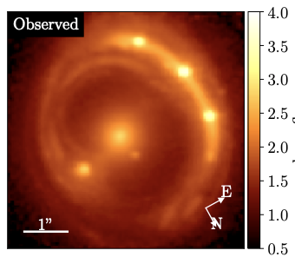
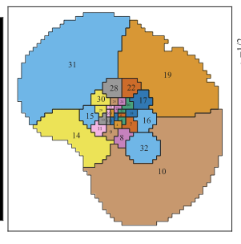
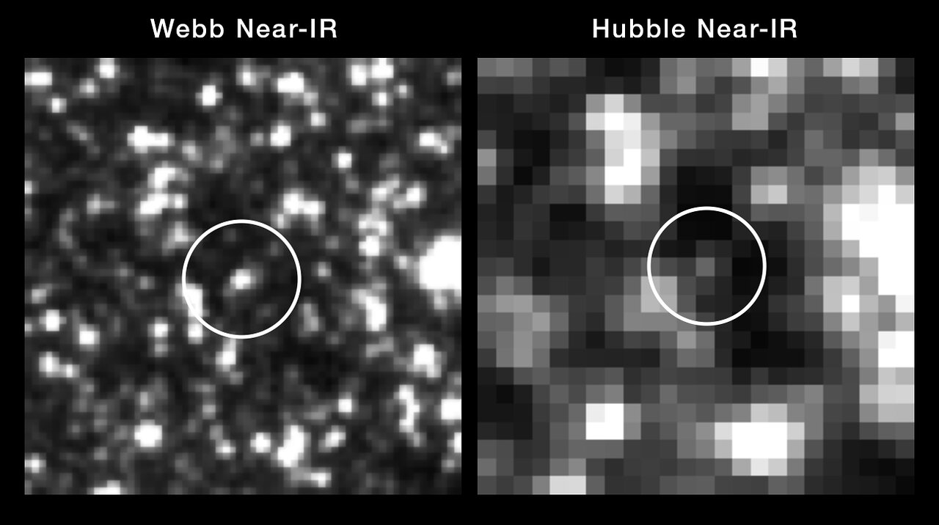
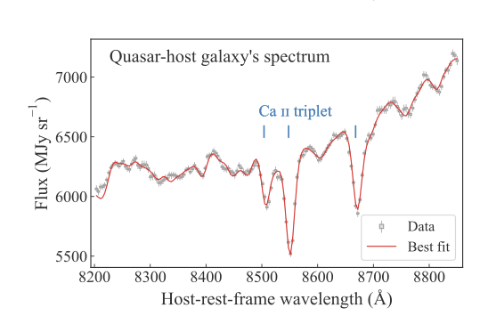
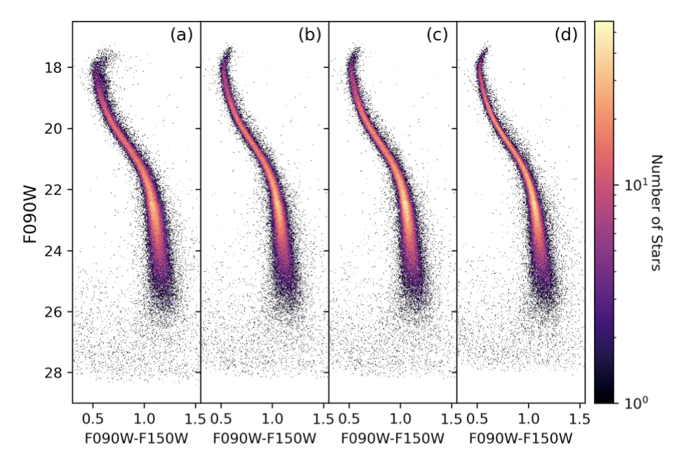
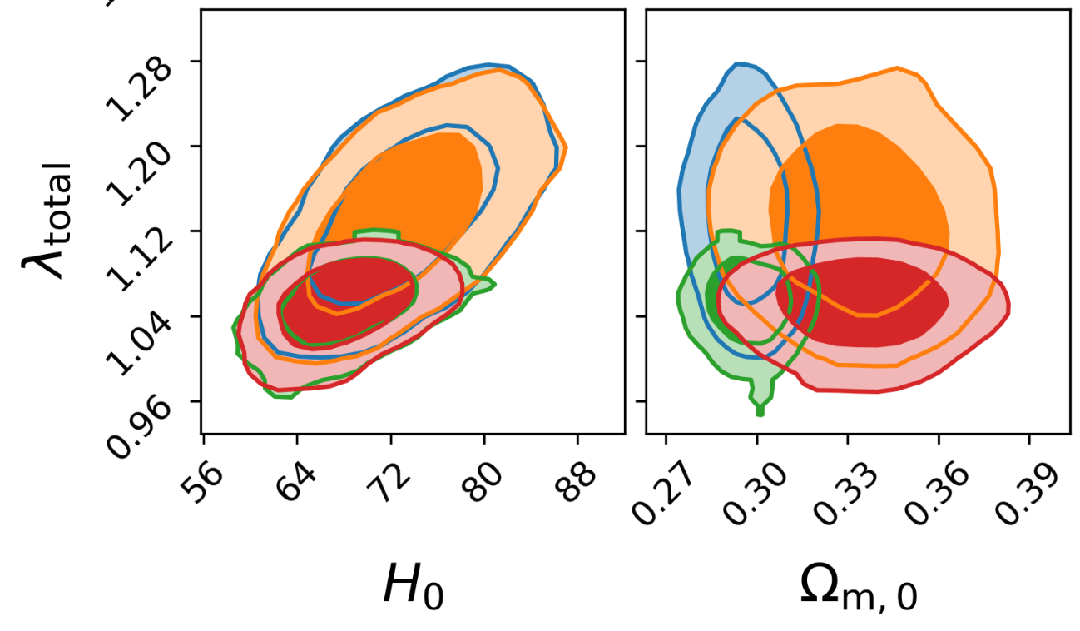
JWST can do cosmology….
Time Delay in multiply lensed QSO —> H0
Confirms distance ladder based on Cepheids
Shajib, Treu+25,
Sheu, Treu +, 26
TDCOSMO
Weisz+24
Riess+24

Slide 9
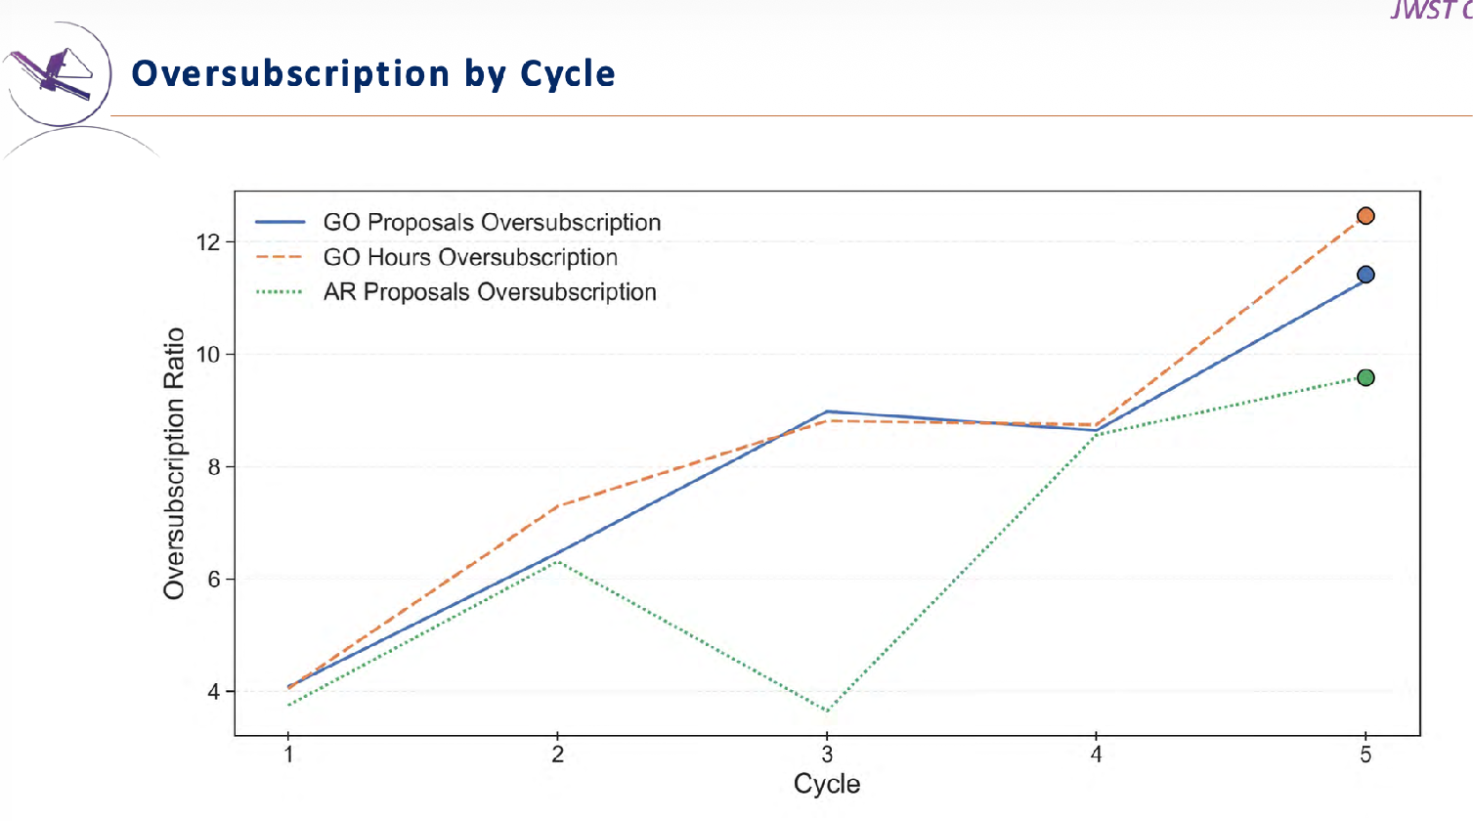
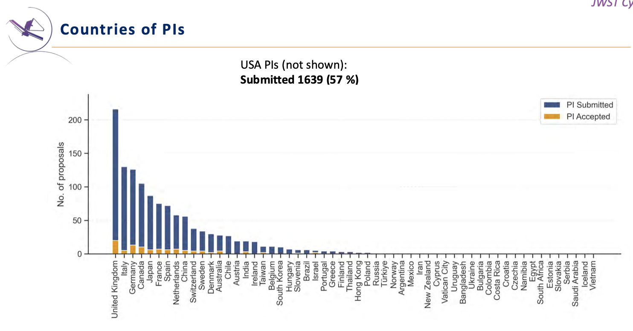
Observatory
Highly over-subscribed (8% chances!)
JWST
Will (hopefully!!!) remain operative until ~2040.
Combination of JWST and ELT can be ground-breaking

Slide 10
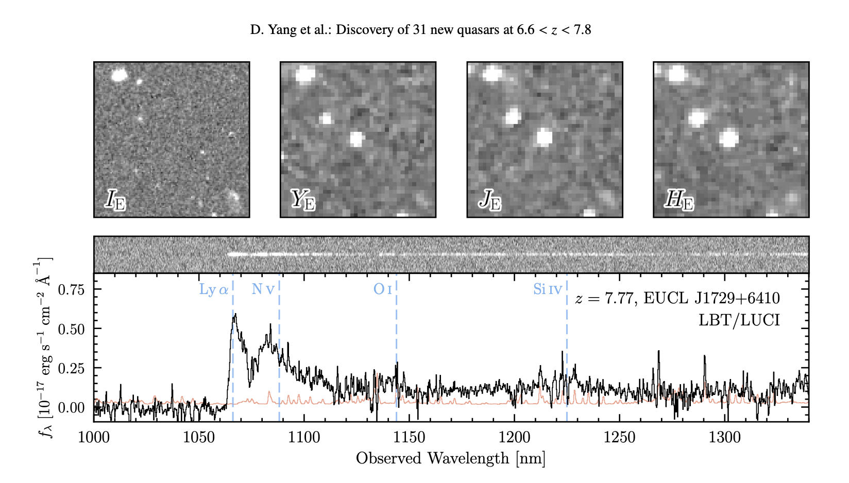
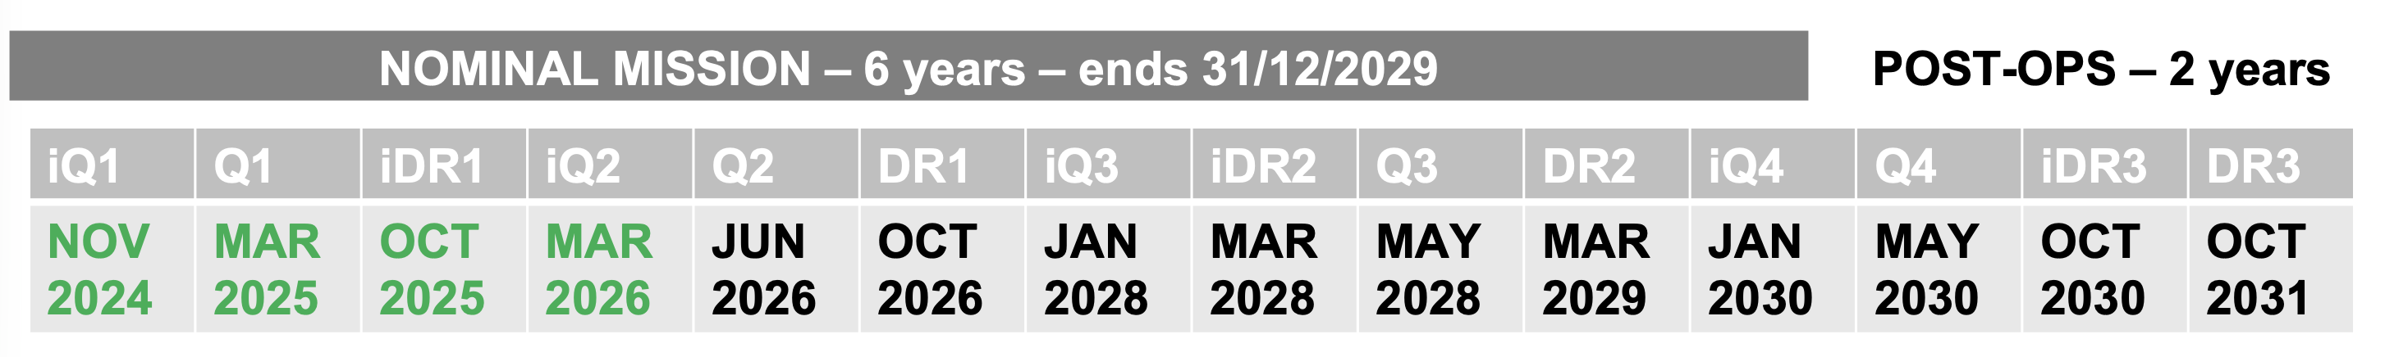
EUCLID Wide field (15000sq deg) survey of the extragalactic sky
Secondary goal: legacy science
Highest redshift QSO (z=7.77): Euclid + LBT
Yang et al, subm.
“Euclid Preliminary”
Wide field (15000sq deg) survey of the extragalactic sky
Main goal: dark matter / dark energy
Secondary goal: legacy science

Slide 11
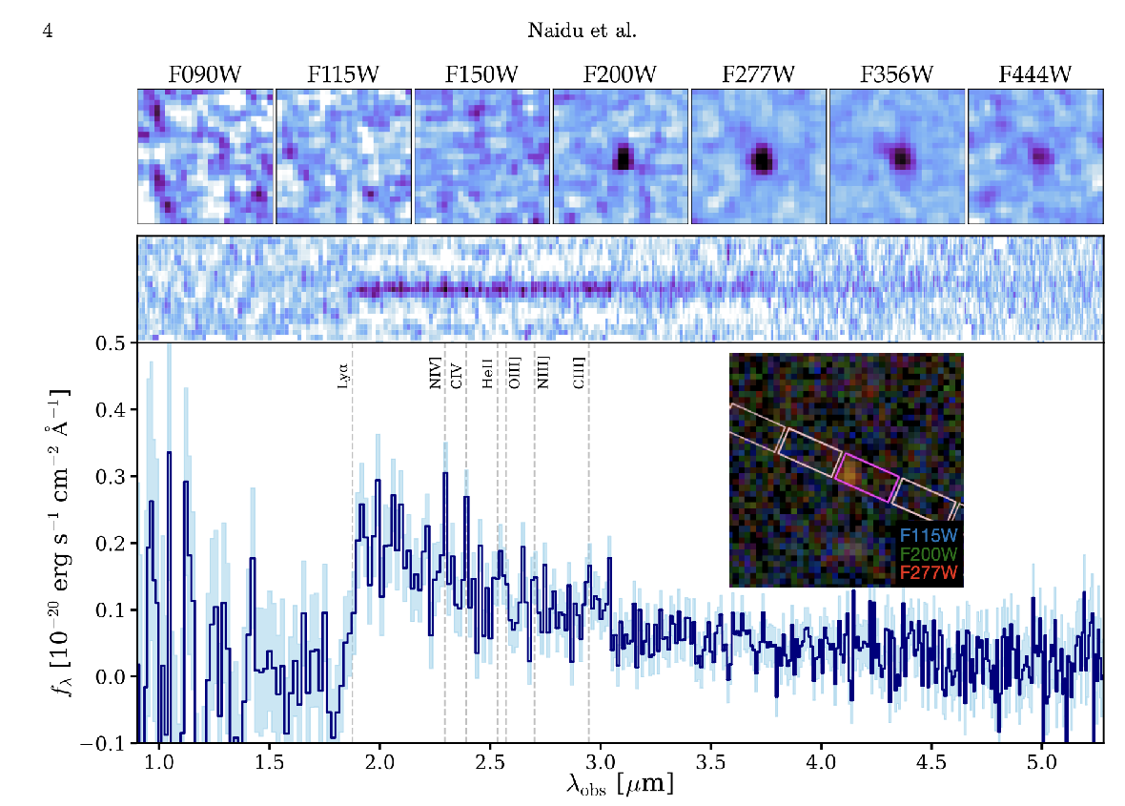
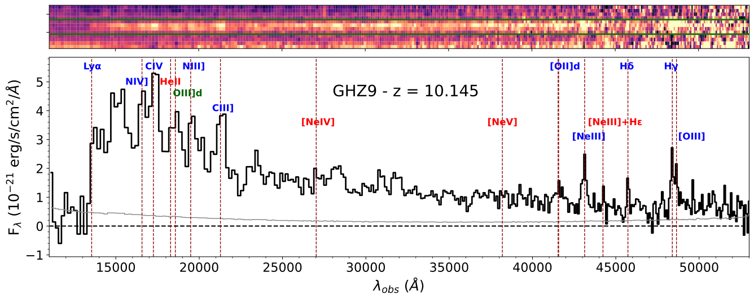
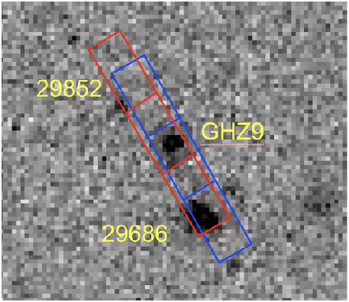
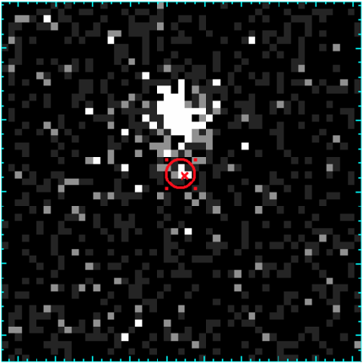
JWST is a unique machine to study the birth of galaxies…
1) An unexpected number of galaxies at z>10
Highest redshift galaxy (z=14.44)
Naidu+25
2) An unexpected number of AGNs at z>7
Napolitano+25

Slide 12
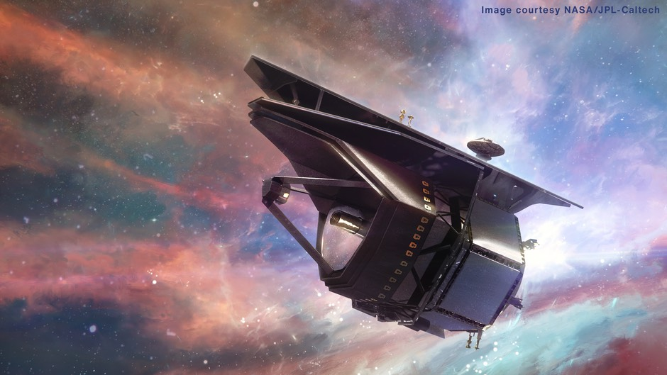
PRIMA will be launched in 2033(?)
1.8m telescope
IR window 24-260μm
Hyperspectral capabilities
Polarimetry
Spectroscopy
Supports both single-object and survey mode

Slide 13
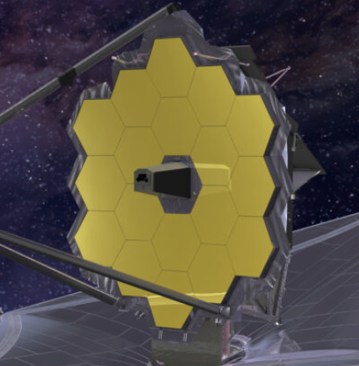
Extremely Large Telescope
James Webb

Slide 14
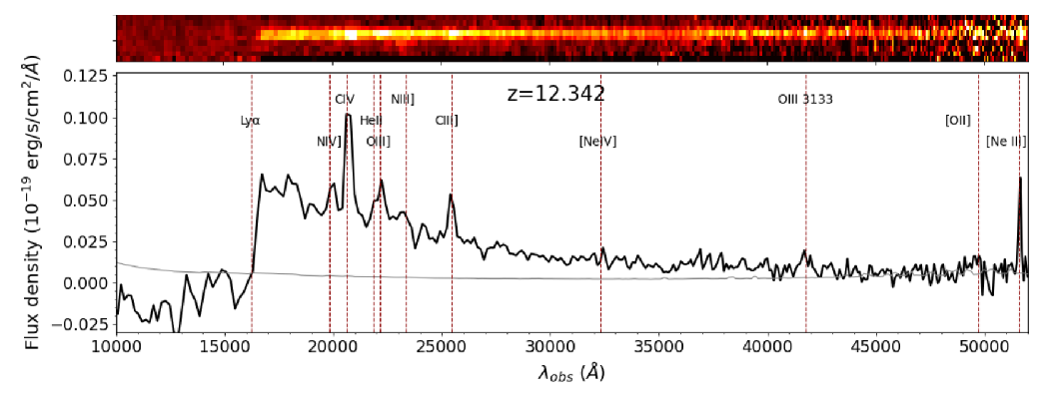
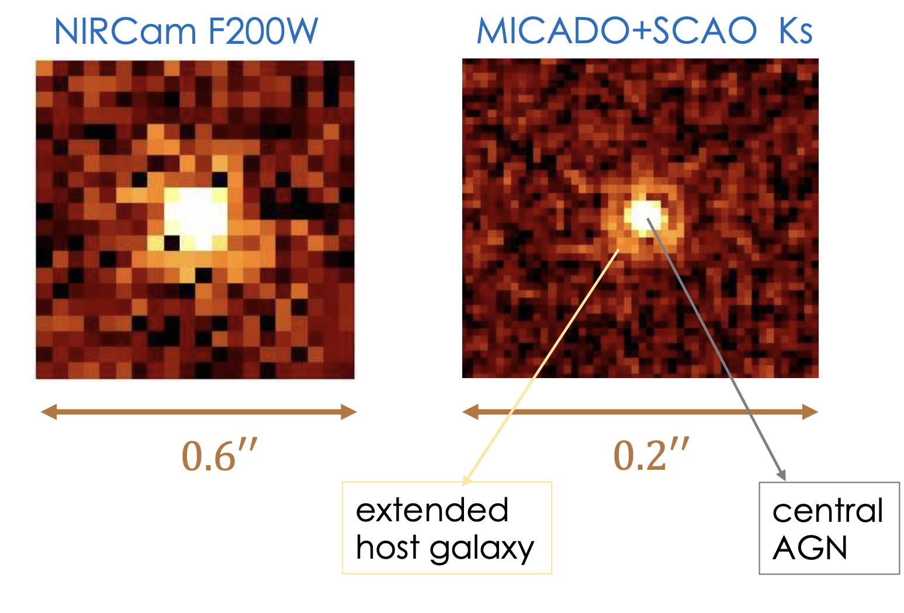
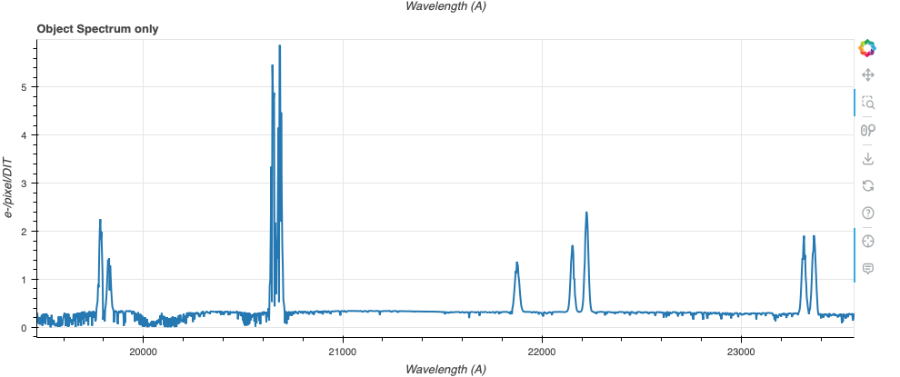
NIRSPEC
Castellano+2024
GHZ12 @ ELT
How many galaxies host a BH? What is the BH mass?
CIV
OIII]
NIII]
NIV
HeII
Composite AGN???
SHARP/ELT simulator

Slide 15
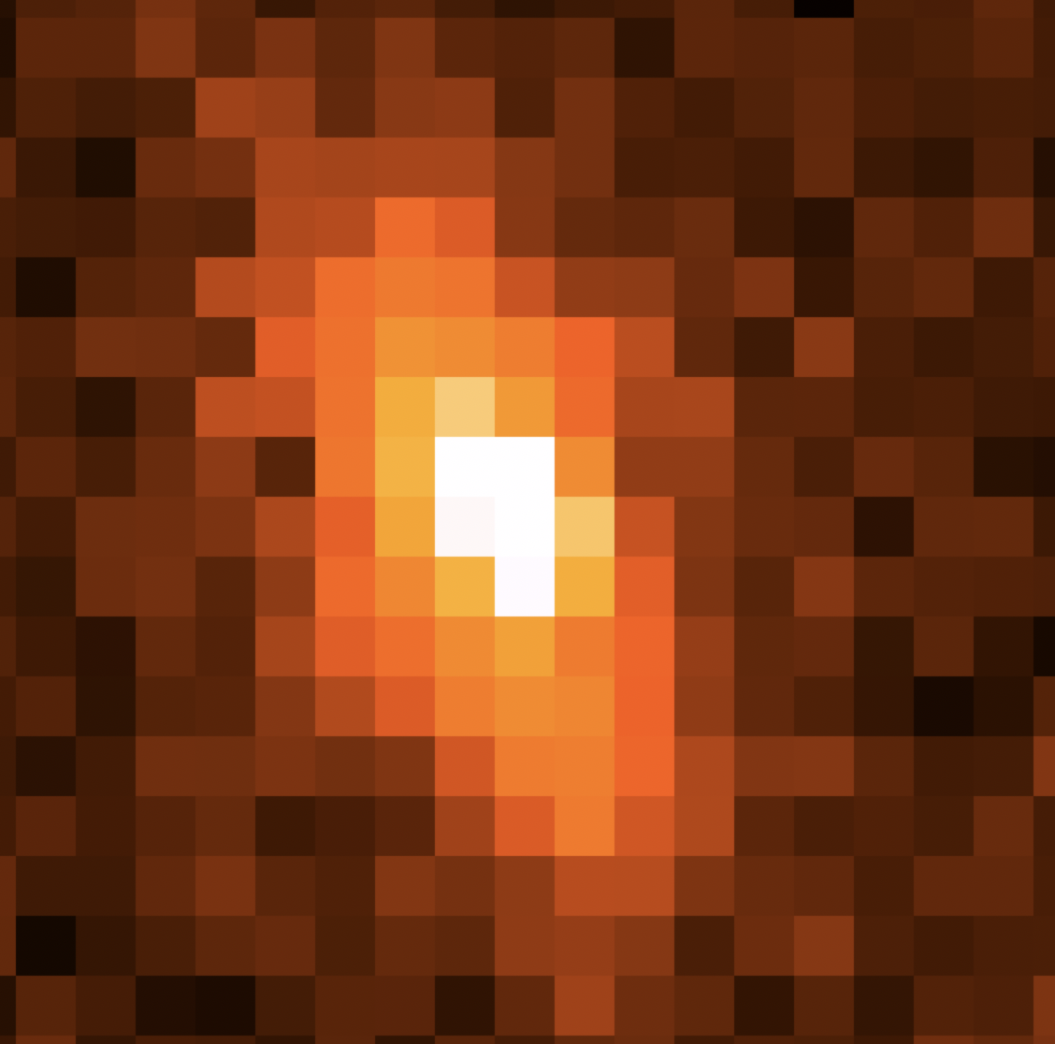
The questions on the ground
Internal Dynamics will be hardly measured with JWST —> no 3D shape, Mass.
GHZ1 z~10
GHZ2 z~12
Two of the brightest galaxies ever detected z>10
JWST
IFU
ELT
HARMONI
Is it a rotating disk at z=10???
Composite AGN???

Slide 16
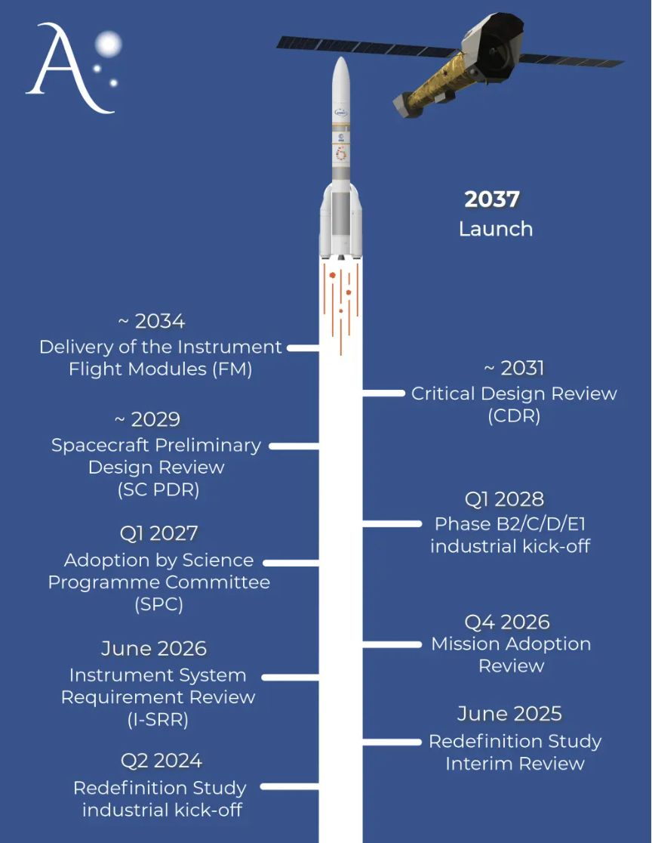
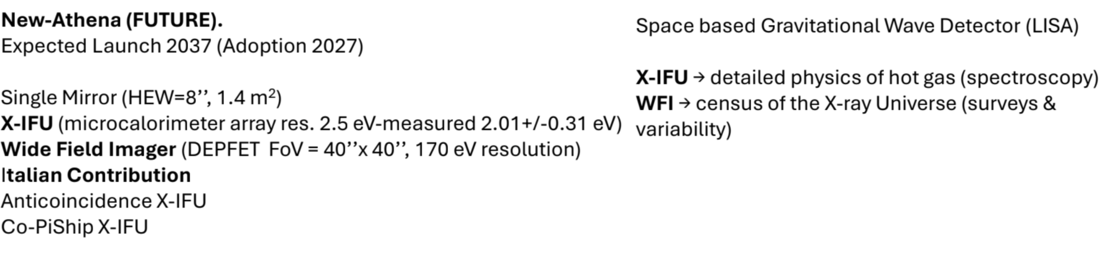
High AGN are one example of science case where we clearly lack an efficient X-ray satellite

Slide 17
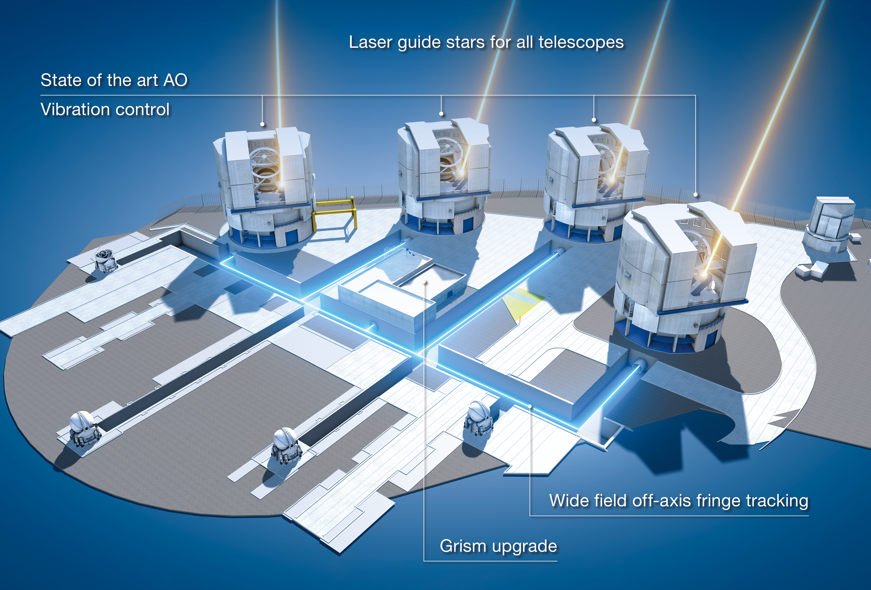
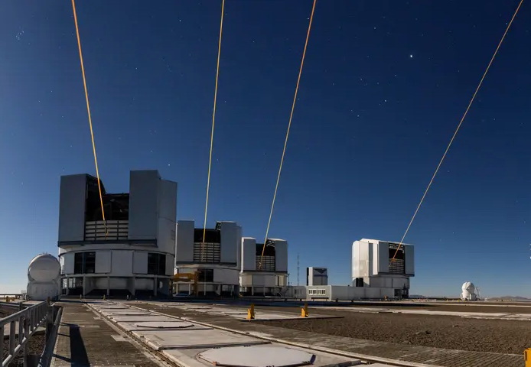
GRAVITY and GRAVITY+
Combines all four 8-m UTs
In operation since 2016
Provides: spectroscopy, polarimetry, astrometry,
quasi-imaging.
Science cases include:
Galactic Centre,
Exoplanets,
Micro-Lensing object masses,
SMBH masses.
Upgrade to GRAVITY+ is now complete…
Phase 1: Wide Angle Off-axis Fringe Tracking
Phase 2: State of the Art Adaptive Optics
Phase 3: Laser Guide Stars for all UTs
A. Berdeu/ESO
Courtesy of R. Davies

Slide 18
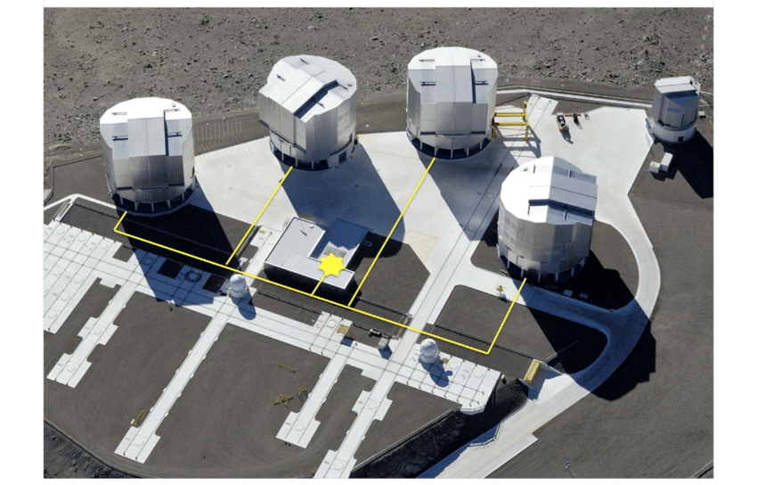
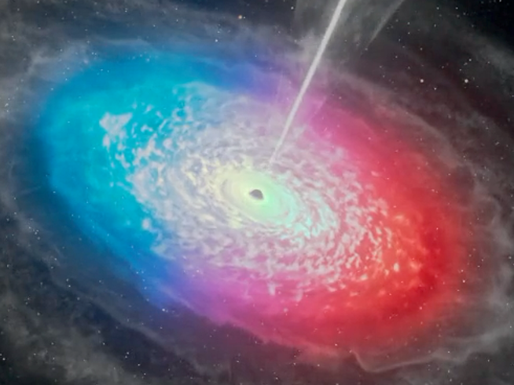
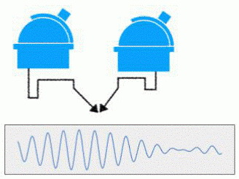
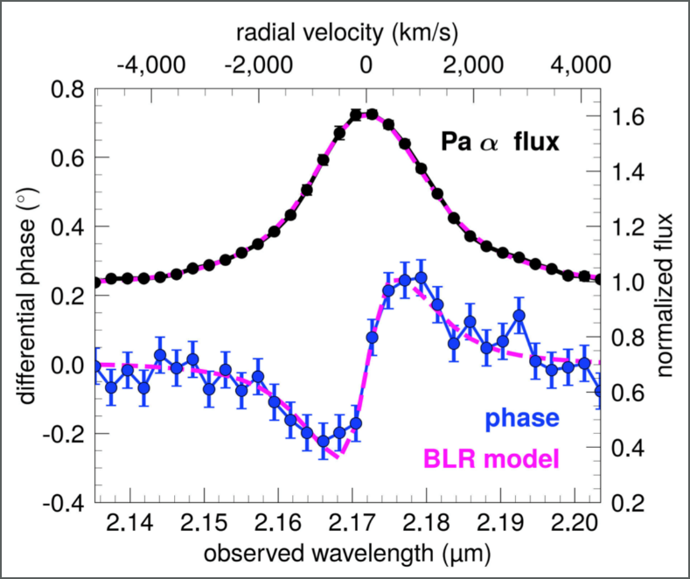
GRAVITY+: Interferometric vs Classical Spectroscopy
Spatially resolving BLR kinematics
Classical rotation curve
  Measure velocity as a function of position
Spectro-astrometry
  Measure position as a function of wavelength
  via shift of fringes (differential phase) -> very precise
GRAVITY Collab 2018
first result: 3C273 R_{BLR} = 46µas
UT3
UT2
Paα
flux
&
phase
UT4
Line emitting clouds in the BLR, velocity colour-coded
UT1
Interferometry
130 m
Courtesy of R. Davies
Courtesy of R. Davies

Slide 19
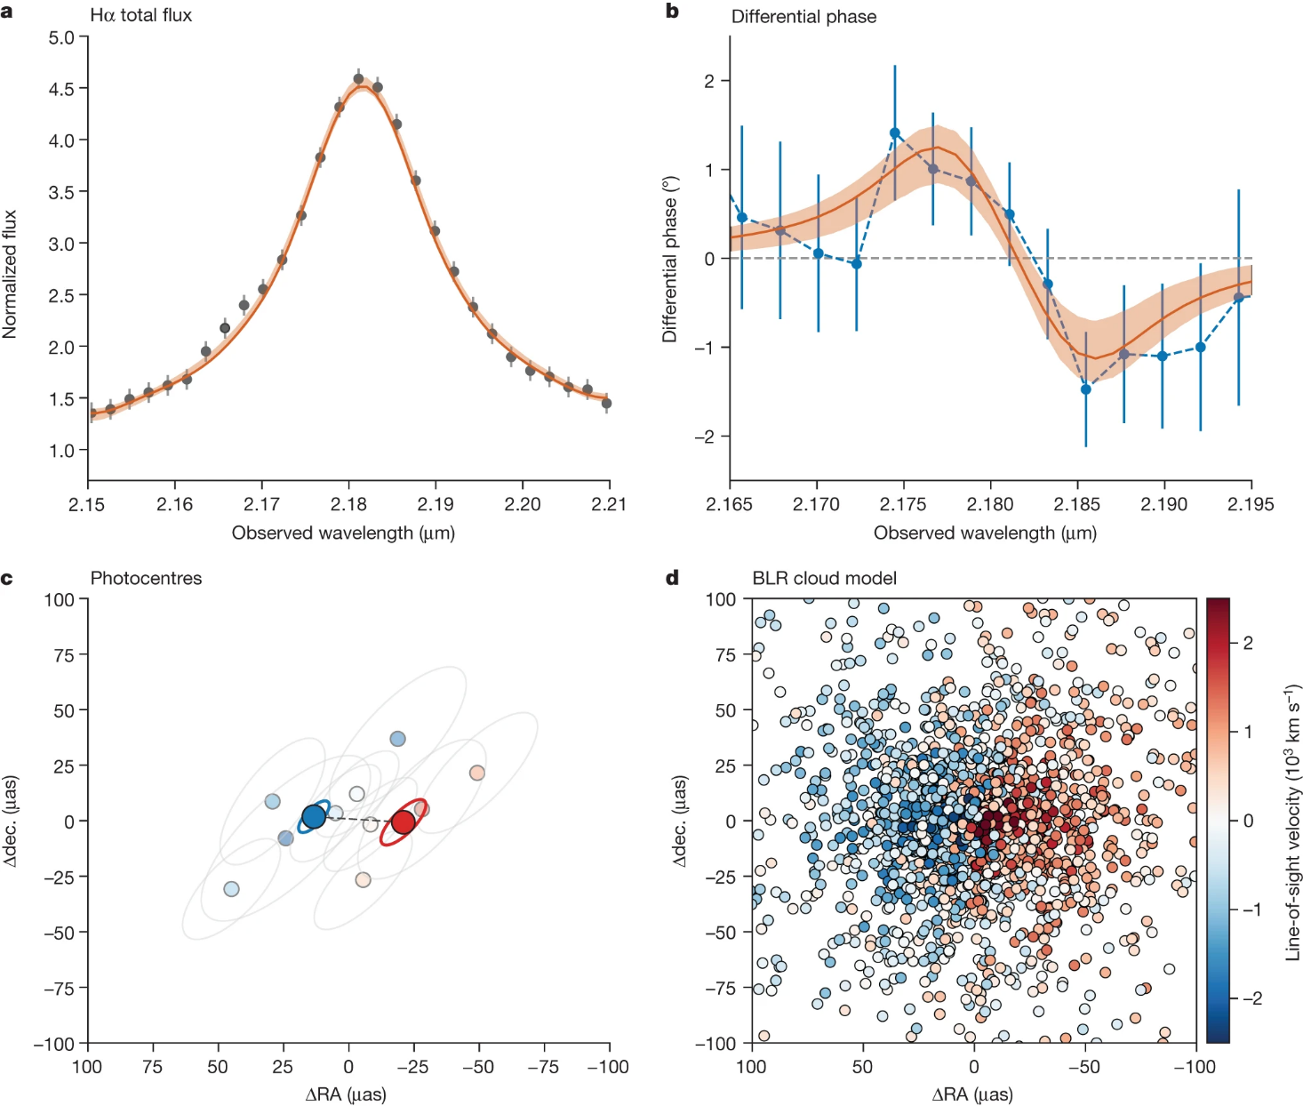
Black Hole Mass in a z~2 QSO
Abuter+ (Shimizu) 2024, Nature
J0920 at z=2.3 from Million Quasar Catalog
Star 12.7” away (adaptive optics & fringe tracker)
Log L_{bol} (erg/s) ~ 47.5
Differential Phase
Hα total flux
3.6 hrs integration over 2 months.
Due to (1+z) time dilation, RM would require ~6 years of monitoring to measure a time lag.
Photocentres
BLR cloud model
R_{BLR} ~ 40 µas (0.34pc)
  factor ~2.5 smaller than R-L relation
Log M_{BH} = 8.5 +/- 0.2 M_{sun}
L_{bol}/L_{Edd} = 7 - 20
Courtesy of R. Davies

Slide 20
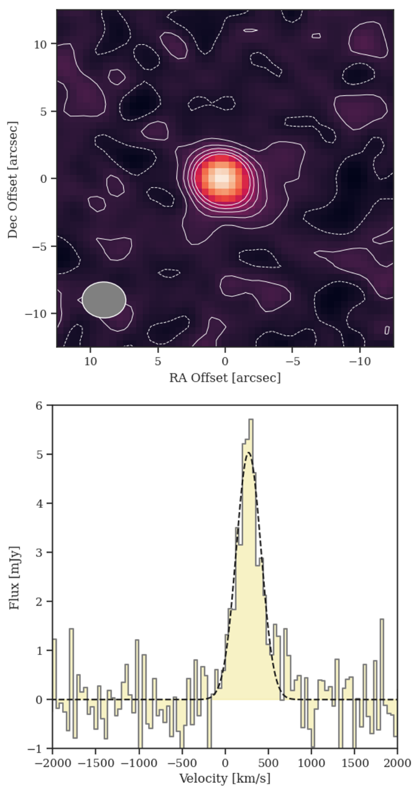
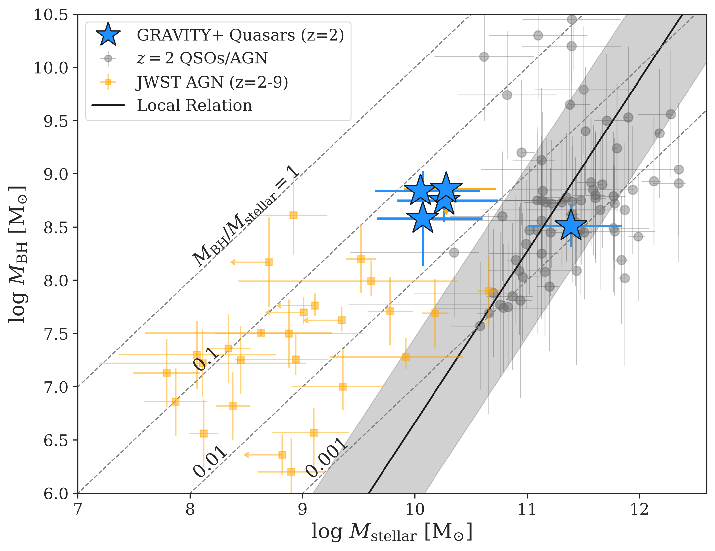
Host Galaxy Properties of z~2 QSOs observed with GRAVITY
CO3-2 & CO4-3 detections with ALMA or NOEMA
J0023-3350
Courtesy of R. Davies

Slide 21
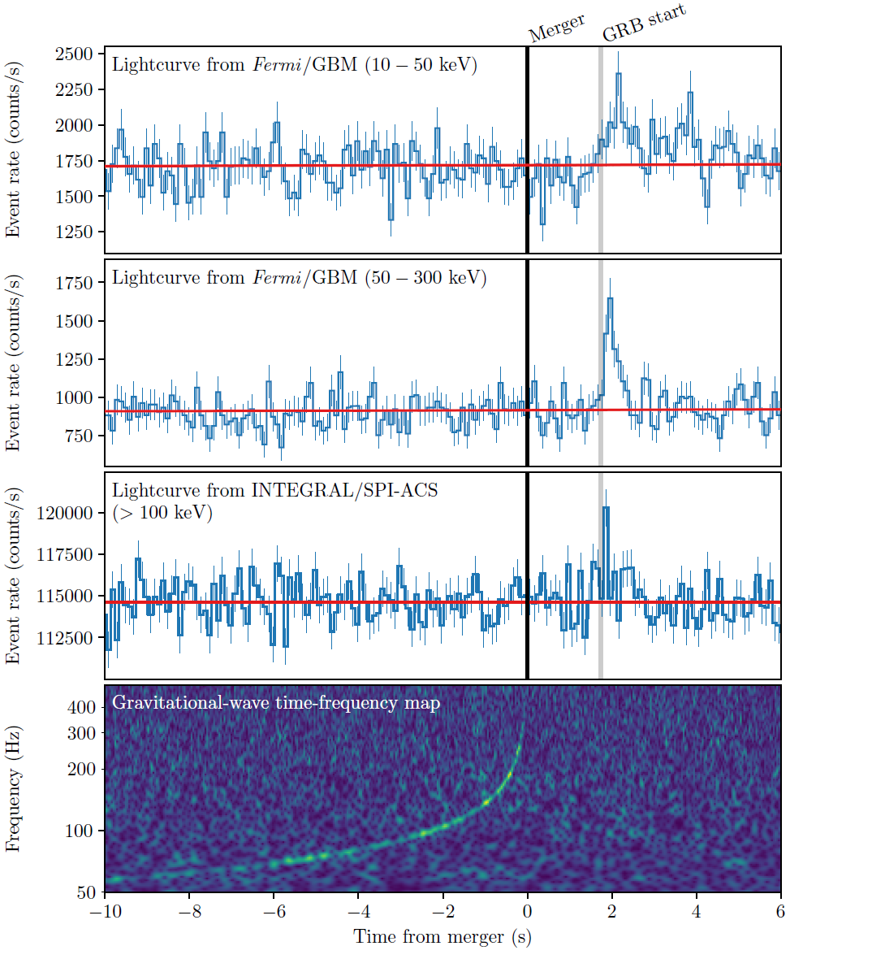
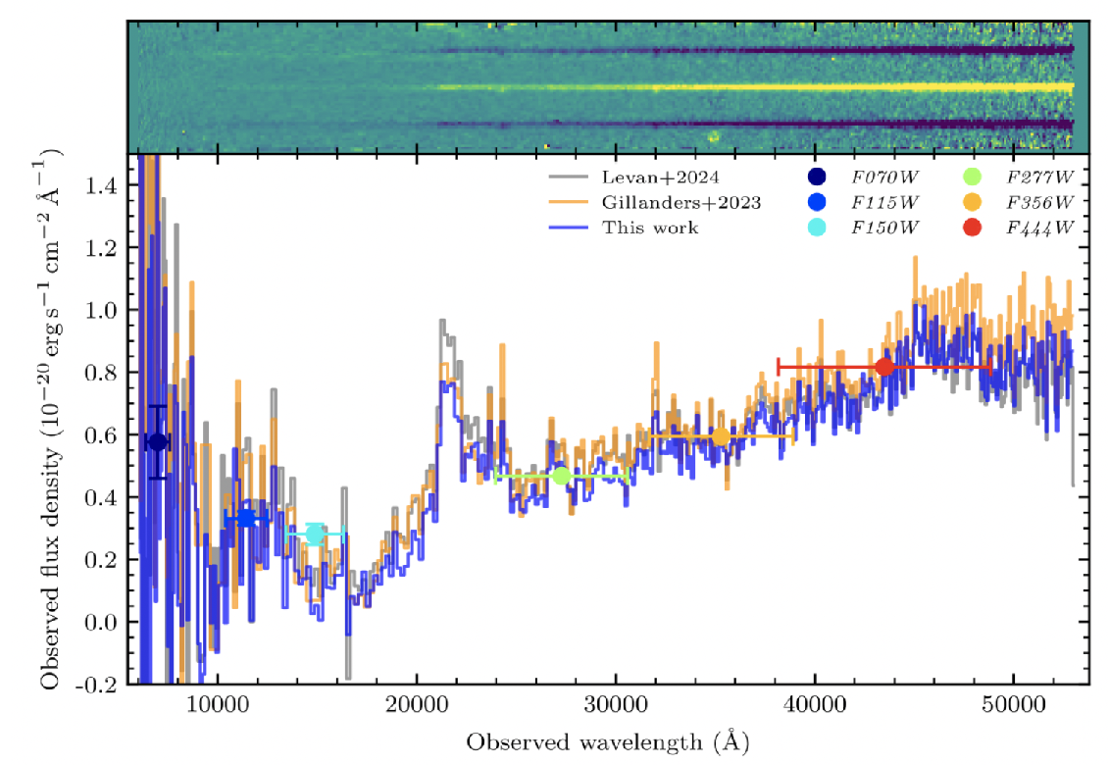
New multi-messenger astrophysics: i) search for GRB/e.m. counterparts of GW events (NS-NS merging)
Multimessenger astronomy
Kilonova: tellurium detection in GRB 230307A
Gillanders and Smart 24
Abbott et al., ‘17, ApJL

Slide 22
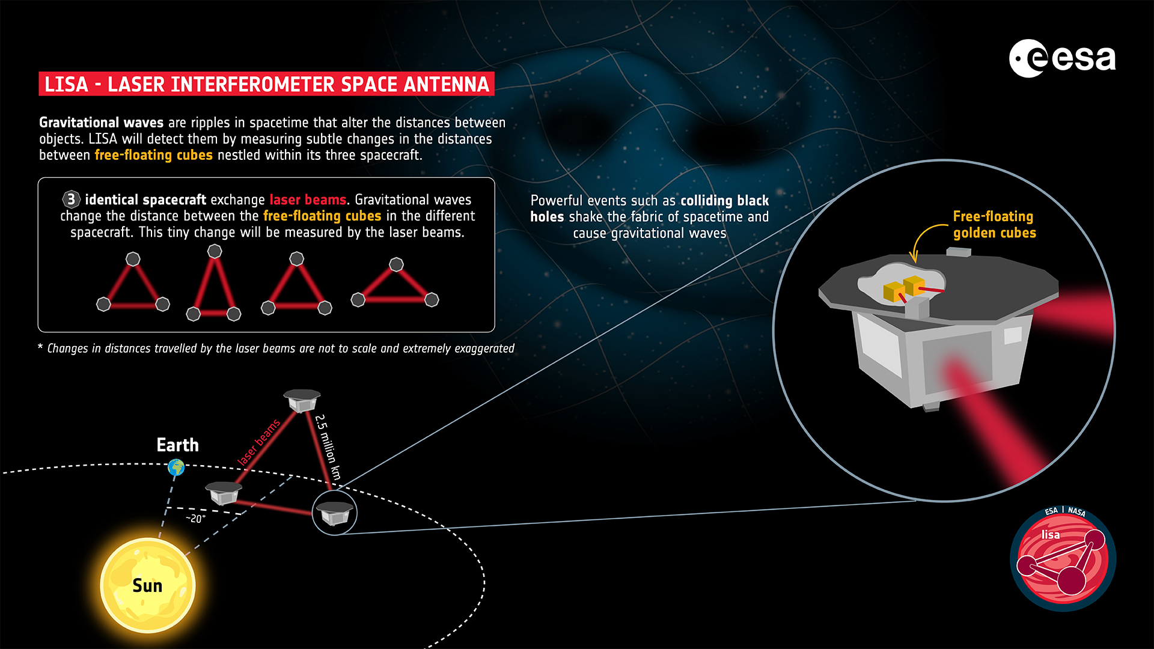
LISA will detect:
WD merging in the MW
IMBH (${10}^{5}-{10}^{7}M_{⊙}$) merging
spiralling BH pairs (alerts)
primordial GW?
Thousands of detections/yr
Launch date: 2035

Slide 23
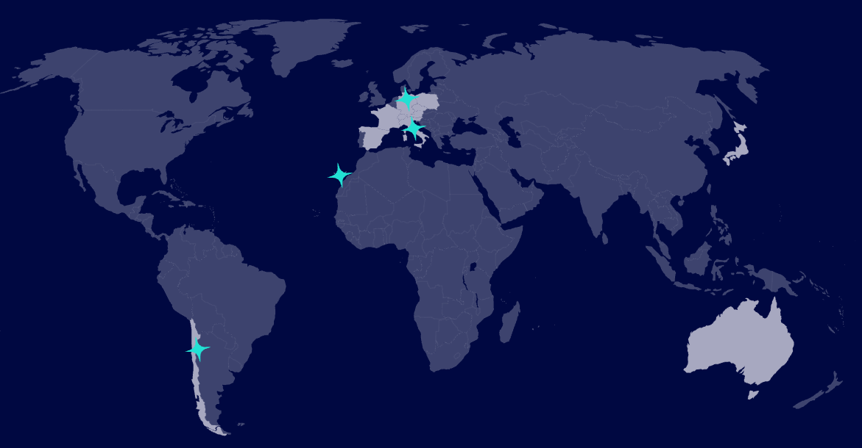
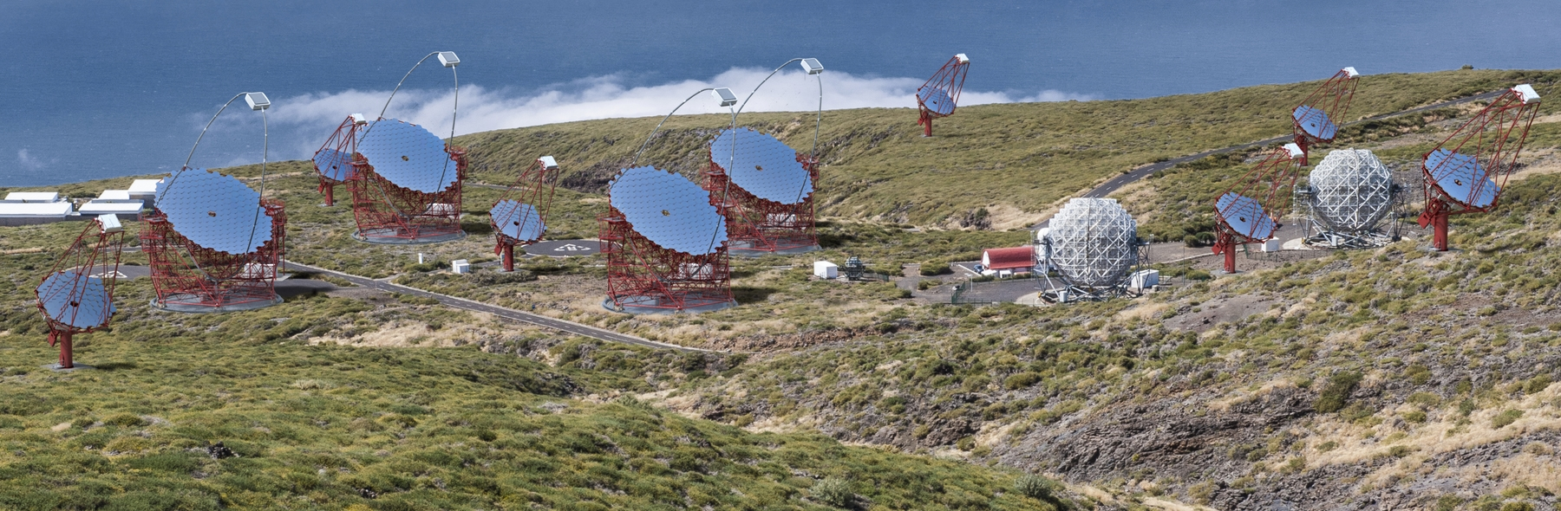
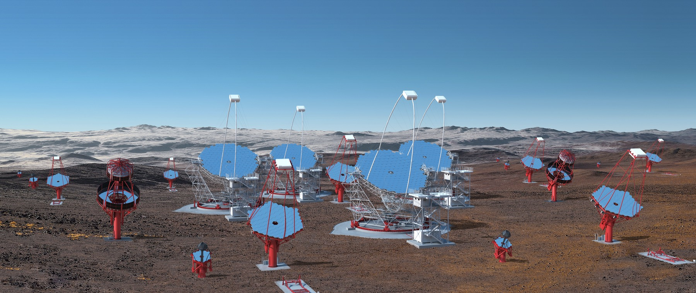
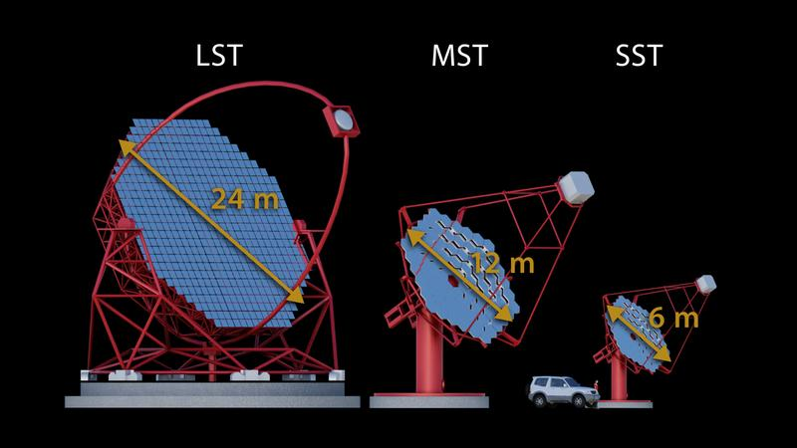
The CTAO Observatory (+ CTA+) in a nutshell:
  ERIC Infrastructure (one of the biggest in EU) started in January ’25
  Italy’s contribution second only to DE, first ERIC with HQ in Italy
  2 observing sites (North and South hemispheres):
      a) CTAO-N (La Palma, Canary Islands): 4 LSTs + 9 MSTs (NB: ASTRI MA in nearby Tenerife with 9 ASTRI-tel (~SSTs))
      b) CTAO-S (Chile, Paranal): 14 MSTs + 37 SSTs
CTAO-N (La Palma)
CTAO-S (Cile)
+ 2LST-S and 5 SST with CTA+!! (PNRR project)
Courtesy of M. Cappi

Slide 24
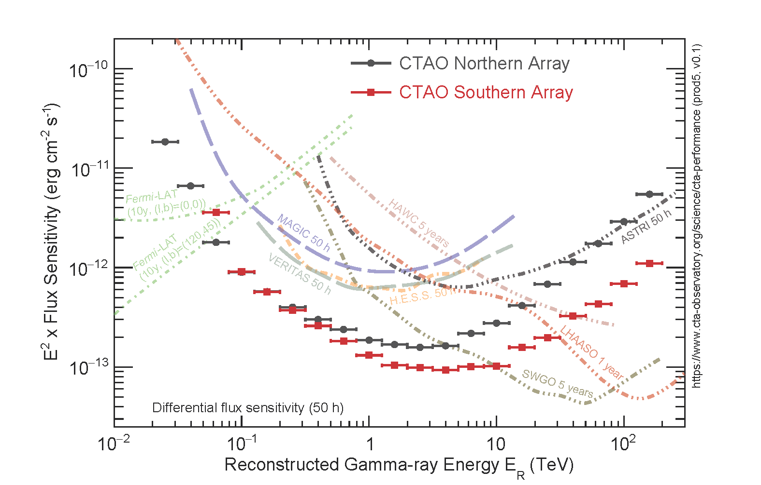
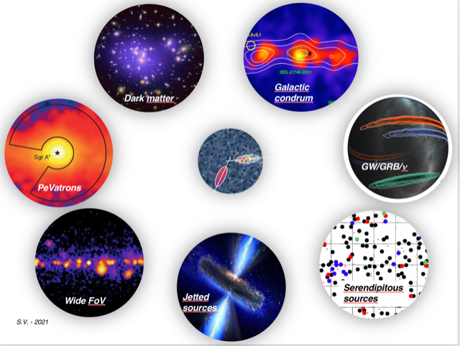
The ASTRI-MA/CTAO Projects: The New Italian/Open Observatories in the TeV energy range
The ASTRI-MA/CTAO Projects: The New Italian/Open Observatories in the TeV energy range
ASTRI-MA and CTAO will revolutionise the TeV science and community,
and expect the unexpected!
Courtesy of M. Cappi

Slide 25
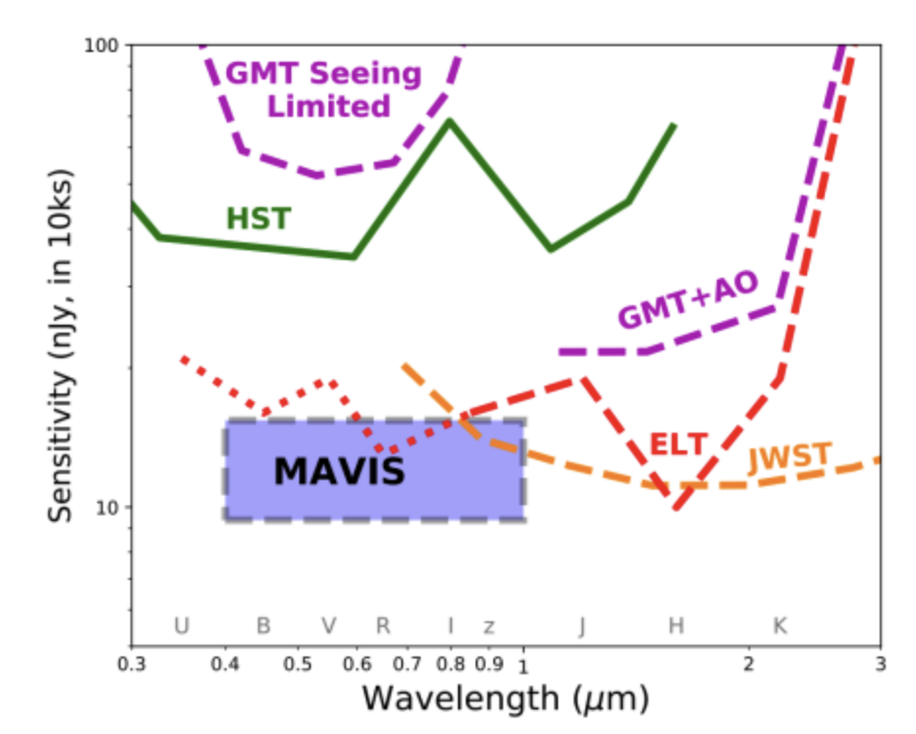
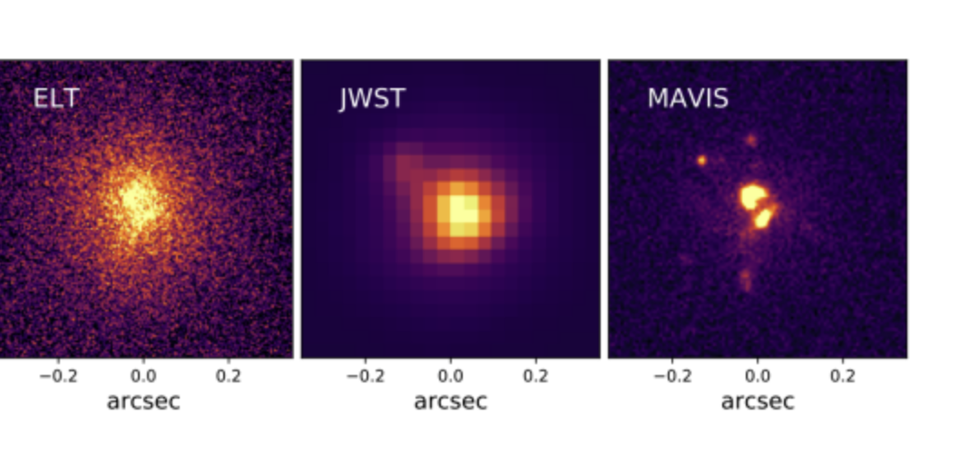
Resolution $Θ$ scales like $Θ=1.22\frac{λ}{D}$…
….making a 8m in the V band equivalent to a 40m in K…
MAVIS @ VLT (2030s)

Slide 26
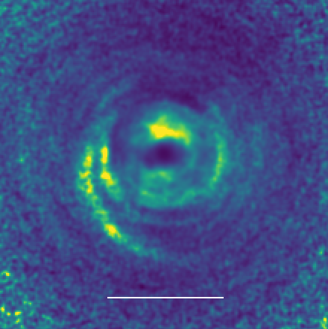


SHARK-VIS@LBT
Y-band Sphere
0.85mm ALMA
MWC 758
Hα
Deng+18

Slide 27


(44) Nysa is one of the largest known E-type asteroids.
SHARK-VIS@LBT
Satellite(!)
Trilobate structure
Minker+26

Slide 28



Exoplanet: atmosphere characterisation
Madhusudhan+25
Glidden+25

Slide 29


PLATO
ARIEL
Imaging for transit detection of long period earth like exoplanets
IR Spectroscopy for atmosphere characterisation
Italy is a major (2nd) contributor to both missions

Slide 30
Habitable Worlds Observatory
Telling the Story of Life in the Universe
A super-Hubble to search for life in the universe and perform transformative astrophysics

Slide 31

Another Earth
Preliminary simulated high-contrast image of the
Solar System with a coronagraph on HWO
Credit: Kammerer, Pueyo (STScI), Juanola Parramon, Stark (GSFC)
Notes:
New HWO simulation

Slide 32


ANDES@ELT
Will do - for instance - absorption spectroscopy of rocky planets…

Slide 33




Preliminary specs & candidate instruments
Telescope
Coronagraph
High-Resolution Imager
UV Multi-Object Spectrograph
Diameter | ≳6.0 m
Bandpass | ~100–2500 nm
Diff. Limit @ | ~500 nm
High-contrast imaging and imaging spectroscopy
Bandpass | ~350–1700 nm
Contrast
 | Vis: ~140 NIR: ~70, 200
UV/Vis and NIR imaging
Bandpass | ~200–2500 nm
Field-of-View | ~
60+ science filters & grism
High-precision astrometry?
UV/Vis multi-object spectroscopy and FUV imaging
Bandpass | ~100–1000 nm
Field-of-View | ~
Apertures | ~
 | ~500–50,000
Fourth Instrument
To be defined
Candidates include NUV Coronagraph, FUV IFS, UV Spectropolarimeter
Ceres
Notes:
Line of sight pointing jitter ~ 4 mas

Slide 34


The Most Chemically Primitive Stars
Image of I Zw 18 from HST
Massive stars produce most of the common heavy element (C, N, O).
Early in cosmic history, these massive stars may have lived and died in a manner very different from today.
The metal-poor galaxy I Zwicky 18 is one of the few places in the local Universe where we can observe individual massive stars that are chemically primitive.
Only HWO:
can resolve massive, clustered stars at UV wavelengths where they emit most of their radiation.
    measure temperature, mass, metal content, and age for these unique stellar populations.
    Hubble lacks the resolution and JWST & Roman lack the UV sensitivity to perform these observations.
The center of I Zw 18 as seen by
Hubble
HWO @ 8 m

Slide 35



The building blocks of galaxies
Hubble
HWO
Preliminary simulation
Credit: Postman, Snyder (STScI)
Low-mass dwarf galaxy at redshift = 2
Notes:
LUVOIR-B simulation

Slide 36


ELT Competitors (are there any?)
GMT
TMT
24m-equivalent tel to be located in Chile
30m tel to be located in …? Canary?
Allowed to proceed to phase B with NSF funds.
Construction not granted so far.
NOT funded by NSF

Slide 37



GMT mirrors are being cast in Tucson (4/7 done, 5th in progress)

Slide 38


GMT/TMT(?) Instruments are somewhat simpler by design…
GMT/TMT(?) have 10-15 years of lag wrt ELT.

Slide 39



NASA budget
2005
2026
NSF budget

Slide 40

NASA budget
2005
2026
China space science budget

Slide 41


Chinese investments in ground based astronomy are ramping up
+ SKA… but out of TMT
Lenghu site is comparable to Mauna Kea:
4200m, 75% time seeing <0.75”
(Deng+, Nature 2021)

Slide 42
Conclusions
1) We have an unique opportunity:
ELT (+SKA) will be the major discovery machine(s) in the 30s.
Europe - we - can lead the field.
2) “Go big or go home”: Be bold, be ambitious.
We need to aim at transformational discoveries.
VLT still has the latitude and power to be at the front line - if we keep innovating.
3) Italy is uniquely placed to exploit synergies: Euclid, SKA, CTA, LSST, etc

