Slide 1
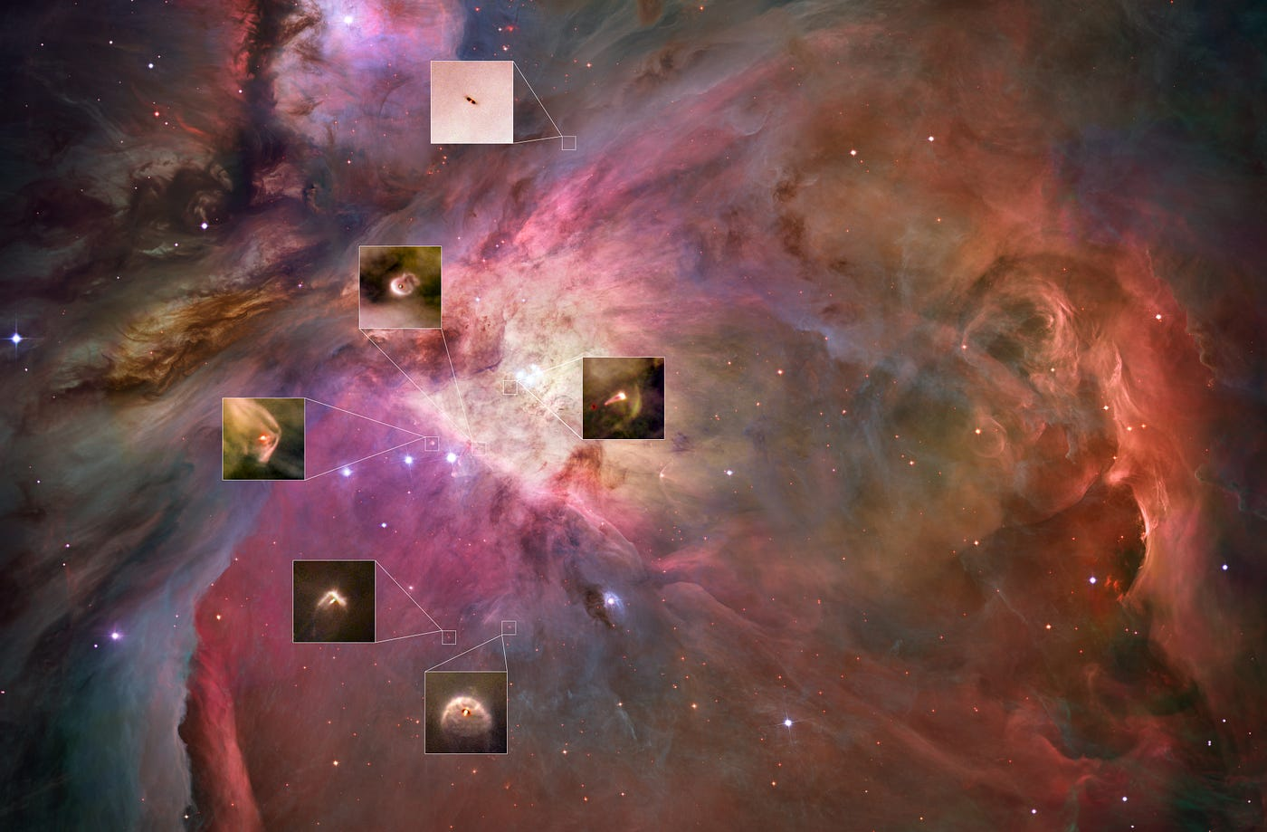

Disk populations and their evolution in various galactic environments
CLOSE ENCOUNTERS
Mario Giuseppe Guarcello
INAF
Osservatorio Astronomico di Palermo

Slide 2
DEFINITION
A flyby occurs when a star on a parabolic or hyperbolic orbit (e>1) perturbs another star
Pioneering work by Clarke & Pringle (1993) motivated by binary star formation
Fundamental enviroment parameter: stellar density

Slide 3
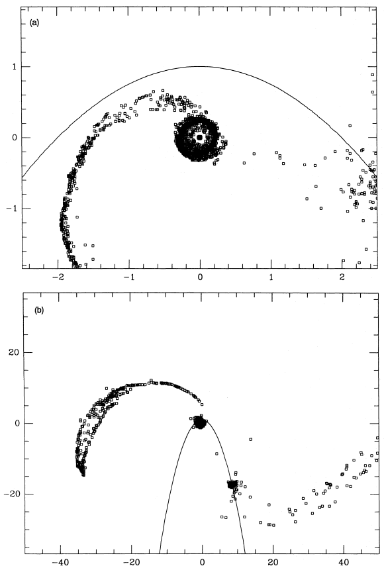
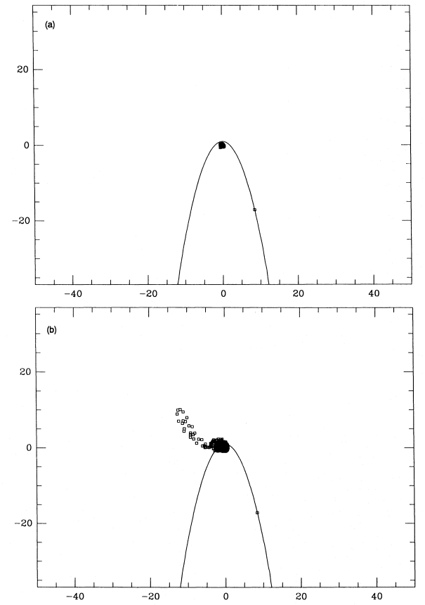
EFFECTS ON PPDs
coplanar-prograde
coplanar-retrograde
Clarke & Pringle (1993):
More effective feedback for coplanar-prograde interaction
Less effective feedback for coplanar-retrograde interaction
Effects:
Spiral formation
Disc truncation
Disc misalignment
Dust trapping
Accretion events

Slide 4
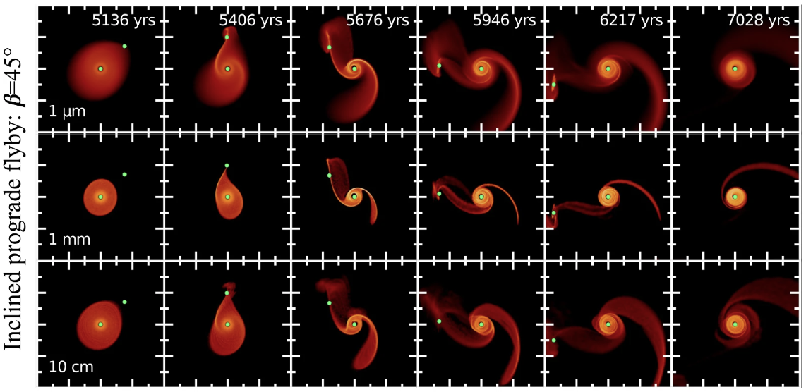
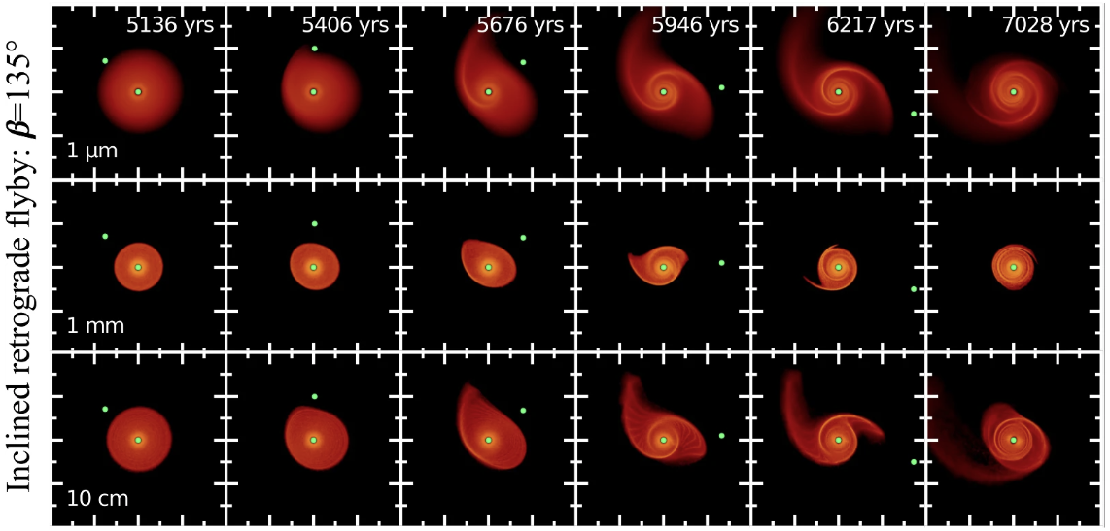
EFFECTS ON PPDs
In >30 yrs, tons of simulations produced. Cuello+2023 extensive review
Most destructive flybys: prograde, parabolic and disc-penetrating
Different dust dynamics at different flyby geometry:
µm-size: gas-coupled
mm-size: compact disc and spirals
>10 cm-size: decoupled from gas, behave like particles

Slide 5
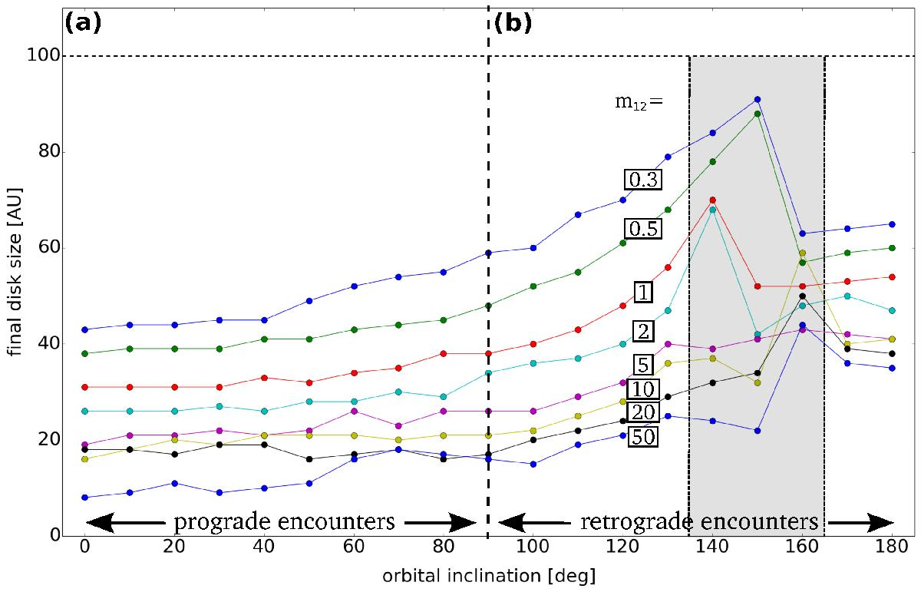
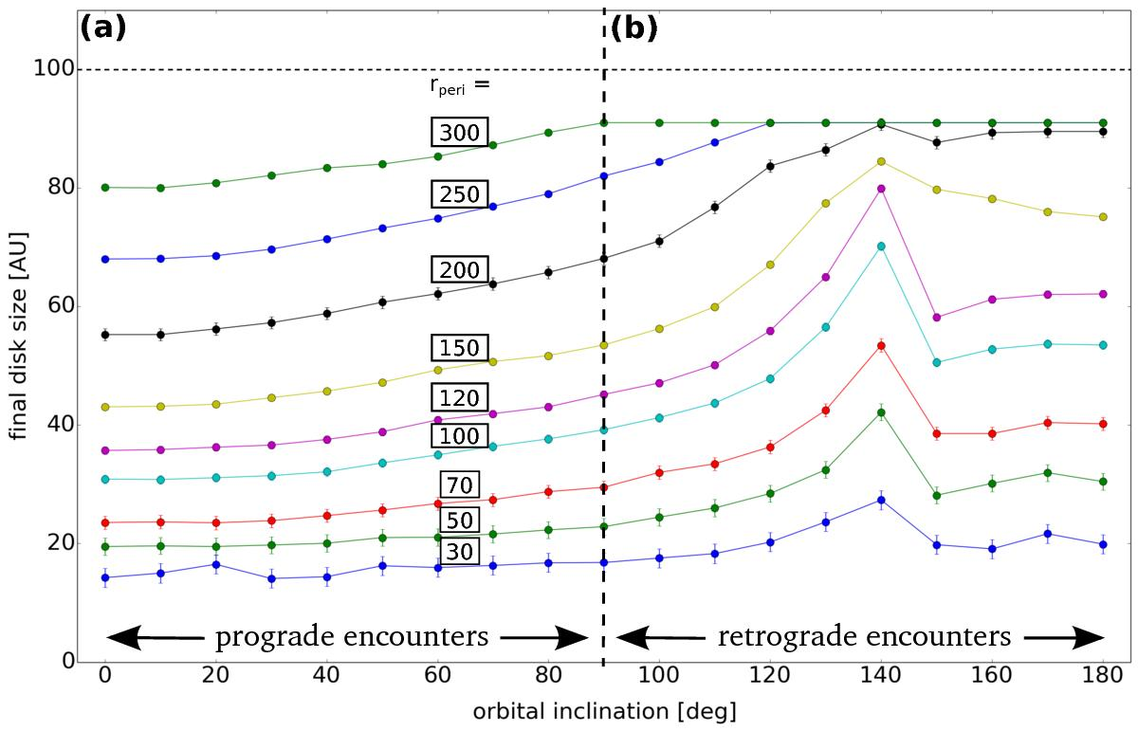
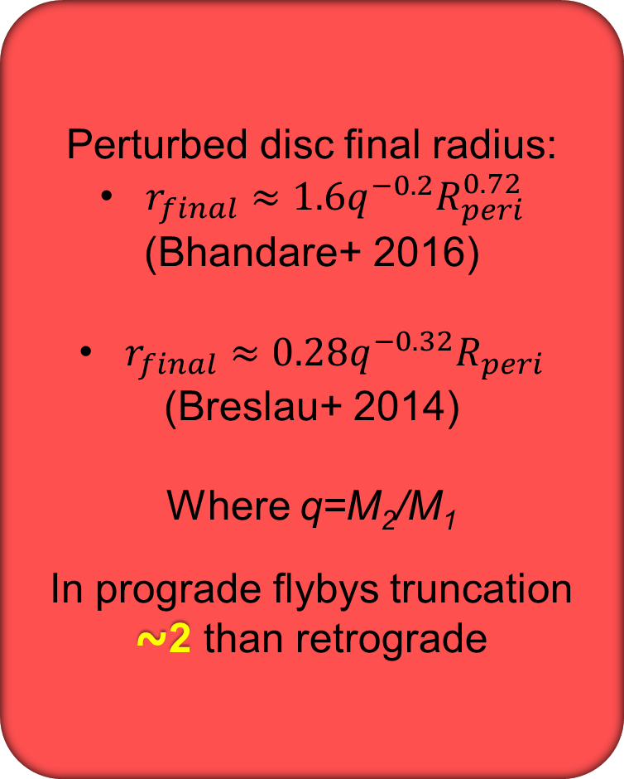
DISC TRUNCATION
Perturbed disc final radius:
$r_{final}≈1.6q^{−0.2}R_{peri}^{0.72}$
(Bhandare+ 2016)
$r_{final}≈0.28q^{−0.32}R_{peri}$
(Breslau+ 2014)
Where q=M₂/M₁
In prograde flybys truncation ⁓2 than retrograde
Final disc size vs mass ratio, R_{peri}, orbital inclination for prograde and retrograde flybys
(Bhandare+ 2016)

Slide 6
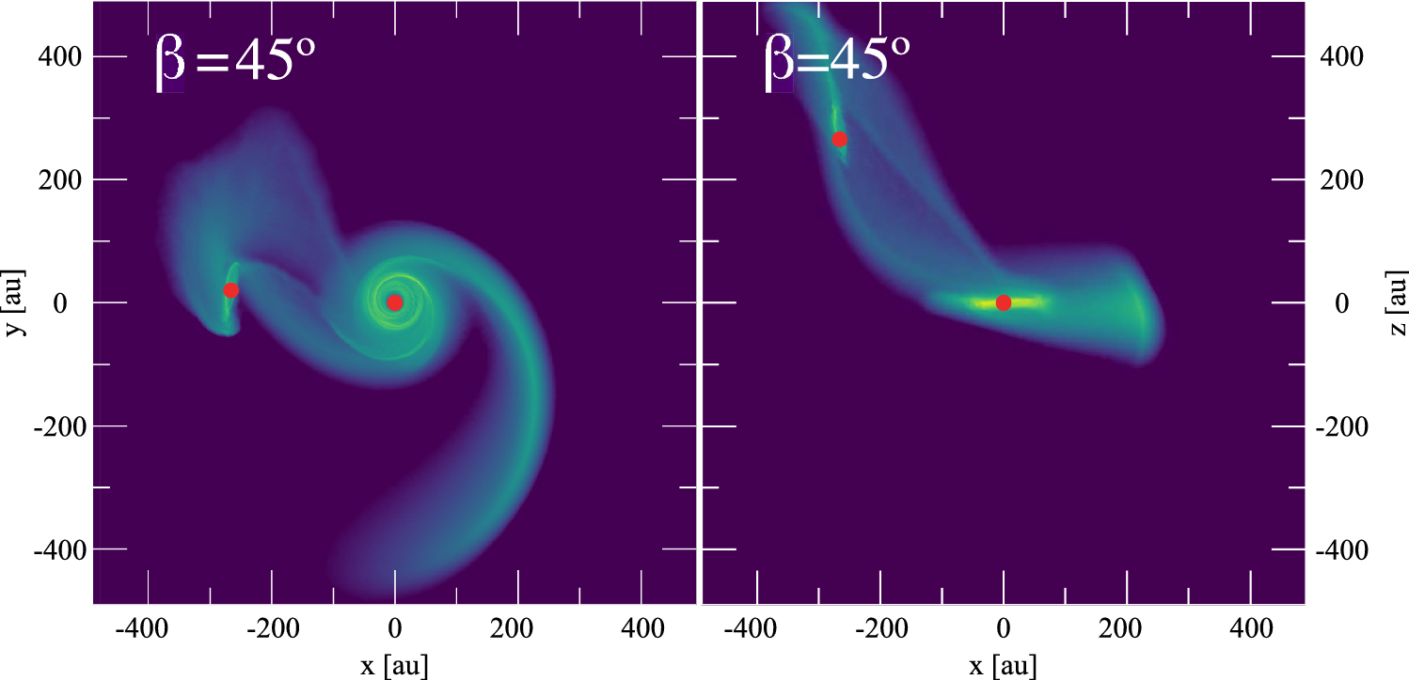
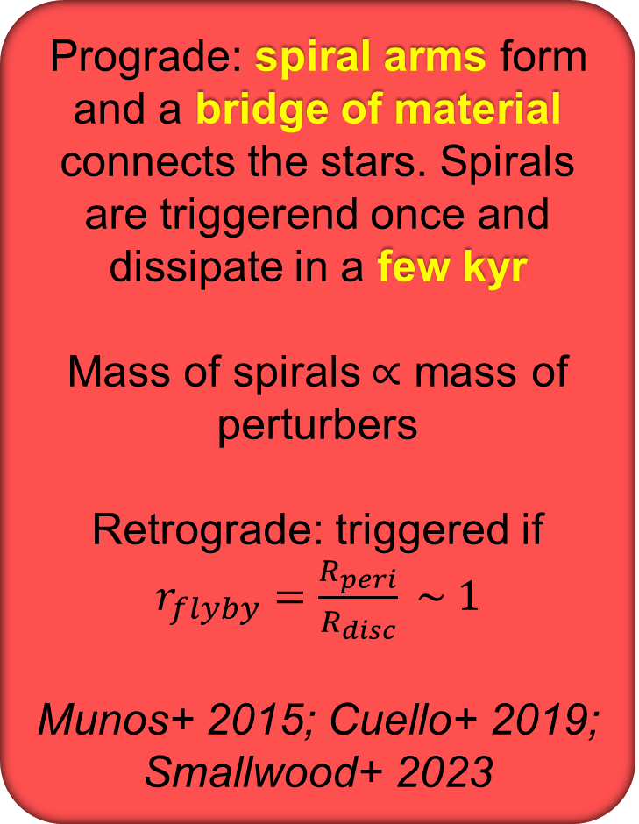
SPIRAL ARMS
Prograde: spiral arms form and a bridge of material connects the stars. Spirals are triggerend once and dissipate in a few kyr
Mass of spirals $∝$ mass of perturbers
Retrograde: triggered if $r_{flyby}=\frac{R_{peri}}{R_{disc}} \sim 1$
Munos+ 2015; Cuello+ 2019; Smallwood+ 2023
Bridge formed during an inclined prograde flyby (Cuello+2019)

Slide 7
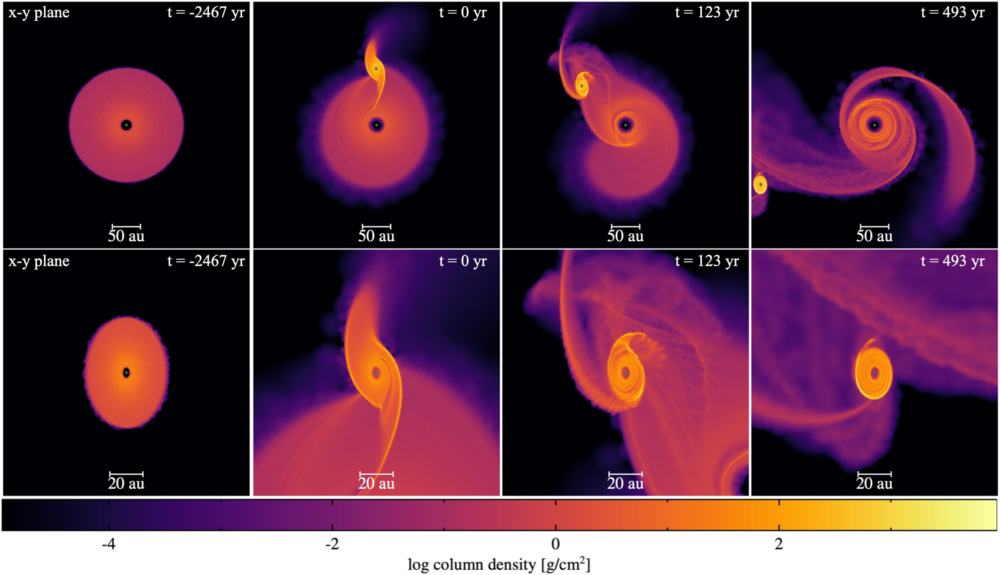
DISC CAPTURE: STELLAR THIEVES AND 2-GENERATION DISC
For r_{flyby}⁓1 → perturber capture material, which form a disc
Mass transfer at periastron
If the perturber has a disc, this result in complex geometries
Observational signatures: spirals, warps, twisted velocity maps, tail-like structure
Cuello+2019; Picogna+ 2014; Vorobyov+ 2020; Pinte+ 2022; Huhn+ 2025
Evolution of discs around primary and perturber during a coplanar prograde flyby
Orientation of the second-generation disc related to flyby geometry (Smallwood+ 2023)

Slide 8
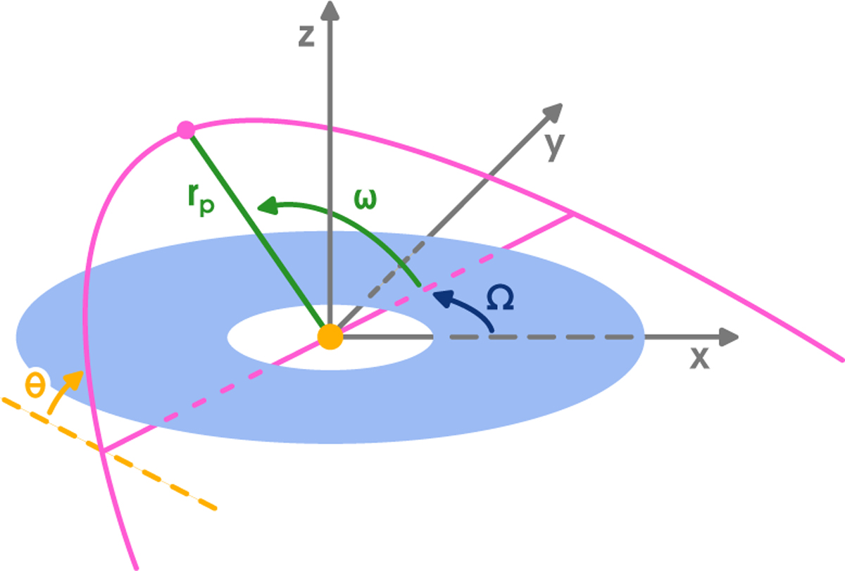
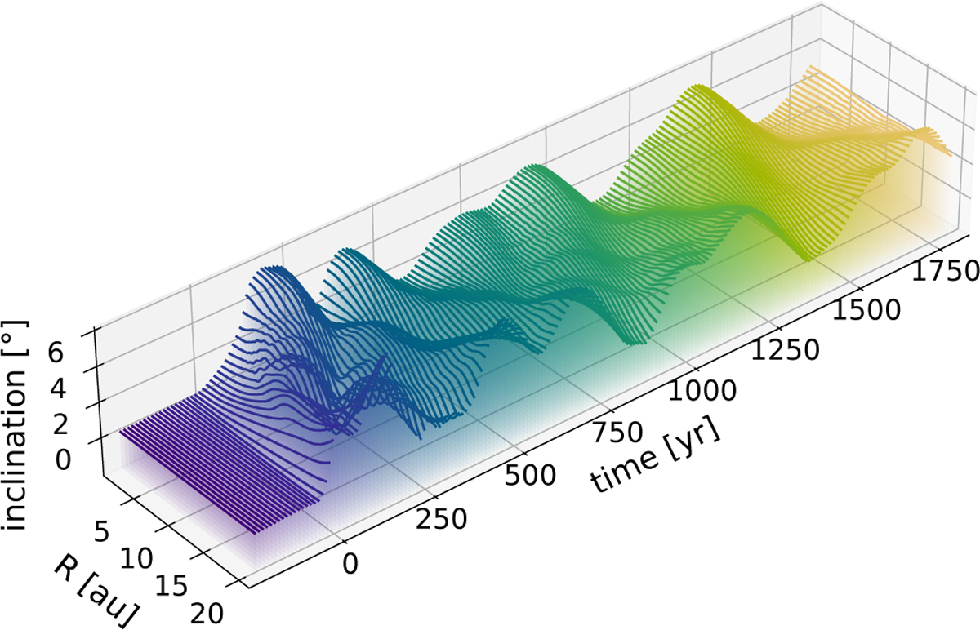
DISC WARPS
Inclined flybys can excite warps of a few degrees
Exact outcome depends on the specific geometry of the encounter
Strongest warps: retrograde flyby, periastron not in disc plane
Spirals last shorter than warps
(Kimmig+ 2026)
Flyby geometry
Simulated time evolution of the warp produced in RW Aur A after the flyby occured at t=0

Slide 9
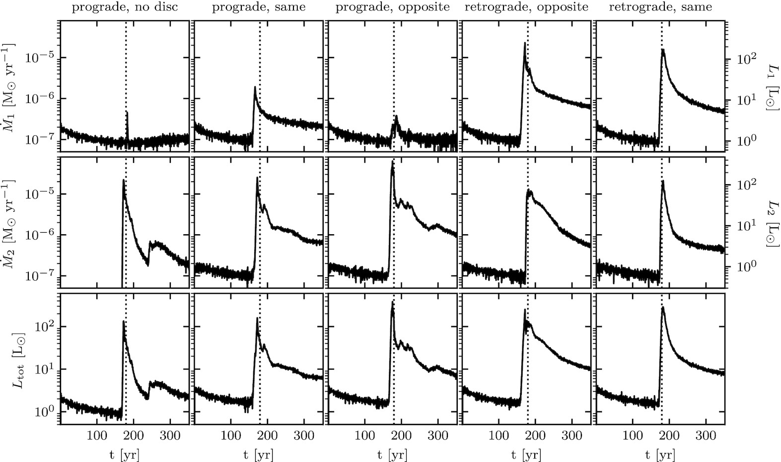
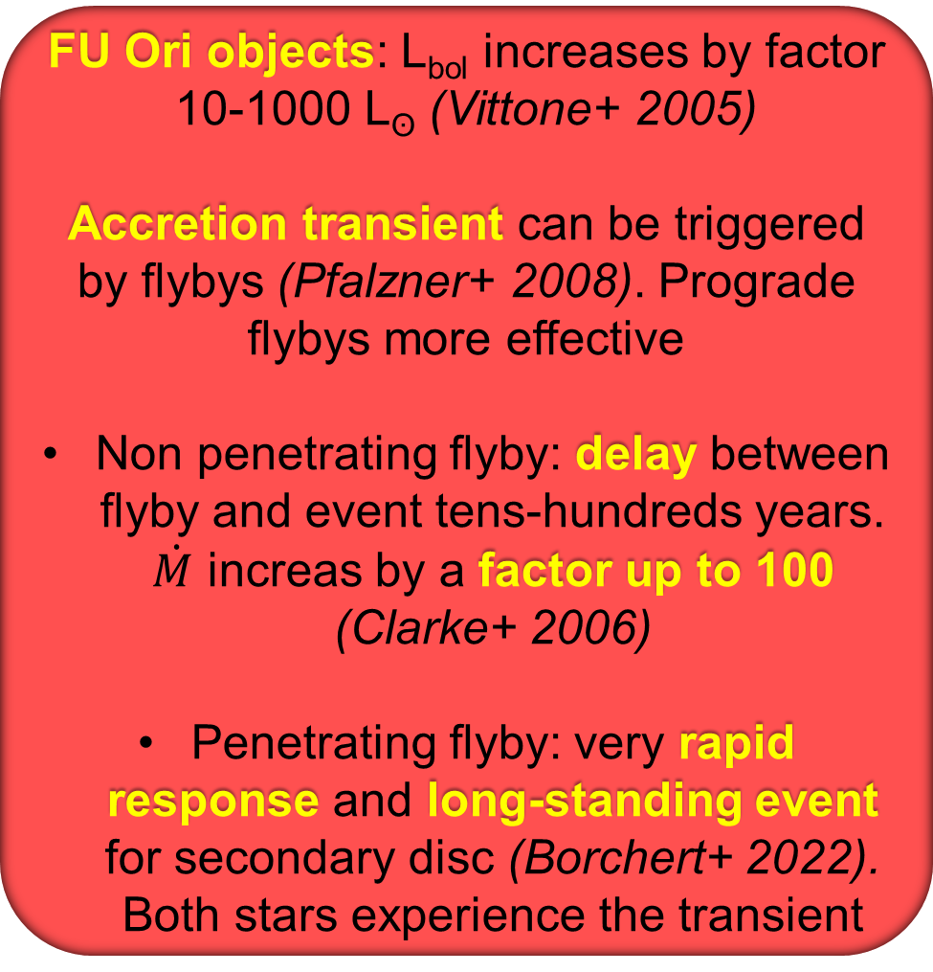

ACCRETION TRANSIENTS
Prograde
No disc
Prograde
Same rot.
Prograde
Oppos. rot.
Retrograde
Same rot.
Retrograde
Oppos. rot.
FU Ori objects: L_{bol} increases by factor 10-1000 L_{ʘ} (Vittone+ 2005)
Accretion transient can be triggered by flybys (Pfalzner+ 2008). Prograde flybys more effective
Non penetrating flyby: delay between flyby and event tens-hundreds years. $\dot{M}$ increas by a factor up to 100 (Clarke+ 2006)
Penetrating flyby: very rapid response and long-standing event for secondary disc (Borchert+ 2022). Both stars experience the transient
$\dot{M}$ vs. time for different penetrating flybys.
Primary: top; Secondary: middle: Total: bottom.
Vertical line: periastron passage
(Borchert+ 2022)

Slide 10
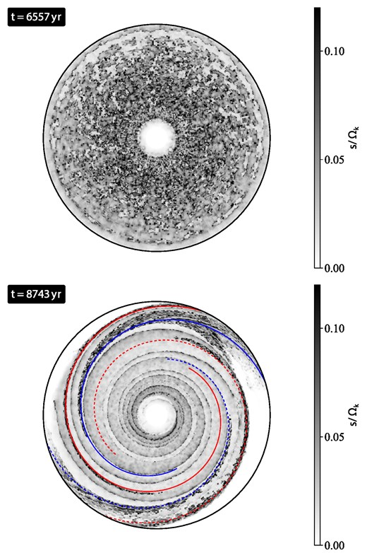
STREAMING INSTABILITIES
In both retrograde and prograde (more effective) flybys, structures works ar dust traps (e.g. increasing dust density and dust/gas ratio) – Prasad+ 2025
Possible triggering of streaming instabilities
Likely depends on q (Su+ 2026):
q<<1 → suppression dust trapping
q⁓1: enhancing dust trapping
SI growth number before and after the flyby
S: growth rate which depends on Stokes number, dust/gas ratio, and pressure gradient
Ω_{K} Keplerian orbital frequency
(Su+ 2026)
Notes:
Keplerian orbital frequency ($\Omega_K$) is the rate at which an object completes an orbit

Slide 11
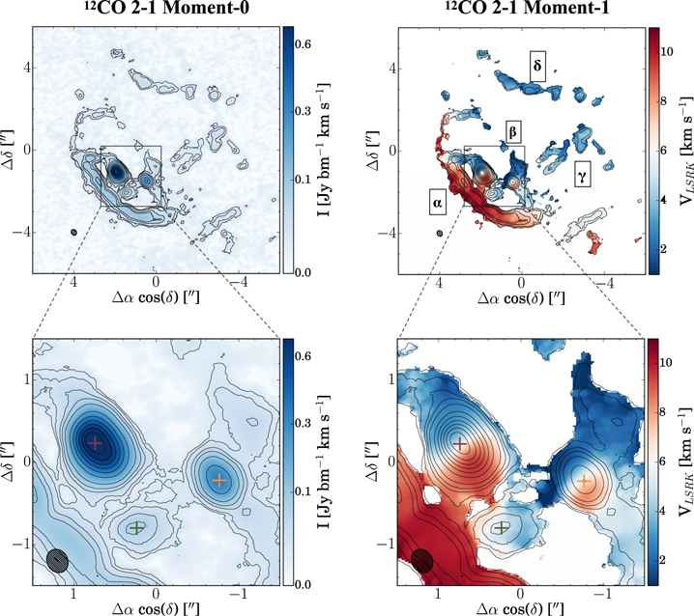
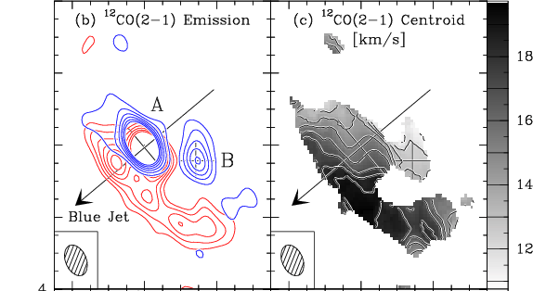
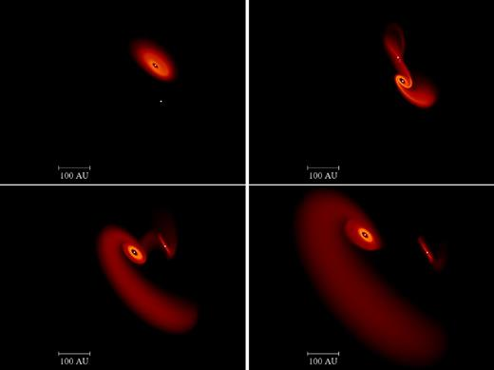
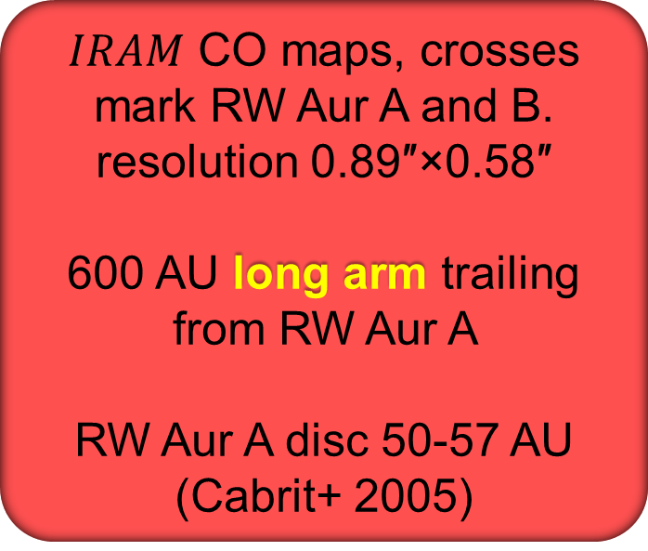
FLYBY COUGHT IN THE ACT: RW AUR
$IRAM$ CO maps, crosses mark RW Aur A and B. resolution 0.89″×0.58″
600 AU long arm trailing from RW Aur A
RW Aur A disc 50-57 AU
(Cabrit+ 2005)
Two simulated snapshots of the flyby
(Dai+ 2015)
ALMA CO map 0.89″×0.58″
Discs 58 AU and 38 AU.
Multiple flybys: moment-1 map reveals four arms
(Rodriguez+ 2018)
Notes:
Moment-1 map as shown in Figure 2 overlaid with Moment-0 contours. The original tidal arm discovered by Cabrit et al. (2006) is labeled “α,” the second counter-spiral arm is labeled “β”, and the two new tidal streams identified are labeled “δ” and “γ.” The dashed black line outlines the two spiral arms that form the apparent ring and the additional tidal streams to the NW.

Slide 12
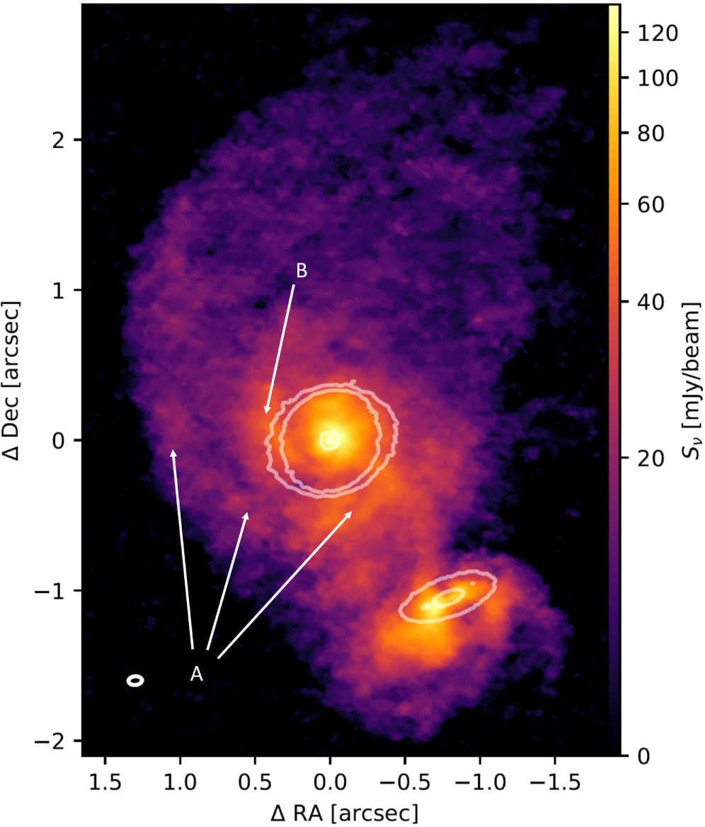
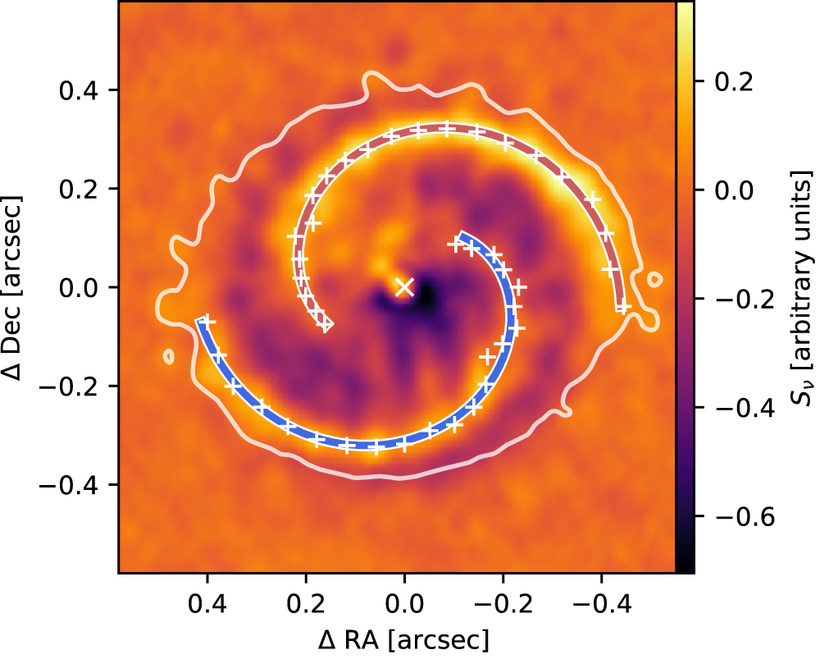
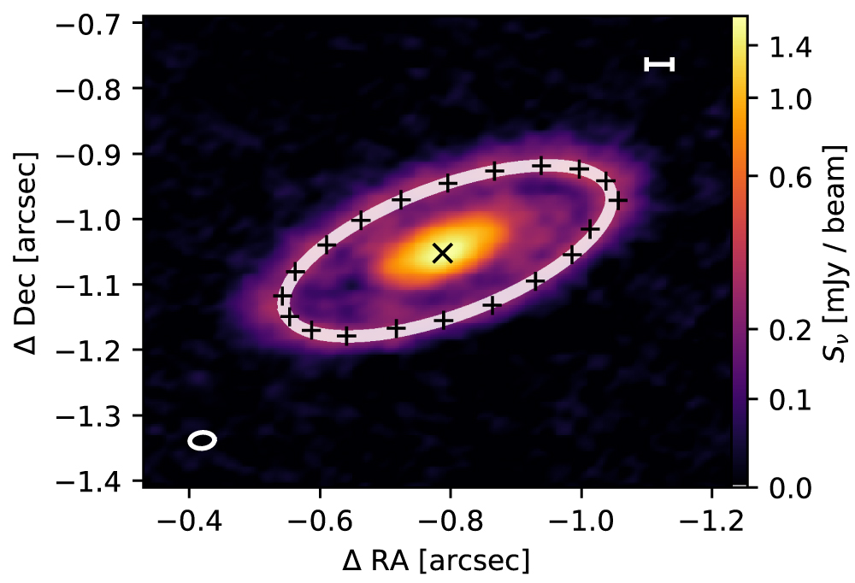
FLYBY COUGHT IN THE ACT: AS 205
AS205 N
ALMA CO map (project DSHARP). Two arcs surrounding AS205 N
Proj. sep. 168 AU
AS205 N disc with spiral arms
(from 20 to 55 AU)
AS205S 34 AU disc
Product of flyby
(Kurtovic+ 2018)
AS205 S

Slide 13
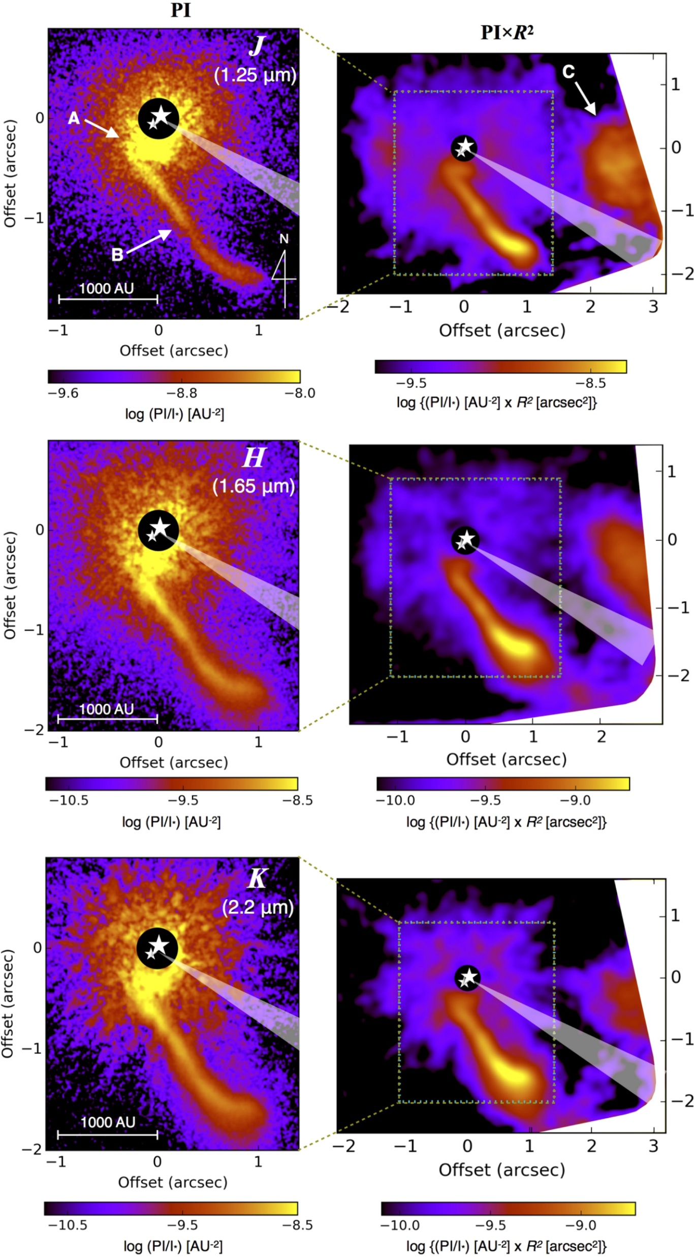
FLYBY COUGHT IN THE ACT: Z CMa
Subaru AO polarized light images in JHK bands
Stars symbols mark the position of the binary components (16 M_{ʘ} Herbig Ae/Be and 3 M_{ʘ} Fu Ori-type star). Circumbinary disc.
Triangles show the direction of jet
PI: brightness of the polarized light
Tail A 2″ long (about 2000 AU)
Accretion burst triggered by flyby.
Perturber at 4700 AU (outside the image)
(Takami+ 2018)
Notes:
In observations of protoplanetary disks, the central star emits unpolarized light, while dust grains in the disk scatter this light, causing it to become linearly polarized.
PIxR2 is a geometric correction that accounts for the less incident radiation at larger distance

Slide 14
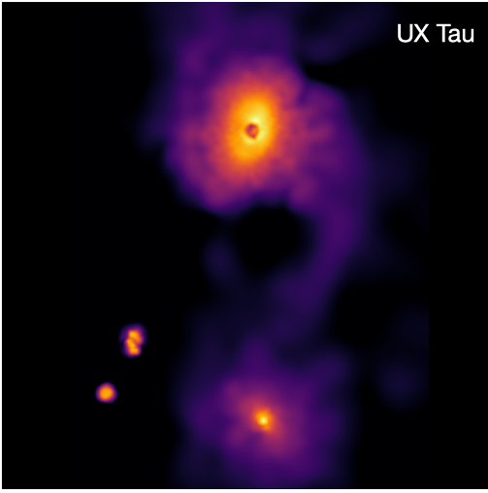
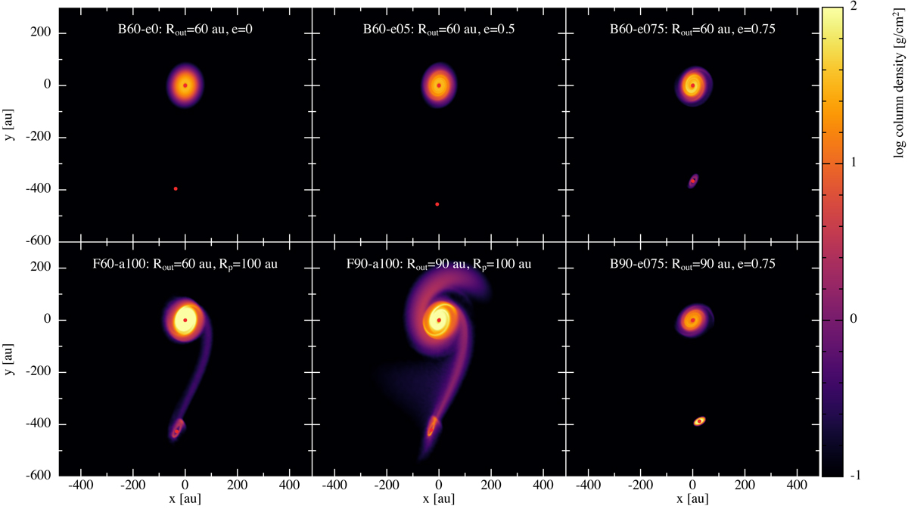
FLYBY COUGHT IN THE ACT: UX TAU
UX Tau A
UX Tau
Top: JH polarization SPHERE@VLT image 0.012″/pix (Menard+2020; Cuello+ 2023)
Detected:
Long bridge between UX Tau A and C
Spirals around UX Tau A
Faint compact disc around UX Tau C
Simulations suggest prograde flyby
⁓1000 years ago
bridge
UX Tau C

Slide 15
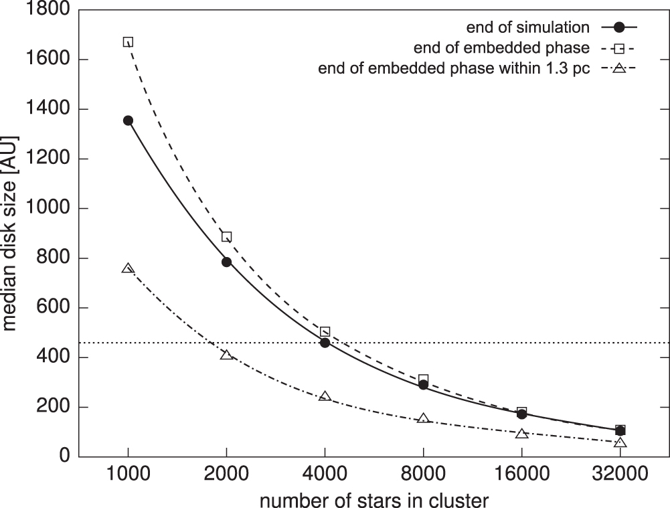
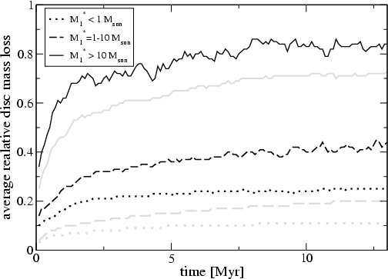
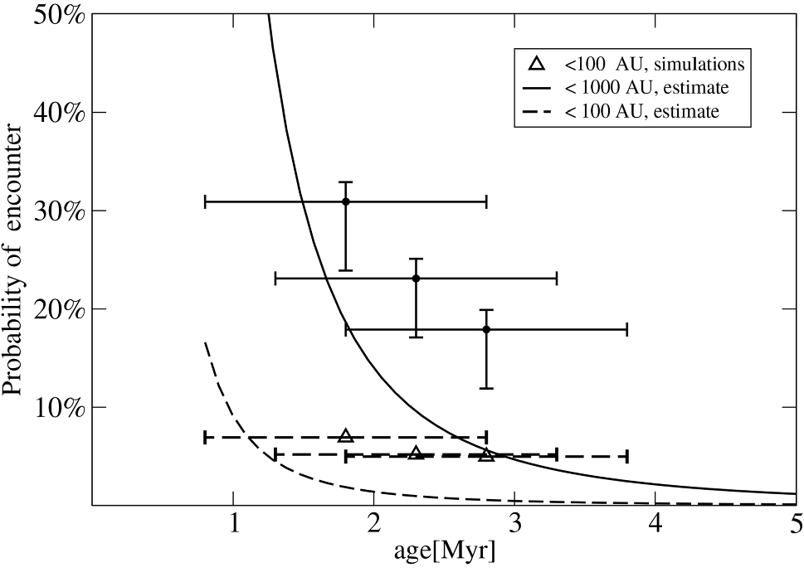
THE IMPACT OF FLYBYs ON DISCS POPULATIONS
Close encounters are important in clusters, depending on stellar number density, gas espulsion timescale and velocity dispersion
Disc size in simulated clusters.
Phases: 2-10 Myrs
Vincke & Pfalzner 2016
Percentage of solar-type stars experiencing in sparse clusters, 0.5 pc from the cluster center. (Pfalzner+2013)
Average mass-loss in ONC-like environment as a function of stellar mass and time (Pfalzner+ 2006)

Slide 16
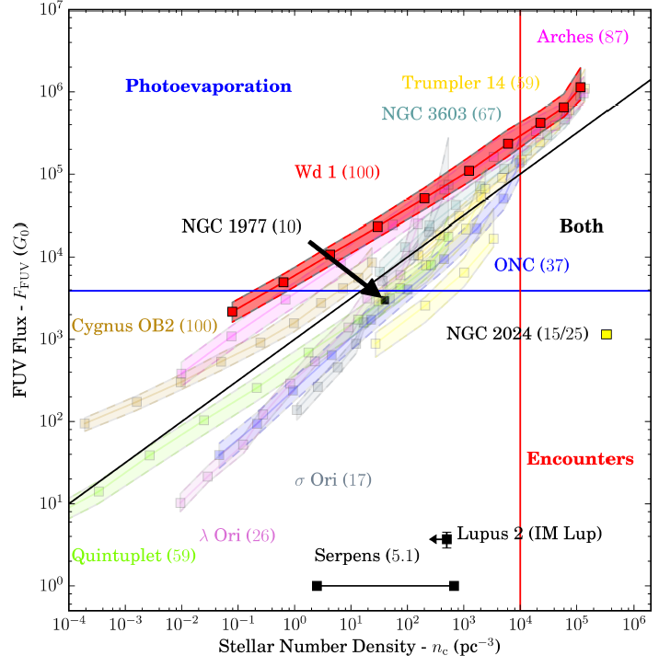
PHOTOEVAPORATION VS. CLOSE ENCOUNTERS
Recent models combining photoevaporations and close encounters (Winter+ 2018, 2022)
Stellar number density > 10⁴/pc³ required to have large impact on discs population
Two stages:
Embedded stage: Flyby dominate the feedback and set discs initial conditions
Cleared stage: photoevaporation dominate the feedback
FUV vs stellar density in a sample of stellar clusters. All clusters divided into radial bins and values for each bin are marked with squares. Numbers in brackets represent the assumed maximum stellar mass in M⊙
(Winter+ 2018, Haworth+ 2018, Facchini+ 2016)

Slide 17
OPEN QUESTIONS
What is the impact on planet formation? Can induced pressure traps survive longer to facilitate planetesimals formation?
What is the effects of spirals in dust aggregation vs. fragmentation?
How long triggered warps survive? Do they efficiently shadow the disc? Does this impact thermal profile, snowlines, etc…?
What the impact on the FuOri and ExOri phenomena?
If a disc has already formed planets, what is the impact of flybys?

