Slide 1
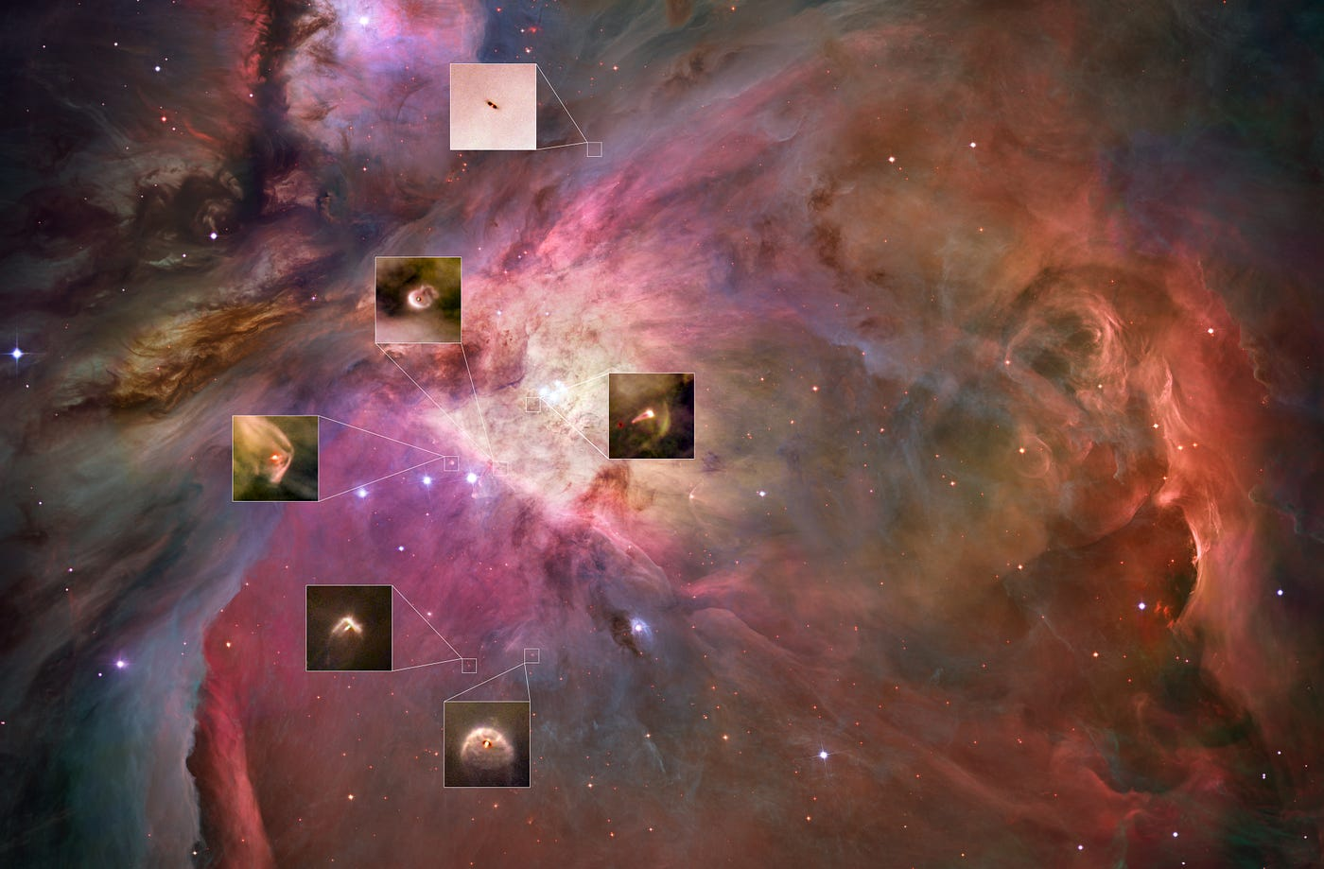

Disk populations and their evolution in various galactic environments
Low Metallicity
Mario Giuseppe Guarcello
INAF
Osservatorio Astronomico di Palermo

Slide 2
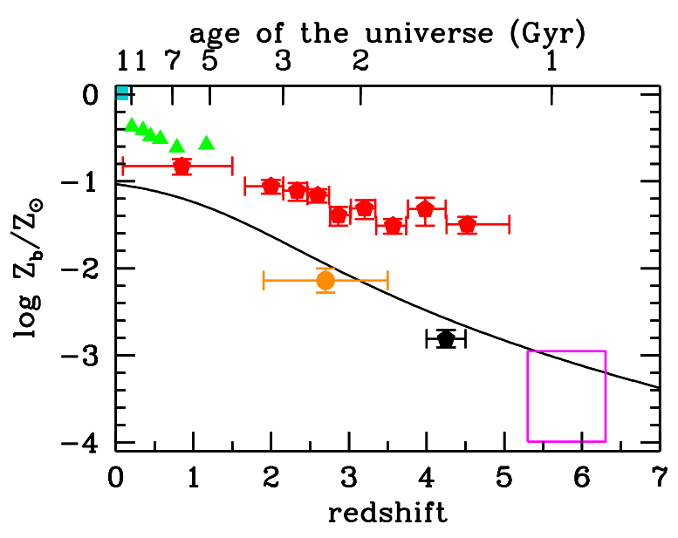
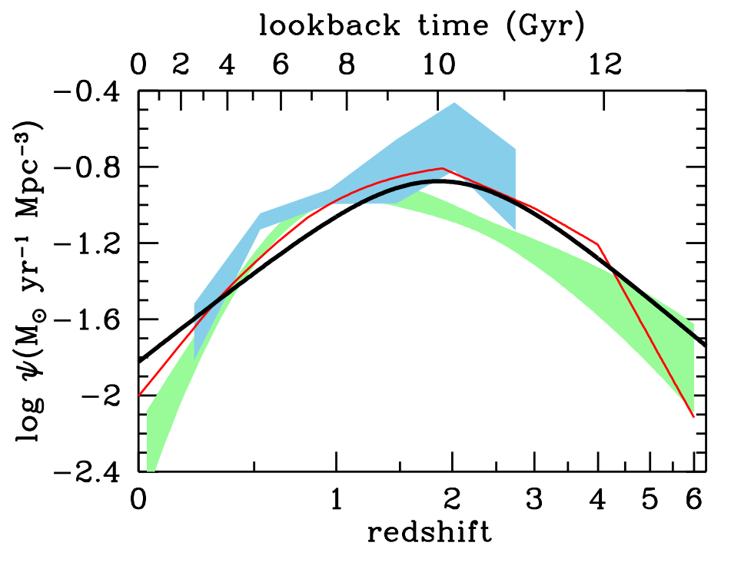
METALLICITY vs. COSMIC TIME
Mean metallicity vs. redshift.
Solid line: model from Madau+2014
Green: galaxy clusters (Balestra+2007)
Red: from Lyα absorption (Rafelski+2012)
Orange and black: IGM metallicity (Aguirre+ 2008; Simcoe+2011)
Turquise: local from SDSS (Gallazzi+2008)
SF history vs. redshift.
Solid line: model from Madau+2014
Red: BH accretion history (Shankar+ 2009)
Green: SF history from Aird+ 2010
Blue: SF history from Delvecchio+ 2014

Slide 3
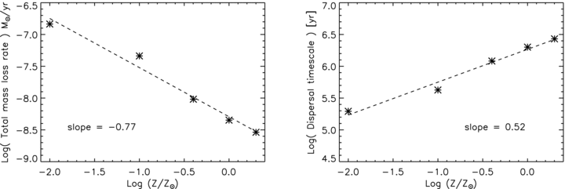
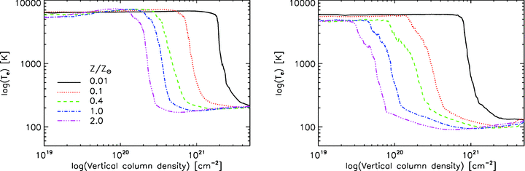
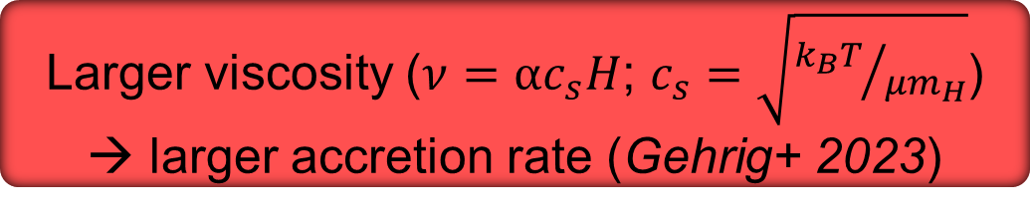
PREDICTIONS AT LOW METALLICITY: ACCRETION AND LIFETIME
higher ionization fraction → larger accretion rate and photoevaporation (Hosokawa & Omukai 2009, Ercolano & Clarke 2010)
Less efficient dust cooling → Higher gas temperature (Dopcke+ 2013)
Larger viscosity ($ν=αc_{s}H$; $c_{s}=\sqrt{{k_{B}T}/{μm_{H}}}$) → larger accretion rate (Gehrig+ 2023)
Mass loss rate and disc lifetime vs. metallicity. Mainly disc dispersal drivers: internal photoevaporation and planet formation
(Ercolano & Clarke 2010)
Gas temperature at 5 (left) and 20 (right ) AU at different metallicities
(Ercolano & Clarke 2010)

Slide 4

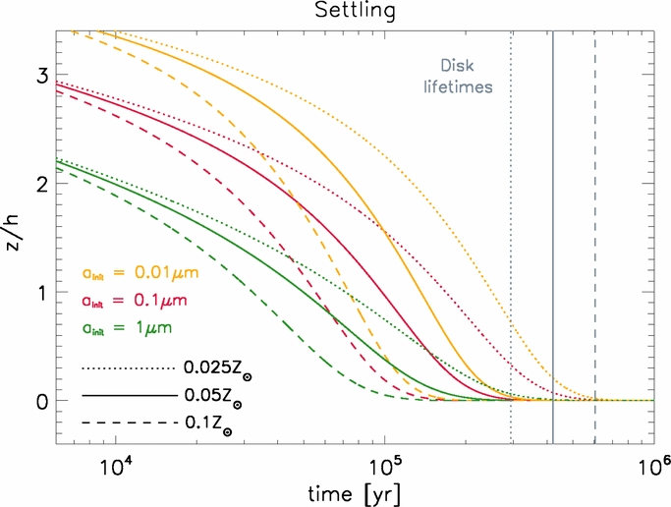
PREDICTIONS AT LOW METALLICITY: DUST EVOLUTION
At low and super-low Z, vortex trapping+dust growth allows for efficient planetesimals formation. Vortices produced by instabilities (Eriksson+ 2025, Carrera+ 2025)
Low metallicity → less efficient solid clumping (Johansen+2009)
Z≥0.1Z_{ʘ}: dust reaches maximum cm-size, almost no growth at ⁓100 AU. Minor dust-gas coupling, more efficient SI
(Matsukoba+ 2024, arxiv)
Dust settling timescale at low Z suggests a critical metallicity lower limit for planet formation (0.025-0.05Z_{ʘ})
(Johnson & Li 2012)

Slide 5
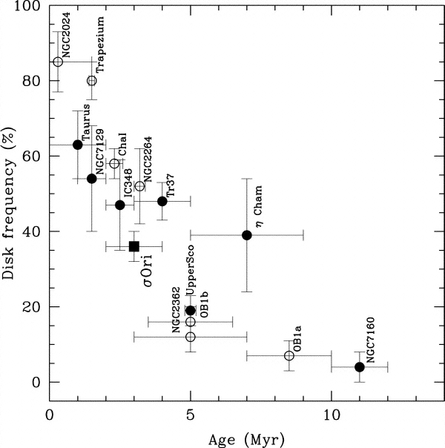
OBSERVATIONS AT LOW METALLICITY: DISC FRACTION
Testing metallicity effects on discs lifetime by disc fraction
The fraction of cluster members that still host a disc declines with the age of the cluster, and it can be used to estimate the intensity of the environment feedback
Caveats:
Accurate membership of both disc-less and disc-bearing stars
Completeness
Star formation history
Decline of the disc fraction with the cluster age (Hernandez+2007)

Slide 6
OBSERVATIONS AT LOW METALLICITY: DISC FRACTION
Stars with discs
IR excesses from disc thermal emission
Spectroscopic diagnostics of accretion
Disc-like variability (variable extinction, accretion bursts)
SED analysis (model dependent)
Stars without discs
Intense X-ray activity (discarding discs)
Lithium abundance (discarding discs)
Cluster dynamics (discarding discs)
Statistical analysis of diagrams

Slide 7
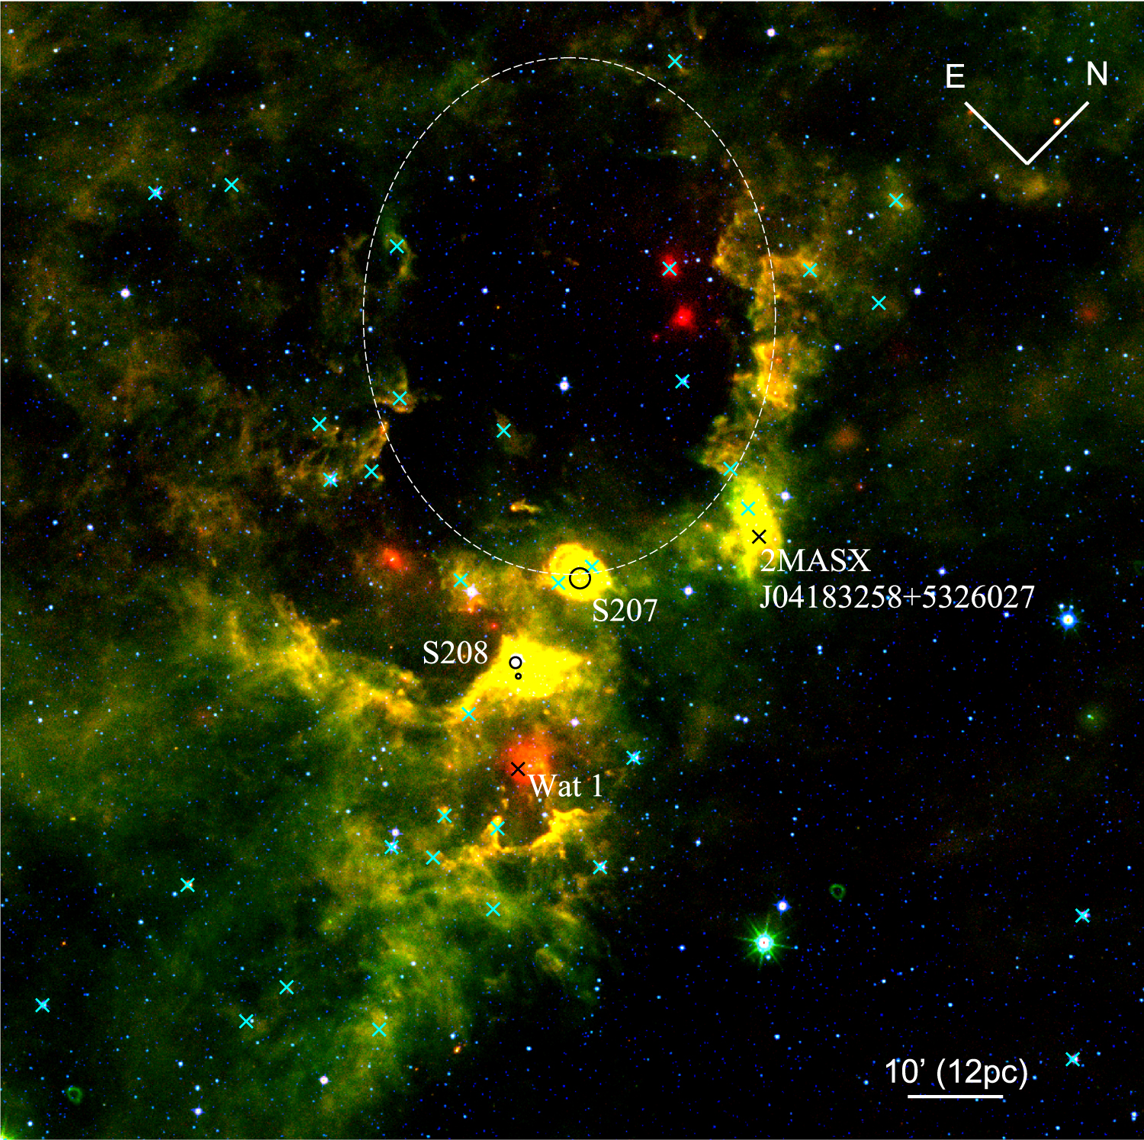
LOW METALLICITY IN THE MILKY WAY: NIR EXCESSES
SH 2-208
[O/H]=-0.8 dex; 0.5 Myrs, 11.5 kpc
Disc Fraction: 27%±6% (Yasui+2016)
Sh2-127
[O/H]=-0.7 dex; 0.5-1 Myrs, 10 kpc
Disc Fraction: 28%±3% (S217A) and 40%±4% (S127B)
(Yasui+2021)
WISE image of the region containing
Sh2-207 and Sh2-208

Slide 8
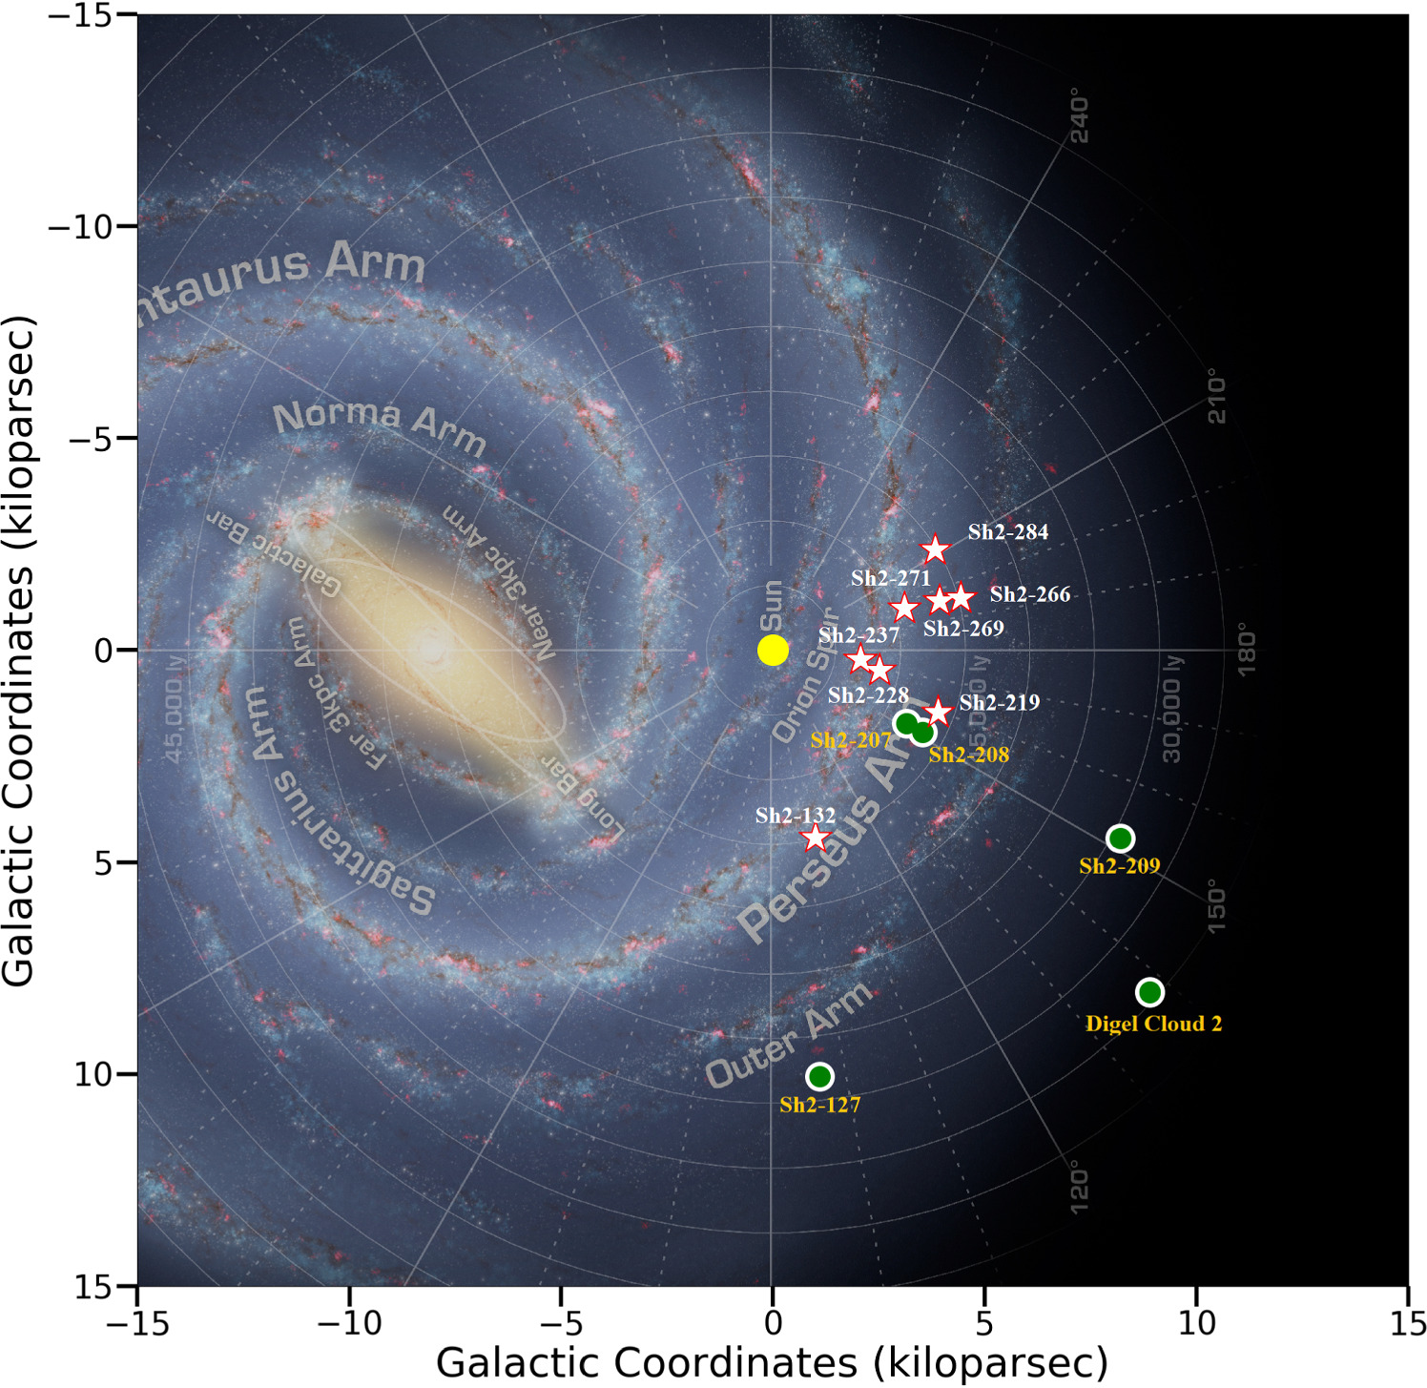
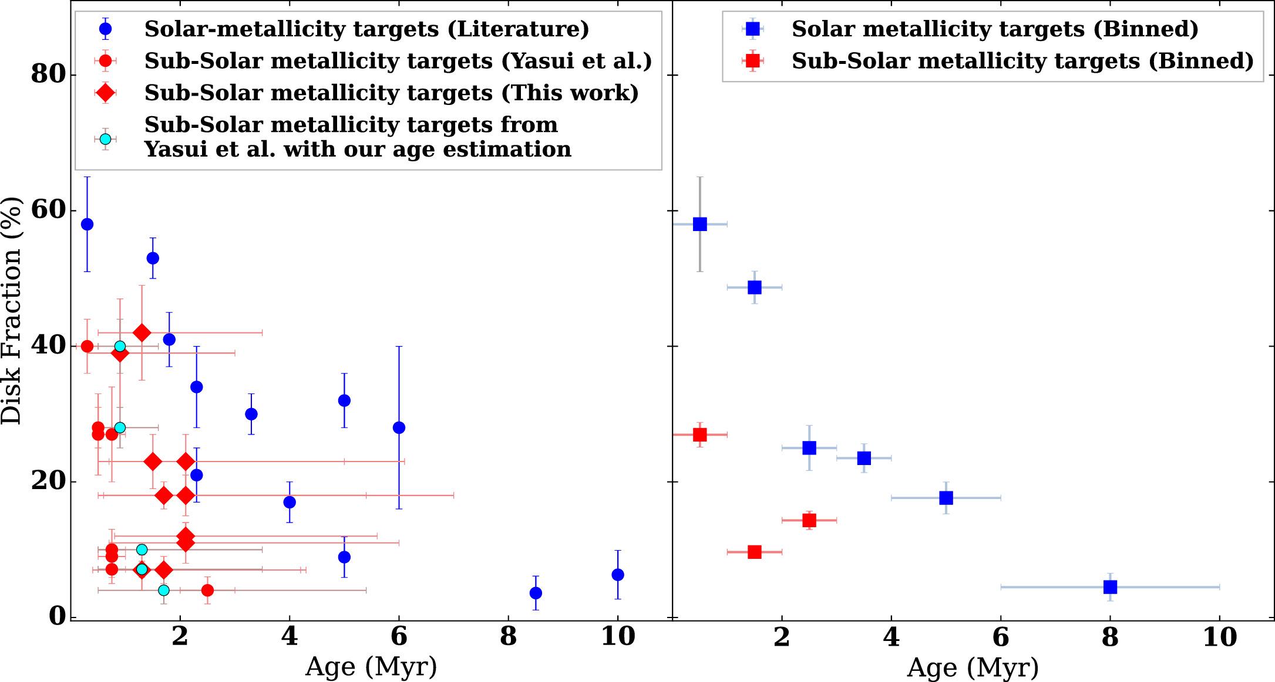
LOW METALLICITY IN THE MILKY WAY: NIR EXCESSES
18 regions with 0.25-0.85 Z_{ʘ}
Disc fraction on average 2.6±0.2 times smaller than coeval clusters (Patra+2024)
Left: position of the low-Z Sharpless regions in the Milky Way
Top: Disc Fraction in low-Z and solar-Z regions

Slide 9
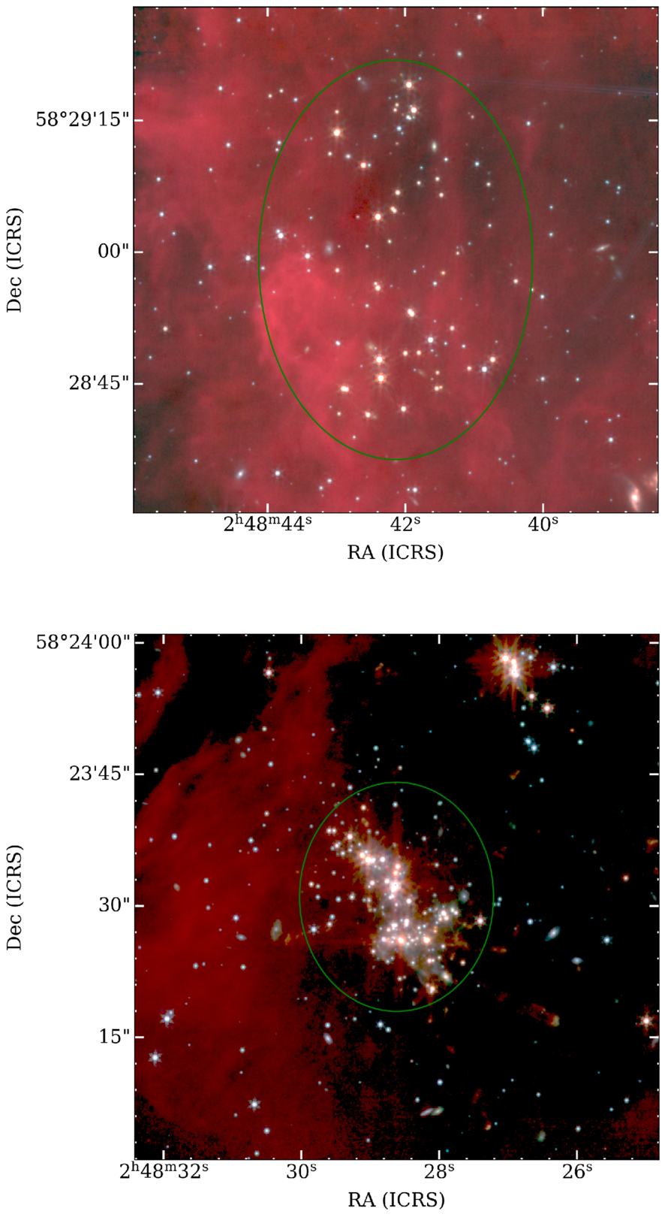
IMPORTANCE OF MEMBERSHIP
Digel 2 Cloud
Distance 10 kpc
[O/H]=-0.7 dex (LMC -0.5, SMC -0.9)
Dust to gas ratio 0.001; 10 times smaller than Solar neighborhood (Ruffle+ 2007)
Age 0.5 Myrs (Yasui+ 2006)
Disc Fraction:
9%±4% (Cloud 2-N) and 27%±7% (Clouds 2-S)
(Yasui+ 2009 using SUBARU)
74%±15% and 81%±17%
(Yasui+2026, using JWST)
JWST/NIRCam images of Cloud 2-N (left) and Cloud 2-S (right)

Slide 10
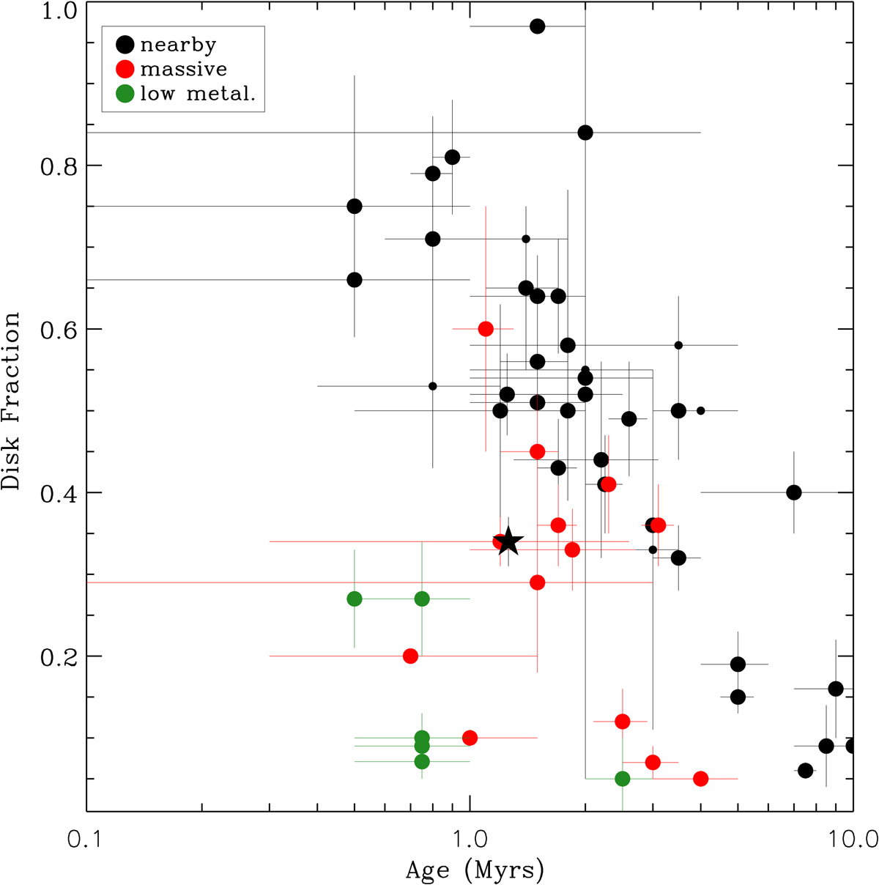
THE ONLY NEARBY LOW-Z SFR: Sh2-284 WITH DOLIDZE25
Sh2-284 and Dolidze25
Z=1.5 Z_{ʘ}
1-2 Myrs, 4.5 kpc
Disc fraction ⁓34%
(Guarcello+ 2021)
Disc fraction in solar-metallicity SFRs, massive SFRs and low-Z SFRs
(Guarcello+2021)

Slide 11
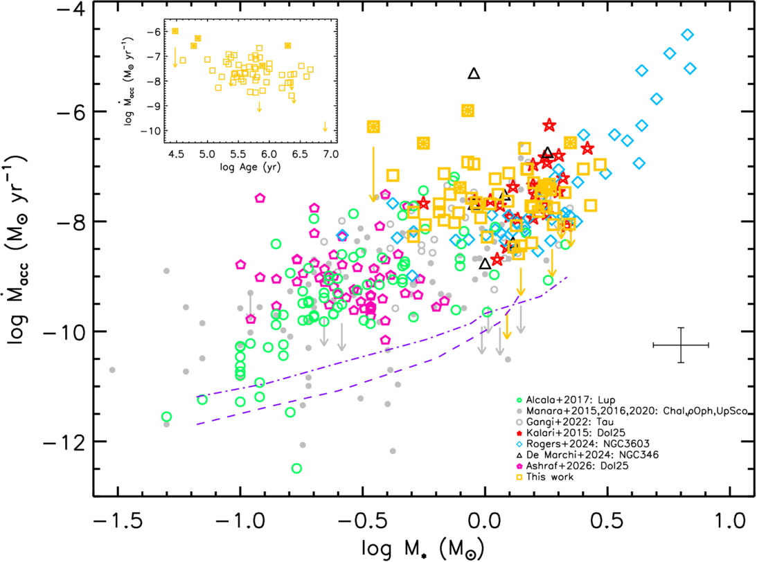
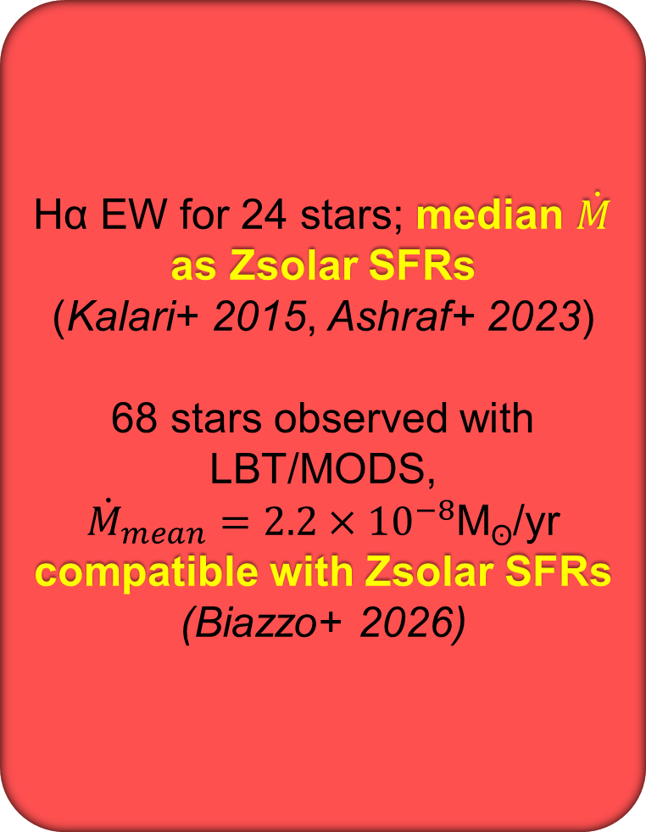
THE ONLY NEARBY LOW-Z SFR: Sh2-284 WITH DOLIDZE25
Hα EW for 24 stars; median $\dot{M}$ as Zsolar SFRs
(Kalari+ 2015, Ashraf+ 2023)
68 stars observed with LBT/MODS,
${\dot{M}}_{mean}=2.2×{10}^{−8}$M_{ʘ}/yr
compatible with Zsolar SFRs
(Biazzo+ 2026)
Accretion rate in Dolidze25 and a set of solar-metallicity SFRs
(Biazzo+2026)

Slide 12
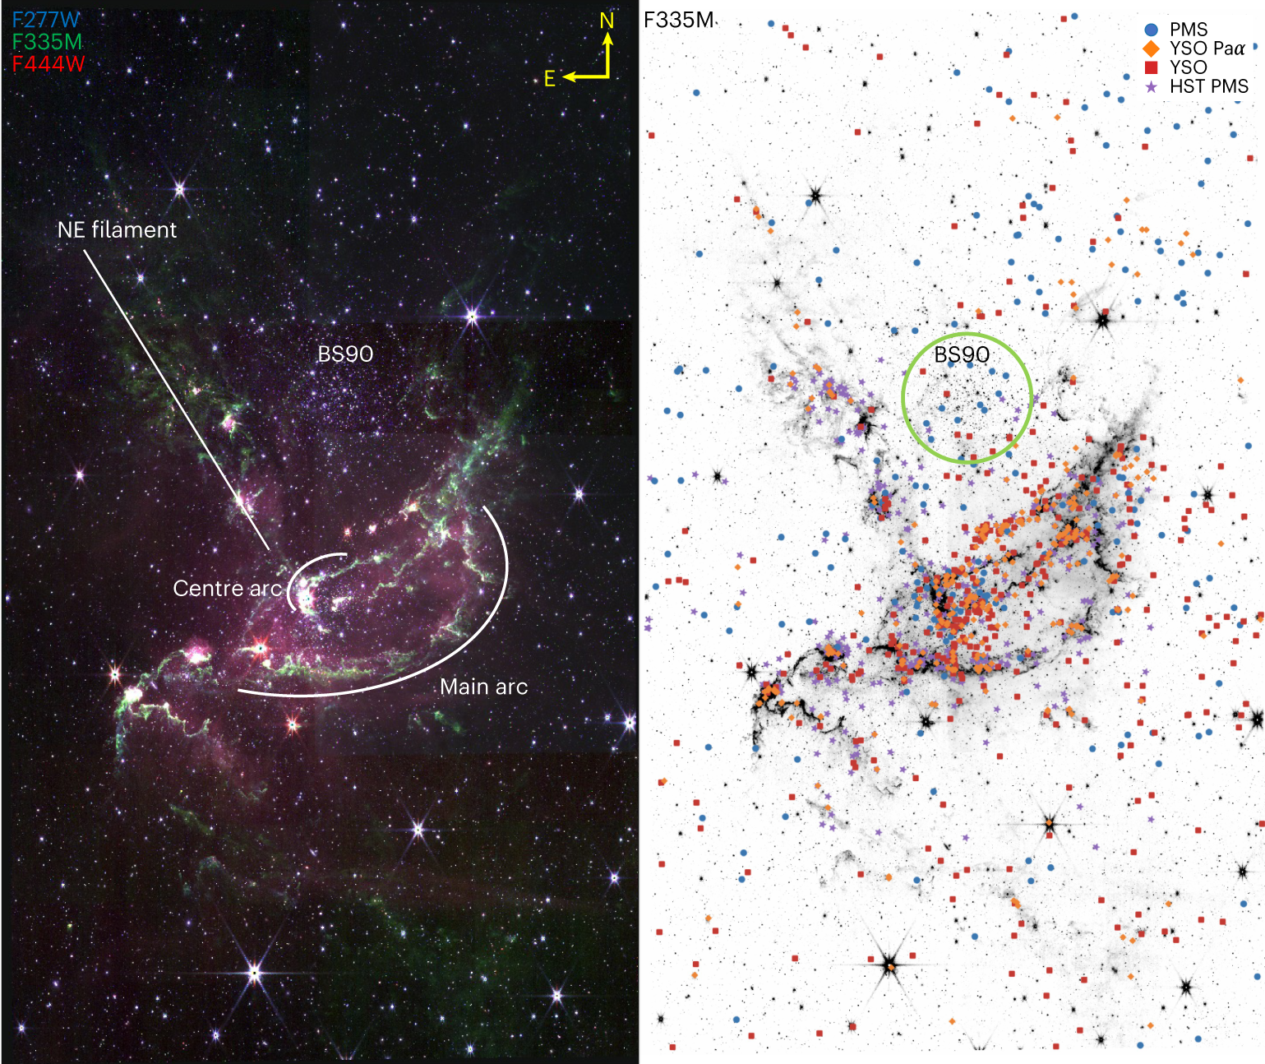
DISCS IN THE MAGELLANIC CLOUD
NGC346 (SMC)
3 Myrs, 62 kpc
30 massive (35-100 M_{ʘ}) stars
From JWST/NIRCam and MIRI observations:
>500 stars with discs down to 0.1 M_{ʘ} (Jones+ 2023)
833 stars with discs down to 0.4 M_{ʘ} (Habel+2024)
Rich disc-bearing population despite Z=0.2Z_{ʘ}
NIRCam image and selected stars with discs
(Jones+ 2023)

Slide 13
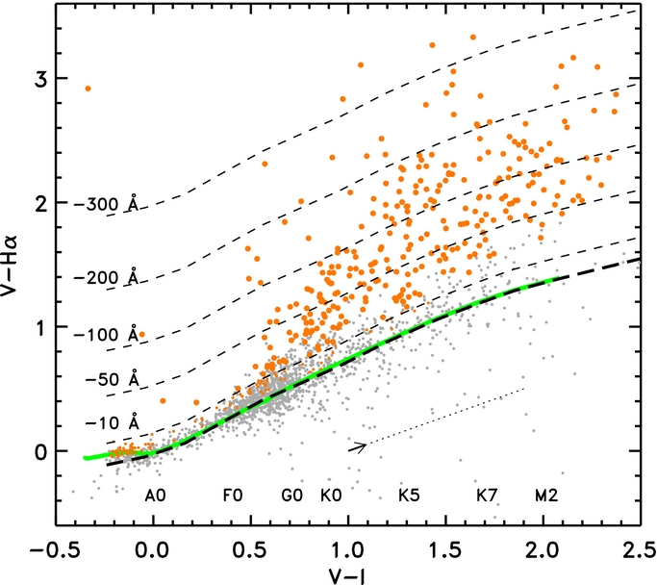
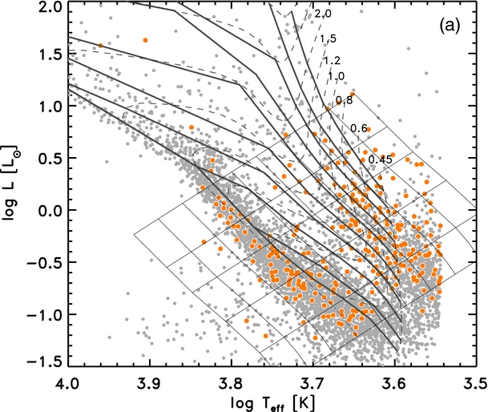
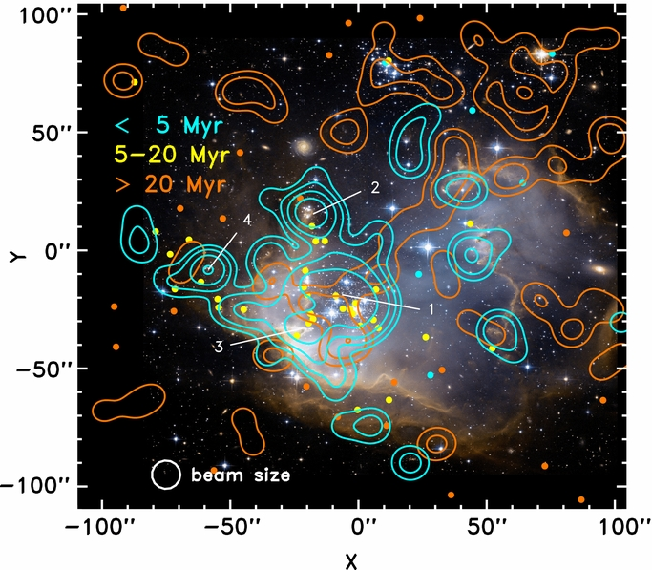
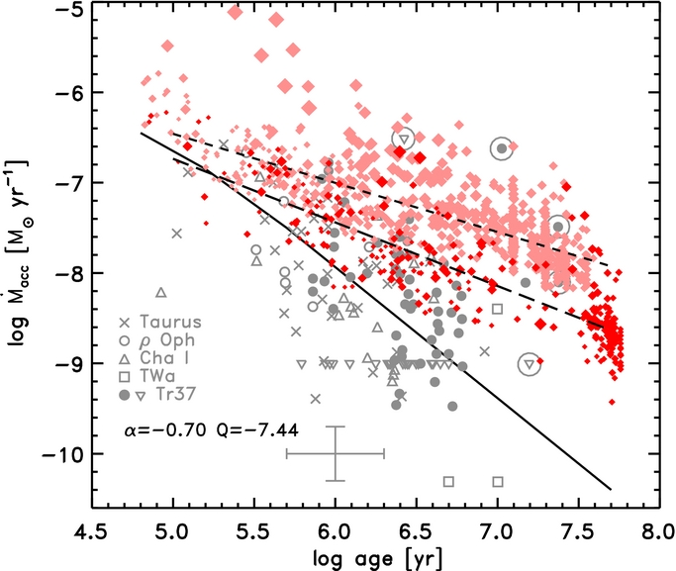
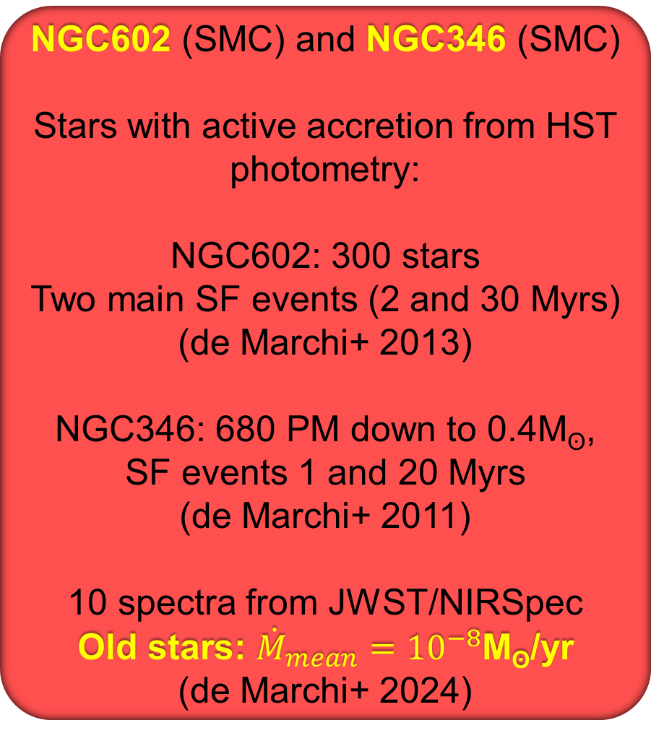
LONGER ACCRETION IN SMC
NGC602 (SMC) and NGC346 (SMC)
Stars with active accretion from HST photometry:
NGC602: 300 stars
Two main SF events (2 and 30 Myrs)
(de Marchi+ 2013)
NGC346: 680 PM down to 0.4M_{ʘ},
SF events 1 and 20 Myrs
(de Marchi+ 2011)
10 spectra from JWST/NIRSpec
Old stars: ${\dot{M}}_{mean}={10}^{−8}$M_{ʘ}/yr
(de Marchi+ 2024)
Selection diagram and HR diagram of stars in NGC602
Spatial distribution in NGC602; accretion rate of NGC206 (red) and NGC346 (pink) (de Marchi+ 2013)
Notes:
Derived mass accretion rates as a function of the age of the PMS stars. Dark diamonds (red in the online version) are for stars in NGC 602, whereas light gray diamonds (pink in the online version) are for the PMS objects in NGC 346. In both cases, the size of the symbols is proportional to stellar mass. The long- and short-dashed lines are the best linear fits to the observed distributions in NGC 602 and NGC 346, respectively (the slope α and intercept Q at 1 Myr are given for NGC 602). The other symbols, as per the legend, correspond to a sample of Galactic T-Tauri stars studied by Sicilia-Aguilar et al. (2006), with their typical uncertainty shown by the large cross at the bottom (the large circles around some of the symbols indicate dwarfs of spectral type G in the Trumpler 37 sample). Their distribution, in spite of the large scatter, is consistent with the models of viscous disk evolution of Hartmann et al. (1998) shown by the solid line.

Slide 14
DF vs. ACCRETION
IN LOW METALLICITY CLUSTERS DF SEEMS TO DECLINE FASTER AS A CONSEQUENCE OF SHORTER DISC LIFETIME
IN LOW METALLICITY CLUSTERS ACCRETION IN STARS WITH DISCS ACCRETION LAST LONGER THAN AT SOLAR METALLICITY

Slide 15
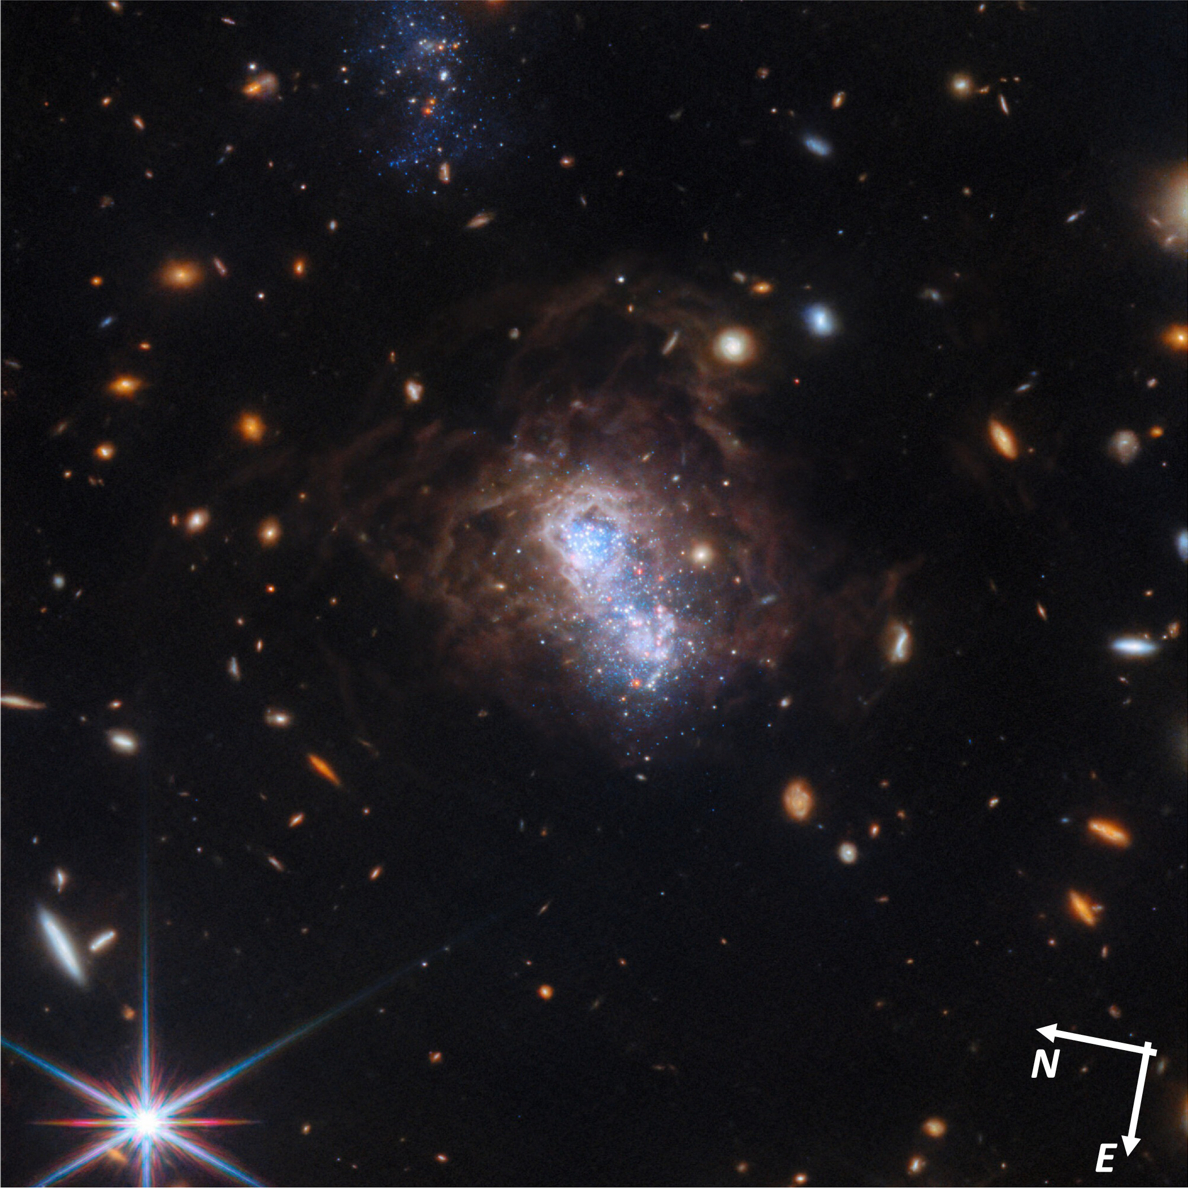
STAR FORMATION HISTORY IN LOW-Z NEARBY GALAXY I Zw 18
JWST observations of the low-Z (⁓3% Z_{ʘ}) galaxy I Zw 18 in the local group (Hirschauer+ 2024)
Three main SF episodes: > 1 Gy (halo); 100-800 Myr (SE SFRs), < 30Myrs (NW SFRs)
The galaxy is currently experiencing its strongest SF episode
15 embedded actively accreting YSOs identified
(Bortolini+ 2024)

Slide 16
OPEN QUESTIONS
What is true disc survival at low-Z?
At low-Z is disc dispersal dominated by internal photoevaporation or viscous accretion?
Can solid grow at low-Z? Are SI efficient? Is there a critical low-Z for planet formation
How does low-Z affect affect snow-lines?
Do low-Z protoplanetary discs produce different molecular budget than solar Z?

