Slide 1
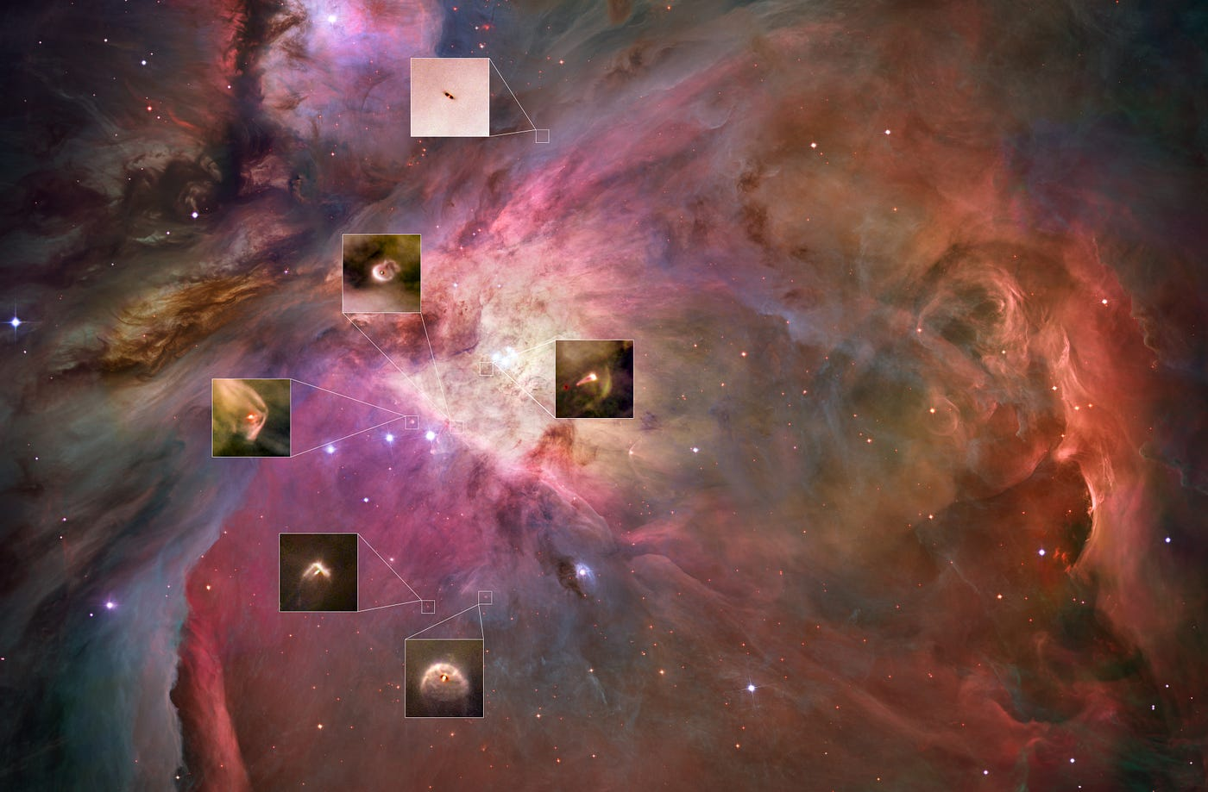

Disk populations and their evolution in various galactic environments
Late Accretion
Mario Giuseppe Guarcello
INAF
Osservatorio Astronomico di Palermo

Slide 2
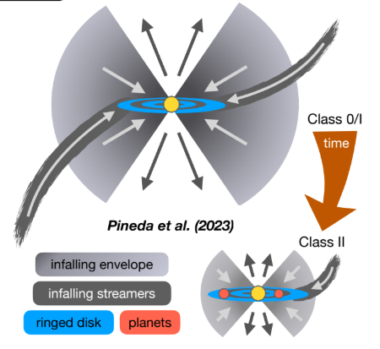
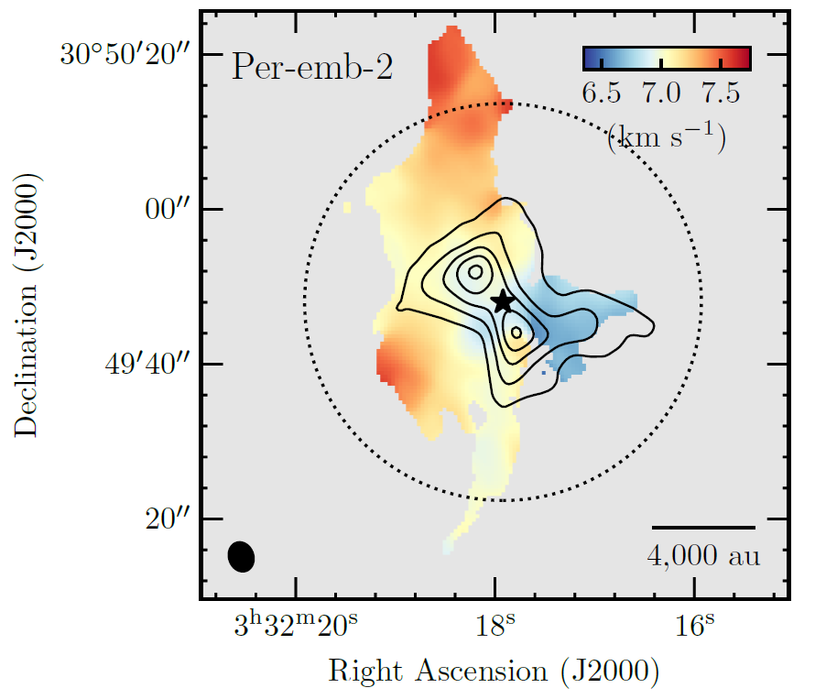
STREAMERS ON YOUNG STARS
Infall from the ambient on YSOs at various stage
Kinematic structure of streamers: smooth velocity gradient+rotation
Class 0:
Streamers driving accretion on the protostars observed since Spitzer
Example, protostar Per-emb-2 in Perseus (NOEMA,Pinada+ 2020):
Streamer size ≈10000 AU
Infall rate 10⁻⁶ M_{ʘ}/yr
Scheme of accretion streamers from the ambient
Long scale streamers around Per-emb-2.
Dense core emission (contours) traced by N₂H⁺ integrated intensity

Slide 3
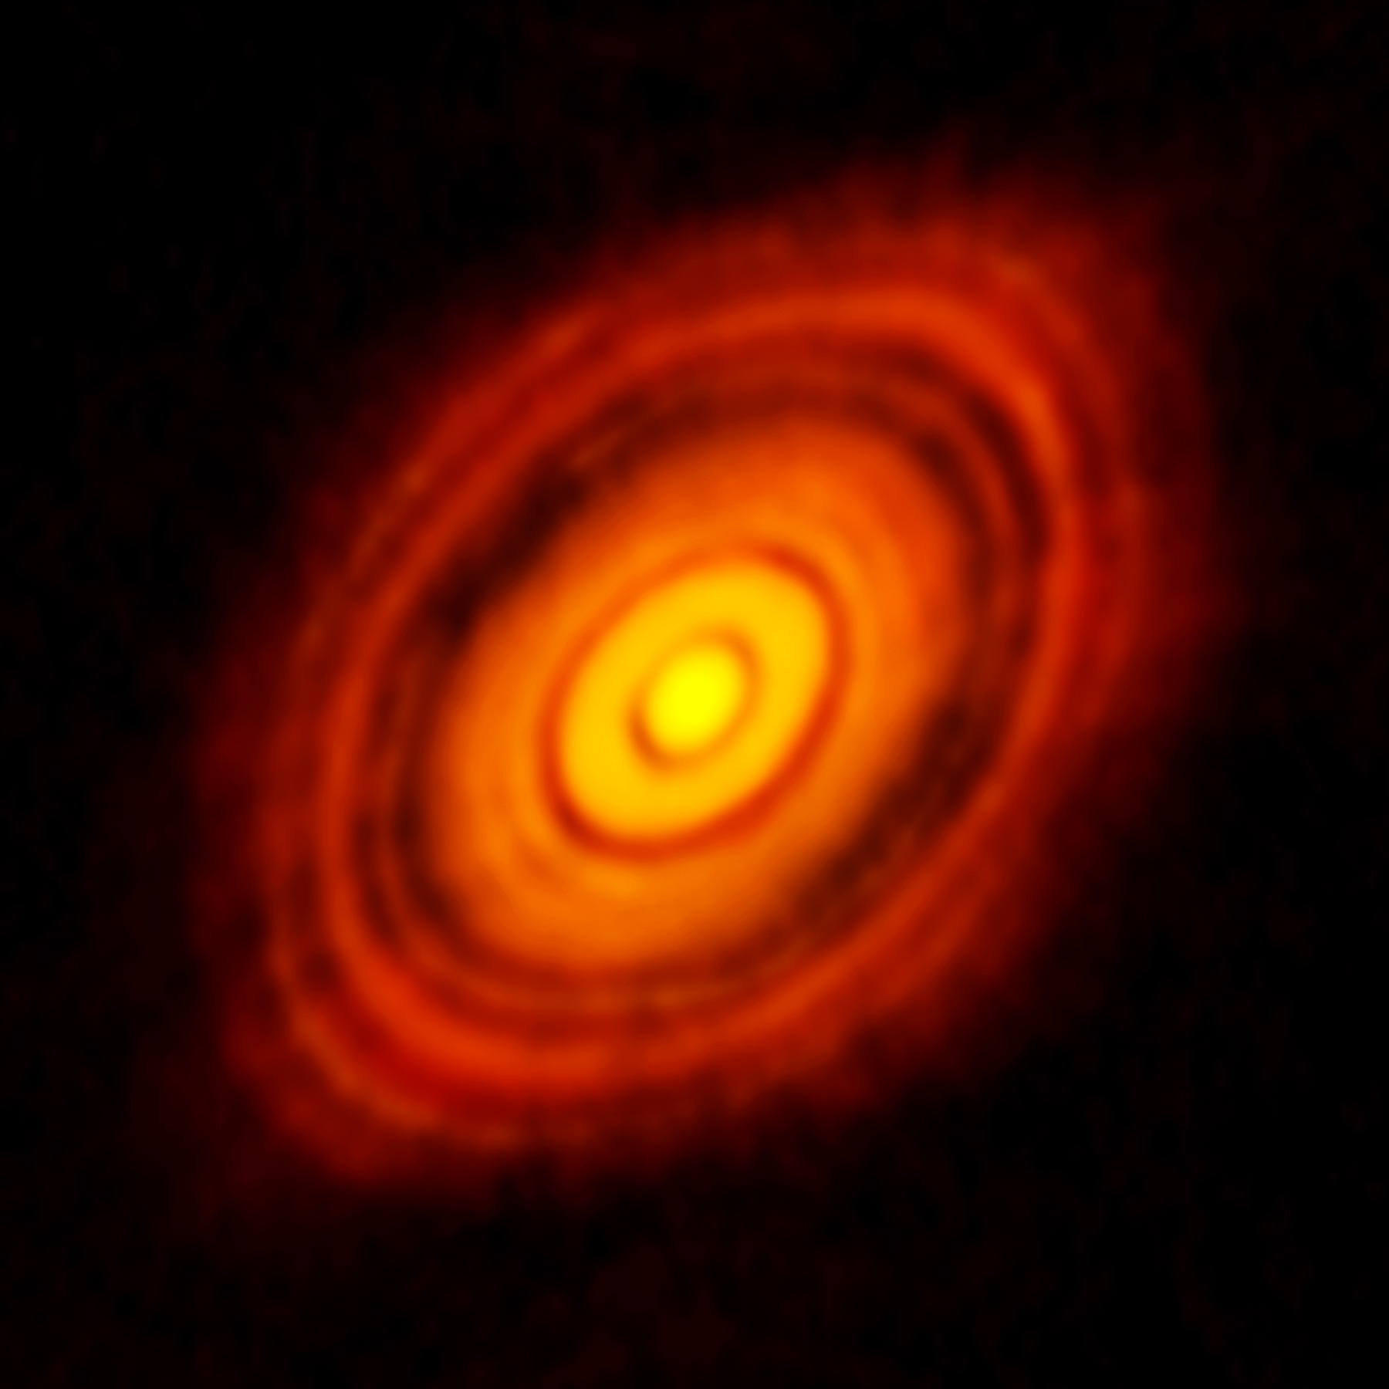
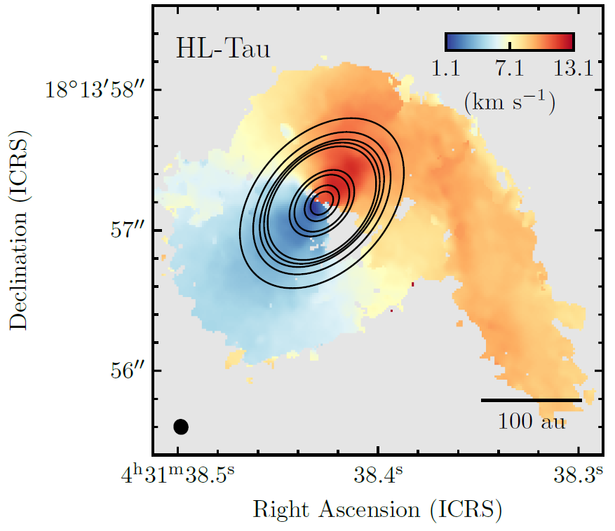
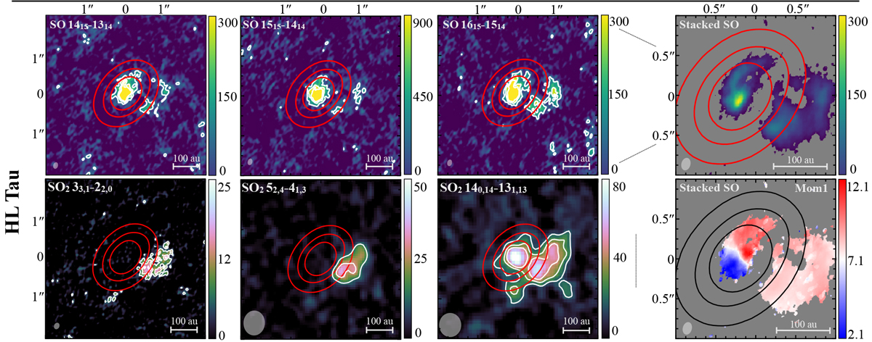
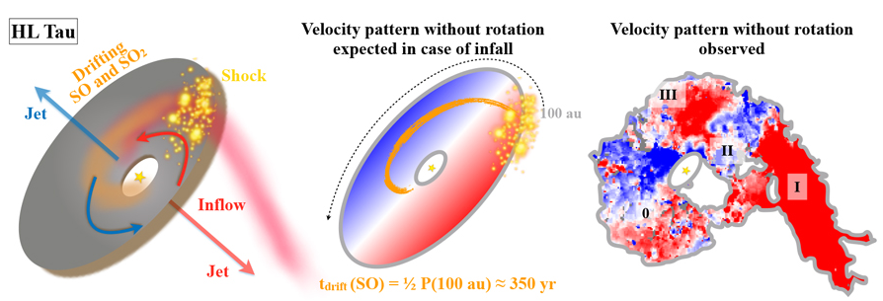
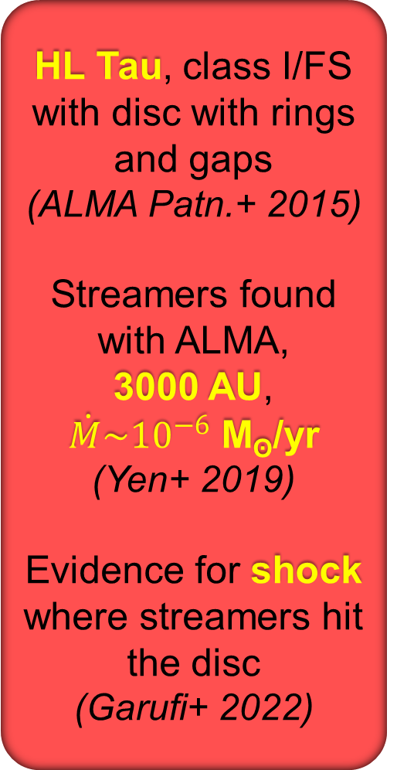
STREAMERS ON CLASS I: HL TAU
HL Tau, class I/FS with disc with rings and gaps
(ALMA Patn.+ 2015)
Streamers found with ALMA,
3000 AU,
$\dot{M}\sim {10}^{−6}$ M_{ʘ}/yr
(Yen+ 2019)
Evidence for shock where streamers hit the disc
(Garufi+ 2022)
Streamer and disc in HL Tau
Centroid from HCO+ (contours)
(Yen+ 2019)
Top: moment 0 at SO and SO₂, stacked moment o and 1 in the right panels
Bottom: Illustrative sketch of the environment in HL Tau and the position of the streamers shocks
(Garufi+ 2022)

Slide 4
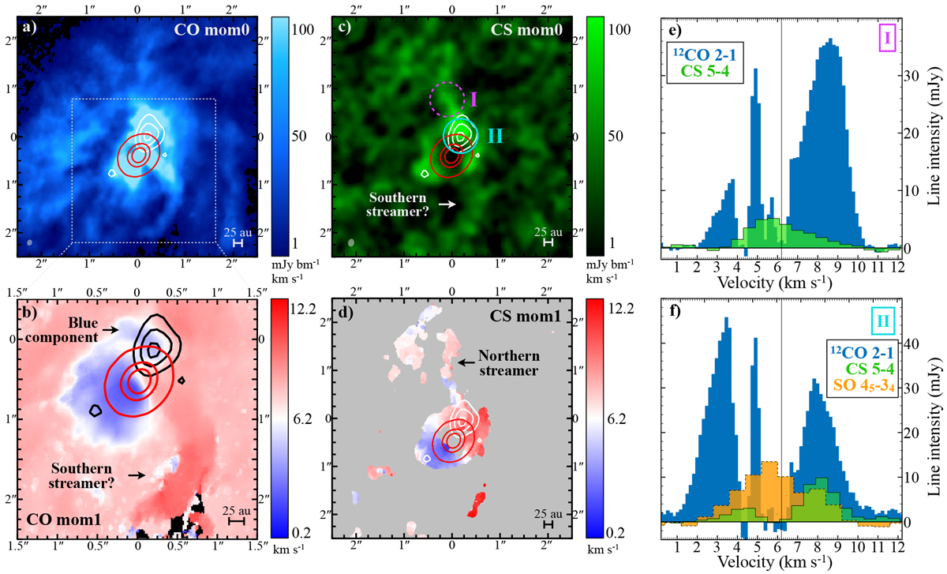
STREAMERS ON CLASS II: DG TAU
Streamers detected in class II objects
DG Tau: complex environment in ¹²CO
a blueshifted streamer in the NW, where disc is reshifted
a possible redshifted arm in the South
SO emission where NW streamer impacts the disc
(Garufi+ 2022)
Moment-0 and moment-1 ¹²CO and CS maps of DG Tau streamers.

Slide 5
LATE ACCRETION: THE IMPORTANCE OF ANGULAR MOMENTUM
The falling material this does not fall onto the star, but tries to orbit around it
Arc-shaped accretion stream
Captured cloudlet carry very high specific angular momentum with respect to the star
Star has no disc
Late-accretion disc
Tilted inner disc (Dullemond+ 2019)
falling material has a very different angular momentum
Star has a disc
Spirals (Hennebelle+ 2017)

Slide 6
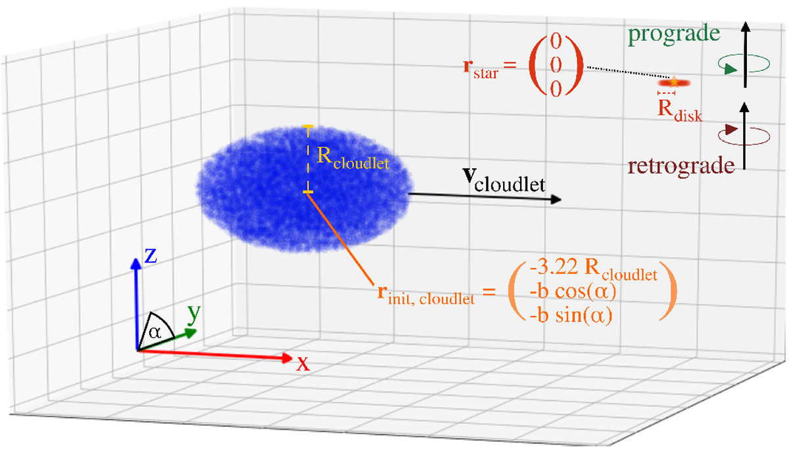
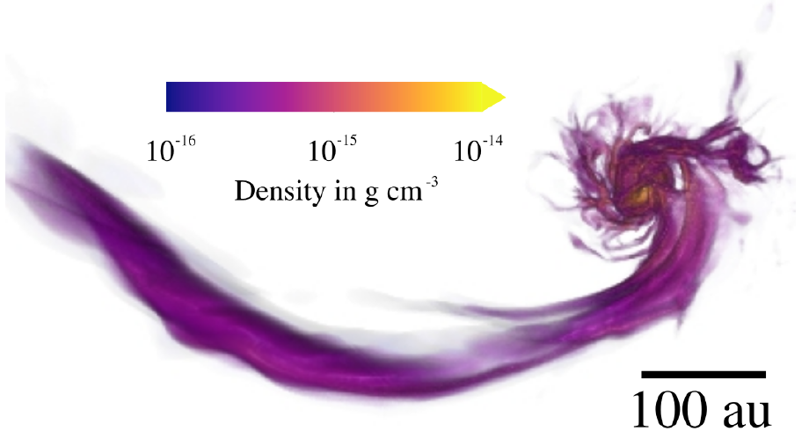
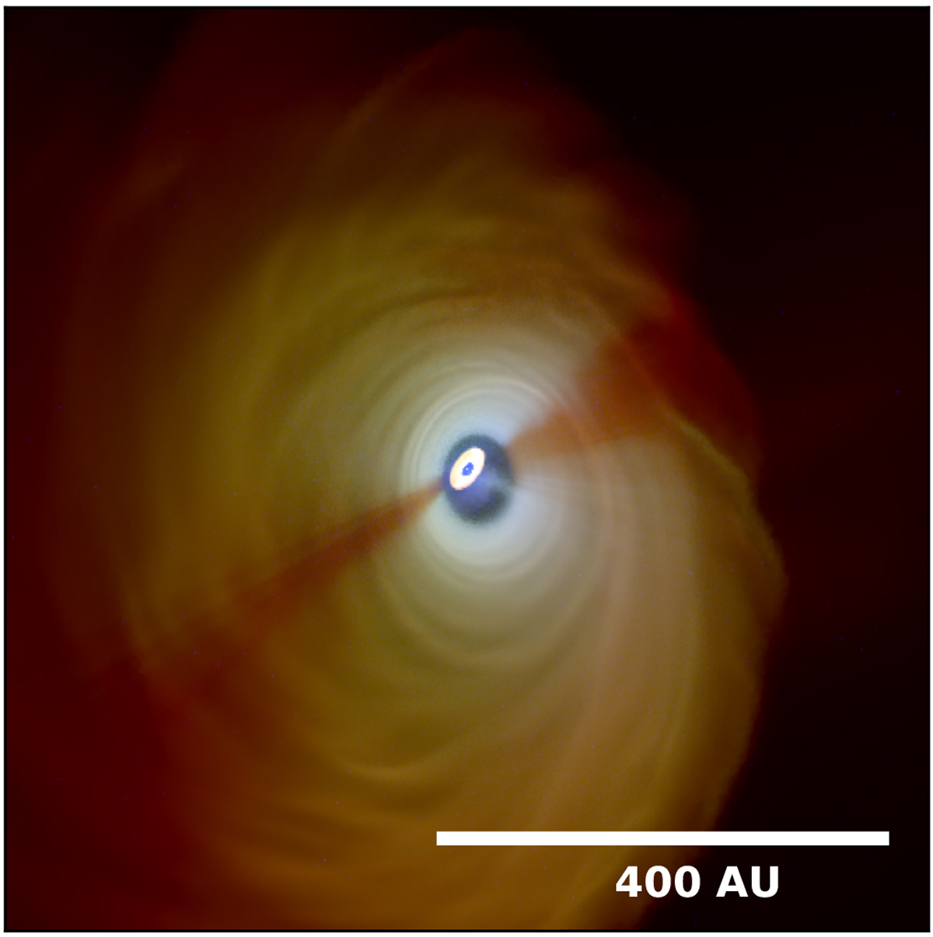
LATE ACCRETION AND 2° GENERATION DISC
Simulated accretion of incident cloudlet by a 2.5 M_{ʘ} star (Kuffmeier+ 2021) producing an accretion stream and an inclined disc
Initial setup
Resulting streamer and second generation disc
Simulated inclined inner disc casting shadows

Slide 7
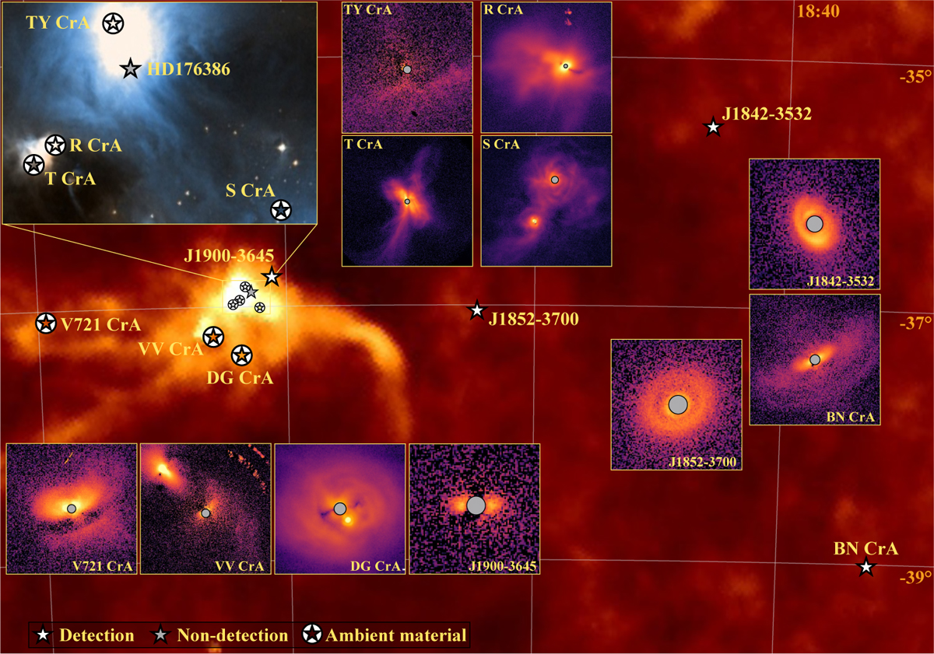
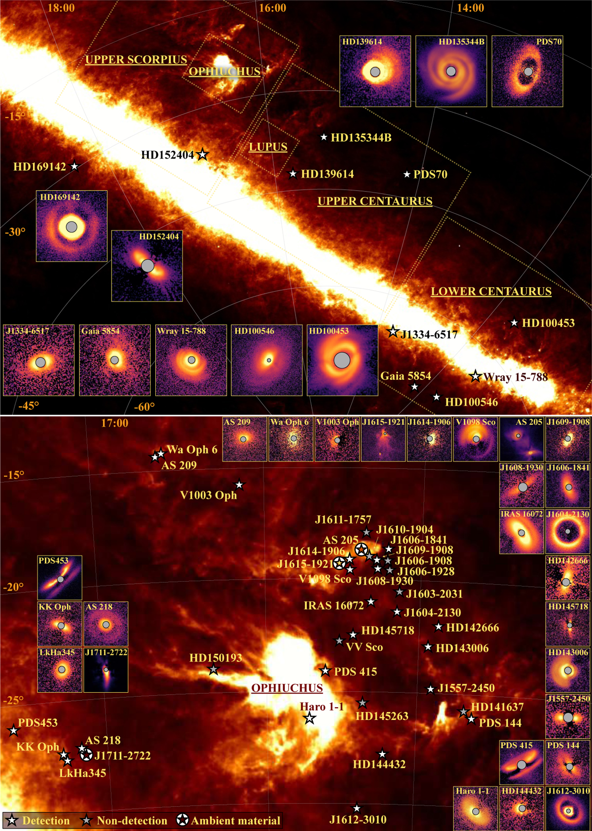
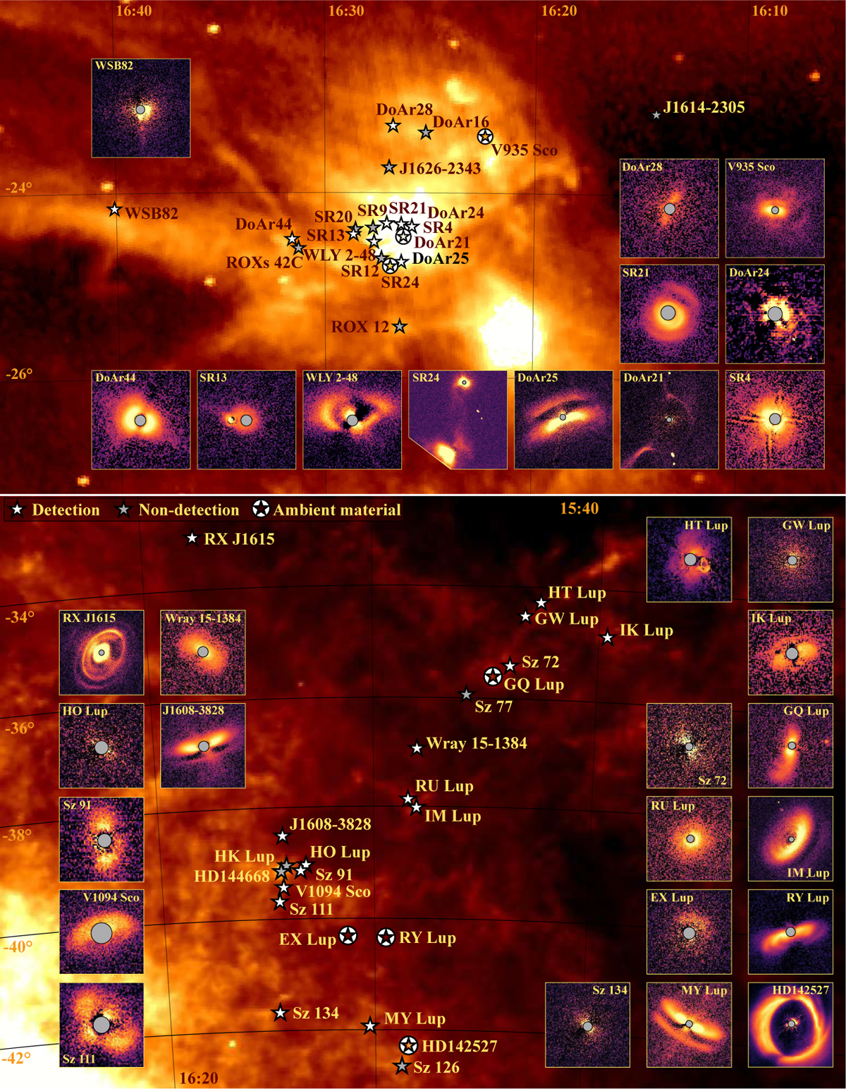
STREAMERS, NIR EXCESS AND VARIABILITY
Ophiucus
Corona Australis
268 resolved discs
(Garufi+ 2026)
Centaurus
Lupus

Slide 8
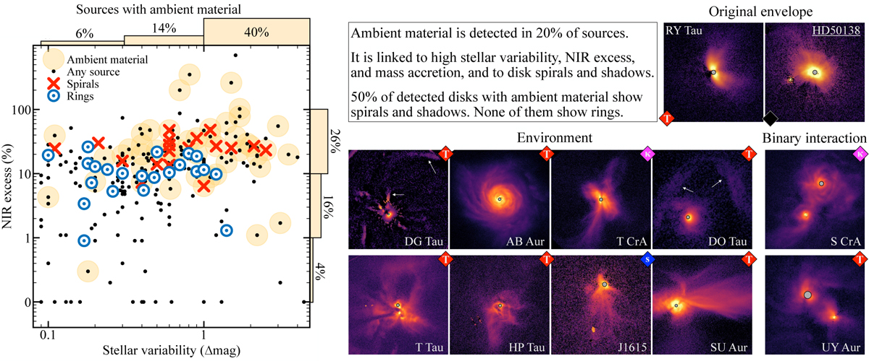
STREAMERS, NIR EXCESS AND VARIABILITY
Ambient material detected in 20% of sources, 50% have spirals
Frequency drops with time:
⁓25% 1-3 Myrs, ⁓0% >8 Myrs
Ambient material related to larger NIR excess and variability (Garufi+ 2026)
A sample of sources with ambient material
NIR excess and variability of sources in the survey

Slide 9
STREAMERS, NIR EXCESS AND VARIABILITY
Late accretion
Replenishment with not processed dust
Maintain high dust surface density
In accretion shock in the disc kinetic energy is converted into heat
Higher disc temperature
Angular momentum of accreting material
Warps and disalignment
Accretion on the disc is not steady
Variable accretion rate
Larger NIR excesses
Larger variability

Slide 10
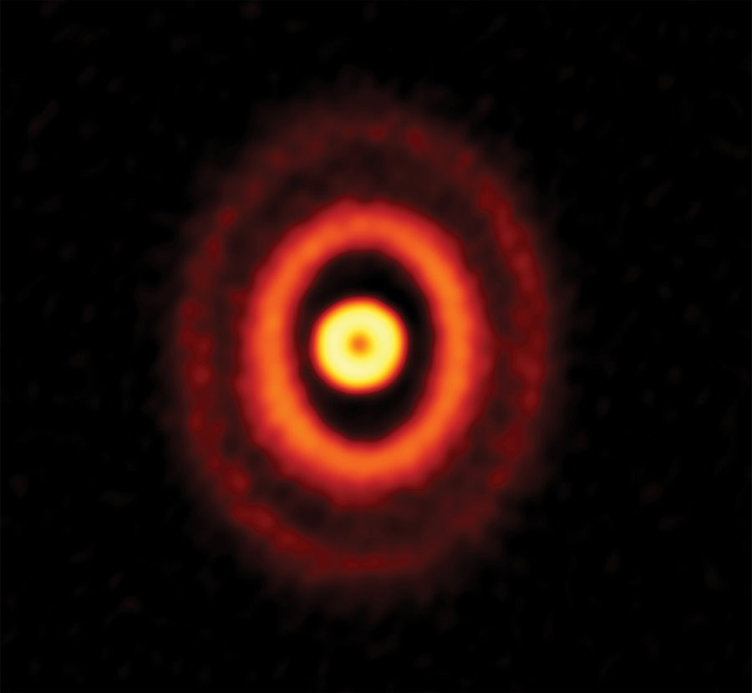
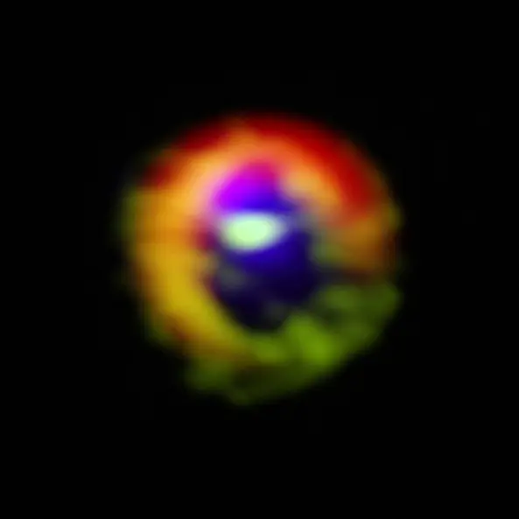
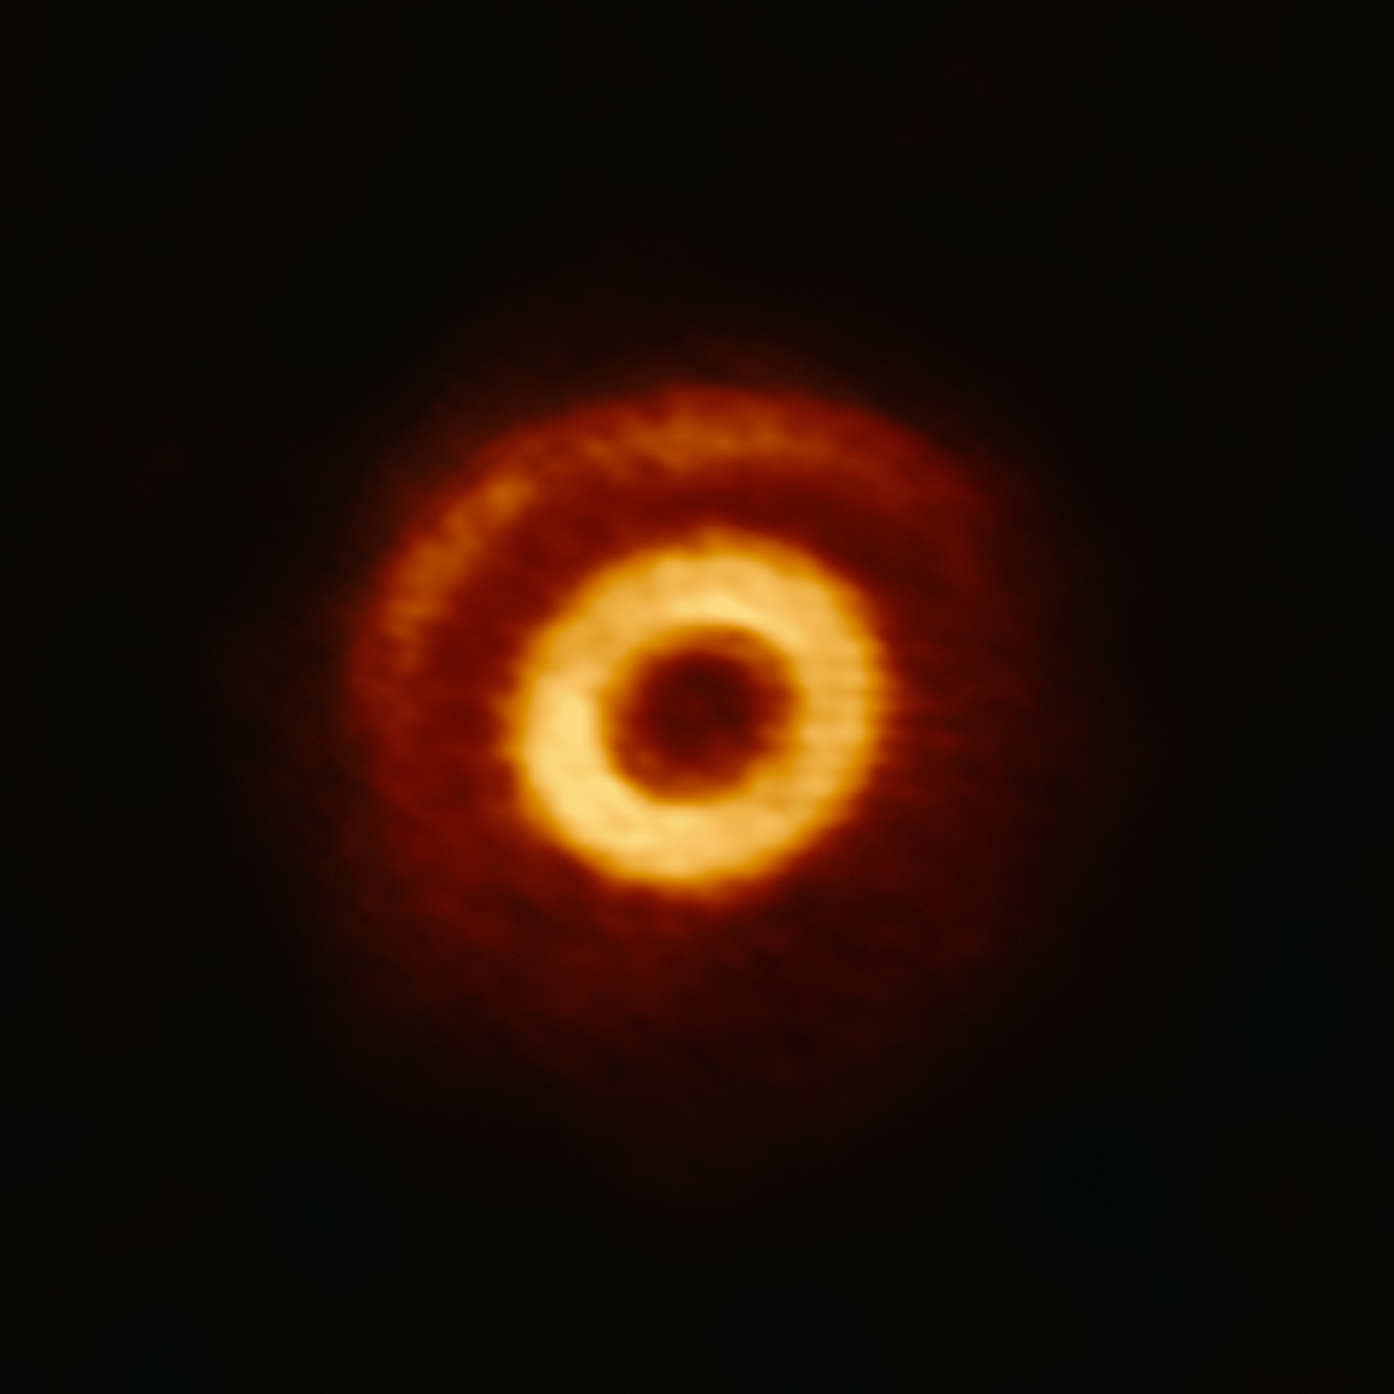
LATE ACCRETION AND MISALIGNED DISC
A few misaligned inner disc (sometime casting shadows) have been observed.
Common causes: multiple stellar systems and planets
GW ORI – ALMA
Central triple star system
Kraus+ 2020, Bi+ 2020
HD142527 – ALMA
Tidal interaction with low-mass companion
Marino+2015, Casassus+ 2015
V1247 Ori – ALMA
Inclined giant planet or brown dwarf at ⁓50AU
Kraus+ 2013, 2017

Slide 11
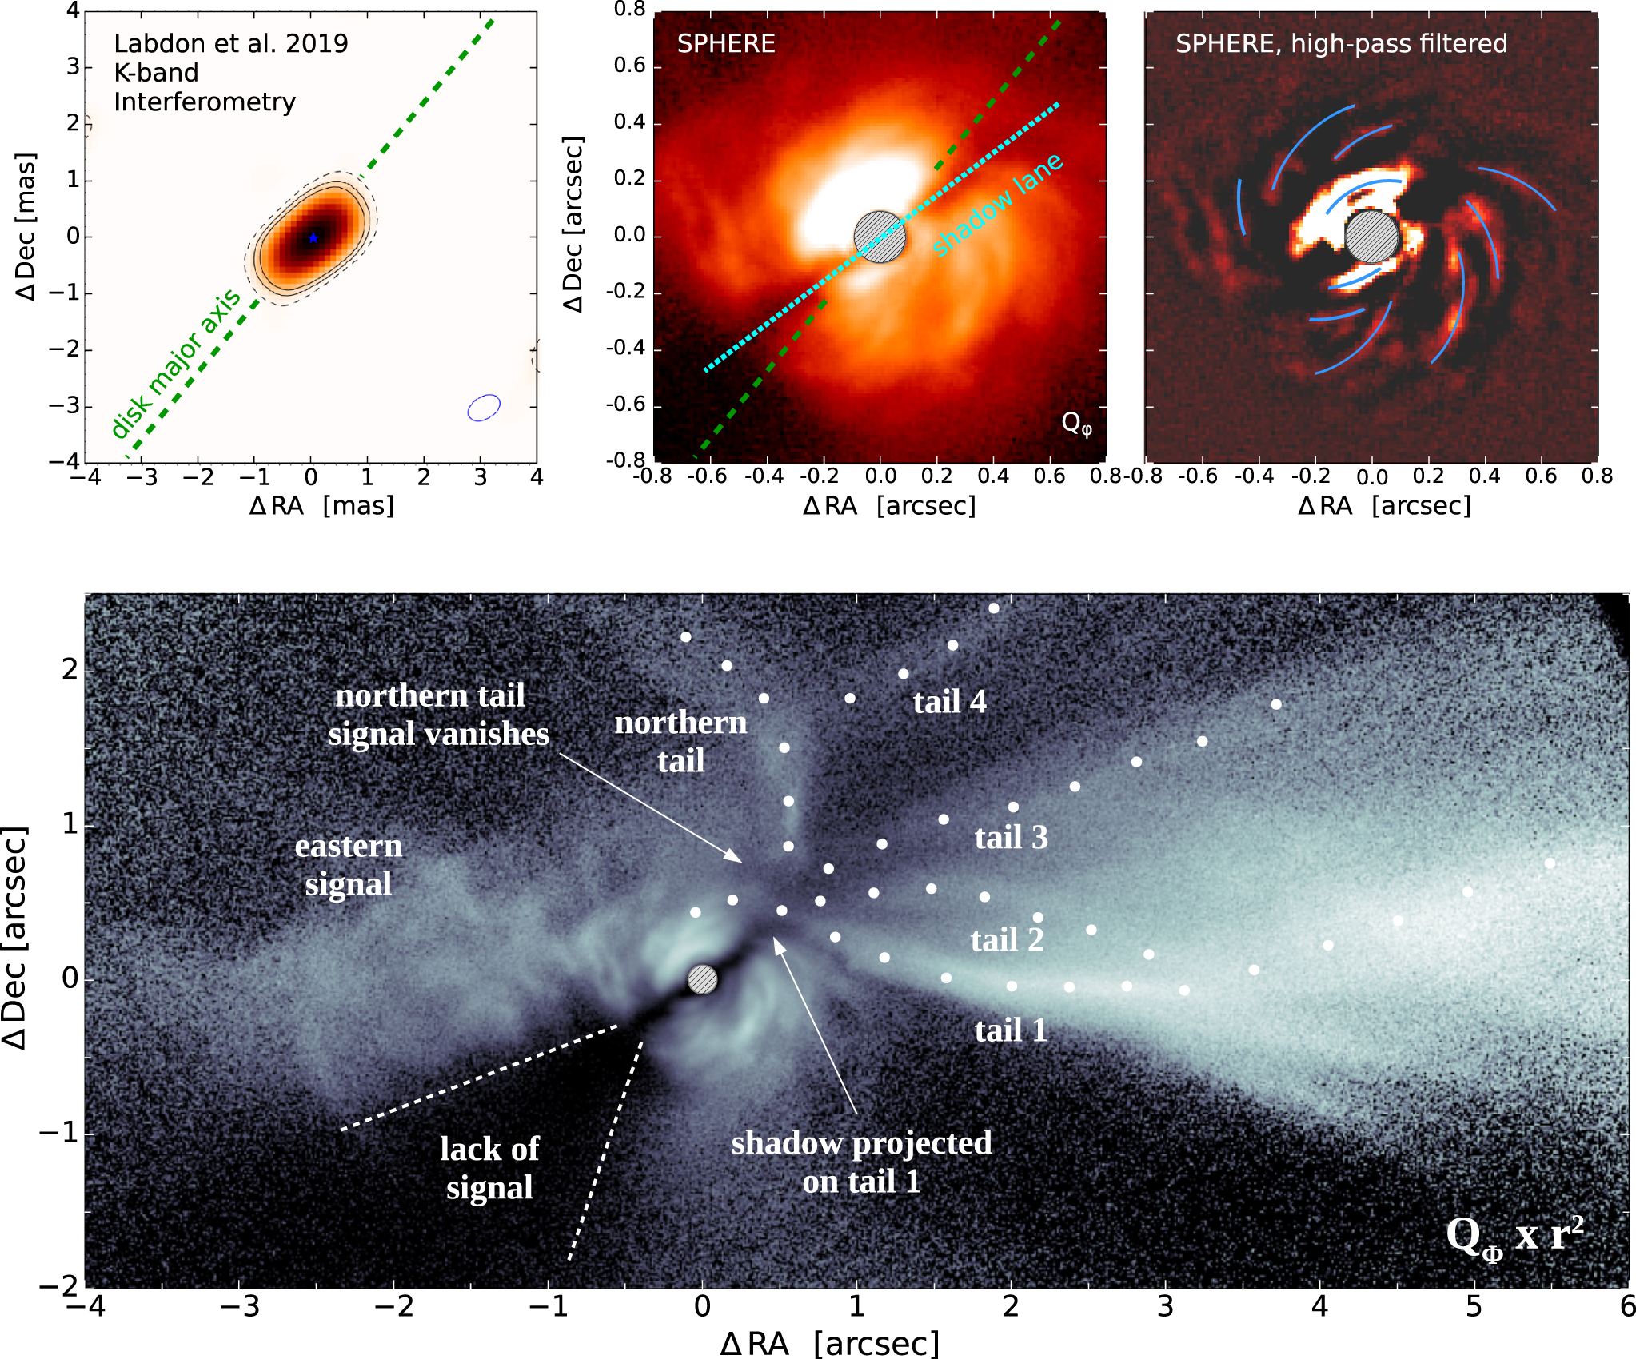
LATE ACCRETION AND MISALIGNED DISC
SU Aur
70° inclined inner disc
Shadows casted on the outer disc
Image in K band (CHARA array) of the inner disc
SPHERE image showing the shadow lane
Detected spirals
NACO K2 image showing surrounding tails
Spirals and misaligned inner disc caused by late infall
a)
b)
c)
d)

Slide 12
LATE ACCRETION AND MASSIVE STARS
Massive stars evacuate the parental cloud quickly, trigger discs photoevaporation, and pollute the surrounding environment
Disc property | Late accretion effect | FUV-dominated environment
Radius | High angular momentum streamers expand outer radii | Photoevaporation disperse discs from outside-in
Mass and lifetime | Disc rejuvenation | Mass removal and short lifetime
Kinematic and structure | Tilted inner disc, warps, twisted velocity map | Inner orientation is preserved
Dust and IR excess | Not-processed dust boost NIR excess | Small dust are removed in wind, gas/dust affected
Accretion and variability | Enhanced, variable accretion and extinction | Not affected
Chemistry | Disc rejuvenation | Impacted by FUV, EUV, cosmic rays

Slide 13
OPEN QUESTIONS
How common is late accretion? How does it depend on environment
Continuous or episodic? On what timescale does it operate?
Can warps and disc misalignment tearing discs apart?
How long warps and disc misalignment survive?
What is the impact on disc dust?
What is the effect on planet formation?
Does late accretion solve the «disc mass paradox»?
What is the connection between late accretion and FuOr/ExOr phenomena?
Does late accretion impact disc chemistry?

