Slide 1
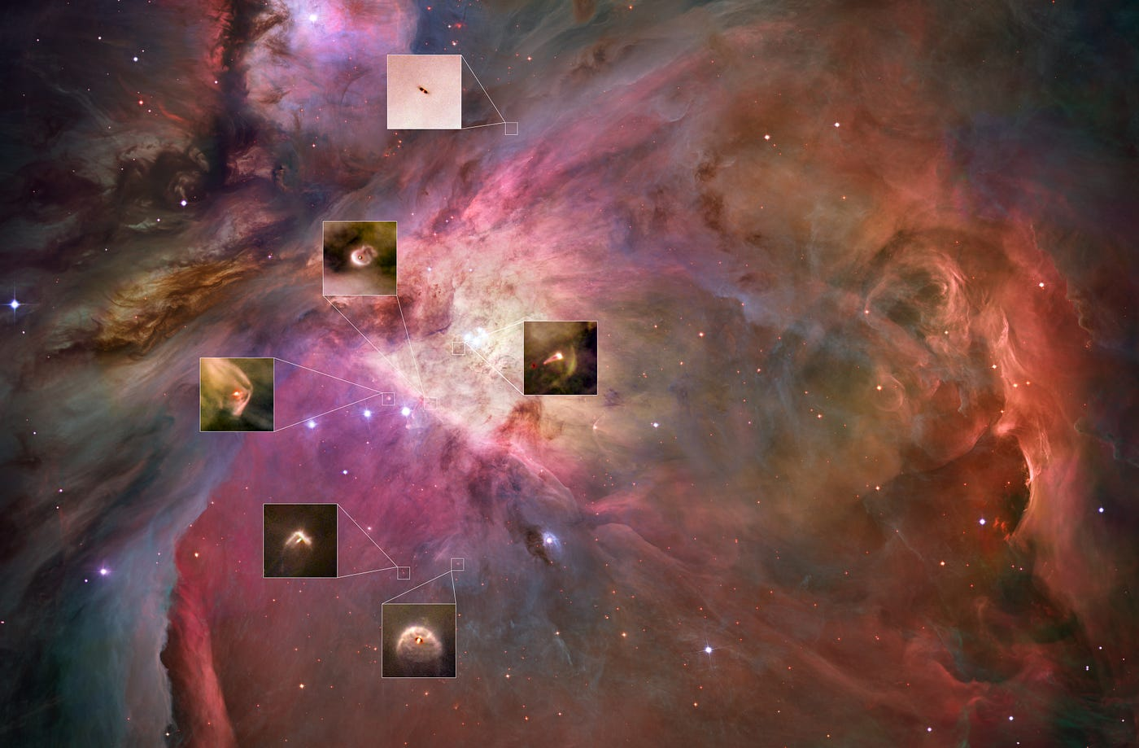

Disk populations and their evolution in various galactic environments
Mario Giuseppe Guarcello
INAF
Osservatorio Astronomico di Palermo
Where to Look?

Slide 2
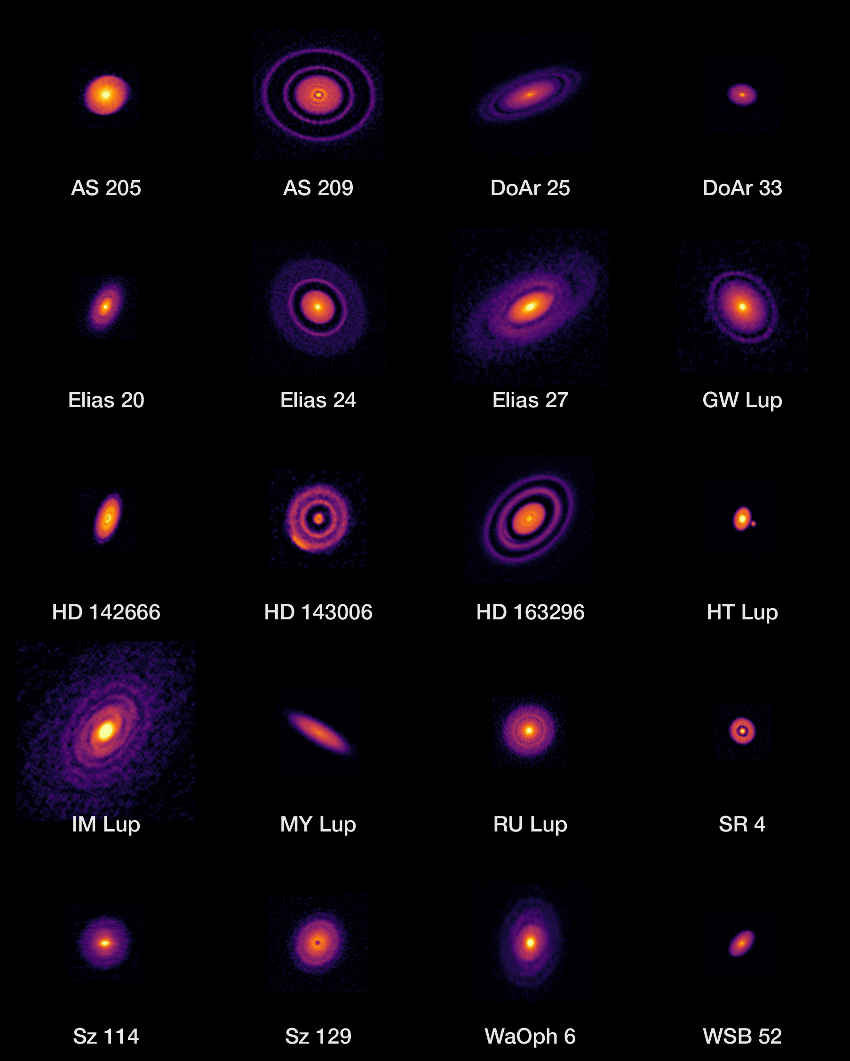
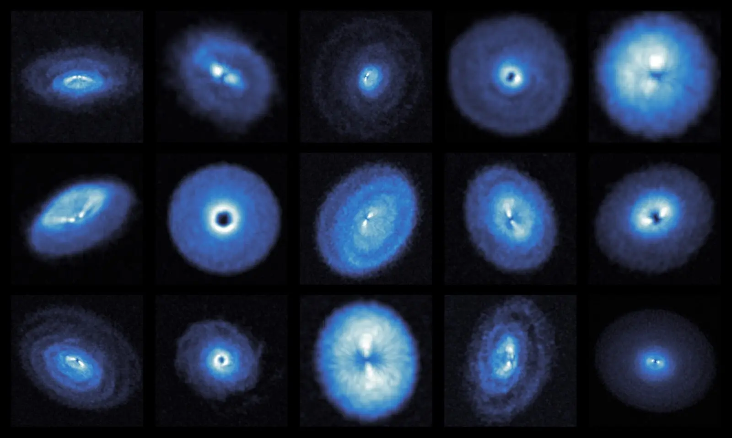
ARE PROTOPLANETARY DISCS ISOLATED?
ALMA observations of discs;
project DSHARP; Andrews+ 2018
¹²CO ALMA images of discs;
Project exoALMA;
Teague+ 2025

Slide 3
ARE DISCS TRULY ISOLATED?
Lada & Lada 2003: 70%-90% of stars formed in clusters
Gutermuth+2009: YSOs (Spitzer) within 1 kpc typically found in dense regions with high surface density
Bressert+2010: YSOs (Spitzer) within 0.5 kpc, 40%-90% found in clusters, <26% found in massive clusters
Andrè+2010: first results from the Gould Belt Survey (Herschel), SF in filaments, where most of dense cores are located
… stars typically do not form in isolation..
… but still an open question (e.g. Ward & Kruijssen 2018)

Slide 4


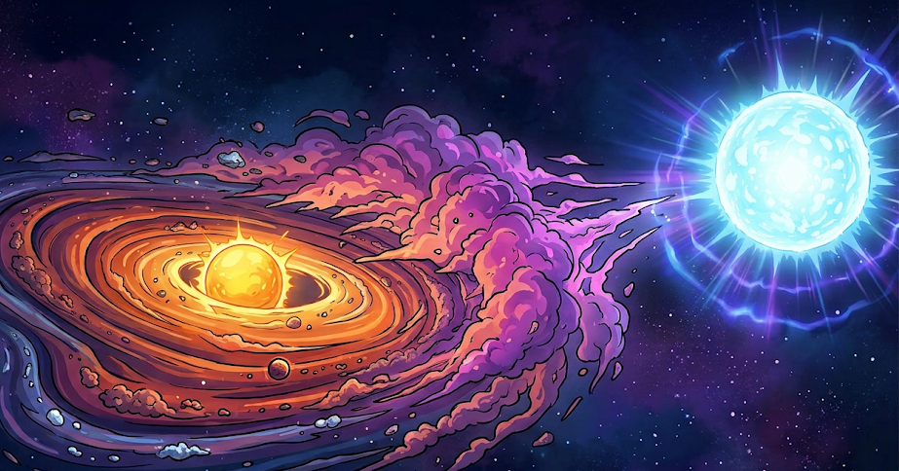
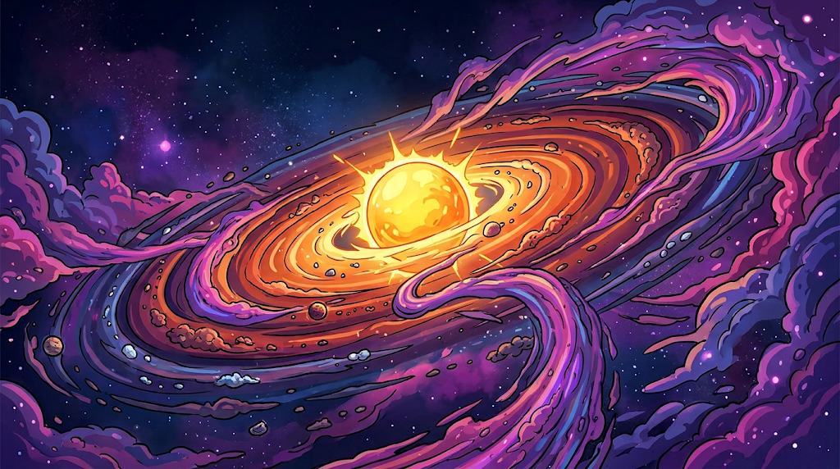
KNOWN ENVIRONMENT FEEDBACK ON DISCS
EXTERNALLY DRIVEN PHOTOEVAPORATION
INDUCED BY: incident UV radiation
EFFECTS: rapid dispersal, UV-driven chemistry
LATE ACCRETION
INDUCED BY: gas and dust rich environment
EFFECTS: new pristine material in the disc; morphology; accretion bursts

Slide 5
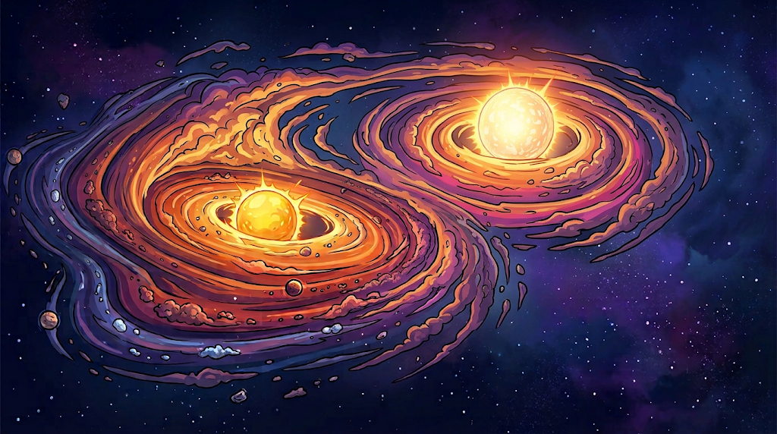


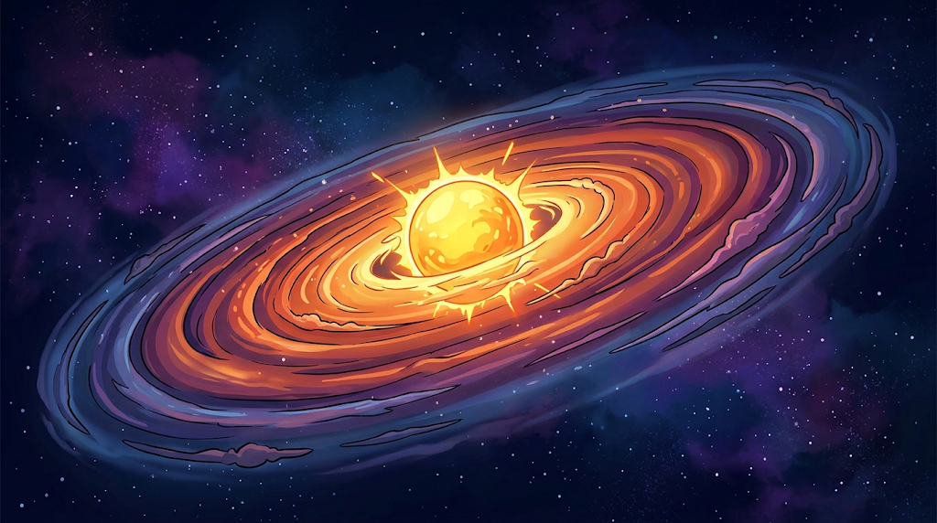
KNOWN ENVIRONMENT FEEDBACK ON DISCS
CLOSE ENCOUNTERS
INDUCED BY: stellar fly-by
EFFECTS: morphology, mass-loss
LOW METALLICITY
INDUCED BY: low-Z SF environment
EFFECTS: evolution, accretion, dispersal

Slide 6
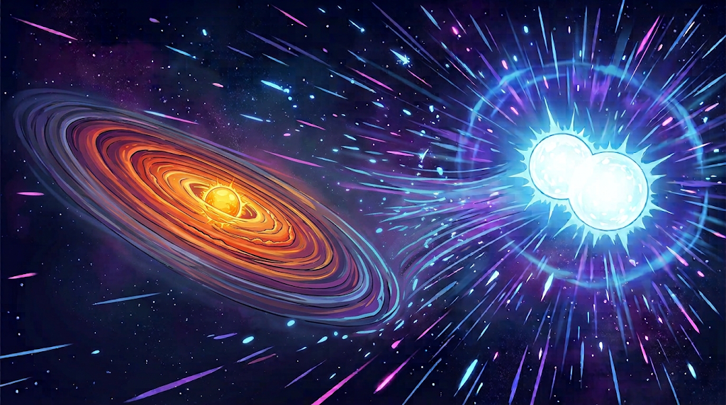

KNOWN ENVIRONMENT FEEDBACK ON DISCS
RELATIVISTIC PARTICLES
INDUCED BY: specific systems of massive stars
EFFECTS: ionization, chemistry

Slide 7
WHICH ENVIRONMENTAL PROPERTIES MATTER?
INTENSE LOCAL UV FLUX
G₀ > 10³
DENSE STAR FORMING REGIONS
N_{star} > 10³/pc³
LOW METALLICITY
Z=0.15-0.3 Z⊙
RICH NEBULAR REGION
Parental cloud still not dispersed
STELLAR WINDS
Energy > several 10⁵⁰ erg
Note: 1 G₀ = 1.6×10⁻³ erg/cm²/s

Slide 8
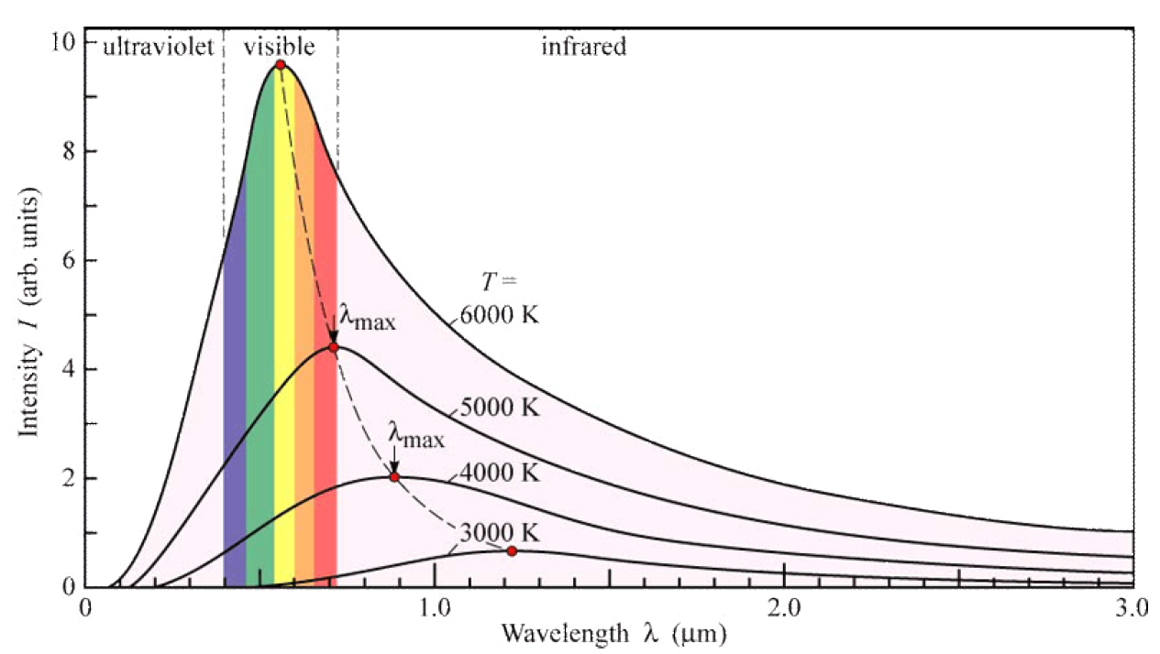

THE IMPACT OF MASSIVE STARS: UV RADIATION
Spectral Type | Teff (K) | Mass (M⊙) | L_{FUV} (L⊙)
O3V | 45000 | 58 | 1.5×10⁵
O5V | 41000 | 40 | 8.0×10⁴
O7V | 37000 | 28 | 3.5×10⁴
O9.5V | 32000 | 18 | 1.2×10⁴
B0V | 30000 | 15 | 7.0×10³
B1V | 25000 | 10 | 1.8×10³
B3V | 19000 | 6 | 2.5×10²
B5V | 15000 | 4 | 4.0×10
Wolf Rayet stars
Late WN | 35000 45000 | >20 | 3×10⁵ 1×10⁶
Early WN | >60000 | >20 | >1×10⁵
Late WC | 40000 60000 | >20 | 8×10⁴ 2×10⁵
Early WC | >75000 | >20 | >7×10⁴
Wien law:$\text{λ}\text{MAX}=$ $\frac{\text{2.89×10}\text{−3} m K}{T}$
Parravano, Hollenbach & McKee (2003) for MS stars
Crowther 2007 for WR stars

Slide 9
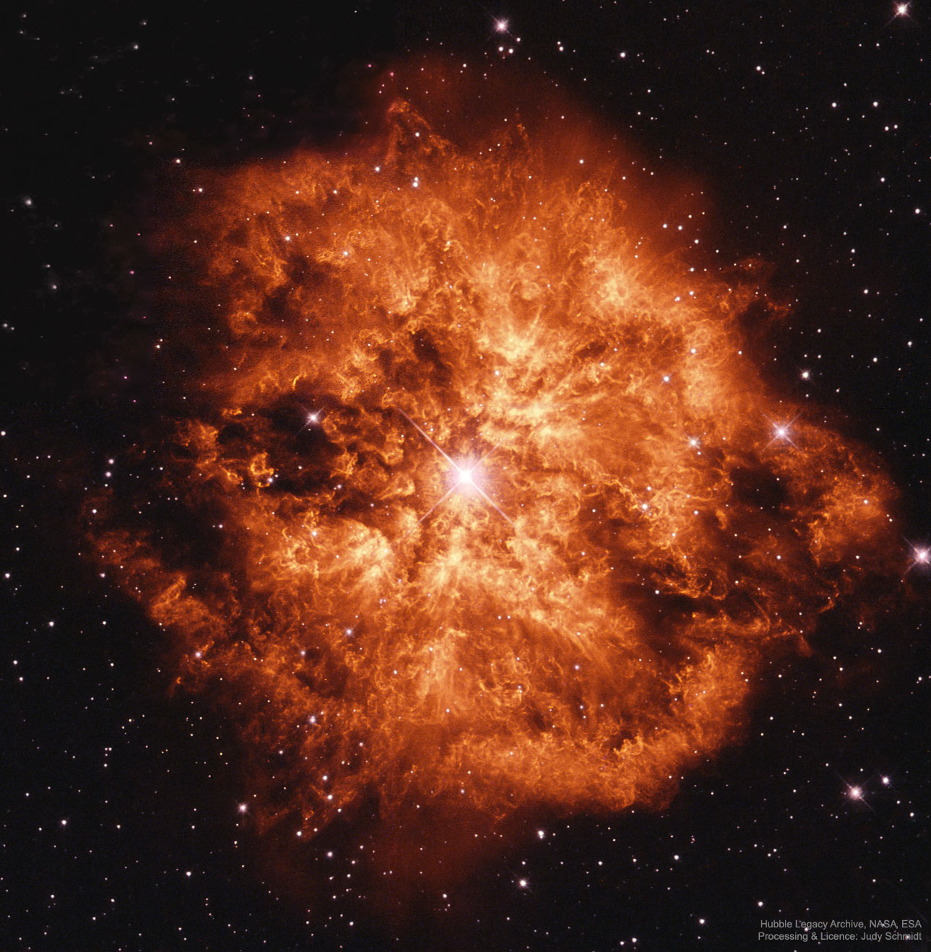
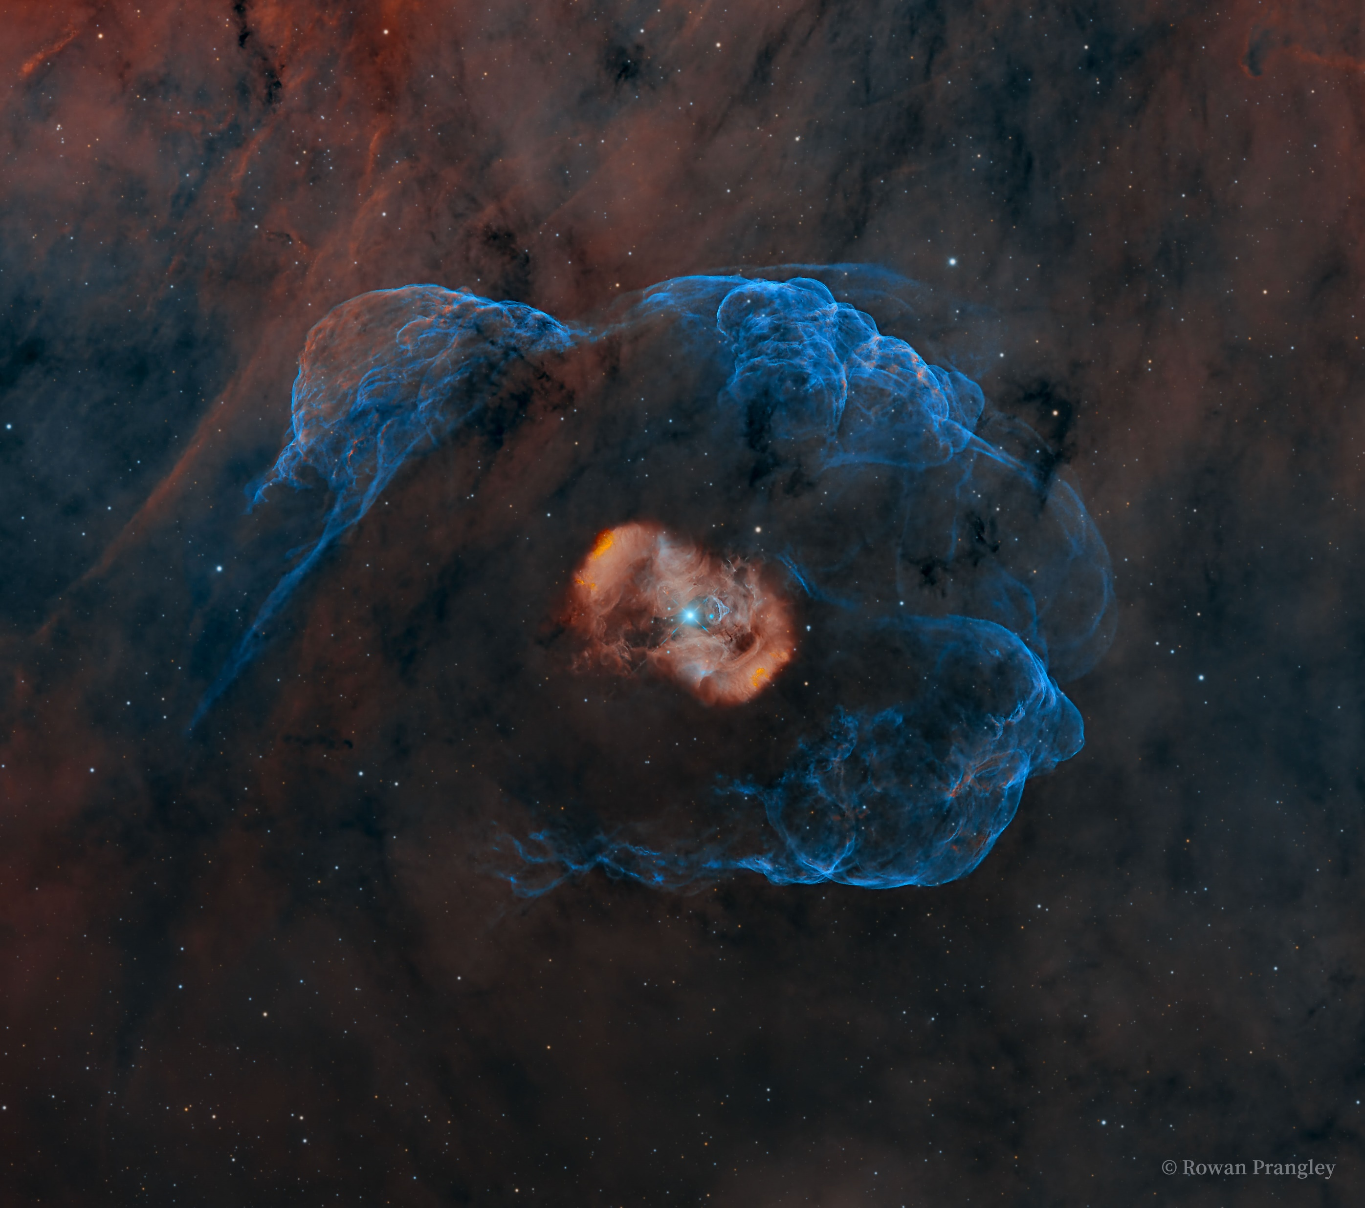
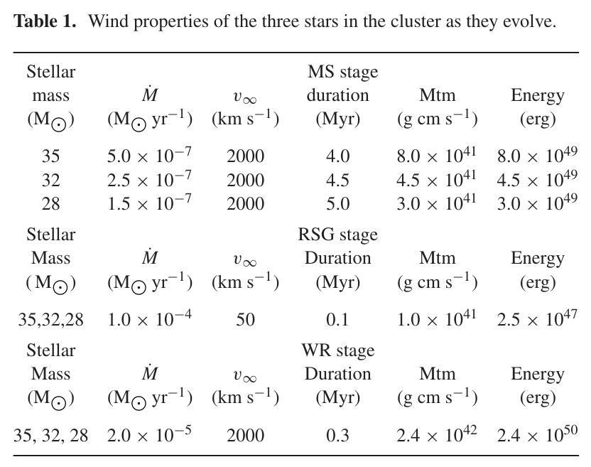
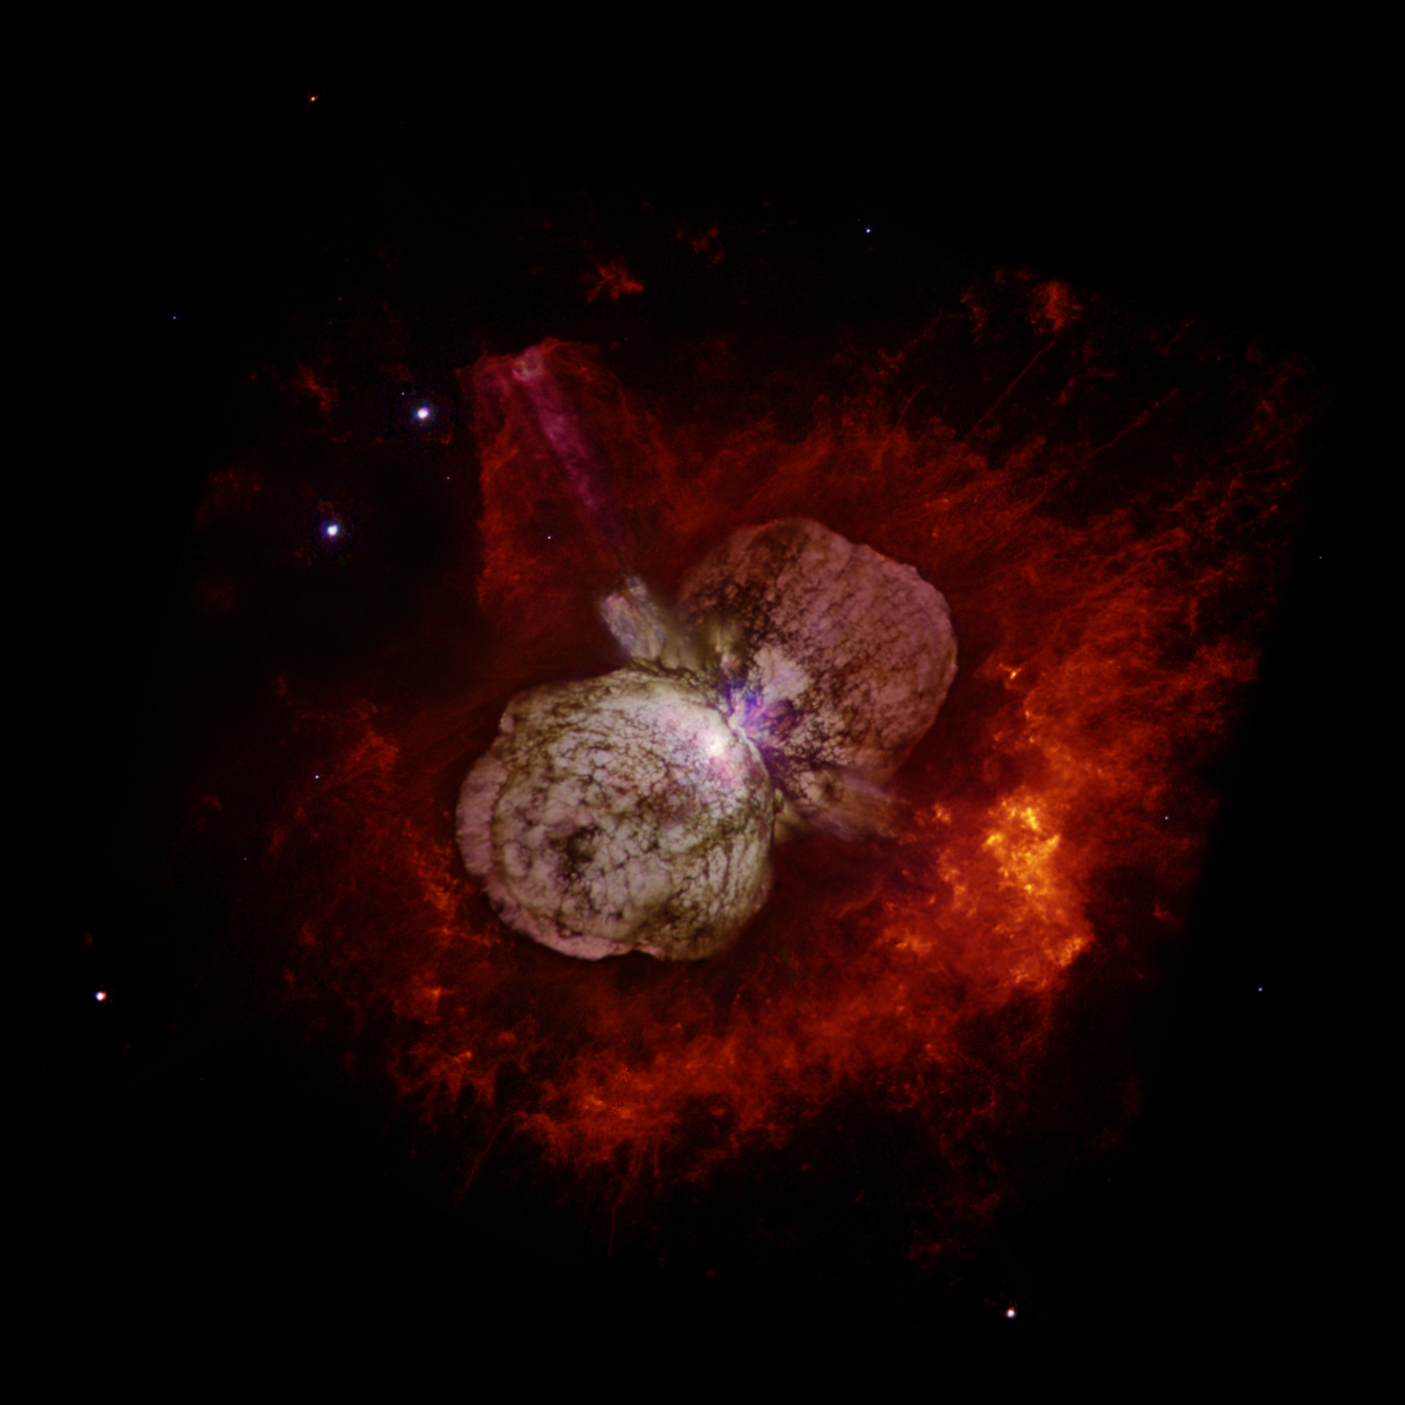
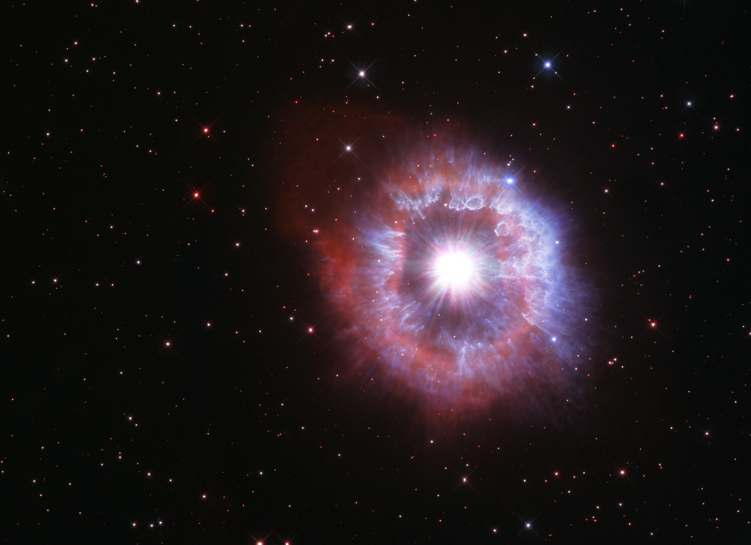
THE IMPACT OF MASSIVE STARS: WINDS AND OUTFLOWS
Massive stars evolve quickly loosing significant mass in winds and outbursts
Wind properties change drastically during massive stars evolution
WR124
NGC6164
AG Carinae
Rogers & Pittard 2013
η Carinae

Slide 10
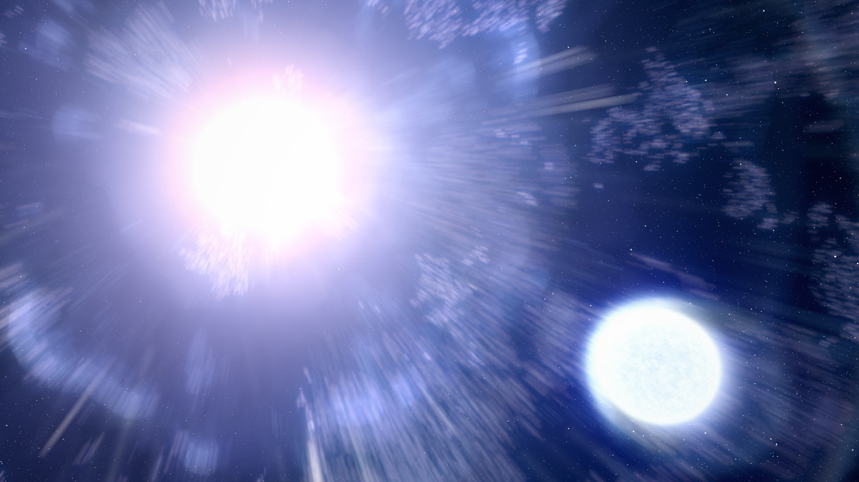
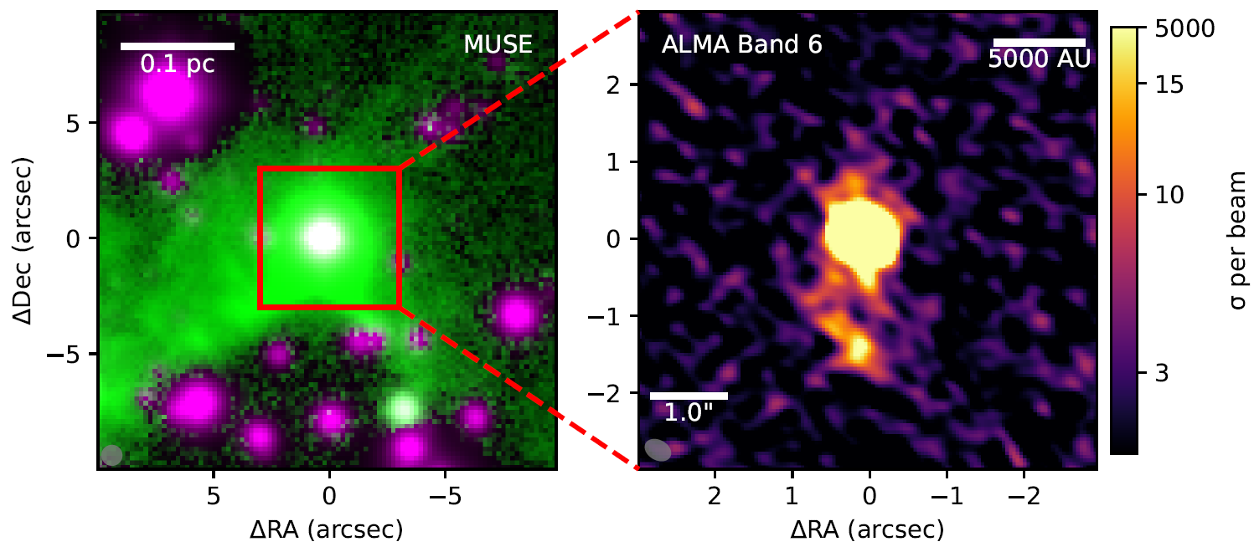
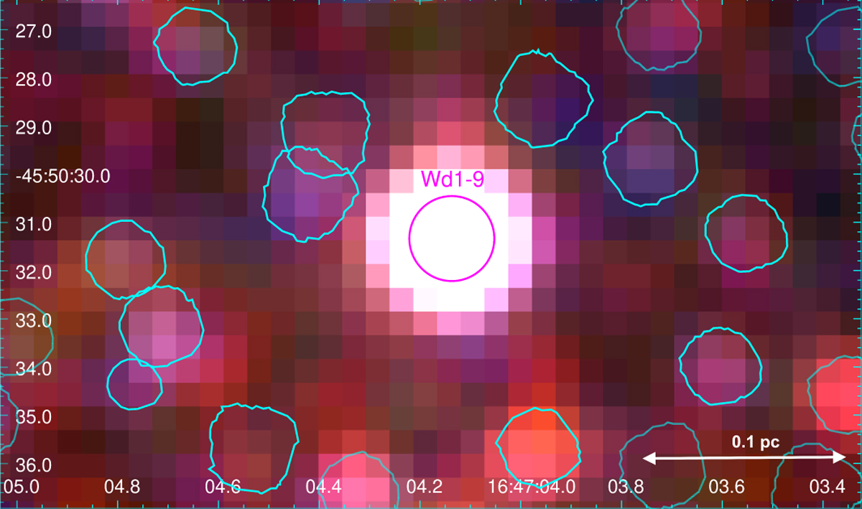
THE IMPACT OF MASSIVE STARS: MASSIVE BINARY SYSTEMS
Most of the very massive stars are in binary systems
Close binary systems:
wind-wind collision,
>10MK plasma and relativistic particles
Mass-transfer episodes and violent outburst
(c)
(a)
(b)
Massive binary system Wd1-W9 in Westerlund1 observed with MUSE at: (a) [SII] 9069
(b) ALMA Band 6
(c) X-rays
Project EWOCS
Anastasopoulou+2025 (EWOCS-IV)
Larkin+ subm.; King+ in prep

Slide 11
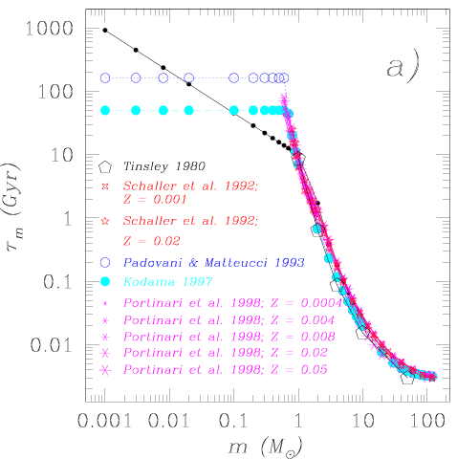
MASSIVE STARS: RARE AND SHORT-LIVING
Massive stars are rare and short-living objects
Can be found only in young stellar clusters
Stellar lifetime as a function of stellar mass. Romano+ 2004
Data from Maeder & Meynet (1989; dots); Tinsley (1980; pentagons); Schaller+ (1992; stars); Padovani & Matteucci (1993; empty circles); Kodama (1997; filled circles); Portinari+ (1998; asterisks)

Slide 12
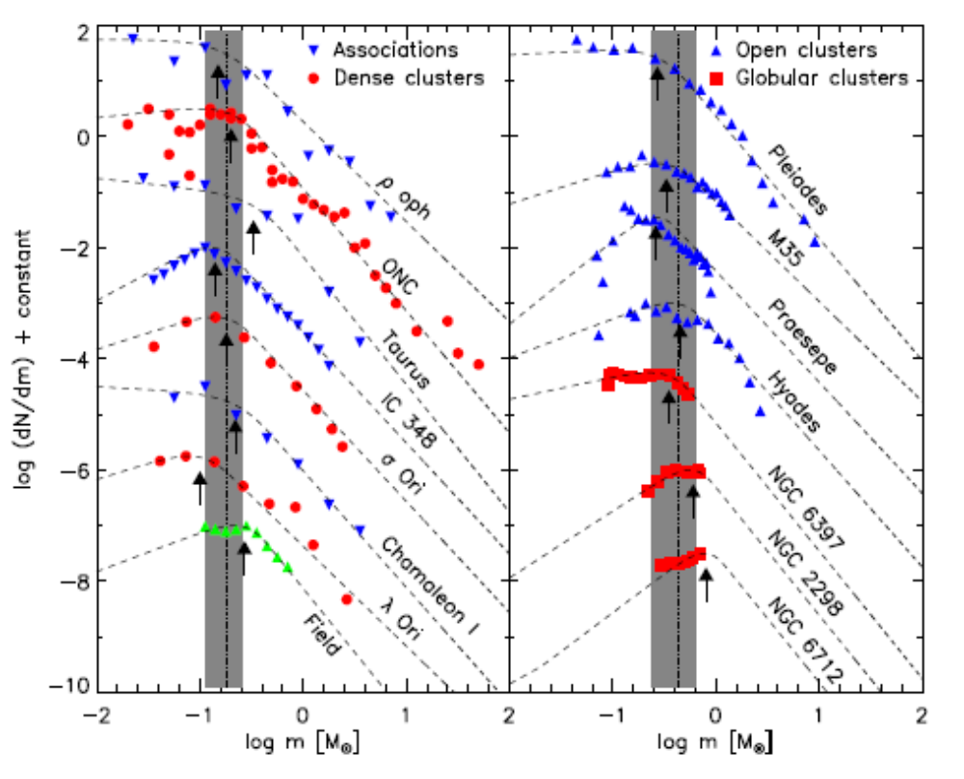
MORE MASS – MORE STARS – MORE MASSIVE STARS
The initial mass function (IMF) describes how the mass of a young stellar ensemble is distributed
Nearly all clusters exhibit a present-day mass function that resembles a dynamically evolved Kroupa-/Chabrier-type IMF peaking at m_{p}=0.23±0.1M⊙
(de Marchi+2010; Bastian+2010)

Slide 13
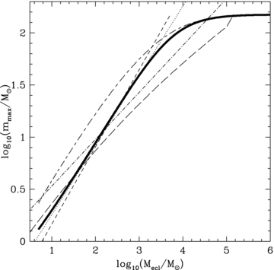
MORE MASS – MORE STARS – MORE MASSIVE STARS
A random sampling of the IMF results in a relation between the mass of clusters and that of their most massive stars
Massive stars are found in young and richly populated stellar clusters
Elmegreen 1983 [long dashed line], Elmegreen 2000 [short-dashed line], Bonnel+2003 [dotted line], Larson+2003 [dash-dotted line], Weidner & Kroupa 2004 [thick-solid line], Oey & Clarke 2005 [short-dashed–long-dashed line]

Slide 14
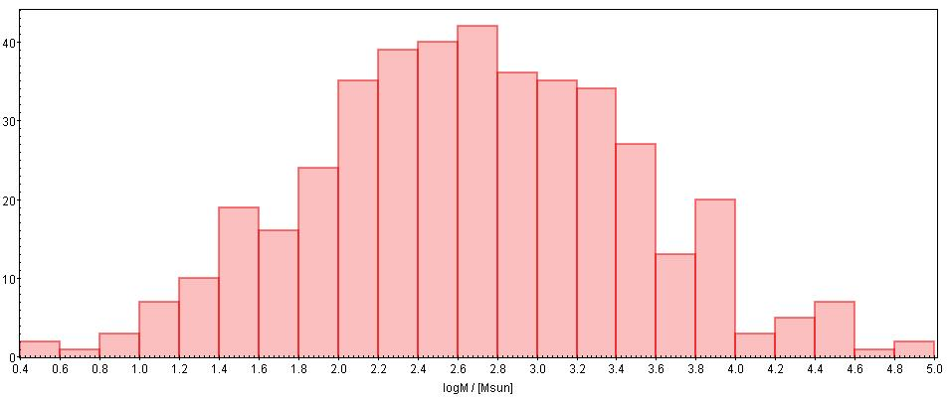
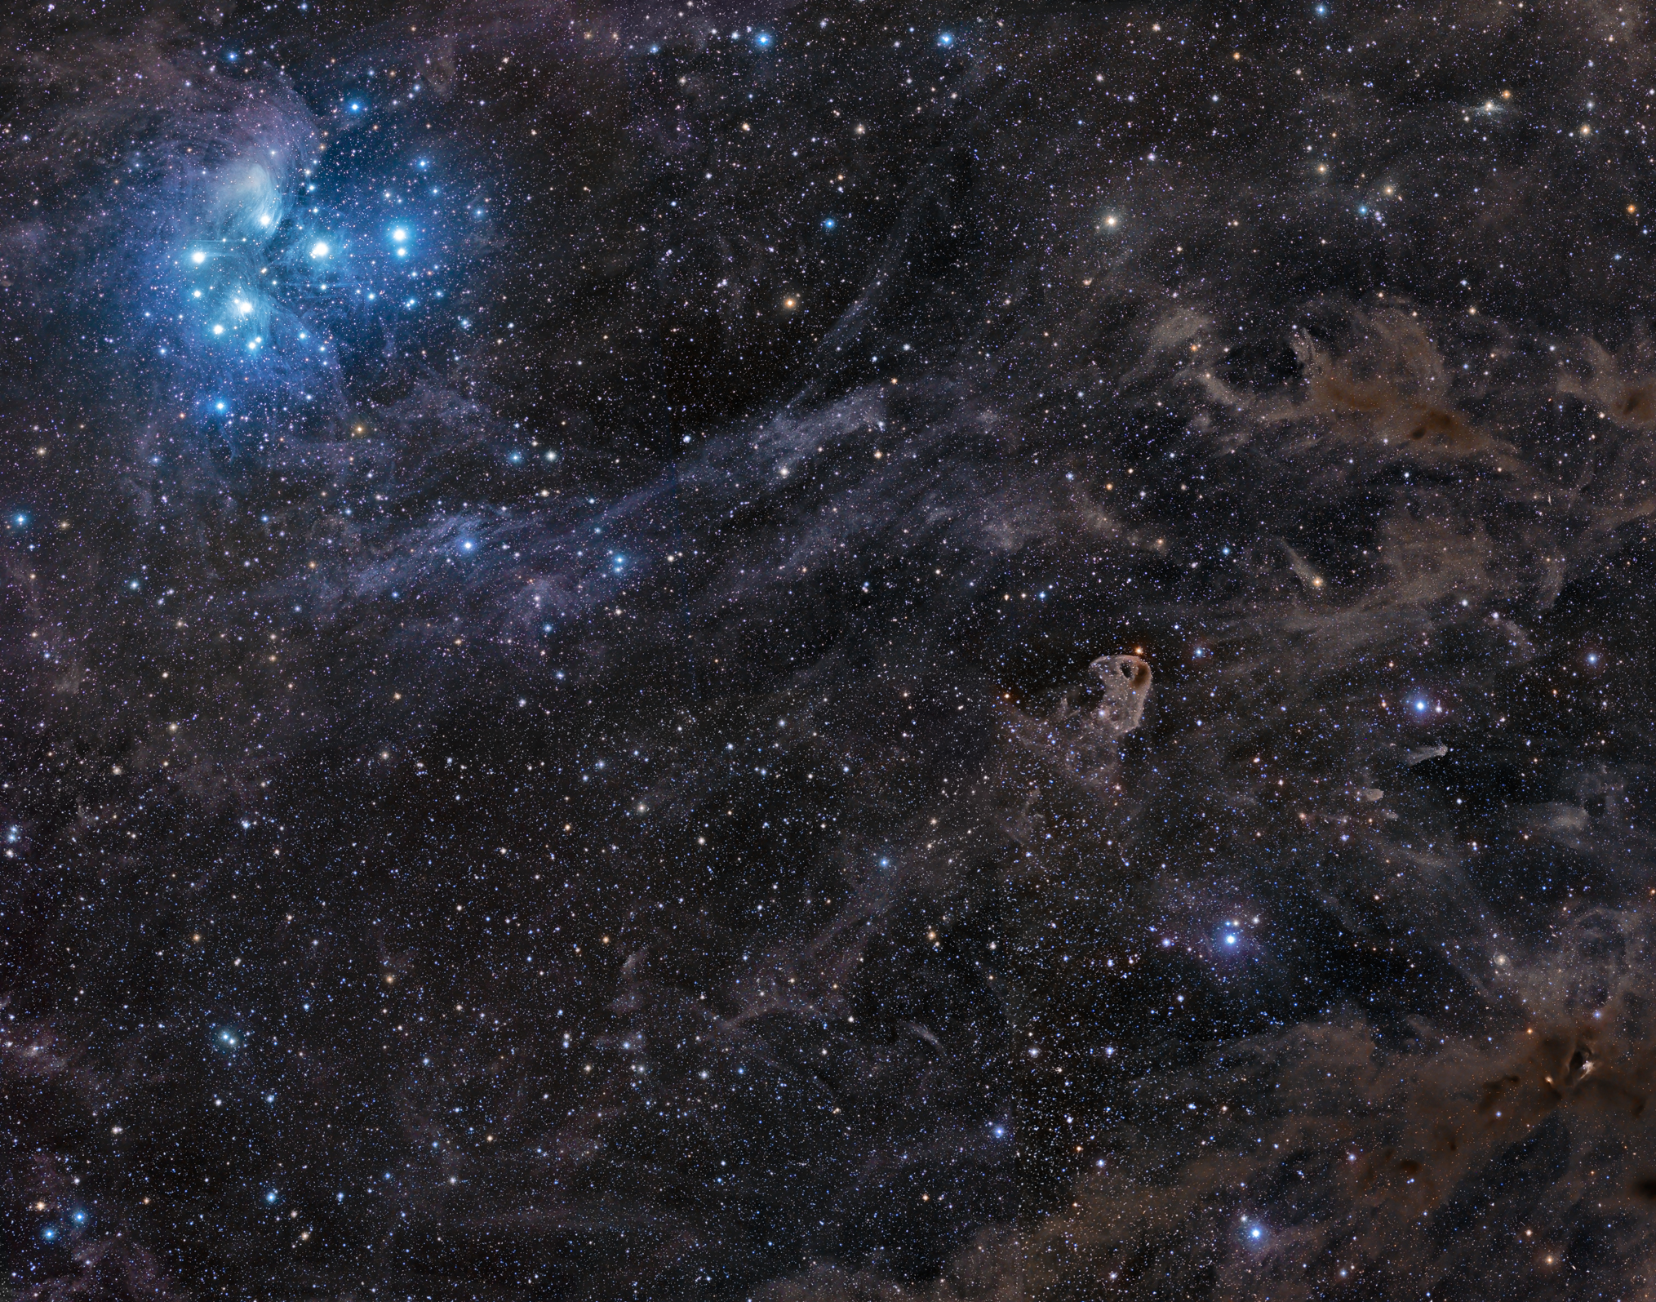
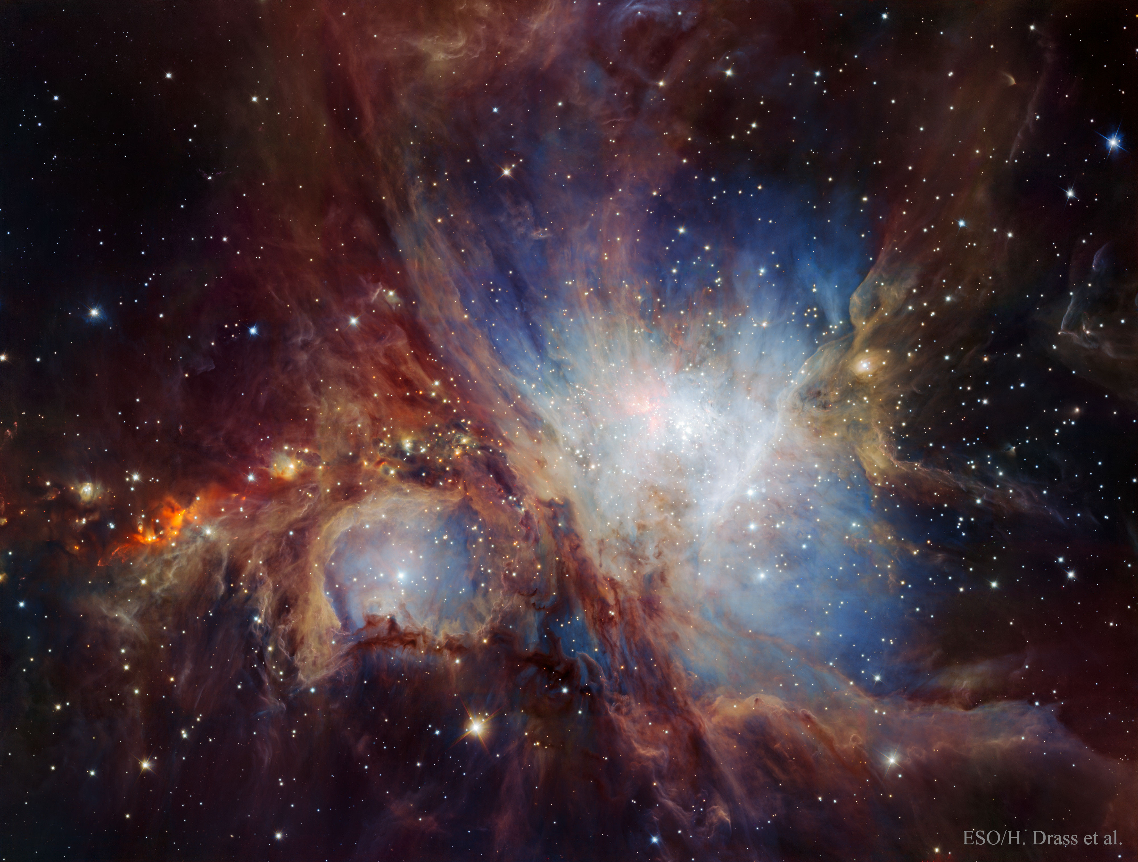
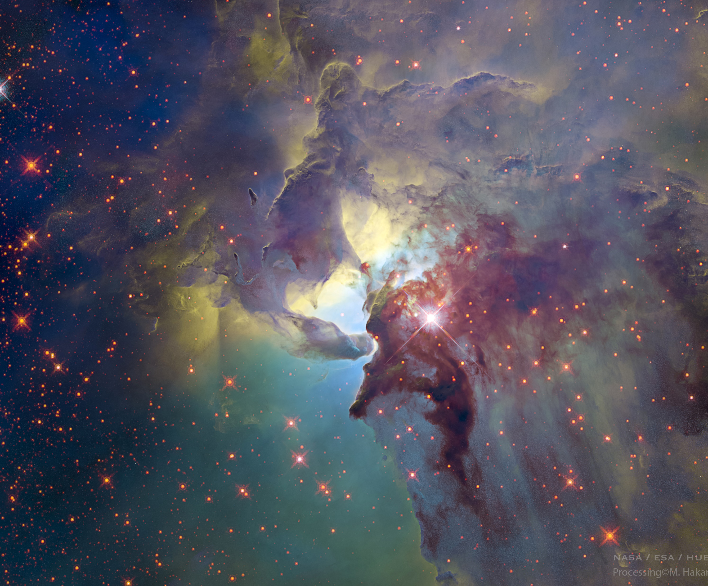
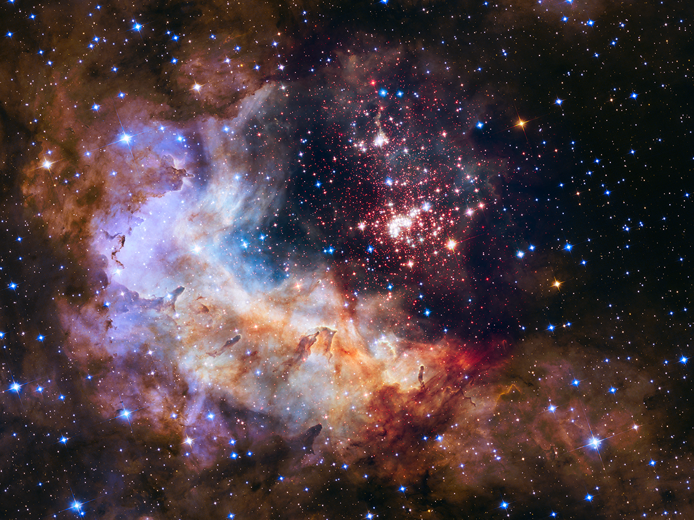
STAR CLUSTERS IN THE MILKY WAY
LOW-MASS
MASSIVE
N_{stars} >10³⁻10⁴
SUPER-MASSIVE
N_{stars}>10⁵
(N_{stars} 10²-10³)
Gozha+2012
TMC
ONC
Lagoon
Westerlund 2

Slide 15
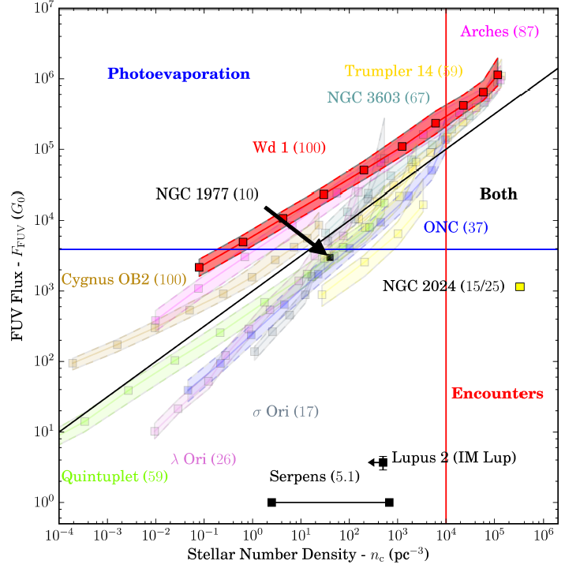
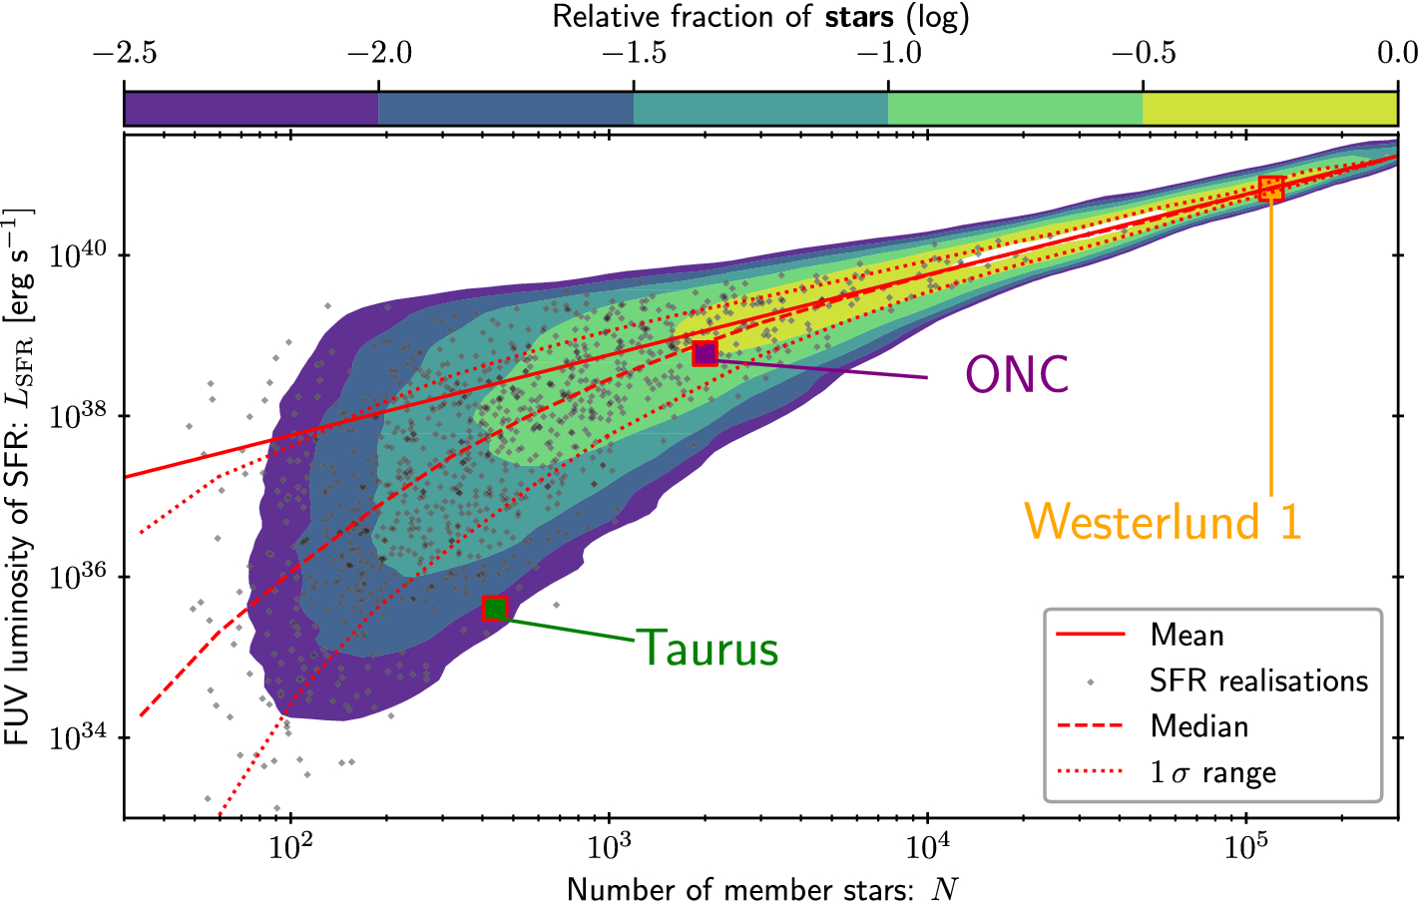
WHERE TO LOOK?
FUV field vs. Nstars randomly sampling 1 Myrs clusters from CMF and stars from IMF
Marked: Taurus (Low-mass SFR),ONC (massive SFR), and Westerlund 1 (Supermassive SFR) Winters & Haworth 2022
FUV field intensity vs stellar density in a sample of stellar clusters. All clusters divided into radial bins and values for each bin are marked with squares. The numbers in brackets represent the assumed maximum stellar mass in M⊙
(Winter+ 2018, Haworth+ 2018, Facchini+ 2016)

Slide 16
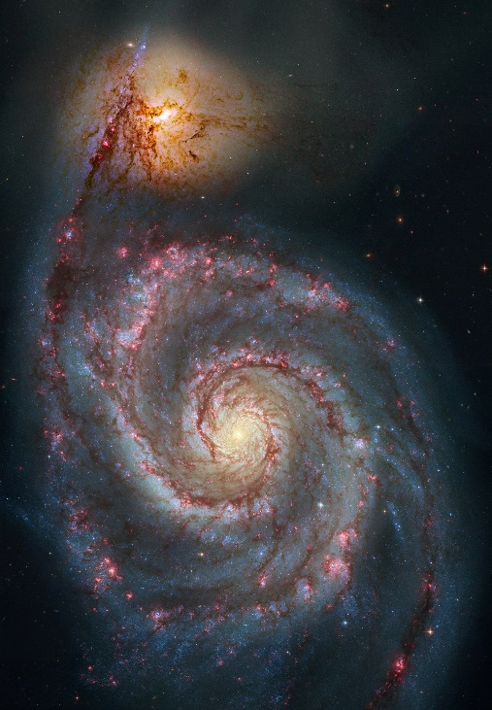
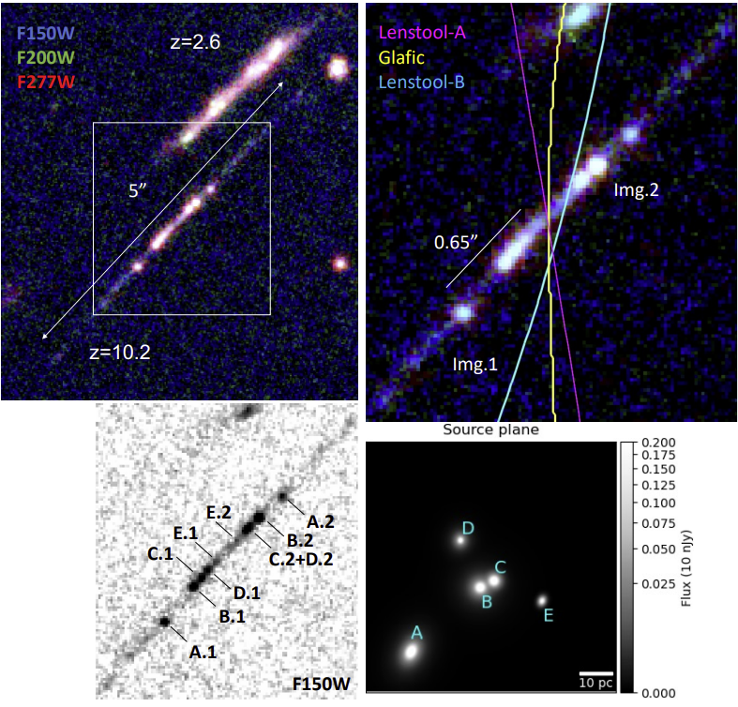
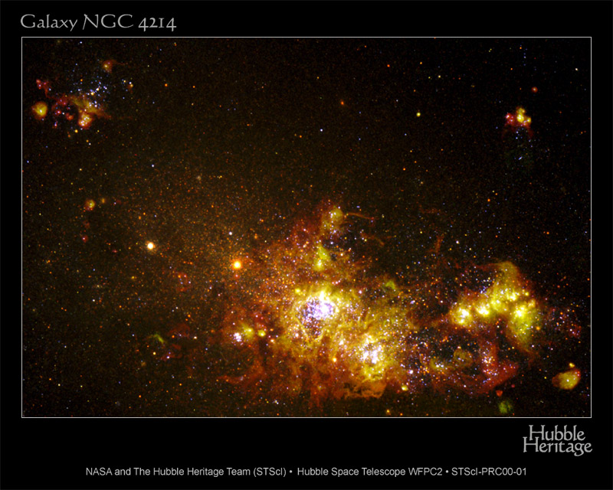

MASSIVE CLUSTERS AND STARBURST
In galaxies experiencing starbursts, star formation mainly takes place in concentrated and very massive clusters (e.g. de Grijs+2001, 2003)
Proto-super massive clusters in the Cosmic Gems galaxy (z$\sim$10.2)
Adamo+2024
NGC4214 (HST)
HST image of M51

Slide 17
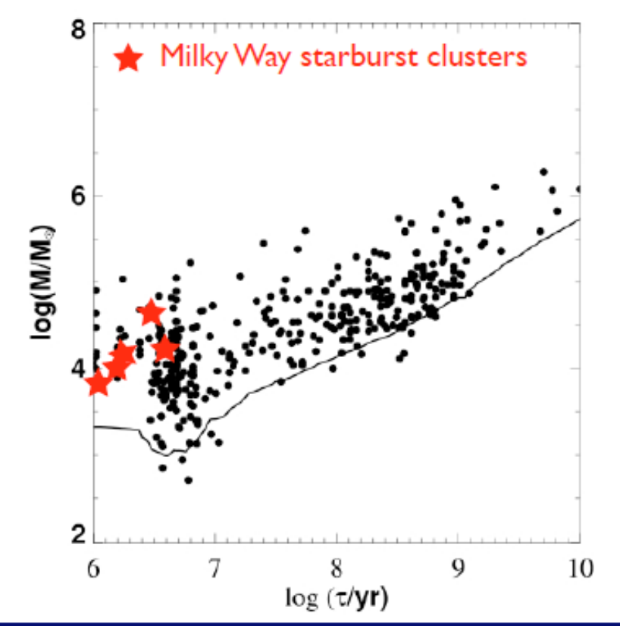
MASSIVE CLUSTERS AND STARBURST
Star formation rate enhanced by the collision (e.g. Smith+2007, Smith & Struck 2010)
Large population of massive and supermassive clusters and candidate young globular clusters (Whitmore+2000)
Cluster mass vs. age scatter plot in M51 compared with the starburst clusters of the Milky Way (adapted from Lee+2005)
M51 observed by HST

Slide 18
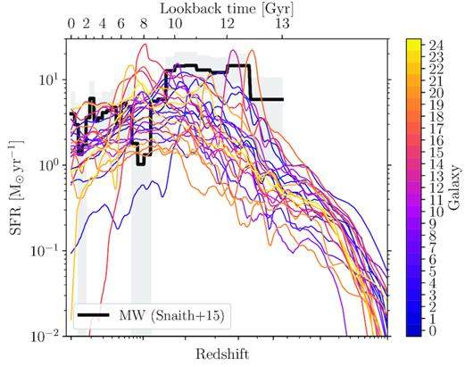
STAR FORMATION RATE ACROSS COSMIC TIME
Star formation rate in the Milky Way today:
0.68 to 1.45 M⊙/yr from GLIMPSE (Robitaille & Whitney 2010)
1.65 ± 0.19 M⊙/yr from a Bayesian statistical analysis of previous studies (Licquia & Newman 2015)
SFR varies during the evolution of galaxies, as a function of the general conditions of the ISM (e.g.: gas pressure, surface density, velocity dispersion; Bolatto+2008, Madau&Dickinson 2014)
Evolution of SFR as a function of time in 25 galaxies from the E-MOSAIC simulations (Kruijssen+2019 ; see also Hopkins+2014, Pfeffer+2018)

Slide 19
WHICH ENVIRONMENTAL PROPERTIES MATTER?
INTENSE LOCAL UV FLUX
G₀ > 10³
DENSE STAR FORMING REGIONS
N_{star} > 10³/pc³
LOW METALLICITY
Z=0.15-0.3 Z⊙
RICH NEBULAR REGION
Parental cloud still not dispersed
STELLAR WINDS
Energy > several 10⁵⁰ erg
Note: 1 G₀ = 1.6×10⁻³ erg/cm²/s

Slide 20
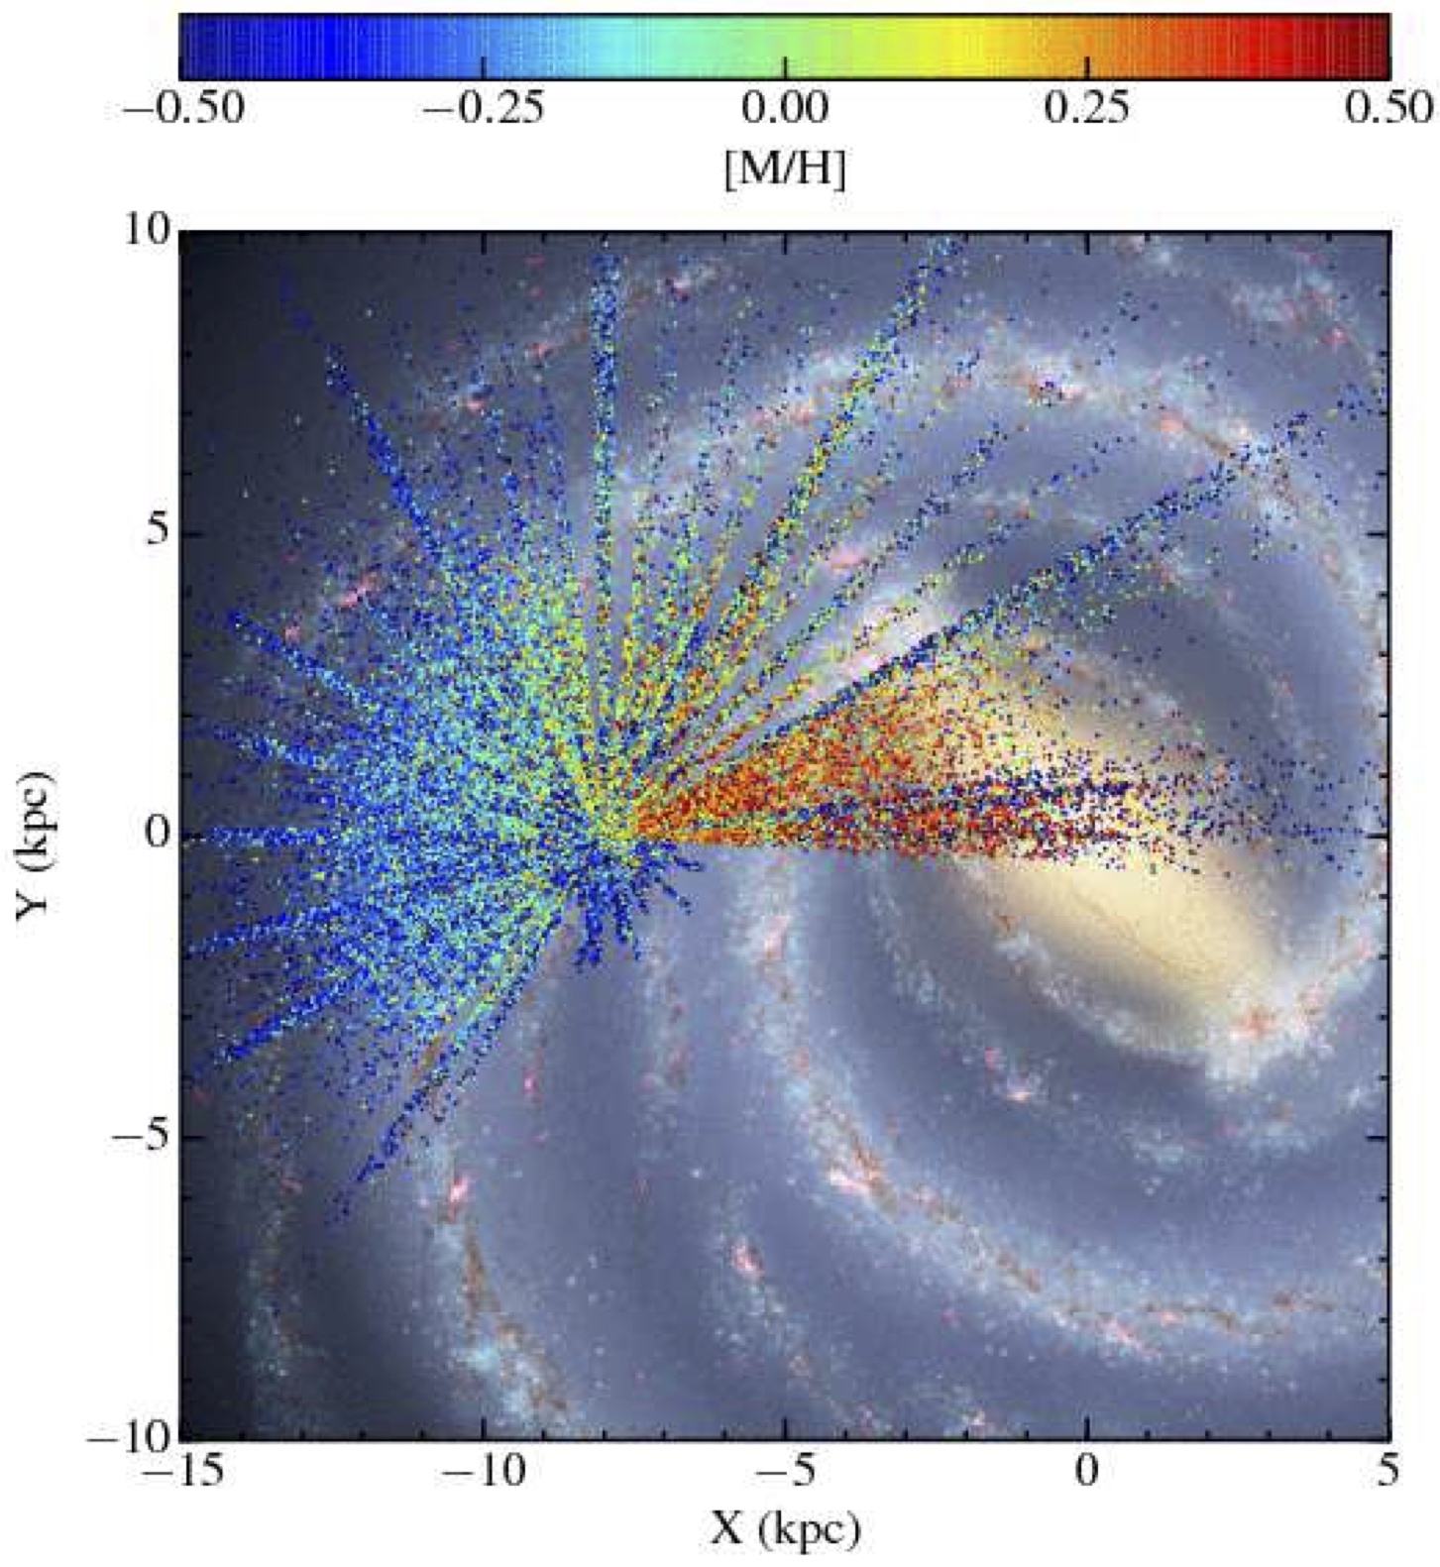
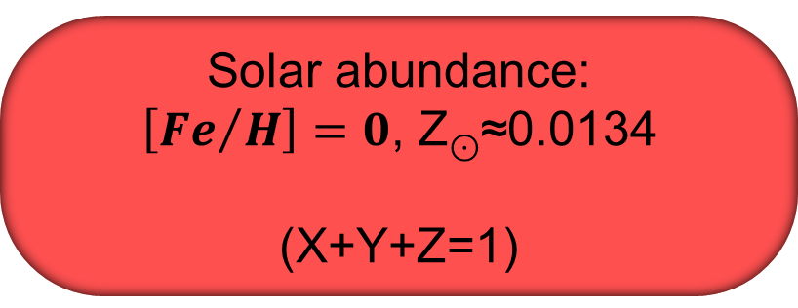
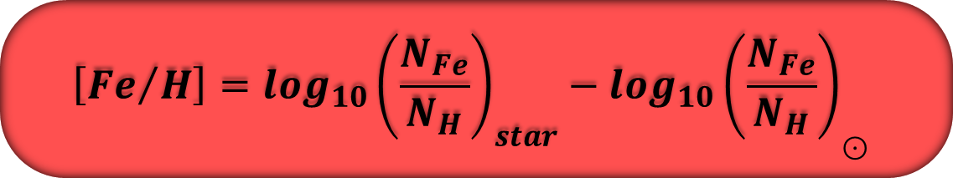
METALLICITY: DEFINITIONS
Measured as abundance of iron over hydrogen with respect to the Sun
$$\left[{Fe}/H\right]=\log_{10}{\left(\frac{N_{Fe}}{N_{H}}\right)}_{star}−\log_{10}{\left(\frac{N_{Fe}}{N_{H}}\right)}_{\text{⊙}}$$
Solar abundance:
$\left[{Fe}/H\right]=0$, Z$\text{⊙}$≈0.0134
(X+Y+Z=1)
Projection of the APOGEE-1 observations onto an artist's impression of the Milky Way. The points are color-coded by their metallicity.
(Majewski+ 2017)

Slide 21
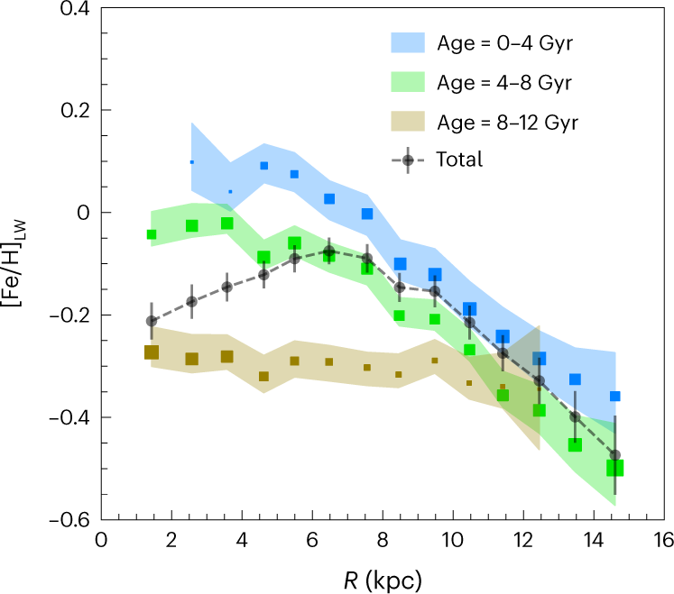
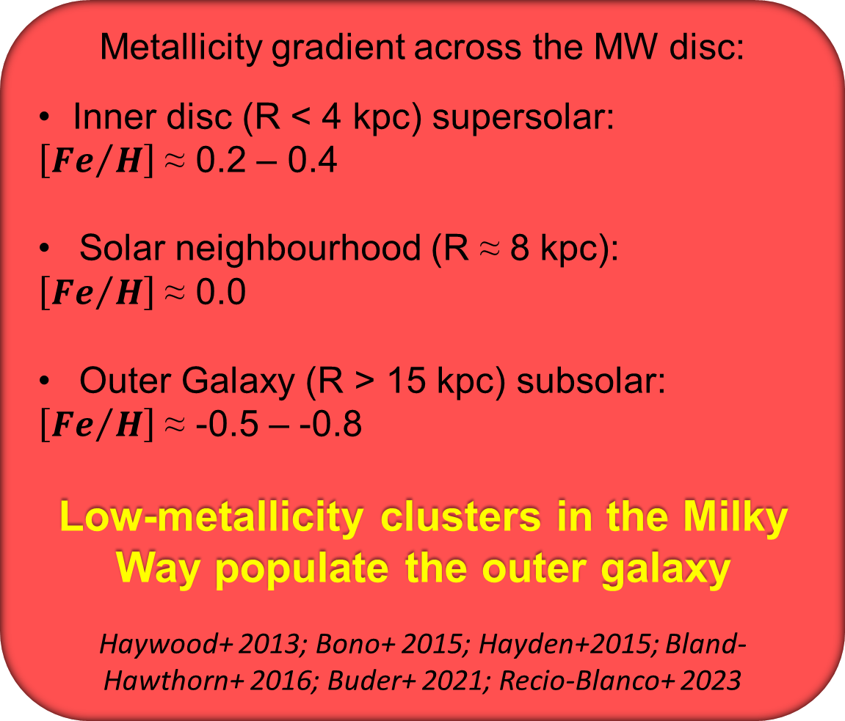
METALLICITY ACROSS THE GALAXY
Metallicity gradient across the MW disc:
Inner disc (R < 4 kpc) supersolar:
$\left[{Fe}/H\right]$ ≈ 0.2 – 0.4
Solar neighbourhood (R ≈ 8 kpc):
$\left[{Fe}/H\right]$ ≈ 0.0
Outer Galaxy (R > 15 kpc) subsolar:
$\left[{Fe}/H\right]$ ≈ -0.5 – -0.8
Low-metallicity clusters in the Milky Way populate the outer galaxy
Haywood+ 2013; Bono+ 2015; Hayden+2015; Bland-Hawthorn+ 2016; Buder+ 2021; Recio-Blanco+ 2023
Average stellar iron abundance profiles of the Milky Way galaxy as a whole and of three different age populations (Lian+ 2023)

Slide 22
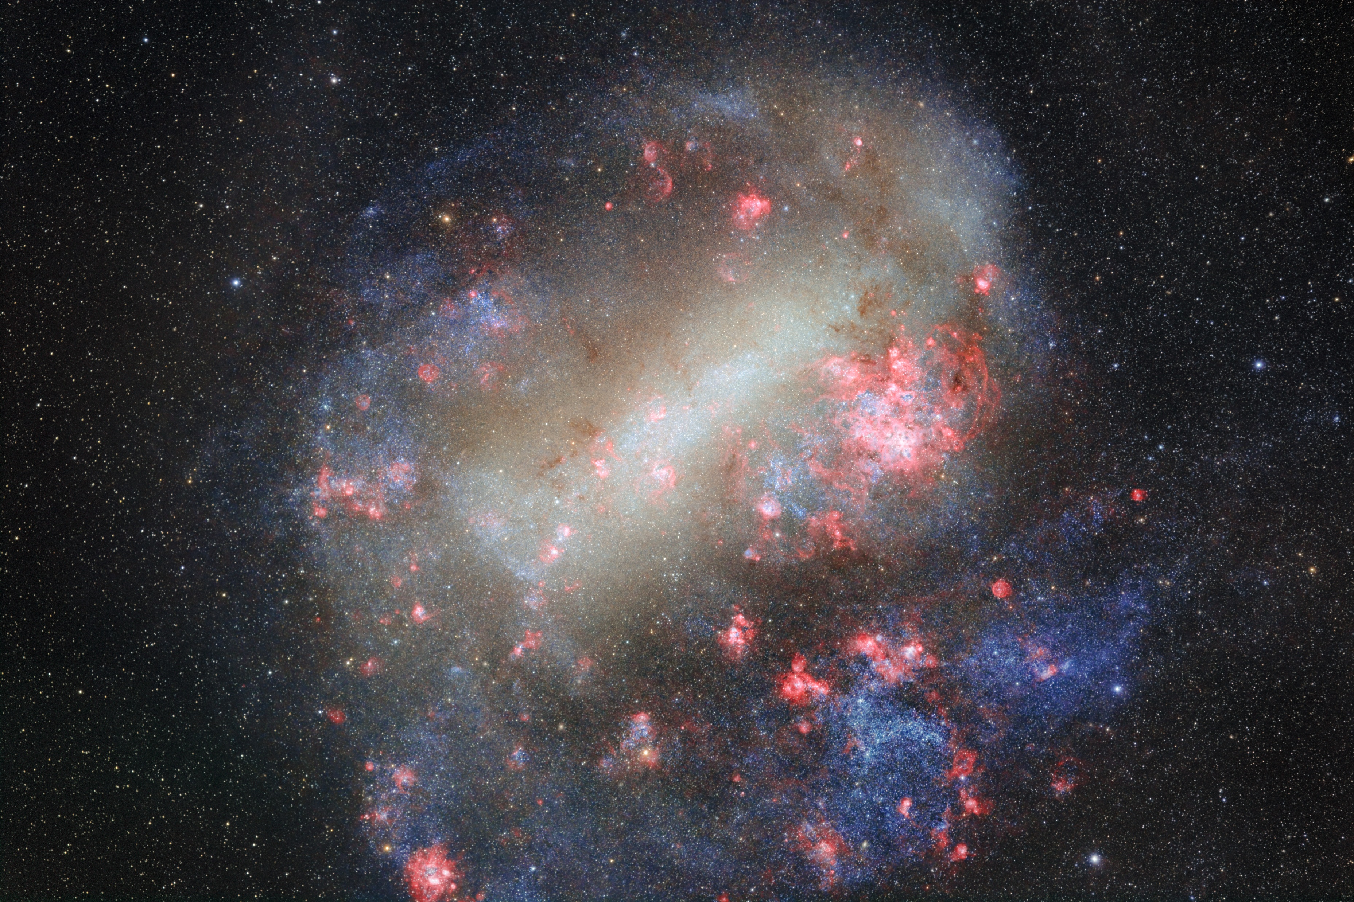
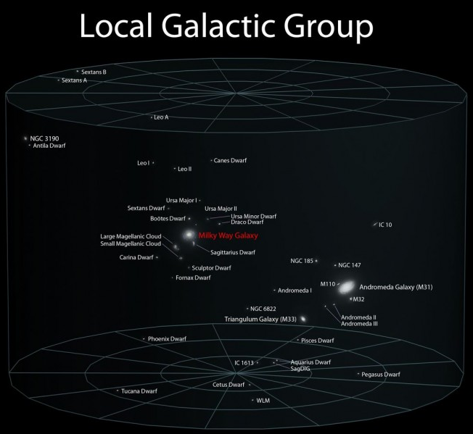
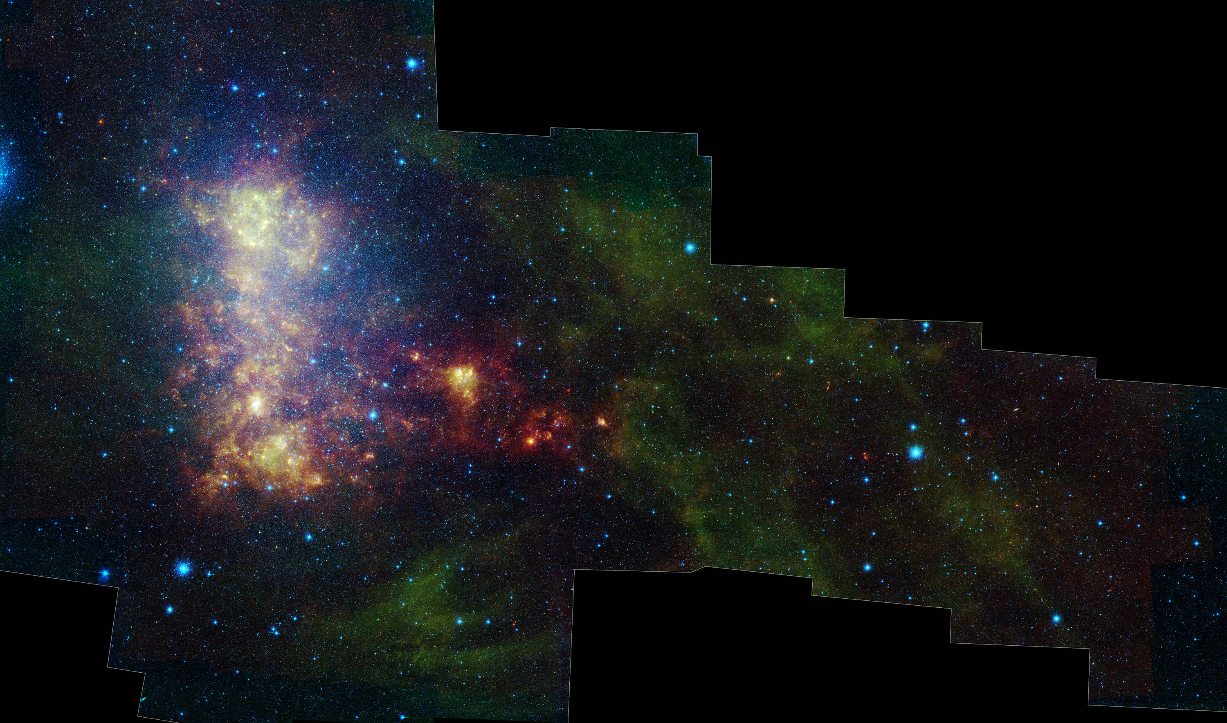
THE MAGELLANIC CLOUDS
LARGE MAGELLANIC CLOUD
Satellites galaxies of the MW
LMC: distance 49.6 kpc; stellar mass 3×10⁹ M⊙; Z=0.4-0.5 Z⊙
SMC: distance 62.1 kpc; stellar mass 4×10⁸ M⊙; Z=0.15-0.2 Z⊙
Gemini South
SMALL MAGELLANIC CLOUD
Westerlund 1997
Van den Bergh 2000
McConnachie 2012
Harris+ 2004, 2009
Spitzer; Gordon+2011

Slide 23
WHICH ENVIRONMENTAL PROPERTIES MATTER?
INTENSE LOCAL UV FLUX
G₀ > 10³
DENSE STAR FORMING REGIONS
N_{star} > 10³/pc³
LOW METALLICITY
Z=0.15-0.3 Z⊙
RICH NEBULAR REGION
Parental cloud still not dispersed
STELLAR WINDS
Energy > several 10⁵⁰ erg
Note: 1 G₀ = 1.6×10⁻³ erg/cm²/s

Slide 24
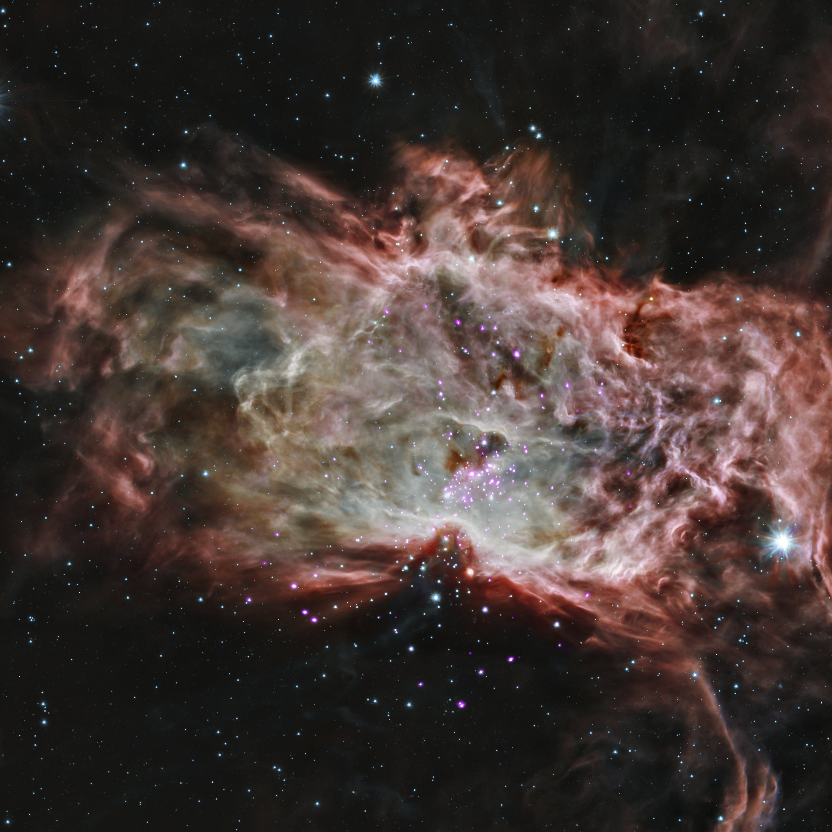
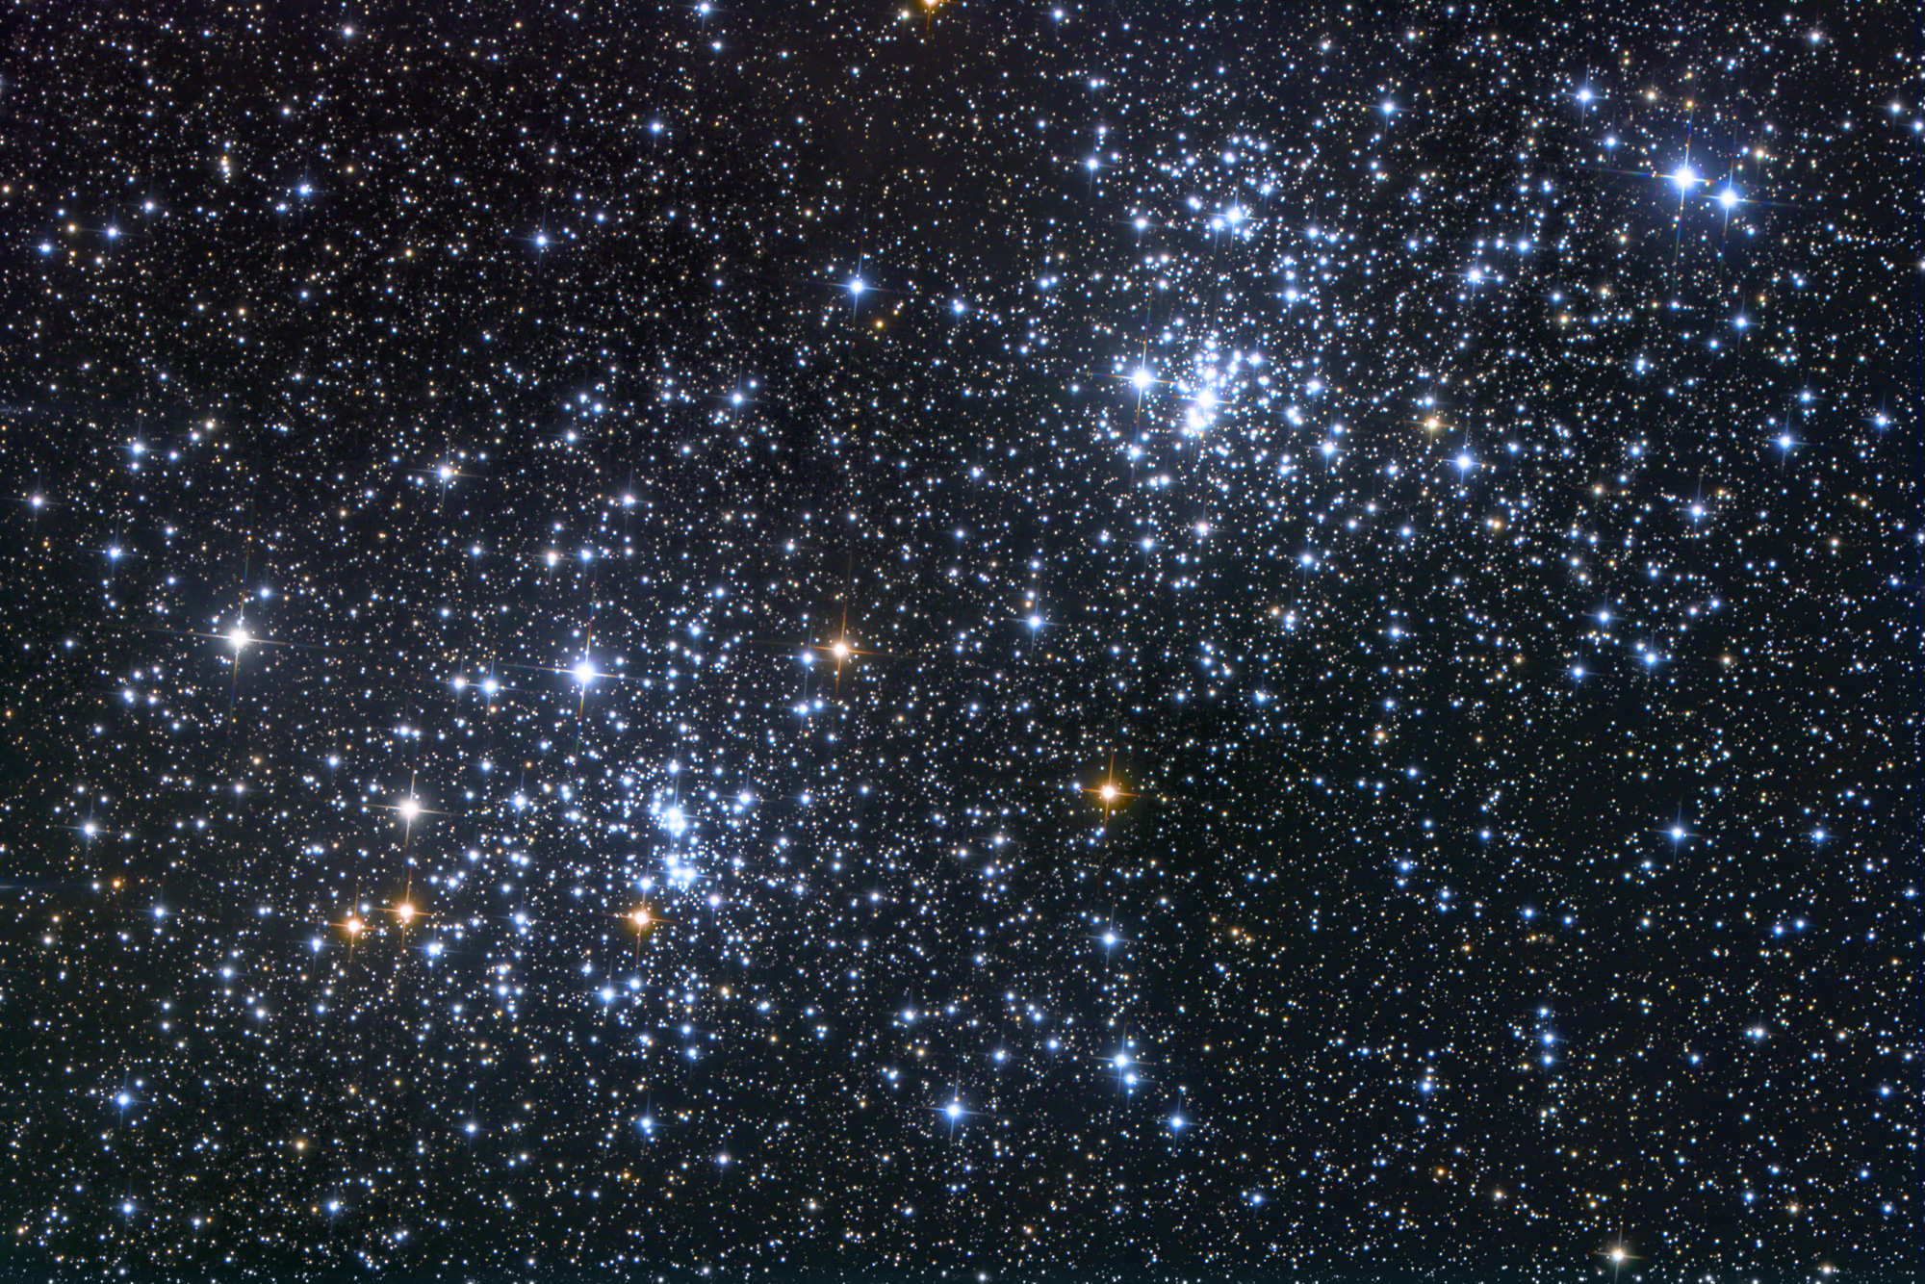
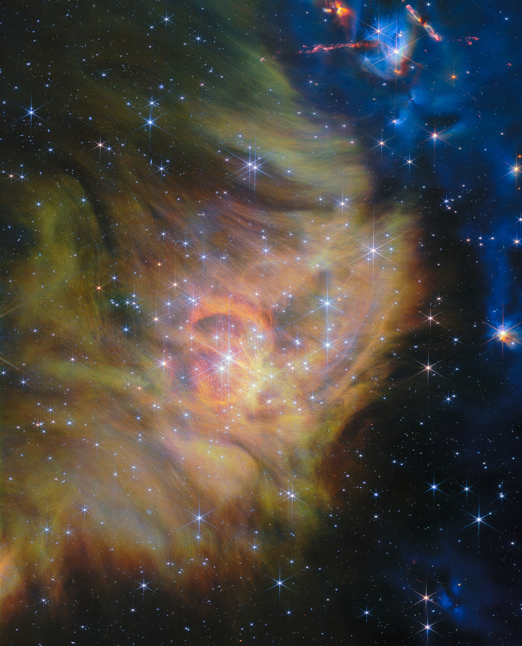
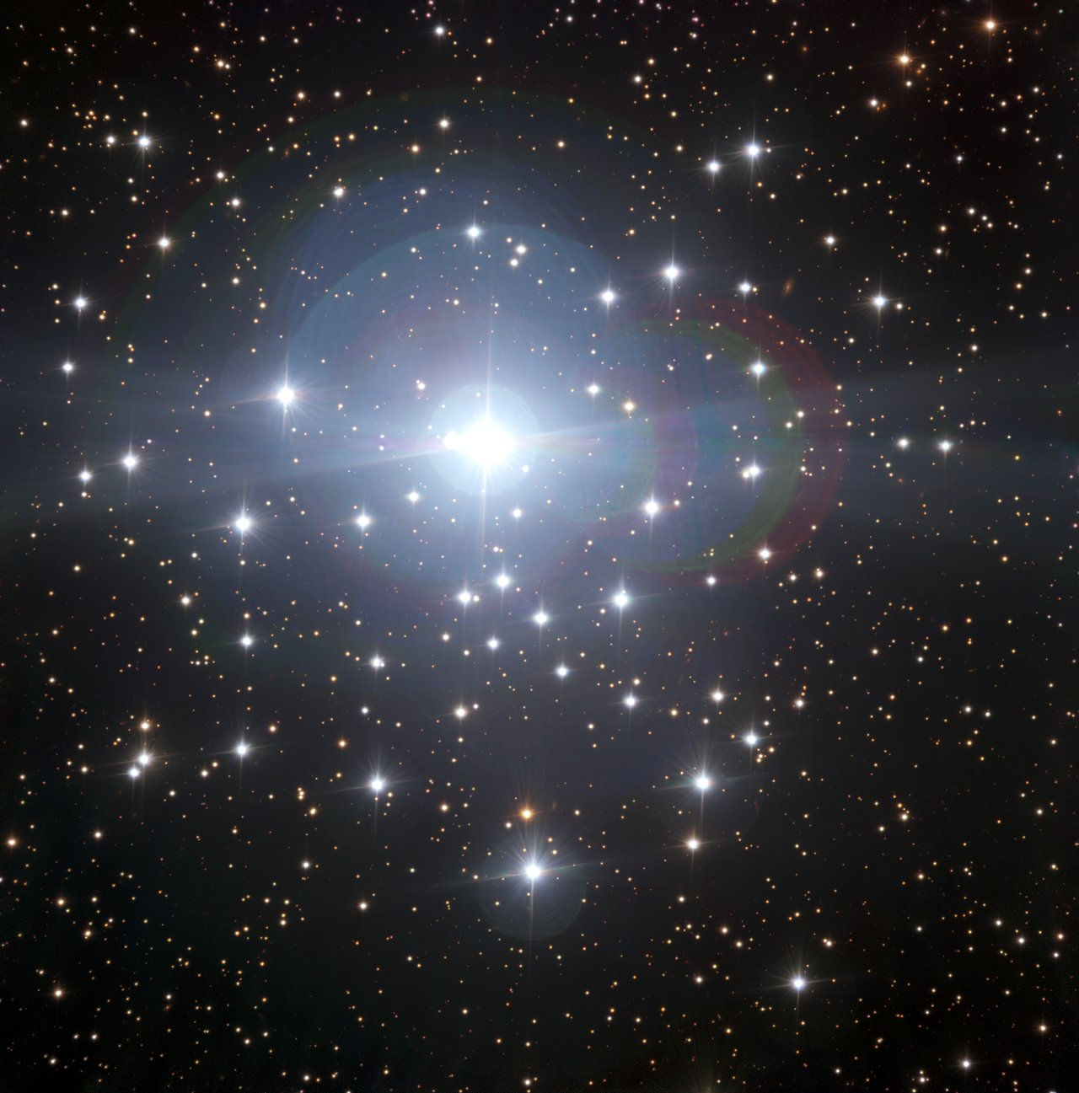
THE DISPERSAL OF THE PARENTAL CLOUDS
NGC2024
0.5-1 Myrs
h e χ Persei
13-14 Myrs
IC348 3-5 Myrs
NGC2362
5-6 Myrs
CLUSTER
Orion Molecular Cloud
1-2 Myrs
AGE

Slide 25
WHAT DRIVES THE DISPERSAL?
No massive stars
Protostellar jets: by supersonic shocks, inject momentum and carve out cavities
Stellar winds (a few 100 km/s)
X-ray and soft UV emission (magnetic activity and 2-30 MK coronal plasma)
The cloud is not violently ejected: clearing timescale
⁓5 Myrs
Shu+ 1987; Feigelson & Montmerle 1999; Matzner & McKee 2000; Bally+ 2016
Massive stars
1000-3000 km/s stellar winds
Ionization of surrounding gas by EUV radiation, HII cavity inside the cloud
Supernovae, releasing 10⁵¹ erg as kinetic energy, 3%-10% transferred into the surrounding cloud
The cloud is quickly and violently cleared
Chu & Kennicutt 1994; Spitzer 1998; Dale+ 2005; Oey+2007; Arthur+ 2011; Walch+ 2012, 2013; Krause+2013, Dale+ 2014; Geen+2015

Slide 26
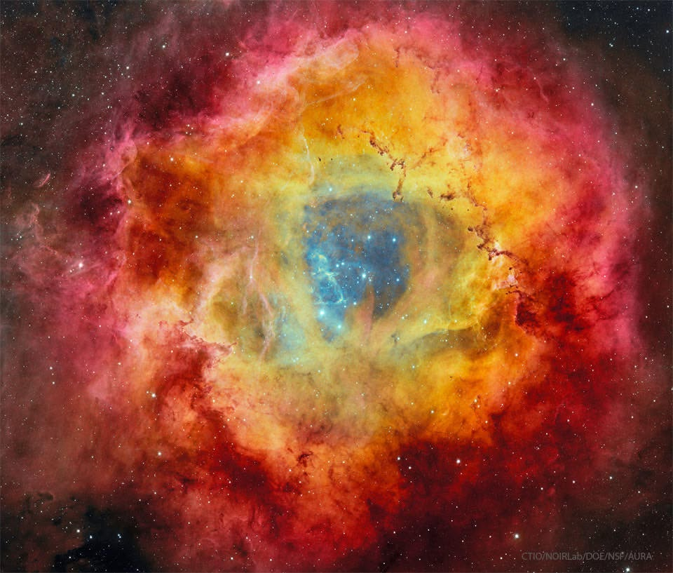
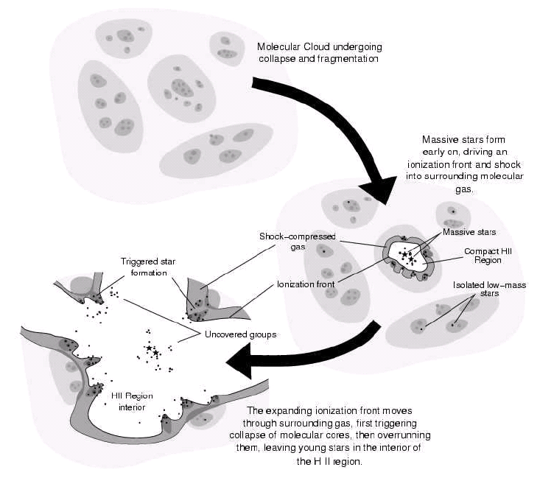
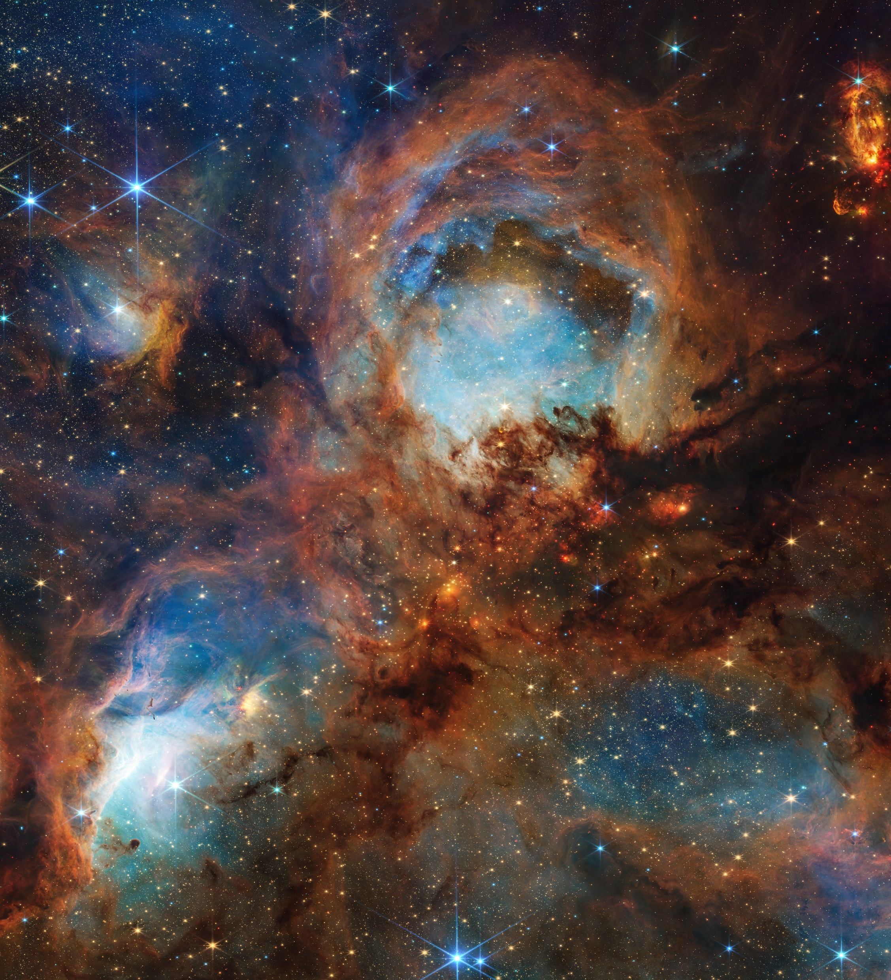
CLEARING DRIVEN BY MASSIVE STARS
Rosette Nebula
4m Blanco Telescope@CTIO
NGC6334
NIRCam@JWST
Andrè+2025
Hester & Desch, 2005

Slide 27
WHERE TO LOOK
PHOTOEVAPORATION
Cores of young massive clusters and supermassive clusters
LATE ACCRETION
Young nebular regions, mainly low mass young clusters
CLOSE ENCOUNTERS
Very dense clusters, very young star formation sites
LOW METALLICITY
Clusters in the outer Galaxy or in the Magellanic Clouds
ENERGETIC PARTICLES
Massive clusters with evolved massive stars and close massive binary systems

