Slide 1
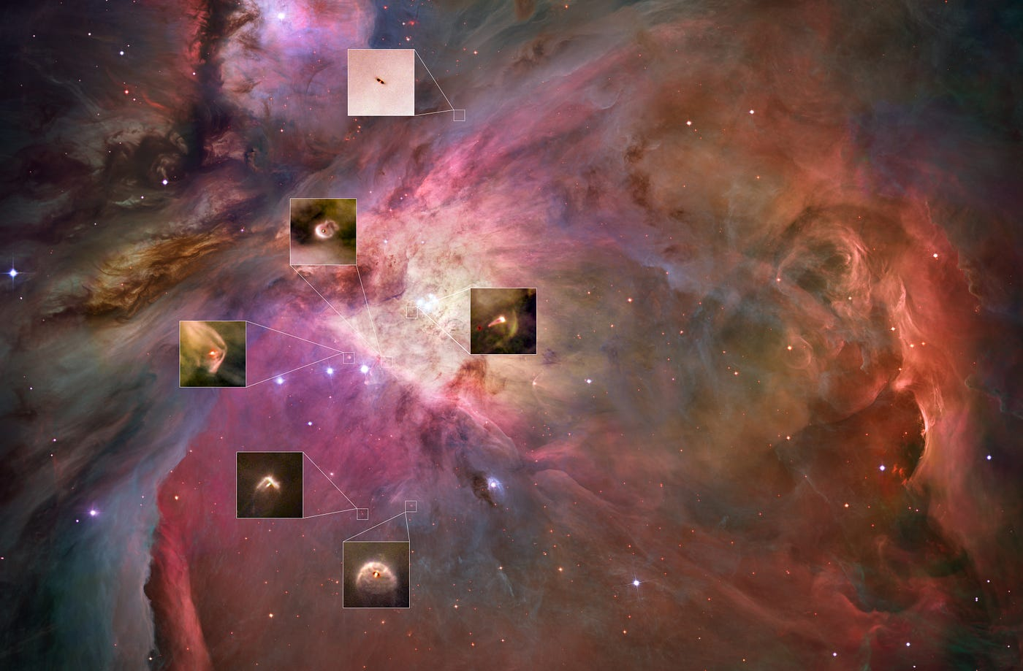

Disk populations and their evolution in various galactic environments
Mario Giuseppe Guarcello
INAF
Osservatorio Astronomico di Palermo
Photoevaporation

Slide 2
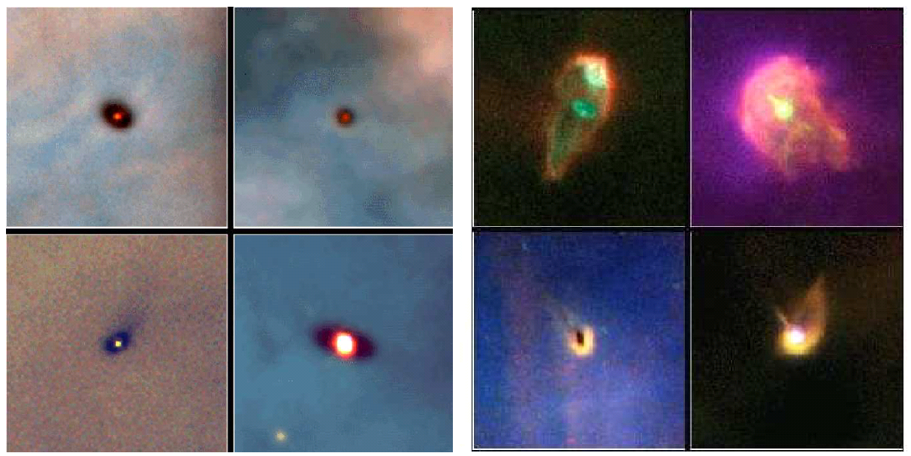
FIRST RESOLVED IMAGES OF PROTOPLANETARY DISCS
Resolved images of PPDs in the Orion Nebula Cluster
N-filters enclosing [OIII] 5007, Hα, [NII] 6583, [OI] 6300, [SII] 6731 plus M- and W-filters for continuum
First evidence for discs embedded in evaporating structures
O’Dell et al. 1993; O’Dell & Wen 1994; O’Dell 1998; Ballyet al. 2000
Protoplanetary discs observed in the Trapezium by HST.
The discs in the left panels are distant from θ¹ Ori.
Discs in the right panels are closer than 0.5 pc from the O star, and they are loosing gas and small dust (O’Dell & Wong 1996, Bally+2000)

Slide 3
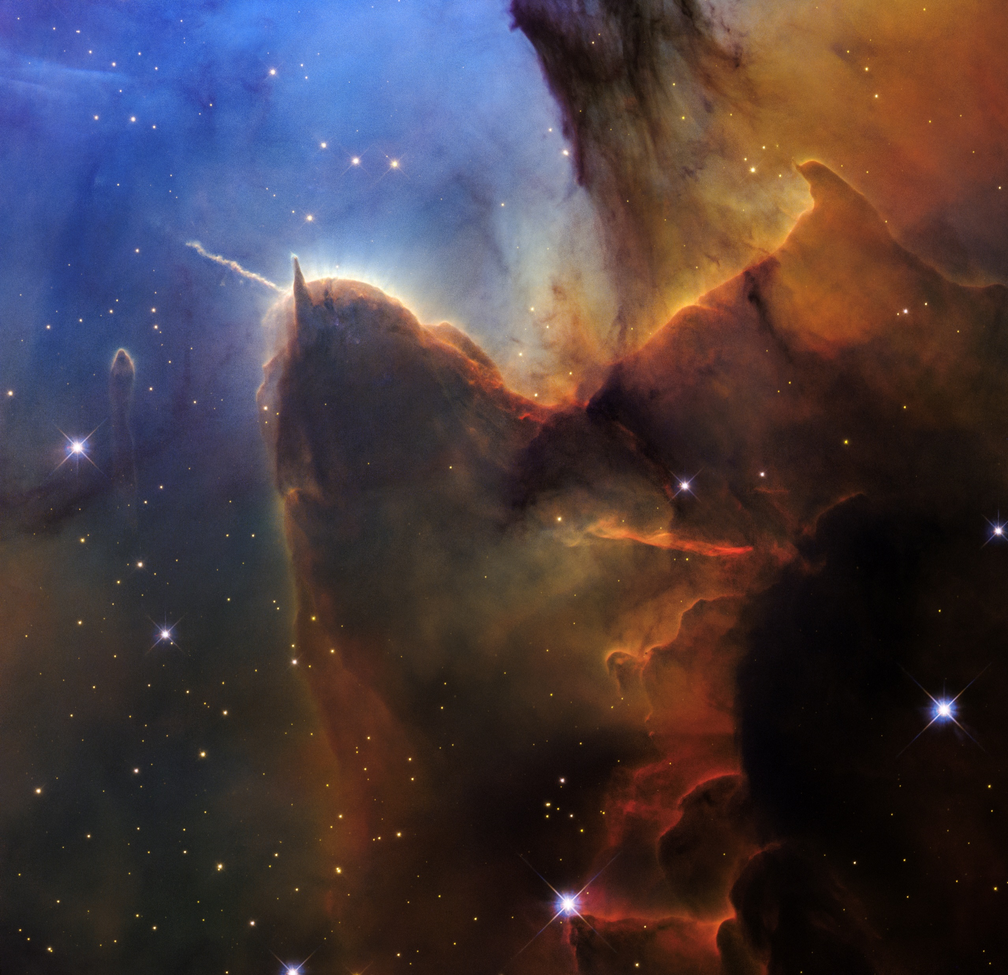
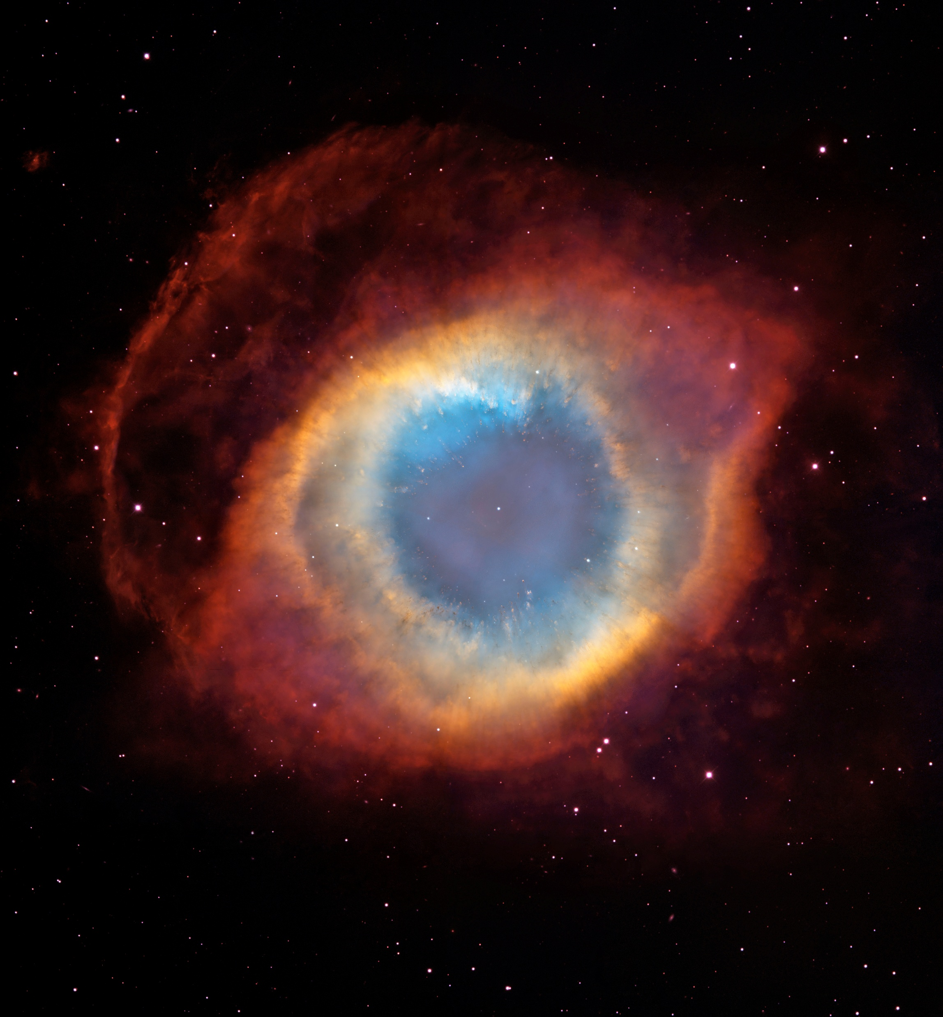
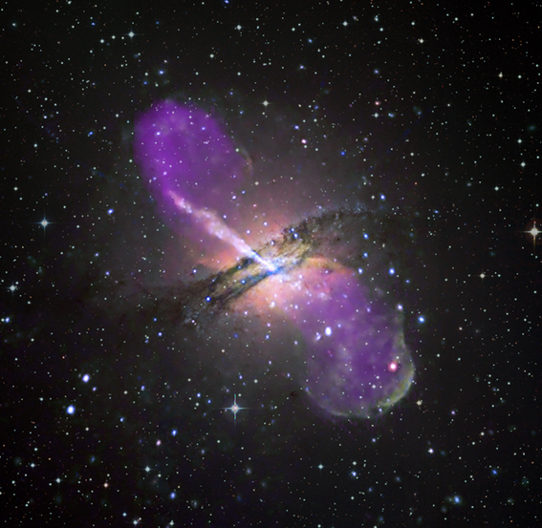
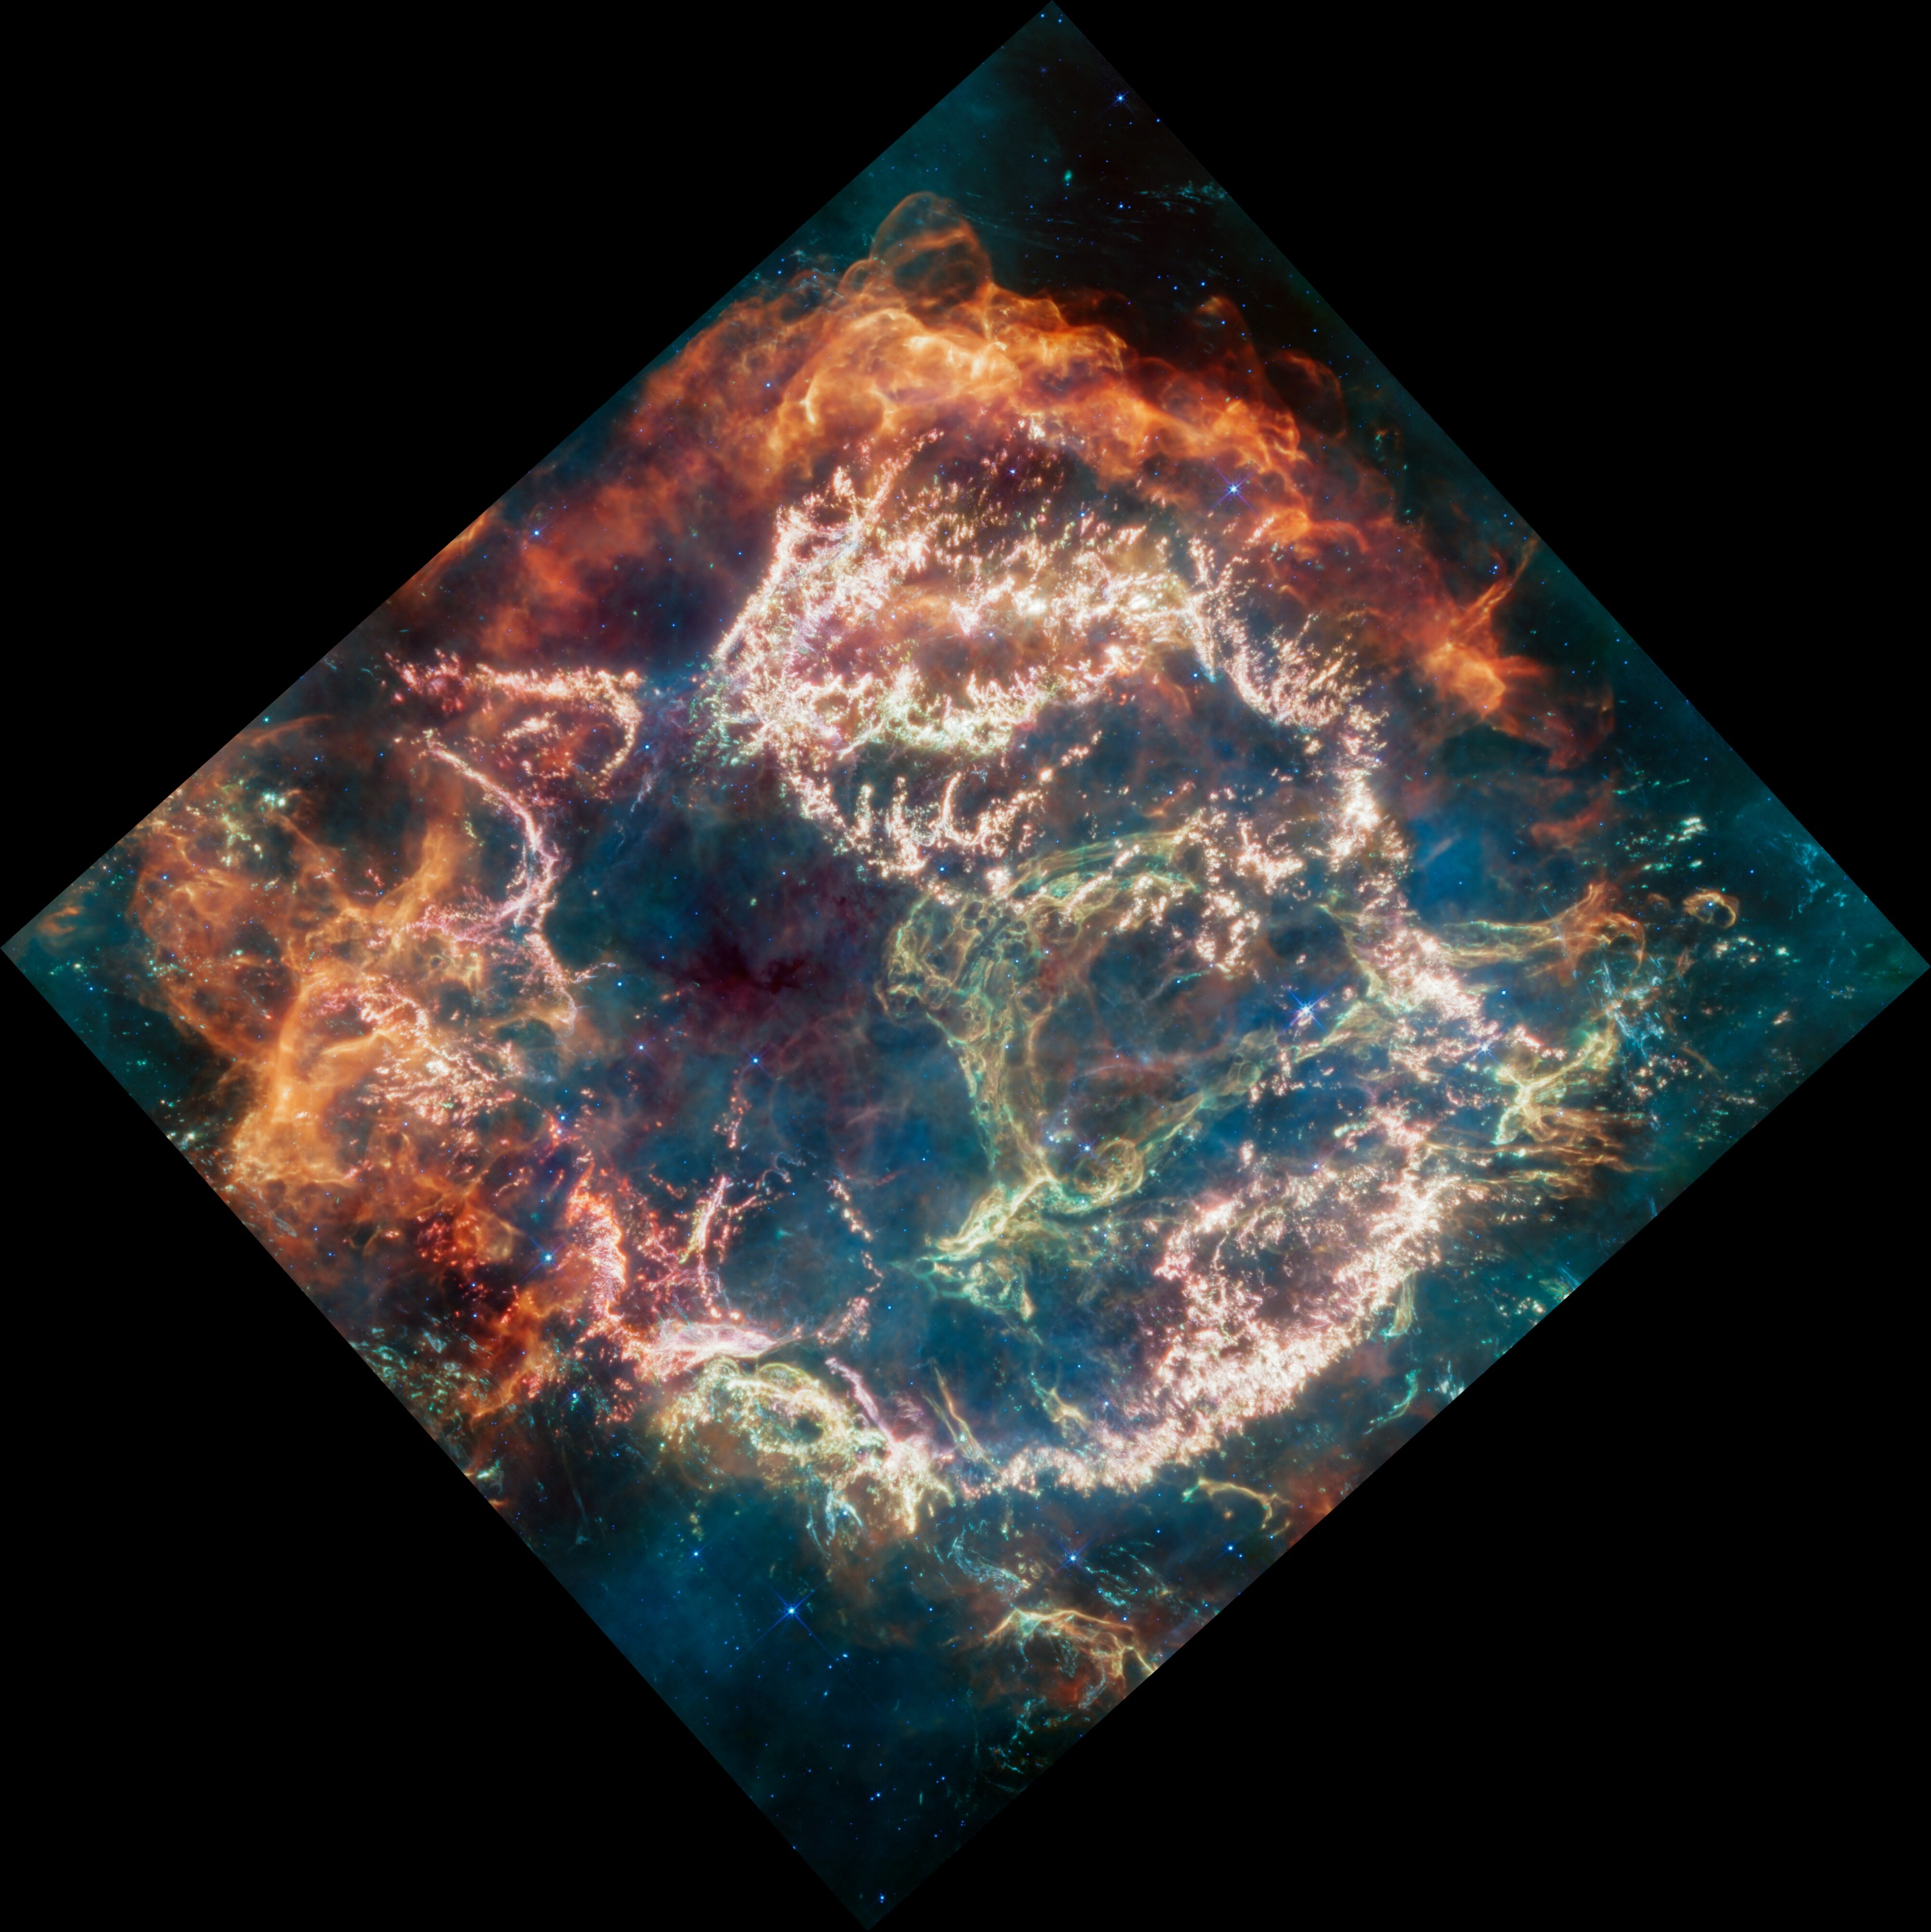
WHY NARROW-BAND FILTERS?
N-filters encompass specific lines and Forbidden Emission Lines (FELs)
FELs probe low-density hot gas (radiative decay more probable than collisional)
Provide diagnostics for temperature and density
HII Region
(Trifid Nebula)
Planetary nebule (Helix)
Active galaxies (CenA)
SNR (CasA)
Protostellar jets (HH12)

Slide 4
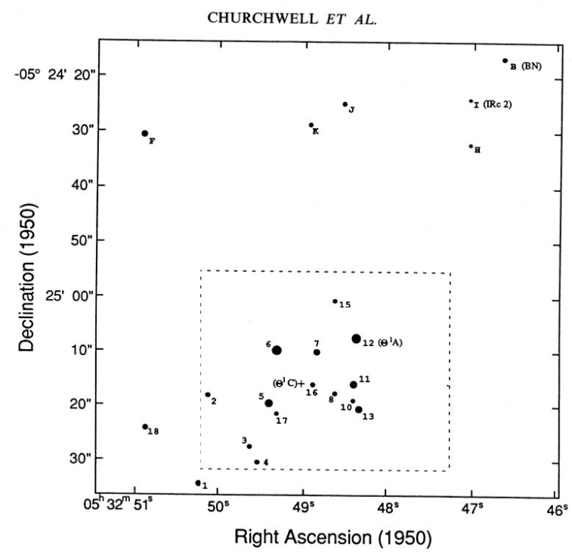
PREVIOUS CLUES FROM RADIO OBSERVATIONS
VLA 14.94 GHz radio observations detected 22 compact radio sources (Churchwell+1987)
Main hypothesis: solar mass stars surrounded by evaporating discs
From free-free (bremsstrahlung) emission from the ionized evaporative wind
External ionizing source (θ¹ Ori)
Ionized mass <10⁻⁶ M⊙
Electron density >10⁶ cm⁻³
Mass loss rate 10⁻⁶ M⊙ /yr
Detected compact sources;
dots dimension proportional to source flux

Slide 5
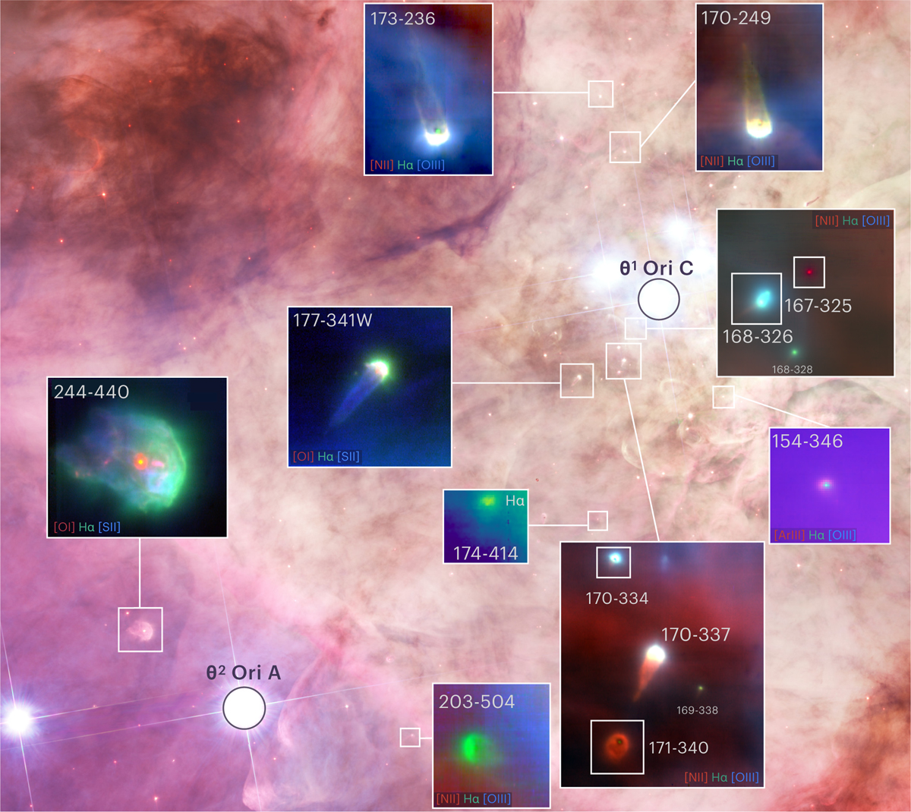
THE ORION PROPLYDS TODAY
Evaporating discs observed in Orion with MUSE (Aru+ 2024)

Slide 6
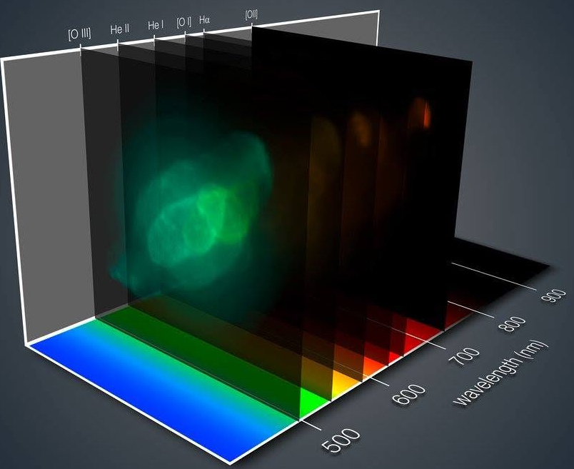
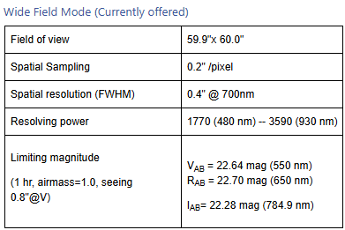
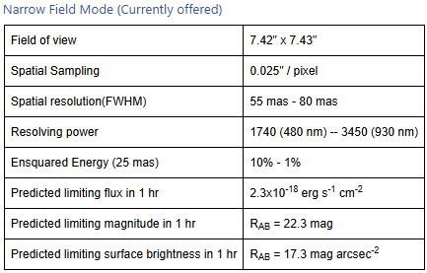
MUSE@VLT
MUSE (Multi-Unit Spectroscopic Explorer), @VLT UT4
24 IFUs covering a 1 squared arcmin FoV
Spectral range: 480-930 nm
Spatial resolution 0.2" in WF Mode with no AO
AO corrected 1'x1’ FoV 7.5"x7.5" laser-tomography adaptive optics spatial resolution 0.025"/pixel

Slide 7
THE BASIC PHYSICS

Slide 8
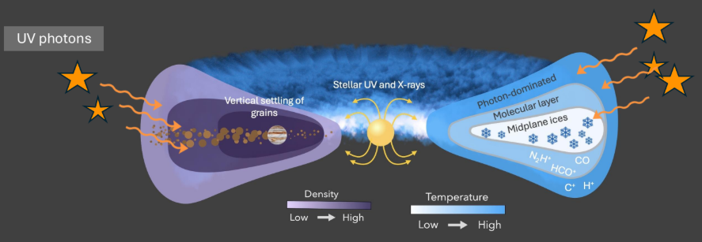
HEATING RADIATION
Basic modelling by:
Johnstone+ 1998; Henney & Arthur 1998; Störzer & Hollenbach 1998; Richling & Yorke 2000
Heating is driven by EUV (hν > 13.6 eV) and FUV (6 eV < hν < 13.6 eV) photons emitted by nearby massive stars

Slide 9
FUV HEATING MECHANISMS
Absorption by H₂ molecules →
Excitation of H₂ atoms →
Vibrational energy is converted into heat via collisional de-excitation
Disc temperature > 1000 K
Neutral gas expands being launched as a thermal wind
FUV photons
Absorption by dust grains →
Release of energetic electron →
Kinetic energy released as heat after collision with gas particles
Johnstone+ 1998; Adams+ 2004

Slide 10
HEATING MECHANISM IN EUV REGIME
Direct ionization of H atoms
Energy stored in the electrons converted into heat by collisions
Gas temperature 7000 – 10000 K
Formation of a ionization front, dominated by EUV photons, surrounding a PDR dominated by FUV photons
EUV photons

Slide 11
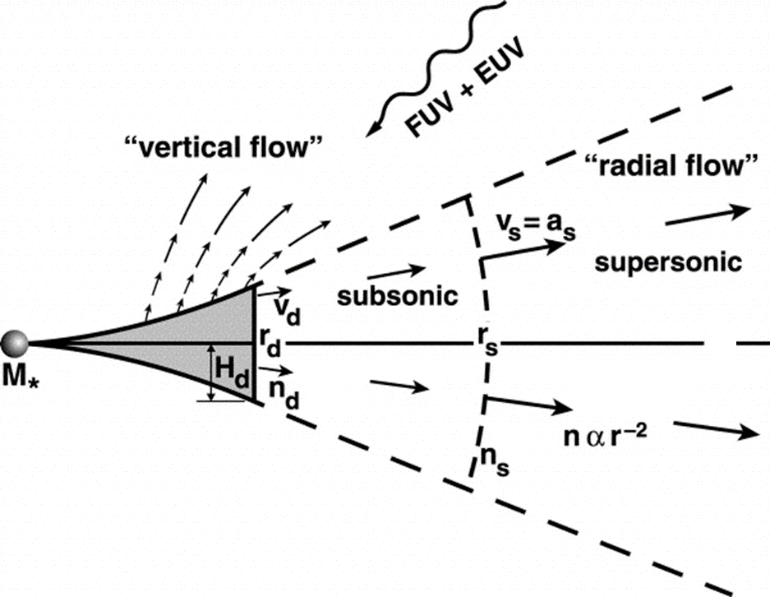
PHOTOEVAPORATIVE FLOW IN FUV REGIME
Rd = disc radius
Rs= sonic radius (transition from subsonic to supersonic flow)
Adams+ 2004

Slide 12
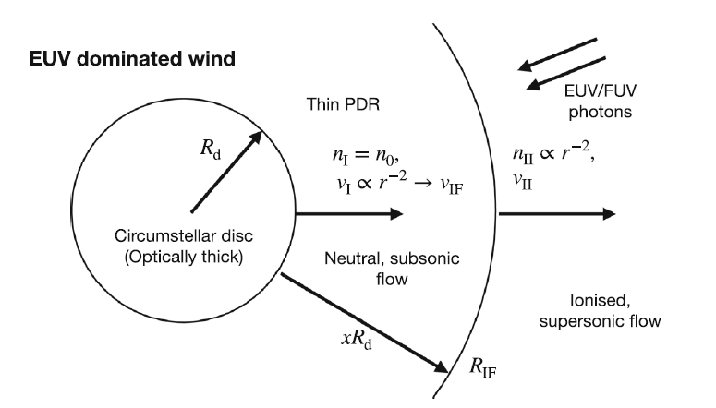
SIMPLIFIED SCHEME OF A EUV-EVAPORATING DISC
Ionized wind over Rif
T≈10⁴ K
Velocity at about 10 km/s (a_{II})
Density drops as R⁻²
Rd= disc radius
Incident FUV creates a thin PDR region
In the PDR: gas neutral and subsonic
Gas density constant →
Velocity grows at R⁻²
EUV penetrates at R_{if}, where gas is ionized → ionization front
T increases abruptly
Johnstone+ 1998 Winter+2022
Notes:
Enormous Thermal Jump: As gas crosses $R_{\text{IF}}$, its temperature spikes from $T_{\text{PDR}} \sim 1,000 \text{ K}$ to $T_{\text{II}} \sim 10,000 \text{ K}$, causing the local sound speed to jump from $a_{\text{I}} \approx 2 - 3 \text{ km/s}$ up to $a_{\text{II}} \approx 10 \text{ km/s}$.
Thermal Pressure Barrier: This sudden ten-fold increase in temperature creates a massive thermal pressure gradient across the boundary. The hot $10^4 \text{ K}$ ionized gas expands violently outward.
Sonic Exit Velocity: Under steady-state hydrodynamic flow, a gas escaping through a physical boundary into a lower-pressure region reaches a maximum stable mass flux when it leaves the interface at the local sound speed of the exiting medium. Thus, the ionized gas launches away from the front at approximately its own sound speed ($v_{\text{II}} \approx a_{\text{II}}$).

Slide 13
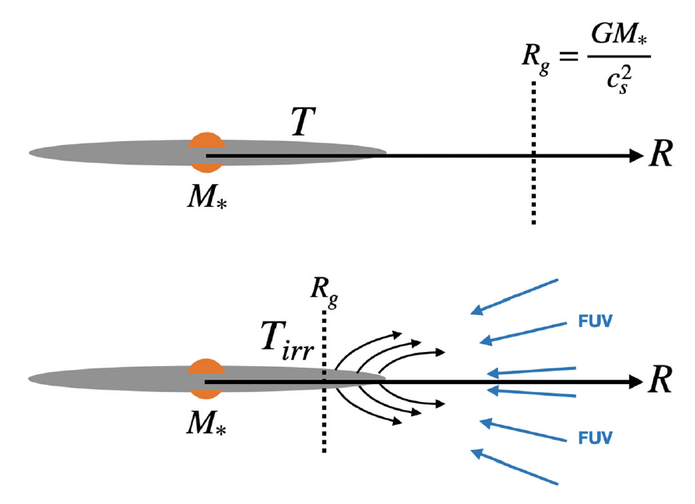
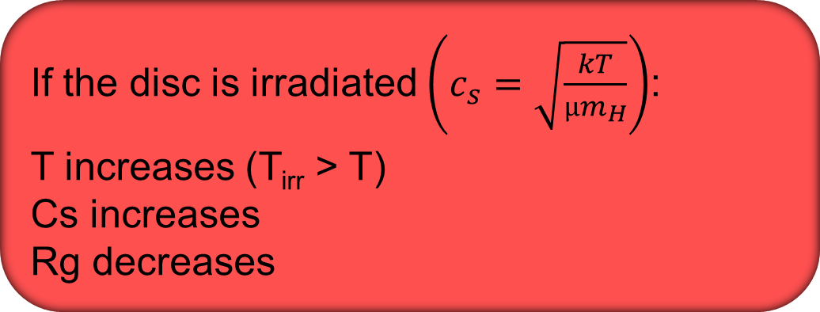
THE GRAVITATIONAL RADIUS
In the simplified hypothesis of an isothermal disc, below Rg the disc material is gravitationally bond to the disc
If the disc is irradiated $\left(c_{s}=\sqrt{\frac{kT}{µm_{H}}}\right)$:
T increases (T_{irr} > T)
Cs increases
Rg decreases
EUV regime: c_{s}≈10 km/s; ionized H (µ≈0.5) → Rg=7-10 AU
Rg
FUV regime: c_{s} ≈1-3 km/s; molecular or atomic H (µ≈1.3-2.3) → Rg > 100 AU
Notes:
Equating escape velocity with the speed of sound

Slide 14
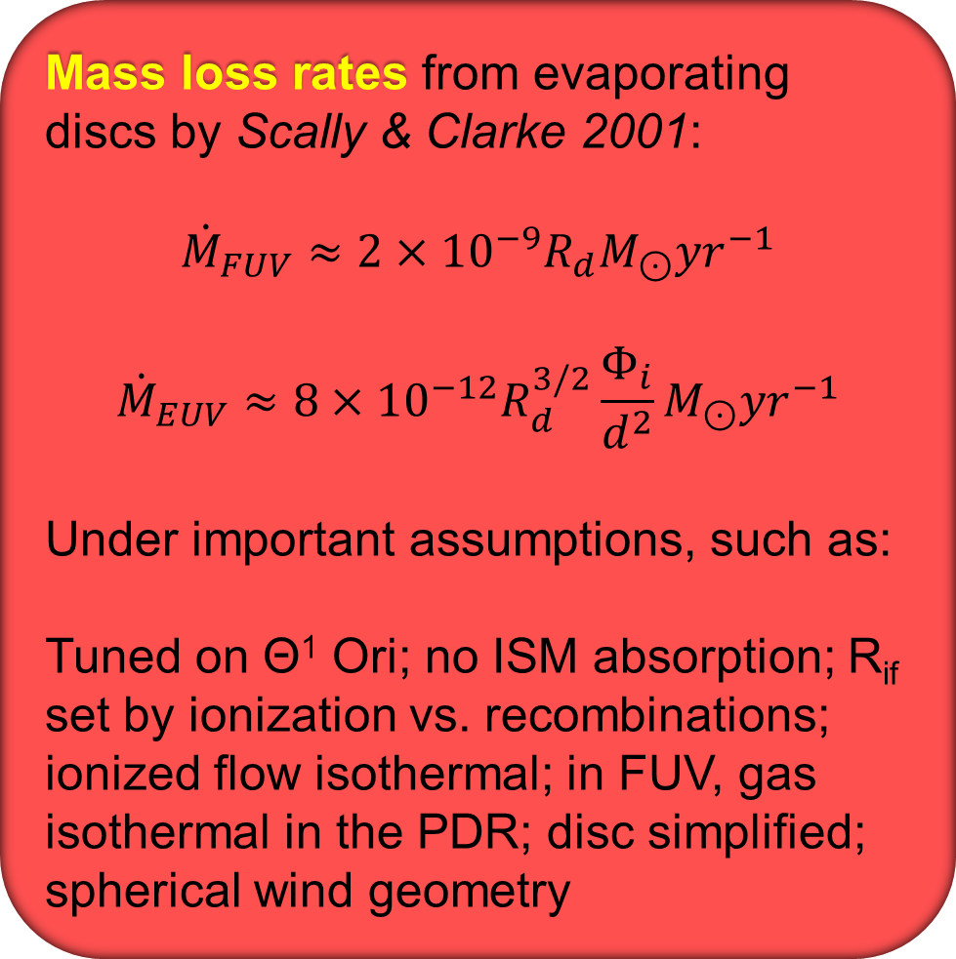
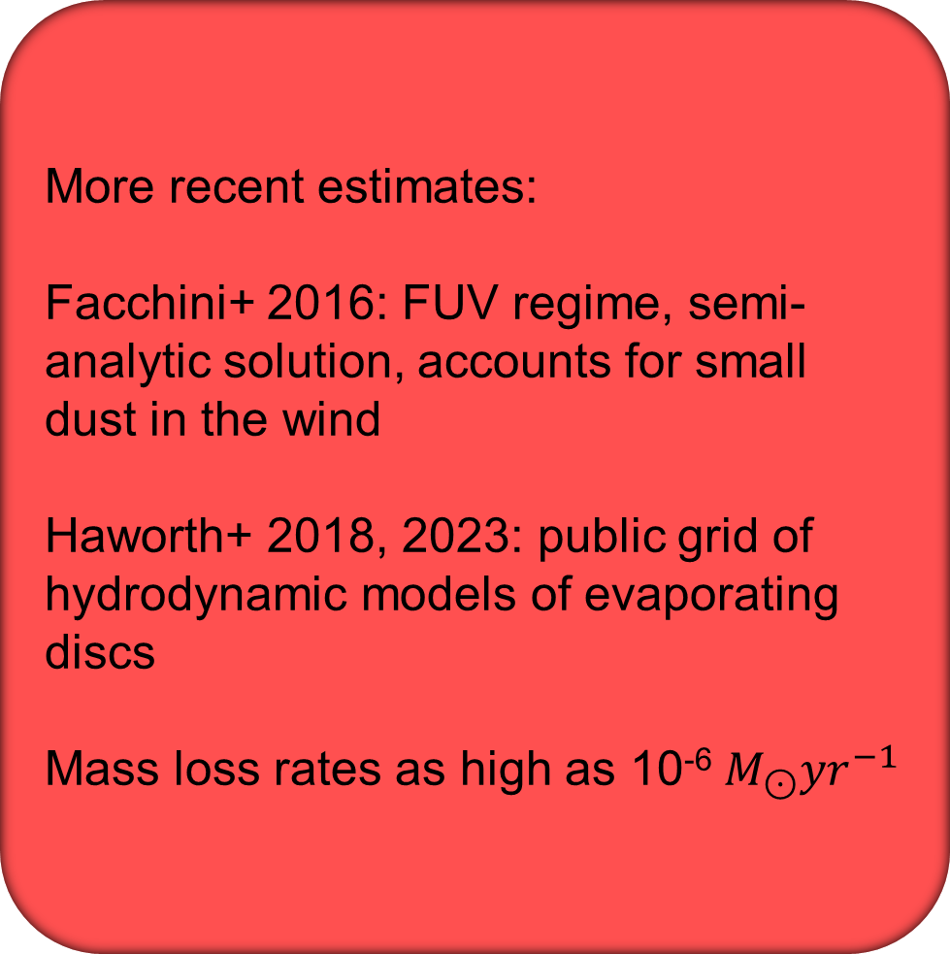
MASS LOSS RATES FROM MODELS
Mass loss rates from evaporating discs by Scally & Clarke 2001:
$${\dot{M}}_{FUV}≈2×{10}^{−9}R_{d}M_{⊙}{yr}^{−1}$$
$${\dot{M}}_{EUV}≈8×{10}^{−12}R_{d}^{3/2}\frac{Φ_{i}}{d^{2}}M_{⊙}{yr}^{−1}$$
Under important assumptions, such as:
Tuned on Θ¹ Ori; no ISM absorption; R_{if} set by ionization vs. recombinations; ionized flow isothermal; in FUV, gas isothermal in the PDR; disc simplified; spherical wind geometry
More recent estimates:
Facchini+ 2016: FUV regime, semi-analytic solution, accounts for small dust in the wind
Haworth+ 2018, 2023: public grid of hydrodynamic models of evaporating discs
Mass loss rates as high as 10⁻⁶ $M_{⊙}{yr}^{−1}$

Slide 15
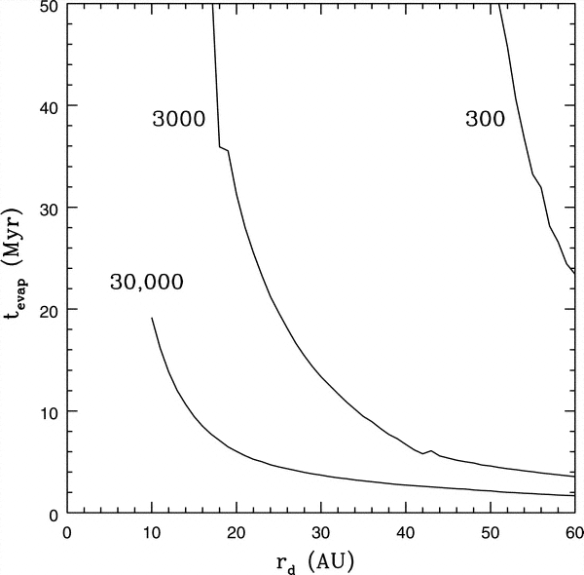
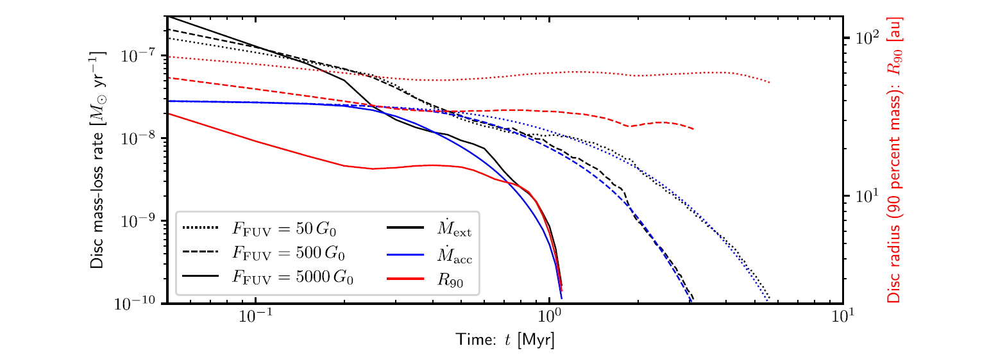
DISPERSAL TIMESCALES
Dispersal timescales can be significantly short
Comparison between mass loss rate, mass accretion rate and disc size increasing FUV intensity field (Winter & Haworth 2022)
Evaporation timescale for a 0.05 M⊙ disc around a 1 M⊙ star
(Adams+2004)
In EUV regime, disks closer to 0.5 pc to O stars are dissipated in <10⁶ years down to 0.5-0.2 Rg (Johnstone+ 1998)

Slide 16
PROPLYDS

Slide 17
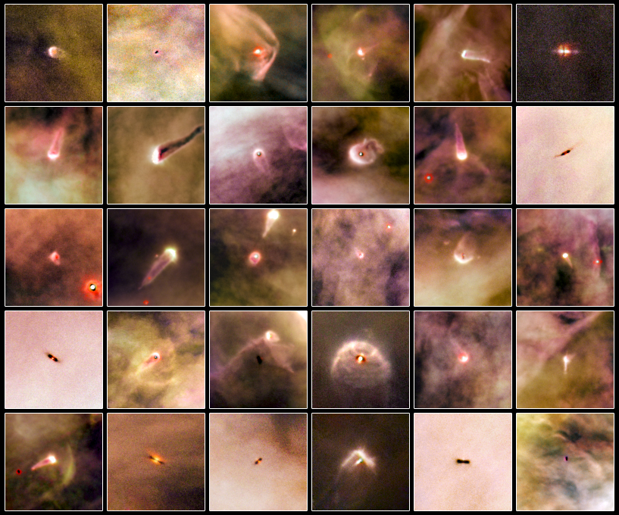
PROPLYDS
Gallery of protoplanetary discs (isolated and evaporating) in the ONC observed by HST
Ricci+ 2008

Slide 18
PROPLYDS IN EUV- AND FUV-DOMINATED REGIONS
From the JWST PDR4All ERS program (Bernè+ 2022)
Images of Orion proplyds in N-filters
F164N → [FeII]
F187N → Paα
F212N → H2
F335M → PAH
A rich sample of morphologies which depend on the external irradiation
Amiot+ 2026

Slide 19
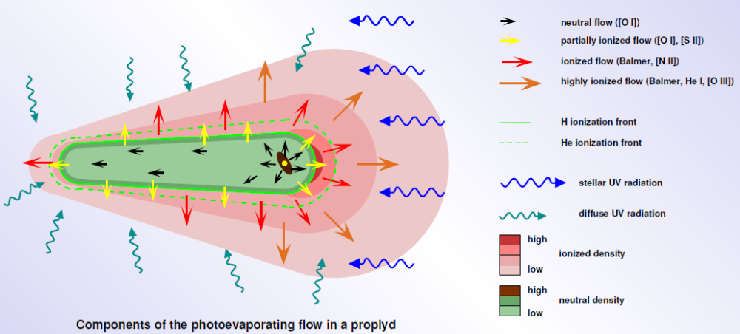
MODELLING PROPLYDS SHAPE
Schematic representation of an evaporating proplyd
FUV photons penetrate to the surface of the disc, driving a slow neutral flow
The flow goes supersonic before Rif
The tail is fed by gas redirected from the front side by pressure gradient (Bertoldi & Johnstone 1999)
Henney & O’Dell 1999

Slide 20
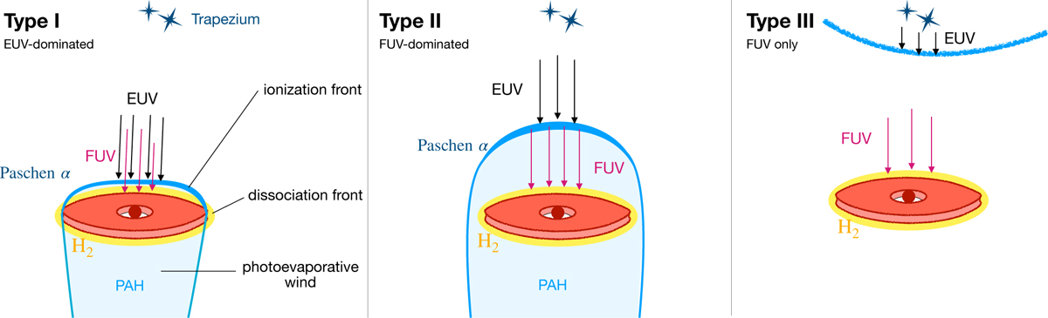
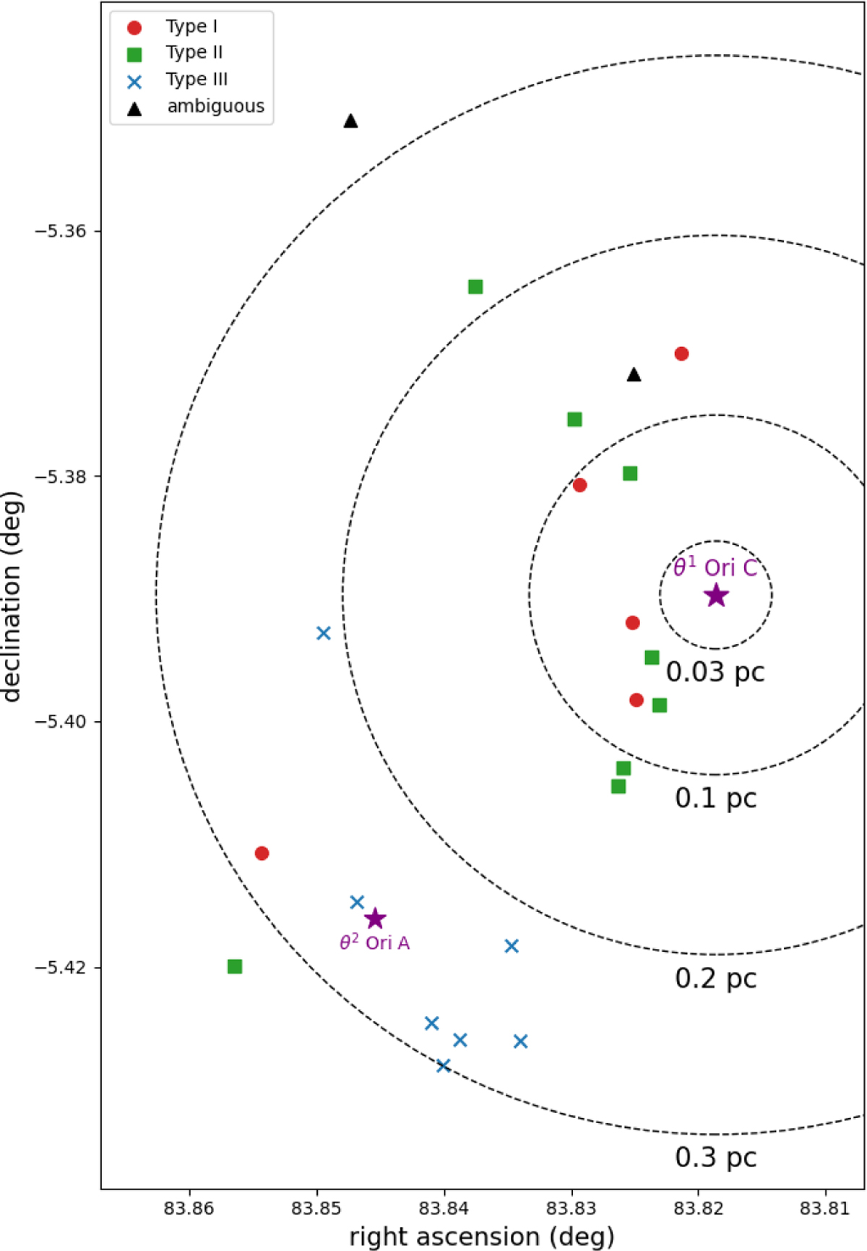
PROPLYDS IN EUV- AND FUV-DOMINATED REGIONS
Type I → EUV dominated → IF lies close to the disc, very small PDR region
Type II → FUV dominated → IF far from the disc, large PDR
Type III → no EUV (outside the Strömgren sphere) → no IF
Amiot+ 2026

Slide 21
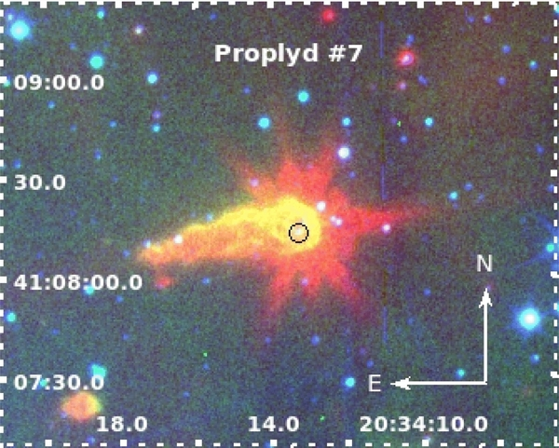
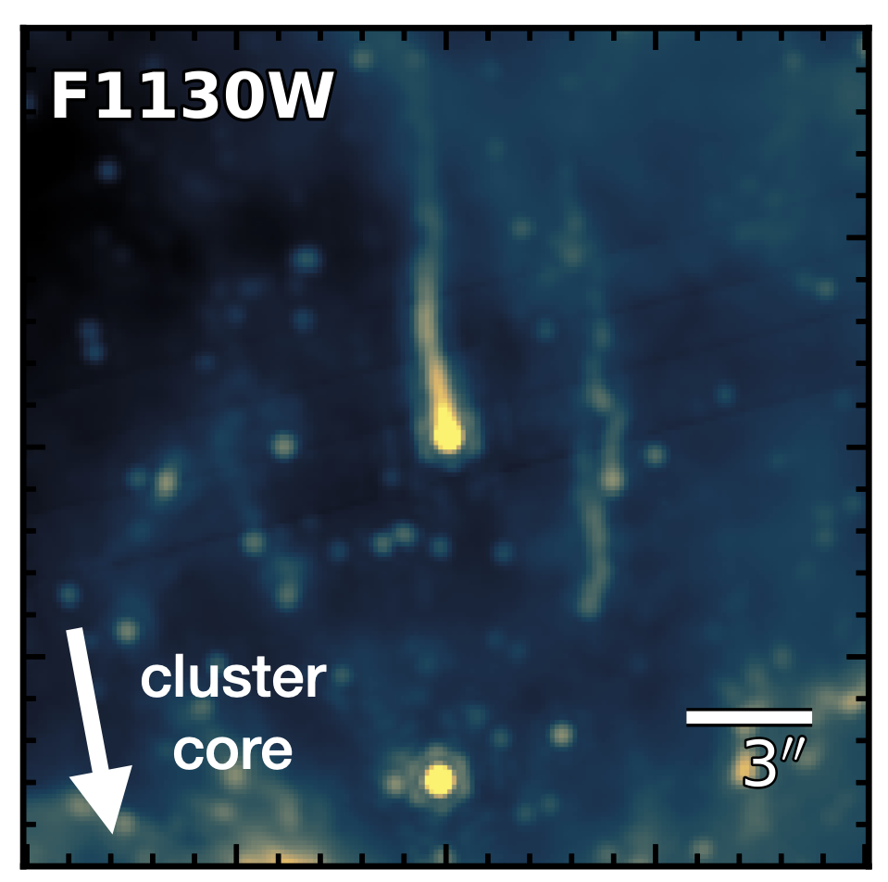
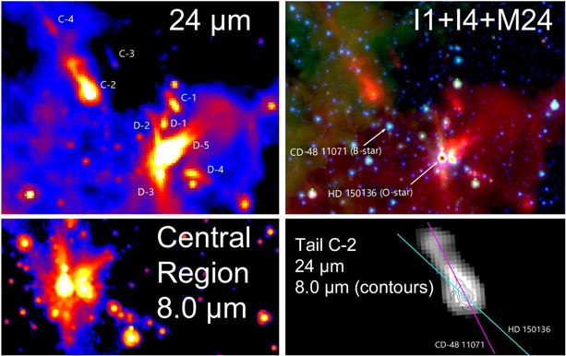
NOT ONLY ORION
A proplyd-like object in CygOB2 ([8.0]+Hα+r) with a spectrum rich of emission lines from OSIRIS.
6-14pc from massive stars
Size: 18000 AU
(Wright+2012, Guarcello+2013)
Evaporating star in Westerlund2 from the EWOCS project
Size: 12600 AU
Monsch+ in prep
Cometary tails around the O stars in NGC 6193 observed with Spitzer
Thevenot 2020

Slide 22
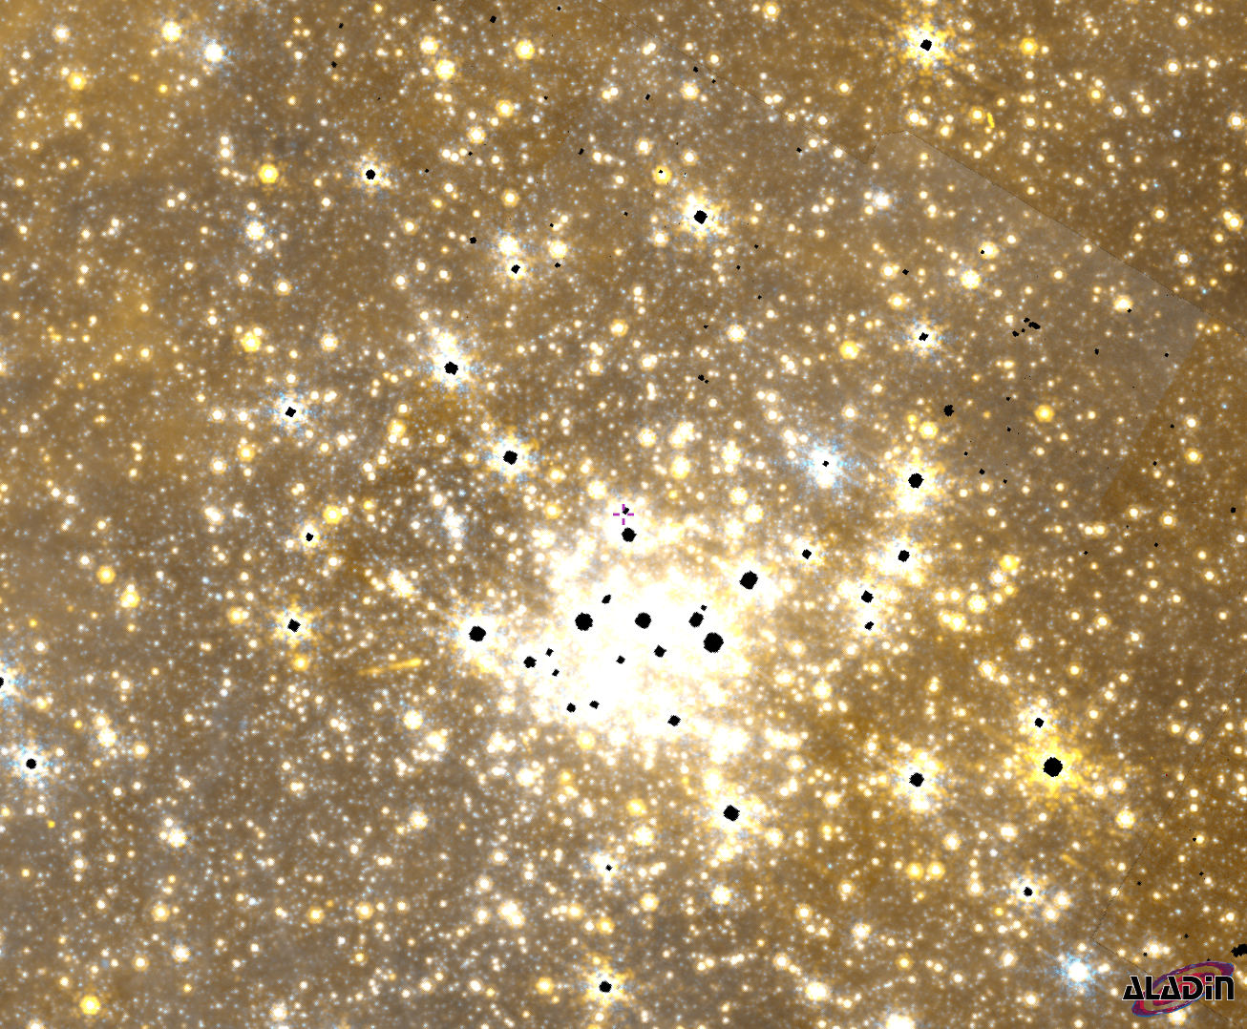
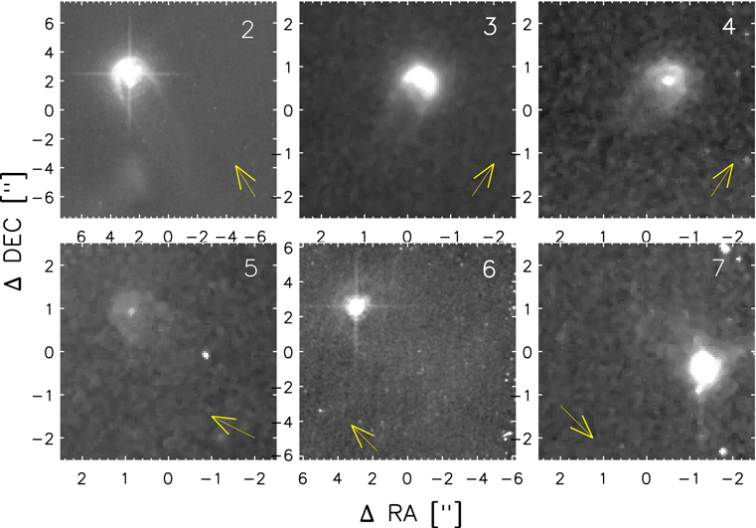

NOT ONLY ORION
Evaporating discs around 42 Ori (B1V) observed with HST/ACS
Kim+ 2016
${\dot{M}}_{loss}$=10⁻⁹--10⁻⁸ M_{ʘ}/yr (Boyden & Eisner 2024)
Evaporating structure in the Arches (⁓8 kpc); JWST-GC Treasury Program (Schoedel+)

Slide 23
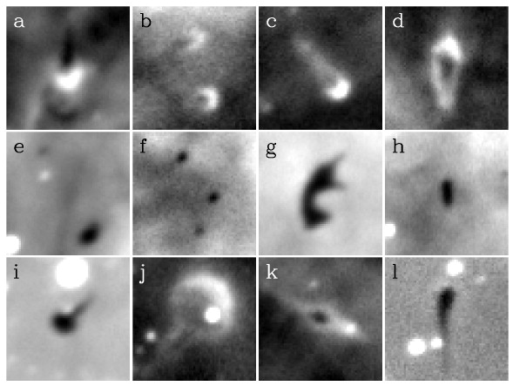
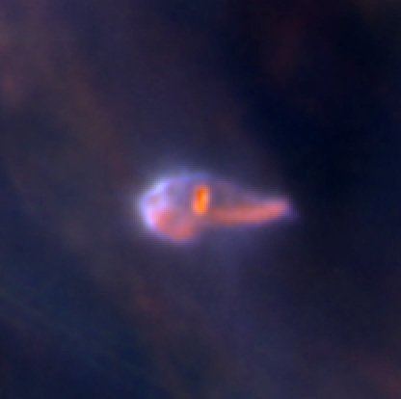
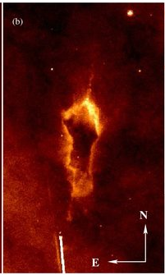
PROPLYDS vs. EGGs
Globulette in Carina (Hα)
Smith+2003
Grenman & Gaham 2014
Not trivial to distinguish between an evaporating disc and a disc accreting from an evaporating EGG-like envelope
Proplyd 182-413
JWST/NIRCam
(F821M, F300M, F360M)
McCaughrean+2024
frEGG1 in Carina (HST F865N), previously indicated as a proplyd, but later discovered a significant mass (0.35 M_{ʘ}) in the envelope (Sahai+2012, Mesa-Delgado+2016)

Slide 24
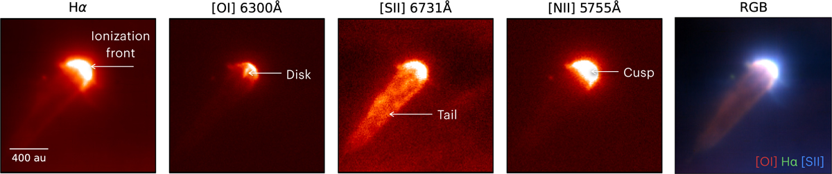
HOW TO BE SURE? RESOLVE STAR AND DISC
In nearby regions, by using proper filters it is possible to resolve the different components of proplyds
e.g. Kirwan+ 2023; Haworth+ 2023a; Aru+ 2024a
Proplyd 177-341W observed with MUSE
(Aru+2024)

Slide 25
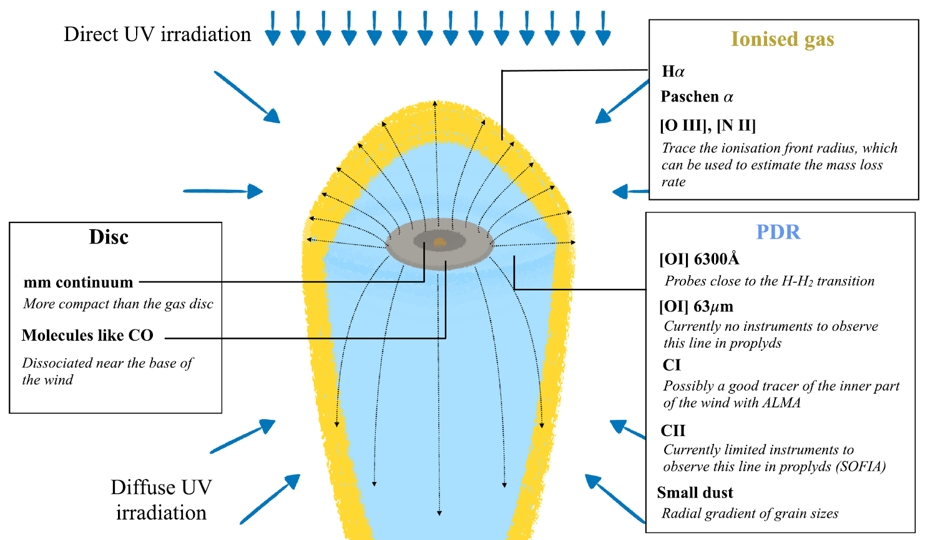
HOW TO BE SURE? LINE DIAGNOSTICS
Winter & Haworth 2022

Slide 26
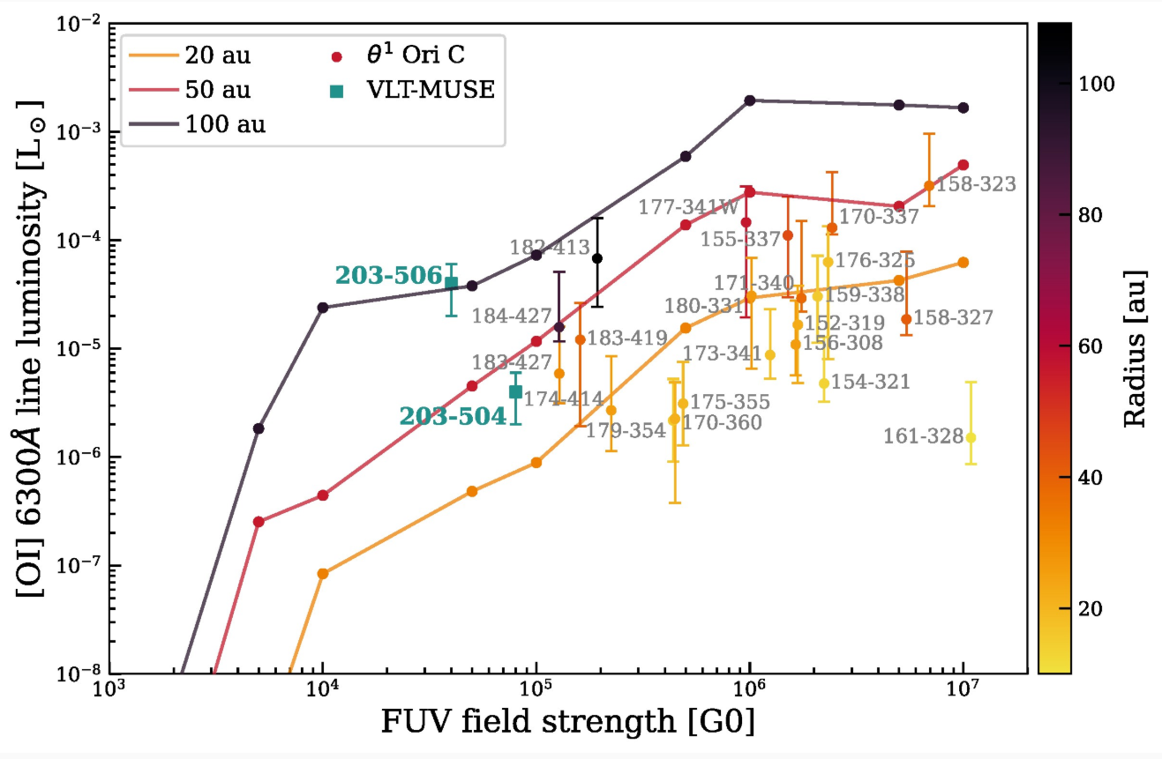
LINE DIAGNOSTICS: OI[6300]
[OI] 6300 is an efficient probe for inner disc wind (thermally excited)
In evaporative wind, [OI] 6300 results from the dissociation of OH, and its intensity correlates with FUV flux strength
Ballabio+ 2022
Model and observed [OI]6300 line luminosity for ONC proplyds
Ballabio+ 2022

Slide 27
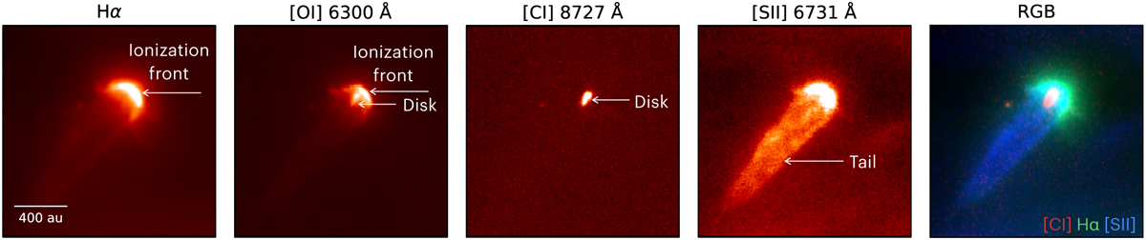
LINE DIAGNOSTICS: CI[8727] and CI[9850]
Proplyd 177-341. Single line intensity map from MUSE
(Aru+2024)
[OI] 5577 cospatial with disc
[OI] 6300 cospatial with disc and IF
[CI] 8727 cospatial with disc, tracing the base of the evaporating wind
Confirm previous models of excitation of neutral carbon in irradiated discs, which scales with G₀ (Goicoechea+ 2024)

Slide 28
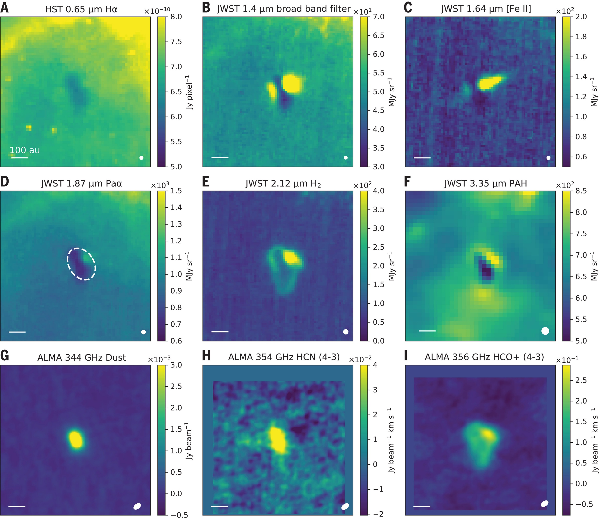
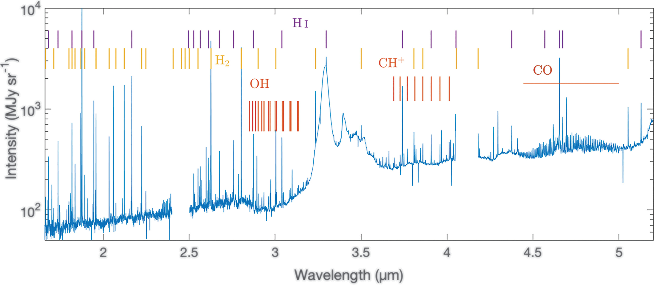
LINE DIAGNOSTICS PROBING THE PDR
Proplyd d203-506 (Orion)
NIRSpec spectrum shows CO, OH, CH⁺, and H2 lines which probe the PDR region
Together with PDR model, provide n_{H} (5.5×10⁵ – 10⁷ cm⁻³), T_{gas} (1250 K),
c_{s} (3.3 km/s), and R_{g} (26AU)
Line (HST, JWST) and ALMA maps of d203-506
Bernè+ 2024

Slide 29
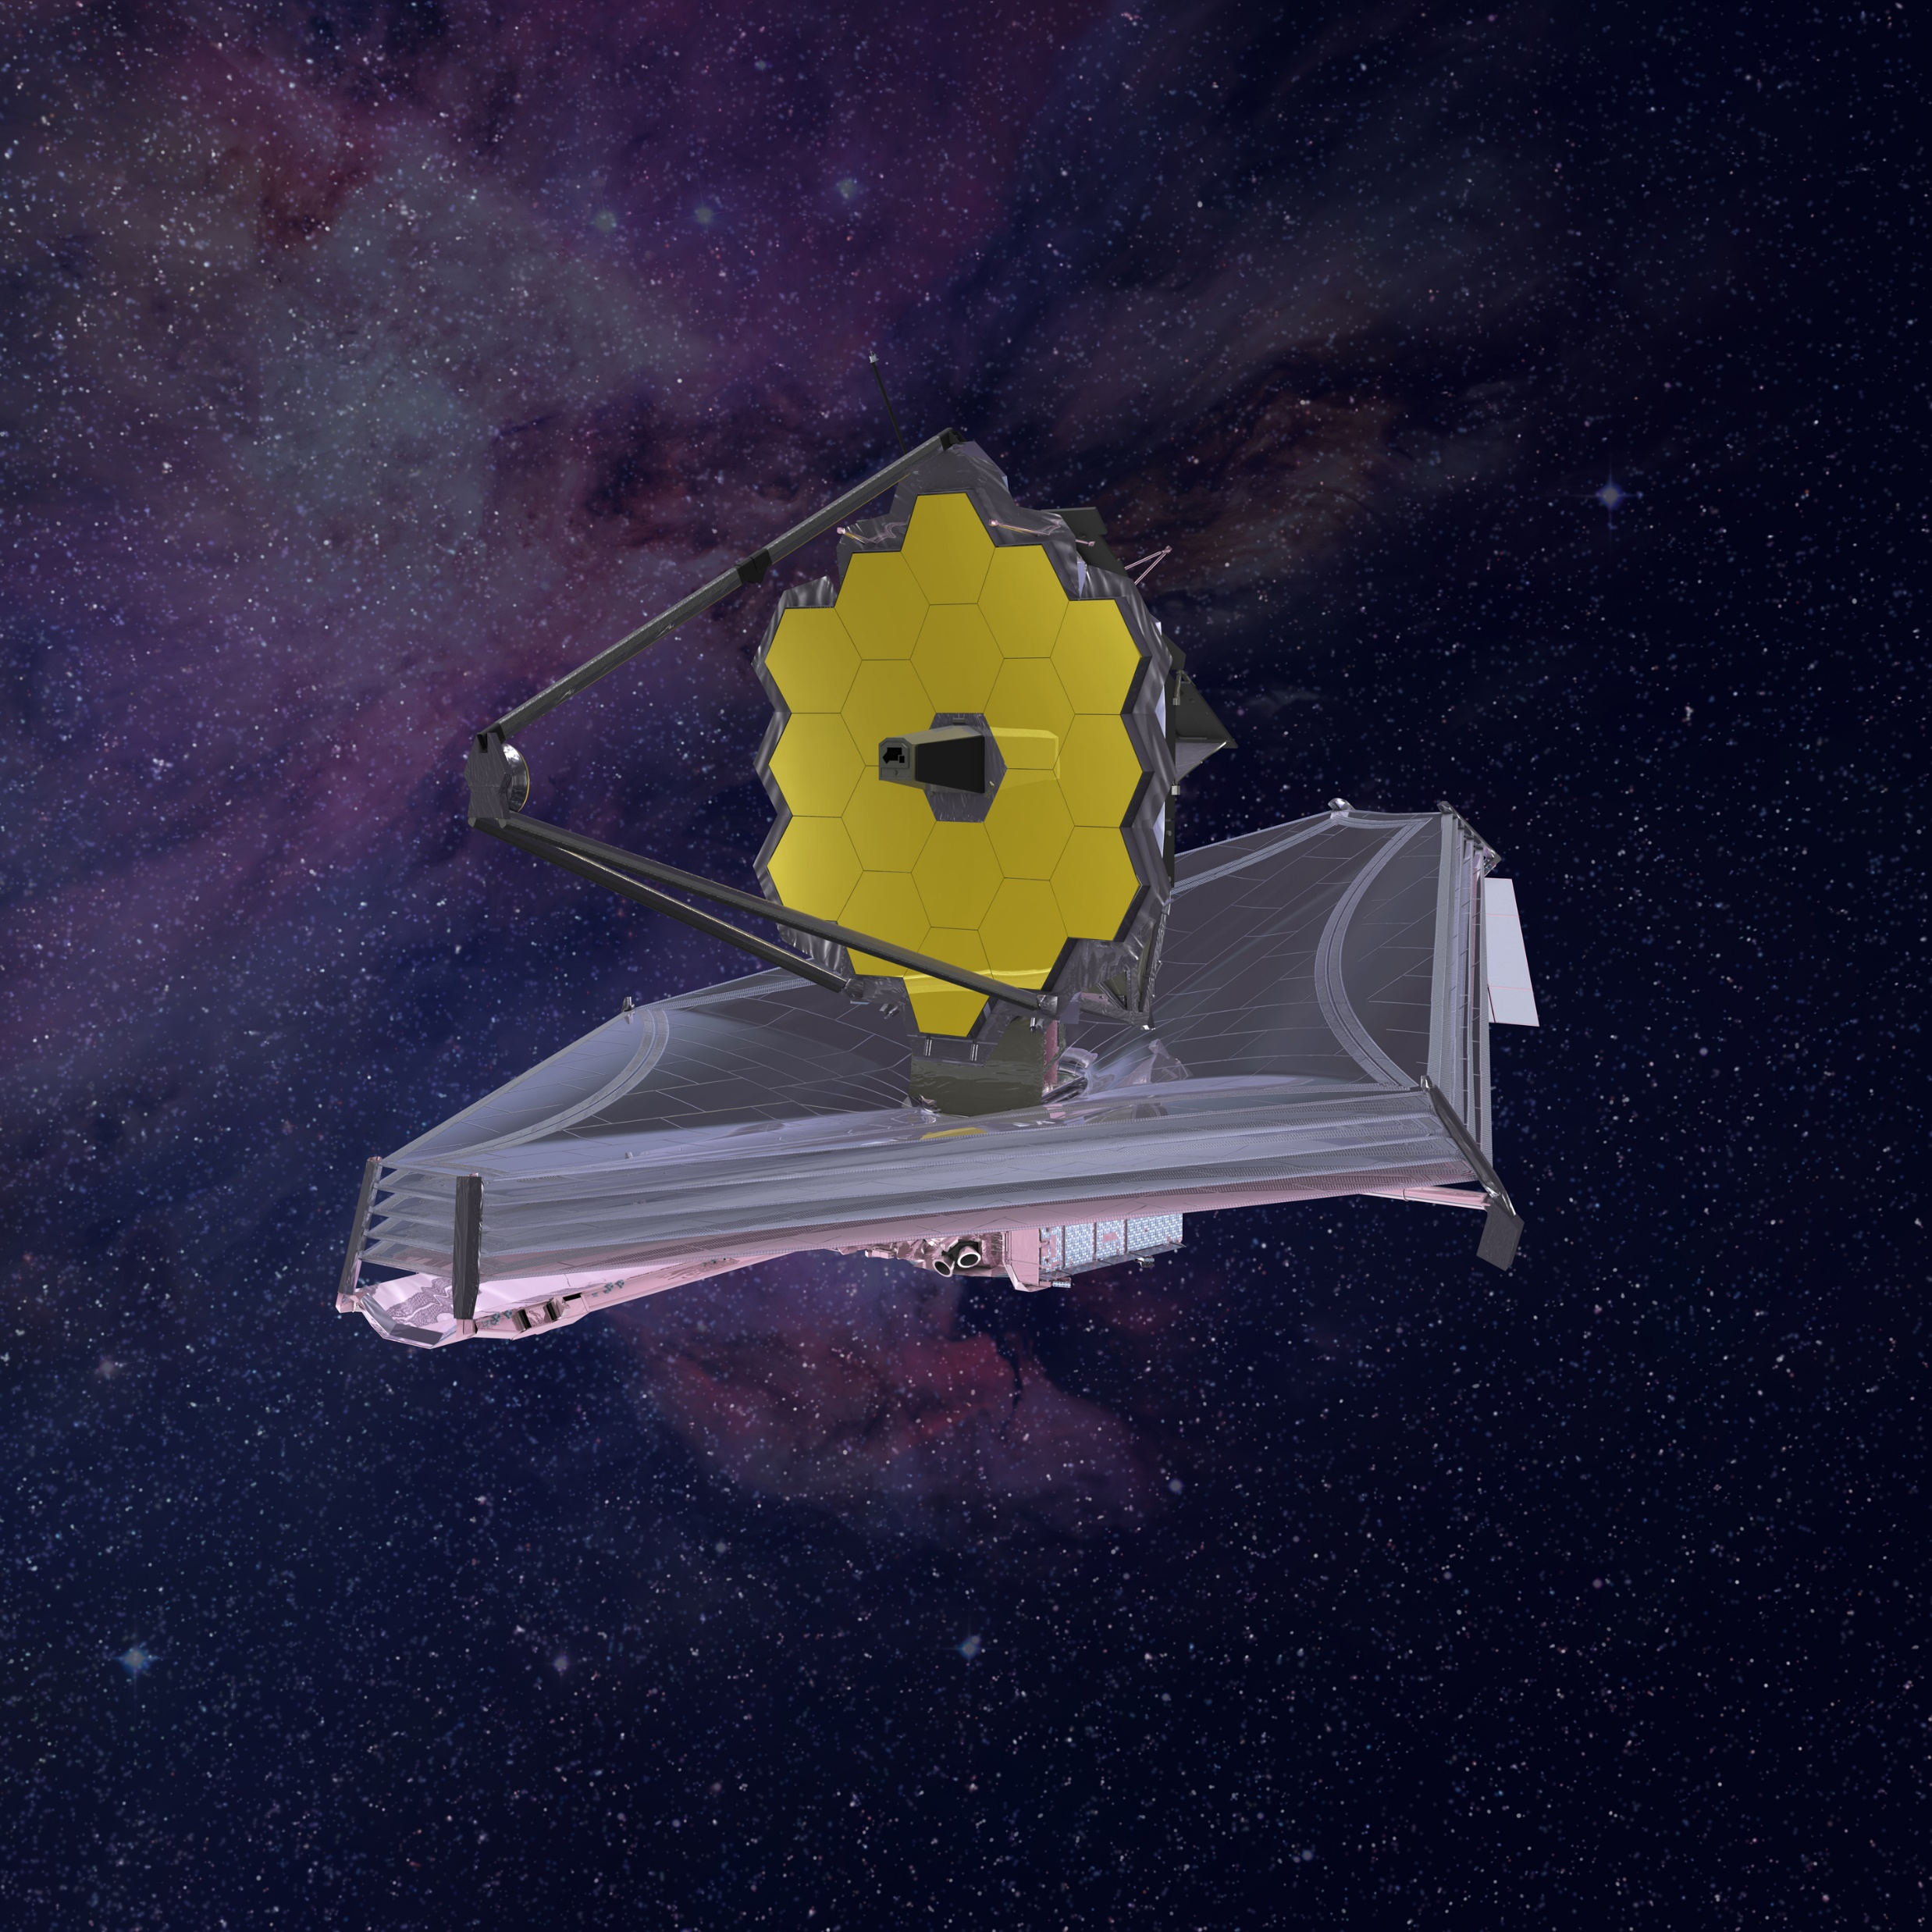
JWST
Primary mirror
The most complex space telescope ever built
Wavelength coverage 0.6-28.3 µm
4 Instruments, 17 possible different configurations and observing modes
Lifetime from 10 yrs to > 20 yrs
Secondary mirror
ISIM
Thermal shield
Bus and antennae

Slide 30
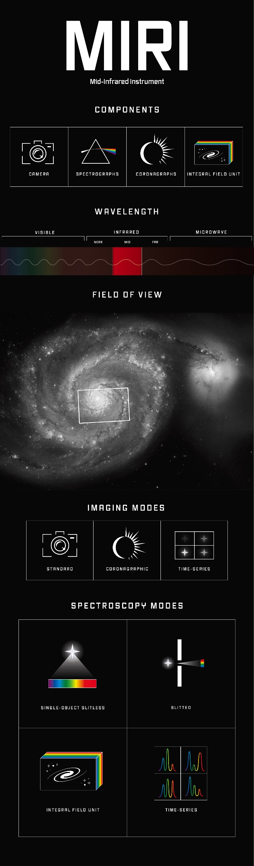
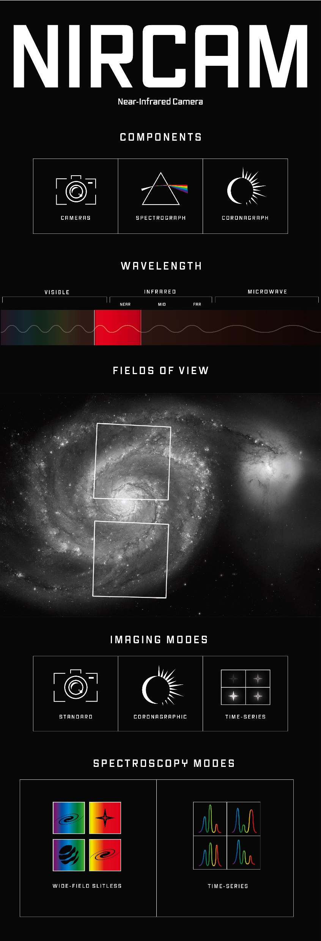
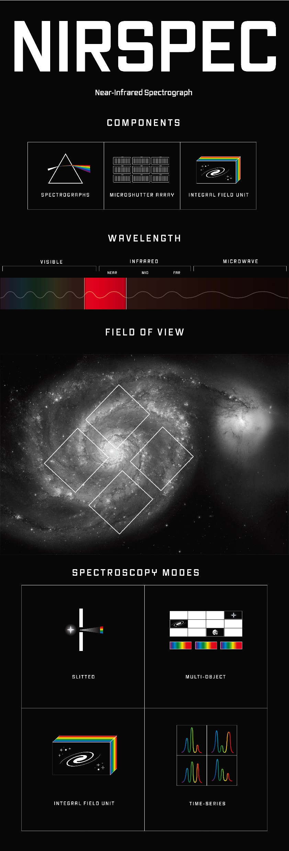
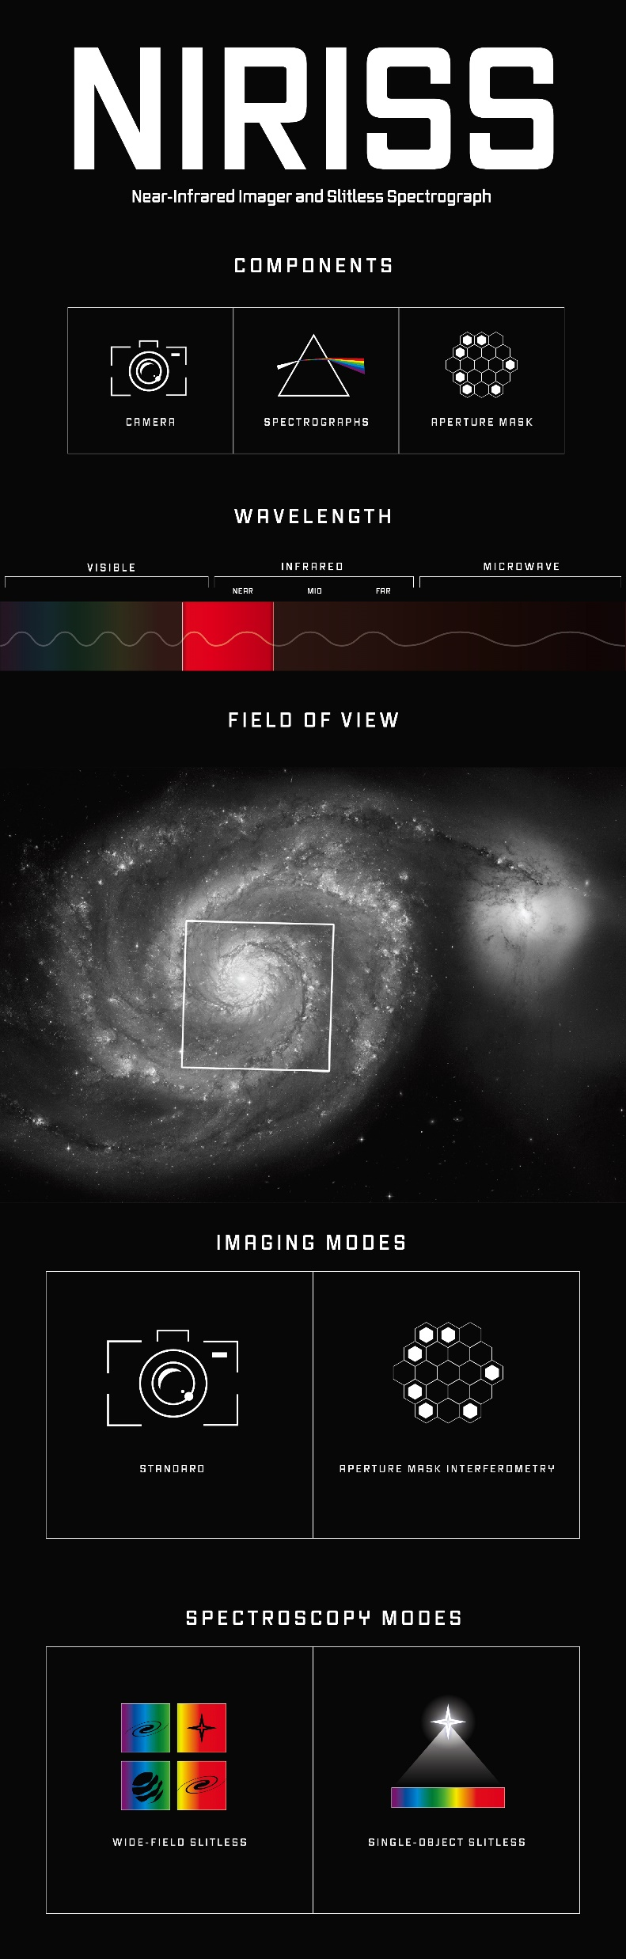
JWST INSTRUMENTS
MIRI
4.9-28.3 µm
PSF: 0.031'' -0.063‘’
R: 40-3500
NIRCam
0.6-5 µm
PSF: 0.072'' -0.160''
R: 150-1600
NIRSpec
0.6-5.3 µm
R: 30-3500
NIRISS
0.6-5.0 µm
R=150-700

Slide 31
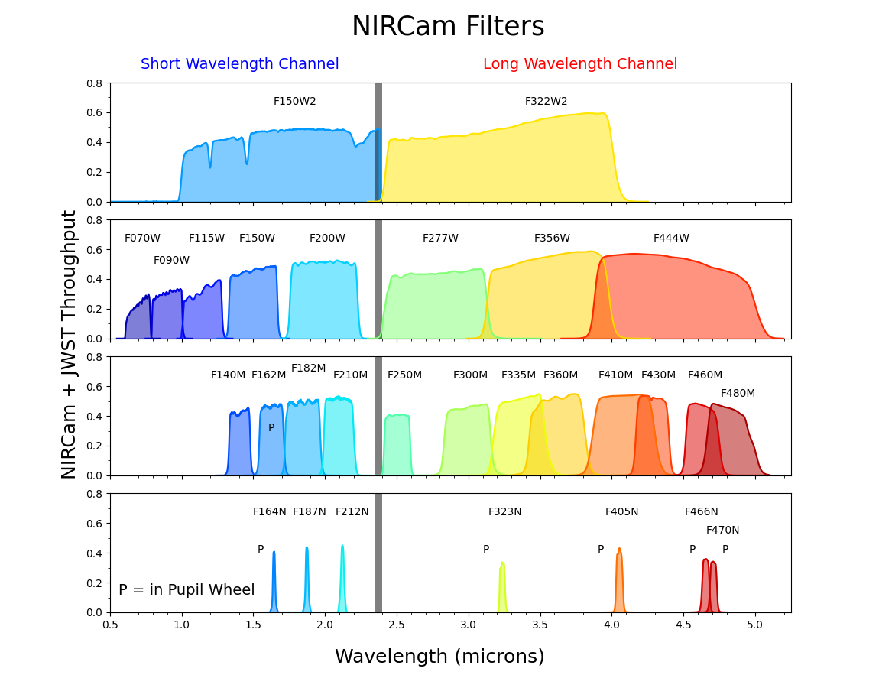
NIRCam
FILTERS
F164N → [FeII]
F187N → Paα
F212N → H2
F323N → H2
F405N → Brα
F466N → CO
F470N → H2

Slide 32
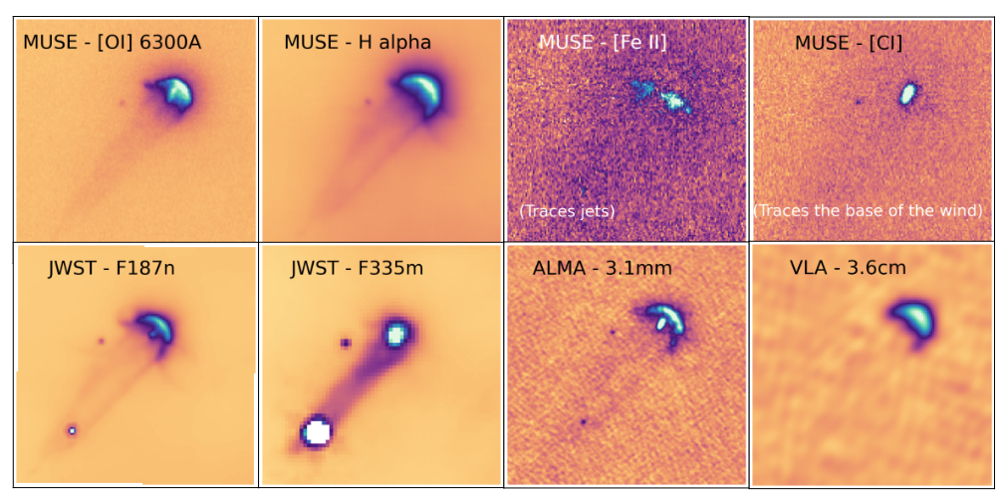
ANATOMY OF AN EVAPORATING DISC (177-341)
IF
Jet
Base of the wind in the PDR
Disc, PDR and IF
IF
IF
PAH continuum
Dust in disc and FF emission in IF
Haworth+ 2026

Slide 33
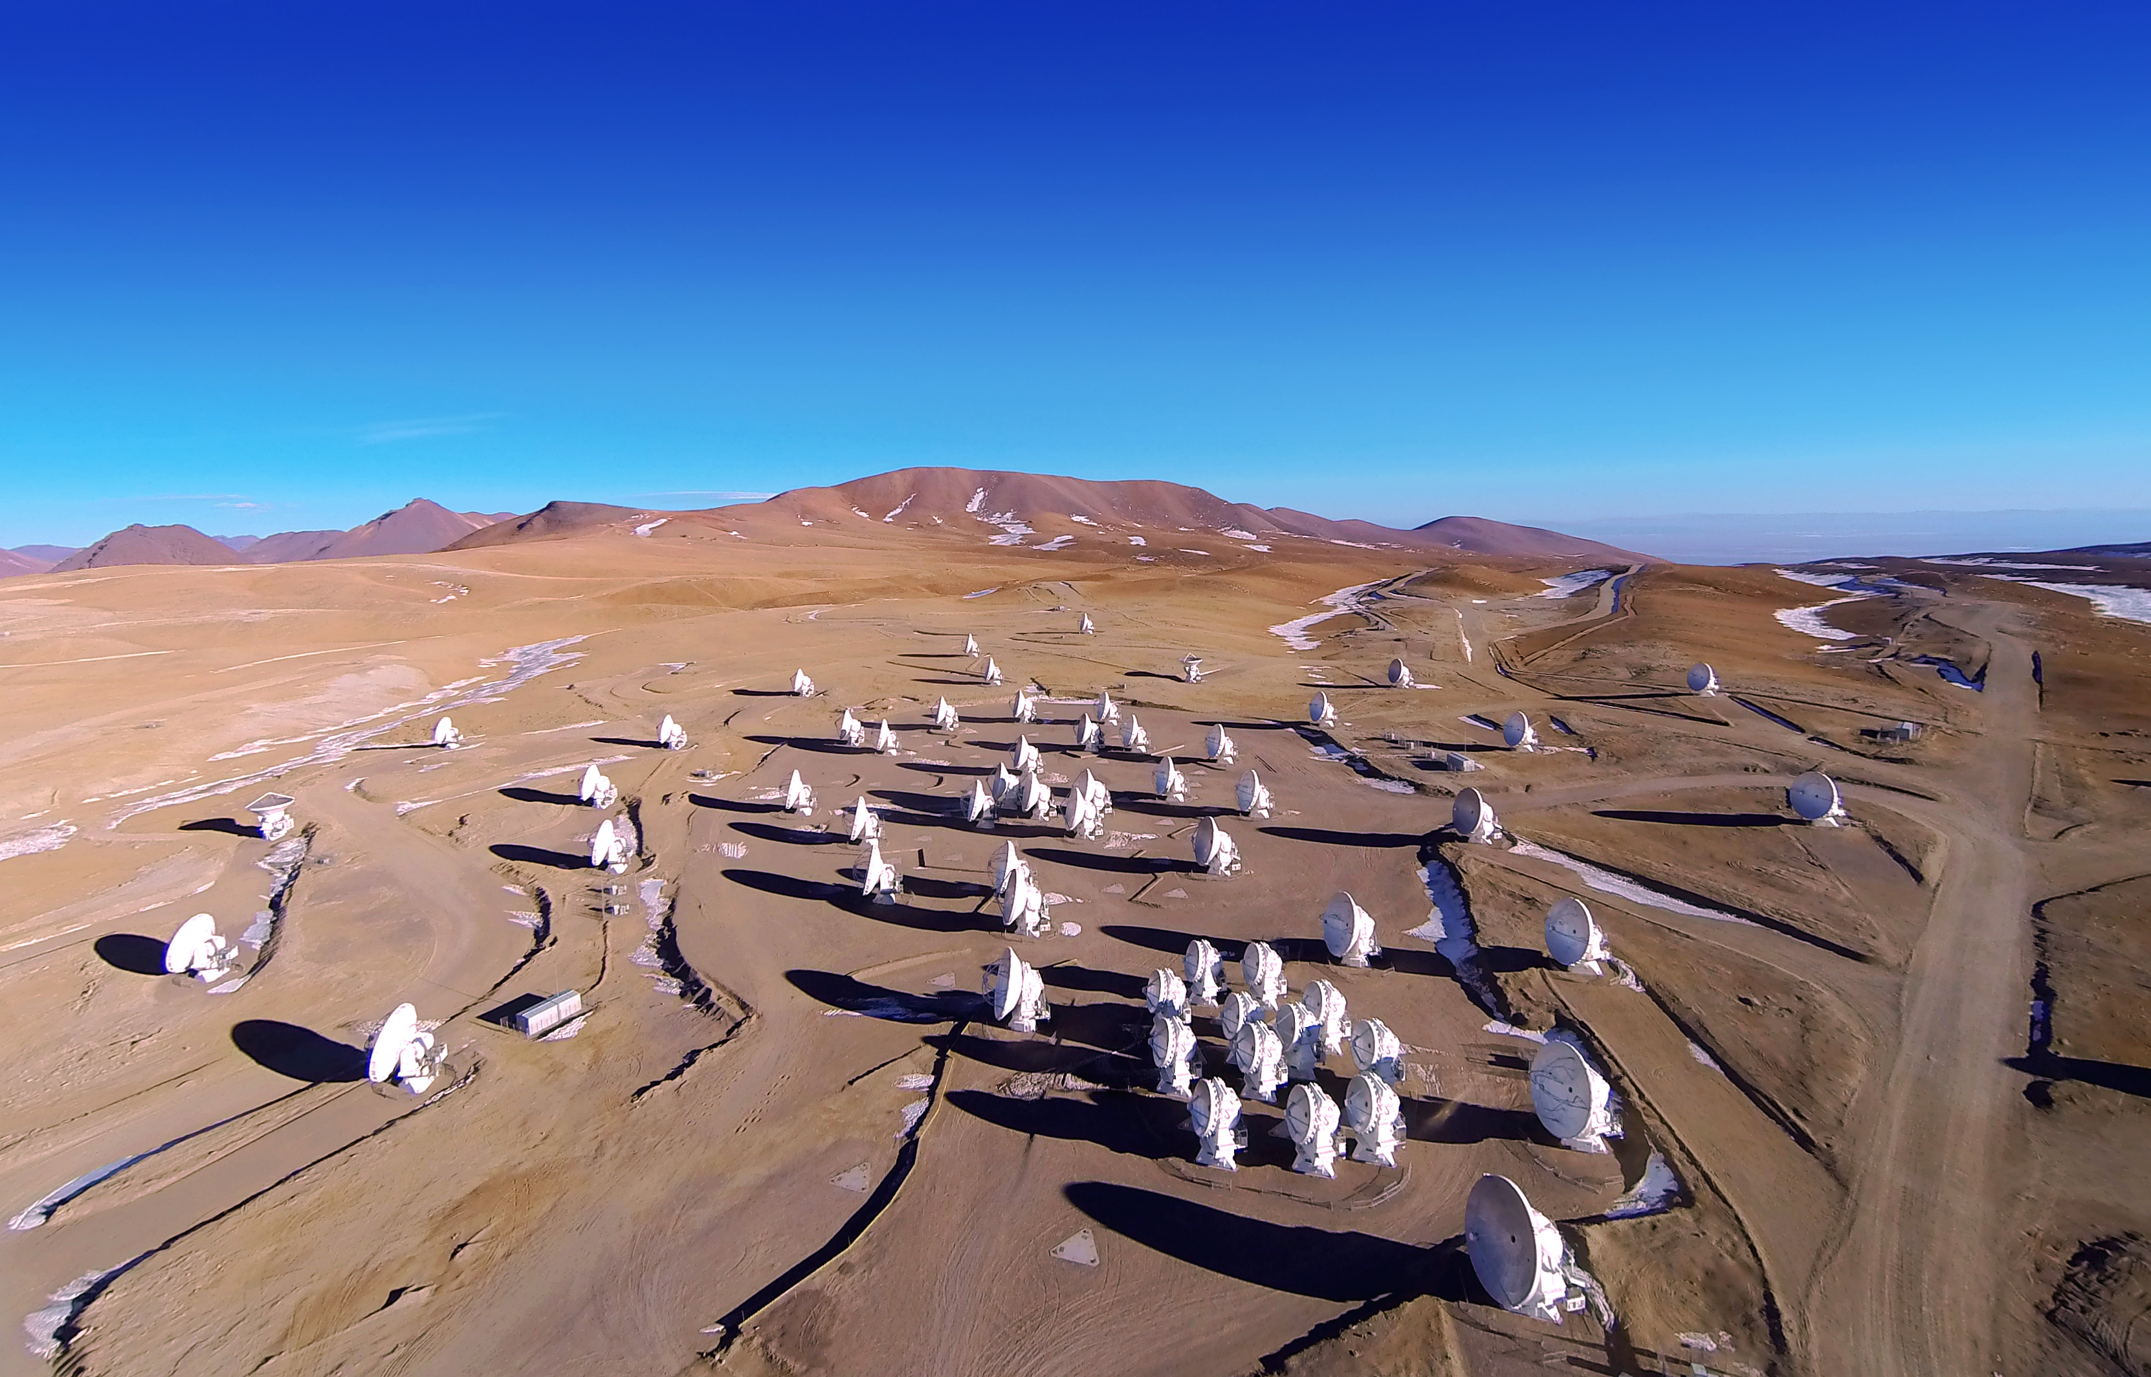
ALMA
Interferometer operating in mm/sub-mm (0.32-8.5 mm; 35-950 GHz)
66 antennas
50 12-m baseline 150m-16km (main array)
12 7-m for compact array imaging
4 12-m used for single-dish
10 Bands
Best spatial resolution 0.005ʺ
Best spectral resolving power 0.01 km/s
Full polarimetry available

Slide 34
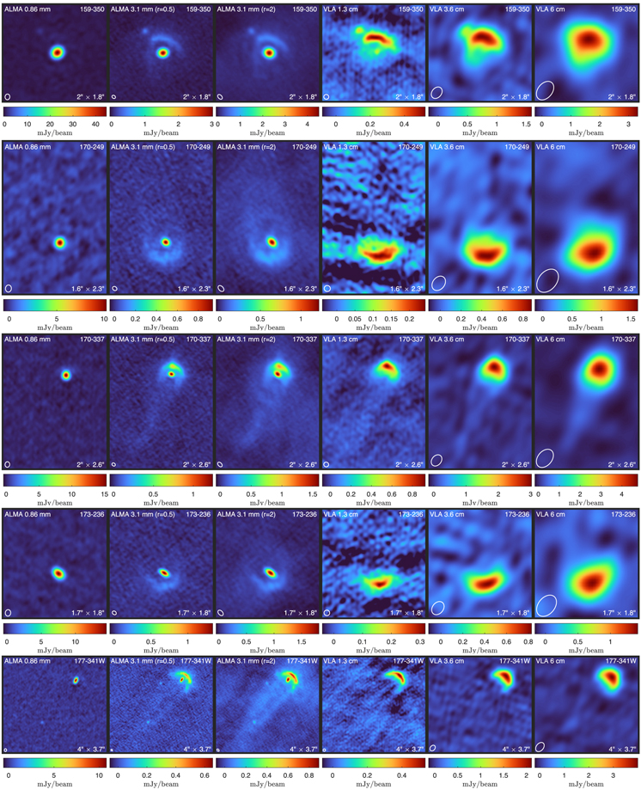
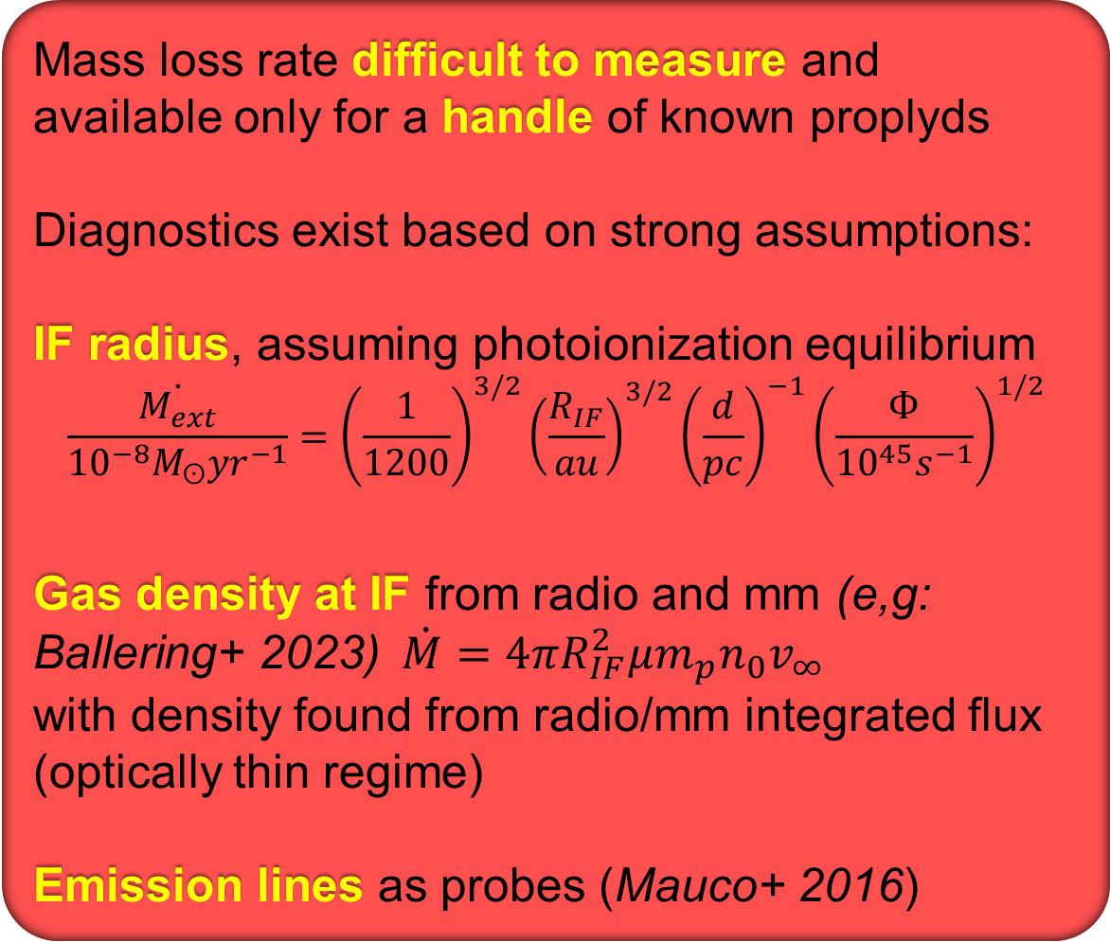
EVAPORATION TIMESCALE AND THE LIFETIME PROBLEM
Mass loss rate difficult to measure and available only for a handle of known proplyds
Diagnostics exist based on strong assumptions:
IF radius, assuming photoionization equilibrium
$$\frac{\dot{M_{ext}}}{{10}^{−8}M_{ʘ}{yr}^{−1}}={\left(\frac{1}{1200}\right)}^{3/2}{\left(\frac{R_{IF}}{au}\right)}^{3/2}{\left(\frac{d}{pc}\right)}^{−1}{\left(\frac{Ф}{{10}^{45}s^{−1}}\right)}^{1/2}$$
Gas density at IF from radio and mm (e,g: Ballering+ 2023)$\dot{M}=4πR_{IF}^{2}μm_{p}n_{0}v_{∞}$
with density found from radio/mm integrated flux (optically thin regime)
Emission lines as probes (Mauco+ 2016)
ALMA observations of resolved discs and IFs used to derive the mass loss rate
Ballering+2023
Notes:
Il flusso radio $S_\nu$ scala con la misura di emissione ($\int n_e^2 \, dl$). Misurando la densità al raggio del fronte di ionizzazione ($r_{\text{IF}}$) o al raggio sonico ($r_s$), il tasso di perdita di massa è dato da:
$$\dot{M} = 4\pi r_{\text{IF}}^2 \mu m_p n_e(r_{\text{IF}}) v_{\text{wind}}$$

Slide 35
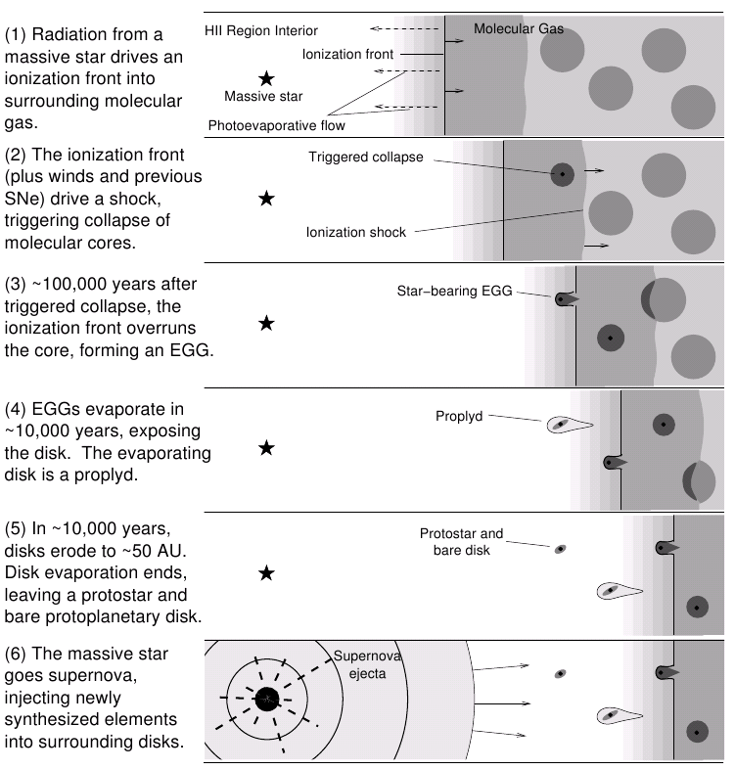
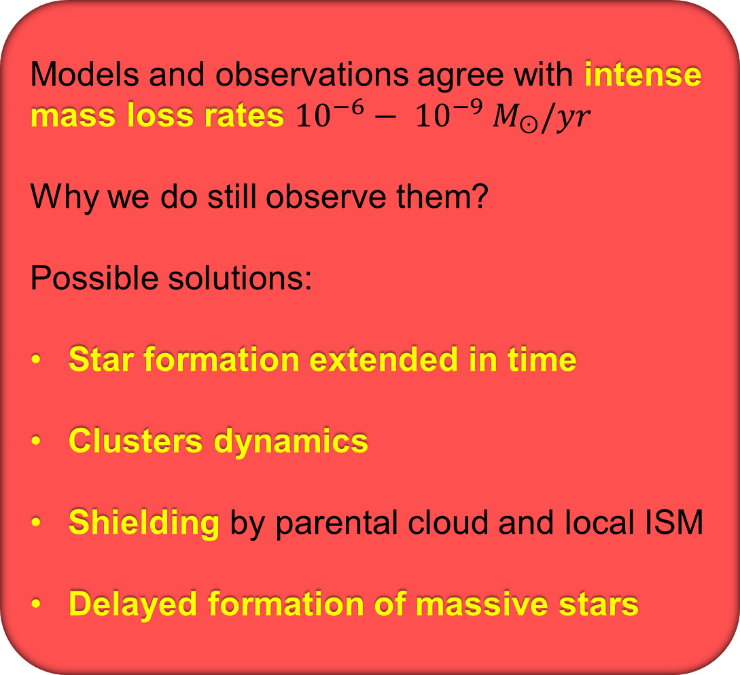
EVAPORATION TIMESCALE AND THE LIFETIME PROBLEM
Models and observations agree with intense mass loss rates ${10}^{−6}− {10}^{−9} M_{ʘ}/yr$
Why we do still observe them?
Possible solutions:
Star formation extended in time
Clusters dynamics
Shielding by parental cloud and local ISM
Delayed formation of massive stars
Hester & Desch, 2005
Notes:
Ballering+ 2023: We derive their photoevaporative mass-loss rates in two ways: first, by invoking ionization equilibrium and second, by using the brightness of the free–free emission to compute the density of the outflow

Slide 36
PHOTOEVAPORATION AND PLANET FORMATION

Slide 37

CONSEQUENCES ON PLANET FORMATION
Growth and coagulation of solid bodies from µm-size grains to planetesimals is a complex process occurring in the first Myrs of discs evolution
Consequences of photoevaporation on planet formation investigated with models, but a general picture is still missing…

Slide 38


DUST IN EVAPORATING FLOW
IR images reveal that µm-size grains are trapped in the evaporative flow
Scattered stellar light from the photoevaporative flow require the presence of µm-size grains
This is supported by theory: size of dragged grains from balance between aerodynamic drag and gravity:
$a_{max}\sim \frac{{\dot{M}}_{wind}v_{wind}}{4πGM_{∗}ρ_{s}}$
$\dot{M}\sim {10}^{−7}M_{ʘ}/yr$ → a_{max}=1-10 µm
Throop& Bally 2005; Facchini+ 2016; Owen & Altaf 2021; Gárate+ 2024; Paine+ 2025
24 micron image (from Spitzer) of a proplyd in NGC2244 and IC1396
(Balog+ 2006)

Slide 39


DUST IN EVAPORATING FLOW
114-426, HST/ACS images in F435W, F555W, F685N, F775W, F850LP
From the extinction of background light in different bands → size of dust particles
Result: evidence for spatial gradient of dust grains size: from 0.2 µm to 0.7µm becoming smaller as distance from the disc increases
Miotello+2012
HST image of 114-426 in the F555W filter.
Possible outflow

Slide 40

DUST IN WINDS: IMPLICATIONS
The dust in the wind set the extinction across the flow → implications for $\dot{M}$
Potentially provide diagnostics to estimate $\dot{M}$
Reduce the reservoir of small solid bodies for planet formation
Photoelectric effects less important → possible implication for the lifetime problem?
e.g.: Sellek+ 2020; Qiao+2023

Slide 41
CONSEQUENCES ON PLANET FORMATION
Disc dust-to-gas ratio increasing → more efficient small planets formation (Throop & Bally 2005; Carrera+2017; Hawort+2018)
Combined with radial drift → no effects on dust-to-gas ratio
If planet formation is quick, small planets are favoured (Selleck+2020)
Pressure traps and dust pile-up on ice lines may slow down migration (Schoonenberg & Ormel 2017, Rosotti+ 2020)
Notes:
Building a $10 \, M_\oplus$ solid core followed by runaway gas accretion requires gas disc lifetimes of $\sim 1 - 3 \text{ Myr}$. Rapid outer disc removal depletes the overall gas reservoir before cores can grow massive enough to initiate runaway envelope accretion.

Slide 42

PEBBLE ACCRETION VS. PHOTOEVAPORATION
Outer disc dispersal by photoevaporation
→
decline of pebble migration inward →
Less efficient pebble accretion
Shielding for 0-3 Myrs is important
Final planetary mass as a function of the shielding time and initial orbital radius of the planetary seed, in a 10⁴ G₀ environment.
Contours show the final semimajor axis of the planets in AU (Qiao+2023)
Planetary seed orbit
Planet final size
Shielding time

Slide 43


MODELS
PUFFIN enables rapid creation of externally irradiated disk+wind density structures. Efficient exploration of chemistry across a wide parameter space
Keyte & Haworth (2025-2026)
Available grid of models of mass loss from evaporating discs
Haworth+ 2018, 2023

Slide 44
PHOTOEVAPORATION AND DISCS POPULATIONS

Slide 45

PHOTOEVAPORATION ON DISCS POPULATIONS: PROS AND CONS
PROS
Rich statistics: distant clusters can host hundreds/thousands of stars with discs
Extreme environments: among the distant clusters there are many massive and all known supermassive clusters
CONS
Distant: no resolved images
Messy: bright nebular emissions, source confusion
Challenging: Av can be high, low mass stars with discs can be faint
Westerlund 2
Supermassive cluster
JWST, EWOCS project

Slide 46

2D PROJECTION OF REAL 3D DISTRIBUTION
Studies rely on projected distances → overestimate of incident fluxes
Anania+2025: a new method (M3) that estimate real 3D separations from projected 2D local density distribution and distance uncertainty sampling
Caveats: it assumes isotropy and does not account for ISM
Comparison between real and projected FUV fluxes in simulated clusters
Three method tested
Method M3 reproduces real fluxes

Slide 47

EFFECTS OF PROJECTIONS AND STELLAR MASSES
Parker+ 2021 presented a different interpretation:
Observed effects with local FUV fluxes are artifacts
Effects of 3D → 2D projection on disc mass
Discs dust mass is proportional to central star mass → observed effects local FUV vs. M_{disc} may be a consequence of such imprint
Projection effects hide and mimic radial local FUV vs. disc properties
Cluster dynamic evolution shuffle any local effect

Slide 48

OTHER CAVEATS
Intracluster ISM attenuates incident FUV fluxes
$${N_{H}}/{A_{V}}=1.8×{10 }^{−21}{cm}^{−2}{mag}^{−1}$$
$${A_{FUV}}/{A_{V}}≈2.7$$
Values of extinction easy to achieve. How to account for the 3D distribution of intracluster ISM?
The larger the massive stars population, the more efficient the clearing
FUV exposure history can depend on the dynamical evolution of the cluster (Reiter+ 2022)
Important also star formation history, and dynamics of different «generations» of stars, as proposed in Orion (Beccari+ 2017, Winter+ 2019)

Slide 49


CLUSTERS GEOMETRY AND INITIAL CONDITIONS
Photoevaporation stronger in:
Highly substructured clusters than in smooth and centrally concentrated
Subvirial clusters undergoing collapse than in virial equilibrium or expanding
The initial conditions greatly impact the evolution and lifetime of protoplanetary discs
Nicholson+2019
Fractal dimension:
1.6 = substructured
3 = smooth
Virial ratio:
0.3 subvirial
0.7 supervirial
Points from Haisch+2001
Richert+2018

Slide 50

DISC FRACTIONS VS. FUV
Testing photoevaporation destructive capability on clusters population by disc fraction
The fraction of cluster members that still host a disc declines with the age of the cluster, and it can be used to estimate the intensity of the environment feedback
Caveats:
Accurate membership of both disc-less and disc-bearing stars
Completeness
Star formation history
Decline of the disc fraction with the cluster age (Hernandez+2007)

Slide 51
TYPICAL MEMBERSHIP DIAGNOSTICS
Stars with discs
IR excesses from disc thermal emission
Spectroscopic diagnostics of accretion
Disc-like variability (variable extinction, accretion bursts)
SED analysis (model dependent)
Stars without discs
Intense X-ray activity (discarding discs)
Lithium abundance (discarding discs)
Cluster dynamics (discarding discs)
Statistical analysis of diagrams

Slide 52





TESTING PHOTOEVAPORATION WITH LOCAL DISC FRACTION
Disk fraction vs. local UV flux or distance from OB stars shows a decline of disk fraction in the clusters core
Examples: Cygnus OB2 (Guarcello+ 2023); NGC 6231 (Damiani+ 2016); Pismis 24 (Fang+ 2012); NGC 6611 (Guarcello+ 2009, 2010); NGC 2244 (Park & Sung 2002); Trumpler 14 and 16 (Reiter & Parker 2019)
CygnusOB2
NGC6611
NGC6231
NGC2244
Pismis24

Slide 53


DISC FRACTIONS VS. LOCAL FUV
Smooth decline of disc fraction in Cygnus OB2
Disk fraction vs. local FUV flux in CygOB2
(Guarcello+2023) from the CCLP Project
Spitzer [8.0], IPHAS Hα, and Chandra/ACIS-I image of Cygnus OB2

Slide 54

RESULTS FROM THE MYSTIX SURVEY
MYStIX survey provides memberships from X-ray and IR data for 20 young clusters, some with a rich population of OB stars (Feigelson+2013, Broos+2013)
Four (NGC 6611, NGC 6357, Orion, Rosette) do not show depletion of stars with disks within 0.2 pc from O stars; two show inconclusive results (M17 and Carina)
(Richert et al. 2015)
Emipirical cumulative distribution functions of distances from massive stars (cutting at 0.5 pc, sampled in two bins) of disk-bearing (red line) and disk-free (blue line) YSOs. The dashed black line is a parabola, expected when distributions do not decline with distances from O stars.
Notes:
Critical points in Eric&Alexander method: use of distances rather than UV fluxes, binning all massive stars n two bins; cutting at 0.5pc; counting sources multiple times when more O stars are present within 0.5pc

Slide 55


TESTING PHOTOEVAPORATION WITH GLOBAL DISC FRACTION
Global DF in massive clusters compared with expected DF from DF vs. age relation
If the samples are homogeneous, it allows to compare disc evolution in different environment
Winter+ 2022
Special care in accounting for homogeneity

Slide 56


DISC ACCRETION AND PHOTOEVAPORATION
How photoevaporation impacts accretion:
Removal of the mass reservoir
Once the outer reservoir is consumed, ${\dot{M}}_{acc}$ drops
Decline of surface density
Effects on disc properties
(e.g. T)
Clarke+ 2007, Coleman+ 2022
Interplay between the radius enclosing 90% of the disc mass, mass loss and mass accretion rates in M_{disc} 0.1 M_{ʘ} (initial) at various G₀. No wind.
Haworth+2018

Slide 57


DISC ACCRETION
Measured through:
Balmer jump at 364 nm to determine L_{acc} (Gullbring+ 1998)
Photometry in U band excess due to accretion spot (Gullbring+ 2000); narrow-band photometry (de Marchi+ 2010)
Spectroscopy of lines sensitive to accretion and calibrated to $\dot{M}$ (Ha, Hb, HeI, CaT, Pab, Bry…) (Natta+2004; Alcalà 2014, 2017)
UV and X-ray spectroscopy (Ardila+2012)
Hartmann+ 2016; Ray & Ferreira 2022

Slide 58


DISC ACCRETION: CAVEATS
Accretion is intrinsically variable
2-weeks variability in accreting stars in NGC2264
(Venuti+ 2014)
Accretion measurements always show large spread
(e.g. Manara+2023)

Slide 59



DISC ACCRETION VS. LOCAL FUV IN THE LAGOON
Not many attempts of correlating ${\dot{M}}_{acc}$ with local FUV exist
In NGC6530 (Lagoon): ${\dot{M}}_{acc}$ from VST/Omegacam photometry
d<1.2 pc from massive stars moderate accretion
(median ∼5×10⁻⁹ M⊙/yr)
1.2 pc<d<3.5 pc:
median ∼3×10⁻⁸ M⊙/yr
Venuti+2024
3pc
Spatial variation of ${\dot{M}}_{acc}$ sampled in bins of 0.05 deg.
Asteriscs: O stars
Crosses: B stars

Slide 60
DISC RADIUS VS. LOCAL FUV
WARNING!!!
Dust disc radius can be different than gas-disc radius
Resolved discs
Radius enclosing fraction of flux
Modelling the observed radial profile
Modelling visibility (interferometers)
How to measure disc radius?
Not resolved discs
SED modelling
Resolving Keplerian rotation from high-R spettroscopy

Slide 61


SMALLER DISCS IN HIGH-UV ENVIRONMENTS
Two of the observed proplyds, maps ALMA and VLA
Ballering+ 2023: 12 proplyds in ONC
Radii from resolved ALMA Band 3 (3.1 mm) image
Discs are small (6.4-38 AU)
Discs size correlate with R_{if} and distance from
Θ1 Ori

Slide 62


SMALLER DISCS IN HIGH-UV ENVIRONMENTS
Eisner+ 2018: 89 resolved ONC members with ALMA Band 7.
Disk radii < 60AU
Otter+ 2021: 127 YSOs in ONC and OMC
72 sources resolved with ALMA Band 3, 7 and 9 images
Discs radii 8-100 AU
Discs are smallen than other SFRs. Photoevaporation in ONC, but in OMC?

Slide 63


DISC MASS VS. LOCAL FUV
How to measure disc mass?
Commonly from flux measurement in sub-millimeter and millimiter:
$$M_{dust}=\frac{S_{ν}d^{2}}{k_{ν}B_{ν}\left(T_{dust}\right)}$$
$S_{ν}:$ total integrated flux; $d$: distance; $k_{ν}$: dust opacity; $B_{ν}$: Planck function
Assumptions:
$T_{dust}=20K$ isothermal disc
Gas/dust ratio = 100
Entire disc optically thin
$k_{ν}=2{cm}^{2}g^{−1}$
No background emission
Dynamical mass for spatially and spectrally resolved discs
Map of the velocity field $v_{θ}\left(r\right)$ across the disc
Modelling the rotation curve including stellar potential (GM*/r), disc potential and pressure gradient
$$v_{rot}^{2}=R\frac{∂φ_{∗}}{∂R}+R\frac{∂φ_{d}}{∂R}+\frac{R}{ρ}\frac{∂P}{∂R}$$
Veronesi+ 2021; Lodato+ 2022

Slide 64


DISC MASS VS. LOCAL FUV IN σ Ori
In σ Ori dust disc mass declines closer than 0.5 pc from the massive star
(>10⁴ G₀)
Ansdell+2017
Mauco+2023
Mauco+ completed the sample studied by Ansdell+
The feedback is visible only for more massive stars

Slide 65


DISC PROPERTIES VS. LOCAL FUV
Stars with discs in L1647, L1641, NGC1980 and Orion, colored according the the incident local UV flux
Background image from Herschel
(van Terwisga & Hacar 2023)
Disc mass vs. local UV irradiation

Slide 66



DISCS LIFETIME VS. PHOTOEVAPORATION
The ratio between M_{disc} and ${\dot{M}}_{acc}$ provides an estimate of disc lifetime
$In$σ Ori disc lifetime ($\frac{M_{disc}}{{\dot{M}}_{acc}}$) is shorter than the age of the cluster
Tentatively, disc lifetime declines closer than 0.5 pc from the massive star (G₀=10⁴)
Mauco+ 2023

Slide 67



THE DIMENSIONLESS ACCRETION PARAMETER
$η=\frac{τ\dot{M}}{M_{disc}}$ (Rosotti+2017)
Viscousity-driven evolution: η=1
Photoevaporating disc: η>1
With expansion phase (low G₀)
Without expansion phase (high G₀)

Slide 68



EVOLUTION OF AN EVAPORATING DISC
Simulated mass loss from a 0.1 M_{ʘ} disc around a 1 M_{ʘ} star for 3 values of G₀ (Winter+ 2018)
${\dot{M}}_{disc}$ declines with time
Disc destruction times marked with red lines
For G₀<300, disc first expands
It shrinks when ${\dot{M}}_{loss}> {\dot{M}}_{acc}$

Slide 69
PHOTOEVAPORATION AND DISCS CHEMISTRY

Slide 70
THE EXPECTED IMPACT OF UV RADIATION
Models resolving the disc chemistry treat the transport, absorption, and energetic deposition of stellar radiation through radiative transfer and thermochemical
For FUV-irradiated discs, possible effects supported by models:
Photodissociation of major volatile carriers (H₂O, CO…)
Enrichment of fully dissociated atomic and ionized gas
Effects on abundances of CO isotopologues
Effects on grains (ejecting ice molecules, processing organic molecules)
FUV photons drive photodissociation and photoionization
Gas heating
Ionization
Molecules destruction
Molecules synthesis

Slide 71

EFFECTS IN MODERATE IRRADIATION
Even at moderate irradiation (1-100 G₀) impact on outer disc:
Photodissociation impacts population of molecules such as C⁺, N2H⁺, C, CS (increasing) or HCN (decreasing)
Effects depend on disc structure (density) and chemistry of the precusors
(Gross & Cleeves 2025)
Simulated column density for models of 50 AU (top), 100 AU (middle), and 200 AU (bottom) discs.
Variation at increasing G₀ are visible in the outer discs

Slide 72

MODERATE IRRADIATION: THE IMPORTANCE OF THE WIND
Keyte & Haworth 2025: incorporates wind absorption and re-emission from dust
UV radiation is easily absorbed, but wind dust thermal emission enhances disc heating, increase disc gas phase and impact abundance of some key volatiles such as CO, CH₄, CN (also at low G₀)
Abundance of key volatiles, 5000 G₀.
Left: wind model; central: no wind model; right: residuals

Slide 73


CHEMISTRY VS. INTENSE FUV FIELDS
Walsh+ 2013: Model of T-Tauri disc (0.5 M_{ʘ}, 2 R_{ʘ}, 4000 K) with 0.01 M_{ʘ} disc with
$\dot{M}$=10⁻⁸ M_{ʘ}/yr
FUV field 4×10⁵ G₀
Significant effects on disc temperature structure and chemical composition in outer disc
Enhanced abundances of key volatiles such as CN, CS, and CO
Disc interior shielded and predominantly molecular
Synthetic spectra in ALMA band 6-9 for isolated and irradiated disc

Slide 74

CHEMISTRY VS. INTENSE FUV FIELDS
Calahan+ 2025:
2D thermodinamical model DALI
FUV: 1 G₀, 10⁴ G₀, 10⁶ G₀
Disc truncated at 30 AU
K star, M_{disc} 1% M_{star}, gas/dust=1000
H2O snow line impacted: less icy grains, smaller ice/gas ratio for critical molecules
d>1 AU, UV penetrates down to the midplane, breaks down molecules, and heats up the midplane enough to sublimate some molecules off of grains
1G₀
ice
10⁴ G₀
10⁶ G₀

Slide 75

DISCS WITH UNEFFECTED CHEMISTRY: XUE PROGRAM
JWST/MIRI observations of 12 1-4 Mʘ stars with discs in NGC 6357:
10³-10⁶ G₀ uniformly distributed
Rich molecular inventory H₂O (no cold water), CO, HCN, C₂H₂, OH, and ¹²CO₂
Discs in high G₀ show chemical complexity
None of observed stars show signs of UV-driven chemistry
(Ramirez-Tannus+ 2025)
Compact truncated discs?
(Portilla-Revelo+ 2025)
Optically thick emitting gas?
(Gross & Cleeves 2025)

Slide 76

DISCS WITH UNEFFECTED CHEMISTRY: ORION
ALMA observations of discs 216-0939 and the 253-1536A/B (binary system), irradiated by 10²-10³ G₀
Rich chemistry detected (CO isotopologues, HCN, H₂CO, and C₂H)
No significant difference from isolated discs found
Díaz-Berríos+ 2024

Slide 77

DISCS WITH FUV-DRIVEN CHEMISTRY
Proplyd d203-506: undepleted abundance of neutral atomic carbon
(Goicoechea+ 2024; ALMA and JWST)
Notes:
Images of d203-506 (same field of view). (a): C¹⁸O J = 3–2 and [C I] 609 μm integrated line emission (spatially unresolved). Contours show 10σ and 20σ intensity levels for C¹⁸O, and 5σ and 10σ for [C I] 609 μm. Synthesized beam sizes are shown at the bottom corner. The apparent larger extent of the C¹⁸O emission is due to the larger beam and faint background emission. (b): [C I] 0.9853 μm emission from the photo-evaporative wind observed with NIRSpec (colored image). Orange contours show he 0.8 mm dust continuum observed by ALMA (from Berné et al. 2024).

Slide 78

DISCS WITH FUV-DRIVEN CHEMISTRY
Irradiated disc d203-506 (0.2 M_{ʘ}), JWST/MIRI observations.
Methyl cation CH3+ detected
Strong FUV radiation, coupled with high density, responsible for its formation
CH₃⁺ reactions (mainly with H₂) result in CH₂, CH and C, and lead to complex organic molecules
No isolated discs have CH3+ detection
Bernè+ 2023
Images of d203-506 and a sketch of the system
(PDR4All program)
See also Schroetter+ 2025

Slide 79

DISCS WITH FUV-DRIVEN CHEMISTRY
Irradiated disc d203-506
JWST/MIRI observations detect H₃⁺ emission
Abundances of key molecular species (notably molecular radicals and reactive ions) are significantly enhanced in the PDR component of externally irradiated disks
Goicoechea+2025

Slide 80

FUV-DRIVEN WATER CYCLE IN DISCS
JWST/MIRI observations of the irradiated disc d203-506
Intense hydroxyl radical (OH) lines observed
Highly excited OH rotational lines → H₂O destruction by FUV radiation
OH rovibrational lines →
Chemical excitation by the key reaction O + H₂ → OH + H →
Formation of water in the gas phase
Zannese+ 2024
Top: MIRI-MRS spectrum. Rotationally excited OH lines are marked in red. Bottom: synthetic spectrum
Notes:
. We infer that, in this source, the equivalent of Earth oceans’ worth of water is destroyed per month and replenished

Slide 81
PHOTOEVAPORATION VS. OTHER ENVIRONMENT FEEDBACKS

Slide 82

PHOTOEVAPORATION VS. CLOSE ENCOUNTERS
Recent models combining photoevaporations and close encounters (Winter+ 2018, 2022)
Stellar number density > 10⁴/pc³ required to have large impact on discs population
Two stages:
Embedded stage: Flyby dominate the feedback and set discs initial conditions
Cleared stage: photoevaporation dominate the feedback
FUV vs stellar density in a sample of stellar clusters. All clusters divided into radial bins and values for each bin are marked with squares. Numbers in brackets represent the assumed maximum stellar mass in M⊙
(Winter+ 2018, Haworth+ 2018, Facchini+ 2016)

Slide 83
LATE ACCRETION vs. FUV
Massive stars evacuate the parental cloud quickly, trigger discs photoevaporation, and pollute the surrounding environment
Disc property | Late accretion effect | FUV-dominated environment
Radius | High angular momentum streamers expand outer radii | Photoevaporation disperse discs from outside-in
Mass and lifetime | Disc rejuvenation | Mass removal and short lifetime
Kinematic and structure | Tilted inner disc, warps, twisted velocity map | Inner orientation is preserved
Dust and IR excess | Not-processed dust boost NIR excess | Small dust are removed in wind, gas/dust affected
Accretion and variability | Enhanced, variable accretion and extinction | Not affected
Chemistry | Disc rejuvenation | Impacted by FUV, EUV, cosmic rays

Slide 84
A FEW OPEN QUESTIONS
What sets the temperature and density of photoevaporative winds? PAH?
How does mass loss rate variation with time impacts the evolution of dust?
What is the interplay between internal MHD and external evaporating wind?
Non isothermal disc in evaporation models?
How significant is photoevaporation in weak UV environments?
How to observationally study uresolved proplyds in distant SFRs?
Small dust depletion: wind vs. rapid inward drift?
How does photoevaporation affects streaming instability?
Effects on the disc chemistry

Slide 85
A FEW OPEN QUESTIONS
How does photoevaporation affect planet formation and early evolution?
How can we account for dynamics in star clusters?
How does all this change with cosmic time?
Exactly where and when in clusters photoevaporation drives disc dispersal?
How to match observed disc ages in massive clusters with rapid disc dispersal?

Slide 86
Disk populations and their evolution in various galactic environments
Mario Giuseppe Guarcello
INAF
Osservatorio Astronomico di Palermo
Cosmic rays and energetic particles

Slide 87

COSMIC RAYS: A BASIC INGREDIENT
Fundamental ingredient in discs evolution, which impacts:
Ionization rate ζ_{CR} → coupling with magnetic field and angular momentum transport
Formation of the dead zones
Chemical reactions
Schematic structure of the protoplanetary disk with low ionization and dead zone. Stellar X-rays ionize only the disk surface. Armitage+ 2011, Champion+2019

Slide 88
WHY SO IMPORTANT?
FUV and X-rays dominates ionization at disc surface (Σ<10² g/cm²)
CRs reach surface densities Σ>10² g/cm² down into the disc internal region
(Padovani+ 2018)
Ionization agent | Typical energy | Penetration column depth Σ (g/cm²) | Primary ionization effect | Disc region
FUV | 6-13.6 eV | 10⁻⁴ – 10⁻² | Photoelectic, Photoionization | Atmosphere, surface
EUV | 13.6-100 eV | <10⁻⁴ | H and He ionization | Wind
X-rays (corona) | 1-10 keV | 1-10 | Inner-shell ionization, Secondary e⁻ | Intermediate molecular layer
Galactic CRs | ⁓ 1 GeV | >100 | Impact ionization | Midplane
Notes:
While FUV cannot ionize $\text{H}$ or $\text{He}$, it has more than enough energy to directly photoionize elements with lower first ionization potentials ($I_p < 13.6 \text{ eV}$):

Slide 89


MODELLING CRs IONIZATION IN PPD: IM Lup
Outer disc: high CR ionization rates as diffuse ISM (Seifert+ 2021, Fujii & Kimura 2022)
Inner disk: low CR ionization rates, which explains observations (abundances of N₂H⁺ and H¹³CO⁺)
The transition between high and low CR environments at
∼ 80–100 AU
Midplane ionization rates:
ζ_{CR} ≲ 10⁻²⁰ s⁻¹ <100 AU
ζ_{CR} ≳ 10⁻¹⁷ s⁻¹ 100--300 AU
Model abundances after 0.5 Myrs
UV- and CR- driven reaction channel for HCO⁺

Slide 90

ARE T TAURI STARS DEFENSLESS?
References for propagation of CRs in PPDs
Feigelson+ 2002 (ignoring stellar magnetosphere)
Rodgers-Lee+ 2017 (including turbulent magnetic field)
Rab+2017 (ignored magnetic field, included chemical signatures)
Fraschetti+ 2018 (included stellar wind)
Less energetic CRs can be blocked by the extended magnetosphere in T Tauri stars
Cleeves+ 2013: magnetic protection in can be extended for the whole disc
CRs accelerated in SFRs can udergo severe energy loss as they travel through dense material (Offner+ 2019)

Slide 91



MAIN SOURCES OF GALACTIC CRs (≤1 TeV)
SNRs
Massive clusters wind termination shocks
Colliding stellar winds in massive binary systems
Main mechanism: Diffuse Shock Acceleration. SNR: Krymskii+ 1977; colliding winds: Eichler & Usov 1993; Massive clusters: Morlino+ 2021

Slide 92

CRs FROM MASSIVE YOUNG STELLAR CLUSTERS
Padovani+ 2020: young 10⁶ M_{ʘ} clusters, such as the progenitor of GCs, yeld ionization rates ζ>10⁻¹⁴ s⁻¹, typical of the Galactic center
10⁴-10⁵ M_{ʘ} clusters detected in γ-ray:
CygnusOB2 (Aharonian+ 2002)
NGC3603 (Saha+ 2020)
Westerlund2 (Aharonian+ 2007)
Westerlund1 (TeV Abramowski+ 2012; GeV Ohm+ 2013)
RCW38 (Pandey+2024)
Also less massive clusters (Peron+ 2024)
CR density declines as r⁻¹ → relativistic particles are continuously injected (Aharonian+2019)
γ-ray emission around Westerlund 1 from HESS (Aharonian+2022)

Slide 93

EFFECTS OF INCREASING CRs FLUX
Kobayashi+ 2023: MHD simulation of formation and early evolution of PPD with increasing CR incidence
Higher ionization rate
Smaller disc size and mass
Earlier onset of outflow
Larger angular momentum transported by the outfow
Time evolution of the mass of disc (solid line), protostar (dashed), and total (dotted) for two values of ionization rate and dust/gas mass ratio (f)

Slide 94

EFFECTS OF INCREASING CRs FLUX
Nishio+2025
MHD simulation of formation and evolution of the disc with not uniform CR
Formation of the disc unaffected
Impacted angular momentum transport:
More efficient MF-disc coupling
Less turbulent MF
Less efficient angular momentum transport
Less effective accretion but disc more gravitationally unstable
Distribution of gas density, Toomroe Q value, Reynold number of ambipolar diffusion and CRs ionization rate

Slide 95

HOW TO CONFIRM PREDICTIONS?
CRs in PPDs cannot be measured through γ-ray emission
Observations determine abundance of molecules that constrain the ionization rate
Cleeves+2015: HCO+ and N2H+, constrained ζ_{CR} ≤ 10⁻¹⁹ s⁻¹ in TW Hya. But caveats.
Velocity integrated SMA images. Very-extended+extednded+compact array data (a, c), only very-extended (b, d)

Slide 96
OPEN QUESTIONS
Effects of energetic particles in massive and supermassive SFRs on PPDs almost completely unexplored

