Slide 1


Data-driven Maneuver Detection and Prediction for Catalogue Maintenance
Final Meeting
Martedì 30 Giugno – Giovedì 02 Luglio
OAC - Osservatorio Astrofisico di Arcetri

Slide 2
Outline
Introduction
Motivations and challenges
Approach Overview
Describing the approach
Maneuver Detection
Creating the Pattern of Life
Maneuver Prediction
Predict future maneuver
Applications for Catalogue Maintenance
How to exploit the information
Conclusion
Missione 4 • Istruzione e Ricerca

Slide 3
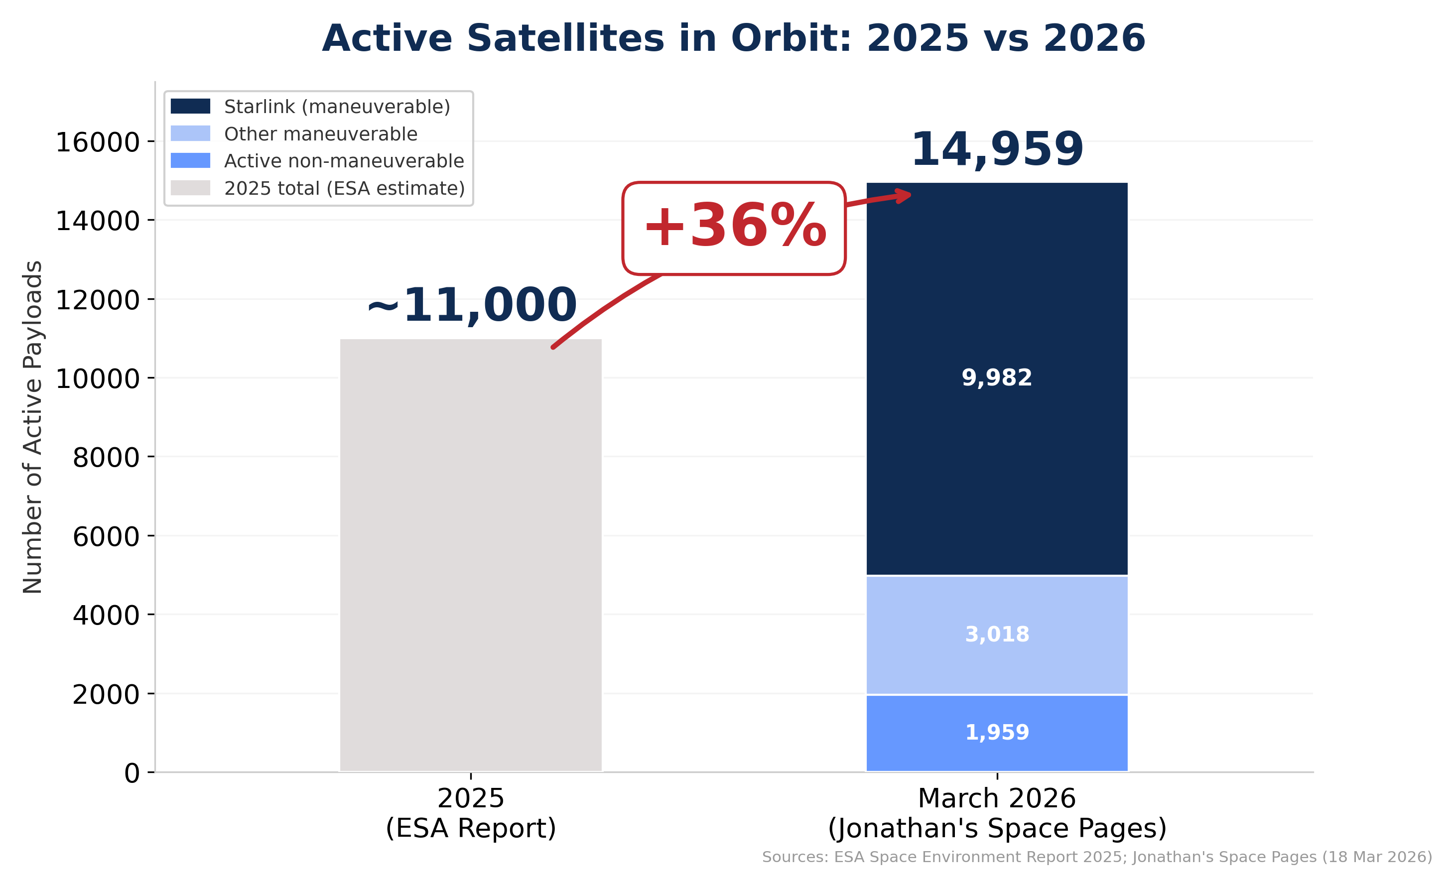



Introduction
Active satellites are rapidly increasing: +36% in one year
Deployment of large constellations
Expected to reach ∼100,000 by 2030 (according to ESA projections)
Transition from ballistic to behavior-driven dynamics
Tracking can no longer rely only on physics-based propagation
Accurate trajectory prediction requires reliable maneuver information
Missione 4 • Istruzione e Ricerca
Missione 4 • Istruzione e Ricerca

Slide 4
Introduction
Active satellites are rapidly increasing: +36% in one year
Deployment of large constellations
Expected to reach ∼100,000 by 2030 (according to ESA projections)
Transition from ballistic to behavior-driven dynamics
Tracking can no longer rely only on physics-based propagation
Accurate trajectory prediction requires reliable maneuver information
Missione 4 • Istruzione e Ricerca
Missione 4 • Istruzione e Ricerca

Slide 5


Introduction
Catalogue
Catalogue Build Up and Maintenance
Complex processing chain involving multiple association and estimation steps.
New Track
Track-to-orbit correlation
Uncorrelated
Tracks (UCTs)
NO
Maneuver
Hypothesis
Reactive maneuver handling, triggered only after track-to-orbit correlation fails
Success?
YES
YES
NO
Refined Orbit
Determination
(ROD)
NO
Track-to-track
correlation
Success?
Success?
With more maneuverable object, association ambiguity and the number of uncorrelated tracks (UCTS) may increase
YES
Catalogue Update
New Object
Initial Orbit Determination
(IOD)
Missione 4 • Istruzione e Ricerca

Slide 6
Introduction
Catalogue
Catalogue Build Up and Maintenance
Complex processing chain involving multiple association and estimation steps.
New Track
Track-to-orbit correlation
Uncorrelated
Tracks (UCTs)
NO
Maneuver
Hypothesis
Reactive maneuver handling, triggered only after track-to-orbit correlation fails
Success?
YES
YES
NO
Refined Orbit
Determination
(ROD)
NO
Track-to-track
correlation
Success?
Success?
With more maneuverable object, association ambiguity and the number of uncorrelated tracks (UCTS) may increase
YES
Catalogue Update
New Object
Initial Orbit Determination
(IOD)
Missione 4 • Istruzione e Ricerca

Slide 7
Introduction
Catalogue
Catalogue Build Up and Maintenance
Complex processing chain involving multiple association and estimation steps.
New Track
Track-to-orbit correlation
Can catalogue maintenance move from reacting to maneuvers after correlation failures to exploiting past orbital behaviour before ambiguity accumulates?
Uncorrelated
Tracks (UCTs)
NO
Maneuver
Hypothesis
Reactive maneuver handling, triggered only after track-to-orbit correlation fails
Success?
YES
YES
NO
Refined Orbit
Determination
(ROD)
NO
Track-to-track
correlation
Success?
Success?
With more maneuverable object, association ambiguity and the number of uncorrelated tracks (UCTS) may increase
YES
Catalogue Update
New Object
Initial Orbit Determination
(IOD)
Missione 4 • Istruzione e Ricerca

Slide 8
Approach Overview
Target Object
(≠ reference ones)
Orbital data history
Orbital data history
Orbital data history
Maneuver
Detection
Maneuver
Prediction
Maneuver Probability
Maneuver history
Reconstructed Pattern of Life
Reference
Active Objects
??
Improved catalogue maintenance
Missione 4 • Istruzione e Ricerca

Slide 9
Approach Overview
Target Object
(≠ reference ones)
Orbital data history
Orbital data history
Orbital data history
Maneuver
Detection
Maneuver
Prediction
Maneuver Probability
Maneuver history
Reconstructed Pattern of Life
Reference
Active Objects
Sensor Tasking
Informed Tracking
Informed track-to-orbit correlation
…
Improved catalogue maintenance
Missione 4 • Istruzione e Ricerca

Slide 10
Approach Overview
Target Object
(≠ reference ones)
Orbital data history
Orbital data history
Orbital data history
Maneuver
Detection
Maneuver
Prediction
Maneuver Probability
Maneuver history
Reconstructed Pattern of Life
Reference
Active Objects
Sensor Tasking
Informed Tracking
Informed track-to-orbit correlation
…
Improved catalogue maintenance
Missione 4 • Istruzione e Ricerca

Slide 11
Approach Overview
Target Object
(≠ reference ones)
Orbital data history
Orbital data history
Orbital data history
Manoeuvre 1 @YYYY-MM-DD hh:mm:ss
Manoeuvre 2 @YYYY-MM-DD hh:mm:ss
Manoeuvre 3 @YYYY-MM-DD hh:mm:ss
…
Manoeuvre i @YYYY-MM-DD hh:mm:ss
…
Manoeuvre n @YYYY-MM-DD hh:mm:ss
Maneuver
Detection
Maneuver history
Reconstructed Pattern of Life
Reference
Active Objects
Object history
Missione 4 • Istruzione e Ricerca
Manoeuvre
Prediction
Manoeuvre Probability
Sensor Tasking
Informed Tracking
Informed track-to-orbit correlation
…

Slide 12




Approach Overview
Last manoeuvre: YYYY-MM-DD hh:mm:ss
Drift from target: (…)
Current $x_{1}$ value: (…)
Current $x_{2}$ value: (…)
…
Target Object
(≠ reference ones)
Orbital data history
Orbital data history
Orbital data history
Manoeuvre
Detection
Maneuver
Prediction
Maneuver Probability
Manoeuvre history
Reconstructed Pattern of Life
$$P\left(M \right| x, t)$$
$$x_{t_{k+1}:t_{N}}$$
Reference
Active Objects
$$x_{0:t_{k}}$$
Missione 4 • Istruzione e Ricerca
Manoeuvre
Prediction
Manoeuvre Probability
Sensor Tasking
Informed Tracking
Informed track-to-orbit correlation
…

Slide 13
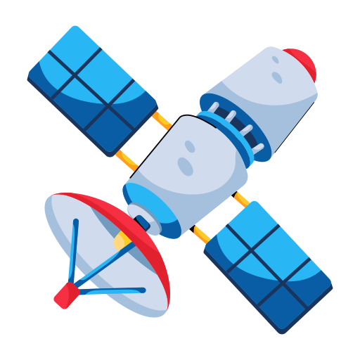




Approach Overview
Target Object
(≠ reference ones)
Orbital data history
Orbital data history
Orbital data history
Maneuver Informed Tracking
Manoeuvre
Detection
Manoeuvre
Prediction
Maneuver Probability
Manoeuvre history
Reconstructed Pattern of Life
Correlated Track
$$P\left(M \right| x, t)$$
Reference
Active Objects
Maneuver
Measurement residuals
$$r_{2}$$
Improved catalogue maintenance
True
Predicted
$$r_{1}$$
3σ ellipsoid
Missione 4 • Istruzione e Ricerca
Manoeuvre
Prediction
Manoeuvre Probability
Sensor Tasking
Informed Tracking
Informed track-to-orbit correlation
…

Slide 14

Maneuver Detection
Target Object
TLE Data
Inference Phase
Latent Space Projection
Similarity Scoring
Temporal Aggregation
Maneuver spans $𝓜$
Common Data
Preprocessing
Data Preparation
Feature Engineering
TLE Data
Training Phase
Training Dataset Definition
CNN
AutoEncoder
Latent Embeddings
Maneuver History
Reference
Active Objects
Missione 4 • Istruzione e Ricerca

Slide 15
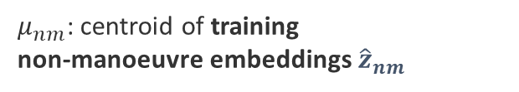

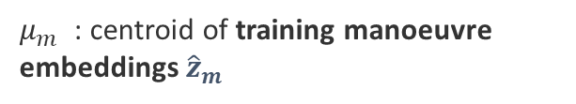
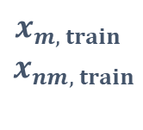




Maneuver Detection
Target Object
TLE Data
Inference Phase
Latent Space Projection
Similarity Scoring
Temporal Aggregation
Maneuver spans $𝓜$
Common Data
Preprocessing
Data Preparation
Feature Engineering
TLE Data
Training Phase
Training Dataset Definition
CNN
AutoEncoder
Latent Embeddings
Maneuver History
$${\hat{z}}_{m, train }$$
Reference
Active Objects
$$x_{2}$$
$μ_{m}$ : centroid of training manoeuvre embeddings ${\hat{z}}_{m}$
$$x_{m, train}$$
$$x_{nm, train}$$
$μ_{nm}$: centroid of training
non-manoeuvre embeddings ${\hat{z}}_{nm}$
Encoder
Bottleneck
$${\hat{z}}_{nm, train }$$
CNN AutoEncoder
$$x_{1}$$
Missione 4 • Istruzione e Ricerca

Slide 16


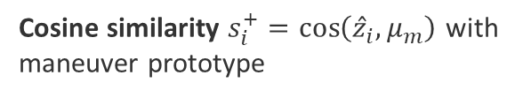

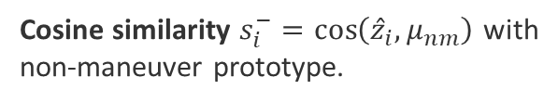



Maneuver Detection
Target Object
TLE Data
Inference Phase
Latent Space Projection
Similarity Scoring
Temporal Aggregation
Maneuver spans $𝓜$
Common Data
Preprocessing
Data Preparation
Feature Engineering
TLE Data
Training Phase
Training Dataset Definition
CNN
AutoEncoder
Latent Embeddings
Maneuver History
Reference
Active Objects
$$x_{2}$$
$μ_{m}$
Cosine similarity $s_{i}^{+}=\cos\left({\hat{z}}_{i}, μ_{m}\right)$ with maneuver prototype
$$x_{i, val}$$
$$z_{i, val}$$
$$μ_{nm}$$
Cosine similarity $s_{i}^{−}=\cos\left({\hat{z}}_{i}, μ_{nm}\right)$ with
non-maneuver prototype.
$$x_{1}$$
Missione 4 • Istruzione e Ricerca

Slide 17






Maneuver Detection
Target Object
TLE Data
Inference Phase
Latent Space Projection
Similarity Scoring
Temporal Aggregation
Maneuver spans $𝓜$
Common Data
Preprocessing
Data Preparation
Feature Engineering
Latent Embeddings
Training Embeddings
$$PCA_{2}$$
a
$μ_{m}$
CNN-AE
$$CS$$
Threshold
$$μ_{nm}$$
t
Window
Due to overlapping windows, scores are aggregated through coverage voting.
$$PCA_{1}$$
Missione 4 • Istruzione e Ricerca

Slide 18
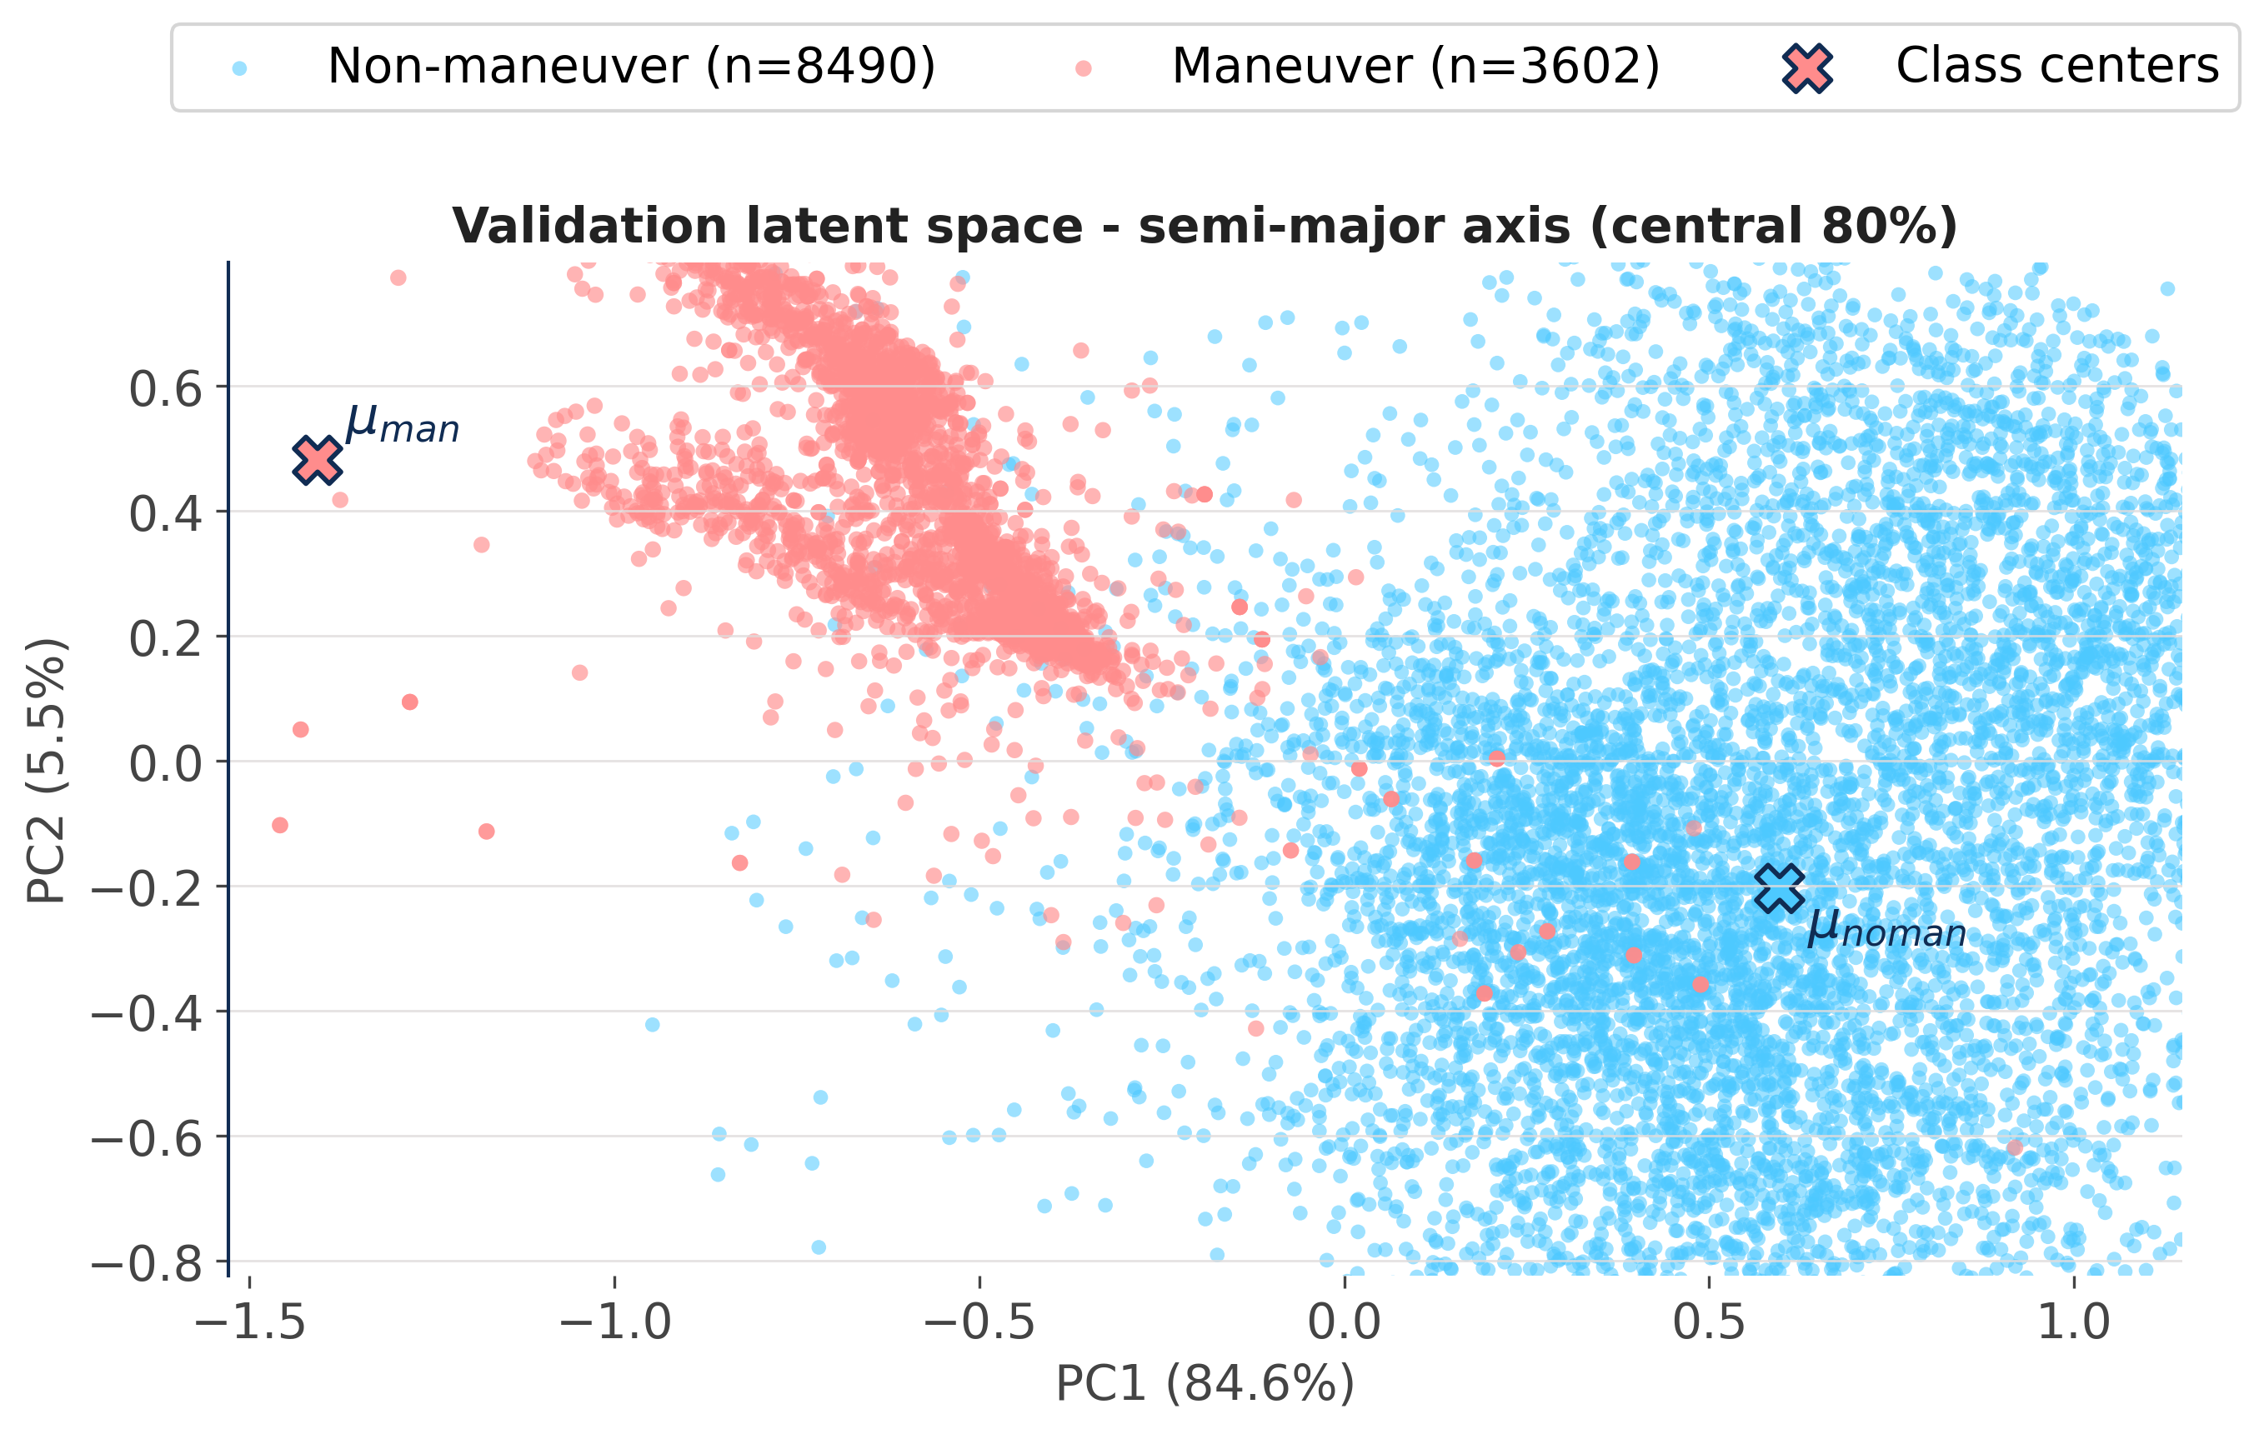
Maneuver Detection
ILRS Satellite Dataset (12 LEO objects, 853 maneuvers)
Training (8 sats)
Validation (2 sats)
Test (2 sats)
Validation latent space
Metric | SMA (a) | INC (i)
ROC-AUC | 0.9957 | 0.9980
PR-AUC | 0.9932 | 0.9979
F1-score | 0.9410 | 0.9840
Precision | 0.9019 | 0.9766
Recall | 0.9838 | 0.9916
Missione 4 • Istruzione e Ricerca

Slide 19
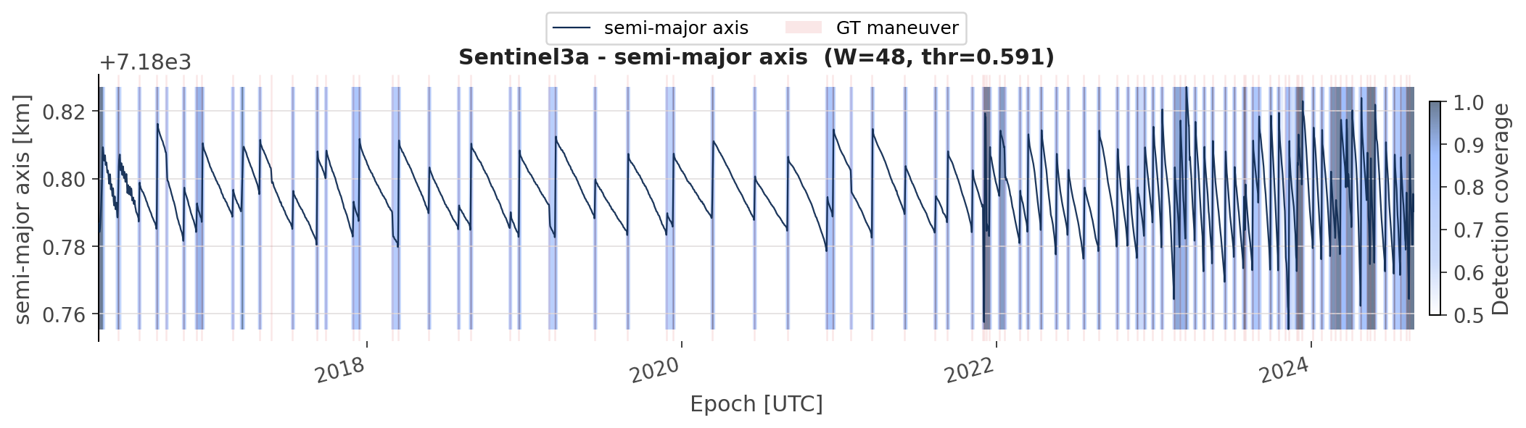
Maneuver Detection
Operational deployment uses one-step sliding windows and coverage voting on the full time series.
SAT1: SENTINEL-3A
Altitude: ~814 km
Coverage peaks align cleanly with reference spans
Only 1 false positive (missing reference label)
Only 1 false negative: altitude decrease maneuver, metric slightly below threshold
Missione 4 • Istruzione e Ricerca

Slide 20

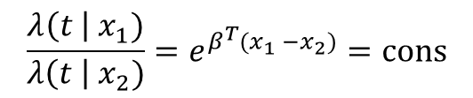
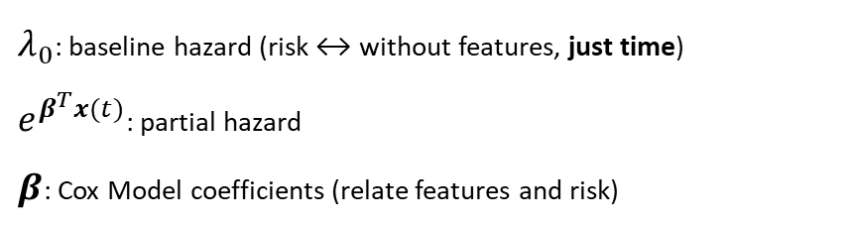


Maneuver Prediction
From Maneuver Detection
Cox proportional model
$$p_{h}\left(t\right)$$
Reconstructed maneuver history
Age of maneuver cycle
Time-varying features
Cox Hazard
$$λ\left(t \right| x(t))=λ_{0}e^{β^{T}x(t)}$$
1
First assumption: time effect is constant
$λ_{0}$: baseline hazard (risk ↔ without features, just time)
$e^{β^{T}x(t)}$: partial hazard
$β$: Cox Model coefficients (relate features and risk)
2
Second assumption: proportional hazard
$$\frac{λ\left(t \right|{ x}_{1})}{λ\left(t \right| x_{2})}=e^{β^{T}(x_{1} −x_{2})}=cons$$
Missione 4 • Istruzione e Ricerca

Slide 21
Maneuver Prediction
From Manoeuvre Detection
Set of features describing the maneuvering behaviour, operational constraints, environmental conditions, and so on.
Cox proportional model
$$p_{h}\left(t\right)$$
Reconstructed manoeuvre history
Age of manoeuvre cycle
Time-varying features
1
Time since last manoeuvre
2
Eccentricity
3
Inclination drift
4
Semi-major axis variation
5
Groundtrack Drift
6
Local Time @ Ascending Node Drift
7
Day-of-year (sine/cosine)
8
Space Weather (F10.7, Ap index)
Missione 4 • Istruzione e Ricerca

Slide 22
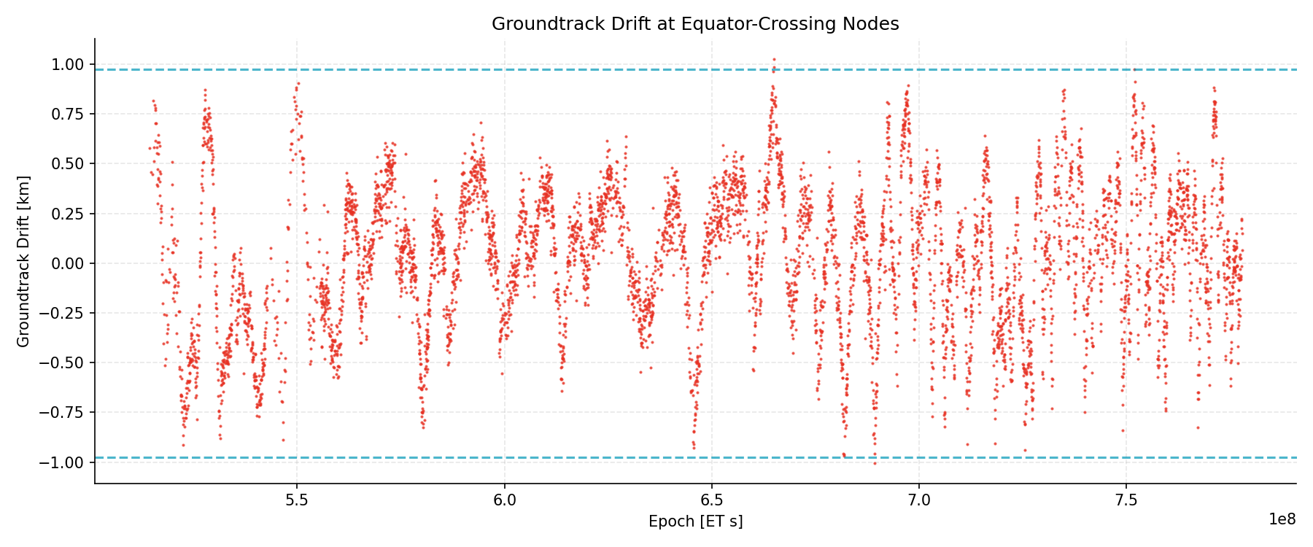
Maneuver Prediction
From Manoeuvre Detection
Set of features describing the maneuvering behaviour, operational constraints, environmental conditions, and so on.
Cox proportional model
$$p_{h}\left(t\right)$$
Reconstructed manoeuvre history
Age of manoeuvre cycle
Time-varying features
5
Groundtrack Drift
Parabolic behaviour
Drift toward east (negative values) is often indicator of imminent maneuver
Missione 4 • Istruzione e Ricerca

Slide 23
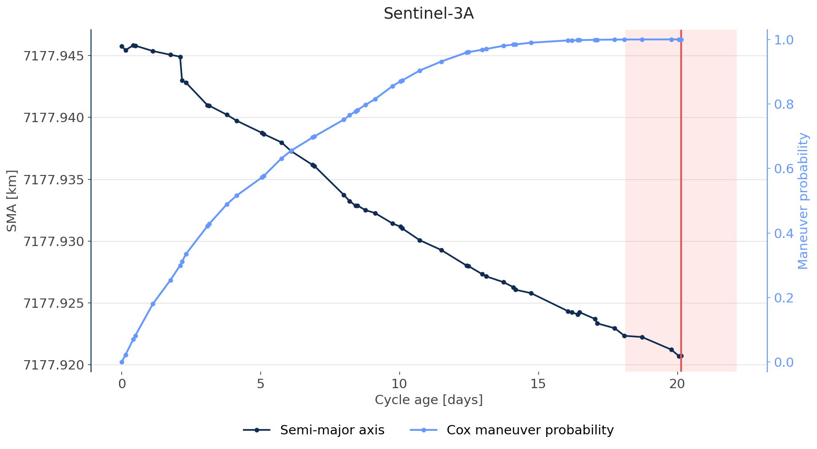
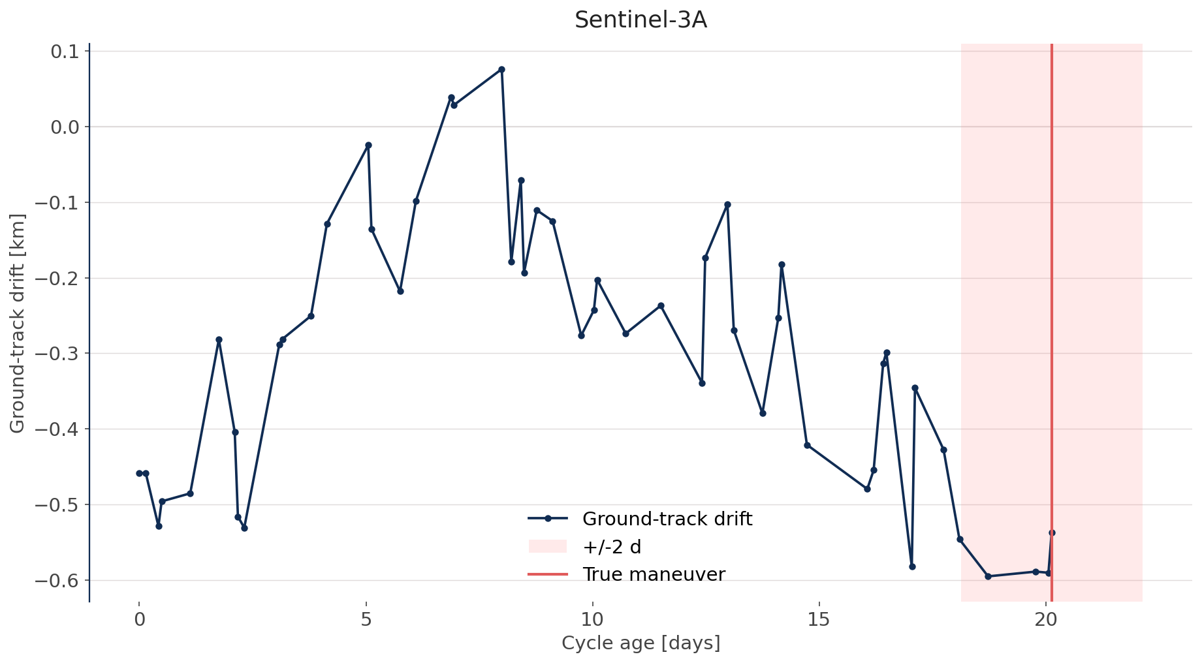
Maneuver Prediction
Prediction results on SENTINEL-3A (well-conditioned cycle)
Cycles are defined as time intervals between two consecutive maneuvers (free motion under perturbations)
Maneuver probability saturates some days before the true maneuver epoch (cycle duration = 20 days)
Missione 4 • Istruzione e Ricerca

Slide 24
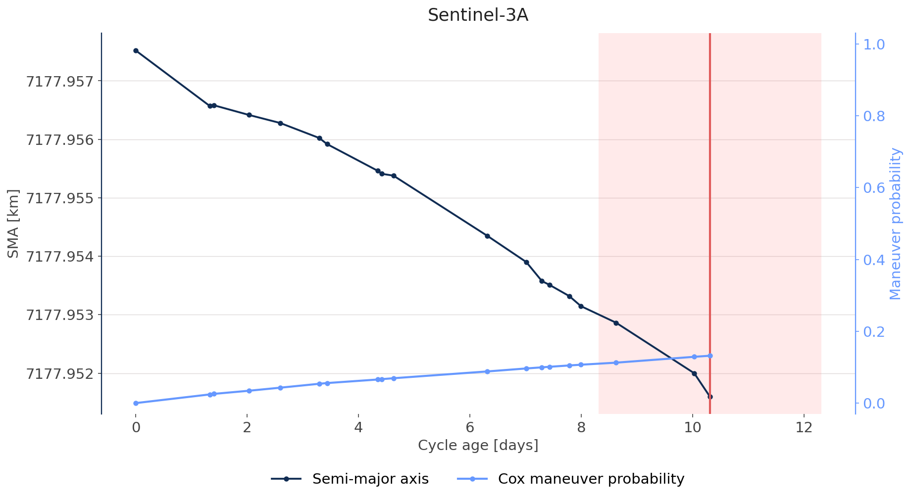
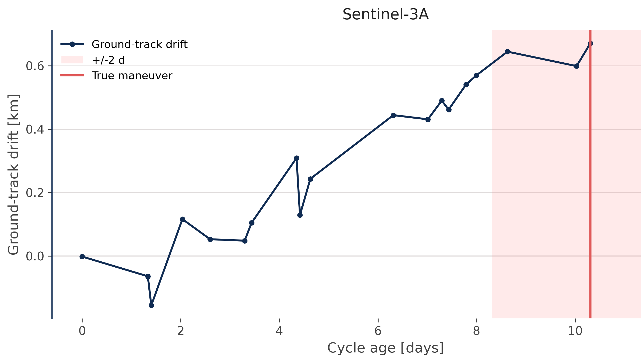
Maneuver Prediction
Prediction results on SENTINEL-3A (bad cycle)
Bad conditioned cycle: Sentinel-3A maneuver from West to East (decreasing the semi-major axis)
The probability is still influenced by other parameters and time (slightly increases)
Missione 4 • Istruzione e Ricerca

Slide 25

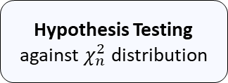






Applications for Catalogue Maintenance
Maneuver-Informed Tracking
Residual-based approach
Correlated Tracks
Orbit Determination
(Sequential Filter)
Normalized Innovation Squared (NIS)
$$x_{0}, P_{0}$$
$$NIS=y_{k}^{T}S_{k}^{−1}y_{k}$$
Prior fusion and detection
Evidence
Accumulation
Hypothesis Testing against $χ_{n}^{2}$ distribution
$$P(M)$$
+
Posterior
$$H_{0}$$
Prior
-
$$t$$
$$t$$
Maneuver
$H_{1}$?
Missione 4 • Istruzione e Ricerca

Slide 26
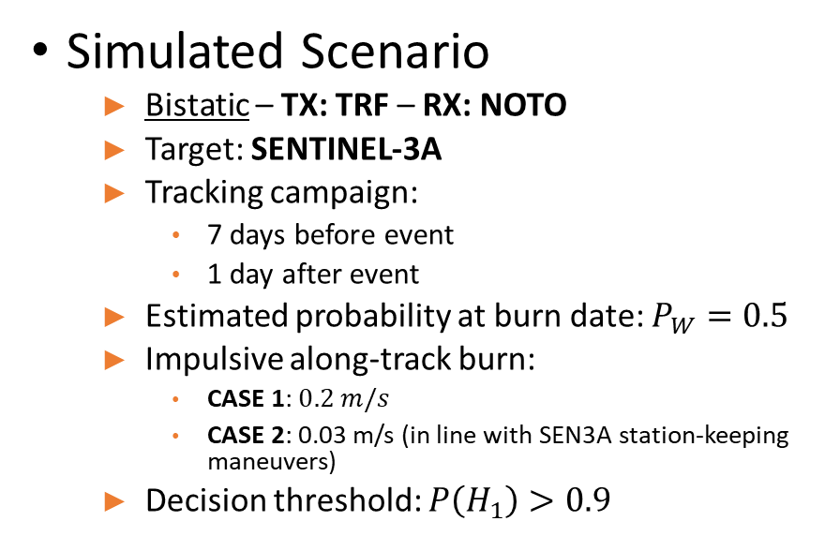
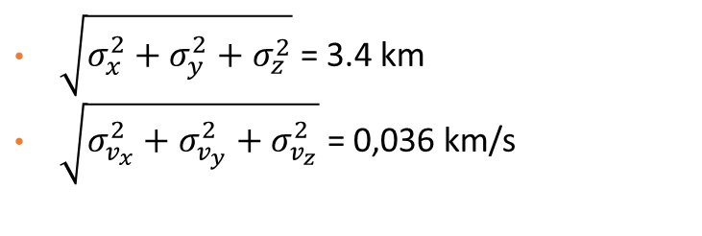
Applications for Catalogue Maintenance
1
Simulated Scenario
  Bistatic – TX: TRF – RX: NOTO
  Target: SENTINEL-3A
  Tracking campaign:
    7 days before event
    1 day after event
  Estimated probability at burn date: $P_{W}=0.5$
  Impulsive along-track burn:
    CASE 1: $0.2 m/s$
    CASE 2: 0.03 m/s (in line with SEN3A station-keeping maneuvers)
  Decision threshold: $P\left(H_{1}\right)>0.9$
Dynamical mismatch
2
Process noise
3
Initial uncertainty
$\sqrt{σ_{x}^{2}+σ_{y}^{2}+σ_{z}^{2}}$ = 3.4 km
$\sqrt{σ_{v_{x}}^{2}+σ_{v_{y}}^{2}+σ_{v_{z}}^{2}}$ = 0,036 km/s
4
Range and range-rate
Missione 4 • Istruzione e Ricerca

Slide 27
Applications for Catalogue Maintenance
1
Simulated Scenario
  Bistatic – TX: TRF – RX: NOTO
  Target: SENTINEL-3A
  Tracking campaign:
    7 days before event
    1 day after event
  Estimated probability at burn date: $P_{W}=0.5$
  Impulsive along-track burn:
    CASE 1: $0.2 m/s$
    CASE 2: 0.03 m/s (in line with SEN3A station-keeping maneuvers)
  Decision threshold: $P\left(H_{1}\right)>0.9$
Dynamical mismatch
2
Process noise
3
Initial uncertainty
$\sqrt{σ_{x}^{2}+σ_{y}^{2}+σ_{z}^{2}}$ = 3.4 km
$\sqrt{σ_{v_{x}}^{2}+σ_{v_{y}}^{2}+σ_{v_{z}}^{2}}$ = 0,036 km/s
4
Range and range-rate
Missione 4 • Istruzione e Ricerca

Slide 28
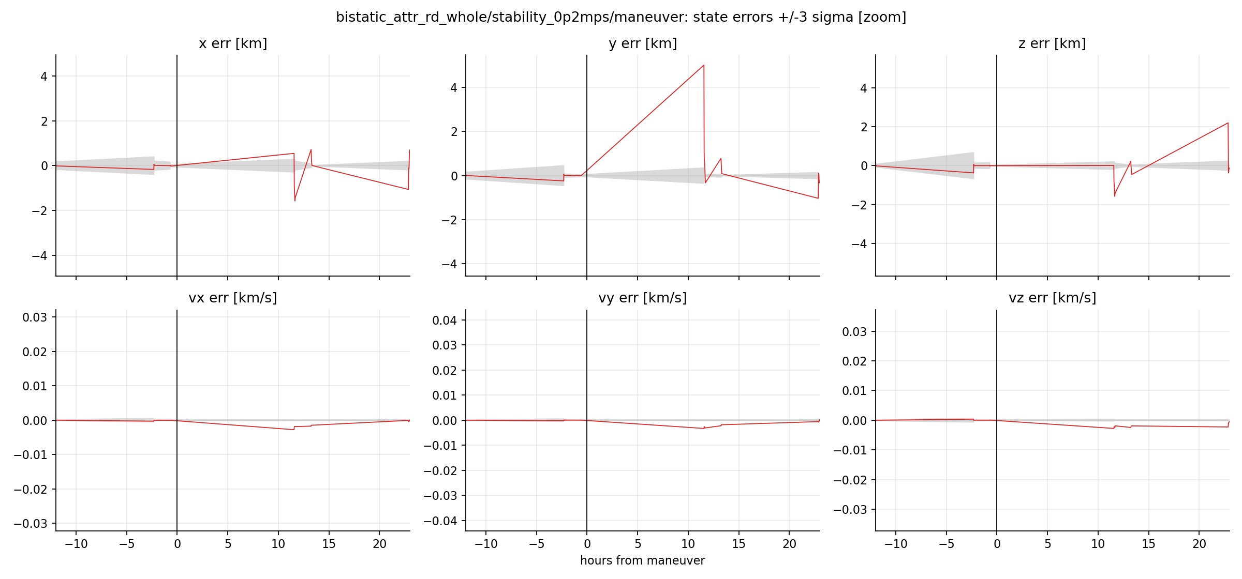

Applications for Catalogue Maintenance
Simulated Scenario CASE 1: 0.2 m/s
TRF – NOTO Bi – State error and +/- 3$σ$
Missione 4 • Istruzione e Ricerca

Slide 29
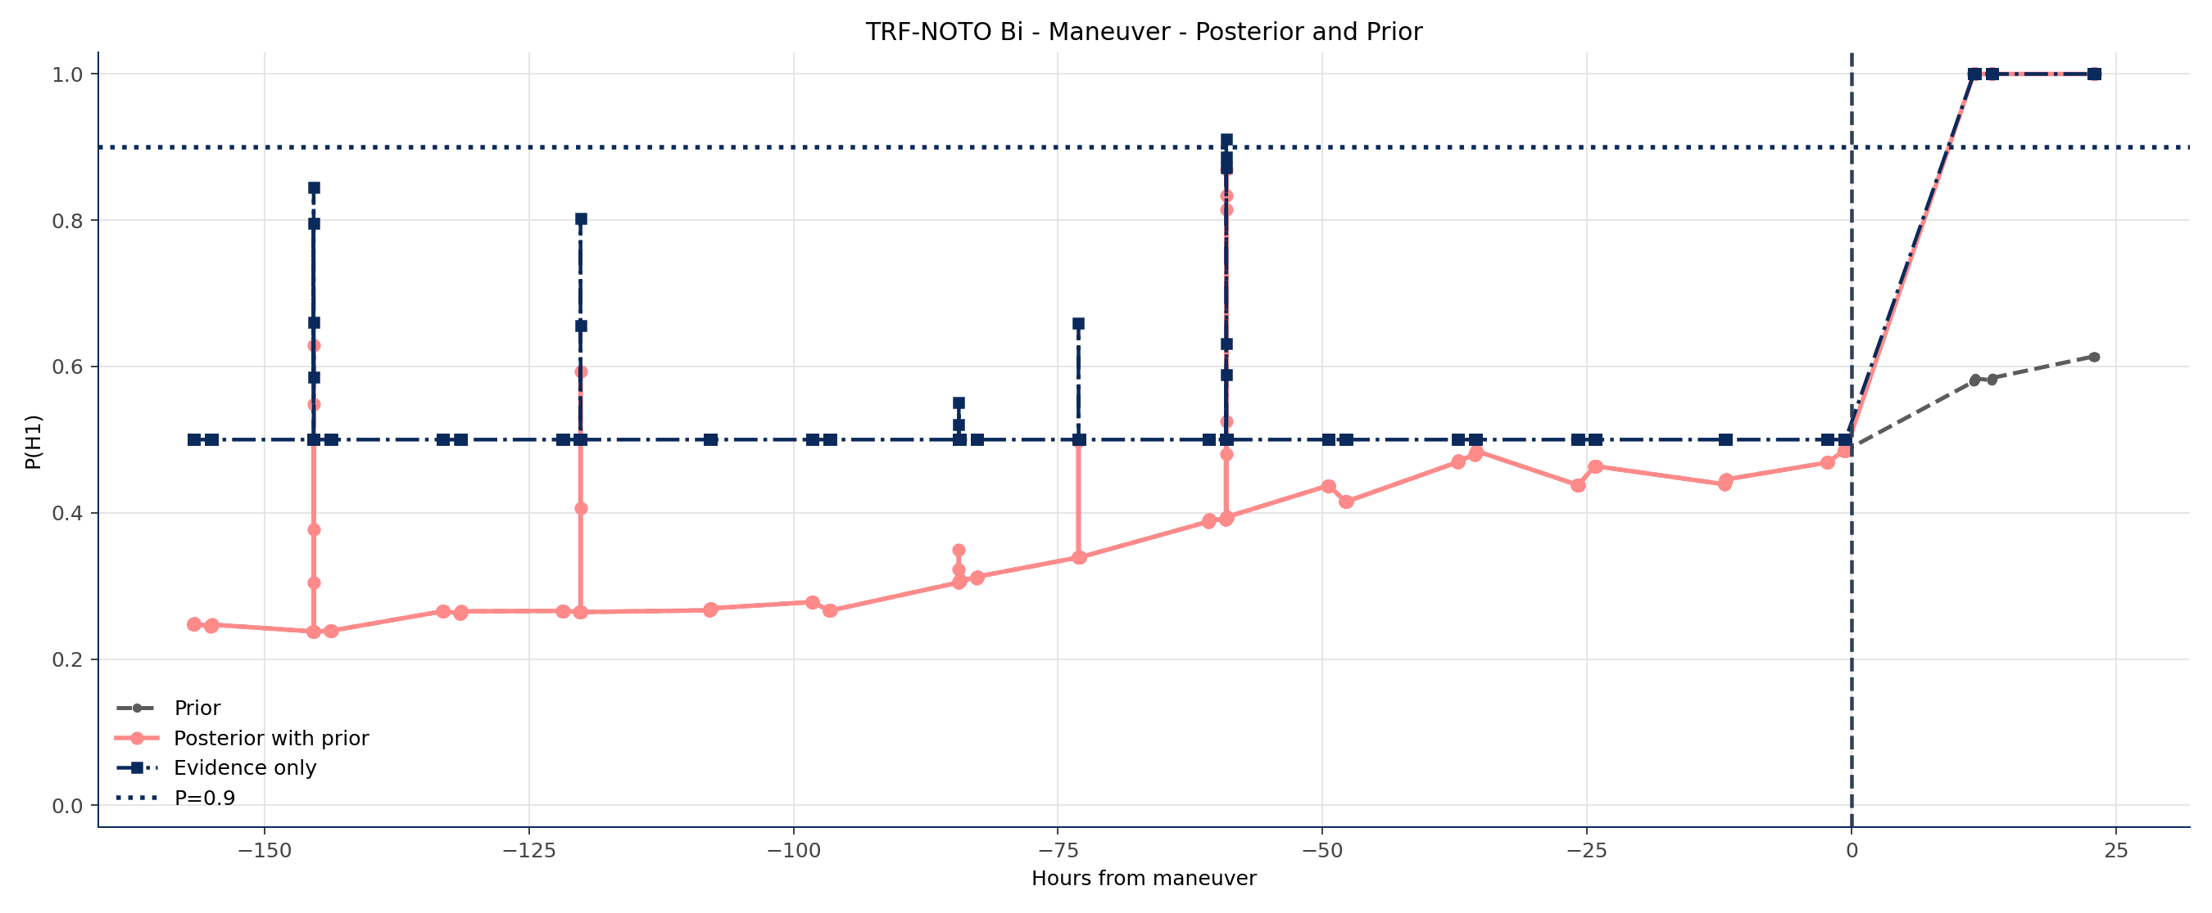

Applications for Catalogue Maintenance
Simulated Scenario CASE 1: 0.2 m/s
TRF – NOTO Bi – State error and +/- 3$σ$
Prior dampens potential false alarms
Missione 4 • Istruzione e Ricerca

Slide 30
Applications for Catalogue Maintenance
Simulated Scenario CASE 1: 0.2 m/s
TRF – NOTO Bi – State error and +/- 3$σ$
Detection at first available tracks.
Prior dampens potential false alarms
Missione 4 • Istruzione e Ricerca

Slide 31
Applications for Catalogue Maintenance
Simulated Scenario CASE 2: 0.03 m/s
TRF – NOTO Bi – State error and +/- 3$σ$
Same as before: saturation at first track
Missione 4 • Istruzione e Ricerca

Slide 32
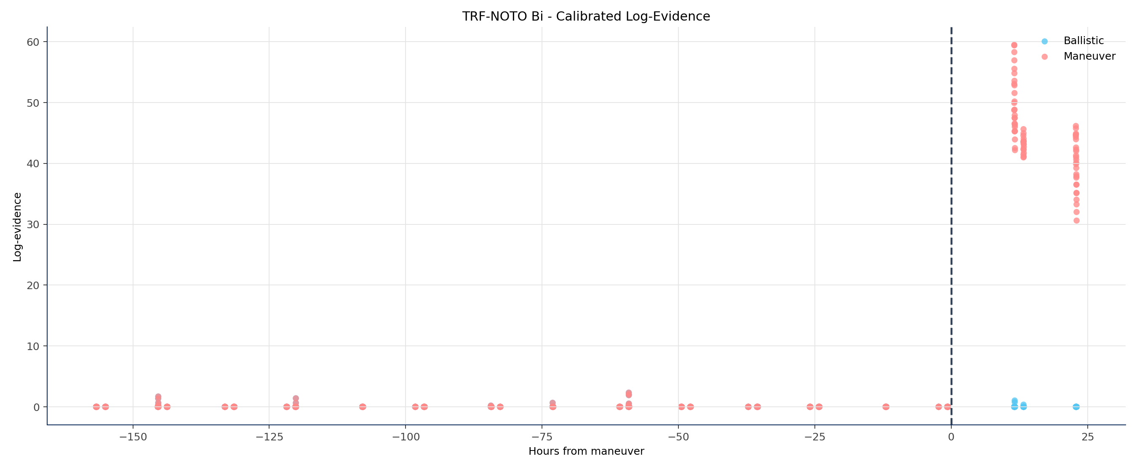
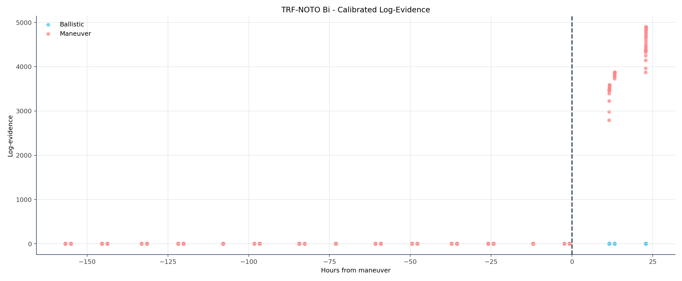
Applications for Catalogue Maintenance
Comparing evidences for each compressed track
CASE 2
CASE 1
Missione 4 • Istruzione e Ricerca

Slide 33
Applications for Catalogue Maintenance
Comparing evidences for each compressed track
CASE 2
CASE 1
Missione 4 • Istruzione e Ricerca

Slide 34
Conclusions
Working catalogue maintenance pipeline (more tests are work in progress)
  Actively track objects that are likely to maneuver
  Exploit information for scheduling
  Better evidence from simple decision-based methods
More work to do:
  Stronger predictor -> maneuver model (time and magnitude)
  Extend to track-to-orbit correlation processes
Missione 4 • Istruzione e Ricerca

Slide 35
Thanks for the attention!
Final Meeting
Martedì 30 Giugno – Giovedì 02 Luglio
OAC - Osservatorio Astrofisico di Arcetri

