Slide 1


Radar Measurements for the Characterization of Resident Space Objects
Final Meeting
Martedì 30 Giugno – Giovedì 02 Luglio
OAC - Osservatorio Astrofisico di Arcetri
M.A. De Luca

Slide 2




TABLE OF CONTENTS
01
Background
04
Sidereal Spin Period + Spin Axis Estimation (from RCS time series)
02
Synodic Spin Period Estimation
05
Conclusions
03
BIRALES Test Case
Missione 4 • Istruzione e Ricerca
Missione 4 • Istruzione e Ricerca

Slide 3
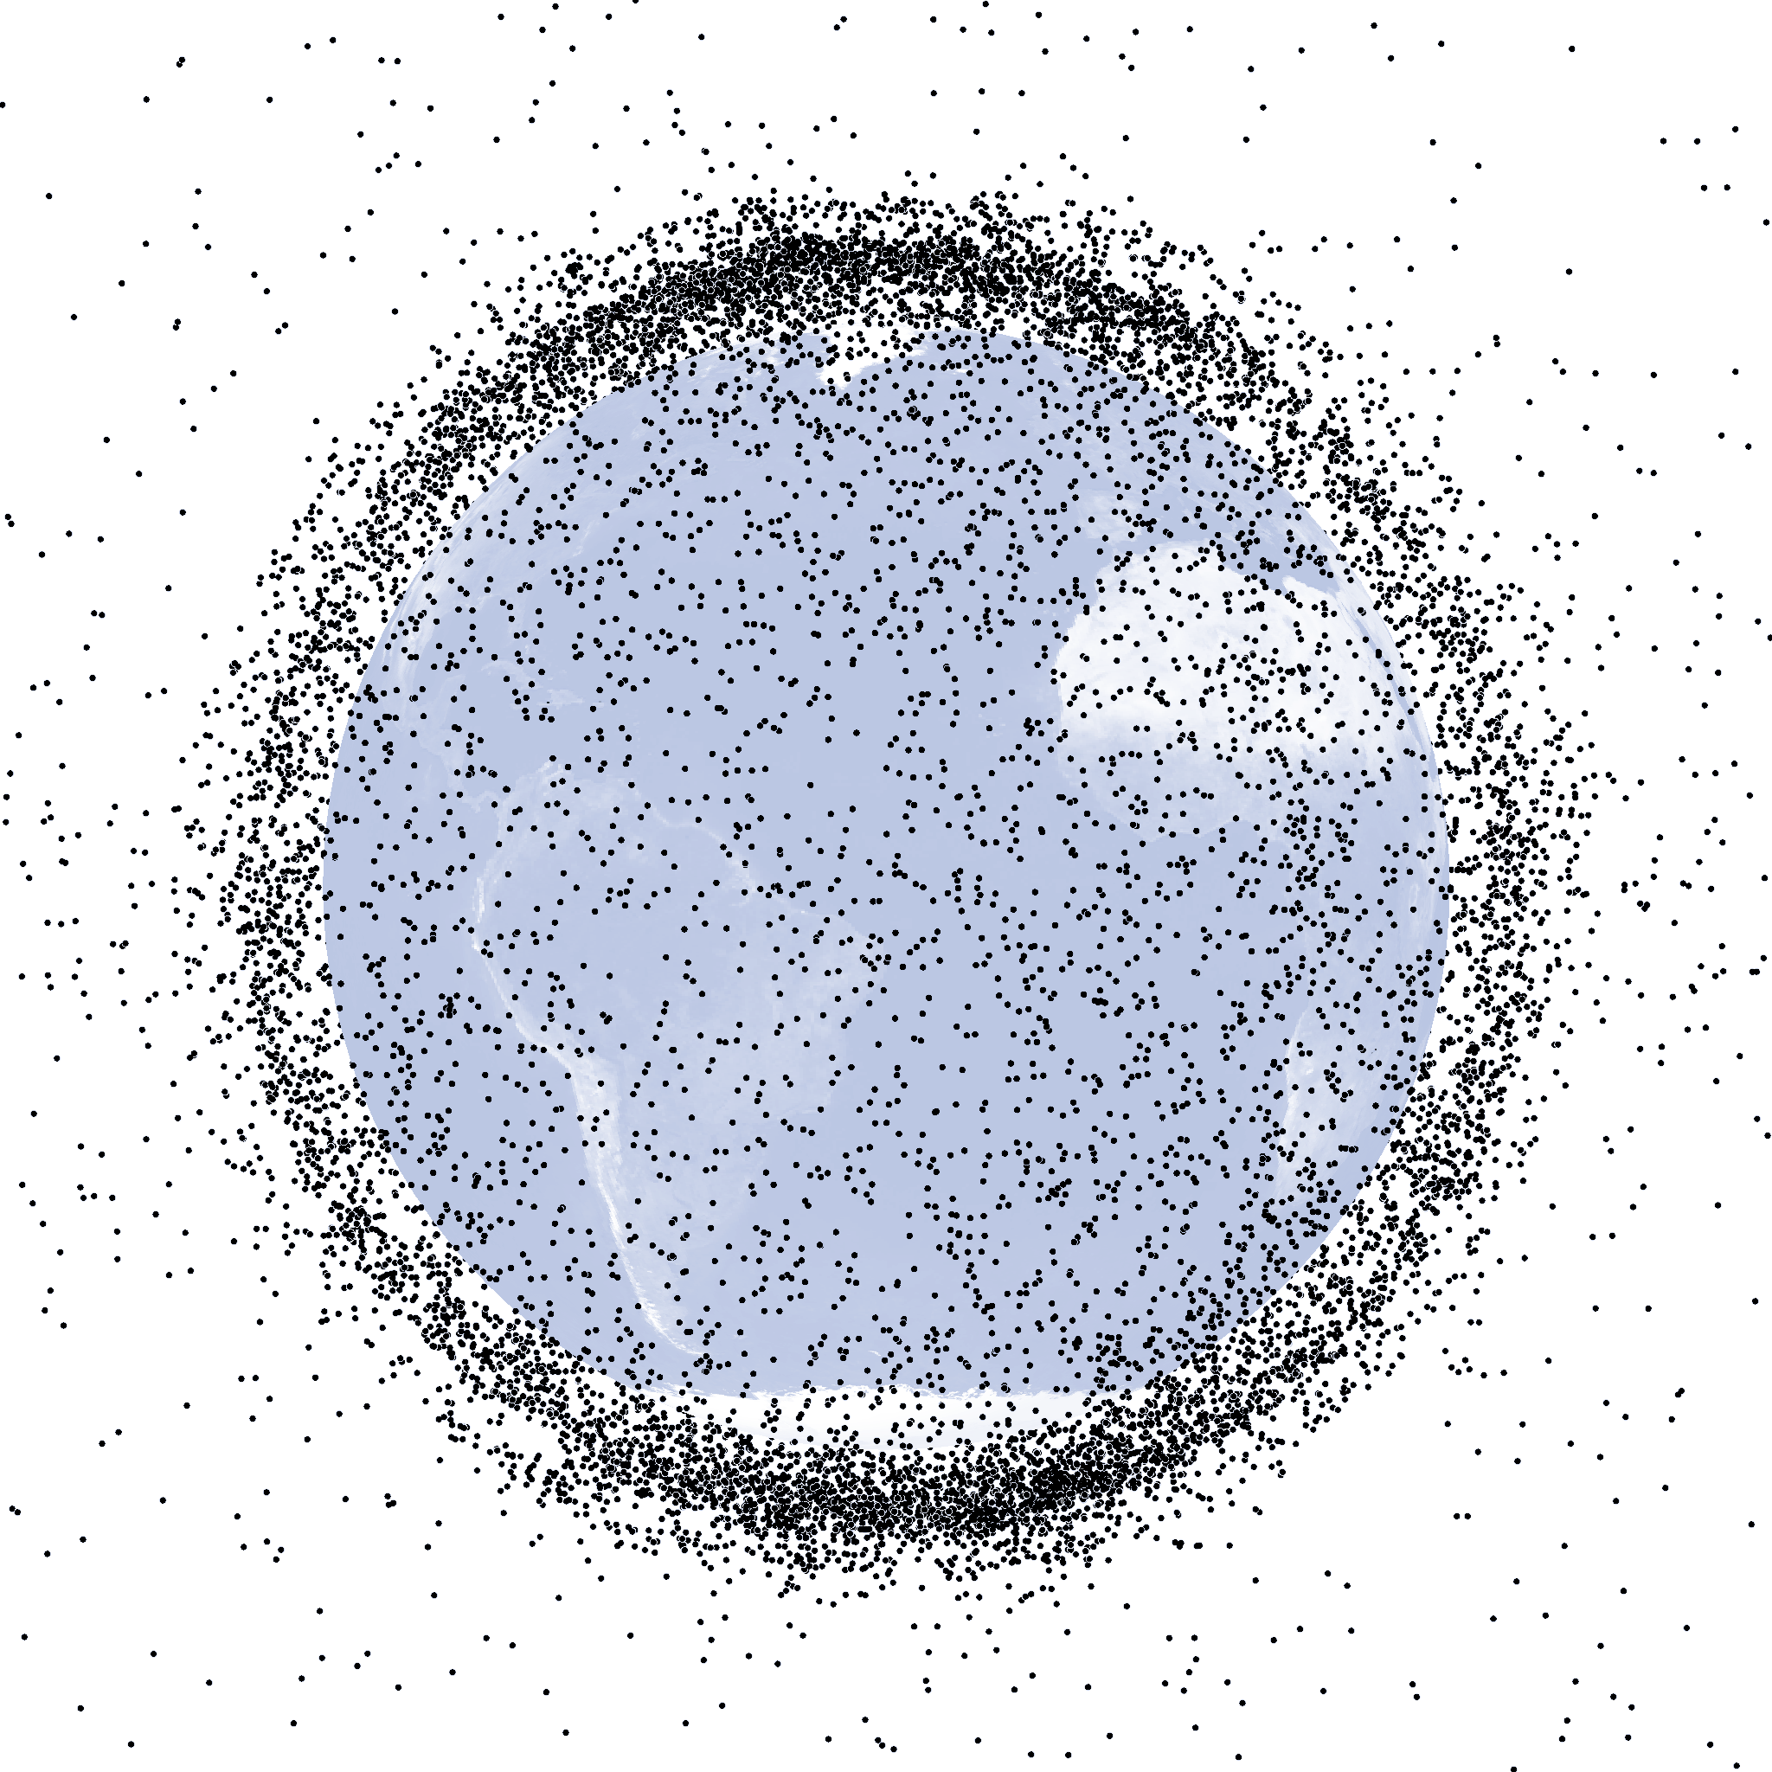
BACKGROUND
Resident Space Object (RSO)
active satellites, decommissioned spacecrafts, orbital debris
~54000 RSO in orbit ( > 10 cm)*
Orbital Motion
For space traffic monitoring, effective characterization of orbiting objects is essential
Rotational Motion
Physical Properties
Missione 4 • Istruzione e Ricerca
* https://sdup.esoc.esa.int/discosweb/statistics/ (Accessed 29/06/26)
Missione 4 • Istruzione e Ricerca

Slide 4



BACKGROUND
Resident Space Object (RSO)
active satellites, decommissioned spacecrafts, orbital debris
~54000 RSO in orbit ( > 10 cm)*
OPTICAL SENSORS
Orbital Motion
Light Curves
For space traffic monitoring, effective characterization of orbiting objects is essential
Rotational Motion
RADAR SENSORS
RCS time series
Range and Doppler measurements
Physical Properties
Missione 4 • Istruzione e Ricerca
* https://sdup.esoc.esa.int/discosweb/statistics/ (Accessed 29/06/26)
Missione 4 • Istruzione e Ricerca

Slide 5
BACKGROUND
Resident Space Object (RSO)
active satellites, decommissioned spacecrafts, orbital debris
~54000 RSO in orbit ( > 10 cm)*
OPTICAL SENSORS
Determining the full attitude vector is inherently challenging. It requires:
Accurate shape
Reliable surface properties
Data rarely available in SSA operations
Light Curves
RADAR SENSORS
RCS time series
Range and Doppler measurements
Missione 4 • Istruzione e Ricerca
* https://sdup.esoc.esa.int/discosweb/statistics/ (Accessed 29/06/26)
Missione 4 • Istruzione e Ricerca

Slide 6
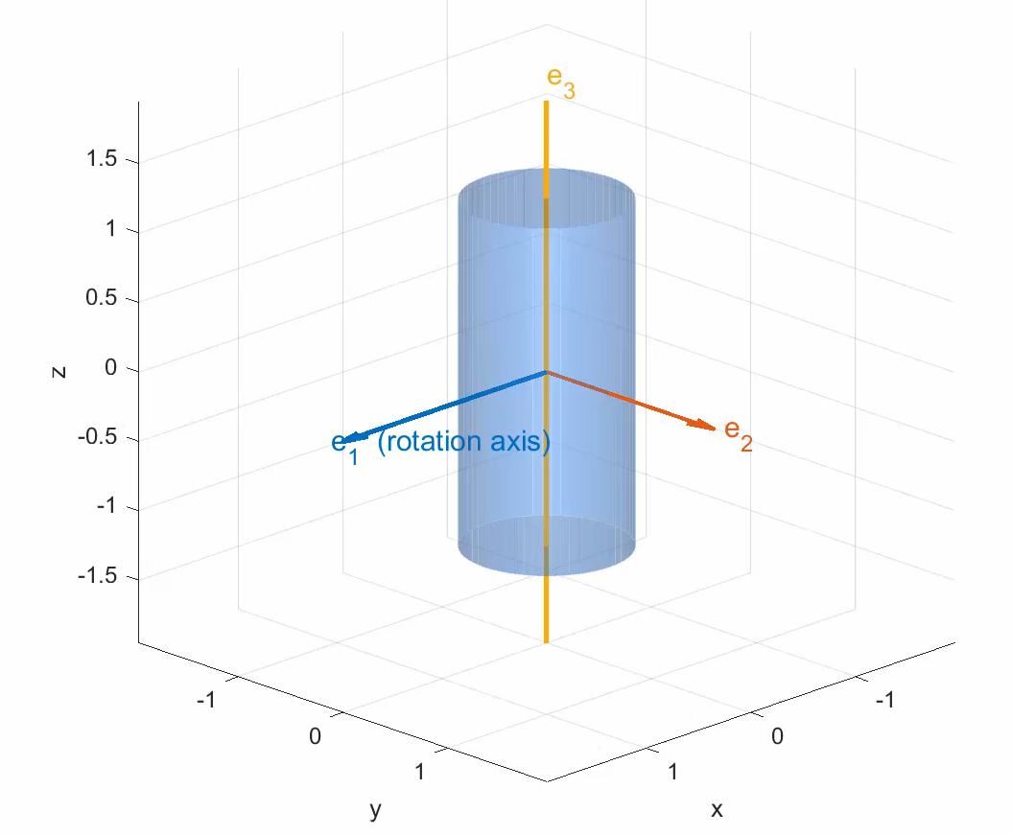
BACKGROUND
Resident Space Object (RSO)
active satellites, decommissioned spacecrafts, orbital debris
~54000 RSO in orbit ( > 10 cm)*
CORE RESEARCH IDEA
OPTICAL SENSORS
Determining the full attitude vector is inherently challenging. It requires:
Accurate shape
Reliable surface properties
Data rarely available in SSA operations
Light Curves
Estimate only key attitude-related parameters of rotating targets:
  Spin Period
  Spin Axis Direction
Model-Free approach: No prior knowledge of the target is exploited
RADAR SENSORS
RCS time series
Range and Doppler measurements
Missione 4 • Istruzione e Ricerca
* https://sdup.esoc.esa.int/discosweb/statistics/ (Accessed 29/06/26)
Missione 4 • Istruzione e Ricerca

Slide 7
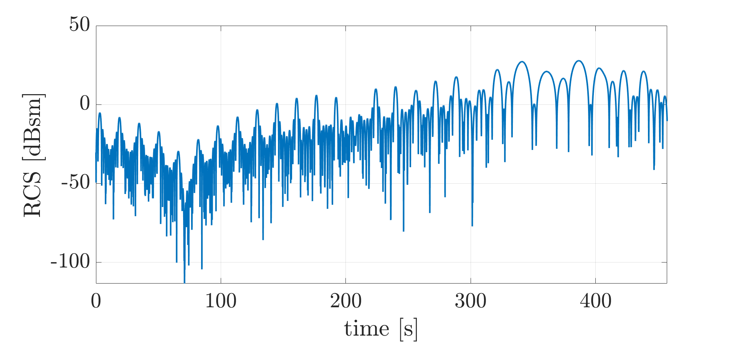
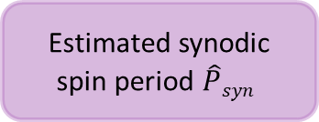
SYNODIC SPIN PERIOD ESTIMATION
1
RCS time series
The estimation strategy depends on the nature of the available measurements :
Time series
Data Pre-Processing
Lomb-Scargle (LS) Periodogram
Power Spectral Density (PSD)
Phase Dispersion Minimization (PDM)
Estimated synodic spin period $\hat{P}syn$
Missione 4 • Istruzione e Ricerca
Missione 4 • Istruzione e Ricerca

Slide 8
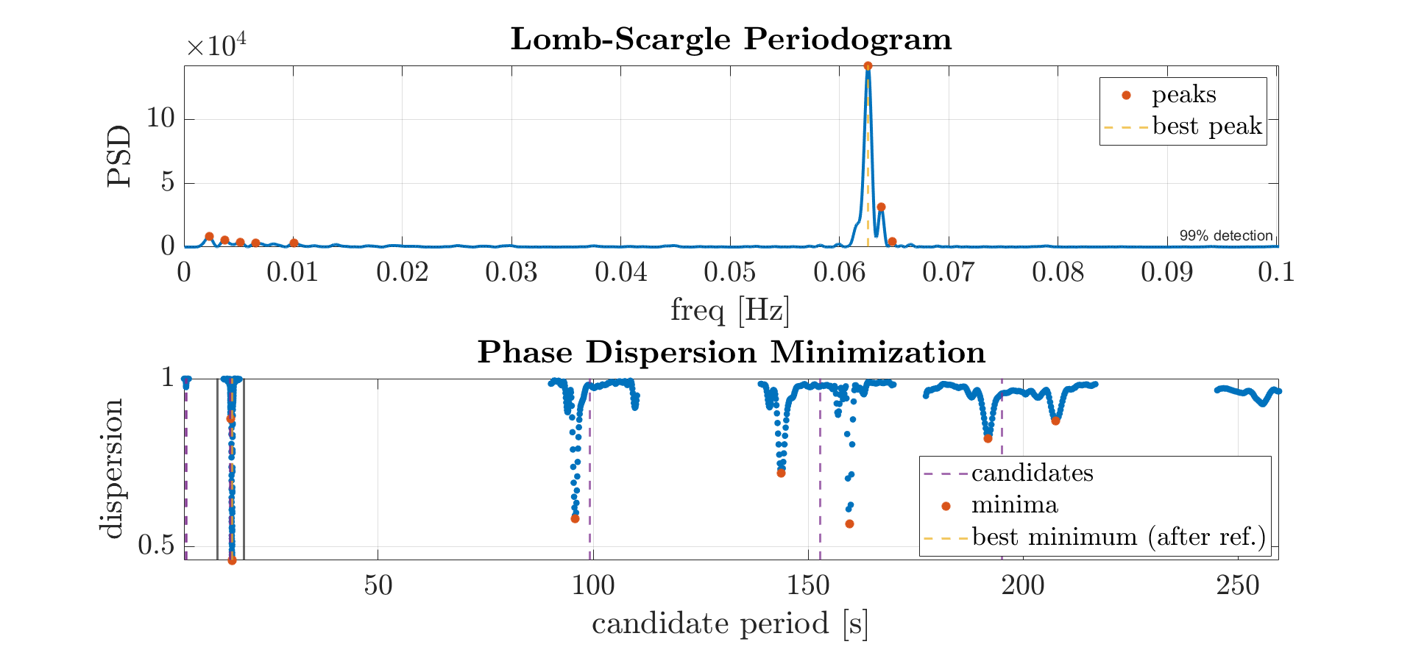
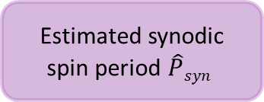
SYNODIC SPIN PERIOD ESTIMATION
1
RCS time series
The estimation strategy depends on the nature of the available measurements :
Time series
Lomb-Scargle Periodogram is used to estimate the PSD of the RCS time-series
The strongest peaks in the PSD are used to identify candidate rotation periods
Data Pre-Processing
Lomb-Scargle (LS) Periodogram
Power Spectral Density (PSD)
Phase Dispersion Minimization (PDM)
Estimated synodic spin period $\hat{P}syn$
Missione 4 • Istruzione e Ricerca
Missione 4 • Istruzione e Ricerca

Slide 9
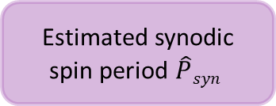
SYNODIC SPIN PERIOD ESTIMATION
1
RCS time series
The estimation strategy depends on the nature of the available measurements :
Time series
The candidates are given as input to the Phase Dispersion Minimization: calculates which one returns the lowest dispersion statistic
Data Pre-Processing
Lomb-Scargle (LS) Periodogram
Power Spectral Density (PSD)
Phase Dispersion Minimization (PDM)
Estimated synodic spin period $\hat{P}syn$
Missione 4 • Istruzione e Ricerca
Missione 4 • Istruzione e Ricerca

Slide 10
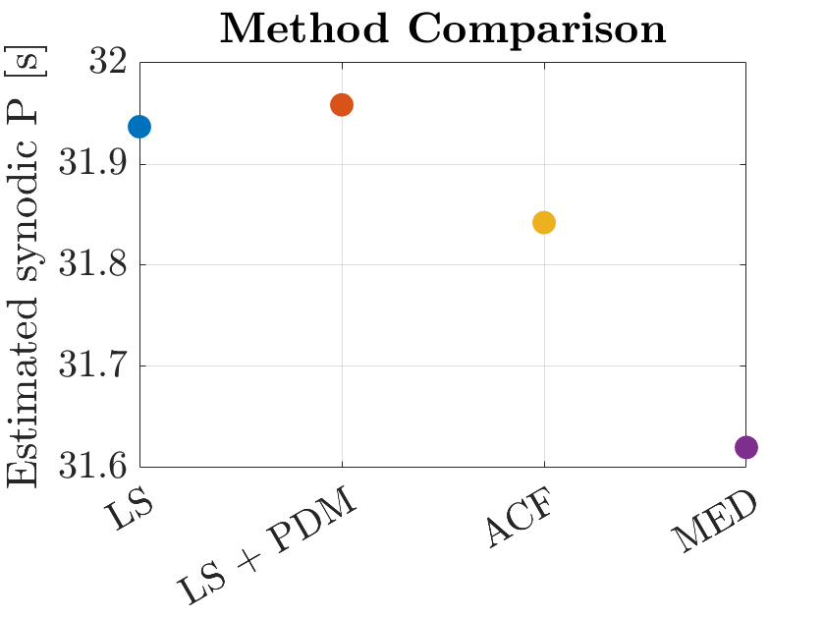
SYNODIC SPIN PERIOD ESTIMATION
1
RCS time series
The estimation strategy depends on the nature of the available measurements :
Time series
Depending on the available input measurements, other strategies can be adopted and compared:
Data Pre-Processing
ACF: Autocorrelation Function
MED: Maximum Entropy Deconvolution
…..
Lomb-Scargle (LS) Periodogram
Power Spectral Density (PSD)
Phase Dispersion Minimization (PDM)
Estimated synodic spin period $\hat{P}syn$
Missione 4 • Istruzione e Ricerca
Missione 4 • Istruzione e Ricerca

Slide 11
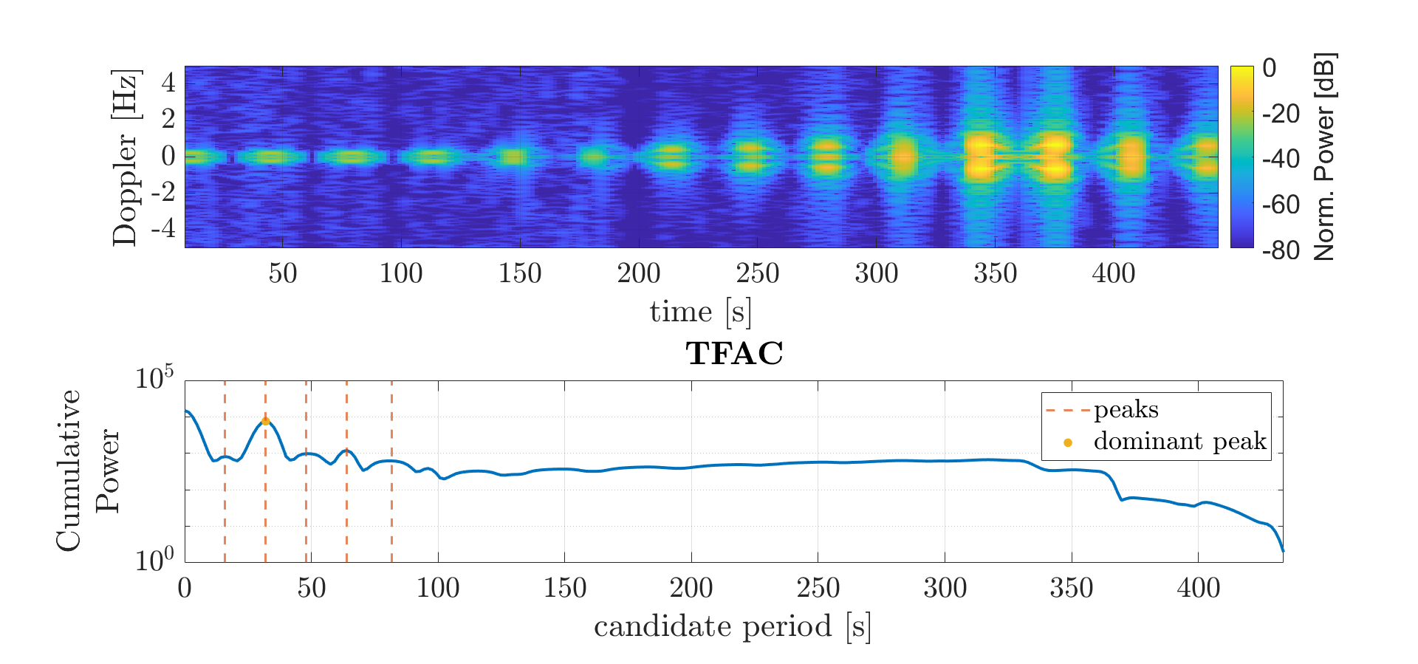
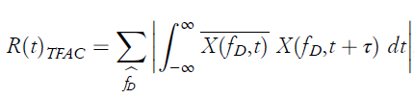
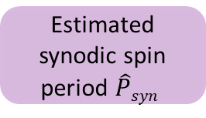
SYNODIC SPIN PERIOD ESTIMATION
2
Micro-Doppler Spectrogram
The estimation strategy depends on the nature of the available measurements :
Micro-Doppler spectrogram
TFAC: variant of the classic autocorrelation algorithm specific for time-frequency data [1]
Time-Frequency Domain Autocorrelation (TFAC)
Estimated synodic spin period $\hat{P}syn$
Missione 4 • Istruzione e Ricerca
Missione 4 • Istruzione e Ricerca
[1] Serrano, A., et al., “Long baseline bistatic radar imaging of tumbling space objects for enhancing space domain awareness” ,2024

Slide 12
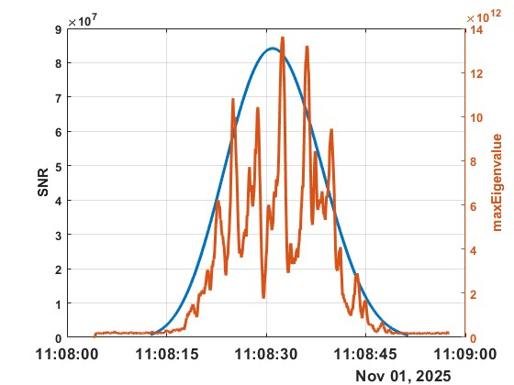
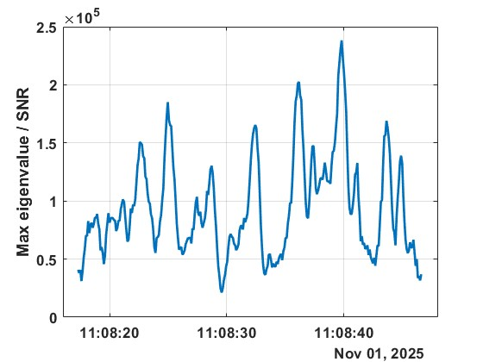
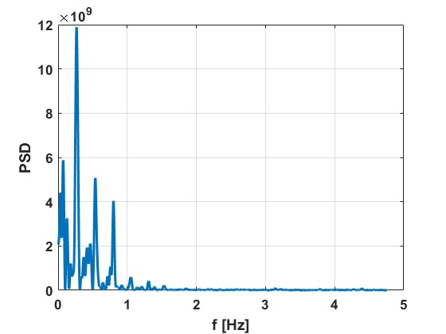
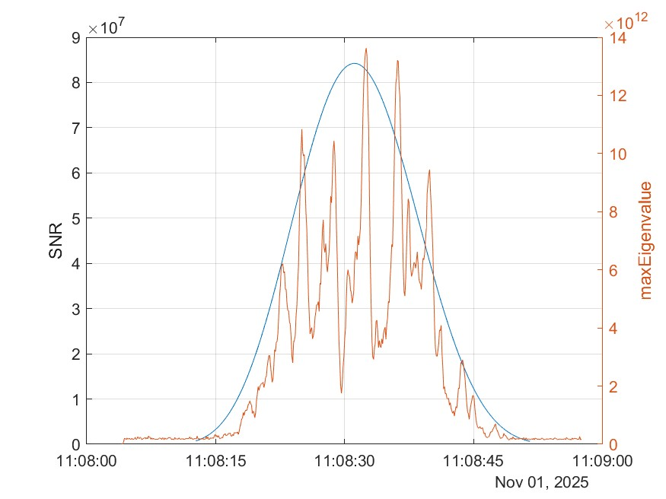
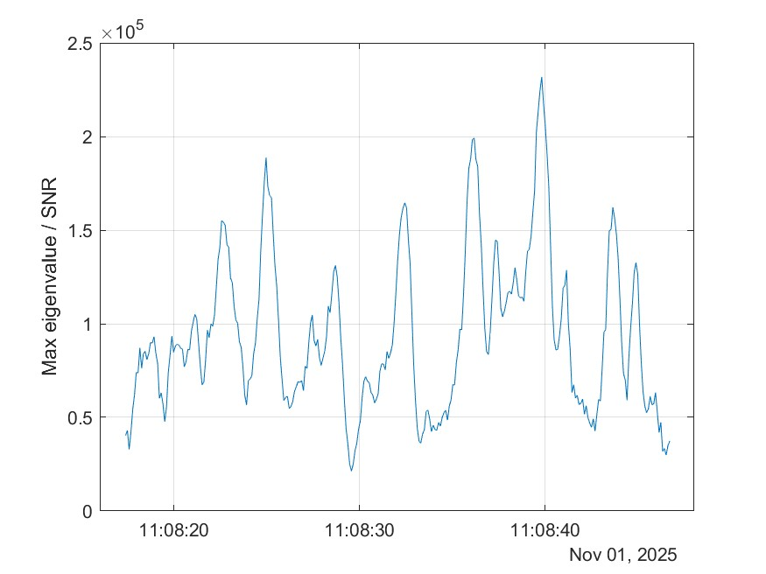
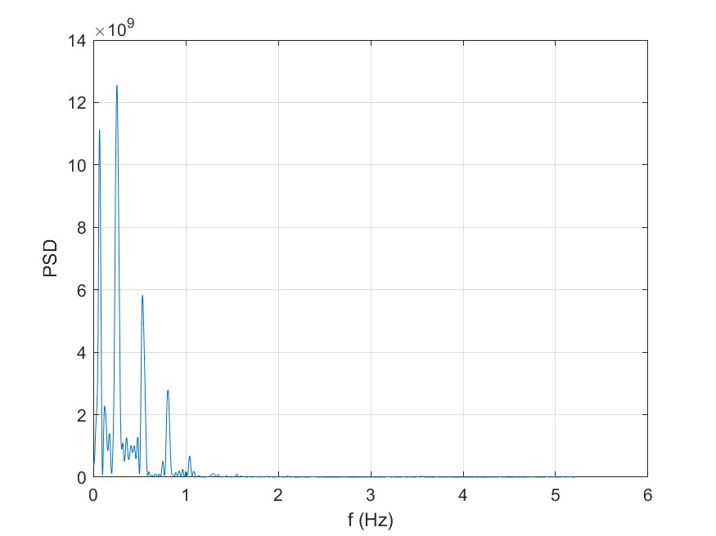
BIRALES TEST CASE
BIRALES detection on November 1st, 2025
Target: Haiyang 2C (Norad ID 46469)
Reference target periodicity: 3.5-4 s
Signal power trend
Bandwidth: 10.43 Hz
Frequency: 0.27 Hz
Periodicity: 3.76 s
Estimated periodicity: 3.76 s
Missione 4 • Istruzione e Ricerca
Missione 4 • Istruzione e Ricerca

Slide 13
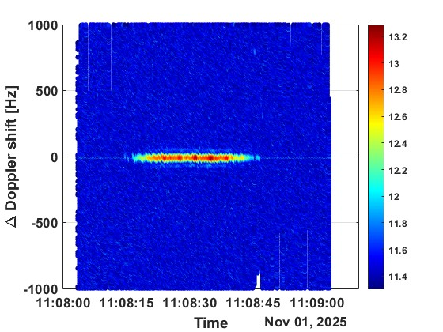
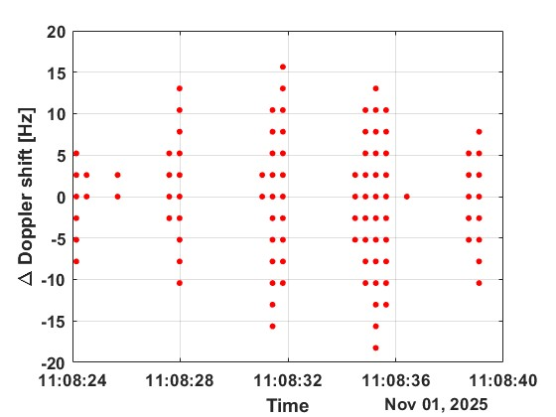
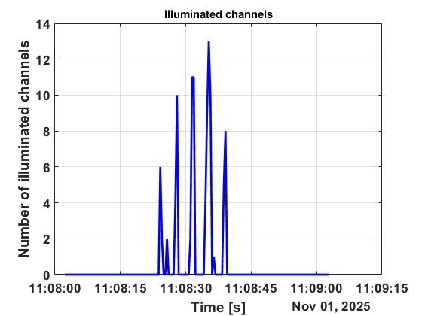
BIRALES TEST CASE
BIRALES detection on November 1st, 2025
Target: Haiyang 2C (Norad ID 46469)
Reference target periodicity: 3.5-4 s
Micro-Doppler
Bandwidth: 2.61 Hz
Estimated periodicity: 3.76 s
Missione 4 • Istruzione e Ricerca
Missione 4 • Istruzione e Ricerca

Slide 14
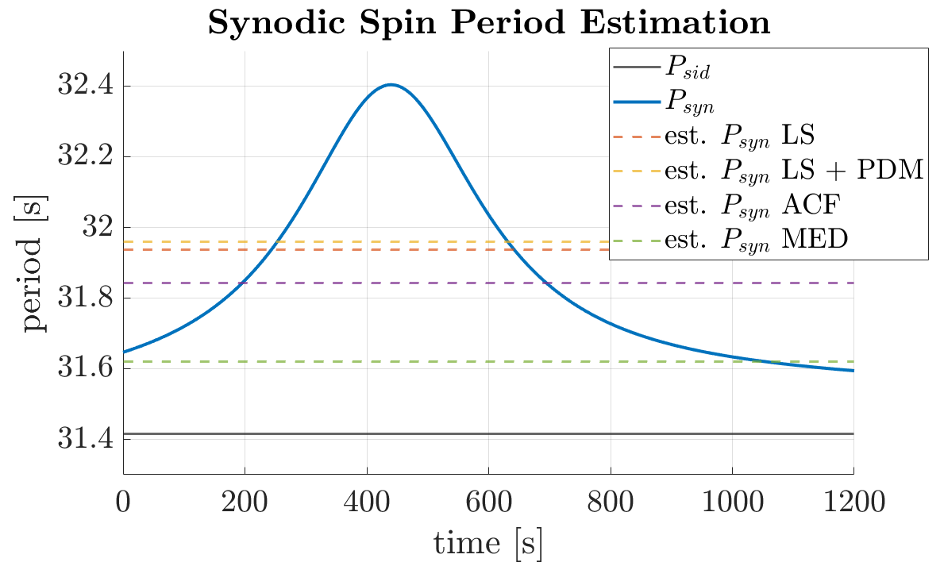

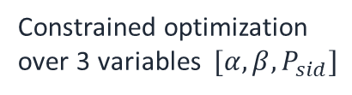
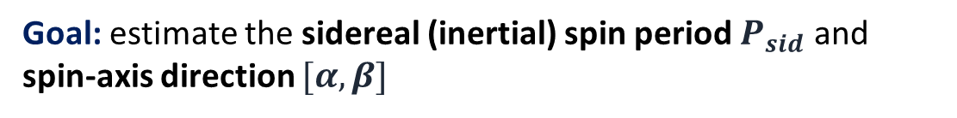
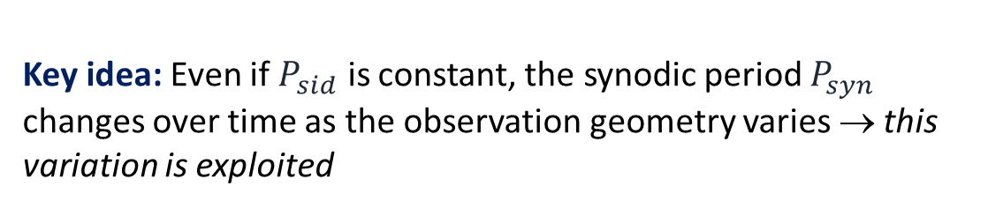
SIDEREAL SPIN PERIOD + SPIN AXIS ESTIMATION (FROM RCS TIME SERIES)
Goal: estimate the sidereal (inertial) spin period $P_{sid}$ and spin-axis direction $[α, β]$
Key idea: Even if $P_{sid}$ is constant, the synodic period $P_{syn}$ changes over time as the observation geometry varies → this variation is exploited
1
Estimate $\hat{P}syn$
2
Patternsearch
3
Clustering & Cleaning
4
Best estimate
4
(synodic spin period estimation)
Constrained optimization over 3 variables $[α, β, P_{sid}]$
Group and filter the candidate solutions
Select best cluster and best estimate
Missione 4 • Istruzione e Ricerca
Missione 4 • Istruzione e Ricerca

Slide 15

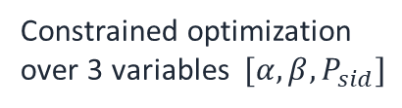
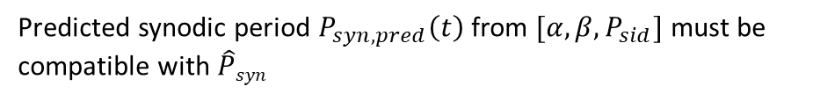
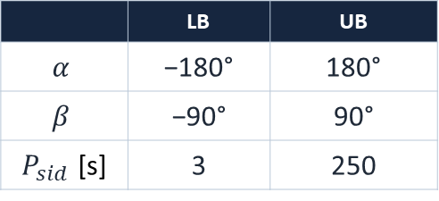

SIDEREAL SPIN PERIOD + SPIN AXIS ESTIMATION (FROM RCS TIME SERIES)
1
Estimate $\hat{P}syn$
2
Patternsearch
3
Clustering & Cleaning
4
Best estimate
4
(synodic spin period estimation)
Constrained optimization over 3 variables $[α, β, P_{sid}]$
Group and filter the candidate solutions
Select best cluster and best estimate
Search Domain
ƒ
Objective function
 | LB | UB
$$α$$ | −180° | 180°
$$β$$ | −90° | 90°
$P_{sid}$ [s] | 3 | 250
Based on a variant of Phase Dispersion Minimization
Constraint function
Multi-Start: 500 Latin-Hypercube start points
Predicted synodic period $P_{syn,pred}\left(t\right)$from $[α, β, P_{sid}]$ must be compatible with $\hat{P}syn$
Missione 4 • Istruzione e Ricerca
Missione 4 • Istruzione e Ricerca

Slide 16
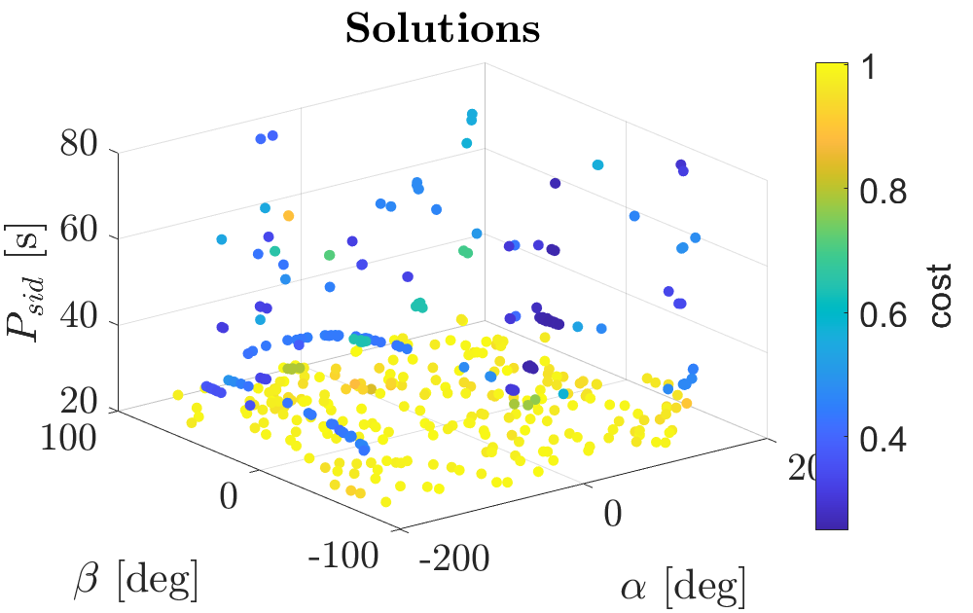
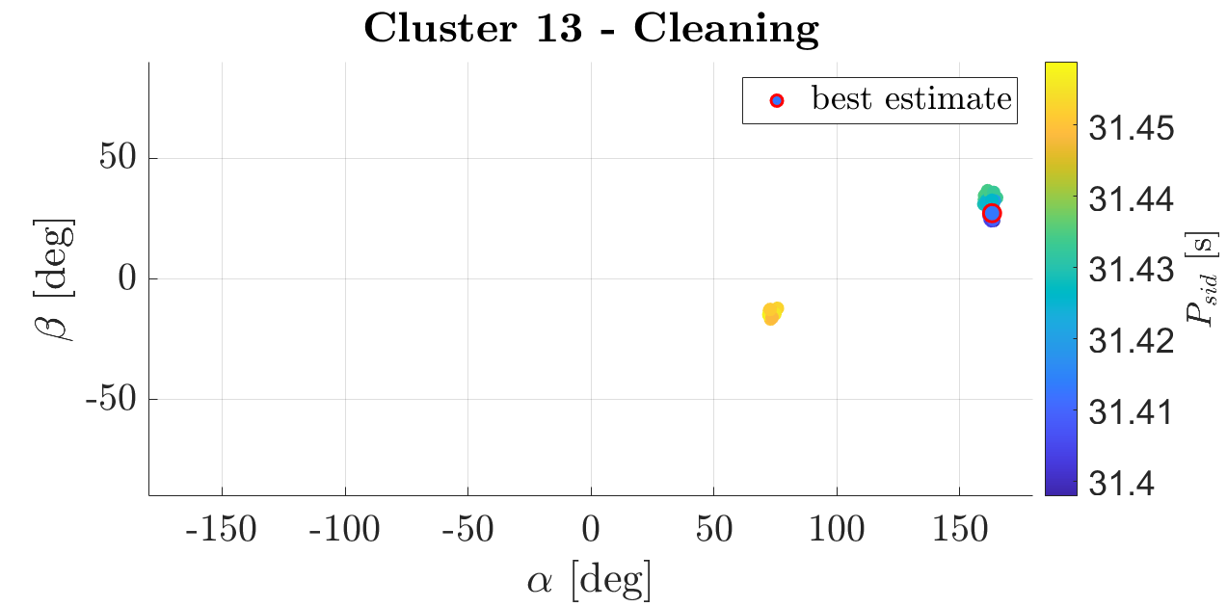
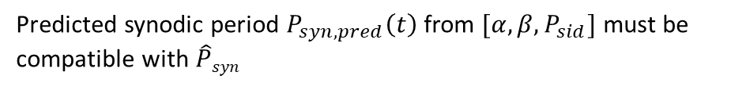

SIDEREAL SPIN PERIOD + SPIN AXIS ESTIMATION (FROM RCS TIME SERIES)
1
Estimate $\hat{P}syn$
2
Patternsearch
3
Clustering & Cleaning
4
Best estimate
4
(synodic spin period estimation)
Constrained optimization over 3 variables $[α, β, P_{sid}]$
Group and filter the candidate solutions
Select best cluster and best estimate
Search Domain
ƒ
Objective function
 | LB | UB
$$α$$ | −180° | 180°
$$β$$ | −90° | 90°
$P_{sid}$ [s] | 3 | 250
Based on a variant of Phase Dispersion Minimization
Constraint function
Multi-Start: 500 Latin-Hypercube start points
Predicted synodic period $P_{syn,pred}\left(t\right)$from $[α, β, P_{sid}]$ must be compatible with $\hat{P}syn$
Missione 4 • Istruzione e Ricerca

Slide 17
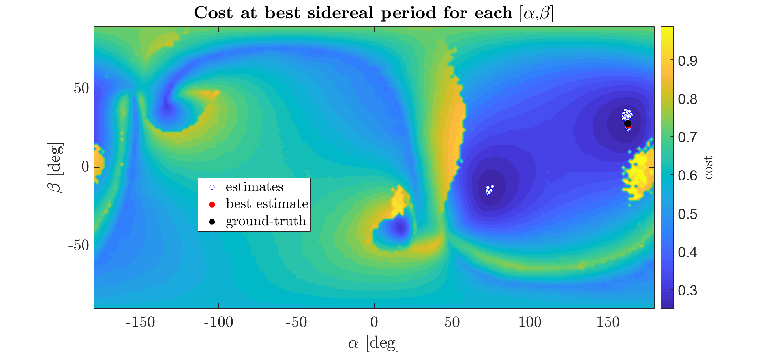
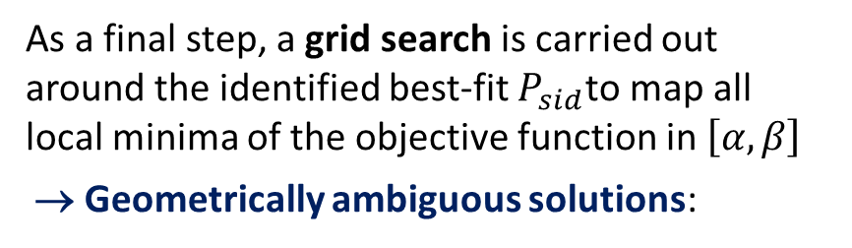
SIDEREAL SPIN PERIOD + SPIN AXIS ESTIMATION (FROM RCS TIME SERIES)
1
Estimate $\hat{P}syn$
2
Patternsearch
3
Clustering & Cleaning
4
Best estimate
4
(synodic spin period estimation)
Constrained optimization over 3 variables $[α, β, P_{sid}]$
Group and filter the candidate solutions
Select best cluster and best estimate
As a final step, a grid search is carried out around the identified best-fit $P_{sid}$to map all local minima of the objective function in $\left[α,β\right]$
→ Geometrically ambiguous solutions:
Missione 4 • Istruzione e Ricerca

Slide 18

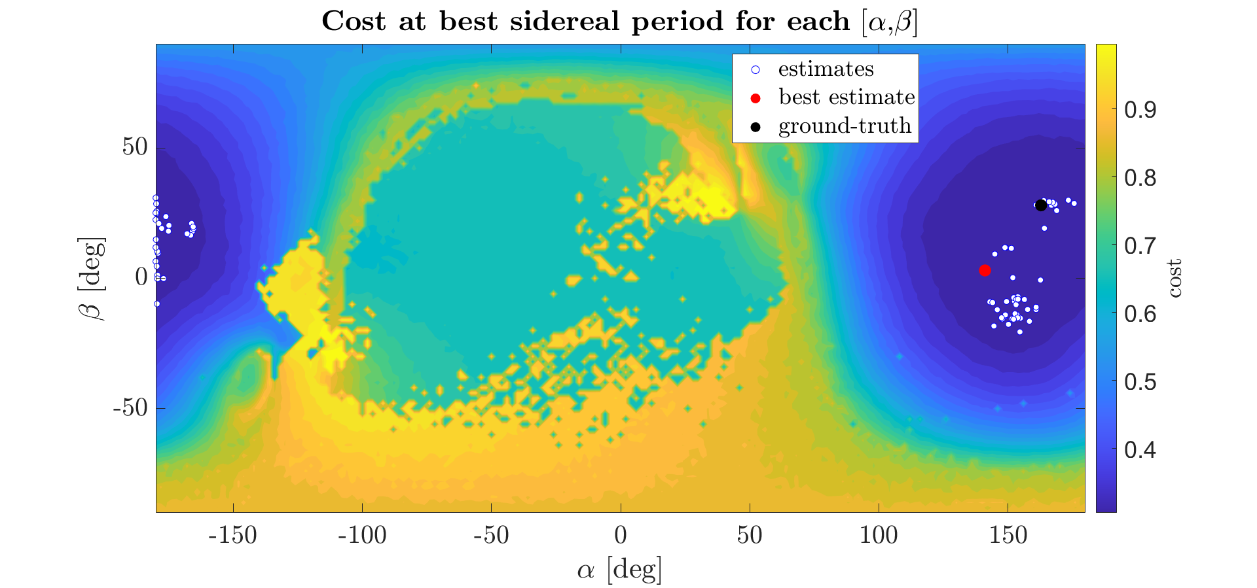
SIDEREAL SPIN PERIOD + SPIN AXIS ESTIMATION (FROM RCS TIME SERIES)
Can the ambiguities be resolved by simultaneously observing the object from multiple locations?
TIRA LOCATION
MEDICINA LOCATION
Missione 4 • Istruzione e Ricerca
Missione 4 • Istruzione e Ricerca

Slide 19
CONCLUSIONS
Different radar measurements can characterize spinning objects:
  RCS: estimates spin period and spin-axis direction
  Micro-Doppler: estimates spin period (spin-axis direction estimation is under development)
Ambiguities are intrinsic to the problem, arising from the observation geometry:
  Multiple simultaneous observations of the same object from different locations may resolve or reduce them
BIRALES test case → potential for spin-axis characterization:
  Acquisition time window increase thanks to the FoV extension
  Conduct analysis with CW only
Missione 4 • Istruzione e Ricerca
Missione 4 • Istruzione e Ricerca

Slide 20
Thank You For Your Attention!
Final Meeting
Martedì 30 Giugno – Giovedì 02 Luglio
OAC - Osservatorio Astrofisico di Arcetri
M.A. De Luca

